Slide 1
Survey comparison

Slide 2
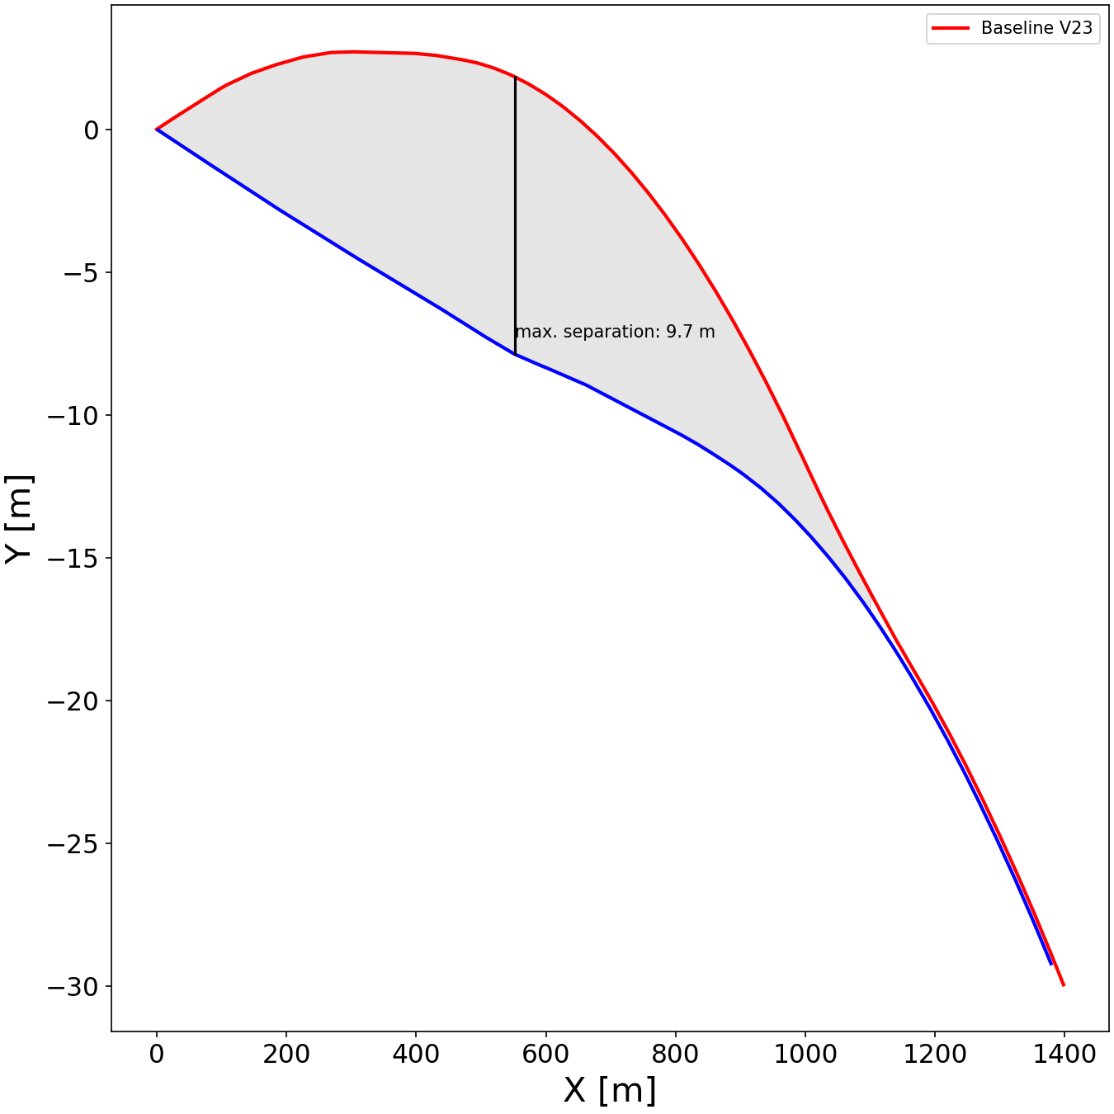
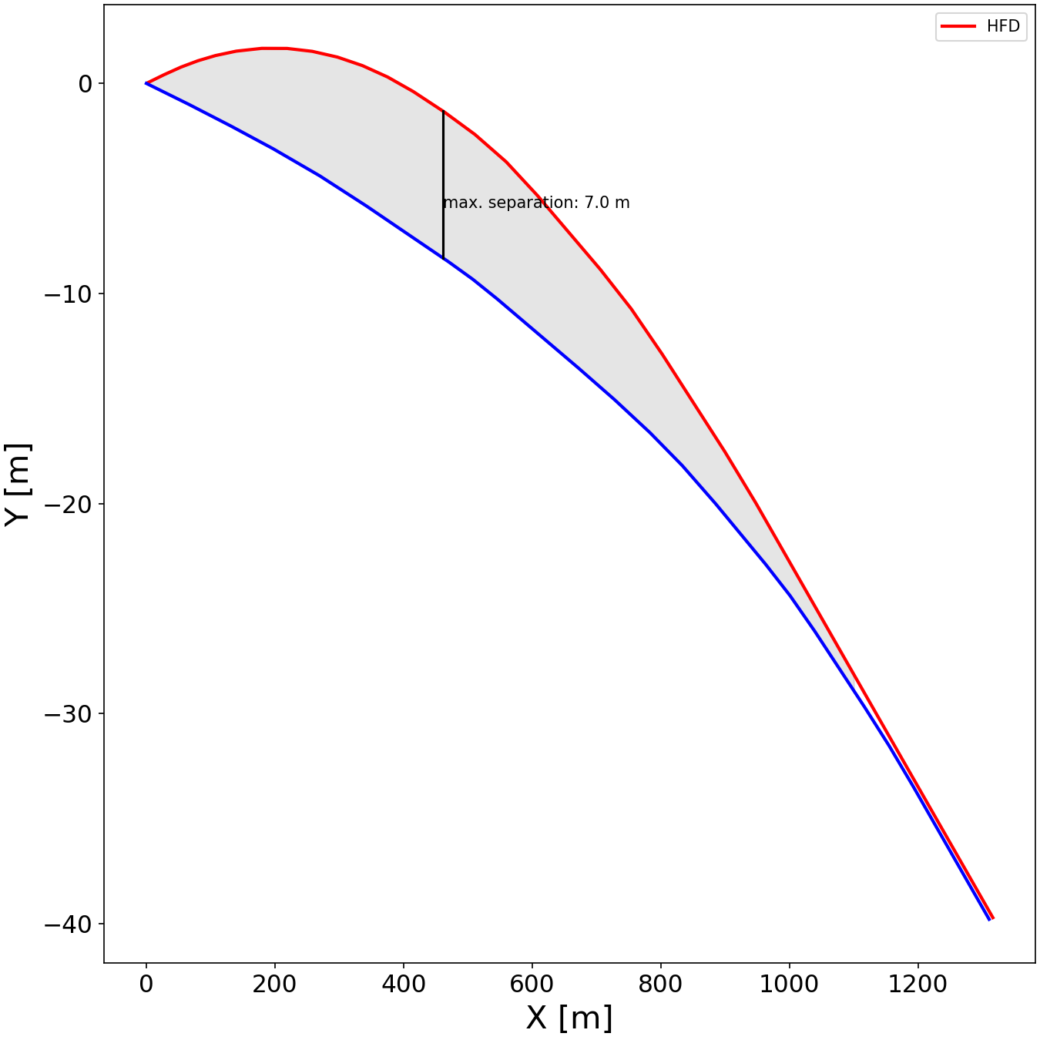
Comparison of tunnel separation after IP
A~6641m² A *separation = 66410 m³
A~4962m² A *separation = 34734 m³

