Slide 1



“HIGHEST”
High-Temperature High-Gradient Superconductors
2024 – 02 – 31 Bellaterra

Slide 2
Agenda for today
9:30 AM → 9:50 AM Welcome and introduction
Speaker: Dr Joffre Gutierrez Royo (ICMAB - CSIC)
9:50 AM → 10:10 AM Status of experiments at SLAC and new ideas
Speaker: Jessica Golm (CERN)
10:10 AM → 10:30 AM Discussion on next steps of the collaboration
10:30 AM → 11:30 AM Laboratory visit
13:00 → 14:30 Lunch
15:00 → 16:00 REBCO Coatings for High-Gradient RF Applications
Speaker: Sergio Calatroni (CERN)

Slide 3
Outline
1 – Quick project overview
2 – D-Nano 40 mm-wide CC tape “batch #1” initial results
3 – Possibility of measuring high-RF powers in CCs lab samples

Slide 4
Outline
1 – Quick project overview
2 – D-Nano 40 mm-wide CC tape “batch #1” initial results
3 – Possibility of measuring high-RF powers in CCs lab samples

Slide 5
HIGHEST Background and aim
  Sustainability of particle accelerators will benefit from a wider use of HTS technology.
  High-Temperature Superconductors (HTS) can fill the operating window between normal conducting RF and traditional low-temperature superconducting RF for high power applications
  Investment in RF hardware and operational energy costs could be lowered in comparison to present-day technologies by operating at liquid-nitrogen temperature
  We have already demonstrated:
  Successfully applying 2D HTS tapes in 3D geometries
  Measuring a higher quality factor of these HTS coated RF cavities at low power
  Aim:
We aim at demonstrating that HTS can be used for high power RF applications
We want to develop and optimize a 3D coating technology and demonstrate its scalability to make practical RF high power devices

Slide 6
WP3 plan and risk mitigation
Risk | Mitigation
Segmented test cavity delayed | HTS optimization studies to be performed with older “RADES” cavities
Quality of 3D coatings on discs | Measurement of superconducting (non-RF) properties at ICMAB will help in optimization work
High power characterization at SLAC delayed | Preliminary low-power characterization is possible with standard laboratory devices

Slide 7
WP3 plan and risk mitigation
Risk | Mitigation
Segmented test cavity delayed | HTS optimization studies to be performed with older “RADES” cavities
Quality of 3D coatings on discs | Measurement of superconducting (non-RF) properties at ICMAB will help in optimization work
High power characterization at SLAC delayed | Preliminary low-power characterization is possible with standard laboratory devices

Slide 8
Outline
1 – Quick project overview
2 – D-Nano 40 mm-wide CC tape “batch #1” initial results
3 – Possibility of measuring high-RF powers in CCs lab samples

Slide 9
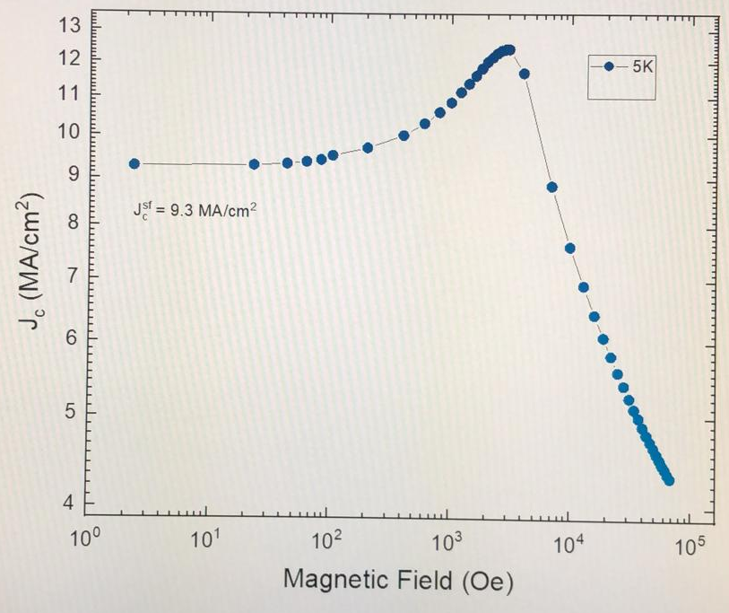
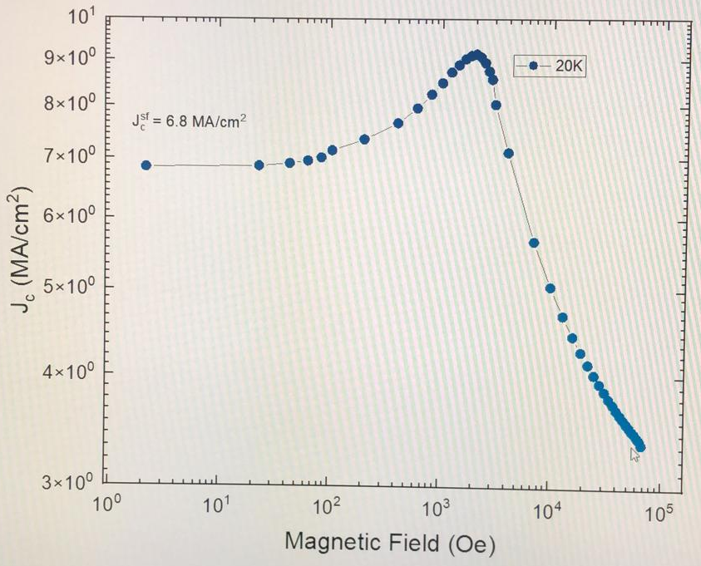
3D HTS coatings will benefit from having wider tapes
40mm-wide D-Nano tape from batch #1 shows rather low J_{c} values

Slide 10
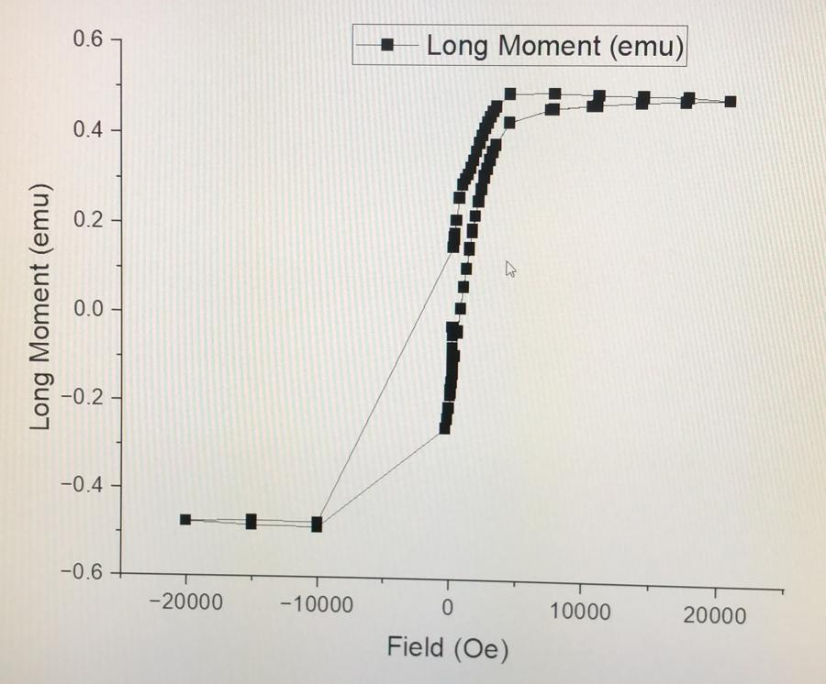
3D HTS coatings will benefit from having wider tapes
77K
Main signal coming from the RABiTS substrate
40mm-wide D-Nano tape from batch #1 shows rather low J_{c} values, particularly at liquid nitrogen temperatures.
Z_{s} characterization remains to be performed

Slide 11
Outline
1 – Quick project overview
2 – D-Nano 40 mm-wide CC tape “batch #1” initial results
3 – Possibility of measuring high-RF powers in CCs lab samples

Slide 12
Initial study shows that CCs have a weak dependence with the RF power
T = 50 K, ν = 8 GHz
Far from high-gradient accelerator requirements
H_{Rf} = 575.000 A/m
P. Krkotic, et al. Supercond. Sci. Technol. 35 (2022)

Slide 13
Initial study shows that CCs have a weak dependence with the RF power
T = 50 K, ν = 8 GHz
Far from high-gradient accelerator requirements
H_{Rf} = 575.000 A/m
P. Krkotic, et al. Supercond. Sci. Technol. 35 (2022)
Higher Rf powers, in the order of high-gradient accelerators requirements, are achievable using a (μ-)stripe resonator technique
There is very limited and “old” data on REBCO RF-power dependence

Slide 14
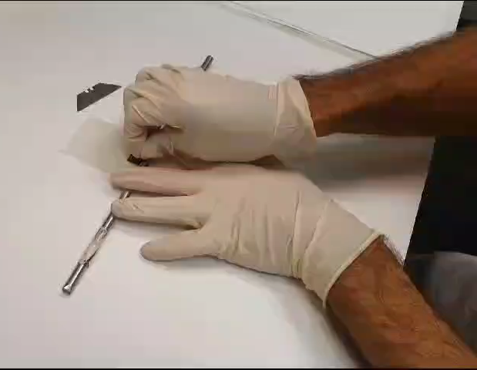
Transferring a REBCO CC to a flexible low-loss dielectric substrate
To use strip resonator techniques we have to get rid of the metallic (Ag & Cu) substrate of our REBCO samples
1st - Delamination

Slide 15
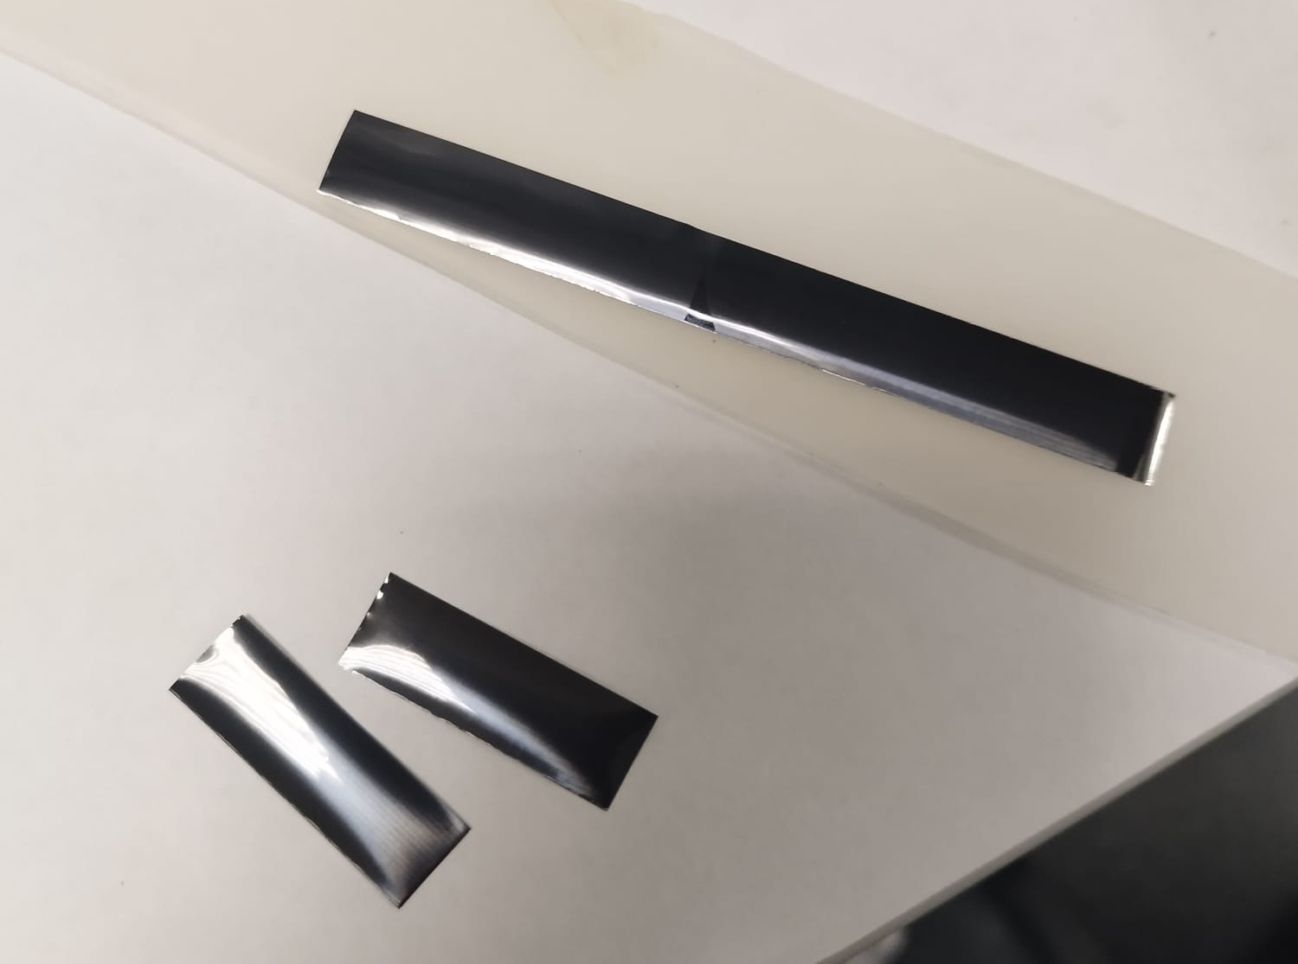
Transferring a REBCO CC to a flexible low-loss dielectric substrate
1st - Delamination
2nd – Transfer to
20 μm thick low-RF loss Kapton
(<1 dB/m loss @6 GHz)

Slide 16
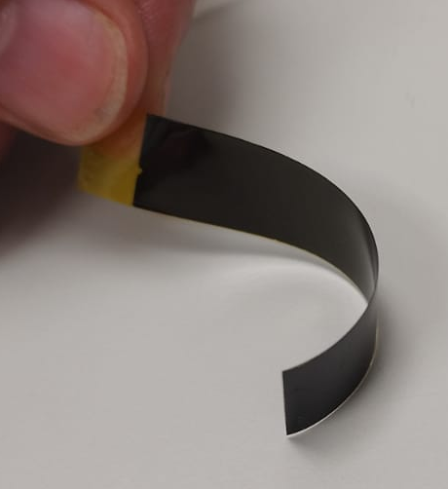
Transferring a REBCO CC to a flexible low-loss dielectric substrate
1st - Delamination
2nd – Transfer to
20 μm thick low-RF loss Kapton
(<1 dB/m loss @6 GHz)
3rd – Etching of Ag & Cu
This allows to “print” REBCO circuits compatible with a (μ-)stripe resonator geometry to study Z_{S}(H,T,H_{RF,} f)

