Slide 1





“HIGHEST”:
REBCO Coatings for High-Gradient RF Applications
Sergio Calatroni, on behalf of the Collaboration.

Slide 2
Outline
HTS cavities at low gradient, in a strong magnetic field
  The present: FCC beam screens and RADES axion detectors
HTS cavities at high-gradient
  The goal of the new iFAST collaboration CERN – KIT – ICMAB
HTS cavities in both high-gradient and strong magnetic field
  The future?

Slide 3
Outline
HTS cavities at low gradient, in a strong magnetic field
  The present: FCC beam screens and RADES axion detectors
HTS cavities at high-gradient
  The goal of the new iFAST collaboration CERN – KIT – ICMAB
HTS cavities in both high-gradient and strong magnetic field
  The future?

Slide 4

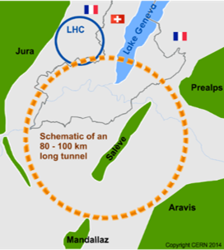
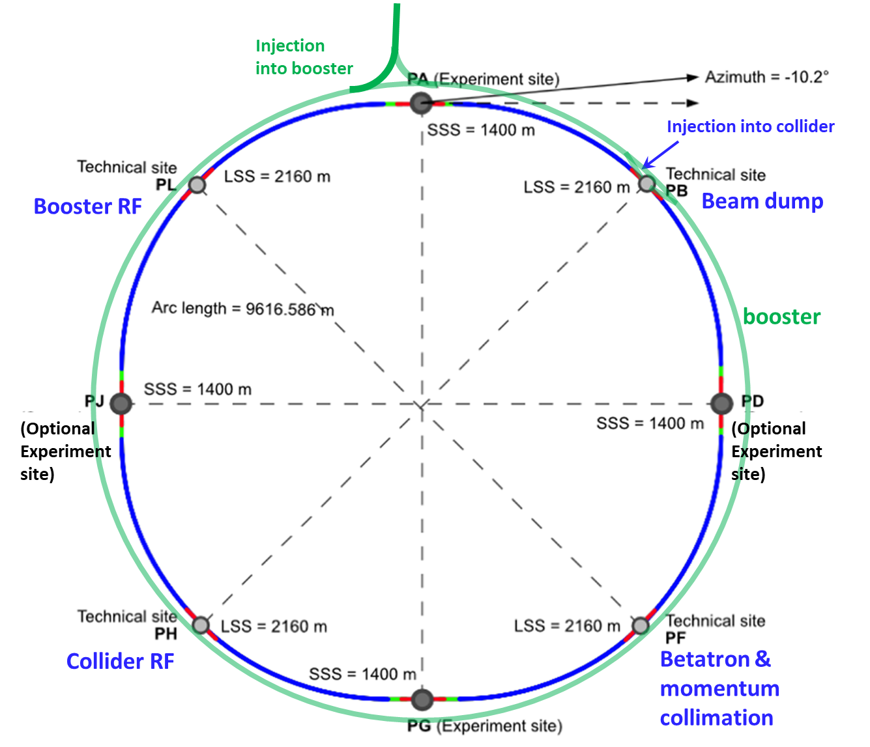
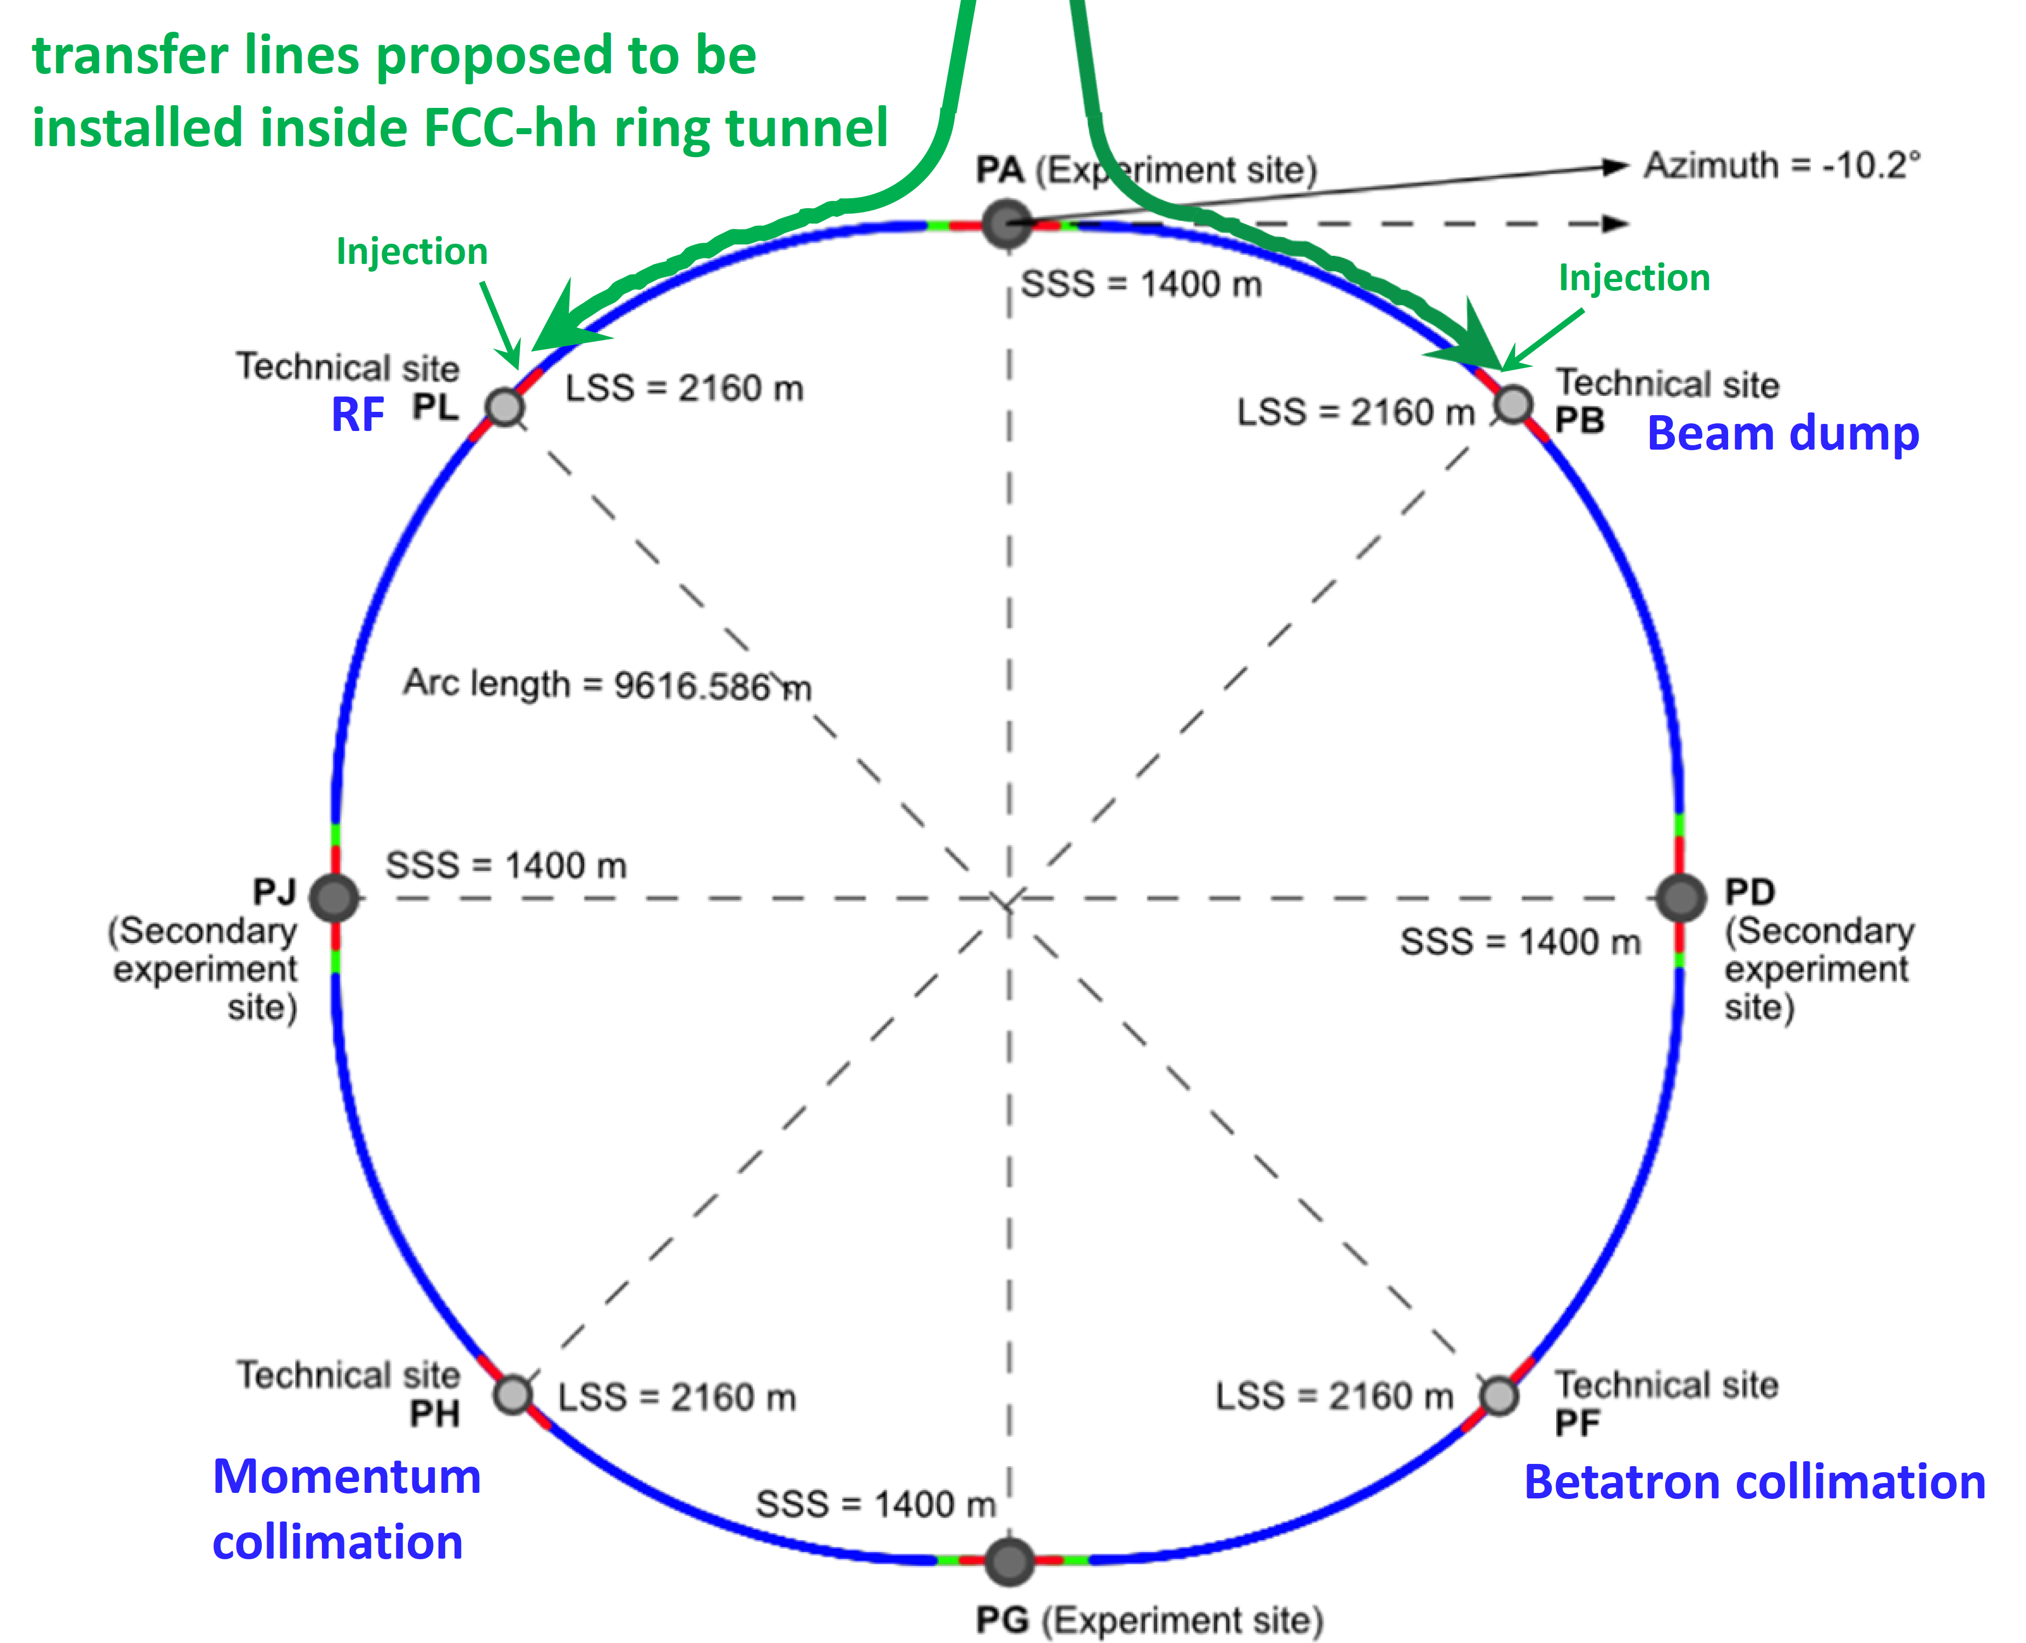
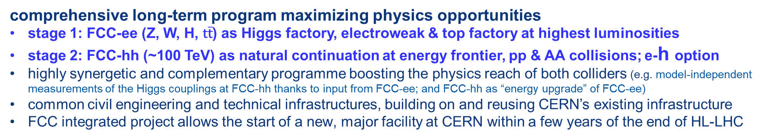
FCC integrated program
Link to last FCC week
comprehensive long-term program maximizing physics opportunities
stage 1: FCC-ee (Z, W, H, $\text{t}\overline{\text{t}}$) as Higgs factory, electroweak & top factory at highest luminosities
stage 2: FCC-hh (~100 TeV) as natural continuation at energy frontier, pp & AA collisions; e-h option
highly synergetic and complementary programme boosting the physics reach of both colliders (e.g. model-independent measurements of the Higgs couplings at FCC-hh thanks to input from FCC-ee; and FCC-hh as “energy upgrade” of FCC-ee)
common civil engineering and technical infrastructures, building on and reusing CERN’s existing infrastructure
FCC integrated project allows the start of a new, major facility at CERN within a few years of the end of HL-LHC
FCC-ee
FCC-hh
2020 - 2040
2045 - 2063
2070 - 2095
From M. Benedikt, FCC Study leader

Slide 5
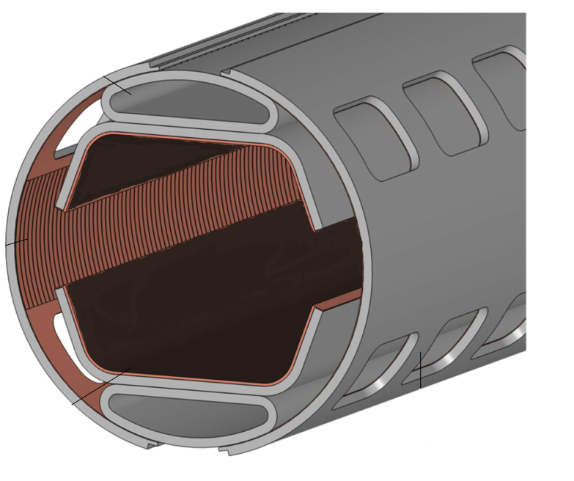
HTS for the FCC-hh beam screen
FCC-hh, a proposed 100 TeV p-p collider at CERN, with 16 T dipoles operated at 1.9 K
A beam screen held at 50 K, to protect the dipoles from synchrotron radiation ~30 W/m/beam (LHC < 0.2 W/m)
HTS materials instead of copper in the FCC-hh beam screen,
to improve beam stability (-> impedance) at 50 K
Bunched particle beams produces RF fields, up to ~1 GHz
Extremely challenging requirements:
  HTS must operate at 50 K and 16 T
  Critical fields Hc₂ , H_{irr} >> 16T
  J_{c} > 25 kA/cm² (2.5x10⁸ A/m²)
  Surface resistance R_{s} better than for copper
Compatible with accelerator environment
  Minimize dipole field distortion due to persistent currents
  UHV compatible, low SEY, lifecycle assessment, etc..
16 Tesla !
Calatroni, IEEE TAS 26, 3500204 (2016)
Calatroni et al, SuST 30, 075002 (2017)

Slide 6
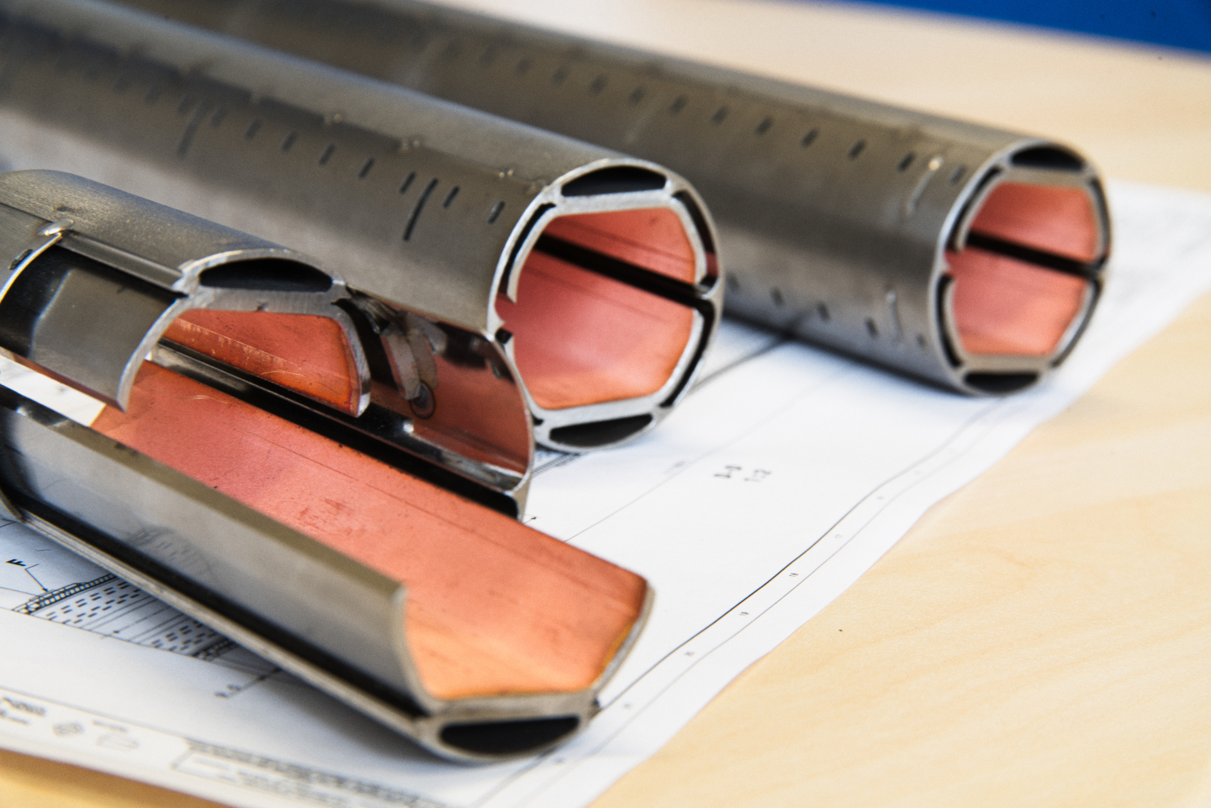












Two material choices
Manufacture the screen using REBCO tapes soldered to the screen
Coat the inside of the screen
with Tl-1223 films

Slide 7
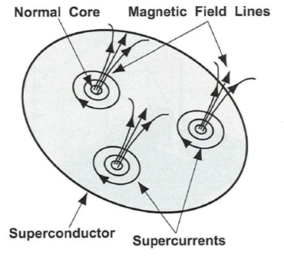
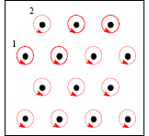
Some theory background: fluxon motion in RF
The motion of the rigid fluxon lattice behaves as a harmonic damped oscillator
(neglecting thermal creep)
d
Pinning centers
B field is normal to surface: worst case
The “depinning frequency”
Surface resistance
Gittleman and Rosenblum: Phys Rev. Lett. 16, 734 (1966)
Calatroni and Vaglio, IEEE Trans. Appl. Supercond. 27 (2017) 3500506
Coffey, Clem PRL 67, 386 (1991)
Brandt PRL 67 2219 (1991)
Silva et al, PRB 78, 094503 (2008)

Slide 8
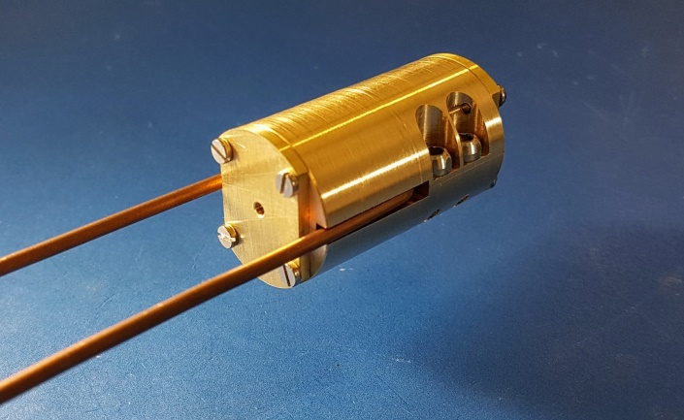
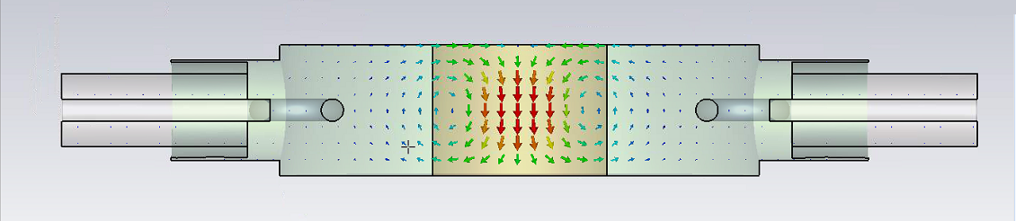
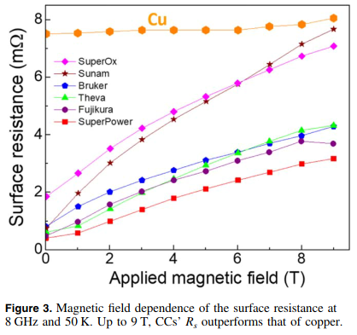
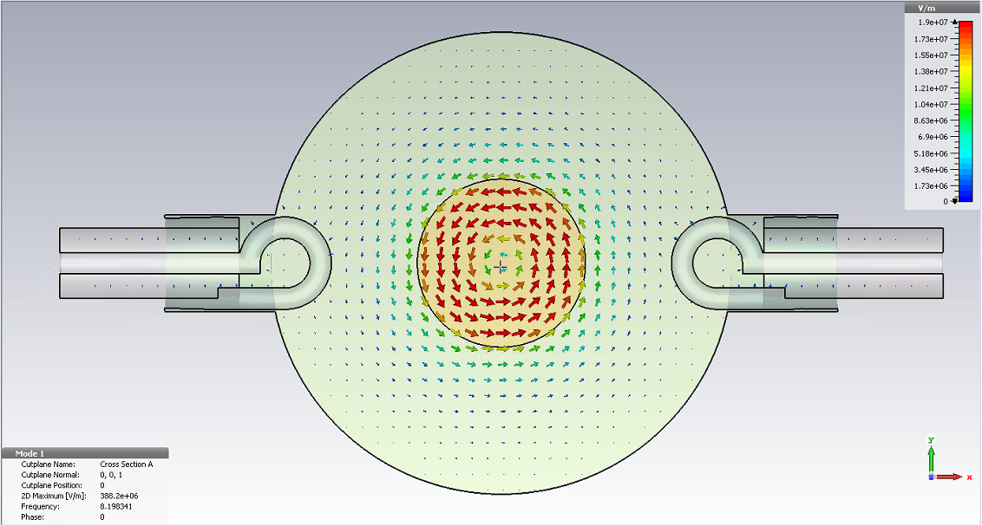

Validation of RF performance (UPC - ICMAB)
In house developed 8.05 GHz cavity resonator compatible with 25mm bore 9 T magnet at ICMAB
REBCO CCs outperform Cu at 50K and up to 9T
R_{S} is microstructure dependent
Surface currents equivalent to 0.1 MV/m of a typical accelerating cavity
Puig et al, SuST 32, 094006 (2019)

Slide 9





HTS coated conductor soldering and delamination
REBCO
Ag
Ag
REBCO
Cu
Buffer layers
Cu
Substrate
Solder
Surface to coat
Cu
Ag
Surface to coat
Cu
N. Lamas et al., to be published
Developed in the context of FCC-hh impedance reduction by coating the beam screen with HTS tapes

Slide 10
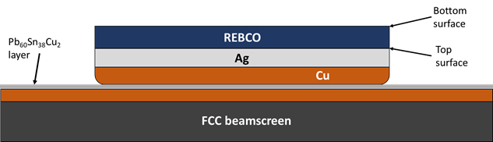
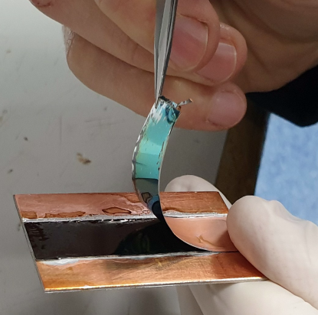
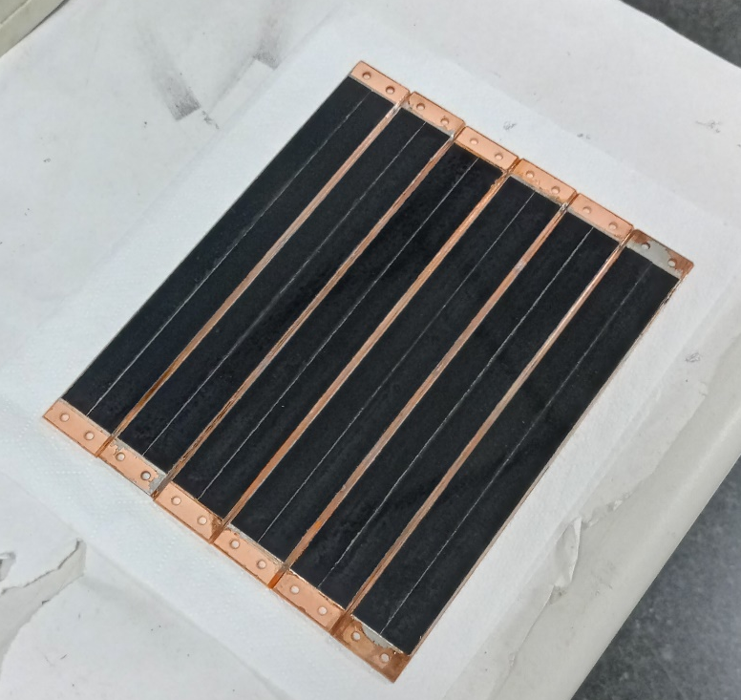
Development of soldering technology
Solder
HTS tapes
Solders based on
Sn / Pb / Cu / Bi & In
temperatures < 220ºC
CC
Beamscreen
2x80 km of beam screens to be coated with HTS

Slide 11

HTS for axion searches
Motivation:
Axion haloscope
$$ℱ \sim { g}_{Aγ}^{4}{ Q T}_{sys}^{−2}{V^{2}G}^{4}m_{A}^{2} B^{4}$$
Increase Q
copper coating → superconducting coating
Requirement: High quality factor in a high magnetic field

Slide 12
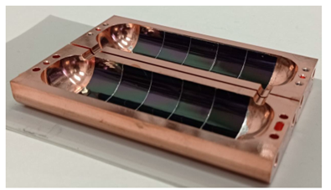
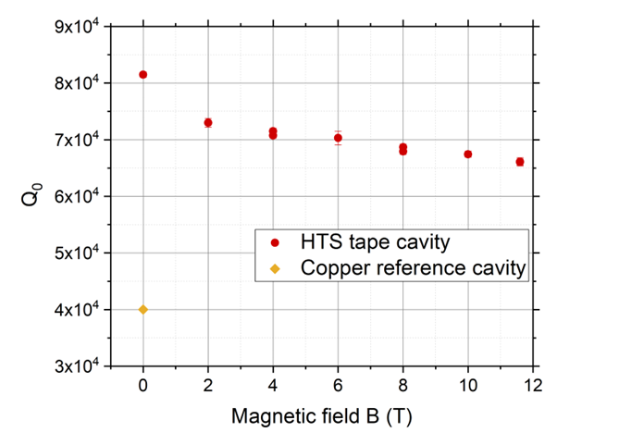
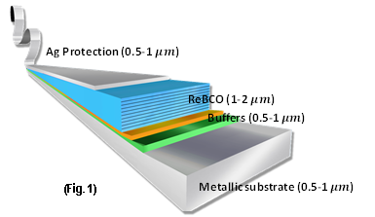
First real cavity, f≈9 GHz
We have developed a technology for applying 2D HTS tapes to 3D RF “RADES” cavities demonstrating the potential of HTS for RF applications J. Golm et al., IEEE TAS, Vol. 32, No. 4, (2022) 1500605
2x improvement of RF quality factor compared to copper
(newer prototype 5x improvement)
12 mm-wide HTS tapes
RADES cavity for axion searches

Slide 13
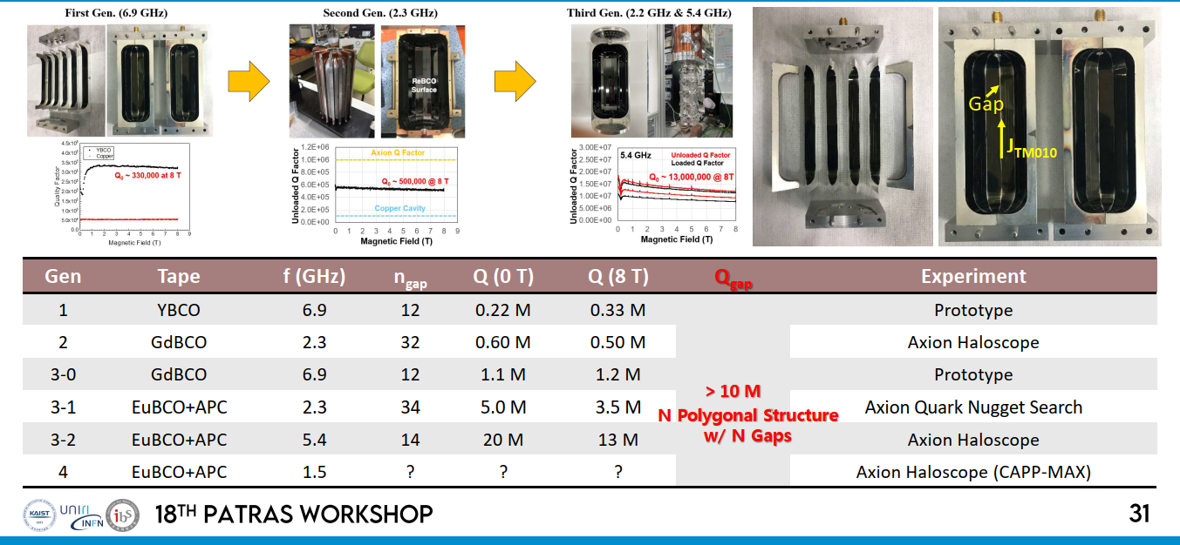
Other results from CAPP
3.5x10⁻⁵ Ω
2.2x10⁻⁵ Ω
From: D. Ahn, CAPP. More info at Patras Workshop

Slide 14
Outline
HTS cavities at low gradient, in a strong magnetic field
  The present: FCC beam screens and RADES axion detectors
HTS cavities at high-gradient
  The goal of the new iFAST collaboration CERN – KIT – ICMAB
HTS cavities in both high-gradient and strong magnetic field
  The future?

Slide 15
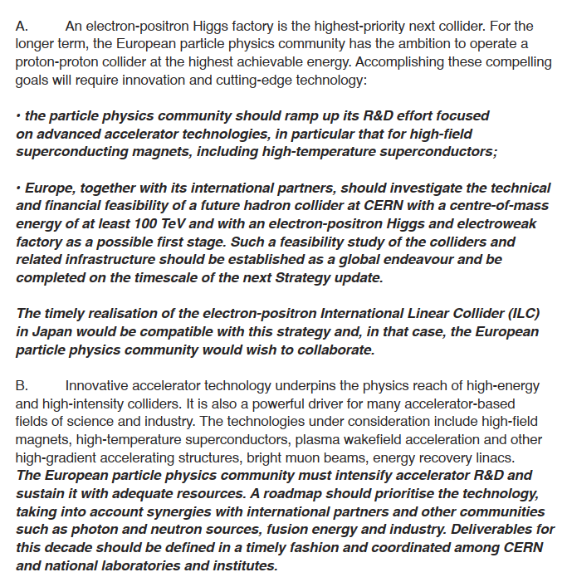
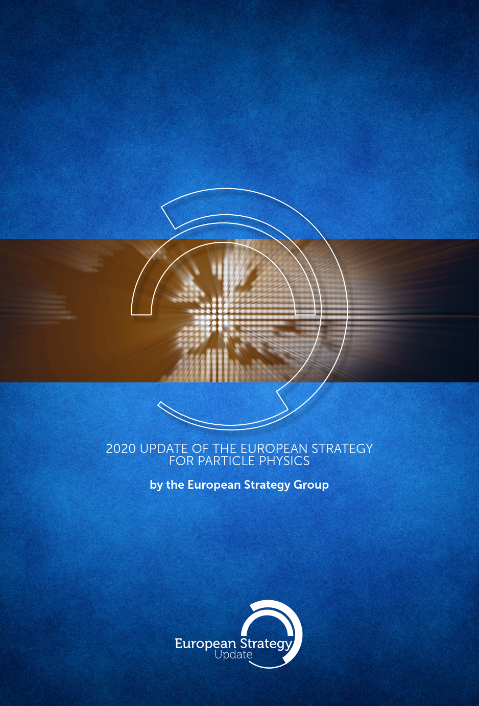
The European Strategy for Particle Physics
High-priority future initiatives
FCC-ee
ILC
CLIC, etc.

Slide 16
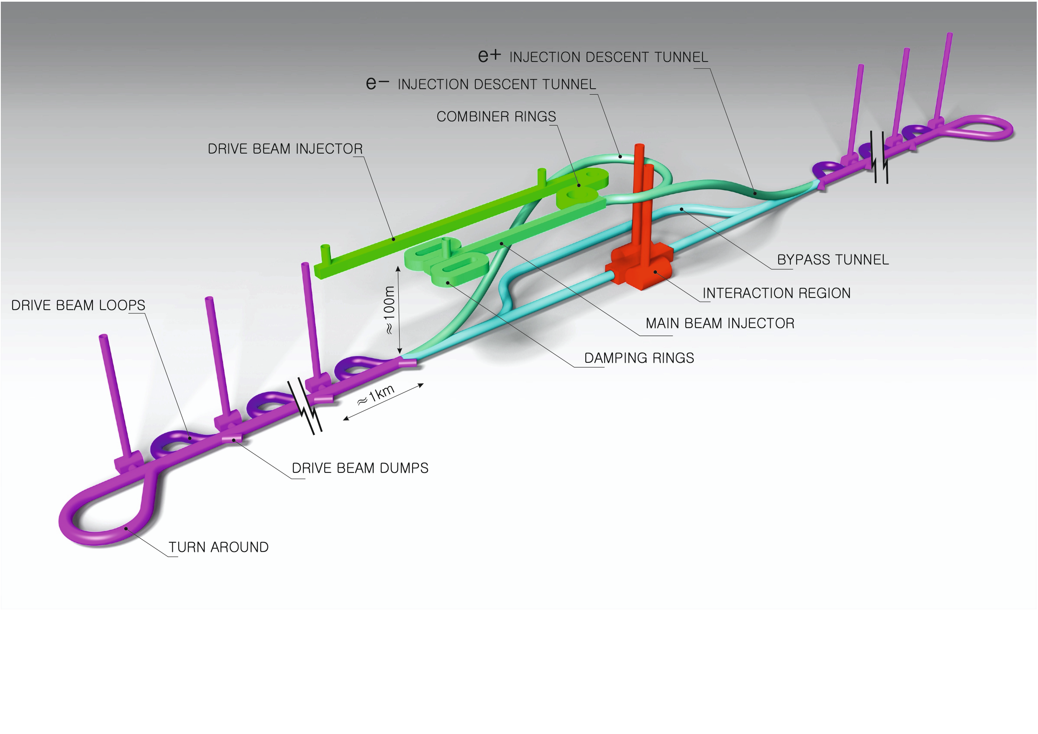
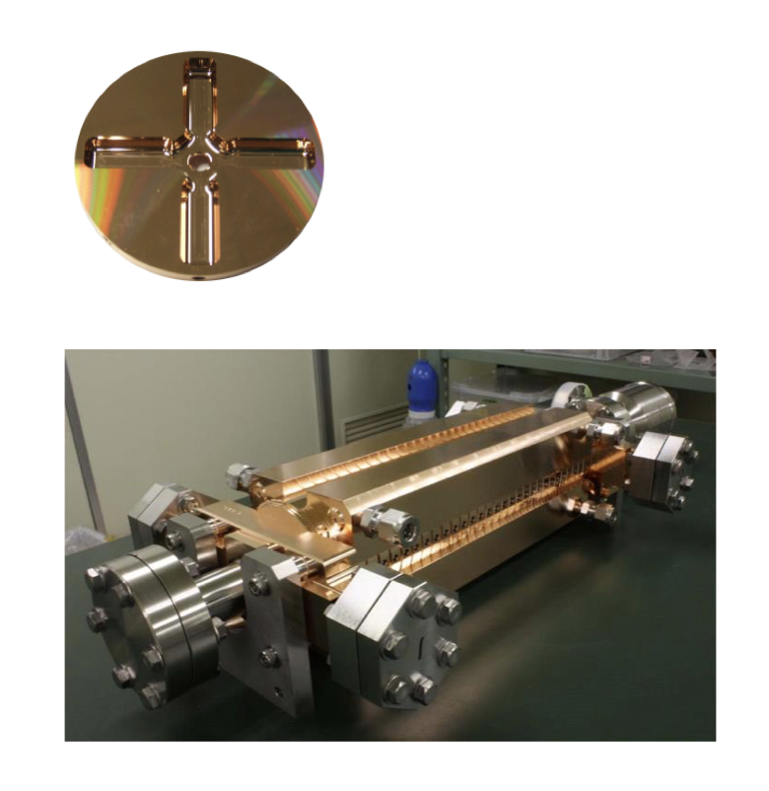
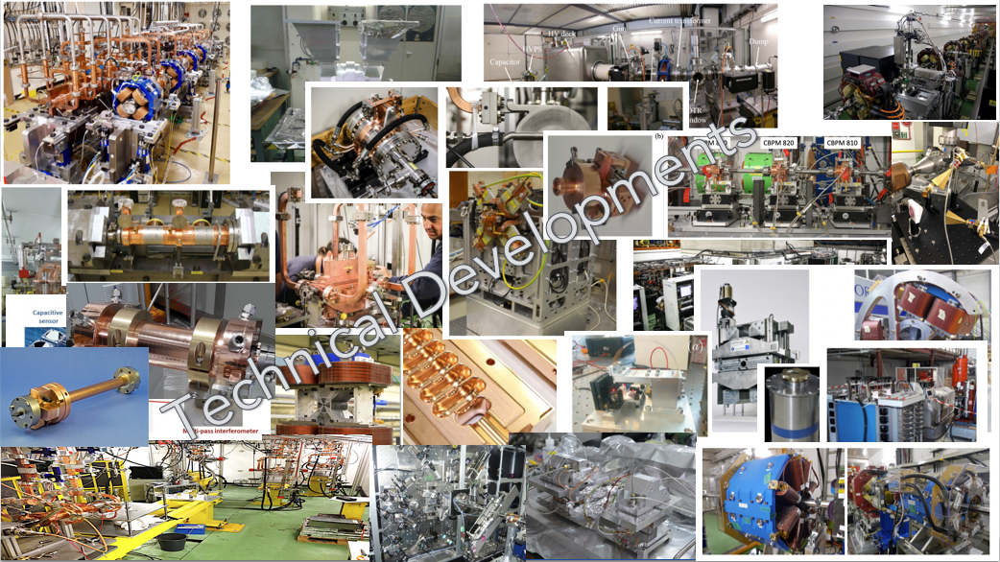
The Compact Linear Collider (CLIC)
  Recent talks: eeFACT-I1 and eeFACTI2
  Timeline: Electron-positron linear collider at CERN for the era beyond HL-LHC
  Compact: Novel and unique two-beam accelerating technique with high-gradient room temperature RF cavities (~20’500 structures at 380 GeV), ~11km in its initial phase
  Expandable: Staged programme with collision energies from 380 GeV (Higgs/top) up to 3 TeV (Energy Frontier)
  CDR in 2012 with focus on 3 TeV. Updated project overview documents in 2018 (Project Implementation Plan) with focus 380 GeV for Higgs and top.
Accelerating structure prototype for CLIC: 12 GHz (L~25 cm)
The CLIC accelerator studies are mature:
Optimised design for cost and power
Many tests in CTF3, FELs, light-sources and test-stands
Technical developments of “all” key elements
From: Steinar Stapnes

Slide 17
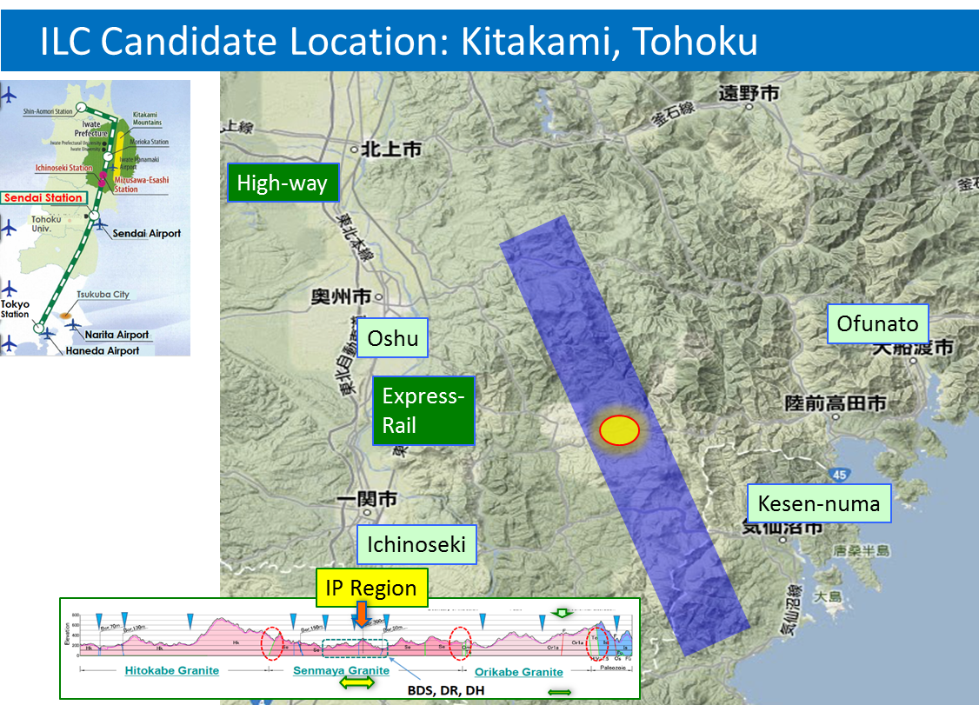
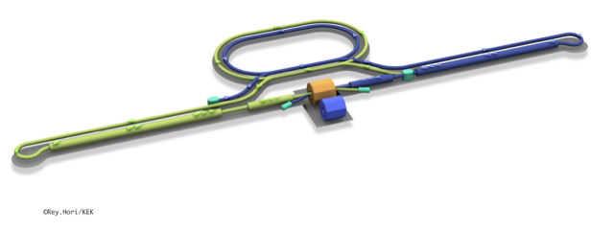
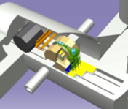
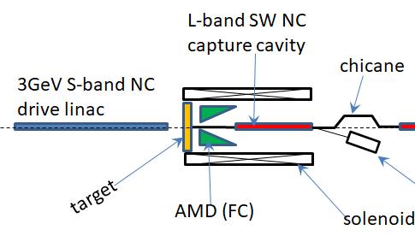
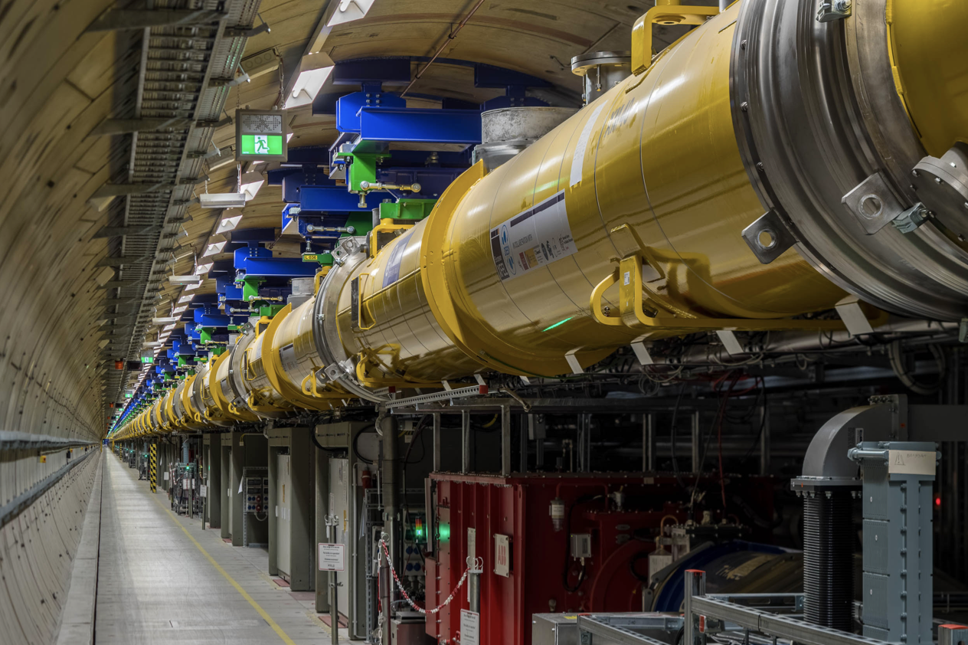
The ILC250 accelerator facility
  Recent talks: eeFACT-I1 and eeFACTI2
Interaction point
Damping Ring
e+ Source
e- Source
e- Main Linac
Beam dump
Physics Detectors
e+ Main Liinac
Bunches of ~10¹⁰ e+/e-
Undulator positron source
Creating particles Sources
  polarized elections/positrons
High quality beam Damping ring
  low emittance beams
Acceleration Main linac
  superconducting radio frequency (SRF)
Collide them Final focus
  nano-meter beams
Go to Beam dumps
Electron driven positron source
From: Steinar Stapnes

Slide 18
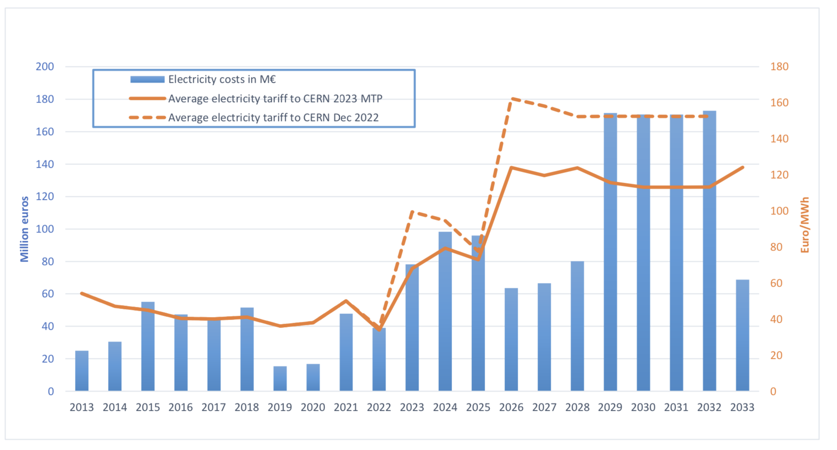
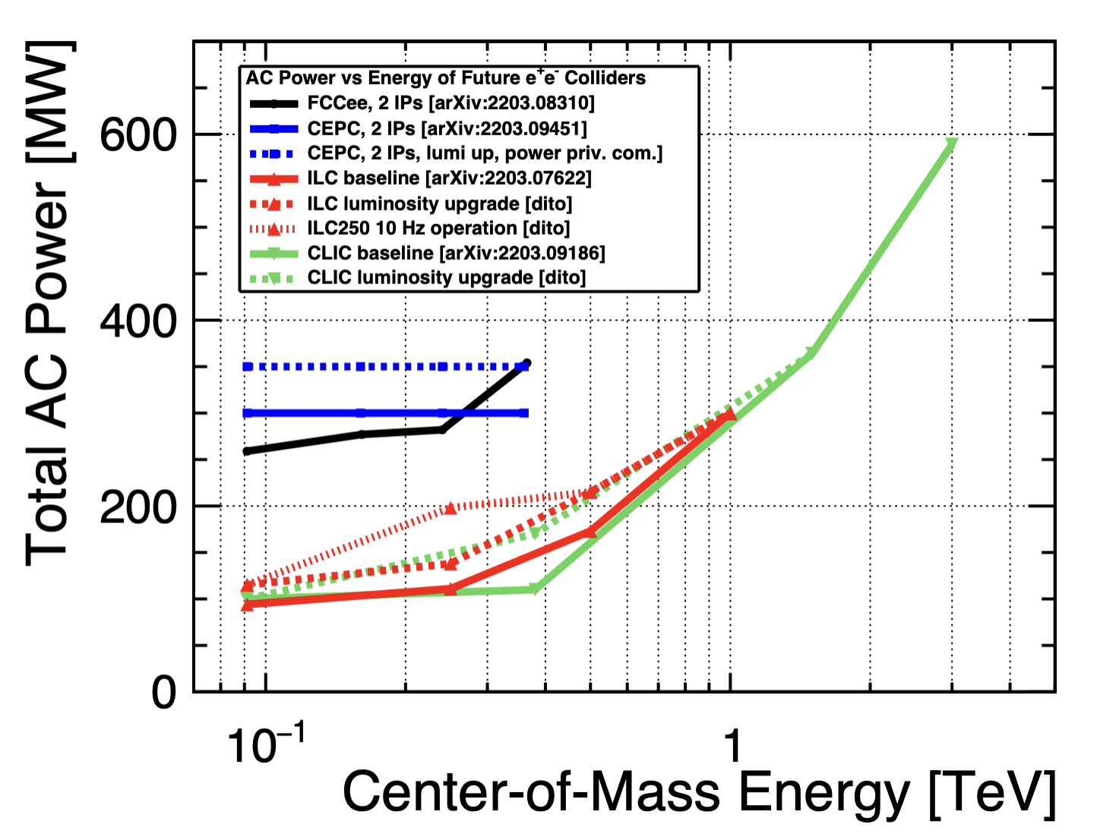
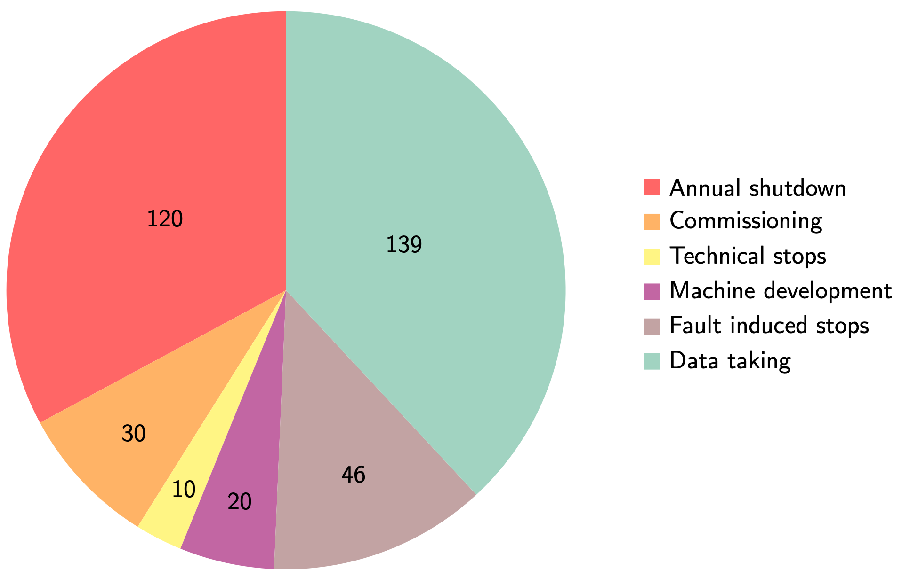
Power and energy: LHC and future machines
Very uncertain but MTP assumes 120 MCHF/TWh beyond 2026.
With “standard” running scenario (on the right) every 100 MW corresponds to ~0.6 TWh annually, corresponding to ~75 MCHF annually.
Linear collider studies predict roughly similar power consumption for equivalent machines (ILC vs CLIC)
From: Steinar Stapnes

Slide 19
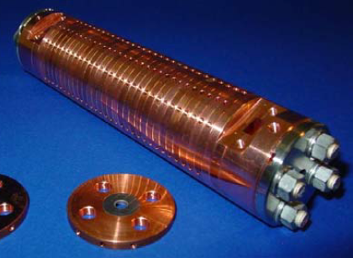
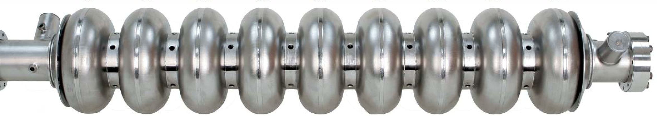
How can SC and NC have the same power consumption?
Linear collider RF systems fall in two categories
Despite the ~10⁶ difference in quality factor (~10³ considering cryo efficiency), pulsing at low duty factor allows reducing the average consumption for NC accelerating structures down to the SC level – which cannot be effectively be pulsed
In our study, we want ultimately to verify whether HTS in pulsed RF mode allows a further power gain compared to both Nb and Cu
SC niobium, Q₀≈10¹⁰, 35 MV/m, CW
NC copper, Q₀≈10⁴, 100 MV/m, pulsed

Slide 20
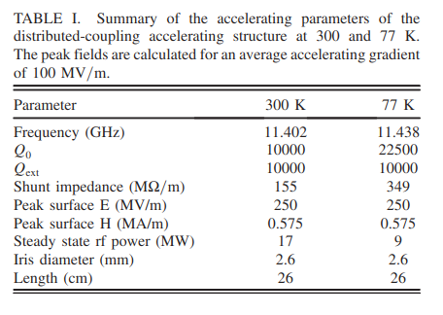
Cryo-cooled copper -> HTS ?
More info on C³ here
New kid on the blocks: the C3 study @ SLAC is based on cryogenically cooled copper, to increase gradient and save on RF power
A potential advantage could come from combining the advantage of higher gradients at lower temperatures, with the higher Q factor of HTS coatings -> energy efficiency
Cryoplant efficiency (Carnot + engineering)
SRF temperature | Ratio W_{300K}/W_{cryo}
77 K | 13
50 K | 20
4.2 K | 230
1.9 K | 920
Thanks to T. Koettig, CERN
E. Nanni et al., PRAB 24, 093201 (2021)
A factor 10÷20 improvement in Q factor compared to copper
could pave the way for energy savings

Slide 21
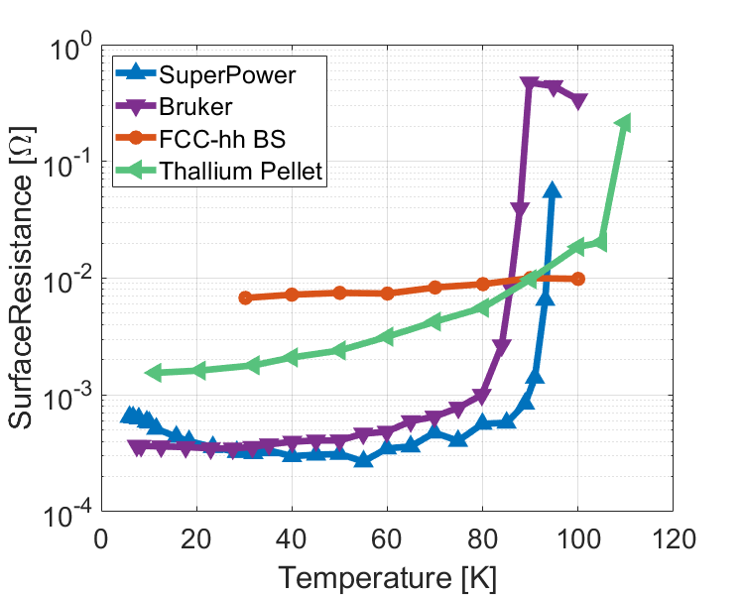
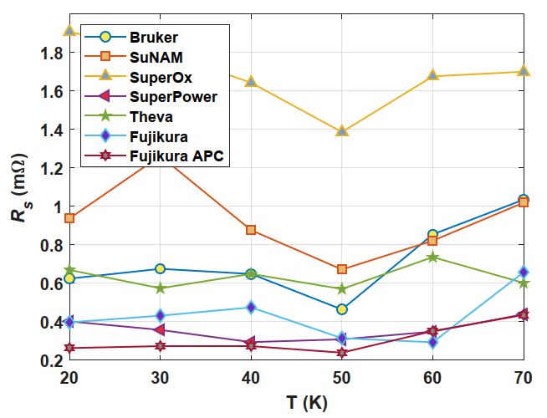
Low-power measurements
An improvement larger than x10 compared to copper (Rs=8mΩ) has been measured on samples of tapes (8 GHz) at low RF power
Cu
Adapted from Romanov et al, Sci. Rep. (2020) 10:12325

Slide 22
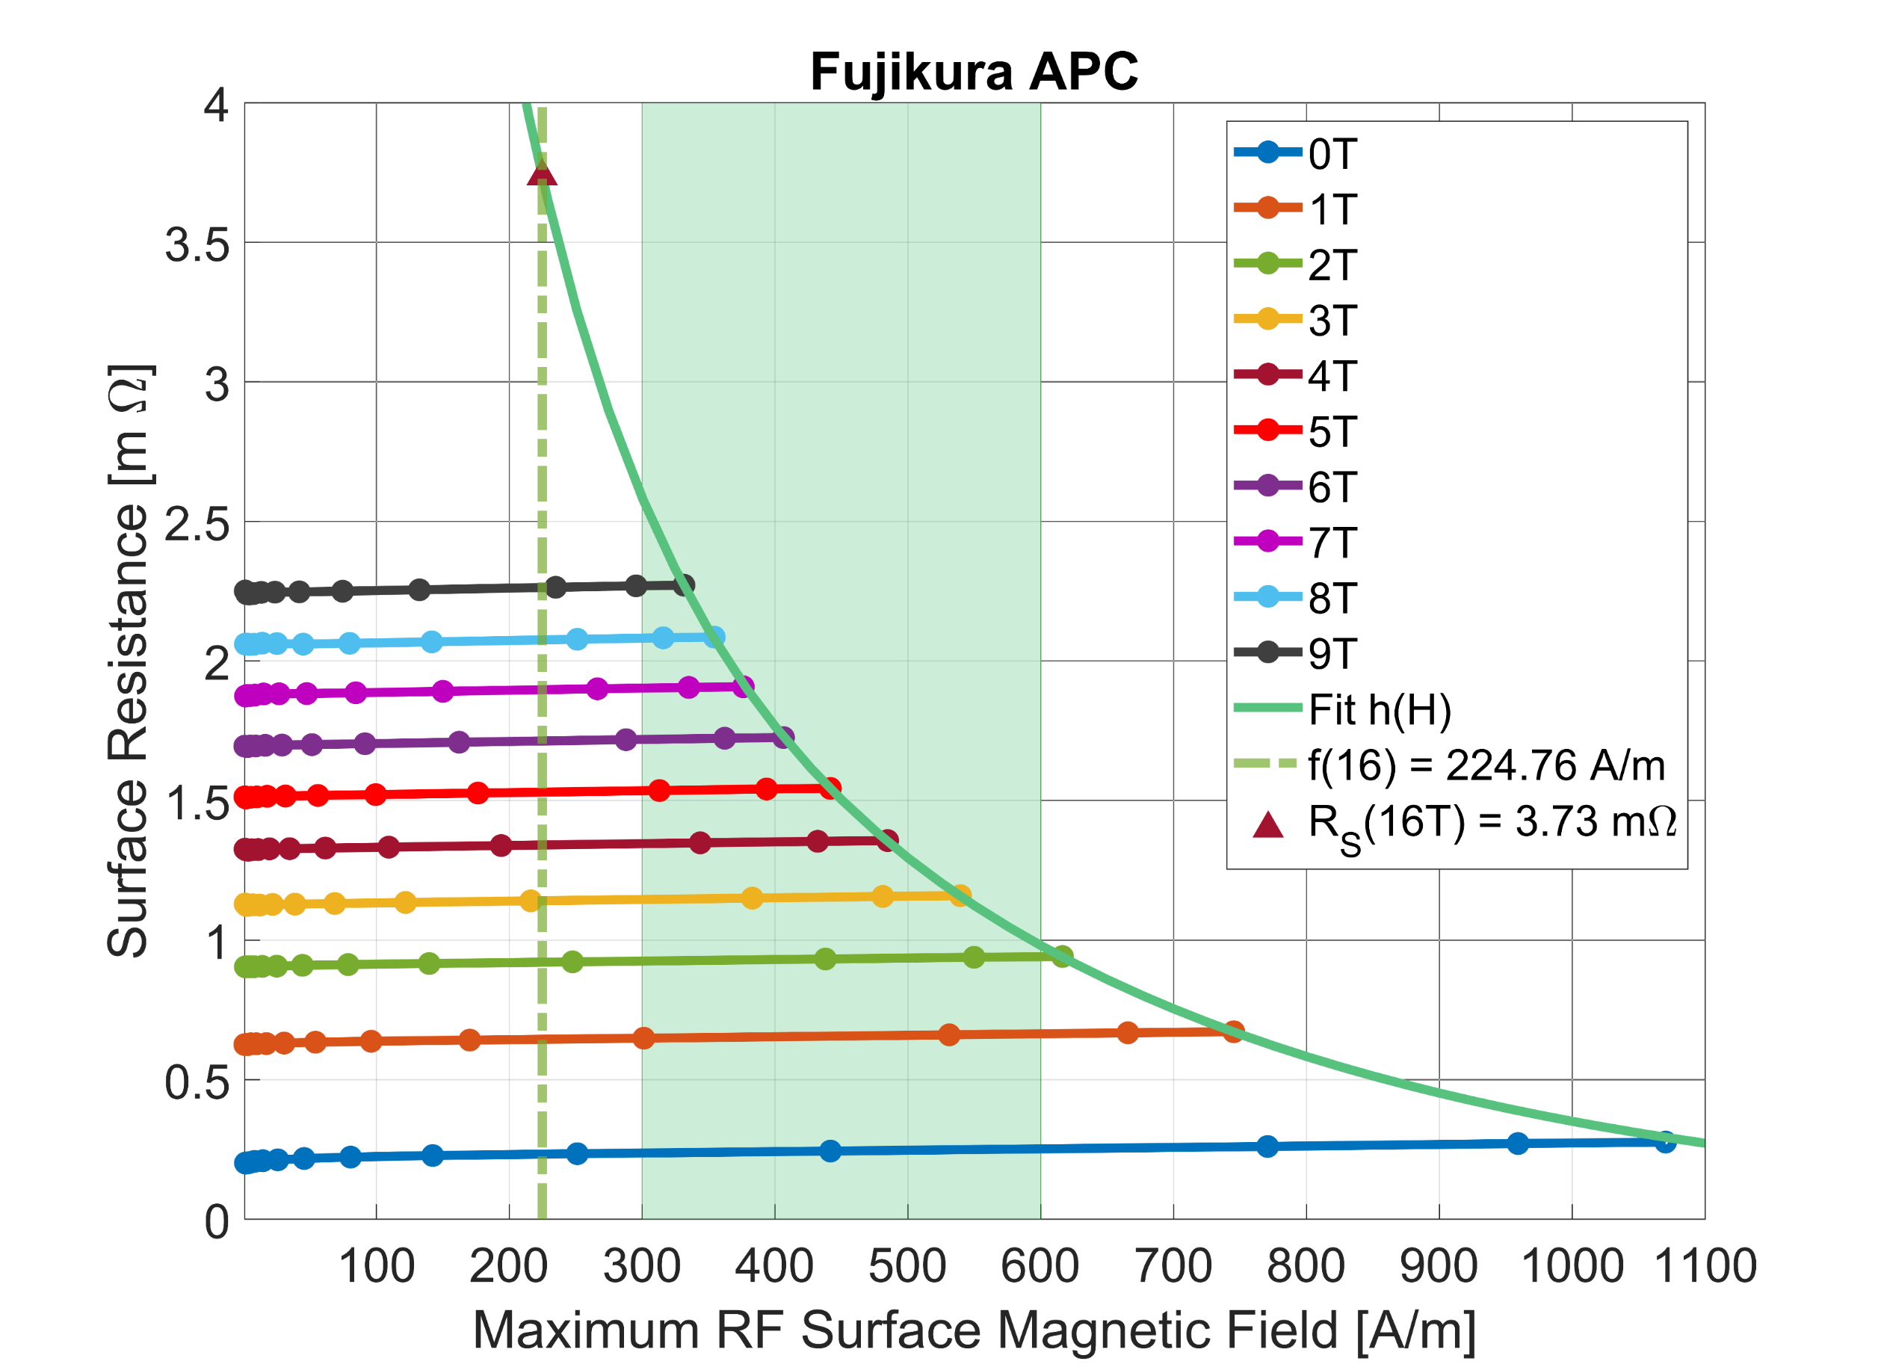
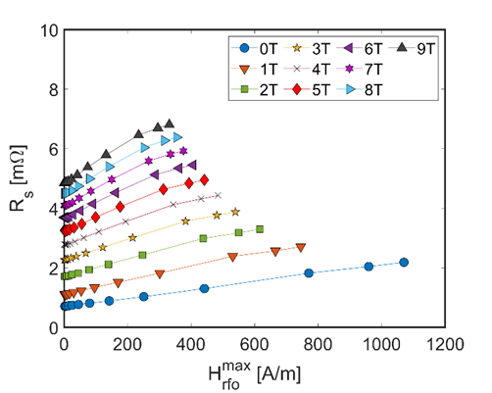
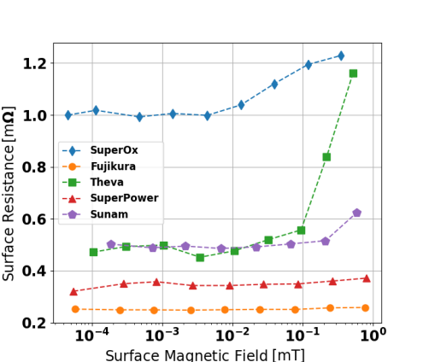
Testing at higher RF power
THEVA inclined deposition
0 T external field
HTS coated conductors at 8 GHz (dielectric resonator) and 50 K
Patrick Krkotic, PhD dissertation, UPC Barcelona 2022

Slide 23
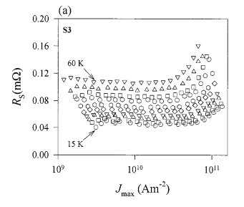
Literature review
There are very few measurements on HTS at high RF currents (mostly microstrip resonators). But physics is proven.
~10¹¹ A/m² RF current (microstrip resonator, 200 µm, 350 nm thick, 8 GHz)
Powell et al. Journal of Applied Physics 86, 2137 (1999)
For 1 µm thickness this is equivalent to 10⁵ A/m (≅ 0.1 T ≅ 25 MV/m)
Entering the “high-gradient” range

Slide 24
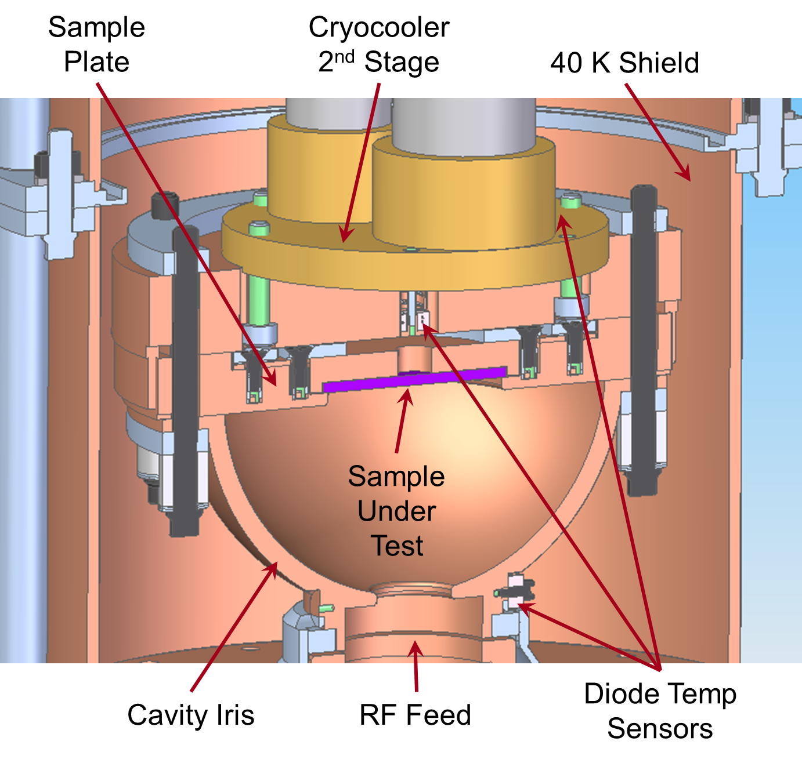
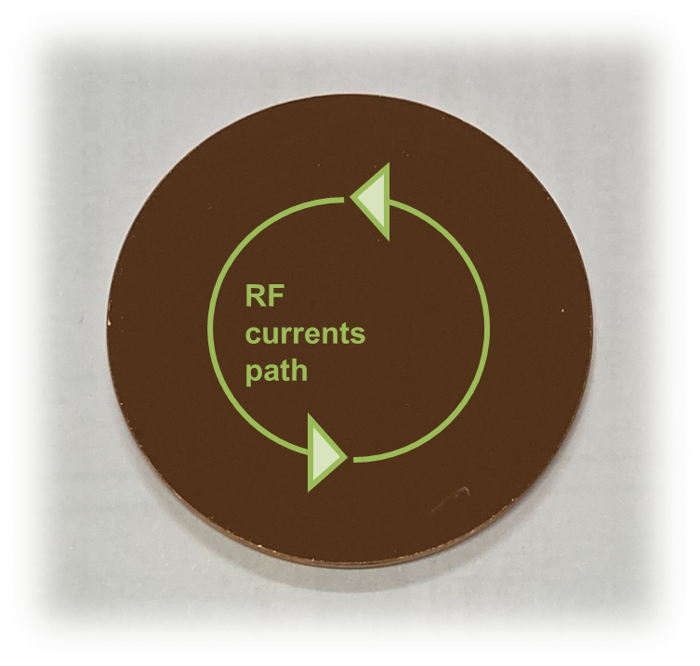
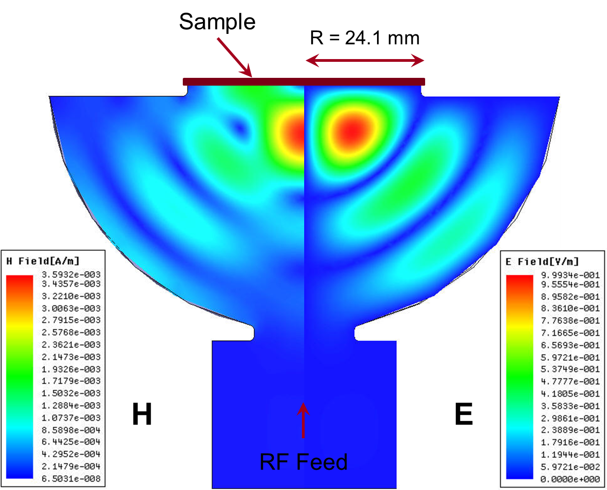
High-gradient testing at SLAC – supported by I.FAST IIF
“Mushroom” cavity. Can achieve H_{peak} of about 360 mT – 2.9x10⁵ A/m (equivalent to ~80 MV/m in a standard accelerating cavity) using 50 MW XL-4 Klystron at 11.4 GHz.
Zero E-field on the sample
Maximum H-field on the sample
Sample accounts for ⅓ of total cavity loss
Goal: demonstrate high-gradient pulsed operation of HTS, at cryo-temperatures

Slide 25
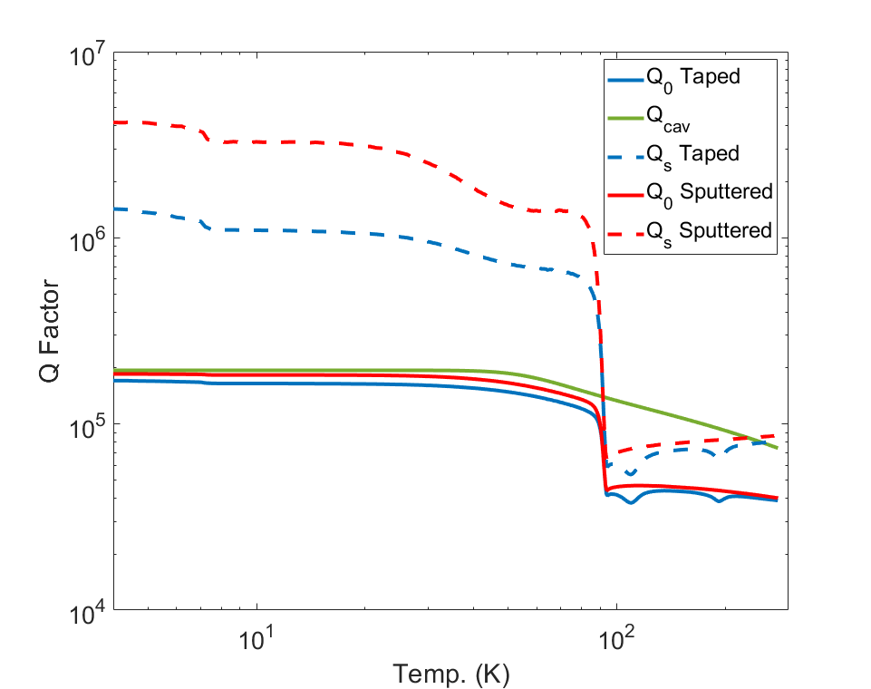
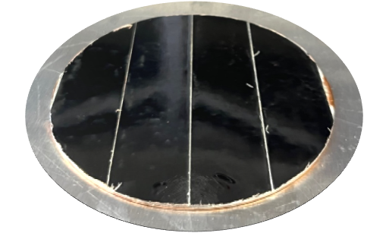
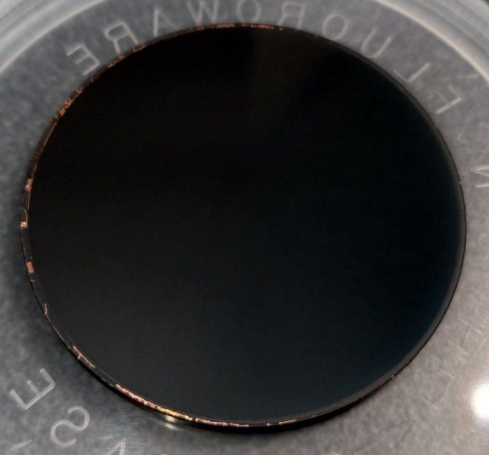
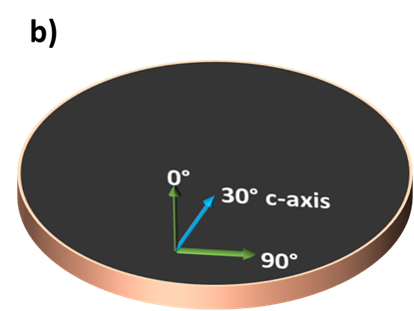
First results at SLAC, at low gradient
Two HTS measurements, after calibration measurements with Cu and Nb
Soldered REBCO-CCs on copper (Fujikura by CSIC-ICMAB)
Directly grown REBCO on MgO on copper (CERACO)
R_{s} Cu ≅ 17 mΩ
R_{s} REBCO tapes ≅ 1.7 mΩ
R_{s} REBCO PVD ≅ 1.0 mΩ

Slide 26
Preliminary SLAC results at high-gradient
From: Mitch Schneider

Slide 27
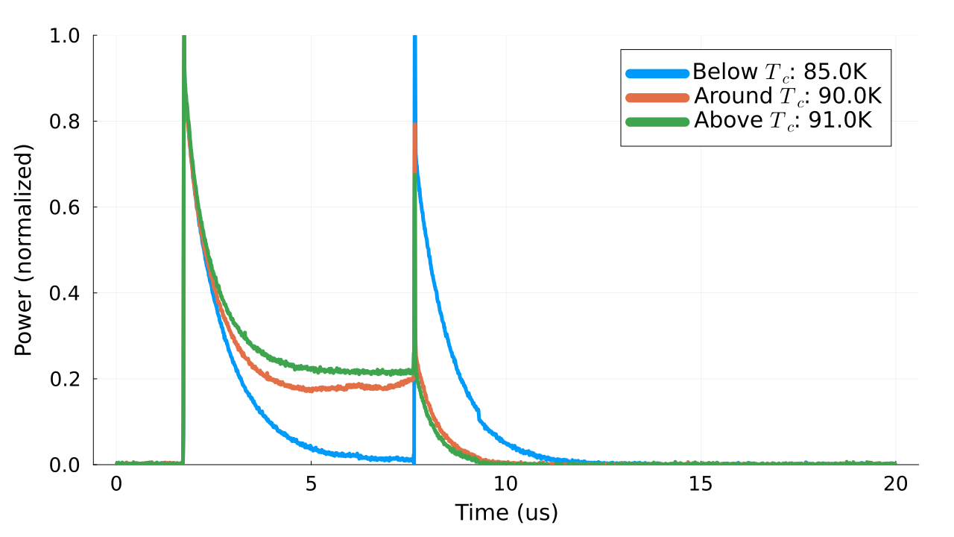
Preliminary SLAC results at high-gradient: different temperatures
1 kW
~7 μs
0 W
Power pulse
From: Mitch Schneider

Slide 28
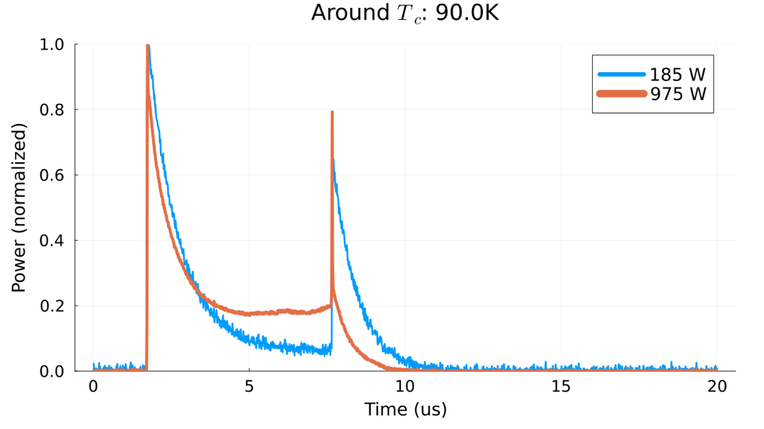


Preliminary SLAC results at high-gradient: different powers
From: Mitch Schneider
~7 μs
0 W
Power pulse

Slide 29




First device validation – supported by I.FAST Innovation Fund
Next goals: develop large-size tapes (50 mm wide) in collaboration with KCT, to be first tested on discs at SLAC. Two-years plan funded by IIF
(Ideally: REBCO coating directly on 3D objects)
Device validation: X-band pulse compressor (SLAC) as first “real” RF device
Coating will be performed by CSIC-ICMAB
Courtesy Greg LeSage, SLAC
Pulse compressor

Slide 30







Axion cavity as earlier demonstrator
Approach being validated also for axion detection cavities in RADES collaboration having a similar geometry
Copper body manufactured at Mainz University, adapted to 12 mm wide coated conductors, coated by CSIC-ICMAB
    f= 9.3 GHz
Q₀ = 356 070
    Surface currents
Axion cavity
    E-field
Q₀ = 268 520 (75%)

Slide 31
Work plan from 4/2023 to 4/2025

Slide 32

Industrial application prospect
At the end of this study, we aim at consolidating TRL4.
Prototype pulse compressor with SLAC will demonstrate TRL6.
  Timescale: 2-3 years after completion of this study
  Need a further round of funding
  This will include the design, fabrication and coating, and its validation in a high-power RF bench test bench.
Future accelerator projects will drive achieving further TRLs and drive commercialization.
  Industry will be involved for construction of devices
  Other companies may be involved for hardware manufacturing

Slide 33


Addressing the European Green Deal
New-generation collider linacs are expected to use hundreds of MW of electricity
Energy savings from HTS are in line with current policies of societal impact minimization
Benefits
Actions

Slide 34
Resources and budget
CERN:
  Provided resources: two senior physicist (scientific coordination, 0.2 FTE) and one senior Fellow (follow up, measurements, 0.5 FTE)
  Requested resources: 10 kEUR (sample manufacturing)
KCT:
  Provided resources: one senior scientist (design, procurement, coating, 1 FTE)
  Requested resources: 100 kEUR (80 kEUR manpower for coating operations, 20 kEUR sample holder manufacturing)
CSIC-ICMAB:
  Provided resources: one senior scientist (0.2 FTE), and one PhD student (0.5 FTE)
  Requested resources: 50 kEUR (40 kEUR PhD student and manpower for coating and characterization work, 10 kEUR consumable)
Ratio for the requested IIF funds: 120 kEUR personnel and labour / 40 kEUR material
Final deliverable is a report on the demonstrated achieved performance, and on the prospects for scalability to accelerator-scale RF devices.

Slide 35
Budget table
 | Manpower | Materials | Total
CERN |  | 10 kEUR | 10 kEUR
KCT | 80 kEUR | 20 kEUR | 100 kEUR
CSIC-ICMAB | 40 kEUR | 10 kEUR | 50 kEUR
 |  |  | 160 kEUR

Slide 36
Outline
HTS cavities at low gradient, in a strong magnetic field
  The present: FCC beam screens and RADES axion detectors
HTS cavities at high-gradient
  The goal of the new iFAST collaboration CERN – KIT – ICMAB
HTS cavities in both high-gradient and strong magnetic field
  The future?

Slide 37



Muon Collider
From: Chris Rogers

Slide 38

Muon collider
Muon cooling system requires RF cavities operating at high-gradient AND in a strong magnetic field.
Normal conducting copper, possibly cryo: baseline option
A dream: High-Temperature Superconductors ?

Slide 39


USA P5 process
https://www.usparticlephysics.org/2023-p5-report/index.html
Recommendation 2c:
Recommendation 4a:

Slide 40





Possible practical implementation of HTS tape-coated cavities
How could a future cavity look like? Bimetallic cavities
B
SC
NC
J. Haimson, WEPMS085, PAC07 (s.steel inserts)
CLIC Mo-iris prototype
P. McIntyre et al., IEEE TAS 19 (2009) 1380
Composite cavities exist and have been demonstrated.
Joints at low-current regions are standard practice even in SRF cavities (ie QWRs)
Segmentation at zero-current region is possible, see device being designed at SLAC

Slide 41
Final remarks
No data exist for HTS at high-gradient (either samples or cavities): experiments needed
Fabrication technologies for real cavities must be developed:
wider soldered tapes (iFAST collaboration “HIGHEST”), and perhaps eventually develop a direct HTS coating technique on copper
Overall energy efficiency would have to be studied, considering: operating temperature, cryo-efficiency, possible Q-factor, pulsed operation

Slide 43







Scaling to lower frequency
REBCO scaled to 1 GHz at 50 K
A parallel-plate resonator is being commissioned to test samples at ~1 GHz
x100 improvement over Cu at 50 K
GHz
38x12 mm samples
50 mm bore
16 T
$X_{s}(T)$ at all frequencies
Romanov et al, SciRep 10:12325 (2020)
For HTS Rs scales as $f^{2}$
For Cu Rs scales as $f^{1/2}$
Will demonstrate real experimental frequency scaling on samples

Slide 44


Surface impedance: the key
τ Risetime of beam instabilities
$$\left|Δω\right|$$
Z_{T} Transverse impedance (property of the beam)
R_{S} Surface resistance (property of the surface)
τ: instabilities rise-time
Δω: betatron tune-shift
I_{b}: bunch current
M: number of bunches
E: beam energy
L: bunch length
R: accelerator radius
c: speed of light
b: vacuum chamber radius
f: wakefields frequency
ρ: electrical resistivity
What could be better than copper at 50 K?
High-Temperature Superconductors (HTS)

Slide 45



New kid on the blocks: the C3 study @ SLAC
More info here
8 km footprint for 250/550 GeV CoM ⟹ 70/120 MeV/m
Large portions of accelerator complex compatible between LC technologies
Beam delivery / IP modified from ILC (1.5 km for 550 GeV CoM), compatible w/ ILC-like detector
Damping rings and injectors to be optimized with CLIC as baseline
Cryogenically cooled – 77 K (liquid nitrogen)
C³ Parameters
C³ - 8 km Footprint for 250/550 GeV (to scale)
Cooling allows for increase in accelerating gradient, and savings in RF power infrastructure
From: Emilio Nanni

Slide 46

Flux pinnining
Typical SRF accelerator cavities are made of niobium
Effect of external magnetic field on SRF accelerating cavities is mostly due to flux pinning, weak pinning in bulk Nb and strong in Nb/Cu
Earth magnetic field should not be an issue for HTS (to be verified)
Strong magnetic shielding needed
Limited or no magnetic shielding

Slide 47


Literature review - II
From: M. Hein, “High-Temperature-Superconductor Thin Films at Microwave Frequencies” (Springer Tracts in Modern Physics, 155)

Slide 48


HTS tape at 8 GHz (dielectric resonator) and 50 K
Patrick Krkotic, PhD dissertation, UPC Barcelona 2022

Slide 49

Zoo of superconductors
J_{c} may vary of orders of magnitude.
H_{c2} has much smaller variation.
YBCO most promising candidate
NbTi – NbTiN possible candidates at B < 10T
Nb₃Sn for B < 15 T
https://nationalmaglab.org/magnet-development/applied-superconductivity-center/plots

Slide 50

Zoo of superconductors
Pinning force
https://nationalmaglab.org/magnet-development/applied-superconductivity-center/plots

Slide 51

Effect of magnetic field: fluxon losses in RF
Surface resistance, reactance due to vortex motion
“safe” zone
“unsafe” zone
To maximize f₀ and minimize fluxon losses we need high J_{c} materials

Slide 52


Predicted surface resistance of HTS in 16 T field
YBCO | T_{c}=92K | T=50K | B₀=16T | J_{c}(50,16)=7.5x10⁹Am⁻² | B_{c2}(50)=40T | ρ_{n}=60μΩcm | f₀=10GHz
Tl-1223 | T_{c}=125K | T=50K | B₀=16T | J_{c}(50,16)=1x10¹⁰Am⁻² | B_{c2}(50)=80T | ρ_{n}=80μΩcm | f₀=14GHz
For HTS the Rs scales as $f^{2}$
For Cu the Rs scales as $f^{1/2}$

Slide 53


Cryogenic losses: SRF aimed at energy saving compared to NRF
Carnot efficiency
Cryoplant efficiency
30%
Power consumption for 1 W @ 77 K | 13 W
Power consumption for 1 W @ 20 K | 50 W
Power consumption for 1 W @ 4.2 K | 230 W
Power consumption for 1 W @ 1.9 K | 920 W
Thanks to T. Koettig, CERN

Slide 54

HTS coating technologies
Patrick Krkotic, PhD dissertation, UPC Barcelona 2022

