Slide 1
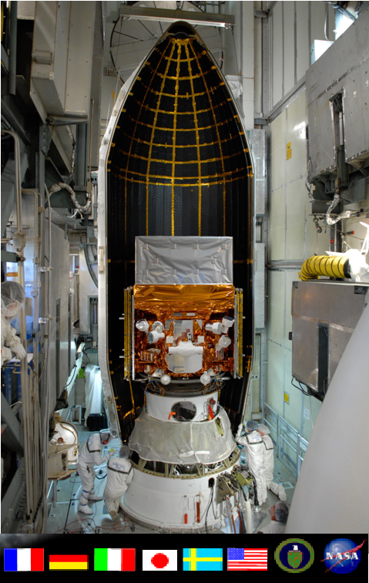
The construction of the Fermi silicon tracker
Ronaldo Bellazzini
INFN-Pisa-Italy
Ronaldo.bellazzini@pi.infn.it
8th International “Hiroshima” Symposium
5-8 December 2011 Academia Sinica
Notes:
i

Slide 2
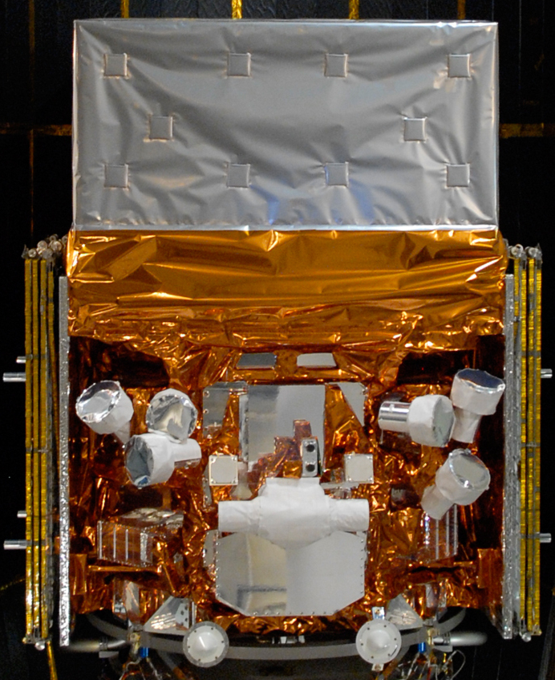
Large Area Telescope (LAT):
Pair-conversion telescope.
Tracker/converter + calorimeter, surrounded by an anticoincidence shield.
Energy range: 20 MeV – 300 GeV.
Gamma-ray Burst Monitor (GBM):
Set of 12 NaI + 2 BGO scintillators.
Monitoring the entire unocculted sky, optimized to detect Gamma-Ray Bursts.
Energy range: 10 keV – 25 MeV.
Key features:
Large field of view (>2 sr for the LAT, 2π sr for the GBM)
Huge energy range (including the essentially unexplored 10--100 GeV band).
Small dead time (26 μs minimum).
Enormous increase in sensitivity with respect to the previous missions.

Slide 3
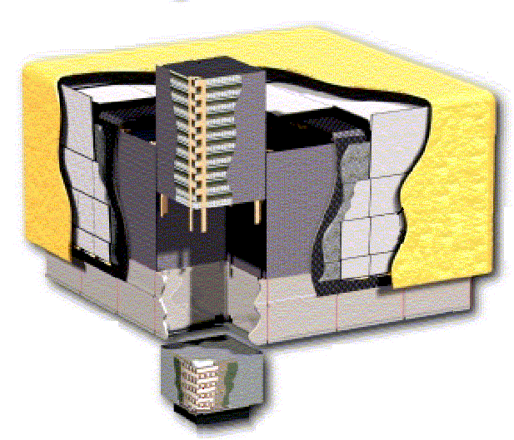
Overview of the LAT detector
Precision Si-strip Tracker (TKR)
18 XY tracking planes
Single-sided silicon strip detectors 228 μm pitch, 8.8 10⁵ channels
Measure the photon direction
Segmented Anticoincidence Detector (ACD)
89 plastic scintillator tiles
surrounding the TKR towers
Reject background of charged cosmic rays Removes self-veto effects at high energy
γ
LAT:
4 x 4 modular array
3000 kg, 650 W
HEP and astrophysics partenrship
USA: US Dept. Of Energy, SU-SLAC, NASA GSFC, NRL
Italy: INFN, ASI, Inst. CR Res (IFC)
Japan: Univ. Tokyo, Univ. Hiroshima, Inst. Space Science, Inst. CR Res. (ICCR)
France: CEA, CNES, IN2P3
Sweden: Royal Inst. Tech., Univ. Stockolm
GRID
Mechanical
backbone
e⁺
e⁻
Hodoscopic CsI Calorimeter(CAL)
Array of 1536 CsI(Tl) crystals in 8 layers
6.1 10⁴ channels
Measure the photon energy,image the shower
Electronics & Flying Software
Data Acquisition System

Slide 4
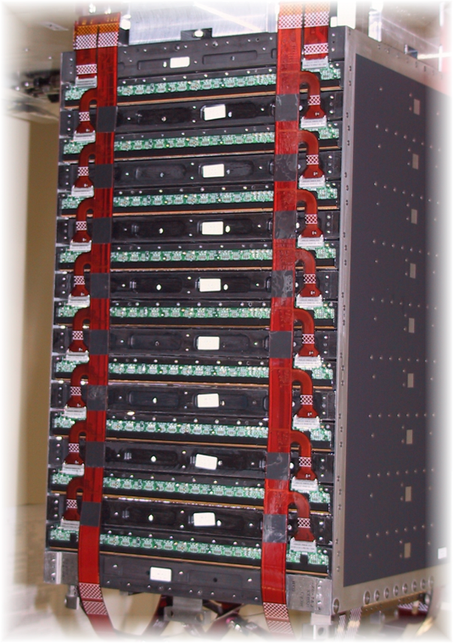
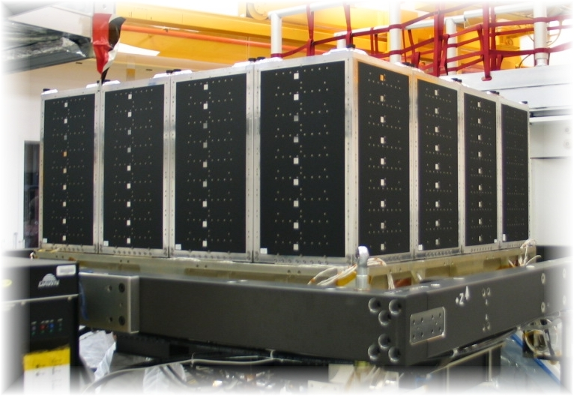
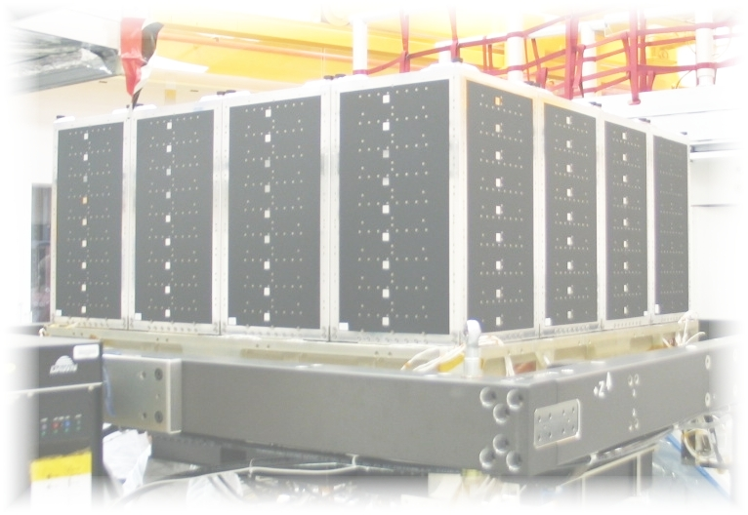
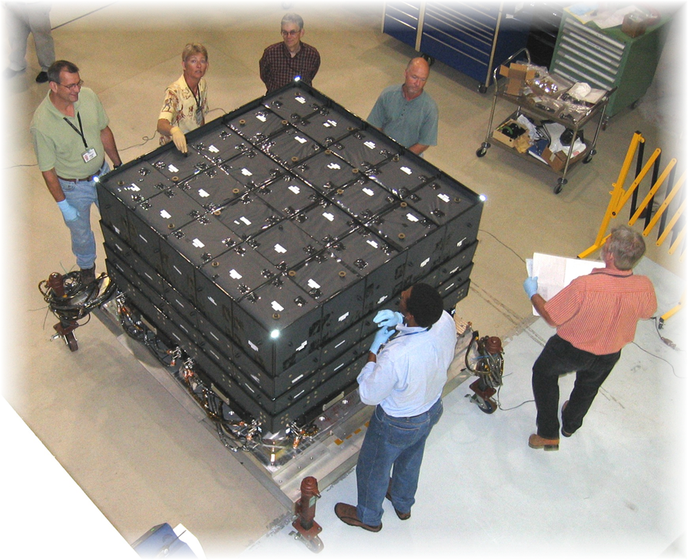
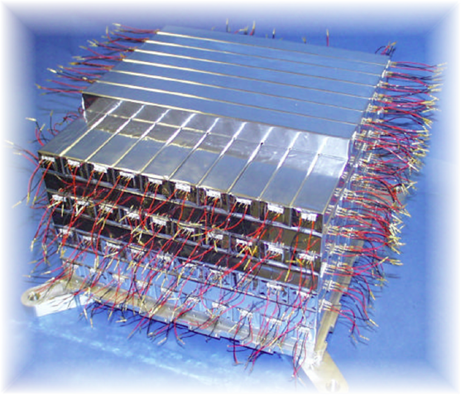
The LAT instrument: how we built it
Overall modular design:
4x4 array of identical towers - each one including a Tracker, a Calorimeter and an Electronics Module.
Surrounded by an Anti-Coincidence shield (not shown in the picture).
γ
Tracker/Converter (TKR):
Silicon strip detectors (single sided, each layer is rotated by 90 degrees with respect to the previous one)
W conversion foils
~80 m² of silicon
~10⁶ electronics chans
fully digital electronics
High precision tracking, small dead time
Anti-Coincidence (ACD):
Segmented (89 tiles)
Self-veto @ high energy limited
0.9997 detection efficiency (overall)
Calorimeter (CAL):
1536 CsI crystals
Analog 4 range readout
8.5 X0
Hodoscopic
Shower profile reconstruction (leakage correction)
e⁺
e⁻

Slide 5
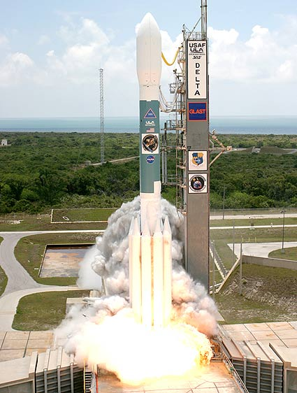

June 11, 2008
12:05 pm (EDT)

Slide 6
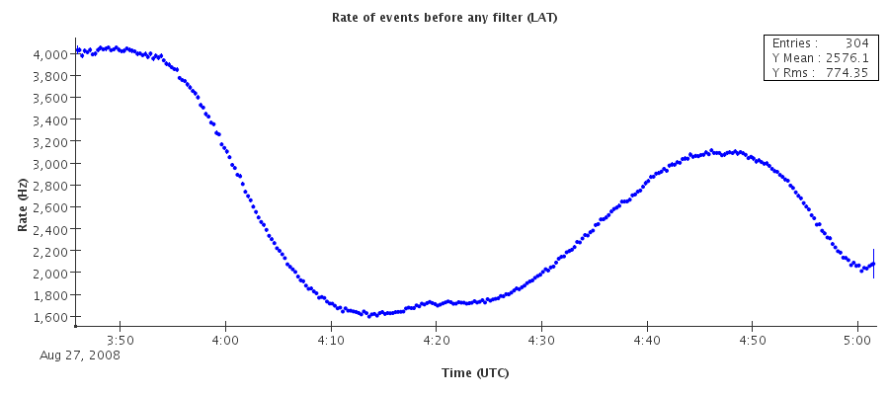
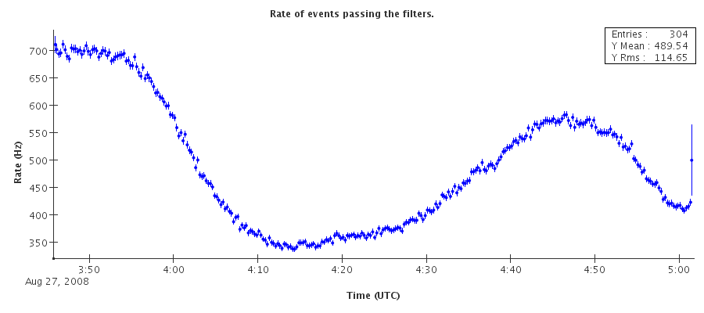
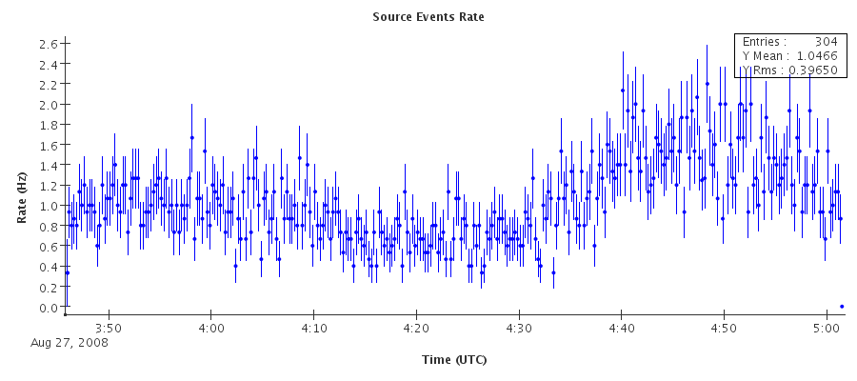
On orbit rates in nominal configuration
Overall trigger rate: ~few KHz
  Huge variations due to orbital effects.
Downlink rate: ~400—500 Hz
  ~90% from GAMMA filter
  ~20—30 Hz from DGN filter
  ~5 Hz from HIP filter
Rate of photons after the standard background rejection cuts for source study: ~1 Hz
Most of the downlinked events are in fact background, final ~ 1000:1 rejection is done in ground processing.
Notes:
GBM:
12 NaI, 2 BGO scintillators.
Wide field of view (all the sky not occulted by the earth).
Short dead time (10 us).
Localization: alert ~15 degrees, final few degrees.

Slide 7
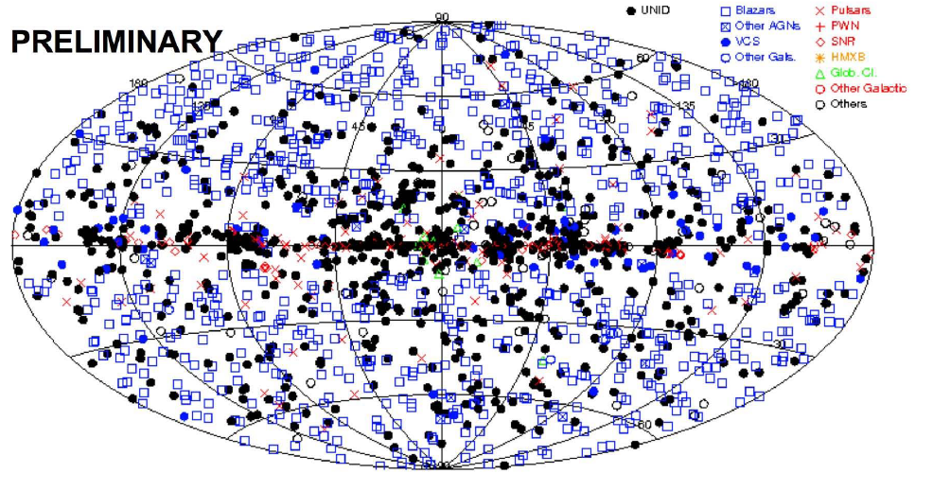
II Fermi catalog

Slide 8
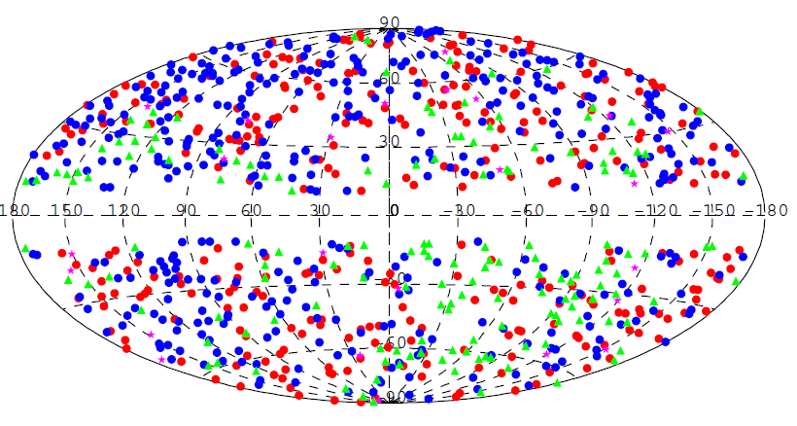
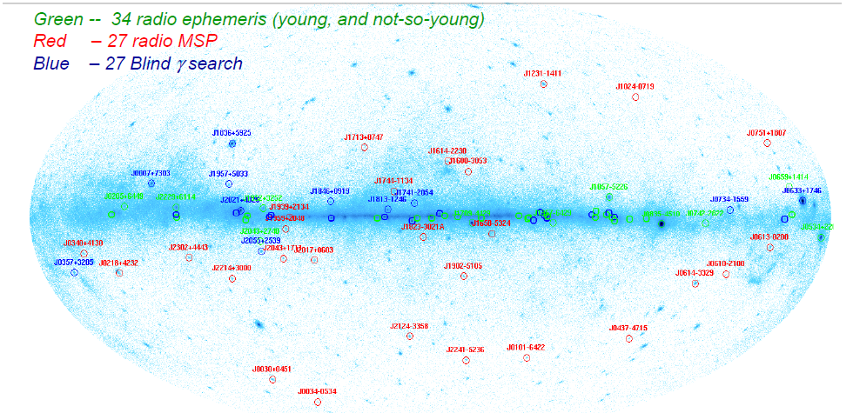
Type | Numb
Active Galactic Nuclei | 832
Candidate AGN | 268
Unassociated | 594
Pulsars (pulsed emissioin) | 86
Pulsars (no pulsations yet) | 26
Supernova Remnants/ Pulsar wind Nebulae | 60
Globular Clusters | 11
Other Galaxies | 7
Bynary Systems | 4
TOTAL | 1888
Red: FSRQs
Blue: BL Lacs
Magenta: non Blazar AGNs
Green: AGNs of unknown type
AGNs map
Pulsars map
For comparison, the 3° Egret catalog (5years) counts 271sources

Slide 9
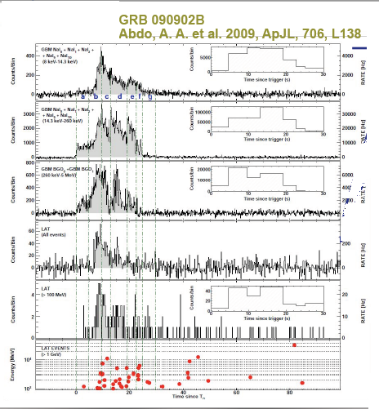
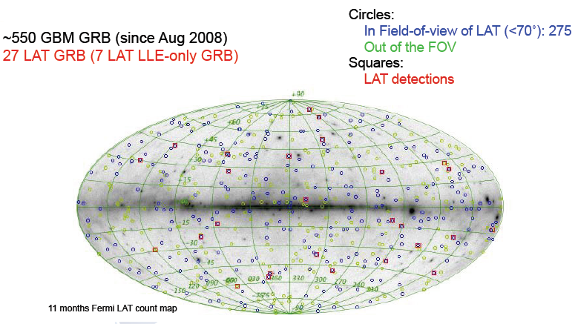
Since August 2008
GRBs detected by GBM = 550
GRBs detected by LAT = 27
GRBs
A limit on the variation of the speed of light arising from quantum gravity effects.
By Fermi GBM/LAT Collaborations Nature 462:331-334,2009.

Slide 10
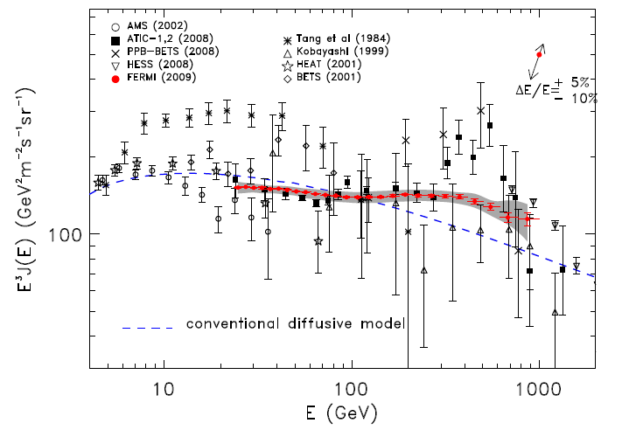
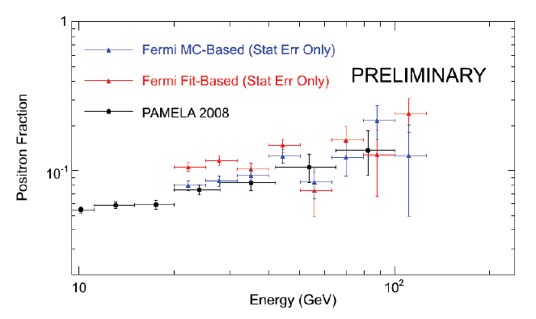
Cosmic Rays Spectra
A large impact paper
>500citations
The e+ fraction grows with energy
Dark matter sign?
Products of a close pulsar ?
e⁺ detected with the earth occultation method
e⁺+e⁻ energy spectrum

Slide 11
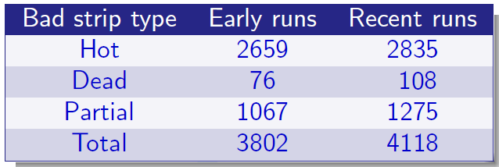
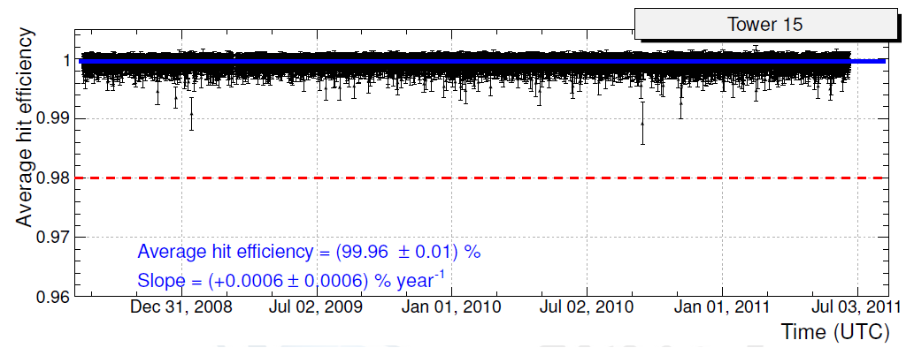
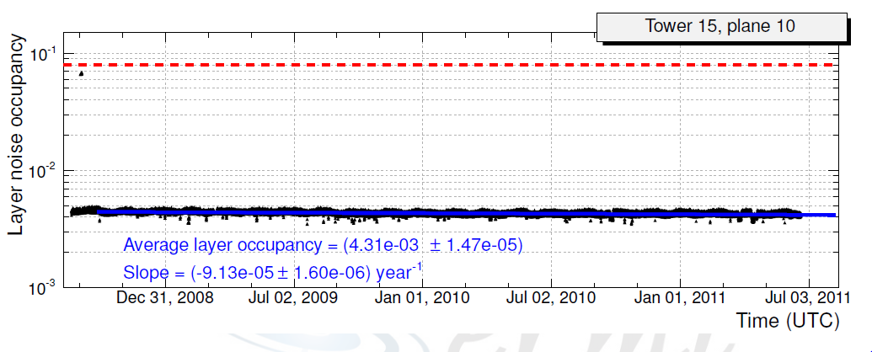
On flight operational stability
2-3 random channels per trigger in the whole tracker

Slide 12

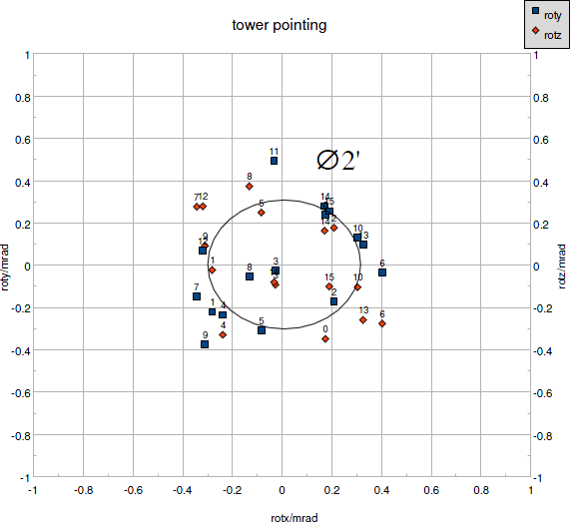
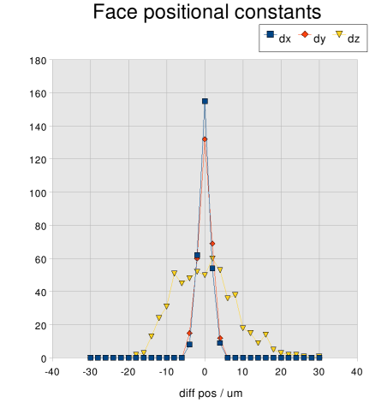

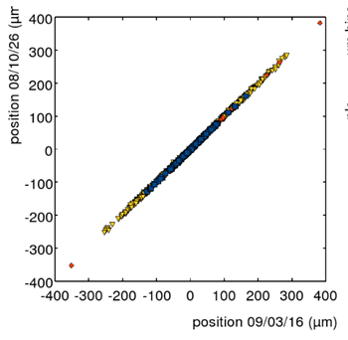
On fligth alignment and mechanical stability
Pointing angles of the tracker
By tracking the Cosmic Rays we measure the deviations from the nominal positions of the detecting planes, and of the towers..
The alignment parameters per detection plane. (16 wafers) are 6 (dx, dy, dz, rotx, roty, rotz). The alignment constants are small (~SSD pitch) and very stable, no need for geometrical updating year after year.
Variations of the alignment constants from ground to space
Correlation of the alignment constants after 1 year in orbit

Slide 13
Fermi: an absolute success
• Launched from Cape Canaveral 11 June 2008
• Science operations since Aug. 08
• First Light - Renamed for E. Fermi
• >1000 days on orbit
• >16000 orbits completed
• Orbit altitude has only decayed by 1.2 km since launch
• Practically no data loss (>99.99% retrieved from the spacecraft over entire mission)
The Silicon Strip LAT Tracker has been the strategic choice to achieve these results

Slide 14
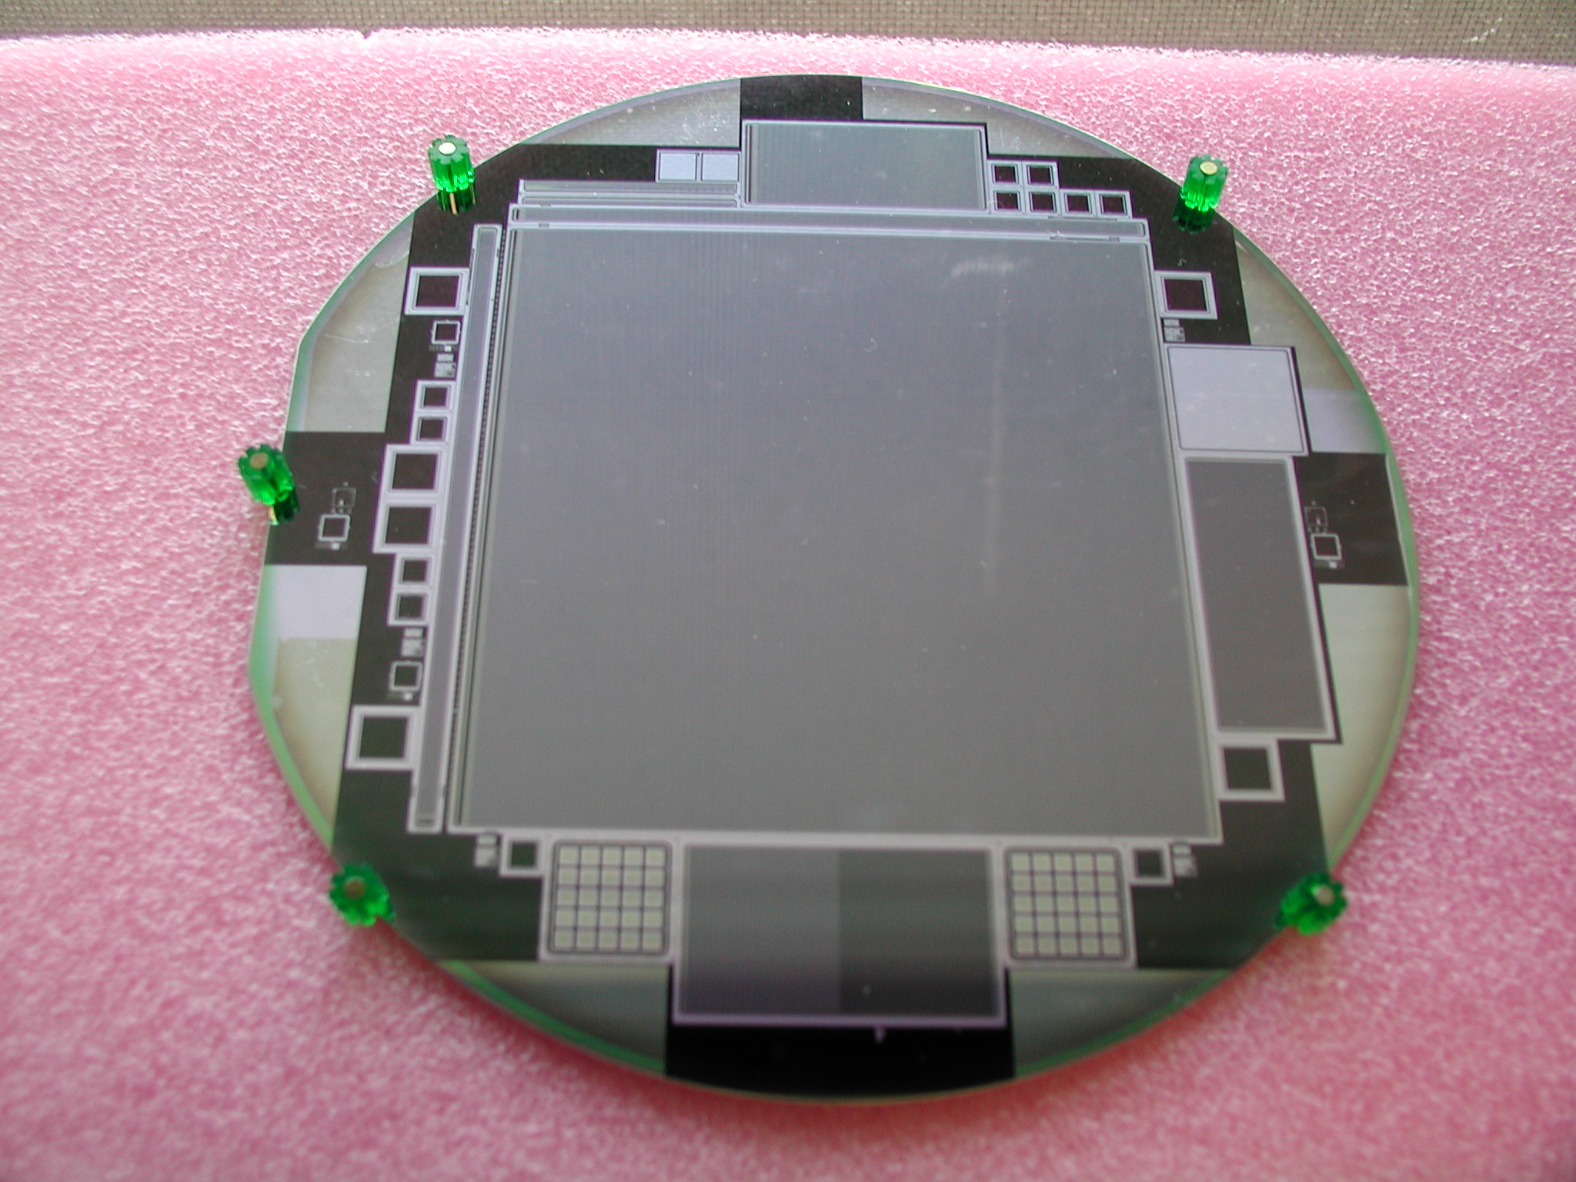
Silicon strip sensors: the foundation brick
Aggressive specs
Standard design
Bias voltage | < 120V
Breakdown | > 175V
Current(@150V) | <500nA AND <200nA (averaged any 100 SSD)
Bad strips rate | 0.2 %
Dicing precision | < 20 μm each corner
Wafer size | 6”
Sensor size (cmXcm) | 8.95X8.95
Thickness (μm) | 400
Doping | n-type
Implant | p+
Read-out | Single-sided
Coupling | AC
Bias | Poly-Si
Strips | 384
Strip pitch (μm) | 228
Implant width (μm) | 56
Hamamatsu Photonics qualified producer
11500 SSDs delivered
up to 700 SSD/month
fully tested at HPK
bulk IV and CV at INFN
final rejection rate ~0.5%

Slide 15
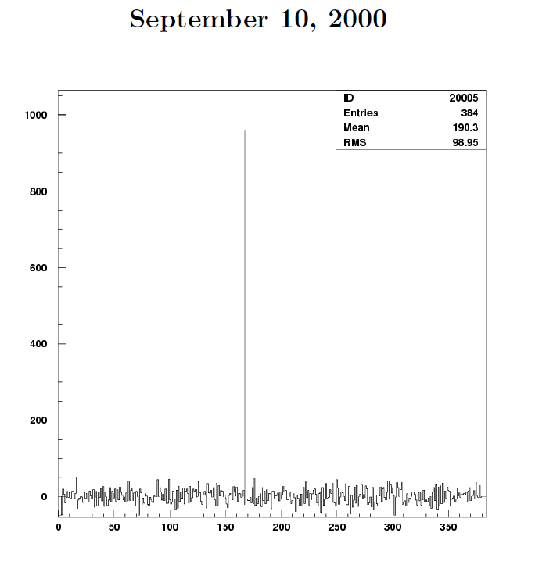
Chi ben comincia…
First signal of a GLAST Si wafer in Pisa
Electronics: PREMUX, 50ns shaping time, CMS tracker prototype, analog readout,
S/N ratio similar to the GLAST case (36cm strips).
All the 384 channels working.
GLAST score:
Bad channel rate:
required: 0.2%
In production (>11,000 wafers) : 0.01% that means
1 bad strip every 26 wafers or every 1.6 detection planes

Slide 16
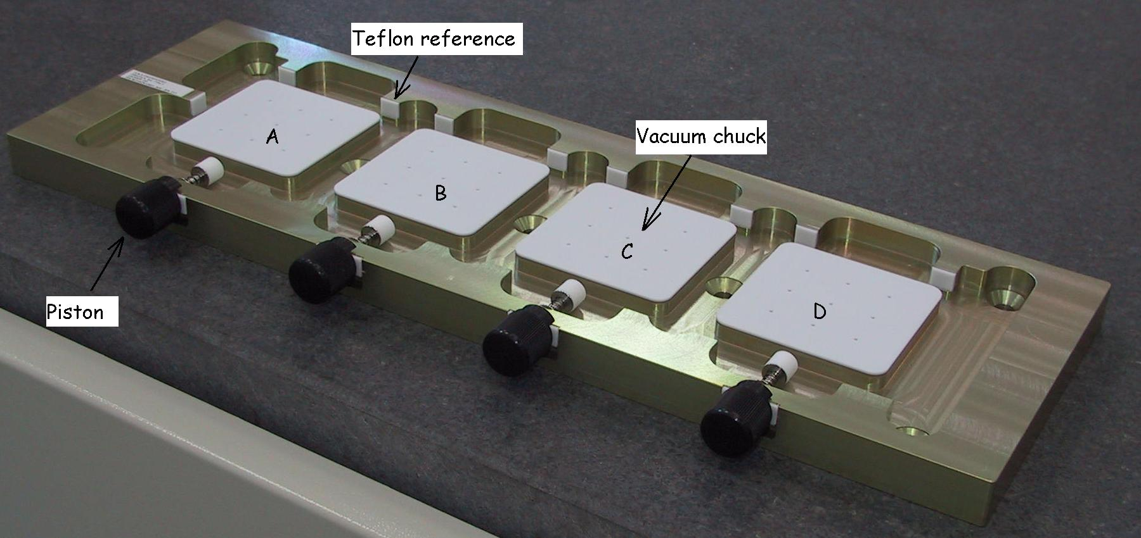
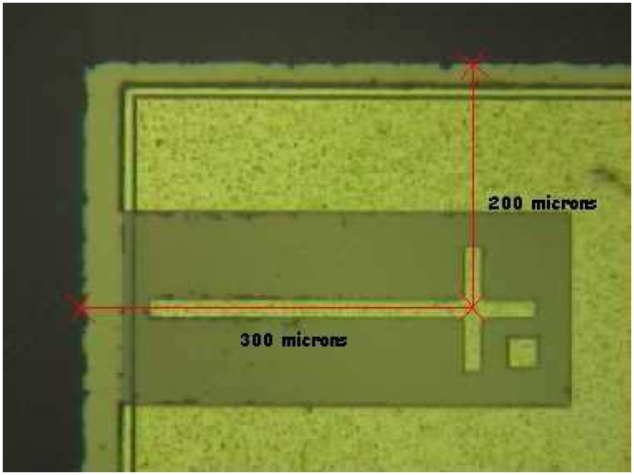
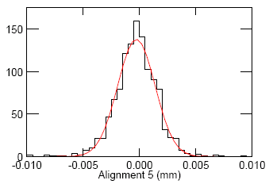
Ladders production
The ladder: 4 wafers glued head to head without any support. The strips are wire-bonded to form a super-wafer 36cm long.
Pure manual alignment against mechanical references. After tiling the relative alignment of the markers on the SSDs was measured with a CMM. To achieve a production rate of 1tower/week, we used 24 tools in parallel.
Ladder el tests: (all ladders, all strips)
Dep.volt., Leak.current, strip continuity, AC insulation
Ref
. Crosses
σ=2μm
Flight ladders production :
Production/Test completed 2850
Ladder rejection ~ 1%
Ladders for Non-Flight use ~ 5%
0.016% bad channels caused by bonding or probing
2 µm RMS alignment spread

Slide 17
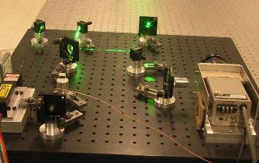
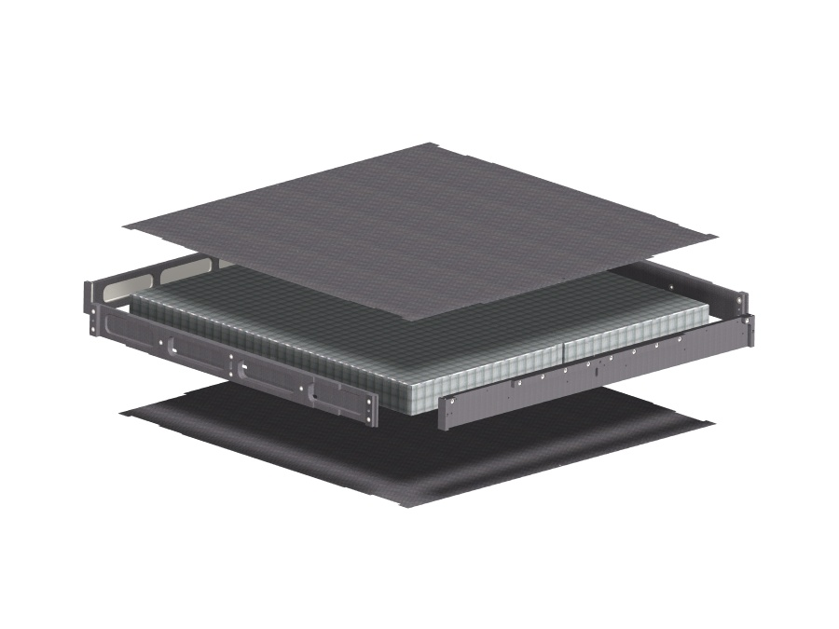
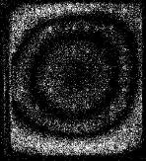
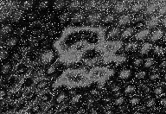
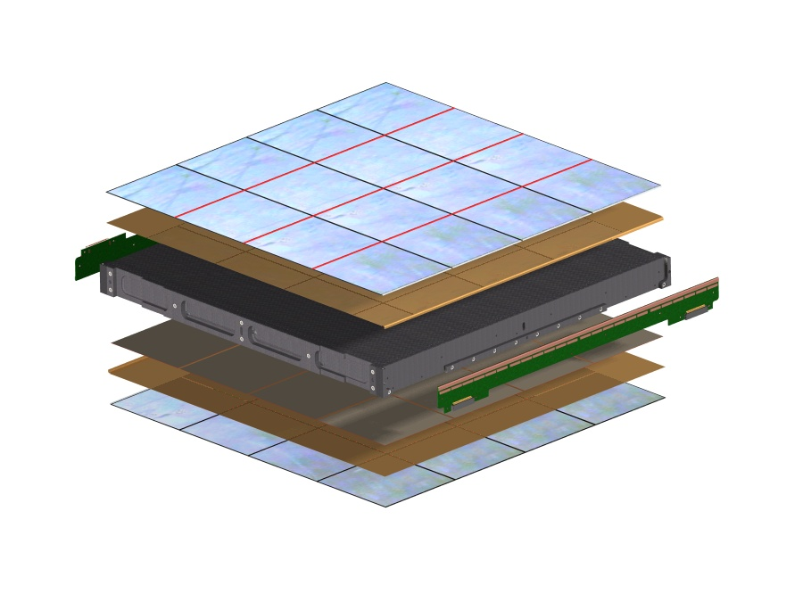
The Tracker Tray (Plyform-Italy)
2
Carbon fiber face sheet
The trays are precise and resistent structures over which we mount the payload.
ESPI test - INFN/PI
Tests on each tray:
CMM
ESPI
Thermo-vac.
Align.holes
Al honeycomb
Carbon-Carbon closeouts
Vib. Mode and Defects search.
Bias-Circuit
SSD’s
The tray is a 17 layers sandwitch. All the layers are glued together and special care was needed to mantain the mechanical tolerances and to avoid bubbles or detachments in thermo-vacuum tests.
Structural Tray Panel
Converter Foils
Bias-Circuit
TMCM
SSD’s
We had the most serious problem in the Tungsten tiles glueing. The problem was solved in september 04 by a NASA-INFN “tiger team” with the fundamental collaboration of industry
Notes:
The tray is essentially a support structure
for layers of silicon detectors. The tray is supported by a sandwich panel with
a structural/thermal closeout frame,top and bottom face-sheet support printed Kapton bias circuits, thin tungsten converter layer,
and silicon strip detectors, 1000 $ dollars per unit, very delicate, a small scratch is enough to cause a short circuit.
Two opposite sides of each tray serve as mounting surface for frontend
electronics PC boards. The tray is the building block…

Slide 18
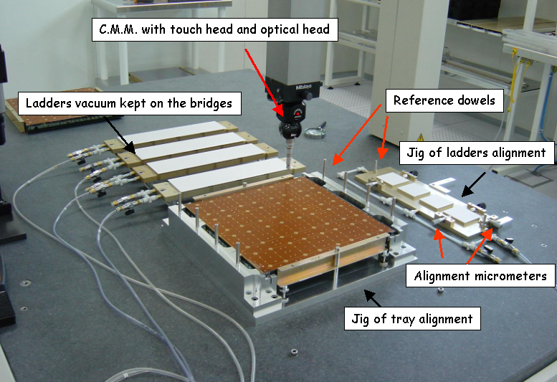
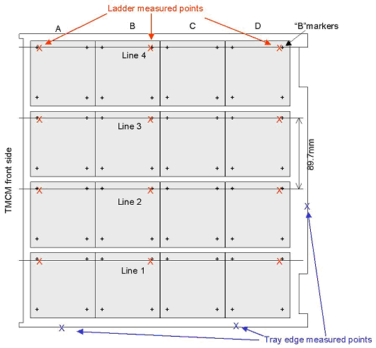
Payload Integration (G&A Engineering –Italia)
4 vacuum bridges capture the ladders from an alignment tool
The adhesive drops are deposited. The bridges are positioned with a dowel-hole system keeping the ladders aligned at the rigth height
The tray is aligned in the tool
The 16 SSDs assembled onto the tray have a very good relative Alignment, and they can be considered as a monolithic Silicon Detector
The strips are bonded to the electronics
The alignemnt, parallelism and flatness are measured with a CMM
Notes:
Ogni ladder misurato in tre punti, all’estremita’ e al centro. Il plot dei “residuals” sono le distanze dei punti misurati dai punti di disegno

Slide 19
The Tracker electronics system
Key features:
Low power consumption
(~ 200 μW/channel).
Low noise occupancy
(< 10⁻⁴ at the single channel level, mainly for the trigger).
Redundant architecture.
Complete digital zero suppression onboard.
Overall design:
24 custom Front End chips + 2 Readout Controller chips handle one silicon layers.
Data can shift left/right to one of the Controllers (single dead chips can be bypassed without loosing data).
Zero suppression takes place in the controllers (data stream includes IDs of the strips fired + TOT of the layer OR, which also provides the trigger).
Two flat cables per side complete the redundancy.

Slide 20
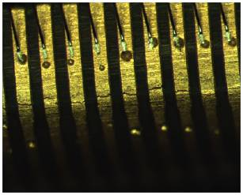
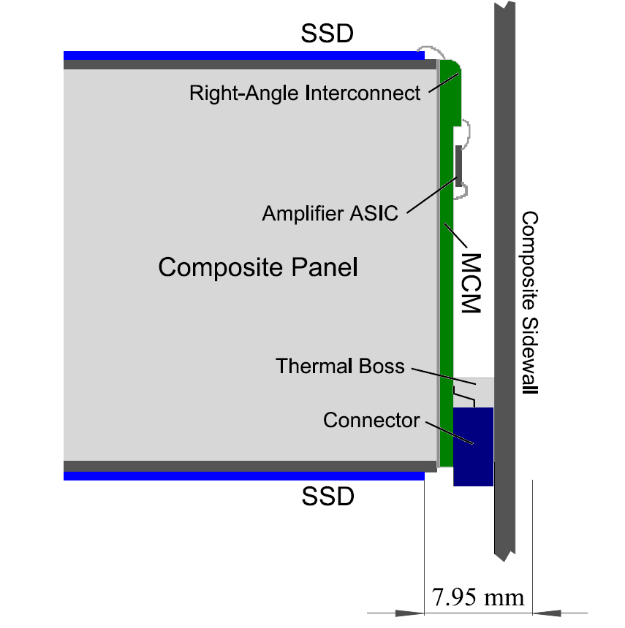
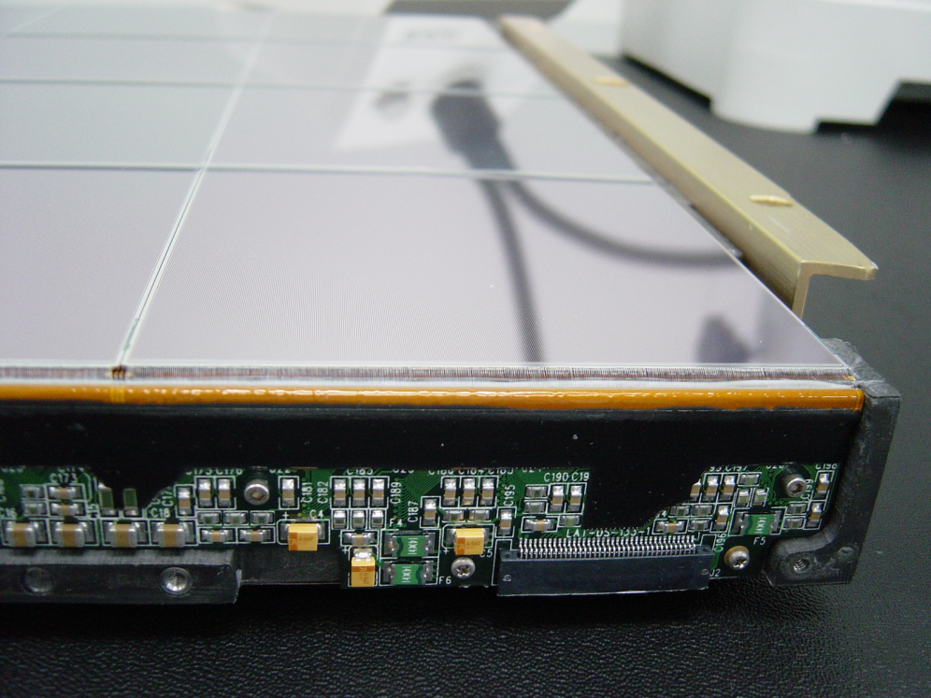
Readout electronics mounted vertically on a pocket of the tray to reduce the infra-towers dead space to <16mm
A tremendous effort was needed to achieve the required 99% yeld of the connection chain from the readout chip to the detectors strip.

Slide 21
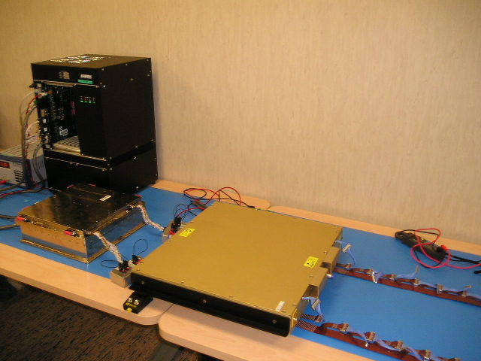
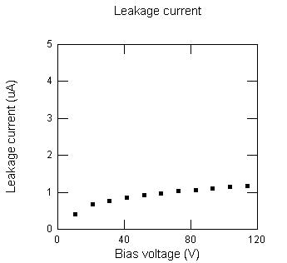
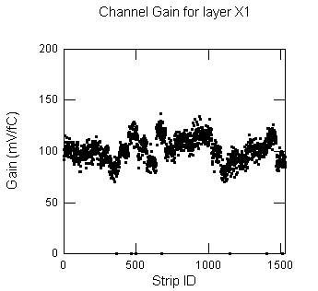
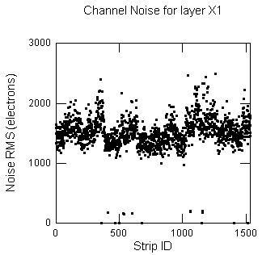
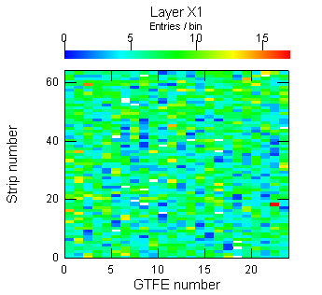
Tracker Tray Functional Tests
Single-tray test-bed
System transferred to G&A and operated by INFN
Leakage current
~100nA/SSD:
the SSD performance are preserved all along the assembly phases
Channels gain
Channels noise
CR data taking
Disconnected channels
Dead channels

Slide 22
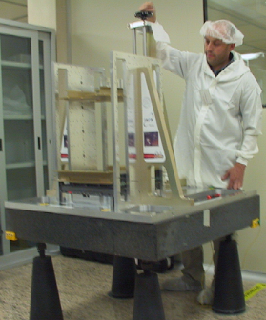
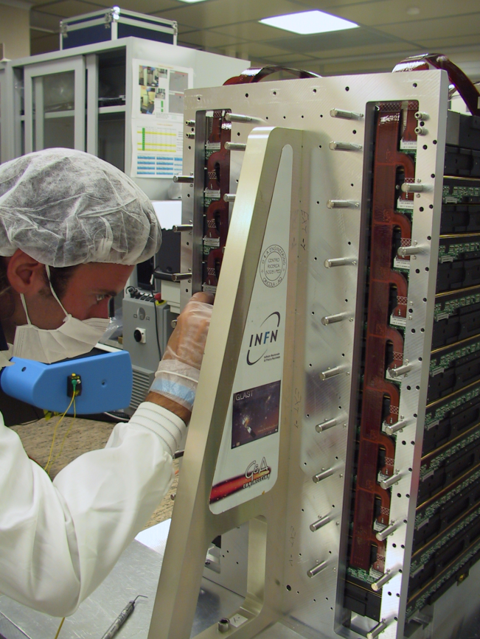
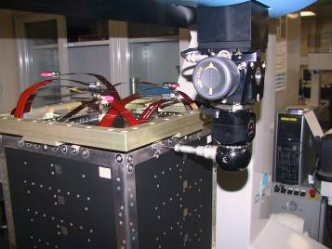
Tower assembly, cabling, alignment
2)The tower is cabled and tested. The cosmic rays flux generates a ~50Hz trigger rate. The tower is auto-triggering, thus it is possible to test it without external equipment.
The high energy muons tracks registered in 3-4 hours are enough for a deep test (efficiency, alignment..);
1) Tray stack assembly: a precision jig fixes the trays in their positions
3)The sidewalls are screwed to close the tower.
The tower is measured and the nominal positions of the reference holes on 3 corners are corrected to the nominal values by a double eccentric system.
4)The tower is ready, it is tested again with cosmic rays,and again, and again…

Slide 23
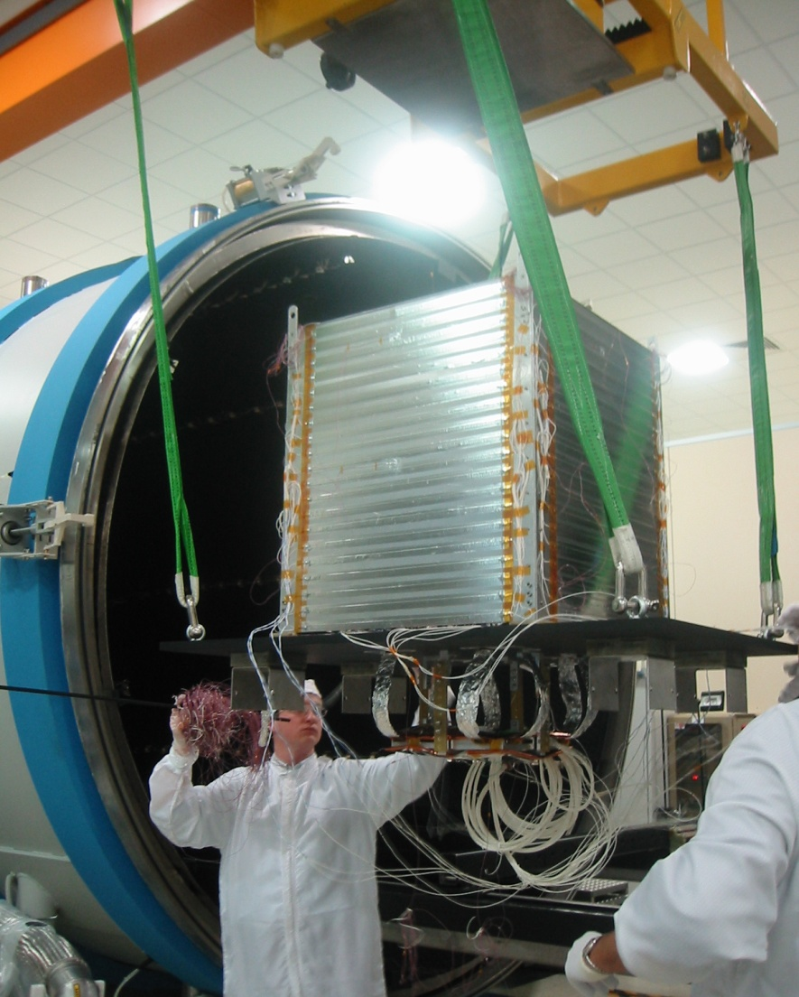
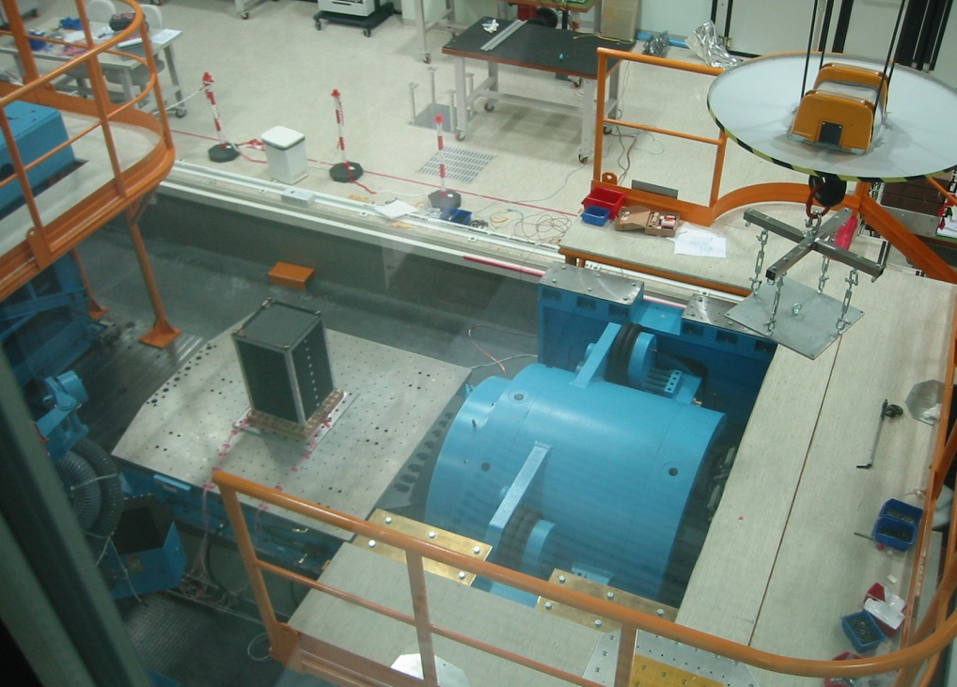

The towers were tested in Alenia-Rome in thermovacuum and on a vibe table for space acceptance tests. The vibe tests did not cause any problem on the flight units. Tower A suuffered a problem on the trays with thick Tungsten tiles loosing 1% of the channels.
The problem was individuated and corrected.
16 other towers were tested and we had to replace 4 trays (2 noisy electronics + 2 glueing problems) and to repeat the acceptance test s

Slide 24



The LAT Silicon tracker numbers
> 60 physicist and engineers involved in the italian teams from INFN (Trieste, Udine, Padova, Pisa, Perugia, Roma2, Bari) in partnership with ASI
11500 sensors
360 trays
18 towers
~ 1M channels
83 m² Si surface
> 240K functional test recorded in DB
~ 30M strip tested
(30 test/strip on average)

Slide 25

Tracker Performance Metric

Slide 26

First photon candidate

Slide 27








April 8, 2005
May 17, 2005
May 19, 2005
June 6, 2005
September 20, 2005
October 3, 2005
October 10, 2005
October 19, 2005: TKR integration complete!

Slide 28


The Calibration Unit
2 Tracker towers +
3 calorimeters units +
a set of ACD tiles
TKR8
TKR16
Calibration + MC tuning on several different cases:
Photons, electrons, hadrons detection, background response, ACD rejection power…..
CAL101
CAL119
CAL109

Slide 29

Beam Test Effort - Data Set Summary
Particle | Energy
γ | 0-2.5 GeV
e- | 1, 5,10,20,50,100,200,280 GeV
e+ | 1GeV (through MMS target)
p | 6, 10GeV (also through MMS), 20,100 GeV
π | 20GeV
C, Xe | 1, 1.5GeV/n, + Xe on target
330 configurations
Incoming angle
impact point
Rate
CU register configurations
1800 runs
100M evts
INFN leading roles
CU Integration, test, calibration
PS and GSI run coordination
Data analysis + coordination
Data processing and simulation
survivors packing the CU after final data taking campaign at GSI

Slide 30
Conclusions
Fermi silicon tracker is the largest silicon system ever launched in space: 83 m² silicon strip detectors, almost 1 million electronic channels.
It has been working perfectly stable in the three and half years after launch.
Crucial to this success is the astonishing quality of the silicon strip detectors developed in Japan by the Oshugi’s group and built by Hamamatsu Photonics.
This development paved the way to the huge fabrication effort necessary for the LHC silicon trackers at CERN.

Slide 31
spares

Slide 32




Tower assembly I
Trays are slit into the assembly jig by means of service handlers
Tray is positioned and the handlers are removed
The stack grows upside-down and is completed with the bottom tray

Slide 33


Tower assembly II
Each side is completed with two readout flex cables (to be connected with the TEM) and the tower is covered with a dark box for a CPT.

Slide 34



LAT as a Gamma-ray Telescope
 | Years | Ang. Res. (100 MeV) | Ang. Res. (10 GeV) | Eng. Rng. (GeV) | A_{eff} Ω (cm² sr) | # γ-rays
EGRET | 1991–00 | 5.8° | 0.5° | 0.03–10 | 750 | 1.4 × 10⁶
AGILE | 2007– | 4.7° | 0.2° | 0.03–50 | 1,500 | 4 × 10⁶/yr
Fermi LAT | 2008– | 3.5° | 0.1° | 0.02–300 | 25,000 | 1 × 10⁸/yr
In few days LAT has surpassed EGRET and AGILE celestial gamma-ray totals
Unlike EGRET and AGILE, LAT is an effective All-Sky Monitor
  whole sky every ~3 hours
EGRET
AGILE (ASI)
CGRO EGRET
Fermi / LAT

