Slide 1
Development of High Performance Avalanche Photodiodes and Dedicated Analog Systems for HXI/SGD Detectors onboard the Astro-H mission
T.Saito, M.Yoshino, H.Mizoma, T.Nakamori, J.Kataoka (Waseda U.), M.Ohno, K.Goto, Y.Hanabata, H.Takahashi, Y.Fukazawa (Hiroshima U.), M.Sasano, S.Torii, H.Uchiyama, K.Nakazawa, K.Makishima (U.Tokyo), S.Watanabe, M.Kokubun, T.Takahashi, K. Mori (ISAS/JAXA), H.Tajima (Nagoya U.) and Astro-H HXI/SGD team

Slide 2
Outline
Introduction
Development of APD
Development of analog systems
-CSA for Astro-H
Analog amplifier
Whole system performance
Summary
BGO
ADC
APD
Digital filter
CSA
Analog amplifier

Slide 3
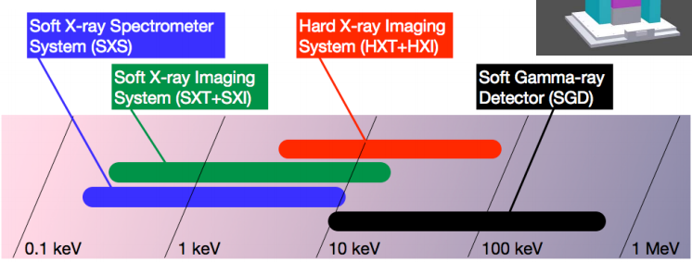
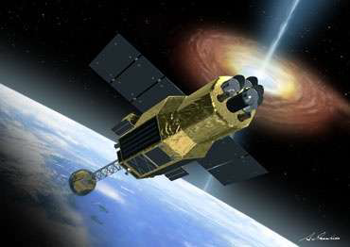
Astro-H Instruments
Astro-H is the 6th satellite of Japanese X-ray observatory series
HXI/SGD detectors employ BGO active shields
to be launched in 2014 with the H-IIA rocket
wide band observation : 0.3 – 600 keV(four instruments)
we are developing readout sensor (APD) and dedicated analog system for BGO active shields.

Slide 4
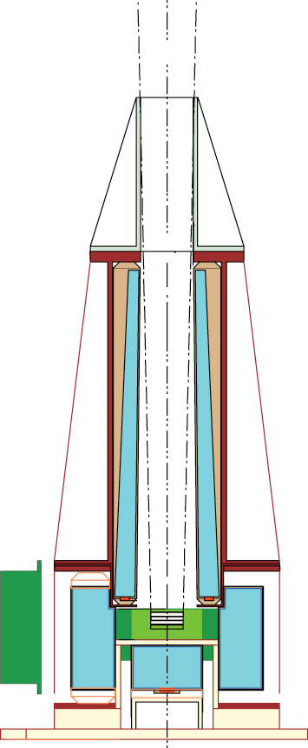
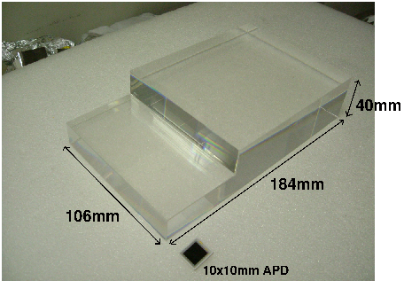
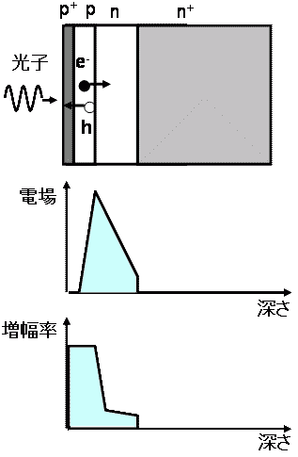
BGO Active Shield
reduce backgrounds by anti-coincidence technique
The main detector is surrounded by BGO scintillators
Avalanche Photodiodes (APD) readout
generating active veto signals to reject cosmic-ray particles and gamma-ray backgrounds
HXI
photon
BGO
BGO
Electric field
APD
Gain
depth
Main camera
depth

Slide 5
BGO
ADC
APD
Digital filter
CSA
Analog amplifier

Slide 6
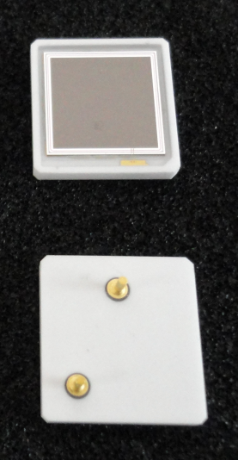
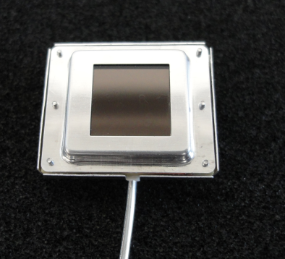
APD for Astro-H
Development of pre-Flight Model (pre-FM) APD
Screening test
－Window material : silicone resin
－Active area : 10 x 10 mm²
－Capacitance : ～400 pF (gain : 50, inc. dedicated cables)
－Dark current : < 0.4 nA (gain : 50 @－15 deg)
EM shield
－Thermal test (silicone or epoxy resin for APD window)
－Radiation tolerance test (⁶⁰Co, the total dose : 10krad)
－pre-FM APD acceptance test (evaluate 20 pre-FM APD)
Flight Model APD screening test (～Apr, 2012)

Slide 7
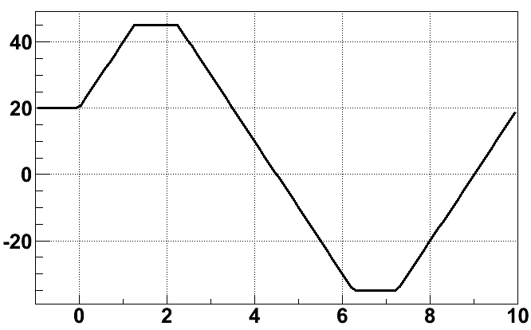
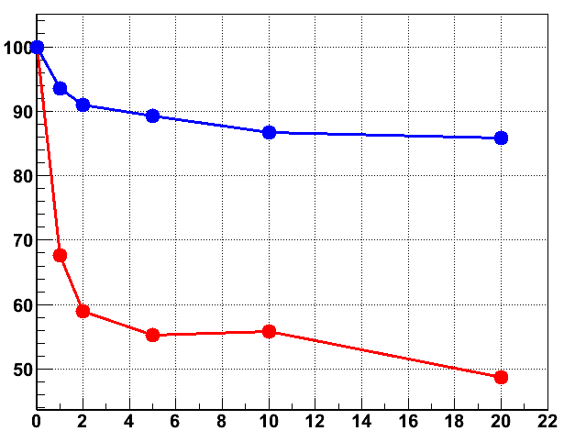
Thermal test
silicone or epoxy resin for APD window
severe temperature environment just after the launch
APD and BGO come unglued?
thermal cycle test
couple each APD with BGO using a space grade silicone adhesive
1h dwell
Comparison of pulse heights
silicone
14% Down
1 cycle (10h)
Temperature [deg]
20 deg/h
Relative light intensity [%]
epoxy
50% Down
1h dwell
Elapsed time [hour]
The number of the Cycle
We selected the silicone resin for the APD window

Slide 8
Radiation tolerance test
⁶⁰Co irradiation (total dose : 10 krad, ～1krad/year)
Breakdown voltage V_{b} decrease?
Deteriorate I_{d} and noise performance?
Performance before and after irradiation
Difference between V_{b} before and after irradiation
Total dose [krad] | Dark current [nA] | Test pulse width [keV] (FWHM)
0 | 0.3 | 10.6
10 | 1.9 | 13.2
The number of APD
Test pulse width evaluated by BGO (1x1x1 cm³) + pre-FM APD
Difference between V_{b} [V]
Breakdown voltage V_{b} did not substantially decrease
Although I_{d} increase 6 times, test pulse width increase only 3 keV!
Because capacitive noise is dominant @－15deg

Slide 9
pre-FM APD acceptance test
Establish how to screen FM APD
dark current I_{d} and operation voltage V_{r} at gain 50
evaluate 20 pre-FM APDs at three temperatures around – 15 degree
high V_{r}
Different changes
Bad (>0.4 nA)
Dark current I_{d} [nA]
Operation voltage V_{r} (gain : 50) [V]
Temperature [deg]
Temperature [deg]
We will do FM APD screening test in a similar way

Slide 10
APD Dark current
Constitution of APD dark current I_{d}
I_{d} = I_{ds} + M * I_{db}
I_{ds} : surface current
I_{db} : bulk current
Leakage path of surface current
Current
I_{d}
I_{ds}
p
Bulk current
n
source
M * I_{db}
π
n
Temperature
Ratio between I_{ds} and I_{db} is possibly different
At in-orbit temperature I_{db} is dominant because of avalanche gain
If APD has higher I_{db}, this APD show different I_{d} changes

Slide 11
BGO
ADC
APD
Digital filter
CSA
Analog amplifier

Slide 12
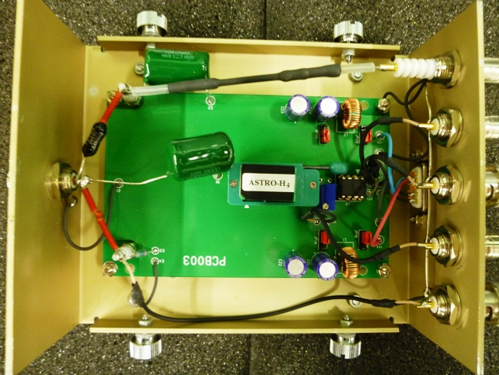
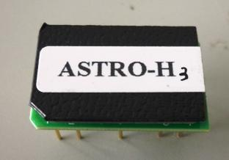
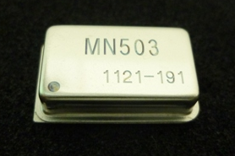
CSA for Astro-H
Charge sensitive amplifier (CSA) specialized for Astro-H
APD capacitance including cables is ～400 pF.
Capacitive noise is dominant @－15deg.
Astro-H CSA need good noise performance
DIP type hybrid IC
CSA-Hybrid IC evaluation circuit
CAN type hybrid IC
(FM type)

Slide 13
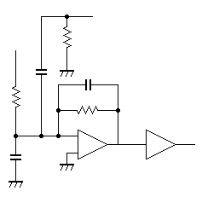
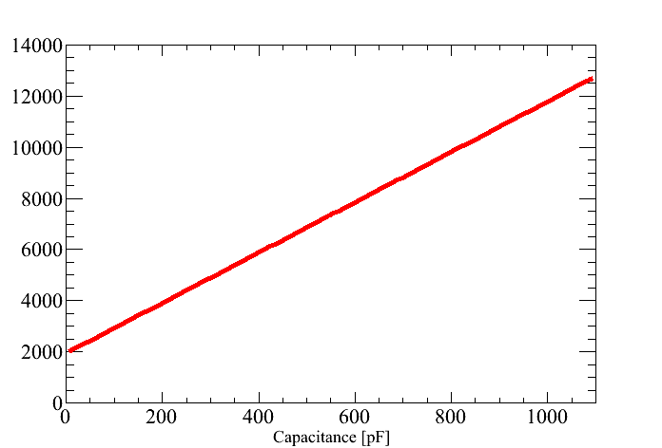
Performance of CSA
Evaluation of CSA assuming APD capacitance ～400 pF
Test pulse
Noise performance
9.8 eV/pF
Testpulse width[eV (FWHM, Si 60keV)]
shaper
APD + cables
capacitance
Detector capacitance
0〜1000 pF
2000 eV
CSA
Detector capacitance [pF]
good capacitive gradient : 9.8 eV/pF
400 pF (APD + cables) testpulse width : 6 keV (FWHM, Si 60keV)
8x8x4 cm³ BGO testpulse width : 21.7 keV (FWHM)
Convert into active shield performance

Slide 14
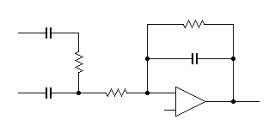
BGO
ADC
APD
Digital filter
CSA
Analog amplifier
single-stage differential and integrating circuit

Slide 15
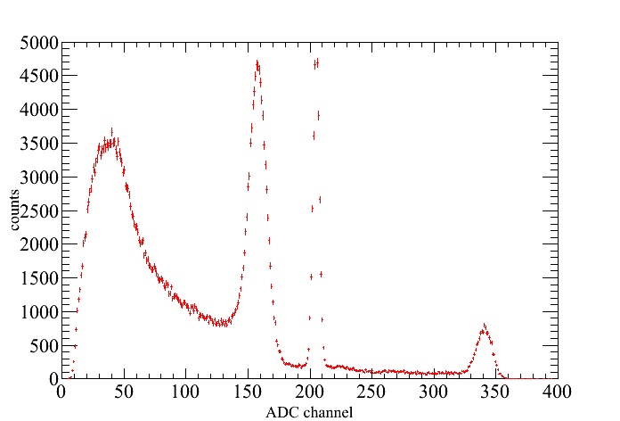
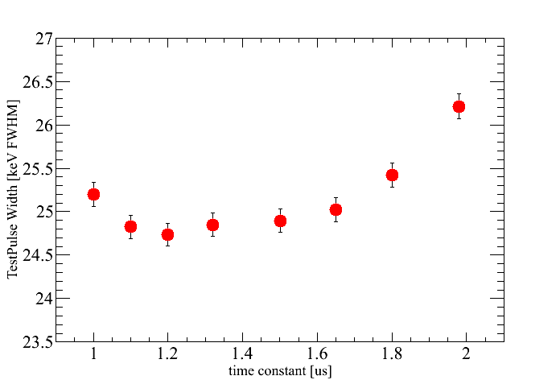
Analog amplifier
Optimize the best “integrating time constants”
“the expended time of output veto signal to the main detector” < 5μs
peaking time adjusted by differential filter (τ > 1.3 μs)
¹³⁷Cs
Testpulse
\
Testpulse width[keV
(FWHM, BGO 662keV)]
count
Without differential filter
ADC channel [ch]
Integration time constant [us]
employ integrating time constants 1.0 – 1.2 μs

Slide 16
BGO
ADC
APD
Digital filter
CSA
Analog amplifier

Slide 17
Whole system performance
Performance of active shield system circuit
using integrating time constants 1.0 – 1.2 μs
Filled marker using analog & digital filter
1.0 μs (only analog)
1.1 μs (only analog)
1.2 μs (only analog)
Ready-made shaper
1.0 μs (analog & digital)
Testpulse width[keV (FWHM, BGO 662keV)]
1.1 μs (analog & digital)
Analog & digital filter
1.2 μs (analog & digital)
CP4417(1.0 μs)
better
ORTEC570(1.0 μs)
Integrating time constant [us]
better than ready-made analog shaper (ORTEC570 & CP4417)
digital filter : Ohno, M. et al. (2011) HSTD-8

Slide 18
Summary
APD
Thermal test employ silicone resin for APD window
Radiation tolerance test passed (⁶⁰Co 10 krad)
pre-FM APD acceptance test establish how to screen FM APD
CSA
good capacitive gradient : 9.8 eV/pF
400 pF (APD + cables) testpulth width : 6 keV (FWHM, Si 60keV)
Analog amplifier
employ integrating time constants 1.0 – 1.2 μs
Whole system performance
achieve a good noise performance (better than ready-made analog shaper)
Future works
large pulse response test (proton, Fe), end-to-end test

Slide 19
Backup slides

Slide 20
Analog noise
total noise of analog circuit
Dark current noise
Capacitive noise
: time constant
: surface current
: bulk current
: gain of APD
: capacitance of APD

Slide 21
Dark current(-20～+25 deg)
Dark current [nA]
Temperature [deg]

Slide 22
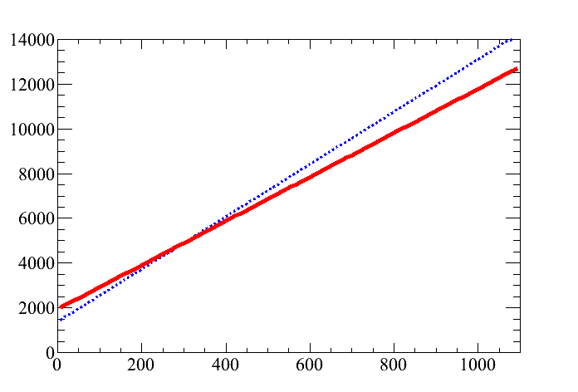
CSA Performance inc. Ref.
Evaluation of CSA assuming APD capacitance ～400 pF
Noise performance
Test pulse
－ : Astro-H CSA
－ : Reference
9.8 eV/pF
Testpulse width[eV (FWHM, Si 60keV)]
shaper
APD + cables
capacitance
Detector capacitance
0〜1000 pF
2000 eV
CSA
Detector capacitance [pF]
400 pF (APD + cables) testpulse width : 6 keV (FWHM, Si 60keV)
8x8x4 cm³ BGO testpulse width : 21.7 keV (FWHM)
Convert into active shield performance

Slide 23
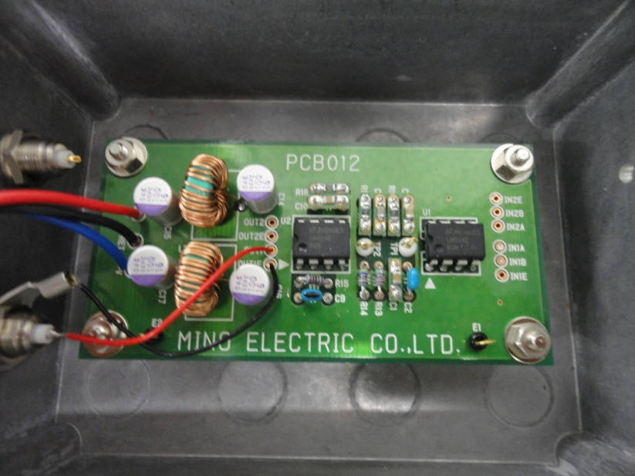
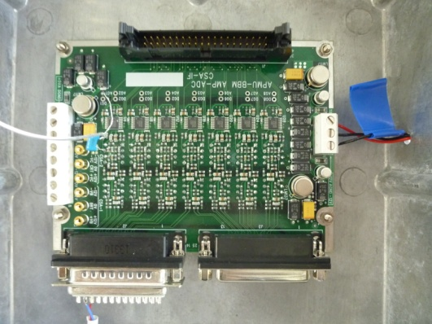
Analog amp. board
APMU analog BBM board
APMU analog BBM board

Slide 24
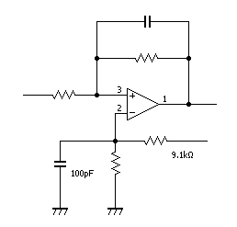
Parameter
No using differential filter
C1
R2
R1
5V
R3
時定数[us] | R1[kΩ] | R2[kΩ] | R3[kΩ] | C1[pF] | Gain(R2 / R1) | offset[V]
1.0 | 5.1 | 10 | 2 | 100 | 1.96 | 0.9
1.1 | 5.6 | 11 | 2 | 100 | 1.96 | 0.9
1.2 | 5.1 | 10 | 2 | 120 | 1.96 | 0.9
1.32 | 5.6 | 11 | 2 | 120 | 1.96 | 0.9
1.5 | 5.1 | 10 | 2 | 150 | 1.96 | 0.9
1.6 | 5.6 | 11 | 2 | 150 | 1.96 | 0.9
1.8 | 5.1 | 10 | 2 | 180 | 1.96 | 0.9
1.98 | 5.6 | 11 | 2 | 180 | 1.96 | 0.9

Slide 25
Without differential filter
＊testpulse width (3xFWHM, BGO 662keV)
typeB
8×8×4

Slide 26
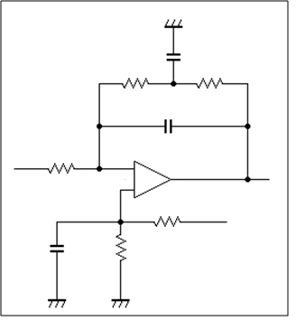
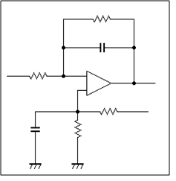
twin-T filter
twin-T filter for the better analog filter performance
equivalent nine-stage integrating circuit
must use a differential filter for peaking time < 5μs
twin-T filter
C
5
3
R
R
R
4
4
C
1
C
2
noise performance is shown in the next slide

Slide 27
Performance inc. twin-T
Performance of active shield system circuit
using integrating time constants 1.0 – 1.2 μs
Filled marker using digital filter
Commercial shaper
Testpulse width[keV (FWHM, BGO 662keV)]
Twin-T
better
Integrating time constant [us]
better than commercial analog shaper(ORTEC570 & CP4417)
digital filter : Ohno, M. et al. HSTD-8

Slide 28
APD window
APD
Window
+ BGO
APD & BGO adhered by DC93-500

