Slide 1
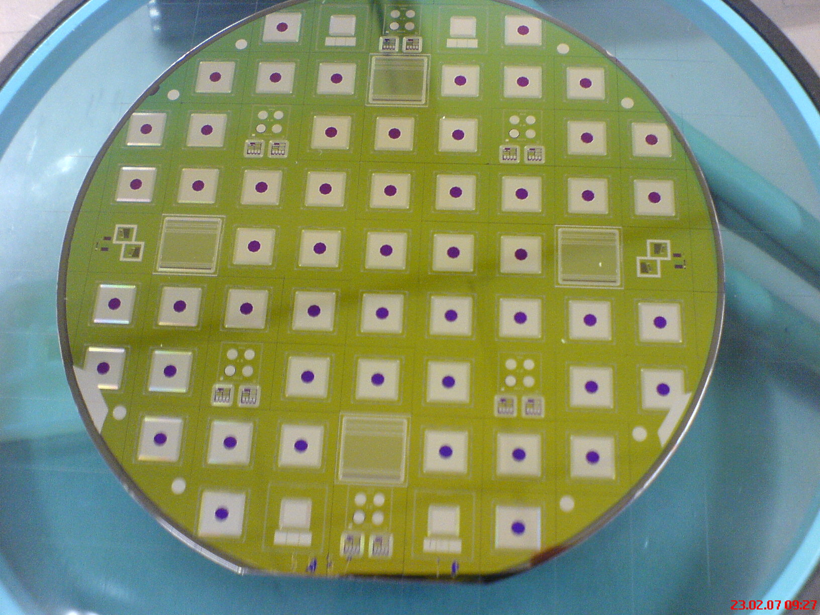

Silicon Sensors for High-Radiation Tracking Detectors- RD50 Status Report
A. Junkes for the RD50 Collaboration
8th International “Hiroshima” Symposium
December 5th to 8th 2011 Taipei, Taiwan

Slide 2
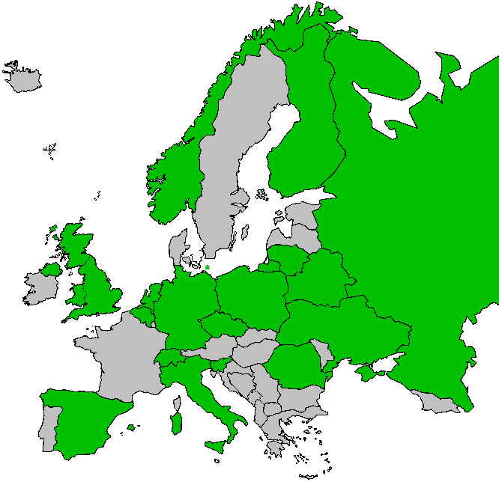
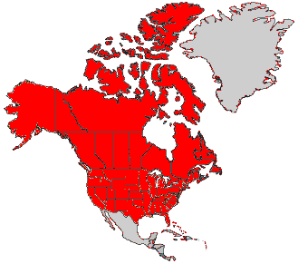

RD50 Status Report HSTD-8 05.12.2011
RD50
The RD50 collaboration
Development of Radiation Hard Semiconductor
Devices for High Luminosity Colliders
RD50
39 European and Asian institutes
Belarus (Minsk), Belgium (Louvain), Czech Republic (Prague (3x)), Finland (Helsinki, Lappeenranta), Germany (Dortmund, Erfurt, Freiburg, Hamburg, Karlsruhe, Munich), Italy (Bari, Florence, Padova, Perugia, Pisa, Trento), Lithuania (Vilnius), Netherlands (NIKHEF), Norway (Oslo (2x)), Poland (Warsaw(2x)), Romania (Bucharest (2x)), Russia (Moscow, St.Petersburg), Slovenia (Ljubljana), Spain (Barcelona (2x), Santander, Valencia), Switzerland (CERN, PSI), Ukraine (Kiev), United Kingdom (Glasgow, Liverpool)
8 North-American institutes
Canada (Montreal), USA (BNL, Fermilab, New Mexico, Purdue, Rochester, Santa Cruz, Syracuse)
1 Middle East institute
Israel (Tel Aviv)
255 Members from 48 Institutes
A. Junkes, RD50 Status Report, HSTD-8, Taipei 05.12.2011

Slide 3
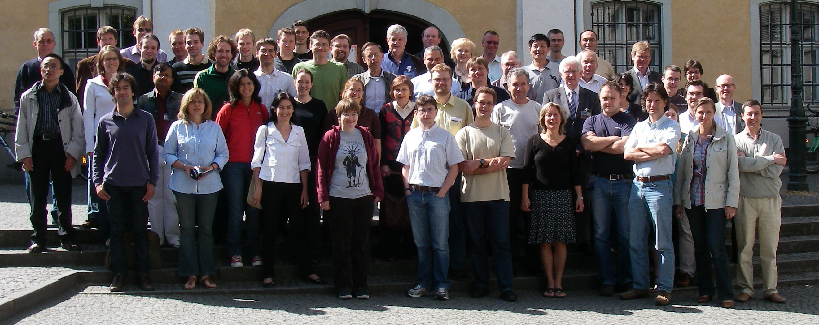
RD50
Scientific Organization of RD50
Co-Spokespersons
Gianluigi Casse and Michael Moll
Liverpool University CERN PH-DT
Defect / Material
Characterization
Mara Bruzzi
(INFN & Uni Florence)
Detector
Characterization
Eckhart Fretwurst
(Hamburg University)
New Structures
Richard Bates
(Glasgow University)
Full Detector
Systems
Gregor Kramberger
(Ljubljana University)
Characterization of
microscopic properties
of standard-, defect engineered and new materials pre- and post- irradiation
WODEAN: Workshop
on Defect Analysis in
Silicon Detectors
(G.Lindstroem)
Characterization of test structures (IV, CV, CCE, TCT,.)
Development and testing of defect engineered silicon devices
EPI, MCZ and other materials
NIEL
Device modeling
Operational conditions
Common irradiations
New Materials (E.Verbitskaya)
Wafer procurement (M.Moll)
Simulations (??)
3D detectors
Thin detectors
Cost effective solutions
Other new structures
3D (R.Bates)
Semi 3D (Z.Li)
Thinned detectors (M.Boscardin)
LHC-like tests
Test beams
Links to HEP
Links electronics R&D
Comparison:
- pad-mini-full detectors
- different producers
Pixel Europe (T.Rohe)
Pixel US (D.Bortoletto)
http://rd50.web.cern.ch/rd50/
CERN contact: Michael Moll
A. Junkes, RD50 Status Report, HSTD-8, Taipei 05.12.2011

Slide 4
Overview
Motivation: Radiation induced damage
  Depletion voltage, Ieakage current, trapping
Defect investigations: Effective doping concentration
Approaches: CMS Si upgrade campaign with
Hamamatsu Photonics
Prospects of conventional planar sensors
  Pixel
Fancy and new:
➔ Charge Multiplication
➔ 3D Detectors
Conclusions
A. Junkes, RD50 Status Report, HSTD-8, Taipei 05.12.2011
Notes:
Several taskforces
Try to cover several approaches

Slide 5
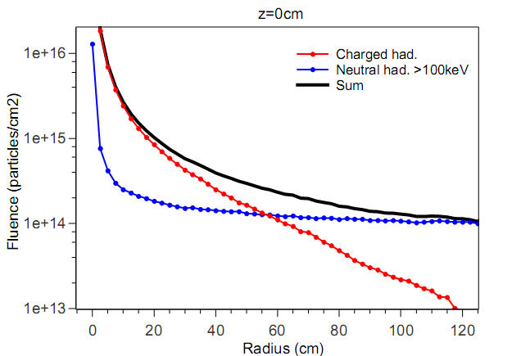
Motivation
Expected HL-LHC fluences
L_{int}=3000 fb⁻¹ @14 TeV
Radiation hardness
requirements for:
Innermost Pixels
Φ_{eq}≈ 2x10¹⁶ cm⁻²
Innermost Strips
Φ_{eq} ≈1x10¹⁵ cm⁻²
S. Müller, PhD thesis, KIT, 2011
Pixels
Strips
Note:
Particle Fluences
are shown!
A. Junkes, RD50 Status Report, HSTD-8, Taipei 05.12.2011

Slide 6
Motivation
Expected HL-LHC fluences
L_{int}=3000 fb⁻¹ @14 TeV
Radiation hardness
requirements for:
Innermost Pixels
Φ_{eq}≈ 2x10¹⁶ cm⁻²
Innermost Strips
Φ_{eq} ≈1x10¹⁵ cm⁻²
Pion damage
dominant
Neutron damage
dominant
S. Müller, PhD thesis, KIT, 2011
Pixels
Strips
Note:
Particle Fluences
are shown!
A. Junkes, RD50 Status Report, HSTD-8, Taipei 05.12.2011

Slide 7
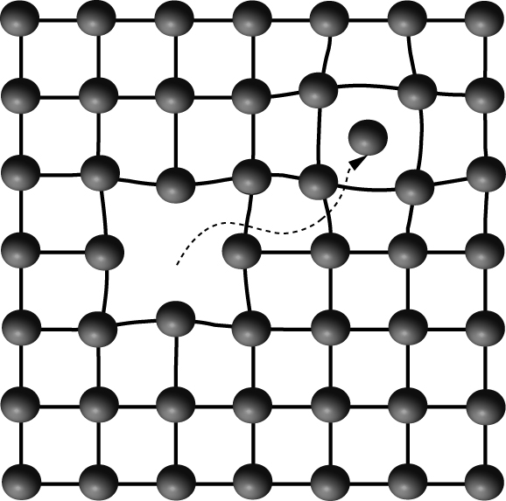
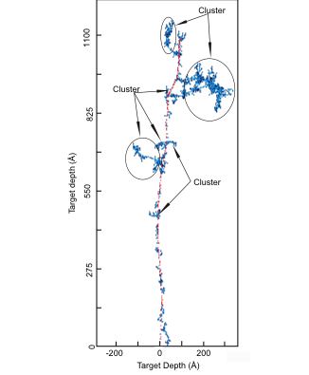
Radiation damage
Radiation damage in silicon
Surface damage (via Ionizing Energy Loss)
Crystal (bulk) damage (Non Ionizing Energy Loss)
Damage in the crystal
Defects composed of:
Vacancies and Interstitials
Compound defects with impurities possible!
I
A.Junkes, PhD thesis, Uni Hamburg 2011
V
Formation of point defects and „cluster“ defects
Introduction of new levels in band gap
Simulation of 50 keV PKA damage cascade (1 MeV n)
A. Junkes, RD50 Status Report, HSTD-8, Taipei 05.12.2011
Depends on particle charge, mass, energy
Pions (and protons) ➔ Point defects and cluster
Neutrons ➔ Large damaged regions
Good, bad or ugly... Influence of defects on detector performance?
Notes:
IF Epka >5 kev not only single vacancies, but this dislocated vacancy can further dislocate silicon atoms and lead to a damage cascade, this is illustrated in this fig

Slide 8



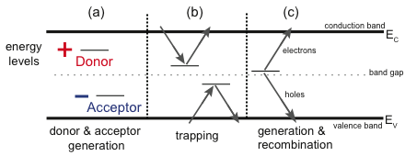
Radiation damage
Change of detector properties
Determined by Shockley-Read-Hall statistics
shallow
deep
shallow
Charged defects (at RT)
➔ N_{eff} , V_{dep}
(Acceptors in the lower half and donors in the upper half of the band gap)
Deep defects
➔ CCE
(Shallow defects do not contribute due to fast detrapping)
Levels close to midgap
➔ I_{dep} (NOISE)
➔ Cooling during operation helps!
A. Junkes, RD50 Status Report, HSTD-8, Taipei 05.12.2011

Slide 9
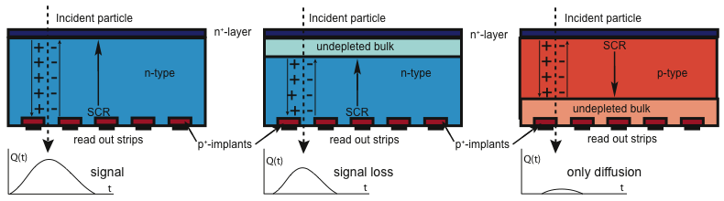
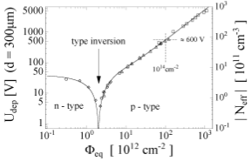
Radiation damage
Change of depletion voltage
With Φ (p-in-n Float Zone Si, neutrons):
Acceptors compensate original doping
Type inversion from n- to p-type
  Increase of depletion voltage after Space Charge Sign Inversion
Detector becomes p-in-p
p-n-junction from wrong side
➔ Loss of resolution
R. Wunstorf, PhD thesis 1992, Uni Hamburg
Need depletion from strip-side!
Change of N_{eff} depends on material!
Needs prediction of N_{eff} for
specific material
A. Junkes
A. Junkes, RD50 Status Report, HSTD-8, Taipei 05.12.2011
Notes:
Changes are known since long times, here is the phd thesis of wunstorf from 1992
And the results are also known- undepletion- signal loss,
Ater type inversion resolution loss or worst case, no signal

Slide 10
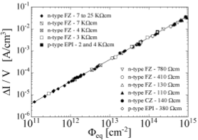
Radiation damage
Change of leakage current
… depending on the fluence
Deep defects act as generation centres
Increase of leakage current
  Increase of shot noise
  Increase of power dissipation
  Risk of thermal runnaway
80min@60°C
M.Moll PhD thesis ‘99
Damage parameter α is a universal parameter
So far not depending on Si material or particle type (N, H)
➔ Cooling necessary
A. Junkes, RD50 Status Report, HSTD-8, Taipei 05.12.2011

Slide 11
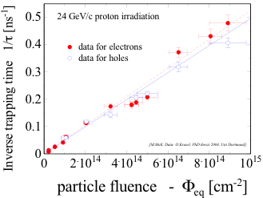
Radiation damage
Trapping
Defects act as trapping centres
  Reduction of collected charge
Trapping dominant effect
at Φ>1x10¹⁵ cm⁻²
Effective trapping times for e⁻ und h⁺
Trapping of e⁻ und h⁺ similar
  No influence of material seen
But:
Collection time 3x smaller for e⁻
  Collect e⁻!
Needs n-side read-out
A. Junkes, RD50 Status Report, HSTD-8, Taipei 05.12.2011
Notes:
Several taskforces
Try to cover several approaches

Slide 12
Overview
Motivation: Radiation induced damage
  Depletion voltage, Ieakage current, trapping
Defect investigations: Effective doping concentration
Approaches: CMS Si upgrade campaign with
Hamamatsu Photonics
Prospects of conventional planar sensors
  Pixel
Fancy and new:
➔ Charge Multiplication
➔ 3D Detectors
Conclusions
A. Junkes, RD50 Status Report, HSTD-8, Taipei 05.12.2011
Notes:
Several taskforces
Try to cover several approaches

Slide 13
Influence of material properties
Defect investigations
N-type
Oxygen rich FZ 50 μm
D. Eckstein, 12th RD50 Workshop Ljubljana, 2008
μm
μm
μm
Φ
A. Junkes, RD50 Status Report, HSTD-8, Taipei 05.12.2011
Notes:
Several taskforces
Try to cover several approaches

Slide 14
Influence of material properties
Defect investigations
Type inversion for 100 μm FZ ✔
N-type
Oxygen rich FZ 50 μm
D. Eckstein, 12th RD50 Workshop Ljubljana, 2008
μm
μm
μm
Φ
A. Junkes, RD50 Status Report, HSTD-8, Taipei 05.12.2011
Notes:
Several taskforces
Try to cover several approaches

Slide 15
Influence of material properties
Defect investigations
Type inversion for 100 μm FZ ✔
No type inversion for 100 μm MCz ✔
N-type
Oxygen rich FZ 50 μm
D. Eckstein, 12th RD50 Workshop Ljubljana, 2008
μm
μm
μm
Φ
A. Junkes, RD50 Status Report, HSTD-8, Taipei 05.12.2011
Notes:
Several taskforces
Try to cover several approaches

Slide 16
Influence of material properties
Defect investigations
Type inversion for 100 μm FZ ✔
No type inversion for 100 μm MCz ✔
No type inversion for 50 μm FZ ✗
N-type
Oxygen rich FZ 50 μm
D. Eckstein, 12th RD50 Workshop Ljubljana, 2008
μm
μm
μm
Φ
A. Junkes, RD50 Status Report, HSTD-8, Taipei 05.12.2011
Notes:
Several taskforces
Try to cover several approaches

Slide 17
Influence of material properties
Defect investigations
Type inversion for 100 μm FZ ✔
No type inversion for 100 μm MCz ✔
No type inversion for 50 μm FZ ✗
N-type
Oxygen rich FZ 50 μm
Radiation damage is always the same!
We need to know:
Differences for n- and p-type material
Influence of N_{eff,0}, [O] (and [C], [H], [N])
D. Eckstein, 12th RD50 Workshop Ljubljana, 2008
Feature of this 50 μm FZ:
OXYGEN
μm
μm
μm
Φ
Task: find optimal material for best efficiency and resolution
Material parameters: [O], N_{eff,0}, p-typ, n-typ, p- and n-irradiation
A. Junkes, RD50 Status Report, HSTD-8, Taipei 05.12.2011
Notes:
Several taskforces
Try to cover several approaches

Slide 18
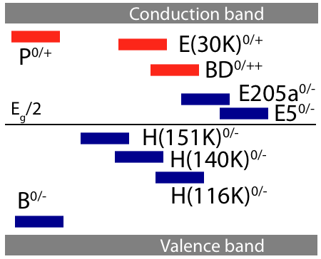
Defect investigations
Radiation induced defects
Defects in the Band Gap
Donors:
positive space charge
Leakage current
Acceptors:
Negative space charge
Generation depends on
type of irradiation!
A. Junkes, RD50 Status Report, HSTD-8, Taipei 05.12.2011

Slide 19
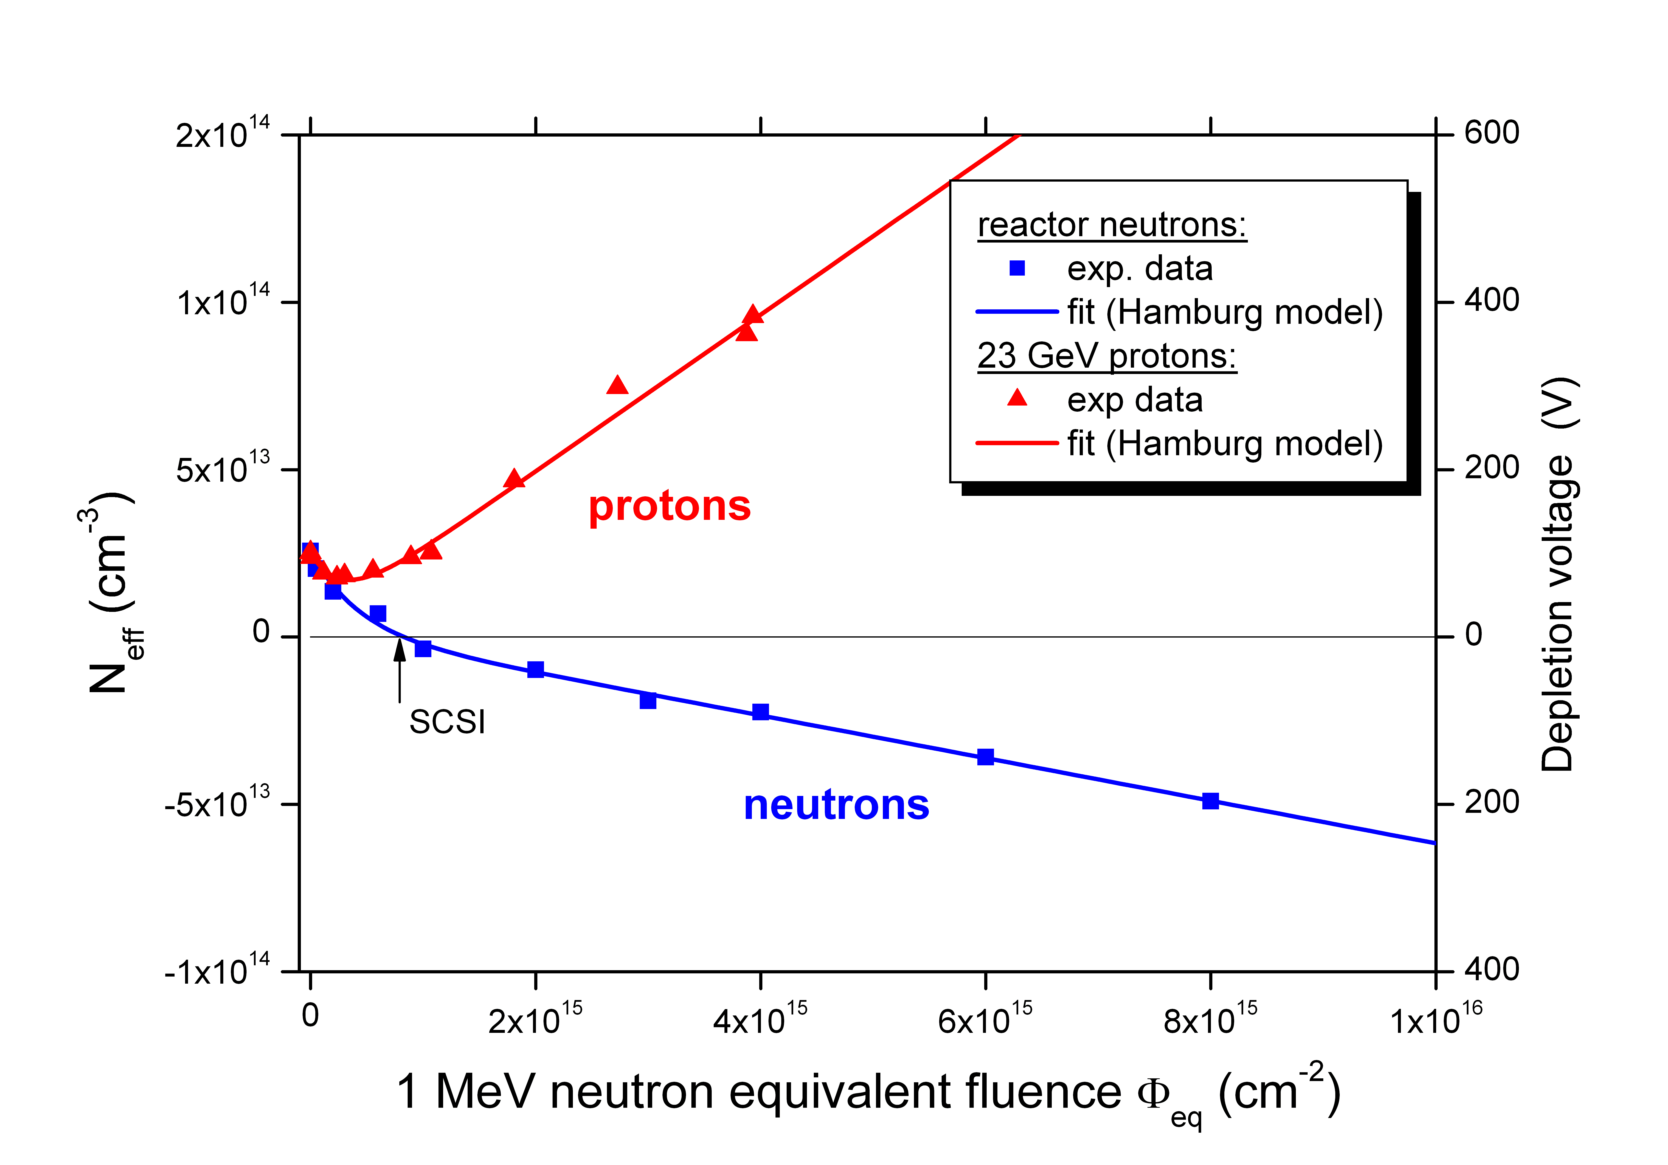
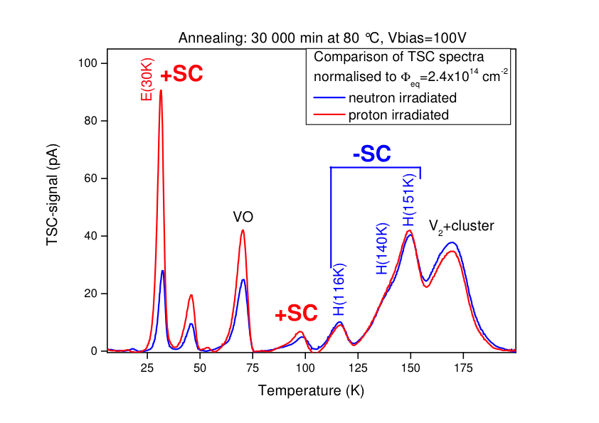
Defect investigations
Defects with impact on N_{eff}
N_{eff} for n and p irradiation (CV) for n-Epi-Do
Corresponding defects (TSC)
A.Junkes, PhD thesis, Uni Hamburg 2011
I. Pintilie et al. NIM A 611 (2009) 52
  Deep acceptors (H-defects) generate negative space charge
  Shallow donor E(30K) generation high for proton irradiation
  E(30K) compensates deep acceptors ➔ no type inversion for protons
A. Junkes, RD50 Status Report, HSTD-8, Taipei 05.12.2011

Slide 20
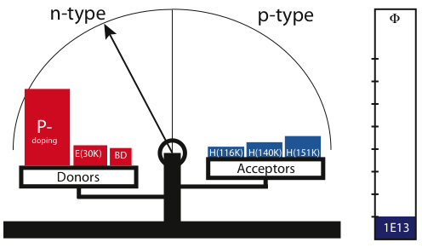
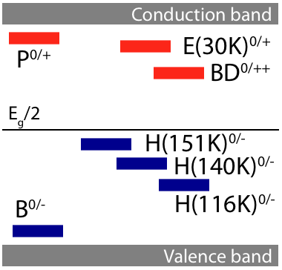
Defect investigations
Defect balance
Neutron irradiation
A. Junkes
I. Pintilie et al. NIM A 611 (2009) 52
A. Junkes, RD50 Status Report, HSTD-8, Taipei 05.12.2011

Slide 21
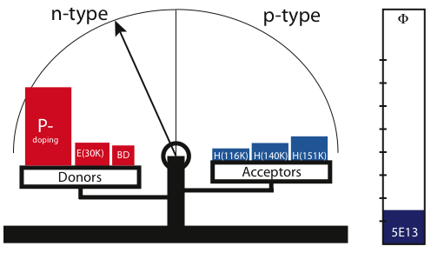
Defect balance
Neutron irradiation
A. Junkes
I. Pintilie et al. NIM A 611 (2009) 52
A. Junkes, RD50 Status Report, HSTD-8, Taipei 05.12.2011

Slide 22
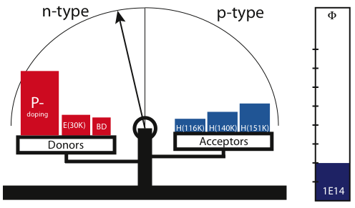
Defect balance
Neutron irradiation
A. Junkes
I. Pintilie et al. NIM A 611 (2009) 52
A. Junkes, RD50 Status Report, HSTD-8, Taipei 05.12.2011

Slide 23
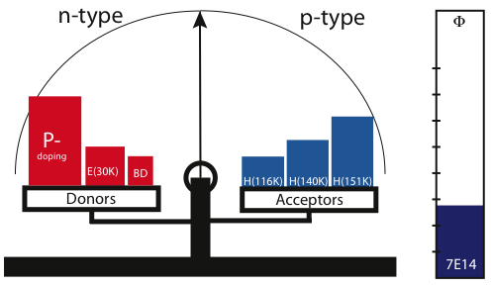
Defect balance
Neutron irradiation
A. Junkes
I. Pintilie et al. NIM A 611 (2009) 52
A. Junkes, RD50 Status Report, HSTD-8, Taipei 05.12.2011

Slide 24
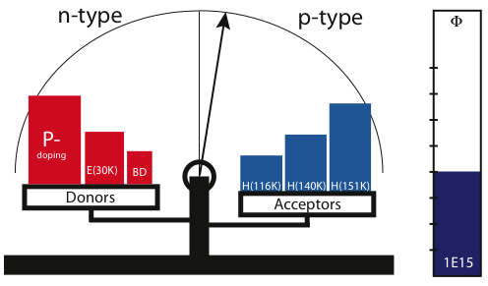
Defect balance
Neutron irradiation
A. Junkes
I. Pintilie et al. NIM A 611 (2009) 52
A. Junkes, RD50 Status Report, HSTD-8, Taipei 05.12.2011

Slide 25
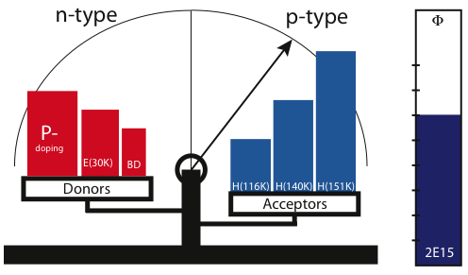
Defect balance
Neutron irradiation
A. Junkes
I. Pintilie et al. NIM A 611 (2009) 52
A. Junkes, RD50 Status Report, HSTD-8, Taipei 05.12.2011

Slide 26
Defect balance
Proton irradiation
A. Junkes
I. Pintilie et al. NIM A 611 (2009) 52
A. Junkes, RD50 Status Report, HSTD-8, Taipei 05.12.2011

Slide 27

Defect balance
Proton irradiation
A. Junkes
I. Pintilie et al. NIM A 611 (2009) 52
A. Junkes, RD50 Status Report, HSTD-8, Taipei 05.12.2011

Slide 28
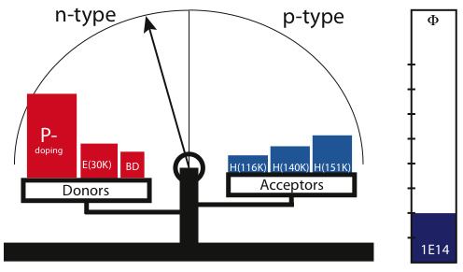
Defect balance
Proton irradiation
A. Junkes
I. Pintilie et al. NIM A 611 (2009) 52
A. Junkes, RD50 Status Report, HSTD-8, Taipei 05.12.2011

Slide 29
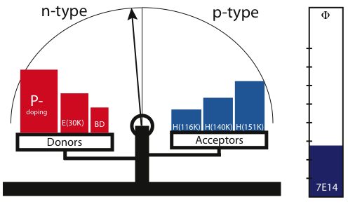
Defect balance
Proton irradiation
A. Junkes
I. Pintilie et al. NIM A 611 (2009) 52
A. Junkes, RD50 Status Report, HSTD-8, Taipei 05.12.2011

Slide 30
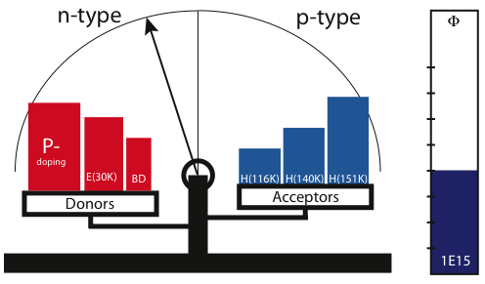
Defect balance
Proton irradiation
A. Junkes
I. Pintilie et al. NIM A 611 (2009) 52
A. Junkes, RD50 Status Report, HSTD-8, Taipei 05.12.2011

Slide 31
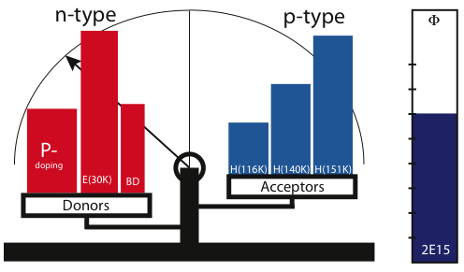
Defect balance
Proton irradiation
A. Junkes
I. Pintilie et al. NIM A 611 (2009) 52
A. Junkes, RD50 Status Report, HSTD-8, Taipei 05.12.2011

Slide 32
Radiation environment
Defect investigations
L_{int}=3000 fb⁻¹ @14 TeV
Radiation hardness
requirements for:
Innermost Pixels
Φ_{eq}≈ 2x10¹⁶ cm⁻²
Innermost Strips
Φ_{eq} ≈1x10¹⁵ cm⁻²
Pion damage
dominant
Pion/Neutron mixture
Neutron damage
dominant
S. Müller, PhD thesis, KIT, 2011
Pixels
Strips
Note:
Particle Fluences
are shown!
A. Junkes, RD50 Status Report, HSTD-8, Taipei 05.12.2011

Slide 33
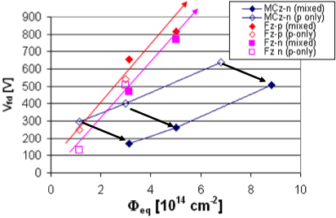
Mixed Irradiations
Defect investigations
Adding up the damage?
Irradiation in two steps
1. Irradiation with protons
2. Irradiation with neutrons
Oxygen lean Float Zone (FZ)
  Damage accumulates (H-defects)
Oxygen rich Magnetic Czochralski (MCz)
  Damage compensated (enhanced
  donor generation)
Defect studies explain this tendency!
Influence of Oxygen has to be known for prediction!
FZ
MCz
G. Kramberger et al., NIM A 609 (2009) 142
Task: find optimal material for best Efficiency and resolution
Material parameters: [O], N_{eff,0}, p-typ, n-typ, p- and n-irradiation mixture
A. Junkes, RD50 Status Report, HSTD-8, Taipei 05.12.2011
Notes:
Several taskforces
Try to cover several approaches

Slide 34
Overview
Motivation: Radiation induced damage
  Depletion voltage, Ieakage current, trapping
Defect investigations: Effective doping concentration
Approaches: CMS Si upgrade campaign with
Hamamatsu Photonics
Prospects of conventional planar sensors
  Pixel
Fancy and new:
➔ Charge Multiplication
➔ 3D Detectors
Conclusions
A. Junkes, RD50 Status Report, HSTD-8, Taipei 05.12.2011
Notes:
Several taskforces
Try to cover several approaches

Slide 35
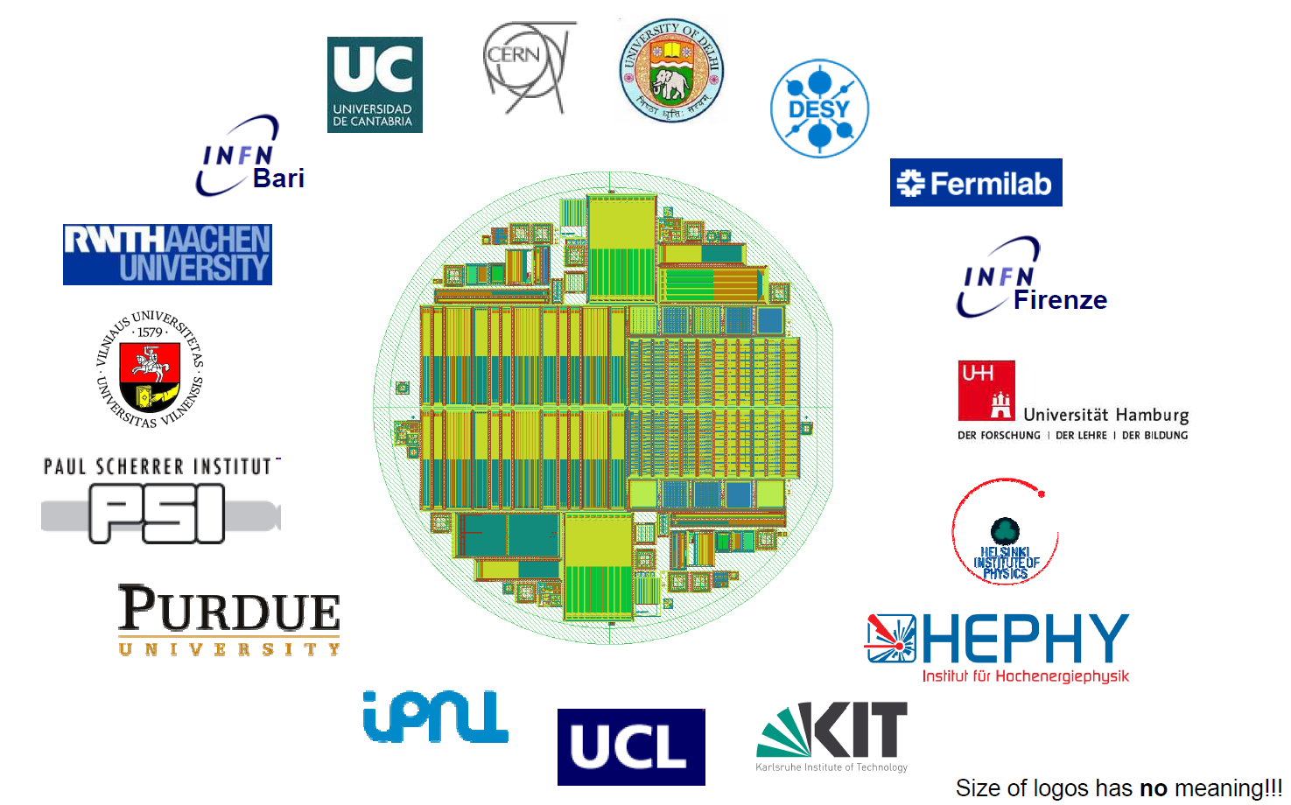
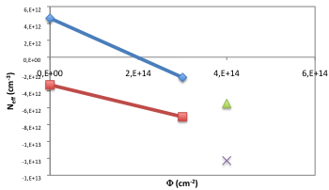
Approaches
CMS Si campaign with Hamamatsu
Aim: Find best material for future CMS tracking detectors
Compare all conventional/available Materials
  Float Zone, Magnetic Czochralski, Epitaxially grown
Thicknesses
  100, 200, 300 μm
p-in-n vs. n-in-p
Test sensor layouts
  Second metal layer...
Mixed irradiations according
to position in tracker
Irradiations and measurements
are ongoing
25 MeV Proton irradiated MCz material
N-type
Proton
irradiation
P-type
Neutron
irradiation
A. Junkes, RD50 Status Report, HSTD-8, Taipei 05.12.2011
Notes:
Several taskforces
Try to cover several approaches

Slide 36
Overview
Motivation: Radiation induced damage
  Depletion voltage, Ieakage current, trapping
Defect investigations: Effective doping concentration
Approaches: CMS Si upgrade campaign with
Hamamatsu Photonics
Prospects of conventional planar sensors
  Pixel
Fancy and new:
➔ Charge Multiplication
➔ 3D Detectors
Conclusions
A. Junkes, RD50 Status Report, HSTD-8, Taipei 05.12.2011
Notes:
Several taskforces
Try to cover several approaches

Slide 37
Conventional planar sensors
CiS n-in-p pixel production
Common PPS ATLAS -CMS pixel production within RD50
Reduced Guard-Ring
MPI+ CERN ATLAS PIxel group
FZ p-type material, 285 μm thick
Inter-pixel isolation:
  Moderated p-spray
  Homogenous p-spray
Bump bonding to the FE-I3 chips (present ATLAS pixel read-out) performed by IZM-Berlin
A. Junkes, RD50 Status Report, HSTD-8, Taipei 05.12.2011
Notes:
Several taskforces
Try to cover several approaches

Slide 38
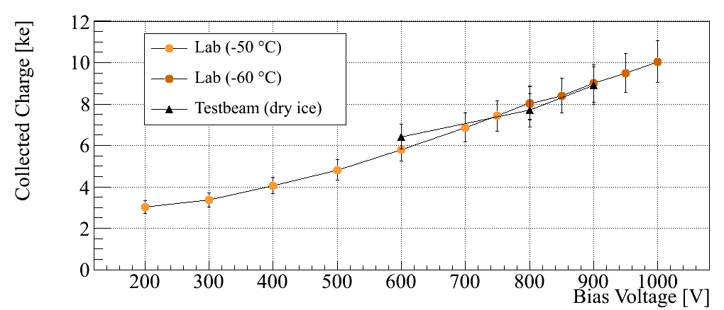
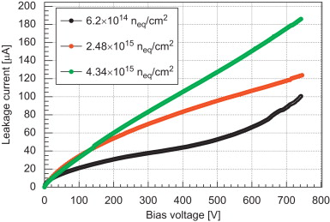
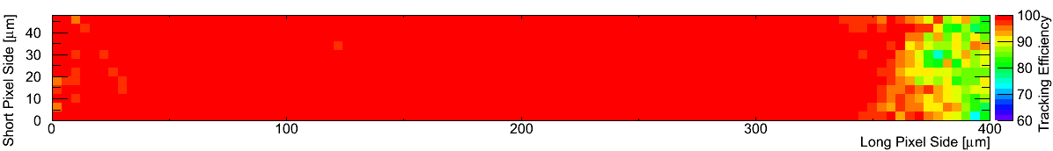
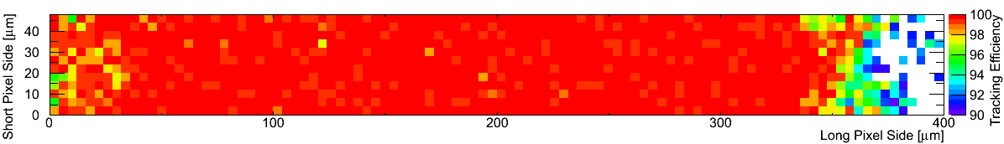
Conventional planar sensors
Test-beam results
First n-in-p modules irradiated to Φ_{eq}=5x10¹⁵ n cm⁻²
I_{leak} at -10 °C in probe station
MPI+ CERN ATLAS PIxel group
98.6%
V_{bias}= 600 V
Most probable charge: 6.4 ke
Overall efficiency: 98.6%
  Loss mostly around bias dot
99.8%
  ε = 99.8 % for most of pixels
A. Junkes, RD50 Status Report, HSTD-8, Taipei 05.12.2011
Notes:
Tracking efficiency

Slide 39
Overview
Motivation: Radiation induced damage
  Depletion voltage, Ieakage current, trapping
Defect investigations: Effective doping concentration
Approaches: CMS Si upgrade campaign with
Hamamatsu Photonics
Prospects of conventional planar sensors
  Pixel
Fancy and new:
➔ Charge Multiplication
➔ 3D Detectors
Conclusions
A. Junkes, RD50 Status Report, HSTD-8, Taipei 05.12.2011
Notes:
Several taskforces
Try to cover several approaches

Slide 40
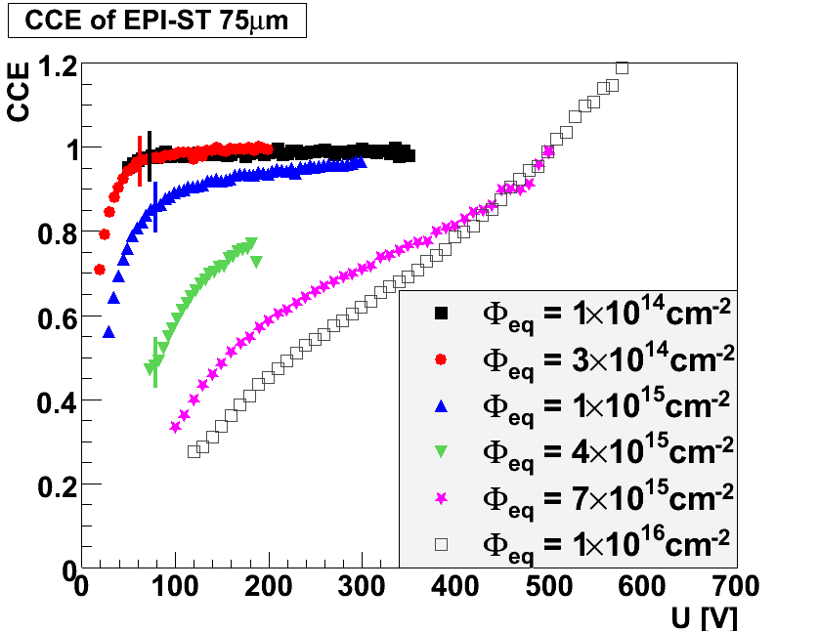
Fancy and new
Charge Multiplication
Observation: Charge Collection Efficiency (CCE) exceeds 1
²⁴⁴Cm α-source
Explanation:
Avalanche multiplication in high field region
Can this effect be used for particle detectors?
Open questions:
Stability in large fluence range
Stability for large detector area
Stability for high voltages
Long term stability
Efficiency vs resolution
Signal/threshold
J.Lange et al., 13th RD50 Workshop, June 2009
Can we controle CM? Studies are ongoing
A. Junkes, RD50 Status Report, HSTD-8, Taipei 05.12.2011
Notes:
Several taskforces
Try to cover several approaches

Slide 41
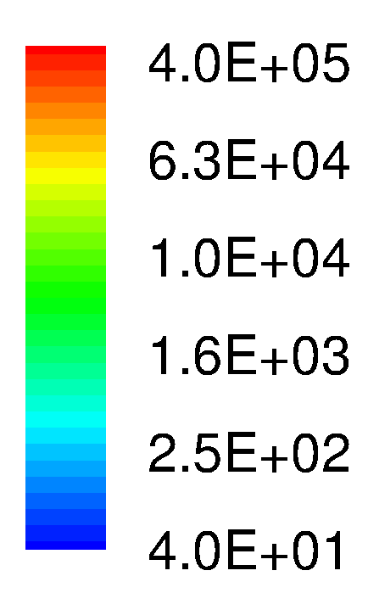
Fancy and new
Stable multiplication region ➔ Trenching
P-type strip detector with small gain ➔ Similar signal before and after irradiation
- Gain limited between 2 and 10
- Multiplication occurs at low bias voltage
    Problems:
    Avoid Crosstalk
    Avoid exceeding the dynamic range of readout electronics
    Avoid higher capacitance -> Higher noise
P-type diffusion
P+ implant under N electrode
Centered, 5um wide
500 V
More information see e.g. G. Pellegrini, 17th RD50 Workshop 2010
First production of structures finished
They work!
CM observed
Problems:
Leakage current high
High cross talk
D. Foreshaw, 19th RD50 Workshop 2011
High Electric Field peak at the centre of the strip
A. Junkes, RD50 Status Report, HSTD-8, Taipei 05.12.2011
Notes:
Several taskforces
Try to cover several approaches

Slide 42
Overview
Motivation: Radiation induced damage
  Depletion voltage, Ieakage current, trapping
Defect investigations: Effective doping concentration
Tools & Approaches: CMS Si upgrade campaign with
Hamamatsu Photonics, Edge TCT
Prospects of conventional planar sensors
  Pixel
Fancy and new:
➔ Charge Multiplication
➔ 3D Detectors
Conclusions
A. Junkes, RD50 Status Report, HSTD-8, Taipei 05.12.2011
Notes:
Several taskforces
Try to cover several approaches

Slide 43
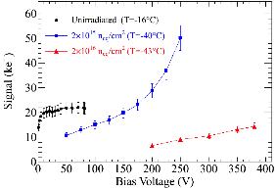
Fancy and new
3D Detectors
3D
PLANAR
“3D” electrodes: - Narrow columns along detector thickness
- Diameter: 10 μm, distance: 50 – 100 μm
Lateral depletion: - Lower depletion voltage needed
- Thicker detectors possible
- Fast signal
p⁺
n⁺
p⁺
p⁺
50 μm
300 μm
-
-
-
-
-
-
-
-
-
+
-
+
+
+
+
+
+
+
+
+
Charge collection with ⁹⁰SR-source
285μm p-type
3D proposed by Parker and Kenney. See NIM A 395 (1997) 328
n-columns
p-columns
Charge
multiplication
M. Köhler et al., NIM A 659 (2011) 272
n-type substrate
A. Junkes, RD50 Status Report, HSTD-8, Taipei 05.12.2011
Notes:
Several taskforces
Try to cover several approaches

Slide 44
Fancy and new
3D Detectors
3D
PLANAR
“3D” electrodes: - Narrow columns along detector thickness
- Diameter: 10 μm, distance: 50 – 100 μm
Lateral depletion: - Lower depletion voltage needed
- Thicker detectors possible
- Fast signal
p⁺
n⁺
p⁺
p⁺
50 μm
300 μm
-
-
-
-
-
-
-
-
-
-
+
Watch out for ATLAS IBL:
¾ of sensors made in planar technology
¼ of sensors made of 3D detectors, If yield sufficient
+
+
+
+
+
+
+
+
+
Charge collection with ⁹⁰SR-source
3D proposed by Parker and Kenney. See NIM A 395 (1997) 328
n-columns
p-columns
Charge
multiplication
M. Köhler et al., NIM A 659 (2011) 272
n-type substrate
A. Junkes, RD50 Status Report, HSTD-8, Taipei 05.12.2011
Notes:
Several taskforces
Try to cover several approaches

Slide 45
Conclusions
RD50 working across experiment boundaries on developing
radiation-hard silicon detectors for e.g. the HL-LHC
Large progress in
    Understanding changes of effective doping concentration
    Origin of the leakage current (not shown)
Charge multiplication observed in many sensors
CCE benefits from it, but open questions remain
  The S/N ratio, S/threshold
  Resolution?
  Can the extra signal be exploited to increase the radiation hardness ?
  Need to study long-term stability
A. Junkes, RD50 Status Report, HSTD-8, Taipei 05.12.2011

Slide 46
Outlook
Be Careful: Clearly biased by my opinion
Planar detectors do surprisingly well
  N-in-p or n-in-n planar detectors
    Good enough for most regions (e.g. Φ=5x10¹⁵cm⁻²)
    P-type detectors reduce trapping effects
    Expect this to be the default material at HL-LHC
    Requires prediction of N_{eff} depending on [O], N_{eff,0}, particle composition
Current RD50 investigations:
  Collation of results of measured materials
  ➔ Find optimal material for sensor-position in tracker
  3D detectors
    Could add extra radiation hardness and operation at lower voltage
    ➔ Follow up ATLAS IBL
  Charge multiplication may give extra signal
  ➔ CM sensor needs more R&D
A. Junkes, RD50 Status Report, HSTD-8, Taipei 05.12.2011

Slide 47
Watch out for:
Mixed irradiations:
Mon. 09:40 / Z. Li, Complete suppression of reverse annealing of neutron radiation damage during active gamma irradiation in MCz Si detectors
Charge multiplication:
Mon. 10:00 / G. Casse, New results of CM in irradiated segmented segmented silicon detectors with special strip processing
3D detectors:
Mon. 11:10 / C. Da Via, 3D slim edge silicon sensors: processing, yield and QA for the ATLAS IBL production
Mon. 11:50 / G. Pellegrini, Status of 3D double sided detector fabrications and their applications at CNM-IMB
CMS Si campaign with Hamamatsu Photonics:
Tue. 11:10 / M. Bernard-Schwarz, Future Silicon Sensors for the CMS Tracker Upgrade
With thanks to: R. Eber, D. Eckstein, J. Erfle, E. Fretwurst, M. Köhler, G. Kramberger, A. Macchiolo, U. Parzefall
A. Junkes, RD50 Status Report, HSTD-8, Taipei 05.12.2011

Slide 48
Back-Up

Slide 49
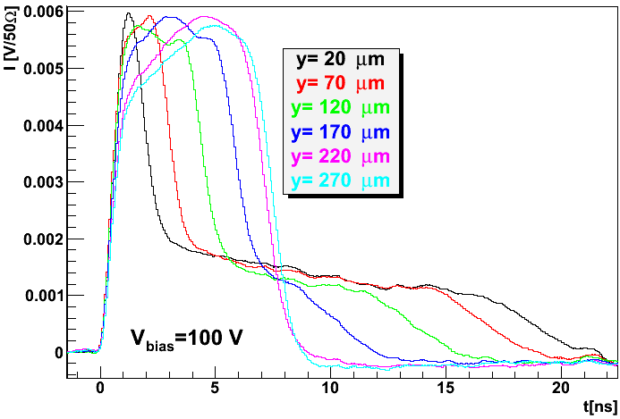
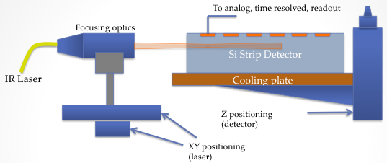
Tools & Approaches
Field distributions: Edge TCT
Motivation:
Understand field effects:
Charge multipication and trapping in highly irradiated sensors
Extract: Charge colltection, trapping
Edge-TCT:
Illuminate sensor from the side
Scan across detector thickness
Measure current vs depth and current vs bias
Reconstruct: electric fiel, charge profile, velocity
profile, Vdep, collected charge
N. Pacificio, 19th RD50 Workshop
G. Kramberger, 6th Trento Workshop, Italy (2010)
A. Junkes, RD50 Status Report, HSTD-8, Taipei 05.12.2011
Notes:
Several taskforces
Try to cover several approaches

Slide 50
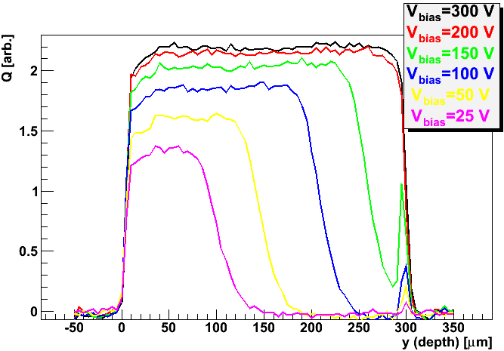
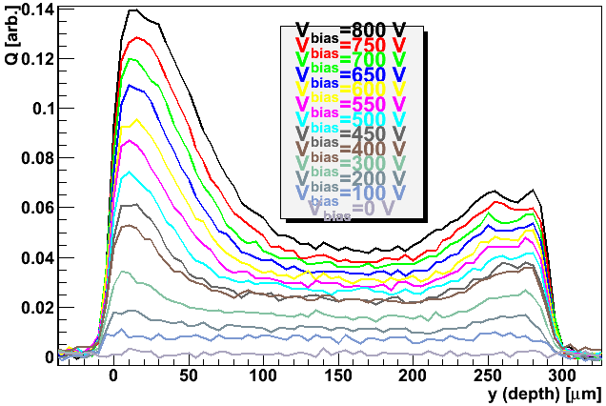
Tools & Approaches
Large field in irradiated sensor
Unirradiated (n-in-p)
Irradiated to Φ=10¹⁶ cm⁻²
HPK 300 μm
Charge
Charge
G. Kramberger, 6th Trento Workshop, Italy (2010)
Front
Depth
Front
Depth
No field in undepleted part
Charge collected only from depletion zone
No charge from undepleted part
Large field present even at low Voltages
Charge collected allways from all regions
High fields at front and rear side
A. Junkes, RD50 Status Report, HSTD-8, Taipei 05.12.2011
Notes:
Several taskforces
Try to cover several approaches

Slide 51
Fancy and new
Simulation of the Electric Field: p-diffusion
Curves at 500 V
No Irradiated
Irradiated. Φ_{eq} = 1 x 10¹⁶
High Electric Field peak at the junction
G. Pellegrini, 17th RD50 Workshop 2010
High Electric Field region driven deep in the bulk
First production of structures finished
They work!
CM observed
Problems:
Leakage current high
High cross talk
High Electric Field peak at the centre of the strip
Notes:
Several taskforces
Try to cover several approaches

Slide 52
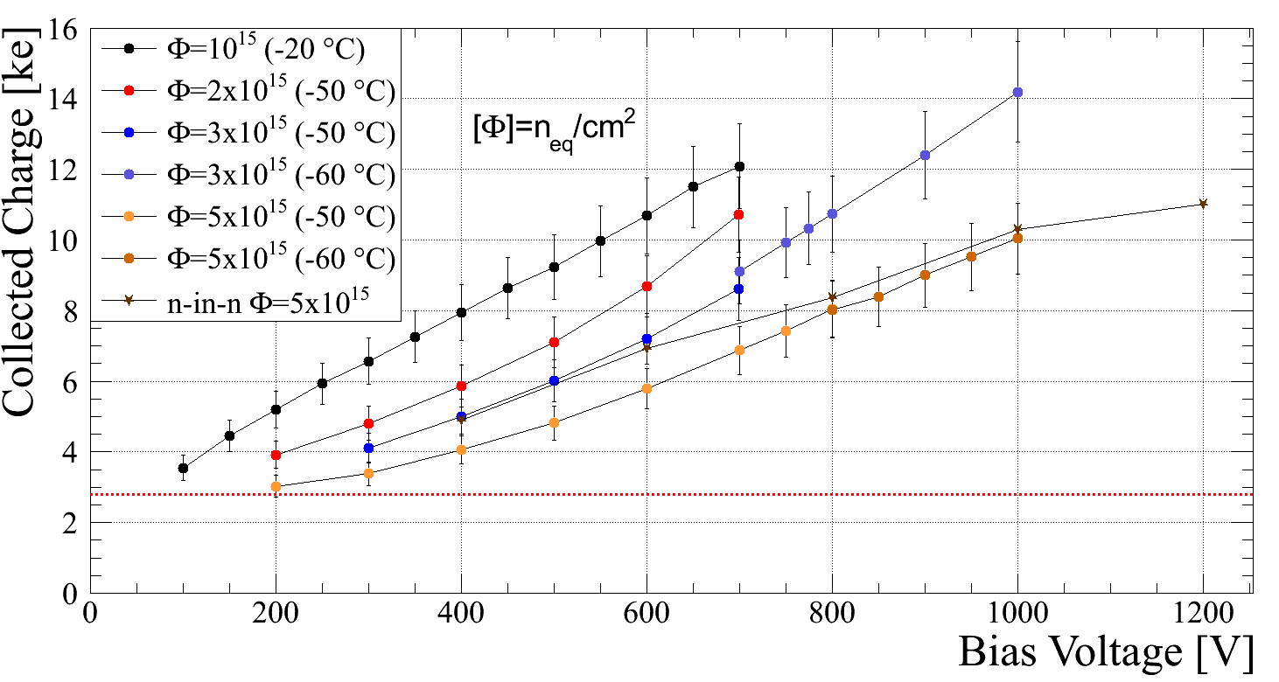
N-in-p pixels produced at CiS
MPI+ CERN ATLAS PIxel group
Φ=5x10¹⁵
V_{bias}=1000V
Φ=5x10¹⁵
V_{bias}=1000V

Slide 53
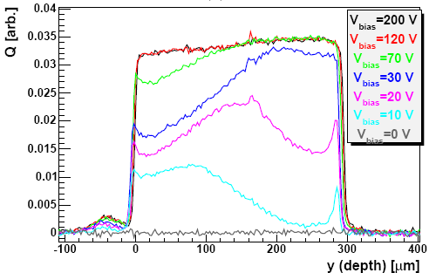
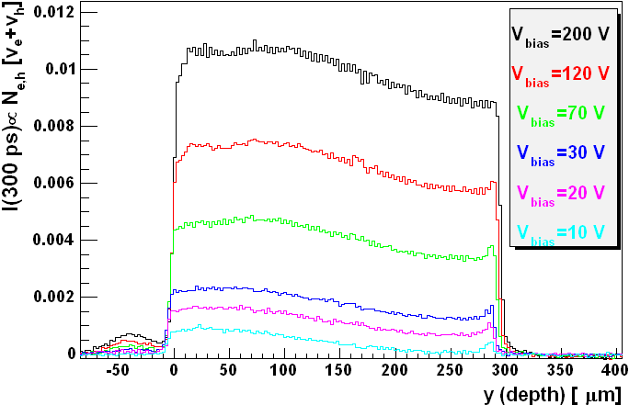
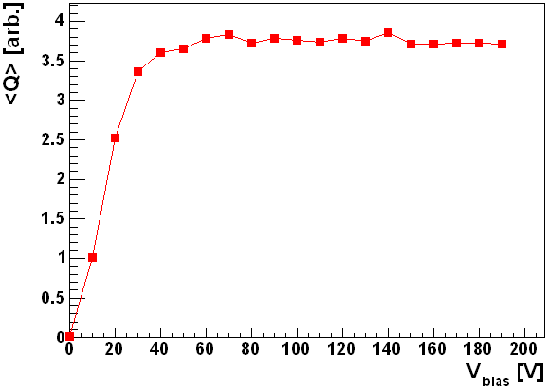
Tools & Approaches
Charge and velocity profiles
RD50 Micron p-type sensor
CHARGE COLLECTION PROFILE
G. Kramberger, 17th RD50 Workshop (2010)
VELOCITY PROFILE
v_{e}+v_{h} [arb.]
charge collection for mip
Notes:
Several taskforces
Try to cover several approaches

Slide 54
Radiation damage
Radiation damage: Summary
Change of effective doping concentration
– Underdepleted bulk
– Unwanted type inversion
    Depending on material
    Needs exact prediction of N_{eff} for specific material
Increase of leakage current
  – Increase of noise
    So far independent of materials
    Cooling necessary
Increase of trapping
        – Loss of signal
        – Most important effect for Φ>1x10¹⁵ cm⁻²
    Independent of material
  But: e-collection 3x faster than h+ collection
    Collect e-
    n-in-n or n-in-p
Notes:
Several taskforces
Try to cover several approaches

