Slide 1
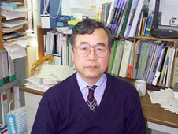
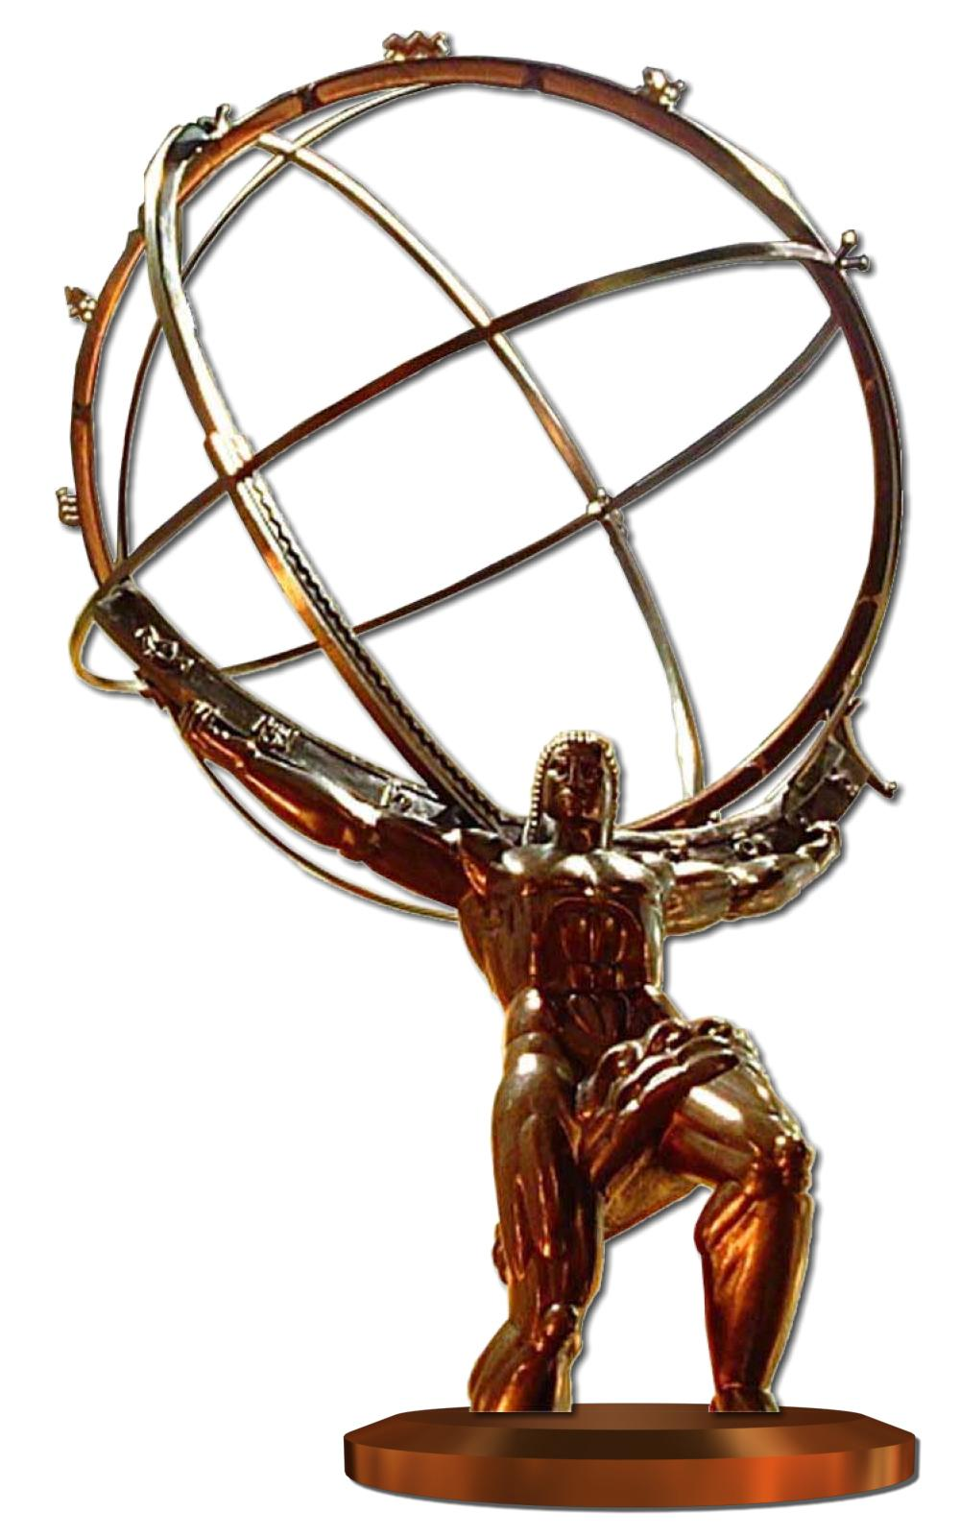


The SCT Project
Building the SemiConductor Tracker of the ATLAS Detector
Marko Mikuž
University of Ljubljana & Jožef Stefan Institute
8th HSTD, Taipei
December 5, 2011
Special session in honour of Professor Takashi Ohsugi

Slide 2
Two HEP Milestones of 1993
On October 21, 1993, following a turbulent summer, US Congress definitely cancels the Superconducting Super Collider project.
On May 22-24 1993 the 1st International Symposium on the Development and Application of Semiconductor Tracking Detectors is held in Hiroshima.

Slide 3
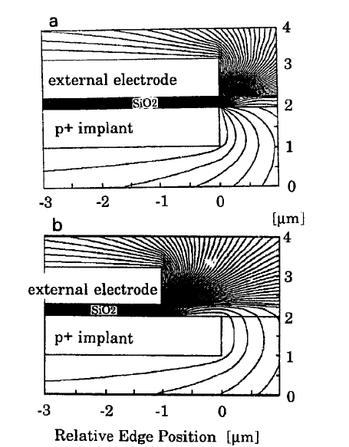
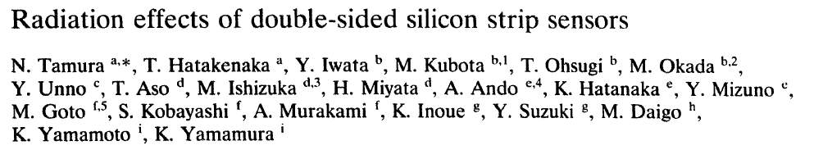
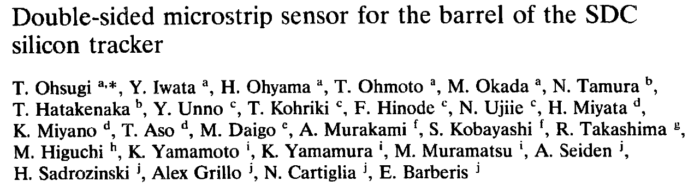
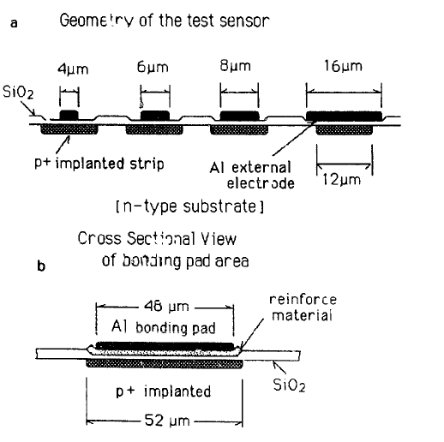
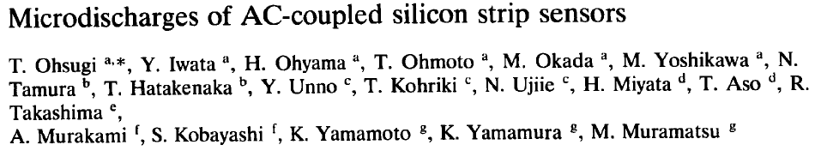
3 selected papers of 1st HSTD
Although aimed at SDC at SSC they prove to be of high relevance to the SCT project

Slide 4
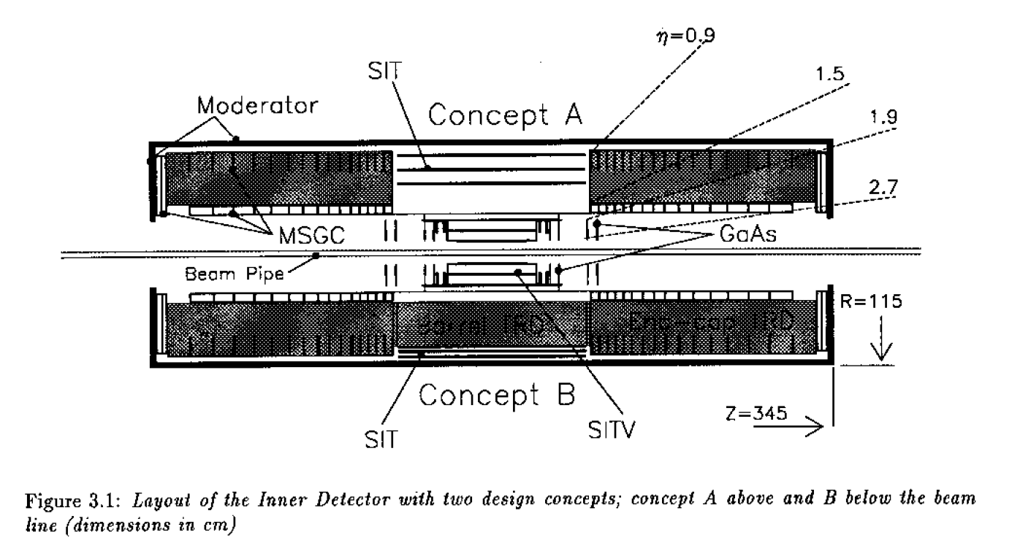
1992 –ATLAS LoI
Proto - SCT in ATLAS LoI (SIT)
  2/3 layers of silicon strips in barrel only
LoI

Slide 5
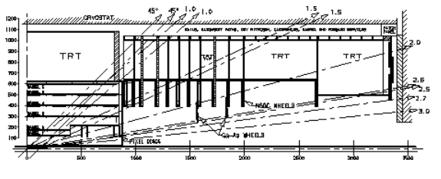
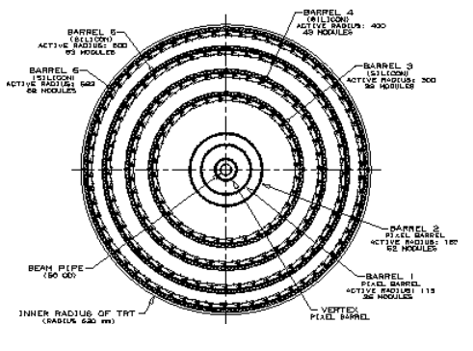
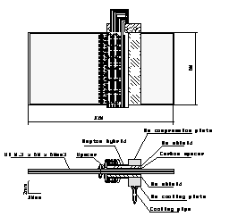
ATLAS TP - 1994
Silicon tracker appearing in the relevant part of the barrel – three layers of pixels, four of strips
“SCT” comprises all ID except the TRT
  Pixels, Strips, MSGC, GaAs
Japanese groups working on SSC strengthen ATLAS
TP

Slide 6
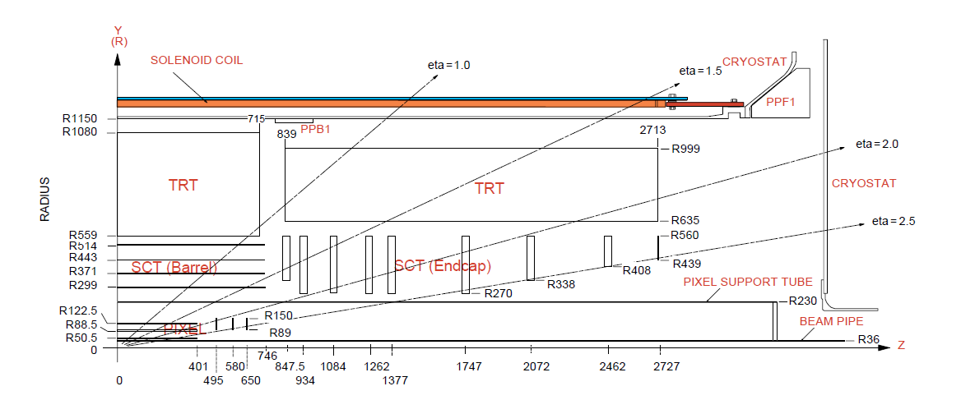
Up to 1997 – ID TDR
Finalized design of the SCT
  Spawned off pixels as independent (sub)detector
  Abolished MSGC and GaAs
All silicon strip tracker – 4088 modules
  2112 barrel modules in four layers
  1976 end-cap modules on 2x9 disks
  2x2 back-to-back sensors per module at 40 mrad stereo provide space-points
    8448 barrel & 6944 strip sensors
    > 60 m² of silicon
  Hermetic design
    4 space-points on track for η<2.5

Slide 7
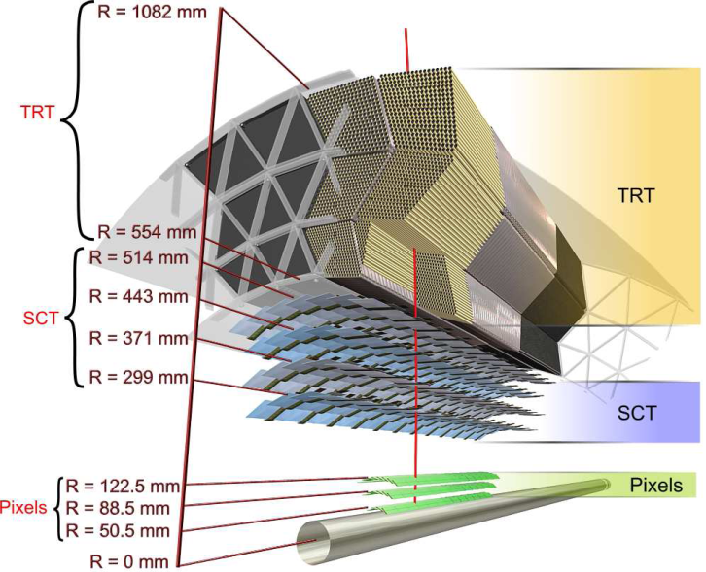
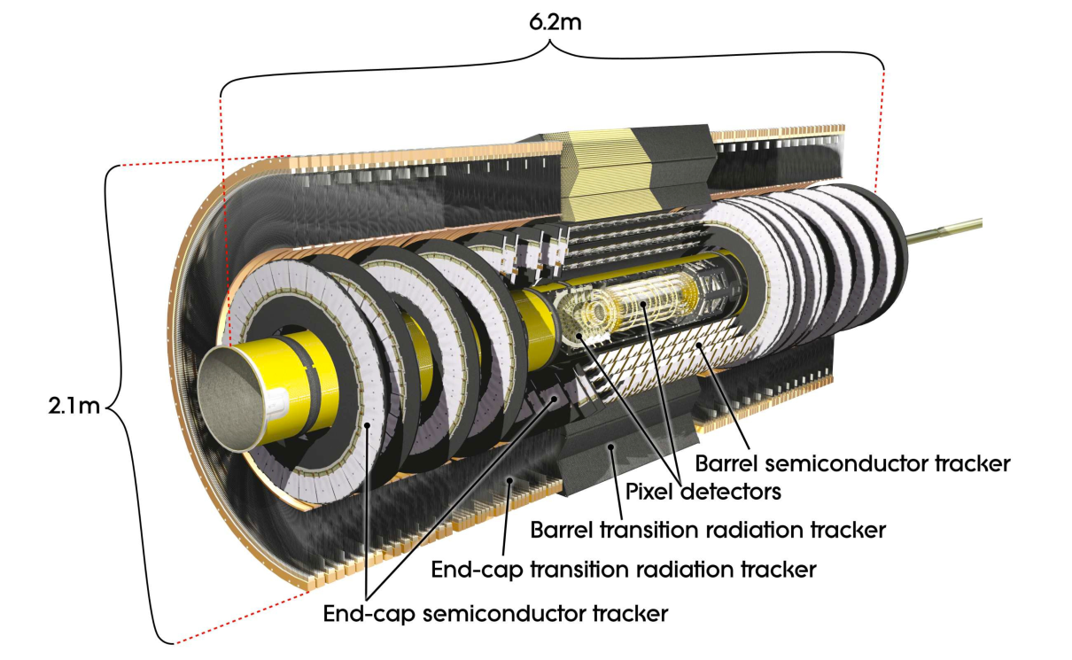
SCT requirements
Find tracks
Each ATLAS ID subsystem exhibits some stand-alone track finding capability
  3 pixel layers
  4 SCT stereo (40mrad) layers
    Strip occupancy < 1%
  36 TRT straw tube layers layers
Measure tracks
Strip pitch (80mm) measures the angle to 1mrad and provides sign of < 0.5 TeV particles.
Minimize 2-track hits.
Use strip length of 12.8 cm
Minimize material
~10% X0 at η=0
Radiation tolerance
2x10¹⁴ n/cm² in 3+7 LHC years (730 fb⁻¹)
Execute project within resources available
~45 MCHF CORE cost,
  ¬15.5 MCHF in sensors
Joint effort of the 40 institutes
~10 years to beam

Slide 8
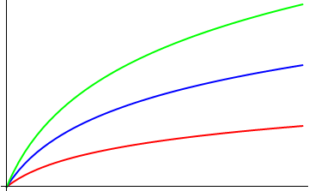
Frustrations of a big project
Schedule
technology leaps
e.g. 4”-> 6”
(R&D, time)
performance
Funding agencies
Requirements
resources

Slide 9
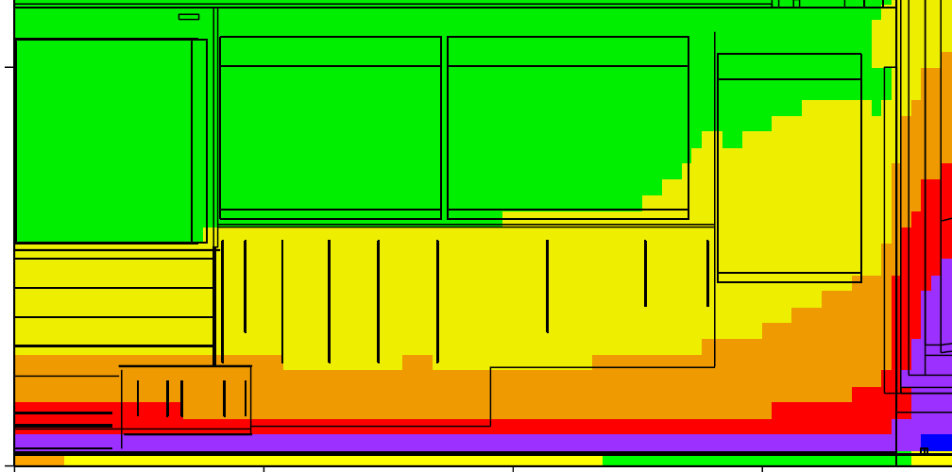
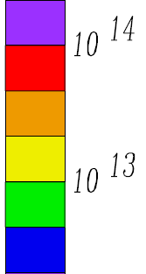
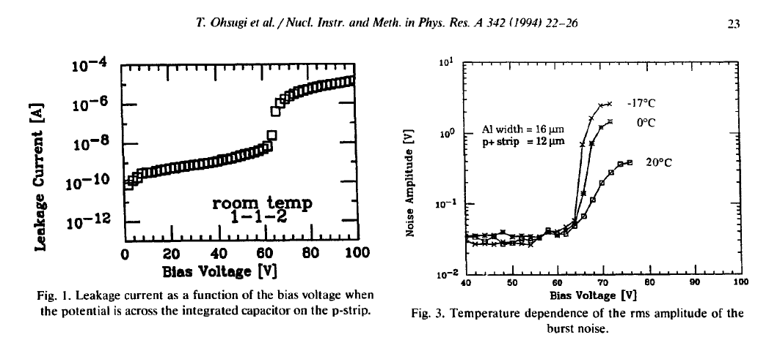
SCT Sensors
Most sensitive and expensive ingredient of SCT
  1/3 of the total cost
Ultimate challenge – radiation hardness
  Benchmark NIEL 2x10¹⁴ n_{eq}/cm², TID ~20 MRad
Lots of R&D for a decade
High operational voltage required
  FDV > 300 V for 300 µm
  High fields help in fast charge collection
High voltage and irradiation
Large currents in detector
NIEL-induced bulk currents
Surface currents due to high fields, modified also by TID
  Micro-discharges leading to sensor beak-down
NIEL per 100 fb⁻¹
SCT
Ohsugi et al. 1st HSTD
~60 V

Slide 10
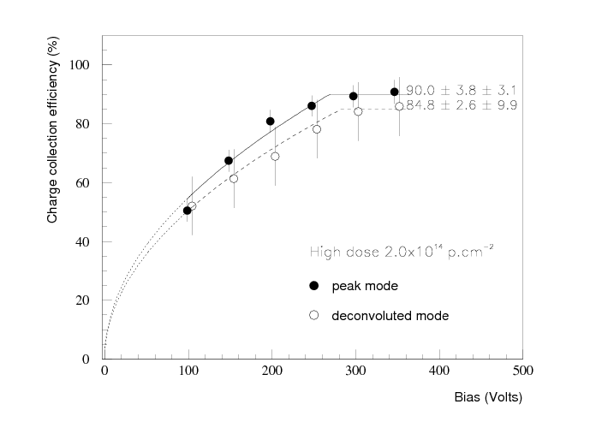
SCT Sensor Choice
SSSD with n⁺ strips on n type bulk the sensor of choice in TDR
  DSSD considered too high risk for HV on readout
  n⁺n allows under-depleted operation
  Elaborate R&D on n⁺ strip insulation with notable contributions of Prof. Oshugi
HV specification 300 V
  The limit of a class of electronics components
Decision overruled the following year
  Resources insufficient to fund n⁺n
    Requires double sided processing
  Revert to p⁺n
    Cost effective, but requires V > FDV
  Voltage spec changed to 350 V,
    With services designed to 500 V
  Soon spec risen to 500 V
TDR n⁺n
300 V

Slide 11
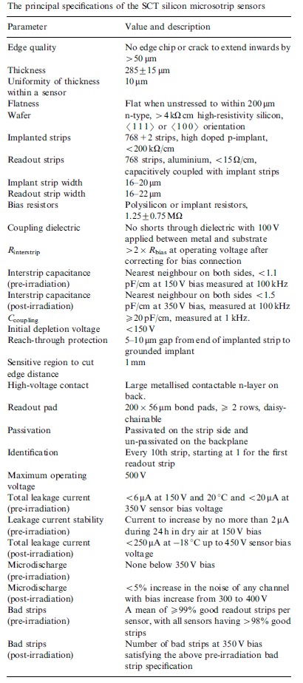
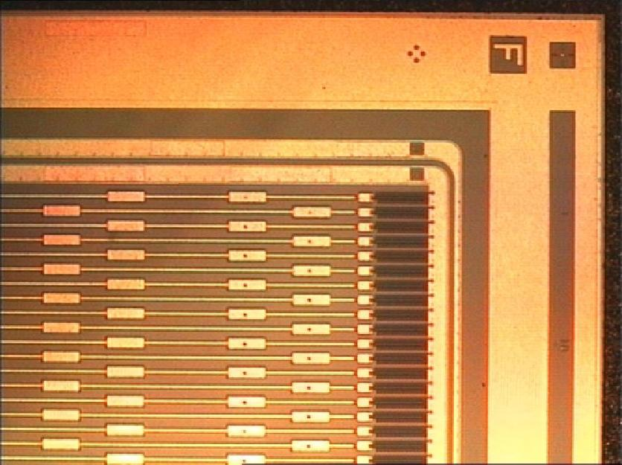
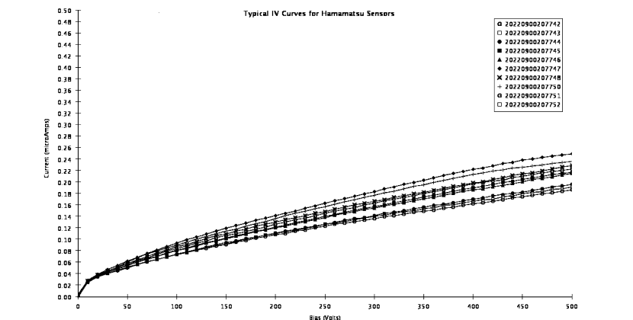
SCT Sensor Procurement
Contact with suppliers from 1995
  Several iterations of prototypes
Specifications in 2000
  Very strict, aimed at ultimate quality
  1 barrel type (square ~64x64 mm²), 5 wedge types for end-cap
Order split between Hamamatsu / CiS by 92.2/7.8 %
Delivery 2001-2003, small part 2004
Perfect sensors delivered by Hamamatsu
  Smooth I-V up to 500 V, before and after irradiation
  No micro-discharges due to field plate, equivalent to the extended electrode concept pioneered by Prof. Ohsugi
Hamamatsu barrel
I-V non-irradiated
NIM A578(2007)98
500 V

Slide 12
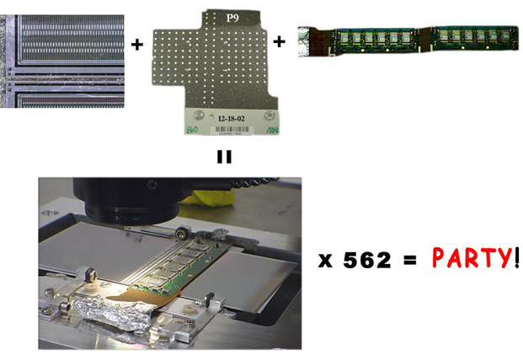
From sensors to SCT - Modules
Perfect sensors don’t make a perfect detector (yet)
Module production organized in clusters
  4 barrel
    Japan
    Nordic
    UK-B
    US
  7 end-cap
Very strict mechanical tolerances required and achieved in module production
  Aimed at providing best possible track alignment seeds for fast physics turn-on

Slide 13
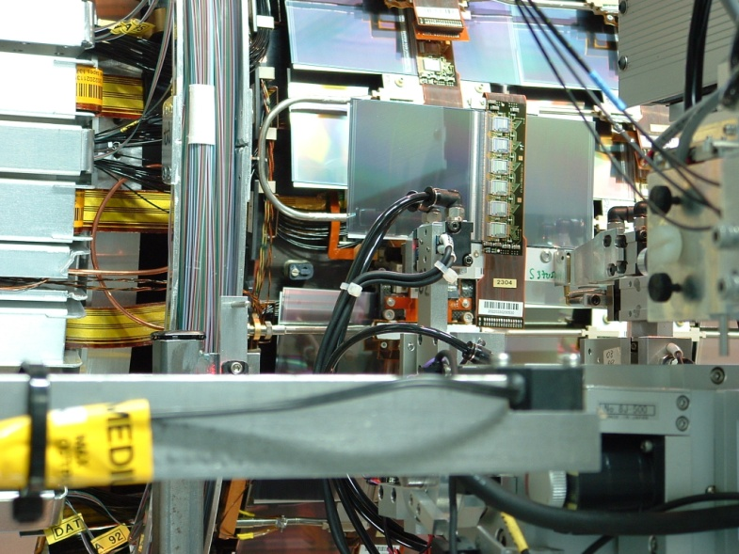
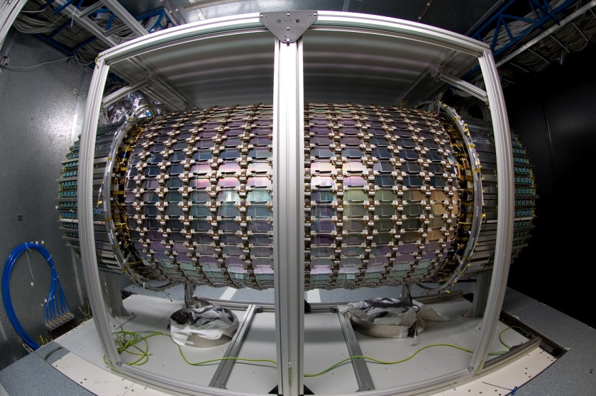
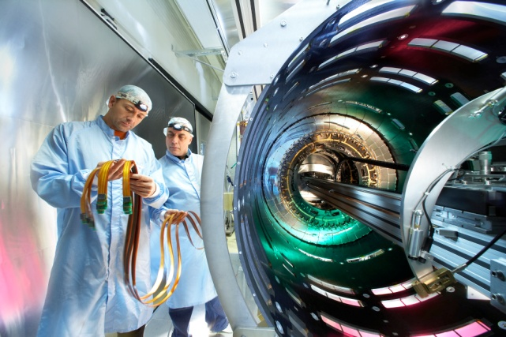
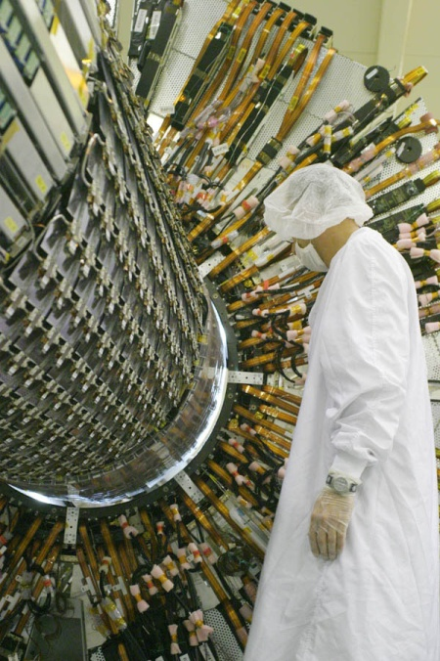
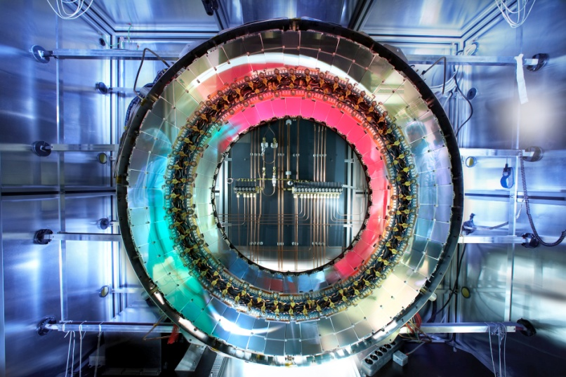
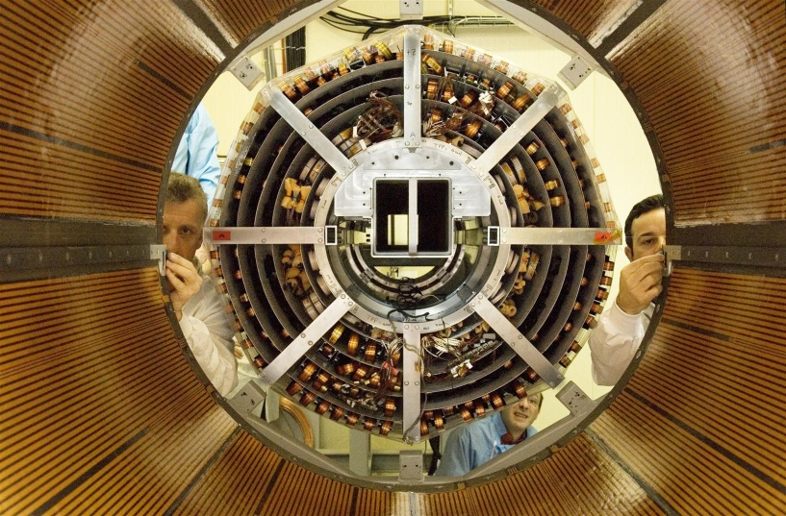
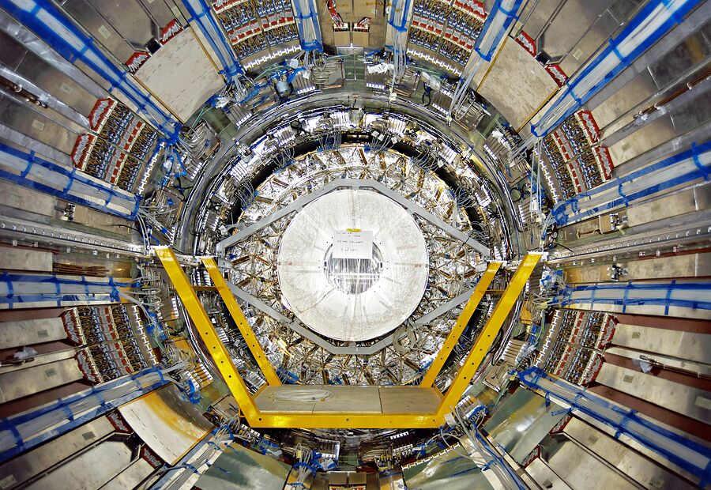
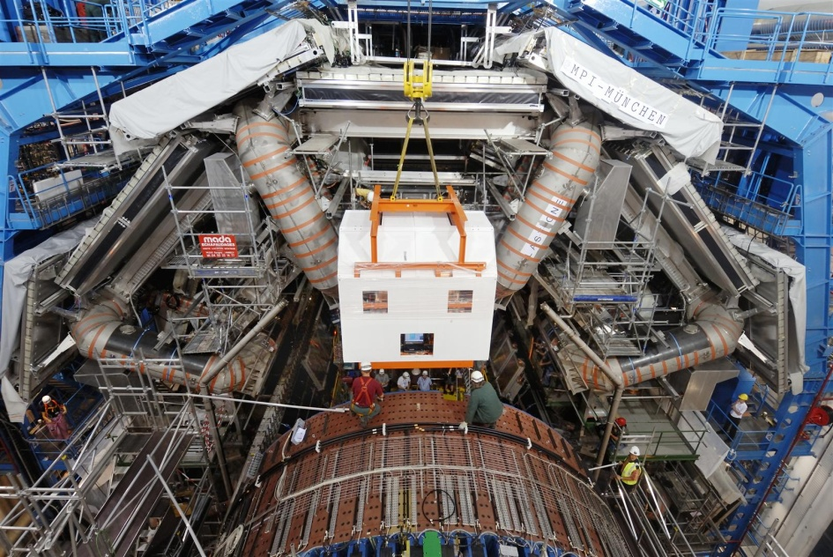
From sensors to SCT - Integration
Integration of sensors on structures with services
  Barrel
    Modules on barrels: Oxford
    4 barrels: CERN
  End-caps
    Liverpool
    NIKHEF
SCT in TRT: CERN
SCT & TRT in ATLAS pit inside solenoid
Connect services
Commission

Slide 14
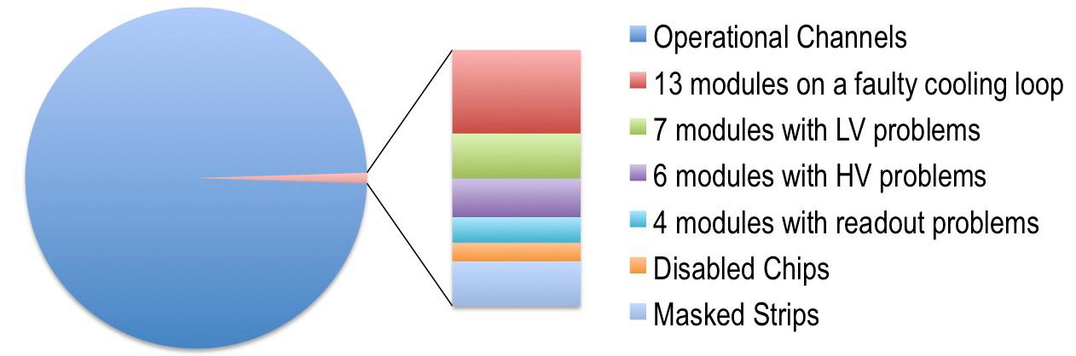
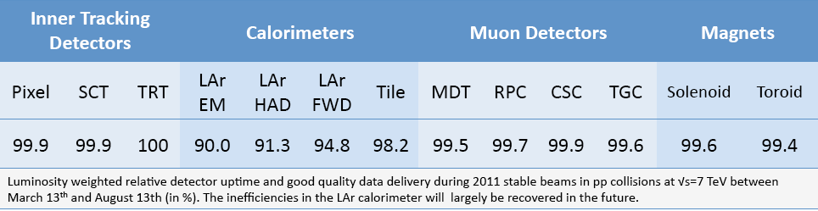
SCT Operational Performance
>99 % of all channels operational
Availability 99.9 %
We can all be proud
of having built such
a perfect tracking detector !

Slide 15
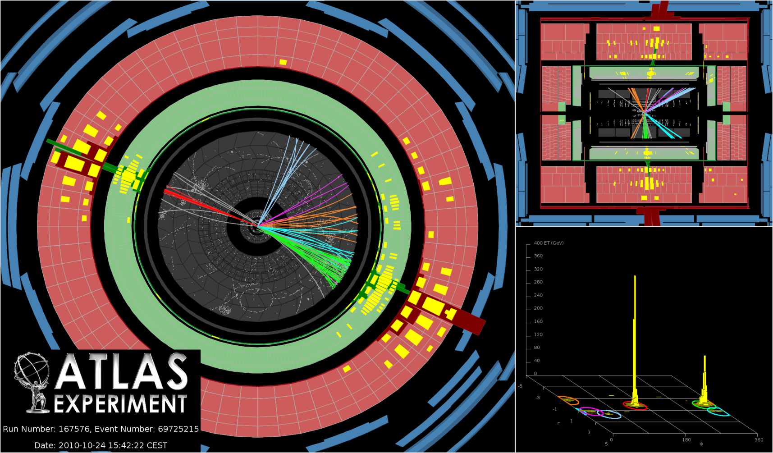
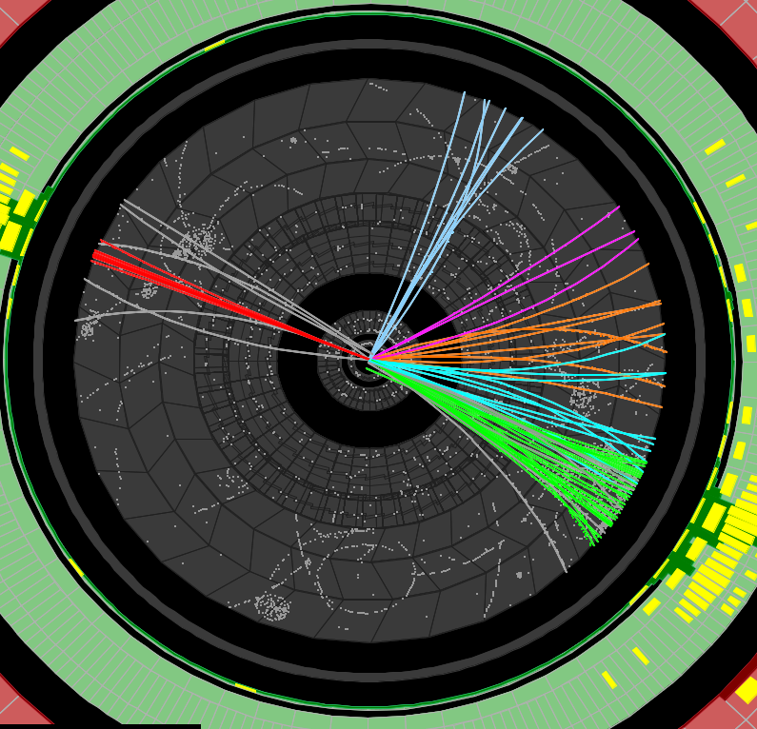
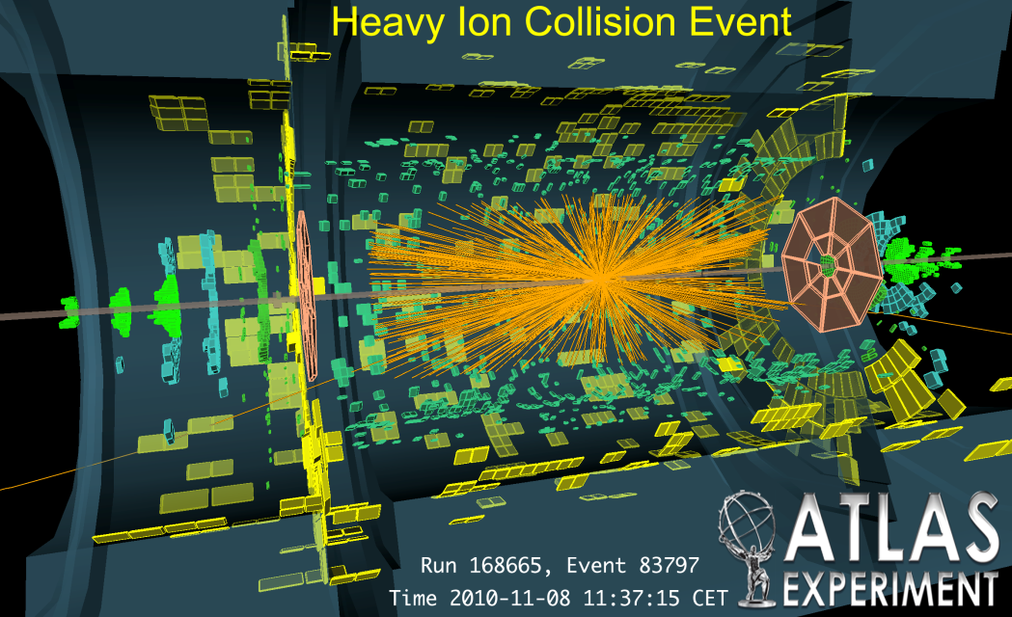
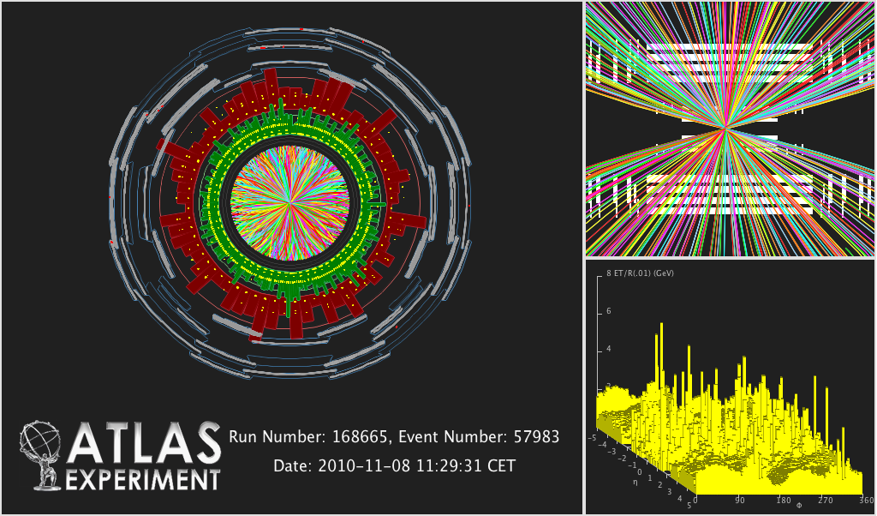
SCT performance with LHC collisions
> 1000 reconstructed tracks
More on SCT operation and performance
  Talk by Dave Robinson Wednesday 9:30

Slide 16
Ohsugi-san, let me conclude by:
thanking you for sharing your knowledge and experience, helping us to build one of the best silicon tracking devices ever,
wishing you many happy and fruitful years fulfilling also all your interests you lacked time for during your exceptional career.

