Slide 1






A MAPS detector application in a Young-Feynman interference experiment with single electrons
F. Giorgi⁽¹⁾, S. Frabboni⁽³⁾, A. Gabrielli^{(1,2)},
G.C. Gazzadi⁽³⁾ , G. Matteucci⁽²⁾, G. Pozzi⁽²⁾,
N. Semprini^{(1,2)}, M. Villa^{(1,2)}, A. Zoccoli^{(1,2)}
INFN – Bologna, Italy
Physics Department – University of Bologna , Italy
CNR-Institute of Nanoscience-S3 and University of Modena and Reggio Emilia, Italy

Slide 2
Outline
Young’s double slit interference experiment
Historical notes on electron interference
Setup of a quantum experiment with single electrons
The digital sensor
Measures and results
Conclusions

Slide 3
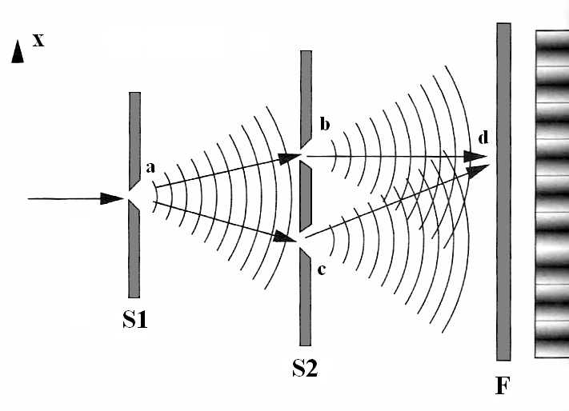
Young’s double slit experiment
  LIGHT
  Monochromatic and coherent source
  Two slits at distance d (primary wave split into 2 sources of coherent waves)
  Detection on screen at distance D>>d
  Fringes at multiples of θ = λ /d
  PARTICLES (i.e. electrons)
  Mono-energetic and coherent (small) source
λ_{De Broglie} @ 60 KeV ~ 5 ∙ 10⁻¹² m (0.05 A)
(~ 1/20 Hydrogen’s Bohr diameter)
d
R. Feynmann: “We should say right away that you should not try to set up this experiment”
Lecture on Physics, vol 3. (1963)
D

Slide 4
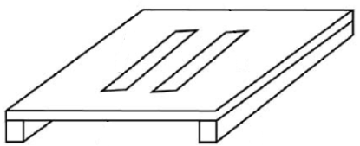
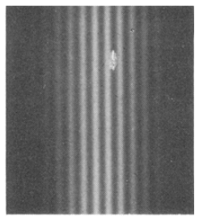
Young’s double slit experiment
  LIGHT
  Monochromatic and coherent source
  Two slits at distance d (primary wave split into 2 sources of coherent waves)
  Detection on screen at distance D>>d
  Fringes at multiples of θ = λ /d
Material
double slit
  PARTICLES (i.e. electrons)
  Mono-energetic and coherent (small) source
λ_{De Broglie} @ 60 KeV ~ 5 ∙ 10⁻¹² m (0.05 A)
(~ 1/20 Hydrogen’s Bohr diameter)
High electron
flux
R. Feynmann: “We should say right away that you should not try to set up this experiment”
Lecture on Physics, vol 3. (1963)
1961 – Jönsson C. (Zeitschrift für Physik 161, 454-474) English translation:
Electron Diffraction at Multiple Slits on the American Journal of Physics (1974) 42, 4-11

Slide 5
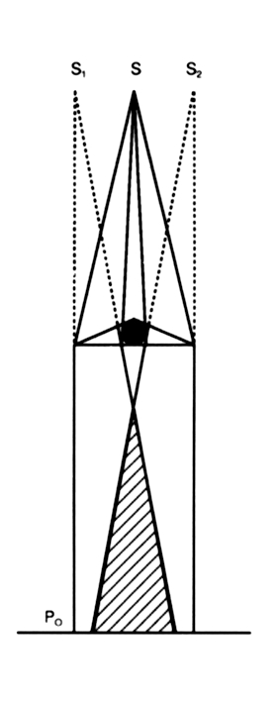

Young’s double slit experiment
  LIGHT
  Monochromatic and coherent source
  Two slits at distance d (primary wave split into 2 sources of coherent waves)
  Detection on screen at distance D>>d
  Fringes at multiples of θ = λ /d
Electron
bi-prism
  PARTICLES (i.e. electrons)
  Mono-energetic and coherent (small) source
Low-flux:
Average e⁻ distance: >10 km→
single electrons!
λ_{De Broglie} @ 60 KeV ~ 5 ∙ 10⁻¹² m (0.05 A)
(~ 1/20 Hydrogen’s Bohr diameter)
R. Feynmann: “We should say right away that you should not try to set up this experiment”
Lecture on Physics, vol 3. (1963)
1972 – O. Donati, G.F. Missiroli, G. Pozzi (American Journal of Physics (1973) 41, 639-643)
1974 – P.G. Merli, G.F. Missiroli, G. Pozzi (American Journal of Physics (1976) 44, 306-7)
1987 – A. Tonomura (American Journal of Physics (1989) 57, 117-120)

Slide 6
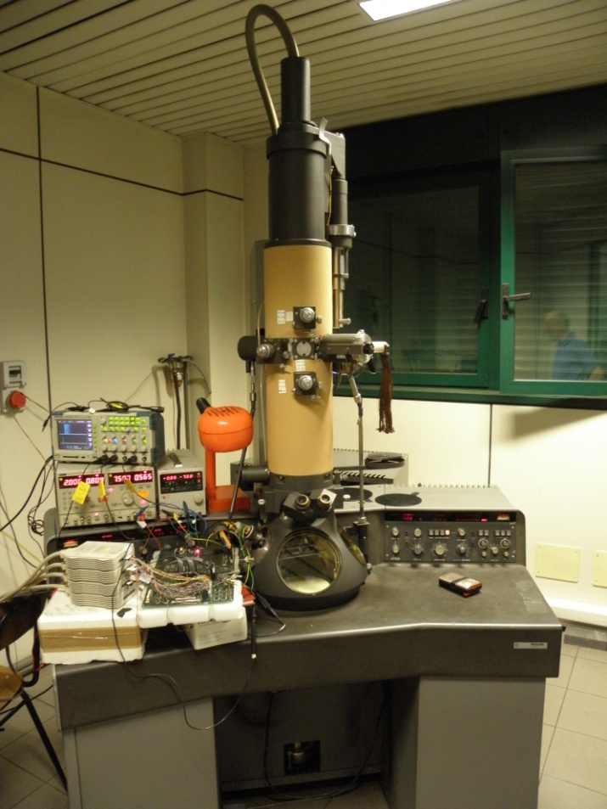
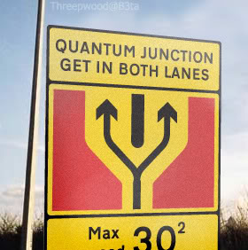
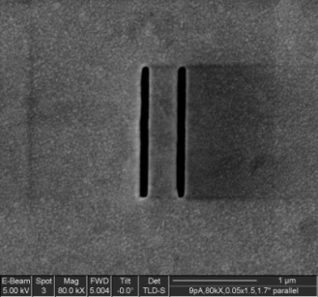
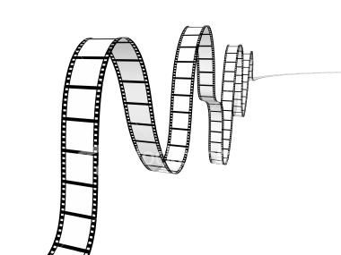
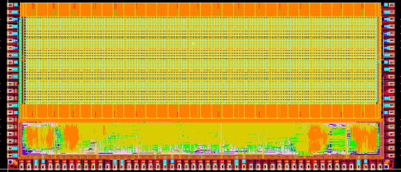
From gedanken to real, a step further
TEM Philips M400T
Thermo-ionic electron emitter
actual
double slit
mechanical
stopper
HEP MAPS sensor
APSEL4D chip by SLIM5 (INFN)
single counts
AND
Time-tagging
“Digital movie”
shot @ 6000 fps
→
Custom DAQ board

Slide 7
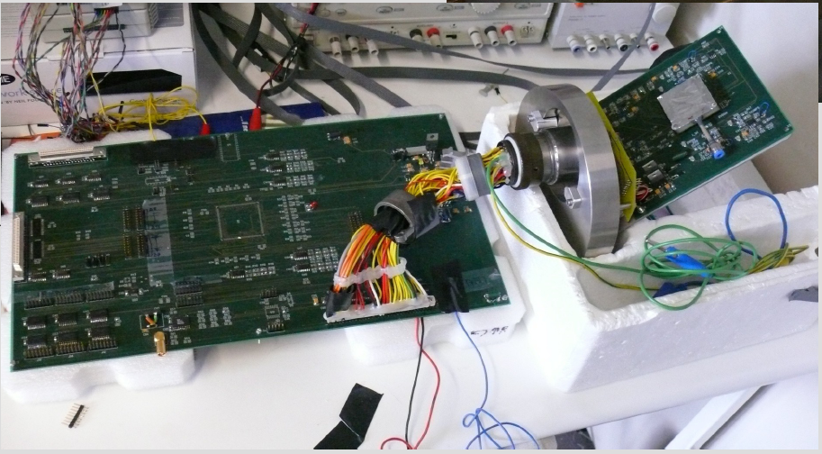
DAQ Boards
Back-end board
MAPS sensor
Vacuum connector

Slide 8
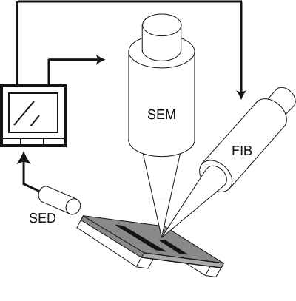

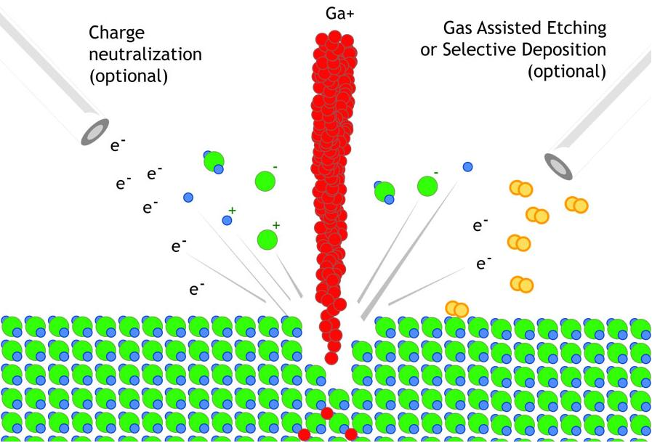
Nanometric Double Slit
FIB (Focuses Ion Beam) 30 keV Ga+ source. 10 pA beam.
Carbon membrane with Au deposition ( 50-100nm thick).
SEM Image
Length: 1550nm.
Width: 100nm.
Distance: 450nm.
2007 – S. Frabboni, G. C. Gazzadi e G. Pozzi (American Journal of Physics (2007) 75, 1053)

Slide 9
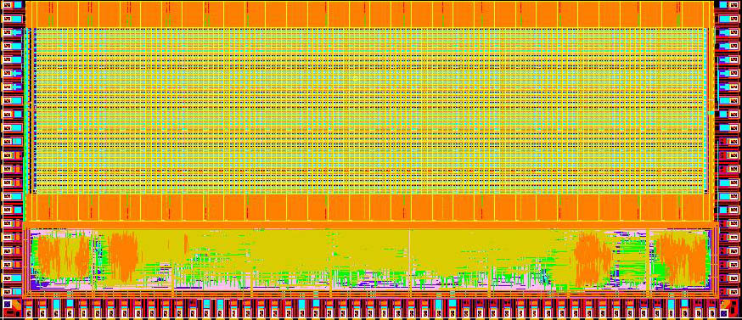
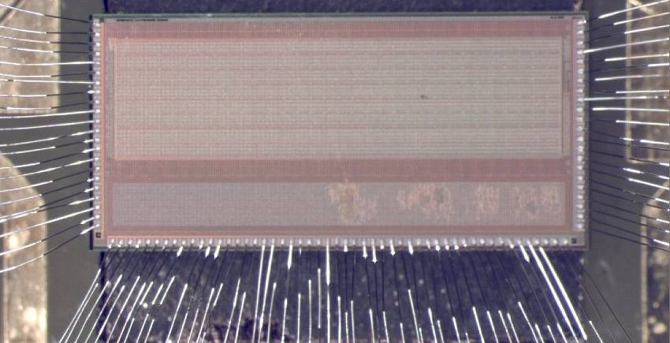
The MAPS sensor APSEL4D
Developed by the INFN SLIM5 collaboration: R&D for HEP collider experiments.
MAPS: Monolithic Active Pixel Sensor
CMOS ST .13 μm technology
Thickness 300 μm, pitch 50x50 μm
4096 channels (32x128)
ENC 75 e⁻
S/N ~ 20 (MIP)
Signal discriminator with extern. threshold
Binary hit information.
Digital readout:
  Data Driven
  Sparsified hit extraction
  Time tagging down to 1 μs.
Clock frequency 20-50 MHz
Efficiency ~ 90% measured at CERN with 12-GeV proton beam.
4096-MAPS matrix
100k std-cell area
Sensitive area: 6.4 mm x 1.6 mm ~ 10 mm²
32x128 pix - 50 μm pitch
periph & spars logic
2008 – S. Bettarini et Al. (Nuc. Instr. And Meth. A, 623 (2010) 942-953)

Slide 10
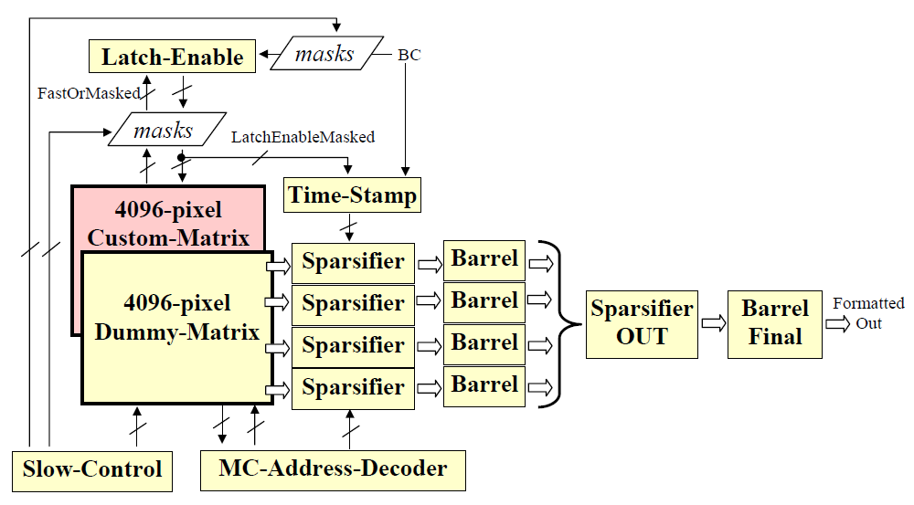
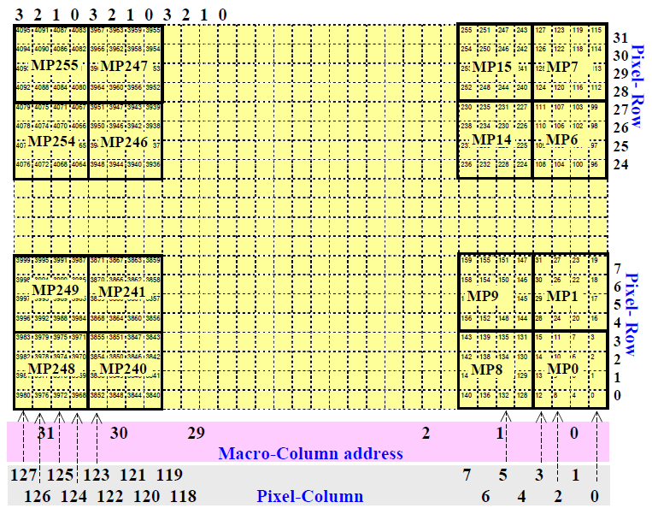
Sparsified Digital Readout
Macro Pixels (MP) have dedicated lines
1 Fast OR
1 Latch enable

Slide 11
Sparsified Digital Readout
Macro Pixels (MP) have dedicated lines
1 Fast OR
1 Latch enable
TIME STAMP
TIME STAMP

Slide 12
Sparsified Digital Readout
Macro Pixels (MP) have dedicated lines
1 Fast OR
1 Latch enable
Pixel hit extraction
1 column at a time
Only fired MP are inspected column by column

Slide 13
Sparsified Digital Readout
Macro Pixels (MP) have dedicated lines
1 Fast OR
1 Latch enable
Pixel hit extraction
1 column at a time
Only fired MP are inspected column by column

Slide 14
Sparsified Digital Readout
Macro Pixels (MP) have dedicated lines
1 Fast OR
1 Latch enable
Pixel hit extraction
1 column at a time
Only fired MP are inspected column by column

Slide 15
Sparsified Digital Readout
Macro Pixels (MP) have dedicated lines
1 Fast OR
1 Latch enable
Pixel hit extraction
1 column at a time
Only fired MP are inspected column by column

Slide 16
Sparsified Digital Readout
Macro Pixels (MP) have dedicated lines
1 Fast OR
1 Latch enable
Pixel hit extraction
1 column at a time
Only fired MP are inspected column by column

Slide 17
Sparsified Digital Readout
Macro Pixels (MP) have dedicated lines
1 Fast OR
1 Latch enable
Pixel hit extraction
1 column at a time
Only fired MP are inspected column by column

Slide 18
Sparsified Digital Readout
Macro Pixels (MP) have dedicated lines
1 Fast OR
1 Latch enable
Pixel hit extraction
1 column at a time
Only fired MP are inspected column by column

Slide 19
Sparsified Digital Readout
Macro Pixels (MP) have dedicated lines
1 Fast OR
1 Latch enable
Pixel hit extraction
1 column at a time
Only fired MP are inspected column by column

Slide 20
Sparsified Digital Readout
coded hit
Macro Pixels (MP) have dedicated lines
1 Fast OR
1 Latch enable
x
y
time
Pixel hit extraction
1 column at a time
Only fired MP are inspected column by column
Fired pixel in the active column are coded by sparsifier components
Hits converge on a common formatted output.

Slide 21
The Measures

Slide 22

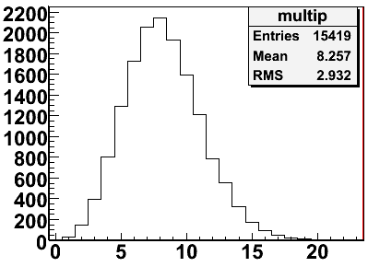
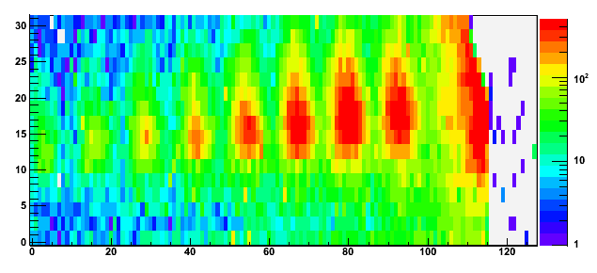
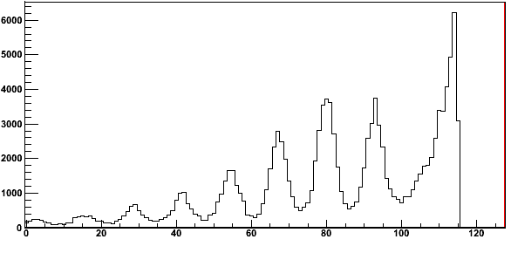
System test: Carbon-grating diffraction
Grid sample pitch: 400 nm
40 keV electrons: λ=h/p= 5.9 pm ; θ ~ 10⁻⁵ rad
3 ms time resolution: 333 fps
Y pixel
X pixel
High average number of electrons per frame
dN/dx
Peak distance: 13 pixels
→ 0.65 mm
X pixel

Slide 23
The single electron interference experiment results
40 keV electrons
165 μs time resolution: ~6000 fps

Slide 24

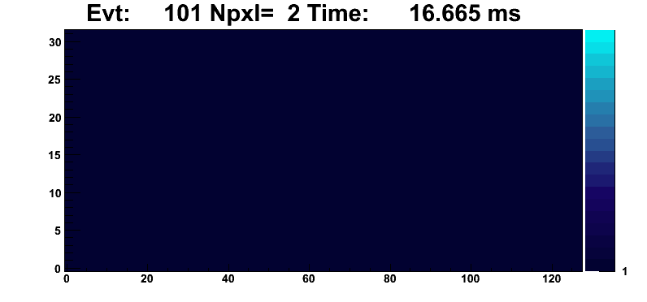
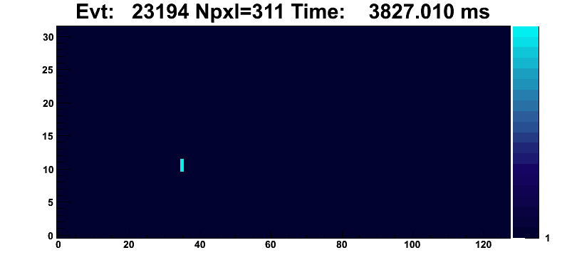
Vast majority of frames are empty (empty/hit ~ 70)

Slide 25
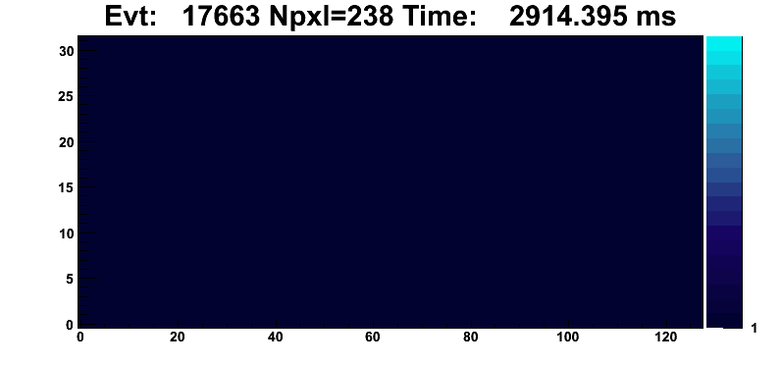
The edited movie
1st part: Both empty and single-electron frames are being played
2nd part: Empty frames are being skipped.
~80 e⁻/s →
1500 km
av. Distance
(β~.5)
3rd part: Single electron frames are overlapped together
96k e⁻ recorded
~20 min. run

Slide 26
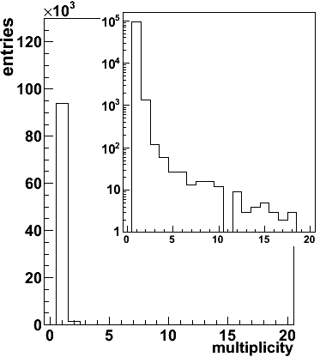
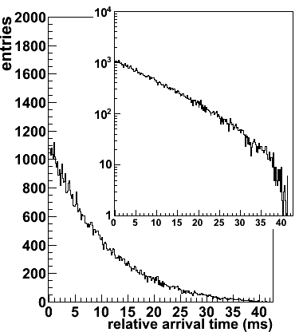
Frame data analysis
Electron multiplicity in frames
Time distance between electrons
zero-multiplicity (empty frames) ~ 7x10⁶
Almost every electron was already “on tape” before the next one was emitted

Slide 27
Conclusions
A Young-Feynmann experiment with a sub-micron double slit, a HEP pixel sensor and a Transmission Electron Microscope was setup.
40KeV Single electrons could be detected, time-tagged with a 165 µs time resolution and taped out one by one → For the 1st time the arrival time distribution (mean ~10 ms) has been reconstructed.
The double slit interference pattern was build up off-line with a statistic of about 100k electrons that travelled at an average distance of ~1500 km between each other.

Slide 28
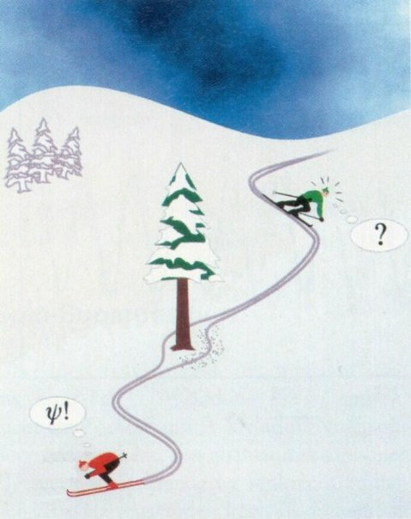
Thank you

Slide 29
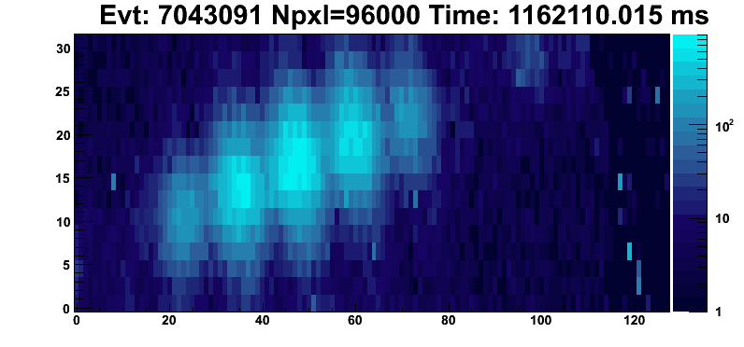
Still image of the overlapped single electron frames

