Slide 1
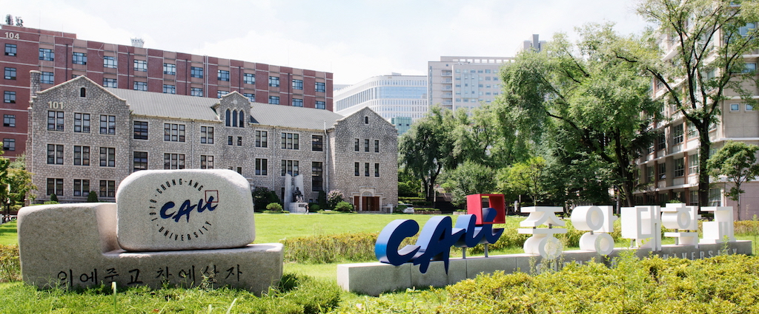
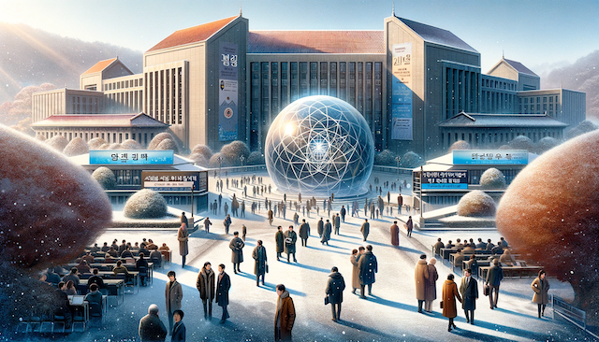
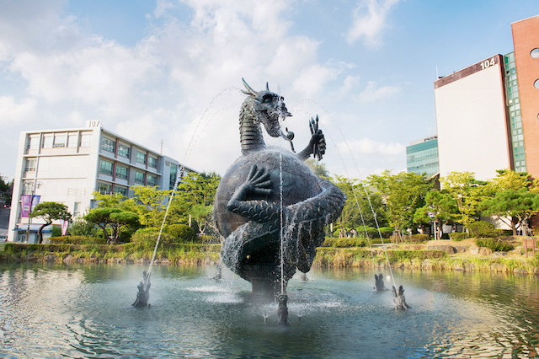
Search for
Axions and Axion-Like Particles
CAU-PNU BSM Workshop
Feb. 19 2024 Chung-Ang Univ.
SungWoo YOUN
IBS-CAPP
DALL-E

Slide 2

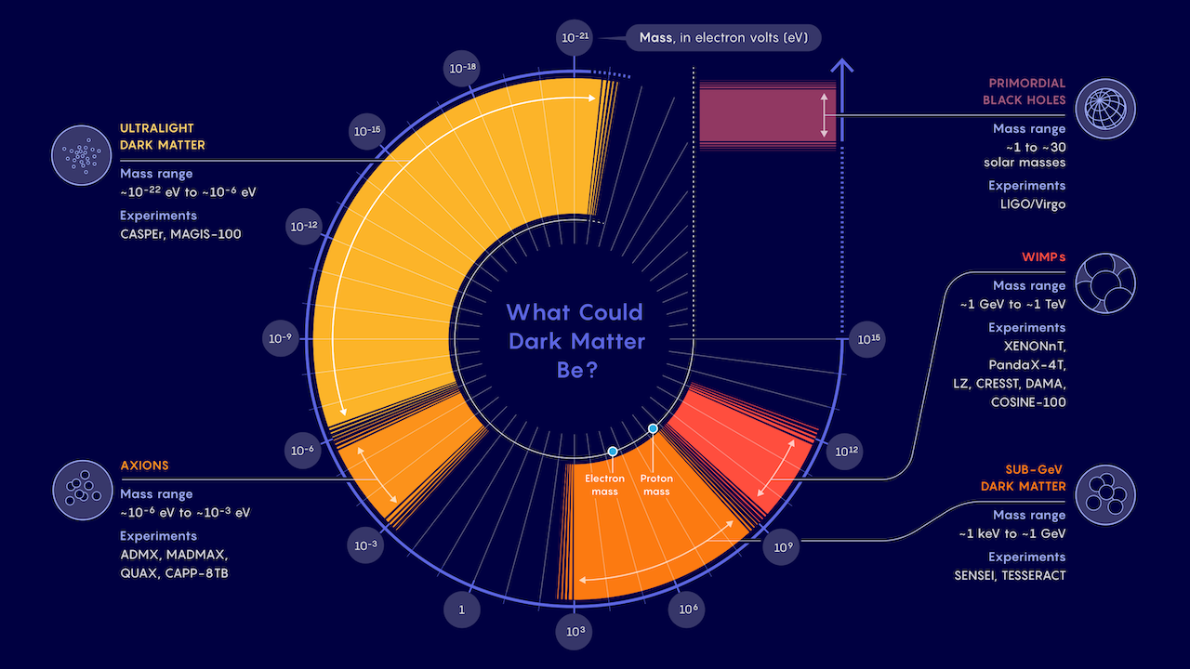
Dark matter business expanding
WIMPs may be down, but not out
Samuel Velasco/Quanta Magazine

Slide 3

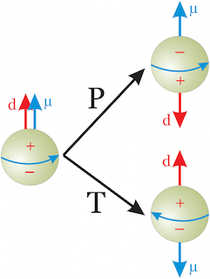
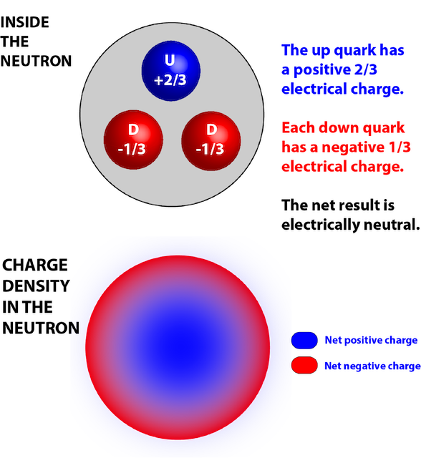
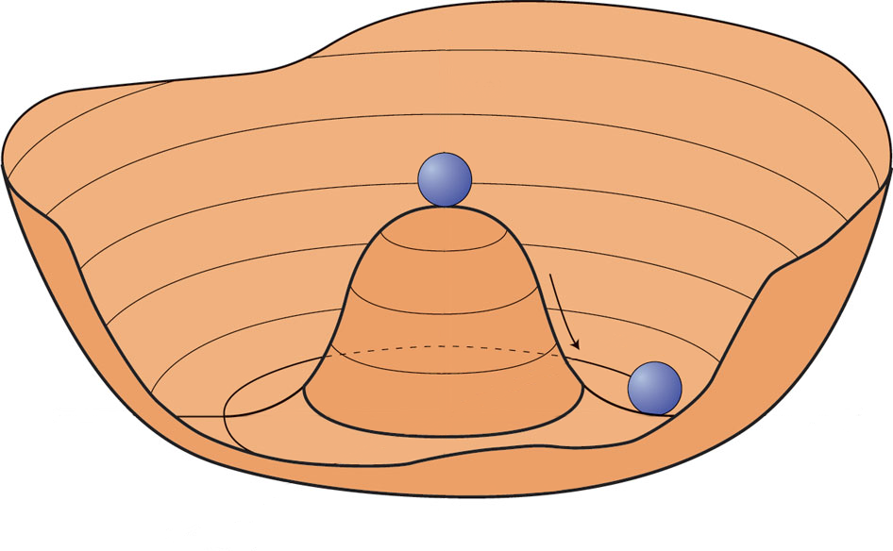
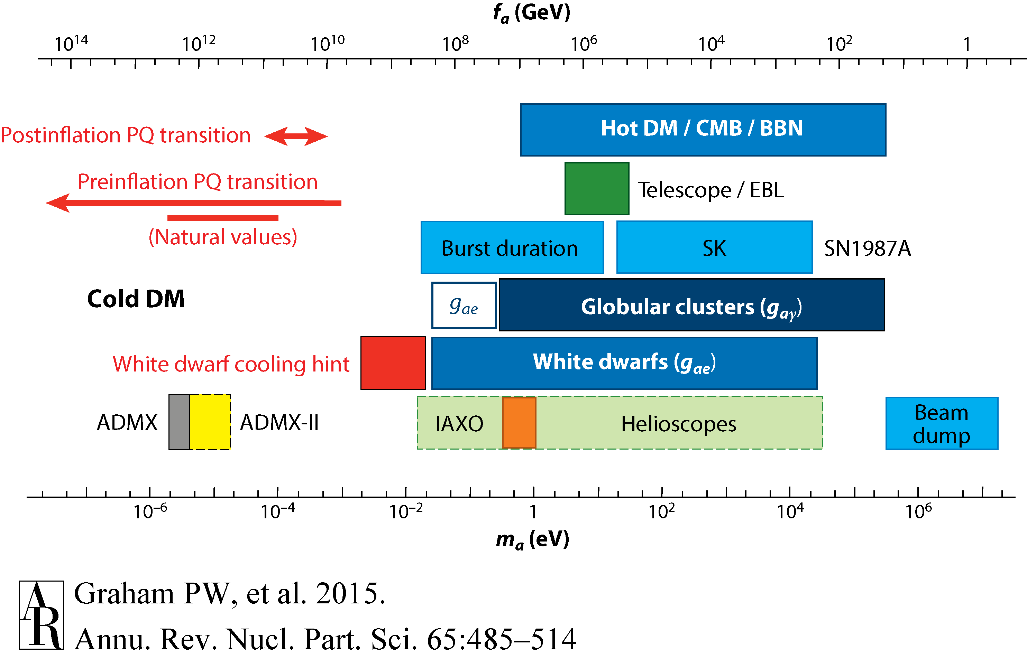
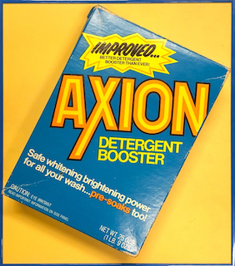
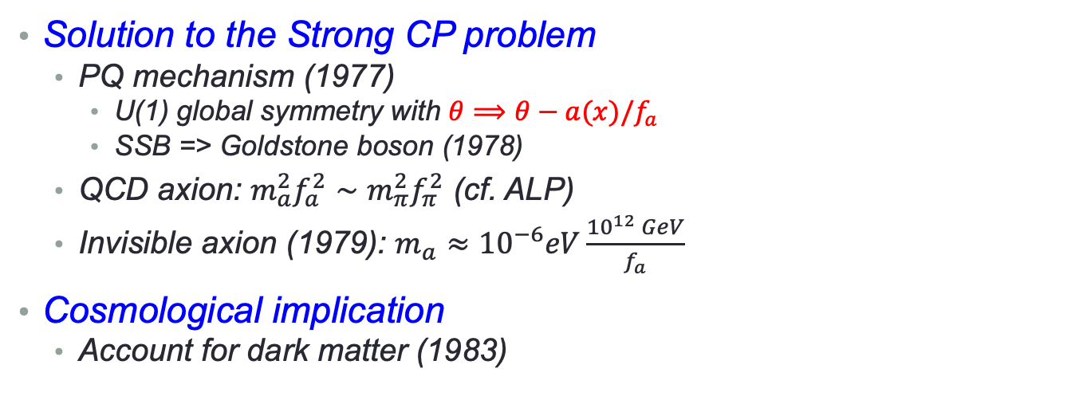

Axion dark matter
Solution to the Strong CP problem
  PQ mechanism (1977)
    U(1) global symmetry with $θ⟹θ−a(x)/f_{a}$
    SSB => Goldstone boson (1978)
  QCD axion: $m_{a}^{2}f_{a}^{2}∼m_{π}^{2}f_{π}^{2}$ (cf. ALP)
  Invisible axion (1979): $m_{a}≈{10}^{−6}eV\frac{{10}^{12} GeV}{f_{a}}$
Cosmological implication
  Account for dark matter (1983)
vs.
Absence of nEDM
$$a(x)=θ×fa$$
Spontaneuous PQ symmetry breaking
Goldstone boson
Annu. Rev. Nucl. Part. Sci. 65 485 (2016)

Slide 4
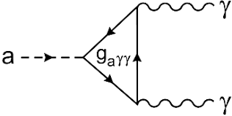
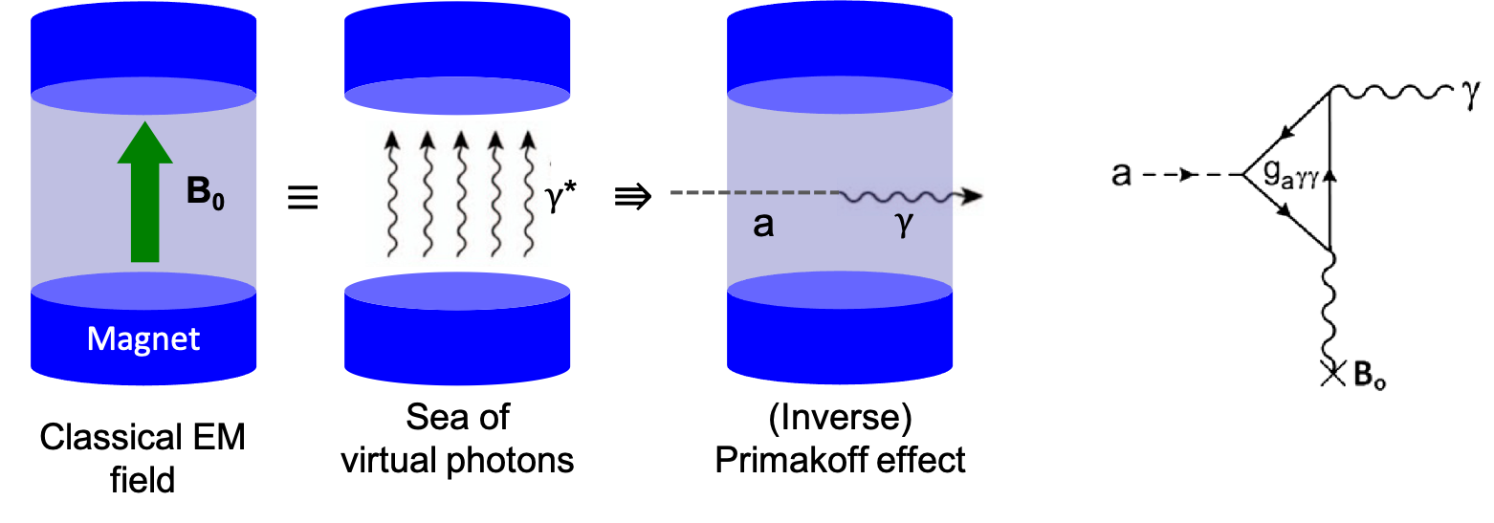

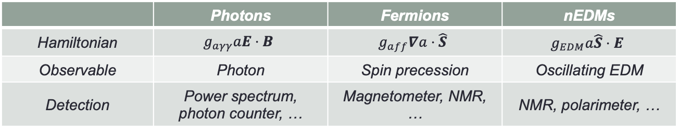
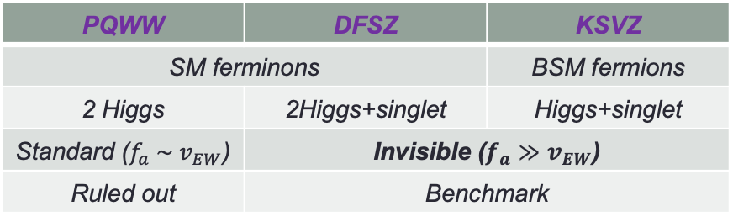

Axion models and detection
Axion coupling to SM
Axion models
Detection principle
  Sikivie effect (1983)
    Macroscopic Primakoff
 | Photons | Fermions | nEDMs
Hamiltonian | $$g_{aγγ}aE⋅B$$ | $$g_{aff}∇a⋅\hat{S}$$ | $$g_{EDM}a\hat{S}⋅E$$
Observable | Photon | Spin precession | Oscillating EDM
Detection | Power spectrum, photon counter, … | Magnetometer, NMR, … | NMR, polarimeter, …
PQWW | DFSZ | KSVZ
SM ferminons |  | BSM fermions
2 Higgs | 2Higgs+singlet | Higgs+singlet
Standard ($f_{a} \sim v_{EW}$) | Invisible ($f_{a}≫v_{EW}$)
Ruled out | Benchmark
SM fermions
BSM fermions
PQWW
(2Higgs)
DFSZ
(2Higgs+singlet)
KSVZ
(Higgs+singlet)
Standard ($f_{a} \sim v_{EW}$)
Invisible ($f_{a}≫v_{EW}$)

Slide 5
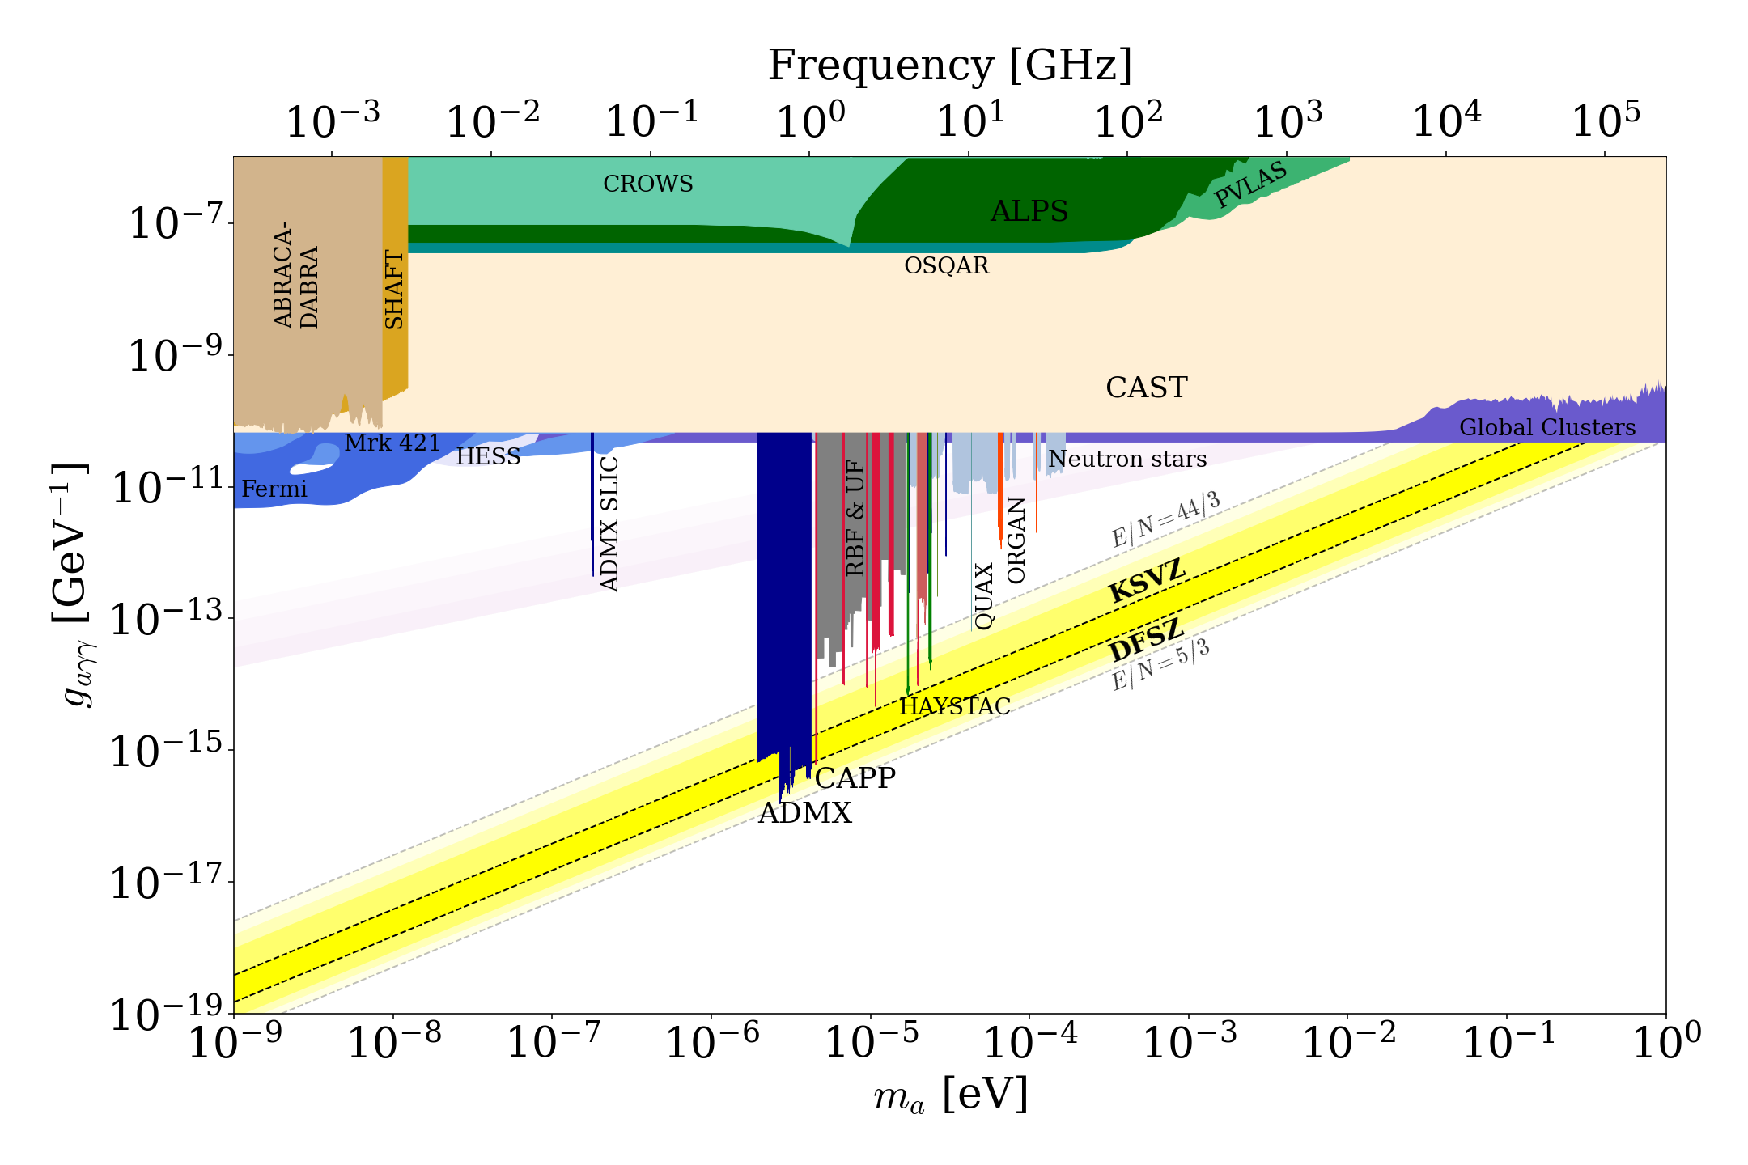
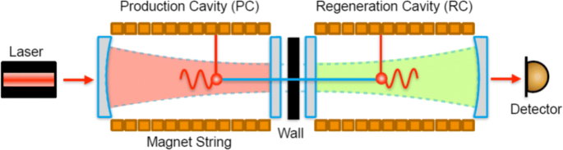
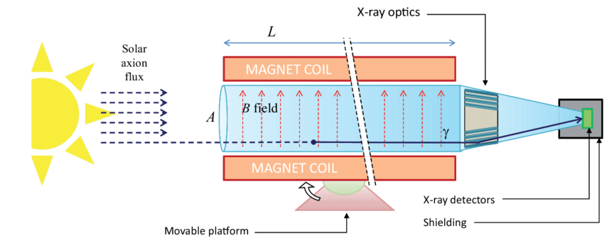
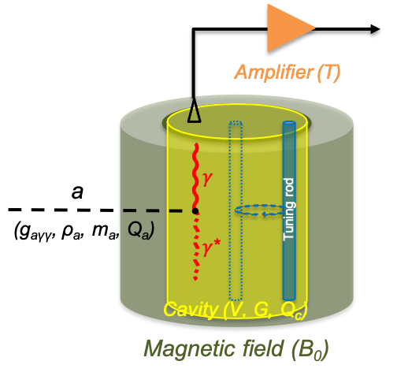
Axion searches
1 GHz = 4.2 ueV
Helioscope (solar axion)
LSW (axion at lab)
Haloscope (DM axion)

Slide 6
Haloscope Searches

Slide 7
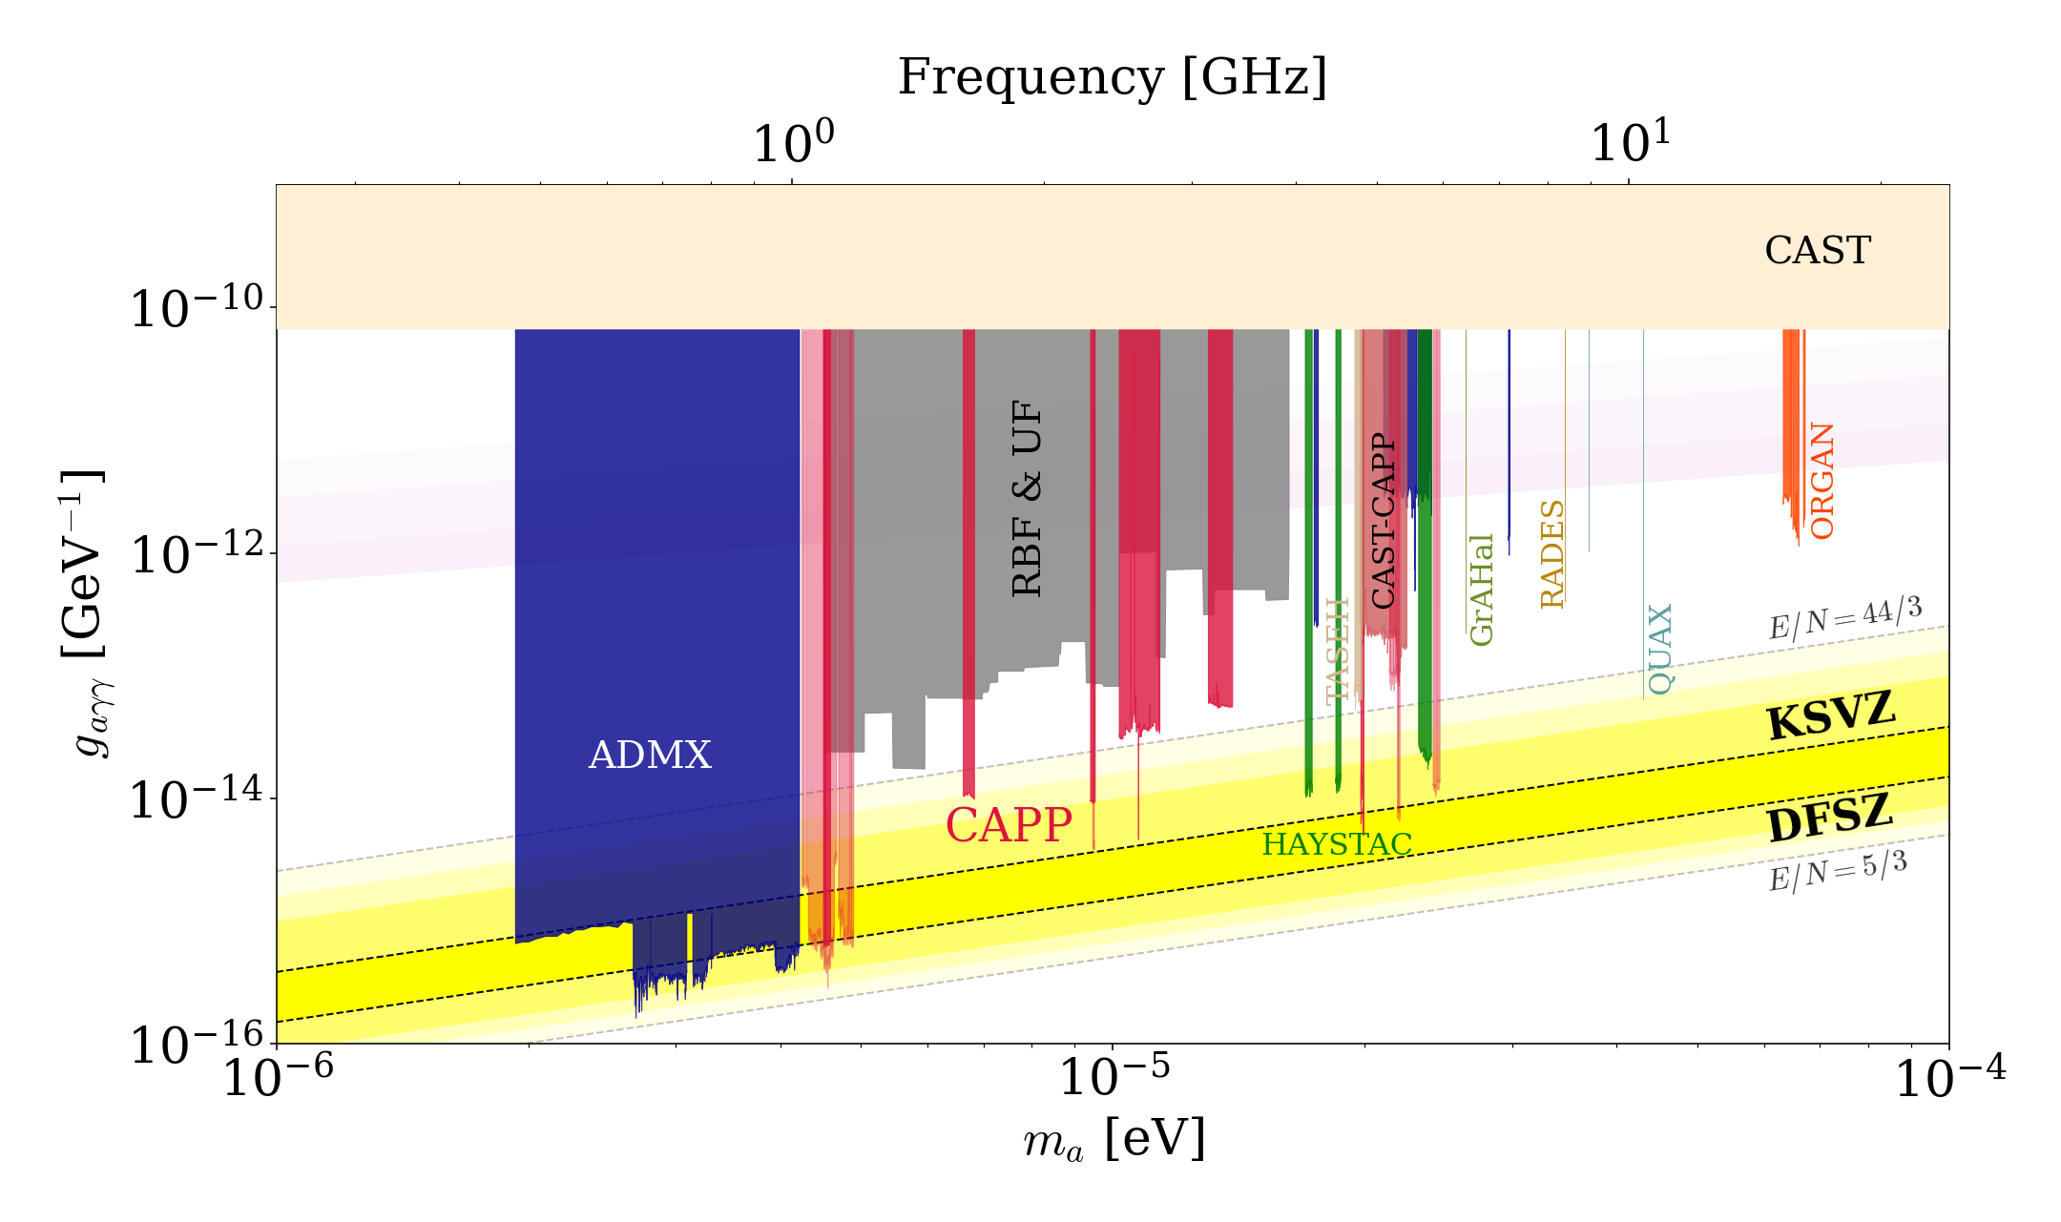
Haloscope searches

Slide 8
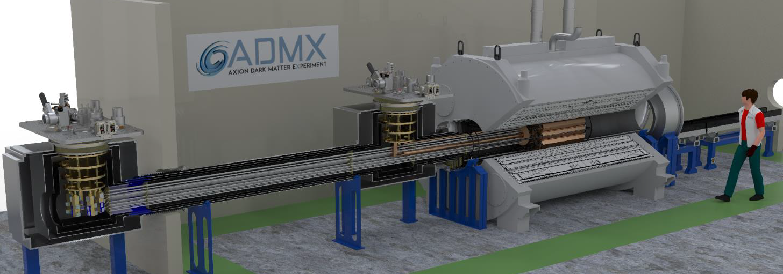
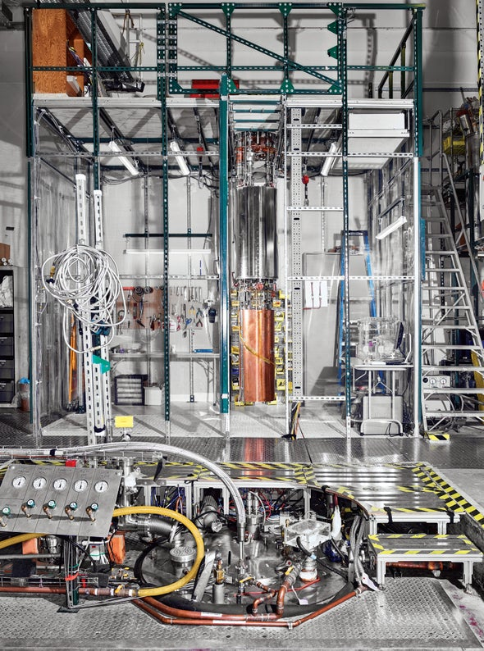
Search highlight – ADMX
ADMX
EFR: 2027 ~
MRI (9.8T, 80cm)
ADMX
(9T/600mm)
First DFSZ searches
PRL 127 261803 (2021)
Resumed search in 2024
Extended search in 2027
(MRI magnet)

Slide 9
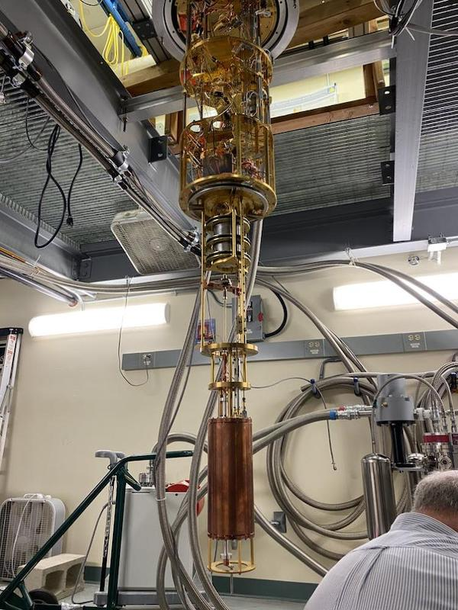
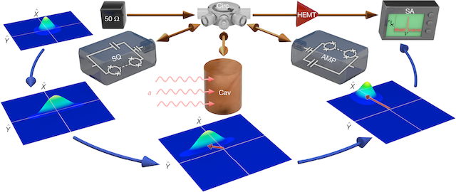
Search highlight – HAYSTAC
HAYSTAC
HAYSTAC
(9T/125mm)
Quantum squeezing
PRD 107 072007 (2023)

Slide 10
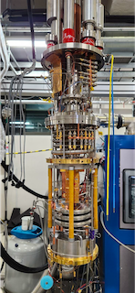

Search highlight – CAPP
CAPP-12TB
(12T/320mm)
T_{sys} < 250 mK
df/dt~1.5 MHz/day @ DFSZ
Extended scan ($∆f$~120 MHz)
To be submitted to PRX
Ready for up to 1.5 GHz

Slide 11
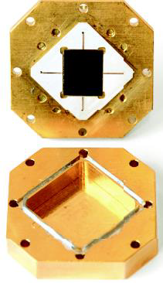
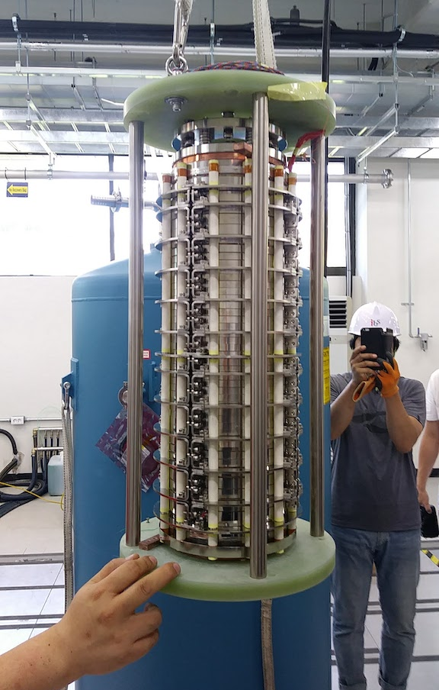
Search highlight – CAPP
CAPP-18T
(18T/70mm)
HTS SC magnet
JPC (T_{sys} ~ 600 mK)
KSVZ sensitivity
PRL 131 081001 (2023)

Slide 12
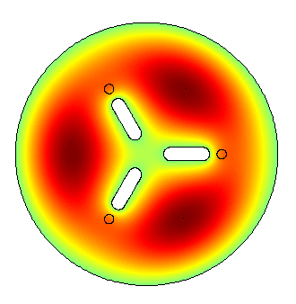
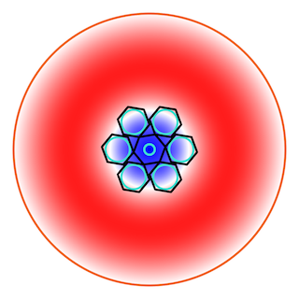
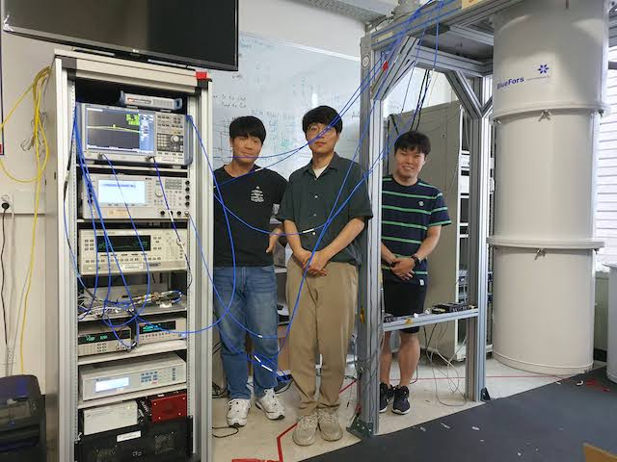
Search highlight – CAPP
CAPP-12T
(12T/96m)
3-cell pizza cavity + JPA
KSVZ sensitivity
arXiv:2312.11003
CAPP-9T
(9T/127mm)
TM₀₂₀ mode
Physics run just decommitioned
Paper under preparation

Slide 13
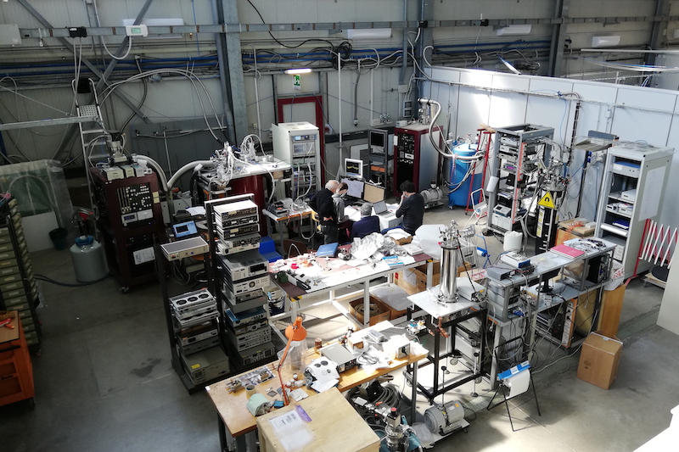
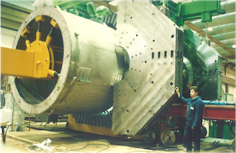
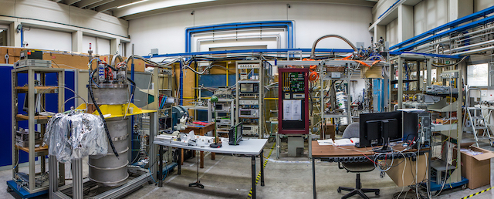
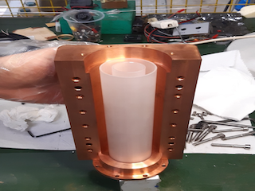
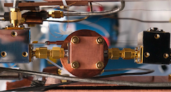
Search highlight – QUAX
QUAX (LNF)
FINUDA magnet
(1.1 T, 1.4 m)
QUAX
(8T/150m)
Dielectric cavity + TWPA
PRD 108 062005 (2023)
Commissiong Flash experiiment
QUAX(LNL)

Slide 14
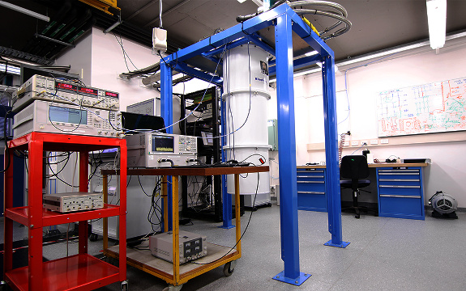
Search highlight – ORGAN
ORGAN
ORGAN
(14T/65mm)
ALP Cogensis + SMASH
PRL 132 031601 (2024)

Slide 15
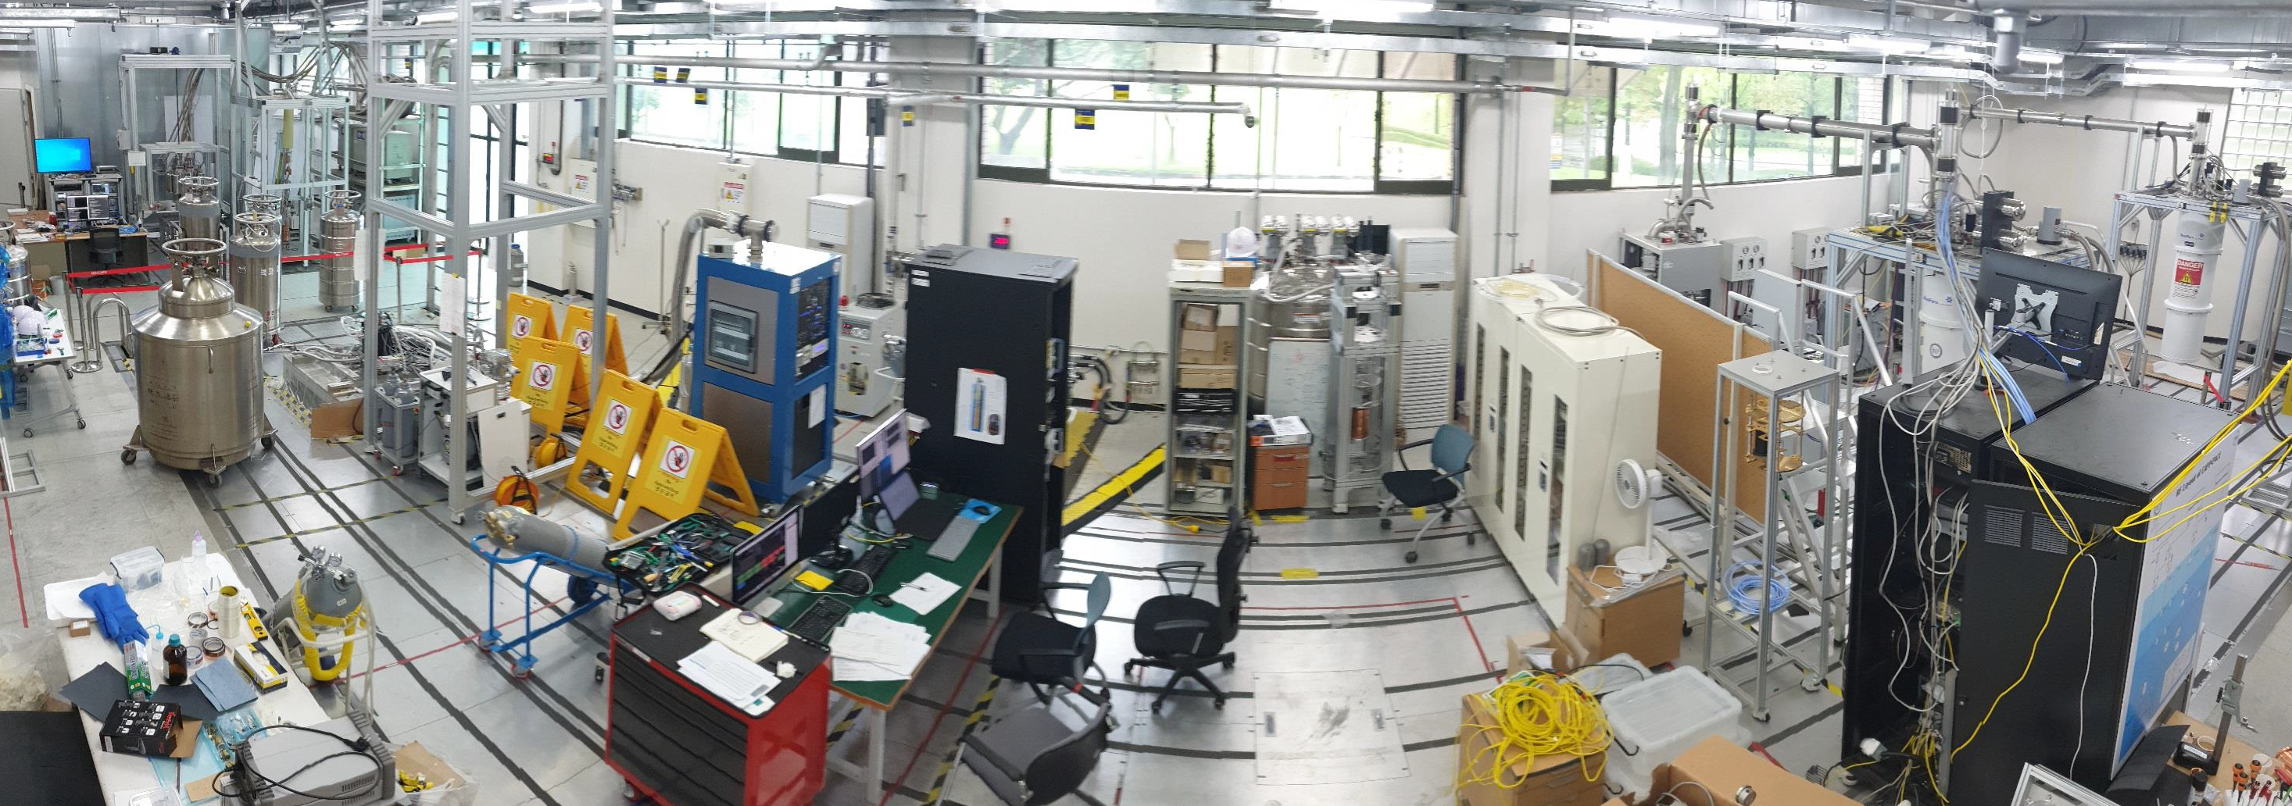

Cavity haloscopes
ADMX
HAYSTAC
QUAX
ORGAN
CAPP
${1≲f}_{a}≲10 GHz$

Slide 16
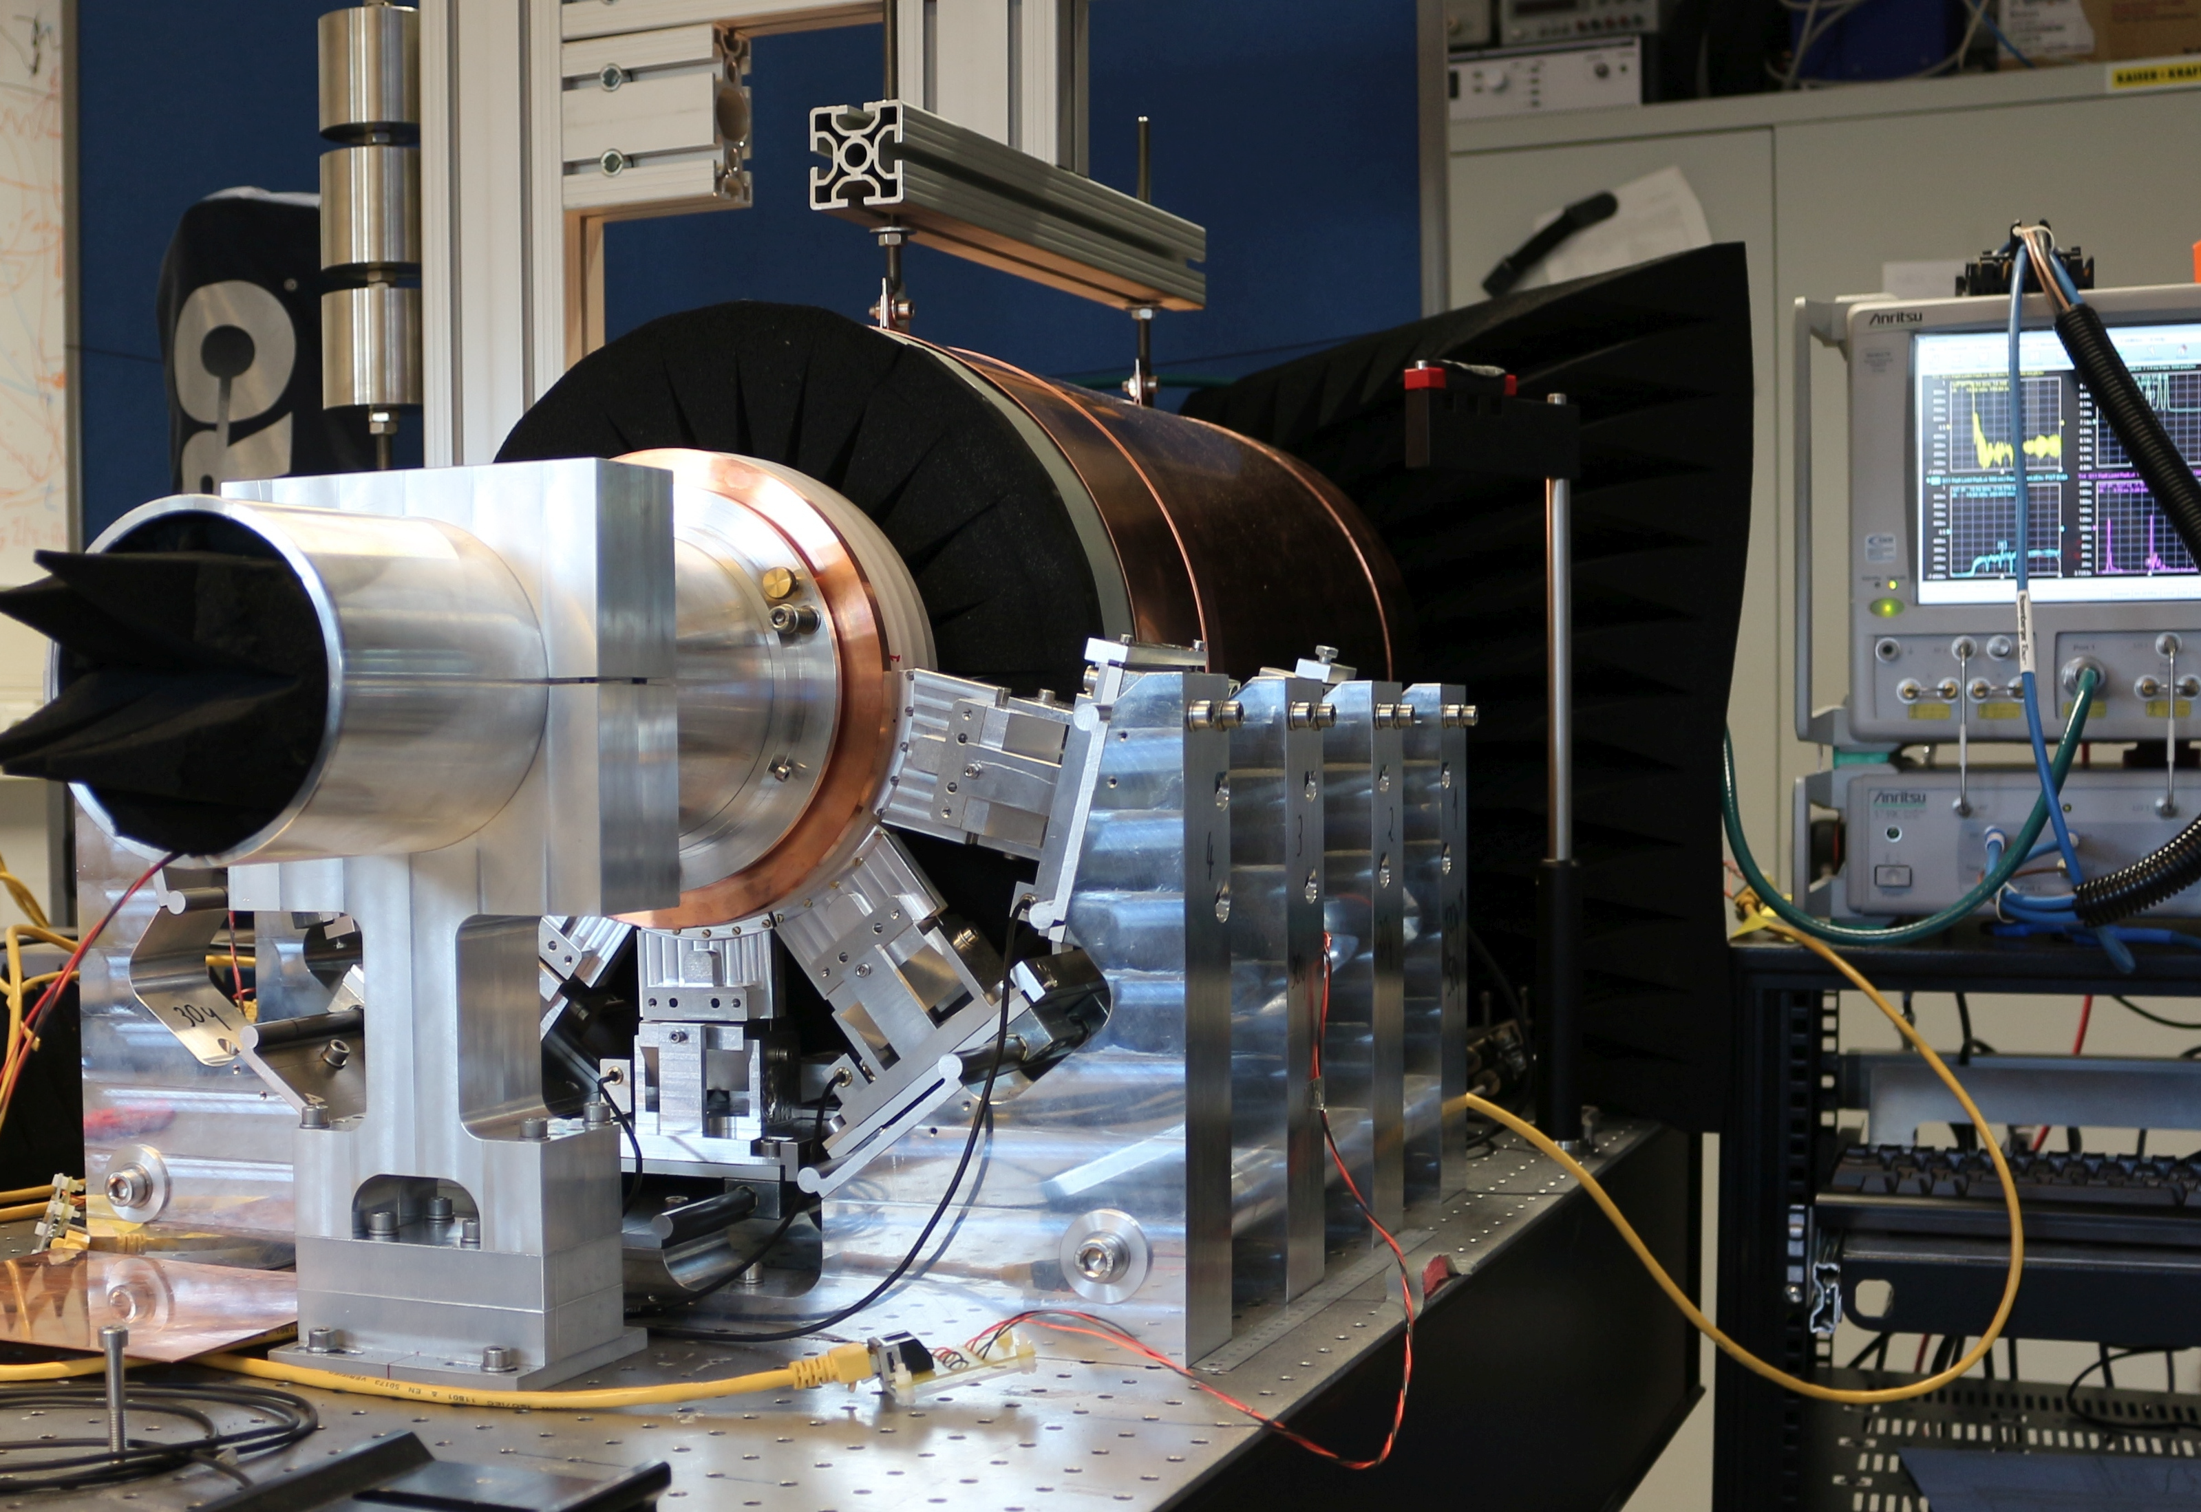
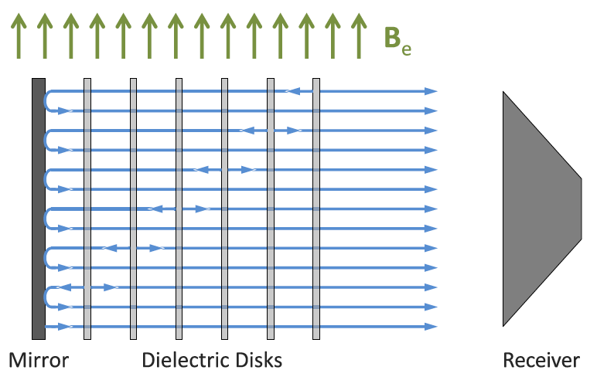
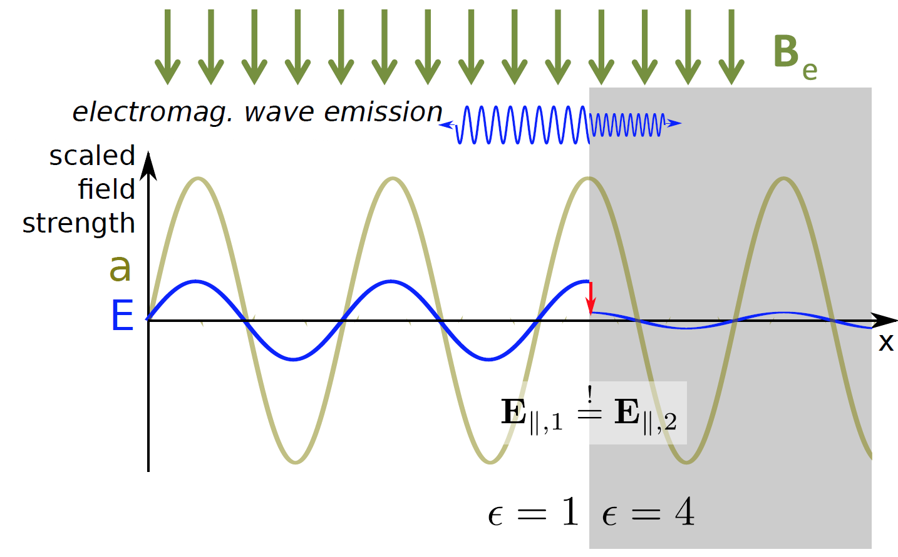
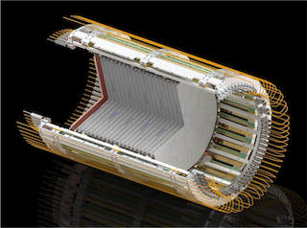
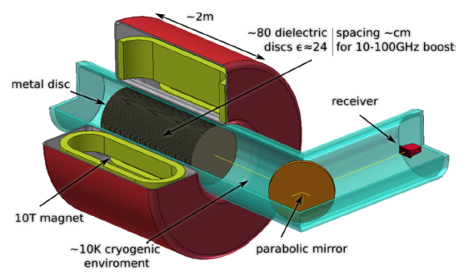
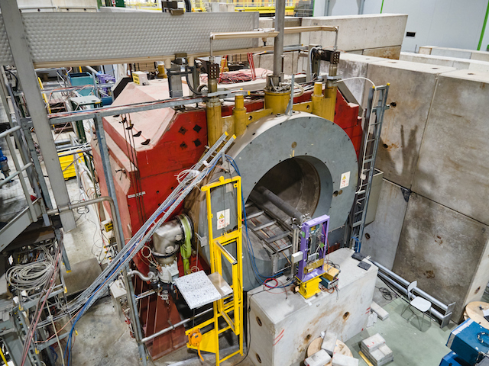
MADMAX
Dielectric power booster
Proof-of-concept
5 disks
Suitable for high-freq. search
Full scale experiment
20 disks
30cm diameter
Prototype (2024)
Morpurgo (1.6T)

Slide 17
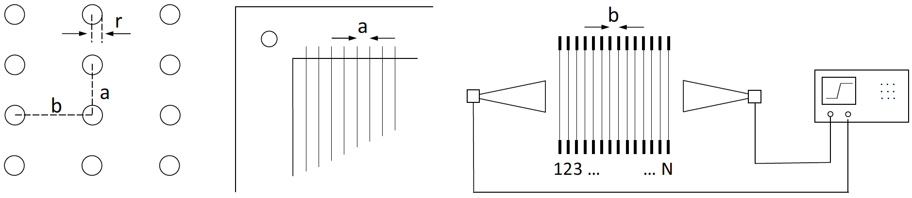
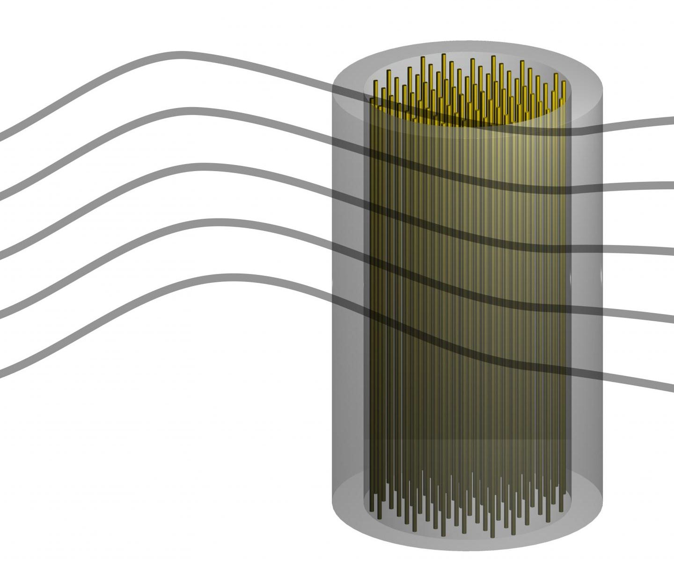
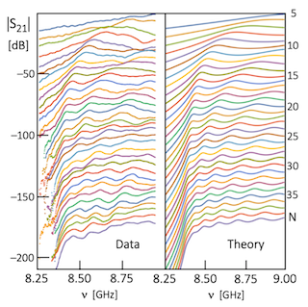
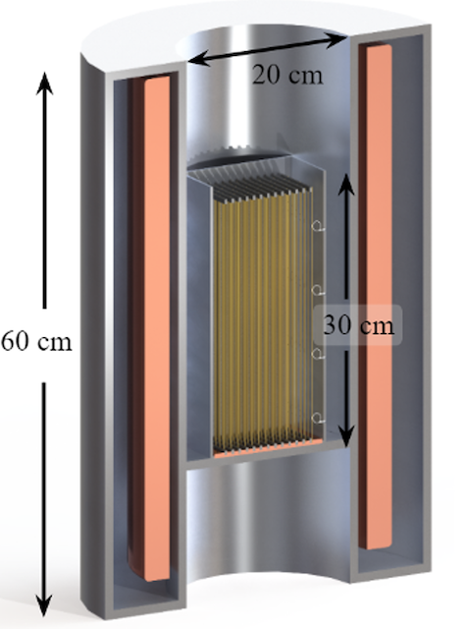
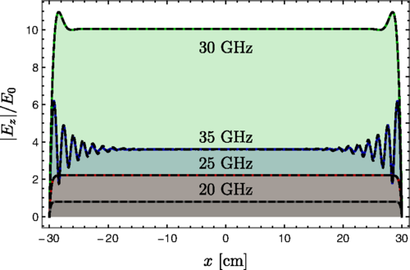
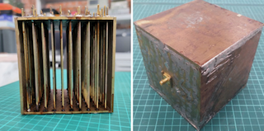


ALPHA
$ω_{p}^{2}=\frac{n_{e}e^{2}}{m_{e}}=\frac{2π}{b^{2}log⁡(\frac{b}{r})}$ => high-frequency search
Plasma haloscope
PRD 107 055013 (2023)
Axion-plasmon interaction
Periodic structure $⟹$ Meta-material
Wire array $⟹$ bulk plasmon
Physics data in 2026

Slide 18
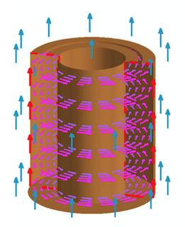



DM Radio
Lumped element haloscope
  Broadband low mass (<1 ueV) search
  Sensitive to pre-inflationary scenario
DM Radio-m³
Solenoidal goemetry
PRD 106 103008 (2022)
ABRACADABRA-10cm
PRL 127 081801 (2021)
DM Radio-50L
Toroidal goemetry
(under construction)

Slide 19
Other haloscopes
Recent
  CAST-CAPP: phase-matched cavities, ~20 ueV
  RADES: microwave fiber, ~34 ueV
  Grenoble Axion Haloscope
    14T/52mm magnet, ~26 ueV
  Taiwan Axion Search Experiment with Haloscope
    4.7 GHz, 11 x g_{arr}^{KSVZ}
  Superconducting axion search
    SC cavity, 14T, 8.4 GHz (under construction)
Proposed
  Broadband Reflector Experiment for Axion Detection
    Parabolic reflector, THz region
  Canfranc Axion Detection Experiment
    90 GHz (W-band), Kinetic Induction Detectors
Nat. Comm. 13, 6180 (2022)
JHEP 2021 75 (2021)
arXiv:2110.14406
PRL 129 111802 (2022)
PRL 128 131801 (2022)
JCAP 11 044 (2022)

Slide 20
Helioscope Searches

Slide 21



Helioscope
Solar axion telescope
History
  BNL, JAPAN
  CAST decommissioned in 2015
  IAXO in plan
Black-body photons (keV) to axions
In dense stellar plasma
Reconversion into photons (X-ray)
in laboratory magnetic fields
Nature Phys. 13 584 (2017)
$$𝒫_{a→γ}\sim \left(\frac{g_{aγγ}B_{0}}{q}\right)\sin\left(\frac{qL}{2}\right), q≡ \frac{m_{a}^{2}}{2E_{a}}$$

Slide 22




IAXO
Full IAXO
International AXion Observatory
  Large toroidal helioscope
    8 dipoles (5.4 T, 20 m, 600 mm)
  Diverse physics over wide range
    QCD axions / ALP miracle / Astrophysical hints
  Goal : $g_{aγ} \sim {10}^{−12} GeV^{−1}$
Baby-IAXO
  Approved in 2020 (DESY)
  First step towards full IAXO
    4 T / 10 m long => 10 x CAST
Baby-IAXO

Slide 23
Laboratory Searches

Slide 24



Light shining through a wall
Axion production at laboratory
  Model independent search
    No need of cosmo./astrophys. source => pure axion-photon coupling
History
  BFRT (Brookhaven-Fermilab-Rochester-Trieste)
  OSQAR (LHC dipole at CERN) – most stringent limit
  ALPS (HERA dipole at DESY)
Two vertices => fourth power of coupling

Slide 25



ALPS II
Any Light Particle Search II
150 kW
~ 1 photon/day
(g_{arr} = 2x10⁻¹¹ GeV⁻¹)
HET/TES
Early science run (30 x ALPS)
3 orders of magnitude w/ PC

Slide 26
Summary
Axions address two fundamental questions
  Strong CP problem & dark matter mystery
Theoretically well motivated but experimentally challenging
  Weak coupling and unknown mass
Tremendous search efforts
  Different technologies targeting at different mass ranges
Axion community is getting larger
  New results, new groups and new ideas
Next few decades must be critical/exciting
  Covering a substantial portion of the parameter space
  Uncovering the nature of dark matter

Slide 28


Weakly Interacting Slim Particles
WISP zoo
Pseudo-scalar
Axion
  PQ solution to strong CP problem (1977)
  $$m_{a}f_{a}\sim Λ_{QCD}$$
  Invisible axion (1979)
  Dark matter candidate (1983)
Mili-chaged particle
.
.
.
J^{p} = 0–
J^{p} = 0⁺
Axion-Like Particle (ALP)
  Generic axion w/o solving the strong CP problem
  $$m_{a}f_{a}≁Λ_{QCD}$$
ALP
Chameleon
Axion
J = 1
Scalar
  Chameleon (2003)
  Dark energy candidate
Hidden photon
Vector
  Hidden photon
  Gauge field in hidden sector
Others
  Mili-charged particle, …

Slide 29





Where are dark matter axions?
Different PQ breaking scenarios
=> Different mass ranges
=> Different search strategies
(Depending on $λComp$ w.r.t. D_{exp})
Theoretical scenarios
Photon coupling
Fermion/gluon coupling
Quasistatic regime
$$λComp≫Dexp$$
Cavity regime
$$λComp \sim Dexp$$
Radiation regime
$$λComp≪Dexp$$

Slide 30

Detector of halo axions
Most sensitive approach in $μ$eV regime
  Resonant enhancement of axion-induced photons
Conversion signal power (a→γγ)
Signal-to-noise ratio (SNR)
Scanning rate (F.O.M.):
- theoretical parameters
- experimental parameters
Cavity Q factor
Axion Q factor
Coupling constant
Effective volume
Axion number density
Magnetic field
Integration time
Axion bandwidth (~10⁻⁶ f)
System noise temperature

Slide 31







Cavity haloscope – in a nutshell
Enhancing the experimental performance
Quantum noise limited amplifier T
Cryogenics T
Signal amplification w/ minimal noise added
Lowering thermal noise
$$a$$
$$γ$$
Tunable High-Q resonator
V, Q, C, Δf
High field Magnet B
$γ$*
Small-scale experiments!
Boosting a→γγ conversion rate
Resonant frequency tuning

Slide 32

Haloscope searches

Slide 33



High frequency searches
Periodic array of dielectric or metal
  Search frequency
    Depending on interspace
    Independent of detector size
  Large conversion volume
ORPHEUS PRD 91 011701 (2015)
MADMAX
JCAP 04 016 (2013)
ALPHA
PRL 123 141802 (2019)
Metal Wires
  Suitable for post-inflation scenario (10–100 GHz)

Slide 34






Magnet
CAPP (12T/320mm)
CAPP (18T/70mm)
Grenoble (43T/34mm)
ADMX (8T/600mm)
YBCO pancakes
CERN (1.6T)
UIC (9.4T/800mm)
DESY (10T, dipole)

Slide 35








Cavity
arXiv: 2203.14923
PRD 99 101101 (2019)
9 GHz
PRL 125 221302 (2020)
D. Ahn (Tue)
arXiv: 2205.08885
NIM 985 164641 (2021)
10.9 GHz
5.4 GHz
Q₀ > 10⁷

Slide 36





Microwave photon detector
Power detection
(w/ amplifiers)
vs. photon counting
(w/ single photon detector)
HEMT
Transistor-based
(T_{N} ~ K)
f = 10 GHz
JPA
Quantum limited
(T_{SQL} ~ 50 mK x f [GHz])
Game changer
at high freq. and low temp.
Nature 590 238 (2021)
IEEE TASC 2850019 (2018)
PRL 126 141302 (2021)
Quantum squeezing (T_{N} < T_{SQL} )
Single photon counting (T_{N} << T_{SQL})

Slide 37



Fermion coupling
QUAX-ae
  Ferromagnetic haloscope
    Axion-electron spin
  Photon-magnon system
    Series of YIG spheres
    TM₁₁₀ of a cylindrical cavity
  Upgraded with JPA
  Best limit near m_{a} ~ 43 $μ$eV
LACME
  Low temperature Axion Chiral Magnetic Effect
    Axion-electron coupling, axion as chemical potential for electron
    Correlated signal
arXiv:2207.06884
Nature Phys. 17 1396 (2021)
PRL 124 171801 (2020)

Slide 38




Fermion/EDM coupling
Cosmic Axion Spin Precession Experiment
  CASPEr-wind(gradient)
    Axion-nuclear spin (axion wind)
  CASPEr-electric
    Axion-nEDM (electric field)
    Probe for $aG\tilde{G}$ (QCD axion?)
  Nuclear magnetic resonance
    $ω_{L}\left(∝B_{0}\right)=m_{a}$
    Highly sensitive to m_{a} < 10^{–8} eV
H. Bekker, Thu

Slide 39




CPV and EDM
CPV in QCD
  $θ_{eff}≡θ_{QCD}−\frac{a}{f_{a}}=0$
  QCD axion => EDM = 0
Storage ring proton beam
  Direct probe for pEDM
  Sensitivity improvement
    pEDM ~${10}^{−29} e⋅cm$
Additional CPV in nature
  $θ_{eff}≡θ_{QCD}−\frac{a}{f_{a}}+ …≠0$
  EDM $≠$ 0 => non-QCD axion field?
ARIADNE
  Nucleon-nucleon interactions
    5th force mediator
  No cosmological assumptions
Decisive exclusion
  Negative results from the two independent experiments
  0.1 meV < m_{a} < 10 meV
vs.
A. Geraci (Thu)

Slide 40



Hidden photon
Vector field
  Gauge boson in hidden sector + dark matter
  Kinetic mixing with SM gauge fields
LSW-type w/ no magnets PLB 659 509 (2008)
Cavity searches
  ADMX PRL 105 171801 (2010)
  UWA PRD 82 052003 (2010)
  CROW PRD 88 075014 (2013)
  SC cavities and …
  New ideas R. Cervantes, O. Tajima (Thu)
  PRD 103 055004 (2021)

Slide 41






Chameleon
Scalar field
  Dark energy candidate PRD 69 044026 (2004)
Effective potential dependent on ambient matter / EM field
  $$V_{eff}\left(φ,\vec{r}\right)=Λ^{4}e^{\frac{Λ^{n}}{φ^{n}}}+e^{\frac{β_{m}}{M_{Pl}}φ}ρ_{m}(\vec{r})+e^{\frac{β_{γ}}{M_{Pl}}φ}ρ_{γ}(\vec{r})$$
Searches
  Afterglow effect
    GammeV, CHASE, ADMX, …
  Solar chameleon
    Similar to solar axion search
    CAST ($φ−γ$) and KWISP ($φ−m$)
    $P_{φ→γ,m}∝β_{γ,m}^{2}B^{2}L^{2}$
Matter coupling
Photon coupling
Phys. Dark Univ. 26 100367 (2019)

Slide 42


Axion searches – present
Axion searches – future
Most parameter space will be explored within the next few decades!
Most parameter space is unexplored

Slide 43

Axion mas predictions

