Slide 1
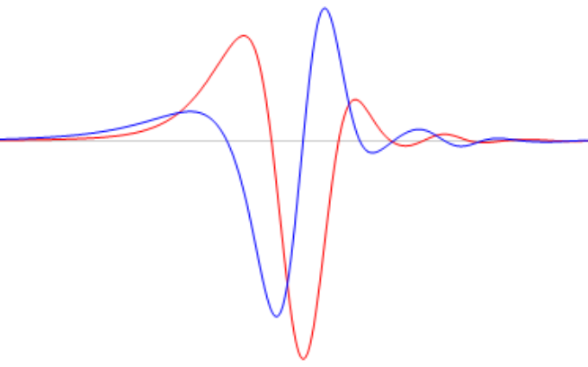
Ringdown Gravitational Waves from Close Scattering
of Two Black Holes
Young-Hwan Hyun (KASI)
Collaborated with
Yeong-Bok Bae, Gungwon Kang (CAU)
“2024 CAU-PNU Beyond the
Standard Model Workshop”
@Chung-Ang University (Seoul)
2024.02.20. Tuesday
arXiv: 2310.18686

Slide 2
GW Observation
Current Status:
  First Detection by LIGO in 2015
  Advanced Detectors: improvements in LIGO, Virgo, KAGRA
  Catalog of Events: growing catalog of GW events
  (BBH, BNS, BH-NS mergers)
Significance of GW Observations from BHs:
  Testing Relativity: Provide a testbed for Einstein's theory of GR
  Black Hole Properties (BH parameters, BH dynamics..)
  Astrophysical Processes (Binary evolution, stellar collapses..)
  Universe's History (BH formation, Cosmic expansion, Dark matter..)

Slide 3
GW Observation Enhancement
Enhanced Detection Capabilities:
  Increased Sensitivity: Enhanced sensitivity of LIGO and other detectors leading to more frequent detections.
  Collaborative Observations: Global network of GW observatories
Expanded Catalog of GW Events with Diverse Sources:
  Not only BBH but also BNS, .., Dynamical capture, hyperbolic encounters
Advancements in Multi-Messenger Astronomy:
  Electromagnetic Counterparts: Detecting electromagnetic signals alongside GWs (GW170817).
Next-Generation Detectors:
  LIGO-India, LISA, Einstein Telescope, Cosmic Explorer
  for observing GWs from a broader range of sources.

Slide 4
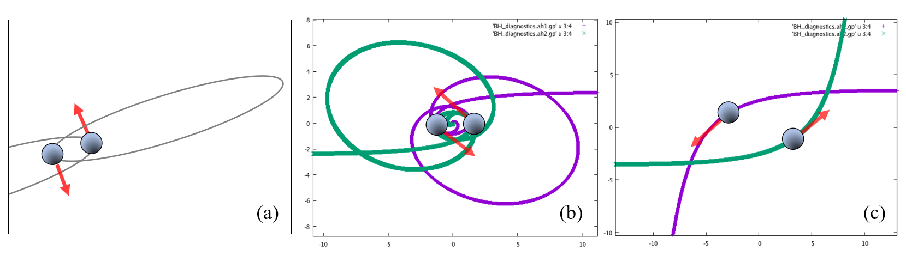
Extended GW Sources (Close Encounters)

Slide 5
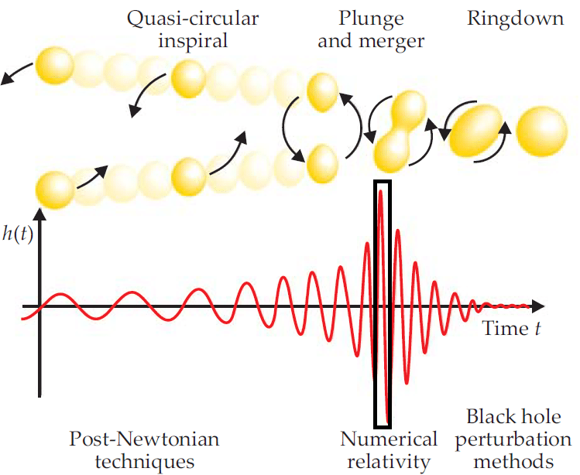
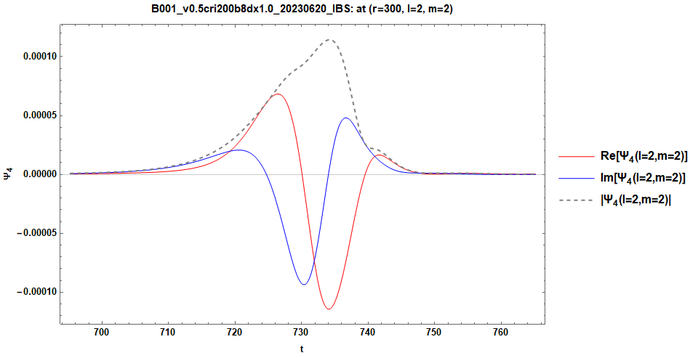





Study of waveforms for BBH
?
$$Ψ_{4,ingoing}$$
$$Ψ_{4,outgoing}$$
$$Ψ_{4,inspiral}$$
$$Ψ_{4,merging}$$
$$Ψ_{4,ringdown}$$

Slide 6
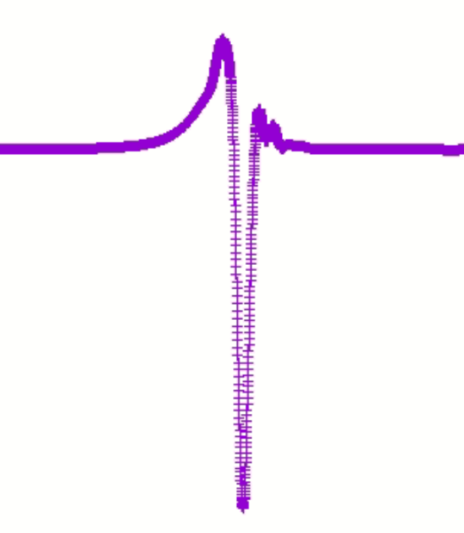
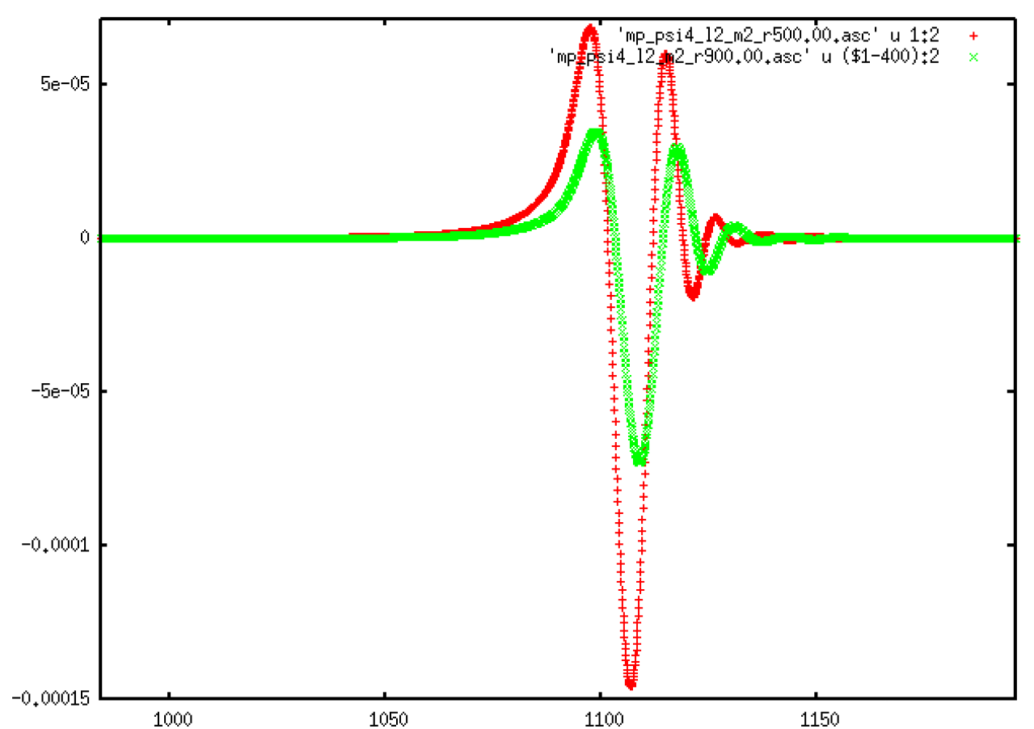
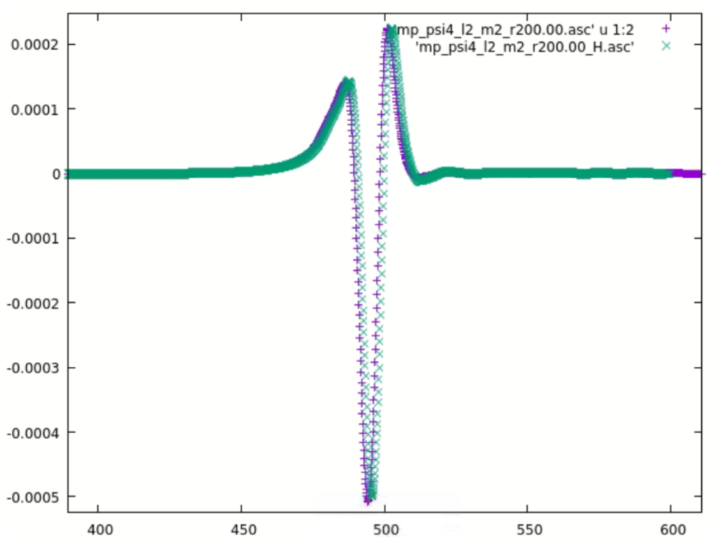
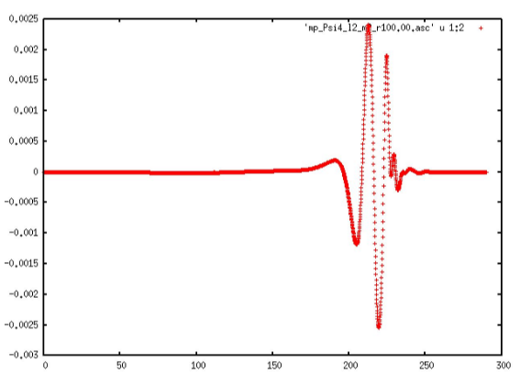
Unknown Signals (Numerical hints)

Slide 7
Analytic hints
BH-particle model:
  BH-partilcle model: K.-i. Oohara and T. Nakamura (1984), Y. Kojima and T. Nakamura (1984), J. Thornburg, B. Wardell, and M. van de Meent (2020), V. Cardoso, S. Hopper, C. F. B. Macedo, C. Palenzuela (2016)
BH-BH model: Tidal Deformation Studies,
  Non-vanishing Love number in BBH Coalescence [PRD105,044019(2022)]
  (Schwarzschild Black Holes: Tidal Love numbers vanish for Schwarzschild BHs in four dimensions [PRD80.084018,2009]
  Spinning (Kerr) Black Holes: Tidal Love numbers may not vanish for certain types of perturbations​​ [PRL.126,131102(2021)])

Slide 8
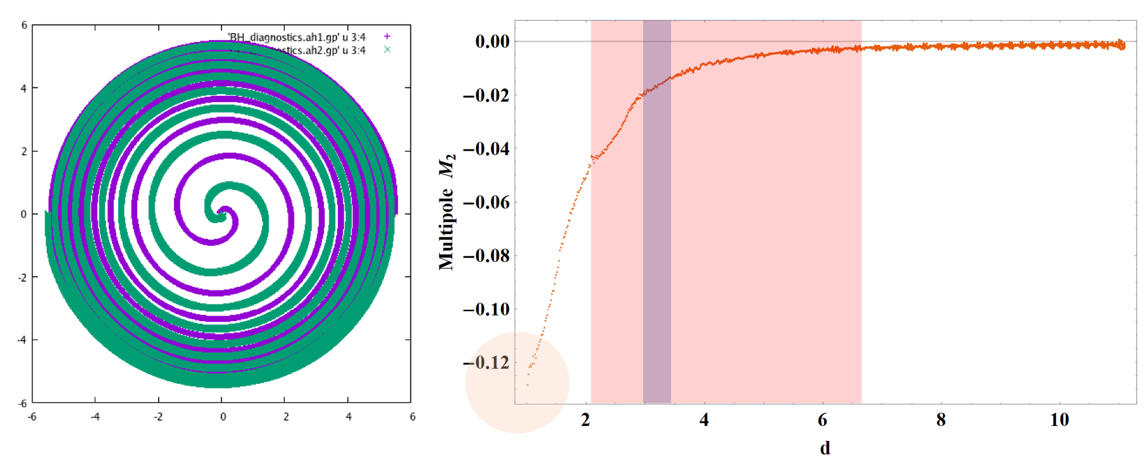
Numerical hints again
(Tidal Deformation is Generic Feature.)

Slide 9
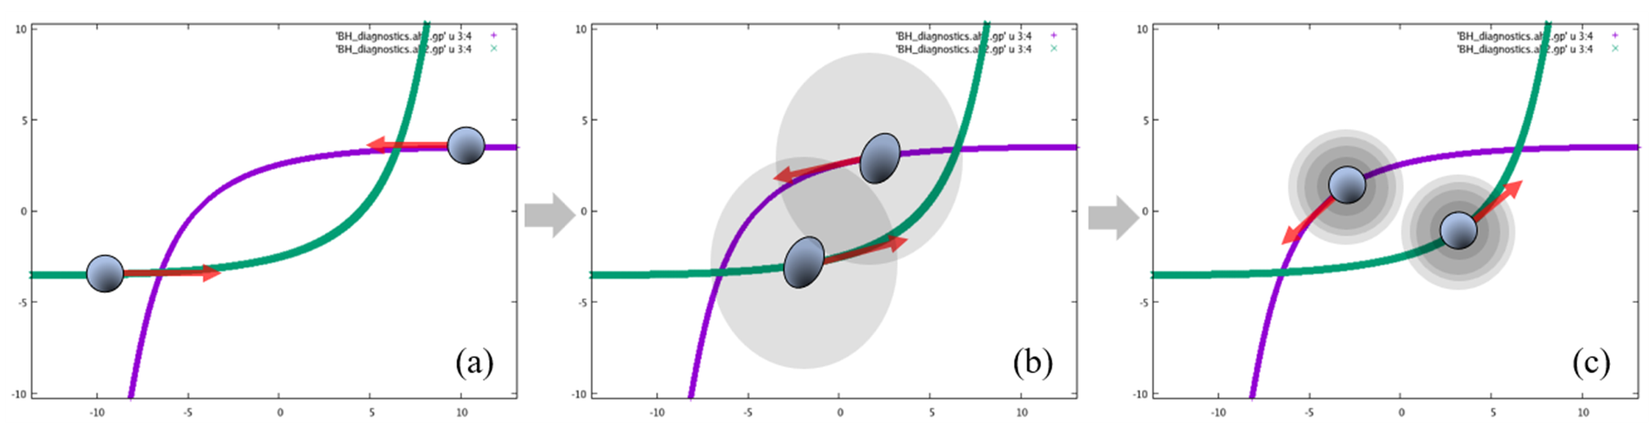
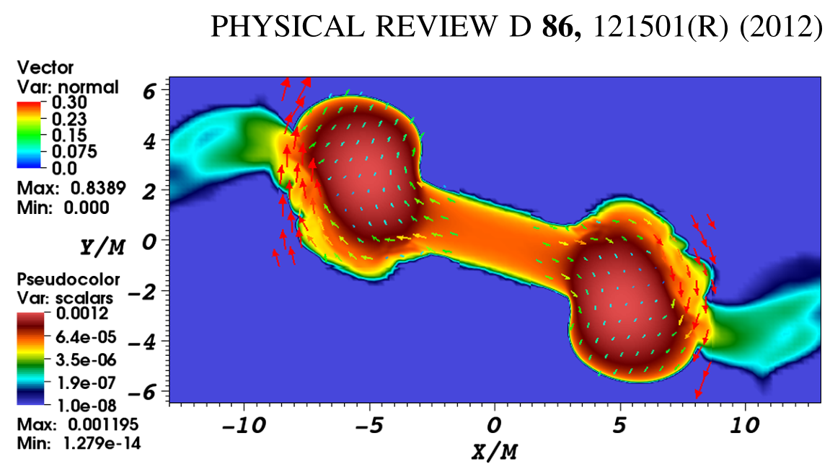
Q1. Ringdown from Close Encounters?
(ex)
Neutron star tidal deformation

Slide 10
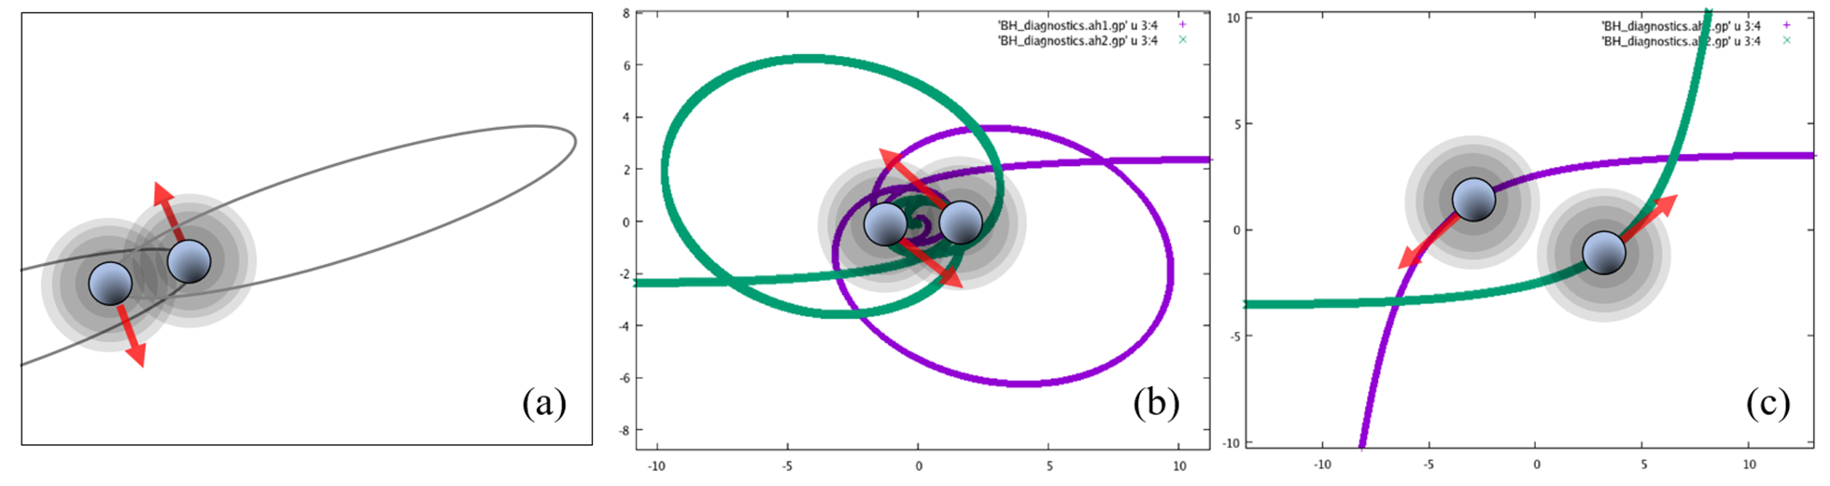
Sources with Non-merging Ringdown

Slide 11

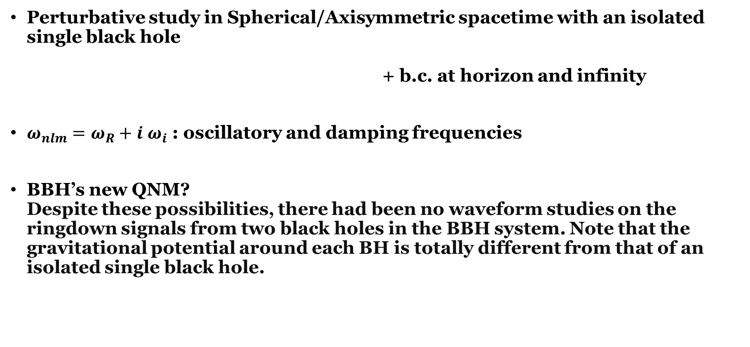
Q2. QNM of Non-merging Ringdown GW?
Perturbative study in Spherical/Axisymmetric spacetime with an isolated single black hole
+ b.c. at horizon and infinity
$ω_{nlm}=ω_{R}+i ω_{i}$ : oscillatory and damping frequencies
BBH’s new QNM?
Despite these possibilities, there had been no waveform studies on the ringdown signals from two black holes in the BBH system. Note that the gravitational potential around each BH is totally different from that of an isolated single black hole.

Slide 12
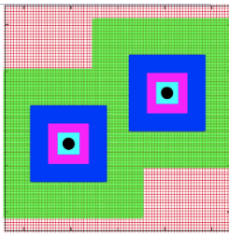

Numerical Study Setup
We used EinsteinToolkit code,
one of the most widely used
open-source codes
based on the Cactus framework
200 M (initial position)
770 M
(computational domain)
|p|= 0.2886751 M (~0.5c)
7th mesh refinement levels
dx=0.1M, 0.875M
(finest grid: dx=0.0137M, 0.0156M)
b
We considered
two different impact parameters
b=8, b=10.
Total ADM Energy ~ 1.1563547M
McLachlan is used for time evolution of the system
with 8th order spatial finite difference method,
and Carpet for the adaptive mesh refinement of the numerical grids

Slide 13



Numerical Resources
IBS Supercomputer
for fine resolution simulations
KISTI Nurion(Skylake) Supercomputer
for coarse resolution simulations
KASI Gmunu Supercomputer
for test simulations

Slide 14
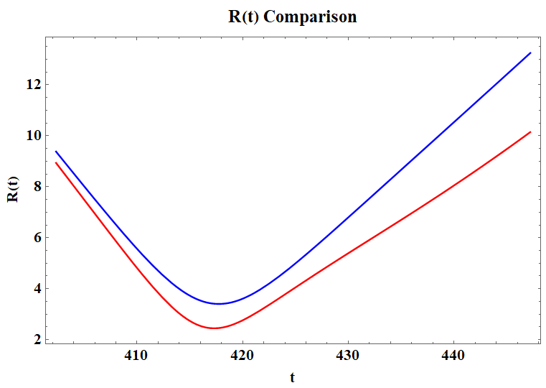
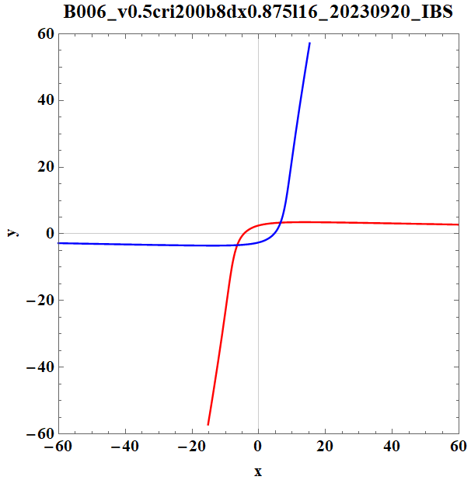
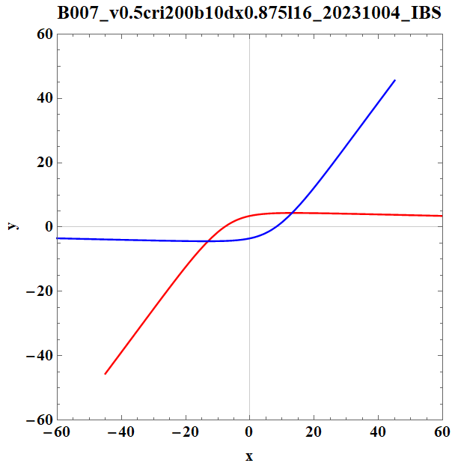
NR Result of Close Encounter:
Strong Gravity Regime
Minimum coordinate distance from origin:

Slide 15
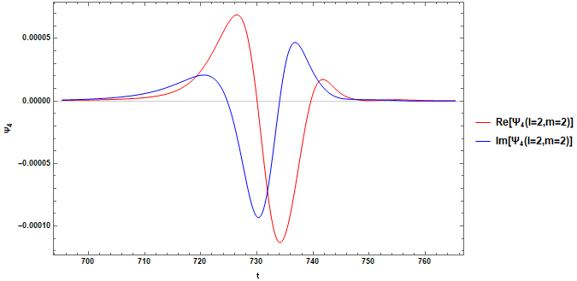
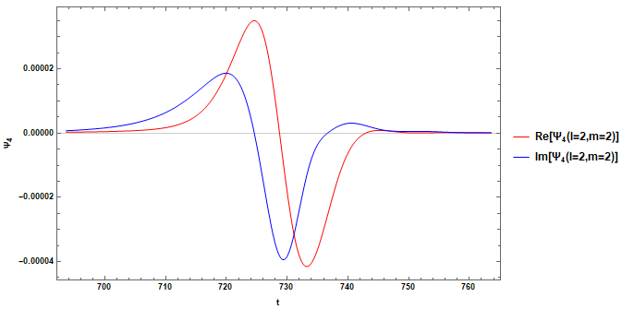
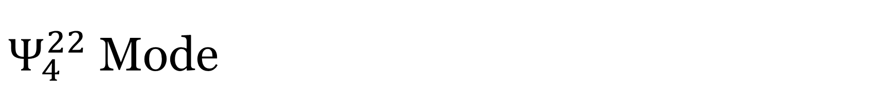

$Ψ_{4}^{22}$ Mode
Spin-weighted spherical
harmonics decomposition
The most dominant mode
At $r_{extraction}=300M$
Two polarizations
(red:+, blue:$×$)
Burst-like waveform
Ringdown?
b=8
b=10

Slide 16
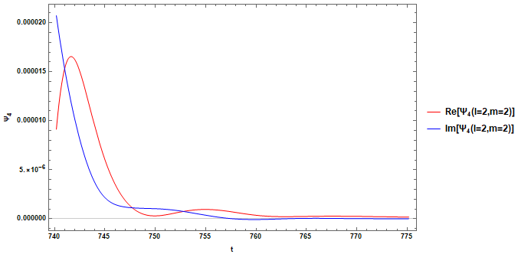
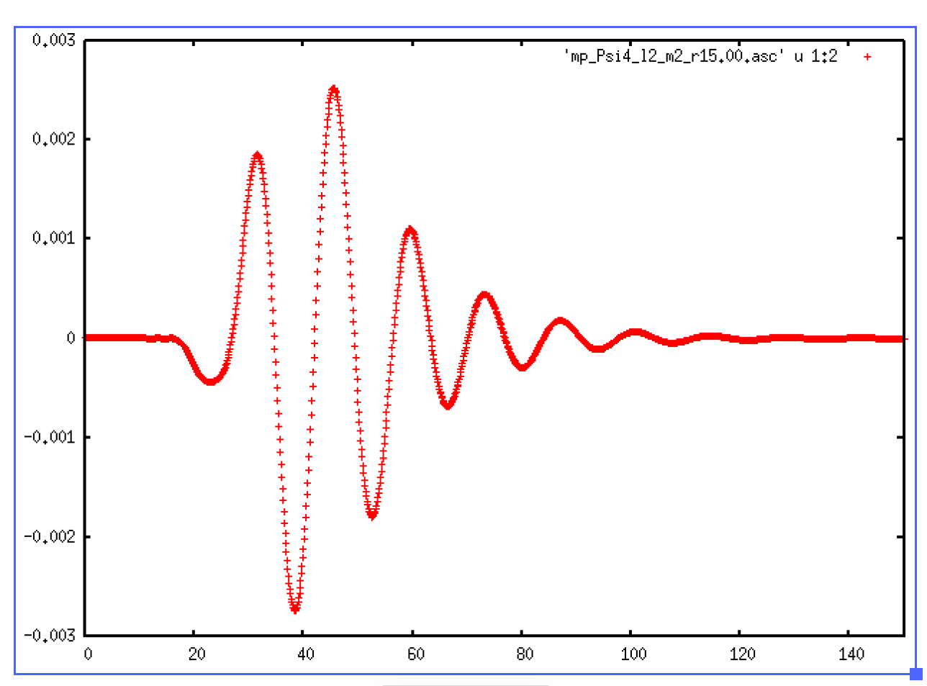
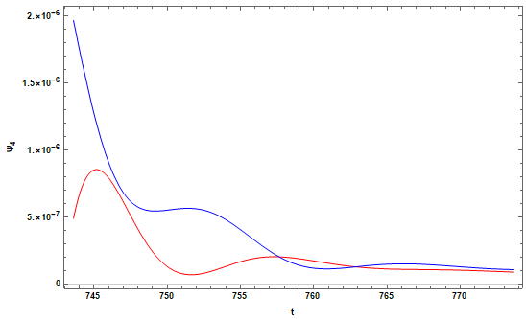
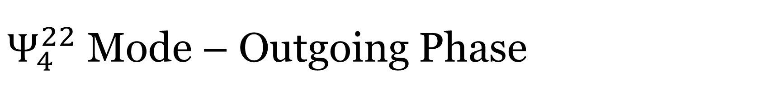
$Ψ_{4}^{22}$ Mode – Outgoing Phase
Looks weak, modulated
> ringdown?
b=8
b=10

Slide 17






Understanding BH Scattering System
When each BH is tidally deformed and stabilized, its GW radiation….
Possible modulation causes: When radiating ringdown,
  v: BH is moving: red/blue Doppler shift
  (One BH is red shifted,
  the other is blue shifted for any observer)
  (Relativistic Doppler shift including time dilation)
  v(t): BH speed is not constant.
  (Doppler shift is a time-varying effect.)
  (d1,d2): Different positions of two black hole
  (phase difference between two ringdown signals)
  V(r,θ,φ): Not spherical or axisymmetric background
  due to the other BH
  (gravitational lensing effect, absorption)
  x(t)$≠$0: BH’s ringdown signal comes NOT from the origin
  (mode mixing during wave extraction)
The above modulations appear differently depending on direction.
And multipole modes, which are obtained by integrating over whole direction,
show highly modulated ringdown signals.
$$z$$
Ψ4
$$v$$
$$y$$
$$v$$
$$x$$

Slide 18






Symmetrical Observer and its GW
Among possible observer direction,
the most symmetric location is north/south pole.
Possible modulation causes:
When radiating ringdown,
  v: BH is moving: red/blue Doppler shift
  (One BH is red shifted,
  the other is blue shifted for any observer)
  (Relativistic Doppler shift including time dilation)
  v(t): BH speed is not constant.
  (Doppler shift is a time-varying effect.)
  (d1,d2): Different positions of two black hole
  (phase difference between two ringdown signals)
  V(r,θ,φ): Not spherical or axisymmetric background
  due to the other BH
  (gravitational lensing effect, absorption)
  x(t)$≠$0: BH’s ringdown signal comes NOT from the origin
  (mode mixing during wave extraction)
$$z$$
$$v$$
$$y$$
$$v$$
$$x$$

Slide 19
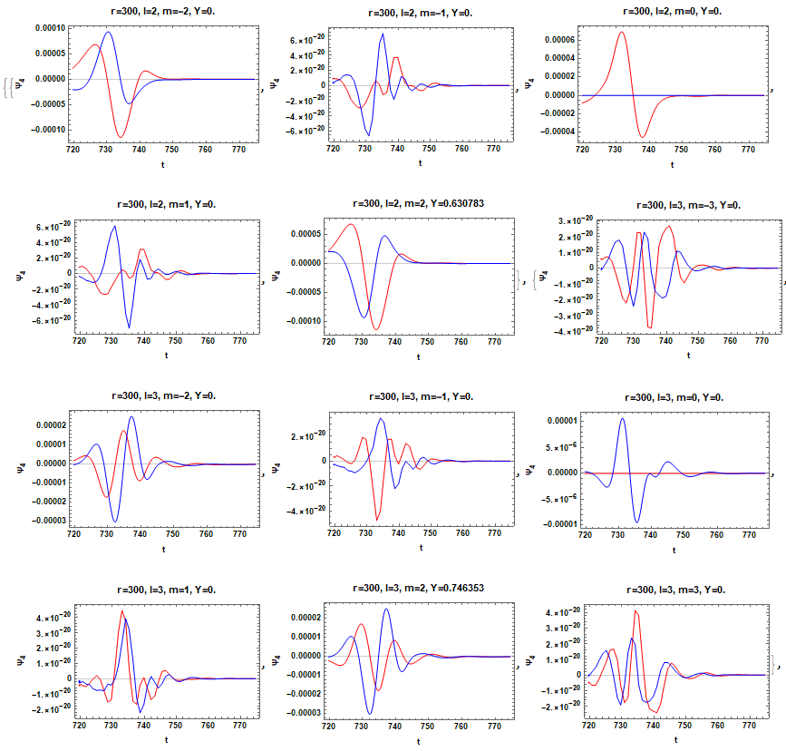


Modulations of the Ringdown-like Signal
In the multipole modes,
ringdown-like signal shows
highly modulated behaviors
as we discussed.
Therefore, to check the signal,
we consider a specific observer.
This can be done by just reading $Ψ_{4}$.
We used the multipole modes
up to l=16.

Slide 20
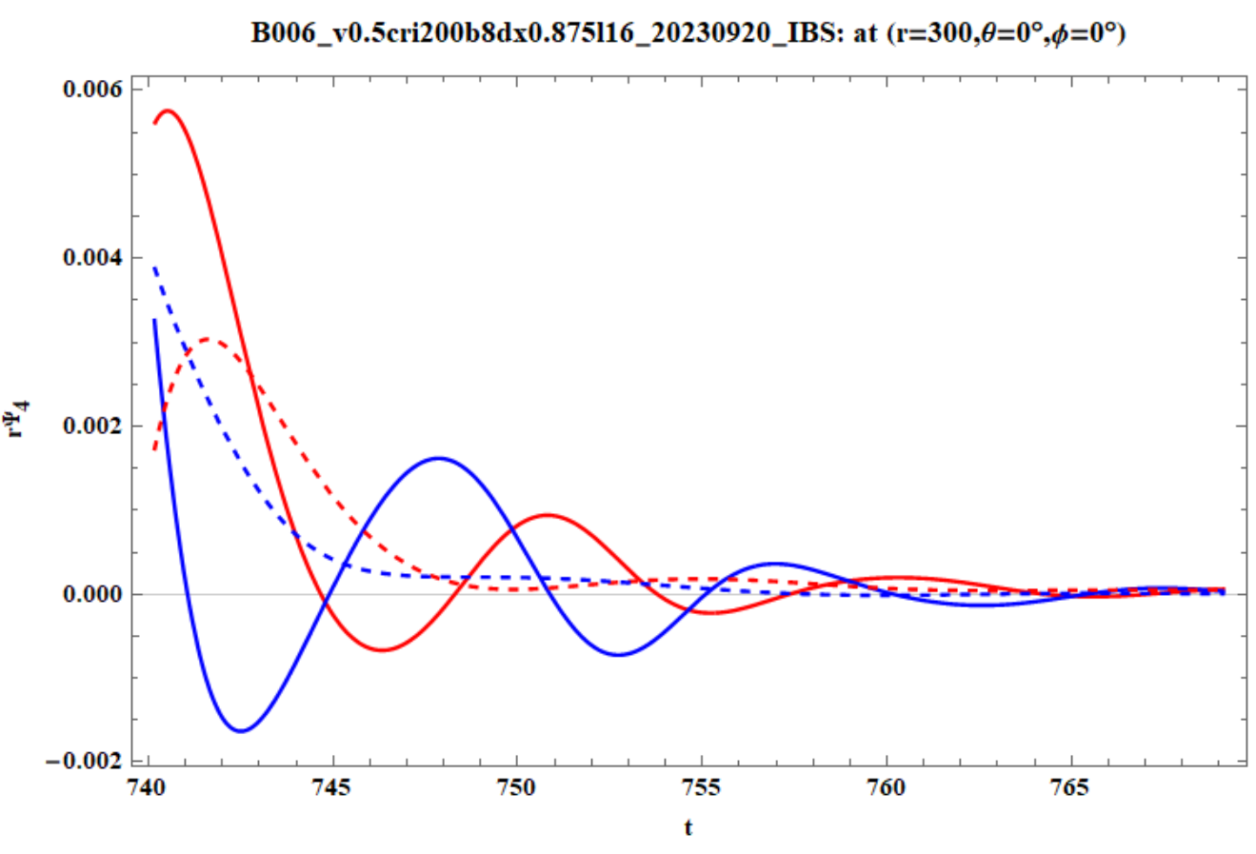
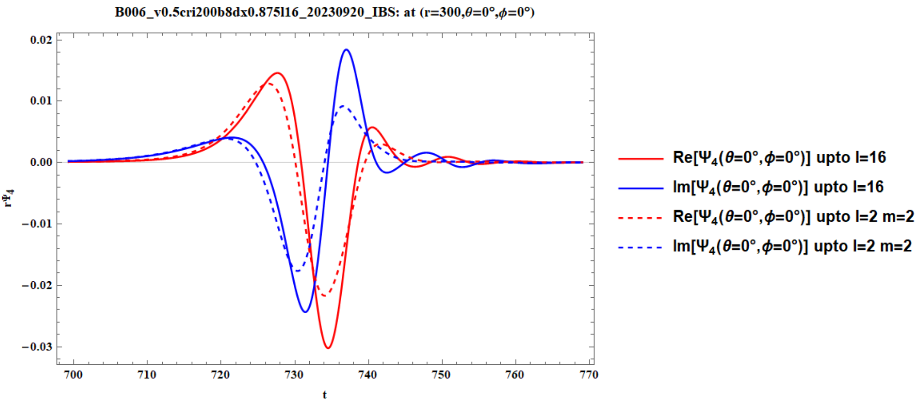
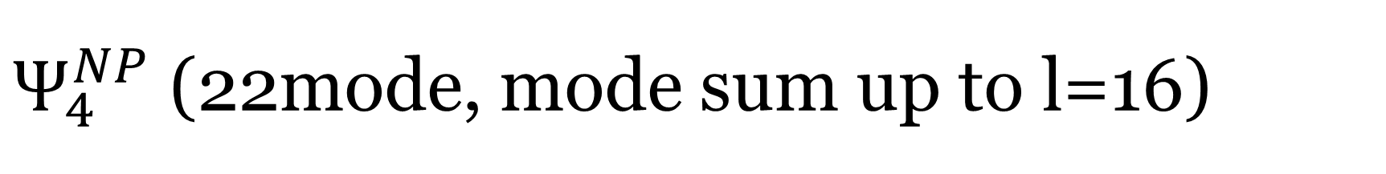
$Ψ_{4}^{NP}$ (22mode, mode sum up to l=16)

Slide 21
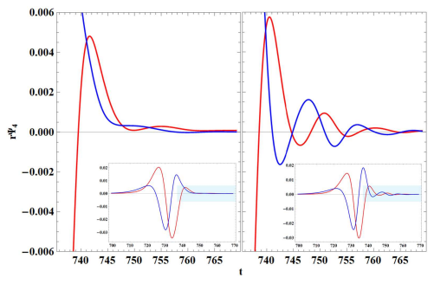

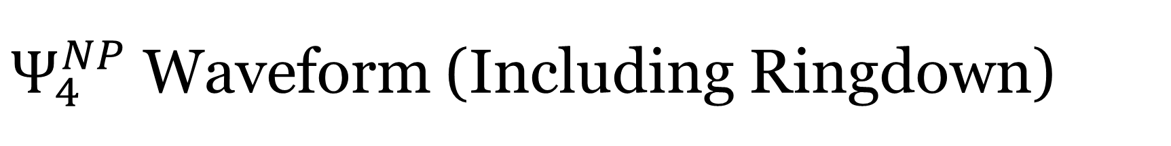


$Ψ_{4}^{NP}$ Waveform (Including Ringdown)
$$Ψ_{4}^{22} Ψ_{4}^{NP}$$
At $r_{extraction}$=300M
At northpole, we observe
a distinct ringdown signal.
Only 1% peak-to-peak amplitude in $Ψ_{4}^{22}$
But 8 times bigger amplitude in $Ψ_{4}^{NP}$.
The non-merging ringdown is hidden
in the multipole modes.
In $Ψ_{4}^{NP}$, we see ringdown has
QNM property (oscillating, damping),
and find its dominant mode.
We can see that the ringdown(RD) signals
from each BH is superposed with
trajectory-driven(TD) waveform,
which is studied in approximation methods.

Slide 22
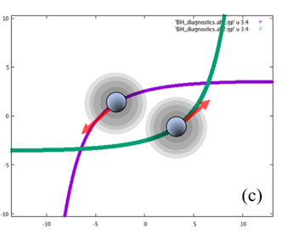
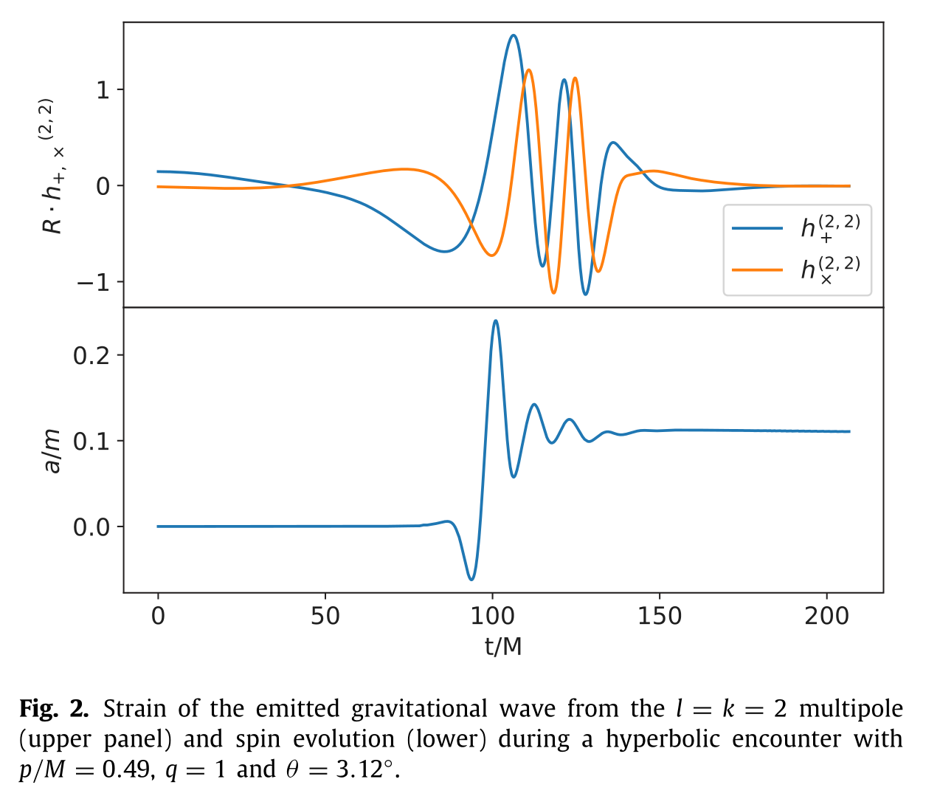
We need a new waveform study including non-merging RD GW

Slide 23
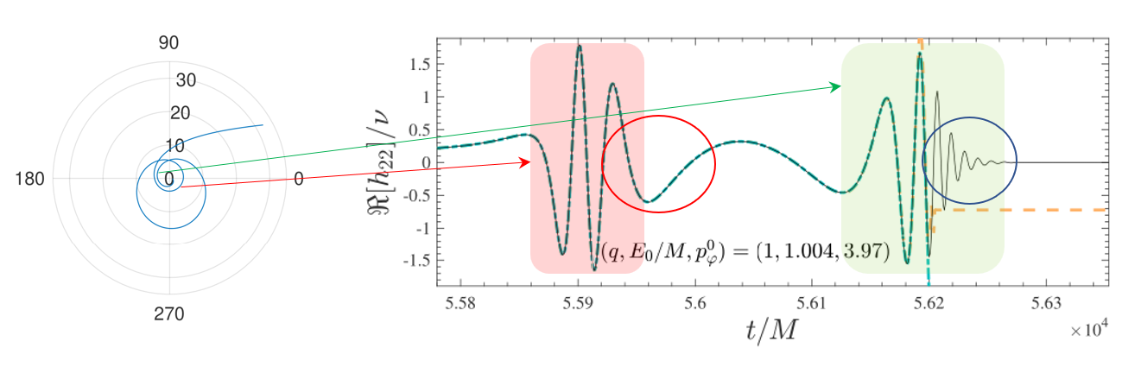
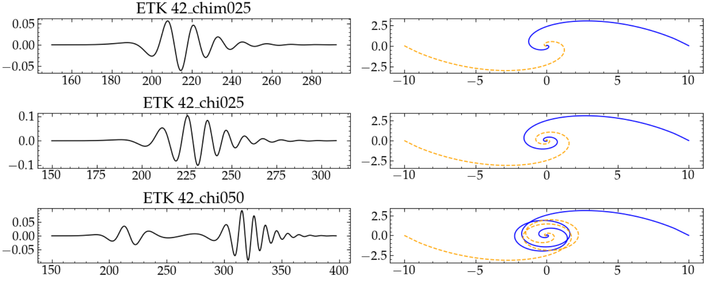
We need a new waveform study including non-merging RD GW
Phys. Rev. D 103, 064013 (2021)
arXiv:2307.08697v1

Slide 24
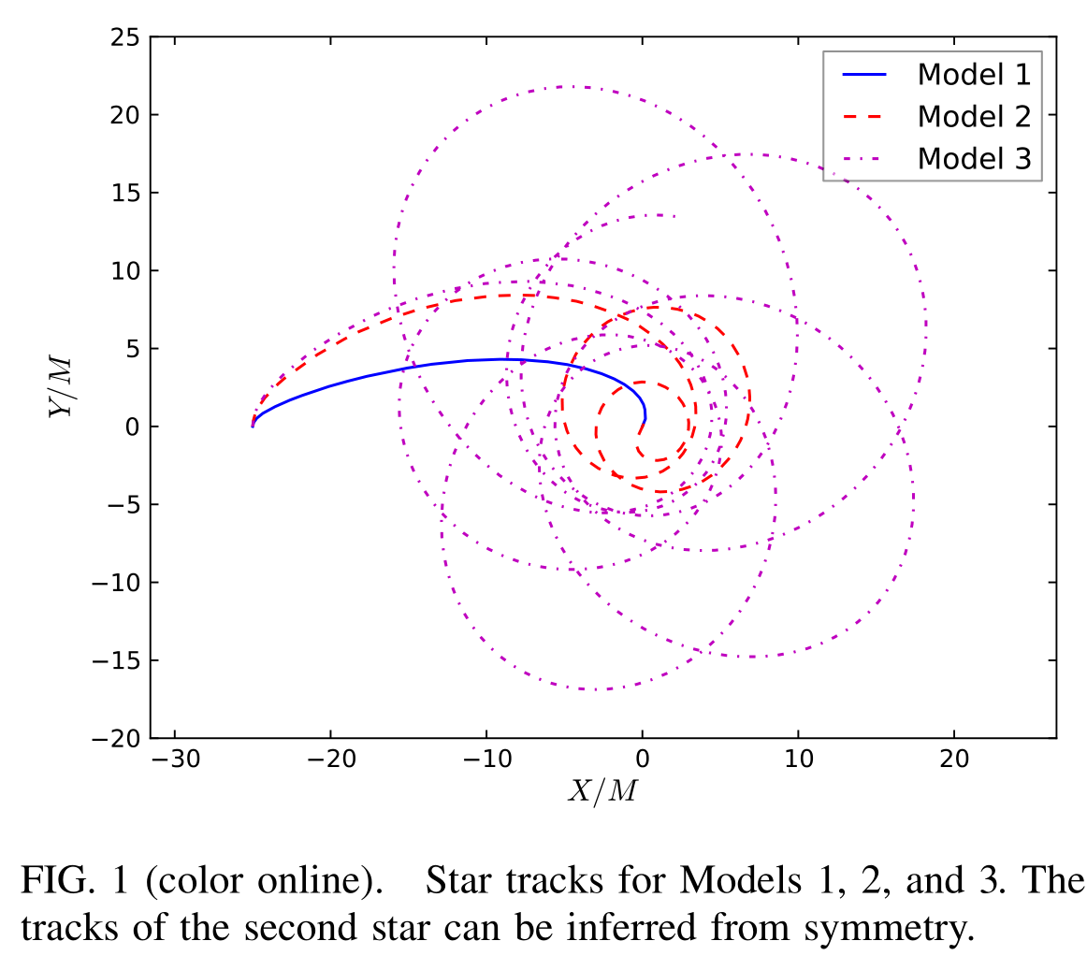
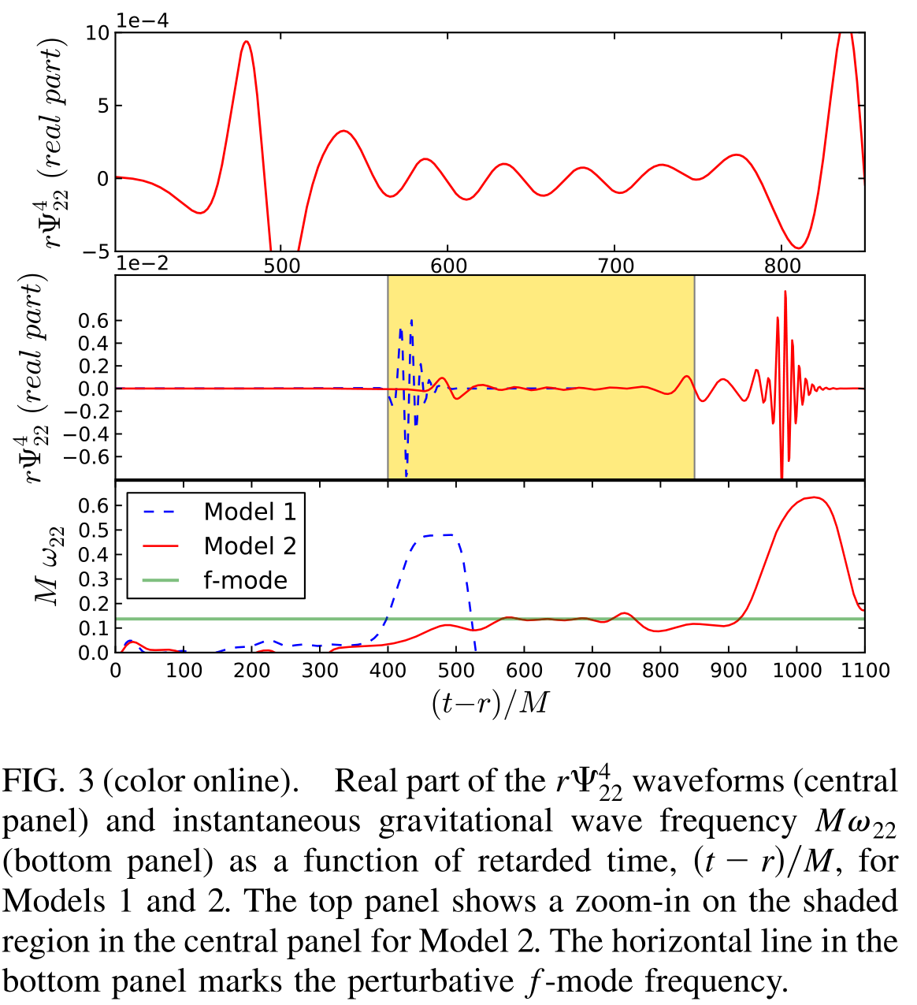
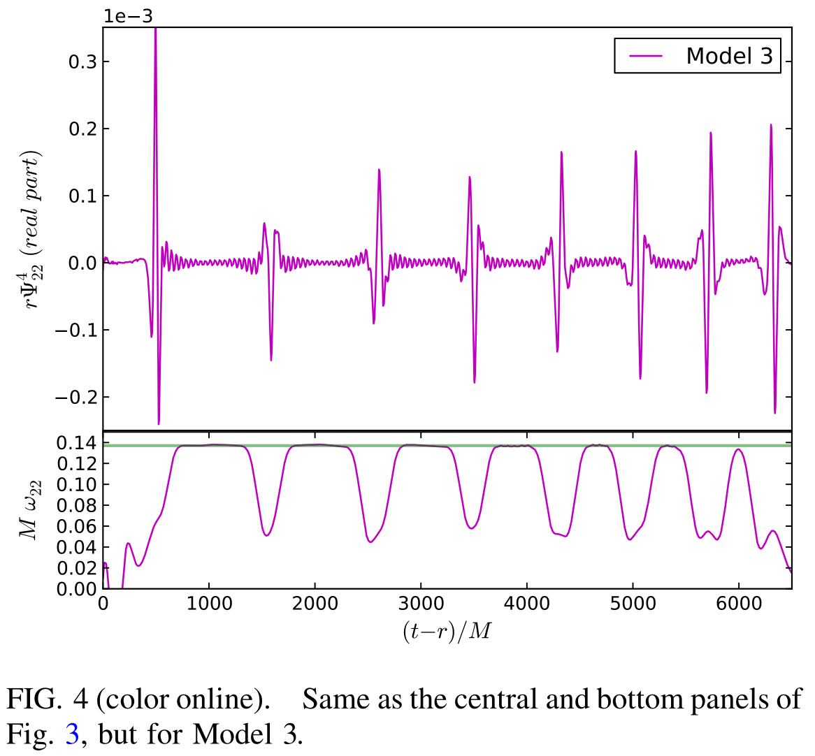
We need a new waveform study including non-merging RD GW

Slide 25
Differences between Post-Merger Ringdown and Non-Merging Ringdown in BBH systems
Post-merger ringdown
  Generated from a single BH
  Radiation from a BH in rest
  (No Doppler shift)
  Propagation through a single BH spacetime
  (effective potential of a single BH)
  Ringdown can be read in multipole modes
  Waveform of ringdown only
  Separated ringdown phase
  QNM of a single BH
Non-merging ringdown
  Radiated from two BHs
  Radiation from BHs in motion
  (Doppler shift from the system dynamics)
  Propagation through a dynamical 2 BHs environment (gravitationally lensing effect)
  Ringdown cannot be read in multipole modes without mode-mixing effect
  Waveform of superposition of ringdowns from two BHs and trajectory-driven wave
  When does it starts?
  QNM of two BH’s system

Slide 26





To identify ringdown as QNM
$$Ψ_{4}^{22} Ψ_{4}^{NP}$$
Frame-rotation
to minimize TD influence
$$z$$
$$v$$
$$y$$
θoutgoing
$$v$$
$$x$$

Slide 27
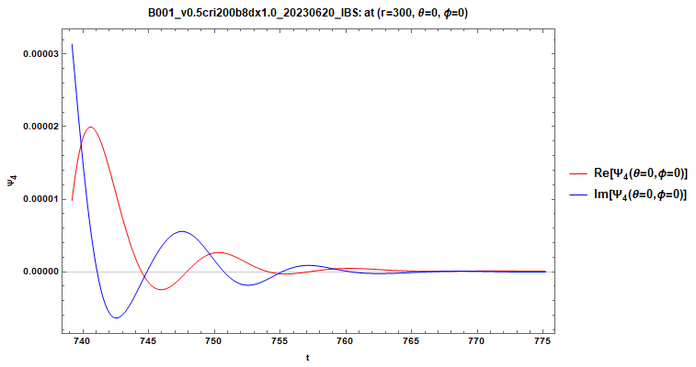
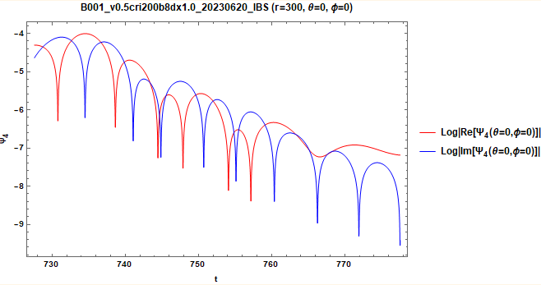
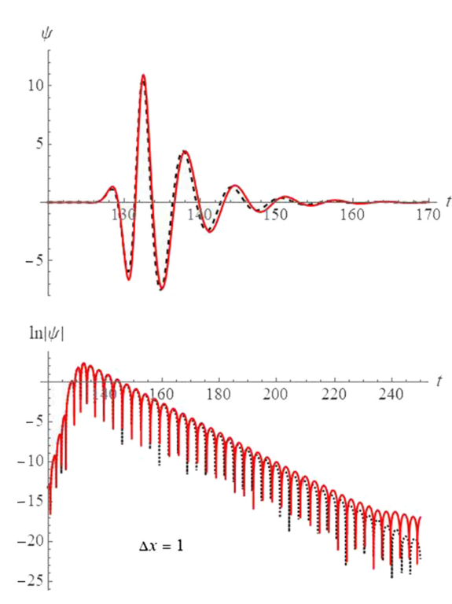
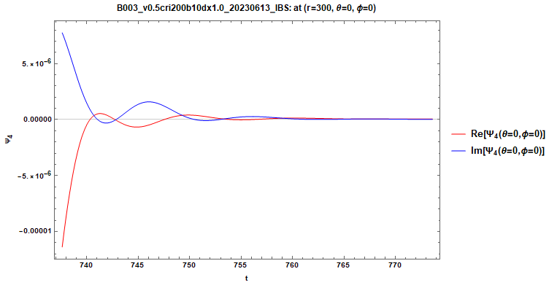
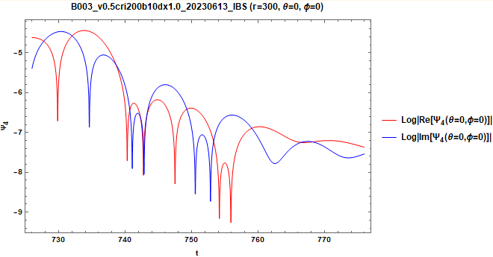
TD Wave Influence in Fitting
Since RD is superposed with TD,
its log plot shows different behaviors from merging ringdown cases:
b=8
b=10

Slide 28
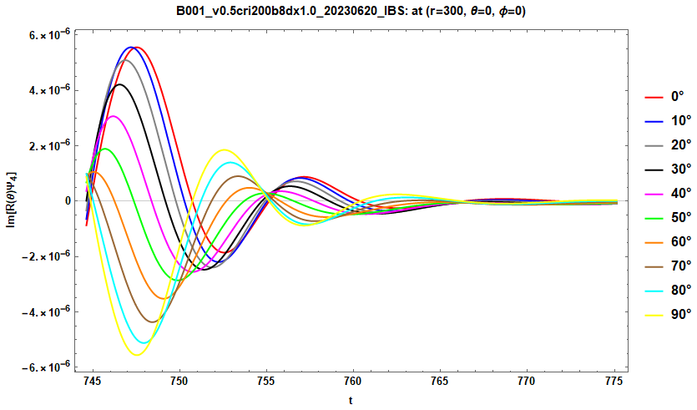
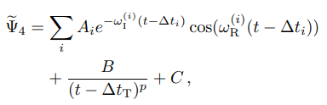

Frame-Rotation and TD Behavior
Frame-rotation
to minimize TD influence
$$z$$
b=8, $r_{ext}$=300
$$v$$
$$y$$
θoutgoing
$$v$$
$$x$$

Slide 29
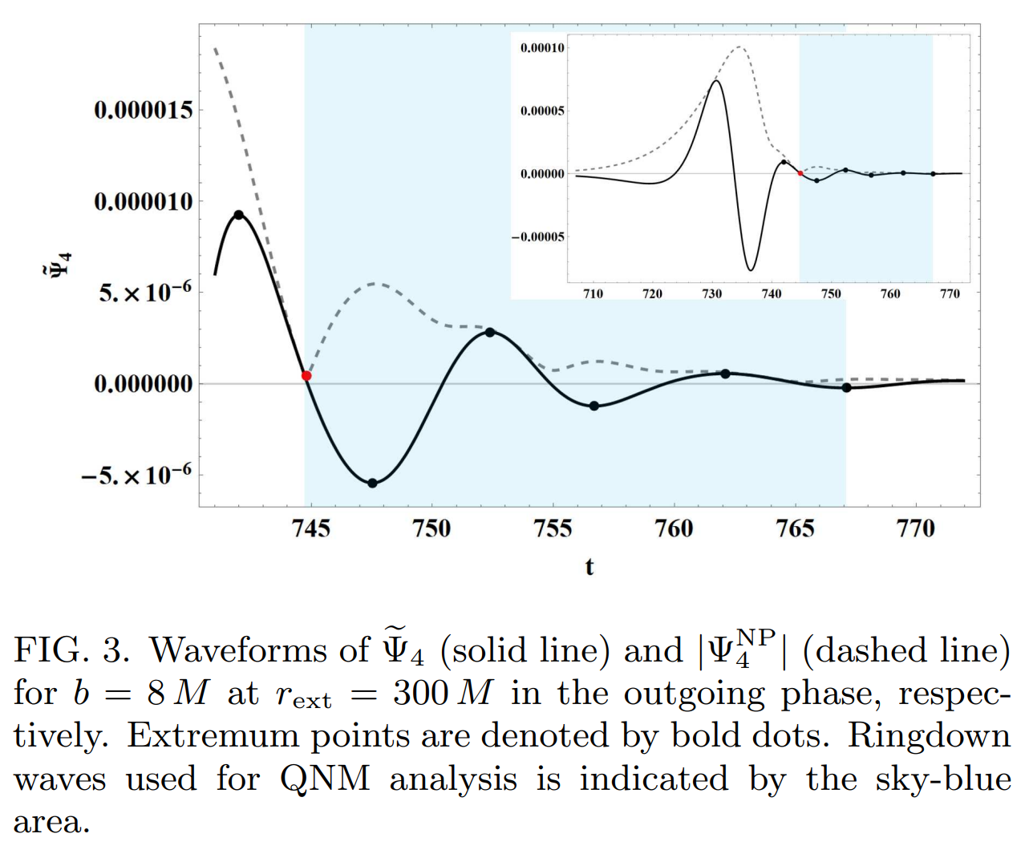


${\tilde{Ψ}}_{4}$ Waveform and QNM identification
In this waveform,
TD is rapidly damping,
we assume it follows
a power-law damping form.
Analysis domain
  From the first peak
  of the $|Ψ_{4}|$
  Until the peak point
  before numerical noise
  becomes comparable.
Analysis time interval
includes only ~2 cycles.

Slide 30






${\tilde{Ψ}}_{4}$ Waveform Fitting Assumptions
Possible modulation causes:
When radiating ringdown,
  v: BH is moving: red/blue Doppler shift
  (One BH is red shifted,
  the other is blue shifted for any observer) >> weak line-of-sight motion
  (Relativistic Doppler shift including time dilation) >>> $ω^{NP}\left(t\right)=ω_{QNM}/γ(t)$
  v(t): BH speed is not constant.
  (Doppler shift is a time-varying effect.) >> about 2% in $γ$ >> $ω^{NP}≡ω_{QNM}/\tilde{γ}$
  (d1,d2): Different positions of two black hole
  (phase difference between two ringdown signals)
  V(r,θ,φ): Not spherical or axisymmetric background
  due to the other BH
  (gravitational lensing effect, absorption) >> assume weak
  x(t)$≠$0: BH’s ringdown signal comes NOT from the origin
  (mode mixing during wave extraction)
Fitting functional form >>>>>>>>>>>>>>>>>
Ψ4,northpole
$$d$$
$$d$$
$$v$$
$$v$$

Slide 31


${\tilde{Ψ}}_{4}$ RD Fitting with Sch. BH. QNM
Dimensionless spin parameter ~ $10^{−4}$
>> We assume the characteristic excitations of the close BH encounter
to be like Schwarzschild BH QNM,
since there’s no study of QNM from two BHs.
For i=1 (single mode fitting), we only consider the dominant QNM.
For i=1,2 (double mode fitting), we consider up to the sub-dominant QNM.
We performed a nonlinear regression using Newton’s method, which iteratively refines the parameter estimates to minimize the sum of squared residuals.

Slide 32




${\tilde{Ψ}}_{4}$ Fitting Result ($r_{ext}$=300, b=8)
For b=8 case,
One mode fitting result
shows deviation
due to the fitting without
non-negligible
sub-dominant modes
In double-mode fitting,
it shows good agreement.
TD wave is minimized
in ${\tilde{Ψ}}_{4}$ , but still gives
uncertainties in fitting.

Slide 33



${\tilde{Ψ}}_{4}$ Fitting Result ($r_{ext}$=300, b=10)
For b=10 case,
One mode fitting result
already shows
good agreement
due to
weak sub-dominant mode
In double-mode fitting,
it also shows
good agreement.
TD wave is minimized
in ${\tilde{Ψ}}_{4}$ , but still gives
uncertainties in fitting.

Slide 34

${\tilde{Ψ}}_{4}$ Fitting Comparison
The strengths of both RD and TD contributions decrease, presumably,
due to the less-strong interactions for the larger impact parameter.
The weakening of the TD radiation is not severe relative to that of the RD one.
The sub-dominant RD contributions are suppressed to about 13 % and 7 % of the dominant ones for the cases of b = 8 M and b = 10 M.

Slide 35


${\tilde{Ψ}}_{4}$ Fitting Frequencies ($r_{ext}$=300, b=8)
In double-mode fitting:
$ω_{R}^{(1)}$= 0.650782$±$0.0000390
$ω_{I}^{(1)}$= 0.1$58008±$0.000040
$ω_{R}^{(2)}$= 1.0732$±$0.000253
$ω_{I}^{(2)}$= 0.1$48805±$0.000254
Now, we obtain the frequencies
measured at infinity
by extrapolating (200~400M)
fitting frequencies.

Slide 36


${\tilde{Ψ}}_{4}$ Fitting Frequencies at $∞$ (b=8)
In double-mode fitting:
$ω_{R}^{(1)}$= 0.662456
$ω_{I}^{(1)}$= 0.155667
$ω_{R}^{(2)}$= 1.08448
$ω_{I}^{(2)}$= 0.148994
Note that, this is not $ω_{QNM}$.
This is $ω_{QNM}/\tilde{γ}$.
And we don’t know $\tilde{γ}$.

Slide 37





Comparison with QNM theory values
In double-mode fitting:
$ω_{R}^{(1)}$= 0.662456
$ω_{I}^{(1)}$= 0.155667
$ω_{R}^{(2)}$= 1.08448
$ω_{I}^{(2)}$= 0.148994
(Note that $ω_{QNM}/\tilde{γ}$)
For l=2, 3 mode,
the QNM frequencies obtained
in the perturbation method
are given in terms of
dimensionless $(M_{BH}ω_{QNM}$) .
The difference comes from ($M_{BH}$, $\tilde{γ}$)
….
[PRD 73, 064030 (2006)]

Slide 38



Boosted Mass Approximation
In double-mode fitting:
$ω_{R}^{(1)}$= 0.662456
$ω_{I}^{(1)}$= 0.155667
$ω_{R}^{(2)}$= 1.08448
$ω_{I}^{(2)}$= 0.148994
(Note that $ω_{QNM}/\tilde{γ}$)
With this approximation,
we can compare NR-obtained dimensionless frequencies with theoretically obtained one when we compare scattering RD frequencies with Schwarzschild one.

Slide 39

QNM Comparison (b=8, fine resolution)
Deviations only a few % for the dominant mode.
Using the Richardson extrapolation with a conservative assumption of 4th-order convergence
for the results from the different resolutions, finally, we present the RD frequencies (see next slide table).

Slide 40

Final Result: QNM Comparison (1)
For the case of b = 8 M, our single-mode fitting shows that the tidally-deformed RD wave could be due to the excitation of the fundamental l = 2 quasi-normal mode within about (4.8, 1.8) % for the oscillatory and damping parts, respectively.
Actually, the QNM frequencies of the overtone mode or higher multipole mode give much larger disagreement, excluding such modes as the dominant excitation.

Slide 41
Final Result: QNM Comparison (2)
For the possibility of sub-dominant QNM excitations, our double-mode fitting shows that l = 2, 3 fundamental modes are excited in agreement within about (1.6, 0.5) % and (0.5, 33.4) %, respectively.
Note that the agreement with the l = 2 mode is improved.

Slide 42
Final Result: QNM Comparison (3)
For the case of a less strong encounter with b = 10 M,
slight enhancement in the agreements of real frequencies for the dominant mode.
This enhancement might be because two BHs are in the linear regime more than the case of b = 8 M.
Or, it could be simply because, the subdominant mode is too weak
so that the dominant mode fitting is already good enough.
Such behavior may also result in a larger deviation for the subdominant mode.

Slide 43
Final Result: QNM Comparison (4)
Note first that the agreement would depend on
how accurately the TD wave can be subtracted from the whole ringdown signal.
We speculate that the decaying behavior of the RD wave is more sensitive than its oscillatory one.
Consequently, the agreements in imaginary frequencies would be worse than those in real frequencies.

Slide 44
Final Result: QNM Comparison (5)
The relative suppression of the TD wave is not severe in the case of b = 10 M, which likely leads to larger deviations in the imaginary frequencies.
It is important to note that the SRD frequency we obtained matches well with the QNM, not that the SRD must match the QNM.

Slide 45
Final Result: QNM Comparison (5)
The important point is that
the scattering ringdown signal emitted from the two black holes we've observed
should not necessarily be close to the QNM of a Schwarzschild black hole.
Rather, it's crucial that the frequency of the scattering ringdown shows
values close to the Schwarzschild QNM
within the initial parameters and analysis range we considered.
To further study the characteristics of scattering ringdown,
more sophisticated and advanced methods will likely be needed.
As this is a study of the ringdown in a new system,
we have focused on verifying the ringdown and comparing it with known QNMs,
but more detailed research will be necessary in the future.

Slide 46
Possible BBH condition?
>> potential for future detection

Slide 47

BBH Parameter Extension

Slide 48
Close encounter for strong gravity test
Simplicity:
  BH do not merge, allowing for a simpler system where the individual properties of each BH (like mass and spin) remain relatively unchanged.
Isolation of Effects:
  No merger, so the strong gravitational interactions can be studied more cleanly without considering non-linear effect associated with merging.
  The tidal deformation and the resulting effects can be examined clearly.
Controllable Parameters:
  By adjusting initial parameters such as impact parameter and velocity,
  we can systematically study the gravitational interaction
  without the complicated merging process.

Slide 49

Conclusion
First numerical evidence that hyperbolic BH encounters can produce non-merging ringdown gravitational waves from dynamic tidal deformations.
Ringdown waves in Ψ4 constitute about 5% of the peak-to-peak amplitude compared to trajectory-driven radiation, matching fundamental quasi-normal modes.
We offers a new method to test strong gravitational interactions, expanding the scope beyond binary BH coalescence.
If observed, these ringdown waves could reveal critical system parameters, such as inclination angle and BH velocities.
Our work paves the way for studying more complex scenarios, including encounters with unequal mass, spinning BHs, and other compact objects.
Scattering ringdown study will enhances our understanding of strong gravitational interactions and the potential for observational tools in astrophysics.

Slide 50


Thank You!

