Slide 1
Simulation of Galaxy Density Profiles with
Velocity-Dependent Self-Interaction
CAU HEP Workshop
THEP
Junho Kang
27 Dec 2023

Slide 2
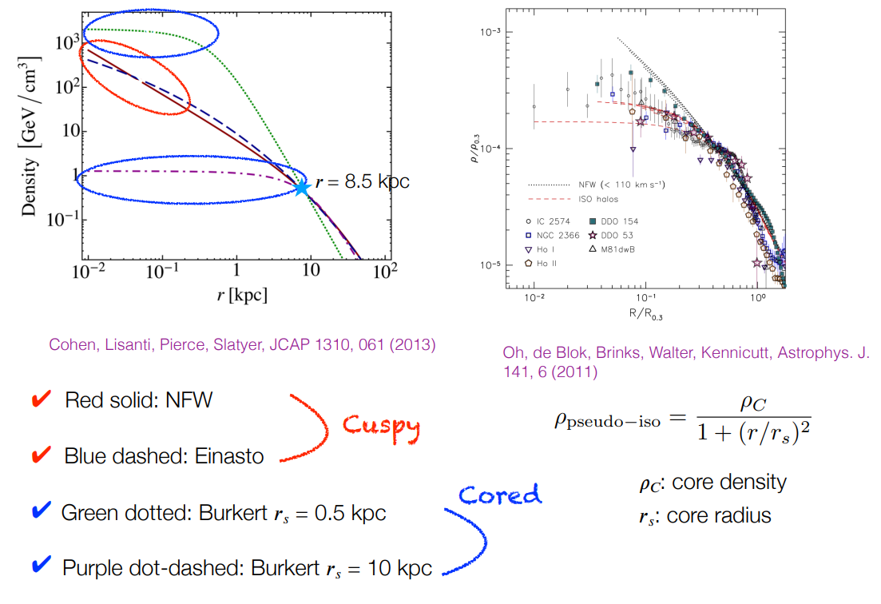
Core - Cusp Problem
Simulation of Galaxy Density Profiles with Velocity-Dependent Self-Interaction

Slide 3
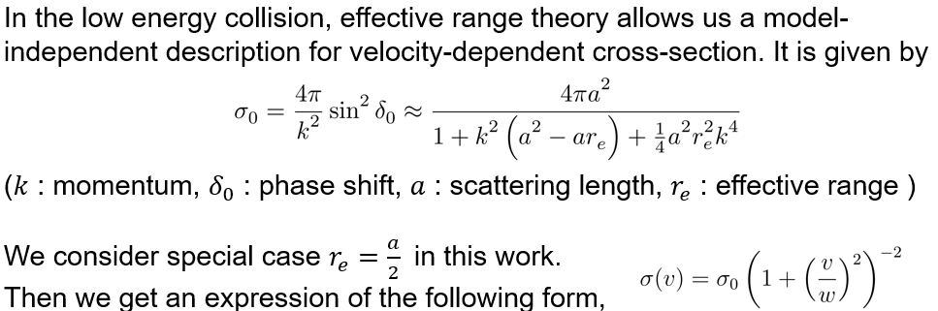
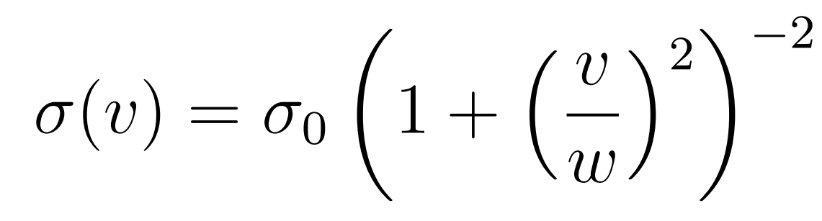
Velocity-dependent Dark Matter
Simulation of Galaxy Density Profiles with Velocity-Dependent Self-Interaction

Slide 4
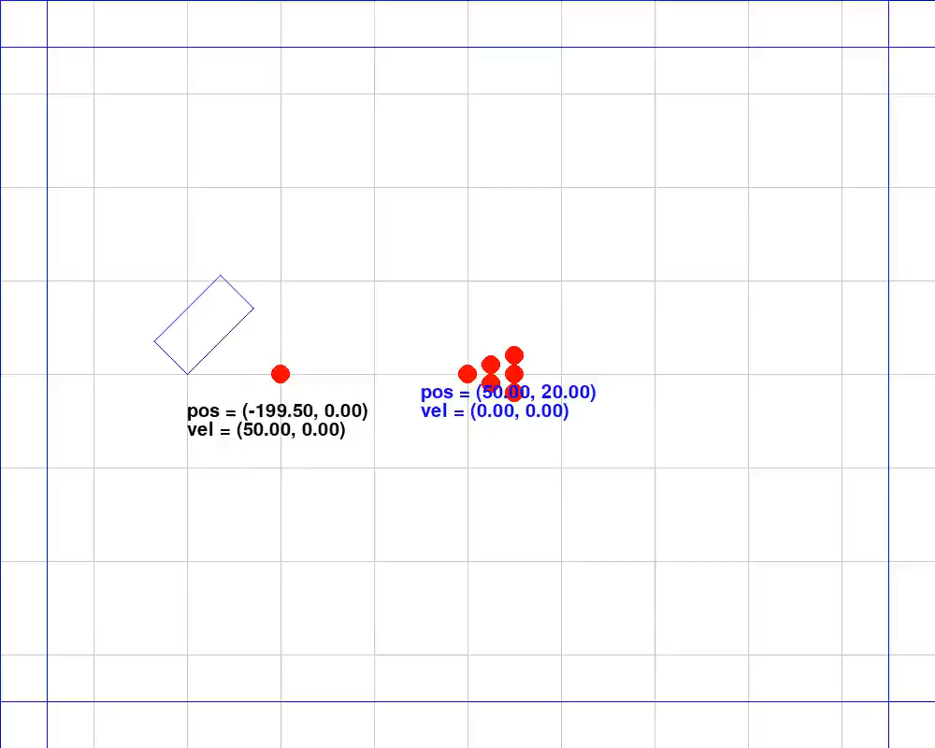
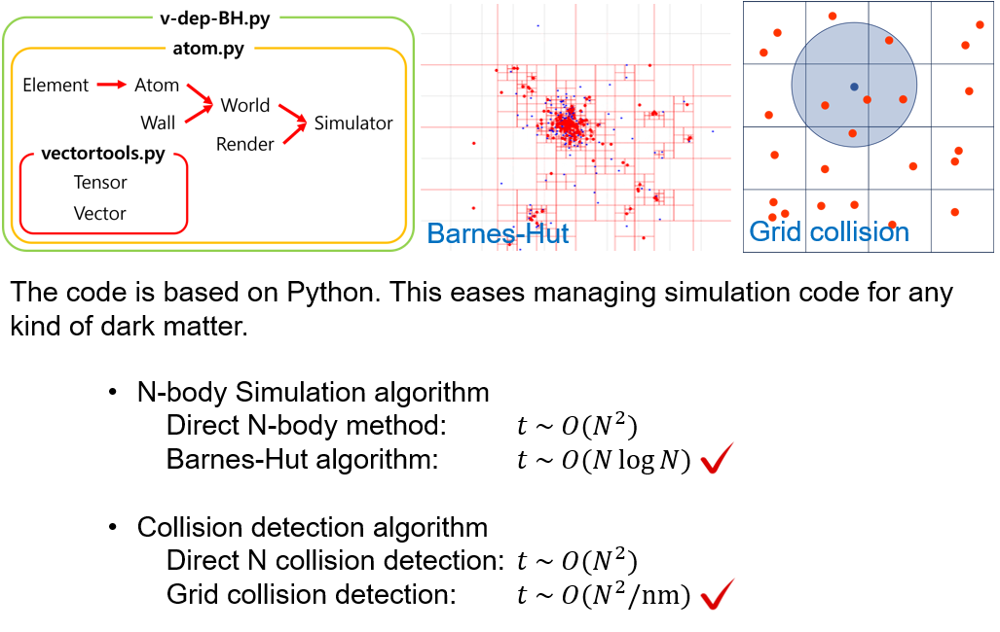
Implement of Dark Matter Simulation
darkmatter.py
atom.py
Simulation of Galaxy Density Profiles with Velocity-Dependent Self-Interaction

Slide 5
Implement of Dark Matter Simulation
Simulation of Galaxy Density Profiles with Velocity-Dependent Self-Interaction

Slide 6
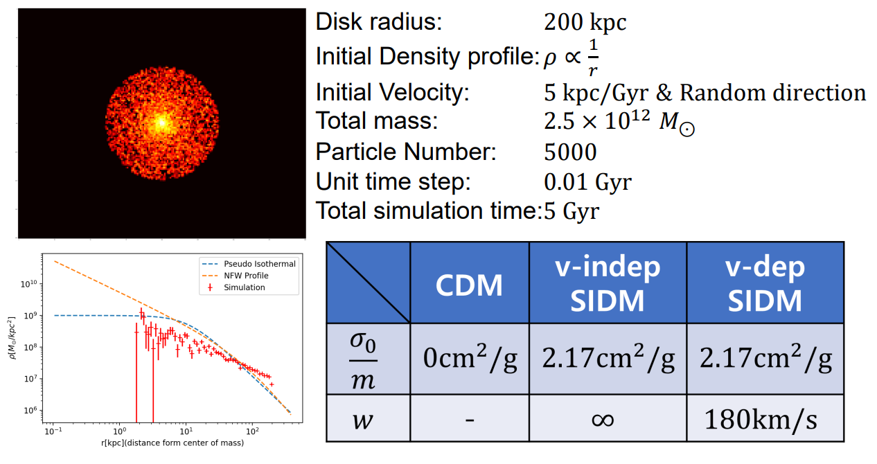
Simulation Setup
Simulation of Galaxy Density Profiles with Velocity-Dependent Self-Interaction

Slide 7
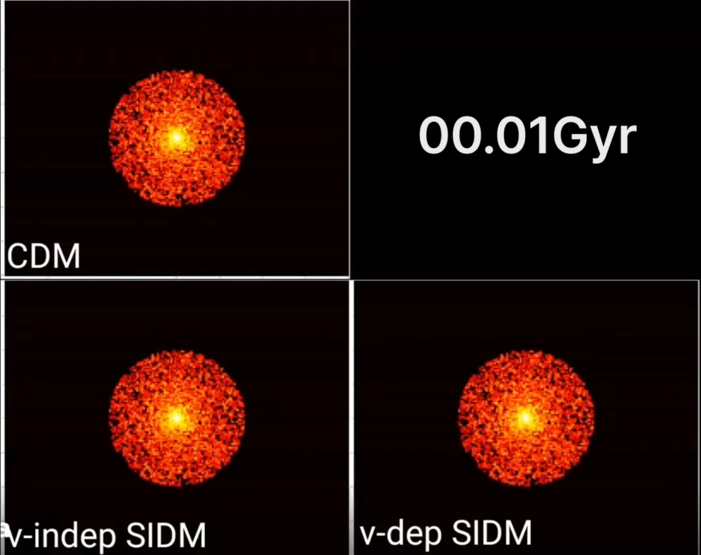

Slide 8
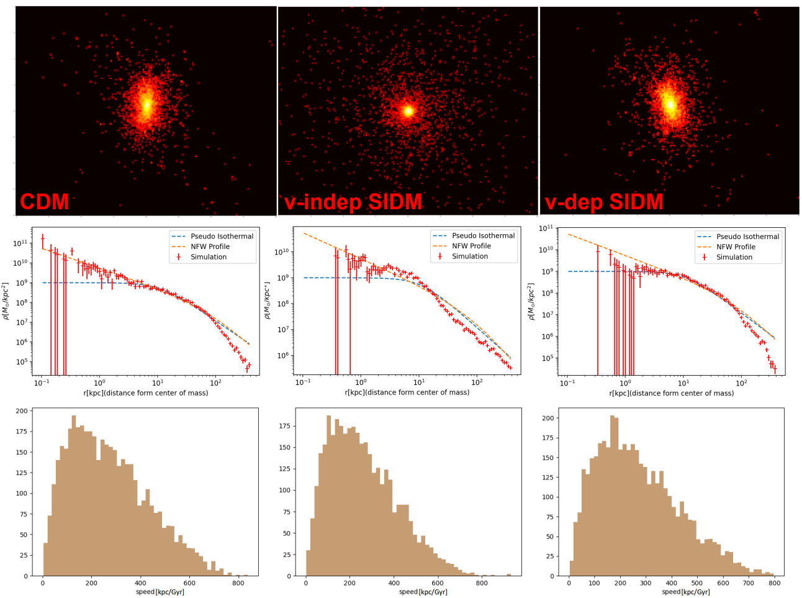
Simulation Results
Simulation of Galaxy Density Profiles with Velocity-Dependent Self-Interaction

Slide 9
References
Marco Cirelli et al (2011). PPPC 4 DM ID: a poor particle physicist cookbook for dark matter indirect detection. Journal of Cosmology and Astroparticle Physics, 2011(03), 051–051.
Sean Tulin, & Hai-Bo Yu (2018). Dark matter self-interactions and small scale structure. Physics Reports, 730, 1–57.
Xiaoyong Chu, Camilo Garcia-Cely, & Hitoshi Murayama (2020). A practical and consistent parametrization of dark matter self-interactions. Journal of Cosmology and Astroparticle Physics, 2020(06), 043–043.
Marchesini, D et al (2002). Hα Rotation Curves: The Soft Core Question. The Astrophysical Journal, 575(2), 801–813.
Yoo-Jin Kang, & Hyun Min Lee (2021). Effective theory for self-interacting dark matter and massive spin-2 mediators. Journal of Physics G: Nuclear and Particle Physics, 48(4), 045002.
Moritz S. Fischer et al (2023). Cosmological and idealised simulations of dark matter haloes with velocity-dependent, rare and frequent self-interactions.
Simulation of Galaxy Density Profiles with Velocity-Dependent Self-Interaction

