Slide 1
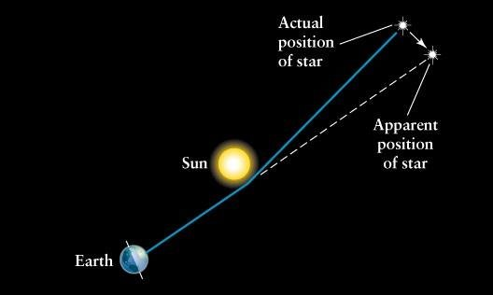
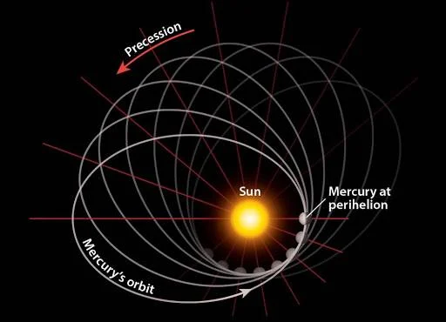
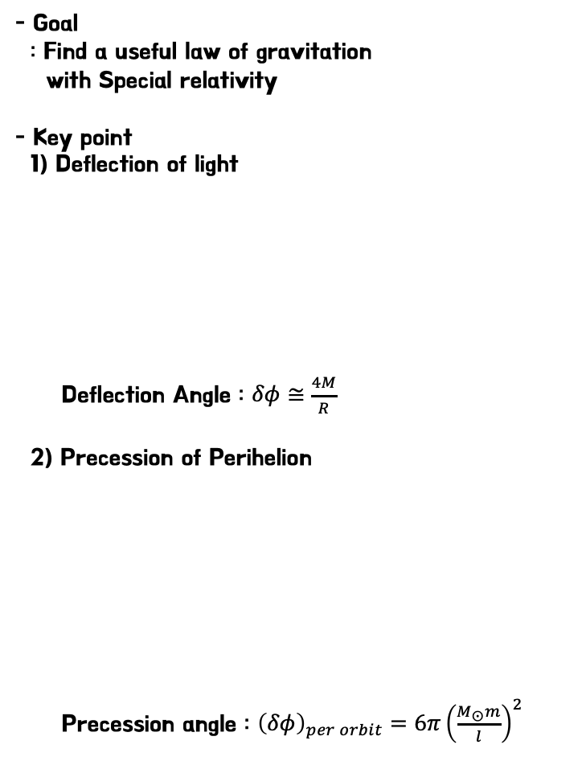
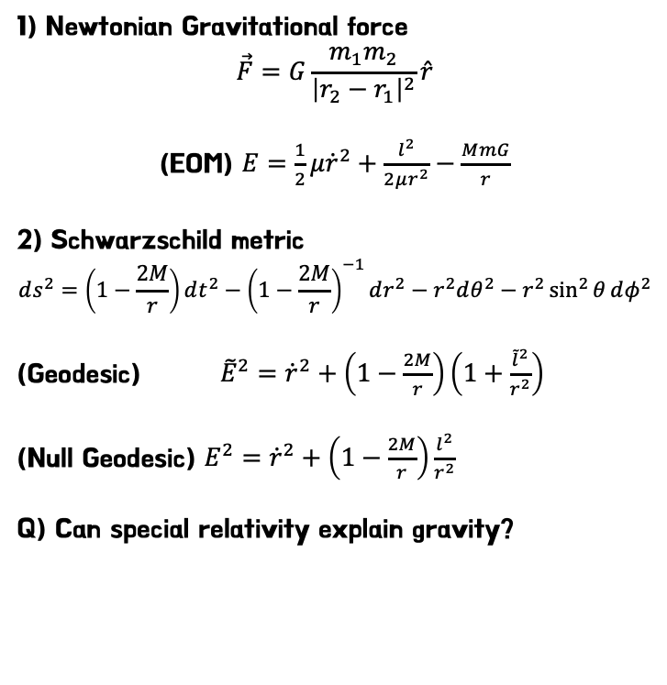
Can Special relativity explain gravity?
AFFILIATION : AXIS
PRESENTATOR : Hyeonguk Son
1) Newtonian Gravitational force
$$\vec{F}=G\frac{m_{1}m_{2}}{{\left|r_{2}−r_{1}\right|}^{2}}\hat{r}$$
(EOM) $E=\frac{1}{2}μ{\dot{r}}^{2}+\frac{l^{2}}{2μr^{2}}−\frac{MmG}{r}$
2) Schwarzschild metric
$$ds^{2}=\left(1−\frac{2M}{r}\right)dt^{2}−{\left(1−\frac{2M}{r}\right)}^{−1}dr^{2}−r^{2}dθ^{2}−r^{2}\sin^{2}{θ}dφ^{2}$$
(Geodesic) ${\tilde{E}}^{2}={\dot{r}}^{2}+\left(1−\frac{2M}{r}\right)\left(1+\frac{{\tilde{l}}^{2}}{r^{2}}\right)$
(Null Geodesic) $E^{2}={\dot{r}}^{2}+\left(1−\frac{2M}{r}\right)\frac{l^{2}}{r^{2}}$
Q) Can special relativity explain gravity?
- Goal
: Find a useful law of gravitation
with Special relativity
- Key point
1) Deflection of light
Deflection Angle : $δφ≅\frac{4M}{R}$
2) Precession of Perihelion
Precession angle : ${\left(δφ\right)}_{per orbit}=6π{\left(\frac{M_{⨀}m}{l}\right)}^{2}$
Newtonian
SR
(Can we..?)
GR
(Geodesic)

Slide 2
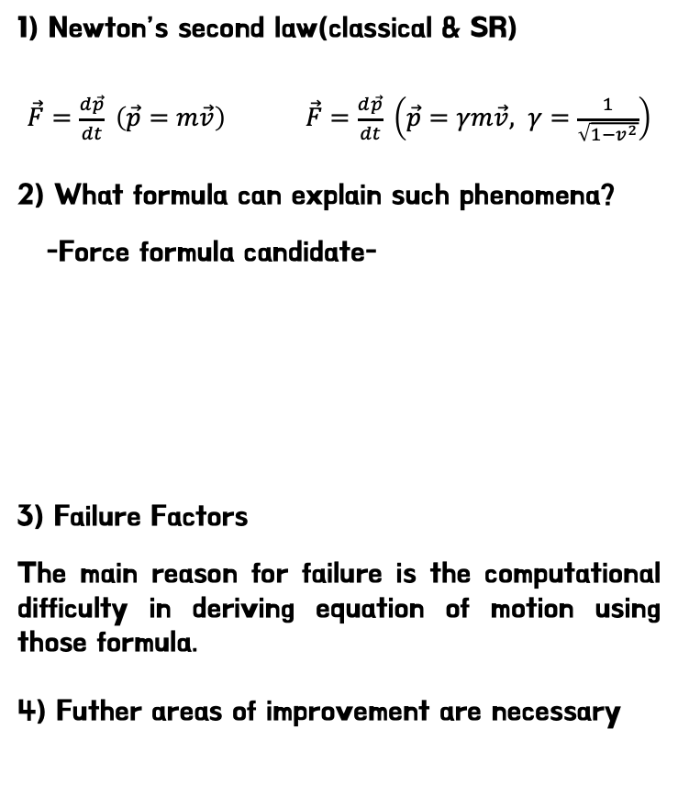
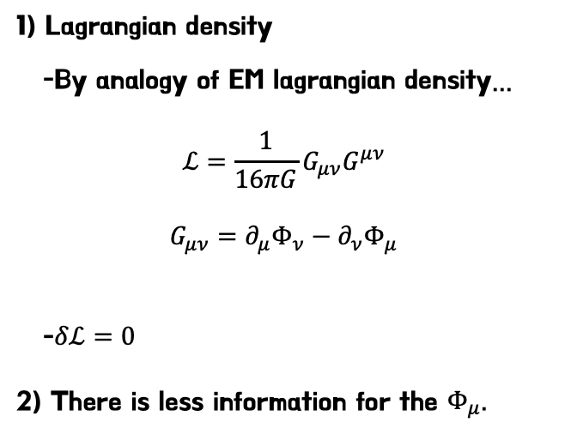

Can Special relativity explain gravity?
AFFILIATION : AXIS
PRESENTATOR : Hyeonguk Son
1) Newton’s second law(classical & SR)
$\vec{F}=\frac{d\vec{p}}{dt} \left(\vec{p}=m\vec{v}\right)$ $\vec{F}=\frac{d\vec{p}}{dt} \left(\vec{p}=γm\vec{v}, γ=\frac{1}{\sqrt{1−v^{2}}}\right)$
2) What formula can explain such phenomena?
-Force formula candidate-
3) Failure Factors
The main reason for failure is the computational difficulty in deriving equation of motion using those formula.
4) Futher areas of improvement are necessary
1) Lagrangian density
-By analogy of EM lagrangian density…
$$ℒ=\frac{1}{16πG}G_{μν}G^{μν}$$
$$G_{μν}=∂_{μ}Φ_{ν}−∂_{ν}Φ_{μ}$$
-$δℒ=0$
2) There is less information for the $Φ_{μ}$.
$\vec{F}=\frac{MmG}{r^{2}}\hat{r}$
$\vec{F}=\frac{1}{γ}\frac{MmG}{r^{2}}\hat{r}$
$\vec{F}=\frac{MmG}{r^{2}}Θ\left(v\right)\hat{r} , Θ\left(v\right)→0(when v→c)$
etc…

