Slide 1
WP5
Innovative gaseous detectors for calorimetry
To develop precise gaseous detectors as active media for future calorimeters
Several technologies are of interest : (M)RPC, MPGD
The boundaries with DRD6 are well defined

Slide 2
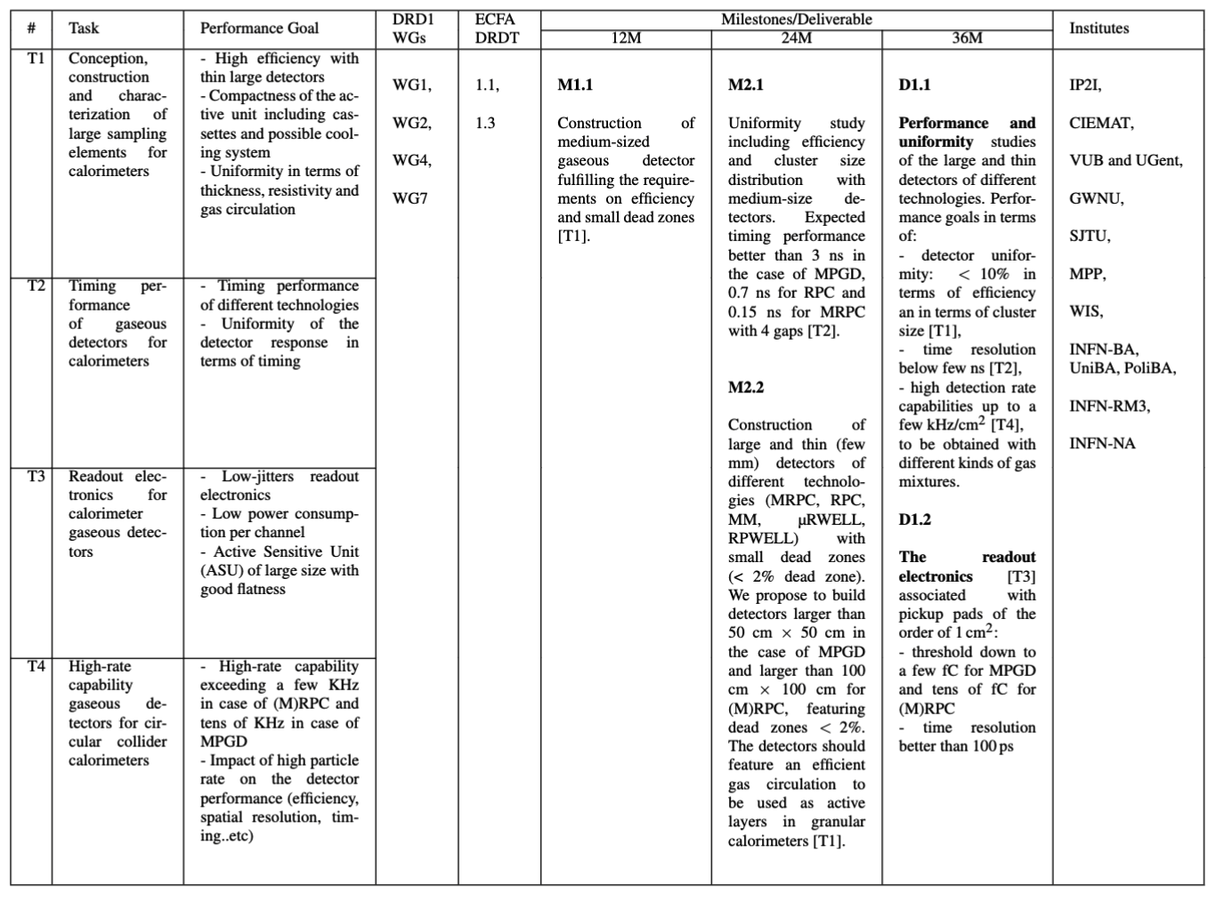
WP5

Slide 3
WP5
How the WP covers the topics in the ECFA roadmap
  DRDTs
  DRDT 1.1 - Precise timing detectors with rate capability, spatial resolution.
  DRDT 1.3 – Study eco-friendly solutions for gaseous timing detector
  Challenges
  -Realization of thin and large surface detectors with high efficiency, excellent uniformity and high-rate capabilities operated with eco-friendly gases
  - Very good time resolution
  -Embedded readout electronics
  Goals
  To provide high granular hadronic calorimeters with active media made of gaseous detectors to efficiently apply the PFA techniques and at the same time provide good energy resolution

Slide 4
WP5
Strategy: One project associating different technologies
Two Deliverables
D1.1- Performance and uniformity study of large detectors built with different technologies ((M)RPC, MPGD) : Uniformity (efficiency&cluster size), high rate, time resolution.
D1.2 – Production of panels equipped with low-noise, low time-jitter readout electronics to read out large detectors of different technologies in collaboration with DRD6
Two milestones
M1.1 : Performance and uniformity study with prototypes of medium size
M1.2: Conception and construction of large surface detectors

Slide 5
WP5
Institut de la physique des 2 infinis (IP2I)
Centro de Investigaciones Energéticas, Medioambientales y Tecnológicas (CIEMAT)
Vrije Universiteit Brussel (VUB)
Gangneung-Wonju National University (GWNU)
Shanghai Jiao Tong University (SJTU)
Max-Planck Institute for Physics (MPP)
Weizmann Institute of Science (WIS)
Bari INFN & University (INFN-ba)
ROME3 University (ROME3)
Naples INFN (INFN-Na)
Institutes
→ 10 institutes from 8 countries
→ Most of all are also involved in DRD6 (calorimetry)
→ Most of them have already worked together on a given
technology but in this proposal common studies will be
an essential feature

Slide 6
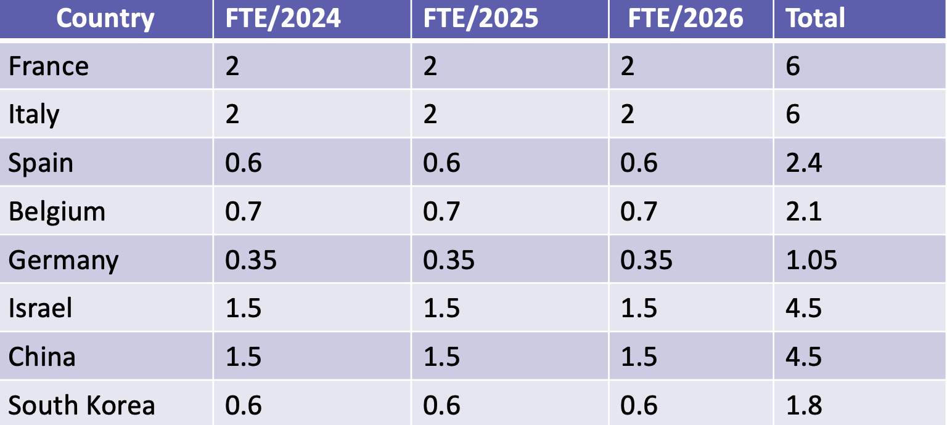
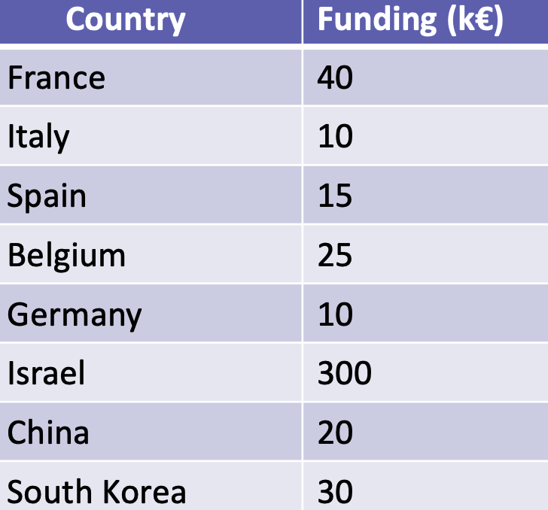

WP5
Existing
Funding
→ The foreseen developments on detectors is already
available or almost sure to be available
→ existing readout electronics could be used to
characterize but new and more performant ones
need to be produced in common with other WPs in
DRD1 and DRD6.
Additional (not existing)

Slide 7
WP5
Next steps
Fist step will be to organize the first official meeting of WP5. The major points to be discussed will be:
Update on the current activities and funding perspectives
Inventory of the available local facilities and tools
Discussion of the common activities across the different technologies
Mechanics, gas, cooling, electronics…
The goal is to build on current R&D activities with available fundings and provide the needed arguments to obtain more fundings and to extend the network to new comers

