Slide 1
TPCs used as reaction/decay chambers
Work Package 8
Esther Ferrer Ribas, Diego González-Díaz
DRD1 Meeting
30th January 2024

Slide 2

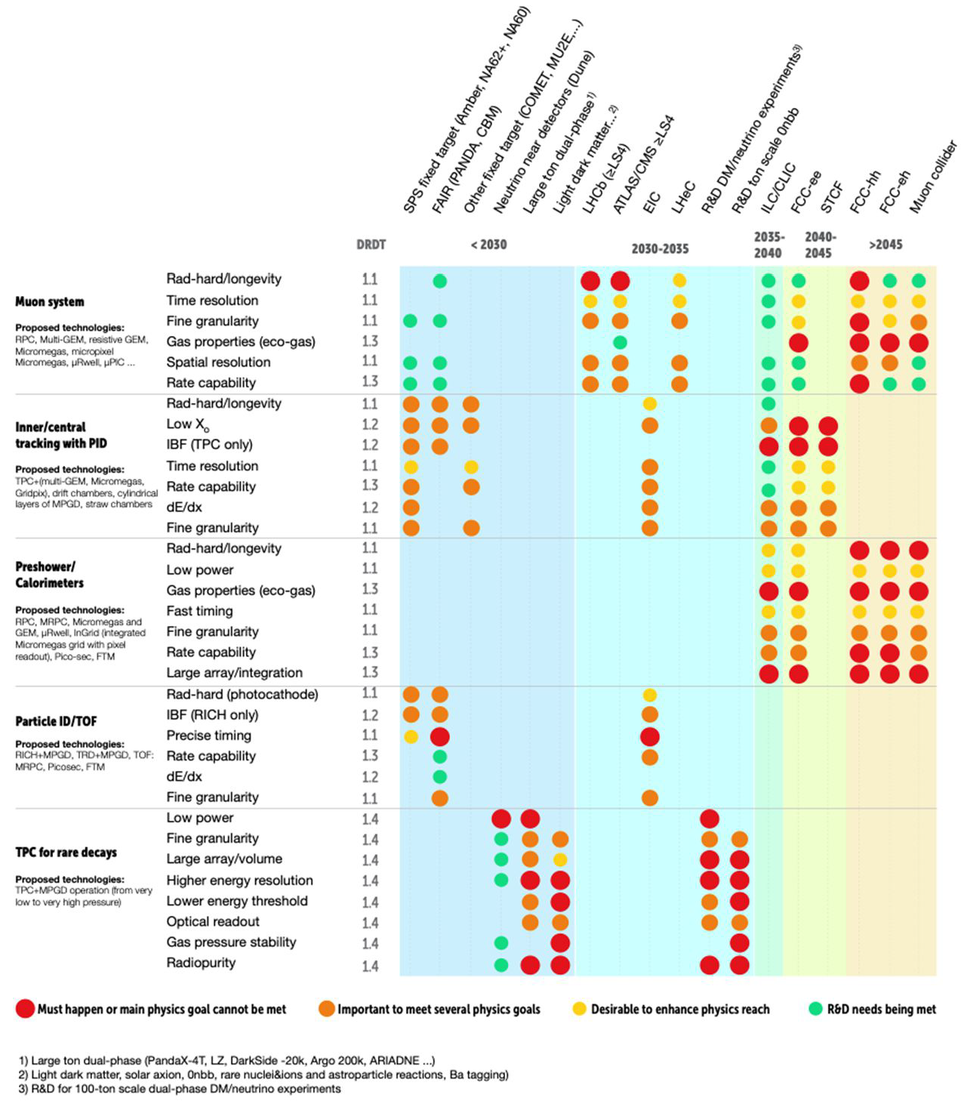
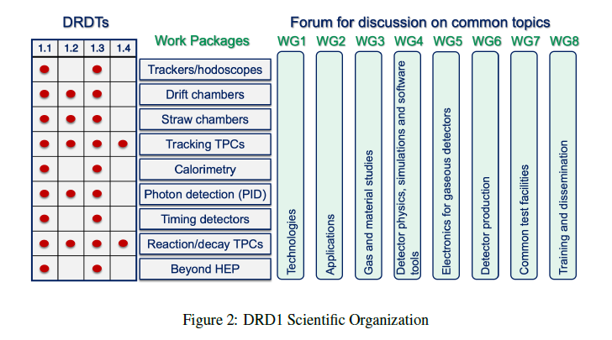
from ECFA to DRD1
ECFA
DRD1
DRDT 1.1 - Improve time and spatial resolution for gaseous detectors with long-term stability.
DRDT 1.2 - Achieve tracking in gaseous detectors with dE/dx and dN/dx capability in large volumes with very low material budget and different read-out schemes.
DRDT 1.3 - Develop environmentally friendly gaseous detectors for very large areas with high-rate capability.
DRDT 1.4 - Achieve high sensitivity in both low and high-pressure TPCs.

Slide 3
yesterday recap
(long story short)

Slide 4
longer version (from DRD1 extended proposal)
overlap with WP4
Space charge /IBF suppresion (heavy ion facilities).
Momentum reconstruction of uncontained tracks for neutrino physics (leptons in CC-interactions).
Pixelated readout for recoil reconstruction (DM)

Slide 5
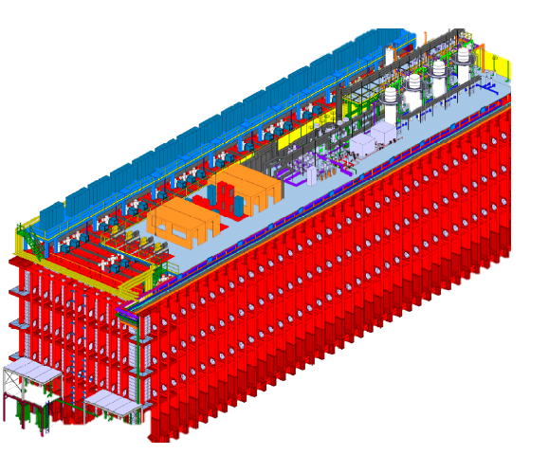
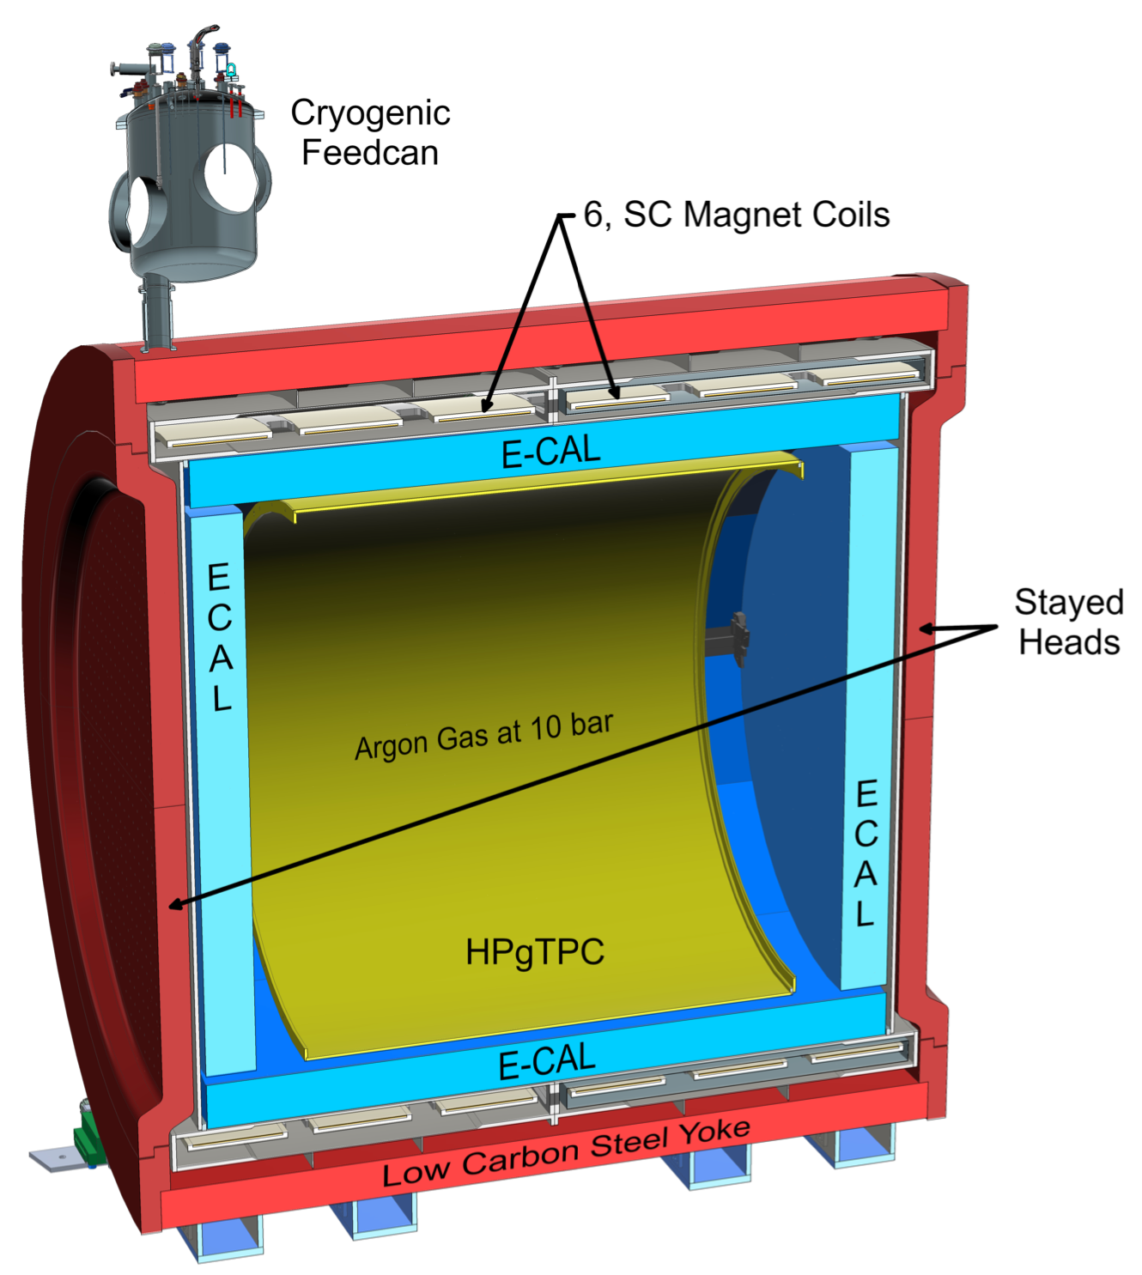
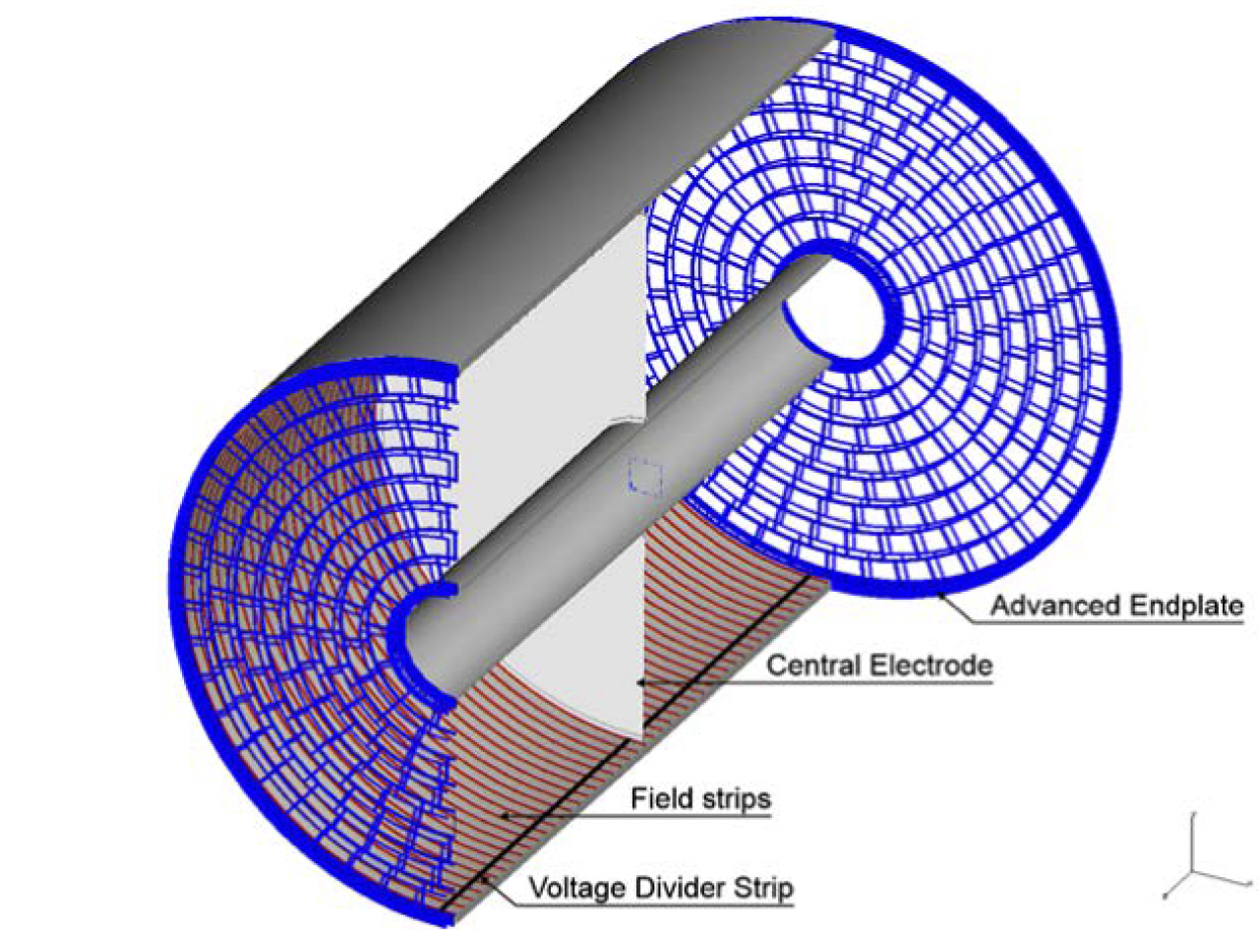
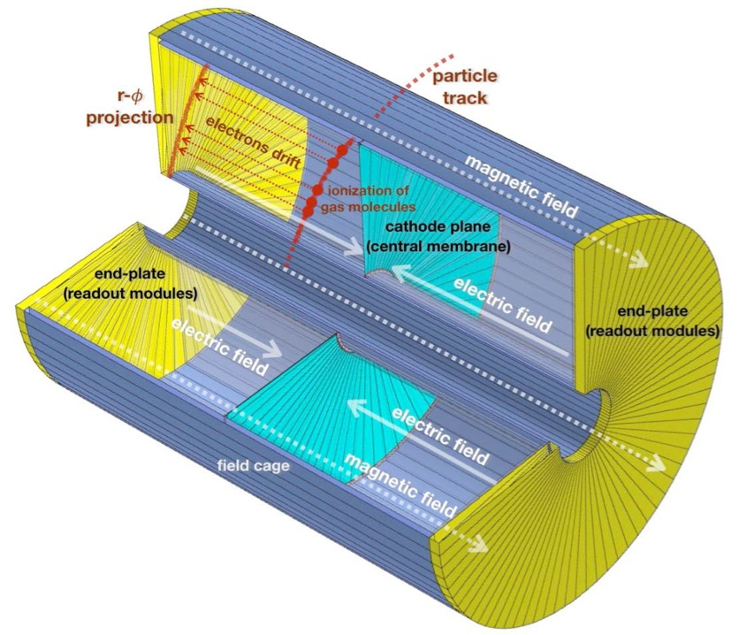
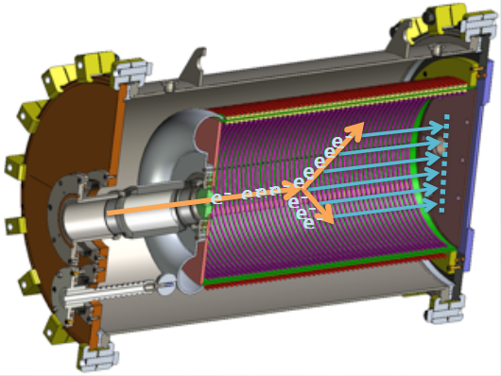
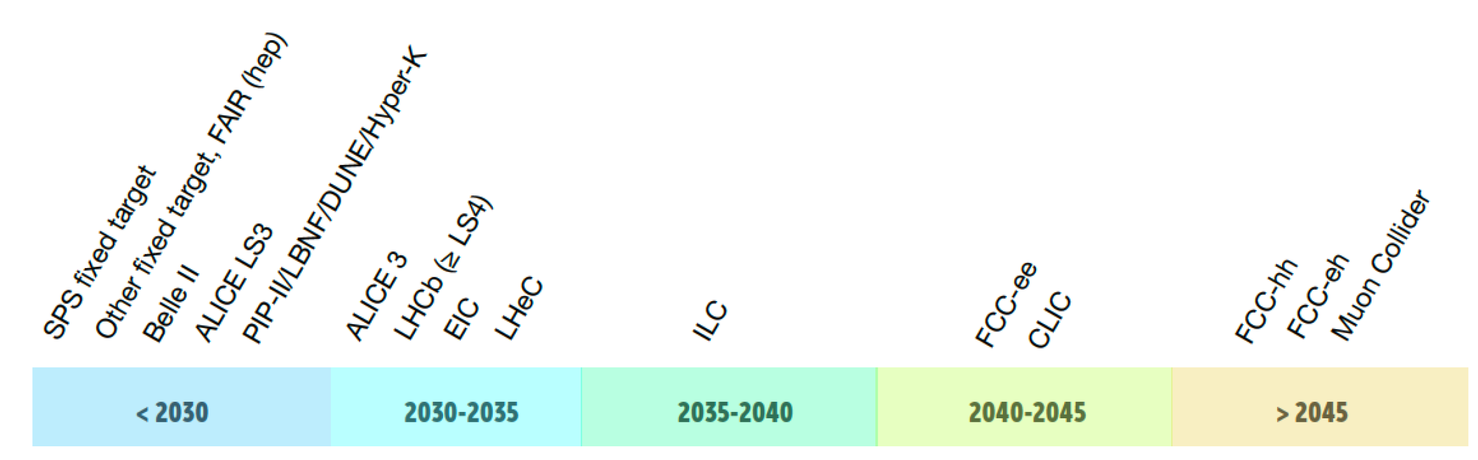
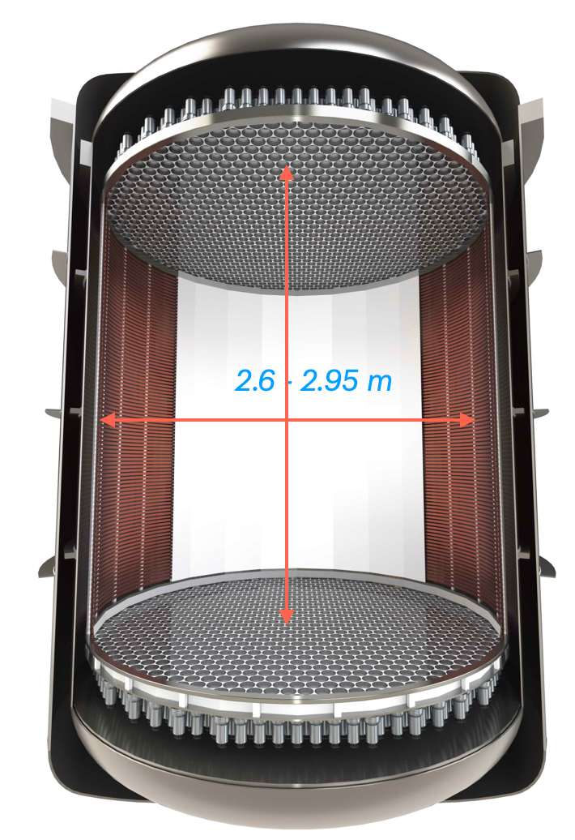
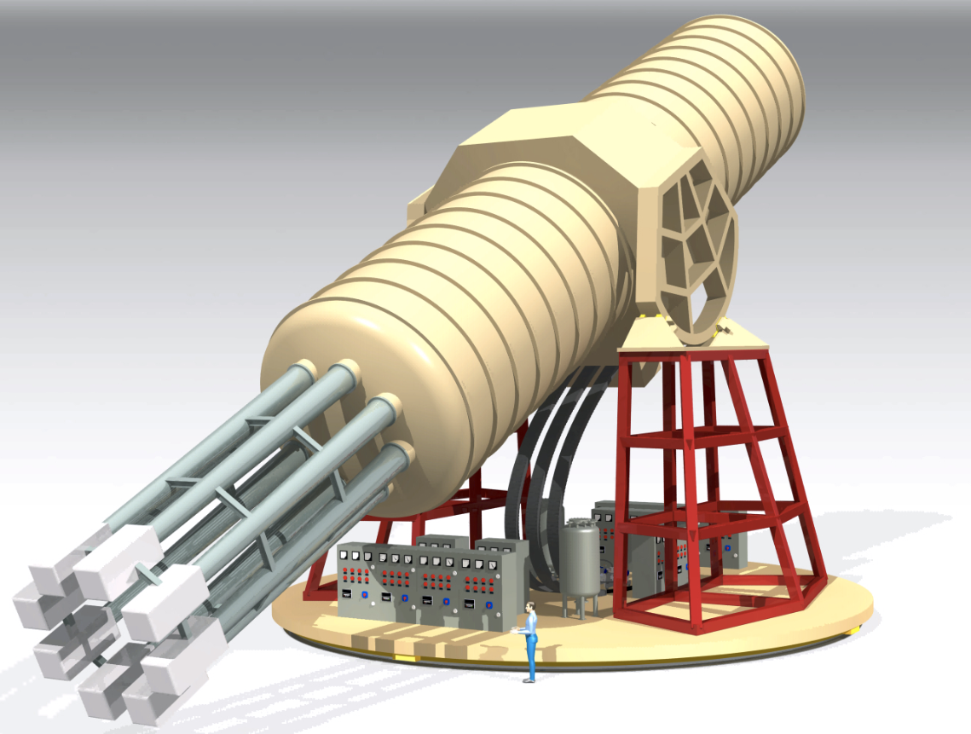
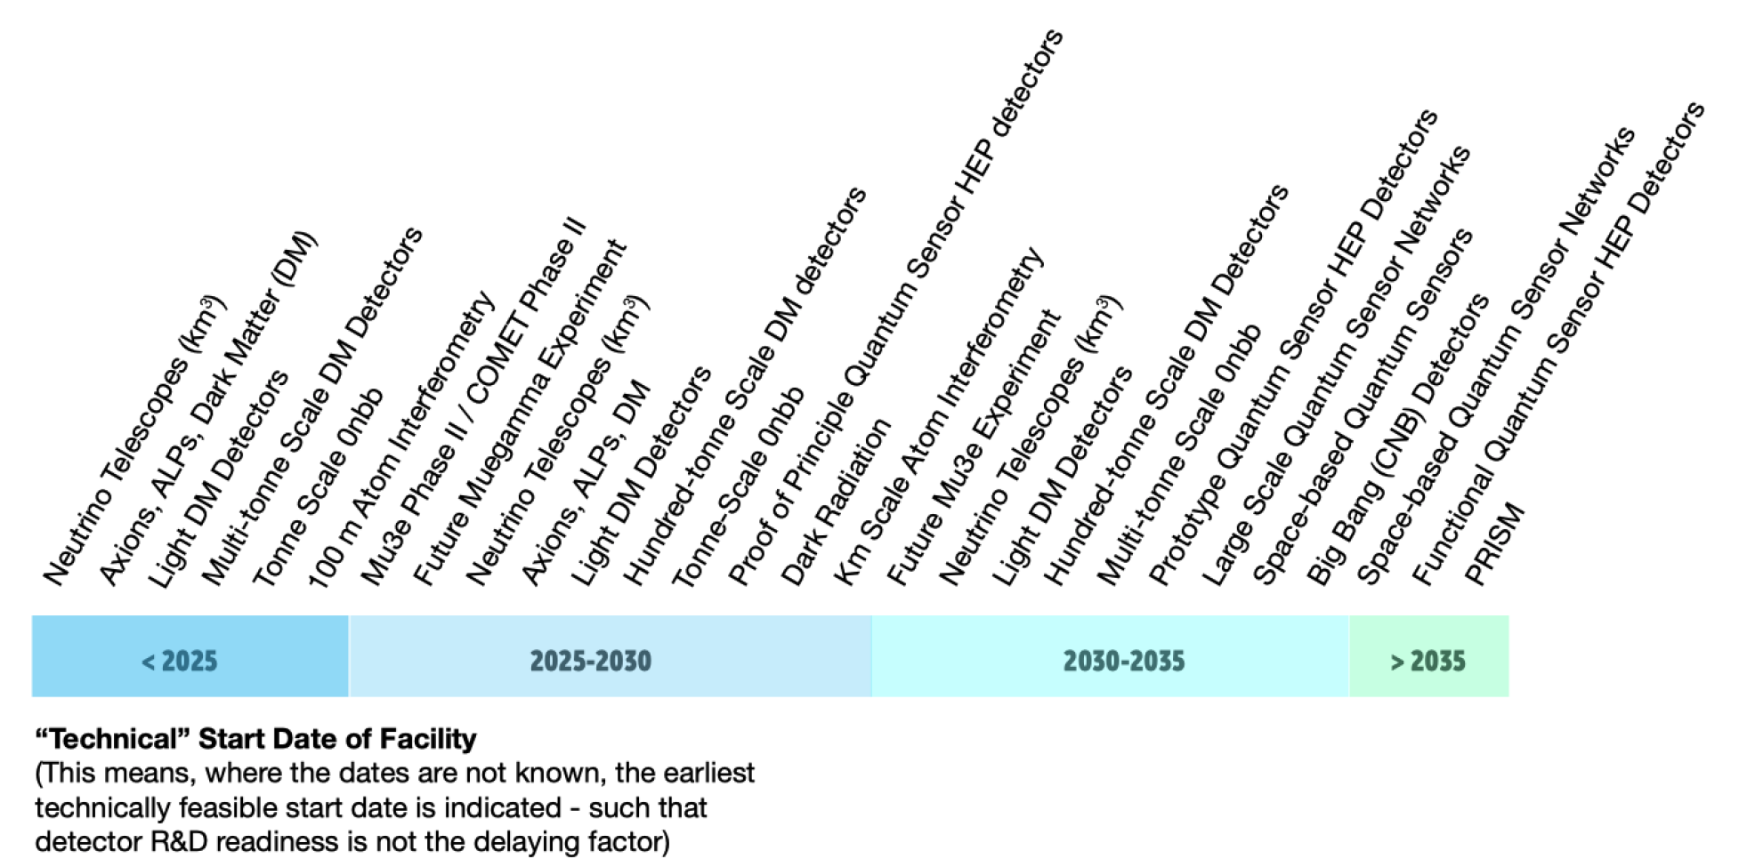
AT-TPC
(and related)
DUNE FD-TPC
ILC TPC
CEPC TPC
DUNE NDGAr
accelerator
& CEPC*
DUNE-NDGAr*
AT-TPC*
ECFA roadmap
(*In grey: added)
leading by example
DARWIN
WP4
WP8
DARKSIDE-20
IAXO
non-accelerator

Slide 6
Overarching WP8 challenges (from DRD1 extended proposal)

Slide 7
WP8 projects
Project A – High Pressure TPCs for precision studies of neutrino interactions. (convening: DGD, Alan Bross (Fermilab))
Project B - TPCs for low-energy nuclear physics. (convening: EFR, Marco Cortesi (MSU))
Project C - Electroluminescence-based TPCs for Rare-Event Searches and other R&D on pure noble-gas amplification. (convening: DGD, Francesc Monrabal (DIPC))
Project D - Radiopure TPCs for precise track imaging and/or calorimetry with avalanche-based readouts. (convening: EFR, Giorgio Dho (GSSI))

Slide 8
WP8 main drivers and facilities
Dark matter
MIMAC, NEWAGE, DRIFT, CYGNUS, TREX-DM, NEWS-G, MIGDAL, IAXO, Darkside, ARGO, PANDA-X 4T, DARWIN
Nuclear reactions
MSCL, ELI-NP, GANIL
Neutrino Physics
NEXT, DUNE, ARIADNE

Slide 9
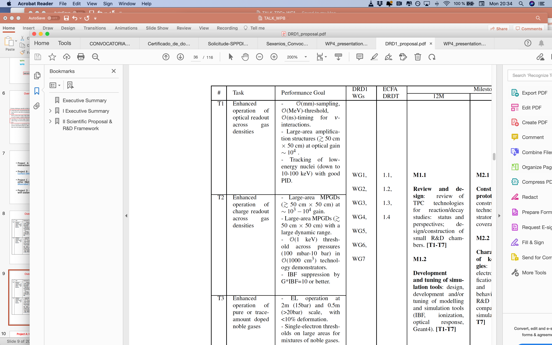
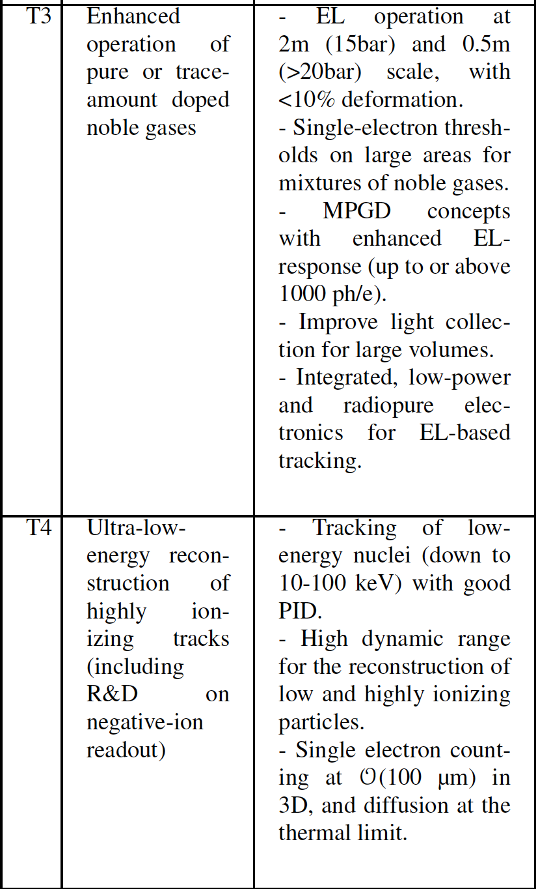
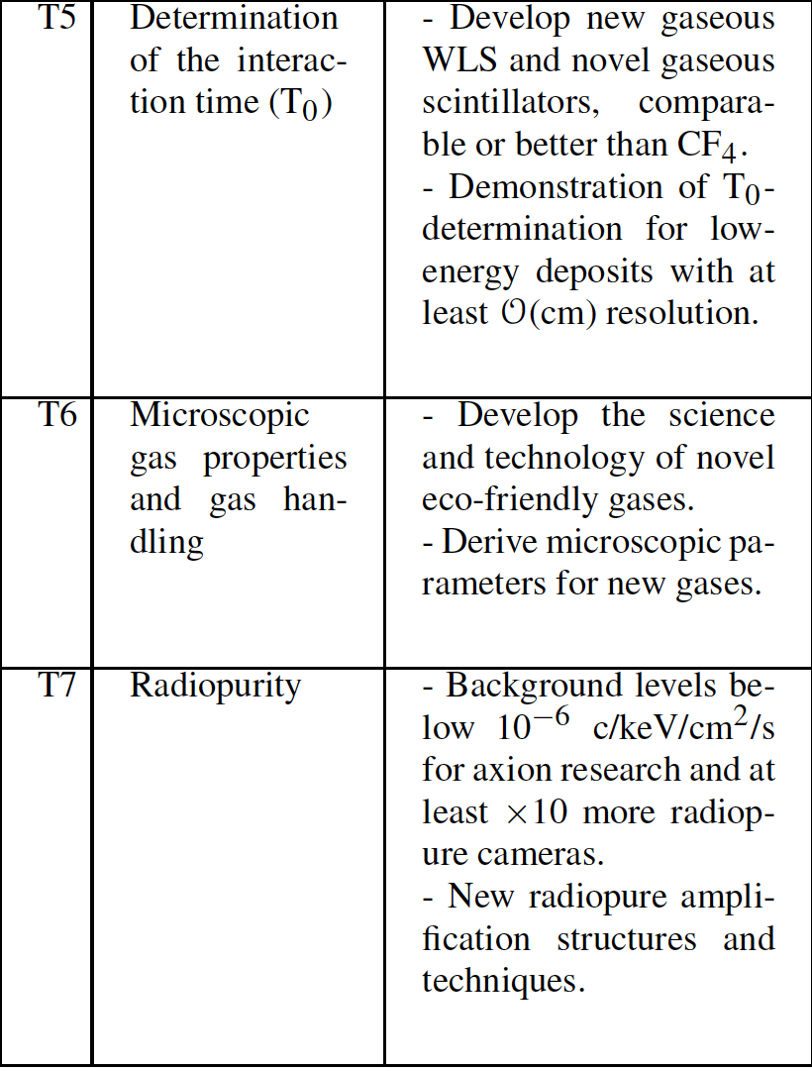
Overarching WP8 challenges + Projects tasks

Slide 10
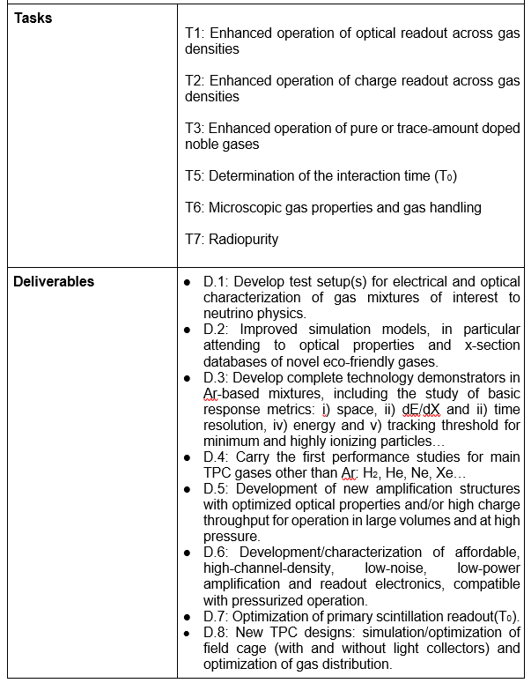
Projects + community feedback project deliverables
Project A: Neutrino Physics
‘High Pressure TPCs for precision studies of neutrino interactions’
conveners: DGD, Alan Bross (Fermilab)
Participating institutes:
RWTH Aachen University III. Physikalisches Institut (RWTH Aachen)
Indiana University (U Indiana)
Université de Genève (U Geneva)
Institut de Fisica d’Altes Energies (IFAE)
University of Liverpool (U Liverpool)
Royal Holloway University of London (RHUL)
Imperial College (Imperial C.)
INFN Sezione di Bari (INFN-Bari)
IGFAE, Universidade de Santiago de Compostela (IGFAE)
Universidade de Vigo (UVigo)
University of Warwick (U Warwick)
Fermilab (Fermilab)
INFN-Padova (INFN-Padova)
Instituto de Física Corpuscular (IFIC)
Uludag University (U Uludag)

Slide 11
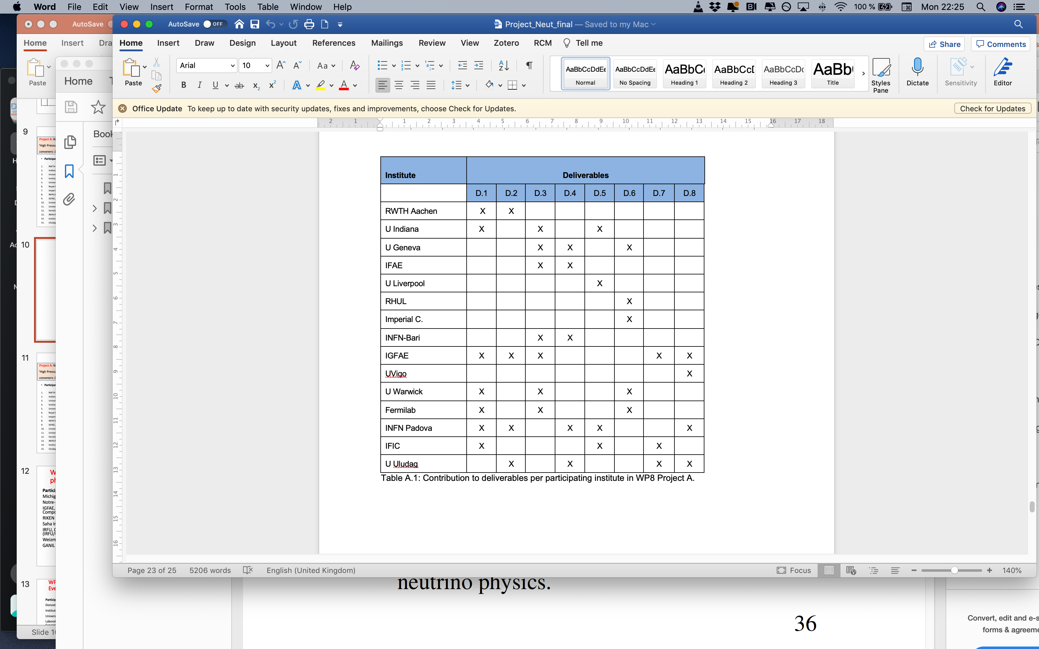
‘High Pressure TPCs for precision studies of neutrino interactions’
Project A: Neutrino Physics
conveners: DGD, Alan Bross (Fermilab)

Slide 12
‘High Pressure TPCs for precision studies of neutrino interactions’
Project A: Neutrino Physics
conveners: DGD, Alan Bross (Fermilab)
Improve TPC design (field cage, gas distribution)
T₀ detection
Development of high-density / low-power electronics
New/optimized amplification structures for high-pressure
Performance studies outside argon (H₂, He, Ne, Xe)
Technology demonstrators (𝜎_{dE/dx} , threshold, space and time res.)
Simulation models (specially: eco-gases and optical properties)
Development of small R&D setups for optical and electrical studies

Slide 13
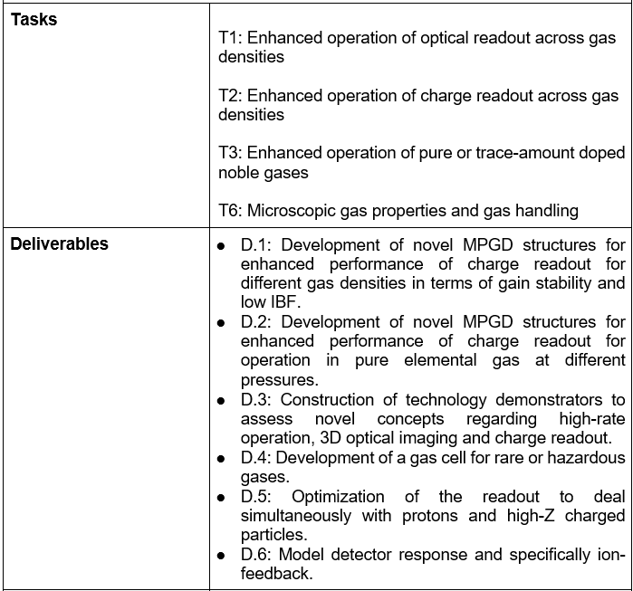
Projects + community feedback project deliverables
Project B: Nuclear Physics
‘TPCs for low-energy nuclear physics’
conveners: EFR, Marco Cortesi (MSU)
Participating institutes:
Michigan State University (MSU)
Notre-Dame University (ISNAP)
IGFAE, Universidade de Santiago de Compostela (IGFAE)
RIKEN (RIKEN)
Saha Institute of Nuclear Physics (SINP)
IRFU, CEA, University Paris-Saclay (IRFU/CEA)
Weizmann Institute of Science (WIS)
GANIL (GANIL)

Slide 14
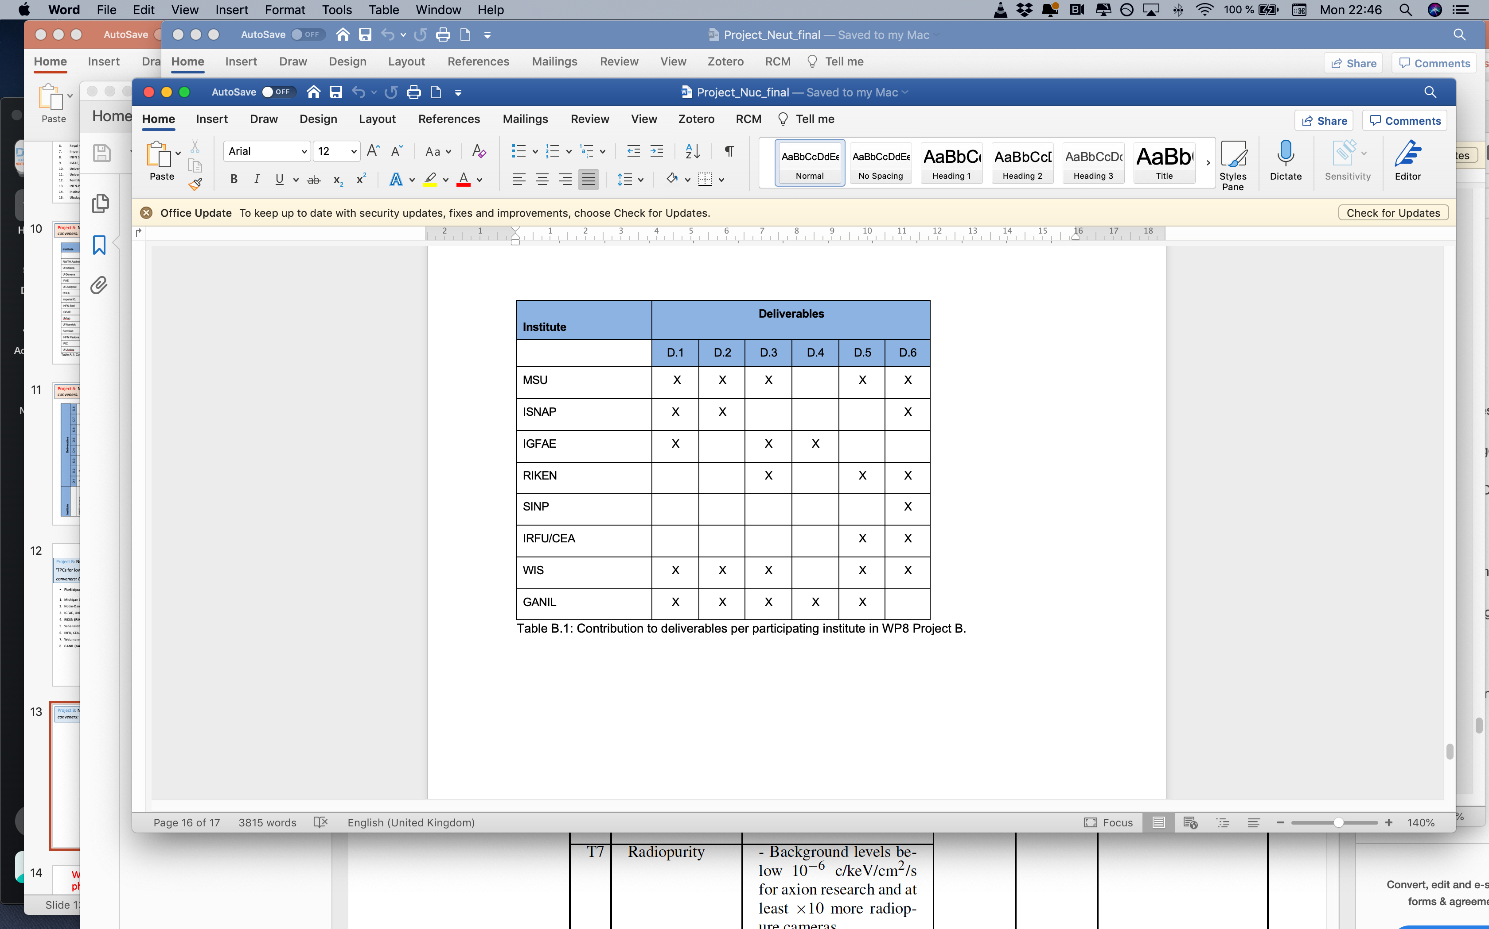
Project B: Nuclear Physics
‘TPCs for low-energy nuclear physics’
conveners: EFR, Marco Cortesi (MSU)

Slide 15
Project B: Nuclear Physics
‘TPCs for low-energy nuclear physics’
conveners: EFR, Marco Cortesi (MSU)
Detector modelling (specifically ion feedback)
Readout optimization to deal with high and low Z simultaneously
Development of a gas cell for hazardous gases
Technology demonstrators (high rate, 3D optical imaging)
New/optimized amplification structures for ≃ 0-1bar in pure gas and high gain
New/optimized amplification structures for ≃ 0-1bar at low-IBF

Slide 16
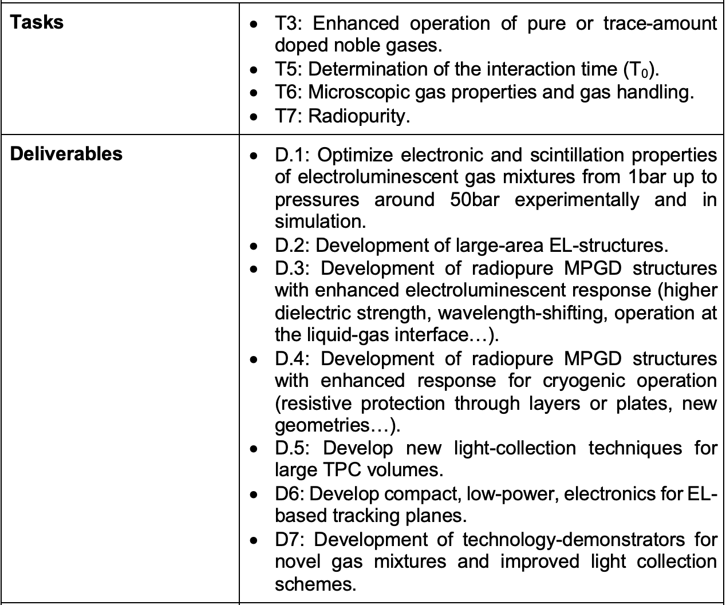
Projects + community feedback project deliverables
Project C: electroluminescence and related
‘Electroluminescence-based TPCs for Rare-Event Searches and other R&D on pure noble-gas amplification ’
conveners: EFR, Francec Monrabal (DIPC)
Participating institutes:
Donostia International Physics Center (DIPC)
Instituto de Física Corpuscular (IFIC)
Universitat Politècnica de València (UPV)
Laboratório de Instrumentação e Física Experimental de Partículas (LIP-Coimbra)
Universidade de Santiago de Compostela (IGFAE)
University of Coimbra (U Coimbra)
University of Aveiro (U Aveiro)
Astrocent (Astrocent)
Weizmann Institute of Science (WIS)

Slide 17
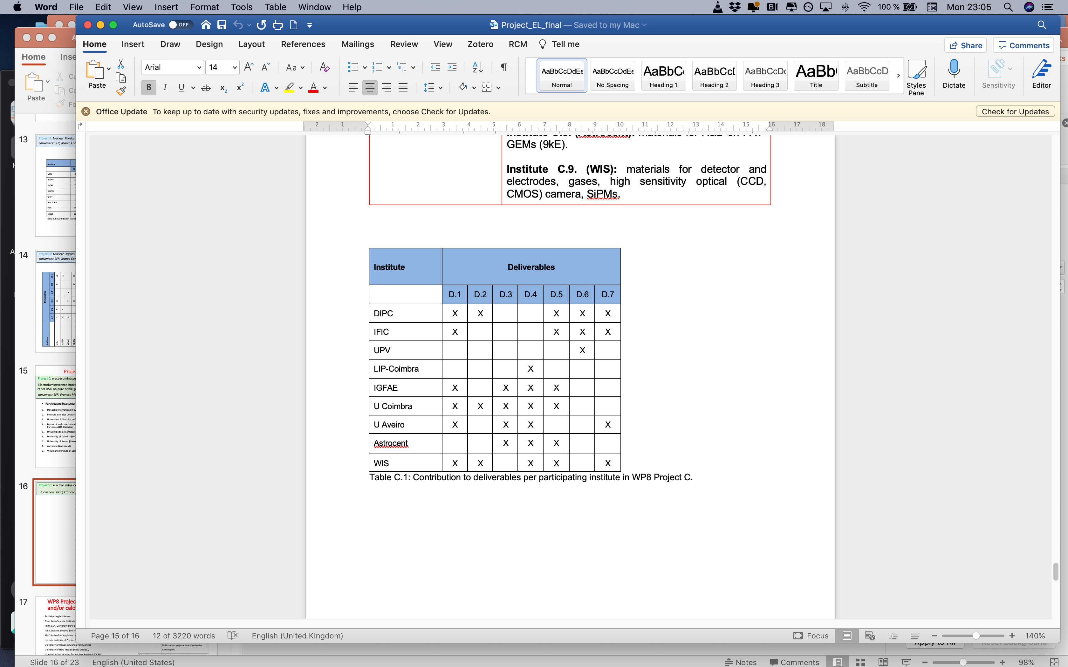
Project C: electroluminescence and related
‘Electroluminescence-based TPCs for Rare-Event Searches and other R&D on pure noble-gas amplification ’
conveners: DGD, Francec Monrabal (DIPC)

Slide 18
Project C: electroluminescence and related
‘Electroluminescence-based TPCs for Rare-Event Searches and other R&D on pure noble-gas amplification ’
conveners: DGD, Francec Monrabal (DIPC)
Technology demonstrators for new gas mixtures and light collection schemes
Compact electronics for EL-based tracking.
Improve light collection
New amplification concepts in cryogenics (RWELL, RPWELL…)
New EL concepts (wavelength-shifting, floating…)
Develop large-area EL structures
Optimize EL structures from 1-50bar (exp. and sim.)

Slide 19
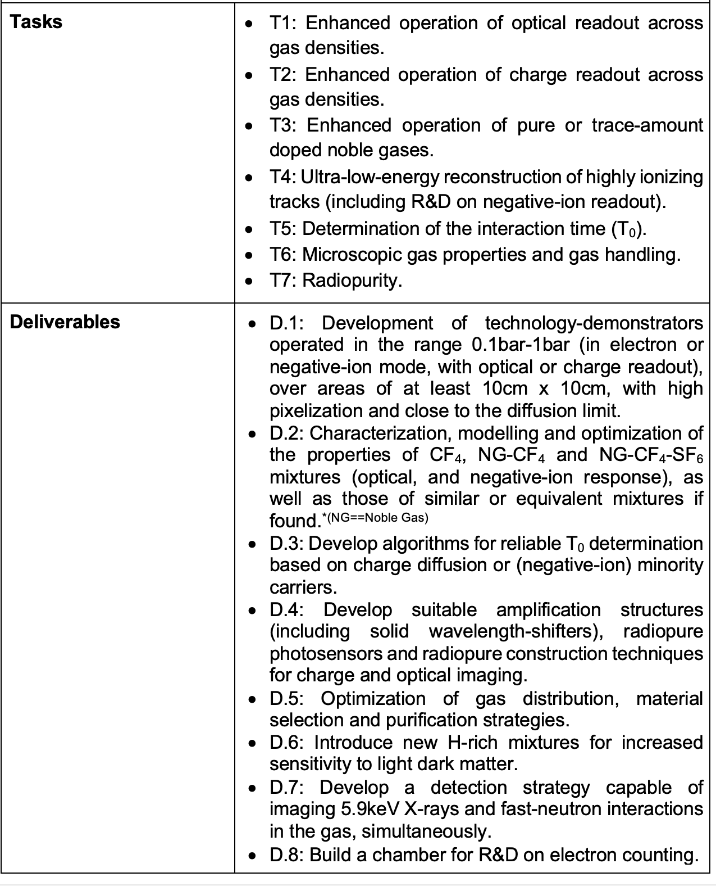
Projects + community feedback project deliverables
Project D: Dark Matter and related
‘Radiopure TPCs for precise track imaging and/or calorimetry with avalanche-based readouts’
conveners: EFR, G. Dho (GSSI)
Participating institutes:
Gran Sasso Science Institute (GSSI),
IRFU, CEA, University Paris-Saclay (IRFU/CEA) ,
INFN Sezione di Roma (INFN-Roma1),
STFC Rutherford Appleton Laboratory (RAL),
Helsinki Institute of Physics (HIP),
University of Hawai at Manoa (UH Manoa),
University of New Mexico (New Mexico),
European Organisation for Nuclear Research (CERN),
CAPA & Universidad de Zaragoza (CAPA/UNIZAR),
Laboratório de Instrumentação e Física Experimental de Partículas (LIP-Coimbra),
Australian National University (ANU),
LPSC-Grenoble (IN2P3/UGA),
Institute of Experimental Physics, Hamburg University (U Hamburg),
Kobe University (U Kobe),
University of Bonn (U Bonn)

Slide 20
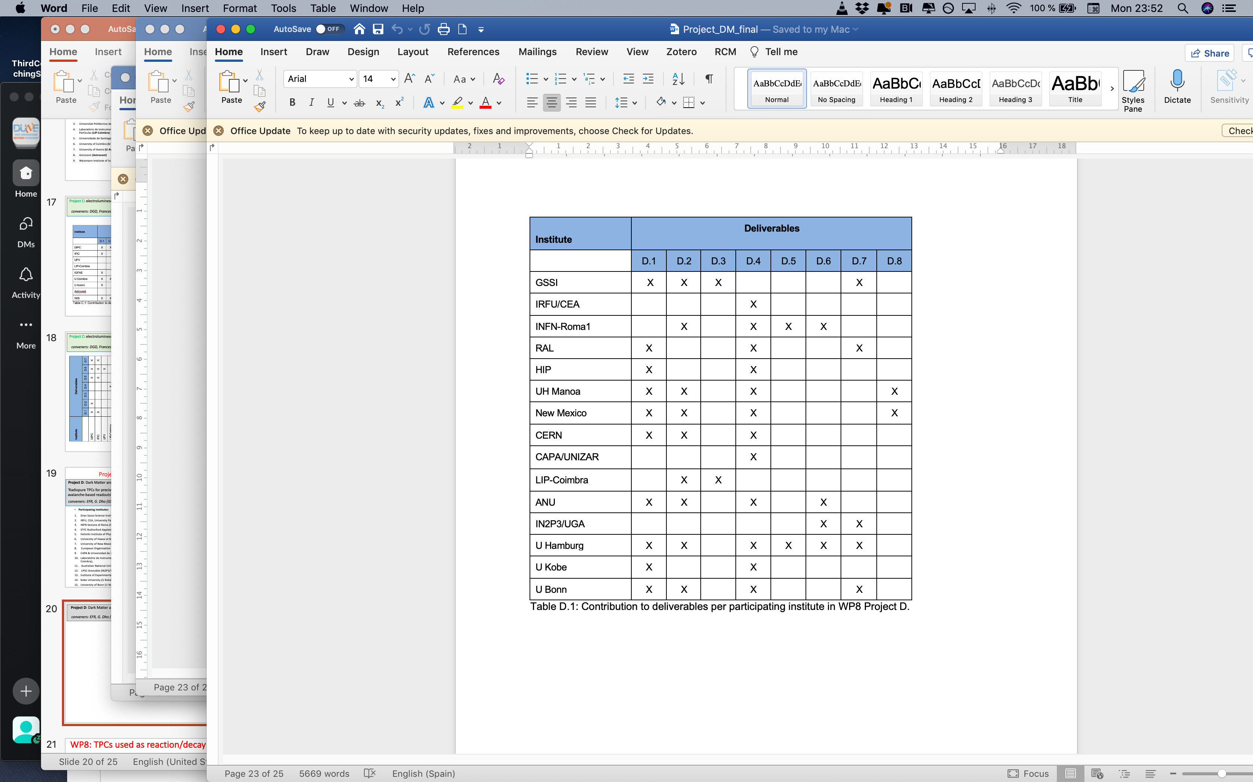
Project D: Dark Matter and related
‘Radiopure TPCs for precise track imaging and/or calorimetry with avalanche-based readouts’
conveners: EFR, G. Dho (GSSI)

Slide 21
Project D: Dark Matter and related
‘Radiopure TPCs for precise track imaging and/or calorimetry with avalanche-based readouts’
conveners: EFR, G. Dho (GSSI)
Build a chamber for R&D on electron counting
Simultaneous reconstruction of electron and nuclear recoils
Study H-rich mixtures
Optimization of gas distribution, material selection and purification
Develop radiopure structures for optical and electrical imaging
T₀-reconstruction through diffusion or minority carriers
Characterization/modelling/optimization of CF₄, NG/CF₄, NG/CF₄/SF₆
Technology demonstrators on ~10cm x 10cm with high pixelization
and close to the thermal limit.

Slide 22
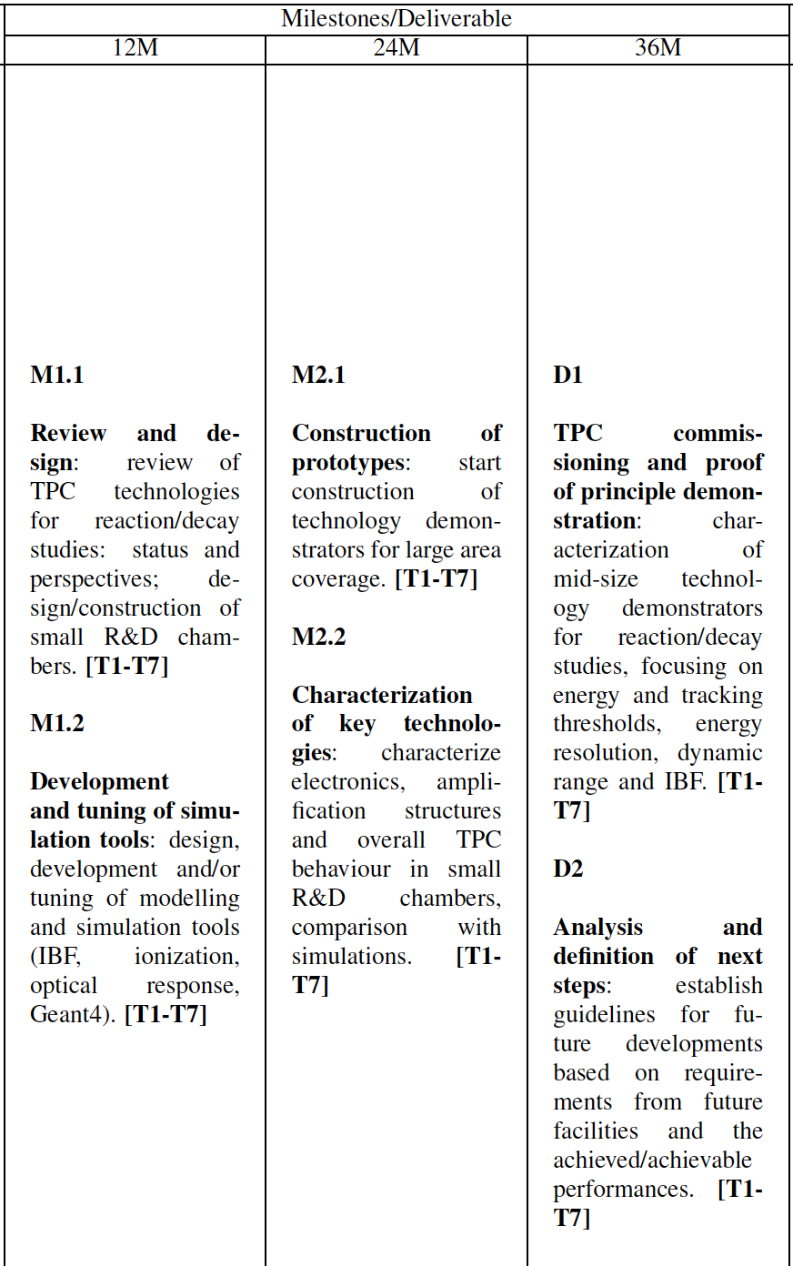
Executive milestones and deliverables

Slide 23
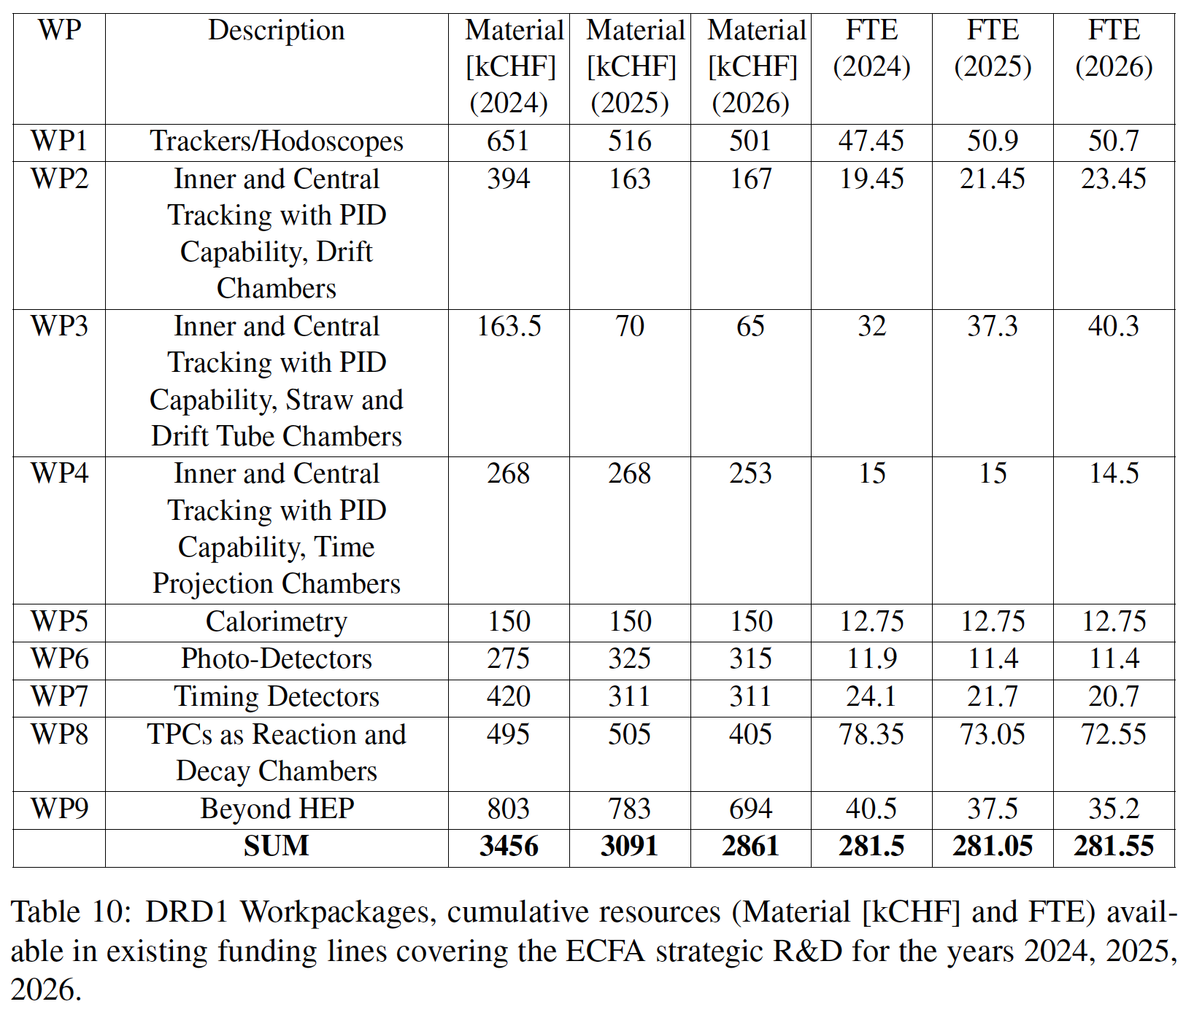
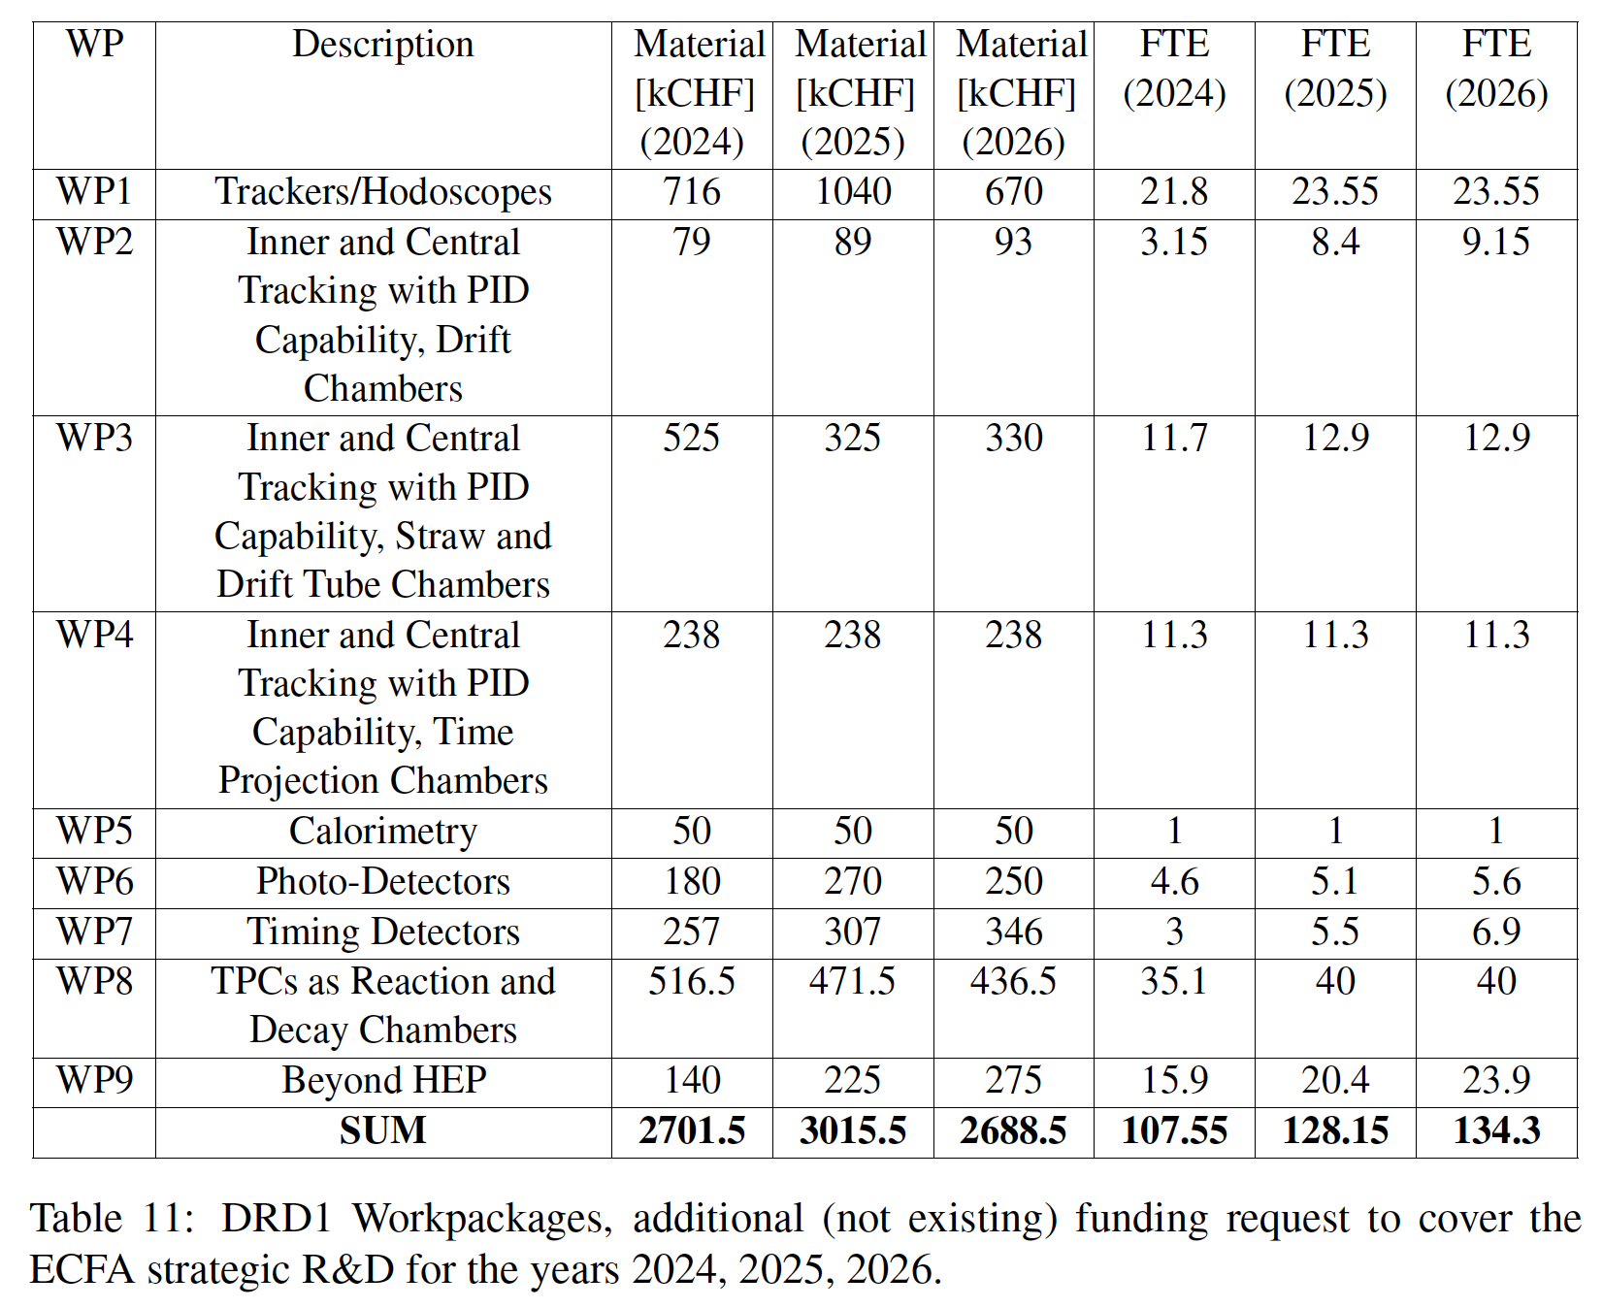
Resources
available
requested

Slide 24
Next steps
WP4/WP8 coordinators:
D. Gonzalez Diaz, E. Ferrer Ribas, F. I. Garcia Fuentes, P. Gasik, J. Kaminski
Email list:
DRD1-WP8-contact@cern.ch
-> one per project perhaps?
Kick-off meeting
Essentially ready, but needs clarification regarding WP-structure. WP8 organization based on project-conveners and WP-coordinators seems satisfactory.
-> Cand this be maintained as we move forward?
Concern (shared by DGD and EFR) that dealing with WP8 without 1 additional person per project is not viable.

