Slide 1
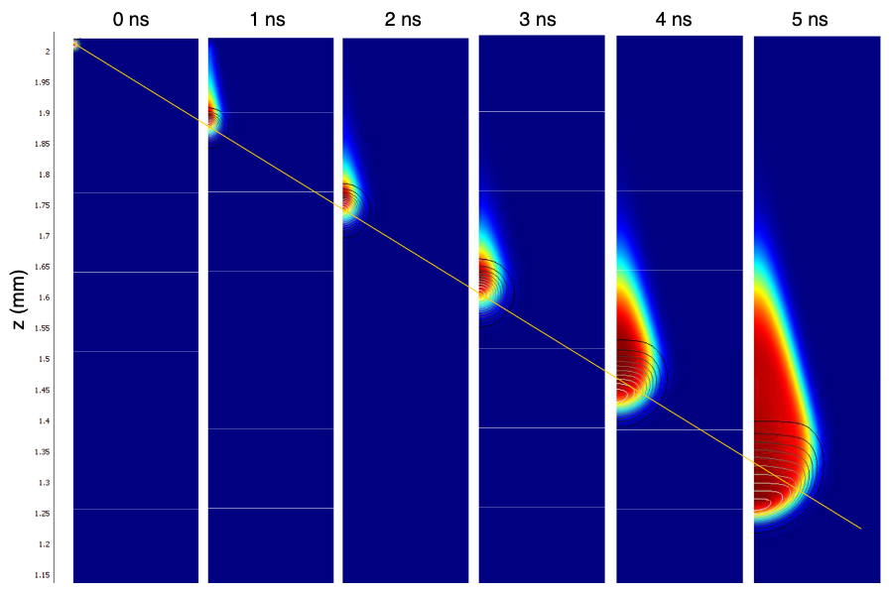
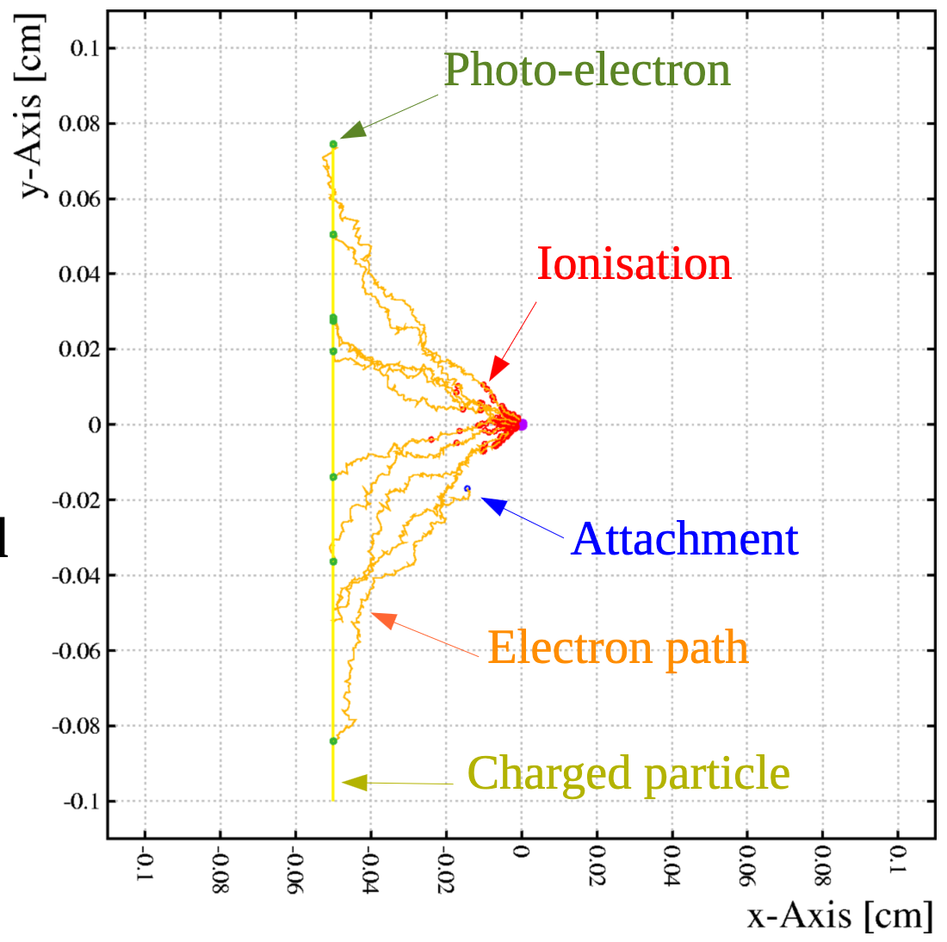
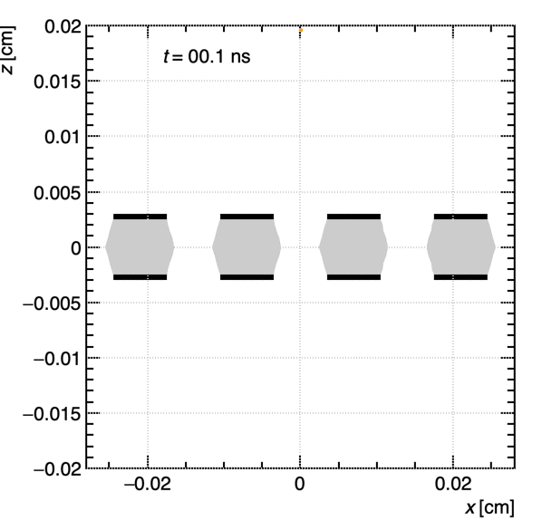
DRD1 WG4
Detector Physics Modelling and Simulation
WG4 Conveners:
Marcello Abbrescia, Maryna Borysova, Paulo Fonte, Supratik Mukhopadhyay, Ozkan Sahin, Rob Veenhof, Piet Verwilligen

Slide 2
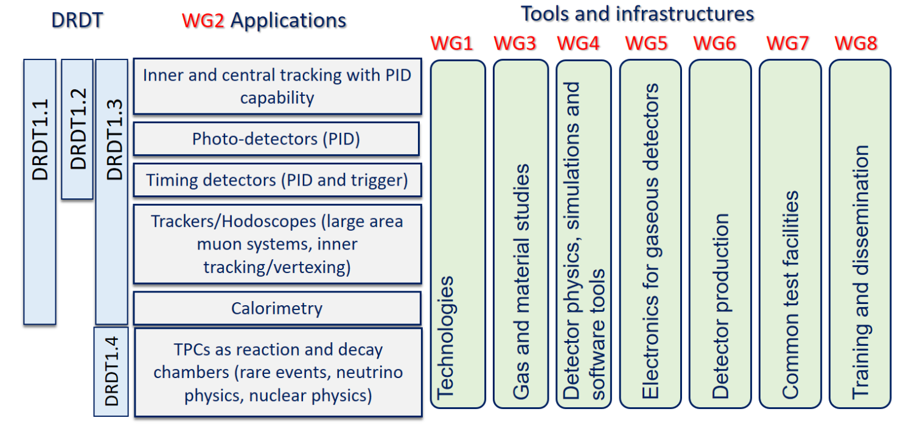
Short Introduction to WG4
Detector Physics, Simulation & Software Tools
WG4 is transversal workgroup:
  Groups people working on simulations
  in various Work-Packages
  Platform to exchange progress & best practices
  In a sense a ”Service” to the community … but only if there is input
  Work together to obtain solutions to common problems
WG4 Aims at:
  Understanding & modelling Physical Processes in Gaseous Det (GD)
  Development of Suitable Simulation & Software Tools
Importance within DRD1:
  Advanced simulations indispensable for GD Detector R&D
  Confirm / Challenge current understanding of Detector Physics
  Note: SW Tools developed within GD community now used for other detection technologies (Liquid / Solid State)

Slide 3
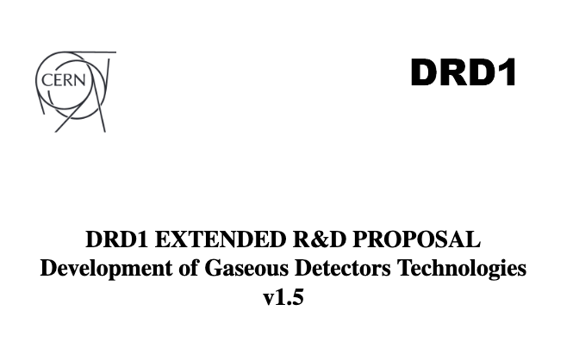
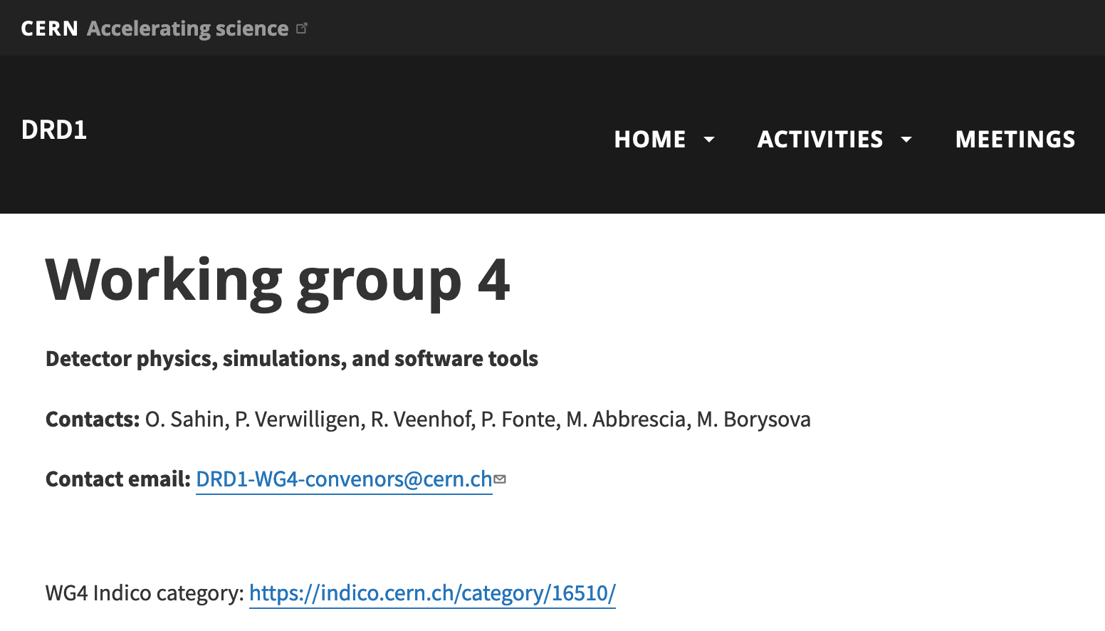
Description WG4 in DRD1 Ext Proposal
Detector Physics, Simulation & Software Tools
8 p in the Extended proposal (p72-80)
Introduction – Motivation
State of the Art:
  What has been simulated in the past
  What are the current limitations in the physics modelling and simulation
Needs of the communities:
  Maintenance & Improvement Garfield++
  Simulation Large Charges & Space-Charge
  Detectors with Resistive materials
  ECO-gases, Penning, Ion mobility
  Electroluminescence, Negative Ions
  Fast / Parametrized Simulations
drd1.web.cern.ch/activities-wg4

Slide 4
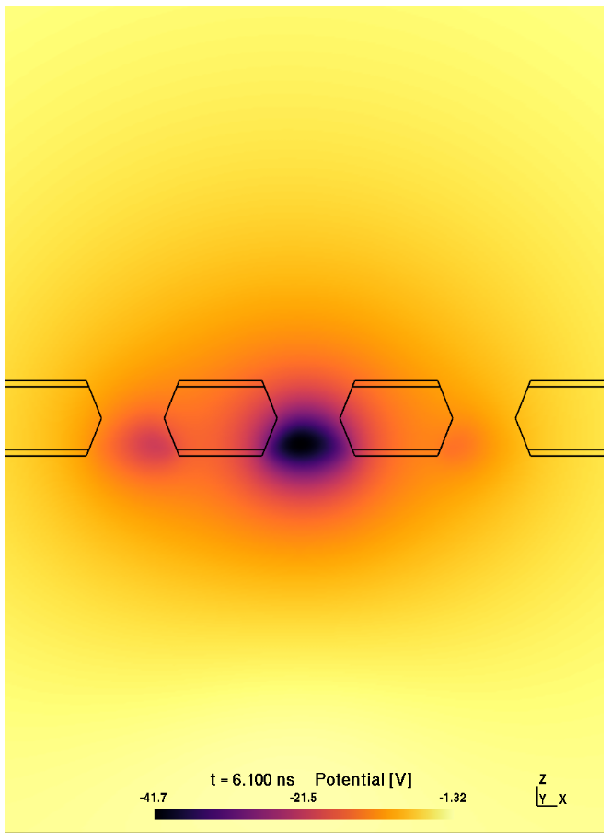
Description WG4 in DRD1 Ext Proposal
Main Limitations of the current simulation Tools
Long computing times / Prohibitive resource use of precise and realistic simulations
  Large Gains, Large Rates
  Space-Charge effects (see also GEMs)
Non-correct signal shape simulation
  Need correct ion species & ion mobilities
Dynamic behaviour (Rate => V-drop)
Unknown effects
  Discharge transition
  Ageing effects
New / Innovative Gases
  Simulation is ideal tool to survey multi-dimensional Parameter space – but need cross-sections of candidate gas components
New concepts:
  Neg Ion drift & amplification
  Electroluminescence & optical readout
Ouroboros BEM on GPU
Microscopic Tracking + E-field update due to Space-Charge
JINST 17 (2022) 01, P01020

Slide 5
Common Objectives WG4 I
Common “Core” Software Development
WP1 | Large area Tracking | WP5 | Calorimetry
WP2 | Drift Ch, Trk & PID | WP6 | Photon Det
WP3 | Straws, Trk & PID | WP7 | Timing Det
WP4 | TPCs, Trk & PID | WP8 | Act Targ TPC
Many possible Tasks:
 | Ref. | Description | Link to WP
4.1.X GARFIELD Modernization | 4.1.1 | Review Core code for Multi-Threading and Heterogeneous Computing (CPU – GPU), optimized C++ code for modern CPUs, … | All WPs
 | 4.1.2 | Add Community Tools (Validation, Automatic Pull-Request Tests, Builds, …) | All WPs
 | 4.1.3 | Review & Accelerate G++ integrated neBEM | All WPs
4.2.X GARFIELD Framework Improvement | 4.2.1 | Recommended Set of Ion Mobilities | All WPs
 | 4.2.2 | Secure long-term solution for Magboltz | All WPs, WG3
 | 4.2.3 | Miscellaneous: better Event Displays, Improve Documentation, Provide Examples | All WPs
We would like / need to collaborate with CERN IT department for Core Code and for the deployment of modern software tools. We would need people willing to push these developments forward and can follow PhD students (partly) working on these topics …

Slide 6
Common Objectives WG4 II
Application Specific Software Development
WP1 | Large area Tracking | WP5 | Calorimetry
WP2 | Drift Ch, Trk & PID | WP6 | Photon Det
WP3 | Straws, Trk & PID | WP7 | Timing Det
WP4 | TPCs, Trk & PID | WP8 | Act Targ TPC
Many possible Tasks:
 | Ref. | Description | Link to WP
4.3.X Simulation of Large Avalanches / Space Charge Effects | 4.3.a.1 | Implementation of Space-Charge | WP 1,6,7
 | 4.3.a.2 | Implementation of E-Field update (on the fly) | WP 1,6,7
 | 4.3.a.3 | Clustering of particles for Large Avalanches | WP 1,6,7
 | 4.3.b.1 | Simulate Discharges using code 4.3.a | WP 1,6,7
4.4.X Simulation of Resistive GDs | 4.4.a.1 | Signals: Time-dependent weighting fields | WP 1,2,4,5,7
 | 4.4.b.1 | Rate-Capability simulation (Equiv. Network) | WP 1,4,5,7
 | 4.4.b.2 | Framework for large-size detectors (cells) | WP 1,7
 | 4.4.c.1 | Model / Sim Dark Count Rate and Ageing | WP 1,2,7
Very important Software development required and once in place several (most) applications will benefit. Community will be allowed to simulate / compare / study effects that could not be studied before … Still funding & manpower should be driven inside Application WPs

Slide 7
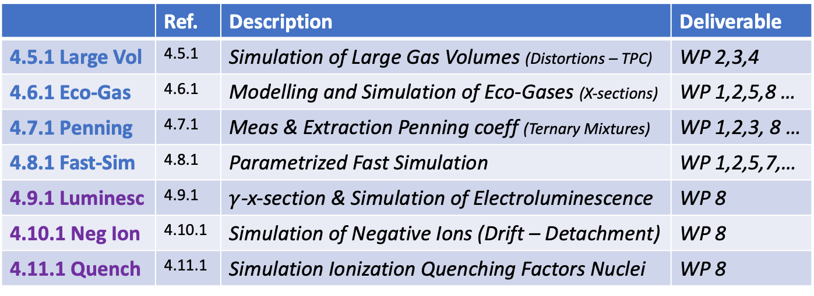
Common Objectives WG4 III
Application Specific Software Development
WP1 | Large area Tracking | WP5 | Calorimetry
WP2 | Drift Ch, Trk & PID | WP6 | Photon Det
WP3 | Straws, Trk & PID | WP7 | Timing Det
WP4 | TPCs, Trk & PID | WP8 | Act Targ TPC
Many possible Tasks:
 | Ref. | Description | Deliverable
4.5.1 Large Vol | 4.5.1 | Simulation of Large Gas Volumes (Distortions – TPC) | WP 2,3,4
4.6.1 Eco-Gas | 4.6.1 | Modelling and Simulation of Eco-Gases (X-sections) | WP 1,2,5,8 …
4.7.1 Penning | 4.7.1 | Meas & Extraction Penning coeff (Ternary Mixtures) | WP 1,2,3, 8 …
4.8.1 Fast-Sim | 4.8.1 | Parametrized Fast Simulation | WP 1,2,5,7,…
4.9.1 Luminesc | 4.9.1 | $γ$-x-section & Simulation of Electroluminescence | WP 8
4.10.1 Neg Ion | 4.10.1 | Simulation of Negative Ions (Drift – Detachment) | WP 8
4.11.1 Quench | 4.11.1 | Simulation Ionization Quenching Factors Nuclei | WP 8
Here these tasks fit naturally into the various Work Packages for the Applications. Funding and (Wo)manpower to work on these tasks should be included in the WP proposals. WG4 acting as a platform for exchange of expertise, coordination and help.
National P.I.s & WP leaders … everybody … please feel responsabilized ☺

Slide 8



Common Objectives WG4 IV
Summary – Call to arms
Lots of (possible) work
  We have envisioned a dream
  work for next 10 years
  Now need to decide what is priority
  => will see what is priority by which projects will dedicate manpower
  => need all of you
If WPs are not going to identify persons to work on certain topics, then these simulation / physics modelling targets will not be reached – even not get started
Remember: we are the community

Slide 9

WG4 Survey
Who are we? What does the DRD1 wants?
We will launch a quick survey
  10 questions – 5’ of your time
  LINK: survey
  Please fill out by 16/02
Aim:
  Get to know who already works on software & simulations
  Get suggestions for future software developments
  Understand priorities from community

Slide 10

WG4 Organization
Who are we? What do we want? How will we work?
We would like to bring people together working on same/similar topics
We will start with monthly WG4 – meetings
  Every 2nd Tuesday of the Month 15:00 – 17:00
Idea: short presentations of ongoing / future work
  Find synergies and get people to start working together
  Easy environment for new persons to start working on tasks
Another Idea:
  WP Task leaders presenting the simulation work they will take up?
Next Meetings:
Feb 13
Mar 12
Apr 9

Slide 11

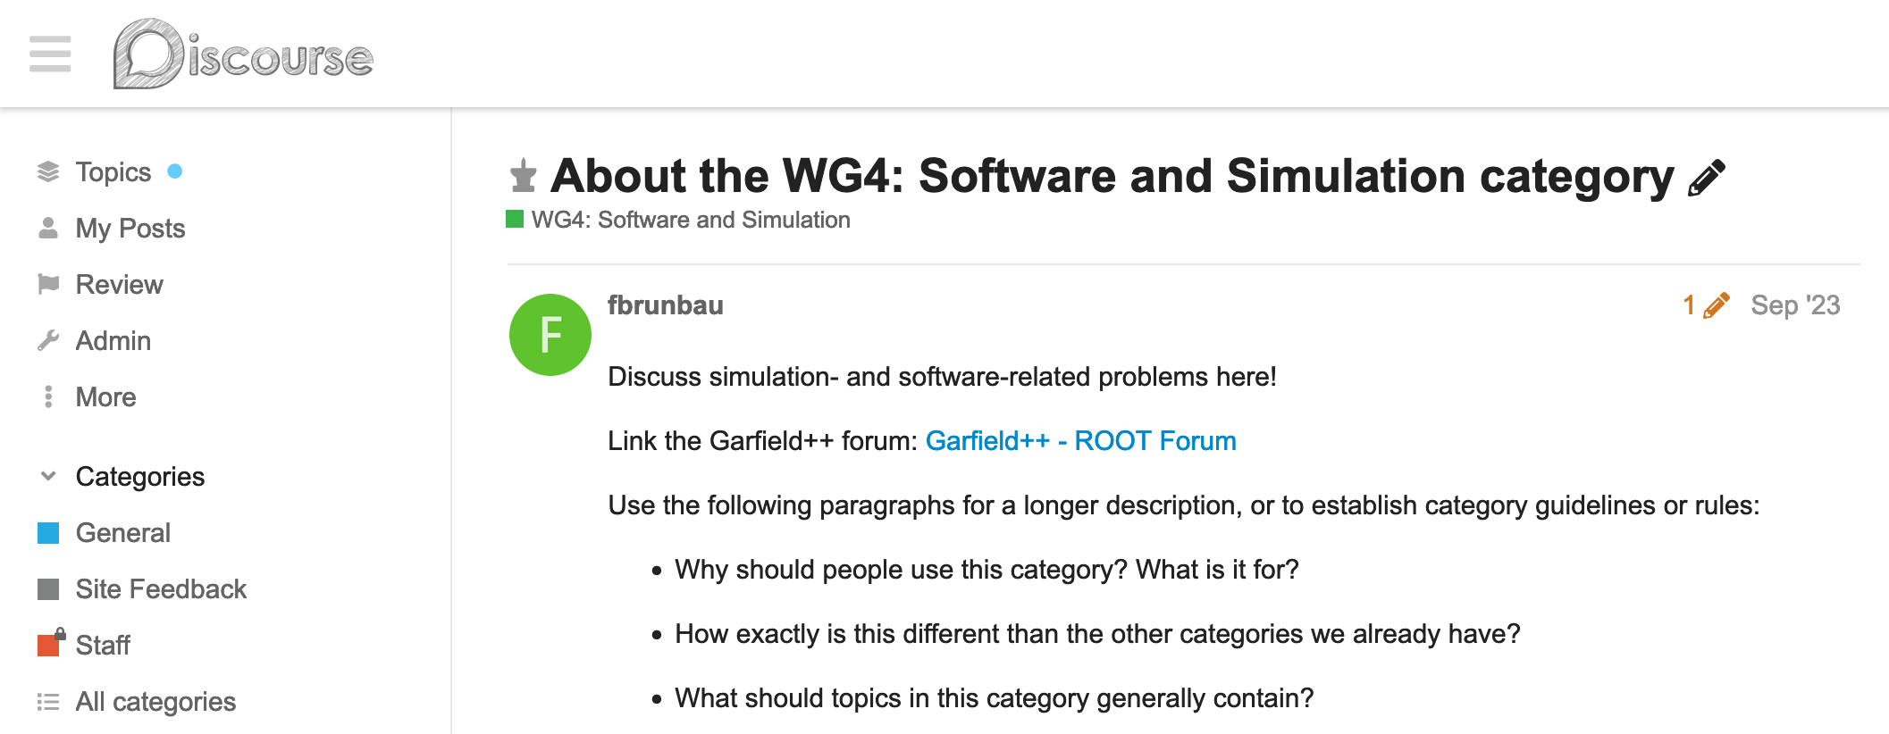
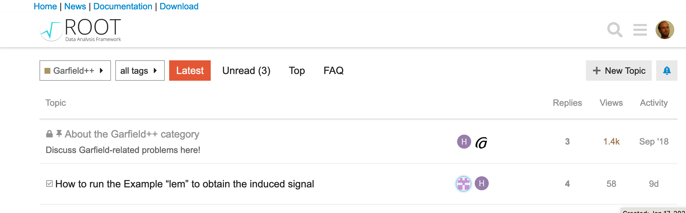
WG4 Tools
What will we use?
DRD1 Website & DRD1 email list – please subscribe!
  drd1-wg4@cern.ch => all persons interested
  drd1-wg4-conveners@cern.ch => conveners
DRD1 Discourse - Forum for WG4
  https://drd1-forum.web.cern.ch/t/about-the-wg4-software-and-simulation-category/19
Garfield++ website
  ROOT Forum dedicated to garfield++
  https://root-forum.cern.ch/c/garfieldxx/25
CERN computing resources:
  LXPLUS / LXBATCH / SWAN / …
  Need to verify whether we need non-experiment quota

Slide 12
Interface with WG8
Knowledge transfer, Training, Career
We would like to increase the base of the pyramid
  More people using simulation SW
  => to more people developing SW
Will integrate into WG8 efforts
  Contribute to eventual detector school in 2024 by
    Developing simulation exercises
    Lecture on simulation “theory” and best practices ….
  Would like to form group to organize simulation school in 2025
SW developer
Simulation SW user

Slide 13
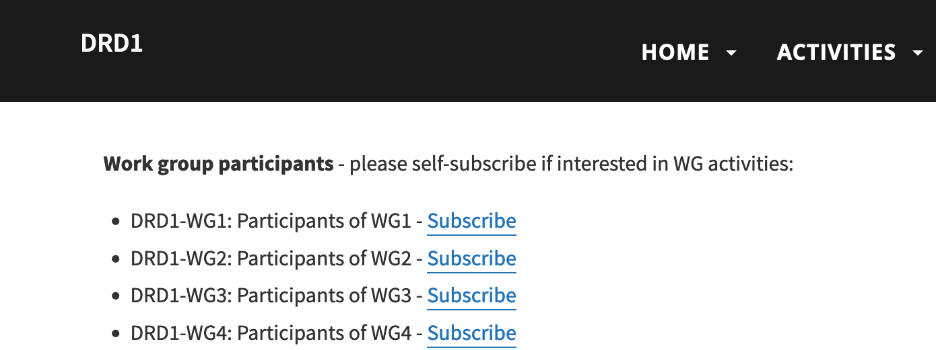
Summary & Homework
What can you do for us – and for yourself?
Summary
  Presented WG4 – Objectives & open Tasks
  Presented WG4 – Organization - Communication
Your homework
  Read the DRD1 proposal – if you did not do so already
  Subscribe to DRD1 WG4 Mailing list
  Fill in WG4 survey
  Present yourself / your institute in WG4 working meetings
    Past, present & future work
    Simulation / SW interests
    Relaxed environment …

Slide 14
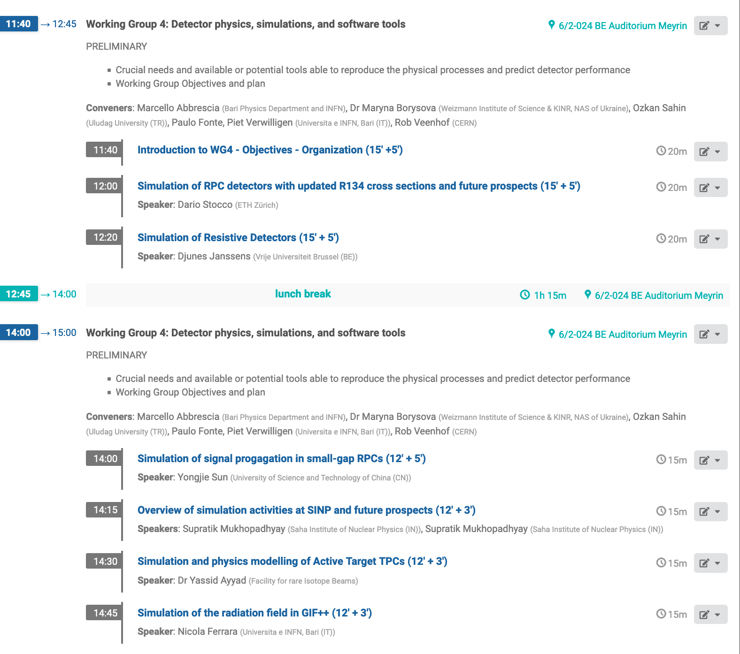
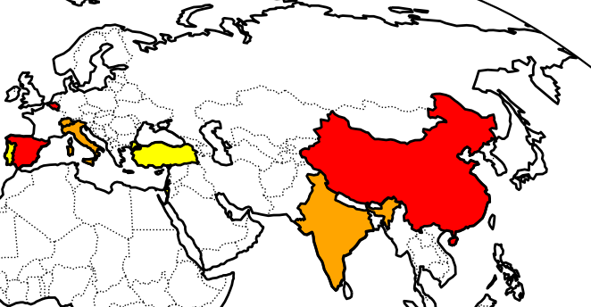
Today’s agenda of WG4 session and now let’s go to work!
Today’s agenda:
Geographical distribution today:
WG4 conveners
WG4 conveners + speakers
WG4 speakers

