Slide 1
Overview of simulation activities at SINP and future prospects
Supratik Mukhopadhyay
on behalf of the SINP team
First Collaboration meeting of the DRD1 Collaboration
29 January 2024 to 2 February 2024 at CERN

Slide 2
Outline of the presentation
Simulation of gaseous ionization detectors at SINP - more or less, a chronological view.
Ongoing activities
Future projections

Slide 3
Initial attempts: a cylindrical proportional counter
Collocation BEM
Acceptable potential
Geometry of a cylindrical proportional counter
doi:10.1109/TNS.2006.872634
Field values not acceptable
Edge effects studied, thanks to numerical implementation
The collocation BEM model found not good enough even for a very simple geometry!

Slide 4
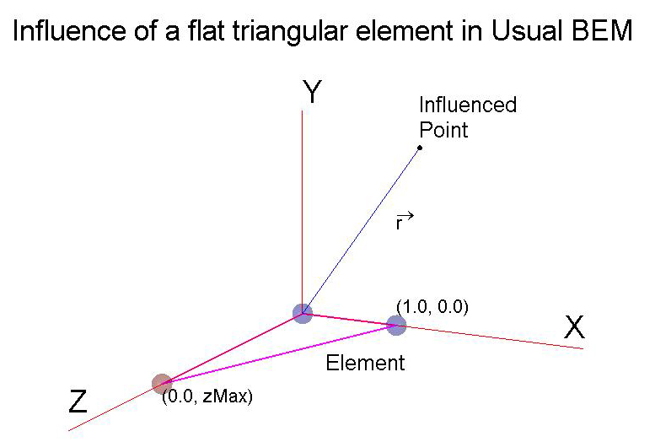
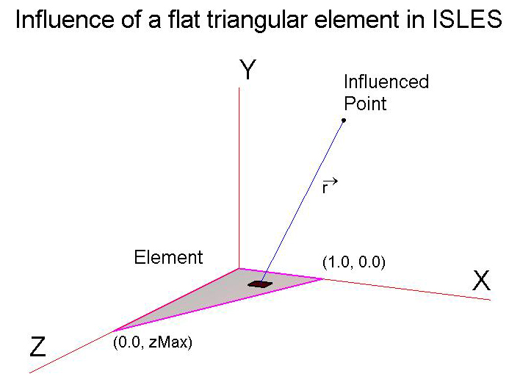
Search for a better solution nodal versus distributed

Slide 5
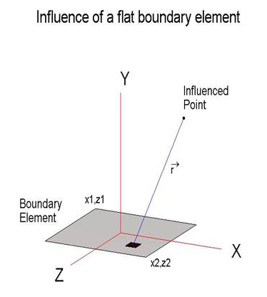
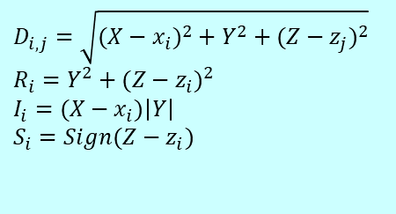

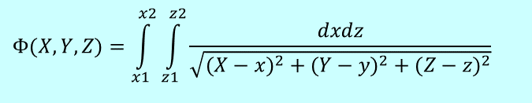
Foundation expressions of ISLES
Inverse Square Law Exact Solutions
Rectangular element
$$Φ(X,Y,Z)= \\ \frac{1}{2}×\left\{\begin{aligned}&2×(X|Z|x_{i}|z_{j})×\ln\left(\frac{D_{i,j}−(X|Z−x_{i}|z_{j})}{D_{m,n}−(X|Z−x_{m}|z_{n})}\right) \\ & \\ &+iS_{j}\left|Y\right|×\left[\tanh^{−1}\left(\frac{R_{j}−iI_{i}}{D_{i,j}\left|Z−z_{j}\right|}\right)−\tanh^{−1}\left(\frac{R_{j}+iI_{i}}{D_{i,j}\left|Z−z_{j}\right|}\right)\right]\end{aligned}\right\}−2πY$$
4 log terms
4+4 complex tanh⁻¹ terms
$$D_{i,j}=\sqrt{(X−x_{i})^{2}+Y^{2}+(Z−z_{j})^{2}} \\ R_{i}=Y^{2}+(Z−z_{i})^{2} \\ I_{i}=(X−x_{i})\left|Y\right| \\ S_{i}=Sign(Z−z_{i})$$
$$Φ(X,Y,Z)=\int_{x1}^{x2}{\int_{z1}^{z2}{\frac{dxdz}{\sqrt{(X−x)^{2}+(Y−y)^{2}+(Z−z)^{2}}}}}$$
May need translation and vector rotation
Value of multiple dependent on strength of source and other physical consideration
doi:10.1016/j.enganabound.2006.03.002

Slide 6
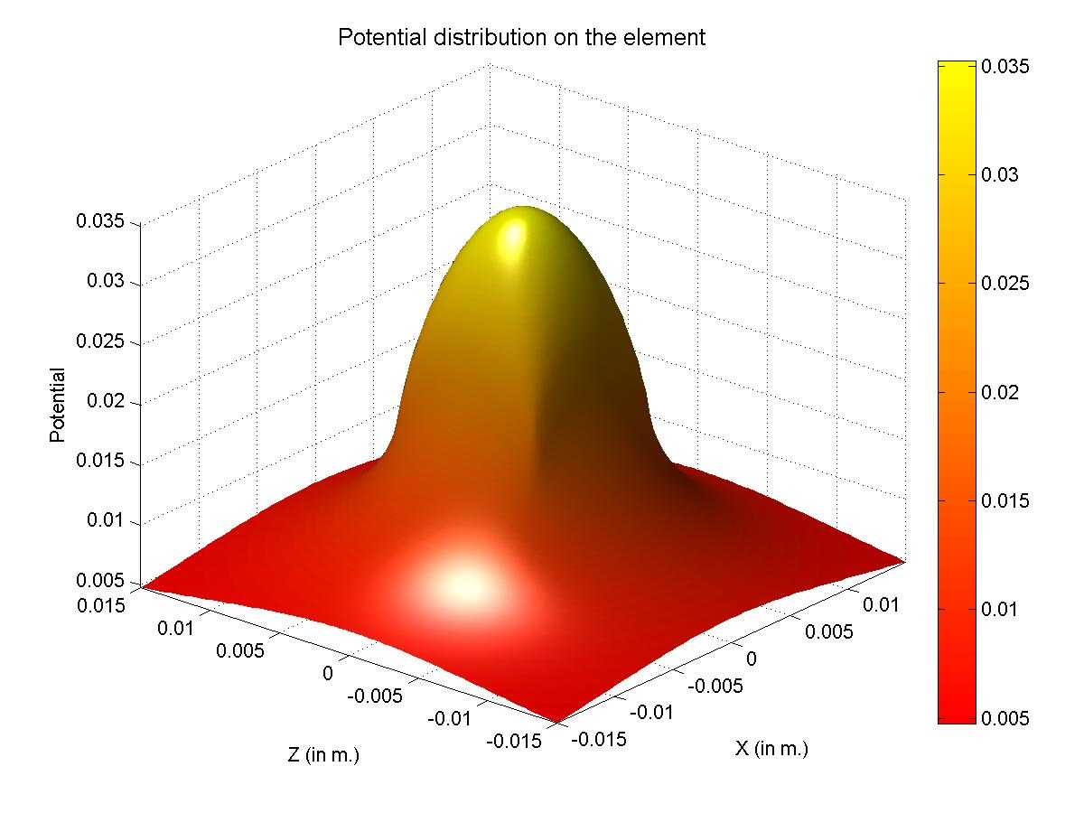
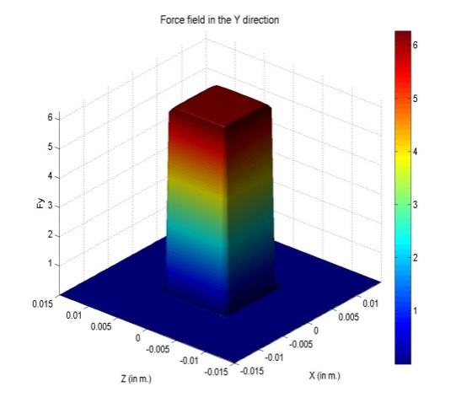
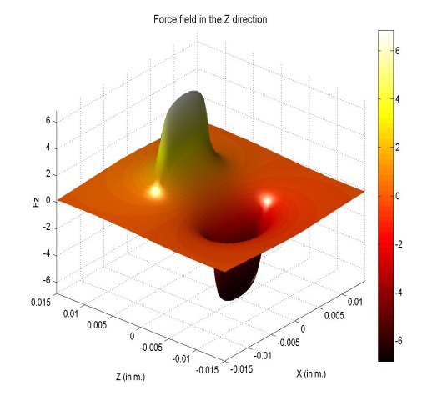
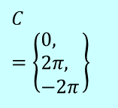
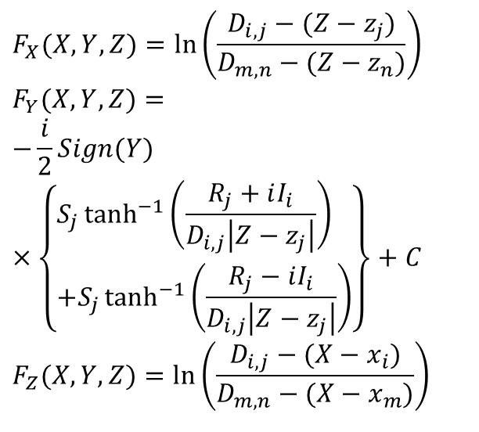
Foundation expressions of ISLES
$$F_{X}(X,Y,Z)=\ln\left(\frac{D_{i,j}−(Z−z_{j})}{D_{m,n}−(Z−z_{n})}\right) \\ F_{Y}(X,Y,Z)= \\ −\frac{i}{2}Sign(Y)×\left\{\begin{aligned}&S_{j}\tanh^{−1}\left(\frac{R_{j}+iI_{i}}{D_{i,j}\left|Z−z_{j}\right|}\right) \\ &+S_{j}\tanh^{−1}\left(\frac{R_{j}−iI_{i}}{D_{i,j}\left|Z−z_{j}\right|}\right)\end{aligned}\right\}+C \\ F_{Z}(X,Y,Z)=\ln\left(\frac{D_{i,j}−(X−x_{i})}{D_{m,n}−(X−x_{m})}\right)$$
2 terms
Validation
4+4 terms
Validation
2 terms
C is a constant of integration
$$C=\left\{\begin{aligned}&0\text{, } \\ &2π\text{, } \\ &−2π\end{aligned}\right\}$$
If outside XZ extent of element
If Y > 0
If Y < 0

Slide 7
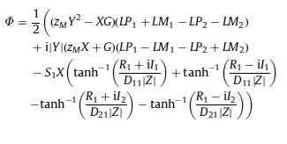
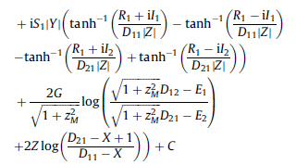
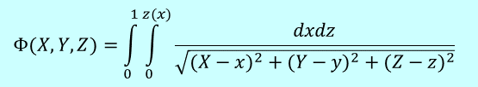
Foundation expressions of ISLES
Triangular element
Similar expressions as for rectangular elements but much longer with larger number of definitions and constants of integration.
$$Φ(X,Y,Z)=\int_{0}^{1}{\int_{0}^{z(x)}{\frac{dxdz}{\sqrt{(X−x)^{2}+(Y−y)^{2}+(Z−z)^{2}}}}}$$
Please note the integration limits: while any length is allowed in one co-ordinate, the other can be varied from 0 to 1, only.
May need translation, vector rotation and simple scalar scaling
doi: 10.1016/j.enganabound.2008.06.003

Slide 8
nearly exact BEM (neBEM)
A new set of closed-form exact solutions for precise estimation of potential and flux due to singularities (sources, sinks, doublets etc) uniformly distributed over rectangular and triangular elements has been found. Functions for wire, ring and disc elements have also been tested. These have evolved into a C library, namely ISLES.
Based on this library, the neBEM (nearly exact Boundary Element Method) solver has been developed to solve problems of interest in science and engineering

Slide 9
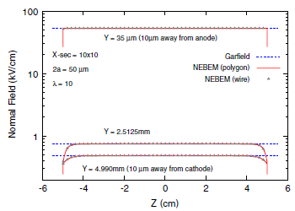
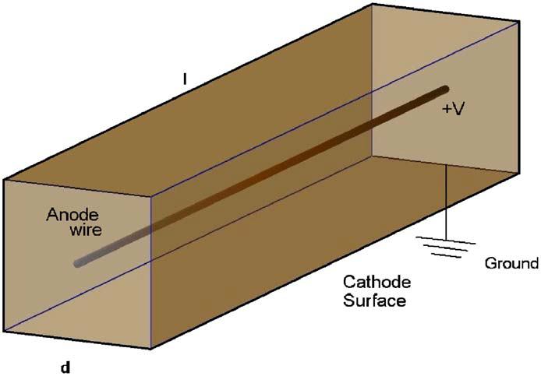
Wire chamber
Fields Very close to the wire of an Iarocci tube
Axial deviation of normal electric field at the mid-plane of an Iarocci chamber with cross-section 10mm × 10mm.
Two different models of wire have been considered
Despite the proximity of the top line to the wire surface, the normal electric field is found to be completely free from jaggedness or oscillations.
doi:10.1016/j.nima.2006.06.035

Slide 10
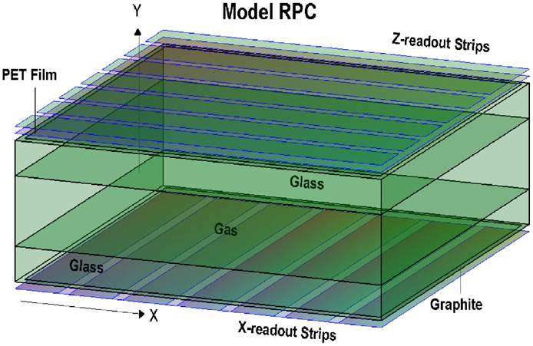
Resistive plate chambers
Number of thin dielectric layers
doi: 10.1016/j.nima.2008.07.033
Strip width: 3.0cm, Strip length: 50.0cm
Layer height: 2.0mm
Layer-3 permittivity (ε_{r}): 7.75 (~glass)
Layer-2 (middle) permittivity (ε_{r}): 1.000513 (~Argon)
Successful validation with Riegler et al.

Slide 11
Simulation framework in 2009
Drift, Diffusion,
Avalanche
Induced signal using Weighting field
Gas, Particle Type,
Energy
Heed
Primary
Ionization
Garfield
Transport Parameters
Field Map
Weighting Field Map
Gas, Temperature,
Pressure
Magboltz
Field Map
neBEM
Geometry, Material,
Boundary Conditions
Each and every component is open-source and free
Garfield: garfield.web.cern.ch, Heed: heed.web.cern.ch, Magboltz: magboltz.web.cern.ch, neBEM: nebem.web.cern.ch

Slide 12
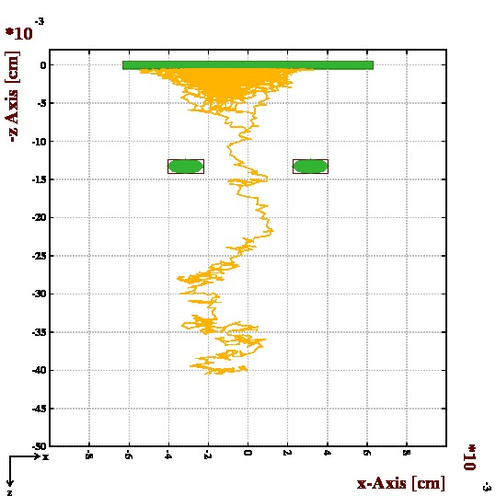
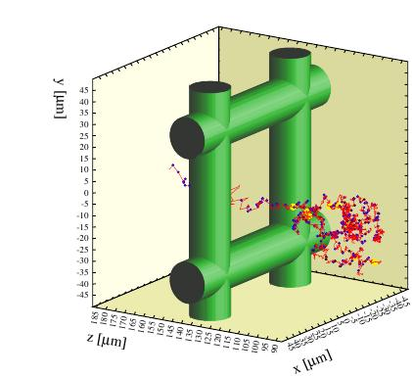
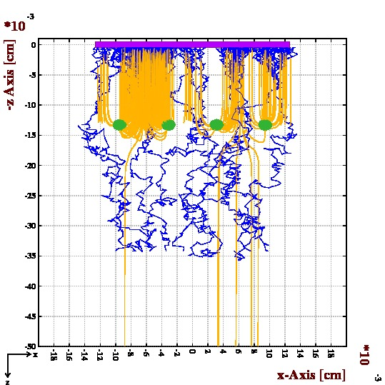
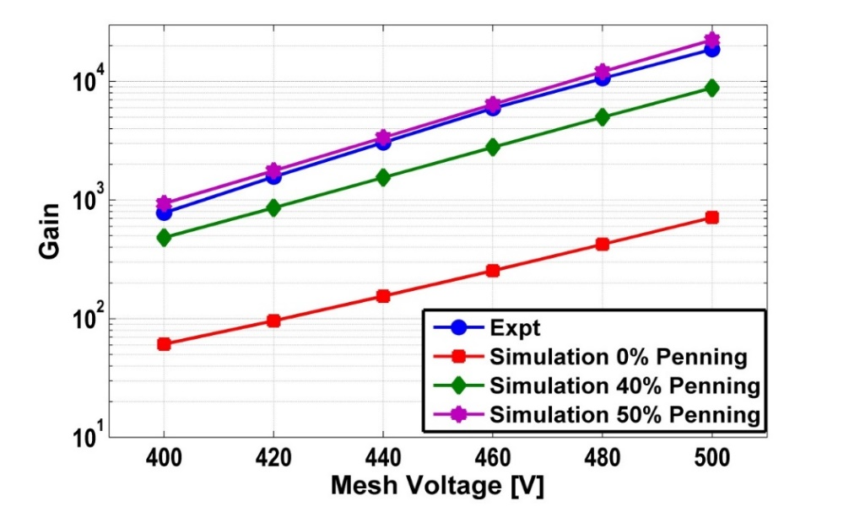
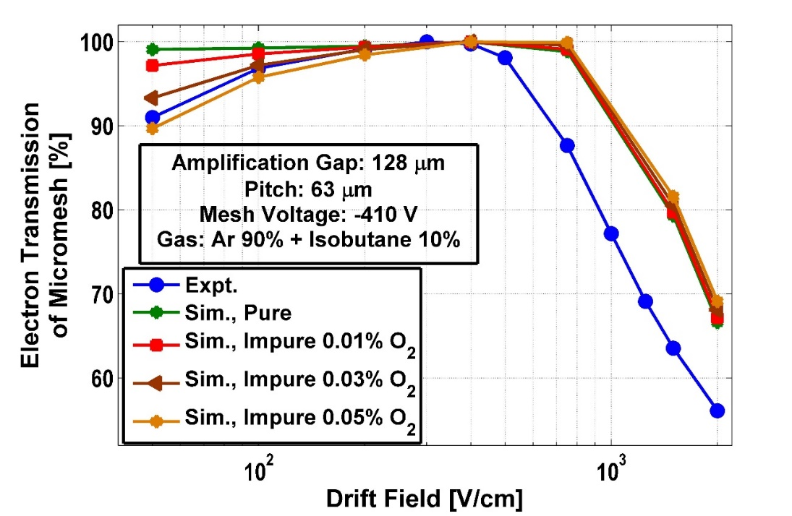
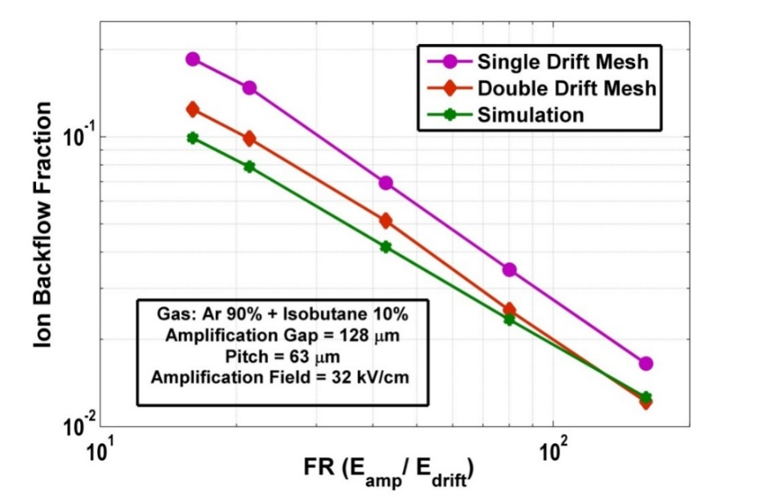
Simulation of Micromegas
1) Gain, energy resolution
2 ) Transparency
3) Ion back-flow
Several other …
doi: 10.1016/j.nima.2010.07.026
doi: 10.1088/1748-0221/6/06/P06011
(2011)
doi:10.1088/1748-0221/10/09/P09017 (2015)
doi: 10.1016/j.nima.2017.04.031

Slide 13
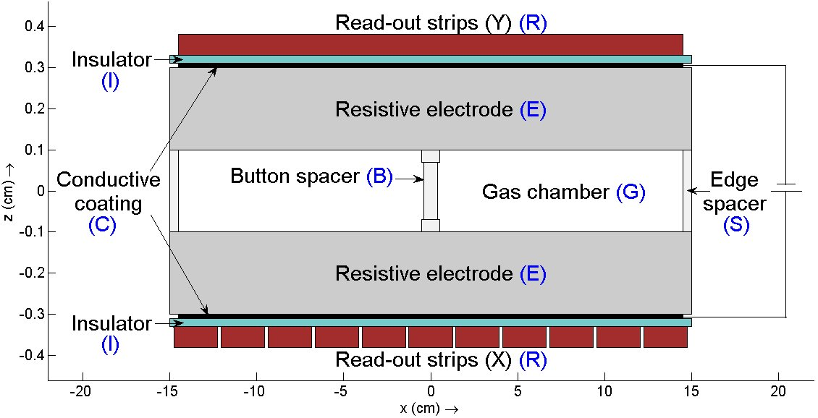
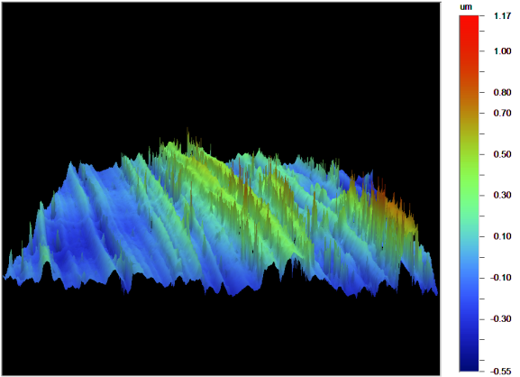
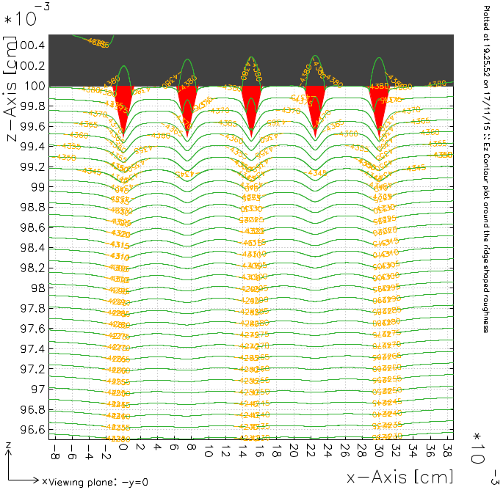
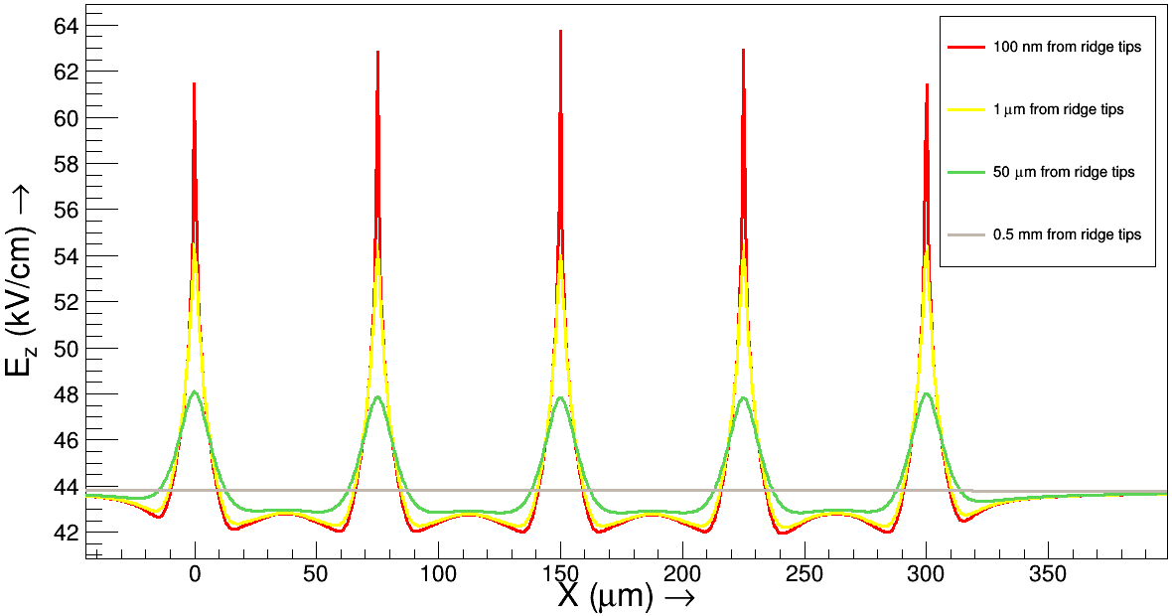
Roughness in RPCs
doi: 10.1088/1748-0221/7/11/T11027 (2012)
doi:10.1088/1748-0221/11/06/C06010 (2016)

Slide 14
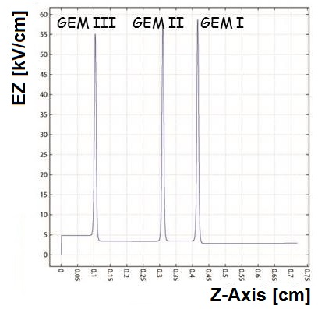
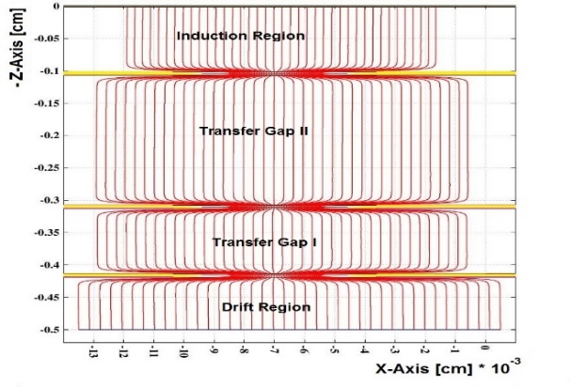
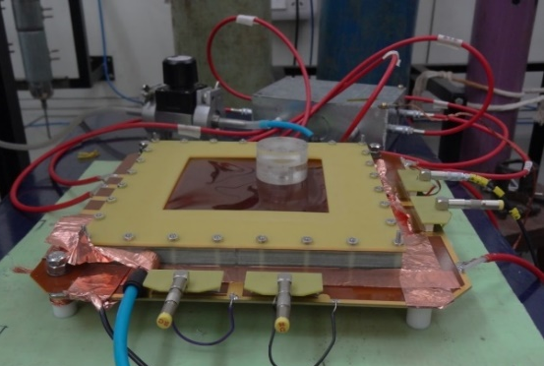
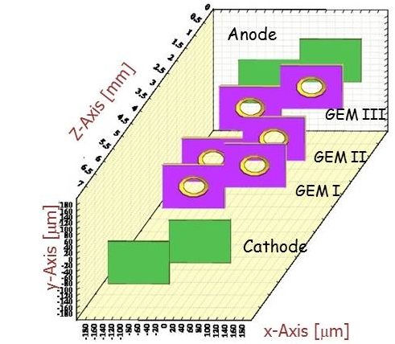
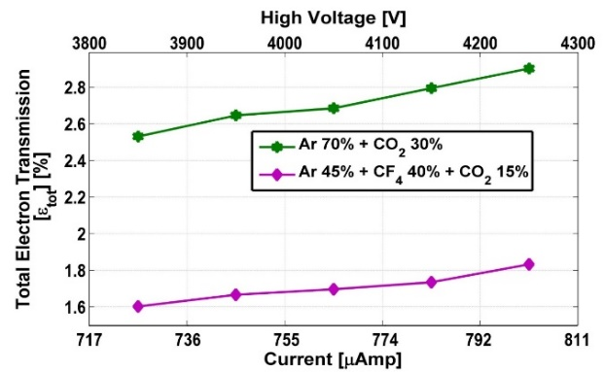
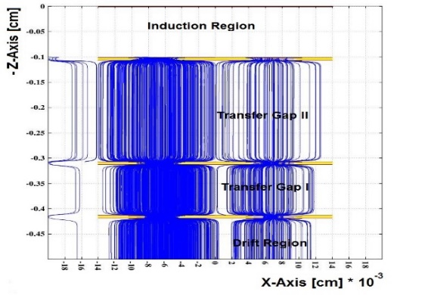
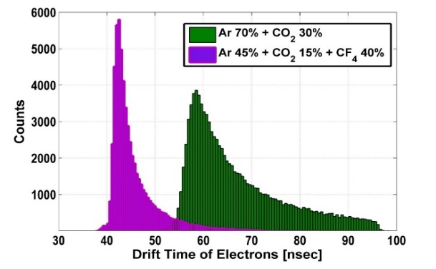
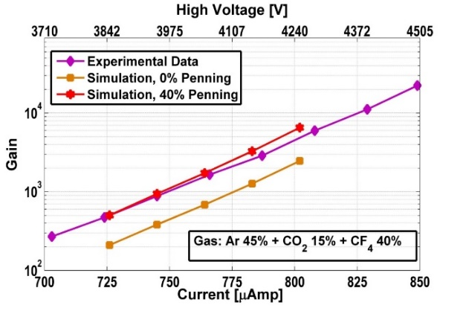
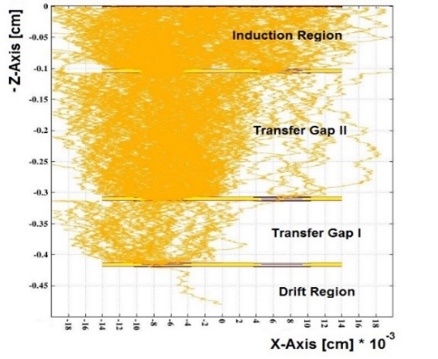
Triple GEM @ CMS
Field Lines
Electric Field
doi: 10.1088/1742-6596/759/1/012071 (2016)
Transmission
Ion Drift Lines
Cell Structure
Temporal Resolution
Gain
doi: 10.1016/j.nima.2017.06.054
Electron Avalanche

Slide 15
Fast Volume
• Typical problem related to MPGD
  Hundreds of primitives, thousands of elements and hundreds of repetitions.
• Time to estimate potential and electric field at each point is significant.
• Complex processes such as avalanche, Monte-Carlo tracking and Micro-Tracking take enormous amount of time.
• Way out is to use pre-computed values of potential and field at large number of nodal points in a set of suitable volumes.
• These, so called Fast Volumes, are chosen such that they can be repeated to represent any region of a given device and simple trilinear interpolation is used to find the properties at non-nodal points.
Effect of using Fast Volume
Computation time | Without FastVol | With FastVol
Charge density | 15s | 5m16s (includes calculation of FastVol)
Field map | 6m33s | 1s (error 0.3%)
Ten drift lines | 7m54s | 2s
Number of avalanche electrons | 712 | 726
Hundred avalanches | 3 days | 21s

Slide 16

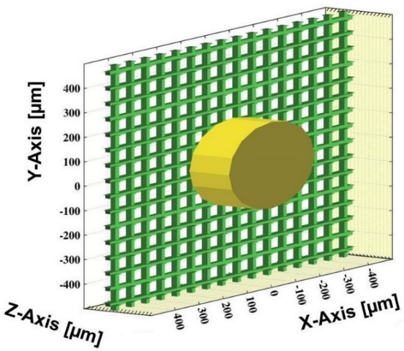
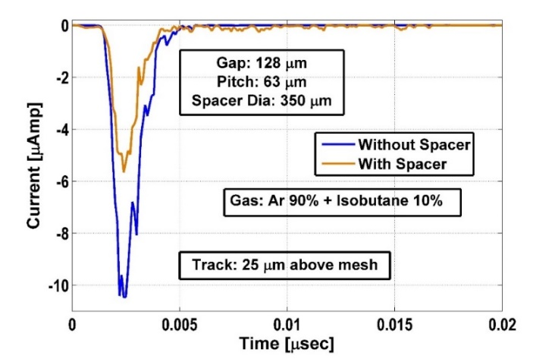
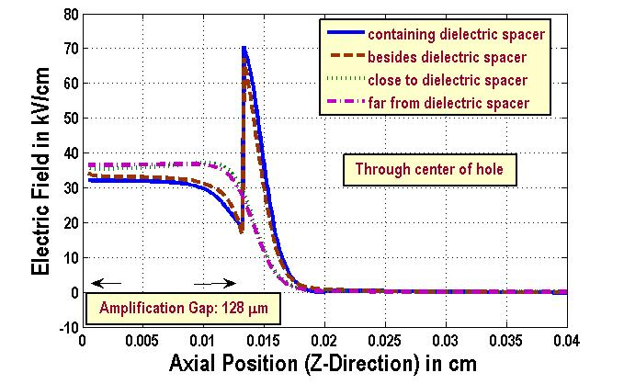
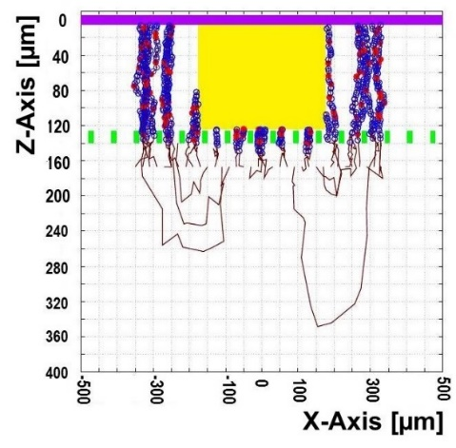
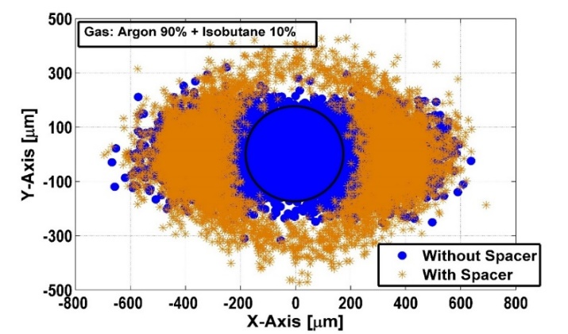
Effect of Spacer
Spacers cause significant perturbation resulting in increased field values, particularly in the regions where cylinders touch the mesh
Electron drift lines get distorted near the spacer, some electrons are lost on it, resulting in a reduced gain
Due to the reduced gain, electron signal strength gets affected significantly, the signal profile consists of a long tail resulting from the distorted drift
Due to the dead regions introduced by the spacer, the readout pads below or close to the spacers are found to be affected which leads to inefficiencies in track reconstruction
Diameter 400 μm, Pitch 2 mm
doi: 10.1016/j.nima.2015.04.051

Slide 17
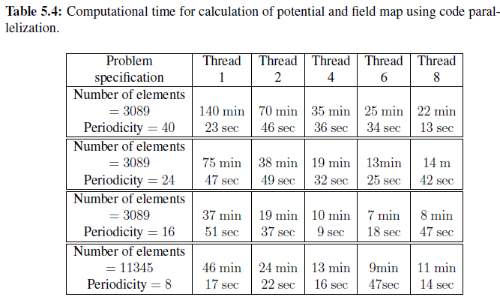
OpenMP code parallelization
Open Multi-Processing (OpenMP): an Application Programming Interface (API).
Supports multi-platform shared memory multiprocessor programming in C, C++ and Fortran on most processor architectures and operating systems.
Consists of a set of compiler directives, library routines and environment variables that influence run-time behavior.

Slide 18
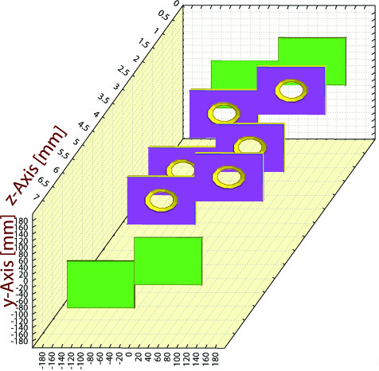
Adaptive meshing
Triple GEM repetitions in X and Y: ~100
The question is:
Can we ignore the variation of charge density on a virtual GEM that is far away from the base device?
Computational time for calculation of charge density, potential and field map with and without AM and estimates of resulting error
PrimAfter | Charge density | Potential and field | Error
0 | 3m25s | 141m2s
2 | 4m42s | 27m69s | 0.5%
5 | 4m27s | 52m56s | 0.3%
10 | 3m26s | 71m28s | 0.1%
Foil thickness : 50 μm
Copper thickness : 5 μm
Hole dia (outer) : 70 μm
Hole dia (inner) : 50 μm
Hole pitch : 140 μm
Configuration : 3:1:2:1 (mm)

Slide 19
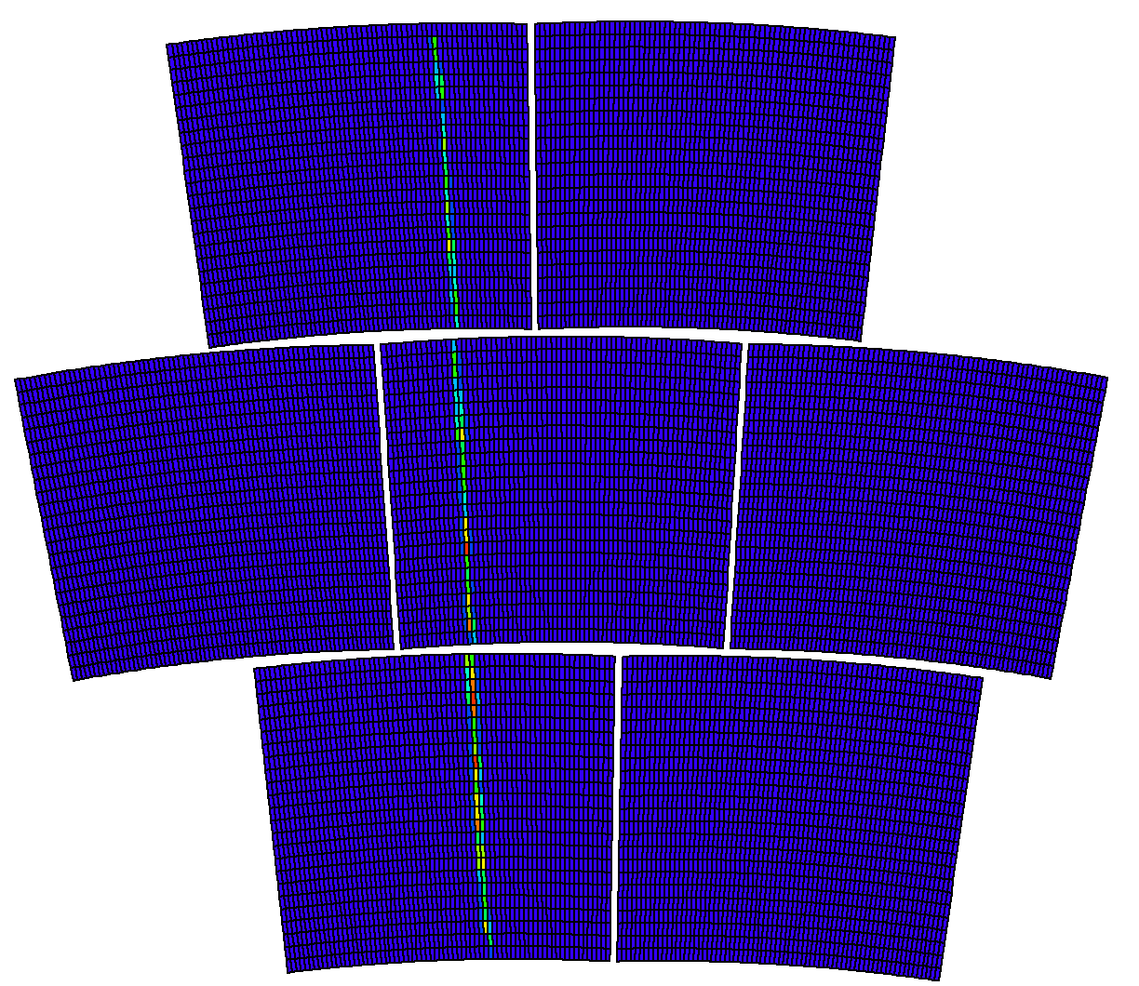
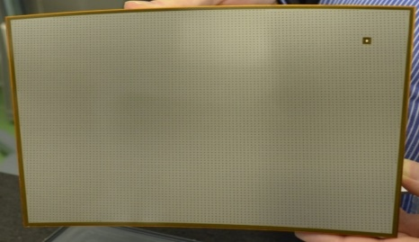
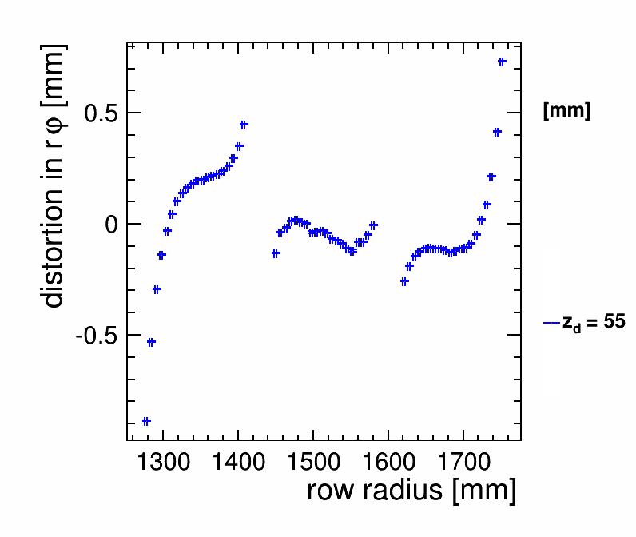
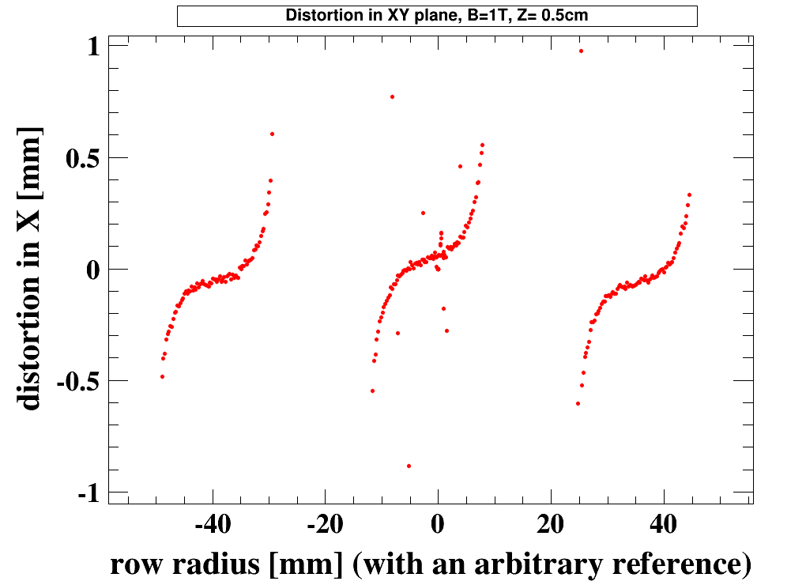
Distortion in Micromegas based TPC
@ ILC
the ground frame
A resistive MM module for the LPTPC
Module size: 22 cm × 17 cm
Readout: 1726 pads, 24 rows
Pad size: ˜3 mm × 7 mm
All modules are identical keystone shaped.
Gap between the modules = 3 mm
Distortion as observed in Experiment
At B=1T. Track is a 5 GeV electron beam.
Correction for the misalignment of the
modules is not done here.
Distortion as obtained from Simulation
at B=1T. The track consists of of 457
equidistant primary electrons.
Result is averaged over 50 tracks.

Slide 20
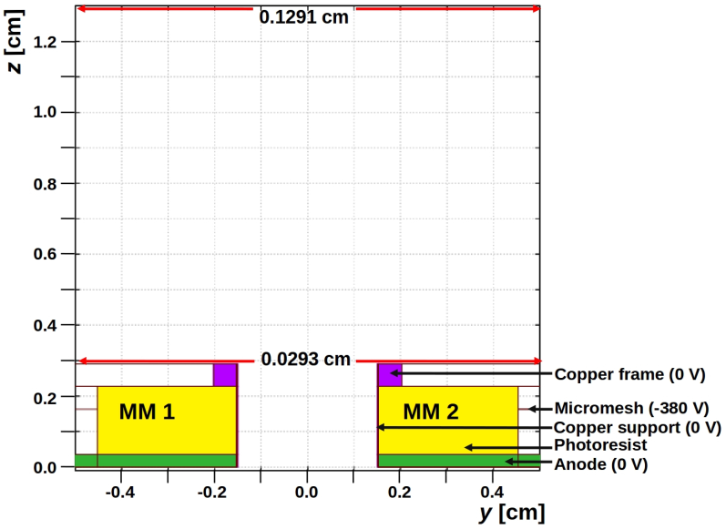
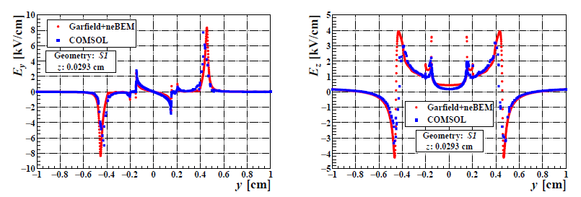
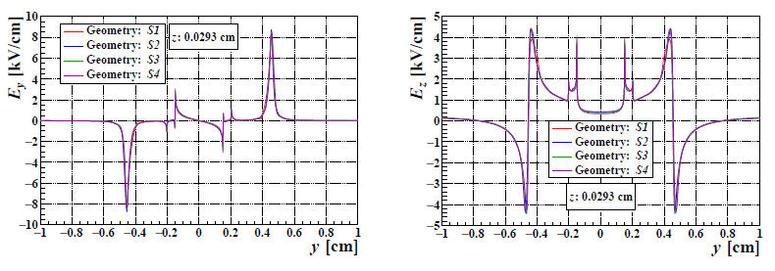

Field non-uniformity and distortion
Extremely difficult problem from the point of view of field solutions:
  The component lengths span over several orders of magnitude. For example, length of a module is 22 cm whereas the copper frame width is 30 μm (7000:1). The situation is even worse if the entire device is considered.
(b)
(a)
doi: 10.1088/1748-0221/15/07/P07030 (2020)
(c)
For the B = 0 T case, distortion in both the cases are found to be around 0.5 mm, while for the B = 1 T case, the distortions are around 2 mm. Thus, the estimates are qualitatively and quantitatively comparable to the experimental results.

Slide 21
RD51 simulation framework in 2018
Drift, Diffusion,
Avalanche
Induced signal using Weighting field
Gas, Particle Type,
Energy
Heed
Primary
Ionization
Garfield++
Transport Parameters
Field Map
Weighting Field Map
Gas, Temperature,
Pressure
Magboltz
Field Map
neBEM
Geometry, Material,
Boundary Conditions
Each and every component is open-source and free
Garfield++: garfieldpp.web.cern.ch, Heed: heed.web.cern.ch, Magboltz: magboltz.web.cern.ch, neBEM: nebem.web.cern.ch

Slide 22
Ongoing work
Charge transport in resistive layers
Space charge effects in general, and also in TPCs / ATTPCs
Charging up effects in relevant detectors
Avalanche to streamer transition
Discharge probability estimation
Next several slides borrowed from presentation by Purba Bhattacharya et al. in “Aging and Stability Conference” at CERN during November 2023.

Slide 23
Charge transport in a resistive layer
1) Finite-Difference-Time-Domain (FDTD) approach.
2) Not very precise, but produces reasonable results without demanding very high-end computing infrastructure.
3) Can be easily coupled with neBEM.

Slide 24
Current through resistive layers
RPC material studies using Comsol
Studies on electrical properties of Resistive Plate Chamber (RPC), Subhendu Das et al., JINST 17 P09041, doi: 10.1088/1748-0221/17/09/P09041

Slide 25

RPC space charge using particle model
In Garfield++, a new class has been added to the existing framework:
pAvalancheMC (loosely based on class AvalancheMC)
The new class contains several new functions such as
  SetNumberOfThreads(20) – carries out OpenMP parallelization.
  SpaceChargeEffectOn()
  SetMinSpCharge(1e4,0)
  SetGridElements(dthta, dx, dy, dz, dr)
  SetElectrodePropertise(thickness, thickness, gasgap, epsilon, true);
  SetElectrodeLocations(electrode_Center1_alongz, electrode_Center2_alongz, gas_Center_alongz);
  GlobalTimeWindow(time);
etc …
Till now, specific to RPCs.

Slide 26

Effect of space charge in an RPC
Variation of number of electrons with time steps of the avalanche for electric fields of 49.85 kV/cm, and 50 kV/cm, (a) without space-charge effect, (b) with space-charge effect, (c) considering negative ions.
Parallelization of Garfield++ and neBEM to simulate space-charge effects in RPCs, Dey et al., CPC, https://doi.org/10.1016/j.cpc.2023.108944

Slide 27




Space charge in GEM particle (Garfield++) and fluid (Comsol) models
All the models produce similar estimates.
This is despite very different mathematical models used in particle and fluid models.
Different particle models agree with each other.

Slide 28


Space charge effects in an ATTPC
Preliminary studies:
1) α-track in an ATTPC
2) Primary ionization information obtained using Geant4
3) Space charge due to an earlier event distorts tracks in subsequent events.

Slide 29



Charging up in GEM particle model
Algo 1: Use end-points provided by Garfield++
  Consider the ending point of charged particles. Garfield++ tries to terminate a drift line close to the boundary.
Algo 2: Assign surface charge densities to elements
  Identify the element on which the charged particles falls. Add all the charged particles on an element to estimate a surface charge density.
For small number of charged particles, algo 1 is good.
For large numbers, algo 2 may be more useful.
Top view
Side view
Some elements representing a GEM hole
start point
element
end point
Kapton

Slide 30


Effects of charging up
Note that the lines do not exactly overlap.
Points to be noted:
Number of charge deposited per element has wide variation – no circular symmetry for one event.
The symmetry may be regained due to overlap of a large number of events.
Accumulation due to large number of events need to be considered.

Slide 31








Charging up in GEM fluid model using Comsol
Charge is accumulated more towards the induction / transfer volume.
Hardly any charge is found on surface towards drift volume.
More negative charges towards induction / transfer volume.
Some positive charges around the middle of the hole.
Note that only collection is simulated at present. Modelling loss of charges will need further efforts.
This will, hopefully, also lead us to a long term model

Slide 32

Streamer Probability in RPC fluid model (Comsol)
Simulated streamer
1) In simulation, use different number of primaries for each voltage. Find out whether streamer occurs, which is defined by the situation that the electrons have reached the cathode.
2) Find out the probability of occurrence of that number of electrons from the HEED primary electron information. Add up the probabilities.
3) For experiment, first find out whether more than one pulse has come or not, if yes then whether the amount of charge is more than 20 pC or not, which is equivalent to Raether Limit.
Voltage (in V) | From experiment | From simulation
9400 | 0.00087 +/- 0.00011 | 0.008
9600 | 0.00091 +/- 0.00015 | 0.008
9800 | 0.00411 +/- 0.00181 | 0.0135
10000 | 0.02681 +/- 0.00052 | 0.0224
Study of streamer development in resistive plate chamber, J.Datta et al., JINST 15 C12006 (Decmber 18, 2020), doi: 10.1088/1748-0221/15/12/C12006

Slide 33
Avalanche to streamer transition in GEM
Experimental setup
3D model in Comsol
Fast simulation of avalanche and streamer in GEM detector using hydrodynamic approach, Rout et al., JINST, https://doi.org/10.1088/1748-0221/16/02/P02018
Numerical estimation of discharge probability in GEM-based detectors, Rout et al., https://doi.org/10.1088/1748-0221/16/09/P09001
Axis-symmetric model
(incorporating appropriate corrections)

Slide 34

Discharge probability in GEM
1) Comparison of discharge probability estimates in single GEM
2) Comparison of discharge probability estimates in triple GEM
3) Comparison of discharge probability estimates with asymmetric distribution of voltages
Simulated transition from avalanche to streamer modes for SYM configuration in Triple GEM: (a) evolution of number of ions and (b) evolution of number of electrons. The avalanche mode is maintained for OA and OB configurations at this drift voltage.
Discharge mechanisms and their prevention in the gas electron multiplier (GEM), Bachmann et al., Nucl. Instrum. Meth. A 479 (2002) 294.
Charge sharing in single and double GEMs, Promita Roy et al., JINST, Volume 16, C05001 (4 May 2021)
doi: 10.1088/1748-0221/16/05/C05001

Slide 35
Future plans
The ongoing set of activities need to be further validated and implemented into Garfield++ in a user-friendly manner.
Attempt to model some amount of (plasma?) chemistry leading to aging.
Device specification and mesh generation have been implemented in a rather simple manner; rigorous but user-friendly implementation is a necessity.
Implementation of better algorithms to handle these huge and dense matrices can make wonders, complex and transcendental functions also may benefit.
Computational effort should be optimized – use of symmetry, adaptive mesh generation can help reducing the computational expenses by a significant amount.
Parallel computation, GPU computation can help the overall detailed simulation.

Slide 36
The TEAM @ SINP
Deb Sankar Bhattacharya
Purba Bhattacharya
Sudeb Bhattacharya
Tanay Dey
Jaydeep Dutta
Abhik Jash
Anil Kumar
Vishal Kumar
Mohammed Salim
Muzamil Ahmad Teli
Nayana Majumdar
Sandip Sarkar
Supratik Mukhopadhyay
Pralay Das
Prasant Kumar Rout
Project students
Promita Roy
Saikat Ghosh
Shubhabrata Dutta
Sridhar Tripathy
Subhendu Das
Beyond SINP: Rob Veenhof, Heinrich Schindler and members of the RD51 collaboration
The names are not in any particular order.
This has been a huge team effort. I just hope that I have not missed anybody. If I have, I surely owe an unconditional apology!

Slide 37
Thank you all!

