Slide 1


CERN EHN1 Test Beam Facility
D. Banerjee, N. Charitonidis on behalf of the CERN BE-EA group
01.02.2024

Slide 2
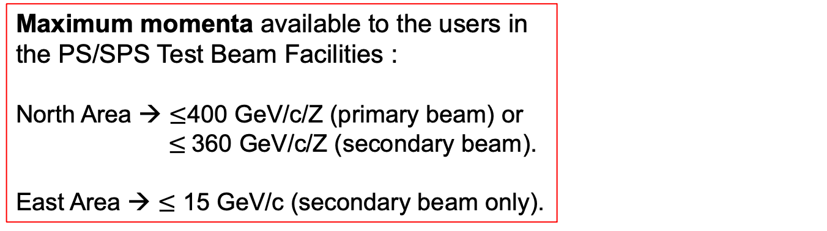
CERN Accelerator Complex
SPS : protons/ions @ 400 GeV/c/Z
PS: protons /ions @ 24 GeV/c/Z
Maximum momenta available to the users in the PS/SPS Test Beam Facilities :
North Area → $≤$400 GeV/c/Z (primary beam) or $≤$360 GeV/c/Z (secondary beam).
East Area → $≤$ 15 GeV/c (secondary beam only).

Slide 3
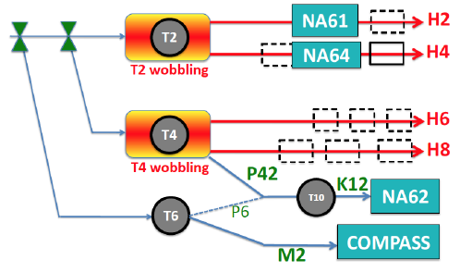
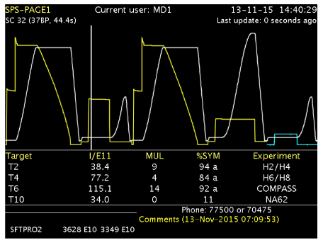
North Area Secondary Beamlines
The 400 GeV/c primary beam is slowly extracted to 3 primary targets → T2, T4 and T6
SPS beam @ 400 GeV/c
E
EHN1
ECN3
EHN2
Spill duration: 4.8 second flat top
Typically : 2 cycles / SPS supercycle for NA and
~ 3000 spills/day
Supercycle structure depends on the physics program of all the facilities served by the SPS including LHC, AWAKE, HiRadMat and the Machine Development program.

Slide 4
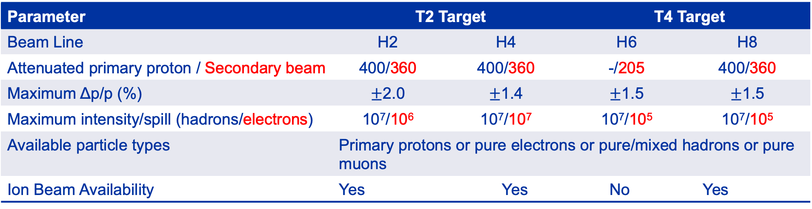
Characteristics of the Beam
Parameter | T2 Target |  |  | T4 Target | T4 Target
Beam Line | H2 | H4 | H4 | H6 | H6 | H8 | H8
Attenuated primary proton / Secondary beam | 400/360 | 400/360 | 400/330 | -/205 | -/205 | 400/360 | 400/360
Maximum Δp/p (%) | $±$2.0 | $±$1.4 | +-1.4 | $±$1.5 | +-1.5 | $±$1.5 | +-1.5
Maximum intensity/spill (hadrons/electrons) | 10⁷/10⁶ | 10⁷/10⁷ | 10⁷/10⁵ | 10⁷/10⁵ | 10⁷/10⁵ | 10⁷/10⁵ | 10⁷/10⁵
Available particle types | Primary protons or pure electrons or pure/mixed hadrons or pure muons
Ion Beam Availability | Yes |  | Yes |  | No |  | Yes
T6 Target → Serves the M2 beam that was used by the COMPASS experiment until 2022 for 20 years and is currently used by AMBER, NA64mu and MUonE.
  < 10⁸ hadrons/spill < 280 GeV/c.
  < 2 x 10⁸ muons/spill < 250 GeV/c.
P42 beam shares the T4 target (with H6/H8) and transports the proton beam that has not interacted, onto the T10 target to produce typically 75 GeV/c kaon beam for NA62.

Slide 5
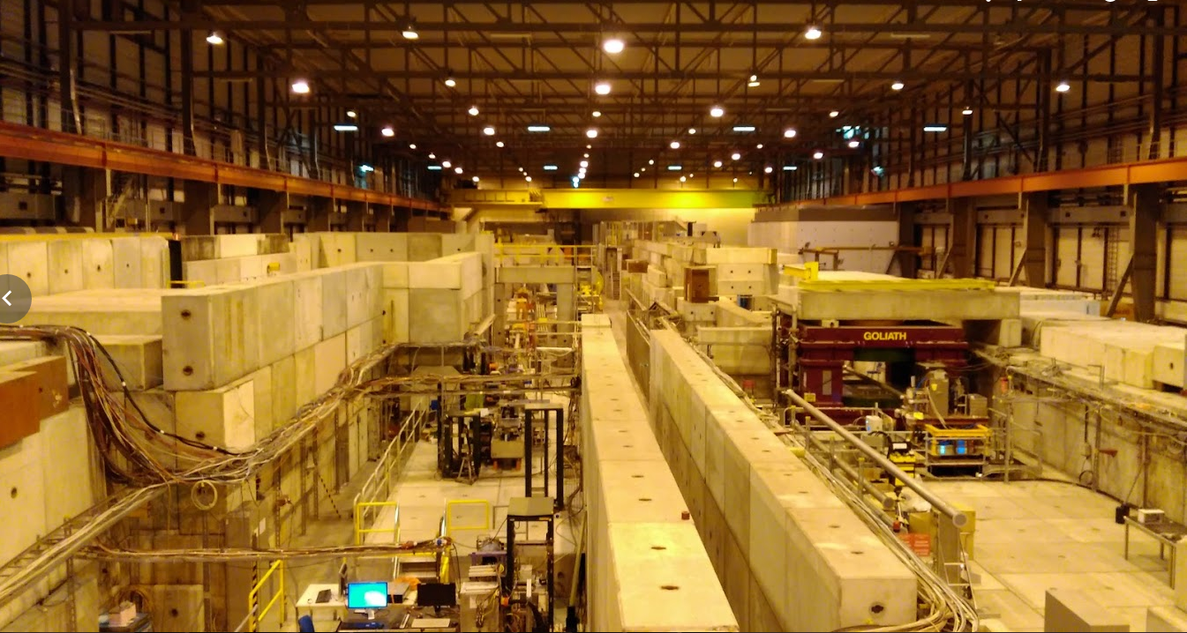
EHN1 (B-887, Prevessin Site)
H6
H8
H4
H2

Slide 6
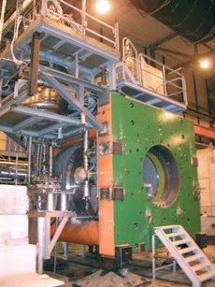
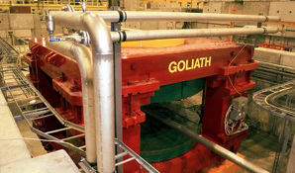
Large aperture magnets available in the North Area for tests with beam
GOLIATH
EHN1, H4 beam line
Large classical dipole
160 x 240 x 360 cm
1.5 T max field
Use of GOLIATH via CESAR (please contact B. Rae)
Morpurgo
EHN1, H8 beam line
Superconducting dipole
1.6 m diameter, 4 m length
1.5 T field
CMS M1 magnet
EHN1, H2 beam line
superconducting dipole
82 cm gap, 1.4m diameter
3.0 T field

Slide 7
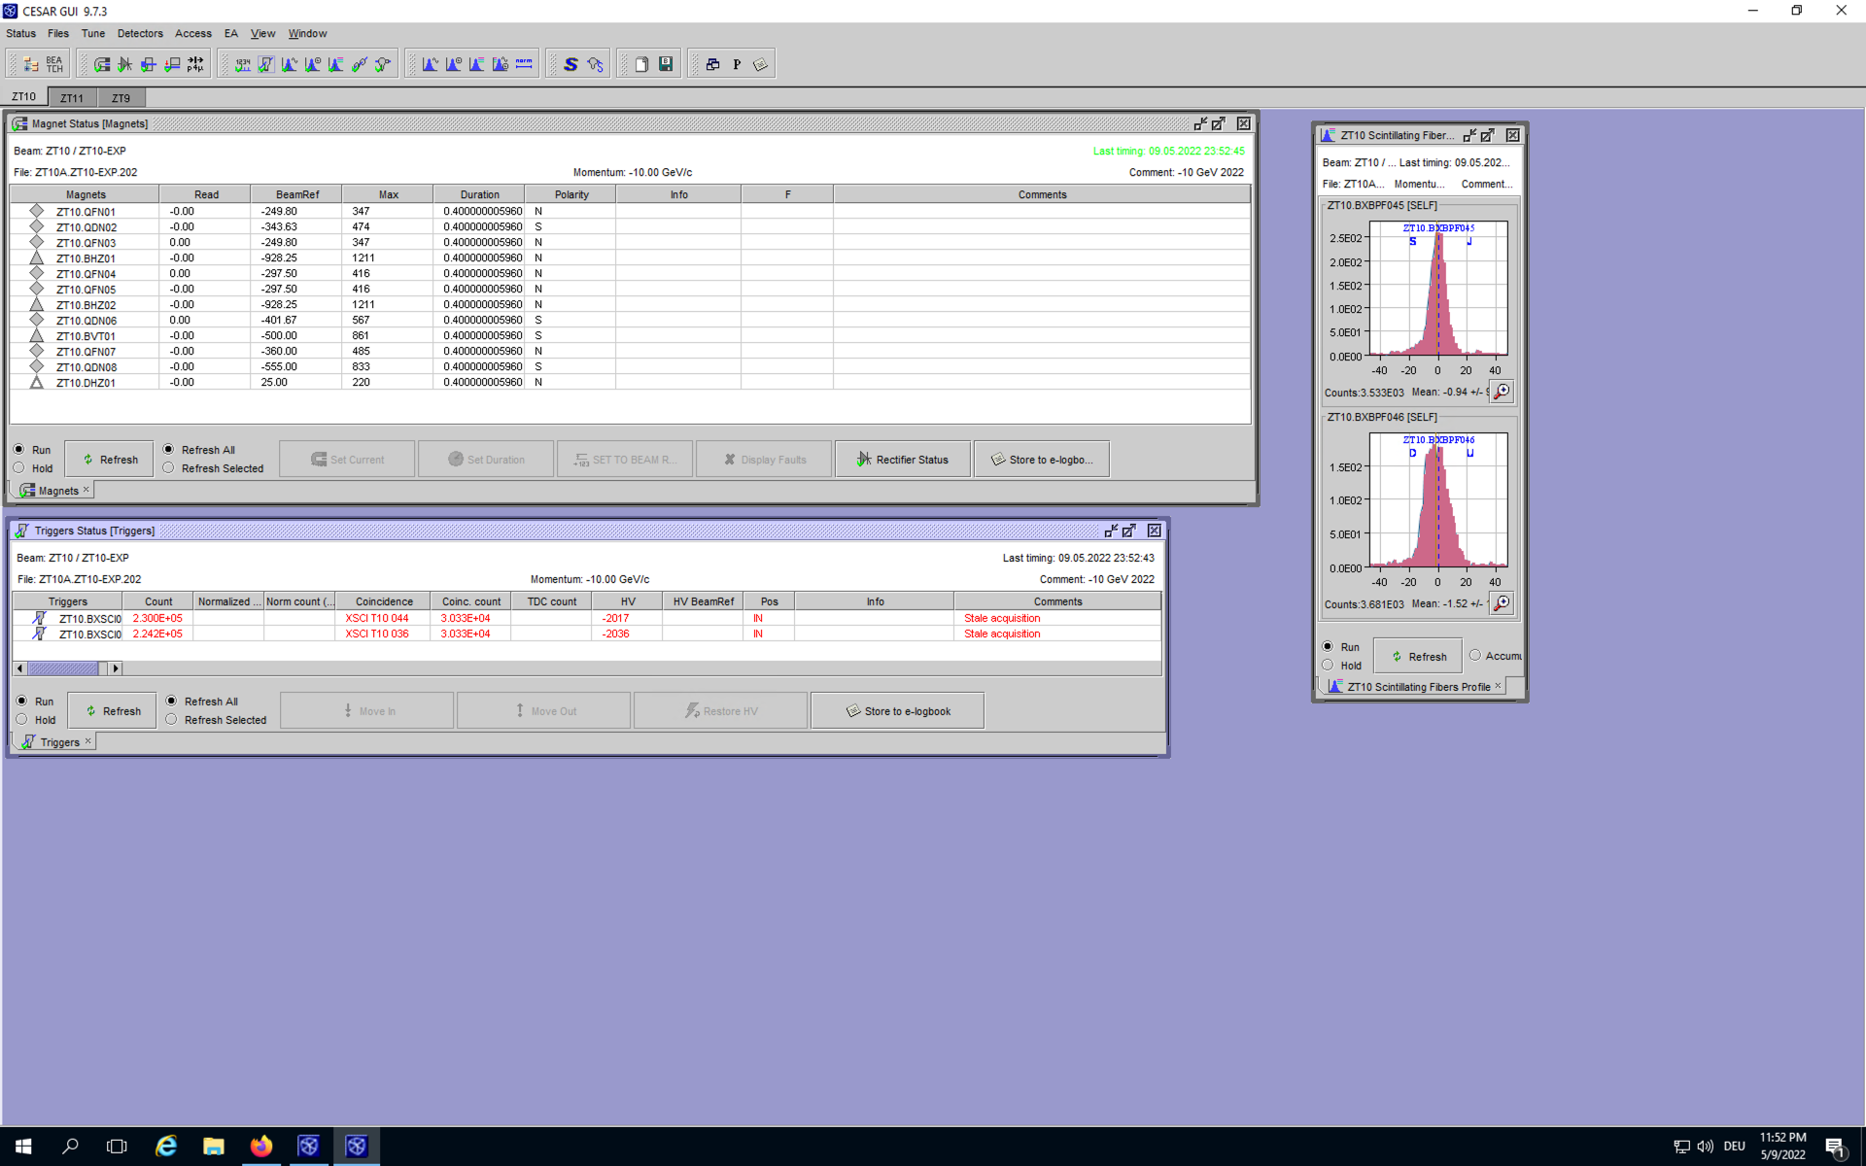
Beam Instrumentation in the North Area
Depending on the beam line and the zone :
  Threshold Cherenkov gas counters (XCET) and CEDARs → used for particle tagging
  Beam profile & intensity monitors:
    scintillators & analog/delay multi wire chambers are installed in several positions along the beam line.
    As part of the consolidation efforts under NACONS all analog/delay wire chambers will be replaced by XBPFs.
  FISC scanners → precise slower profile monitors – can also be used for angular measurements
Beam data available in the control rooms (Online: CESAR, Offline: Timber)

Slide 8
H4 Beamline

Slide 9
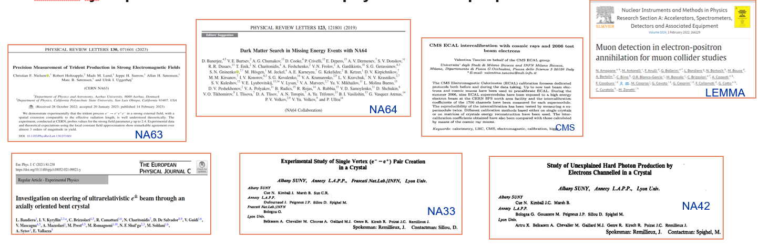
H4
Quite “famous” for the high intensity, high purity electron beam that it can offer.

Slide 10
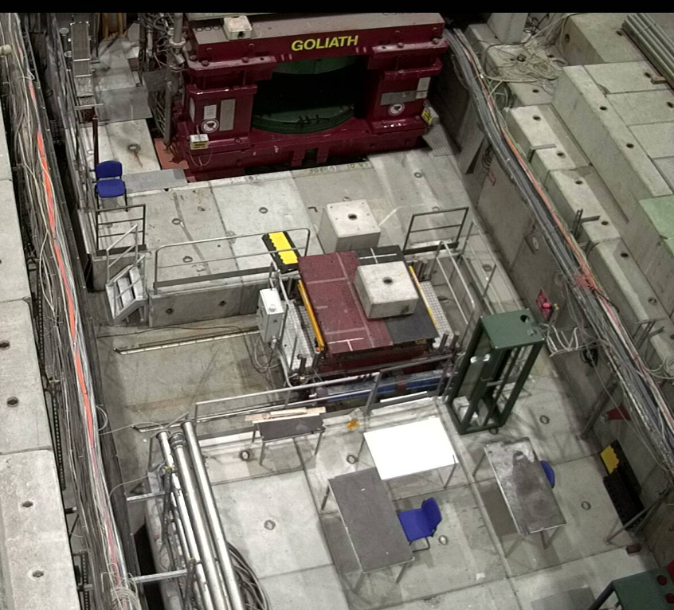
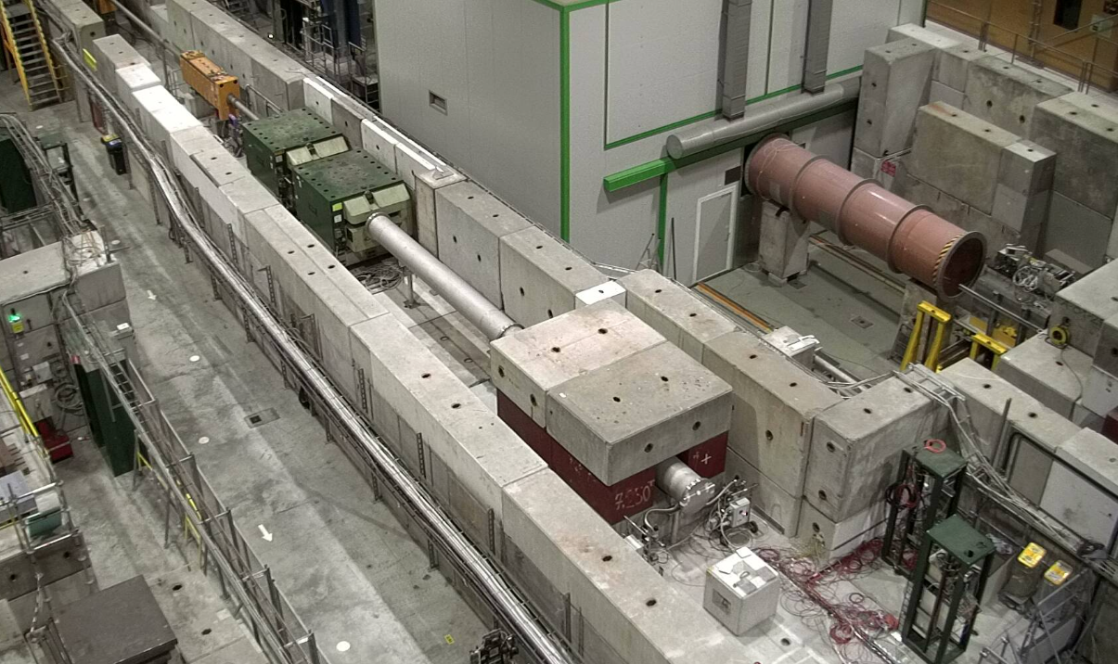
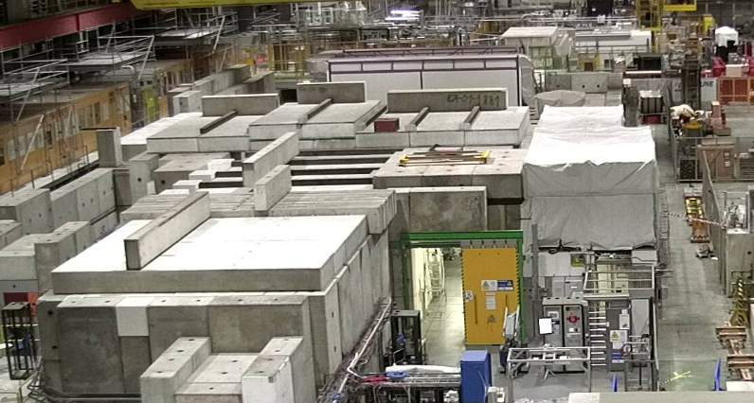
H4 - Experimental Zones
Experimental zones :
  H4A → PPE134, very long and broad area, equipped with GOLIATH magnet. Has an XTDV (beam dump) to separate from PPE144.
  H4B → PPE144, houses the NA64 experiment and upstream of GIF++. Has an XTDV (beam dump) to separate from PPE154.
  H4C → PPE154, GIF++ bunker. Separated from PPE164 with an XTDV.
  H4D → PPE164, Dedicated CMS zone downstream of GIF++.
PPE134
PPE144
GIF++

Slide 11
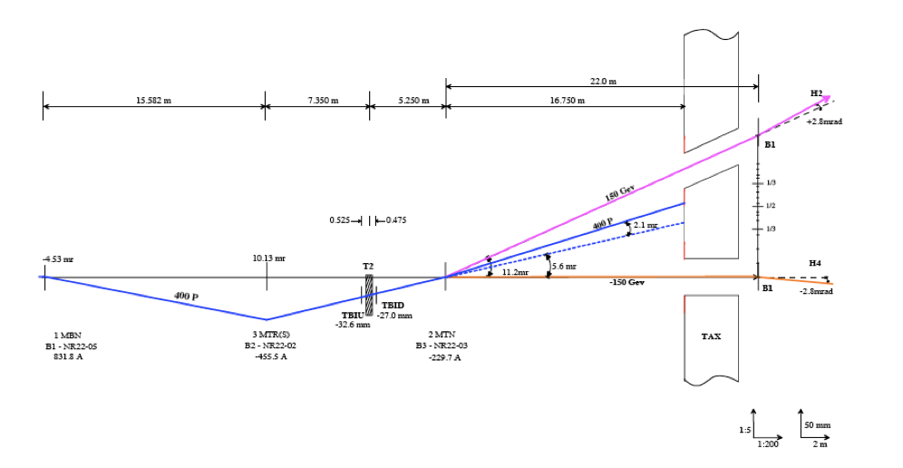
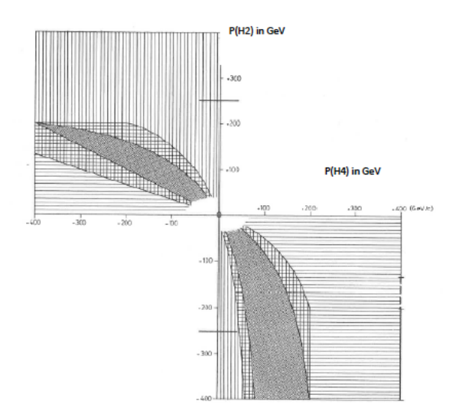
H4 – Available beam modes
H4 shares the target T2 with H2. Therefore, there are some coupling between the momenta available in H2 and H4.
Available beam modes - High energy hadrons (~5E6/spill), muons (1E4/spill) and electrons (7E6/spill) are available upon request

Slide 12
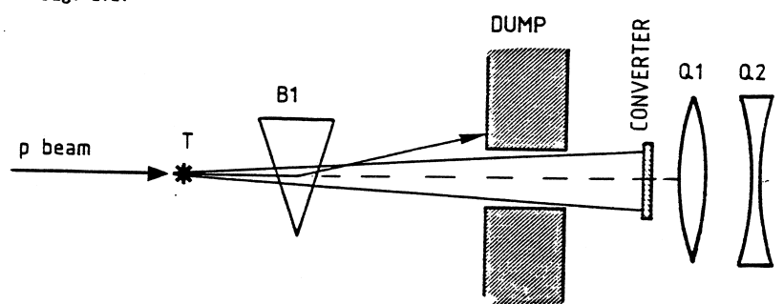
H4 Electron beams
Mechanism : Production of electrons / positrons from the neutral channel (π0→ γγ and then, in a Pb converter γ → e+e- )
Intensities between 10³ – 10⁷ particles per spill, depending on the collimation & momentum selection precision
Purity between 50 – 100% depending on the momentum & exact target station configuration
Converter: Pb, 4mm thickness
Only available in H2 / H4 lines – H6 & H8 don’t have this option
Momentum selection
e+ or e-
Experiments
e+ or e-
Figure: ~5x10¹² protons on target ~1E7 electrons/spill in H4 line

Slide 13
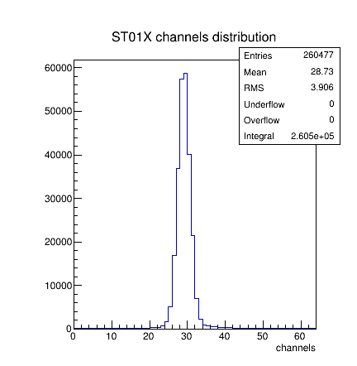
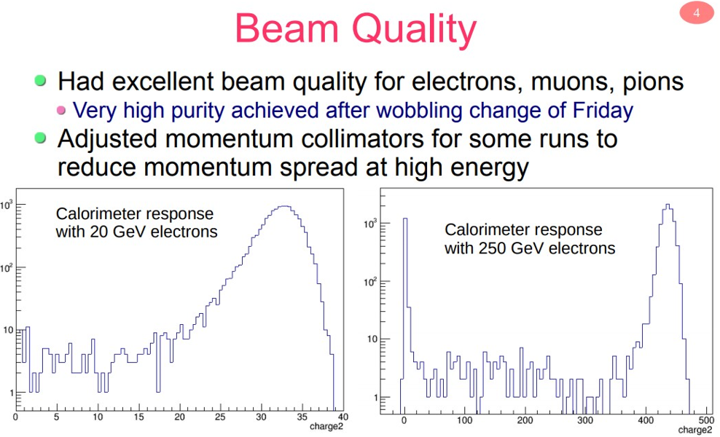
Η4 electron beams - Examples
Courtesy: ΝΑ64
Courtesy: FASER

Slide 14
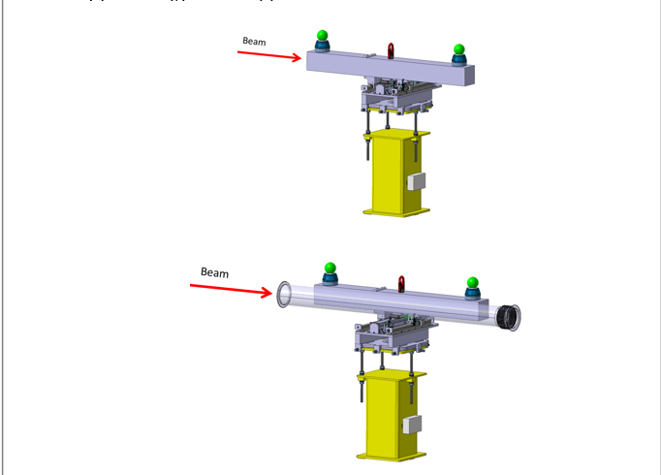
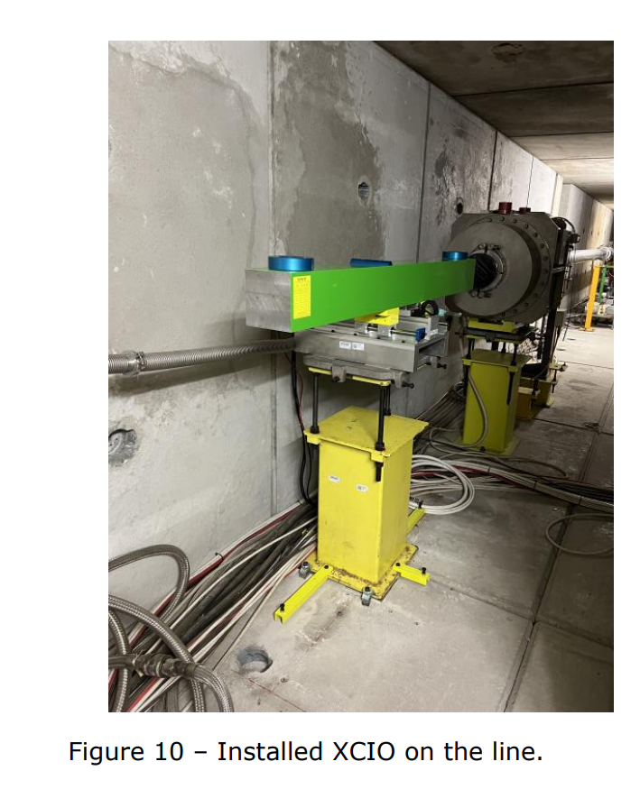
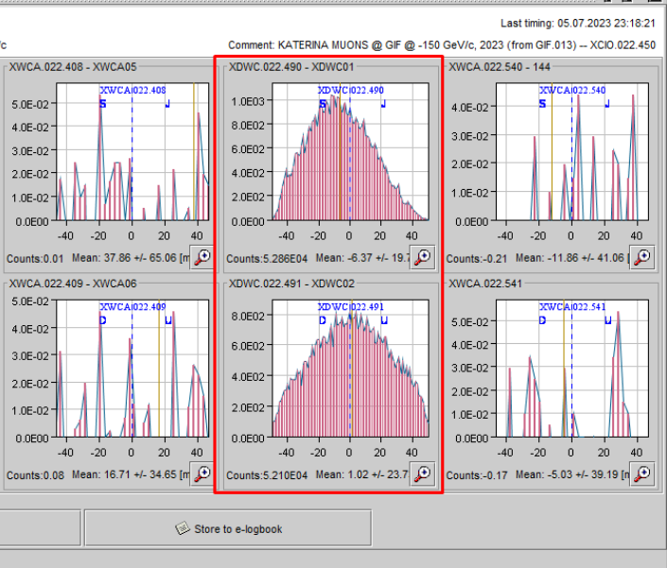
H4 muon beams
In 2022, a new muon target has been installed in PPE124. This greatly improved the muon purity in PPE134 and downstream.
Remember: Muon beams are big ;)

Slide 15
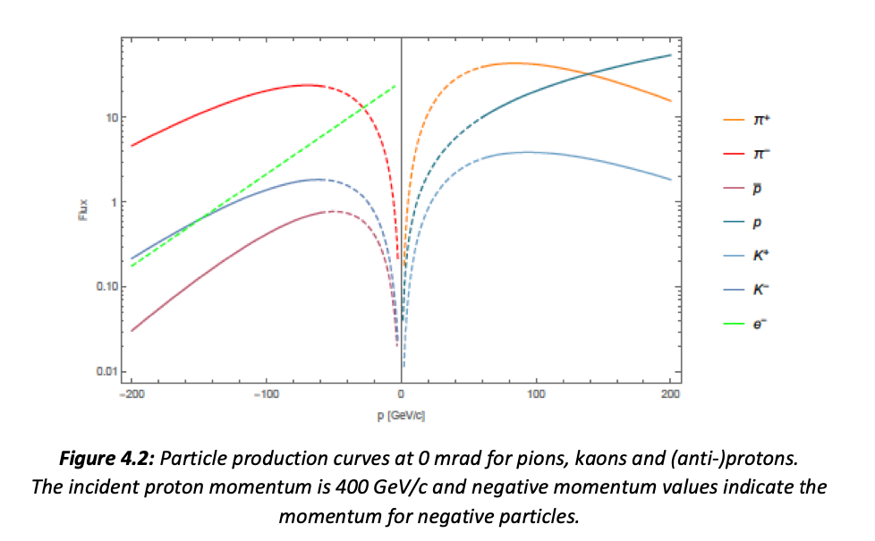
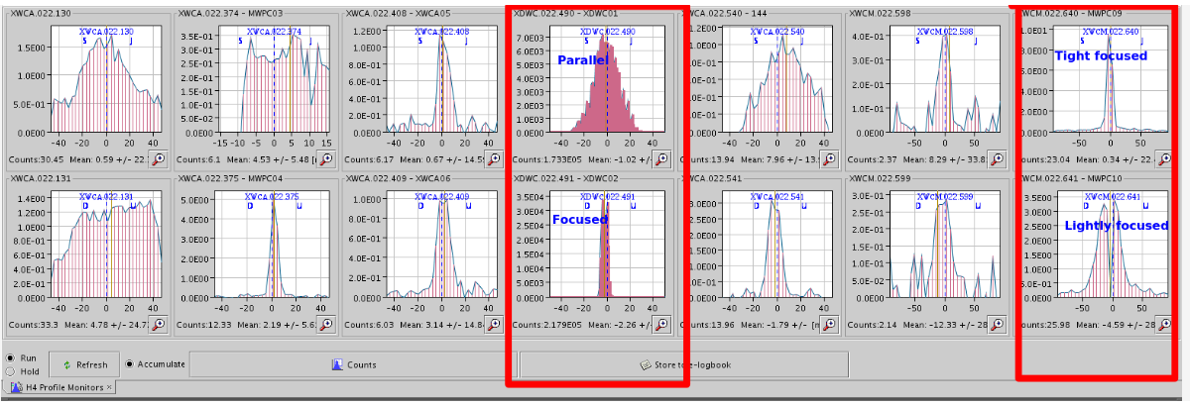
H4 hadrons beams
Mixed secondary hadron beams coming from the protons on target are transported to the experimental zones.
Various optics options possible.

Slide 16
H4 Contact Persons
Responsible liaison physicist – N. Charitonidis (62102/169887)
  Beam composition, intensity, spot-size, PID, vacuum, Cherenkov gases, general layout, possibilities, beam tuning.
Beam line support – B. Rae (63625/167388)
  CESAR training, patron rights training, beam control, file loading, beam tuning…
In the event of absence of both N. Charitonidis and B. Rae (highly unlikely ☺ )
  Deputy beam physicist: D. Banerjee (164065)
  BE-EA-LE Section Leader: J. Bernhard (164896)
Technical Support – M. Lazzaroni (162407)
  “I want help with transport”, “ I need a special table”, “my zone has less blocks than last year and I need them”, “something is broken in the zone”….

Slide 17
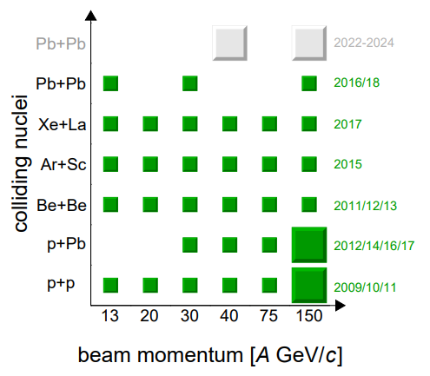
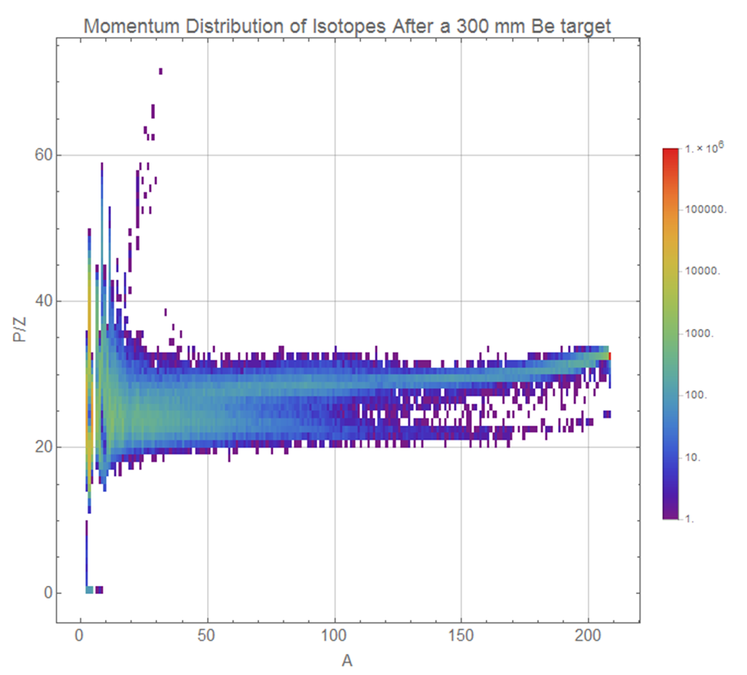
Ion Beams
Ion beams are available in the North and the East Area
  2021: No ions
  2022 - 2024: Pb
  Later : to be defined
Primary and Fragmented ion beams are available.
Availability for test beam users in H2/H4/H8 and T08.
Experiments like NA61 and NA60+ have ion beam programs in the North Area.
Test-beam users like Medipix, Nucleon (satellite experiments), HERD, PAN also request ion beams.
In 2022 and 2023 CHIMERA also took low energy ions in T08.
Courtesy: NA61
FLUKA simulation

Slide 18
Schedule and planning
The beam time request must be sent to the PS-SPS coordinator ~ November for the following year via the link https://ps-sps-users.web.cern.ch.
  Short (<1 week @ SPS or < 2 weeks @ PS) requests can be handled by the PS-SPS coordinator only.
  Longer requests require recommendation by CERN physics committees (SPSC, LHCC, REC, RB)
The scheduling is based on priorities of different experiments and is discussed with the scientific committees. The draft schedule is presented at the CERN research board for approval.

Slide 19
Summary
CERN offers a great variety of test-beam options with beams ranging between 0.1 GeV/c (East Area) – 400 GeV/c (North Area).
H4 in the North Area is notable for the high intensity, high purity electron beam that it can offer.
Additionally muon and hadron beams are also available.
Please contact in advance Sps.Coordinator@cern.ch and sba-operation@cern.ch in order to optimally use your beam time and the facilities.
  Visit https://ps-sps-coordination.web.cern.ch/ps-sps-coordination/ for the updated version of the schedule and other useful information.
Looking forward to seeing you at CERN !!

