Slide 1


Conceptual design of RPCs in future muon systems
G. Aielli Roma Tor Vergata
First DRD1 Collaboration Meeting, January 30 2024, CERN

Slide 2
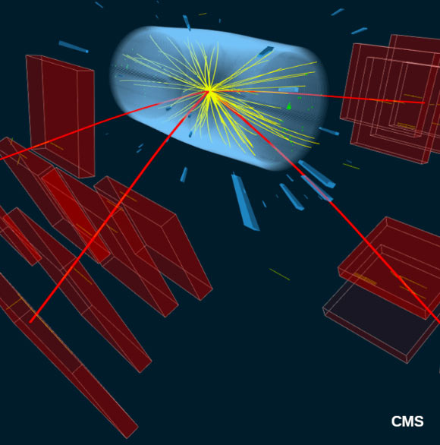
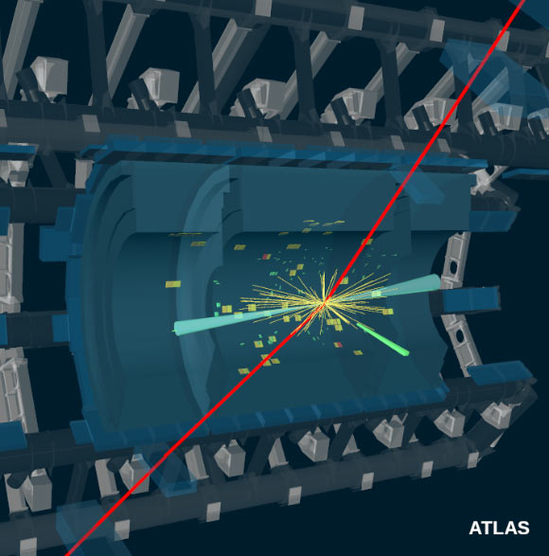
Introduction on muon systems
Typical features for HL-LHC
measure of track curvature → thousands of m^2 instrumented surface
Particle rate << than innermost detectors
Typical tracking precision ⁓ 100 μm (with B ⁓1T and R=5m)
Typical tracking trigger resolution 1 cm
Typical trigger detector resolution < 5 ns
How this will evolve in FFC scenarios and what are the consequences on the muon detector design?
Muon systems is whatever comes after the hadronic calorimeter, wrapping all the other detectors
It is designed to provide a primary trigger on muons and measure their momentum spectrum
It is done by measuring the muon trajectory deflection in a magnetic field

Slide 3
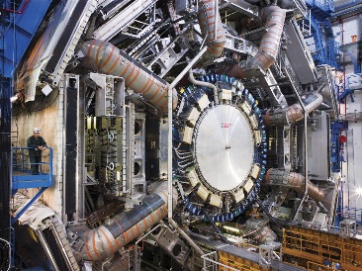
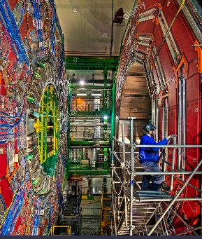
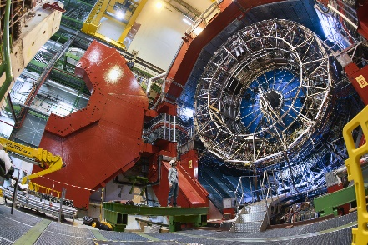
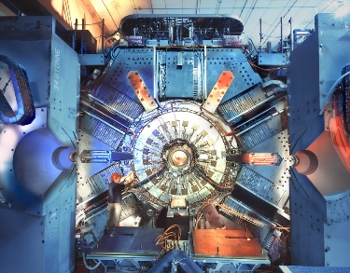
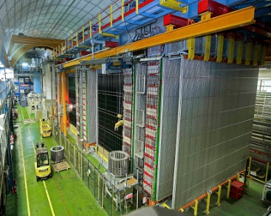
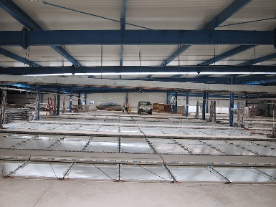
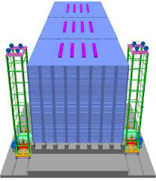
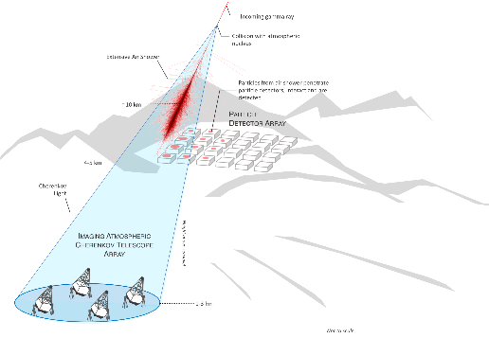
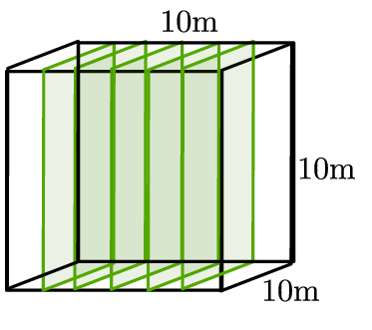
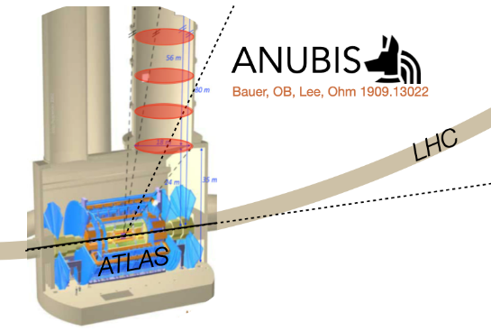

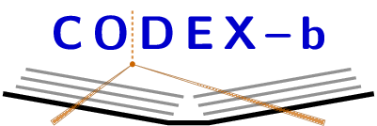
State of the art of classic RPCs
(some of)Present and recent past Application at colliders
Present and recent past Cosmic rays and underground
ATLAS
LHC 7000 m²
HL-LHC1400 m²
Tracking trigger
CMS
LHC 4000 m²
HL-LHC1000 m²
Tracking trigger
ALICE
LHC 144 m²
HL-LHC new RPCs
Tracking trigger
BaBar
SLAC 2000 m²
Instrum. iron
μ identifier
OPERA
CERN ν beam
Instrum. iron
μ spectrometer
ARGO Ybj
CR exp. 7000 m²
4600 m altitude
3D reconstruct.
INO (staged)
ν observatory
150000 m²
Instrum. Iron
active proposals for future experiments using present technology
SWGO - STACEX
CR exp. 22500 m²
5000 m altitude
3D reconstruct. + Cherenkov
CODEX-B
HL-LHC. 3000 m²
Search for DM
Sealed tracking volume
ANUBIS
HL-LHC. 5500 m²
Search for DM
Sealed tracking volume

Slide 4
The quest for FCC
RPC (all versions) is candidate technology for FCC experiments
Key features
  50ps time resolution
  (300 ps for single gap) Single Gap RPC Efficiency > 98%
  2D tracking, resolution up to 0.1 mm
  Proportional response to high track density
  Large size robust and Low cost
  Thin and light
RPCs underwent a substantial performance improvement from LHC to HL-LHC
Can be further improved for FFC…
R&D is needed
Hardest challenge
pp collisions at 100TeV (FCC-hh)
Pileup: 1000 events/bunch crossing → spatial resolution, timing
Muon barrel and endcap
Charged rates ~ 5x10⁴ cm⁻²s⁻¹
photon rates ~ 5x10⁶⁻⁸ cm⁻²s⁻¹
N fluence ~10¹⁴ cm⁻²
Shielding can mitigate the effect on muon chambers

Slide 5
FCC-hh parameters and constraints
parameter | FCC-hh |  |  | HE-LHC | HL-LHC | LHC
collision energy cms [TeV] | 100 |  |  | 27 | 14 | 14
dipole field [T] | 16 |  |  | 16 | 8.33 | 8.33
circumference [km] | 97.75 |  |  | 26.7 | 26.7 | 26.7
beam current [A] | 0.5 |  |  | 1.12 | 1.12 | 0.58
bunch intensity [10¹¹] | 1 |  | 1 (0.2) | 2.2 (0.44) | 2.2 | 1.15
bunch spacing [ns] | 25 |  | 25 (5) | 25 (5) | 25 | 25
synchr. rad. power / ring [kW] | 2400 |  |  | 101 | 7.3 | 3.6
SR power / length [W/m/ap.] | 28.4 |  |  | 4.6 | 0.33 | 0.17
long. emit. damping time [h] | 0.54 |  |  | 1.8 | 12.9 | 12.9
beta* [m] | 1.1 | 0.3 |  | 0.25 | 0.20 | 0.55
normalized emittance [μm] | 2.2 (0.4) |  |  | 2.5 (0.5) | 2.5 | 3.75
peak luminosity [10³⁴ cm⁻²s⁻¹] | 5 |  | 30 | 25 | 5 | 1
events/bunch crossing | 170 |  | 1000 (200) | ~800 (160) | 135 | 27
stored energy/beam [GJ] | 8.4 |  |  | 1.3 | 0.7 | 0.36
Highlighted in red → drivers for muon systems
A factor 6 higher average rate w.r.t HL-LHC
Physics boosted in the forward regions → muon precision |η|~4
Combined muon tracking
Stand-alone muon trigger
X10 pileup → option to lower at 5 ns the BC to reduce the bunch intensity
Constraints given by FCC-ee are less challenging for that concern the background rate and similar for the rest

Slide 6
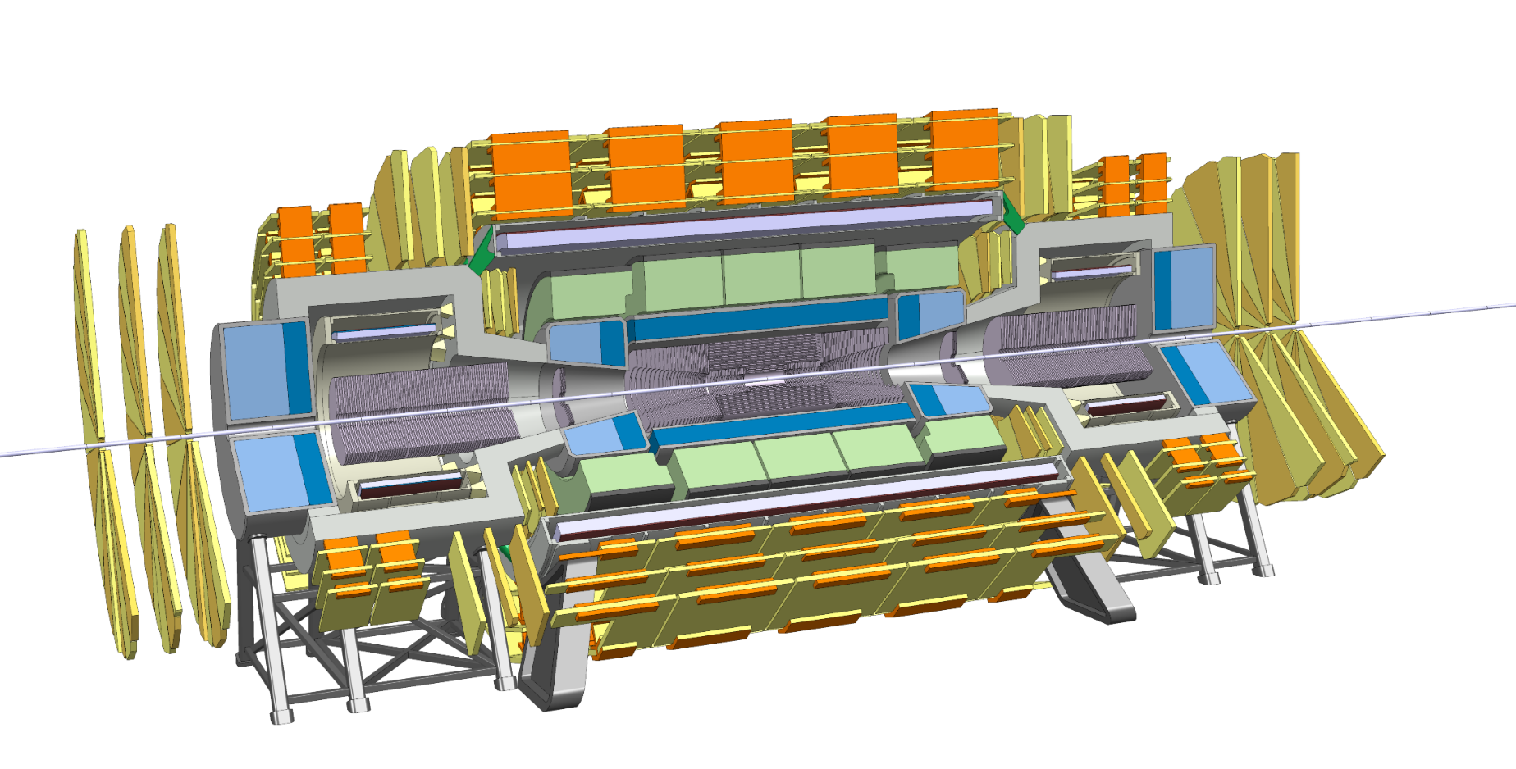
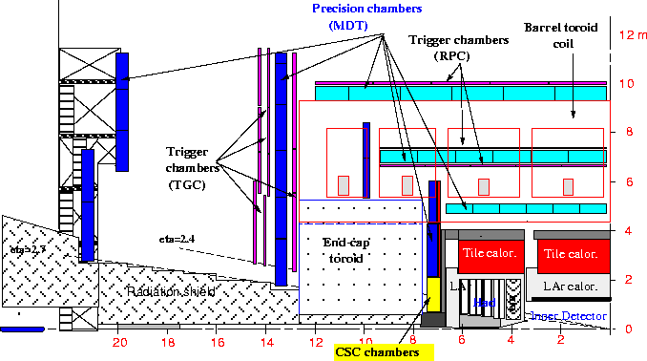
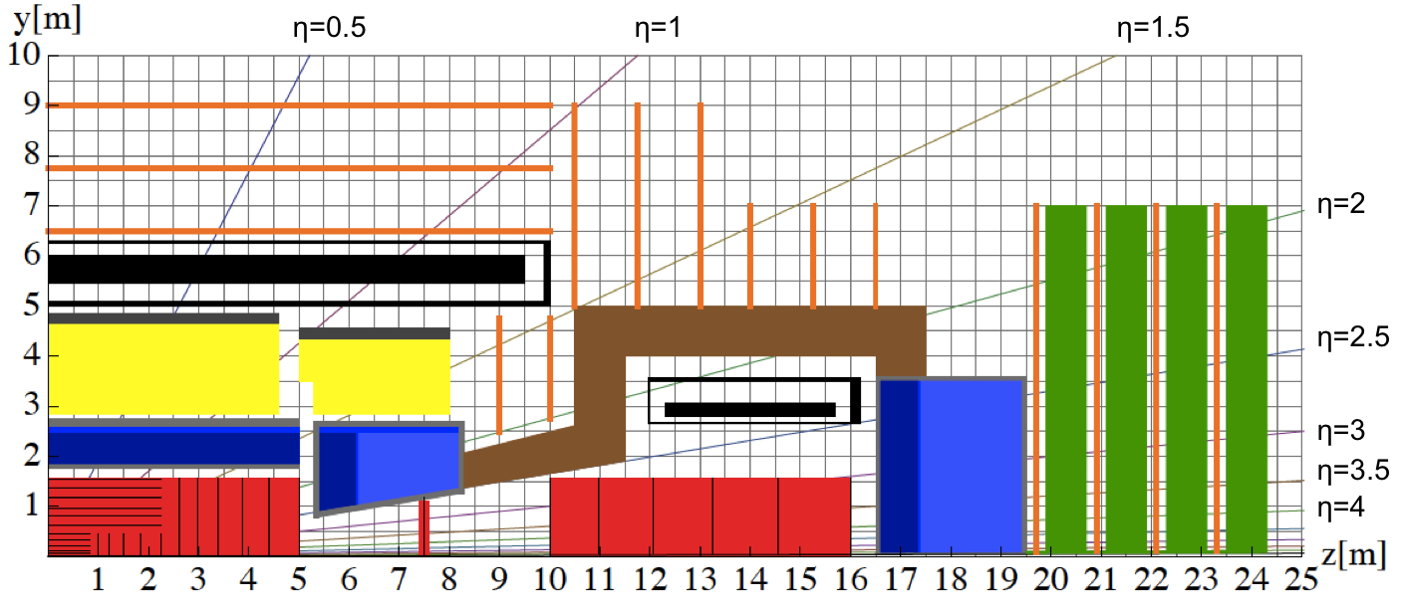
FFC-hh reference detector
4T 10m solenoid
Forward solenoids
Silicon tracker
Barrel ECAL Lar
Barrel HCAL Fe/Sci
Endcap HCAL/ECAL LAr
Forward HCAL/ECAL Lar
MUONS?
  Barrel
  Encap
  Forward
Various gaseous detectors

Slide 7
Constraints from LLP and DM searches

Slide 8
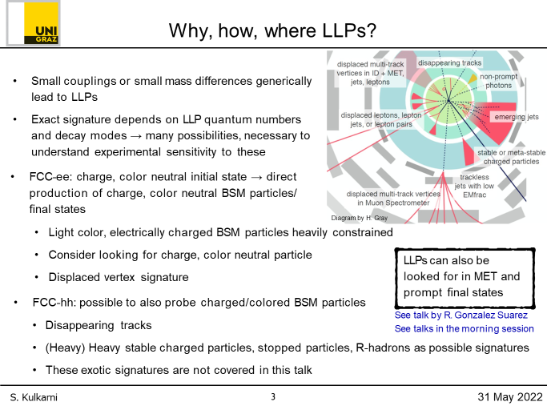
Beyond the muon detector: LLPs
Detector for long-lived particles at high energy of 100 TeV
Has ca 500 times more sensitivity; 150 due to increased cross section and luminosity and factor 3-4 due to moving detector closer to IP
Impact on the muon system
Local vertex identification
3D tracking
~ 100 ps ToF capabilities
Particle identification via ToF and pre-shower layers

Slide 9

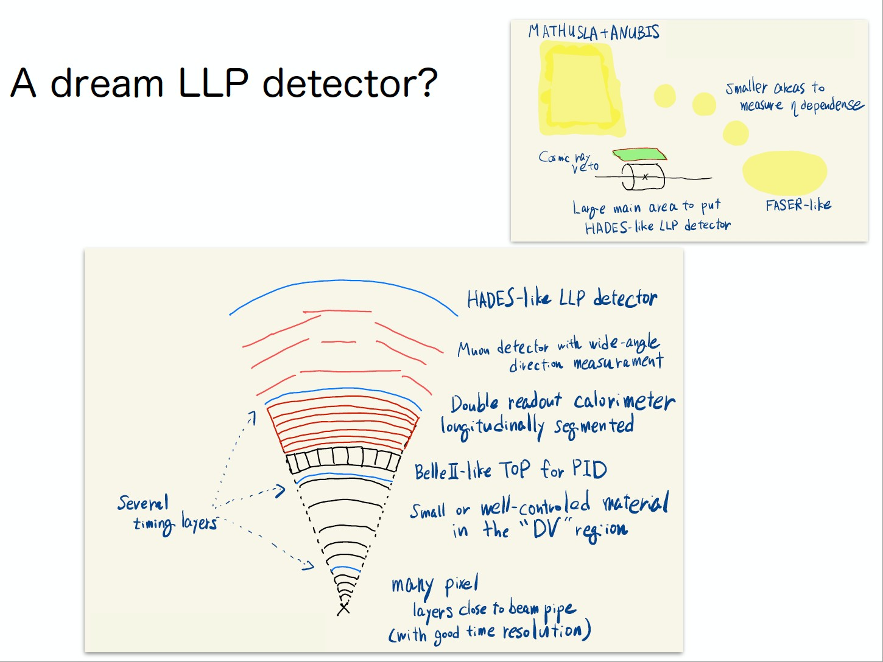
A dream LLP detector?
Adding a good timing and tracking layer extending the muon system...
Ryu Sawada’s first example at the LLP workshop in November-2020

Slide 10
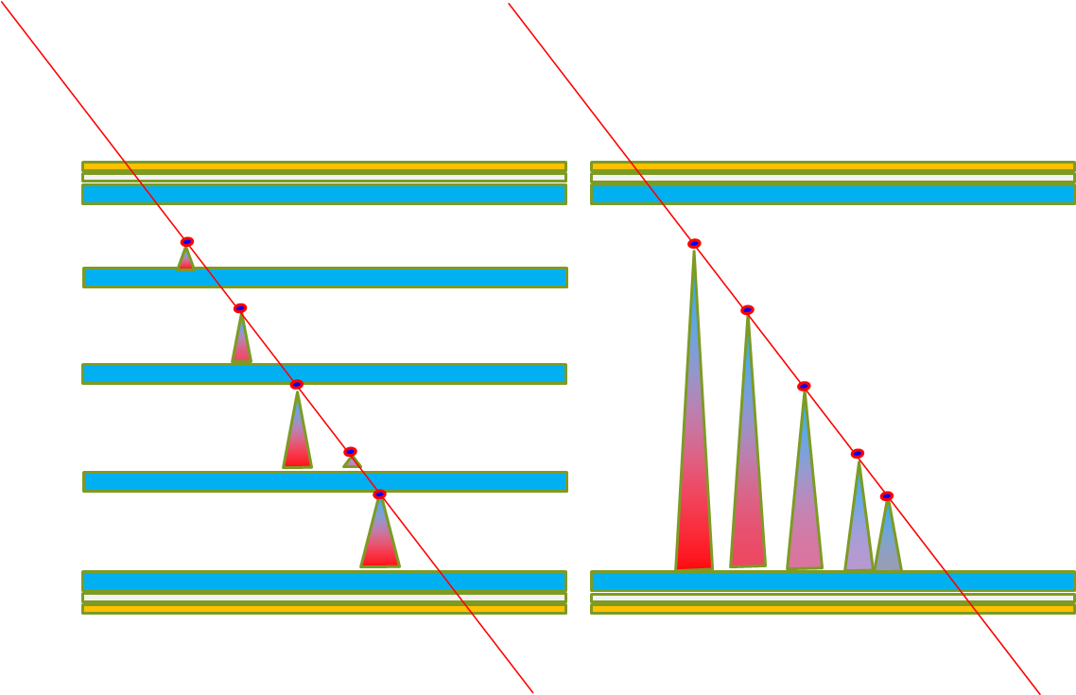
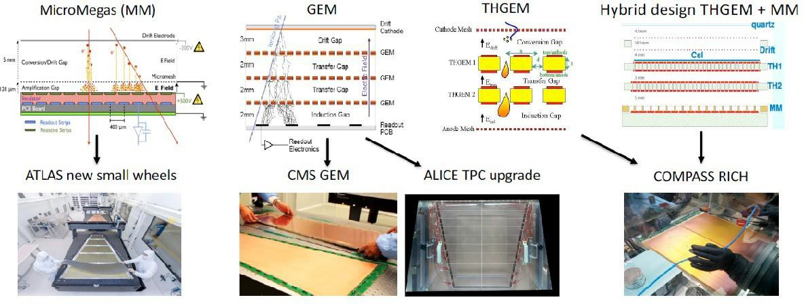
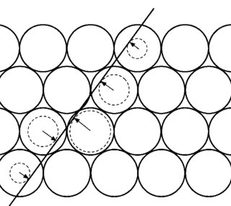
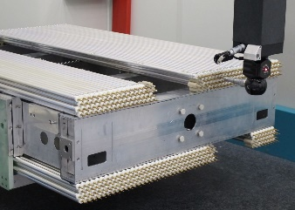
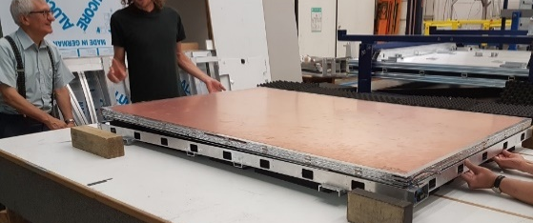
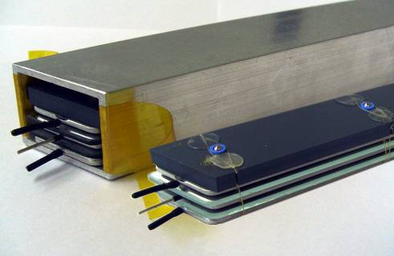
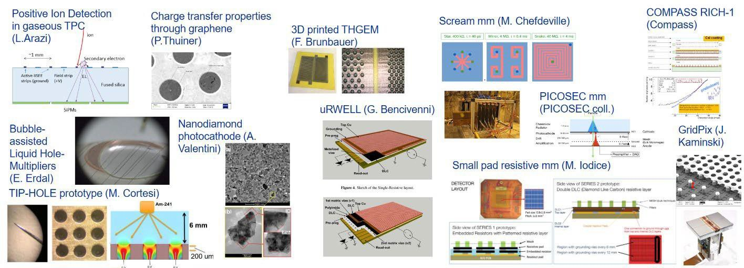

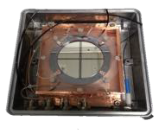



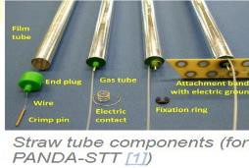
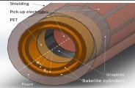
Muon detector technologies
sMDT
RPC
ATLAS Ph1 + Ph2 upgrade and CMS RE3/1 & RE4/1
Several experiments at GSI and RICH
ATLAS Ph1 + Ph2 upgrade
,
And new ideas
sRPC (Bencivenni
single gap semi-conductor
R. Cardarelli
RCC Cardarelli

Slide 11




Basic principles of muon detectors
All gaseous detectors designed for muons share the same base principle:
  A gaseous target thick enough for a MIP to release a sufficient primary ionization
  An electric field sufficiently strong to start an avalanche multiplication
  A segmented pick-up electrode to readout the signal and extact a space-time information
Wire chamber
MPGD
RPC
drift
$$E1$$
$$E=constant$$
$$E≈\frac{1}{r}$$
$$E2≫E1$$
avalanche
Pick-up strips
Resistive electrode

Slide 12
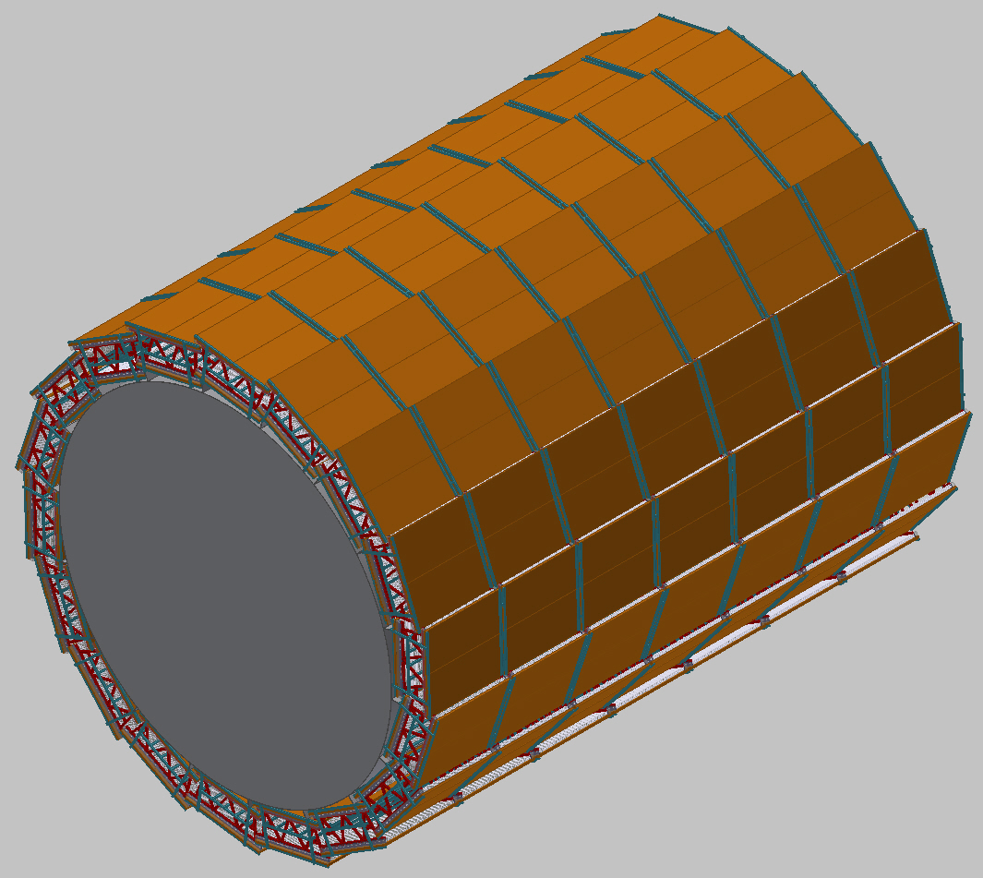
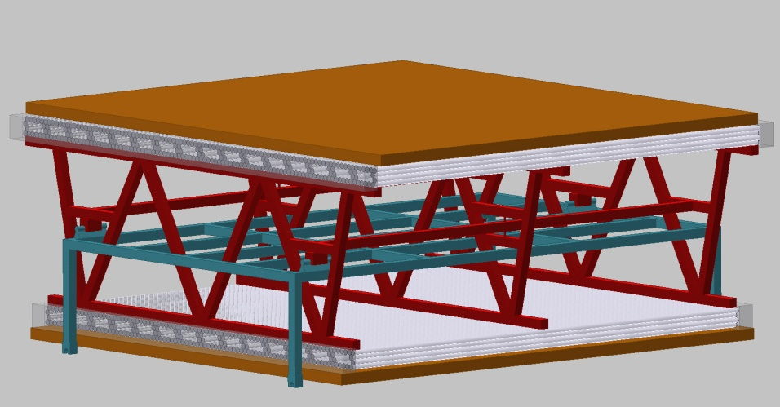
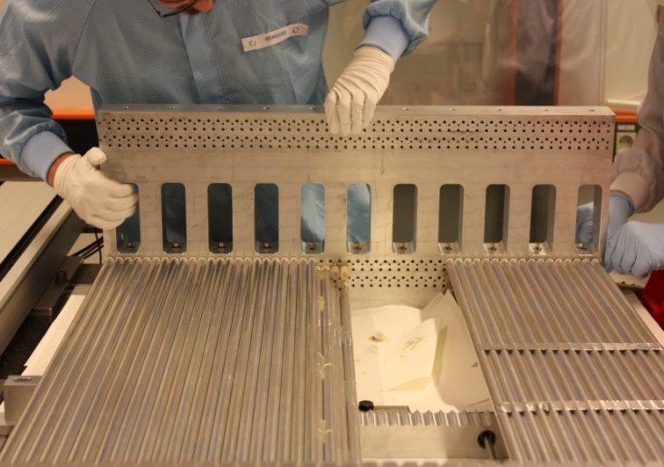
A working proposal (doable now)
Barrel and outer endcaps of FFC-hh:
2 x 4 layers of 2.8 m long drift tubes (axial in barrel, radial in outer endcaps) with 1.4 m multilayer distance provide 40 µm spatial resolution, 60 µrad angular resolution, 100% tracking efficiency up to the maximum background rates.
Monolithic sMDT construction, no optical alignment of multilayers needed. Chambers well accessible.
Embedded new RPCs for trigger, timing, and second coordinate

Slide 13
R&D summary
Time resolution: sub-ns

Slide 14
Outlook of new RPCs for muon systems
Muon systems tend to have large area (even larger in future)
LLP systems are even larger…
The BC timing could need to request resolving 5 ns BCs
The rate expected is from a factor 2 up to a factor 6 with respect tp the HL-LHC values, depending on the region
Higher eta higher rate but also smaller surface
Classic RPCs can fit most to the regions with incremental improvement
Newly proposed ideas can cope with all the areas of future colliders
The R&D must focus mostly in getting rid of environmental unfriendly and expensive gases and in further improving the industrialization to cover such large areas

Slide 15
Conclusions… and a small exercise
Most of the FFC-hh requirements on muon detectors are fulfil
In the regions with higher radiation a substantial improvement is needed
Potential competitor: new generation of Si detectors
Fine timing is needed in the 5 ns BC scenario and for the LLP searches
Muon detector community is sparling new ideas

Slide 16
Technology state of the art evaluation
(my personal view)
Useless = *
Poor = **
Sufficient = ***
Good = ****
Excellent = *****
Incremental R&D = *
Disruptive R&D = *
State of the art | Rate capability | Longevity (hadrons) | Space resolution | Time Resolution | Cost | Industrialization | Scalability
DT | *** | **** | **** | * | *** | **** | ****
sTGC | **** | *** | *** | *** | *** | ** | ****
RPC | *** | *** | *** | ***** | ***** | **** | ****
MPGD | **** | *** | *** | *** | ** | *** | ***
R&D potential | Rate capability | Longevity (hadrons) | Space resolution | Time Resolution | Cost | Industrialization | Scalability
DT | *** | **** | ***** | ** | *** | **** | ****
sTGC | **** | *** | **** | *** | *** | *** | *****
RPC | ***** | **** | **** | ***** | ***** | ***** | *****
MPGD | ***** | **** | **** | **** | ** | **** | ****

Slide 17
Backup

Slide 18
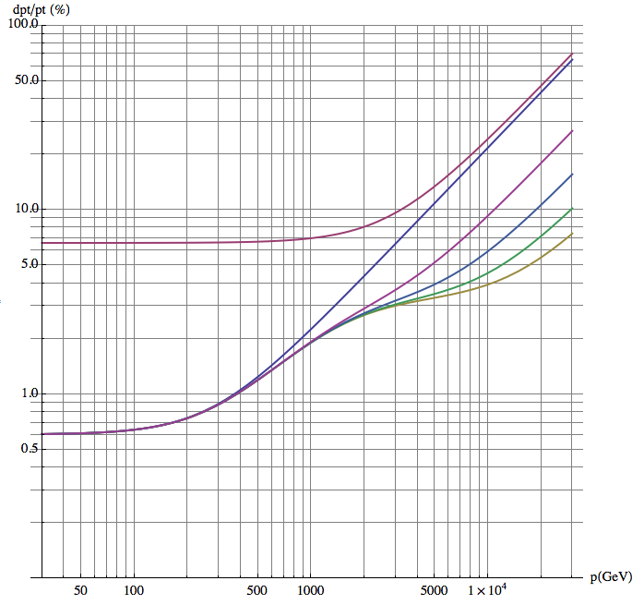
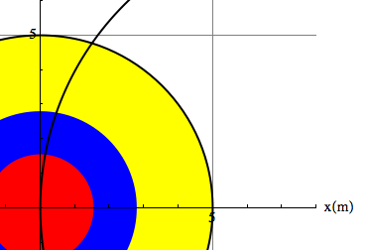
Muon tracking performance
Three methods for the muon momentum measurement
Tracker only with identification in the muon system
Muon system only by measuring the muon angle where it exits the coil
Tracker combined with the position of the muon where it exists the coil
70 µrad muon detector angular resolution:
  < 10% standalone momentum resolution up to 3 TeV, equal to tracker resolution
50 µm muon detector spatial resolution:
  < 10% combined momentum resolution up to 20 TeV.
Multiple scattering limit for track combination (infinite muon detector resolution)
L₁
Analytical calculation, Werner Riegler, FCC Week 2017
L_{Calo}
L₀

Slide 19
Muon system contribution
Tracking
Improvement by muon system for p_{T} > 1 TeV and |η| < 2.5.
Muon and Barrel endcap fully included
Forward is meant principally for muon identification
Trigger
Momentum resolution at pT < 100 GeV dominated by multiple scattering, independent of detector resolution.
For 200 X0 of scattering material in front of the muon system and perfect chamber resolution 5 - 25% standalone pT resolution from η =0 up to | η | = 2.5 for 1st level muon trigger.
Solenoidal B field in forward direction (|η| > 2.5) not suitable for precise standalone momentum measurement for trigger (p_{T} resolution > 80%).

Slide 20
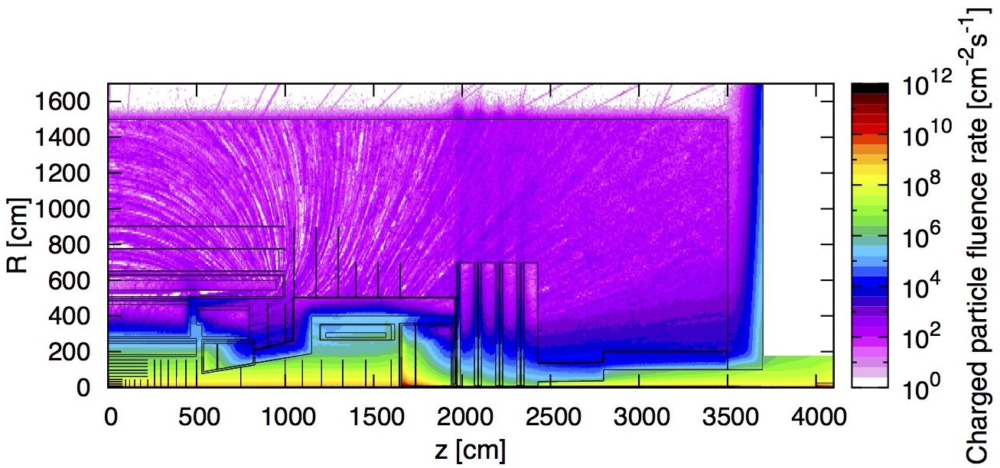
Particle Fluence @ L=30x10³⁴cm⁻²s⁻¹
  Barrel muon chambers: ~300 cm⁻²s⁻¹ to ~500 cm⁻²s⁻¹
Charged rates
  Up to 500 cm⁻²s⁻¹ (R>3m |η|<1.5)
  up to 10⁴ cm⁻²s⁻¹ (R>1m 1.5<|η|<3.5)
  ~ 5x10⁵ cm⁻²s⁻¹ (R<1m |η|>4)
photon rates
  ~ 5x10⁶⁻⁸ cm⁻²s⁻¹
N fluence
  Up to10¹⁴ cm⁻² (shielding to mitigate the effect)
Charged particles Fluence
|η|=1.5
|η|=4
  Endcap Muon Chambers: 10⁴ cm⁻²s⁻¹
  Forward Muon Chambers: 5x10⁵ cm⁻²s⁻¹
Present muon detectors close to fully satisfy this requirement → further R&D needed for completing

Slide 21

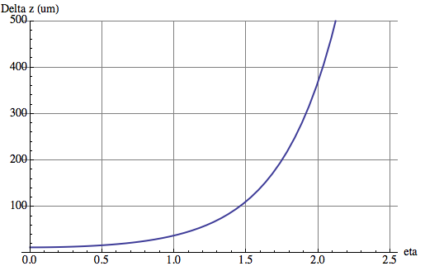

Pileup of 1000 (25ns Bunchcrossing)
HL-LHC average distance between vertices at z=0 is
≈ 1mm in space and 3ps in time.
For 6 times higher luminosity at FCC-hh (an HE-LHC) this would become
≈ 170μm in space and 0.5ps in time.
x=0.8mm, X₀=35.28cm (Be), p=1GeV
θ₀
Beampipe
η
r = 2.5cm
Beam
Δz
Even having a perfect tracking detector, the error due to multiple scattering in the beampipe for η > 1.7 is already larger than the average vertex distance !
Timing, very clever new ideas needed …
W. Riegler; FCC-hh Accelerator and Detectors, Nov. 21 2017

Slide 22
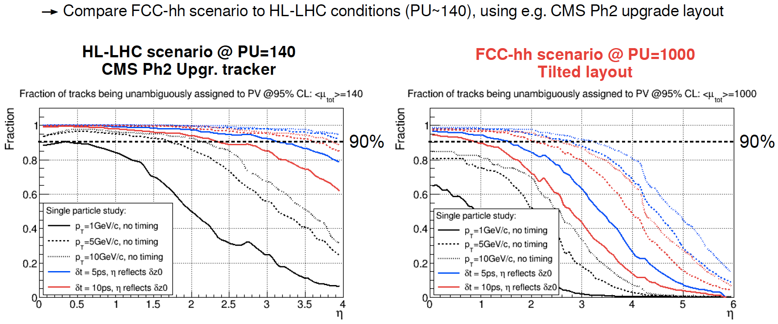
Vertexing at Pileup of 1000, Timing
W. Riegler; FCC-hh Accelerator and Detectors, Nov. 21 2017

Slide 23
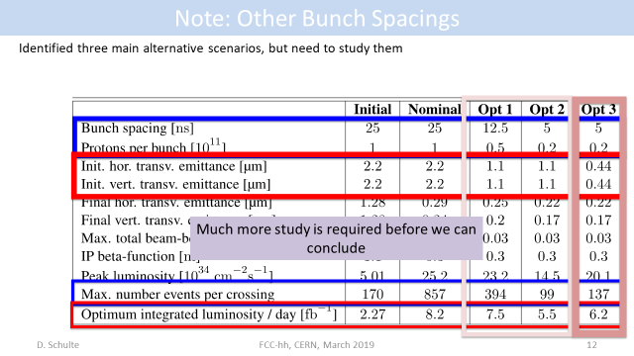
Pileup mitigation - consequences
Shorter BC spacing proposal:12.5 and 5 ns
Correspondingly lower bunch intensity
Pileup reduction
Most of internal detector are developing at least sub ns timing
The BC id. Will require sub-ns timing in the muon system too
At the moment just RPCs can provide this performance among the classical muon detectors → drive of new R&D effort

Slide 24
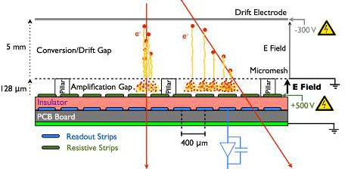
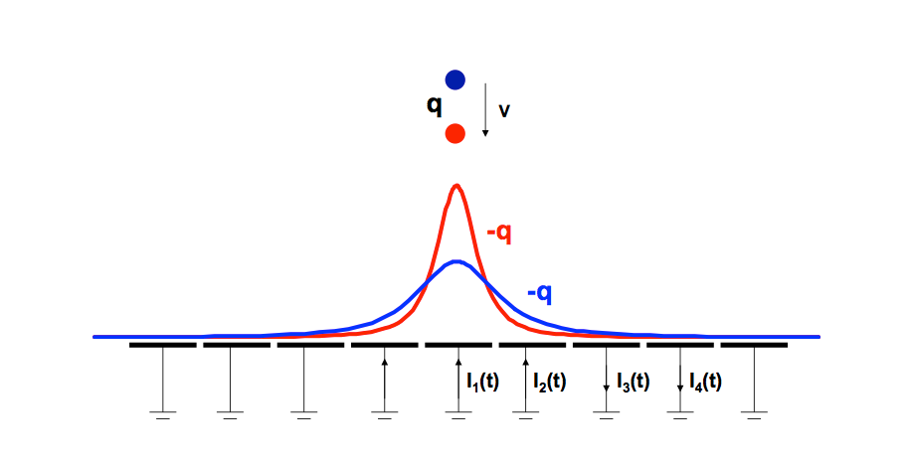

Space resolution principles
MPGD
Space resolution is driven by 2 factors
  Intrinsic localization of the event
  Precision of the chamber geometry
RPCs
Wire chamber
$$E≈\frac{1}{r}$$
Tubes and MWPC exploit the R-t relation of the ions drifting in the gas and rely on their metallic bulks which can be easily machined to offer a precise reference frame. Can obtain high precision with low channel density
RPCs and MPGD exploit electrostatic induction of the moving charges to calculate the charge centroid. The resolution is driven by the readout system segmentation and mechanical precision preserving it on large multi-layer chambers made of composite materials. Can obtain high precision with high channel density

Slide 25
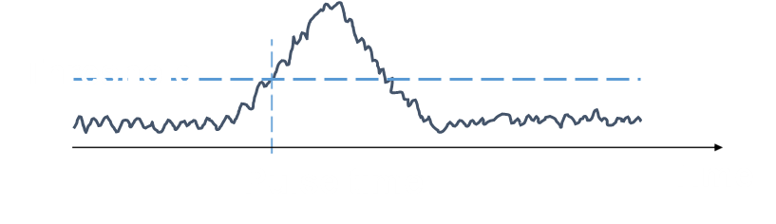

Time resolution principles
Time resolution is driven by
  Avalanche statistical fluctuations
  Drift time (velocity x gap size)
  Electronics noise
Wire chamber
MPGD
$$E≈\frac{1}{r}$$
MWPC and MPGD work on similar principles: the separation of the drift and multiplication introduces irreducible uncertainty on the time resolution, dependent on the drift width
RPCs and MRPCs drift and multiplication space coincide. The multi-micro gap RPC segments the gas gap to further reduce the drift time

