Slide 1
Neutron Science with Gaseuos Detectors
Review and DRD1-WP9 Hints
Gabriele Croci
University of Milano-Bicocca
Department of Physics «G. Occhialini»
Milano, Italy
1st DRD1 Collaboration Meeting
CERN

Slide 2
Outline
Neutron detection principles
  Thermal neutrons
  Fast neutrons
³He
  ³He based detectors for thermal and fast neutrons
  ³He shortage
Novel trends
  Wire-based solutions
  MPGD
  RPC
I apologize if I did not cite some research in this talk for sake of time ….

Slide 3
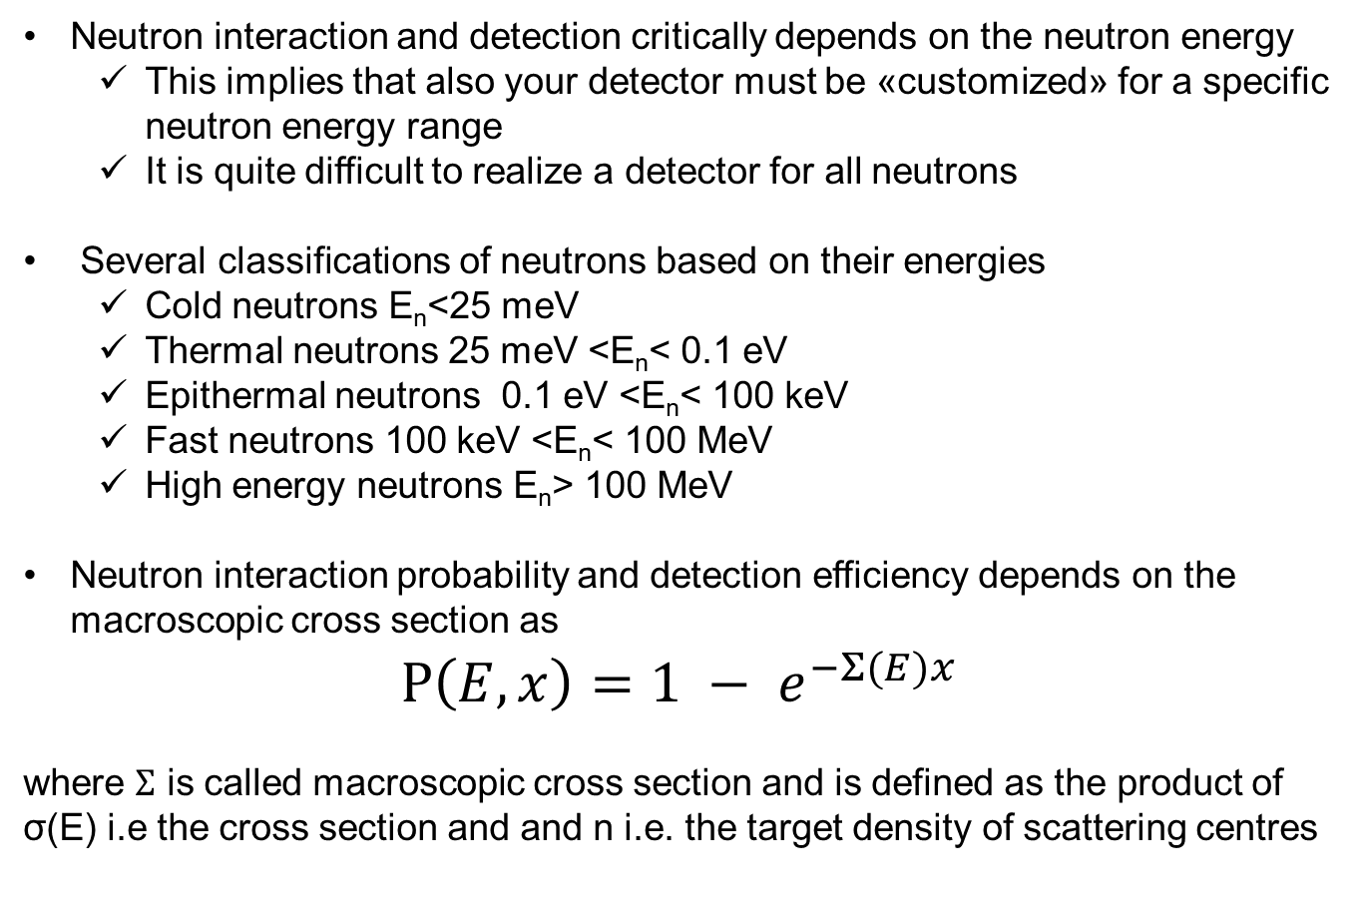
Neutron Interaction and detection
Neutron interaction and detection critically depends on the neutron energy
  This implies that also your detector must be «customized» for a specific neutron energy range
  It is quite difficult to realize a detector for all neutrons
Several classifications of neutrons based on their energies
  Cold neutrons E_{n}<25 meV
  Thermal neutrons 25 meV <E_{n}< 0.1 eV
  Epithermal neutrons 0.1 eV <E_{n}< 100 keV
  Fast neutrons 100 keV <E_{n}< 100 MeV
  High energy neutrons E_{n}> 100 MeV
Neutron interaction probability and detection efficiency depends on the macroscopic cross section as
$$P\left(E,x\right)=1 − e^{−Σ(E)x}$$
where $Σ$ is called macroscopic cross section and is defined as the product of σ(E) i.e the cross section and and n i.e. the target density of scattering centres

Slide 4
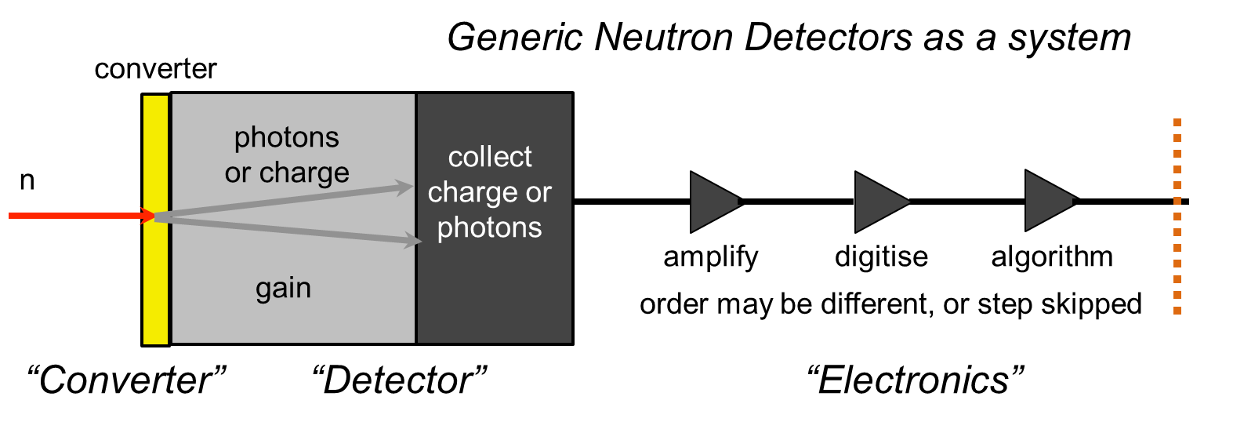
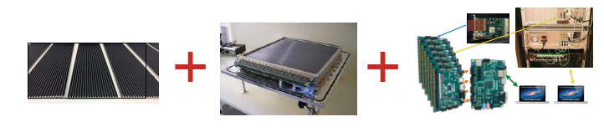
Basic principle to realize a neutron detector
Storage
Converter material depends on the neutron energy you want to detect
Detector is optimized following the requirements of the neutron science you want to explore

Slide 5
Thermal neutrons

Slide 6
³He based detectors: principle
n + ³He → p + ³H + 0.76 MeV σ(λ) = 5333 barn * λ/1.8 Å
Single Wire Proporional Chamber
Increase n (density of scattering centres) by increasing pressure (up to several bars)
Very rubust and simple geometry
Relatively low operation voltages
Most diffused geometry: ³He-tubes

Slide 7
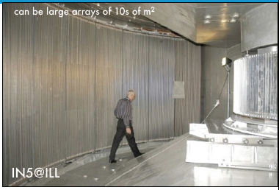
³He tubes applications
Very high efficiency to thermal neutrons
Wide application in all present «neutron science» facilities (i.e. spallation sources and reactors)
  ISIS (UK)
  SNS (USA)
  ILL (FR)
  J-PARC (JP)
  …

Slide 8
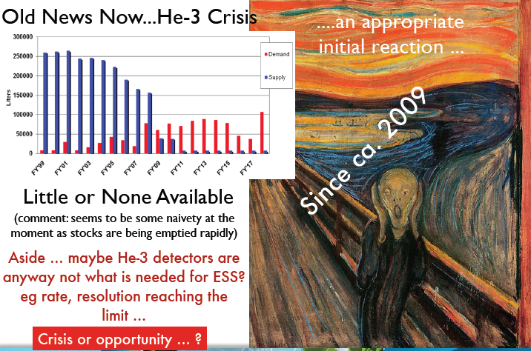
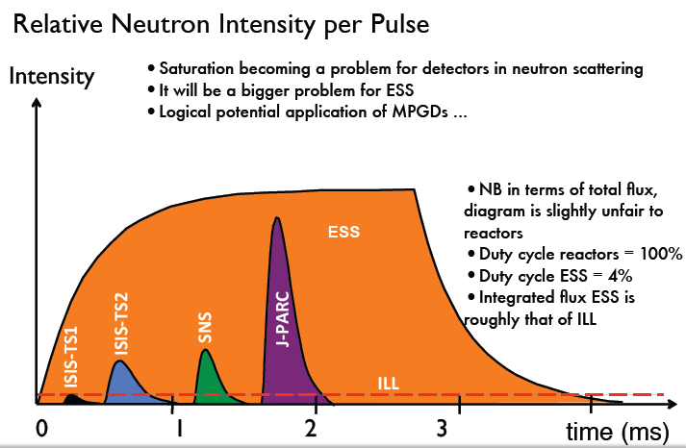
but…
Shortage of ³He gas
³He tubes (as SWPC) are limited in rate capability
→ Maybe an issue for future high intensity neutron sources like ESS
Thanks to R. Hall-Wilton

Slide 9
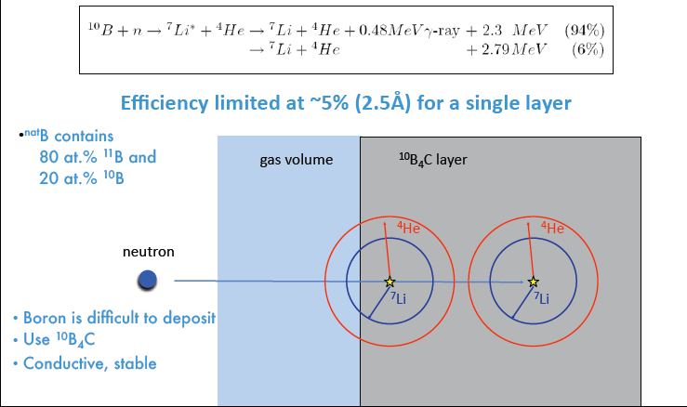
Most common alternative materials to ³He: ¹⁰B and ⁶Li
Solid converters (1/2)

Slide 10
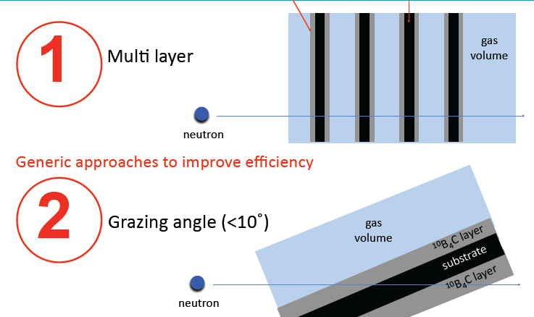
Most common alternative materials to ³He: ¹⁰B and ⁶Li
Solid converters (2/2)
Converting Layer
Substrate

Slide 11
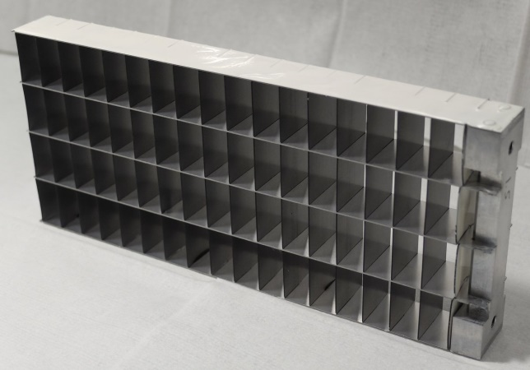
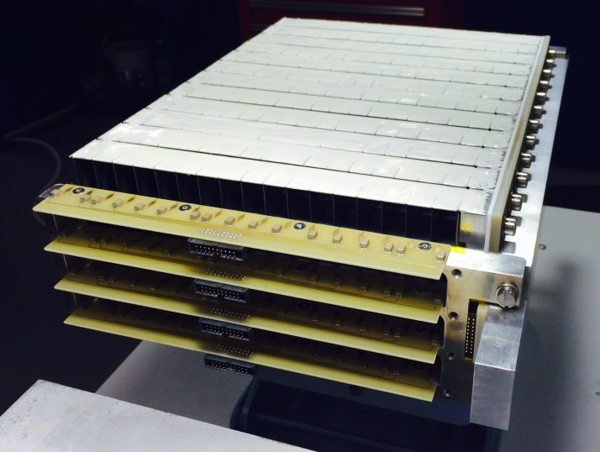
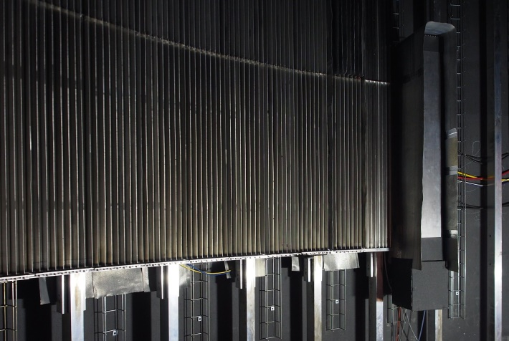
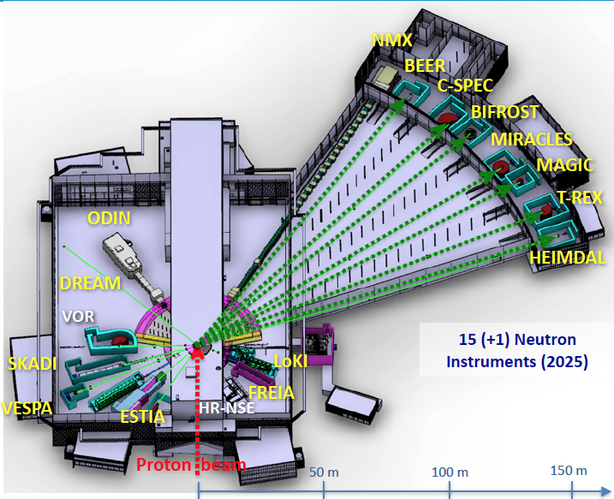
Novel wire-based solutions (mainly for ESS..)
MultiGrid detector – ¹⁰B based
He-tubes
MG
ESS
Multi-SWPC- Large area
High efficiency
Millimetric Spatial resolution
Developed by ILL and ESS

Slide 12
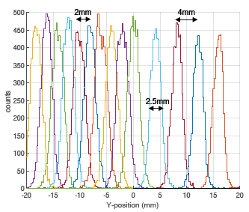
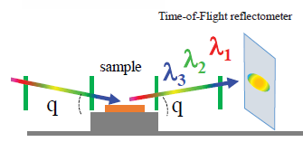
Novel wire-based solutions (mainly for ESS..)
MultiBlade detector – ¹⁰B based
Developed by ILL and ESS
MWPC-based
High efficiency
Millimetric space resolution
High rate
Application: FREIA / ESTIA
Reflectometry instruments at ESS

Slide 13
RPC for neutron detection

Slide 14
MPGD for neutron detection
MPGD detectors born for tracking and triggering applications (detection of charged particles)
In order to detect neutral particles you need a converter
  Thermal Neutrons: ¹⁰Boron converter
    Neutrons are detected using the productus (alpha,Li) from nuclear reaction eg: ¹⁰B(n,alpha)7Li
  Fast Neutrons: Polyethylene converter + Aluminium
    Neutrons are converted in protons through elastic scattering on hydrogen
MPGD offer the following advantages
  Very high rate capability (MHz/mm²) suitable for high flux neutron beams like at ESS
  Submillimetric space resolution (suited to experiment requirements)
  Time resolution from 5 ns (gas mixture dependent)
  Possibility to be realized in large areas and in different shapes
  Radiation hardness
  Low sensitivity to gamma rays (with appropriate gain)
Two dedicated workshops in the last years
  https://indico.cern.ch/event/265187/ (2013)
  https://indico.cern.ch/event/365840/ (2015)

Slide 15
For sake of time I skip all Micro Strip Gas Chamber application to neutron detection
I will concentrate on GEM, Micromegas and THGEM

Slide 16
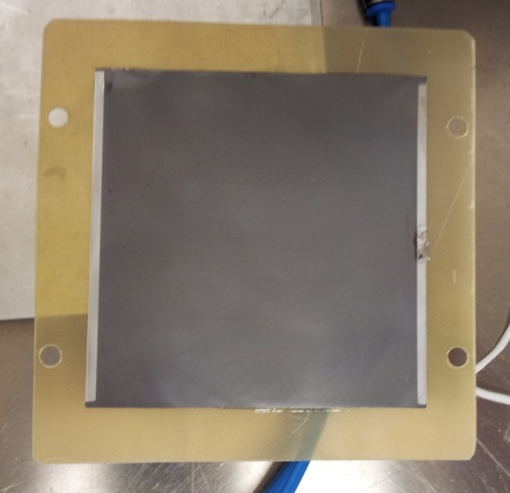
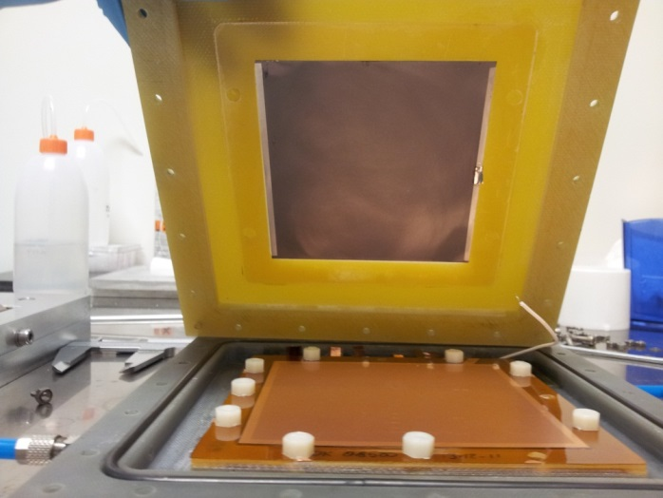
GEM thermal neutron detector
Triple GEM detector equipped with an aluminum cathode coated with 1μm of B₄C: first bGEM prototype
Exploit the ¹⁰B(n,α)⁷Li reaction in order to detect thermal neutrons
n
α
Detector Schematics
B₄C coated aluminium cathode assembled inside the bGEM chamber layout
B₄C coated aluminium cathode mounted on its support
Low efficiency detector (few %)
Several groups around the world (UNIMIB-INFN-CNR, CERN, J-PARC, CSNS …) developed similar solutions

Slide 17
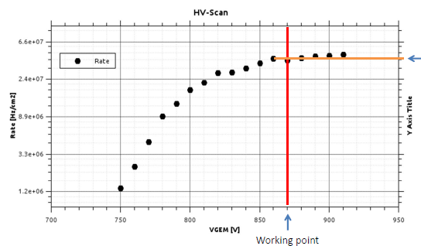
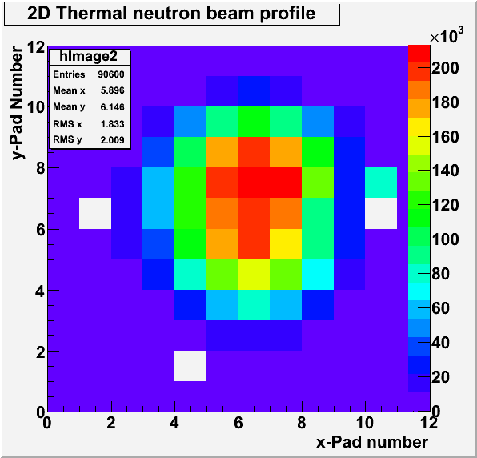
Performances
G. Croci et Al, 2013
40 MHz/cm²

Slide 18
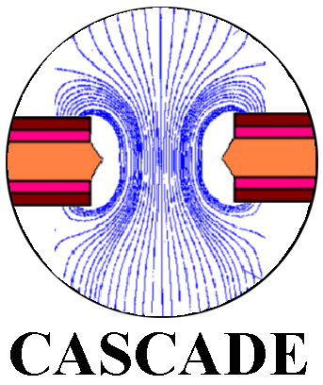
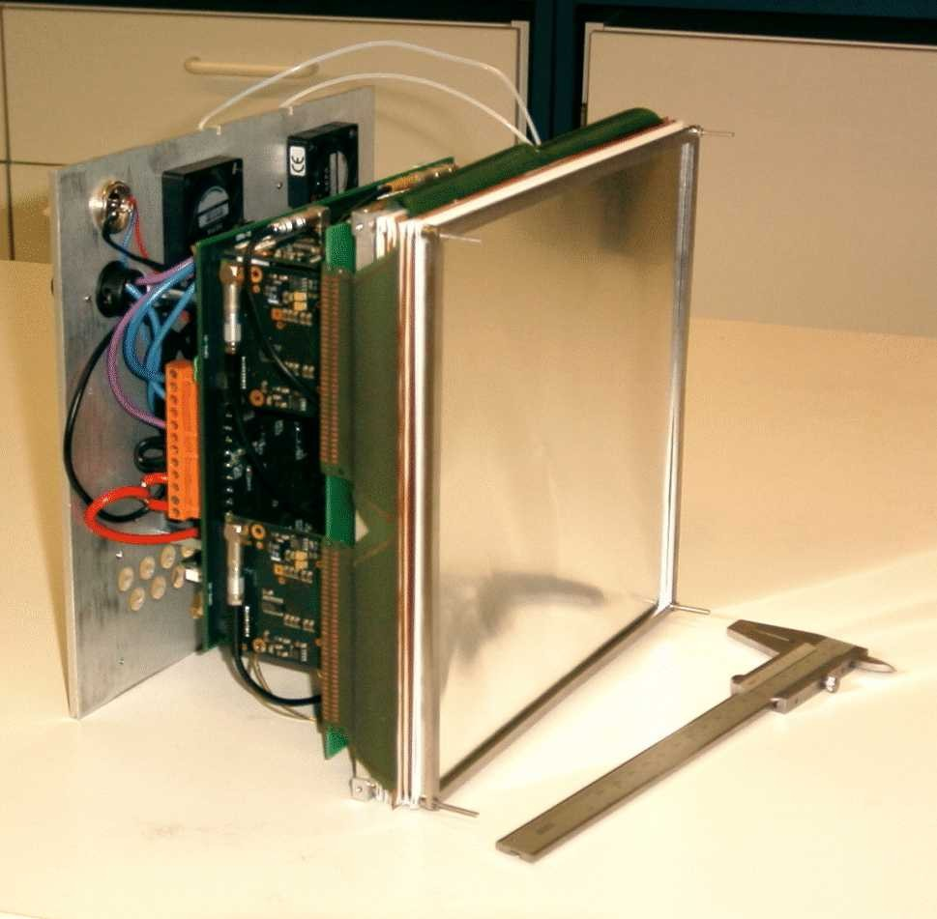
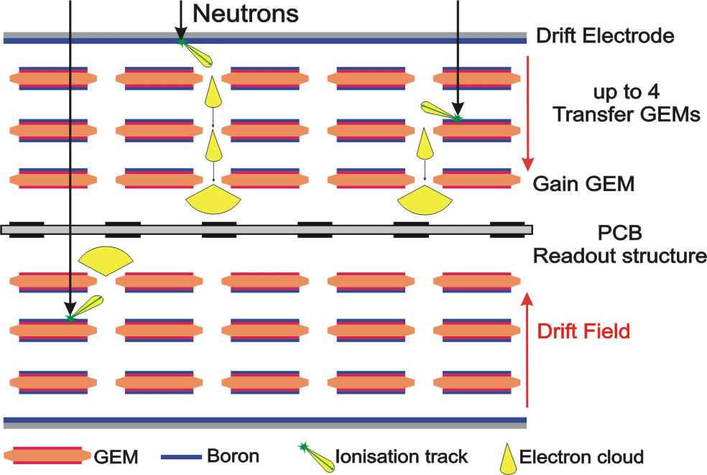

The CASCADE GEM detector
2D-200 CASCADE Detector (200x200 mm²)
Power supply and thermal management
Detector entrance window (100 µm Al)
FPGA based readout board
GEM-foils coated with ¹⁰B and 2D readout structure
Each GEM has two ¹⁰B layers
Last GEM operated as amplifier
10 GEM foils for ~ 50% efficiency
ASIC frontend- electronic
INFM - Perugia Forschungszentrum Jülich Hahn Meitner Institut - Berlin
Ruprecht Karls Universität - Heidelberg AGH University of Sci. and Tech. - Krakow
Christian J. Schmidt et al (GSI, Darmstadt)
18

Slide 19
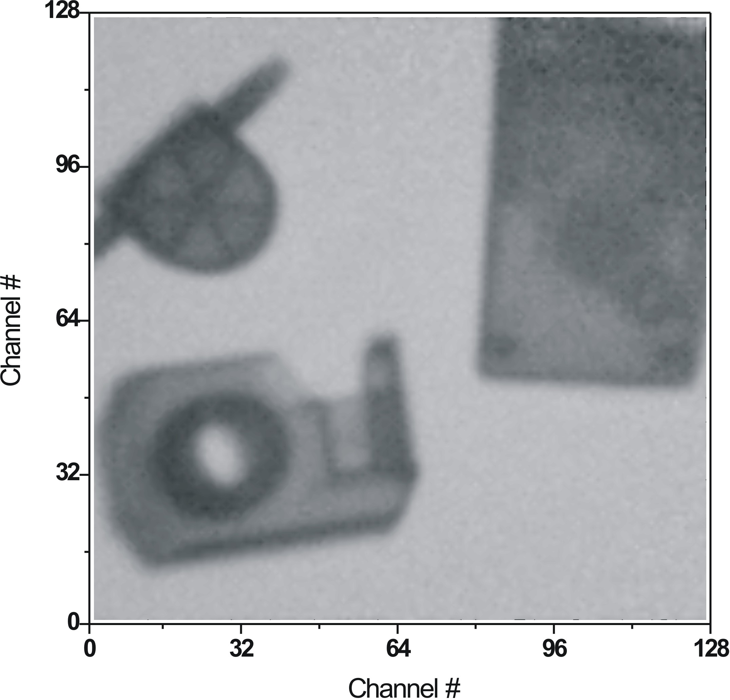
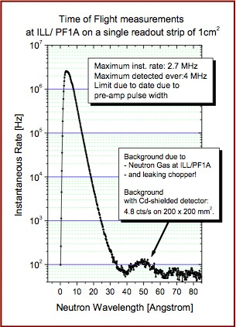
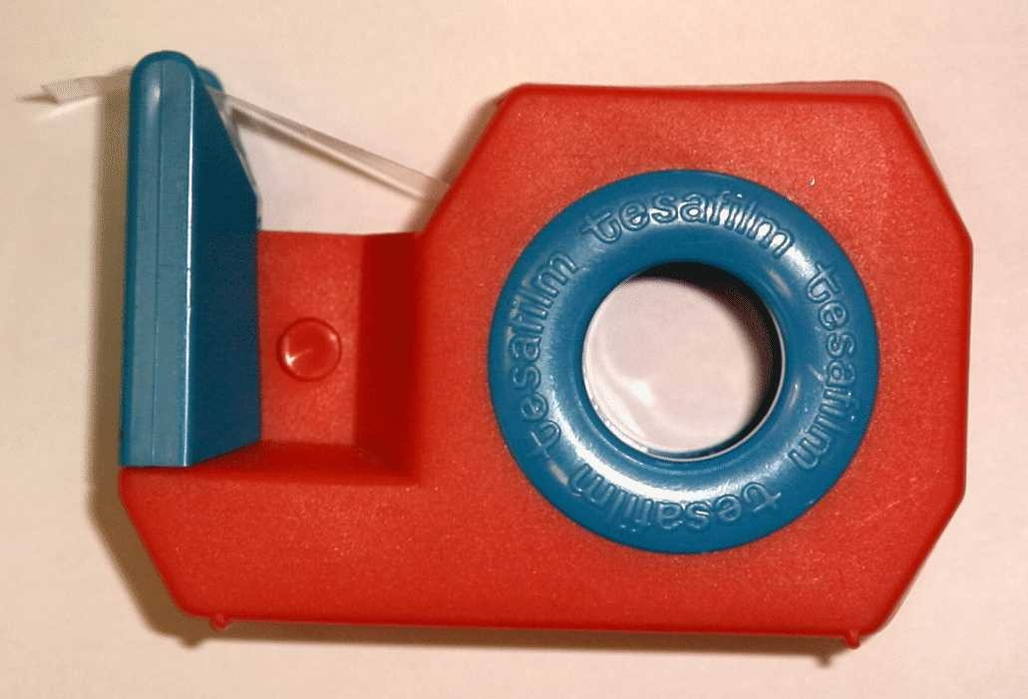
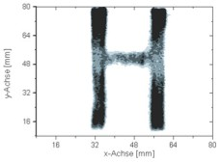
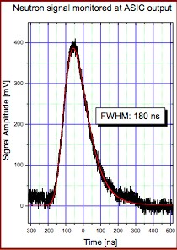
CASCADE GEM detector performances
A radiography with the CASCADE GEM detector TOF Dynamics Achieved with CASCADE
Water Flow-Indicator
Old PC Mouse
Tesa-Tape Dispenser
~ 1-3 mm spatial resolution with 1.56 mm pixel size
10 MHz/cm² counting rate capability
CEA DSM Irfu
Christian J. Schmidt et al (GSI, Darmstadt)

Slide 20
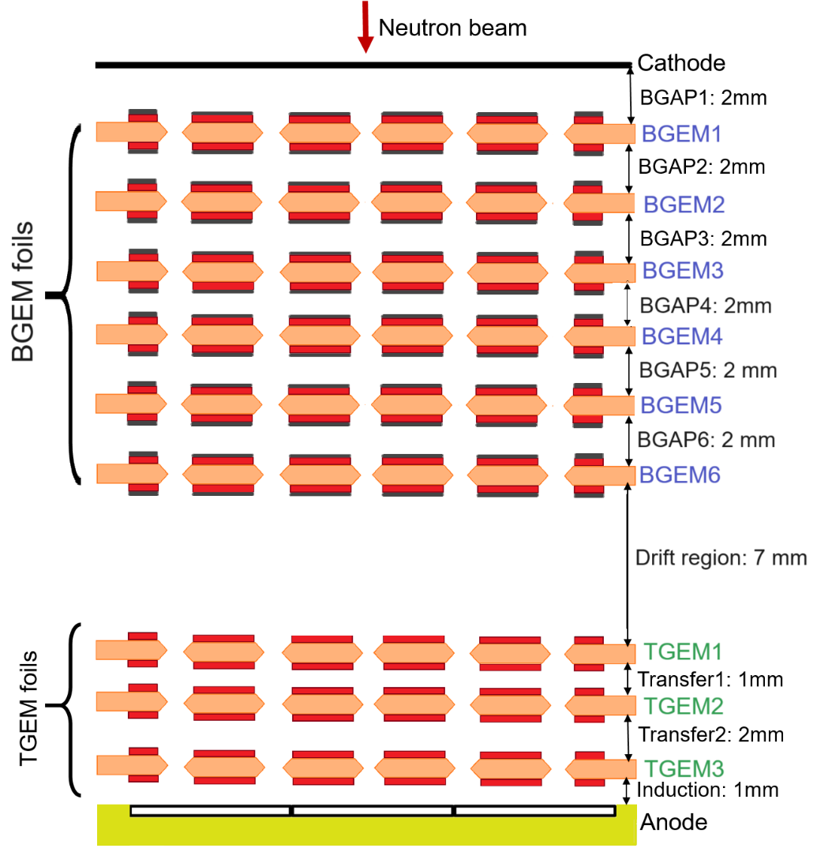
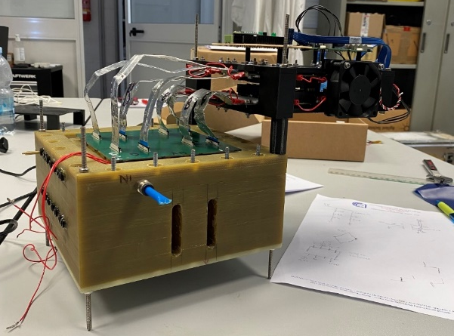
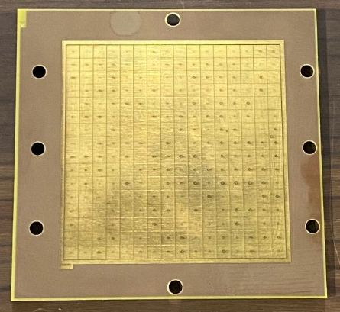
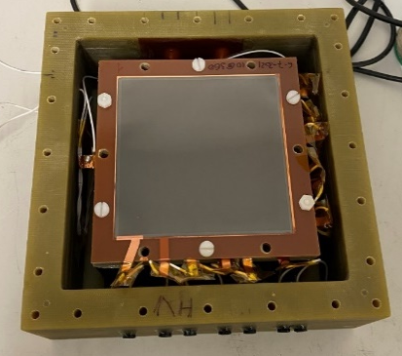
Multi Boron GEM detector
GEM foils of 10x10 cm² covered on both sides with 1μm of ¹⁰B₄C.
Stacking of 6 Boron-coated (BGEM) foils coupled with three standard GEM foils.
Gas Mixture Ar-CO₂ (70%-30%).
Padded anode made of 256 pads of 6x6 mm²
6MBGEM detector coupled with GEMINI electronic readout

Slide 21
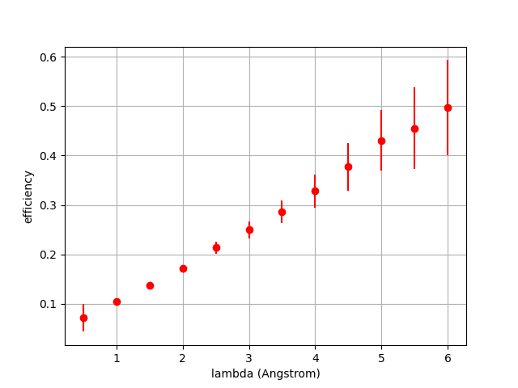
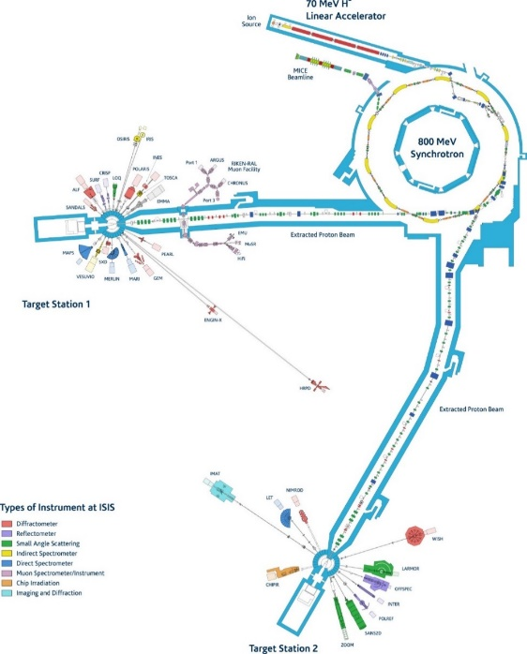

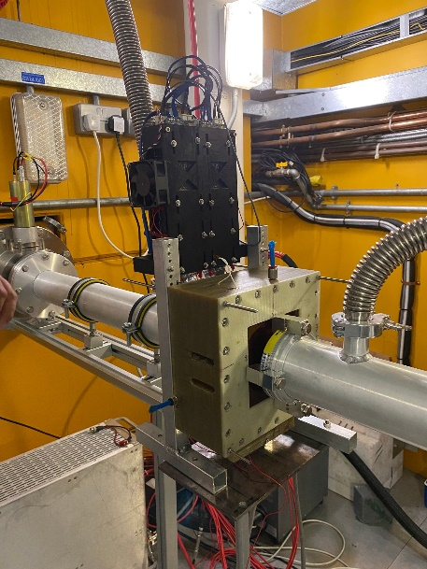
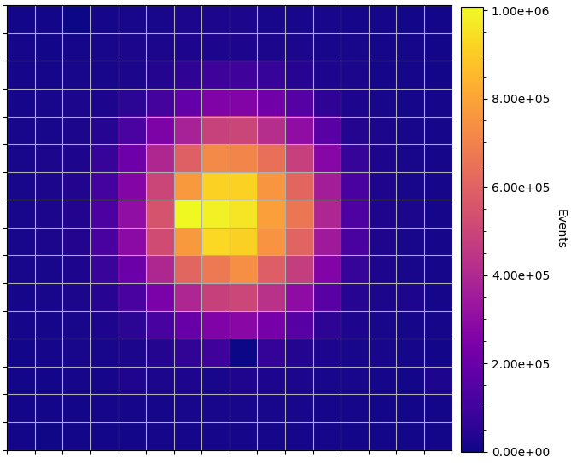
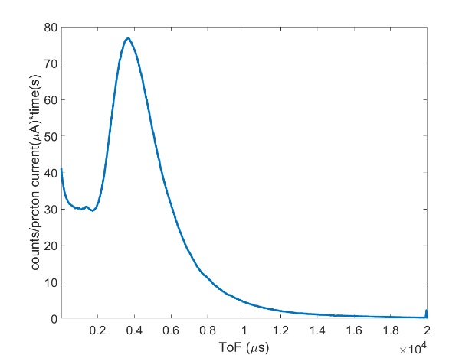
Multi Boron GEM detector performances
At 1,8 Å (25 meV) efficiency is 16%

Slide 22
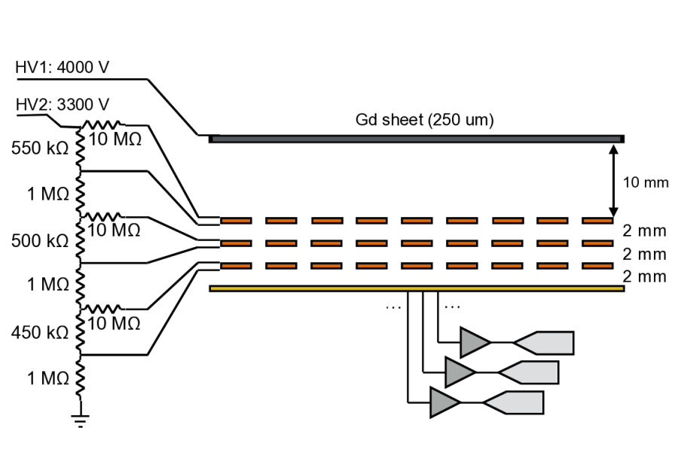
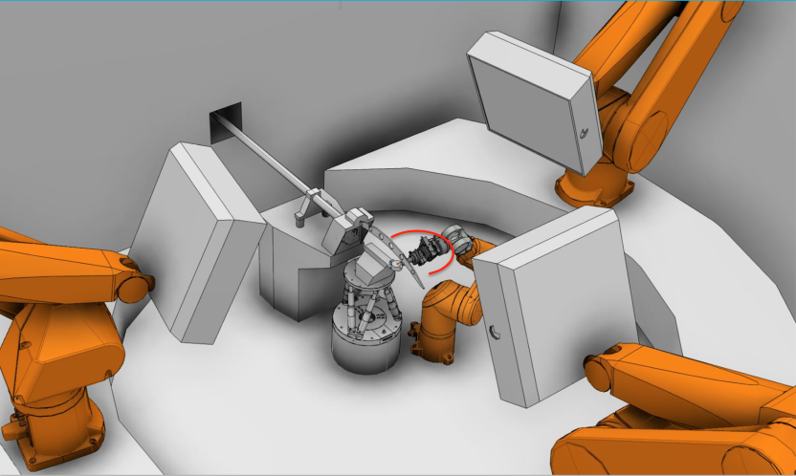
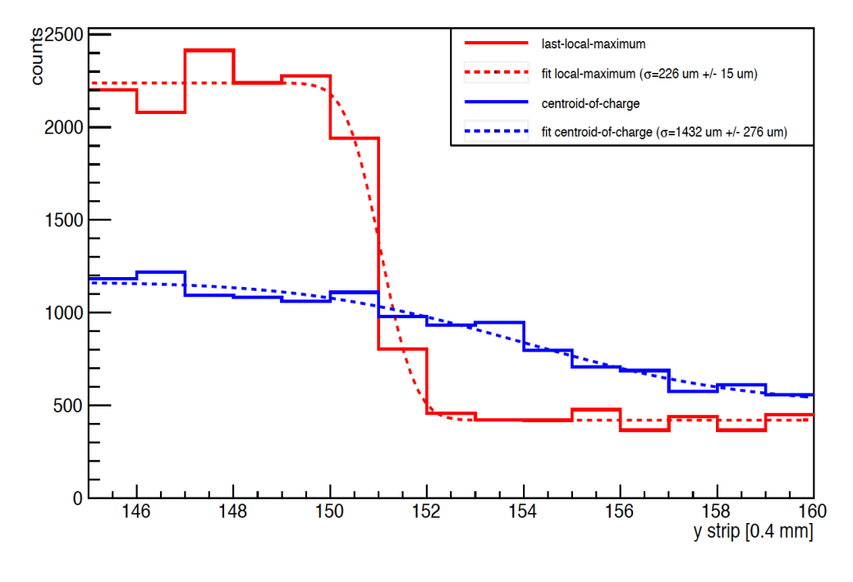
Gd-GEM for NMX @ ESS
D. Pfeiffer et al, 2016 JINST 11 P05011
Position resolution σ <300 μm reached with Triple GEM, APV-25
Detection efficiency < 12 % at normal incidence of neutron

Slide 23
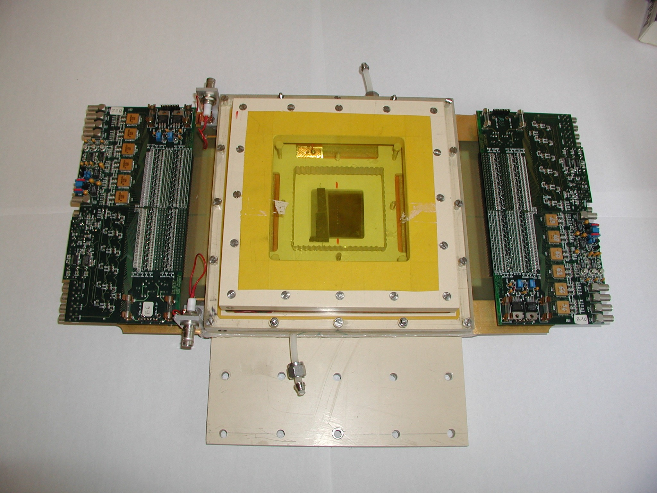


Micromegas for neutron radiography
CEA/DSM-IRFU + CEA/DRT-LIST-DETECS collab.
« classical » micromegas prototype
✓ ⁶Li converter : 50 µm
✓ Conversion gap : 400 µm
✓ Amplification gap : 50 µm
✓ Self-supported 50 μm micromesh
✓ Gassiplex cards readout
Imaging Mask: Gadolinium foil (5x5 cm², 25 µm thin) holes from 75 to 500 µm
Gadolinium object
Holes
neutron
HV1
Li6 converter
conversion (400-700 μm)
E1 ~ 1kV/cm
e-
Micromesh
HV2
amplification (50 μm)
E2 ~ 40kV/cm
Charged particle
100 µm
Thanks to A. Delbart

Slide 24
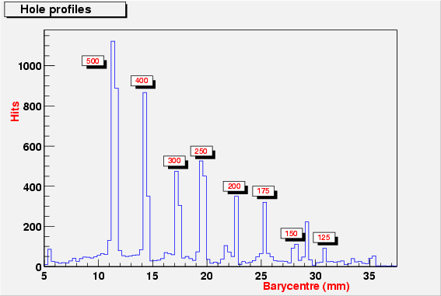
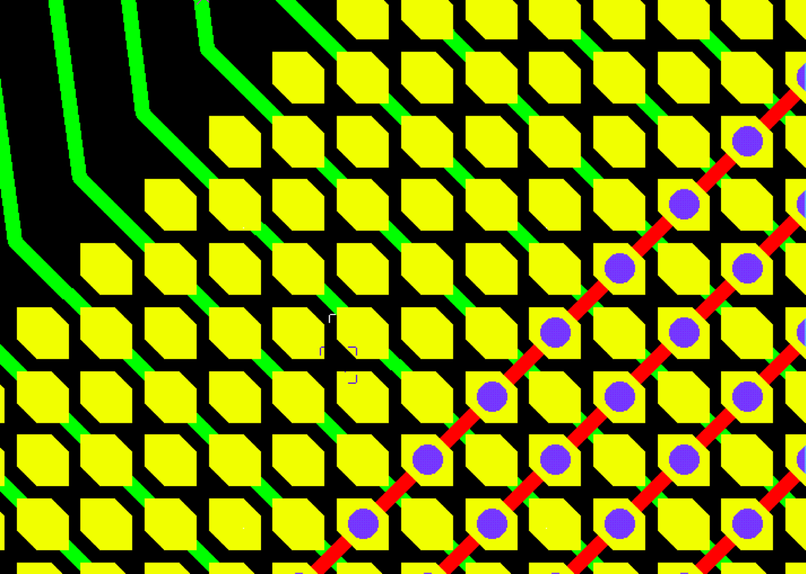




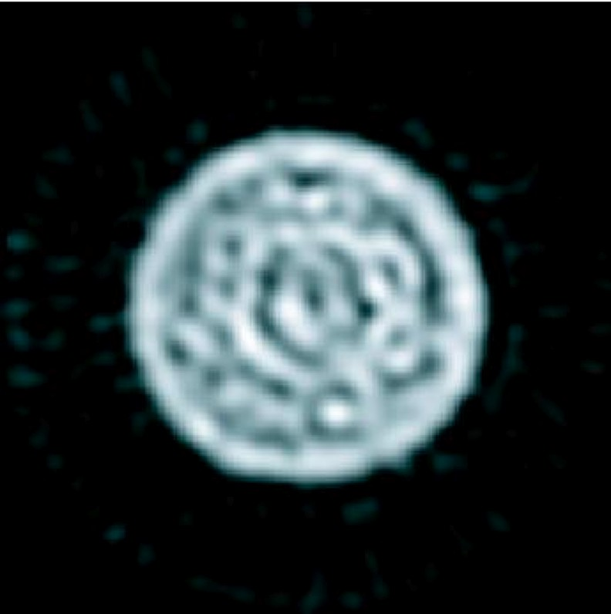
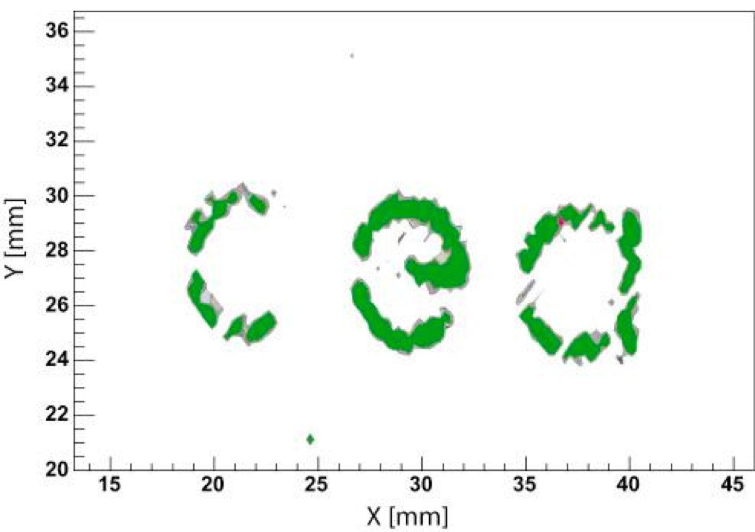
Imaging capabilities of the prototypes
F. Jeanneau, IEEE TRANSACTIONS ON NUCLEAR SCIENCE, VOL. 53, NO. 2, APRIL 2006
3 10⁸ thermal neutrons/cm²/s
350 μm
Image of the Gd mask
Beam tests at the Orphee Nuclear plant
Tomographic image of a multi-wires cable (∅ 6 mm, 12 wires, ∅ 0.5 mm each)
Distorted tomograhy reconstruction with ~160 μm resolution because of the pillars supporting the “classical” micromegas mesh
Should be greatly improved today by use of the 2D micro-­‐‑bulk
Thanks to A. Delbart

Slide 25
Fast neutrons

Slide 26
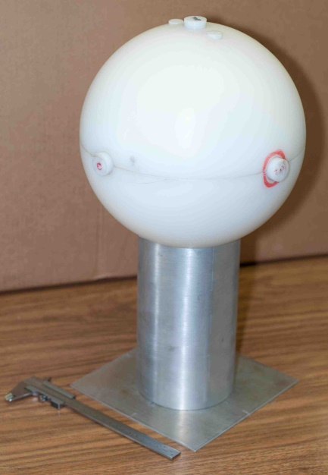
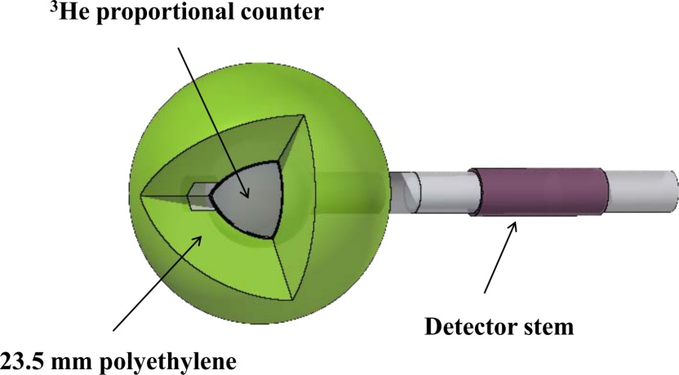
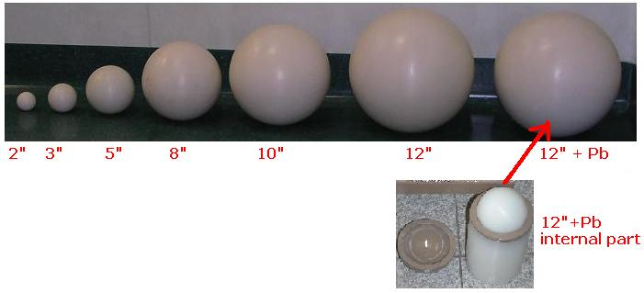
³He tubes applications – fast neutrons
³He detectors can be also used to detect fast neutrons if an appropriate moderator is placed around the detector
BONNER SPHERES

Slide 27
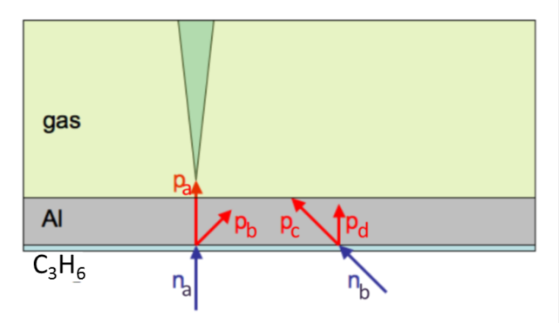
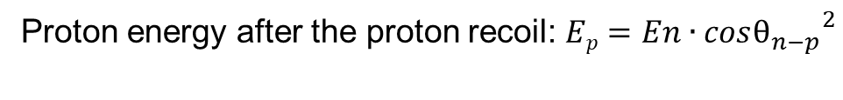
Typical fast neutron converter
Detection of recoiling protons produced by neutrons in plastic
Proton energy after the proton recoil: $Ep=En∙{cosθ_{n−p}}^{2}$
Not in scale.....
With this cathode only a proton recoiled by a neutron incident with an energy and an incidence angle above than a certain threshold can be detected by the charge particle detector, like GEM, MM, …
This introduces also a directionality selection effect to the detector,

Slide 28
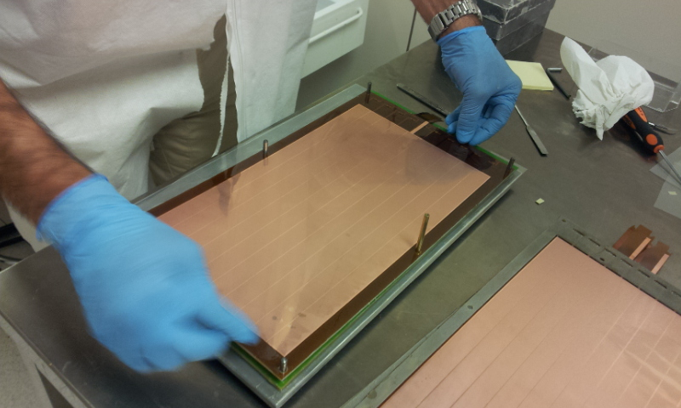
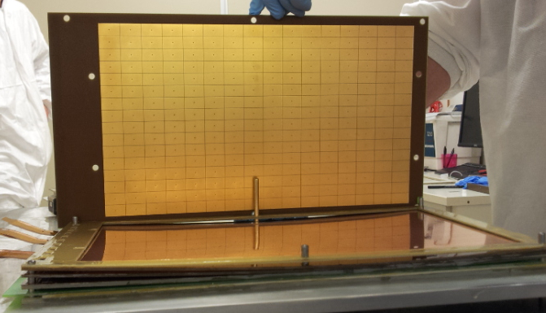

nGEM fast neutron detector
200 mm
352 mm

Slide 29



nGEM Imaging performance
 | a0=MAX [count] | a1 = σ_{X} [mm] | a2 = σ_{y} [mm] | a3 = μ_{x} [mm] | a4 = μ_{y} [mm]
Beam 0 | 299.248 | 17.4720 | 14.5132 | 56.4488 | 48.9141
Beam 1 | 284.144 | 17.4720 | 14.5132 | 102.848 | 49.1036
Beam 2 | 284.677 | 17.4720 | 14.5132 | 53.2270 | 101.164
Beam 3 | 304.999 | 17.4720 | 14.5132 | 100.733 | 101.799
Beam 4 | 269.801 | 17.4720 | 14.5132 | 56.7838 | 73.0534
Beam 5 | 237.176 | 17.4720 | 14.5132 | 96.3992 | 73.5918
The detector is suitable for reconstructing different beams

Slide 30




GEM Neutron Spectrometer (for fusion neutrons)
TPR concept
vacuum
$$E_{p}=E_{n}\cos^{2}{θ}$$
Det.
converter
(thin)
about 8%.
3.4 to 4.2 %
M. Scholtz, 2023 ITPA Diagnostic meeting
Developed by AGH and IFJ, Poland

Slide 31


DEMIN : Micromegas Detector for Neutron spectroscopy for MégaJoules Laser and Inetial Confinement Fusion experiments
Up to 30 MeV neutron spectrum diagnostics for inertial conﬁnment DD and DT fusion
Prototype speciﬁcations
✓ 80x80 mm² « classical » micromegas with 40 x 1 mm width strips
✓ 500 μm thick drift volume, ﬁlled with He+10%C₄H₁₀+10%CF₄
✓ CH₂ converter
Front-end electronics
✓ Fast current preamp + MATACQ readout (SEDI)
✓ 40 electronic channels
Ref: M. Houry et.al., NIM A 557 p648 (2006)
Thanks to A. Delbart

Slide 32







DEMIN : performances
DT SHOT, 31769; 4.10¹³ n_{14MeV}
T₀
Scattered Neutrons in the target bay
Signal (mV)
γ induced by neutrons
Primary neutrons
Tertiary neutrons time window
Time (ns)
30 eV/mm stopping power of 1 MeV e- in gas
→→ the thinner drift gap, the better the γ rejection
Ref: M. Houry et.al., NIM A 557 p648 (2006)
Thanks to A. Delbart

Slide 33

Micromegas Neutron beam loss monitor for ESS
Challenges
RF cavities emit γ's → background for ionization chambers used as BLMs
Imposible of beam tunning, loss origin of gammas
Continuous monitoring of small losses is needed
Zoom
Signature of beam loss: fast neutrons
Cadmium envelop
→ to absorb the incident thermal neutrons
Polyethylene moderator
→ to thermalize the incident fast-neutrons
B₄C layer (1.5 - 2 µm)
→ Increase neutron detection efficiency
Double Micromegas: back to back
→ ~5mm drift → optimize for dynamic range
Gas: He₂ (≈ 1.1 bar) or N₂, Ne…
→ He is better for photon discrimination Addition of a quencher: CO2, methane, ...
Two objectives: monitoring and safety
Thanks to A. Delbart
Developed by CEA

Slide 34

Multi-layer converter + THGEM detector
Antistatic HDPE layer
(no charging up)
Detector Concept:
n scatter on H in HDPE-radiator
foils, p escape the foil.
p induce e⁻ in gaseous conversion gap.
e⁻ are multiplied and localized
in THGEM-detector.
Combine several 1D radiographs
→ 2D cross sectional tomography.
n’
n
ΔV
p
E
THGEM₁
Detector design:
-) Foils thickness (2.5 MeV neutron)
-) Gas gap thickness (Deposited Energy)
-) Converter height (Axial resolution)
-) Number of converter foils (Detector Length)
Detector Performances:
-) Spatial Resolution
-) Efficiency of transport e- in small gap
-) Detector Efficiency
THGEM₂
2D Readout Board
Cortesi et al. 20012 JINST 7 C02056

Slide 35
Conclusions
The concept of a neutron detector is quite difference from the concept of charged particle detector
  You have to face mainly with the «efficiency» challenge
³He crisis and the need of high rate capability detectors fostered several novel applications
Novel wire, RPC and MPGD solutions have been successfully developed in the last 10-15 years and are considered enough mature to be used in future spallation sources like ESS
In WP9 we have to start from this point and further advance

Slide 36
General remarks to realize a neutron detector
A possible WP9 Guideline
Detectors must be chosen/DESIGNED for the speciﬁc application. Typical application is “counting above threshold”
Requirements to be considered when designing neutron detectors:
Gamma-ray sensitivity
Count rate
Time/space resolution
Environment (B ﬁeld, temperature etc)
Low budget material
Low intrinsic radioactivity
Digitize! (if possible)

Slide 37
Spare Slides

Slide 38


Neutron Interaction and detection (2/2)
  In order to realize a neutron detector we thus need a material with a sufficiently high cross section. Nature offers some (but not many materials with such features)
  These materials are used to “convert” neutrons into charged particles
  Neutrons interact with nuclei through the strong force and thus through nuclear intections

Slide 39
³He tubes applications – fast neutrons
³He detectors can be also used to detect fast neutrons if an appropriate moderator is placed around the detector
BONNER SPHERES

Slide 40



Novel wire-based solutions
Jailousie detector
Developed by Heidelberg
CDT©

Slide 41

Measurement of ISIS-vesuvio 2D thermal neutron beam profile
G. Croci et Al, NIMA (2013)
3 cm
The measured FWHM is around 3 cm compatible with ISIS-Vesuvio data

Slide 42
Thermal neutron measurements as a function of detector gain
40 MHz/cm²
Comparable with X-ray GEM rate capability (1MHz/mm² = 100 MHz/cm²)
Expected rate with Φ = 7.88 x 10⁸ n/cm²s and ε_{GEM} = 5% is 39.4 MHz/cm²

Slide 43


NitroGEM neutron beam monitor
The NitroGEM monitor has been designed for use on high intensity neutron beamlines
Nitrogen:
Low efficiency: N₂ absorption cross section 1.9 barn at 1.8 Å
Reaction: n+¹⁴N->p+¹⁴C, 620 keV proton energy
Good to measure gamma/neutron separation, efficiency
Standard GEM from CERN:
Standard electronics used to readout ³He tubes at ISIS
Developed by ISIS

Slide 44




Side-on neutron GEM detector
We developed a new prototype increasing the number of borated strip to 16, in order to obtain an higher efficiency.
Now we used an anode with PADs having a different geometry. There are 32x4 PADs and each PAD is 3x24 mm².
10 cm
10 cm
Now we used ceramic strips (Al2O3) 500 µm thick.
Detector window is placed on the side of the anode with 32 PADs. In this way detector is able to measure also position of small spot beams impinging on the side-on window.

Slide 45



Side-on neutron GEM detector performance
We estimated detector efficiency, making a comparison with an ³He tube which has a 100% absolute efficiency at the used peak energy of 5,11 meV.
Detector efficiency was evaluated on both detector sides:
16 strips efficiency = 31 ± 1 %
1 strip efficiency = 2,8 ± 0,5 %
 | S-GEM | ³He Tube
Overall mean counts [s⁻¹] | 1863 | 6011
Background mean counts [s⁻¹] | 21 | 1586
Signal/Background | 87.7 | 2.8
Efficiency [%] | 31 | 99
Low gamma sensitivity.

Slide 46




Low massNeutron GEM Beam Monitor
GAIN
DRIFT
p
Kapton
Pads
pads on kapton
Mylar 12 um
Triple GEM
3 mm
Low Material Budget !
Electronics out of the beam

Slide 47


Beam Monitor : fast neutron efficiency (nTOF)
40 mm
5 MeV
mm
Efficiency 10⁻⁴
40 mm
1 MeV
mm
F. Murtas measurements

Slide 48


ITER Neutral Beam Test Facility at Consorzio RFX
The ITER project requires additional heating by two neutral beam injectors, each accelerating up to 1 MV at 40 A beam of negative deuterium ions for one hour.
SPIDER
Beam of Hˉ/Dˉ at 100 KeV
Current density:355 A/m²(H) 285A/m²(D)
Surface : >1 m²
Deviation from the uniformity : <±10%
Pulse length : 3600 s
MITICA
Beam of Hˉ/Dˉ at 0.87(H)/ 1MeV(D)
Current:49 A (H)/ 40 A (D)
Surface: >1 m²
Deviation from the uniformity : <±10%
Beam divergence < 7 mrad
Pulse length: 3600 s
Neutralized beam

Slide 49

ChipIR

Slide 50


Fast neutron beam monitor at CHIPIR-ISIS
CHIPIR is a new beam-line dedicated to the irradiation of microelectronics with atmospheric-like neutrons; it has been built on the second target station of the ISIS spallation source
Specifically dedicated to the study of single event effects and its design is therefore optimized to extract a neutron spectrum as similar as possible to the atmospheric one with intensity increased by a factor up to 10⁹ depending on configuration.
Working point determinaton
nGEM installed in Chipir

Slide 51




nGEM characterization for CHIPIR-ISIS
nGEM used to measure different beam sizes.
Beam 12 mm x 12 mm
Beam 30 mm x 30 mm
Counting rate stability
Beam 80 mm x 80 mm

Slide 52



First test of GEM detector for neutron diffraction measurements
INES sample position
GEM – borated cathode
³He tubes
Transmitted neutron beam
Incident neutron beam
λ = [ 0.17 , 3.2 ] Å
128 8x8 mm² pads
GEM position
Interface with ISIS-DAE: Time of Flight measurement perfomed using standard ISIS TOF DAE → First Time a GEM is inside standard ISIS DAQ System

Slide 53

First test of GEM detector for neutron diffraction measurements
TOF- diffractogram recorded from a bronze sample by the GEM detector (to our knowledge the first ever neutron diffractogram recorded by a GEM....)
Time measurements: 18 hours
G. Croci et Al, 2014 EPL 107 12001

Slide 54
BAND-GEM detection principle
Padded Anode
n
θ
Al=200µm
Triple GEM
8 mm
4 mm
E_{GG}
α
V_{TopGrid}
E_{Grid}
3mm
e-
3D
Grid
System+ middle GEM
96 mm
¹⁰B₄C
¹⁰B₄C
α
1mm
V_{Cathode}
Cathode
¹⁰B₄C
¹⁰B₄C
Typical tilt angle Ѳ=5°
Al
n
Aluminum grids coated on both sides with ¹⁰B₄C
Using low θ values (few degs) the path of the neutron inside the B₄C is increased → Higher efficiency when detector is inclined

Slide 55





BAND-GEM full-module: design and construction
The GEM foil
The padded anode
The 3D-C assembled

Slide 56


Efficiency vs neutron wavelength
Tilting angle Ѳ = 8°

Slide 57


Test of the full-module @ TREFF
BAND-GEM
BAND-GEM with GEMINI electronics
Monochromatic neutrons with wavelenght λ=4.78 Å
Neutron beam

Slide 58

Test of the full-module @ LARMOR beam line (SANS instrument). Preliminary results.
SANS measurement performd with a concentrated ludox silica dispersion sample.
With this sample, the expected 2d map on the detector position is a circular ring moving to larger radius at longer wavelengths.
BAND-GEM
1,5 m
Sample
BAND-GEM full module with Cd mask
Neutron beam

Slide 59




Test of the full-module @ LARMOR beam line (SANS instrument). Preliminary results.
Circular ring

Slide 60
General remarks to realize a neutron detector
Detectors must be chosen/DESIGNED for the speciﬁc application. Typical application is “counting above threshold”
Requirements to be considered when designing neutron detectors:
Gamma-ray sensitivity
Count rate
Time/space resolution
Environment (B ﬁeld, temperature etc)
Digitize! (if possible)

Slide 61


Multi-layer converter + THGEM detector Performance
Deposited Energy Spectrum
Distribution of the deposited charge
Parameters
-) HDPE Thickness = 0.4 mm
-) Gas Gap = 0.6 mm
Layers
Signal
Layers
Layers
Layers
Layers
Layers
HDPE foils
Scattering
Detector Vessel
SSR = Signal-to-Scattering ratio
Neutrons (2.45 MeV)
SSR
Cost effective solution: 300 HDPE layer
Conversion Efficiency ➔ ~8%

Slide 62






CERN/n-TOF 2D X-Y neutron beam profiler
128 μm Bulk-micromegas technology with 2D X-Y readout (CAST-like) Use of ¹⁰B(n,a)⁷Li for up to 1 MeV neutron conversion
Woven mesh (30 um)
X & Y strips
+ Y vias
Pyralux pillar (128 μm)
X readout Y readout
50 μm kapton
Speciﬁcations
✓Ar+2%iC₄H₁₀+10%CF₄
✓ 6x6 cm² active area
✓ Φ 60 mm, 24 nm ¹⁰B₄C layer on a 1
μm copper coated 12,5 μm Kapton foil
✓ 212 channels : readout with 2 x 96 ch. Gassiplex cards
HV for the Drift
HV for the Mesh
20 Μm kapton window
Drift electrode (with B-10)
Mesh
HV protection
Ref: S. Andriamonge et.al., proceedings of ND2010, International Conference on Nuclear Data for Science and Technology
Thanks to A. Delbart

Slide 63




n-TOF beam profile and flux monitor
n-­‐‑TOF beam proﬁle (2009)
n-­‐‑TOF beam ﬂux monitoring (2008)
Ref: S. Andriamonge et.al., proceedings of ND2010, International Conference on Nuclear Data for Science and Technology
Thanks to A. Delbart

Slide 64



Micromegas in Mimac Fastn
Detection of recoiling neutron energy after scattering with a fast neutron
Drift in a ionization chamber
Amplification using a Micromegas
Read-out on a pixelated anode sampled at 20 ns.
Example of a recoil track in He/Co2 80/20
Developed by Grenoble

Slide 65

The Piccolo micromegas
In-­‐‑core Nuclear plant integrated neutron ﬂux measurement
Piccolo collaboration (TRADE WG) : IRFU / CEA-DEN
Speciﬁcations
✓Small sealed 10 cm³ micromegas (160 μm)
✓ Standard design, with woven bulk type mesh
✓ Non-flammable Ar+2%iC₄H₁₀
✓ Wide neutron energy sensitivity with :
²³⁵U et 10B, thermal to several MeV
²³²Th , En > 1 MeV
H recoils , thermal to several MeV
✓ Designed for use in the extreme conditions of a reactor core (heated water 300°C, radiation)
✓ Use of stainless steel & ceramic materials
✓ 4 individually polarized anode channels
✓ 2 readout modes :
counting mode with fast current preamp.
+ 1GHz flash ADC + MATACQ (SEDI)
current mode by mesh current reading for high reactor powe
Tested at TRIGA reactor in Italy
Ref: J. Pancin et al., Nuclear Instruments and Methods in Physics Research A 592 (2008) 104–113
65
Thanks to A. Delbart

