Slide 1
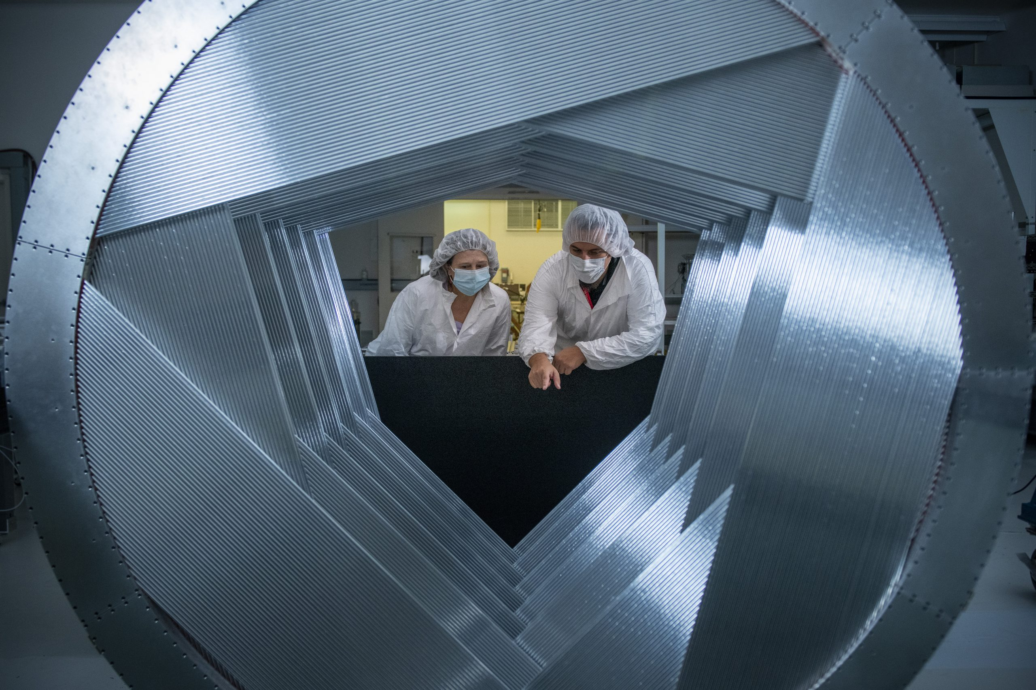
Mu2e Tracker
Aseet Mukherjee (FNAL)
30 January 2024

Slide 2
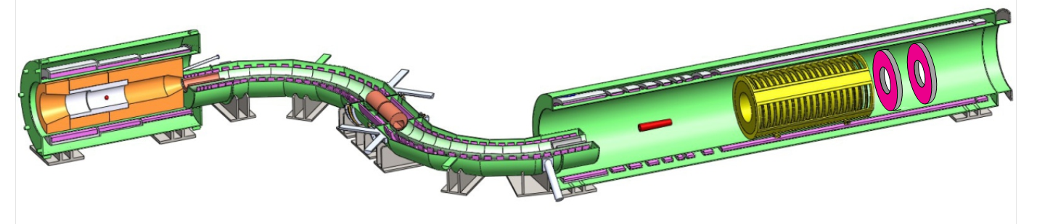
Tracker Environment
(aka the Mu2e Experiment)
Generate muons
Stop them, and let them decay… or convert
Detect outgoing electrons
Production Solenoid
Transport Solenoid
Detector Solenoid
Tracker
Production Target
Stopping Target
Calorimeter

Slide 3
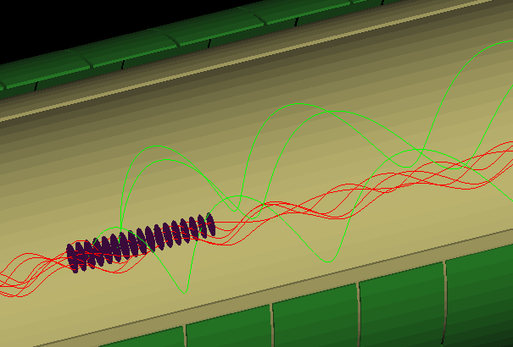
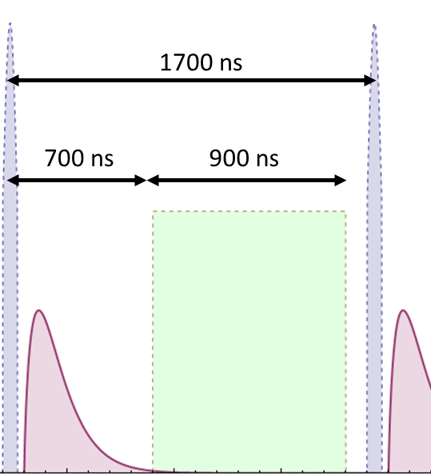
Beam Structure
Protons at Production target
1700 nsec set by Delivery Ring
700 ns wait to allow fast decays to finish
  But tracker still gets hits
Thin Al disks
Stop >50% of muons
Electrons
Live
Window
Muons

Slide 4
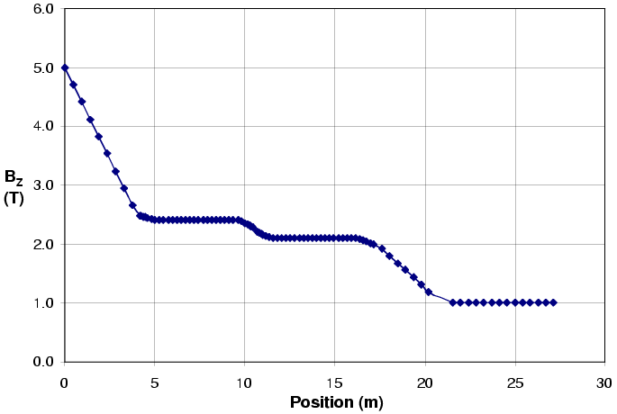
Detector Solenoid
Graded field pushes decay products forward
Uniform field around tracker

Slide 5
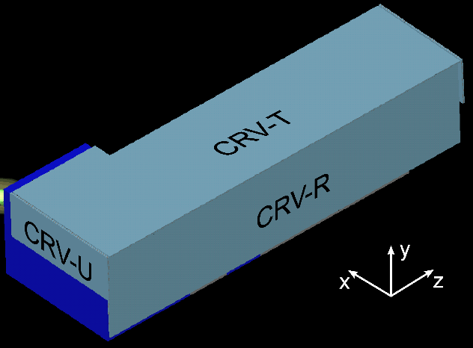

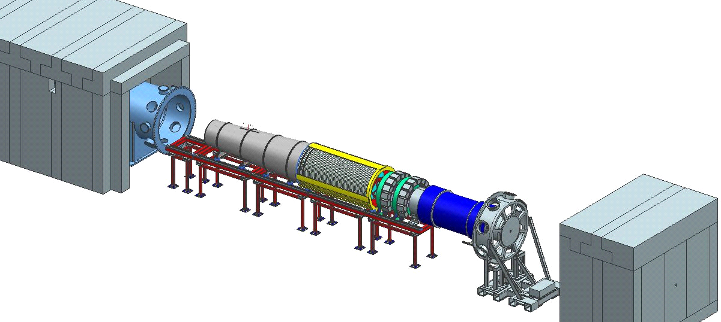
Cosmic Ray Veto (CRV)
By design, covers as much as possible
To access tracker:
  Pull back piece of CRV
  Open DS
  Pull detector “train” out
Slow process

Slide 6
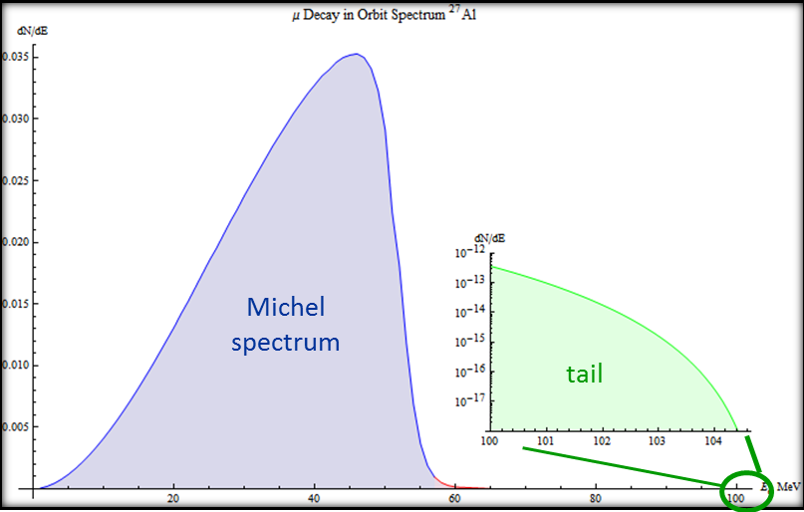
Particles at Tracker
Before live time
  Electrons “flash” scattering off target
  Fast decay products
Lot of hits to recover from!
Extending into live time
  Protons from Nuclear breakup
  Decay in Orbit (DIO)
  i.e. usual μ→eν
DIO
  Mostly <½ m_{μ}
  Nuclear recoil smears up to near 105MeV
Notes:
Show decay again… and give at-rest spectrum with sharp cutoff

Slide 7
Tracker Requirements
Near zero material down the center
↔ ambient vacuum
  Lot of unstopped muons, electron flash, DIO
  Even if tracker could handle it, scattering would create background
Low mass in active region
  105MeV electrons scatter a lot
Momentum resolution
  Primary tool to reject background

Slide 8
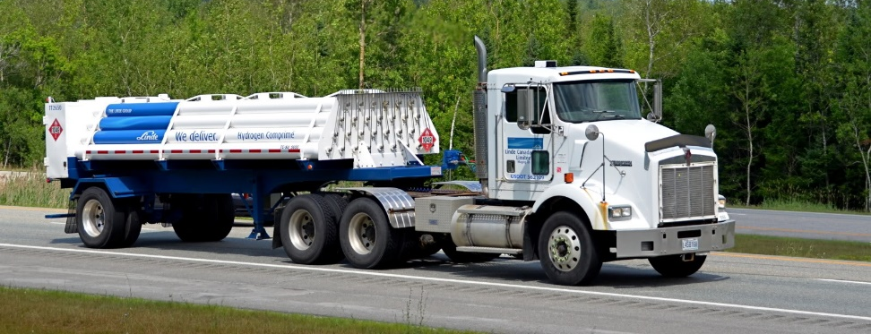
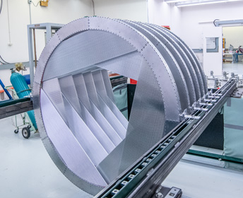
Straw Tracker
Small cylindrical volumes tolerate large pressure differential with minimum material
Fine segmentation gives low occupancy
Successfully used in previous experiments
  Most recently, g-2 used essentially identical straws in vacuum

Slide 9
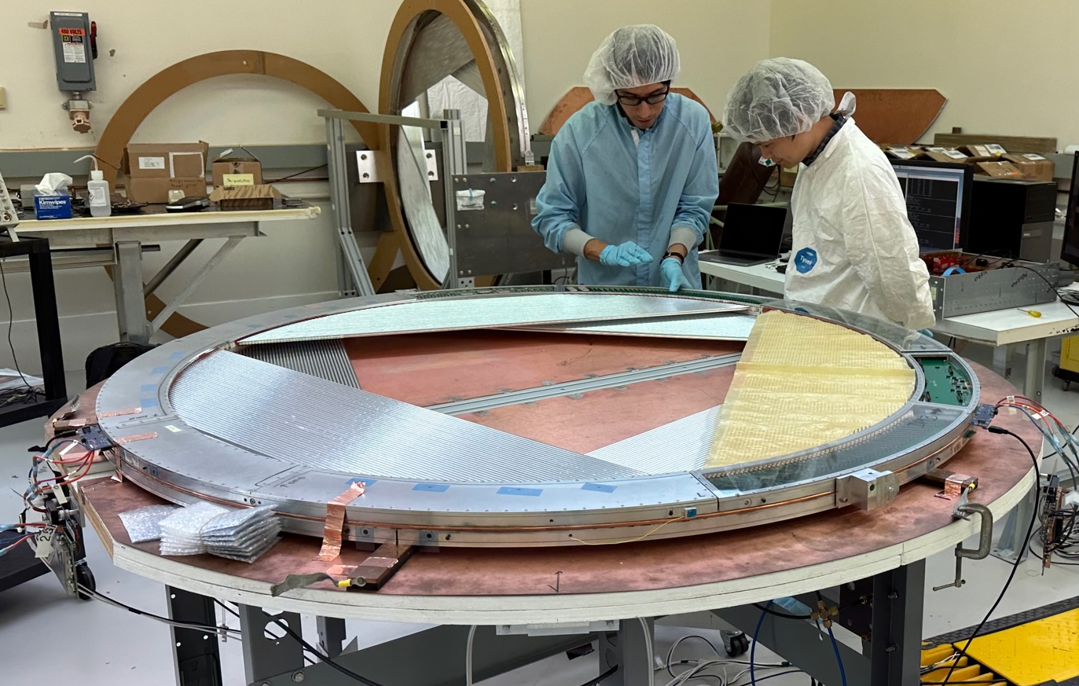
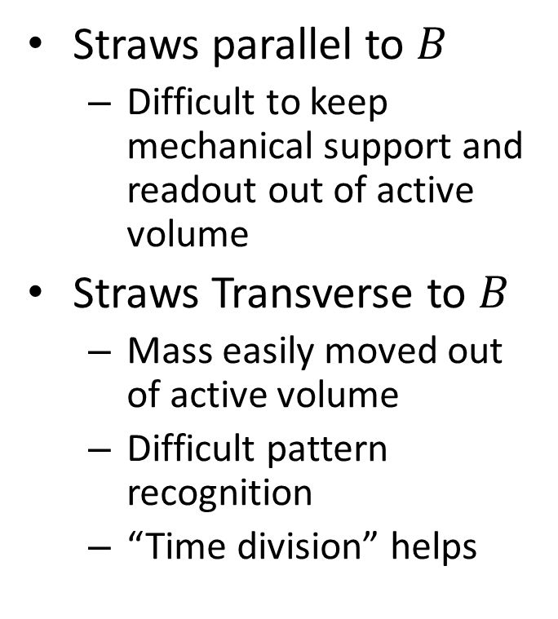
Transverse Tracker
Straws parallel to $B$
  Difficult to keep mechanical support and readout out of active volume
Straws Transverse to $B$
  Mass easily moved out of active volume
  Difficult pattern recognition
  “Time division” helps

Slide 10
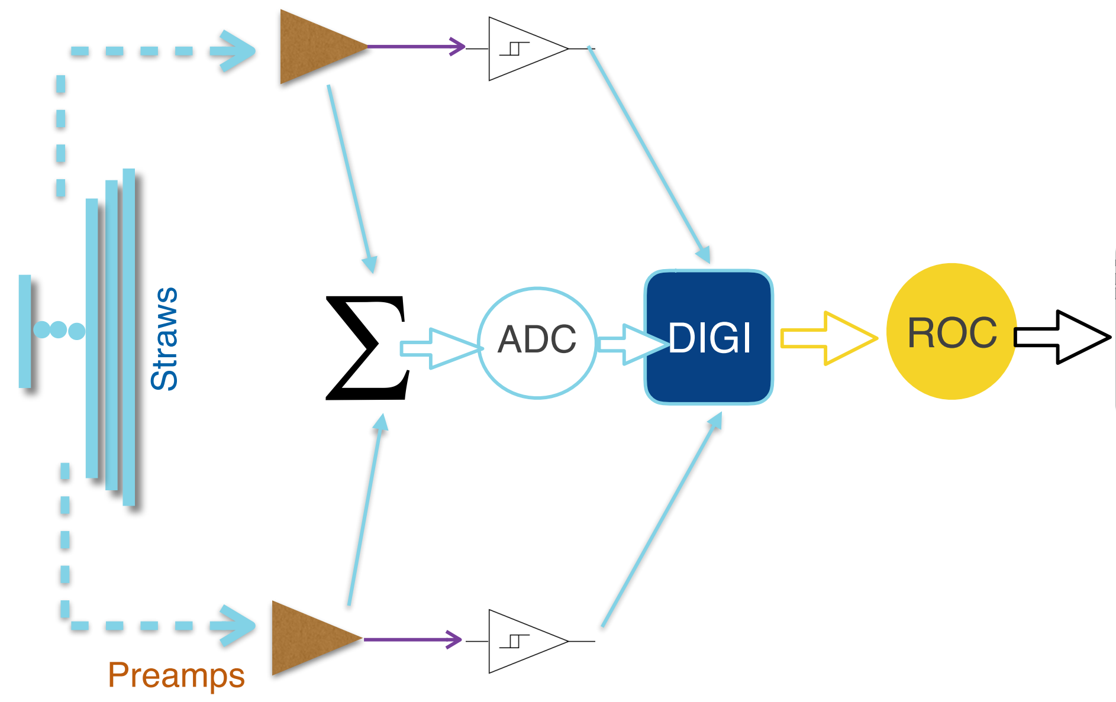
Time Division
Measure hit time at both ends of straw
∆t gives estimate of position along straw
Benefits from TDC precision better than needed for drift time
Dual TDC per straw
Implemented in FPGA
DAQ
Read Out Controller
Implemented in FPGA
Commercial ADC

Slide 11
DC-DC Convertor
48V → 5V & 2.5V
Charge pump
(no magnetic material)

Slide 12
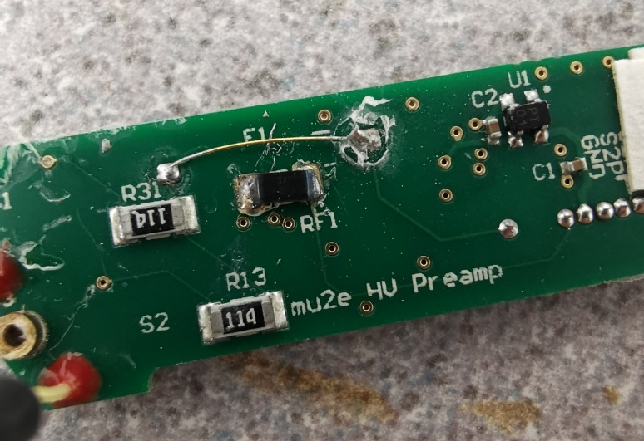
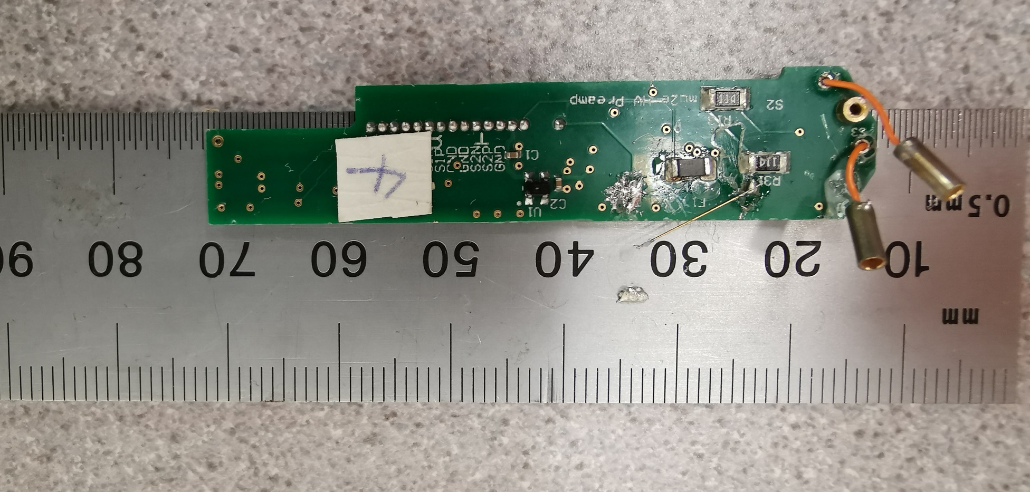
HV Disconnect
Thermal fuse triggered by heating a resistor
Allows individual straw to be disconnected
Commercial fuses had issues with size, outgassing, radiation
Pictures are from a worst-case test with excessive parylene

Slide 13
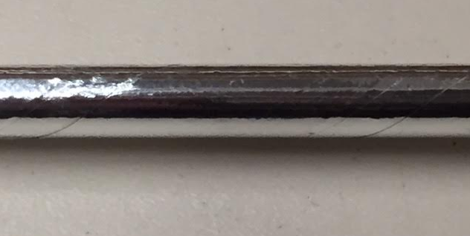
Straws
5 mm diameter, as thin wall as possible
~1 bar internal pressure for easier testing
Ambient vacuum
→ ∆P ≈ 100kPa
Use tension to keep straws straight
Double helical wrap
  2×6 μm Mylar + 3 μm adhesive
Metalized inside and outside to reduce leaks

Slide 14
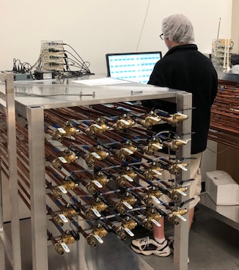
Straw Leak Testing
Thinnest straws made!
Every straw individually tested
  Purge with CO₂, pressurize to 100 kPa
  Place in N₂ purged tube, close tube
  Monitor CO₂ content
    Fast and cheap: big market for CO₂ sensors!
Cross-checked with vacuum tests
Straws slide through ball valve

Slide 15
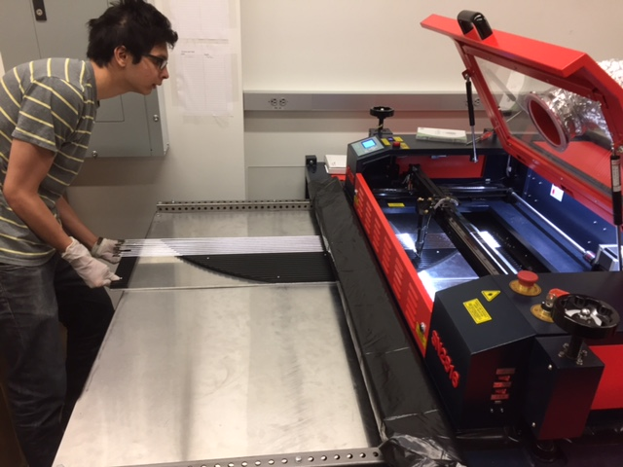
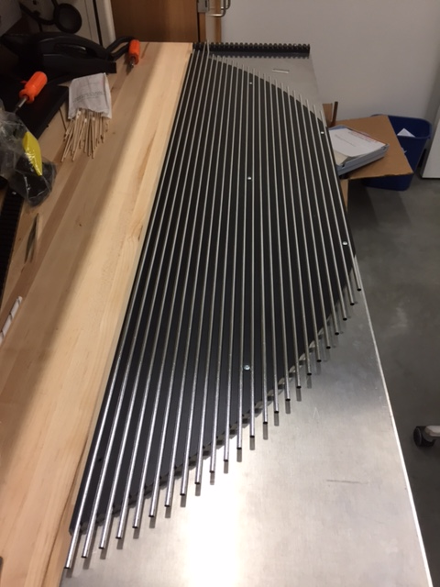
Straw Prep
Laser cutter to generate 48 different lengths
Temperature and humidity compensation
0.2mm accuracy

Slide 16
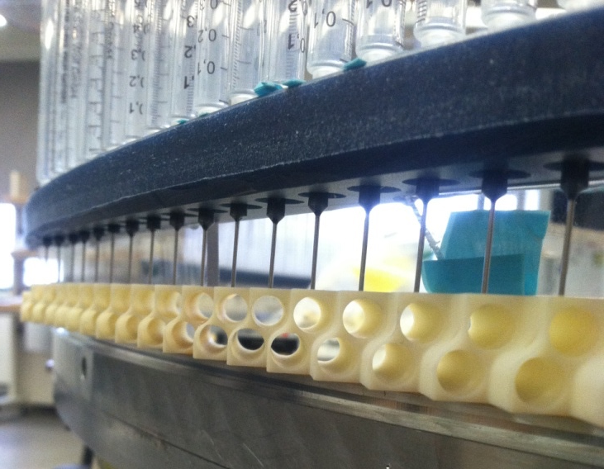
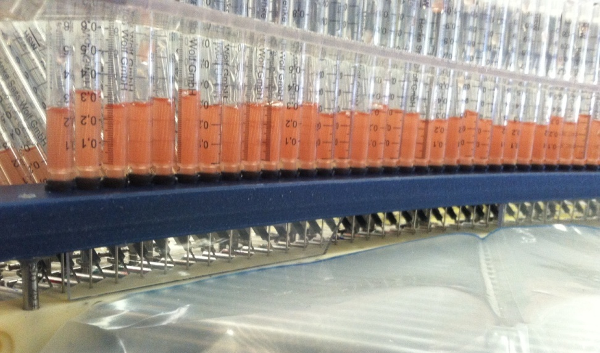
Straw Installation
Straws pulled to tension into 3D-printed piece
Has fine features to allow epoxy to drip onto straw ends
Epoxy drips onto straw end
Straw goes here

Slide 17
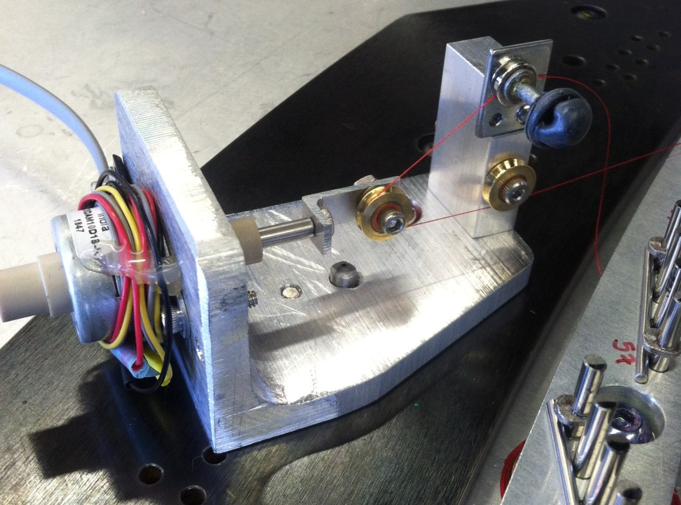
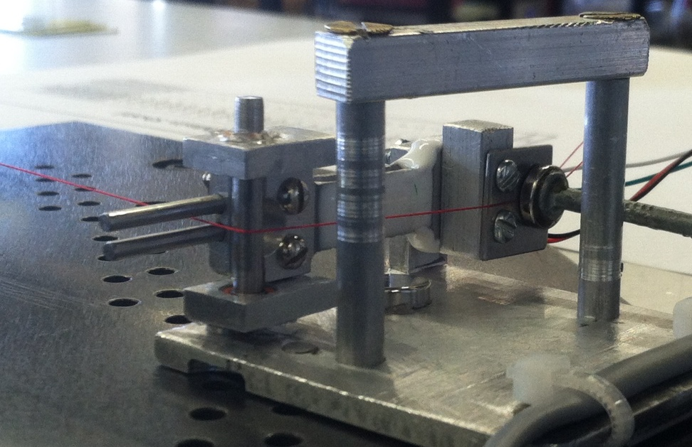
Sense Wire Installation
25µm gold plated tungsten
Tension with load cell and stepper motor
  Work harden wire as part of installation:
  Over-tension, then back off
Pictures show feeder line (thread). Wire too thin to see)
Magnetic clamp
holds wire
Load cell
Pulley
Stepper motor shaft
Magnetic clamp holds wire

Slide 18
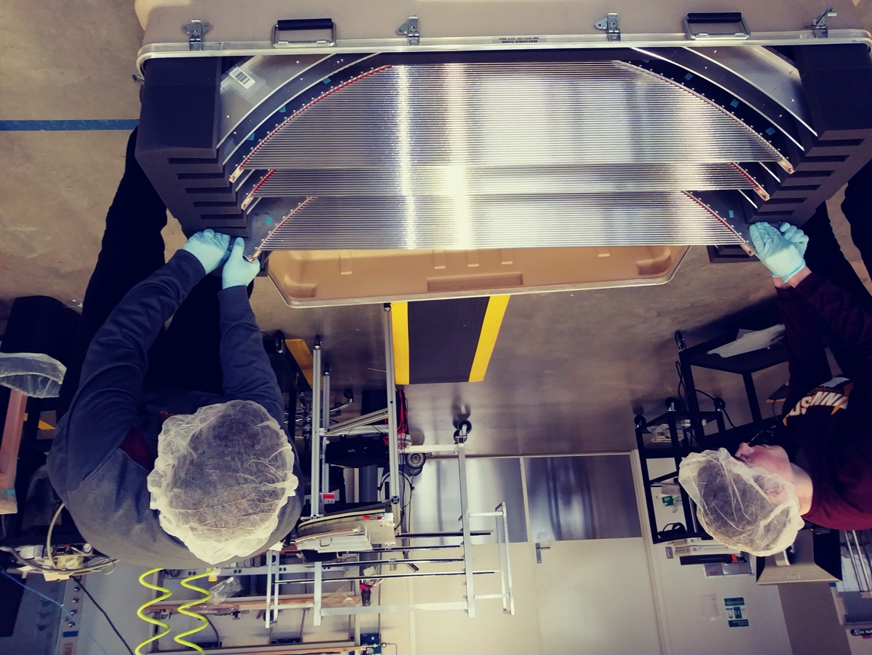
“Panel”
120° sector with 96 straws
Small enough to ship
Straw and Panel work done at U. of Minnesota
Ship to Duke U. for metrology

Slide 19
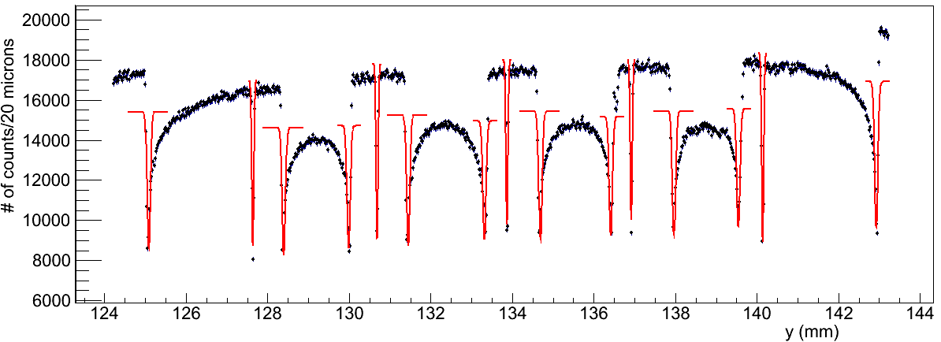
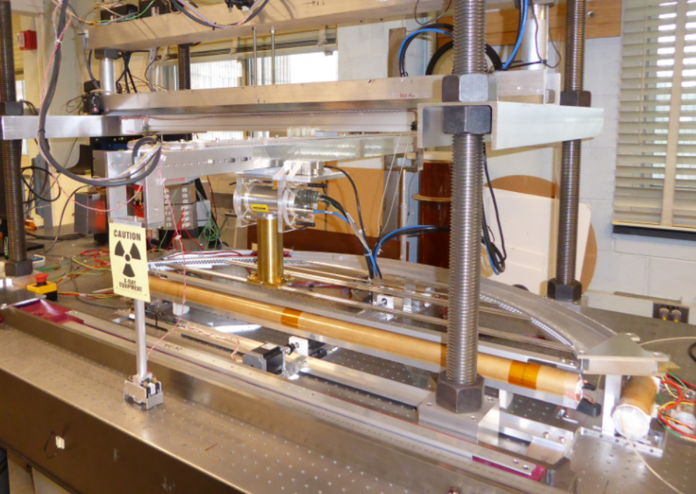
Straw and Wire Metrology
X-ray (almost) all panels to locate wires and straws relative to survey markers
  15° stereo (tilt X-ray) for measuring Z
σ_{y}≈25μm, σ_{z}≈ 75μm
X-ray
Prototype Panel
Slit
Panel Stand
X-ray detector
Straws
Red arrow: Wire Blue arrow: Straw edge

Slide 20
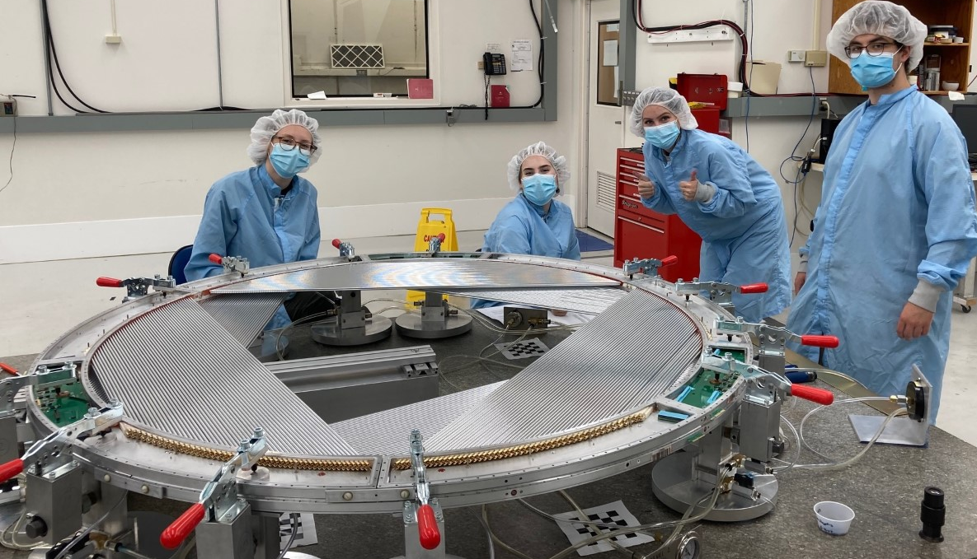
“Plane” and “Station”
Plane: 6 overlapping panels form a complete ring
Station: 2 planes “clocked” to have 12 orientations for straws
Assembled referencing granite table for precision in Z
Assembly precision
~150 μm
Final alignment based on survey points used at Duke

Slide 21
Vertical Slice Test
Plane with full electronics chain
  Shown horizontal – also run vertical

Slide 22
Resolution, Efficiency
ε=0.96
Efficiency
Drift Direction
Along Straw
(time division)
σ=2.5ns=170μm
σ=36mm

Slide 23
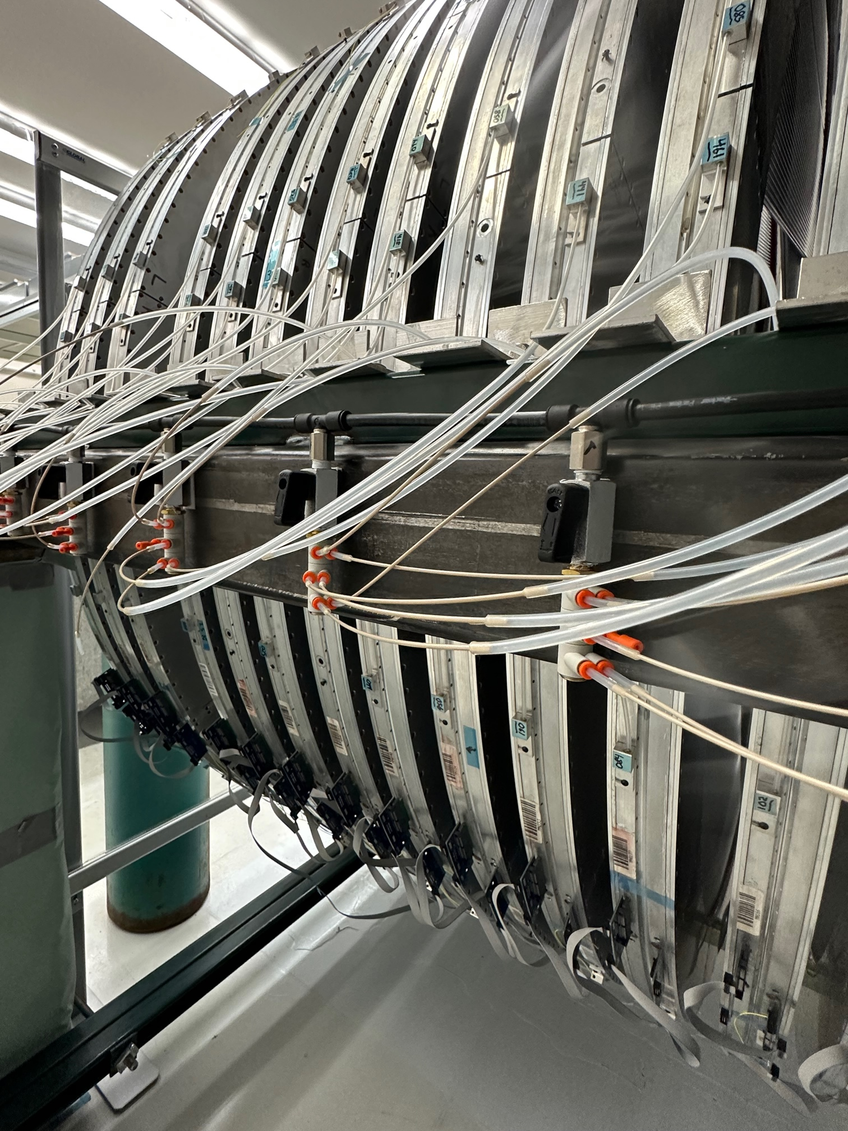
Leak Testing
Done at every step!
  Panels leak tested
    At U.Mn before shipping
    At FNAL after shipping
  After assembly, planes leak tested
    Precision setup, gets leak rate overnight
    Long term leak test while planes are in storage
Capillary to limit flow
100kPa supply
Read out pressure
sensor in panel

Slide 24
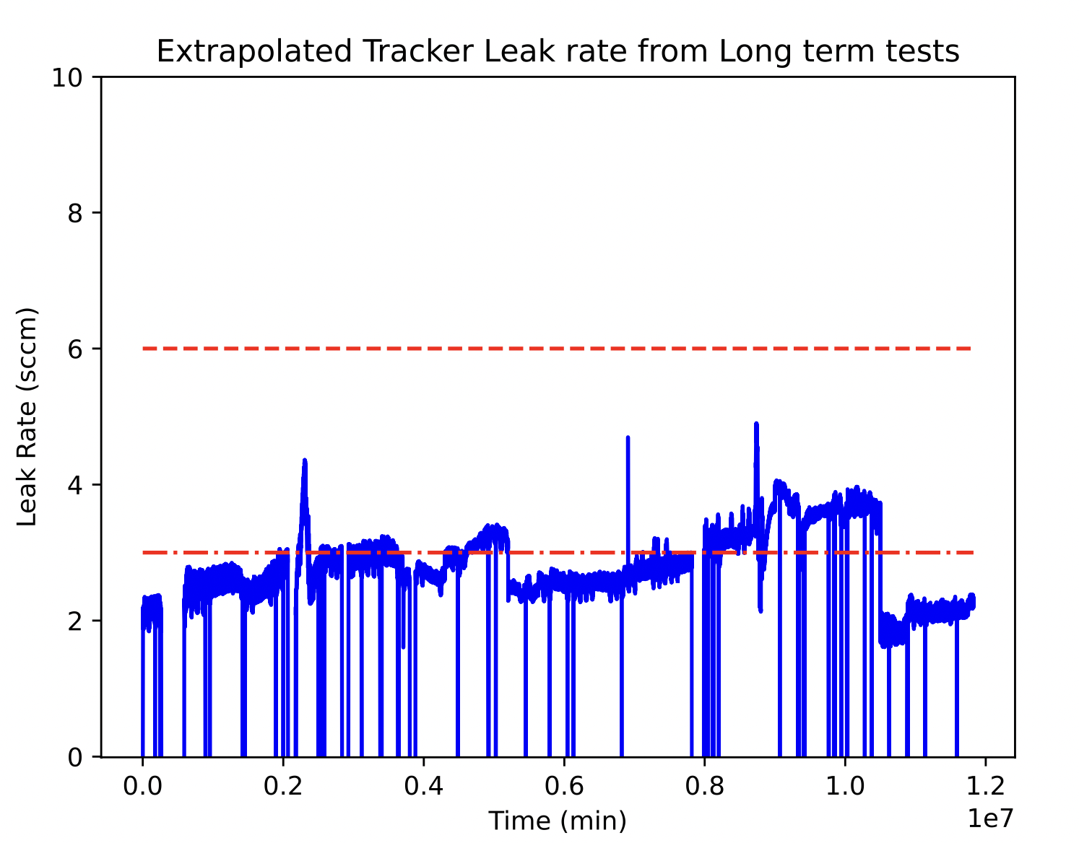
Leak Rate
Looks good so far! But…
  Periodic repairs, not realistic in reality
  Die out over time. Still worrisome
On the other hand
  6 sccm ↔ 10⁻⁴ Torr
  10⁻³ Torr ↔ 60 sccm
  is acceptable
6 sccm total budget
3 sccm Plane
allotment
Drops ↔ Panel(s) removed
(later repaired)

Slide 25
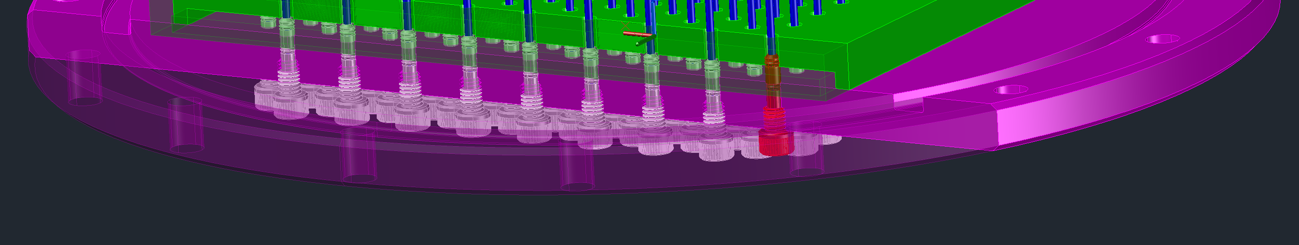
Per-panel Gas Feed
Gas to any panel can be stopped without opening the DS
Do need to access IFB (back of DS)
  Remote control being looked at
Check valves on exhaust side avoid the need for manual valves
Standard
Flange
216 gas lines
Closed valve
(others open)

Slide 26
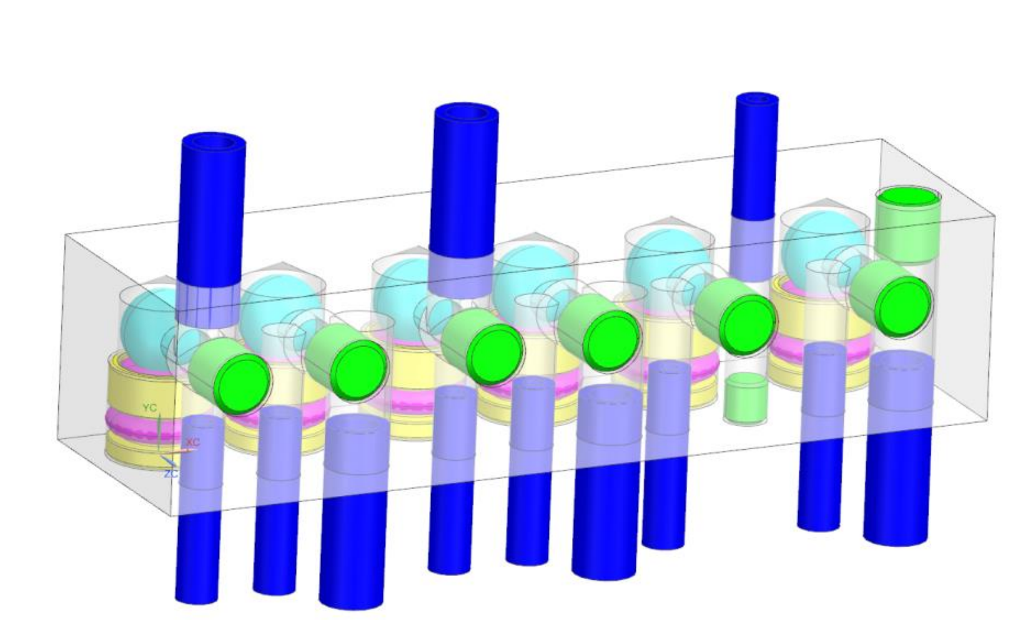
Reverse Pressure Protection
Straws crush if ∆P<0
  Disconnected panel would be destroyed when DS was back filled
Custom, very low opening pressure check valve
  Very little space!
  No suitable commercial valve found
O-ring seat
Glass ball
3D-printed
removable insert
Bottom
Open to DS

Slide 27
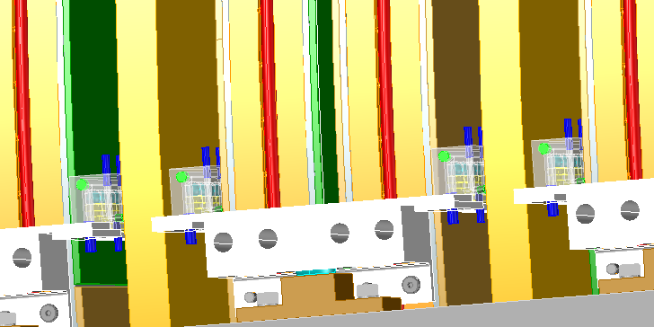
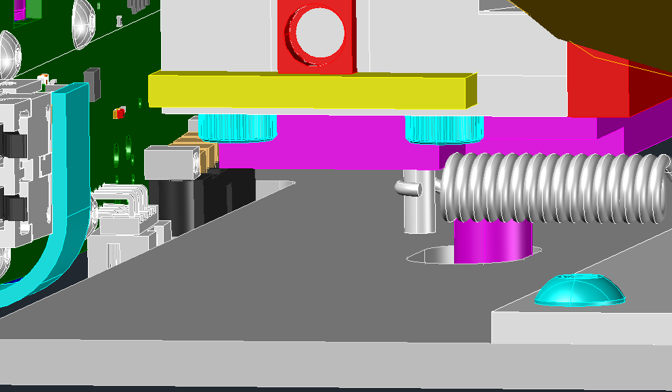
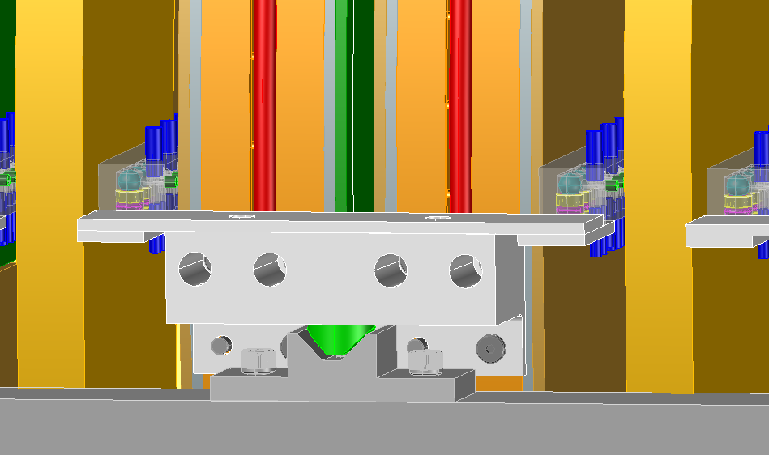
Tracker Frame
Kinematic mount for each station
No stress
→ stable metrology
Sphere in Cup (left)
xyz constraint
Check Valves
Pin in slot (bottom)
z constraint
Sphere in Groove (right)
yz constraint

Slide 28
Summary & Future R&D
Straws are an appealing option for
low mass, high-rate detectors
Looking into even lighter straws for Mu2e-II (and possibly other applications)

