Slide 1
SRS
_{Scalable Readout System}
Hans Muller

Slide 2
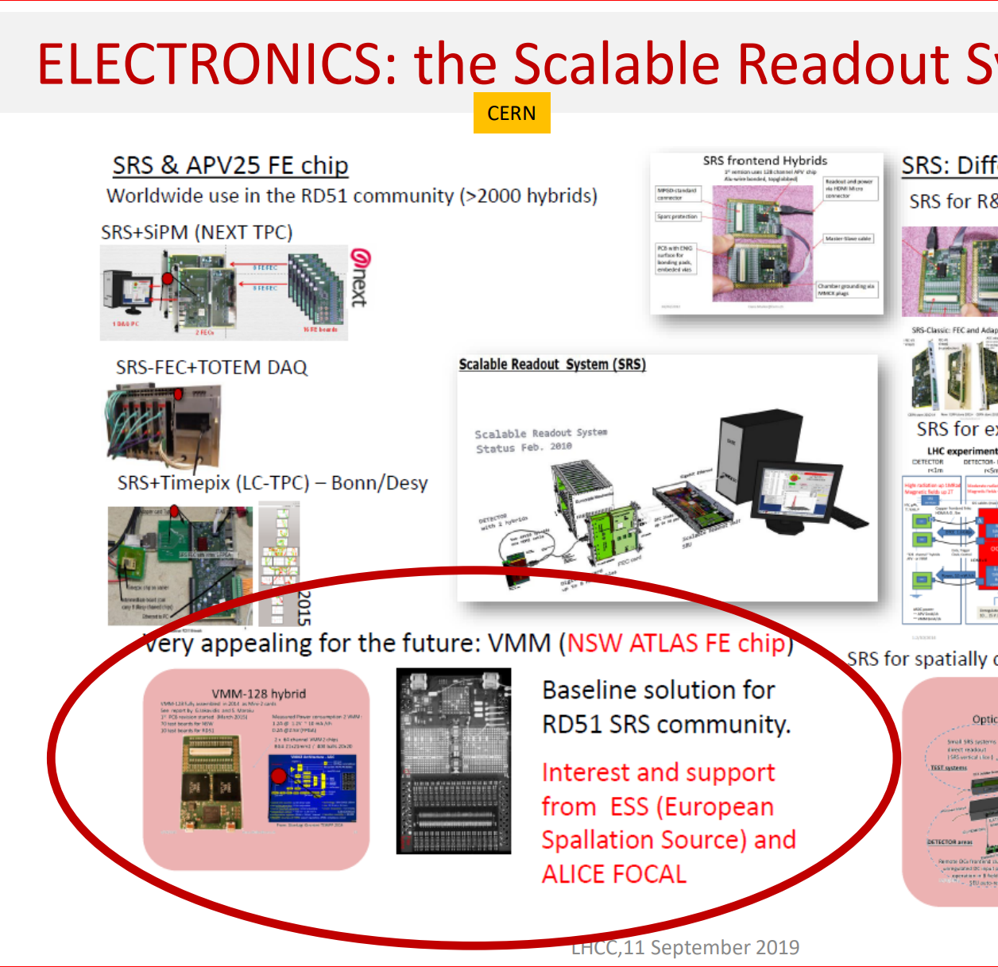
SRS: from RD51 past to DRD1 future
RD51 2009-2023
~ 50 x WG5 meetings RD51
1st presentations SRS 2009
…….follow Indico over 14 years
SRS classic status 2023
SRSe new archtitectures: Last RD51 WG5 Dec 23:

Slide 3
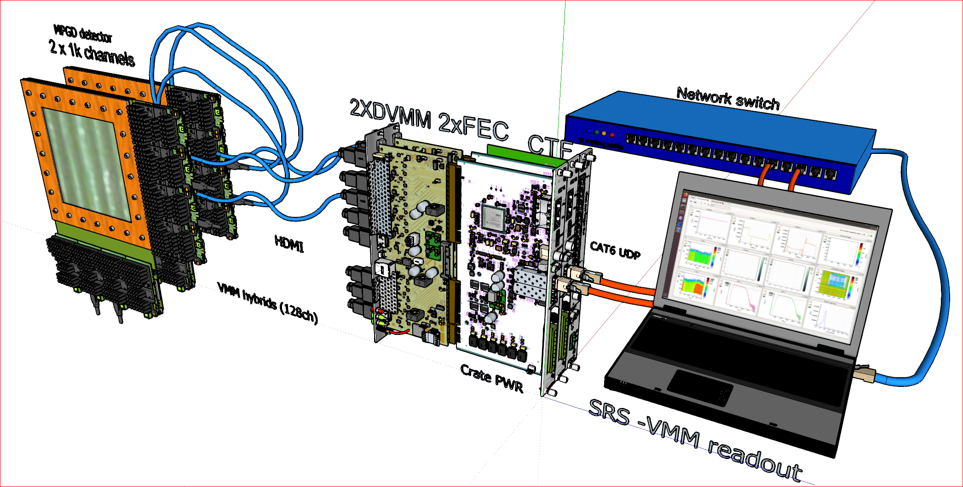
SRS classic Readout system from detector to Online
SRS with VMM frontend, so far implemented as a triggerless, scalable multichannel readout system for gas and photon detectors.
Triggered readout added by FRIB team in 2023/24.
1 FEC for 8 VMM hybrids / 1024 detector channels connected via HMDI AD cables to DVMM. 2 FEC’s with CTF (common clock) for 16 hybrids , 2048 ch. DVMM cards with octal HDMI connector including 70 W power for 16 VMM hybrids. Power / housing for 2 FECs and CTF via 1 Minicrate (not shown). 1 GB Ethernet /UDP uplink from FEC to Network via SFP+ jack, fiber or optical 1 GBE for network with Jumbo packet support. ESS DAQ Software with Vmm Controls installed under Linux.
3

Slide 4
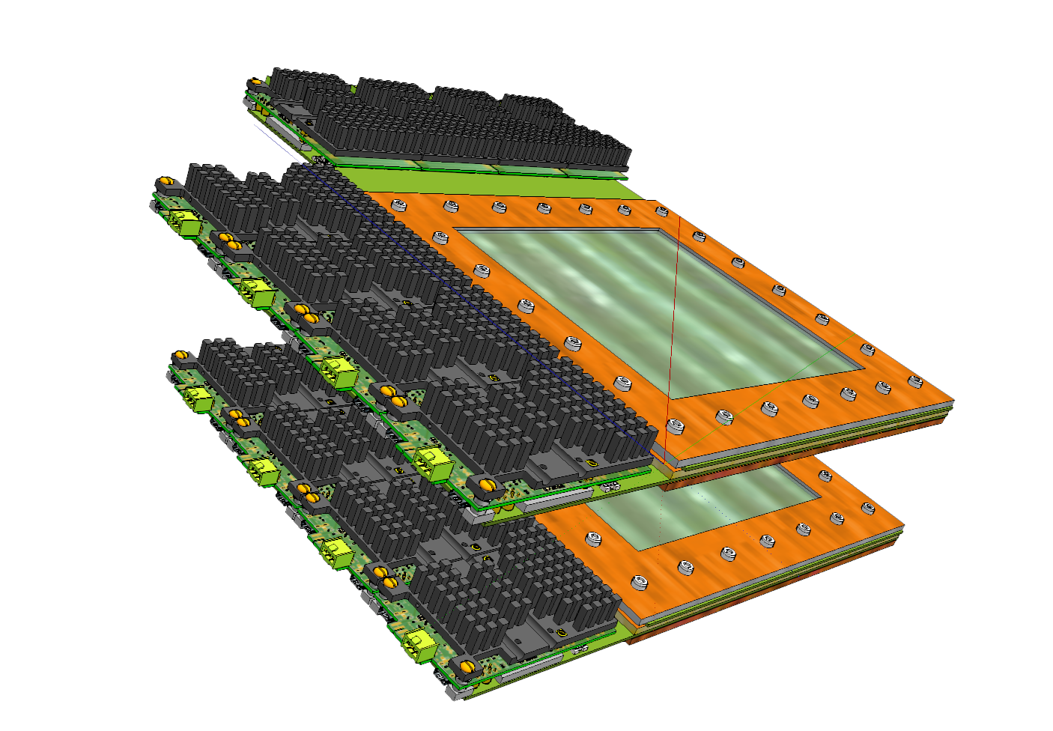
Detectors with VMM hybrids
Since 2019, MPGD detectors are fabricated with 0.5mm pitch, 140 pin HRS connectors* mating with 5mm stackheight
the HRS connectors of VMM hybrids.
10 x 10 GEM detector
4x VMM hybrid in x (512 ch)
4x VMM hybrid in y (512 ch)
total 1024 channels/ detector
140 pin HRS connectors* on detector
weight 8 VMM hybrids ~ 800 g
heat dissipation 8 hybrids~ 30W
1/31/2024
Hans.Muller@cern.ch
4

Slide 5
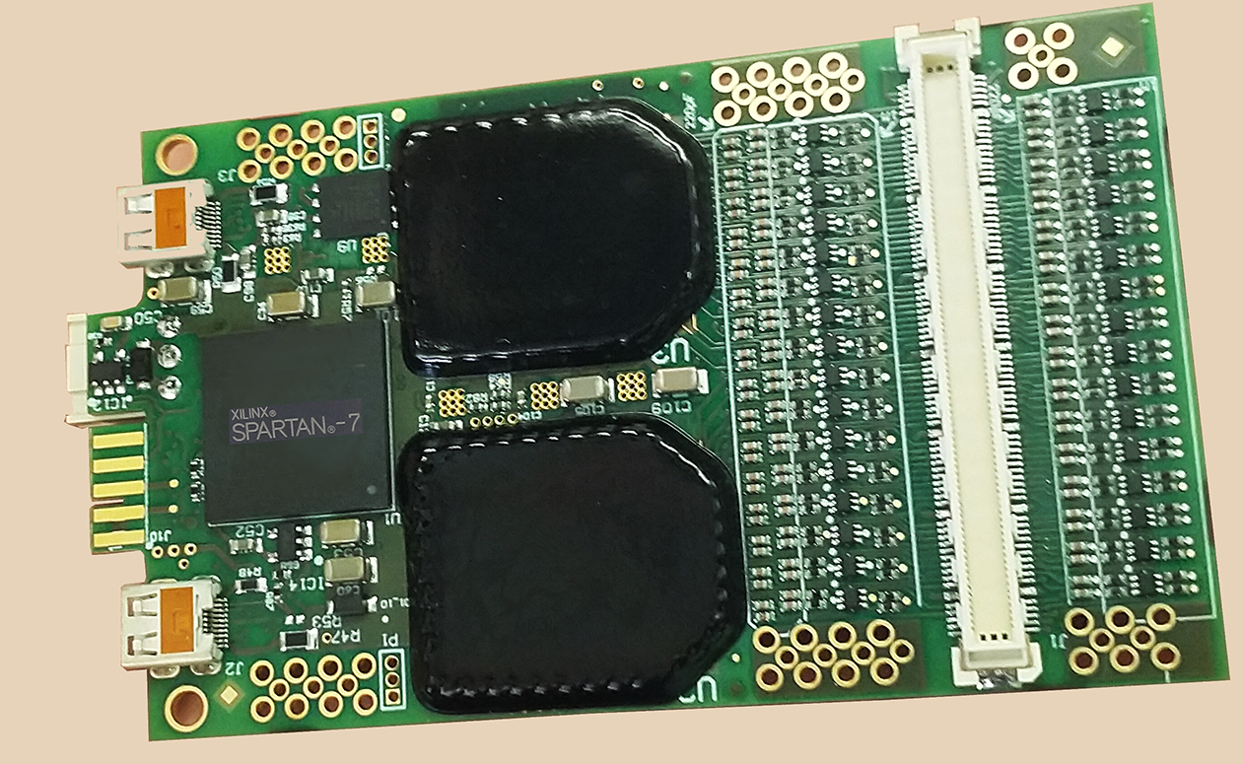
128 ch. frontend hybrid: VMM3a
VMM hybrid user manual
Successor to the
2010-2019 APV frontend hybrid
2x
VMM3a
globtopped
HRS connector
FX10A-140P14-SV1
AC coupling and
TVS spark protection
Spartan FPGA
eadout
link port
micro HDMI
analogue out
Photo VMM hybrid V5 (2022+) bottom side (cooler plate removed)
1/31/2024
Hans.Muller@cern.ch
5

Slide 6
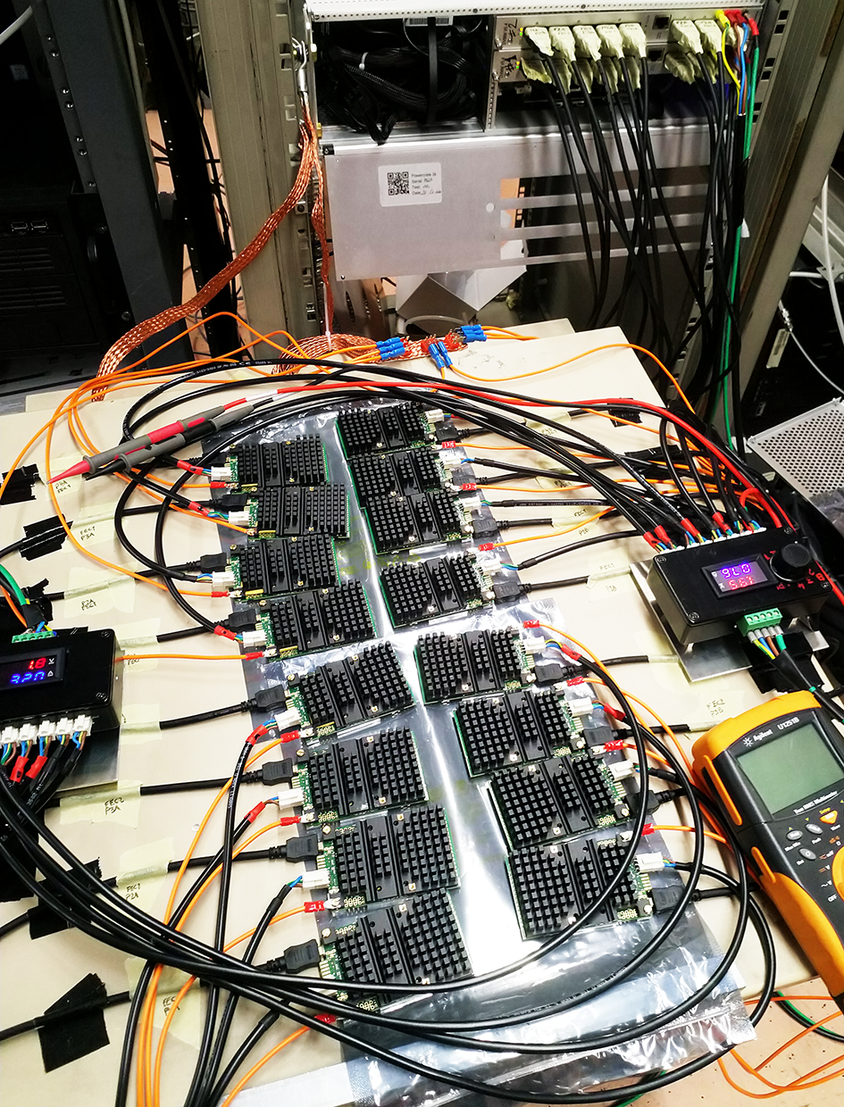
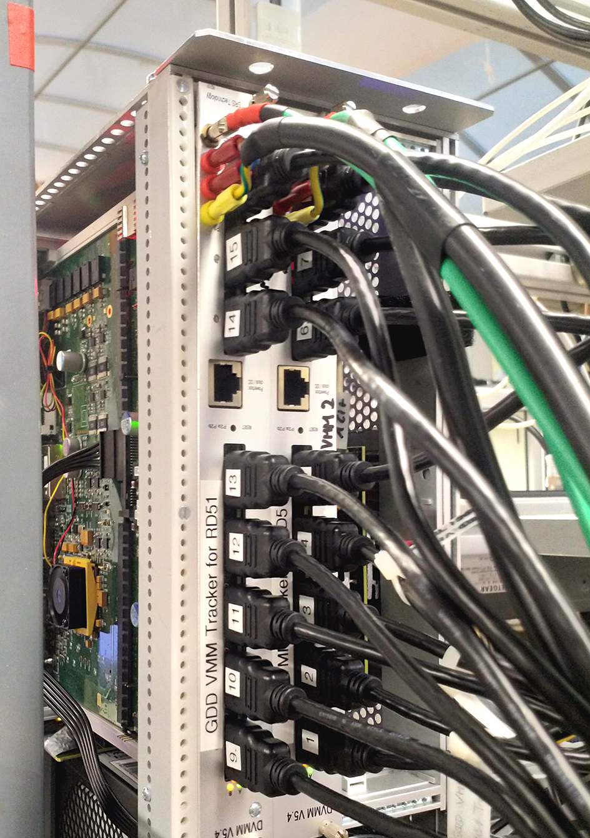
FE links: HDMI
HDMI cables for SRS DTCC links:
5 x twisted pairs up 4.95 Gbit/s
direct power over short cables <5m
up 30m with PBX power
SRS links 320(400) + 640(800) Mbit/s
robust, low-cost and rad-hard
micro HMDI

Slide 7
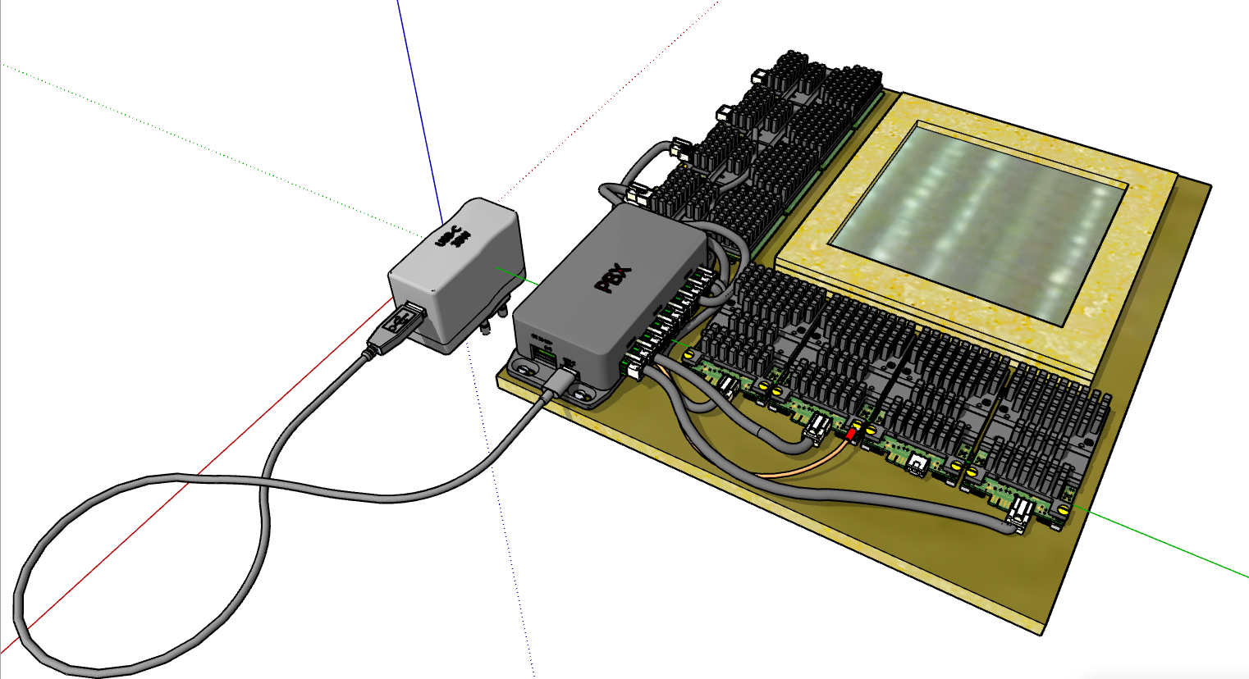
PBX frontend power
PBX user manual
USB-C ( 45W )
PBX powerbox
1k channel detector
With 8x 128 ch VMM3a hybrids
Hans.Muller@cern.ch
7

Slide 8
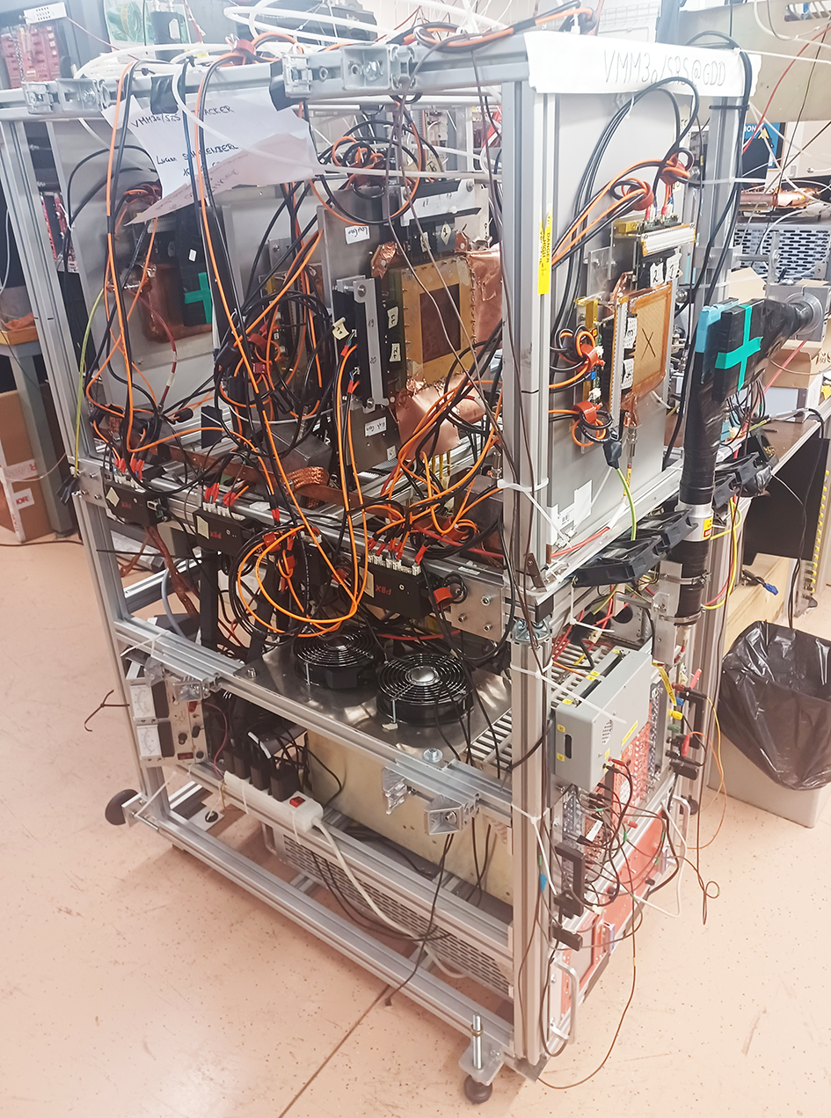
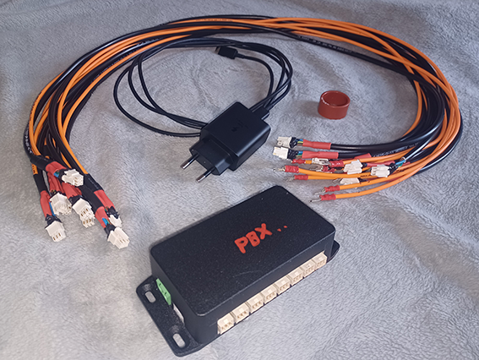
PBX powerbox kit
1 PBX box for 1kch VMM3a
1 USB-C 45W charger
8 x power cables (default 1m)
8 x Ferrite toroids
Quad GEM telescope
fully PBX-powered
-> K. Floethner GDD lab

Slide 9
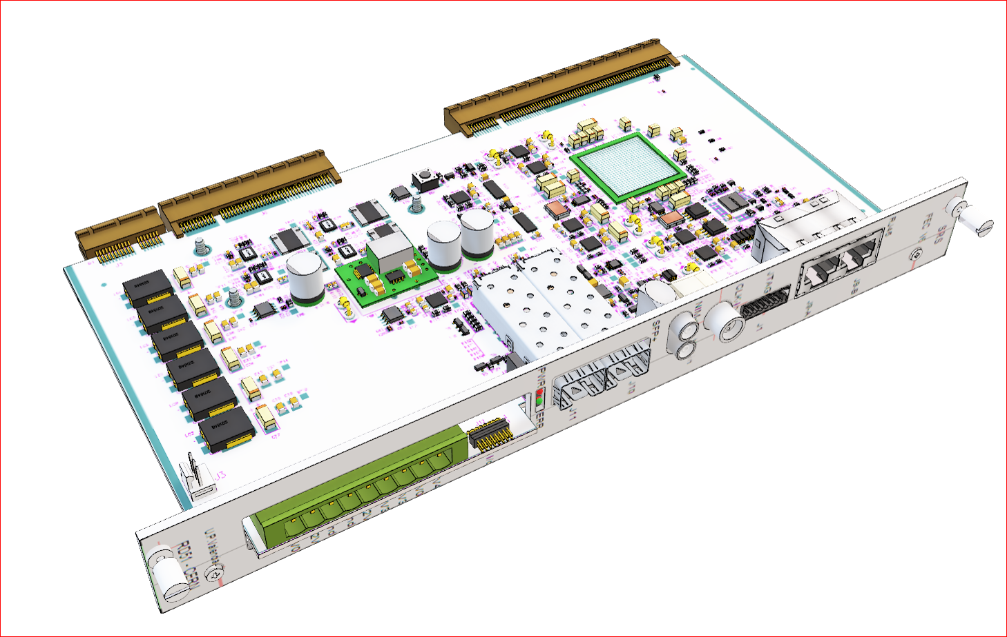
FEC V6 card
The FEC V6 is a FPGA firmware operated frontend concentrator with an SFP port for Gigabit ethernet uplink to Online.
Straddle-mounted frontend adapter like the DVMM or ADC cards interface up to 8 HDMI links to its Virtex-6 FPGA*. Single FEC
cards can read out up to 8x128 channels from a detector equipped with 8 VMM hybrids. Up to 2 FEC cards
can be housed and powered in a 3U Minicrate with a 9-way cable bus powering the FEC via the frontpanel.
The FEC has a default a 40 MHz system clock transmitted to the frontend. Several FEC cards require a common, external
CTF clock, connected via an RG45 cable to an octal CTF fanout card in the same crate.
The FEC V6 frontpanel has a rich
set of connectors and 2 status LEDs.
Several configuration jumpers are on
the FEC PCB
Default FEC firmware for the ESS
DAQ system for VMM frontend
can be updated via
a frontpanel JTAG connector**
Further I/O options require dedicated
Firmware: NIM input, NIM
output, external LVDS Clock input,
16 pin programmable User I/O, RG45
and a second SFP.
A DDR3 memory plugin can be
inserted on the backside of the FEC.
Recommended:
FEC firmware optimization
2018 student report,
by Yan Huang, CCNU Wuhan
* XC6VLX130T-1FFG784C
** the correct Flash Chip and Size needs to be determined, several versions were mounted over time.

Slide 10
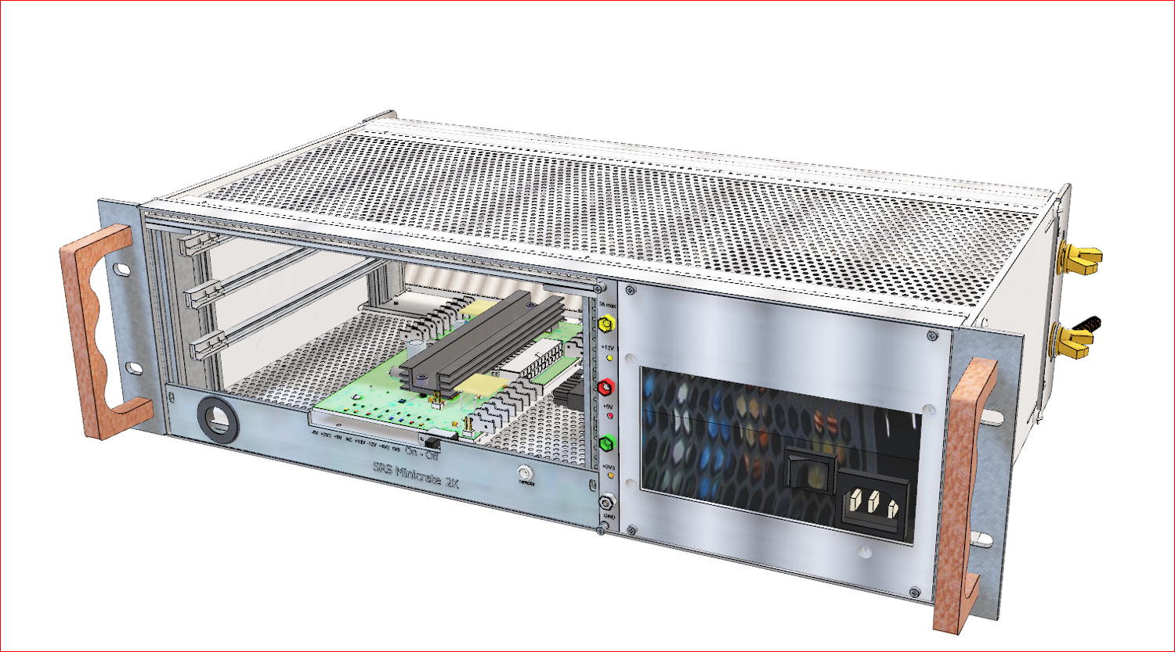
SRS Minicrate
Minicrate for FEC and DVMM cards with CTF card slot and 2x 65W power for up to 16 VMMhybrids. 3U x 84TE rack-mountable
crate 500W AC input, 3 horizontal slots : 2 slot FEC/DVMM, 1 slot CTF card (required for 2 FECs) HDMI links ports on the
rear-side DVMMs. AC power inlet 110-240V AC. Octal frontpanel LED status display of ATX adapter voltages. Slide switch for
remote on/off via coax cable 50Ω terminator, power panel for direct access +12V,+5V,+3.3V for user service electronics.
Rear M8 wing-screws for GND braid attachment to VMM hybrid digital GND. Top cover detachable for access to
trimmers and SATA Power cables. PMX powerbox recommended for HDMI cables > 2m.
Minicrate user manual
ATX adapter user manual
The larger 6U x 80TE SRS Eurocate
serves up to 64 VMM hybrids.
with 2 x 0.5 kW AC input

Slide 11
Scalable RO architecture
Online DAQ
10 GBE
10 Gb switch
SRU
In Virtex-6 FPGA
1 GBE
FEC ₁
FEC _{N}
IP core 1000Base-T
1 FEC: max 17.8 Mhit/s @ 1250 Mbps
from 1024 ch
or max. 1.4 Vmm at full 8Mhit/s
. . .
1 . . .8
LVDS 8b10b DTCC protocol
1 hybrid
(128 ch)
1 Vmm: max 8Mhit/s @ 400 Mbps from 128 ch
FE hybrid
. . .
1/31/2024
Hans.Muller@cern.ch
11

Slide 12
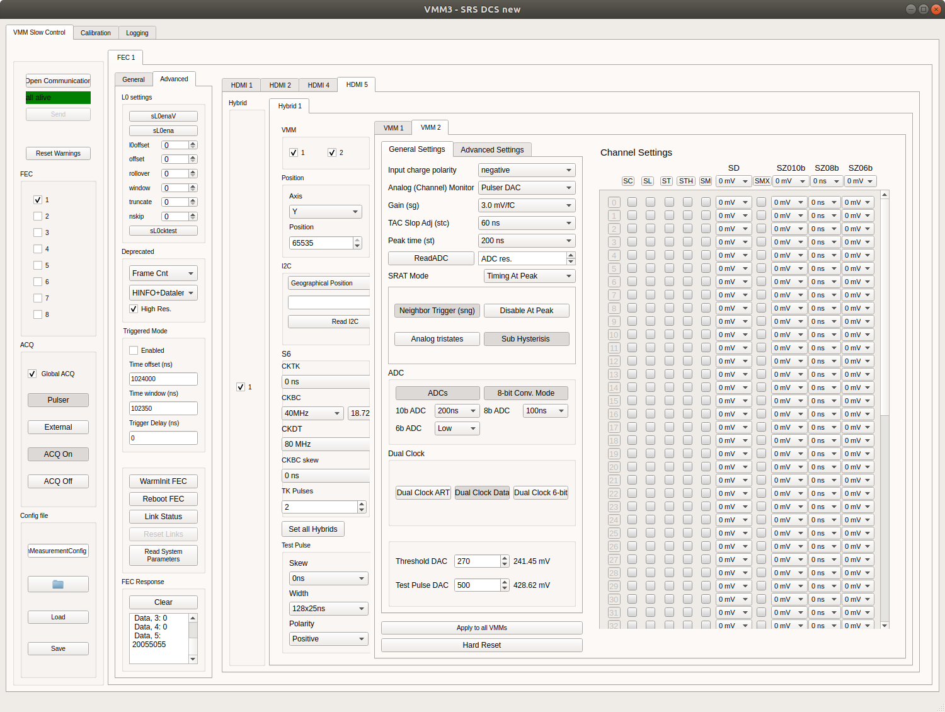
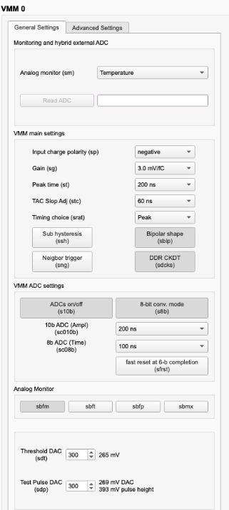
DAQ and Slow controls
ESS DAQ : https://github.com/ess-dmsc/essdaq
Analysis tool for ESS DAQ data :
https://github.com/ess-dmsc/vmm-hdf5-to-root
VMM3a slow control user manual on gitlab
Slow Controls GUI for SRS run control with VMM3 frontend connected via DVMcard
1/31/2024
Hans.Muller@cern.ch
12

Slide 13
List of SRS VMM users (since 2018)
GEMs with VMM frontend and SRS readout SW at the NMX Diffractometer ,Multiblade Detector with wire readout using VMM and SRS readout + other ESS instruments considering VMM frontend, ESS European Spallation Source, Lund Sweden
Gaseous Detectors for Preclinical Proton Beam Monitoring, at Dep Physics Medical, LMU Munich
SRS readout with cooled VMM’s in a vessel for tracking system for the S800 spectrometer at (FRIB RIB Facility Michigan USA )
New TPC for HYDRA at GSI/TU Darmstadt for measuring pions, SRS readout with VMM frontend @ GSI/TU Darmsatadt
muon tomography for geological applications, SRS VMM readout, LSBB Rustrel, FR
use of GEM telescope with SRS/VMM readout and NIP pattern injector, NA61/Shine CERN
Triple GEM in borehole with VMM readout via VTC, OXY colleague LA ,USA
Cygnus neg. ion TPC in pressure vessel for charge readout VMM/ SRS , Hawai Univ. Honululu
Micromegas with VMM SRS readout for PANDA-FAIR phase 0 , MAINZ Univ. Physics DE
GripiX TPC with Timepix 3 readout via SRS adapter, BONN Univ. Physics DE
Qualification MM for Atlas NSW, LMU Physics Faculty Munich
readout of Multiplexed MM with VMM SRS for NA64. Plans for addition of external VMM trigger, ETH Zurich, CH
MPGDs for photon detection, VMM, INFN Trieste
VMM trigger readout Controller ROC for ATLAS NSW, IFIN-HH- RO
SRS ATCA readout system for NEXT TPC, UPV Valencia Sect. Gandia
MPGD’s for several national research project, SRS with VMM included, JLAB T.Jefferson Natl Accelerator USA
cosmic telescope with VMM readout, Universidad de los Andes, Bogota
GEM beam telescope with SRS VMM for testbeams and VMM qualification , GDD lab CERN
XYU-GEM ambiguity-free readout with VMM /SRS (RD51 -Note -2022-09 ), GDD lab CERN
TPC with SRS/VMM readout for search of X17 particle at a 5 MV accelerator , Melbourne Univ. AU
Compass GEM upgrade with SRS VMM3a readout, Univ. Bonn DE
SiPM dual gain readout with VMM/SRS at ALICE FOCAL testbeam
note: this list is not complete

Slide 14
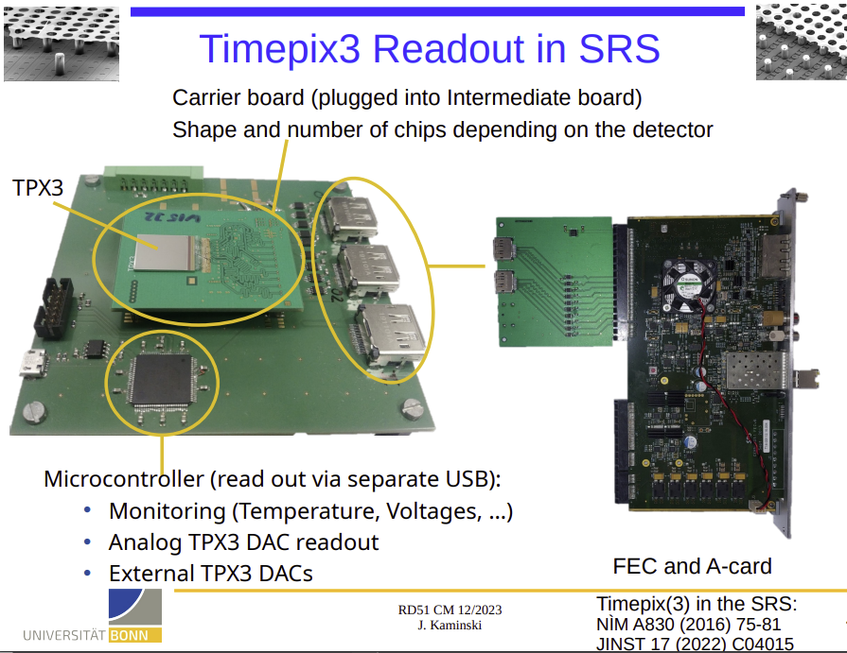
SRS readout Timepix (Univ. Bonn)
more information J. Kaminski Dec. 2023

Slide 15
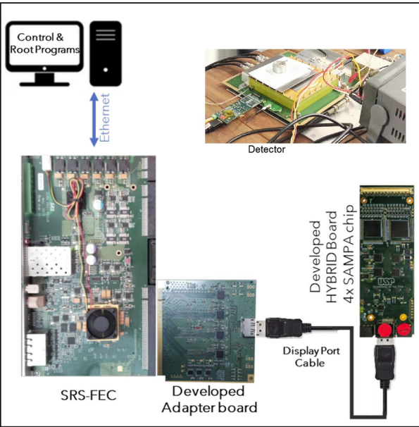
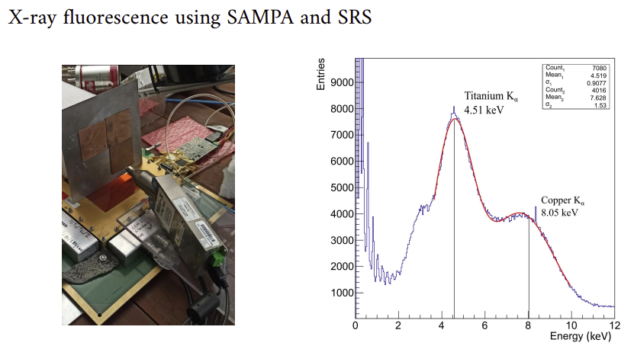
SampaSRS
More information on SampaSRS Dec. 2023

Slide 16
SRS production and availability
CERN store for CERN-registered users ( VMM hybrids, FECs, MiniCrates ..) SCEM 07.89.00 - RD51 SRS
SRS Technology , CH ( VMM-hybrids, FECs, DVMM, CTF, + coming: PBX, uROC , SiPM –adapt..)
Opus Automation, IT ( Minicrates ) - contact available on request
SAMWAY, Bucharest, RO ( FEC V6 cards ) –contact available on request
SRS documentation, FAQ, Repositories
Google drive H.M. SRS HW user manuals, FAQs
Software Installation L.Sch. Software overview and mp4 video on SW installation
Experience with VMM3a L.Sch
Firmware and Software FAQ, Firmware DOC
Gitlab software repository

Slide 17
Recent & new SRS developments

Slide 18
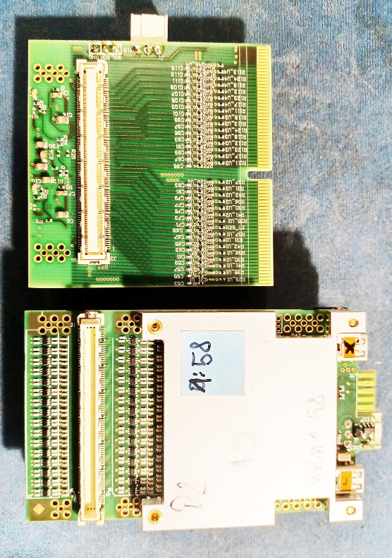
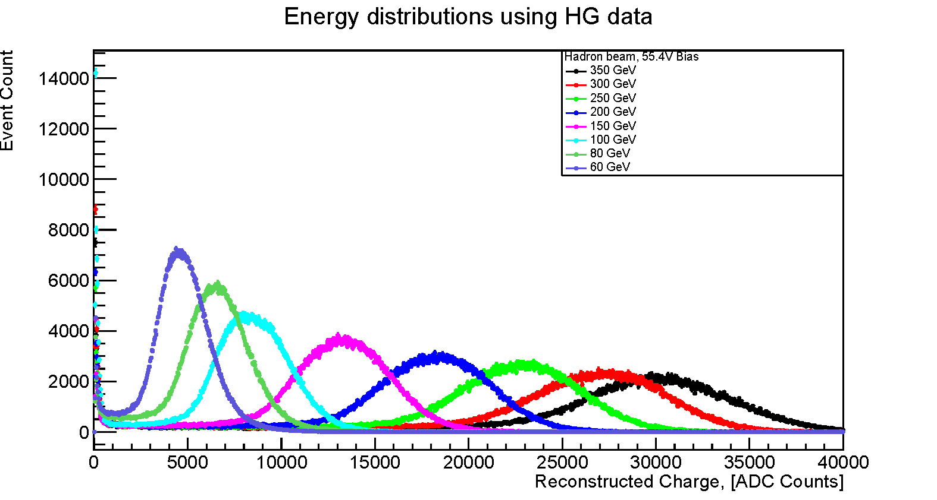
SiPM adapter for VMM hybrids
SiPM Adapter prototype on on Alice Focal Testbeam 2023 with 4 VMM3a hybrids and SRS DAQ
Alice FOCAL testbeam at SPS with SiPM –VMM adapter
& Data Analysis
SiPM adapter
VMM hybrid
64 ch adapter plugs on VMM hybrid
High and low gain
SiPM bias U_{br} 10-80V included
& via Slow Controls

Slide 19
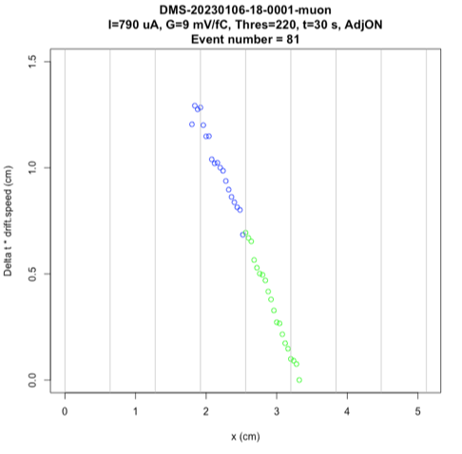
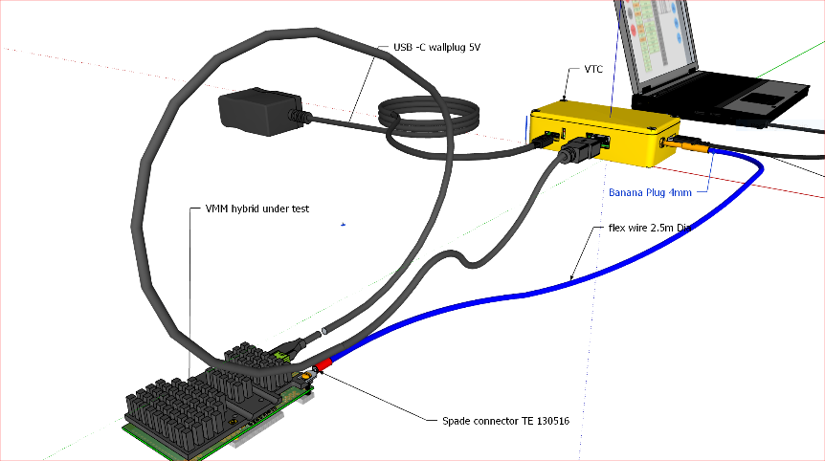
Low- rate, triple GEM readout* with VMM and SoC-based VTC @ OXY Colleague, LA
more information
“Low Noise Electronics Development at Occidental College for Dark Matter and
Muon Research”.
Muon tracks recording
1/31/2024
Hans.Muller@cern.ch
19

Slide 20
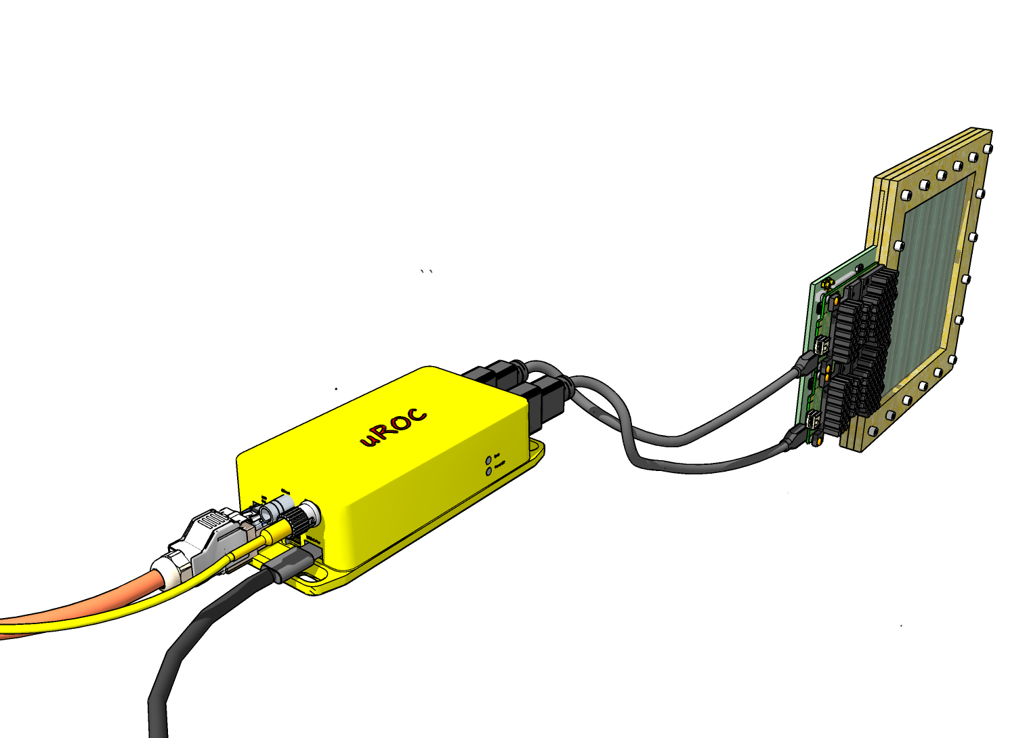
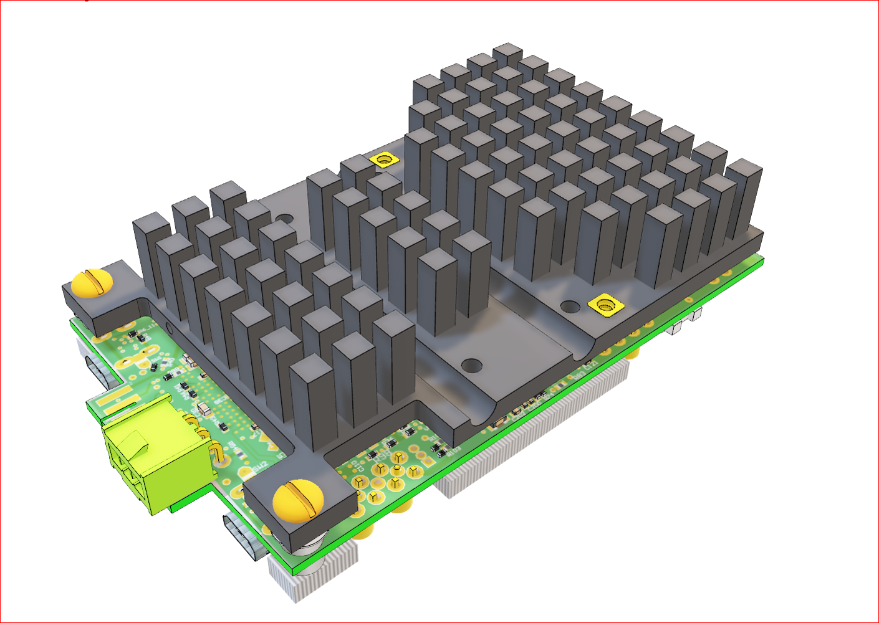
Coming: uROC for 256 ch
RO link:
copper/fiber SFP
to Laptop
Power via HDMI
2x ASIC carriers
ST optical link:
option for clock
sharing
USB-C power ( incl. 2x VMM )

Slide 21
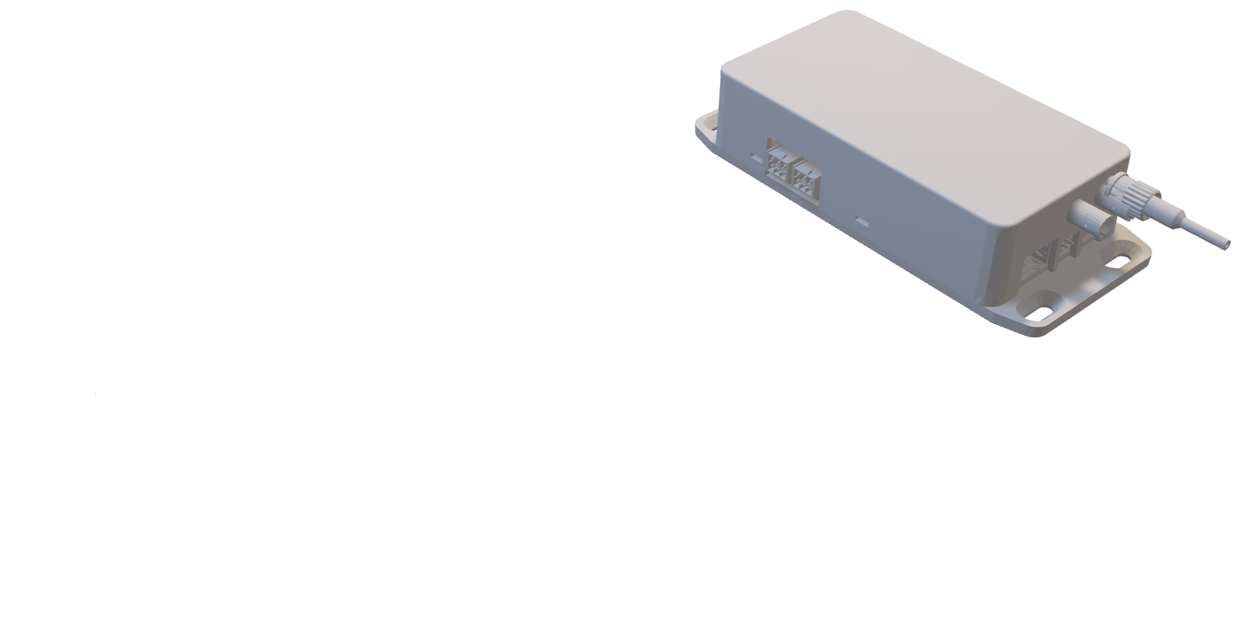
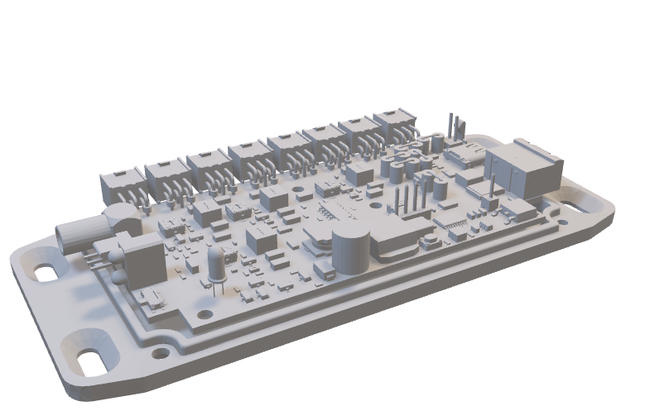
New in 2024: crate-less _{d}FECs
like classic FECs , can directly connect to DAQ on Laptop via ethernet
dFEC’s
portable / hand-sized boxes
state of art FPGA logic
2 ..16 HDMI powered frontend ports
max. 2k channels/ dFEC
USB-C powered
SFP for RO links copper or fiber
switch for ethernet/DTCCe to backend
ST optical clock link (plugin option)
RO-link 1..10 Gbps
to eFEC / Laptop
Long distance
dFEC box (3D)
Protocol switch
DTCCe / UDP
SFP
USB-C
Powerbox
40 W
dFEC
USB-C
FPGA
1…8
HDMI
AC 110-240V
power cables
2..5m
HDMI AD cables
2..5m
2...16 ASIC carriers ( 2k ch max)
PBX powerbox (3D)
DETECTOR

Slide 22
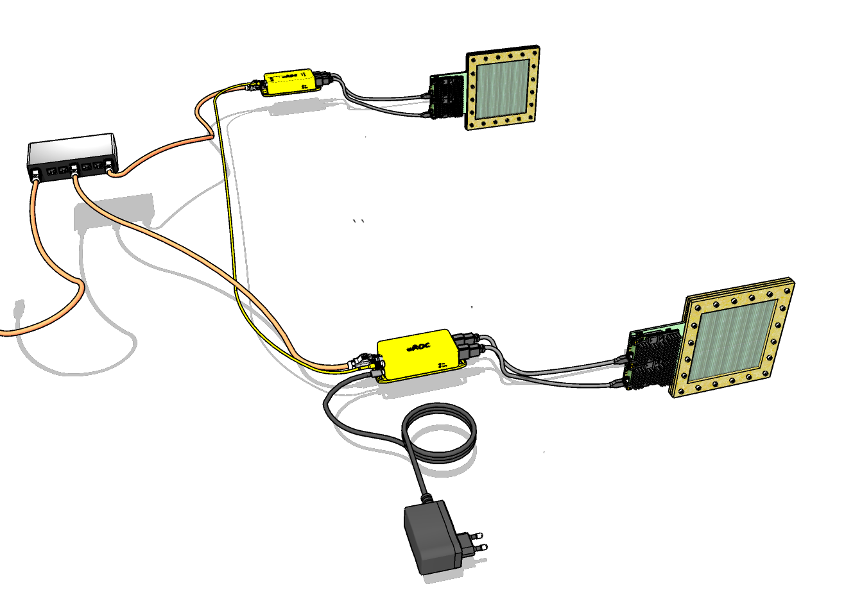
New, distributed, small detectors
Network switch
Detector B
up 2km
optical link (common clock)
dFEC (2, 8,16 links)
Detector A
To Online
HDMI
optical link Ethernet
USB-C power

Slide 23
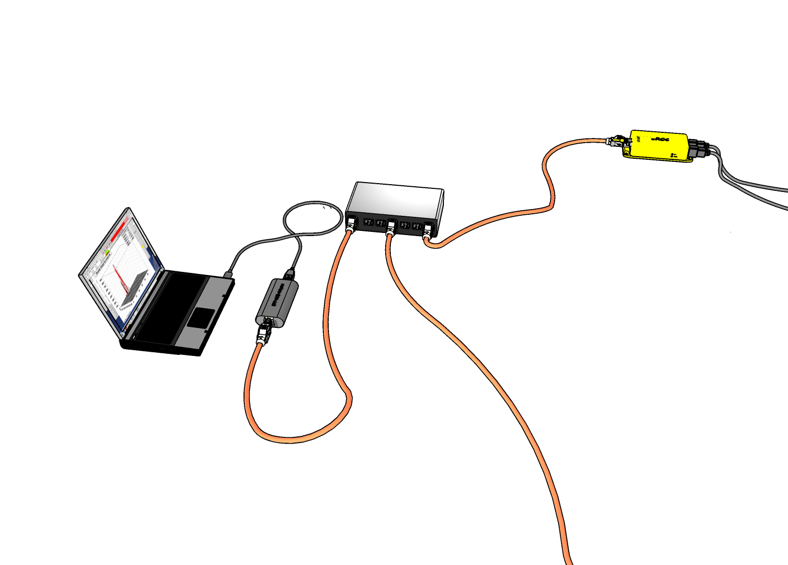
Small systems DAQ
dFEC FW will be adapted to work with ESS- DAQ like classic FEC
dFEC = uROC
ESS DAQ and Controls
on Laptop
Network switch
Small Detector
GEM
MM
SiPM
…
256 channels
VMM
VMM
Ethernet / USB-C adapter
SFP network cables / fibers
to other dFECs

Slide 24
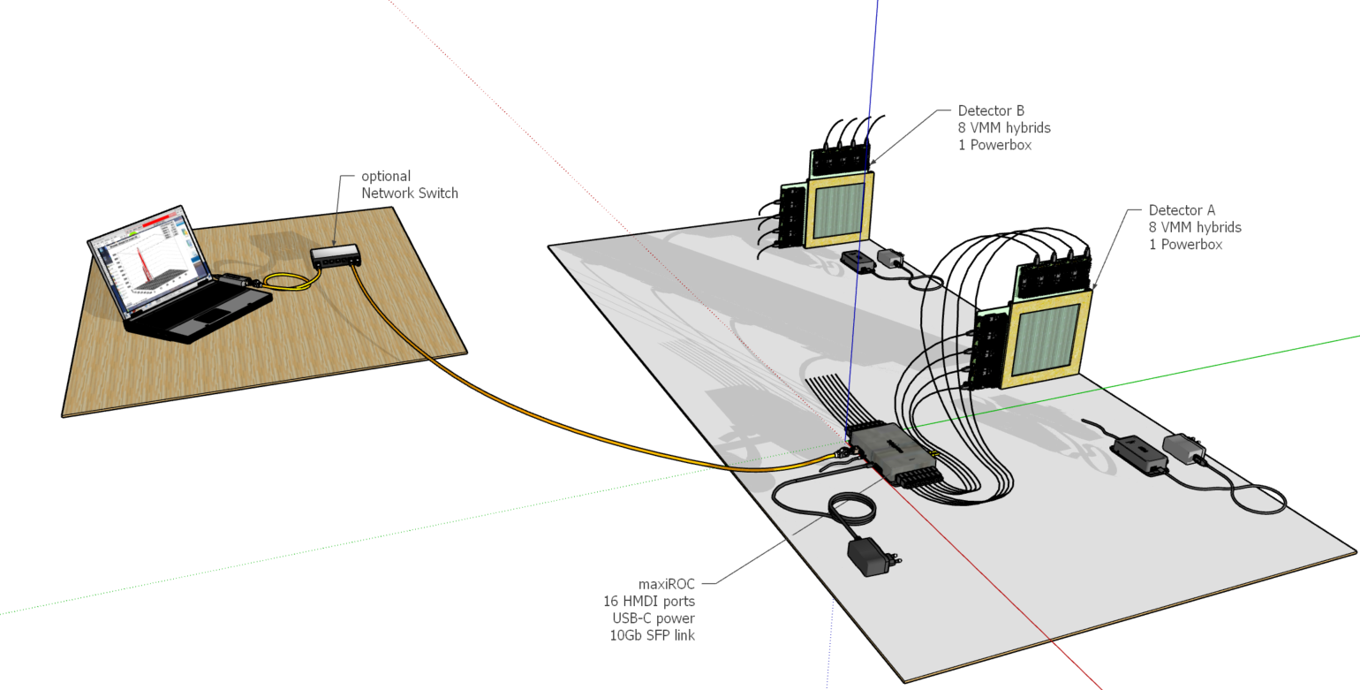
The next step: dFECs for medium-sized detectors
Readout & DAQ of N x 2k detector channels via maxiROC

Slide 25
the full plan: Scalable Readout Architecture
Online
For more details see new archtitectures talk Dec 23:
>=100GBE
1GBE controls
SWITCH
Network switch min 20 Gb per eFEC
4x10 GBE
eFEC
1…x backend eFEC
Laptop
1…200m
optical RxTx fibers
with SFPs at both ends
RO links DTCCe
1 / 2.5 / 10 GBps
UDP mode small systems
( no eFEC backend)
clock links only for small systems
w.out eFEC
Downlink FECs = dFEC
6 per eFEC
different versions
dFEC
8x
Classic
FEC
dFEC
2x
legacy
direct
HDMI
dFEC
16x
…
ASIC carriers over 1…30m
HDMI 1Gbps
. .
.
frontend-ASIC
carriers
on detectors
. .
ASCI carriers
on detectors
8x
8x
2x
( pwr
direct
from
dFEC )
8x
16x
frontend-Powerbox
(USB-C, DC, Battery)
PBX
PBX
PBX
PBX
PBX

Slide 26
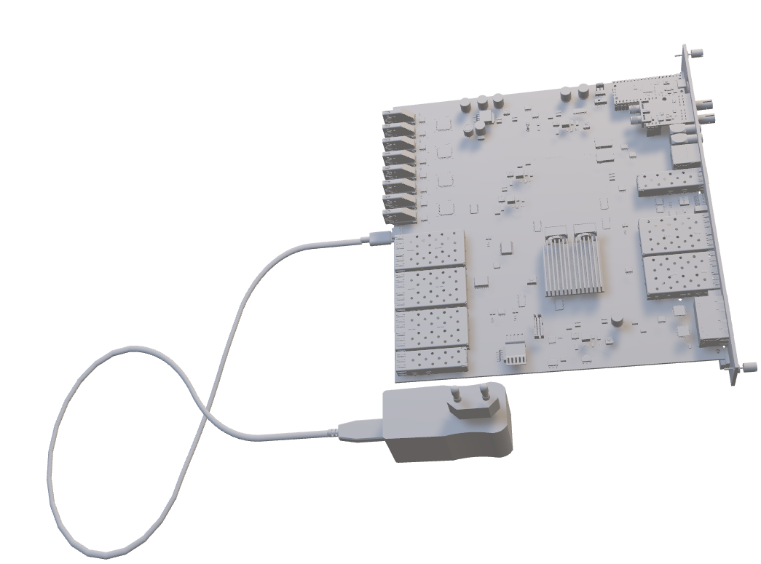
eFEC backend module
( to replace 2009 SRU for 2024+ )
General
same physical outlines as FEC + DVMM together 6U x 220mm
housed and powered (USB-C) in classic SRS crates
Ultrascale+ Zync FPGA
Connectors rear
8 x legacy, powered HDMI link ports to VMM frontend
6x frontend DTCCe link port SFP+ 1 /2.5/ 12.5 Gbps
1x 100Base Ethernet for Controls link
USB-C power connector
Connectors front
4 x uplinks SFP+ to Online 10GBE/UDP
1 x uplink SFP+ vertical architecture summary link
2 coax Trigger Inputs and 2 coax trigger outputs (NIM)
1 CTF⁺ clock and trigger links (RG45)
1 x horizontal Xlink Rx Tx horizontal serial link ( RG45)
1 x horixontal SYNCbus mixed analogue / digital
Plugin options
1 optical ST RX / TX link mezzanine ( serial injector option)
32 bit SoC with USB debug port ( Raspberry Pi pico)
DDR4 plugin 64 GB (backside)
eFEC (3D)

Slide 27
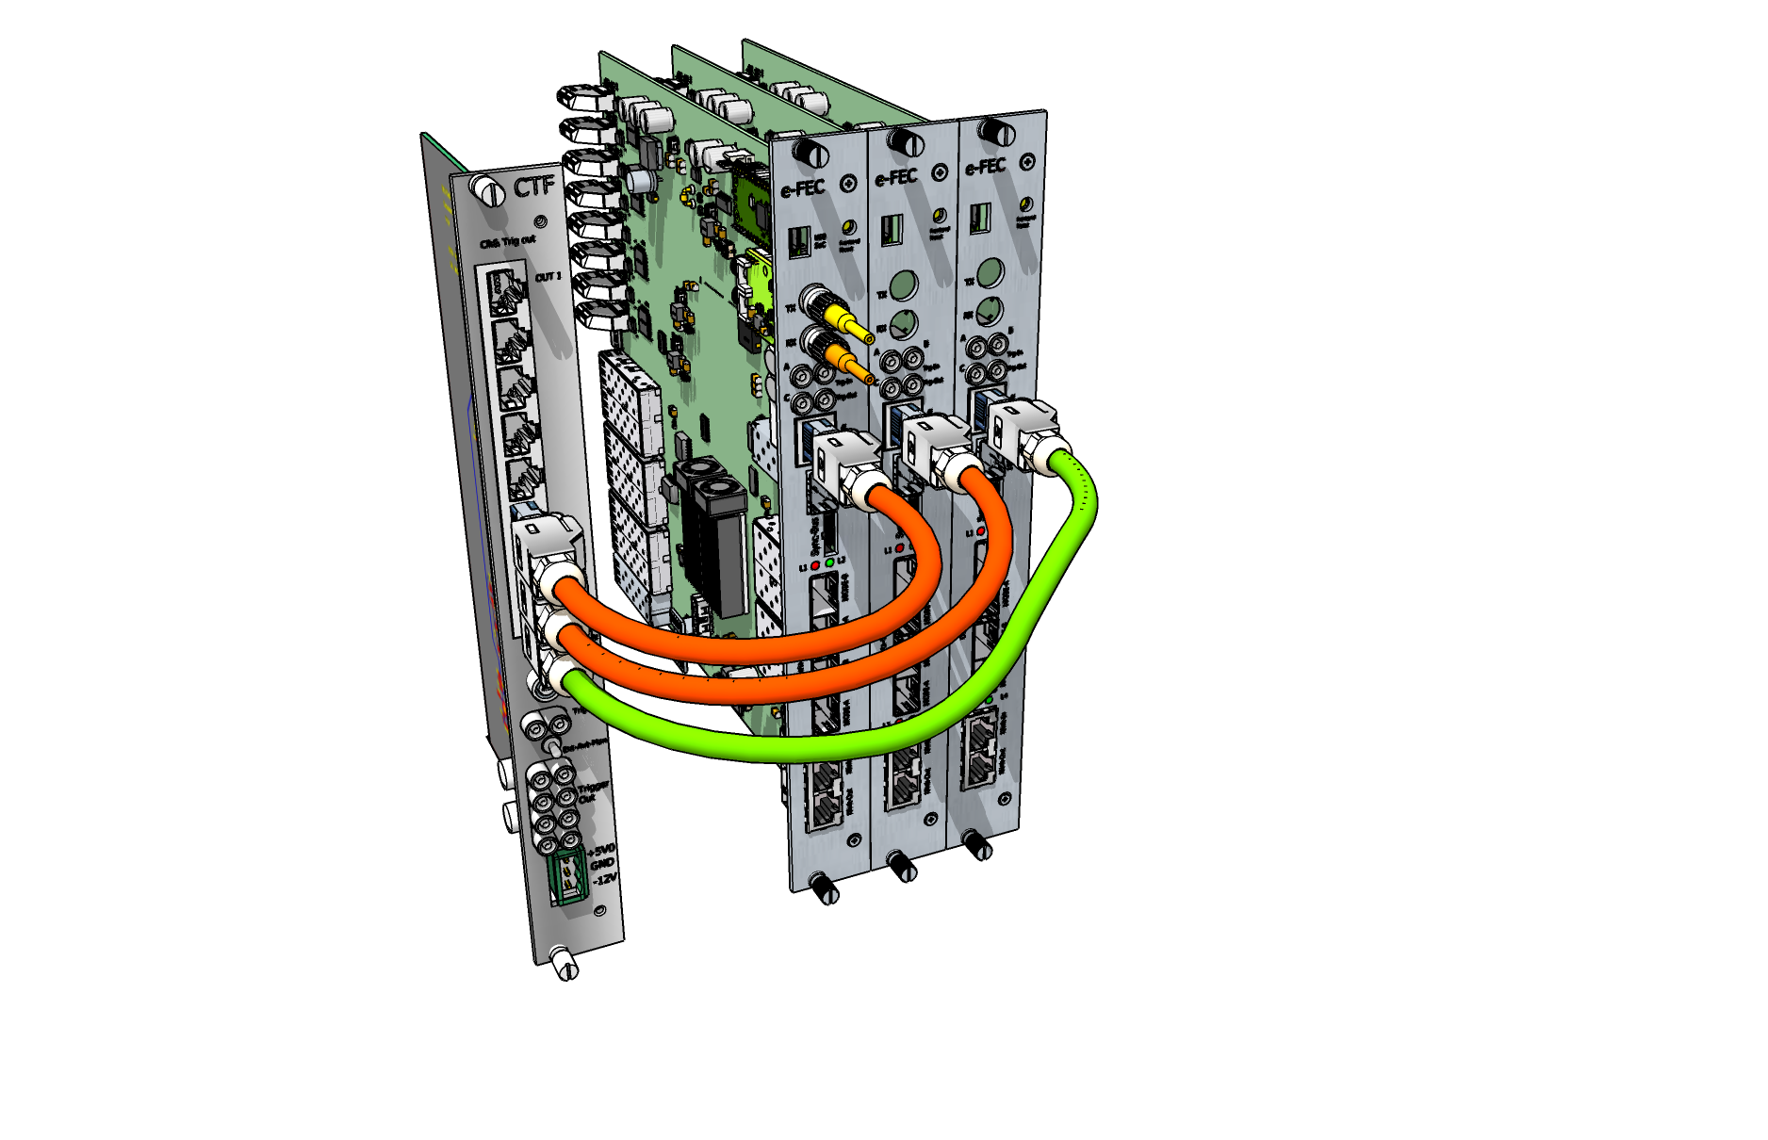
New possibilities: online triggers in FPGAs
Ultrascale FPGA interconnect cabled via frontpanels
Common clock CTF
06/12/2023
Hans.Muller@cern.ch
27

Slide 28
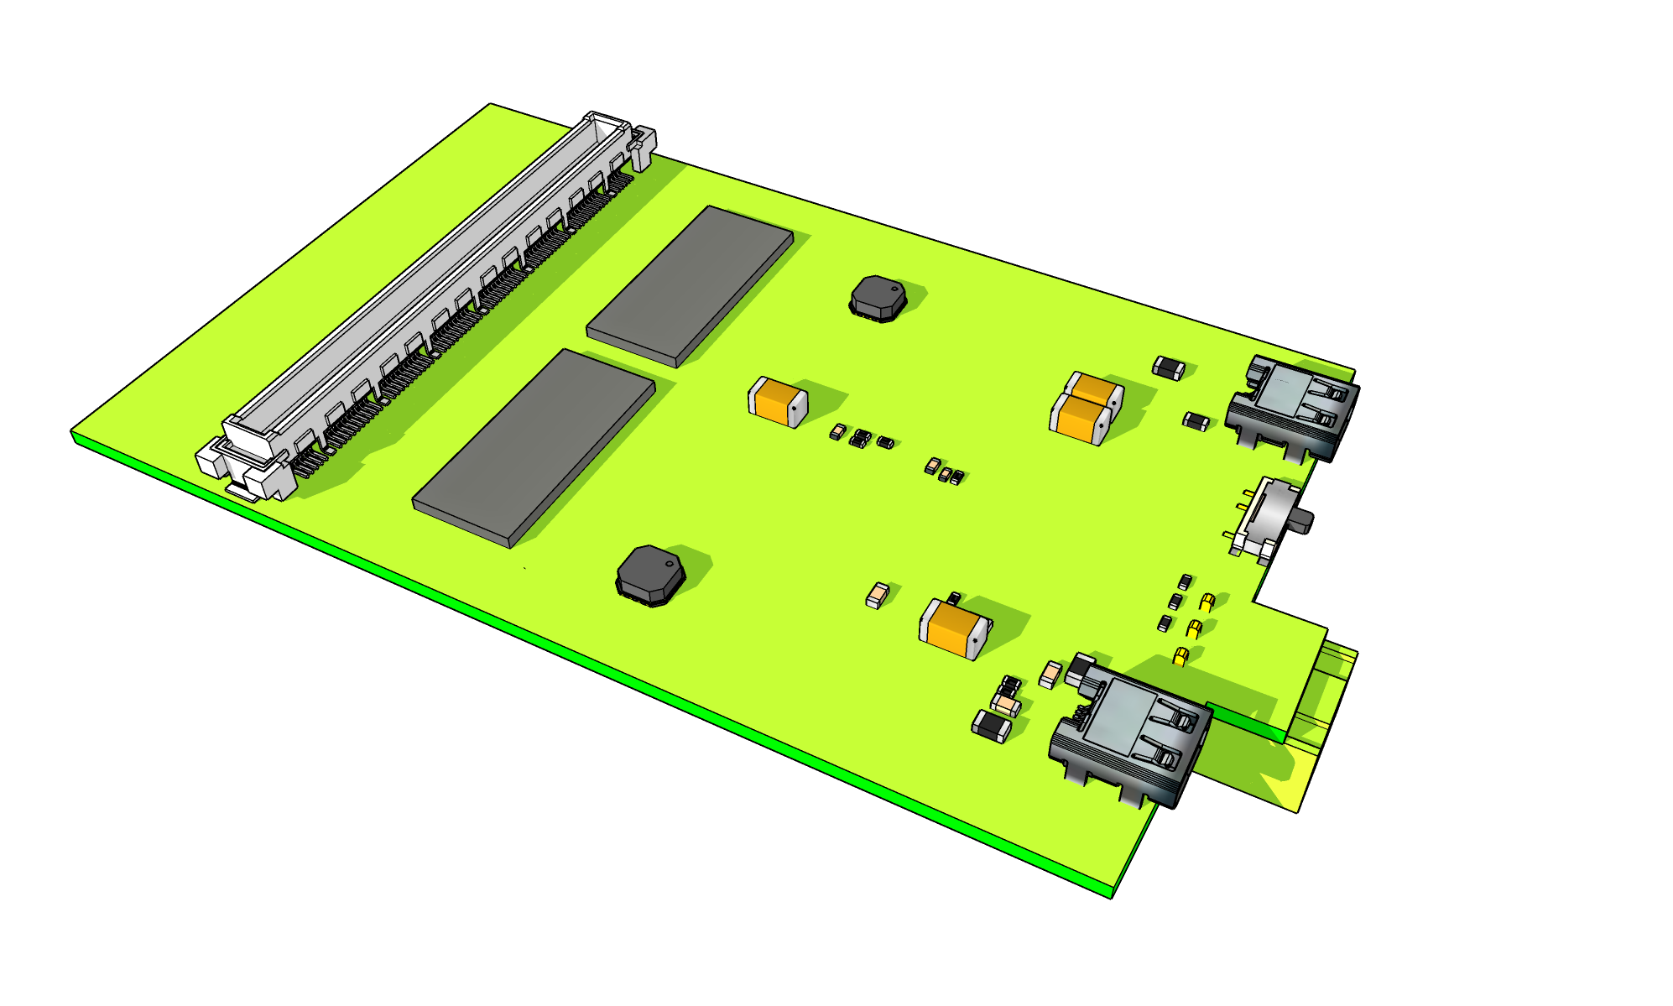
Possible new SRS Frontends (tbd) example study case: 128 ch HGCROC
2x HGCROC per hybrid with 128 ch HRS connector
2 x HDMI –Micro connectors , one per HGCROC
HDMI-D connector pinout compatible with SRS classic
Select switch: data or trigger
LpGPT signals converted to LVDS over HDMI
protocol in FPGA of readout (FEC or dFEC)
HDMI Link HGCROC-1
Select
HGCROC Data/Trigger
HRS connector
P1/P2 power
2 x HGCROC
HDMI Link HGCROC-2

Slide 29
join the SRS user community and developer teams / discussions

Slide 30
Backup material

Slide 31
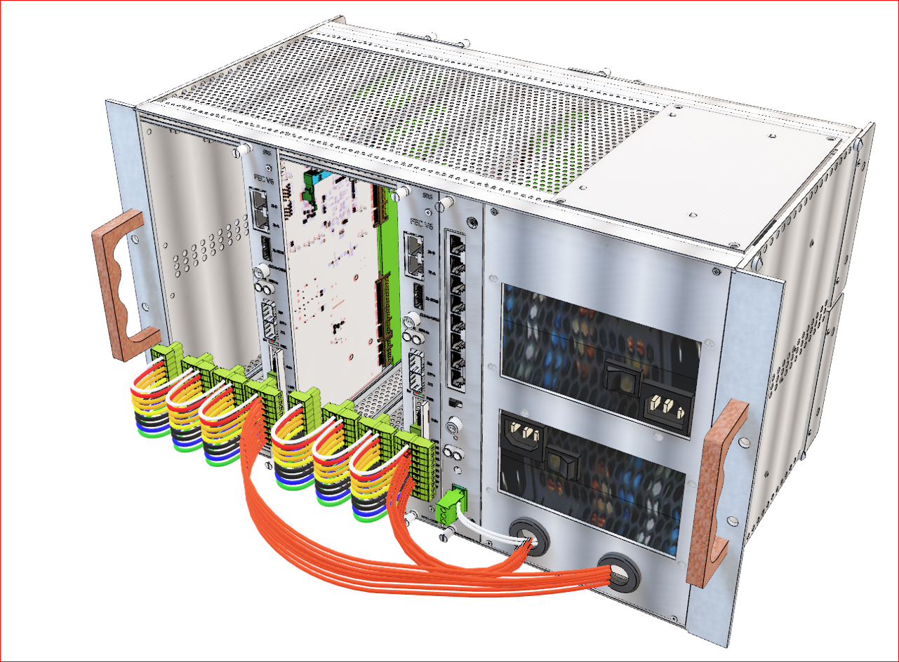
SRS Eurocrate
Eurocrate for FEC and DVMM cards with CTF card slot and 8x 62W power for up to 64 VMM hybrids. 6U x 80TE rack-mountable crate 2x 500W AC input, 9 vertical slots : 8 slots FEC/DVMM, 1 slot CTF card (required for >1 FECs). HDMI links ports on the rear-side DVMMs. Two AC power inlets 110-240V AC for FECs 1-4 and 5-8. Rear-panel with LED status displays two ATX adapter voltages and 2 slide switches for remote on/off via coax cable 50Ω terminator. Rear power panel for direct access +12V,+5V,+3.3V for user service electronics. Rear M8 wing-screws for GND braid attachment to VMM hybrids, 1 per DVMM. Two frontside powerbuses for FEC1-4 and CTF card, FEC 5-8. 5 x SATA cables each with 3 SATA connectors for DVMM card power. With 500 W ATX supply up to 64W @12 V per SATA cable to DVMM (-> 8 VMM hybrids), PMX powerbox recommended for HDMI cables > 2m.
Eurocrate User manual
Note 1: Slot 1 for CTF card only
Note 2: ventilation from the bottom is
mandatory for >2 FECs ( any
commercial 1U rack-mountable
ventilator )
1U air exhaust volume on top
of crate
Note 3: SATA cable routing to DVMMs
required
Note 4: bf default, slide switches on
backpanel must be in “ON” position
3D view download ppt

Slide 32
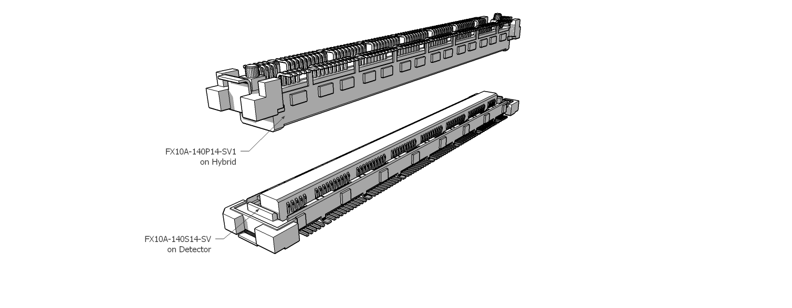
HRS: MPGD connector standard
RD51 decided in December 2016 to replace the legacy Panasonic 130 pin connectors
by new 140 pin HRS FX10A connectors, starting with the VMM SRS hybrids and progressively
implemented on the detector frames.
For a transition time, adapters between Panasonic and HRS are available.
2x 70 pins 0.5 mm pitch
every group 10 pins followed by GND contact

Slide 33
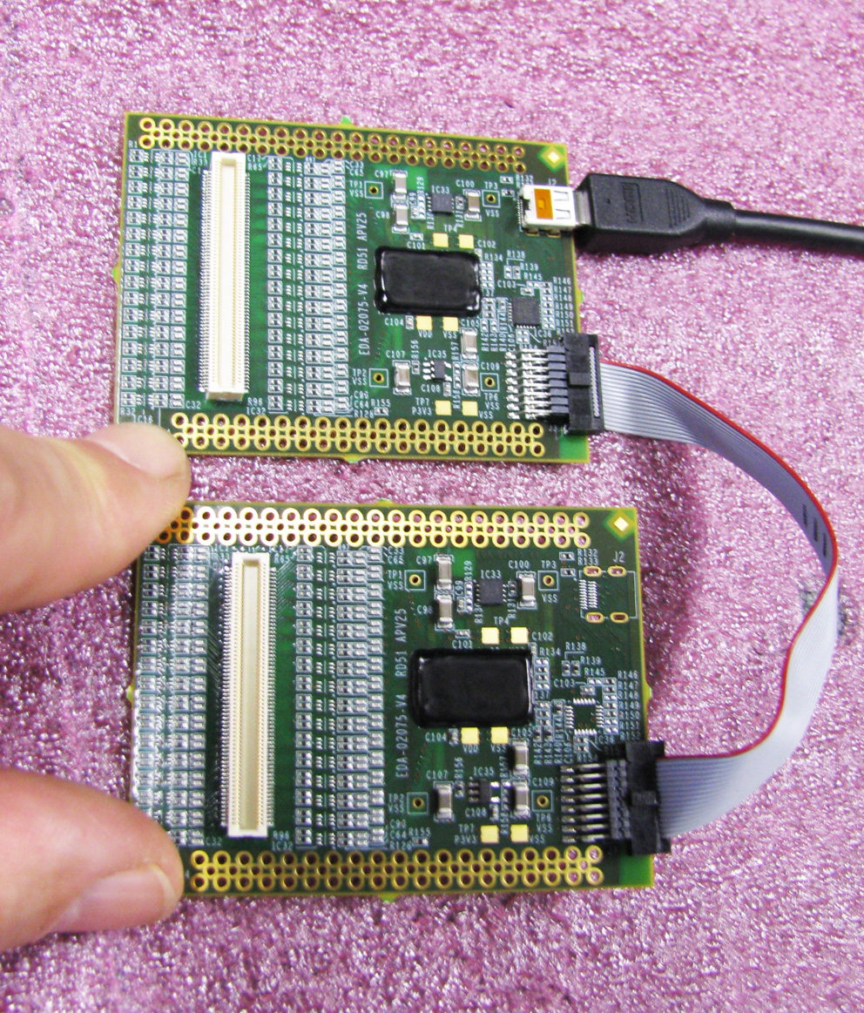
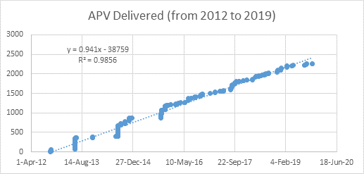
APV 128 ch frontend hybrid
SRS working-horse frontend 2011-2019
requires ADC card interface to FEC card
Panasonic
connector
HDMI power and readout link to FEC/ADC card
Master
Slave
APV hybrid sales via CERN store 2012-2020

Slide 34
ASIC carriers with cooler
VMM hybrid for SRS* , 128 channels, 2 VMM3a ASICs, 100g, 4Watt, plugs directly to a MPGD gas or photon detector with 140 pin HRS connector. Multipurpose ALU cooler ( convection / water pipe ) to keep die temperatures below 55 C for long lifetime and low noise. HDMI readout link to DVMM card via micro HDMI-AD cable. 3-Pin AUX power connector for P1 (+3.3V) and P2 ( +1.8V). PCB Edge connector for Jtag and I2C. Two 3 pin connectors access to analogue VMM signals (shaper , baseline etc )
4.5 Watt ALU cooler
top bottom
Grooves for optional
cooling pipes
total weight: 100g
* latest revision V5, 2022+

Slide 35
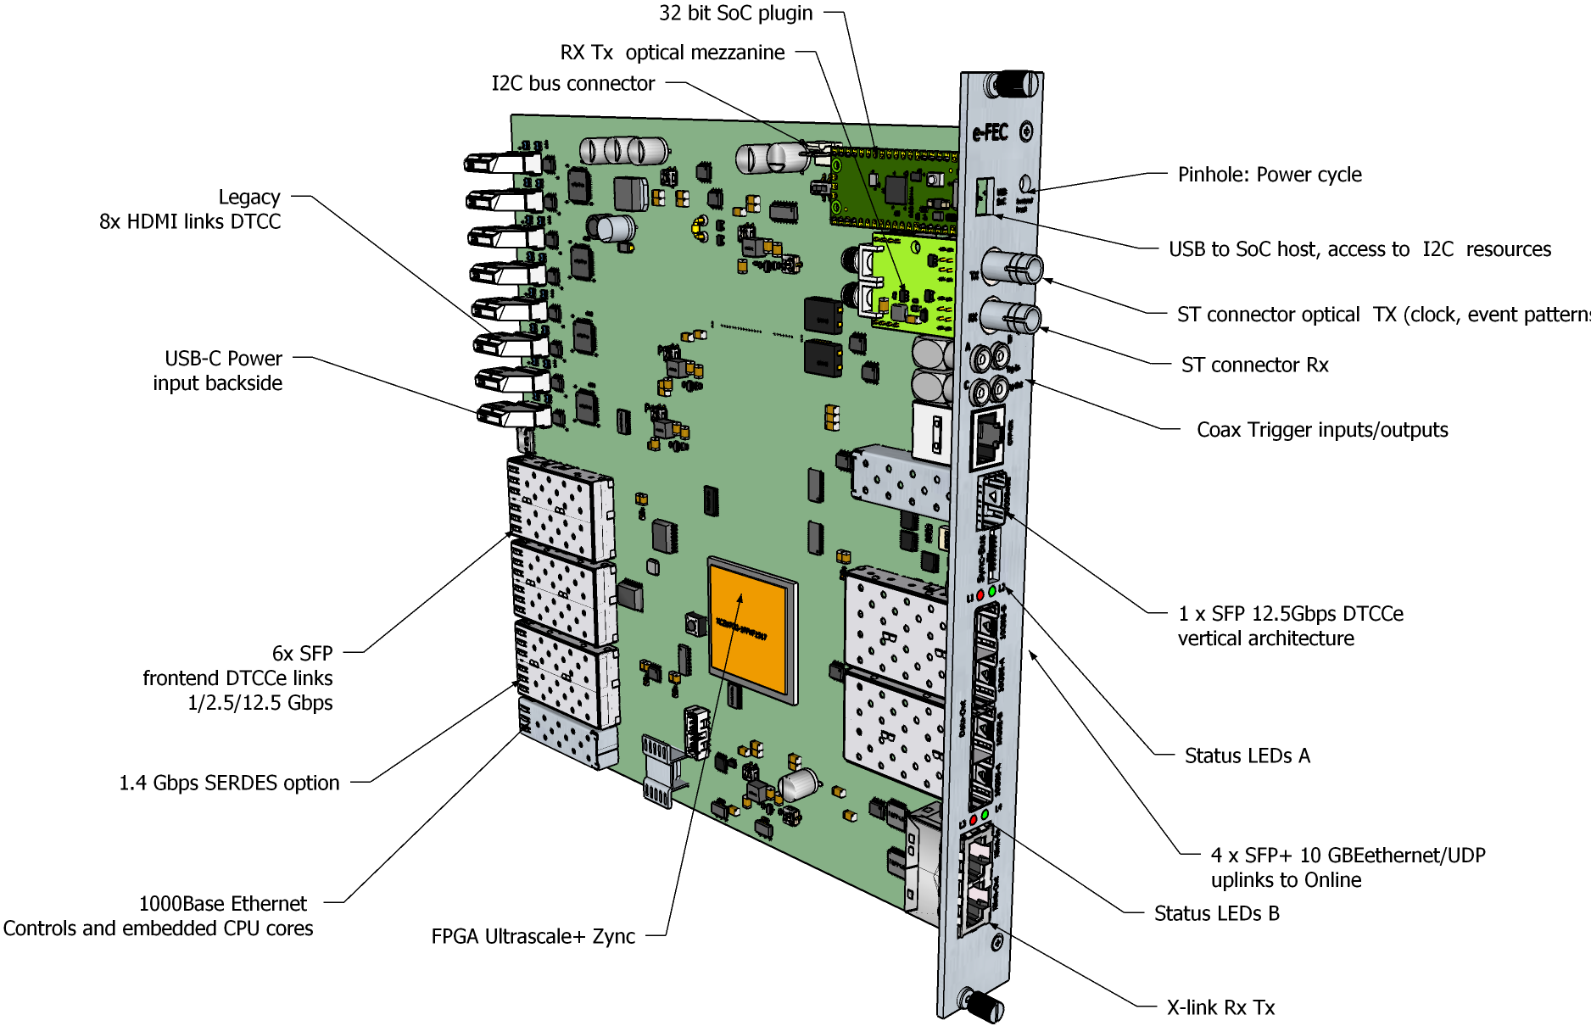
eFEC card preview

