Slide 1

XPU General- Purpose Accelerator (XPU-GPA)
UNSTPB - Politehnica Bucharest / Faculty of Electronics
ETTI-DCAE-ARH group
Speaker: Calin Bira (calin.bira@upb.ro / calin.bira@cern.ch)
Jan.2024

Slide 2
Heterogeneous
Computing System
Complex computation runs on HOST: a mono- or multi-core computation structure (ARM, RISC V, …)
Intense computation runs on ACCELERATOR: a many-core computation structure
ACCELERATOR is seen by the HOST as a hardware library of functions

Slide 3
XPU GENERAL PURPOSE ACCELERATOR (XPU-GPA)
MAP: linear array of execution cells with big register files
CONTROLLER: custom micro-computer used to issue in each cycle a command for MAP
DISTRIBUTE: pipelined log-depth distribution network
SCAN/REDUCE: pipelined log-depth circuit performing reduce functions (add, min, max, …) and scan functions (add prefixes, permute, …)

Slide 4
Architectural acceleration
Test configuration for GEMM of N×N matrices :
  HOST: ARM single-core
  ACCELERATOR: our MapScanReduce accelerator with p = N cells
Architectural acceleration (A): acceleration with HOST and ACCELERATOR running at the same frequency with a x86 mono-core engine
  T_{Multiply}+T_{Transfer} = ((2p² + plog₂ p+9p+5) + (1.5p² + 17p +6) clockCycles
(validated by measurement on GPA simulator’s clock counter)
  T_{multiply+Transfer} = 22×N³ clockCycles (measured running on x86 mono-core)
A => 6.28×p

Slide 5
1024×1024 Matrix Multiplication for ML at 7 nm
On GPU Nvidia’s A100: execution time 0.4ms,
  on 846 mm², with 6912 cells, in 7nm, 1.275 GHz, ~150W, Memory Bus: 5120 bits
On our GPA: execution time 2.9ms,
  on 40 mm² , with 1024 cells, in 7nm, 1.275 GHz, 5.12W, Memory Bus: 128 bits
#cells(GPU)/#cells(GPA) = 6.75 ≈ 7 ≈ time(GPA)/time(GPU) = 7.25
Power(GPU)/Power(GPA) = 78 ➔ 11x computation for the same energy
Area(GPU)/Area(GPA) = 21 ➔ 3x computation for the same area
The evaluation is based on simulation and synthesis made in a master thesis using Cadence environment for GPA,
and on https://www.techpowerup.com/gpu-specs/a100-sxm4-80-gb.c3746
https://docs.nvidia.com/deeplearning/performance/dl-performance-matrix-multiplication/index.html for GPU.

Slide 6
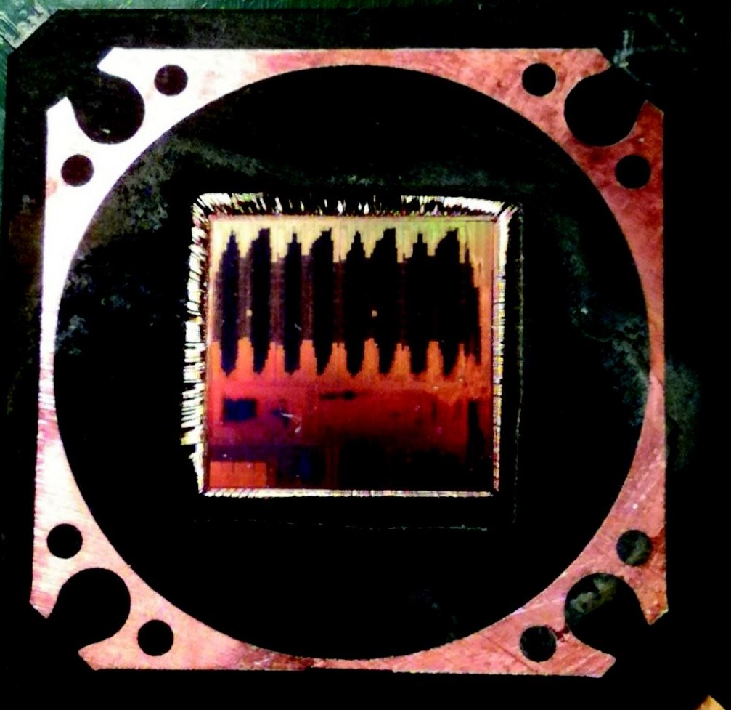
Current stage
Three silicon versions of the accelerator produced in a Silicon Valley start-up (more at: http://users.dcae.pub.ro/~gstefan/2ndLevel/connex.html )
Working prototype, on FPGA development board, for p = 128
The accelerator is programmed in assembly
The performance was investigated for a large number of application domains (dense & sparse linear algebra, FFT, molecular dynamic, automotive, …)
6

Slide 7
Application Domains
Artificial Intelligence
Automotive
Robotics
Bio-Informatics
Security
Digital Signal Processing

Slide 8
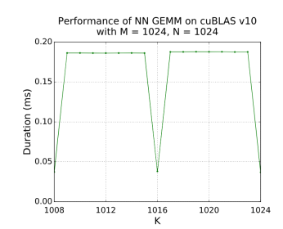
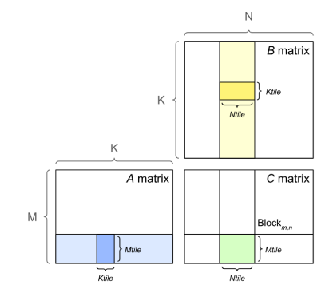
Evaluations against NVIDIA GA100
The evaluation for GPA is based on simulation and synthesis using Cadence environment:
• technology node: 7 nm
• area: 40 mm 2
• number of cells: 1024
• clock frequency: 1.275 GHz
• power: 5.12 W
• memory bus: 128 bis
while for GA100 GPU we used the spec [6]:
• technology node: 7 nm
• area: 846 mm 2
• number of cells: 6912
• clock frequency: 1.275 GHz
• power: 400 W
• memory bus: 5120 bits
For dense matrix multiplication on GA100 the information is provided by [5]
According to figures, the matrix multiplication time for M=K=N on GA100 GPU is t_GPU (1024) = 0.4ms
According to sim on a 1024 GPA the execution time for multiplying 1024 × 1024 matrices is t_GPA (1024) = 2.9ms.

Slide 9
Recap for: 1024×1024 Matrix Multiplication for ML at 7 nm
GPU Nvidia’s A100 vs our GPA:
#cells(GPU)/#cells(GPA) = 6.75 ≈ 7 ≈ time(GPA)/time(GPU) = 7.25
Power(GPU)/Power(GPA) = 78 => 11x computation for the same energy
Area(GPU)/Area(GPA) = 21 => 3x computation for the same area

Slide 10
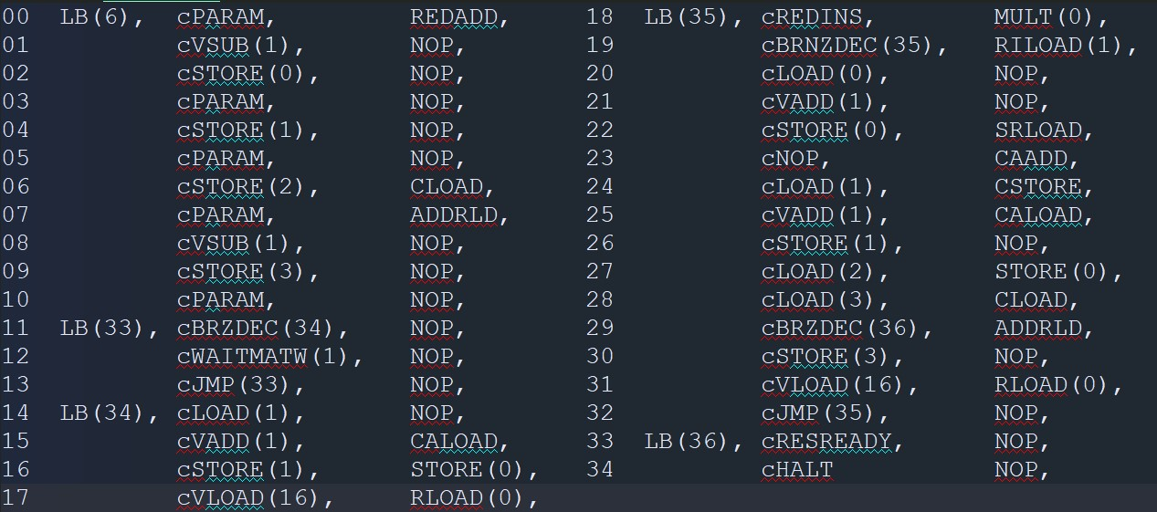
Coding the GPA:
- by coding explicitly the controller and the array, with library of functions:
- by coding directly using source-code based C++ classes that implements a 2-pass assembler

Slide 11
For GEMM, when using large matrices, one will have to use an intermediate layer of software to split the task and merge the results of GEMM-ing smaller matrices:

Slide 12
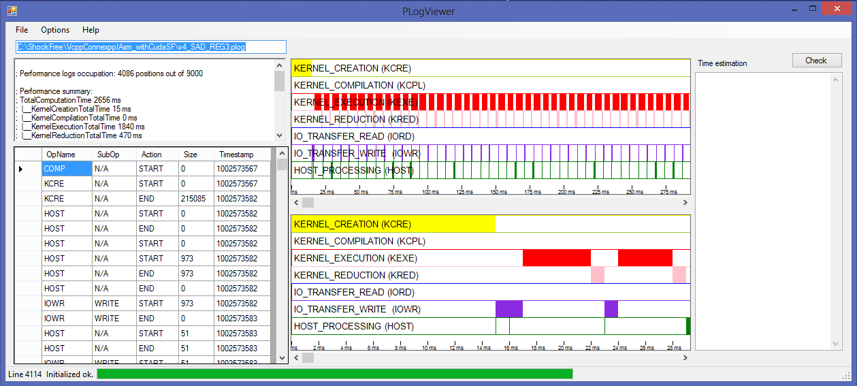
Tools for profiling the code/app

Slide 13
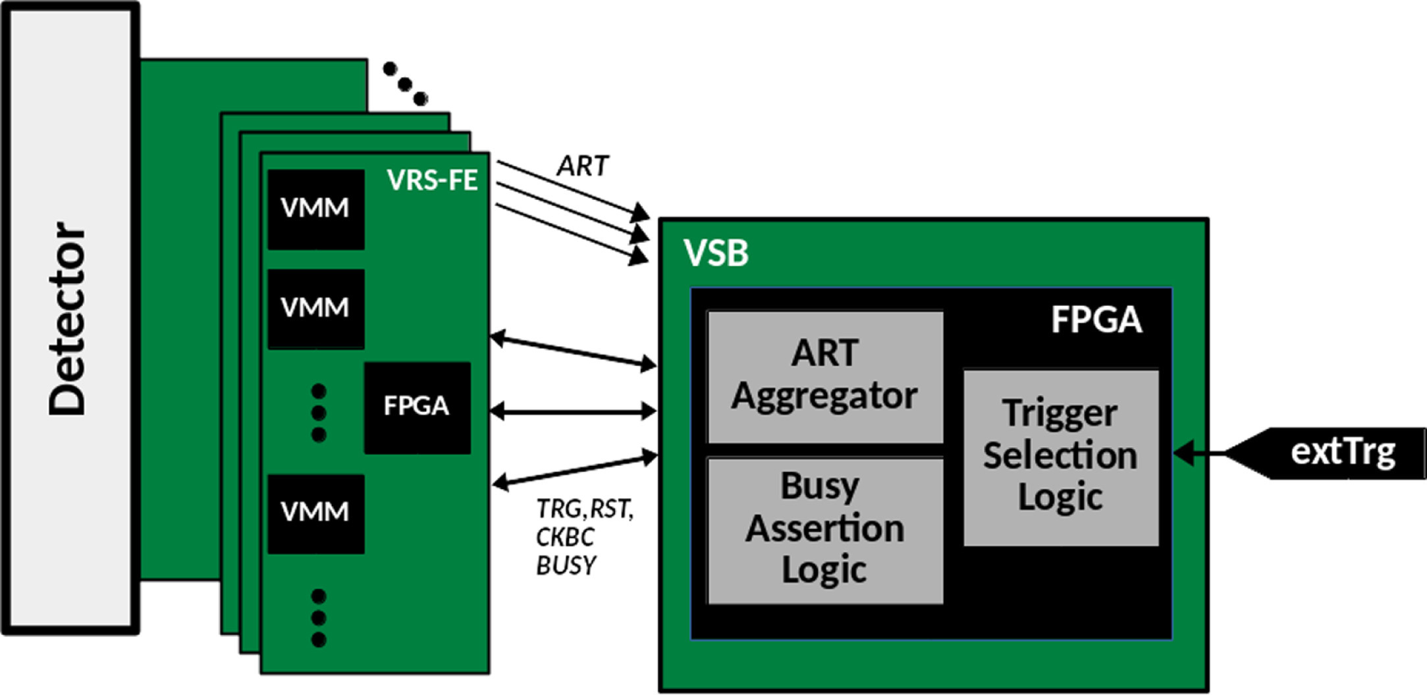
Trigger processor chain

Slide 14
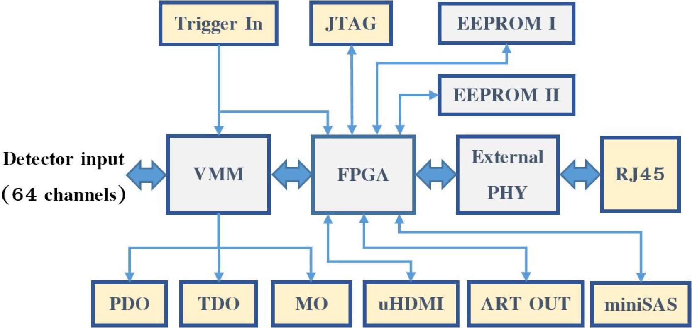
Expected usage in ATLAS: processing 1000+ VMMs output
PE0
PE1023
Advantage: software-programming of PEs, without resynthesis

Slide 15

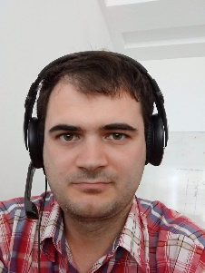





The ARH research team
Prof. Gheorghe Ștefan
Asoc.Prof. Călin Bîră
Assoc. Prof. Radu Hobincu
Asst.Prof. George-Vlăduț Popescu
SR-III Marius Stoian
++
PhD.stud. Mihai Antonescu
PhD.stud. Andrei Simion
Stud. Vlad-Gabriel Serbu
Stud. Andrei Haiducescu
++
PhD.stud. Costin-Emanuel Vasile
Msc. Andrei Alexandru Ulmămei
15

Slide 16
Q & A ?

Slide 17
Backup Slides

Slide 18
References
[1] Mihaela Malit , a, Gheorghe Stefan, Dominique Thiébaut (2007) Not Multi-, but Many-Core: Designing Integral Parallel Architectures for Embedded Computation, ACM SIGARCH Computer Architecture News, 35(5)32:38, Special issue: ALPS ’07 - Advanced low power systems; communication at International Workshop on Advanced Low Power Systems held in conjunction with 21st International Conference on Supercomputing June 17, 2007
Seattle, WA, USA.
[2] Gheorghe Ştefan (2006) The CA1024: A Massively Parallel Processor for Cost-Effective HDTV, SPRING PROCESSOR FORUM JAPAN, June 8-9, 2006, Tokyo.
[3] Gheorghe Ştefan, Anand Sheel, Bogdan Mı̂ţu, Tom Thomson, Dan Tomescu (2006) The CA1024: A Fully
Programmable System-On-Chip for Cost-Effective HDTV Media Processing, Hot Chips: A Symposium on High Performance Chips, Memorial Auditorium, Stanford University, August 20 to 22, 2006.
[4] Gheorghe M. S , tefan, Mihaela Malit , a (2014) Can One-Chip Parallel Computing Be Liberated From Ad HocSolutions? A Computation Model Based Approach and Its Implementation, 18th International Conference on Circuits, Systems, Communications and Computers , Santorini Island, Greece, pp 582-597. http://www.
inase.org/library/2014/santorini/bypaper/COMPUTERS/COMPUTERS2-42.pdf
[5] User’s Guide — NVIDIA Docs (2023) Matrix Multiplication Background, https://docs.nvidia.
com/deeplearning/performance/pdf/Matrix-Multiplication-Background-User-
Guide.pdf
[6] NVIDIA GA100 (2023) NVIDIA GA100, https://www.techpowerup.com/gpu-specs/nvidia-
ga100.g931

Slide 19
The project
Stage 0: we already have:
  ACCELERATOR in FPGA
  Assembler language
Stage 1: with 10 people in 12 months :
  GPA SDK
  the frame for API integration
  partially Kernels up to the level at which system performance can be demonstrated (ONNX)
Stage 2: fully developed Kernels

Slide 20
START_CC : start cycles counter
STOP_CC : stop cycles counter
SEND_INT : send interrupt and cycles counter
MM_EWO : element-wise operation on matrix
SM_MULT : scalar-matrix multiplication
MM_MULT : matrix-matrix multiplication
MM_MAC : matrix-matrix multiplication & accumulate
WRITE_MATRIX : write matrix
READ_MATRIX : read matrix
WAIT_RES_READY : wait for result ready
Subset of kernel library of functions used by the host computer

Slide 21
Evaluations on FPGA
Matrix-Matrix multiplication on GPA with 16 cells
  16x16 matrices: 1489 clock cycles
  32x32 matrices: 9826 clock cycles
  64x64 matrices: 70190 clock cycles
  128x128 matrices: 527806 clock cycles
128x128 Matrix-Matrix MULT on GPA of various size
  16 number of cells: 527806 clock cycles
  32 number of cells: 242253 clock cycles
  64 number of cells: 127082 clock cycles
  128 number of cells: 77204 clock cycles

