Slide 1
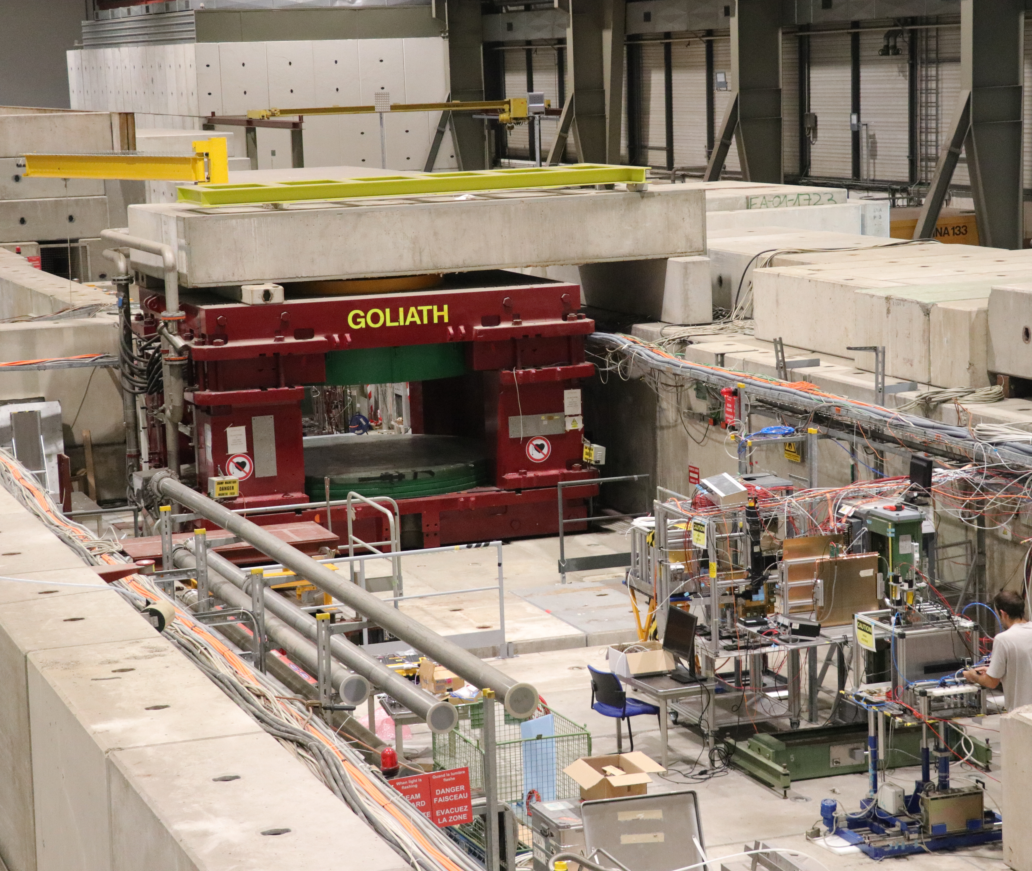
DRD1-WG7: Common Test Facilities

Slide 2
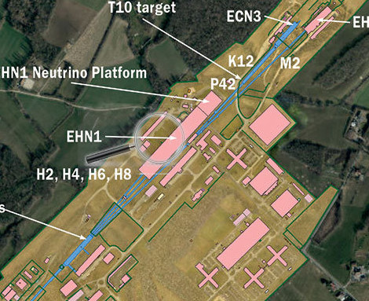
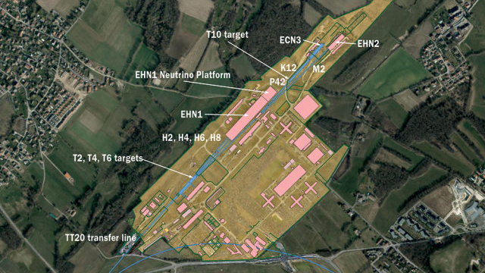

Slide 3
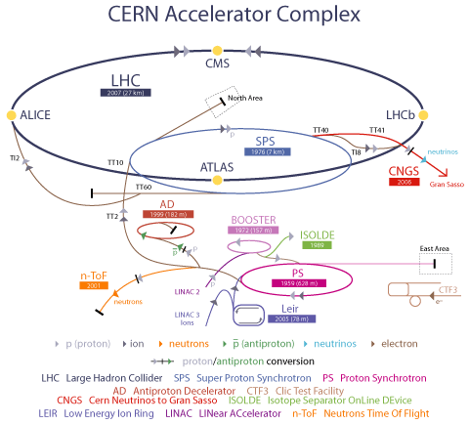
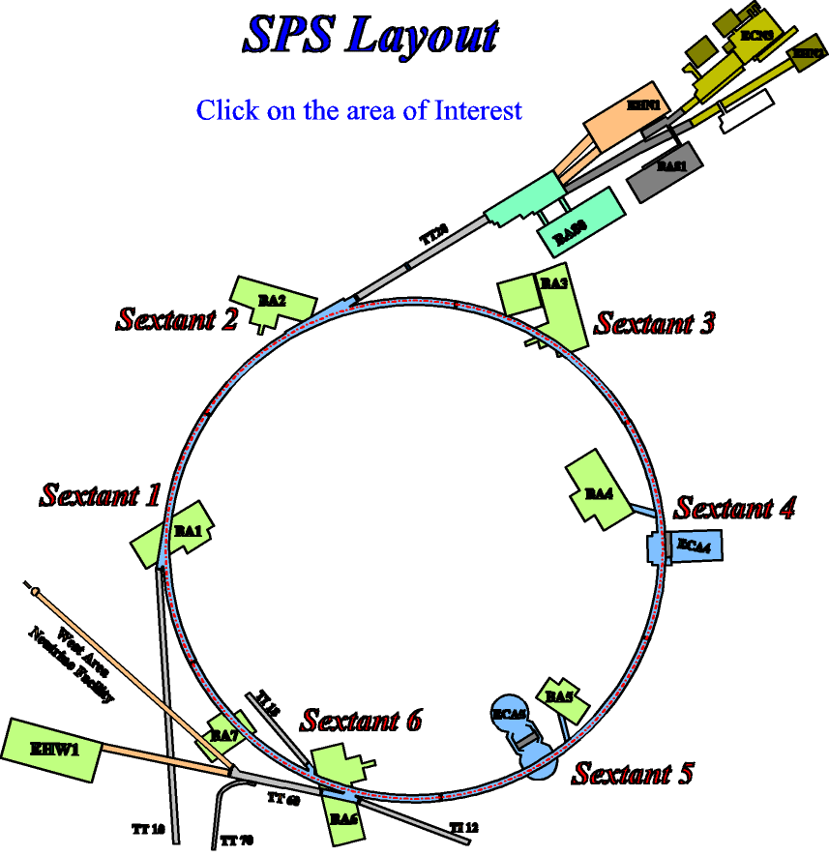
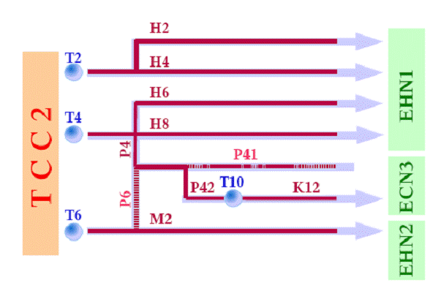
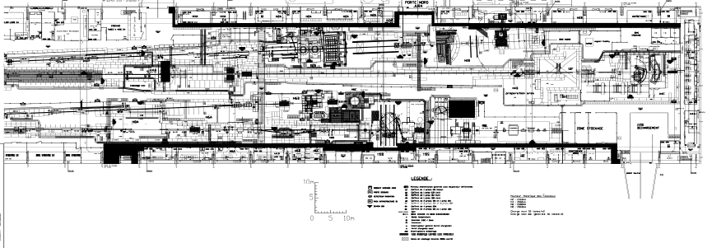
Building 887 – EHN1
https://sba.web.cern.ch/sba/

Slide 4
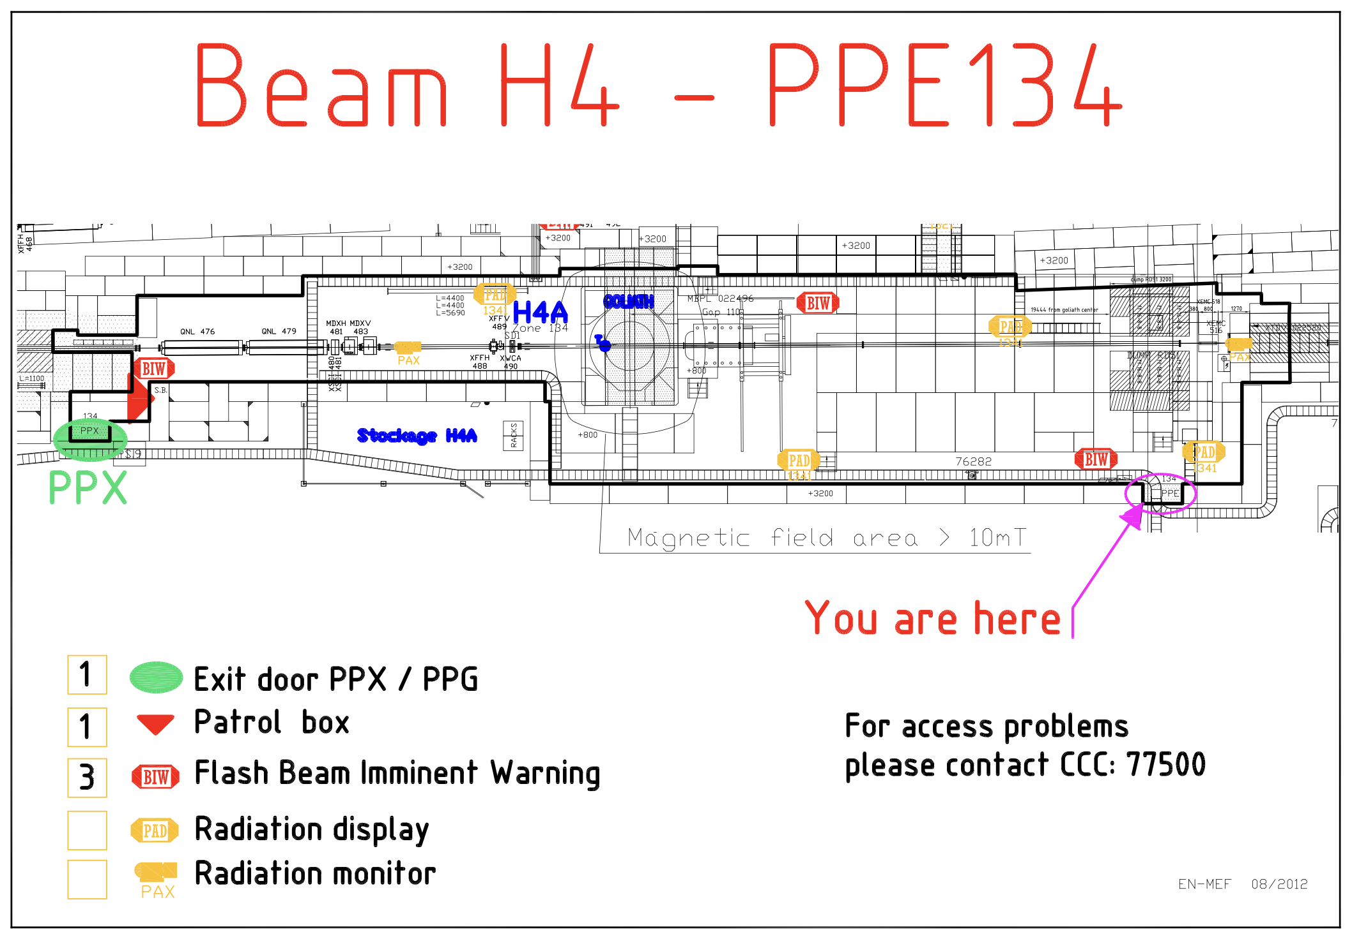
https://sba.web.cern.ch/sba/BeamsAndAreas/H4/H4_presentation.html

Slide 5
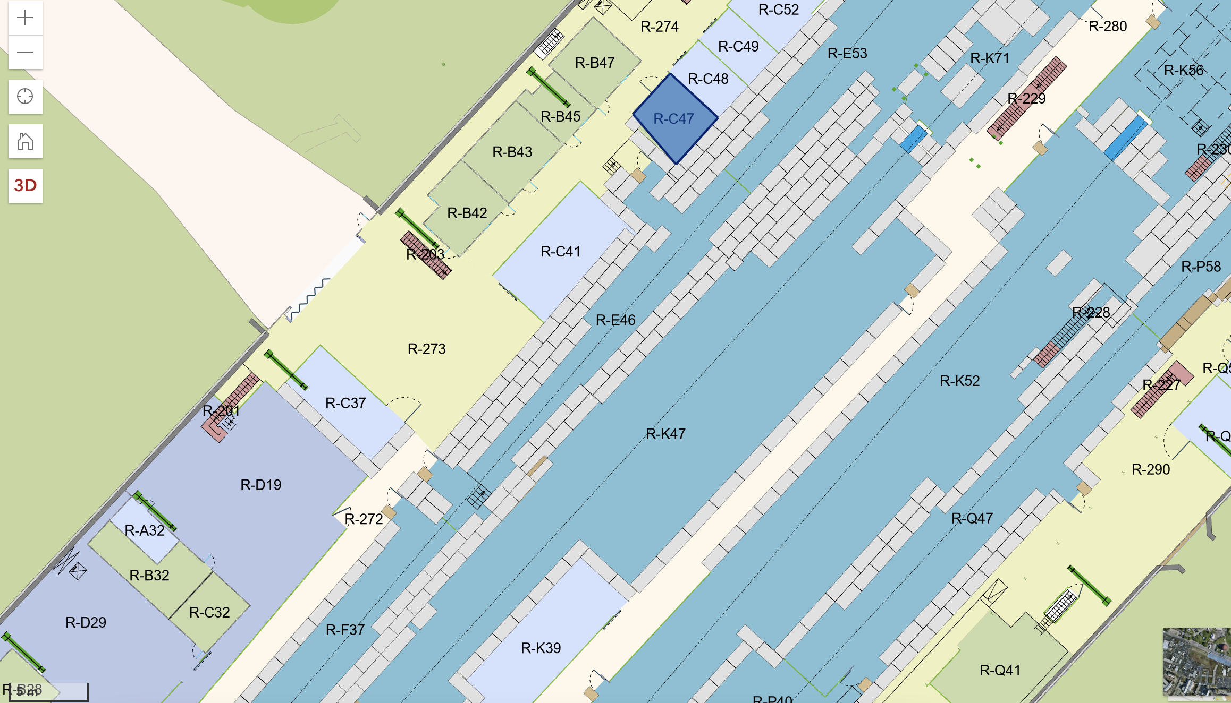
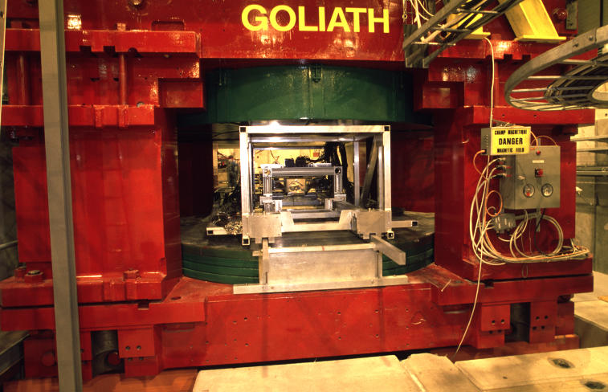
storage
gas
entrance
Beam area

Slide 6
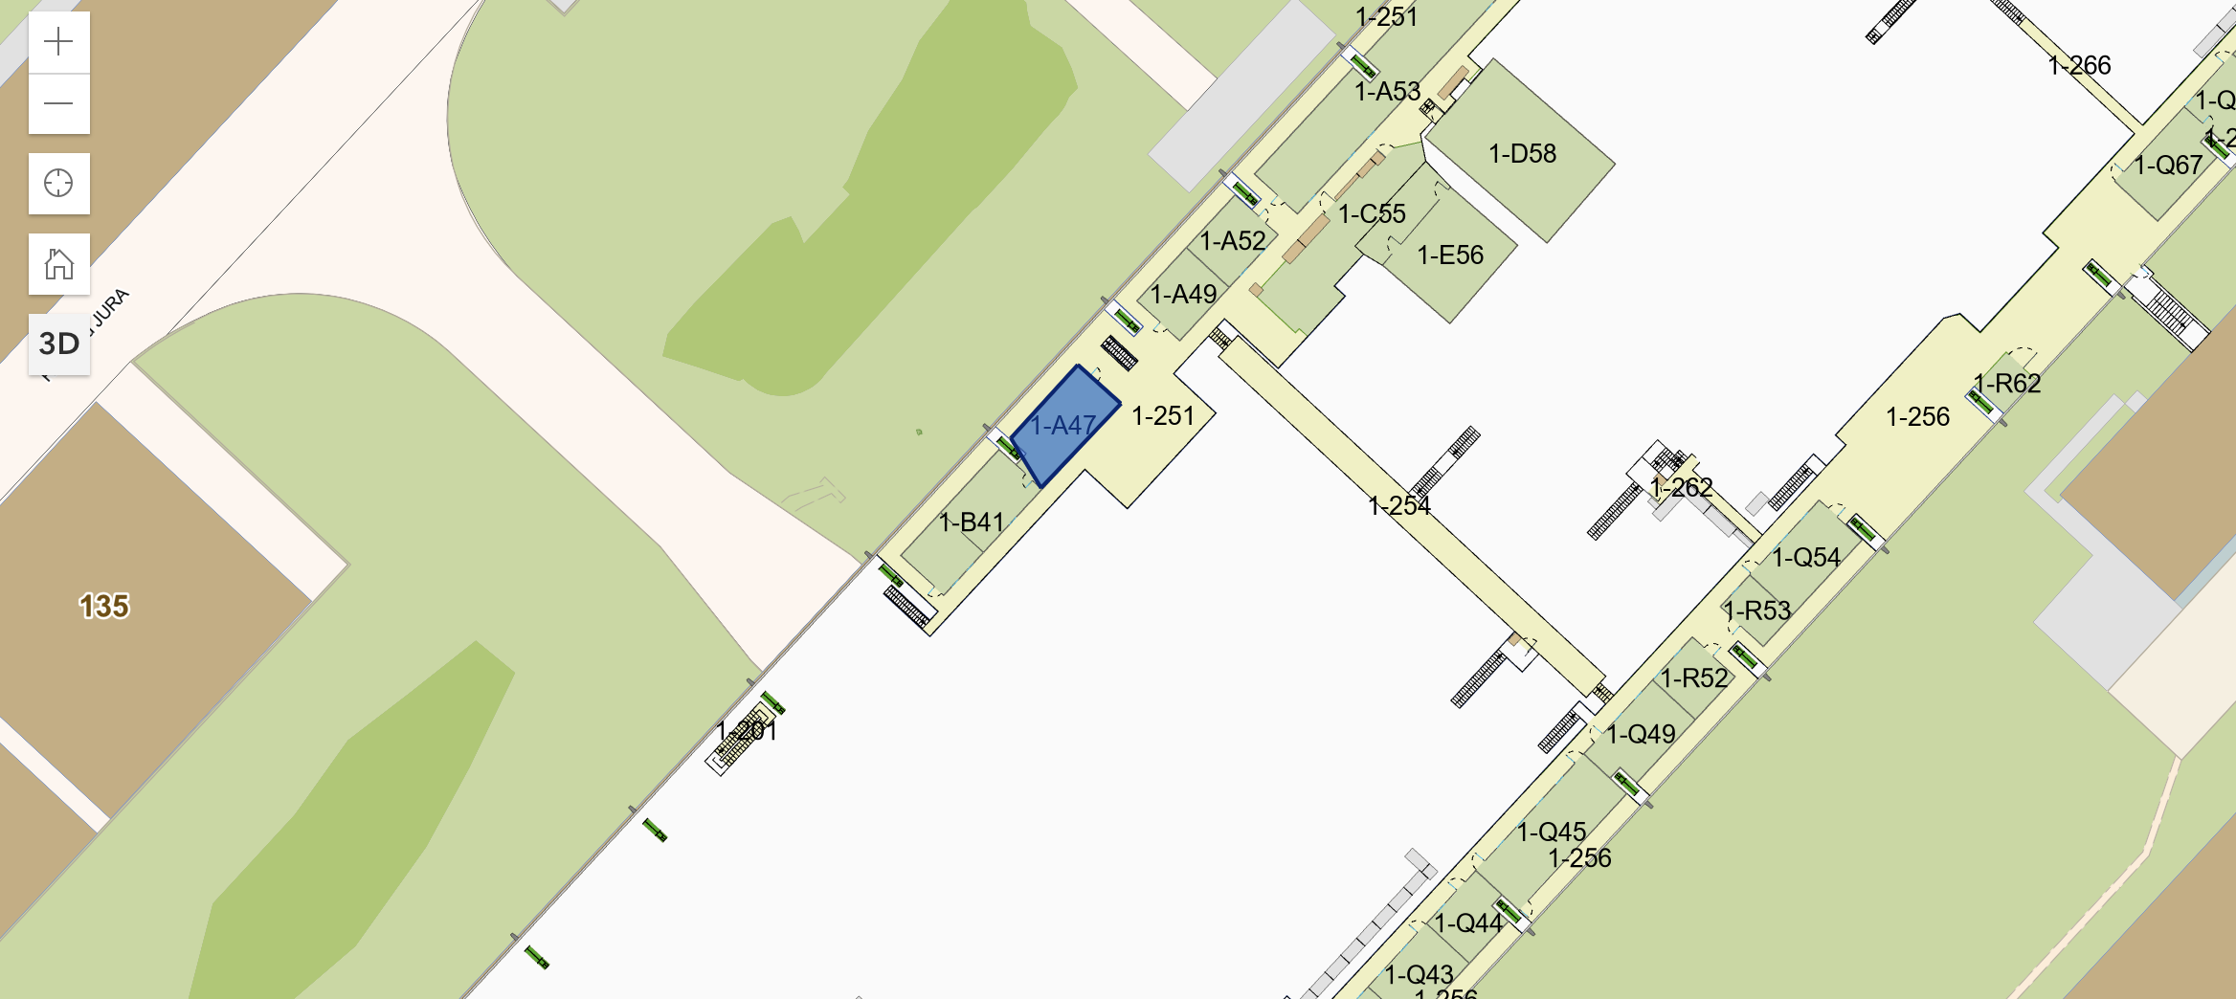
Control
Rooms
storage
gas
Beam area
entrance
Beam area

Slide 7
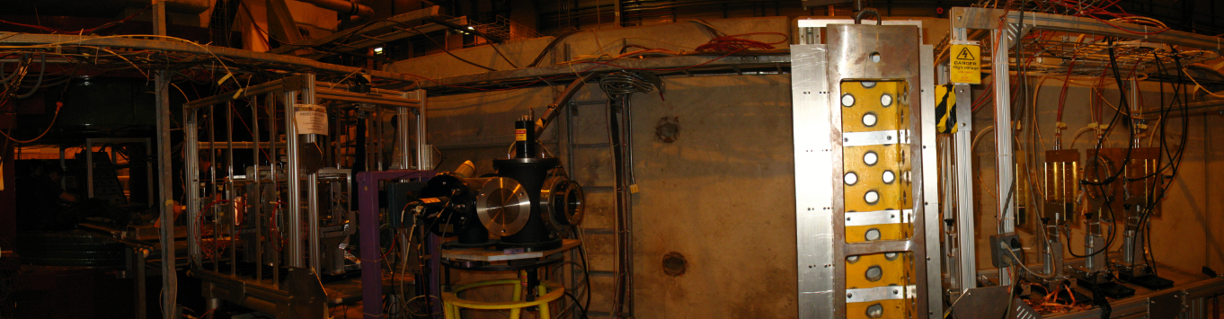
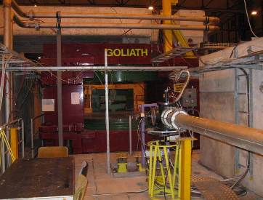
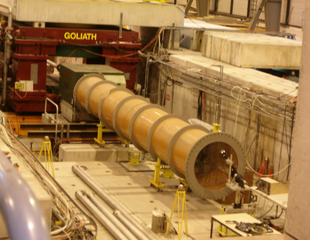
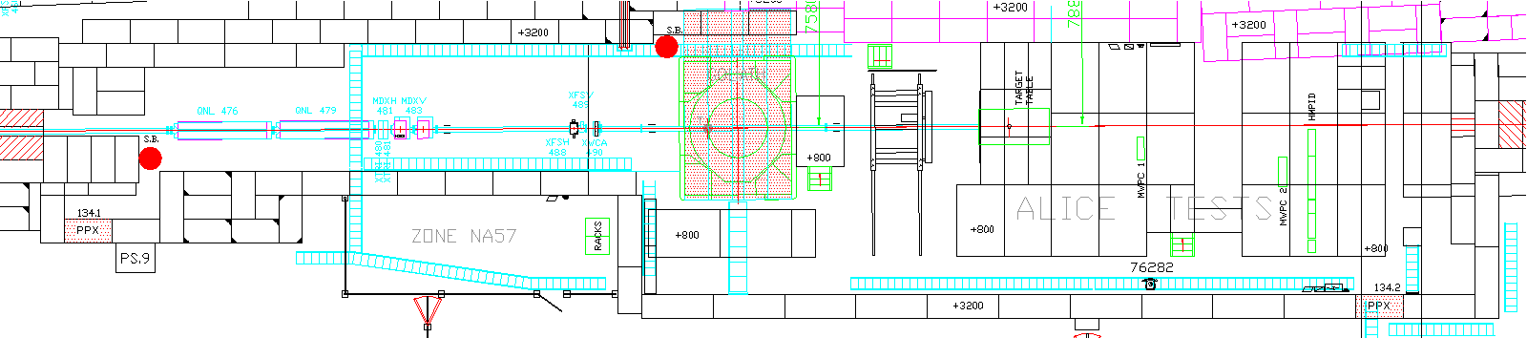

Slide 8
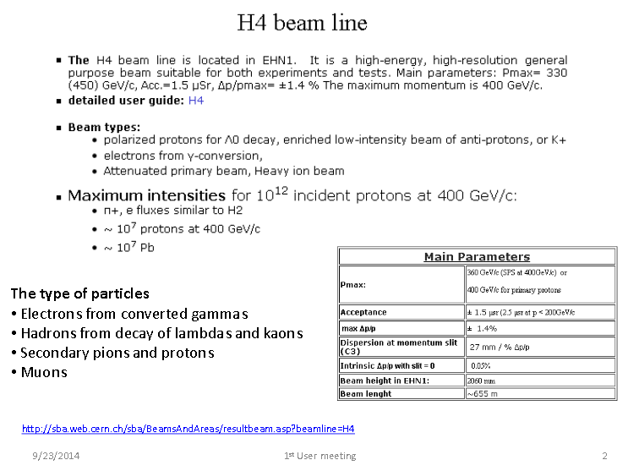

Slide 9
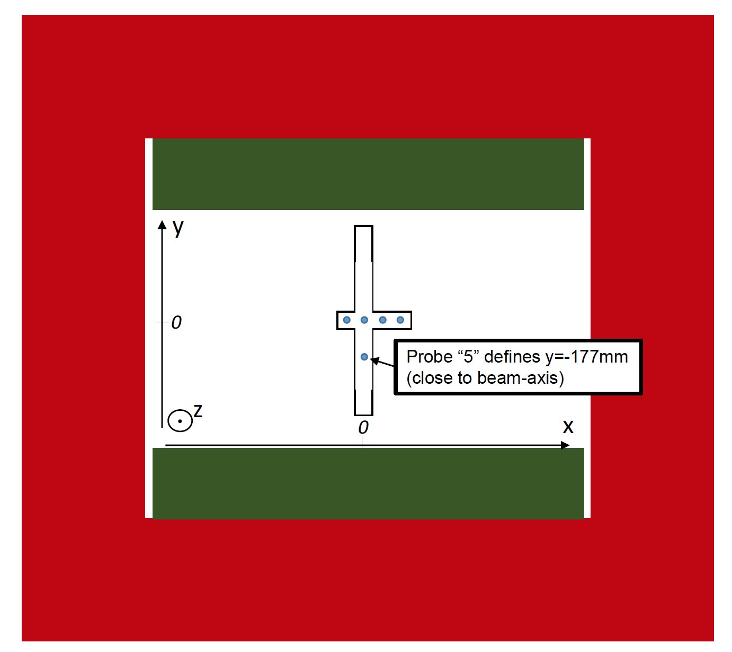
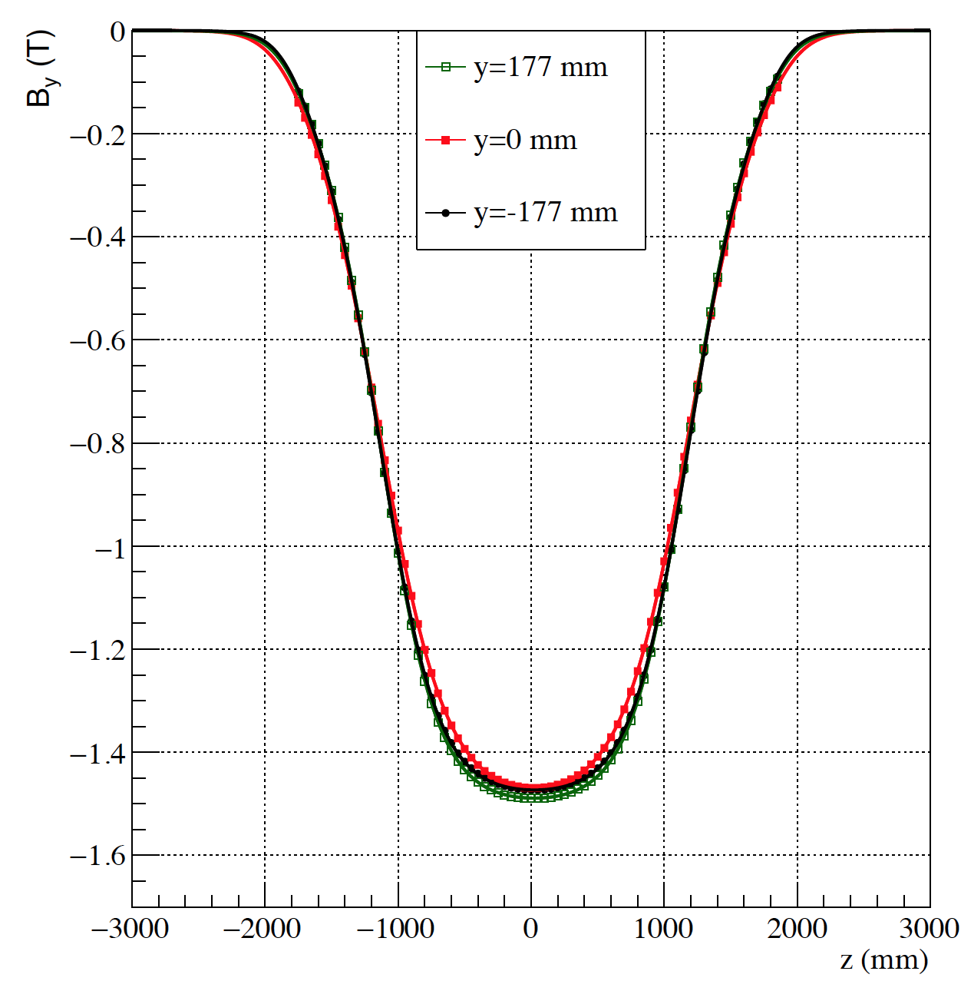
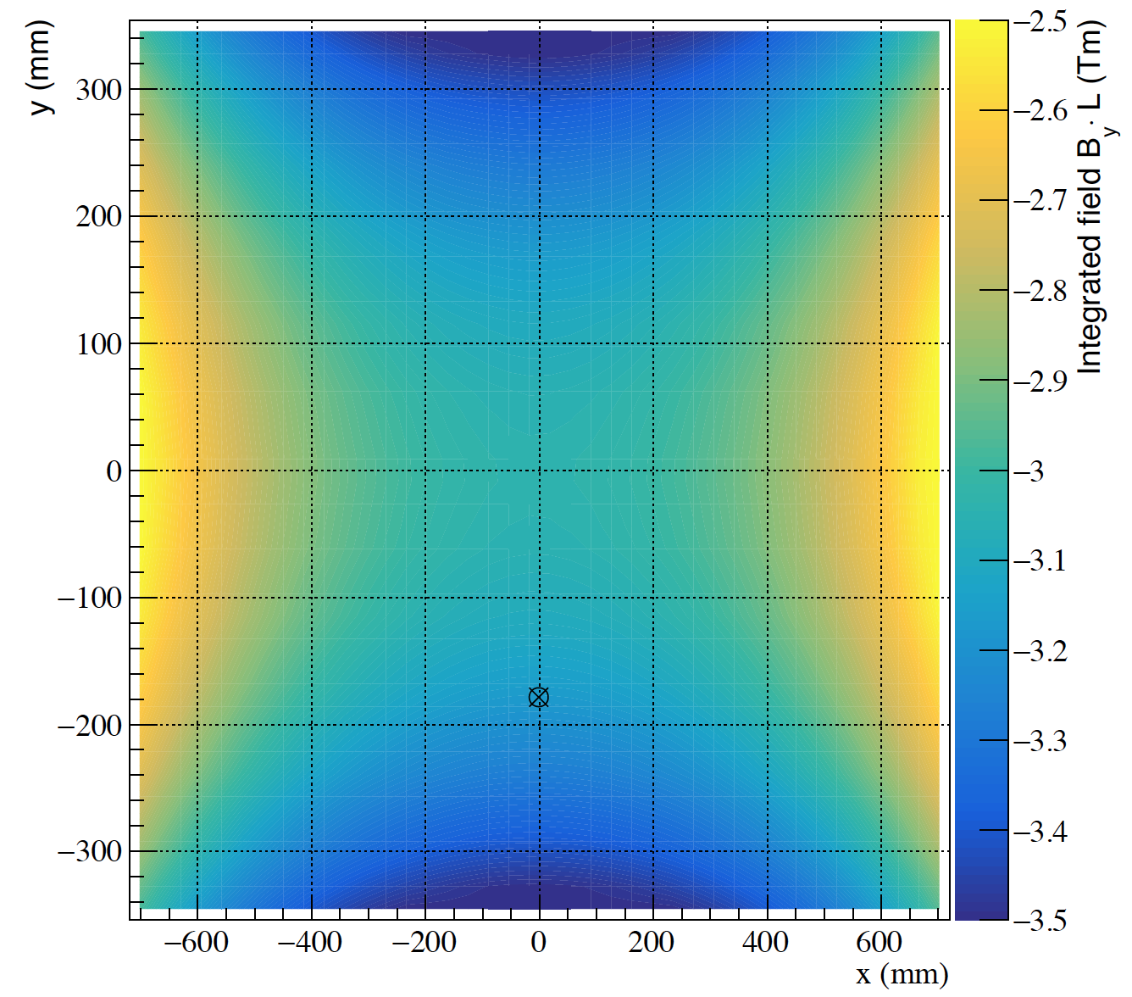

Slide 10
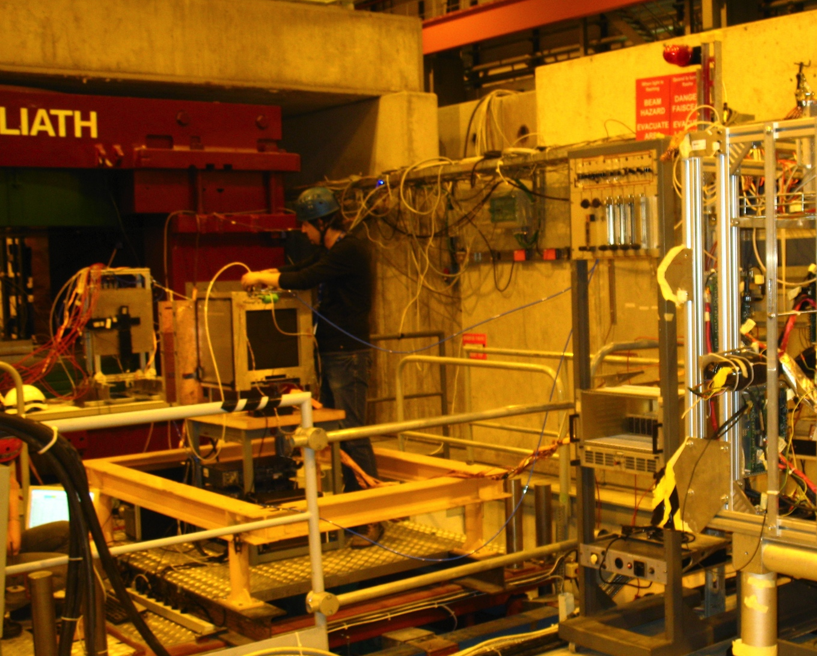
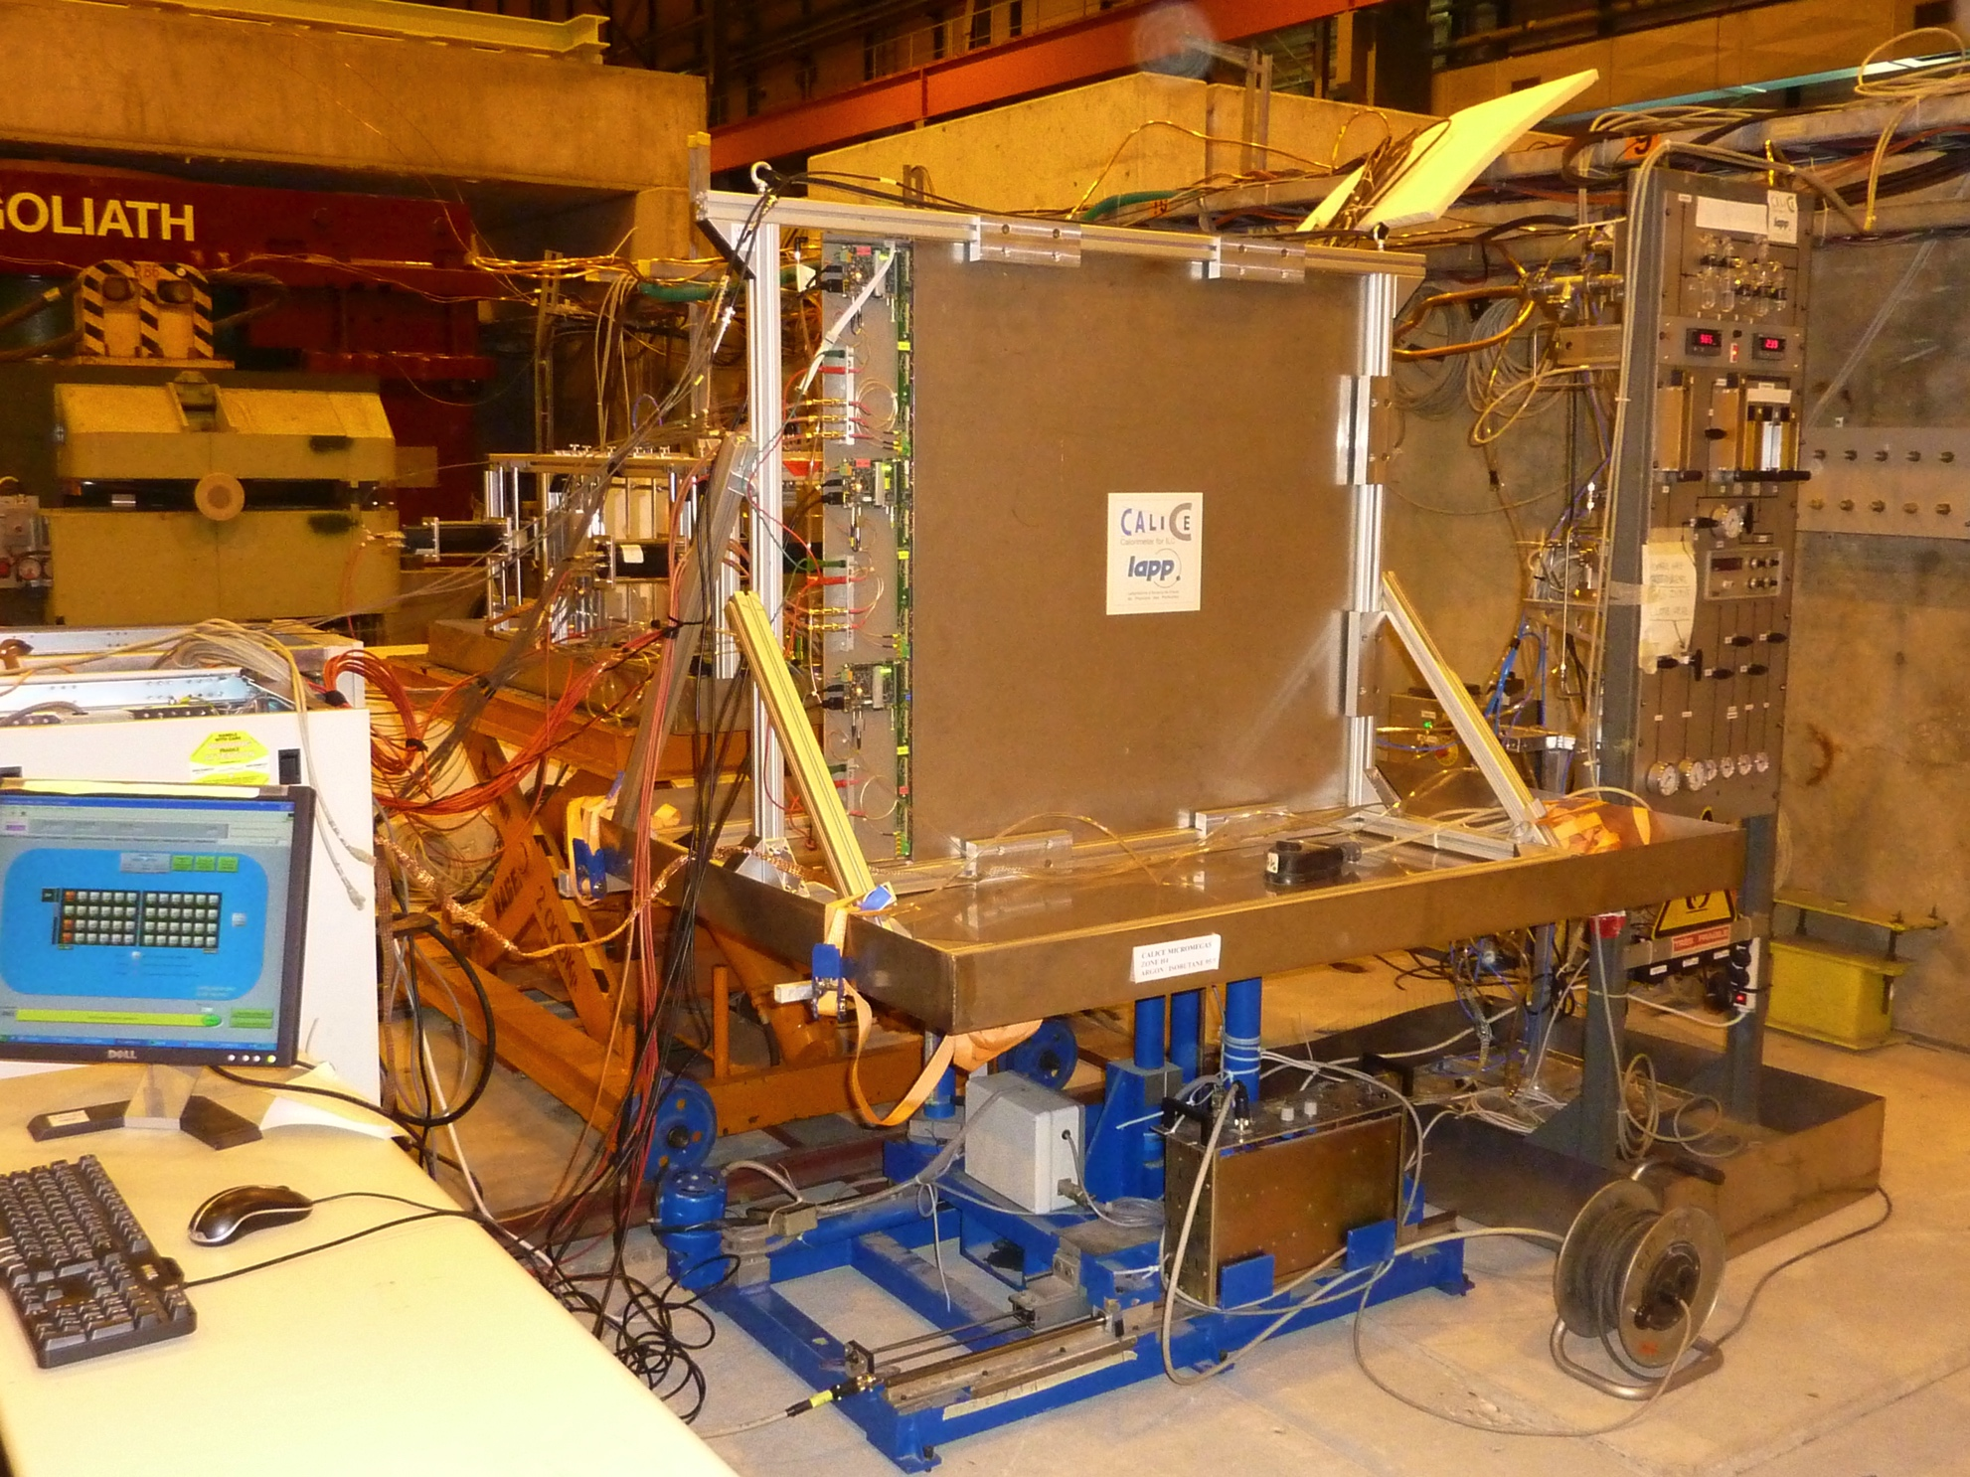
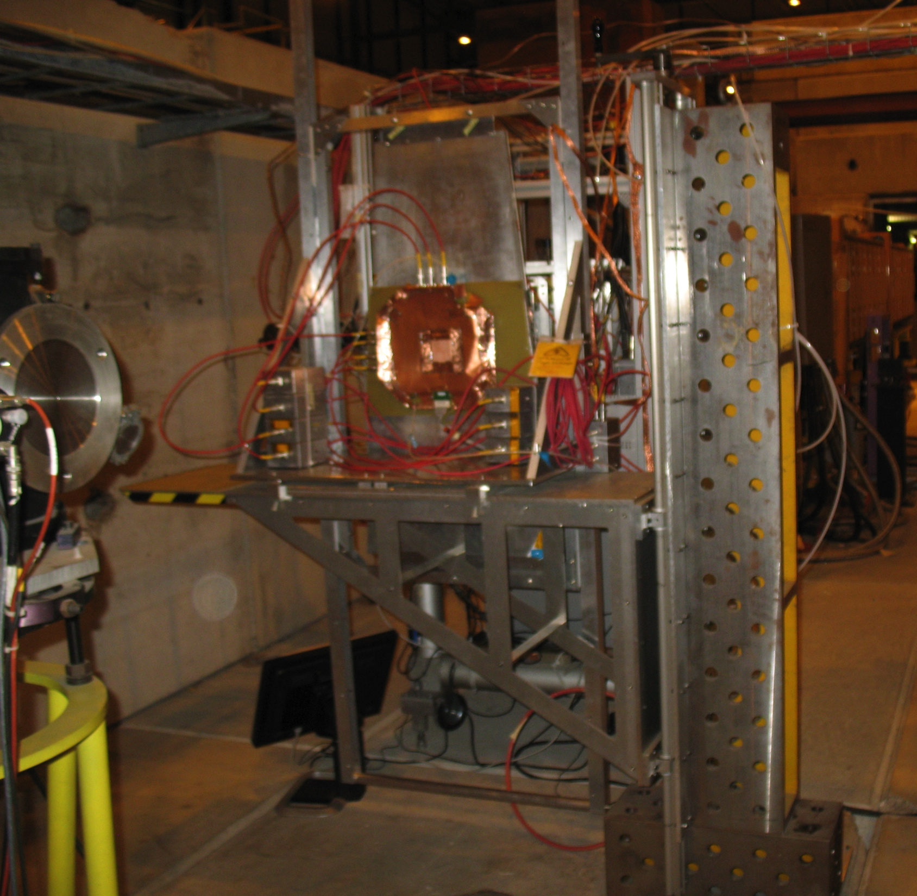
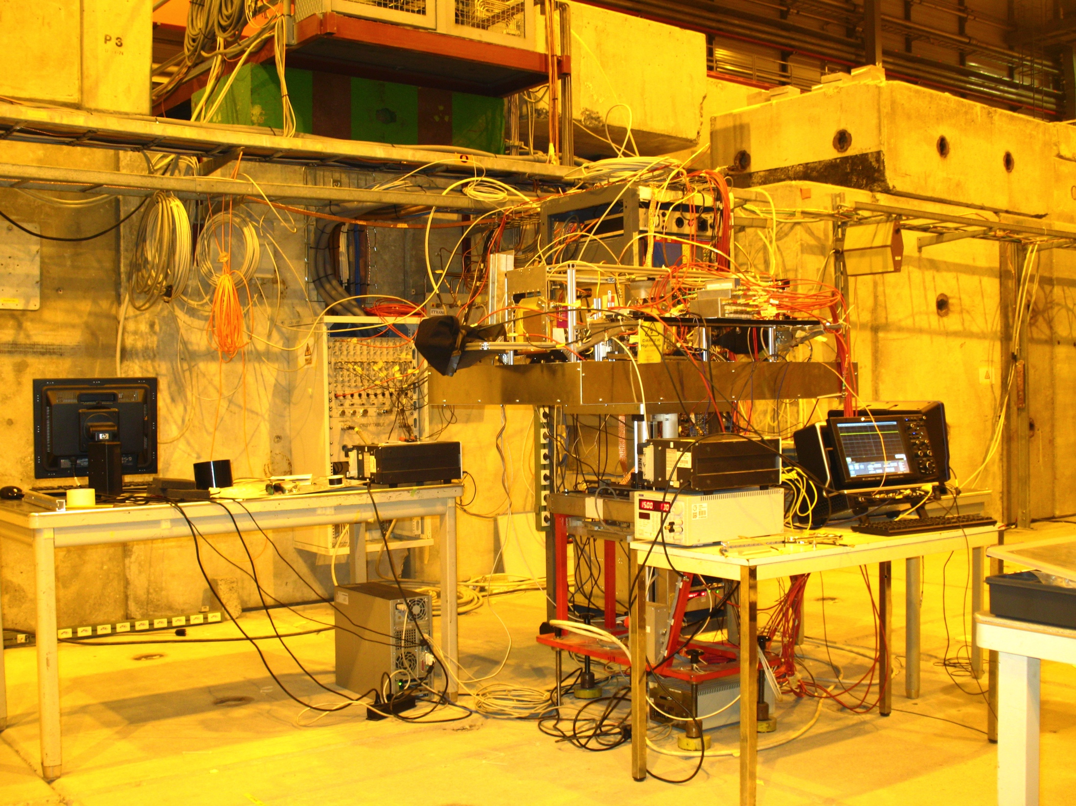
Moving tables & supports

Slide 11
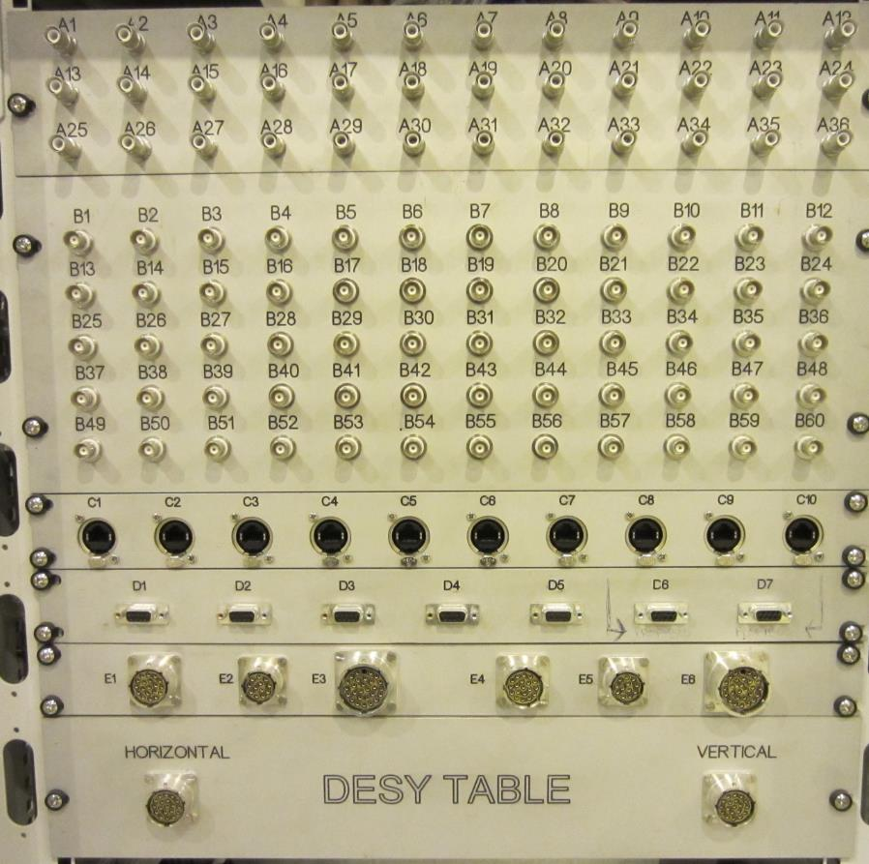
Two panels from the area to the CR
(one on each side of GOLIATH)
36xSVH
60xBNC
10 x RJ45 (Cat.6)
5xSubD9&2xSubD9(Profibus)
2 xBurndy 12,19&28
2 x Burndy 19 for the DESY table

Slide 12
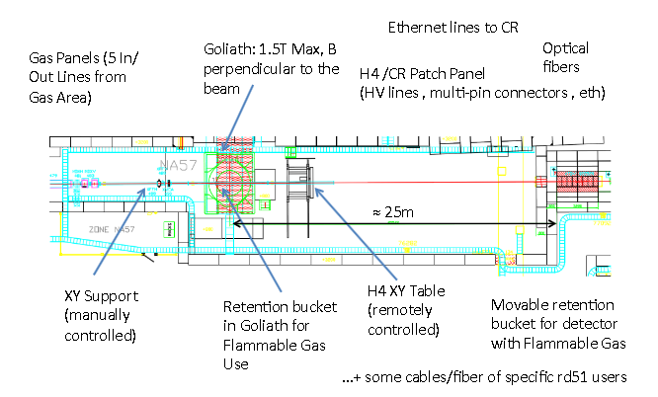
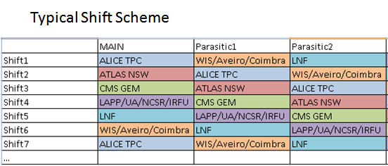
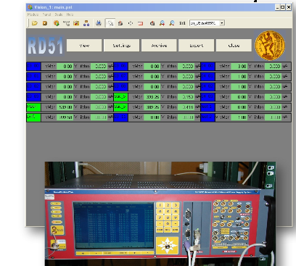
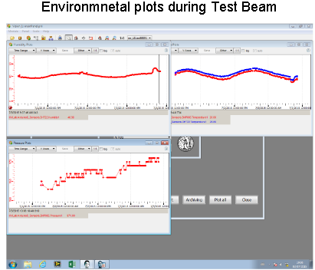
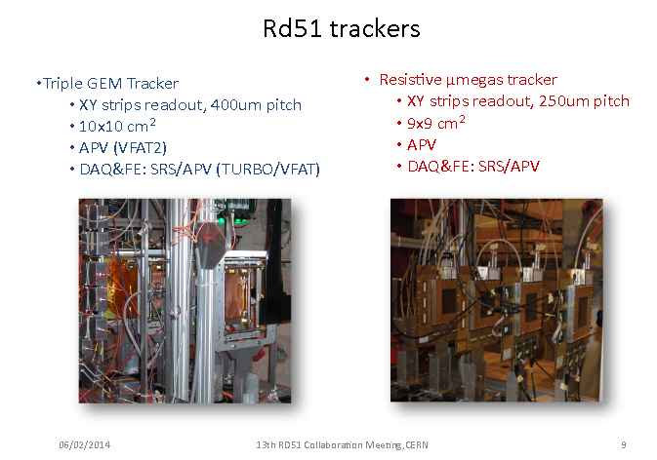
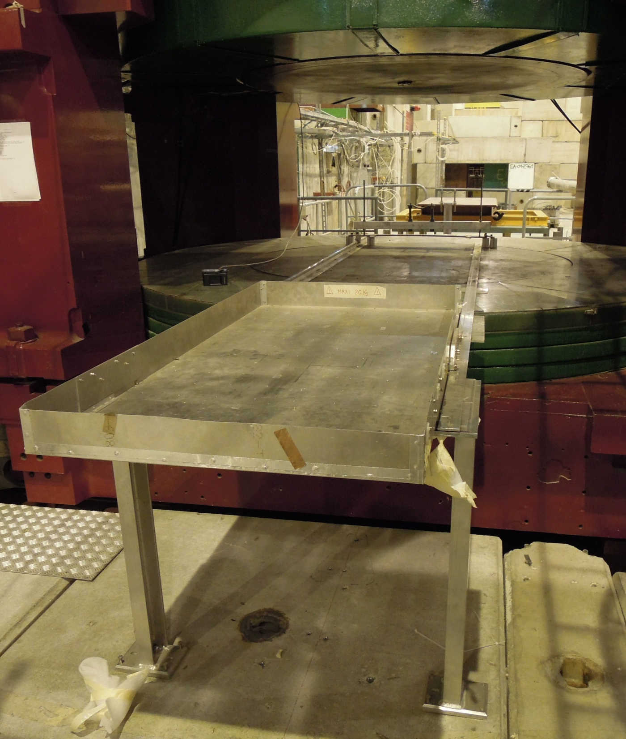
Semi permanent installation EHN1-H4 (SPS North Area)
Infrastructures (gas, HV, LV, sensors,…)
Internal (beam sharing between groups) and external (GIF++ and with any other parallel user) coordination
Mechanical support (Miranda)
RD51 DCS (Control and monitoring)
RD51 Trackers and SRS/APV25 DAQ

Slide 13
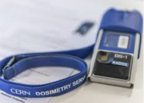
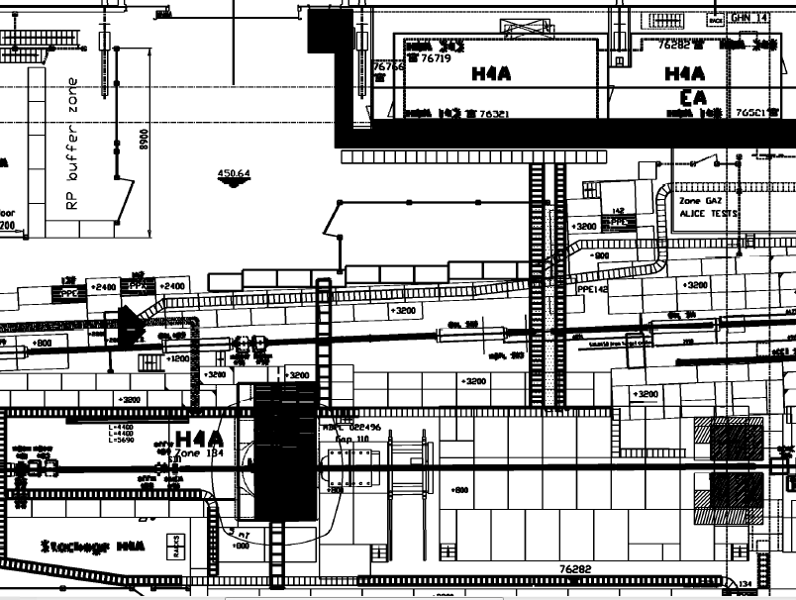



What you need to
access the Test Beam
1. Valid CERN Dosimeter
2. CERN Badge + Validated Access to Counting/Control Room
3. Helmets and safety shoes for the experimental area
Counting/Control Room
+ EDH Request
+ Validation of the card
(see next slides)
Experimental Area

Slide 14
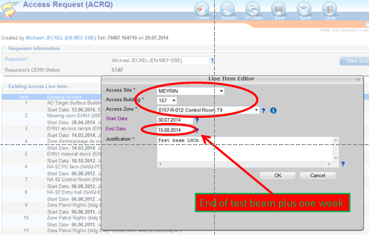
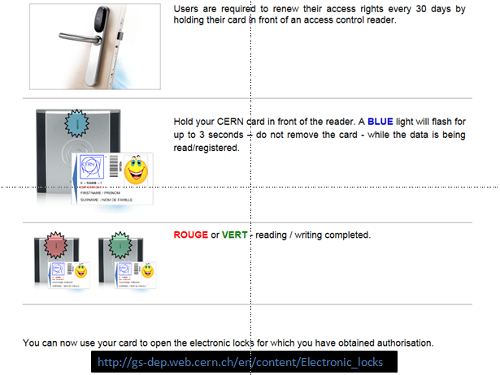
ACCESS TO THE CONTROL/COUNTING ROOM: To Be requested VIA EDH by each user
https://edms.cern.ch/document/1421828/1
Online Reader to validate your access in: R1, R2, R3, EHN1
Ref. To previous link for more info
See next slide for the references to our Counting/Control Room

Slide 15
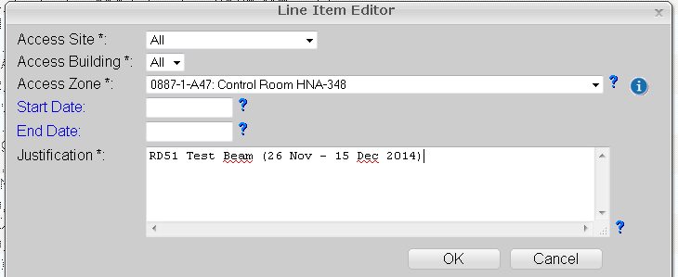
Our Counting/Control Room
SBA zone | Room number | User | Terminal | Phone | Barrack | Building / Office | Host Name
H4-134 | 887/R-K47 | H4A | H4A | 76282 | HNA-348 | 887/1-A47 | cwo-hna348-h4a
Online reader @ R1, R2, R3, EHN1
End Date: 1 week more suggested

Slide 16
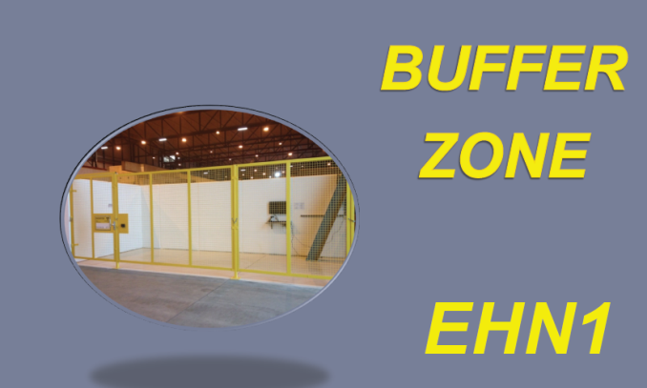
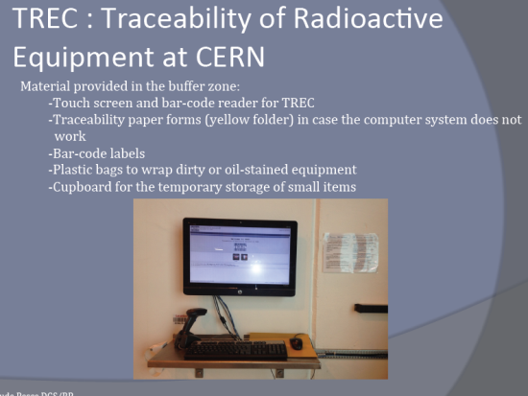
Material leaving the experimental area… just to keep in mind
any export of material from the CERN Experimental Area halls/buildings 157 (East Area), 193 (AD), 887 (EHN1), 888 (EHN2), 911 (ECN3) to an external destination must be:
registered in EDH using the Shipping Request form https://edh.cern.ch/Document/SHIP.
EDH Shipping Requests issued from the above mentioned areas (also for material declared as non-radioactive by the owner) are automatically forwarded to the relevant Radiation Protection Officer that will proceed with the compulsory radiological control before authorizing the transport.
Please note that this procedure also applies to material/goods belonging to external institutes as well as if the material is transported afterwards by the owner itself (e.g. CERN transport services not required in the EDH form).
We will take care of this but keep in mind that you cannot simply leave the area with your equipments without having RP check
New procedure, i.e. possible delay
https://sps-schedule.web.cern.ch/sps-schedule/RadioProtectionDocuments/BufferzoneEHN1-english.pdf

Slide 17
2024
Physics start ISOLDE April 8th
Physics start nTOF March 25th
Physics start PS EA March 18th
Physics start SPS NA protons April 10th
Physics start ELENA April 22nd
Stop protons SPS NA September 26th
Pb Ion physics start SPS NA September 30th
Stop physics beams to AD,
PS EA, SPS NA, ISOLDE, nTOF October 28th
requests by Friday December 22nd 2023
We requested 3 periods of 2 weeks each

