Slide 1
News from CERN
James Gillies, EPPCN meeting, Oslo 5.5.2011

Slide 2
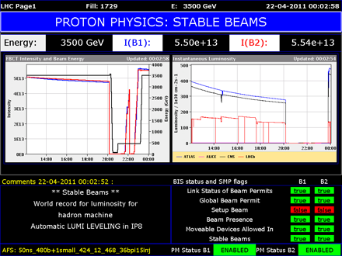
LHC
22 April:
world record luminosity for a hadron machine. Now doubled.

Slide 3
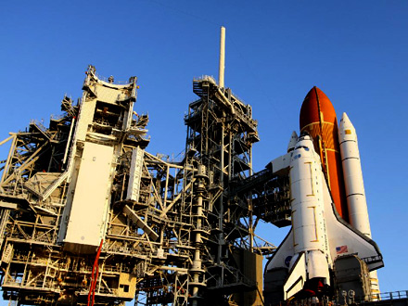
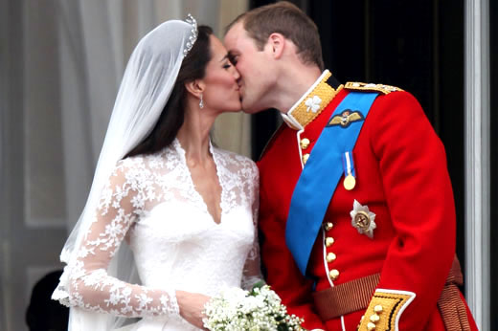
AMS
Launch scheduled for 19 April, then 29 April, now 10 May…
Webcast successful, despite competition and cancellation of launch (~1400 connections)

Slide 4
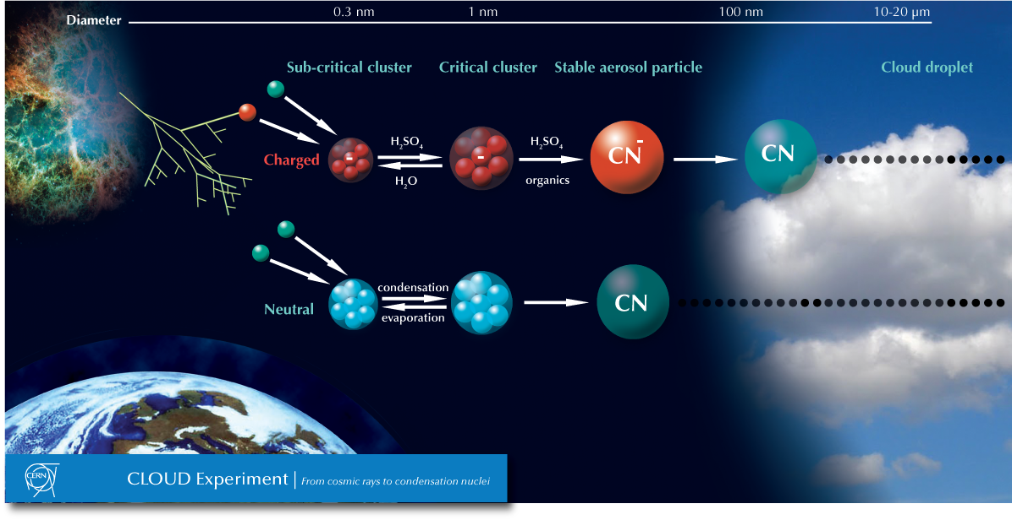
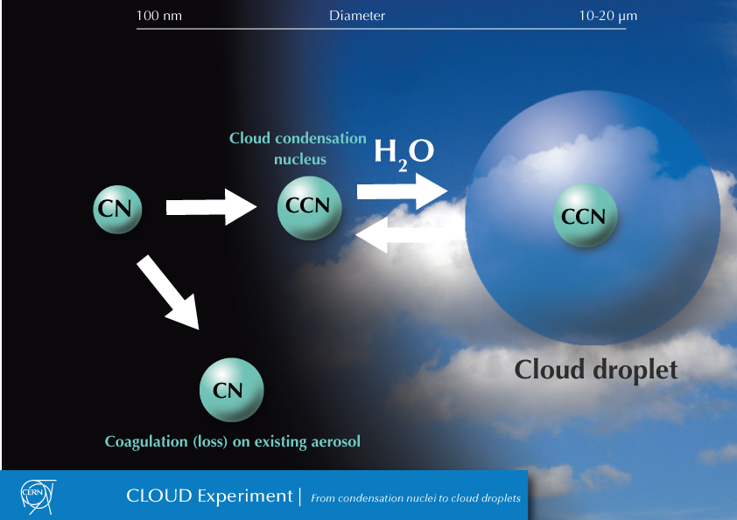
CLOUD
First paper resubmitted. Out for review. Materials including graphics and video in preparation.

Slide 5
AD

Slide 6
Davos
Rolf Heuer presented at Davos, Blogged from Davos, op-eds in Le Temps, NZZ, The Times

Slide 7
Quantum Diaries
Institutions now blogging on Quantum Diaries. 50-100k visits/month

Slide 8
Communication at CERN

Slide 9
Peer review of CERN Communication
Service offered by the InterAction collaboration – in this case helped by EPPCN
Committee: John Womersley (UK, Chair), Anne-Muriel Brouet (CH), Reidar Hahn (US), Judy Jackson (US), Minna Merilainen (FI), Vanessa Mexner (NL), Christian Mrotzek (DE), Youhei Morita (JP)
Secretary: Elizabeth Clements (US)

Slide 10

Available at: http://www.interactions.org/cms/?pid=1030732

Slide 11
New communication plan

Slide 12
Methodology
Why are we doing this now?
CERN communication plans 2004-2010:
- Building visibility for CERN and the LHC
CERN communication plan 2011-2016:
- Using our visibility to pass our key messages

Slide 13
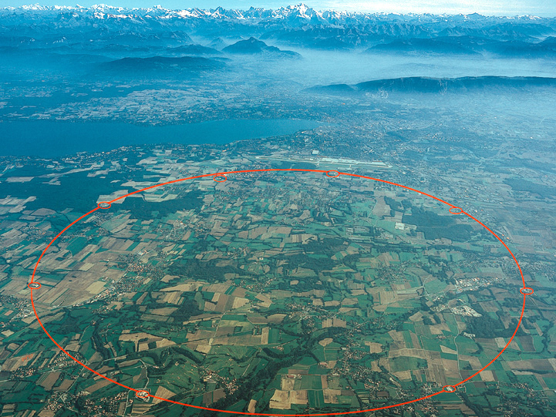
CERN’s communication landscape
CERN’s Communication landscape
Communication group
Education group
IT communications team
Four Experiments
20 member states
Six observer states
100 nationalities
500 institutions
IPPOG
InterAction
EPPCN
Notes:
CERN’s communication landscape is rather complex. Within the laboratory, we have no fewer than seven entities involved in communication, each with their own agenda to push.
There is the communication group, which I head, the Education group, which was spun out of my group this year, there is a communications team in the IT department, largely related to and funded by EU initiatives, and there are the four major LHC experiments.
We are an international organisation with 20 member states, six observer nations, 85 nationalities represented, and 500 collaborating institutions.
We are well networked through bodies like the European Particle Physics Outreach group, originally conceived by Frank Close as a sort of self-help network for particle physicists in Europe, and the Interaction collaboration of communications officers from particle physics labs.
Finally, we have to be aware that LHC is not the only show in town, and that there is a substantial community of our colleagues involved in promoting a future linear collider.

Slide 14
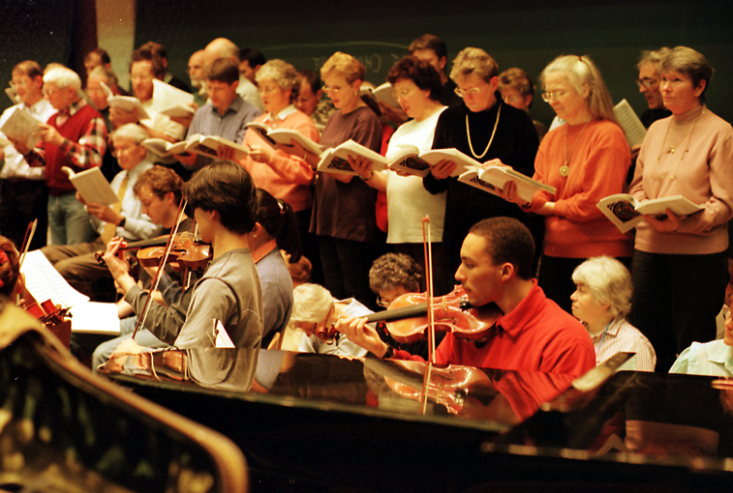
Singing in harmony

Slide 15













Coordination
At a special session in Lisbon on 14 July 2006, the CERN Council unanimously approved a European Strategy for Particle Physics. Communication is integral to this strategy, which states:
"Council will establish a network of closely cooperating professional communication officers from each Member State, which would incorporate existing activities, propose, implement and monitor a European particle physics communication and education strategy, and report on a regular basis to Council."

Slide 16

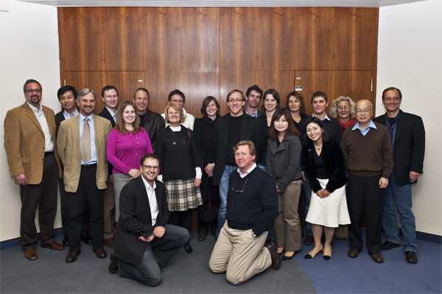
More coordination
Methodology
Founded 2001
2 meetings/year
Press release protocols
Peer reviews
Quantumdiaries…
Networks are indispensable

Slide 17
A brief history of communications planning at CERN
Methodology
1992: First communication plan presented to management by Hannu Miettinen.
Result: Hannu Miettinen left CERN to go back to Heureka in Helsinki.
2005: LHC communication plan presented to Robert Aymar. Result: Approved in 2007 and implemented from 2005 – 2008.
2009: Outline CERN communication plan presented to Rolf Heuer. Result: Approved 2010 and implemented through 2009 and 2010.

Slide 18
Lessons?
Methodology
1992: CERN was not ready for corporate comms.
2005 & 2009: DG-CO effectively worked as DG’s personal comms team. Little awareness elsewhere at CERN, though coordination efforts were made between the communication group and the LHC machine and experiments.
Today: CERN is a much bigger story than it used to be. Reputational risk is correspondingly higher. The relationship with all our publics requires more careful management. In short – we need a well-defined communication strategy and function.

Slide 19
Methodology
What will be in the current communication strategy?
Definition of the desired outcome of the communication
(mid-term / long-term)
Translation of the vision/mission into key messages
Target audiences and prioritisation
Communications objectives according to target audiences
Annual project plan and budgets
Structures, roles, responsibilities and resources

Slide 20
Methodology
What’s at stake?
The LHC is a major opportunity to put science on the map in a society in which increasing reliance on science is accompanied by increasing ignorance of and resistant to science.
Good communication is key to our survival. We need support from many stakeholders. It’s not enough, for example, for policy makers to believe in what we do, civil society also has to love us.
Are we doing enough?
We need to ensure that our communication structures, strategies and plans are up to the task…

Slide 21
Survey conducted by Leidar

Slide 22
Quote: A member of the Extended Directorate
“Communications is doing a great effort to involve more and more people …….
…… physicists believe they know everything. They (also) have the tendency to believe they know how to communicate ….
…… sometimes (they) want to be too precise…
….. we need to work together and (communications) needs to teach us to keep (the positive development) going.”

Slide 23
Associations with CERN
High class research
Basic research
Ground breaking research
Top level research
First class research facilities
Most forward looking research laboratory in the world
Scientific organisation
The mecca of physics
Particle physics
Interesting science
Powerful science
Cutting edge science
Centre of world class science
Leader of the world science
Place dedicated scientists are
Unique centre of excellence
Hi-Tech making progress
Hi-Technology place
WWW
Successful tools
Big Project
The best
Closed organisation
Protected area
Big science
Engineering endeavor
Limited participation of high energy physicists
Nobel prize winning world lab

Slide 24
Associations with CERN
Pushing the frontiers
Digging for explanations
Managing technology
Understanding the universe
Reaching the goals
Finding new frontiers of knowledge
Difficult to understand
Not understood
High costs
Expensive
Innovative
Exciting
International
Magic
Focused
Complex
Complicated
Huge
Far away
Inspirational for young people

Slide 25
Associations with CERN
Excellence
Innovation
Competence
Curiosity
Fascination
Internationality
Philosophy
Excitement
Professional
Technology
Openness
Tolerance
Creativity
Wow factor
Questions
Extra-ordinary tools
Big success
Waste of money

Slide 26
Opinion research – expert survey
46 interviews / structured questionnaire
  33 telephone interviews
  13 by mail
Expert groups:
  15 members of the Extended Directorate
  6 members of the Council Delegates
  8 international science journalists
  6 opinion leader / functionaries in CERN´s neighourhood
  11 member of the information networks
Opinion trends
Perceptions – original quotes

Slide 27

Visibility increased in the last five years? 5= very much / 4=somewhat / 3=no change / 2=decreased somewhat / 1=decreased very much
Total | ExtDir | CouncDel | NetWork | InterMedia | Neighbours
4.83 | 5.0 | 4.83 | 4.82 | 4.75 | 4.50
n=46 | n=15 | n=6 | n=11 | n=8 | n= 6

Slide 28
Visibility increased in the last five years? 5= very much / 4=somewhat / 3=no change / 2=decreased somewhat / 1=decreased very much
Total | ExtDir | CouncDel | NetWork | InterMedia | Neighbours
4.83 | 5.0 | 4.83 | 4.82 | 4.75 | 4.50
n=46 | n=15 | n=6 | n=11 | n=8 | n= 6
Reasons for the Change – Extended Directorate – total mentions: 43
1 | Start of the LHC in general | 26 %
2 | Communications pro-activity Regular media relations / media coverage / www | 21 %
3 | Big events at CERN / Number of visits | 12 %
4 | The incident/accident at the start – and resolving it | 9 %
5 | Change of attitude DG´s attitude / PR-unit / James´ team / more involvement of DG and CERN staff | 7 %
 | Black hole discussion | 7 %
 | Angels and Demons | 7 %
6 | Single mentions Overall excitement / sexy story / real results / things to tell, etc

Slide 29
Visibility increased in the last five years? 5= very much / 4=somewhat / 3=no change / 2=decreased somewhat / 1=decreased very much
Total | ExtDir | CouncDel | NetWork | InterMedia | Neighbours
4.83 | 5.0 | 4.83 | 4.82 | 4.75 | 4.50
N=46 | n=15 | n=6 | n=11 | n=8 | n= 6
Reasons for the Change – Council Delegates – total mentions: 12
1 | Start of the LHC Results / performance / resolving the incident / “blow-up” | 50 %
2 | Director General Active (WEF & private sector) / attention to PR / | 25 %
 | Single Mentions Successful experiments / extraordinary project / media coverage | 25 %

Slide 30
Visibility increased in the last five years? 5= very much / 4=somewhat / 3=no change / 2=decreased somewhat / 1=decreased very much
Total | ExtDir | CouncDel | NetWork | InterMedia | Neighbours
4.83 | 5.0 | 4.83 | 4.82 | 4.75 | 4.50
n=46 | n=15 | n=6 | n=11 | n=8 | n= 6
Reasons for the Change – Network – total mentions: 18
1 | Start of the LHC in general Media coverage / results / disastrous start | 39 %
2 | Public relations /media relations – Coverage / events as ambassadors / media training / CERN´s willingness to take risks with the public | 28 %
3 | Angels and Demons | 11 %
 | Data / results from experiments | 11 %
 | Single mentions CERN as the “world lab” / black holes in the news | 11 %

Slide 31
Visibility increased in the last five years? 5= very much / 4=somewhat / 3=no change / 2=decreased somewhat / 1=decreased very much
Total | ExtDir | CouncDel | NetWork | InterMedia | Neighbours
4.83 | 5.0 | 4.83 | 4.82 | 4.75 | 4.50
n=45 | n=14 | n=6 | n=11 | n=8 | n= 6
Reasons for the Change – International Media– total mentions: 20
1 | Start of the LHC launch / accident - bad start recovery / publicity around start | 50 %
 | Single Mentions Increase of interest in cosmology / science fiction becomes real / big bang / Brian Cox / dooms day / black hole / conspiracy issues / apocalypse / bigger, faster / | 50 %

Slide 32
Visibility increased in the last five years? 5= very much / 4=somewhat / 3=no change / 2=decreased somewhat / 1=decreased very much
Total | ExtDir | CouncDel | NetWork | InterMedia | Neighbours
4.83 | 5.0 | 4.83 | 4.82 | 4.75 | 4.50
n=45 | n=14 | n=6 | n=11 | n=8 | n= 6
Reasons for the Change – Neighbourhood – total mentions: 10
1 | Public Relations / Media Relations Communications team must have increased / Communications did a good job / increased contact and more initiative towards the general public / more visibility thanks to DG | 80 %
2 | Start of the LHC LHC allowed for good communications strategy / the LHC (big magnet) | 20 %

Slide 34
Conclusions

Slide 35
Quotes from journalists
“Not enough press releases on non LHC topics…”
“…. CERN should publish a dictionary of terms and ideas for the general public……”
“… I need one source of information, but today I need to check too many sources….”
“… Best press office I am dealing with….they have a lot of material on their website …. difficult to find..”
“CERN should …. increase the volume of communications..””

Slide 36
Rating of communication activities – Speed of response 5= Excellent / 4=Good / 3=naverage / 2= Quite low/ 1=very low
Total | ExtDir | CounDel | NetWork | InterMed | Neighbours
4.38 | 4.30 | 4.0 | 4.22 | 4.50 | 4.83
n=41 | n=15 | n=3 / 3 na | n=9 / 2 na | n=8 | n= 6
Rating of communications activities – Social media 5= Excellent / 4=Good / 3=naverage / 2= Quite low/ 1=very low
Total | ExtDir | CounDel | NetWork | InterMed | Neighbours
3.85 | 3.69 | 5.0 | 3.83 | 4.0 | Not asked
n=26 | n=13 / 2 na | n=1 / 5 na | n=6 / 5 na | n=6/ 2 na
Rating of communications activities – Website 5= Excellent / 4=Good / 3=naverage / 2= Quite low/ 1=very low
Total | ExtDir | CounDel | NetWork | InterMed | Neighbours
3.40 | 3.07 | 3.83 | 3.40 | 3.69 | 3.5
n=41 | n=15 | n=6 | n=10 / 1 na | n=8 | n= 2 / 4 na

Slide 37
Content/Navigation – Website
Extended Directorate
Council Delegates
Media
5
1 x 5.0 rating
5
1 x 5.0 rating
5
1 x 5.0 rating
4
3 x 4.0 rating
4
3 x 4.0 rating
4
3 x 4.0 rating
3
4 x 3.0 rating
3
2 x 3.0 rating
3
4 x 3.5 rating
2
2 x 2.0 rating
2
2
1
2 x 1.0 rating
1
1
5= Excellent / 4= Good / 3= average / 2= Quite low / 1= very low

Slide 38
Quotes from Council Delegates
“It is important … to give members high quality examples of outcomes to justify budgets – not only related to scientific outcomes – return to the member´s industries, contracts, etc…”
“At CERN experts are communicating for experts… what´s missing (is) a clear explanation of what kind of activities CERN is carrying out…. (a need for) a mission statement, including that CERN is doing something for the benefit of mankind.”

Slide 39
Understanding in the General public 5= Excellent / 4=Good / 3=average / 2= Quite low/ 1=very low
Total | ExtDir | CounDel | NetWork | InterMedia | Neighbours
3.04 | 2.90 | 3.00 | 3.41 | 2.75 | 3.17
N=45 | n=15 | n=5 / 1 na | n=11 | n=8 | n= 6
Understanding in the scientific community 5= Excellent / 4=Good / 3=average / 2= Quite low/ 1=very low
Total | ExtDir | CounDel | NetWork | InterMed | Neighbours
4.30 | 4.50 | 4.13 | 4.36 | 3.64 | 4.60
nN=42 | n=15 | n=4 / 2 na | n=11 | n=7 / 1 na | n= 5 / 1 na
Understanding of Politicians 5= Excellent / 4=Good / 3=average / 2= Quite low/ 1=very low
Total | ExtDir | CounDel | NetWork | InterMed | Neighbours
3.38 | 3.30 | 3.70 | 3.55 | 2.67 | 3.58
n=44 | n=15 | n=6 | n=11 | n=6 / 2 na | n= 6

Slide 40
Has CERN reached its target audiences?
 | Yes | No | N / A
Extended Directorate | 93 % | 7 % | --------
Council Delegates | 67 % | 16 % | 16 %
Information Networks | 90 % | ------ | 10 %
International Media | 100 % | ------ | -------
Neighbourhood | 100 % *
* 4 / 6 mention though, the general public needs an even stronger approach

Slide 41
Recommended Target Audiences
 | Ext. Dir | CounDel | Network | IntMedia | Neighbours
Policy Makers Total: 22 | 9 / 31 | 4 / 17 | 3 / 28 | 3 / 14 | 3 / 10
General Public Total: 14 | 4 / 31 | 1 / 17 | 4 / 28 | 2 / 14 | 3 / 10
Young people/Stud. Total: 11 | 4 / 31 | 1 / 17 | 2 / 28 | 1 / 14 | 3 / 10
Science ex Physics Total: 8 | 3 / 31 | 3 / 17 | 2 / 28 | --------
Media Total: 6 | -------- | --------- | 3 / 28 | 3 / 14
Educators Total: 6 | 2 / 31 | --------- | 3 / 28 | 1 / 14
All target groups Total: 6 | 3 / 31 | --------- | 2 / 28 | 2 / 14

Slide 42
Selected quotes re: Target Audiences

Slide 43
Current international reputation 5= very positive / 4= positive/ 3= no neutral / 2= negative / 1= very negative
Total | ExtDir | CounDel | NetWork | InterMed | Neighbours
4.48 | 4.47 | 4.58 | 4.64 | 4.29 | 4.33
n=45 | n=15 | n=6 | n=11 | n=7 / 1 na | n= 6

Slide 44
Current international reputation 5= very positive / 4= positive/ 3= no neutral / 2= negative / 1= very negative
Total | ExtDir | CounDel | NetWork | InterMed | Neighbours
4.48 | 4.47 | 4.58 | 4.64 | 4.29 | 4.33
n=45 | n=15 | n=6 | n=11 | n=7 / 1 na | n= 6
Reputational aspects – Extended Directorate – total mentions: 29
1 | Positive: Understanding People know us better: top level technology & pushing frontiers CERN = innovation & explains basic science / CERN brings science to the people / successes get visible / interaction & open communications | 35 %
2 | Positive: Interest & excitement Interest is increasing / people are awaiting results /excitement and feeling of importance of fundamental science / Turnaround after crisis | 21 %
3 | Positive: Uniqueness Example of successful European cooperation / international scientist community / magic / | 11 %
 | Negative: Perceptions & threats Difficult to explain / expensive / “nuclear” in the name” / game park for scientists / relative low knowledge levels / fear about what we do | 32 %

Slide 45
Current international reputation 5= very positive / 4= positive/ 3= no neutral / 2= negative / 1= very negative
Total | ExtDir | CounDel | NetWork | InterMed | Neighbours
4.48 | 4.47 | 4.58 | 4.64 | 4.29 | 4.33
n=45 | n=15 | n=6 | n=11 | n=7 / 1 na | n= 6
Reputational aspects – Council Delegates – total mentions: 17
1 | Positive: Performance Scientific output / leading research / paid off investments / biggest machine in the world / frontline laboratories / fixed the problems | 41 %
2 | Positive: Management & organisation Transparent international management / Positive reaction to financial crisis / CERN´s scientific staff / high expertise / intergovernmental organisation (better than UN/less bureaucratic) | 35 %
3 | Single mentions Difficult to explain / dependent on headlines (good or bad) / high technology / Basic science=good for everybody | 24 %

Slide 46
Current international reputation 5= very positive / 4= positive/ 3= no neutral / 2= negative / 1= very negative
Total | ExtDir | CounDel | NetWork | InterMed | Neighbours
4.48 | 4.47 | 4.58 | 4.64 | 4.29 | 4.33
n=45 | n=15 | n=6 | n=11 | n=7 / 1 na | n= 6
Reputational aspects – Information Network – total mentions: 22
1 | Positive: Interest & Understanding (Nearly) always positive media coverage / curiosity about what is going on / cool stuff / world´s interest / exciting times of discovery / interst in “infinite small” and “infinite large” / fascination through 2.0 social media / good scientific results | 45 %
2 | Positive: Performance LHC recovery / 1st beam event / cutting edge R & D / paradigm of world lab / 50 y of scientific excellence / tradition of transparency, tolerance, cooperation, creativity since cold war / | 41 %
3 | Single mentions Fundamental science / people think it is too expensive / students rate visits high / no secrets (military) | 14 %

Slide 47
Current international reputation 5= very positive / 4= positive/ 3= no neutral / 2= negative / 1= very negative
Total | ExtDir | CounDel | NetWork | InterMed | Neighbours
4.48 | 4.47 | 4.58 | 4.64 | 4.29 | 4.33
n=45 | n=15 | n=6 | n=11 | n=7 / 1 na | n= 6
Reputational aspects – International Media – total mentions: 20
1 | Positive: Performance Success of LHC & handling of incident / respect for record breaking scope of research / uniqueness / top end research / www invention | 35 %
2 | Positive: Interest & topicality High interest in science in the public domain / the knowledge generated stimulates enthusiasm / exiting research / Dan Brown | 20 %
3 | Positive: Expectations Dooms day & black holes didn´t appear / place for discoveries & exciting research | 15 %
 | Single mentions: Possible negative impacts Too expensive - too little output / David King got a lot of coverage / negativity towards science in general and nuclear research / required energy | 30 %

Slide 48
Current international reputation 5= very positive / 4= positive/ 3= no neutral / 2= negative / 1= very negative
Total | ExtDir | CounDel | NetWork | InterMed | Neighbours
4.48 | 4.47 | 4.58 | 4.64 | 4.29 | 4.33
n=45 | n=15 | n=6 | n=11 | n=7 / 1 na | n= 6
Reputational aspects – Neighbourhood – total mentions: 14
1 | Behaviour & Performance Island in the middle of the stormy ocean / unique & worldwide / behave modestly – no big black Mercedes / efficient & serious / their passion evokes sympathies | 43 %
2 | Danger & Fears “nuclear” stands for danger/ 50y ago: focus nuclear energy / scary articles about radio-activity underground / nobody really knows what´s going on / | 36 %
3 | Interest More visibility / children as target group & personal interest | 14 %
 | Single mention: Quality of life for the region

Slide 50
Proposed “Call to action” for the extended directorate meeting
Knowledge: Stakeholder assessment (done)
Destination: Communications strategy for the future
Cultural shift: Combine resources, stop free for all
Charter: Communications organization
Resources: Budget and organization
Policy: How to orchestrate the dialogue
Commitment: Awareness, appreciation and agreement to a new approach (solution)
Rules: Brand strategy

