Slide 1
Review of CERN publication strategies
James Gillies, EPPCN, Oslo 6 May 2011

Slide 2
Already established
Press release procedures
Announcement protocol
Underway
Production of supporting material
Preparation of announcement event

Slide 3
Announcement protocol
Draft sent to DG, all experiment spokespersons, DR and PH for approval
DG informs council delegations, personnel
Final press release distributed under embargo by DG-CO to:
Press office journalist list, EPPCN, InterAction, and other press officer contacts
Spokesperson of expt with result triggers process, informing DG, DR, DG-CO, DG-RH
DG contacts all
spokespersons to ascertain whether they have a relevant physical measurement
DG-CO and
expt spokespersons draft press release.
DG-CO and
IT-UDS pre-publish website.
DG-CO informs DG-RH, InterAction, EPPCN and other press officer contacts that a press release is on its way

Slide 4
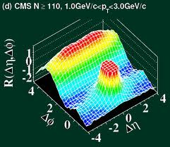
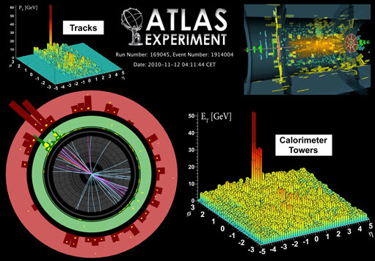
Is it working?
September 2010 CMS ridge
Protocol not followed
November 2010 ATLAS Jet quenching
Protocol not followed

Slide 5
Recent developments
March 2011 CMS Higgs paper
Protocol not followed
Is a pattern emerging?

Slide 6
More recent developments
21 April morning: DG informs me that the experiments have agreed with management how to handle the issue.
21 April afternoon: ATLAS internal note purporting to show non-Standard Model Higgs at 115 GeV leaked to a blog
22 April morning: CERN press office phones start ringing
26 April morning: The inquest begins…
Net result in terms of coverage and reputation is OK – but we can’t afford to do this too often.

Slide 7
Lessons learned
CERN must reinforce the protocol
CERN must ensure communication is fully informed all the time
However…
We (communicators) can never assume 1. and 2.
Therefore…
We (communicators) must be better prepared.

Slide 8
What we are doing…
Preparing backgrounders on:
Higgs
SUSY
Compositeness
Heavy gauge bosons
Gravity
Technicolour
4th generation particles
Dark matter
Antimatter asymmetry
To be accompanied as far as possible by (audio)visual material.
Comment from Kathryn?

Slide 9
What we are doing…
Preparing for result announcement event:
No time to prepare this time, therefore everything has to be ready in advance.
Results seminar at CERN followed by press conference
Press centre to be turnkey ready
Media visits to control rooms

Slide 10
What we plan to do for the next leak…
Prepare standard statement as soon as possible.
Call all major news agencies to ensure the story is correct on the news wires.

