Slide 1
Welcome!

Slide 2
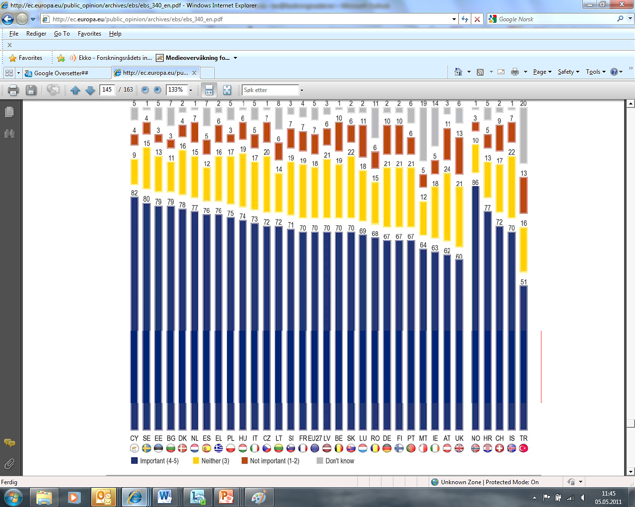

Slide 3

The Research Council’s roles
Adviser to the government
Research funding
  Support basic research
  Implement national thematic priorities
  Support private R&D
Networking and dissemination
Internationalisation

Slide 4
The Research Council of Norway
Division for
Science
Division for Energy, Resources
and the Environment
Director General
Division for
Society and Health
Staff
Division for
Innovation
Division for
Administrative Affairs

Slide 5
Funding received from the ministries (2011)
Foreign Affairs
Administration
Misc.
Health and
Care Services
Education and Research
Environment
Agriculture
and Food
The
Research
Fund
Fisheries
and Coastal Affairs
Petroleum and energy
Trade and
Industry
Total NOK 7250 mill. administration incl.

Slide 6
The Council distributes about 30 % of public expenditures on R&D in Norway
Higher
education
sector
Public
funding
of R&D in
Norway
42%
Ministry of Education
and Research
The Research
Council
Institutes
Other
Ministries
Industry

Slide 7



Slide 8
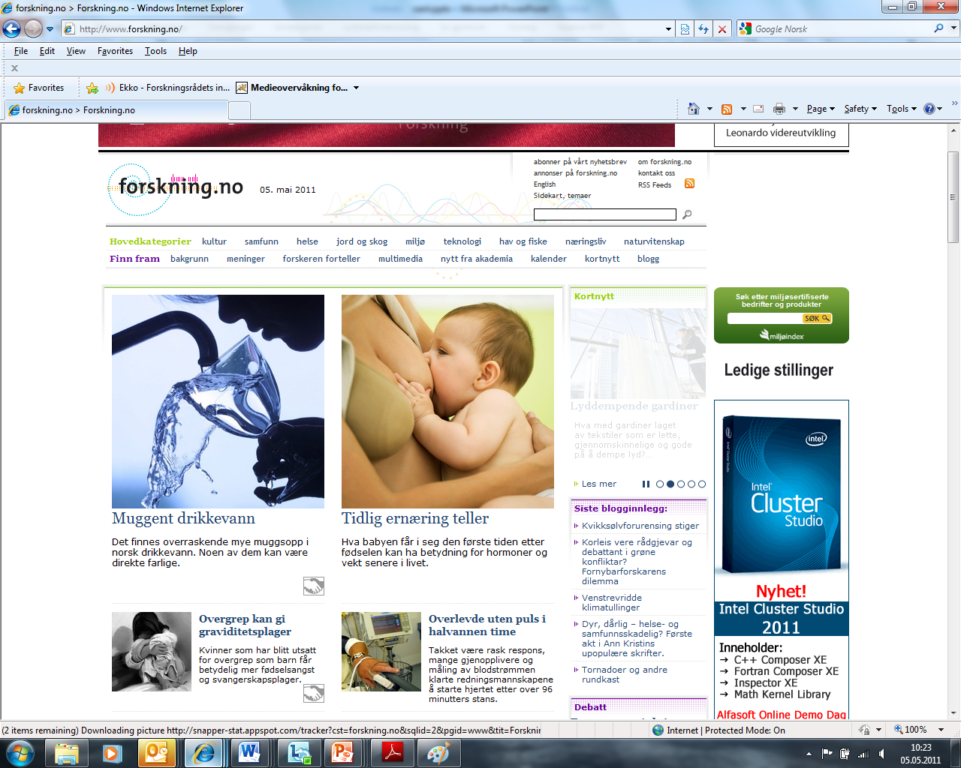

Slide 9


Mass experiment 2010
Norwegian Science Week
Earth worms:
Study on species and geographic spread

Slide 10

Mass experiments arranged in Norway since 2003

Slide 11

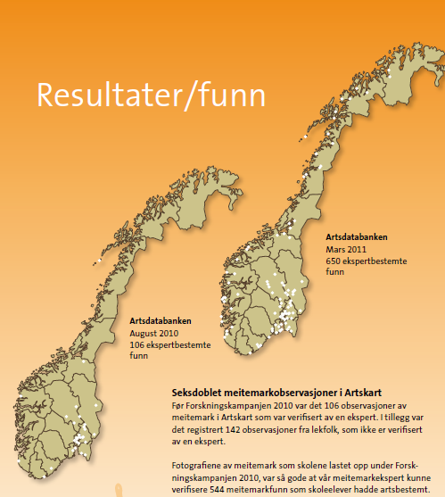
Results
The Earth Worm map of Norway before and after the mass experiment
Before: 106 registrations
Now: 544 registered geographic
worm “hits”

