Slide 1
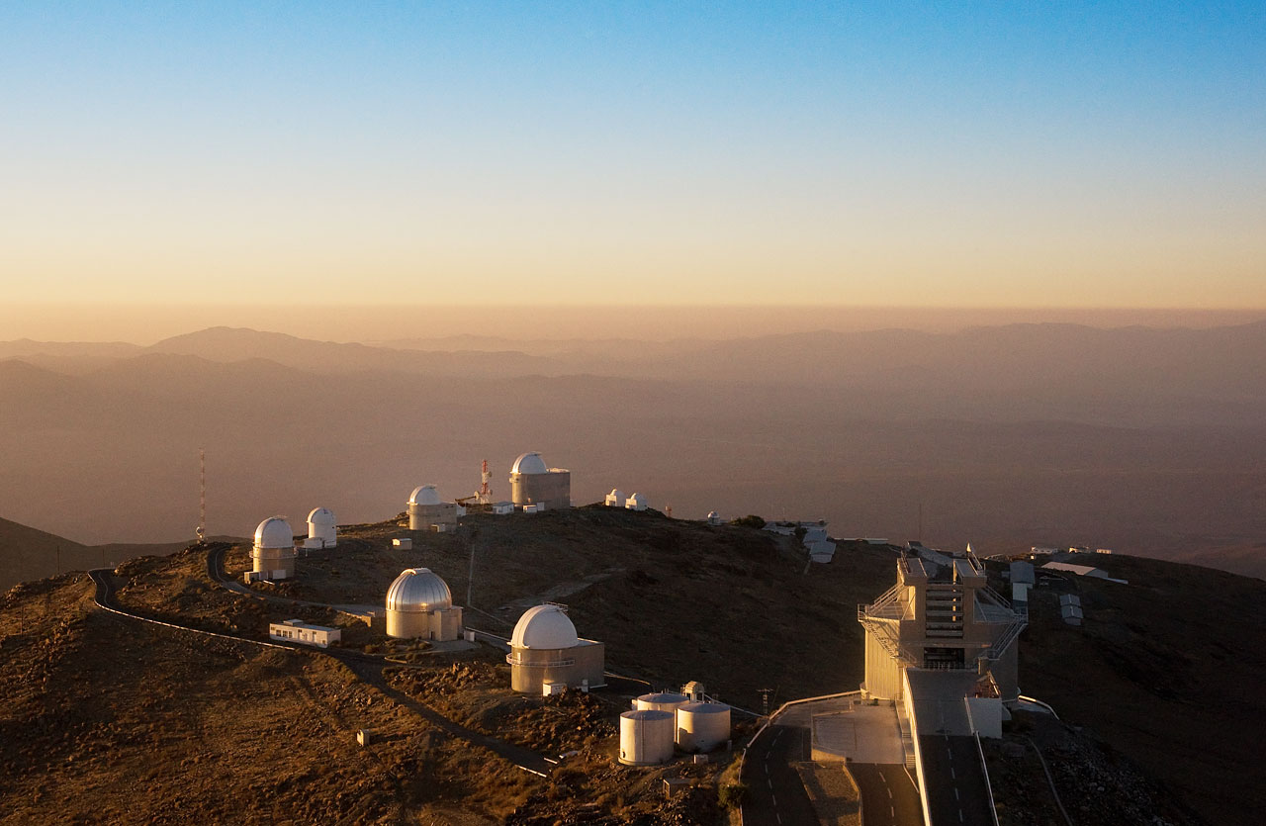
ESO’s Approach to Online Multilingualism
James Gillies, EPPCN meeting, Oslo 05.05.2011
with thanks to Lars Cristensen (ESO)

Slide 2
ESO home page
Clickable

Slide 3
ESO Norway page
National contact

Slide 4
ESO Norway press release
Some content English only

Slide 5
ESO Model
ESO has 14 Member states
Spends approximately €4-5k per country per year for translation plus ~10% FTE at ESO HQ
Coordinated via ESON, the equivalent of EPPCN
ESO has approximately 10k visitors per day (same as CERN)
10% of visitors are on non-English pages
Governed by MoU – ESO found that it did not work on a voluntary basis

Slide 6
ESO Network
ESON mission
“Act as ESO’s media and outreach representative in the member states and potential member states with the general aim of promoting ESO’s mission and demonstrating the many inspirational aspects of astronomy”.

Slide 7
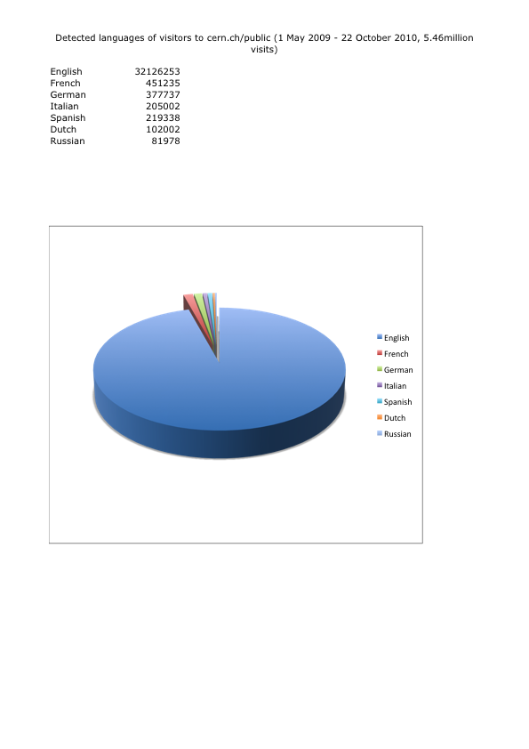
Would this work for us?
CERN has 20 Member states and rising
Annual cost to CERN would be €100k plus
>10% FTE at CERN HQ
Would EPPCN be able to provide the service
at this cost?
Can CERN provide the central resources?

