Slide 1
EPPCN and CERN Council Brussels event in 2012
James Gillies, EPPCN, Oslo 6 May 2011

Slide 2

European Strategy for Particle Physics
Strong national activity & CERN
Globalization
LHC top priority
CLIC
ILC
Neutrinos as part of global effort
Links with ApPEC
Flavour physics
NuPECC
Theory
Update the strategy
Future facilities (Global)
Relationship with EU
Non-MS involvement in strategy
EPPCN
TT
Engagement with industry

Slide 3
Communication at the Brussels meeting: Exhibition
Grass roots
Showcase relevance to MS
Budget will be available
Graphic elements coordinated by CERN
Royal Society a possible model?

Slide 4
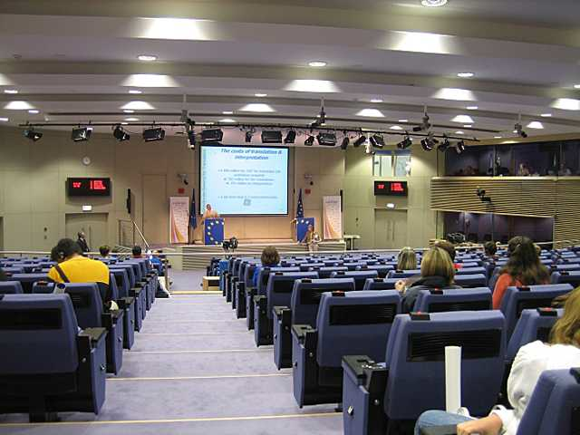
Communication at the Brussels meeting: Press conference
Berlaymont press room
Strategy
LHC status

Slide 5
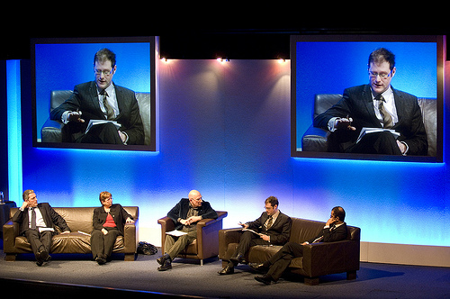
Communication at the Brussels meeting: networking event
Public debate?
Link to exhibition?

Slide 6

Communication at the Brussels meeting: brochure
Needed?
Format?
Contents?
N.B. ICFA brochure

