Slide 1
Reducing the Risks of Nuclear Weapons
Steve Fetter
ETH Zurich
University of Maryland
Experimental Particle and Astro-Particle Physics Seminar
26 February 2024

Slide 2


Slide 3
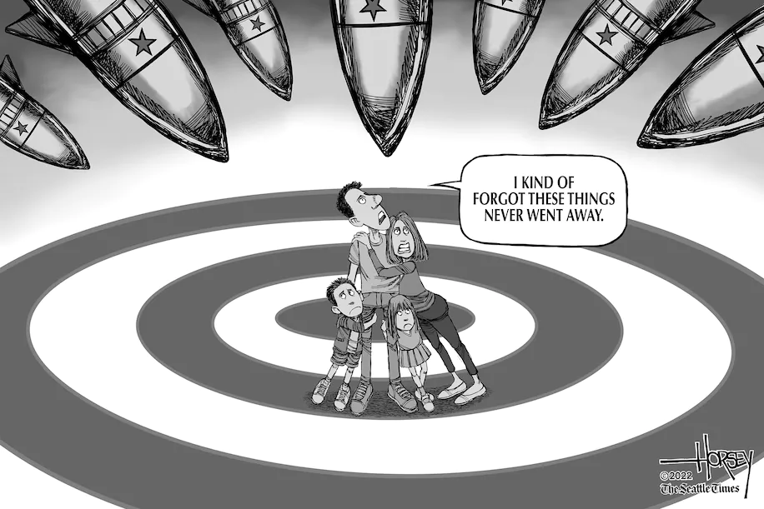

Slide 4
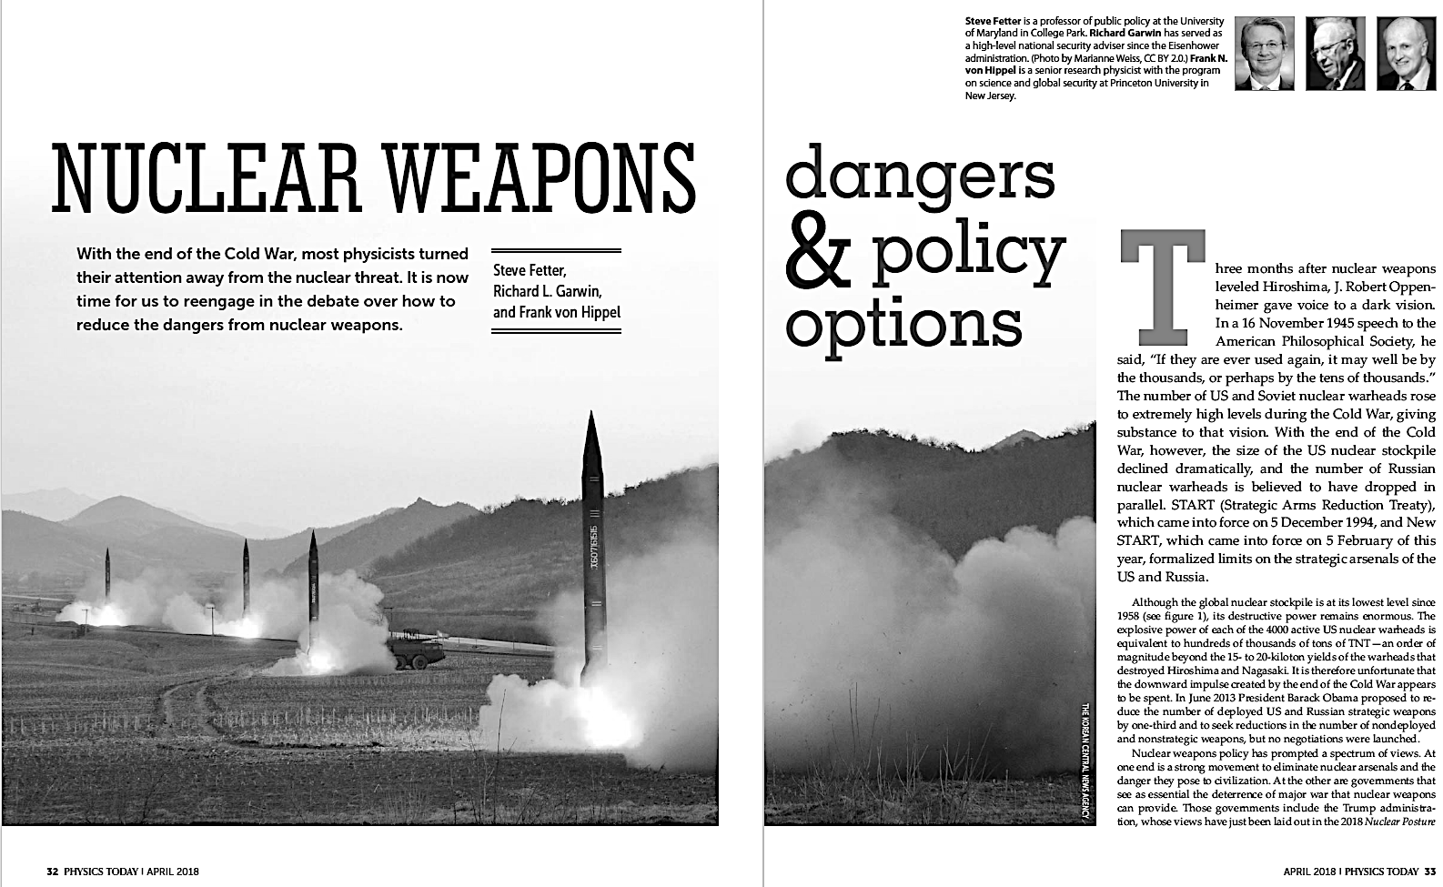
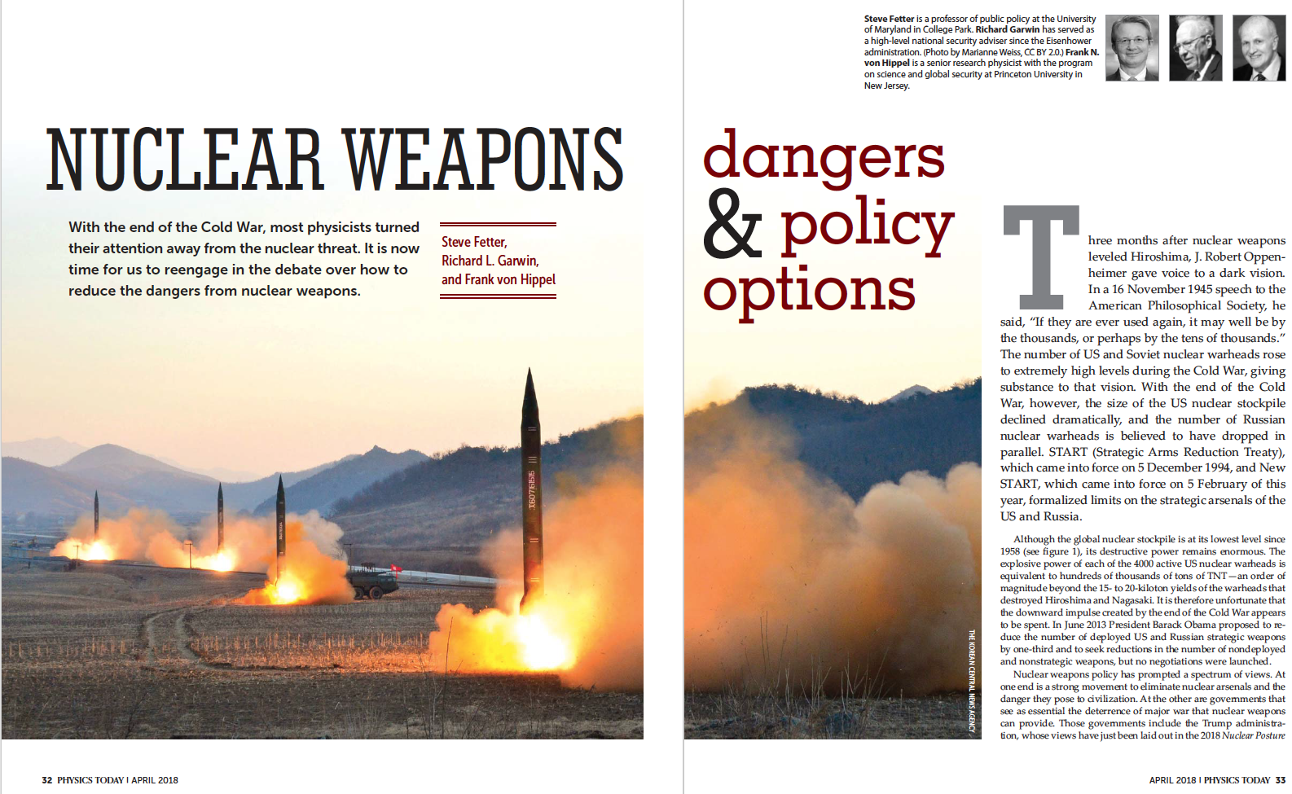

Slide 5
“Physicists invented nuclear weapons and historically have made major contributions to efforts to limit the dangers they pose. We urge concerned physicists to inform themselves and contribute to a new debate over how to reduce those dangers.”

Slide 6
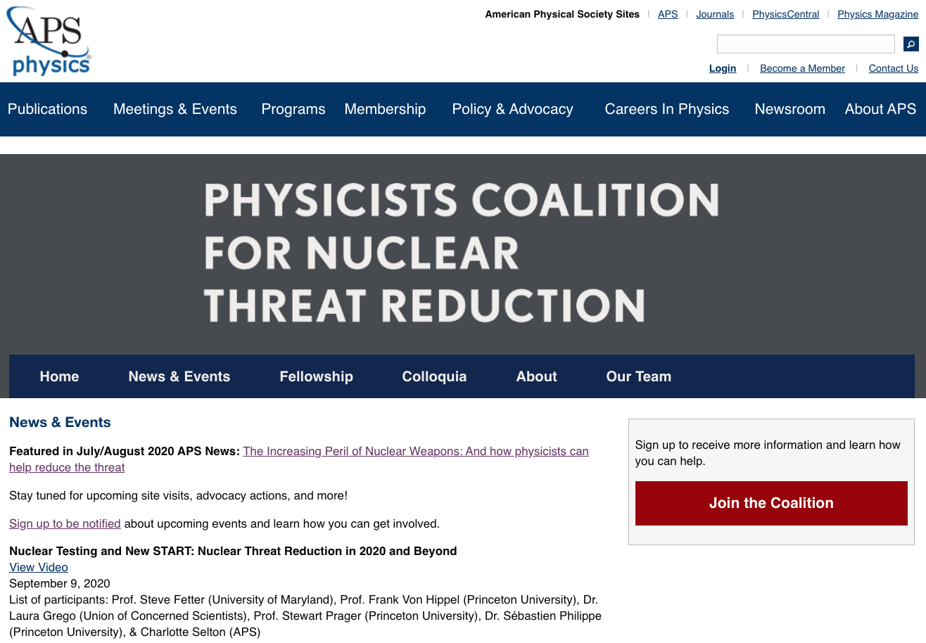

Slide 7
Outline
Nuclear weapon primer
Nuclear weapon effects
Current nuclear arsenals
Modernization and expansion
Deterrence and possible failures
Increasing risks
What can physicists do?

Slide 8
Nuclear Weapons Primer
All nuclear weapons use materials that can sustain a fast-fission chain reaction
Highly-enriched uranium (HEU)
  Natural uranium is 0.7% U235, 99.3% U238
  Isotope enrichment in needed to increase U235 to ~90%
    Electromagnetic, gaseous diffusion, gas centrifuge, laser
Plutonium
  Pu does not exist in nature; produced in reactors from U238:
    1 gram per MW-d (25 MW reactor produces 8 kg per year)
  Pu is chemically separated from highly radioactive spent nuclear fuel in reprocessing plants
Limiting the spread of enrichment and reprocessing technology is key to limiting the spread of nuclear weapons

Slide 9
Fast Fission Chain Reaction
Many possible fission products
U235 or Pu239
What Szilard imagined after reading Rutherford speech calling nuclear energy “moonshine”

Slide 10
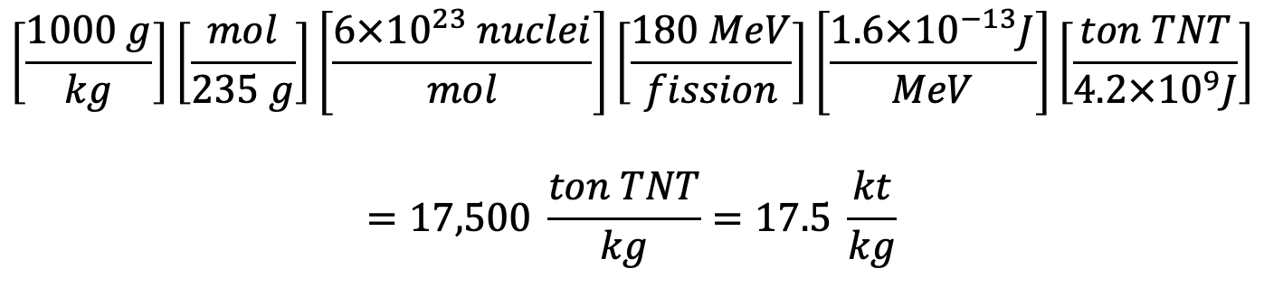
Energy Release from Fission of 1 kg U235 (or Pu239)
200 MeV per fission:
KE of fission fragments 165 MeV
KE of neutrons 5 MeV
Gamma-rays 7 MeV
Decay of fission products 13 MeV
Neutrinos 10 MeV
≈180 MeV Immediately Available
$$\left[\frac{1000 g}{kg}\right]\left[\frac{mol}{235 g}\right]\left[\frac{6×{10}^{23} nuclei}{mol}\right]\left[\frac{180 MeV}{fission}\right]\left[\frac{1.6×{10}^{−13}J}{MeV}\right]\left[\frac{ton TNT}{4.2×{10}^{9}J}\right]$$
$$=17,500 \frac{ton TNT}{kg}=17.5 \frac{kt}{kg}$$
Hiroshima: 15 kilotons (kt)
Nagasaki: 20 kt

Slide 11
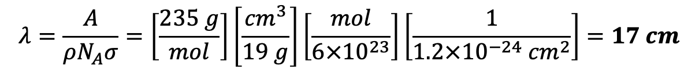
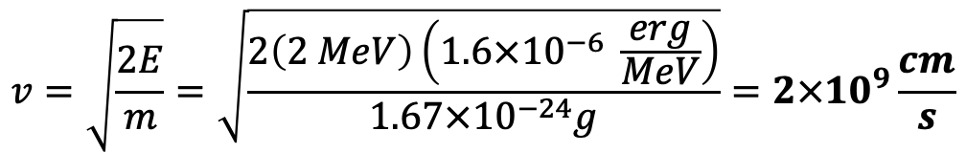
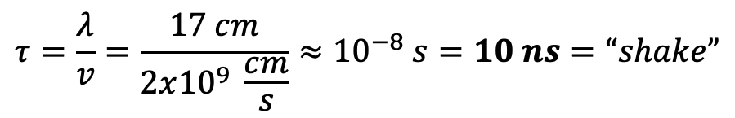
Neutron Velocity, Mean Free Path, Generation Time
200 MeV per fission:
KE of fission fragments 165 MeV
KE of neutrons 5 MeV
Gamma-rays 7 MeV
Decay of fission products 13 MeV
Neutrinos 10 MeV
= (2.5 neutrons/fission) x (2 MeV/neutron)
Cross section for fast fission:
U235: 1.2 barn
Pu239: 1.8 barn
$$v=\sqrt{\frac{2E}{m}}=\sqrt{\frac{2\left(2 MeV\right)\left(1.6×{10}^{−6} \frac{erg}{MeV}\right)}{1.67×{10}^{−24}g}}=2×{10}^{9}\frac{cm}{s}$$
$$λ=\frac{A}{ρN_{A}σ}=\left[\frac{235 g}{mol}\right]\left[\frac{{cm}^{3}}{19 g}\right]\left[\frac{mol}{6×{10}^{23}}\right]\left[\frac{1}{{1.2×10}^{−24}{ cm}^{2}}\right]=17 cm$$
Pu239: 11 cm
$$τ=\frac{λ}{v}=\frac{17 cm}{2x{10}^{9} \frac{cm}{s}}≈{10}^{−8} s=10 ns=“shake”$$

Slide 12
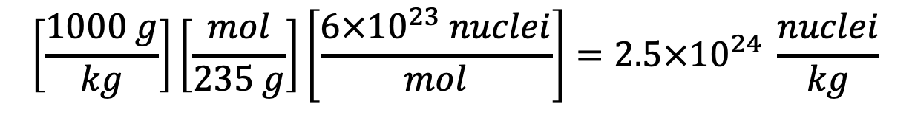
Time to Fission of 1 kg U235
Number of nuclei in 1 kg of U235:
$$\left[\frac{1000 g}{kg}\right]\left[\frac{mol}{235 g}\right]\left[\frac{6×{10}^{23} nuclei}{mol}\right]=2.5×{10}^{24} \frac{nuclei}{kg}$$
If the number of fissions doubles each generation, then after n generations the total number of fissions is:
$$2^{n+1}=2^{81}=2.4×{10}^{24}$$
So about 80 generations to fission 1 kg—less than 1 μs.
99.9% of the energy is released in the last 10 generations, 0.1 μs.

Slide 13
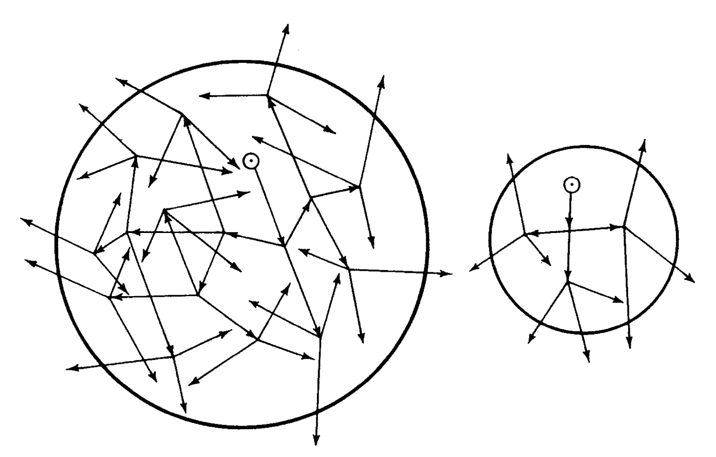
Critical Mass
Assembly of fissile material is “critical” if fission rate and neutron population is constant (i.e., each fission causes one new fission)
super-critical: exponential increase
subcritical:
exponential decrease
Bare critical mass
U235: 52 kg (17 cm sphere)
Pu: 10 kg (10 cm sphere)
Critical mass can be decreased by:
Using a reflector
Increasing density

Slide 14
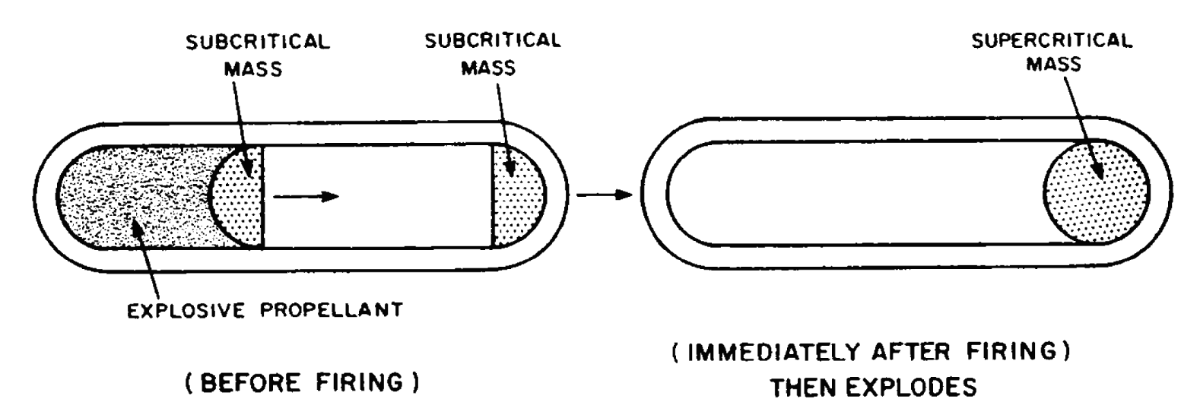
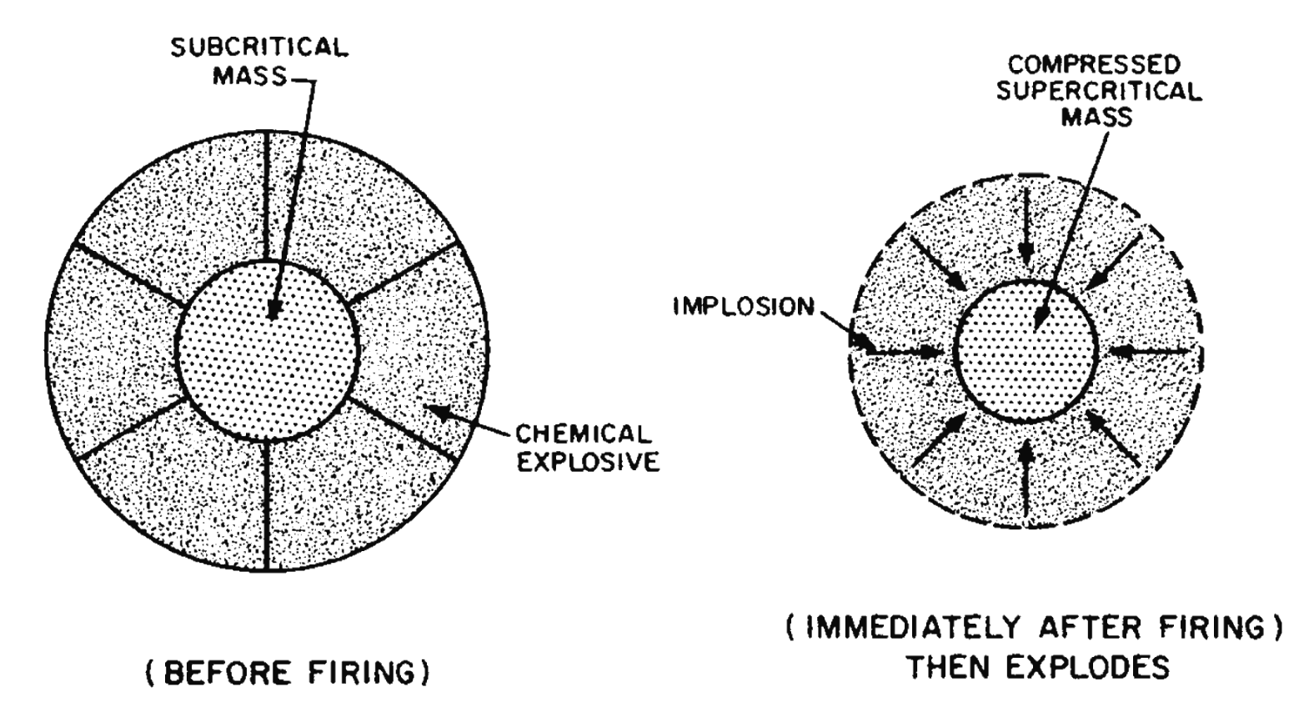
Assembly of Super-Critical Mass: Gun v. Implosion

Slide 15
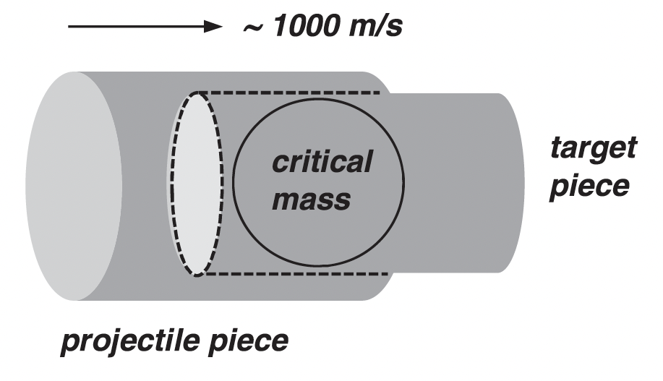
Gun Assembly Works for HEU but not Pu
∼10 cm
Assembly time (first criticality to maximum criticality) ∼ 10⁻⁴ s
 | n/kg-s |  | n/kg-s
U-235 | 0.30 | 80% | 0.2
U-238 | 14 | 20% | 2.8
HEU |  |  | 3.0
 |  |  | x 64 kg
 |  | = 200 n/s
 | n/kg-s |  | n/kg-s
Pu-239 | 650 | 98% | 640
Pu-240 | 910,000 | 2% | 18,000
WgPu |  |  | 19,000
 |  |  | x 20 kg
 |  | = 200,000 n/s

Slide 16
“Little Boy” (Hiroshima)
Gun-type device
4400 kg
64 kg of HEU (51 kg U235)
15 kilotons
Efficiency = 1.7%
“Fat Man” (Nagasaki)
Implosion device
4670 kg
6.2 kg of Pu
20 kilotons
Efficiency = 18%

Slide 17
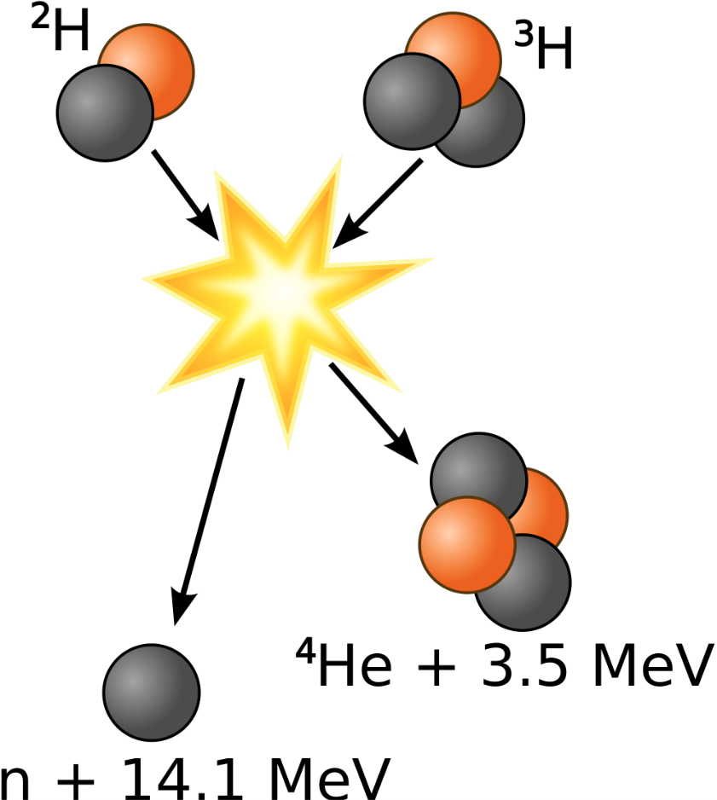
Fusion Reactions
D
T
D + T → He4 + n + 17.6 MeV
D + D → He3 + n + 3.2 MeV
D + D → T + H + 4.0 MeV
T + T → He4 + 2n + 11.3 MeV
D-Li6: 65 kt per kg (∼4x greater than fission)
Li6 + n → He4 + T + 4.8 MeV
↓
D + T → He4 + n + 17.6 MeV
Use fission to cause fusion: boosted and two-stage weapons

Slide 18
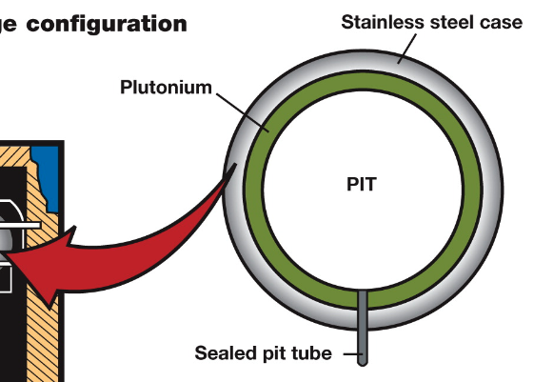
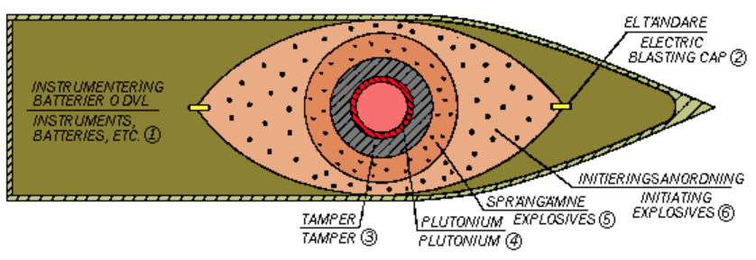
Boosted Fission Weapon
Hollow Pu Pit
The neutrons from DT fusion increase fission by ≈10x, making possible compact fission devices
Fusion does not contribute significantly to the yield
DT gas

Slide 19
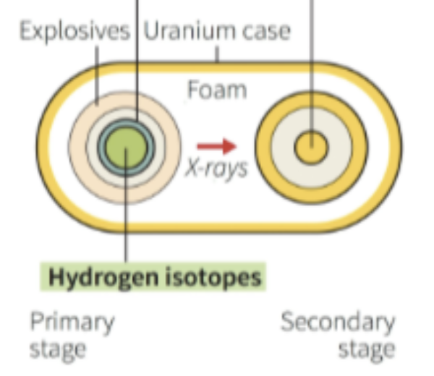
Two-stage Thermonuclear (fission-fusion) Weapon
Pu pit
fusion-fission “secondary”
boosted fission “primary”
Radiation Case
5 - 10 kt
99% fission
100 - 1000 kt
≈50% fission
foam
x-rays
DT boost gas
“radiation implosion” similar to indirect-drive ICF, in which laser pulse on hohlaum produces x-rays to compress fusion capsule

Slide 20
Two-stage Thermonuclear (fission-fusion) Weapons
Using these design principles, the U.S. deployed weapons with yields up to 25,000 kt.
The Soviet Union produced a 100,000 kt device (“Tsar Bomba”), which it tested at 57,000 kt. The nuclear weapons deployed today have an average yield of about 350 kt.

Slide 21
Effects of Nuclear Weapons
Blast and Shock (≈50% of energy)
  Air blast
  Ground shock, cratering
Thermal Radiation (35-45%)
  Fires and firestorms
  Burns, blindness
Nuclear Radiation (5%)
  γ, n released during fission
Fallout (5-10%)
  γ, β released during decay of fission products
  Local (if fireball touches ground)
  Global fallout
EMP and Radar Effects

Slide 22
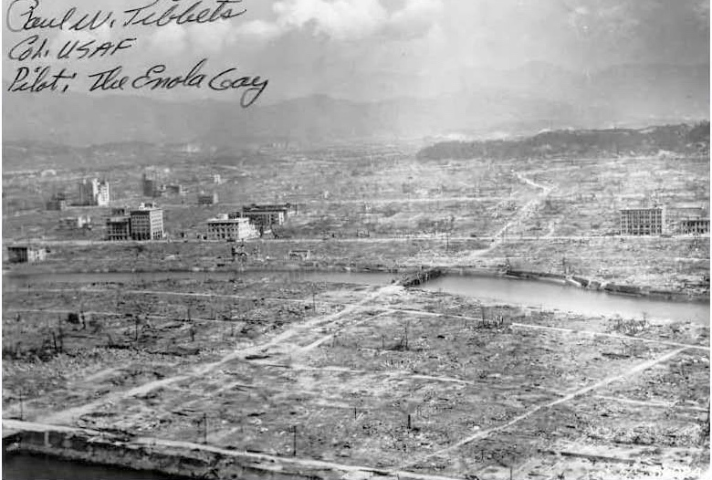
Hiroshima: 125,000 deaths from burns and firestorm; building collapse and flying debris; radiation and radiation-induced cancer

Slide 23

Area of Complete Destruction
350-kt warhead centered on White House
Fire: ∼20 km
blast: ∼ 11 km
About 1 million deaths from blast and fire

Slide 24
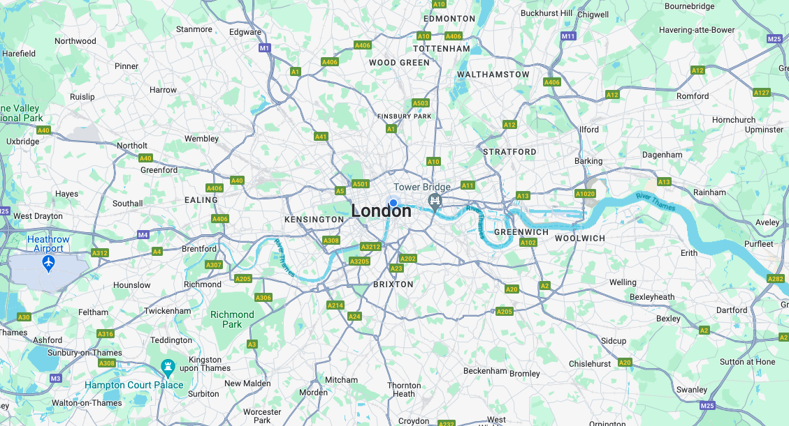
Area of Destruction
350-kt warhead centered on White Hall
Fire: ~20 km
blast: ~11 km
About 1 million deaths from blast and fire

Slide 25
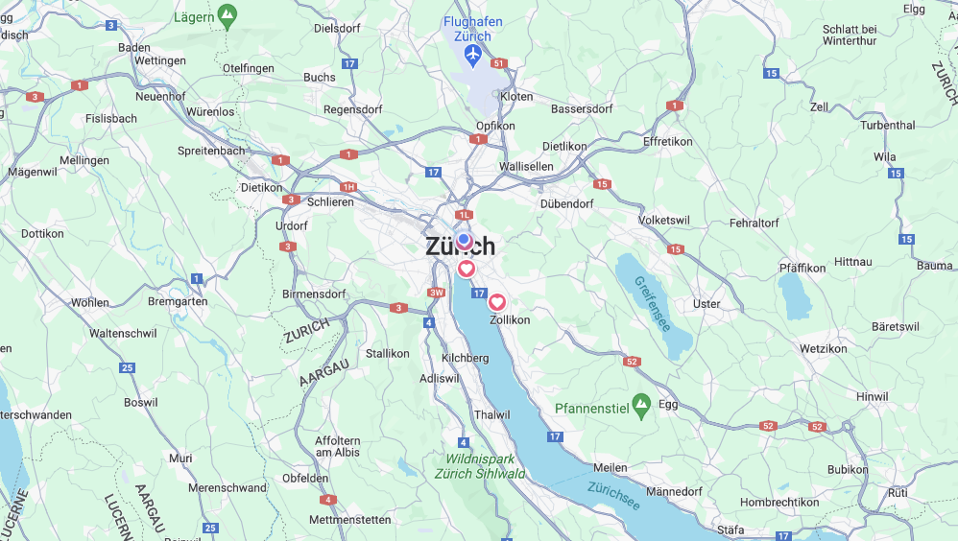
Area of Destruction
350-kt warhead centered on ETH
Fire: ~20 km
blast: ~11 km
About 500,000 deaths from blast and fire

Slide 26
Global Nuclear Arsenals, 1945-2023
INF
START

Slide 27
Global Nuclear Arsenals, 1945-2023
?
INF
START

Slide 28
Global Nuclear Arsenals: 2023
P5 | Russia | 4,500
 | United States | 3,700
 | China | 400
 | France | 300
 | United Kingdom | 220
non-NPT | Pakistan | 170
 | India | 160
 | Israel | 90
 | North Korea | 20-30
 | Total | 9,600
≈ 90%

Slide 29
U.S. Nuclear Stockpile, 2023
 | Delivery Vehicles | Warheads
ICBMs | 400 Minuteman-III x 1 warhead | 400
SLBMs | 12 Trident SSBN x 20 D-5 x 4-5 warheads | 920
Bombers | 45 B-52 x 4 ALCMs x 1 warhead | 180
 | 20 B-2 x 5 bombs | 100
Deployed strategic warheads on alert; can be launched within minutes |  | 1,600 900
Deployed nonstrategic warheads |  | 150
Reserve strategic and nonstrategic warheads |  | 2,050
Total active stockpile |  | 3,800
Retired and awaiting dismantling |  | 2,000

Slide 30
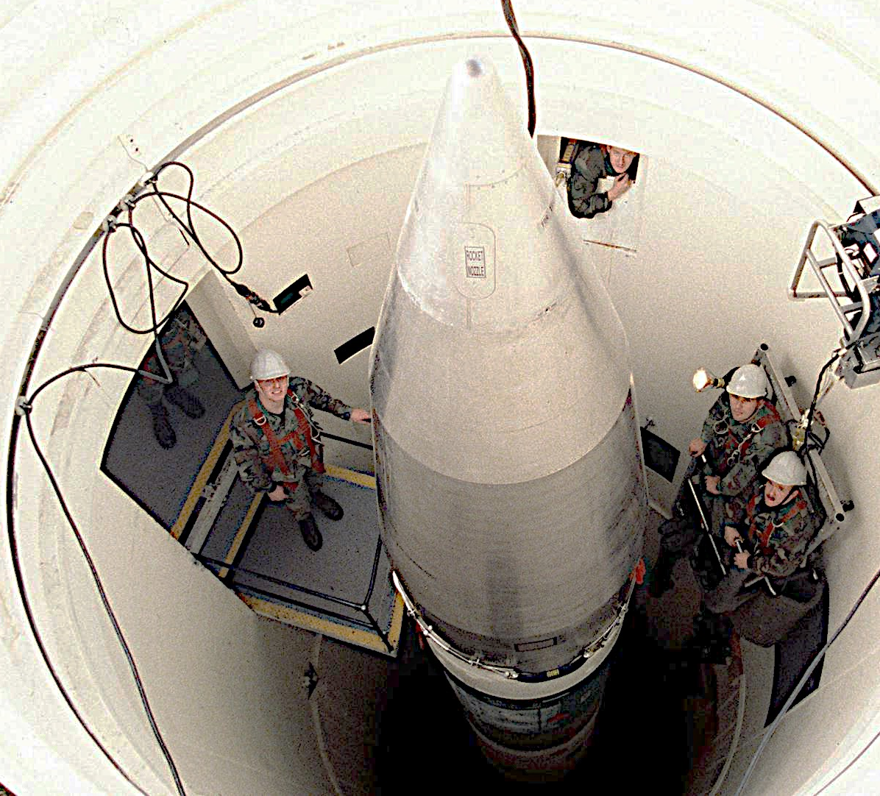
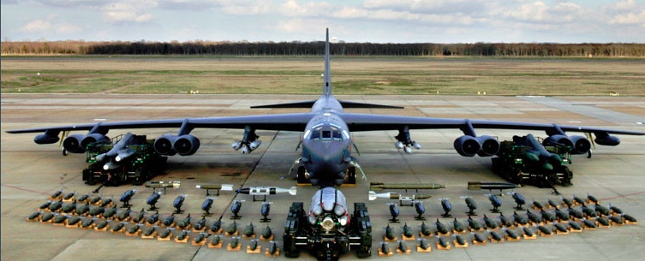
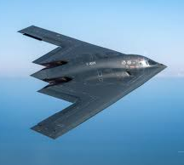

Slide 31
All to be replaced starting 2030

Slide 32
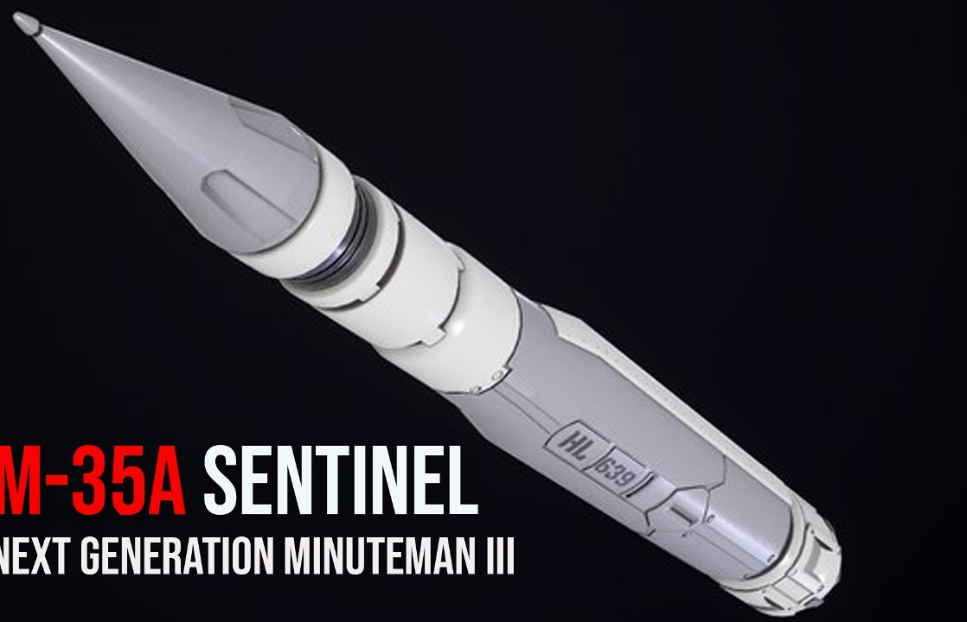
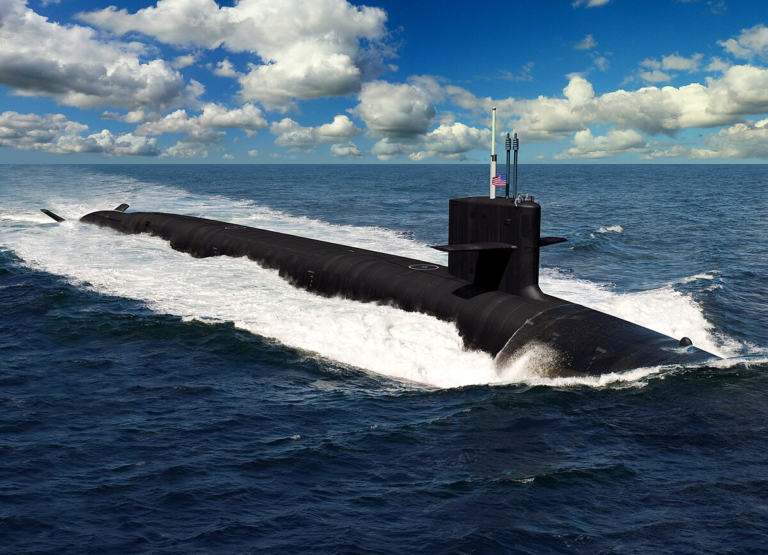
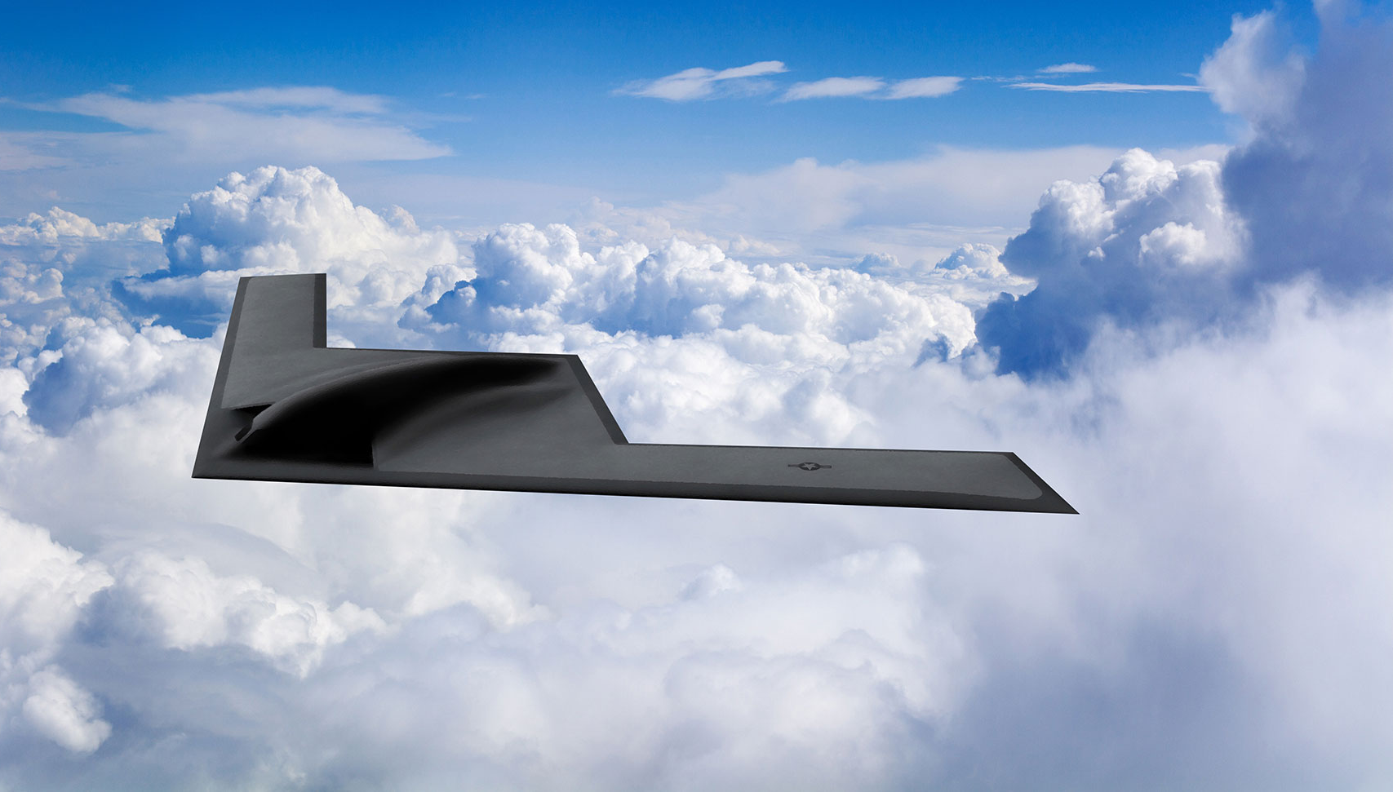
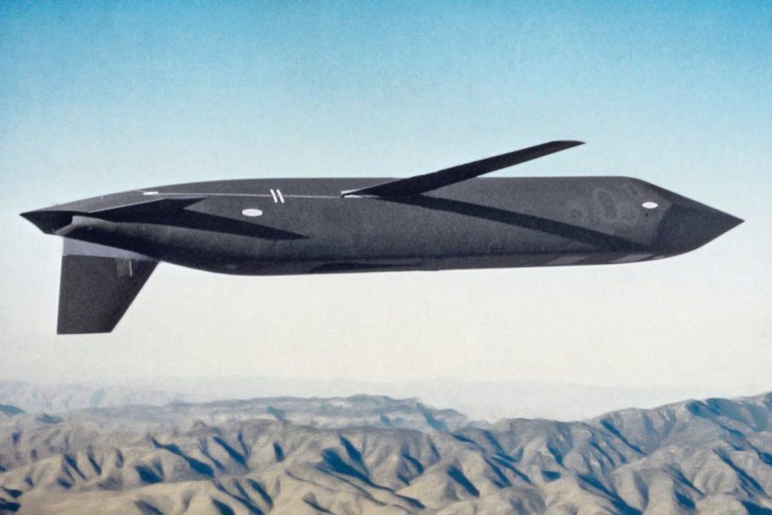
Sentinel ICBM
Columbia SSBN
Total Cost: $1.5 trillion
B-21 Raider
LRSO cruise missile

Slide 33
Russian Nuclear Stockpile, 2023
 | Delivery Vehicles | Warheads
ICBMs | 306 ICBMs x 1-10 warheads | 812
SLBMs | 10 SSBN x 16 SLBMs x 4-6 warheads | 576
Bombers | 68 bombers x 6-16 ALCMs x 1 warhead | 200
Deployed strategic warheads on alert and can be launched within minutes |  | 1,588 1,000
Reserve strategic warheads |  | 1,000
Nonstrategic warheads |  | 1,900
Total active stockpile |  | 4,500
Retired and awaiting dismantling |  | 1,500

Slide 34
Russia’s New Nuclear Weapons
Sarmat ICBM
Avangard hypersonic glide vehicle
Burevestnik Nuclear-powered Cruise Missile

Slide 35
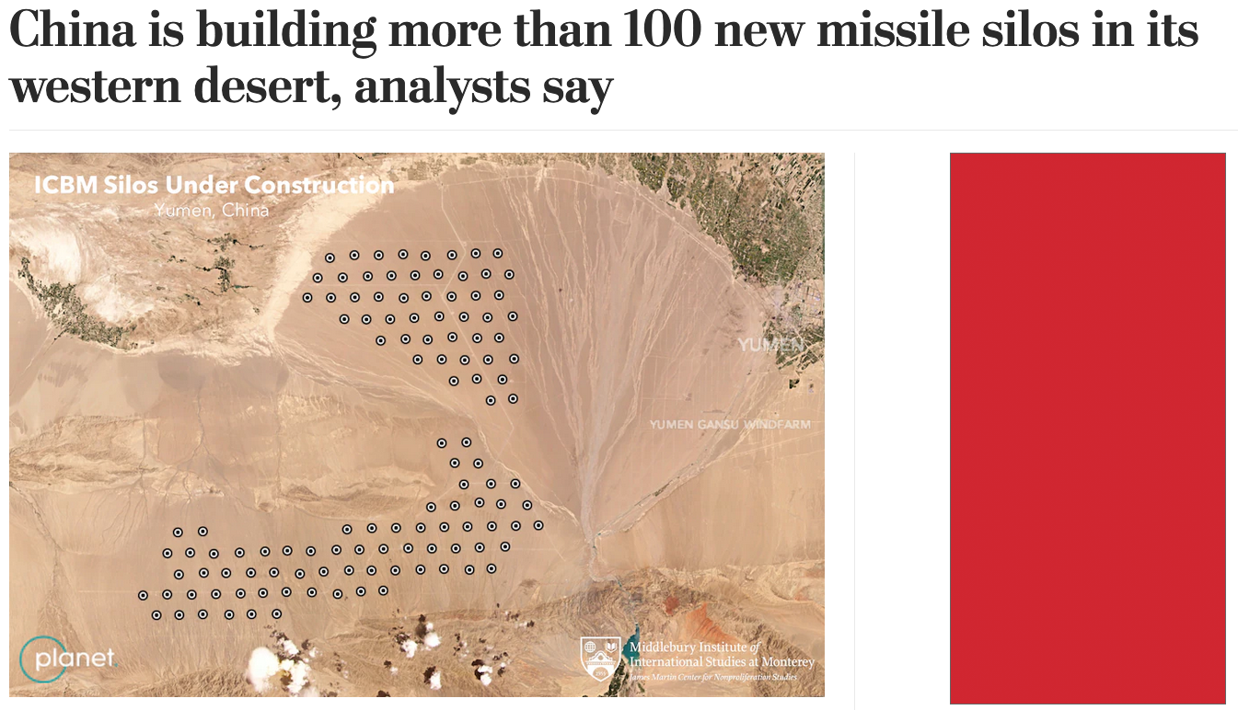
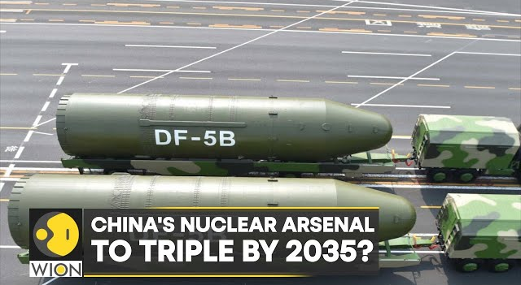
X
300

Slide 36
Deterrence through Assured Destruction
Because nuclear weapons are so destructive, effective defense is impossible
US, Russia, and China can be destroyed by fewer than 100 nuclear detonations
Weapons are deployed on submarines, mobile missiles, and aircraft designed to survive an attack and penetrate missile and air defenses
Because countries cannot prevent a devastating nuclear attack, they deter attack by maintaining a capability to deliver devastating nuclear retaliation
When adversaries both have assured retaliatory capability, a state of “mutual assured destruction” exists
Because no political or military goal is worth destruction, avoid conflicts that could lead to nuclear war

Slide 37
Deterrence Failure and Other Risks
Conflicts that escalates to nuclear use
  Russia v. NATO; China v. Taiwan or Japan; North Korea v. South Korea or Japan; India v. Pakistan; Israel
  Use of nuclear weapons to forestall conventional defeat
Accidental, inadvertent, mistaken, or unauthorized use
  Accidental detonation; false warning; rogue officer
Nuclear terrorism using stolen weapons or materials
Spread of nuclear weapons to additional states (Iran, Saudi Arabia, South Korea, Japan)
Nuclear arms races that result in unnecessary expenditures

Slide 38
“…attempting to return Russia to its 1991 borders will only lead to one outcome: to a global war with Western countries utilizing our entire strategic arsenal, in Kyiv, Berlin, London, and Washington, and all other beautiful historical sites, which have long been included in our nuclear triad's attack goals.”
Dmitry Medvedev, 18 February 2024
Deputy Chairman, Security Council
Prime Minister, 2012-20; President, 2008-12

Slide 39
Deterrence Failure and Other Risks
Conflicts that escalates to nuclear use
  Russia v. NATO; China v. Taiwan or Japan; North Korea v. South Korea or Japan; India v. Pakistan; Israel
  Use of nuclear weapons to forestall conventional defeat
Accidental, inadvertent, mistaken, or unauthorized use
  Accidental detonation; false warning; rogue officer
Nuclear terrorism using stolen weapons or materials
Spread of nuclear weapons to additional states (Iran, Saudi Arabia, South Korea, Japan)
Nuclear arms races that result in unnecessary expenditures

Slide 40
Challenges to the Global Nuclear Order
Stability that characterized post-Cold War period is ending
Russia
  Invasion of Ukraine and nuclear threats
  Suspension of New START, refusal to discuss follow-on
  De-ratification of CTBT
  End of INF and Open Skies
  Development and deployment of new nuclear systems
China
  large expansion of nuclear arsenal
  potential for conflict over Taiwan and South China Sea
North Korea: continued development and testing of ICBMs
Iran: continued production of HEU; failure to restore JCPOA
Emerging technologies: hypersonic and autonomous weapons, space-based radar, AI/ML, quantum sensors

Slide 41
Congressional Commission on Strategic Posture
The following should be pursued with urgency:
  Upload warheads
  Deploy new ICBM in MIRVed or road-mobile configuration
  Increase number of new SSBNs and Trident missiles
  Increase number of new cruise missiles on bombers
  Increase number of new bombers
  Plan for bombers to be on continuous alert
  Develop and deploy additional theater nuclear weapon systems
  Increase production capacity for nuclear weapons and delivery systems
  Develop and deploy homeland missile and air defenses “that can deter and defeat coercive attacks by Russia and China.”

Slide 42
Emerging Technologies and Strategic Stability
“A wide range of new or fast-evolving technologies and applications are creating new challenges for strategic stability.”
—2022 National Defense Strategy
“Emerging and disruptive technologies spell an uncertain future for second-strike retaliatory forces. New sensors and big data may render mobile missiles and submarines vulnerable to detection.”
—Rose Gottemoeller
“Changes in technology are eroding the foundation of nuclear deterrence. Rooted in the computer revolution, these advances are making nuclear forces far more vulnerable than before.”
—Keir Lieber and Daryl Press
“New technology may upset nuclear strategic stability by calling into question the survivability of nuclear forces.”
—Matthew Kroenig

Slide 43
What can physicists do?
Evaluate the impacts of emerging technologies:
Missile/air defense and countermeasures
Directed energy weapons
Large constellations of small satellites in low-Earth orbit
Space-based radar + AI/ML for tracking mobile missiles
Hypersonic weapons
Autonomous air, sea, and land vehicles
Quantum sensing for inertial guidance, sub detection

Slide 44
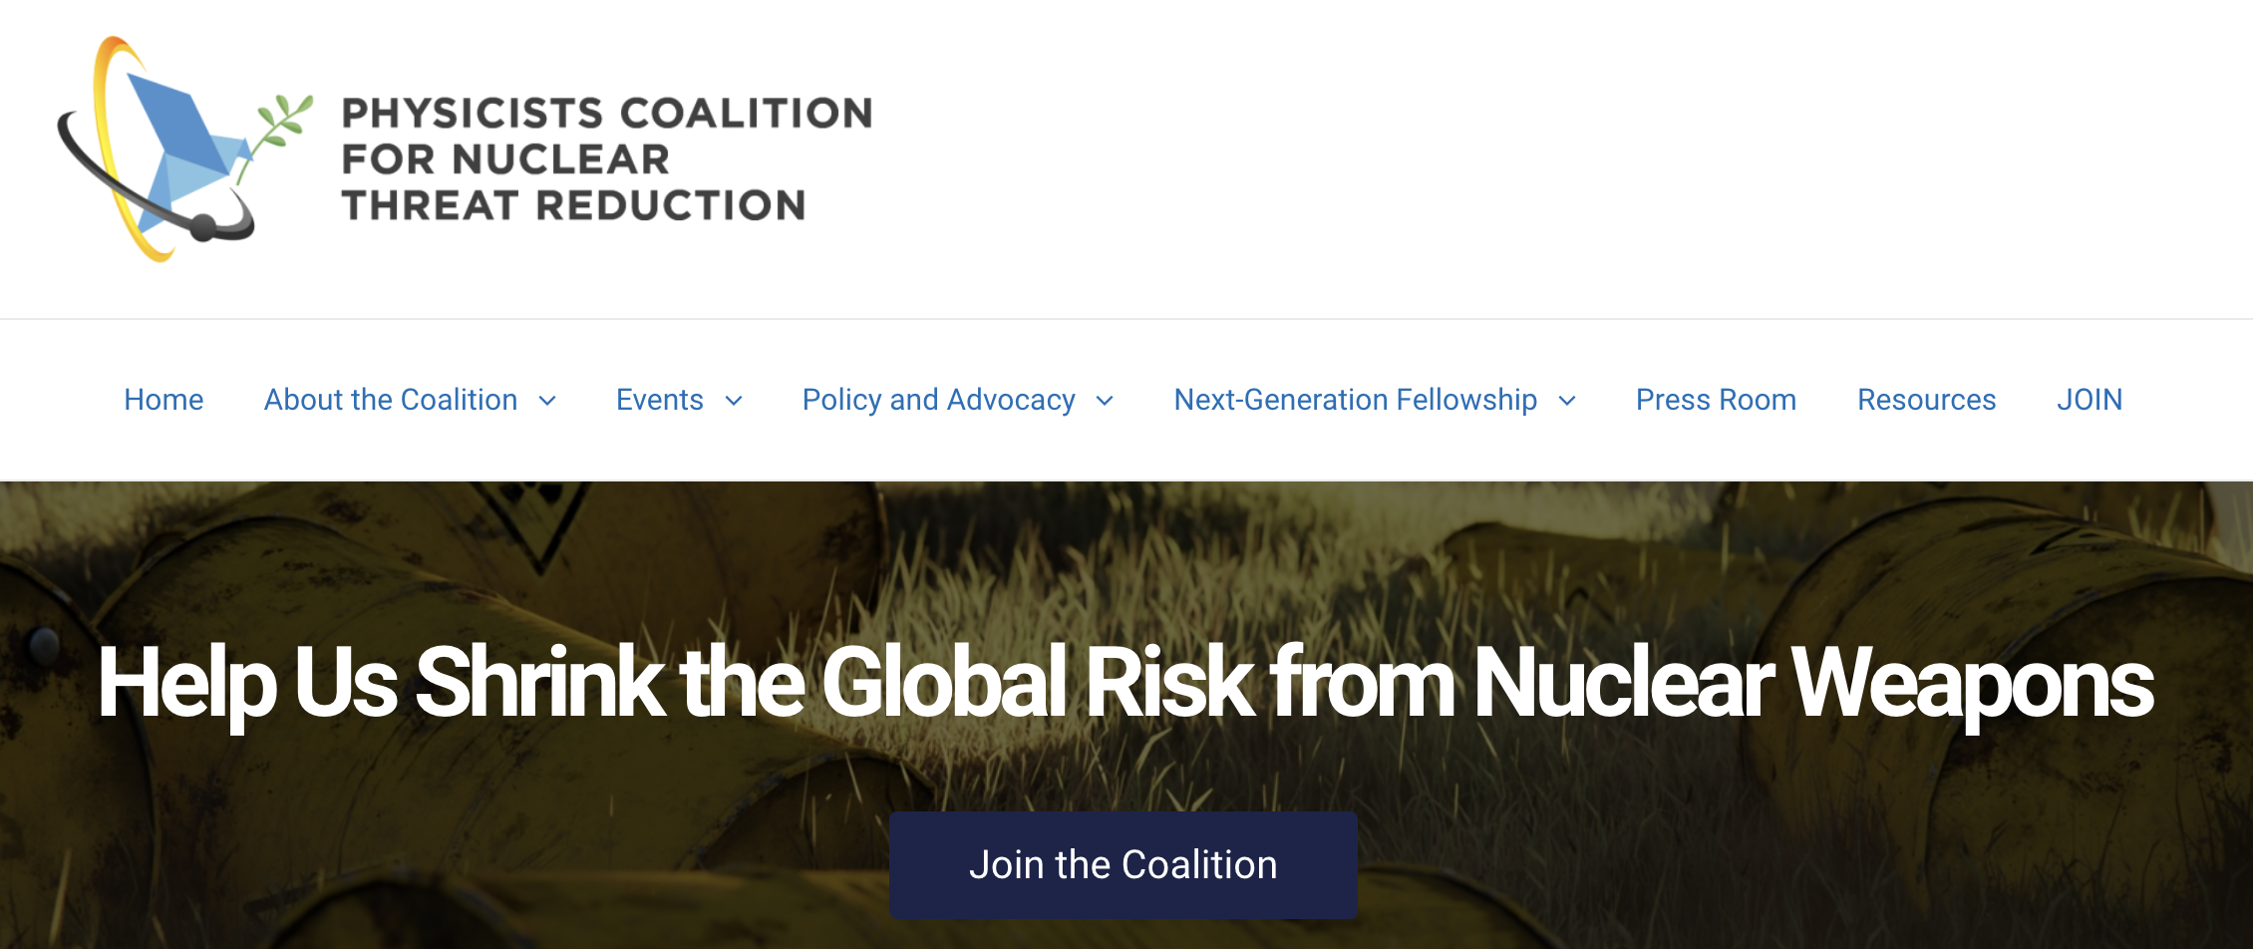
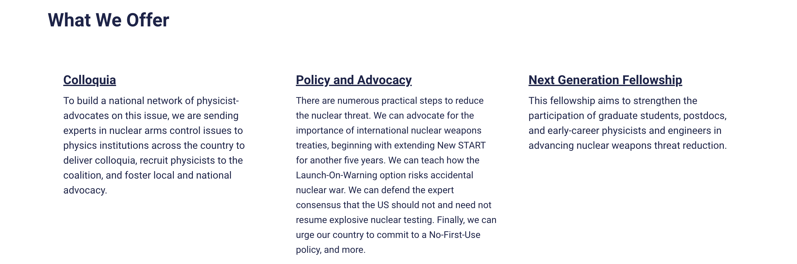
What can physicists do?
https://phycisistscolation.org

