Slide 1
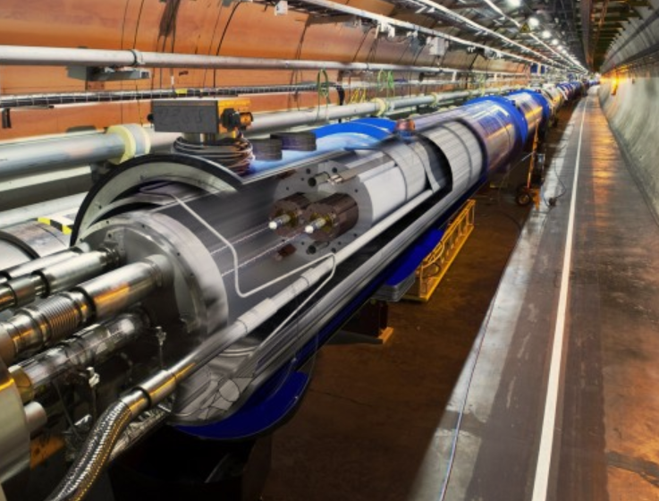
Accelerating Innovation
From CERN Technology to Society
Nick Ziogas
CERN Knowledge Transfer
ziogas@cern.ch

Slide 2
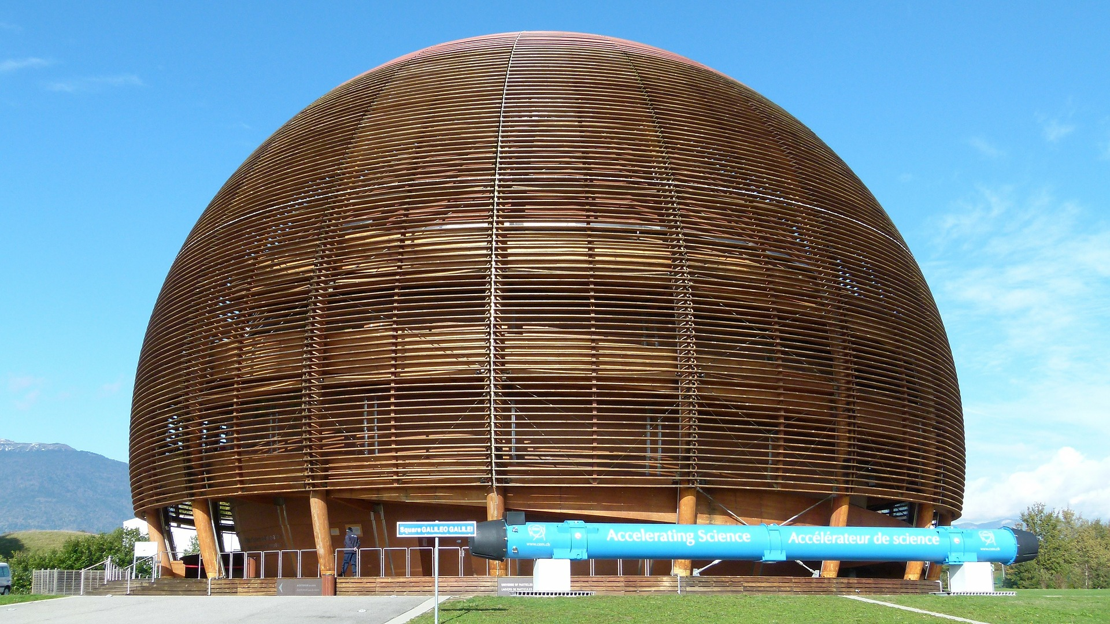
CERN today
CERN: founded in 1954: 12 European States “Science for Peace”
23
Member states
2500
Staff positions
1600
Other personnel
12700
Scientific users
Annual Budget
~1100 MCHF

Slide 3
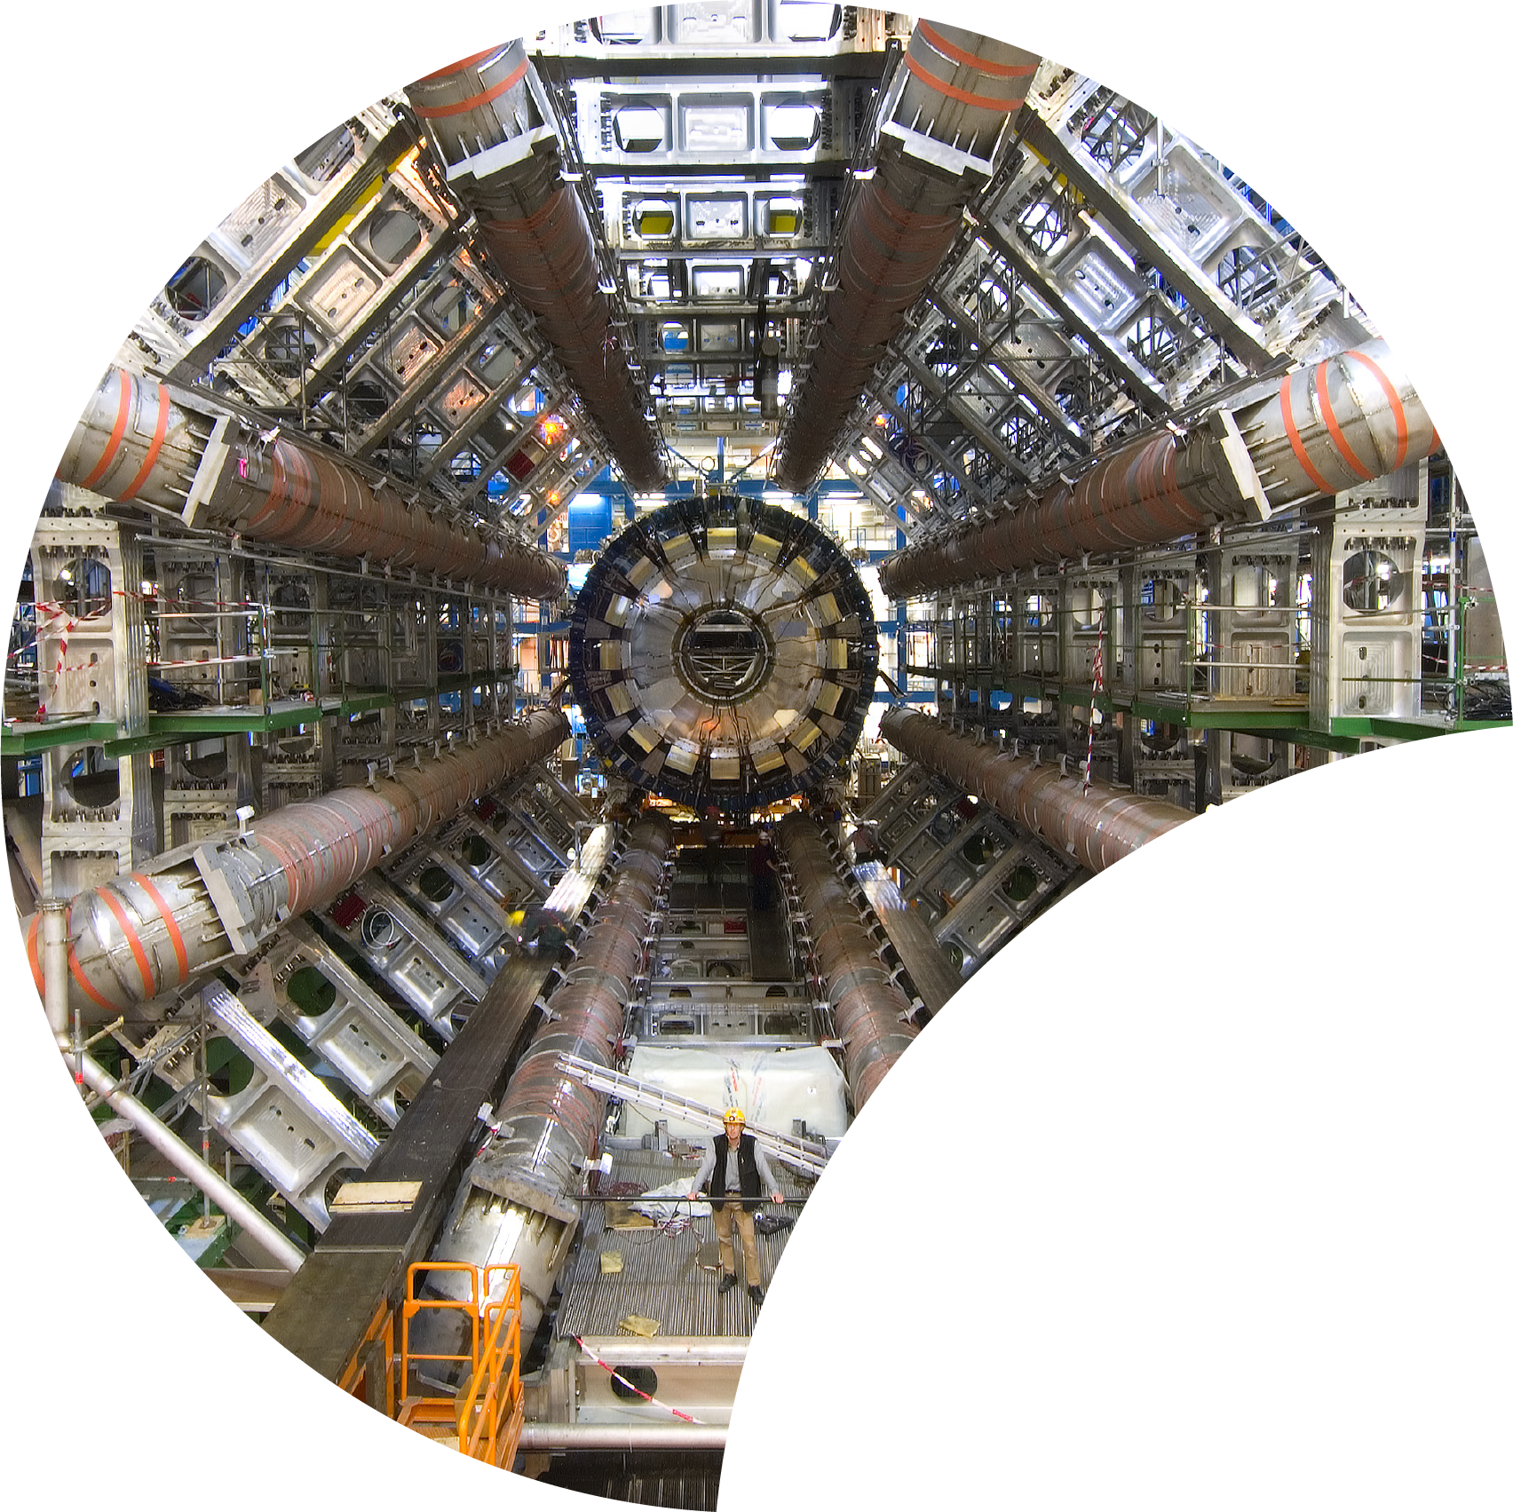
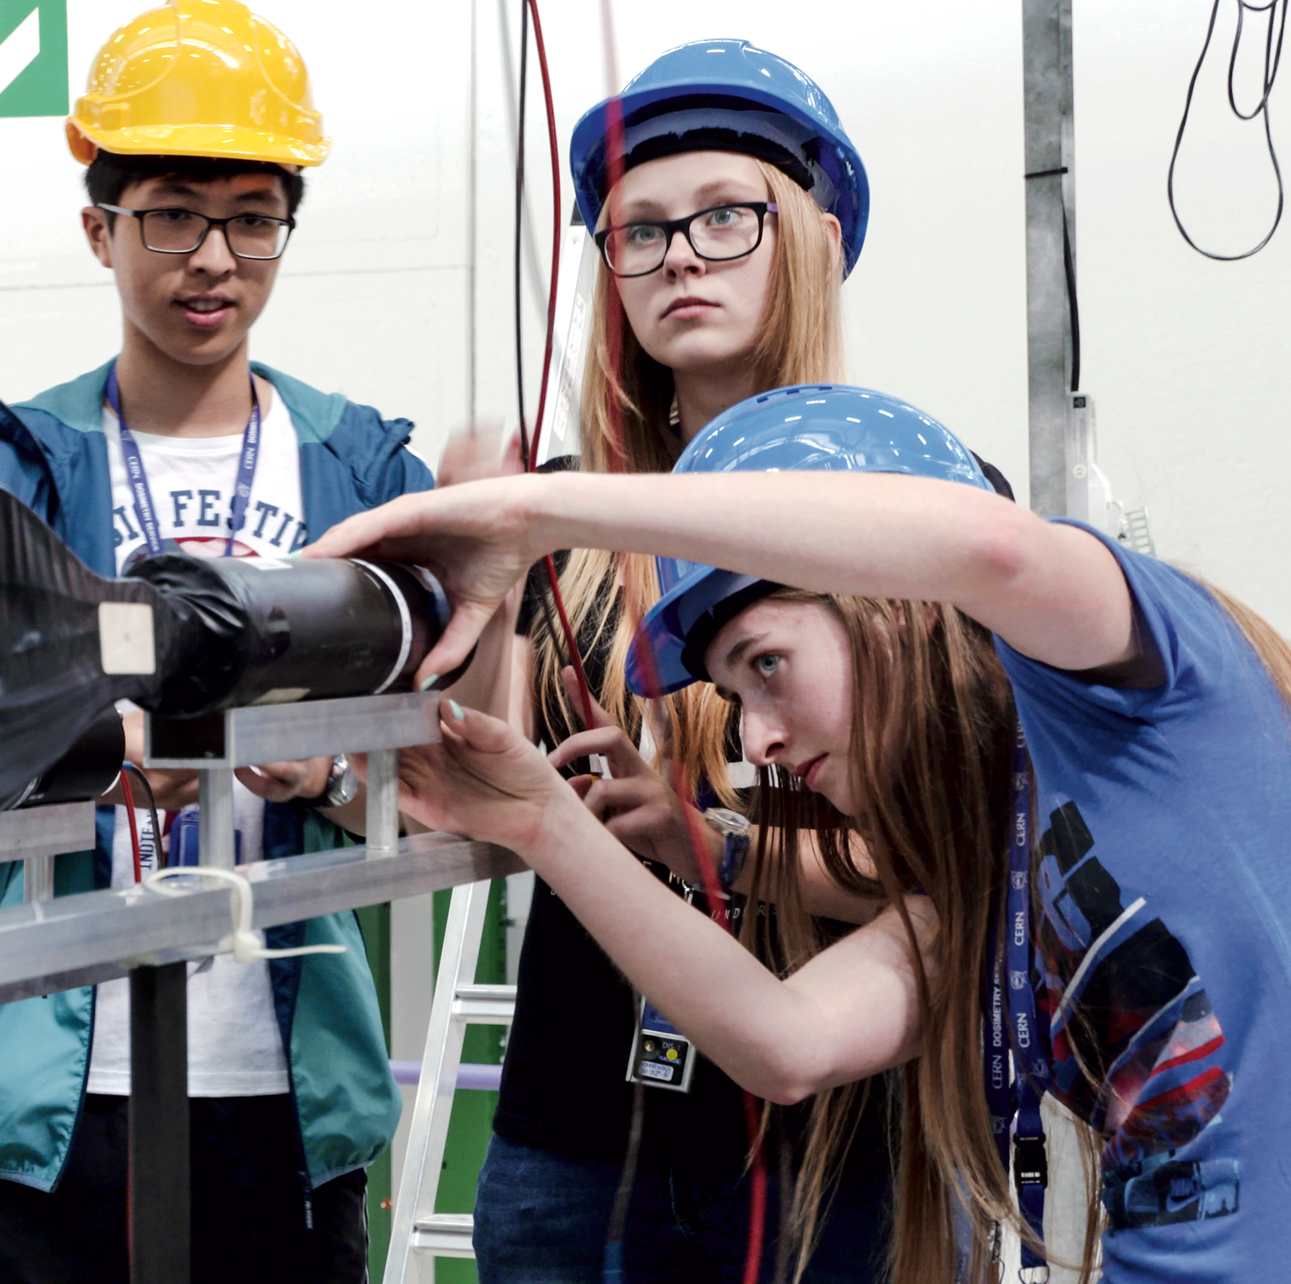
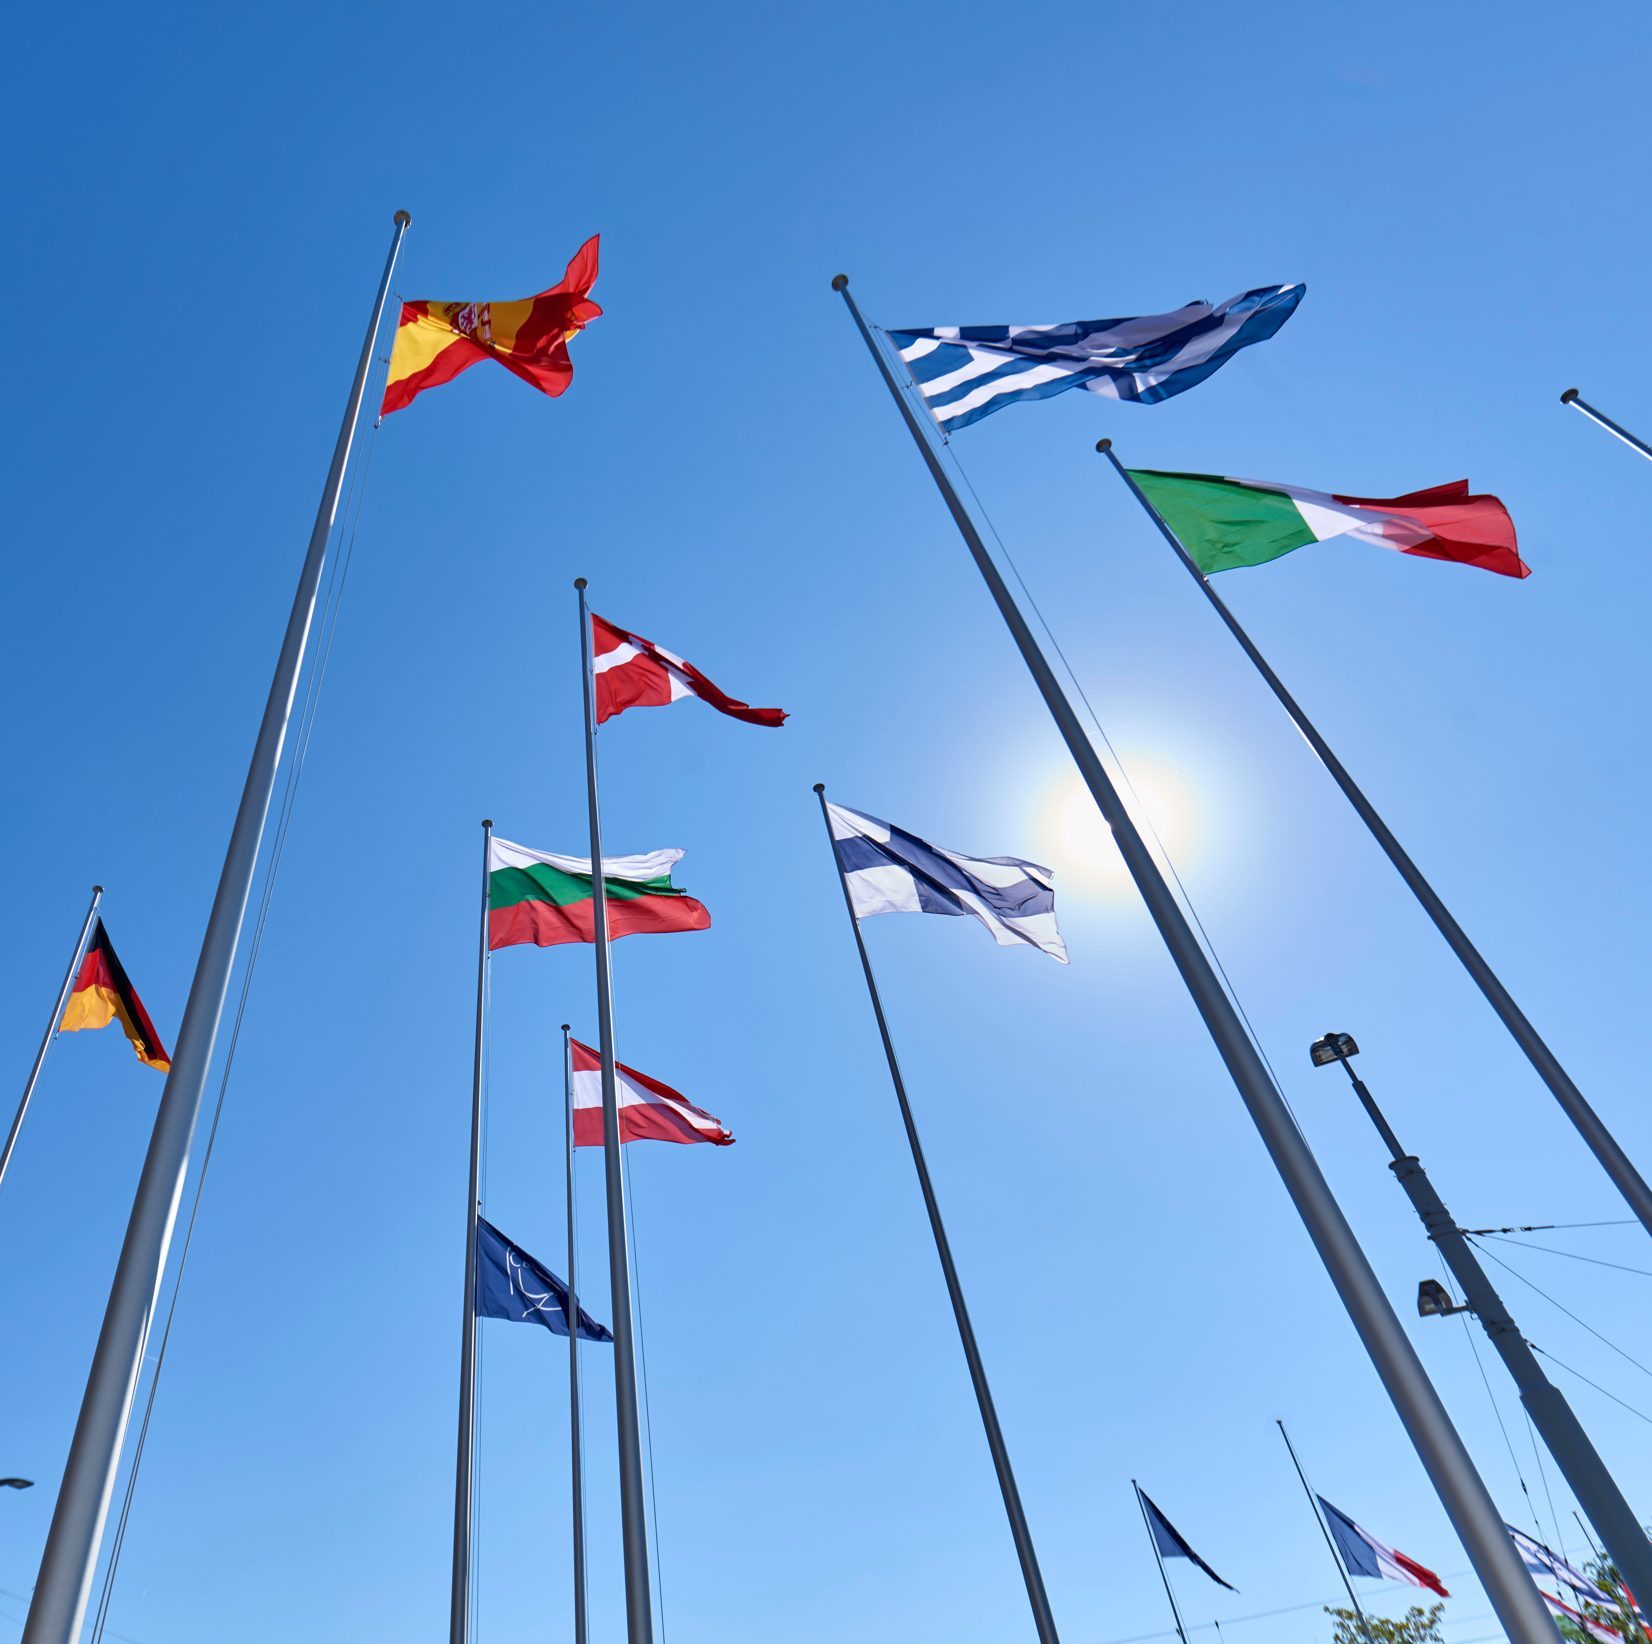
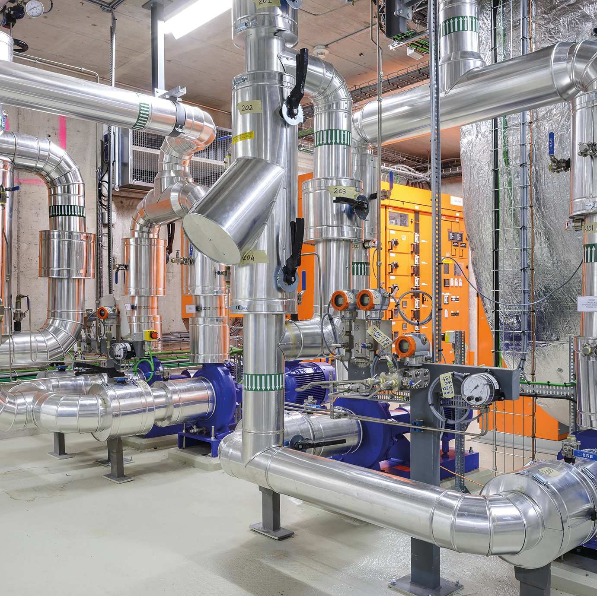

Four pillars underpin CERN’s mission
RESEARCH
EDUCATION
& TRAINING
COLLABORATION
TECHNOLOGY
& INNOVATION

Slide 4

The Higgs Boson completes the Standard Model,
but the Model explains only what concerns ordinary atoms i.e, ~ 5% of our Universe
Dark matter (~24%) and dark energy (~71%) make up the rest. What are they really?
How does gravity really work?
Why there is no antimatter in nature?
Fundamental research is our driver, what this lab is all about

Slide 5
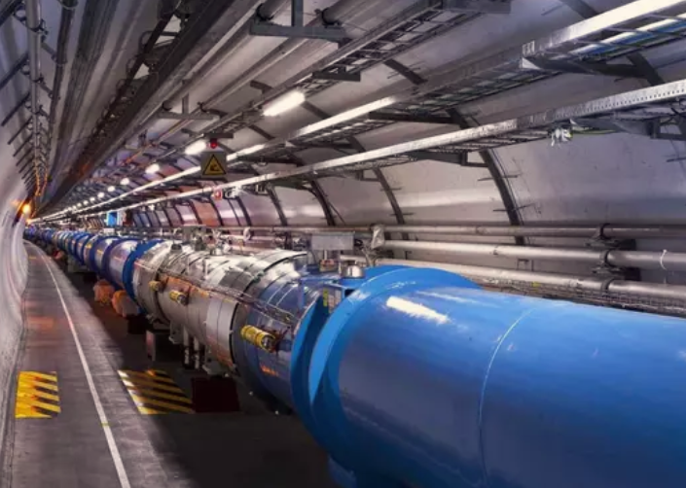
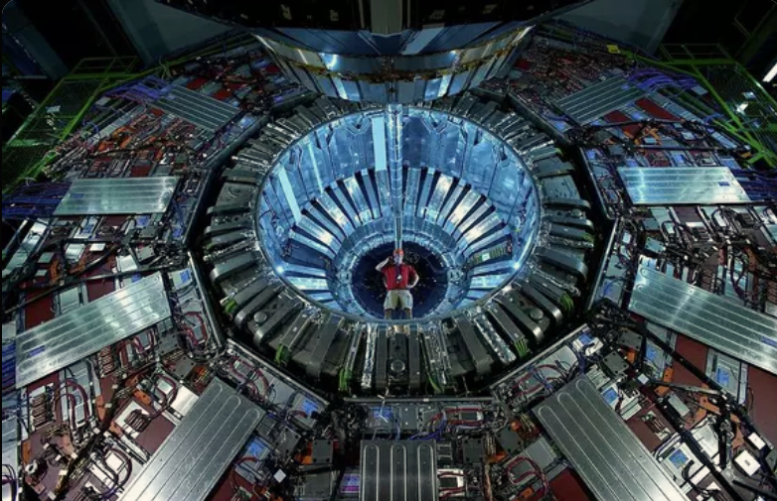
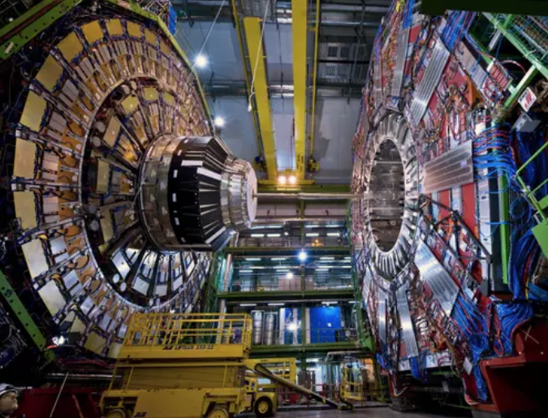
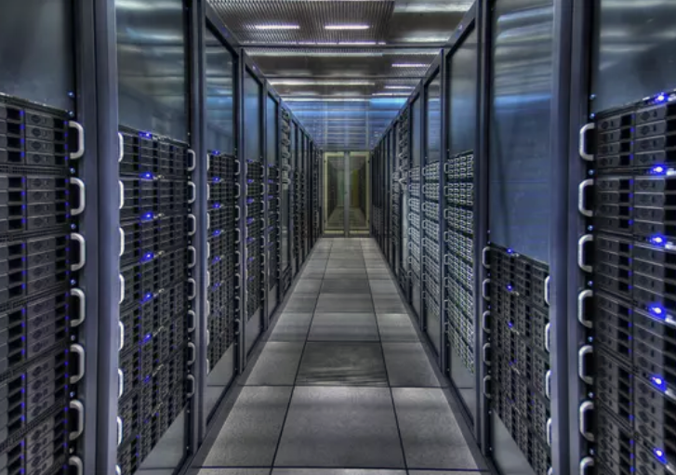
Accelerators
Detectors
Computing

Slide 6
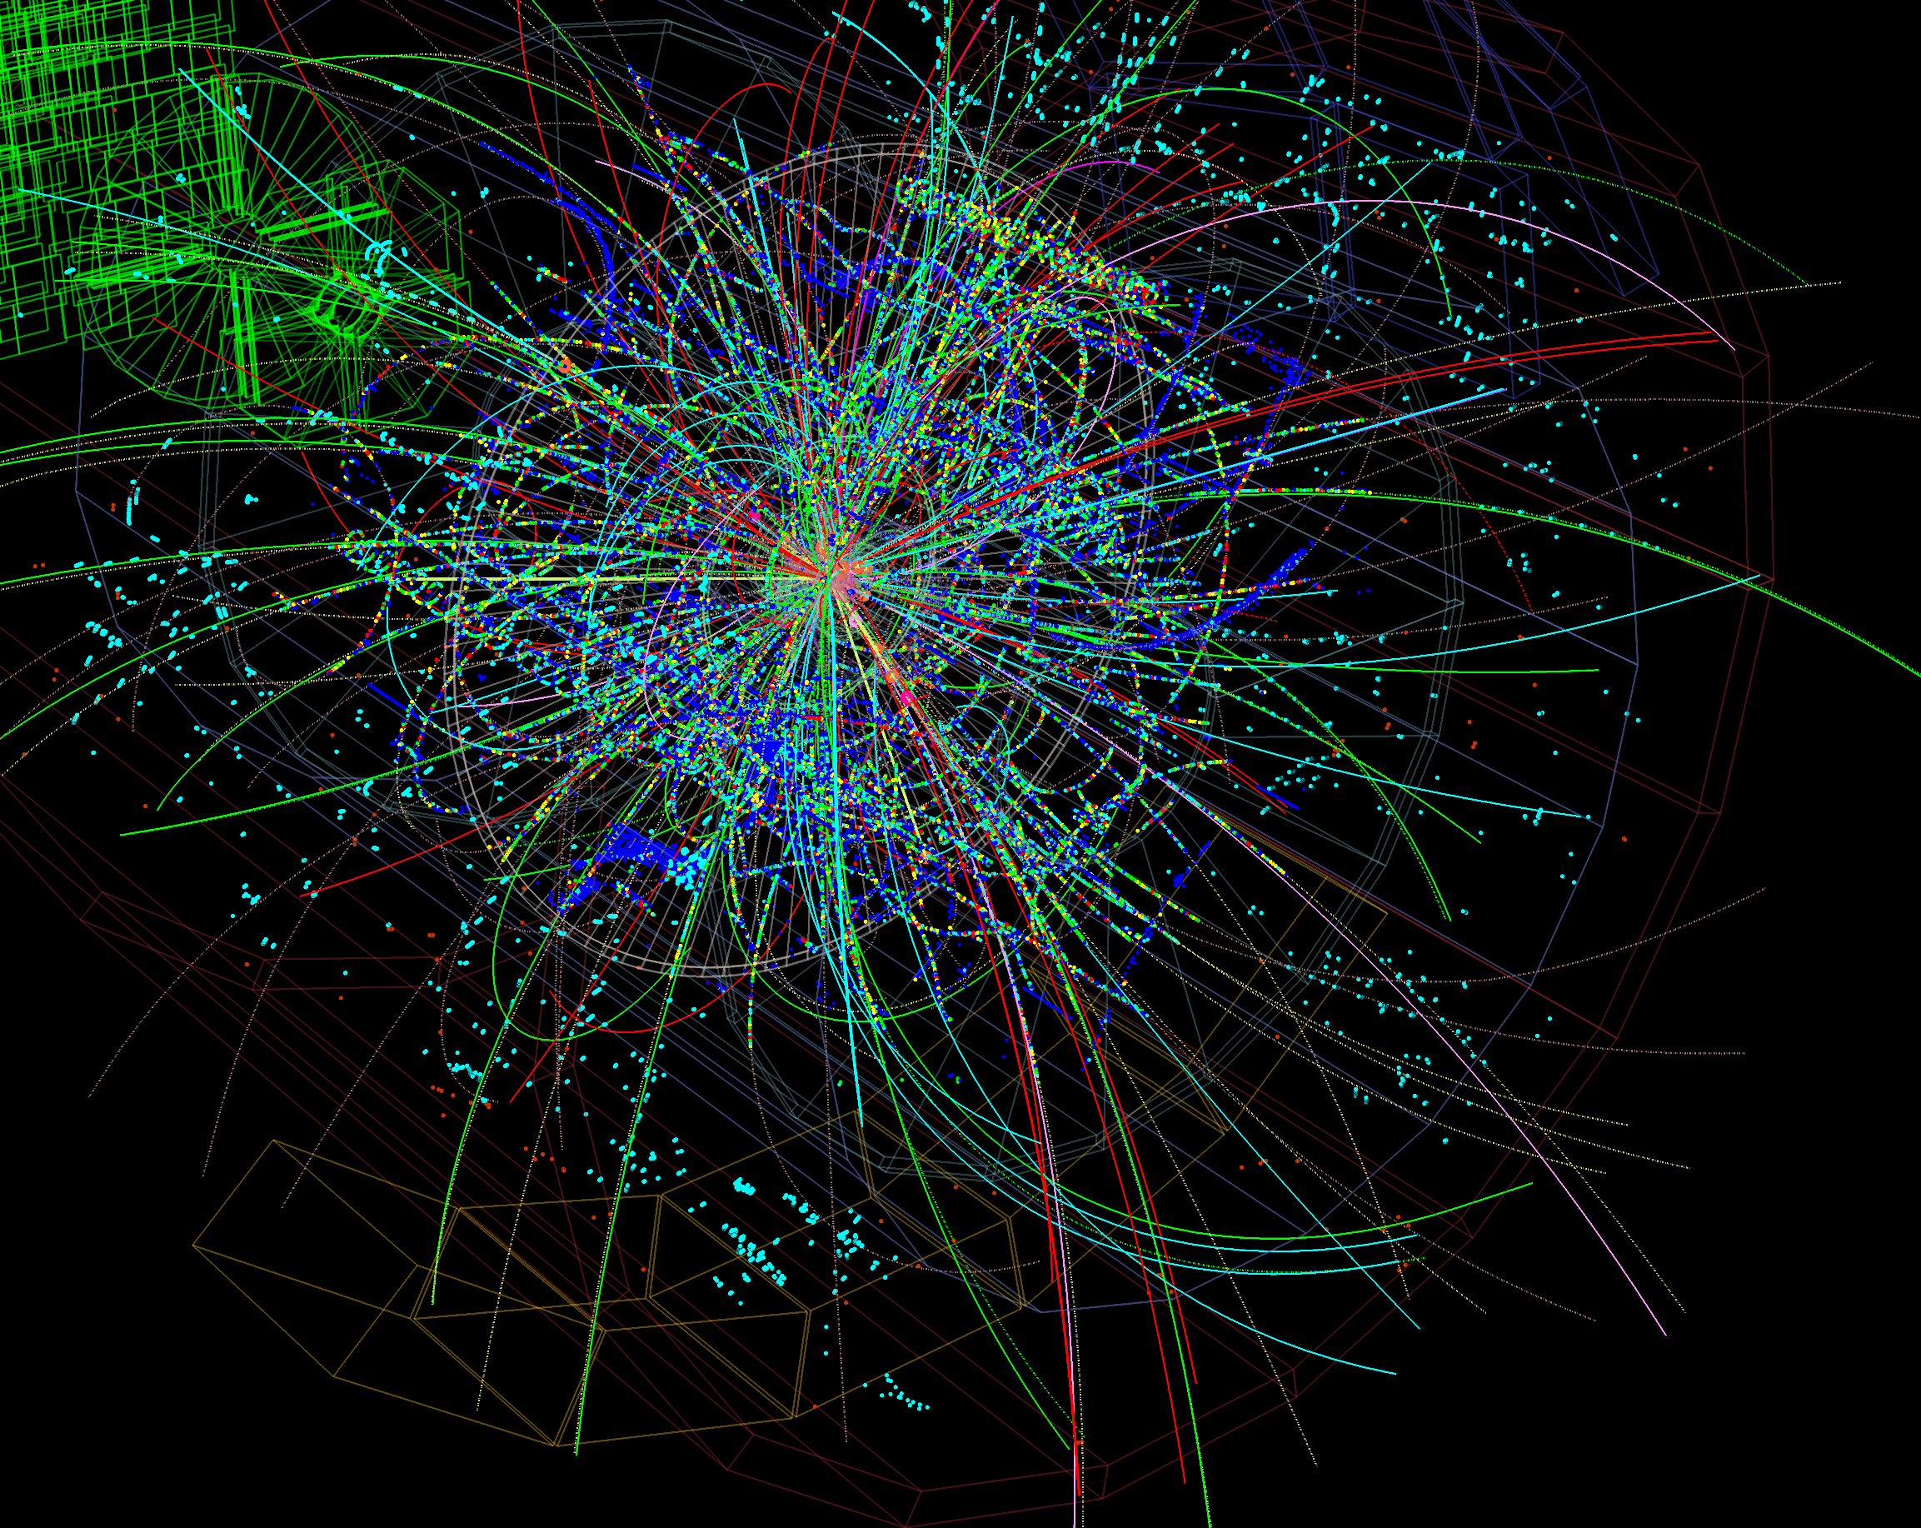
FACTS
The LHC collides protons at unprecedented energy, equivalent to 13,000 times their mass
40 Million collisions/sec, one every 25 ns. About 40 collisions per event. (40 MHz collision rate)
Thousands of particles emerge from each collision
1 MB of data recorded by the detectors at each collision. It represents 40 TB/sec! Too much to be stored.
Only 5% of those are stored after filtering. About 80 Pb of derived data per run.

Slide 7
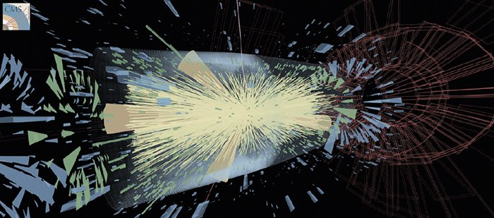
The LHC Big Data Challenge – HL LHC - 2029
High Luminosity LHC - 2029
200 collisions per event vs 40 today. Need to disentangle 200 collisions happening at once.
Event complexity grows non linearly
A HL-LHC run would need to store about 900 Pb of derived data. A data deluge!
Even taking into account HW progress (storage & processing), we are off by a factor of 10, projecting to 2029

Slide 8
Machine Learning and Deep Learning
Industrial Controls and Automation
Metrology
High and Ultra High Vacuum Systems
Data Analytics
Health, Safety and Environment Management
Cryogenics
Optoelectronics and Microelectronics
High Volume Data Management & Storage
Superconducting Magnets
Particle Acceleration and Control
Radiation Protection and Monitoring
Particle Tracking and Calorimetry
Sensors
Material Science
Cooling and Ventilation
Robotics
Collaboration Tools
Radio Frequency Technology
Manufacturing and Mechanical Processes
Nick Ziogas

Slide 9
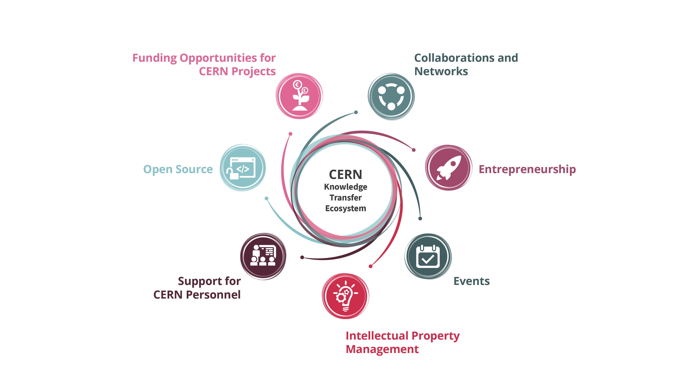
Our toolbox to accelerate innovation

Slide 10
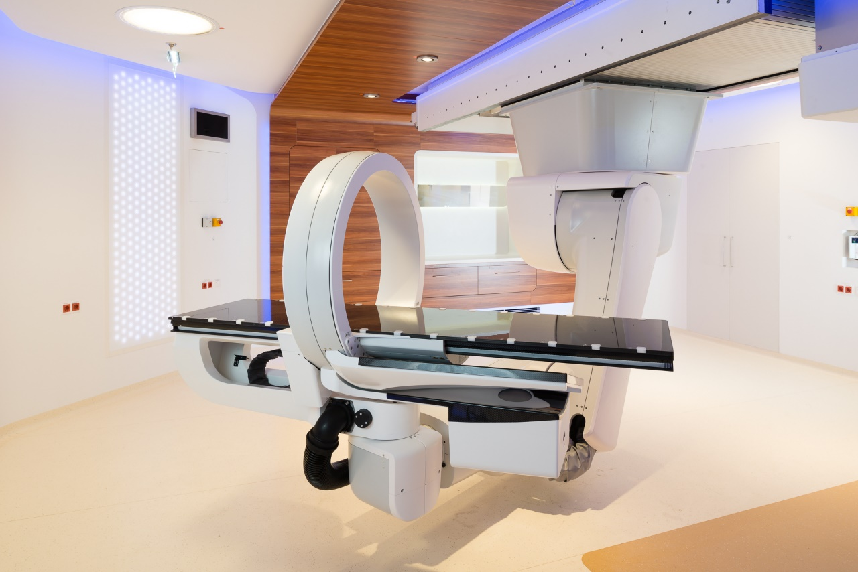
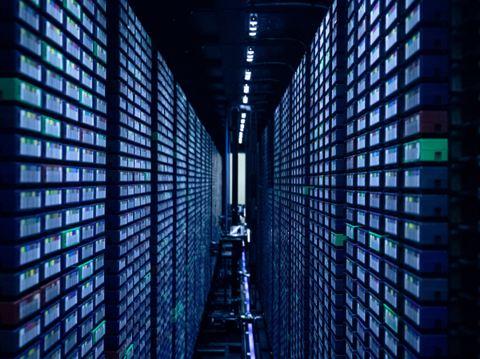
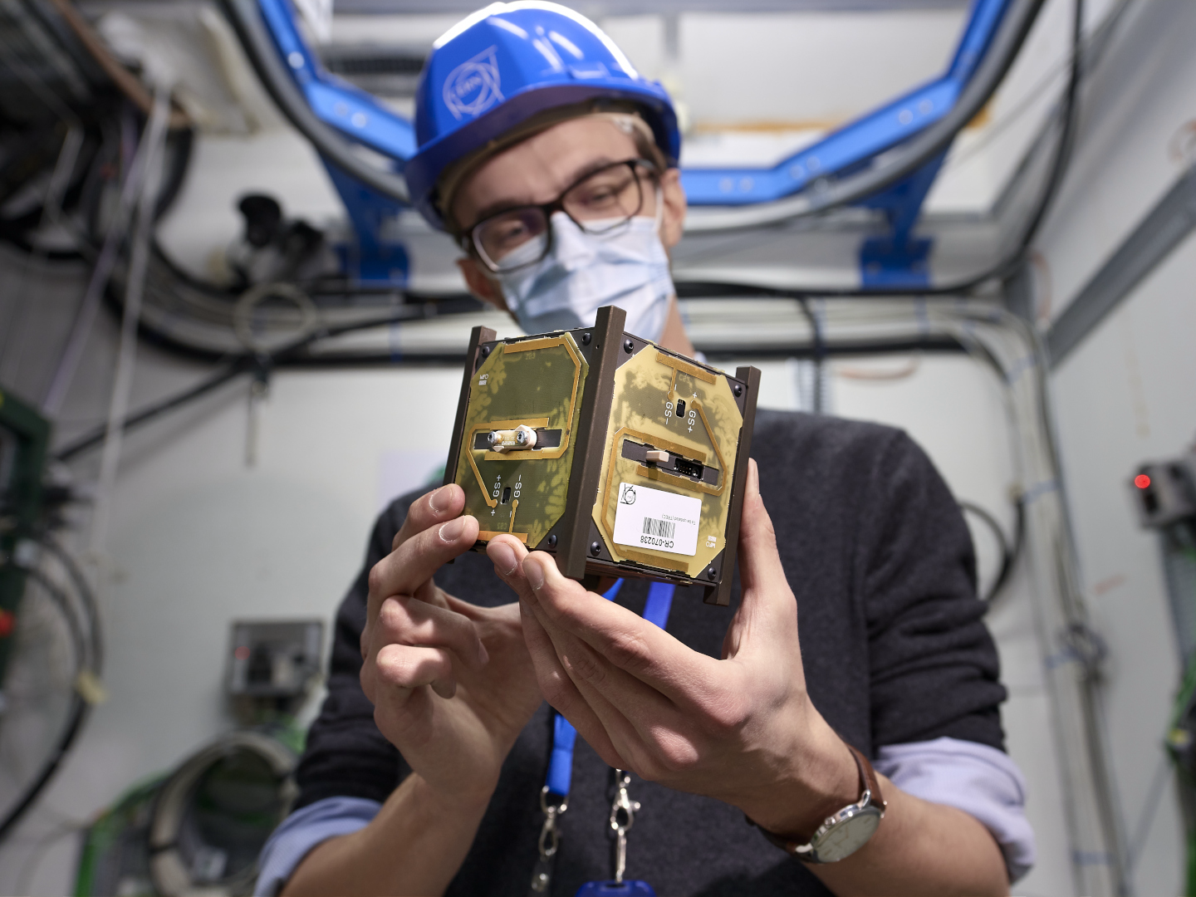

CERN as trusted non-commercial innovation partner
HEALTHCARE
ENVIRONMENT
DIGITAL
AEROSPACE
QUANTUM

Slide 11
Hybrid strategy: tech push & market pull
Scout for technologies
Search unmet needs
Mobilize tech experts
Mobilize innovation partners
Create tech and IP dossiers
Create value propositions

Slide 12
Shaping innovation partnerships
Discover
Discussion with Innovation / R&D management
Discovery day program at CERN
Shape
Define innovation ambitions and technical needs
Discuss expertise contributed by partners
Execute
Formalize partnership:
- License
Find mutual interest
Timeline, resources, IP
- Consultancy / Service
- Contract Research-
- Collaborative R&D

Slide 13
Licence
Access to existing solution
Support to implement
Consultancy/Service
Time of experts
Contract research
Specific solution
Outsource its development to CERN
Collaborative R&D
Time of facilities
Specific issue
General issue
Jointly find solution
Jointly develop solution

Slide 14
How much time does it take to create a R&D Partnership?
What is the % of partnerships that typically make it to the execution phase?
Knowledge Transfer @ CERN

Slide 15
MedAustron and CNAO offer hadron therapy using CERN technology.
Collaborative R&D

Slide 16
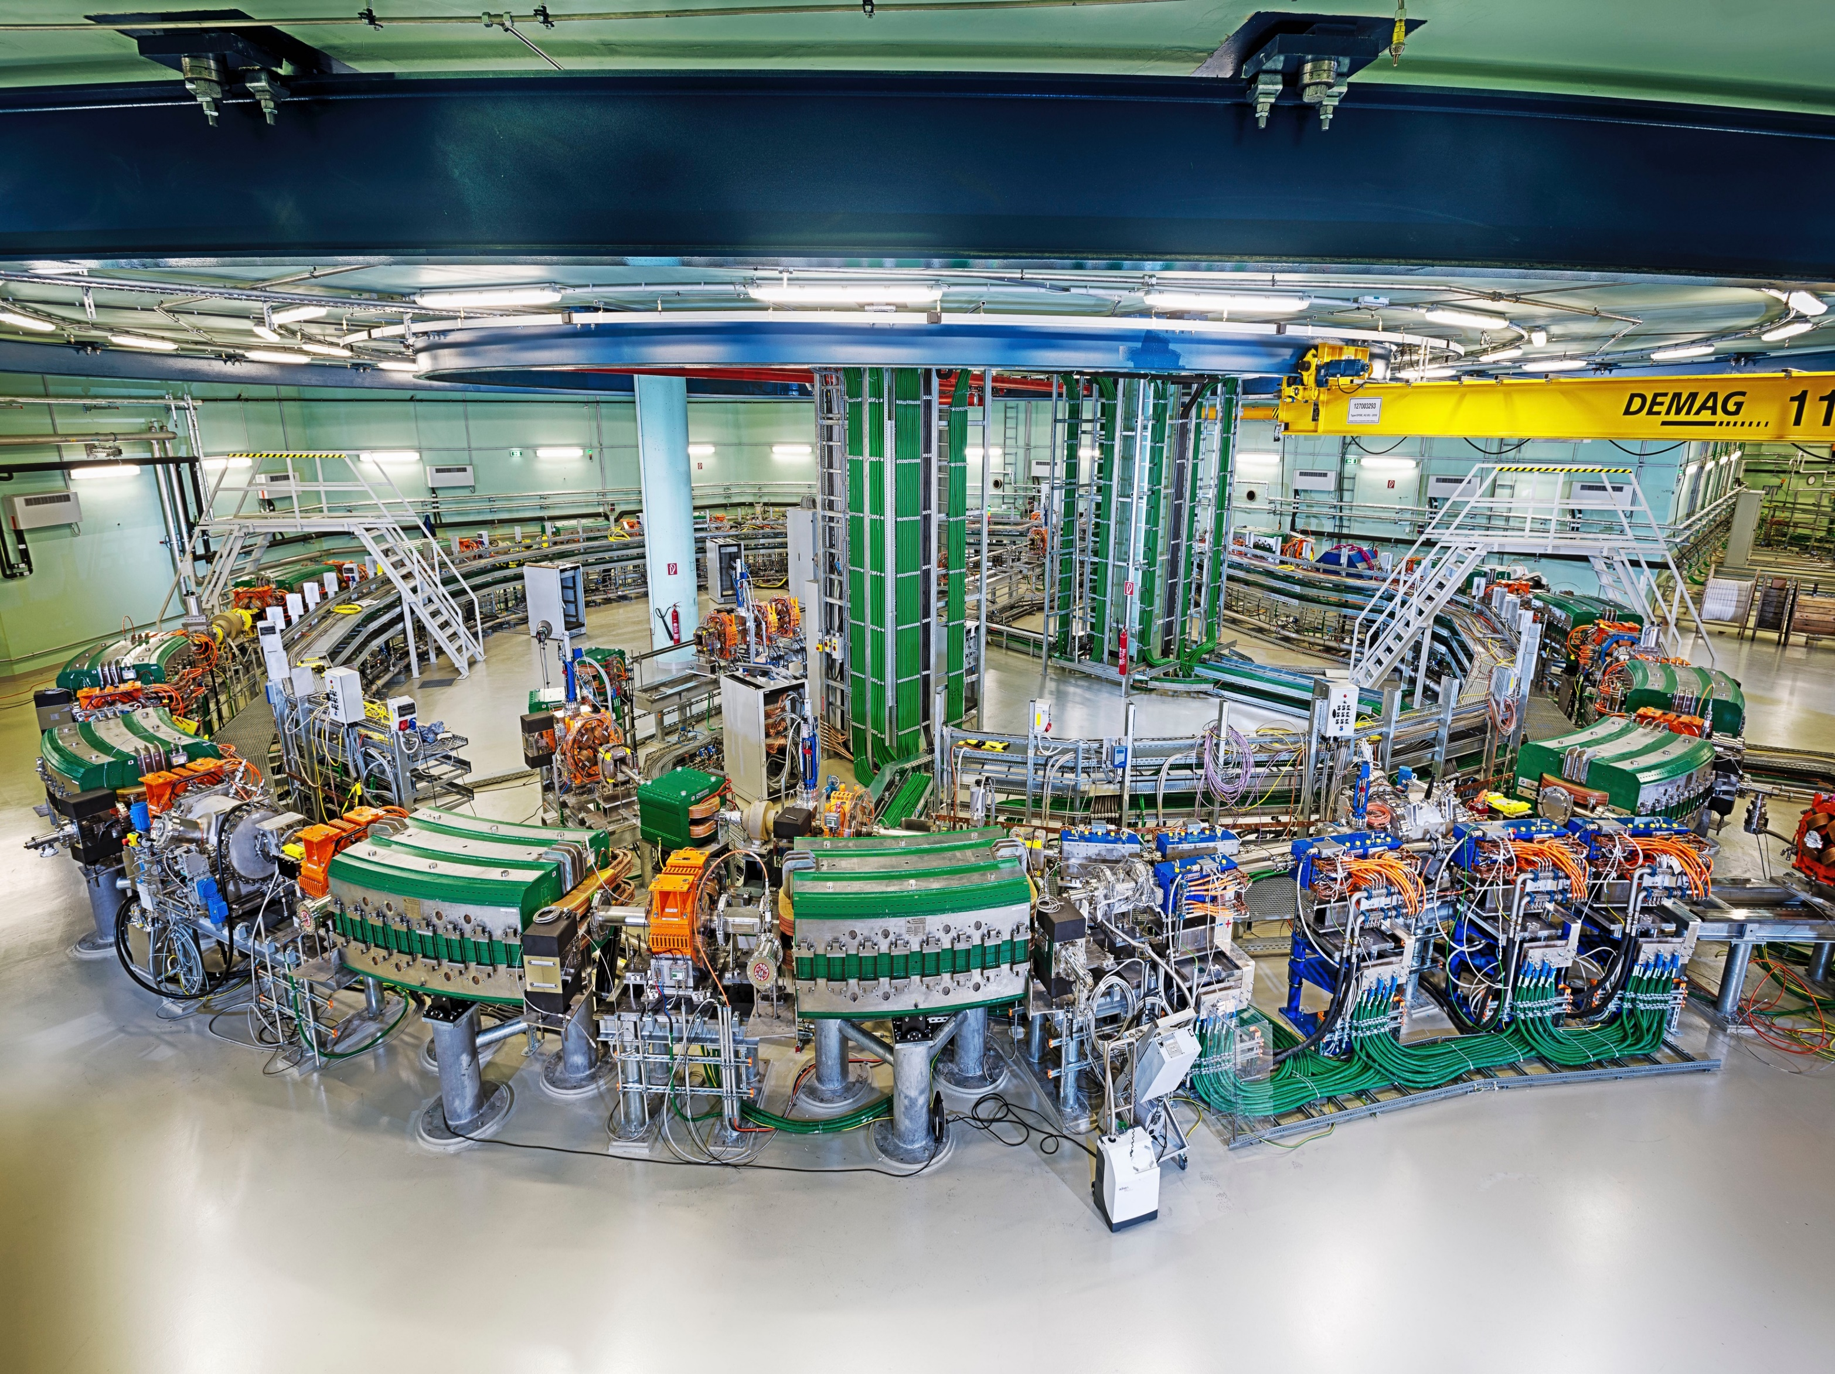
Collaborative R&D
MedAustron and CNAO offer hadron therapy using CERN technology.

Slide 17
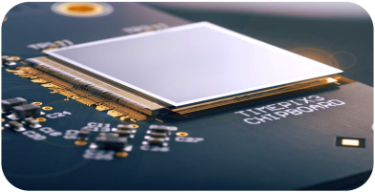
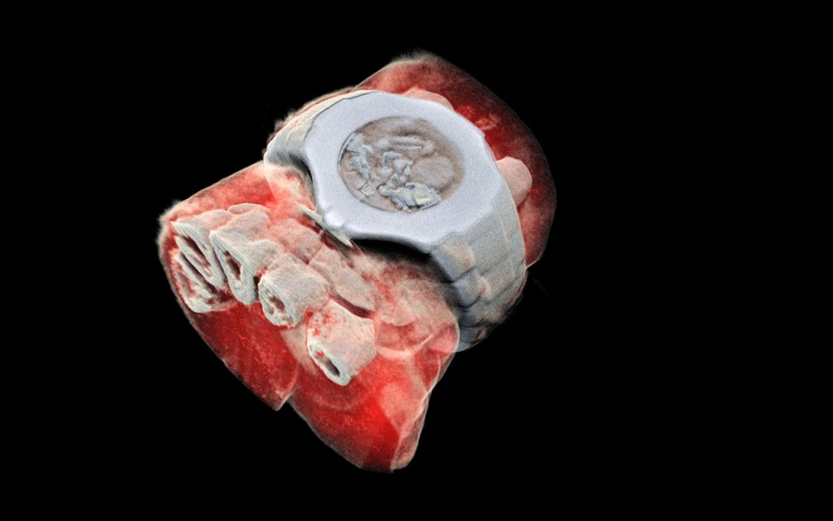
License
MEDIPIX Read-out chips for particle imaging
MARS Bio Imaging: next generation X ray finally in color using CERN chips

Slide 18
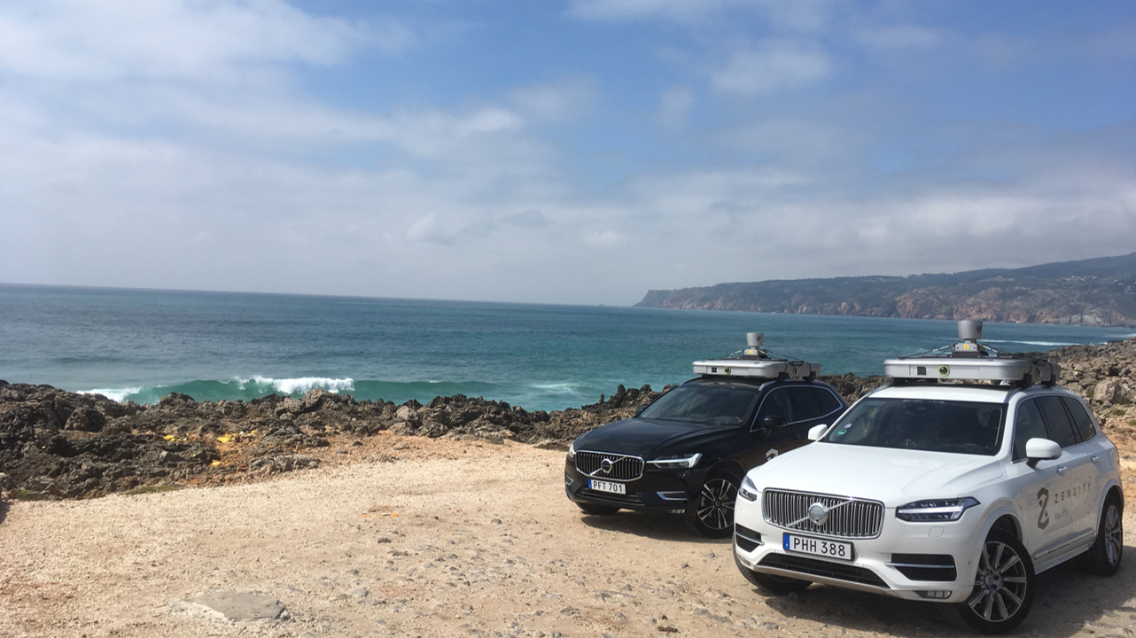
ZENSEACT (Volvo Cars Company) teams up with CERN on extremely fast machine learning using FPGAs.
Collaborative R&D

Slide 19

CEVA and CERN joined R&D on neural network weight and activation compression algorithms aiming make them run more efficiently. Wireless comms & computer vision applications
Collaborative R&D
  General issue
  Jointly find solution
  Jointly develop solution

Slide 20
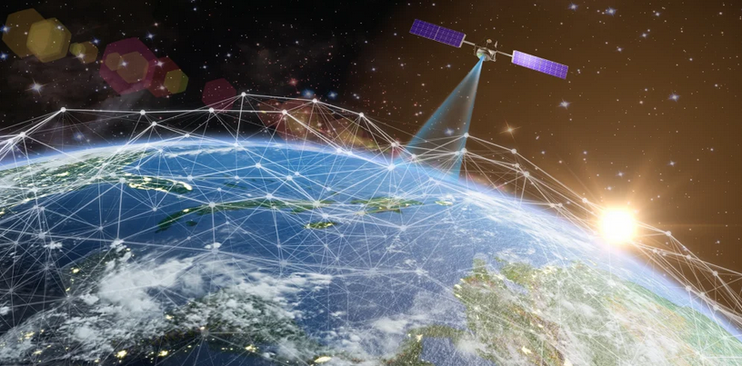





On board inference of Earth Observation images:
Application: Detection of plastic litter at sea.
Next generation EO applications
Successful EU Project Submission

Slide 21
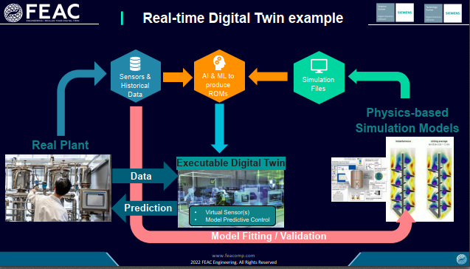
AI enhanced autonomous condition monitoring for Septa magnets, using Digital Twins
Collaborative R&D

Slide 22

ROCHE is using CernVM-FS for application and library distribution worldwide.
Contract Research for a Company in the financial services sector. JumpTrading has strong interest in this tech for fast reliable worldwide file distribution.
Contract Research
  Use case and requirements by the company
  Code contributed to the OS project
  Development @CERN, benefit for HEP applications

Slide 23

Collaborative R&D
Collaboration with CORMEC and WUR to support national banks and regulators to detect trading anomalies in stock market.

Slide 24

Contract research
High energy beam for testing radiation hardness with ESA.
Before embarking on its journey, critical components of ESA’s interplanetary mission were tested in the only facility on Earth capable of replicating Jupiter’s harsh radiative environment.

Slide 25

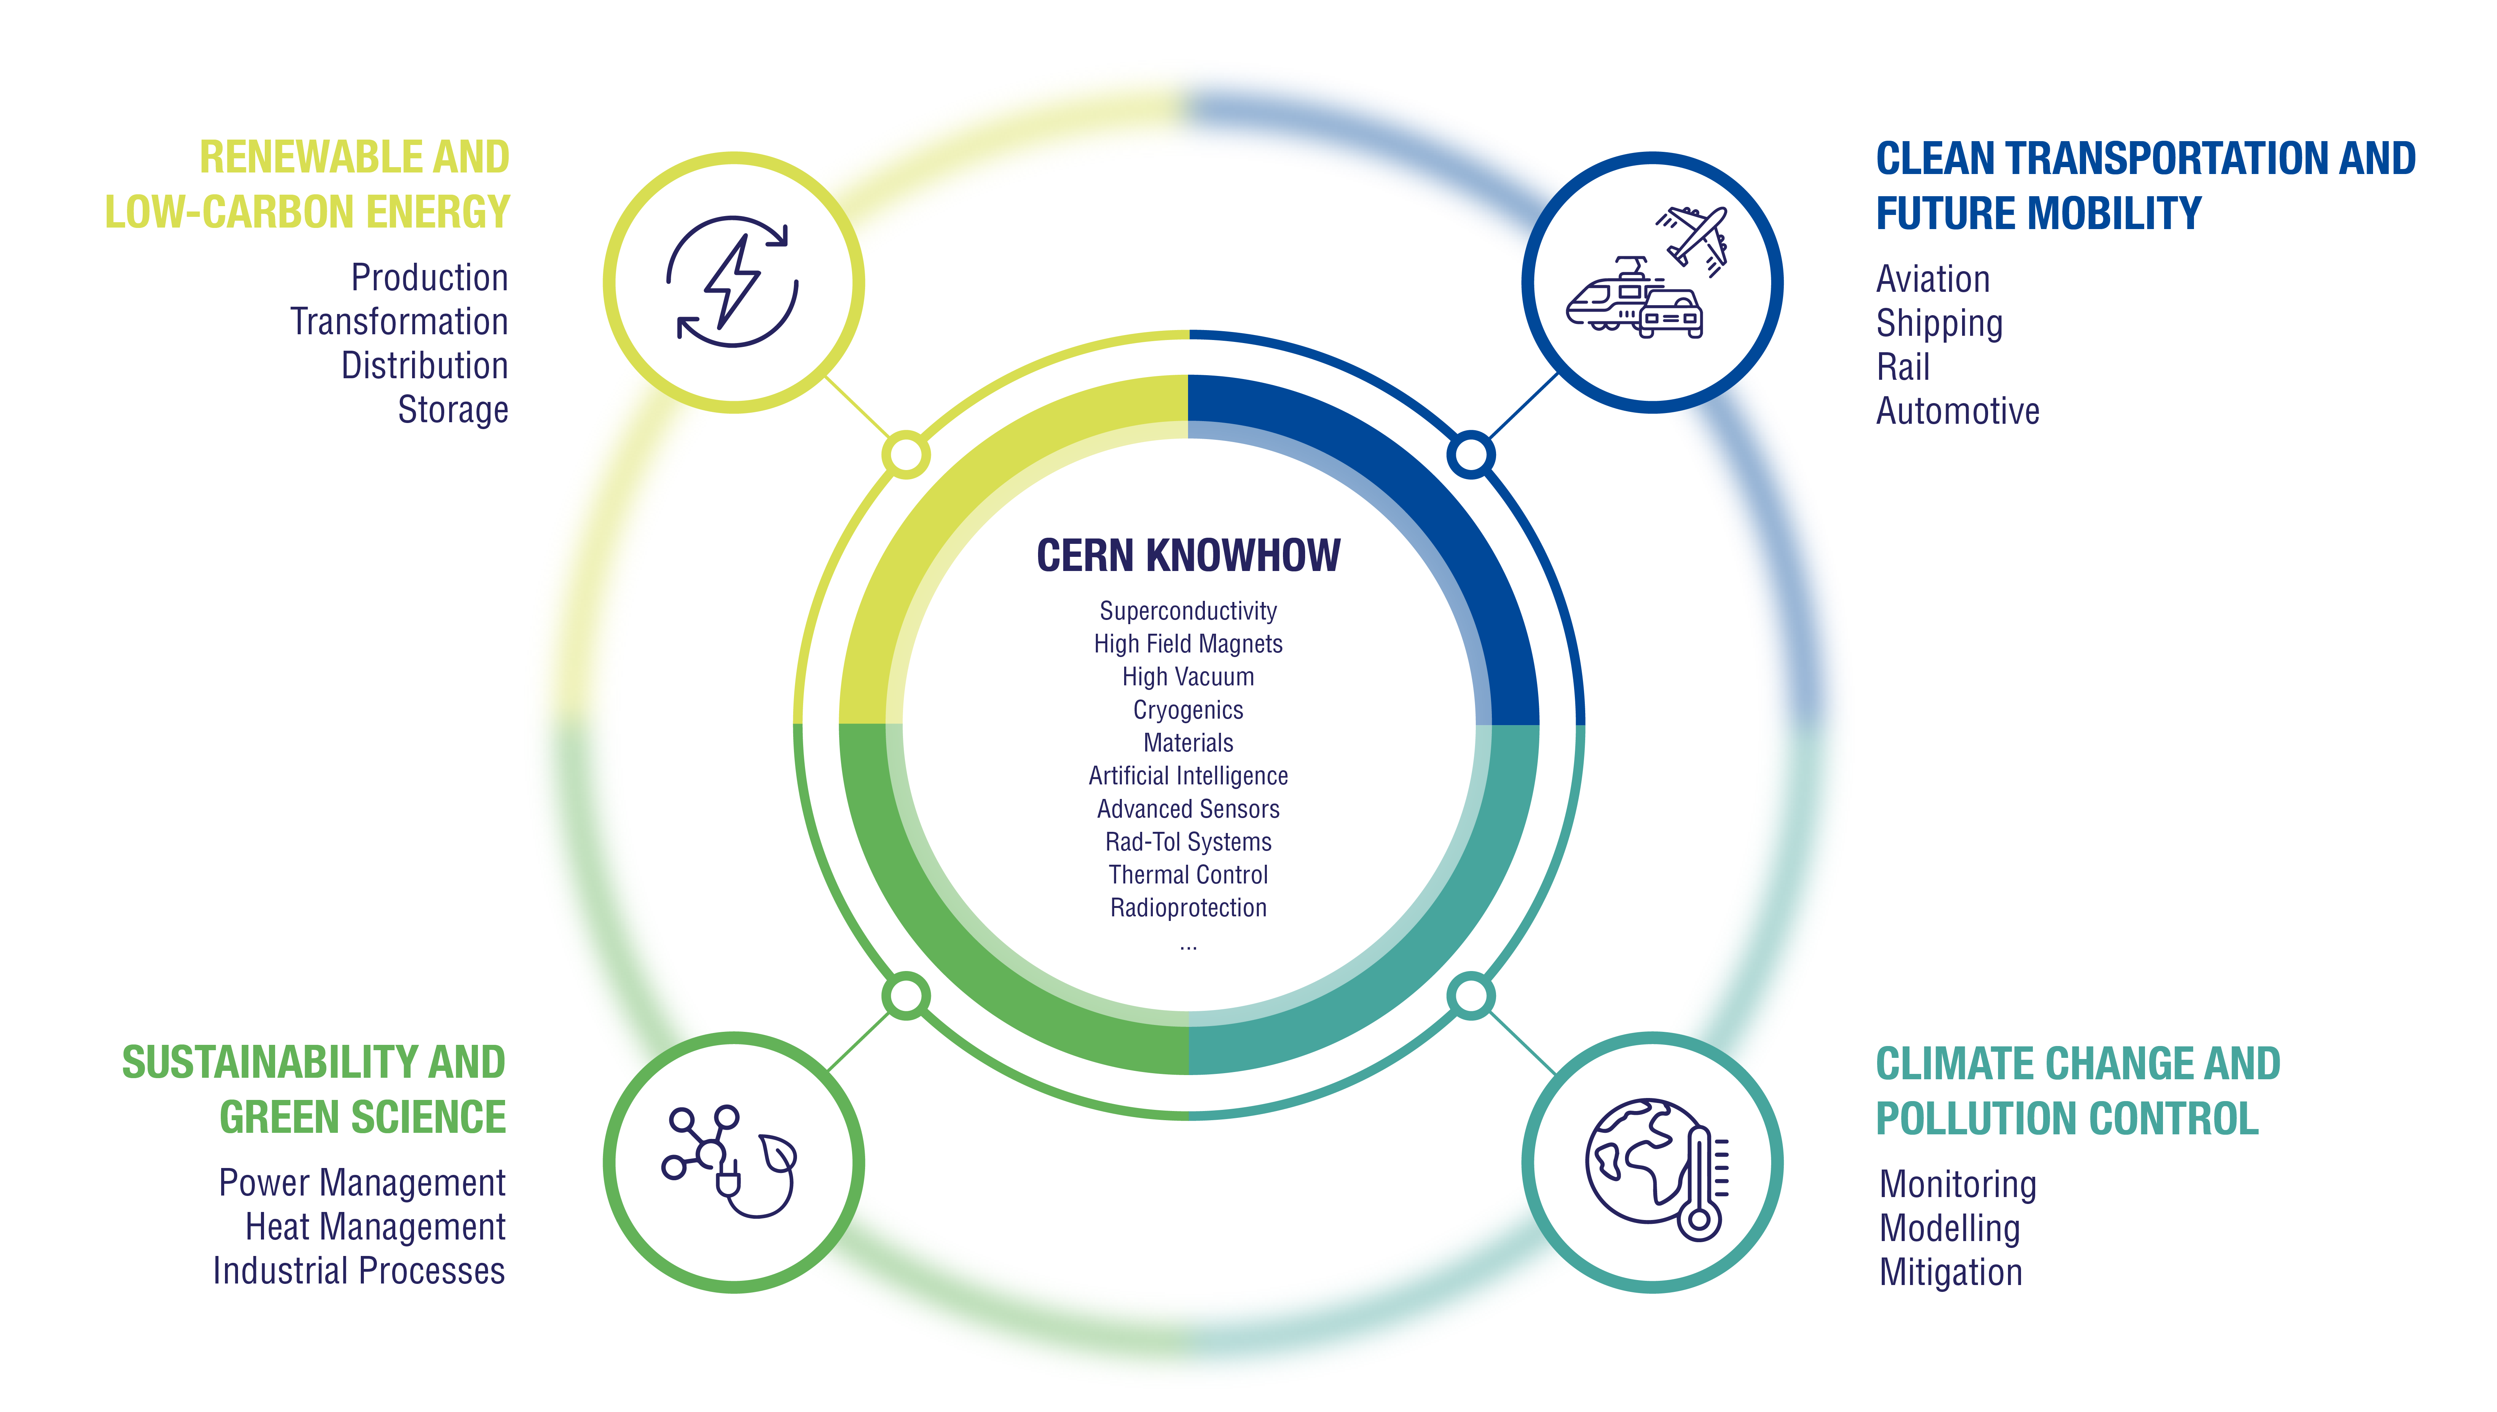

Slide 26
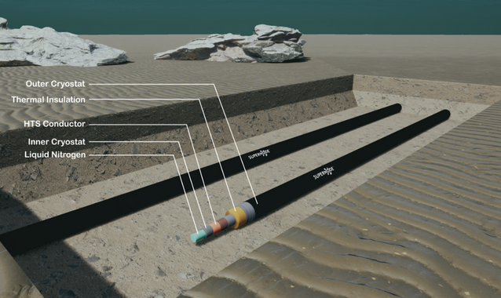
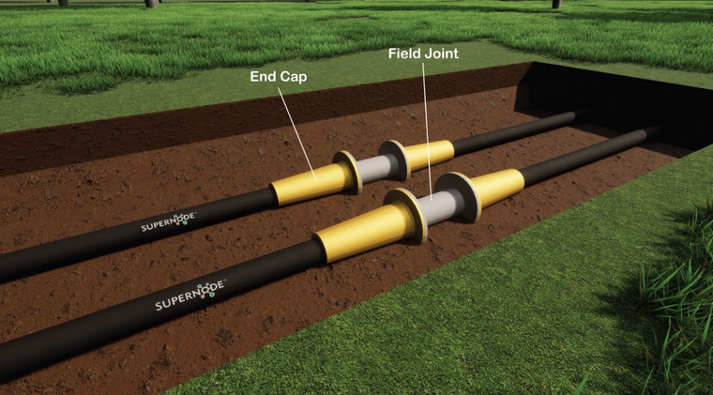
SUPERNODE an IE startup working with CERN on superconducting tech for HVDC transmission
Collaborative R&D

Slide 27
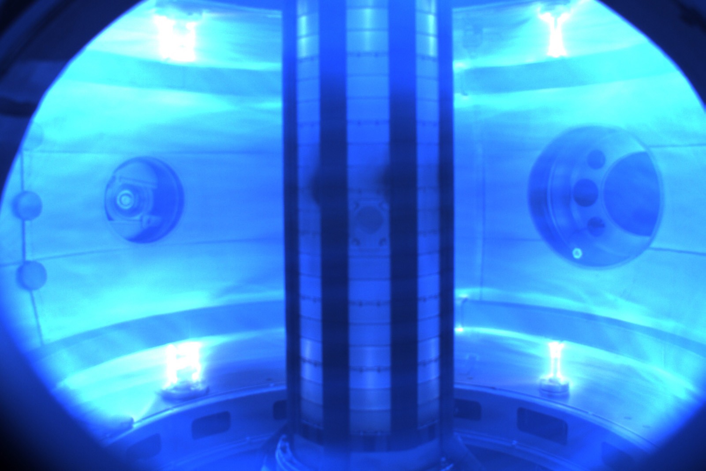
Tokamak Energy (fusion power) taps into expertise of CERN on simulation of currents and magnetic fields.
Consultancy

Slide 28
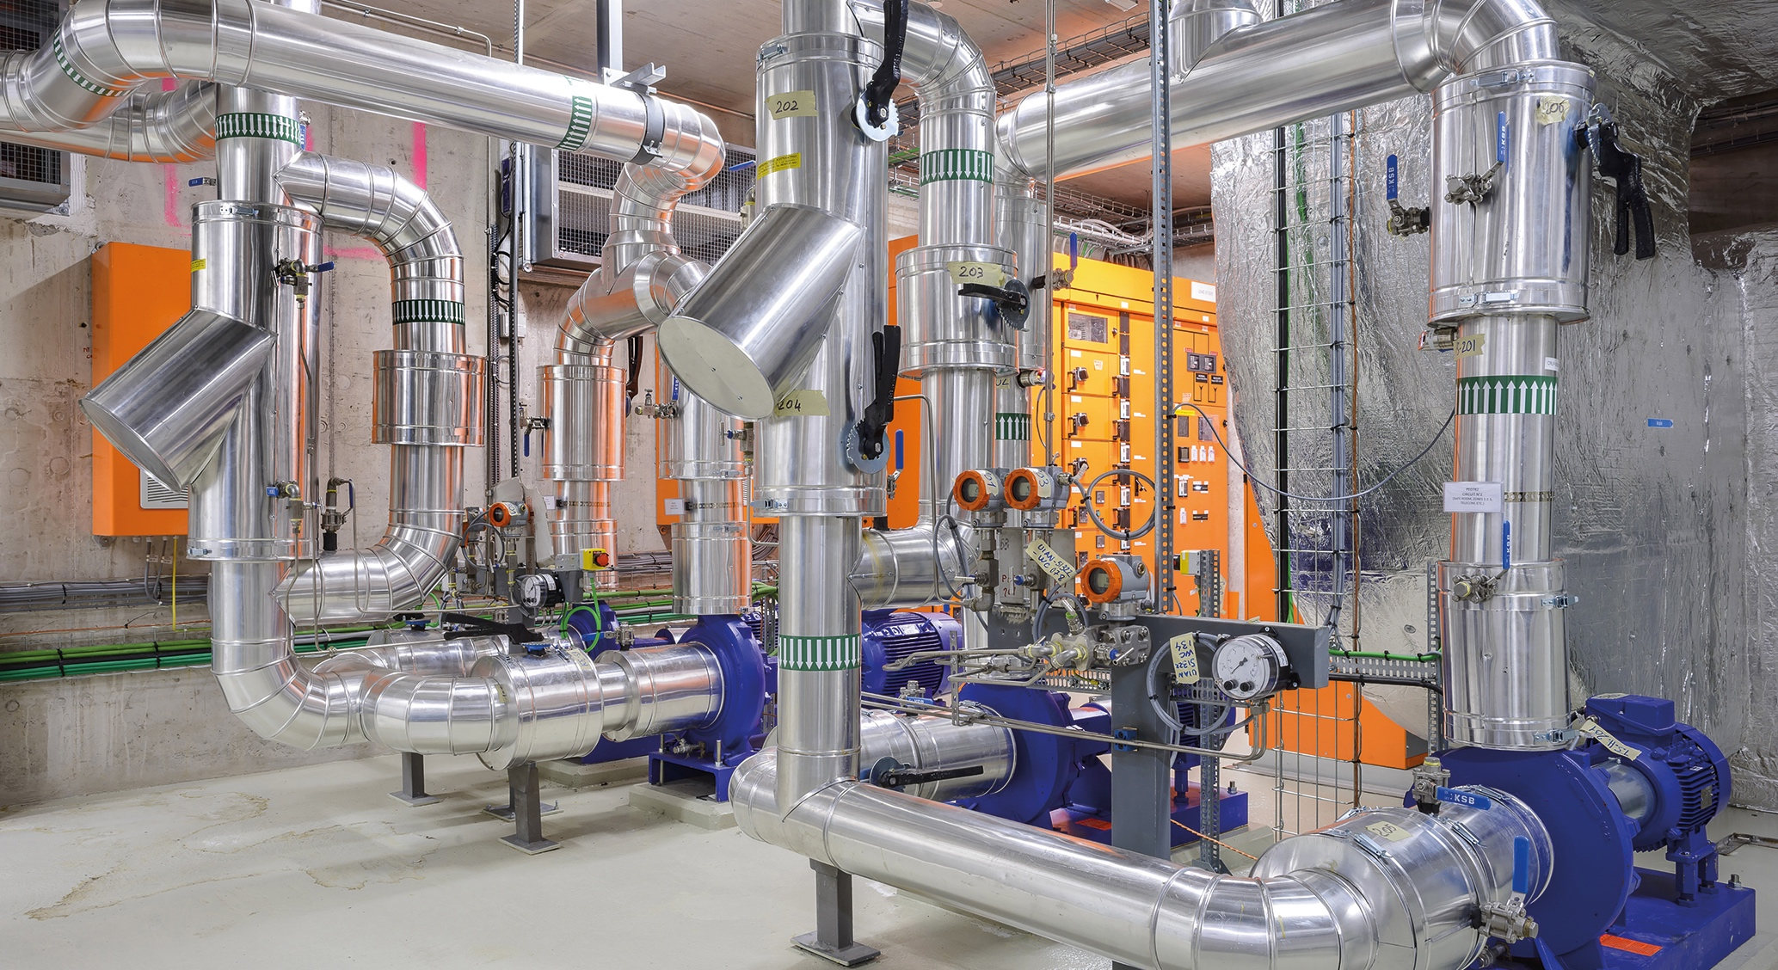
ZENSEACT (Volvo Cars Company) teams up with CERN on fast machine learning using FPGAs.
Collaborative R&D
Collaborative R&D
CERN and ABB team up on reducing electricity in cooling and ventilation.

Slide 29
Key lessons learned when innovating with Industry
  CERN is strong in the ‘extremes’ of the technology scale
  You need passionate experts on both sides to succeed
  Need to identify a concrete project & clear business case
  Keep in mind differences in culture, language, and pace
  Driving deep tech innovation requires courage, commitment & time
  But, results can be way beyond expectations!

Slide 30
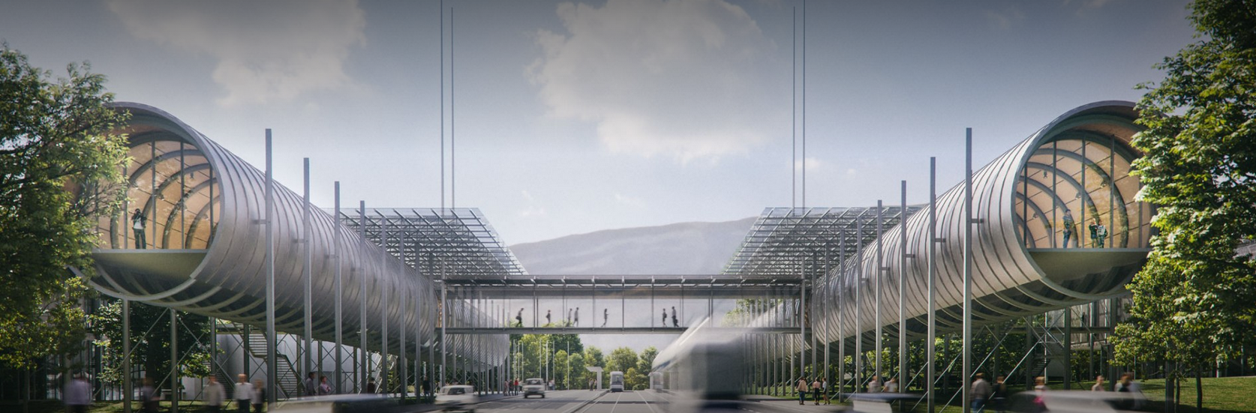

Thank you for your attention
Nick Ziogas@cern.ch
kt.cern

