Slide 1
FAT Tests at MC Uldall for collimator supports - 22/10/2024
Thibaut Parmentier

Slide 2
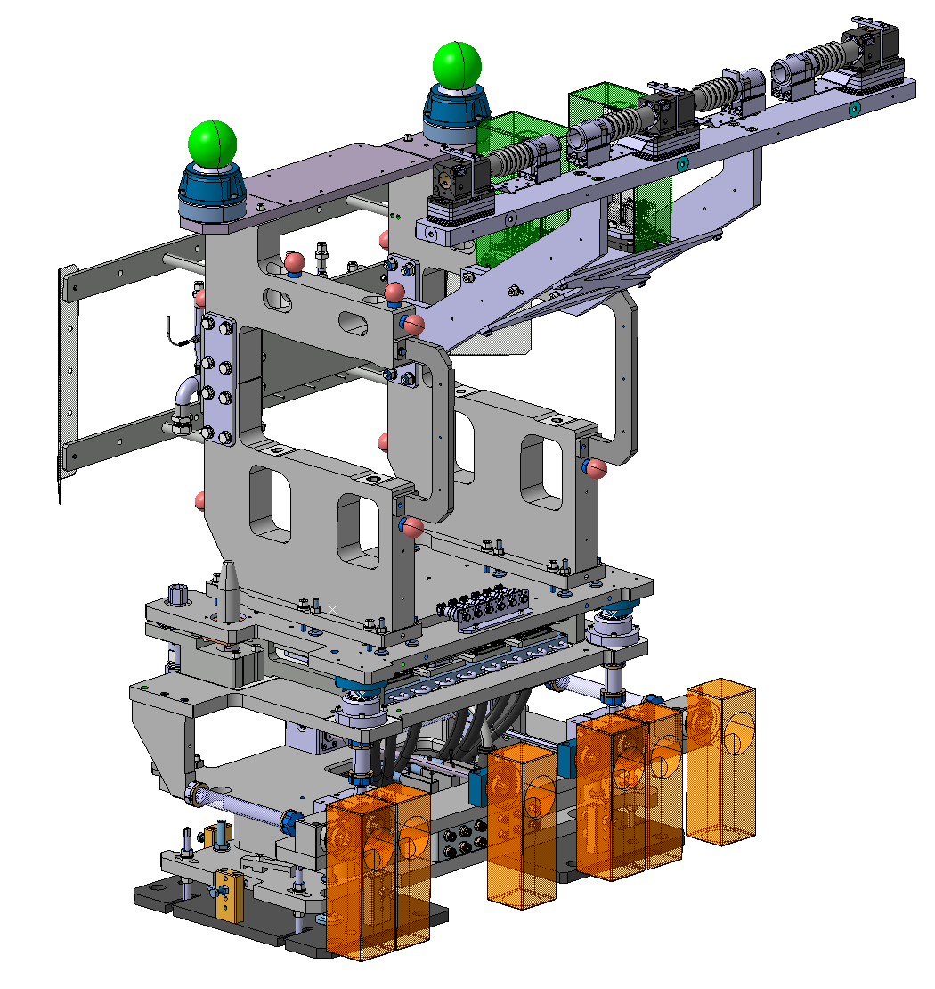
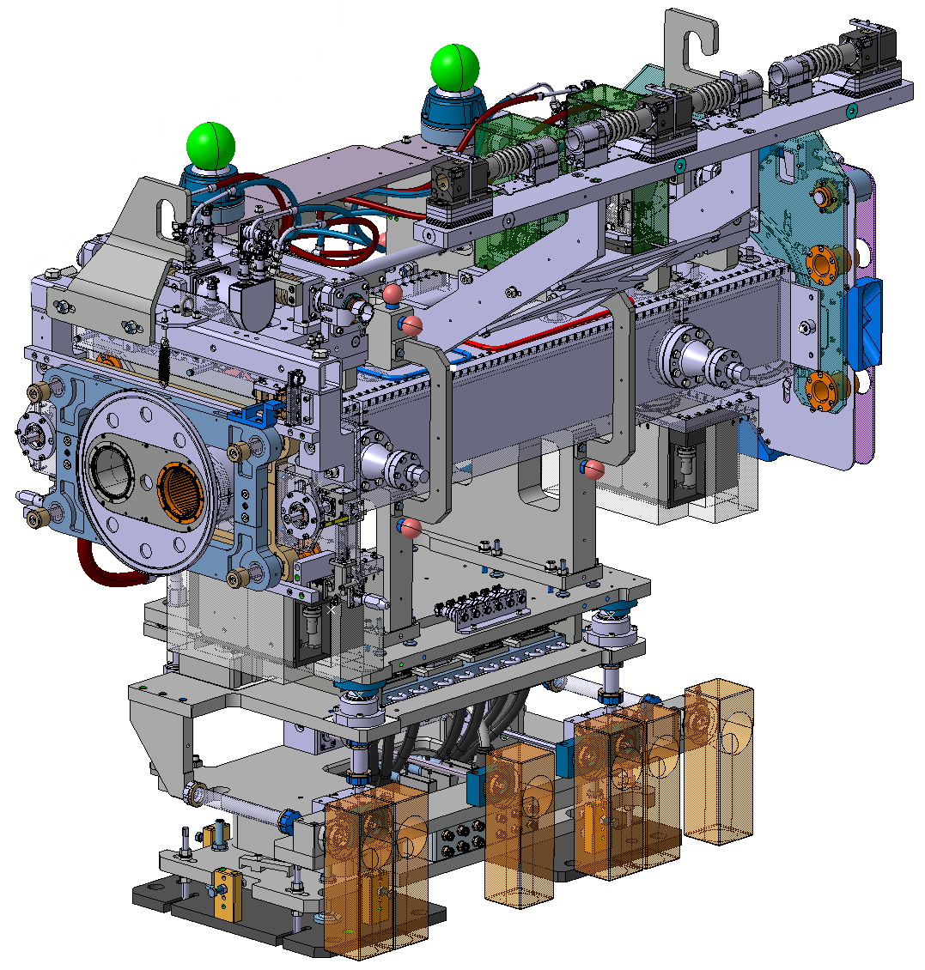
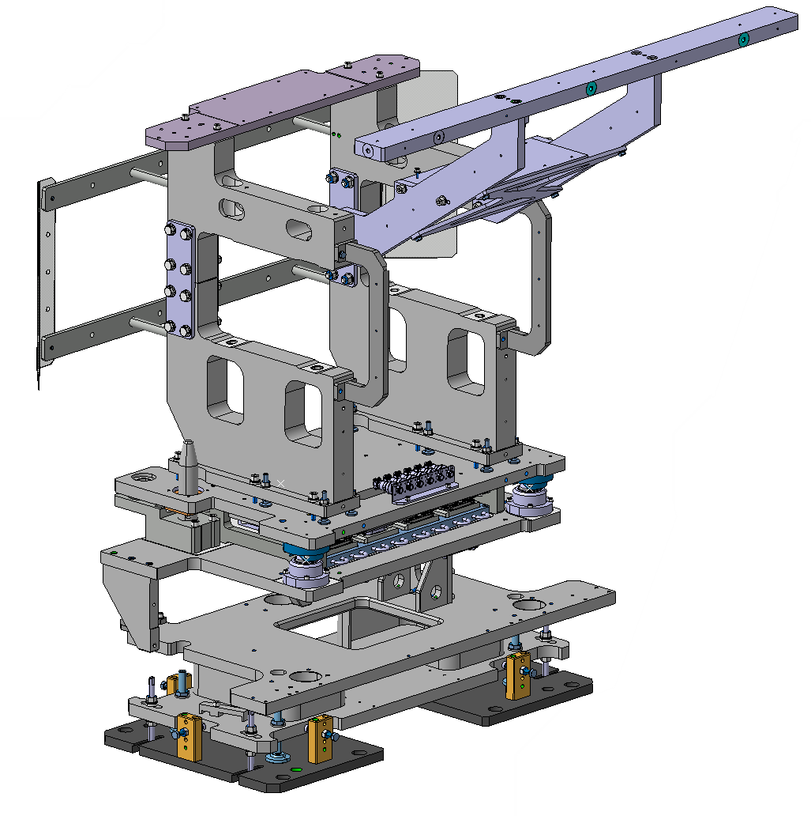
Supports for X-series and masks
Installed collimator (TCLPX)
Collimator support
Produced by MC Uldall

Slide 3
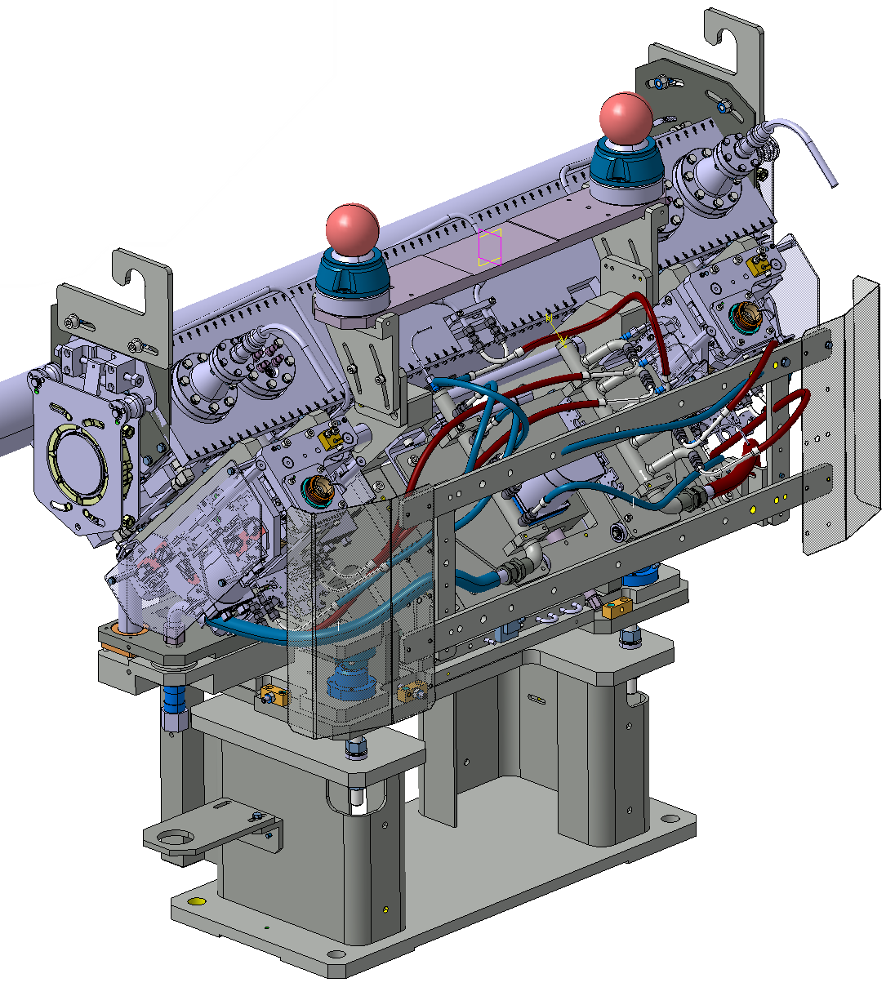
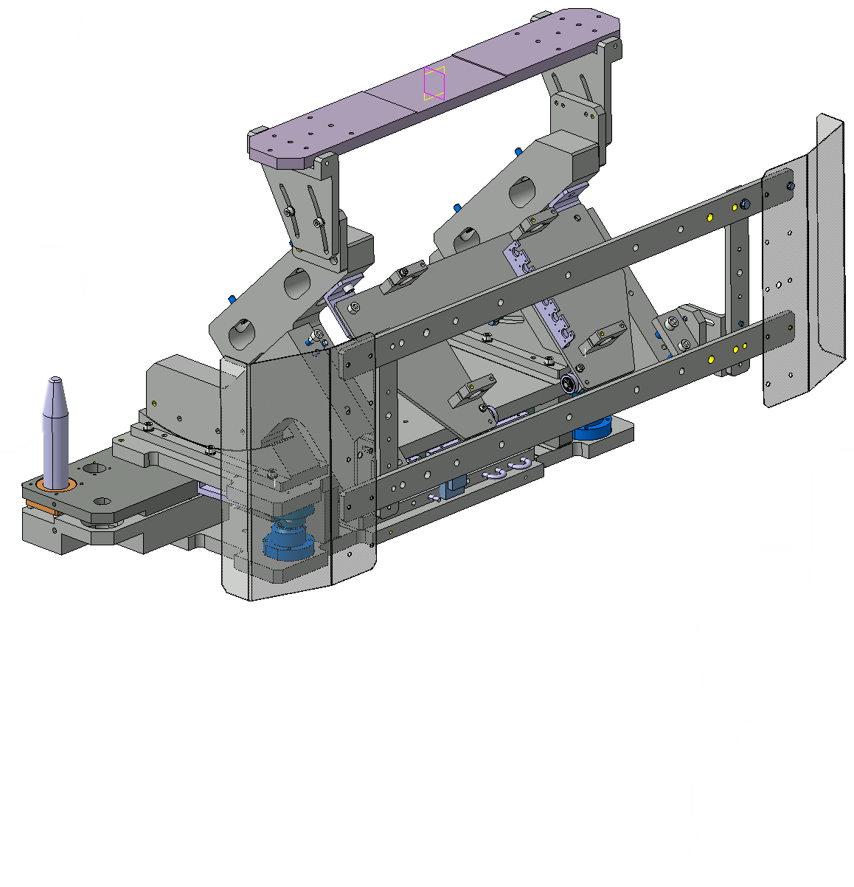
Supports for TCSPM and TCTPM
Installed collimator (TCSPM 45°)
Collimator support
Produced by MC Uldall

Slide 4
Schedule
Week 49 2024: Delivery of the Pre-series units
          3 Supports for X-series and masks
          1 Support for TCSPM
          7 Supports for tests at CERN
          Loose parts for linear stage
Week 27 2025: Delivery of the Series units
          28 Supports for X-series and masks
          11 Supports for TCSPM
          10 Supports for TCTPM

Slide 5
Description of the FAT
Visual inspection
Torque verification
Ball support movement check
Label verification
Hypertac - and BPM connector integration test
Fixation test
Insertion test

Slide 6
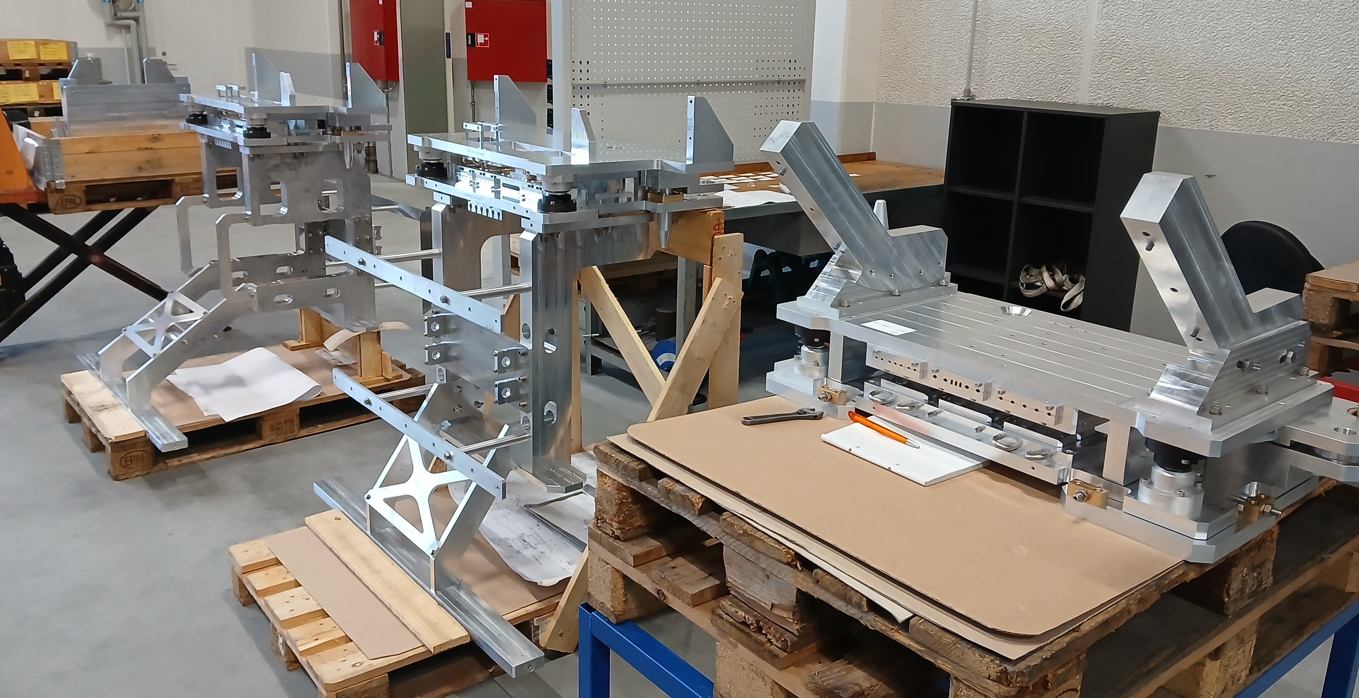
Description of the FAT
Visual inspection

Slide 7
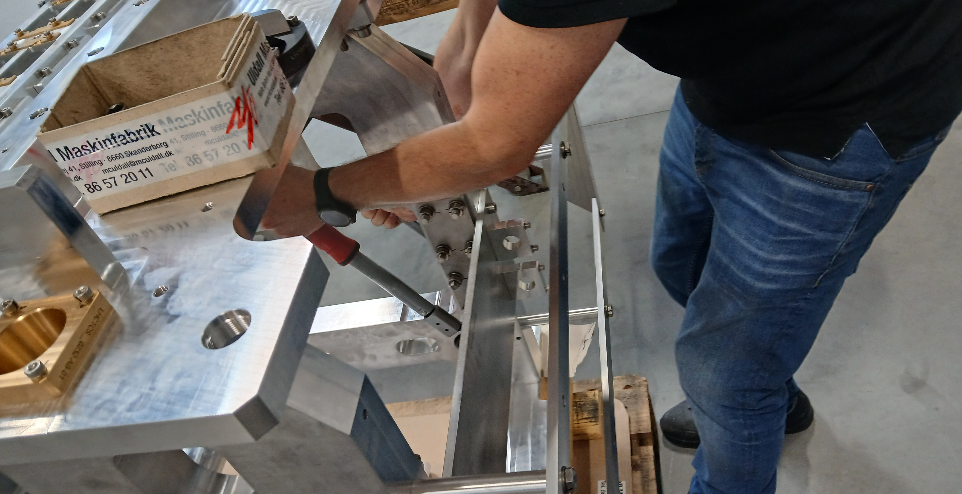
Description of the FAT
Torque verification

Slide 8
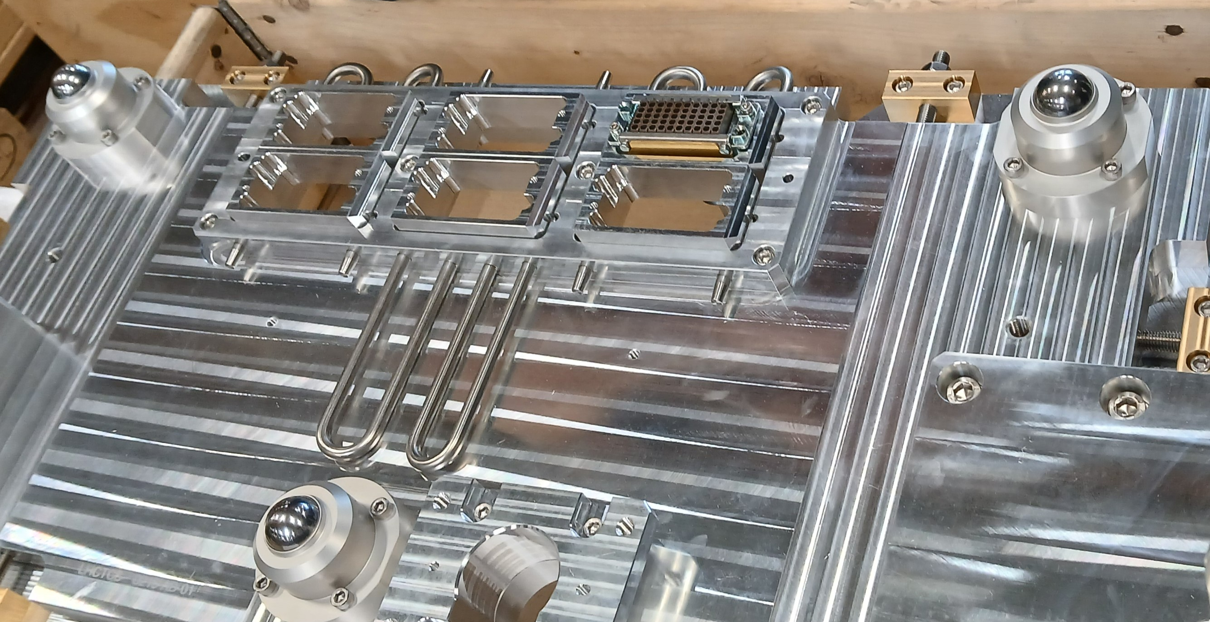
Description of the FAT
Ball support movement check

Slide 9
Description of the FAT
Labelling verification

Slide 10
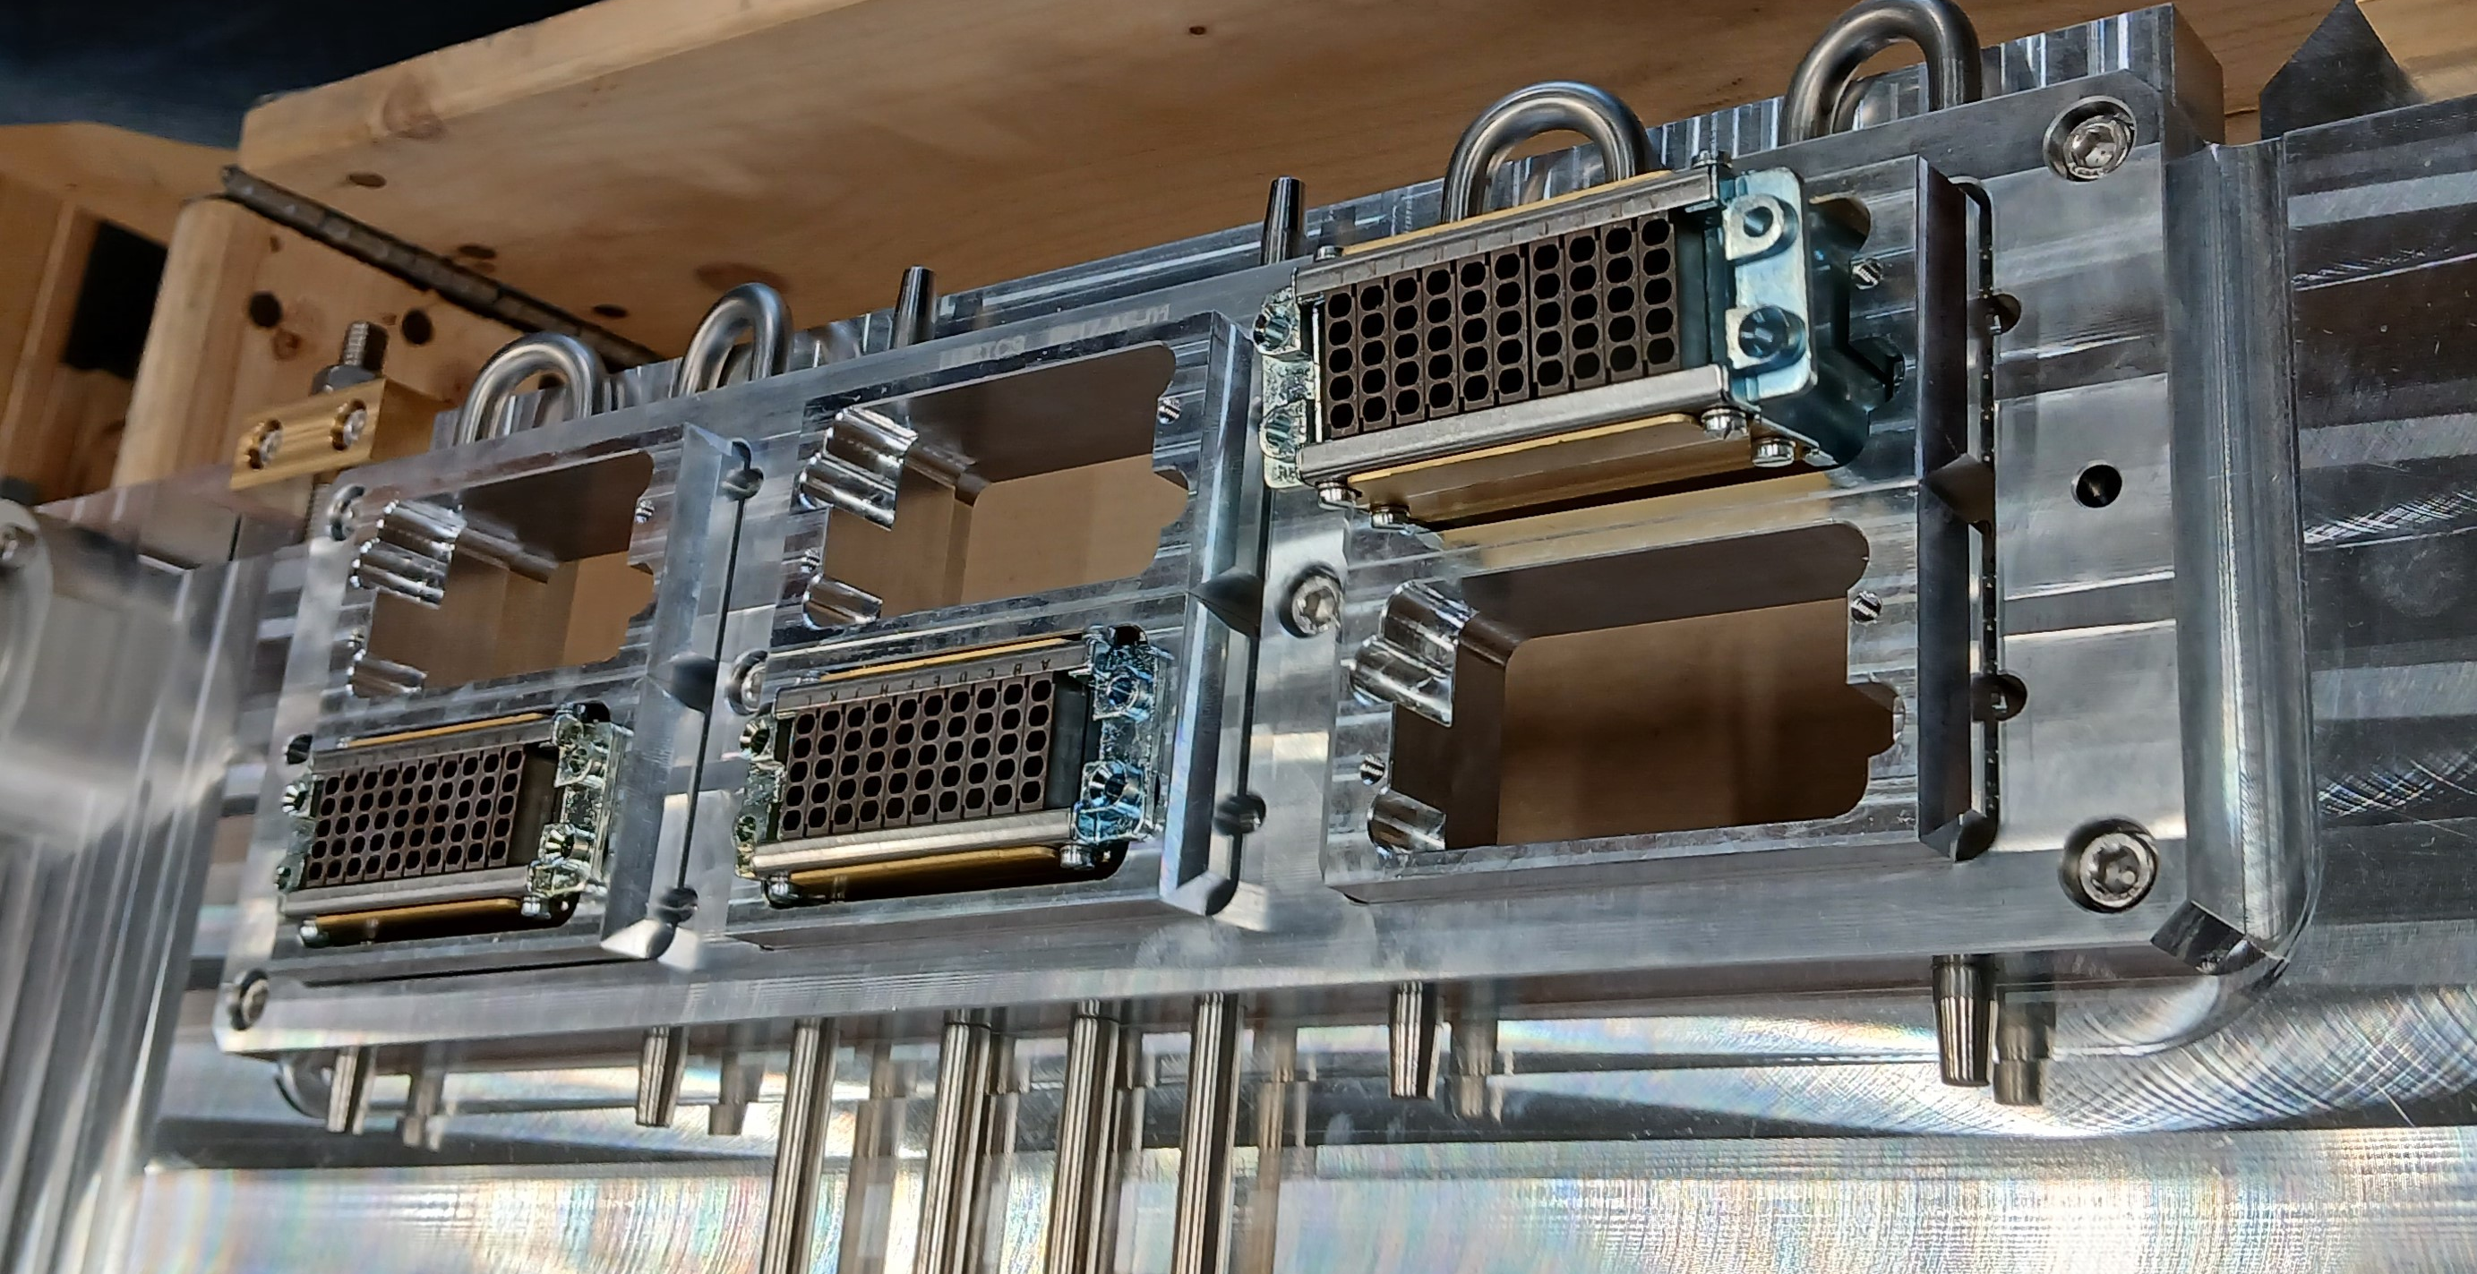
Description of the FAT
Hypertac - & BPM connector integration test

Slide 11
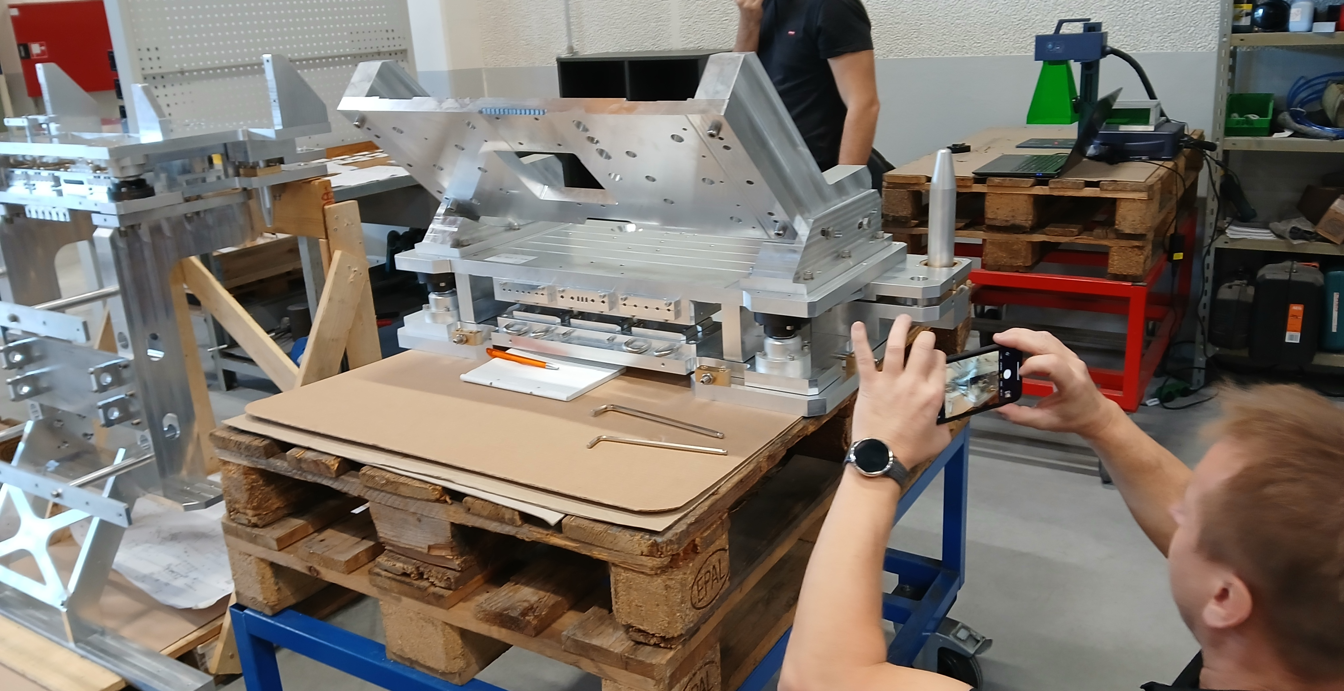
Description of the FAT
Fixation test

Slide 12
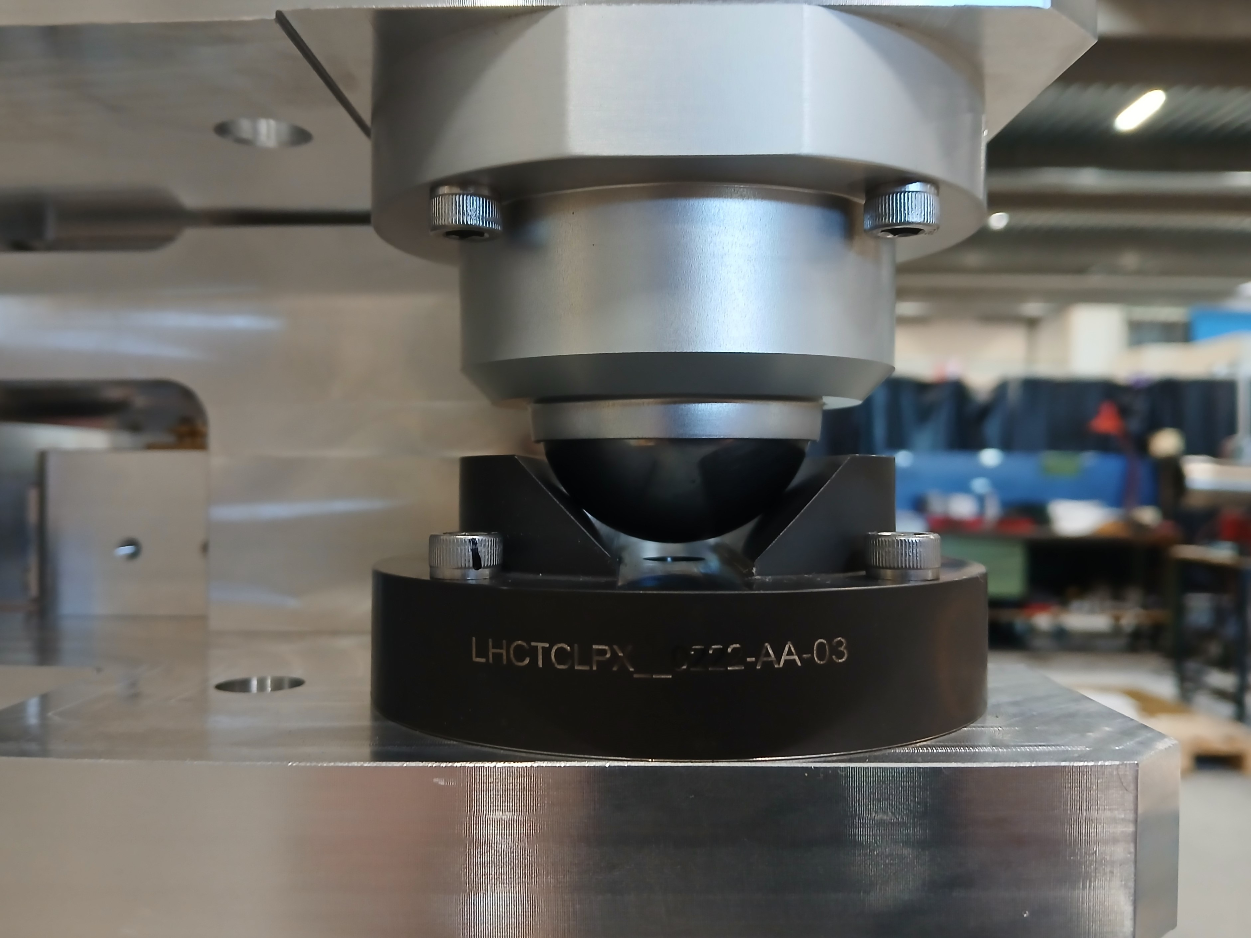
Description of the FAT
Insertion test

Slide 13
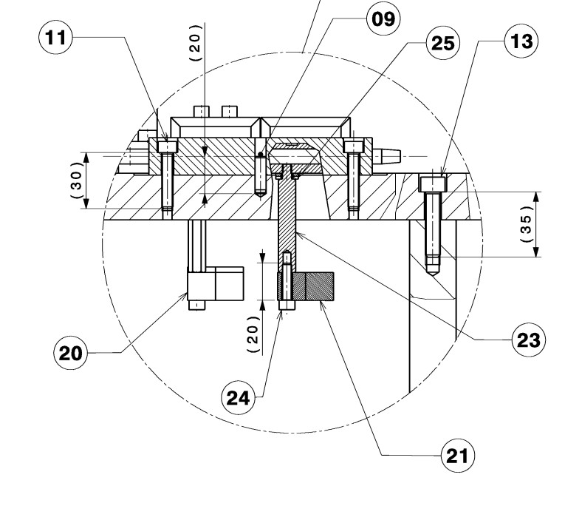
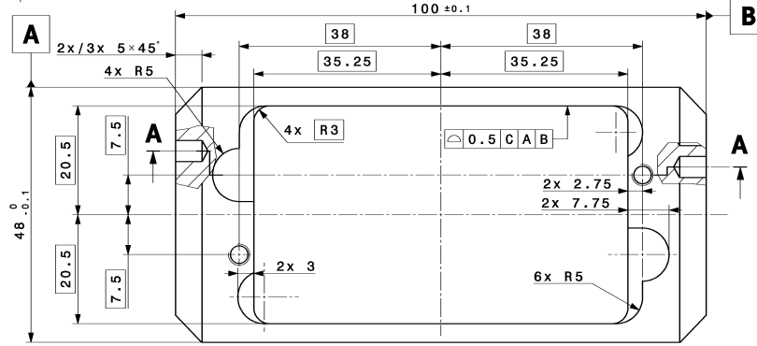
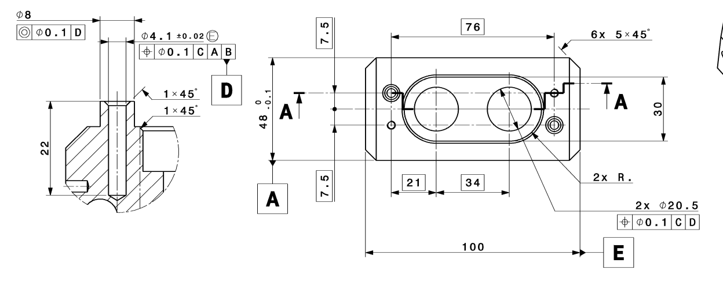
Results of the FAT
Excellent overall
Minor remarks (mostly CERN design):
    Hypertac female connector integration
    Fischer connector guiding pins
    Cable support thread length

Slide 14
Next steps: SAT
Repeat of the FAT
Insertion test with prototype collimators
Assembly of commercial and CERN-made components

Slide 15
Questions

