Slide 1
Cu-coated graphite TCSPMs procurement
C. Accettura, L. Hannemann
CERN, Geneva
November, 4th 2024
https://indico.cern.ch/event/1360943/

Slide 2
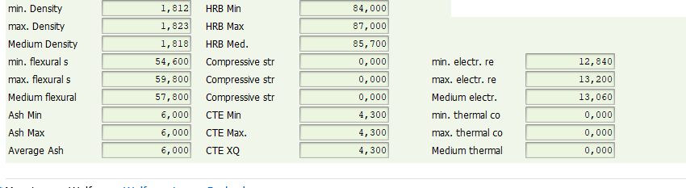
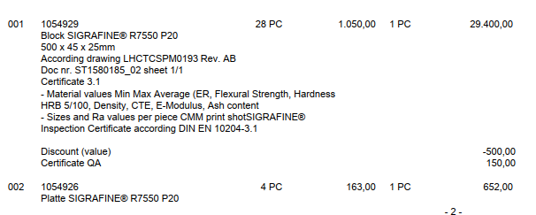

New order
New offer received to replace damaged block
Material from former block gone, need to find a new block→ properties ok and 500EUR discount

Slide 3
Metrology
Ongoing metrology to find new pairs

Slide 4
Thank you!

