Slide 1

Estimation of connection bellows deformation for FRAS safety system
C. Piccinni
WP5.2 Meeting – 04/11/2024

Slide 2
Outline
Introduction;
Movement of connection bellows of collimators;
FRAS safety system: bellows deformation treatment;
Conclusions.

Slide 3
Introduction
Connection bellows = hydroformed bellows;
Connection bellows movements limits will be implemented within FRAS safety functions (WP15.4);
Limit strokes (transversal, torsional, longitudinal) shall be defined to be implemented in protection functions.

Slide 4
Movement of connection bellows
Strokes of Collimators bellows
Bellow type | LHCTCLPX__0060 | LHCTCLPX__0067
Operational stroke* | +5.5/-14 | +5.5/-14
Axial stroke (as per spec) | ± 15 mm | ± 15 mm
Lateral stroke (as per spec) | ± 2.5 mm | ± 2.5 mm
Angular stroke (as per spec) | ± 5° | ± 5°
Lifetime [cycles] (as per spec) | 500 | 500
Total length [mm] | 172.5 | 173
Convolutions length [mm] | 132 | 132.5
From EDMS 2428906:
The nominal stroke is 18.5 mm. It means that when the tool will be in parking position (flanges opened, bellow compressed), it can compress the bellows up to 18.5 mm (from extended position – 163 mm – to compressed position – 144.5 mm).
During this bake-out, the bellows will absorb, by compression, the dilatation of the equipment in the longitudinal direction. For this reason, the bellows are installed at their nominal length + 5mm.
Maximum axial error (mm): +/-0.25 mm
18.5+0.25-5=13.75 → ~ -14 mm
5+0.25=5.25 → ~ +5.5

Slide 5
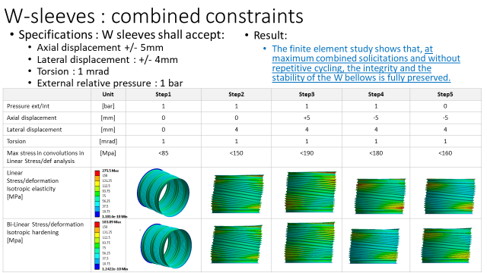
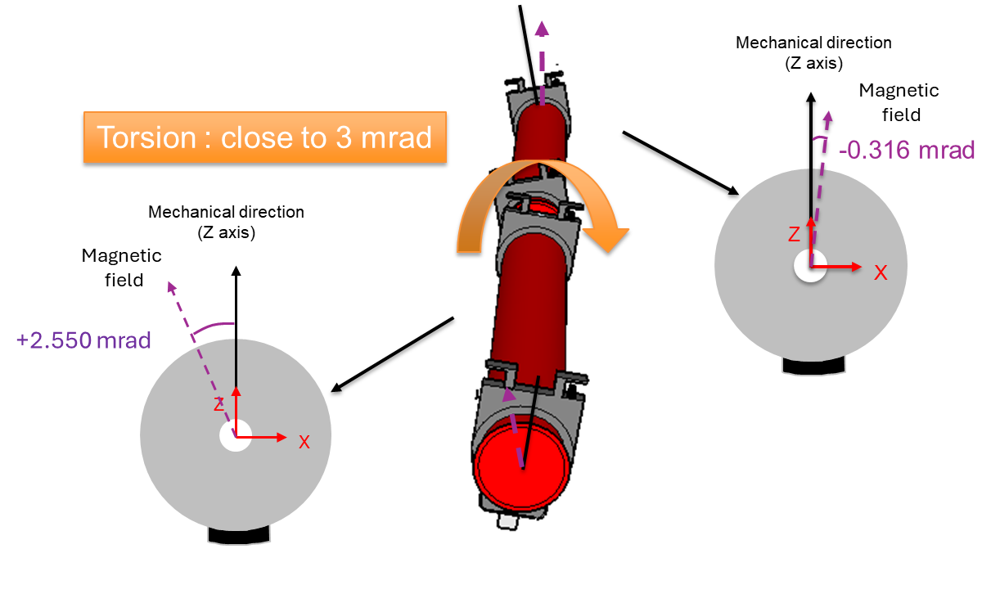
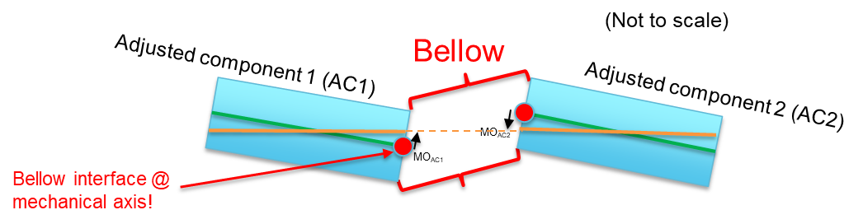
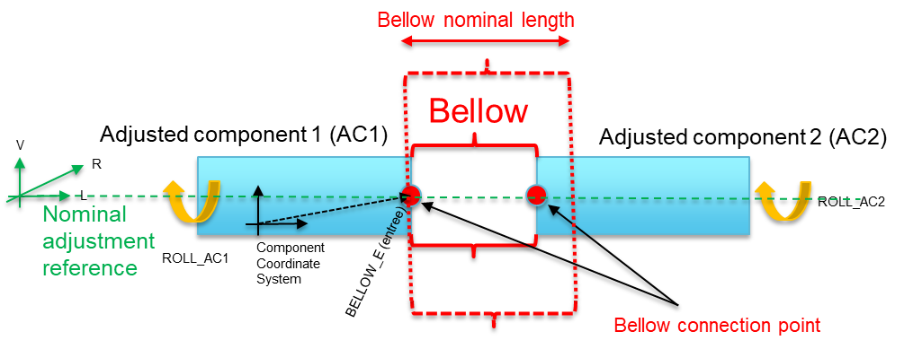
FRAS safety system
From M. Sosin presentation of 23/10/24
Bellows movements limits will be implemented within FRAS safety functions
→ further details in: https://indico.cern.ch/event/1473294/
Bellows deformation treatment:
Bellow
V
Adjusted component 1 (AC1)
BELLOW_S (sortie)
Adjusted component 2 (AC2)
R
L
Nominal adjustment reference
ROLL_AC2
ROLL_AC1
Component
Coordinate
System
BELLOW_E (entree)
Bellow connection point
Torsion
Transversal
Longitudinal
Longitudinal deformation will be measured, but will not be protected by safety functions

Slide 6
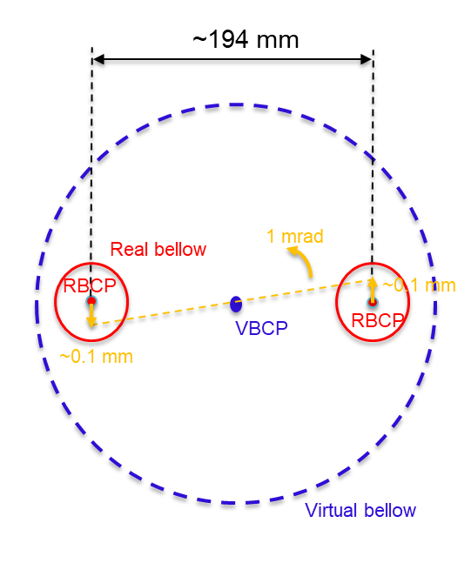
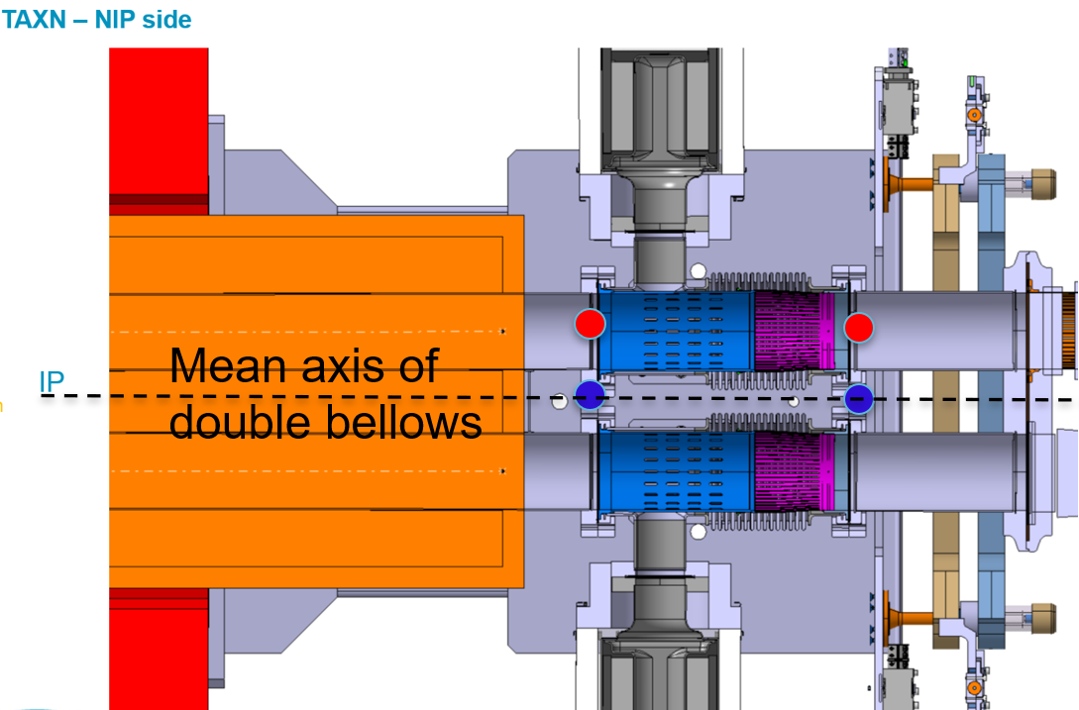
Double-bellow deformation treatment
From M. Sosin presentation of 23/10/24
For double bellow configuration (as per collimators) → Bellow connection point approach:
Virtual Bellow Connections Point (VBCP) in the mid-distance between Real Bellow Connection Points (RBCP) for bellows deformation follow-up
Considering the LHC beams spacing at ~194mm, the maximum vertical offset of +/-0.1 mm is expected at RBCP, when ultimate FRAS rotation (+/-1 mrad) is applied. Rotation of component has negligible impact on radial offset.
According to that:
    The vertical and radial transversal deformation determination will be based on VBCP geometry, with vertical offset threshold limit reduced by 0.1 mm to achieve always RBCP position in its deformation range
    The torsional deformation will be determined in same way as for single bellow configuration, basing on components roll measurement.

Slide 7
Conclusions
Virtual Bellow Connections Point approach will be used for collimators bellows;
Limit movement (transversal, torsional, longitudinal) of VBCP shall be defined to be implemented in protection functions → shall be communicated to WP15.4
Need to identify max values of the secondary movements from cantilever effect on RBCP (torsion under rotation, expansion under drift, shear under translation, etc) -based of allowable stroke of bellows (RBCP)- to evaluate the limit for VBCP;
Need of kinematics study

Slide 8
Thank you for your attention!

