Slide 1
Status of ongoing Actions:
VSC Bill of Materials
H. Havlikova
WP5.2 Meeting - 18/11/2024

Slide 2
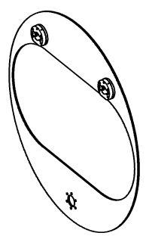
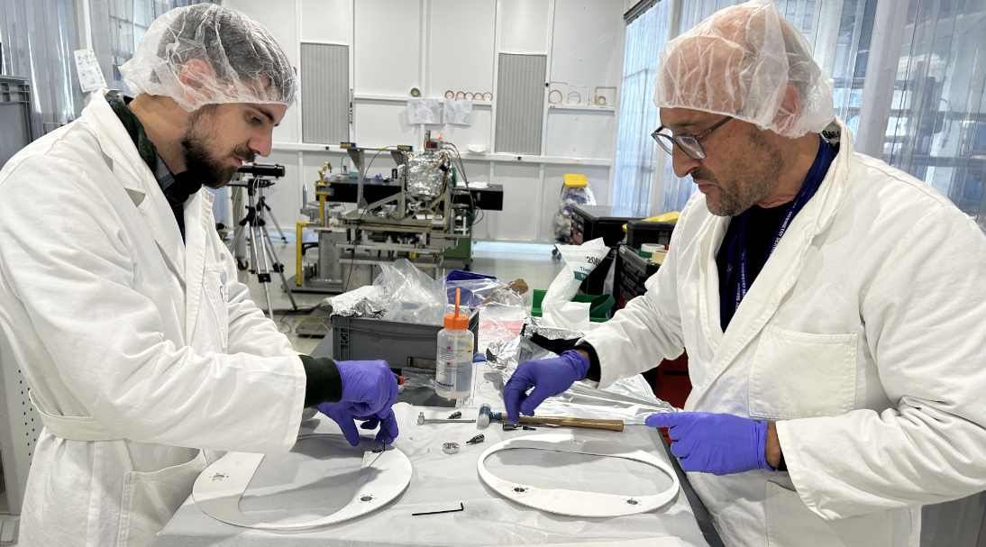
Assembly of gasket removing tool
LHCTCLPX__0230
Assembly of 42 specific DN300 sealing + removing tools
Metrology ongoing on 5 sealing
Stored in B132

Slide 3
Sealing procurement
Reference | Actual quantity | Needed quantity | Actions
DN300 | 110 (Ag) | 50 (No Ag) | Order created Waiting for the delivery from Bostec
DN100 | 240 in CINEL 48 in CERN | - | Needed to repatriate 50 pcs from CINEL
DN63 | 207 in CINEL 178 in CERN | 125 | Received from CERN Store Silver coating on going

Slide 4
Thank you for your attention

