Slide 1
Pairing of Graphite Blocks
Metrology Results
WP5.2 Meeting
November 18th , 2024
^{L. Hannemann, C. Accettura}

Slide 2
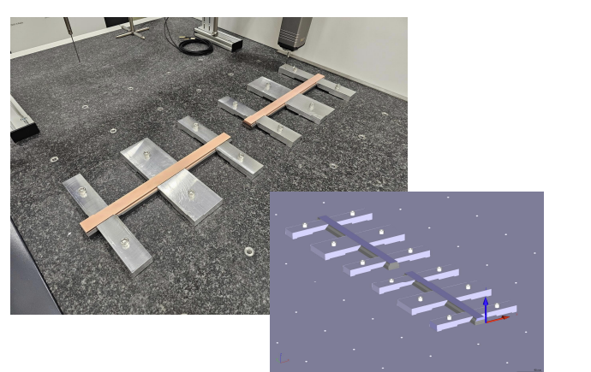
Purpose of pairing Graphite blocks
Block pairs were machined together at SGL.
Due to damage of copper coating, individual blocks might need to get rejected.
Repeated metrology for newly formed block pairs of blocks with similar thickness necessary

Slide 3
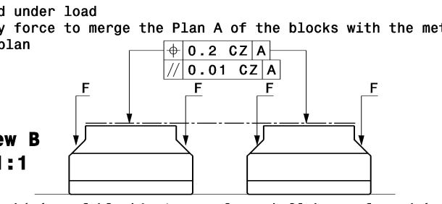
Metrology Results Surface Marking
New block pairs | Parallelism of common surface
S11-1 & S29-1 | 15.1 µm
S22-1 & S23-2 | 12.3 µm
S12-2 & S25-1 | 8.7 µm
S18-2 & S16-2 | 11.5 µm
S10-2 & S24-2 | 12.8 µm
General proposal: accept blocks, since deviations are relatively small

Slide 4
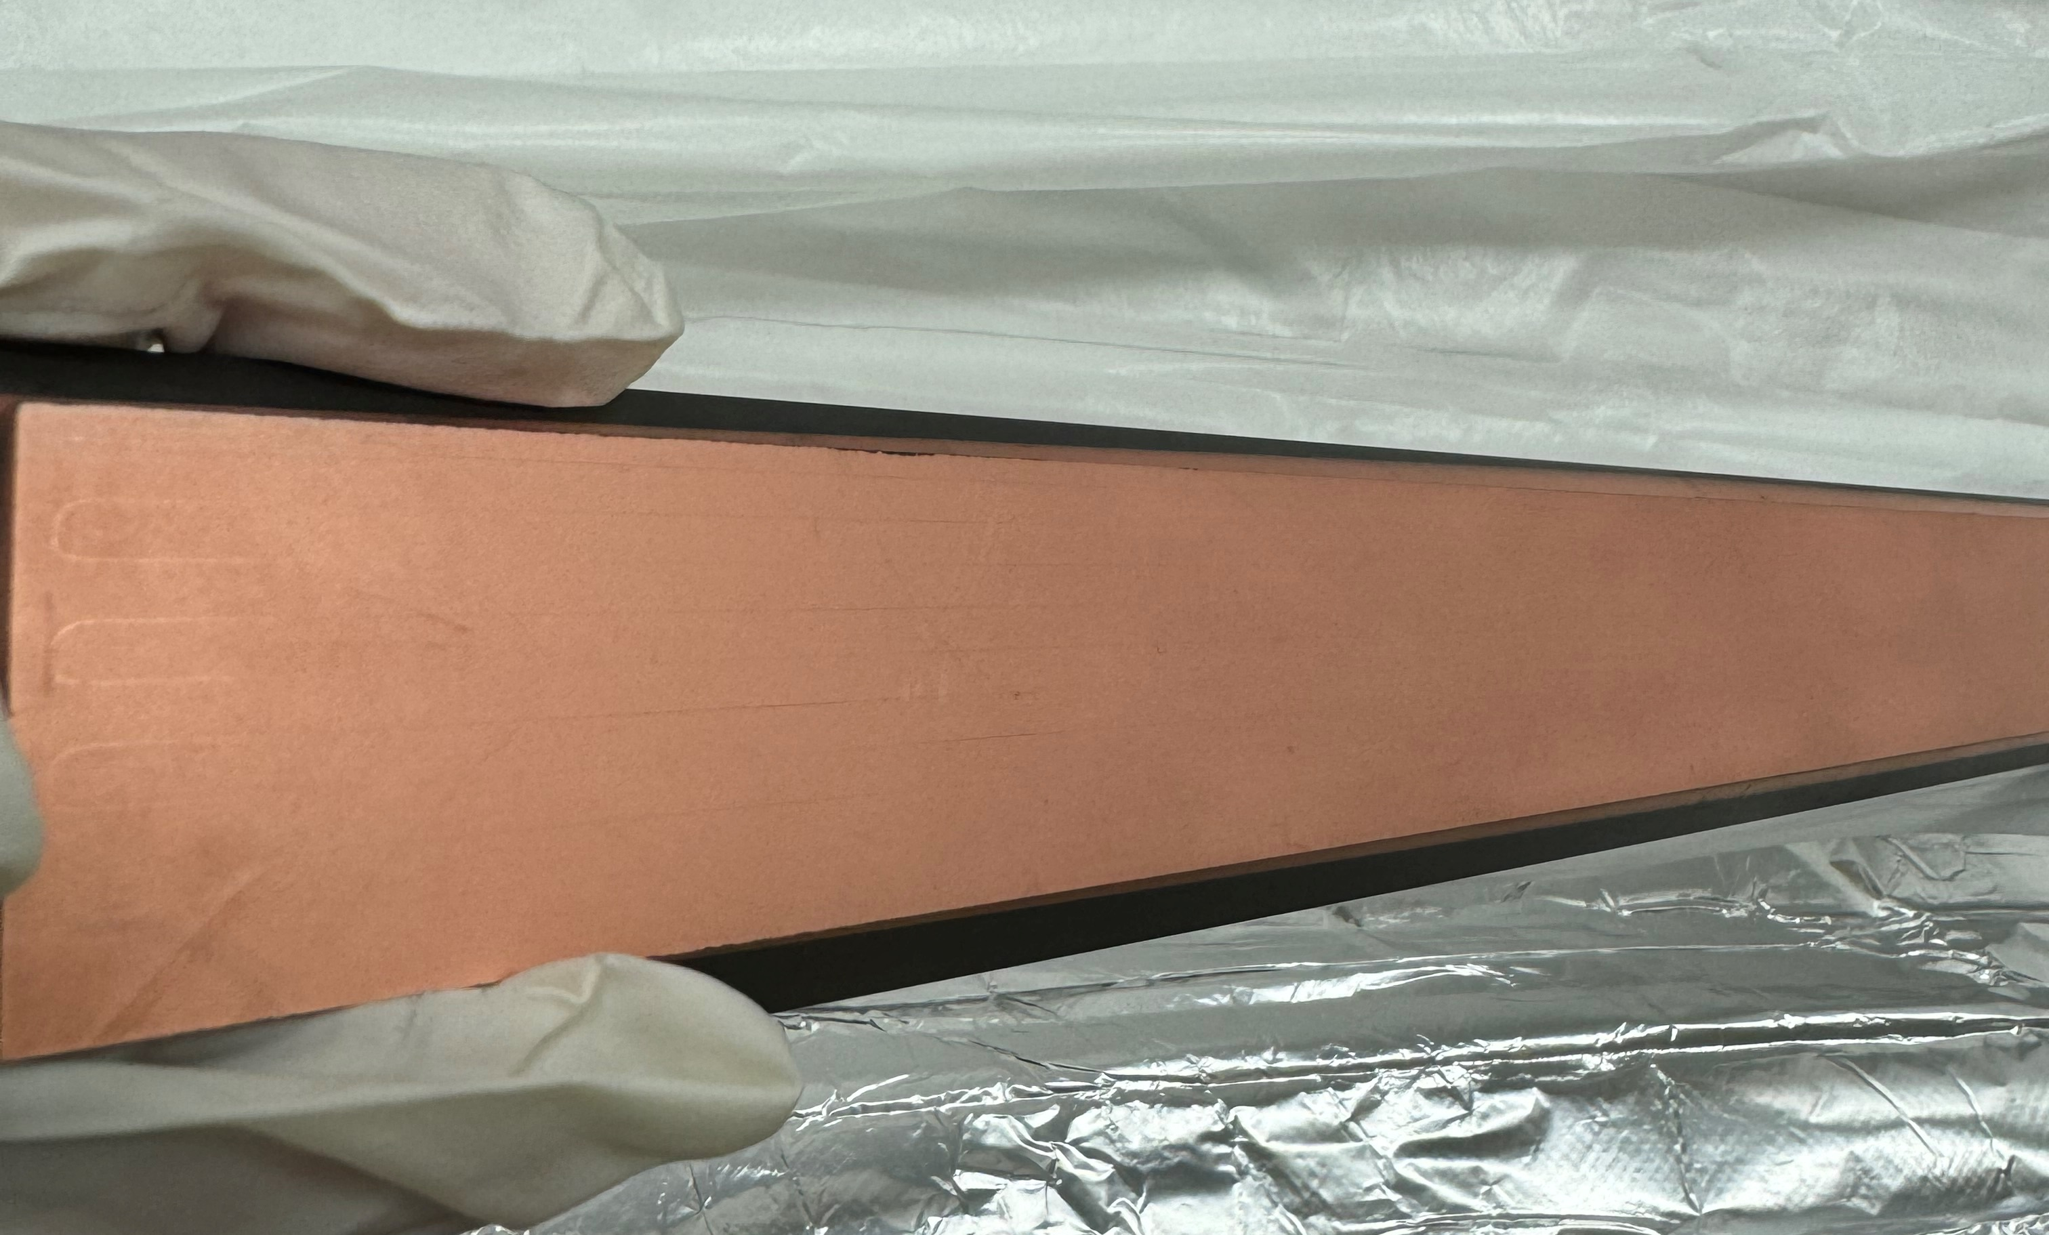
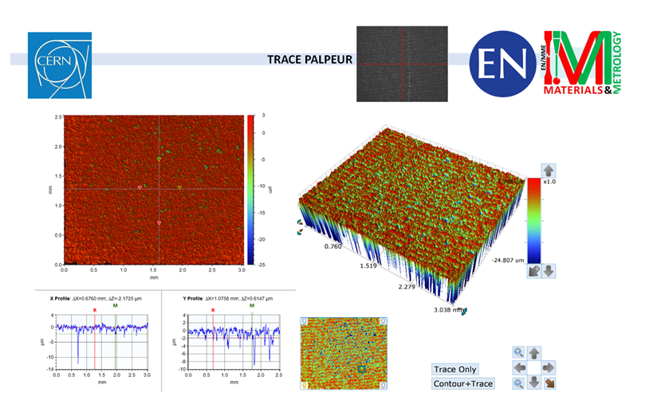
Surface Markings from Metrology
Metrology left visible marks on the coating.
Marks are not significantly deep

Slide 5
Thank you!

