Slide 1
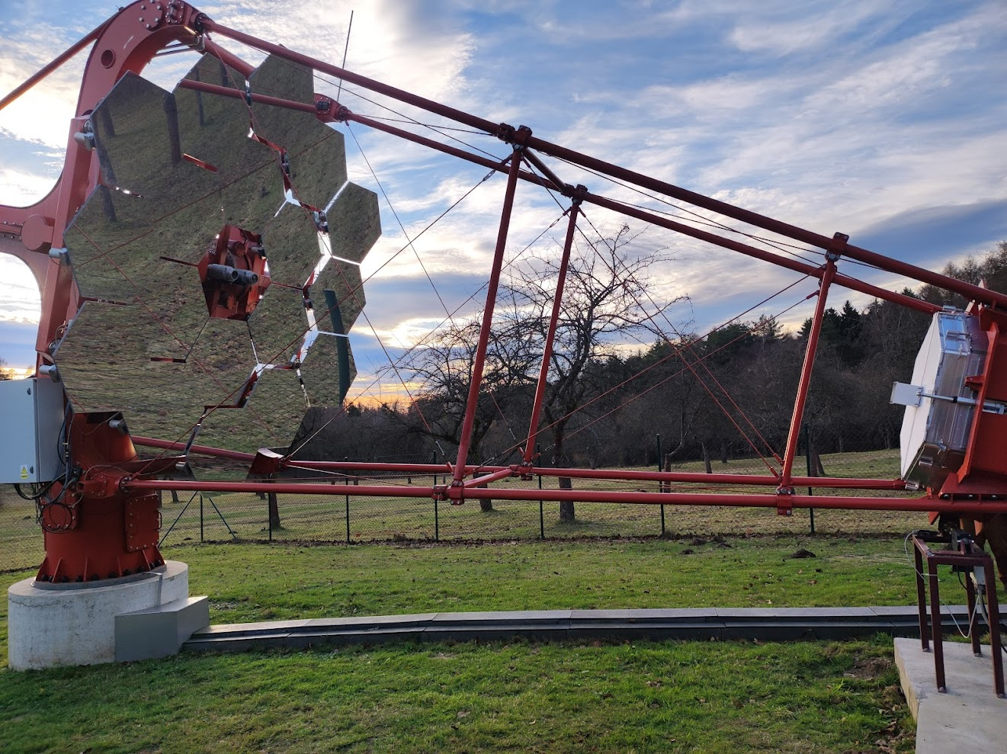




Overview of the SST-1M project – triggering and recent scientific results
Patrik Čechvala° on behalf of SST-1M collaboration
°Institute of Physics CAS, Prague, Czech republic
cechvala@fzu.cz
Triggering Discoveries in High Energy Physics III
11.12.2024

Slide 2
Outline
SST-1M project
Camera overview and trigger
Stereo trigger
Recent scientific results
Triggering Discoveries in HEP III Patrik Čechvala

Slide 3
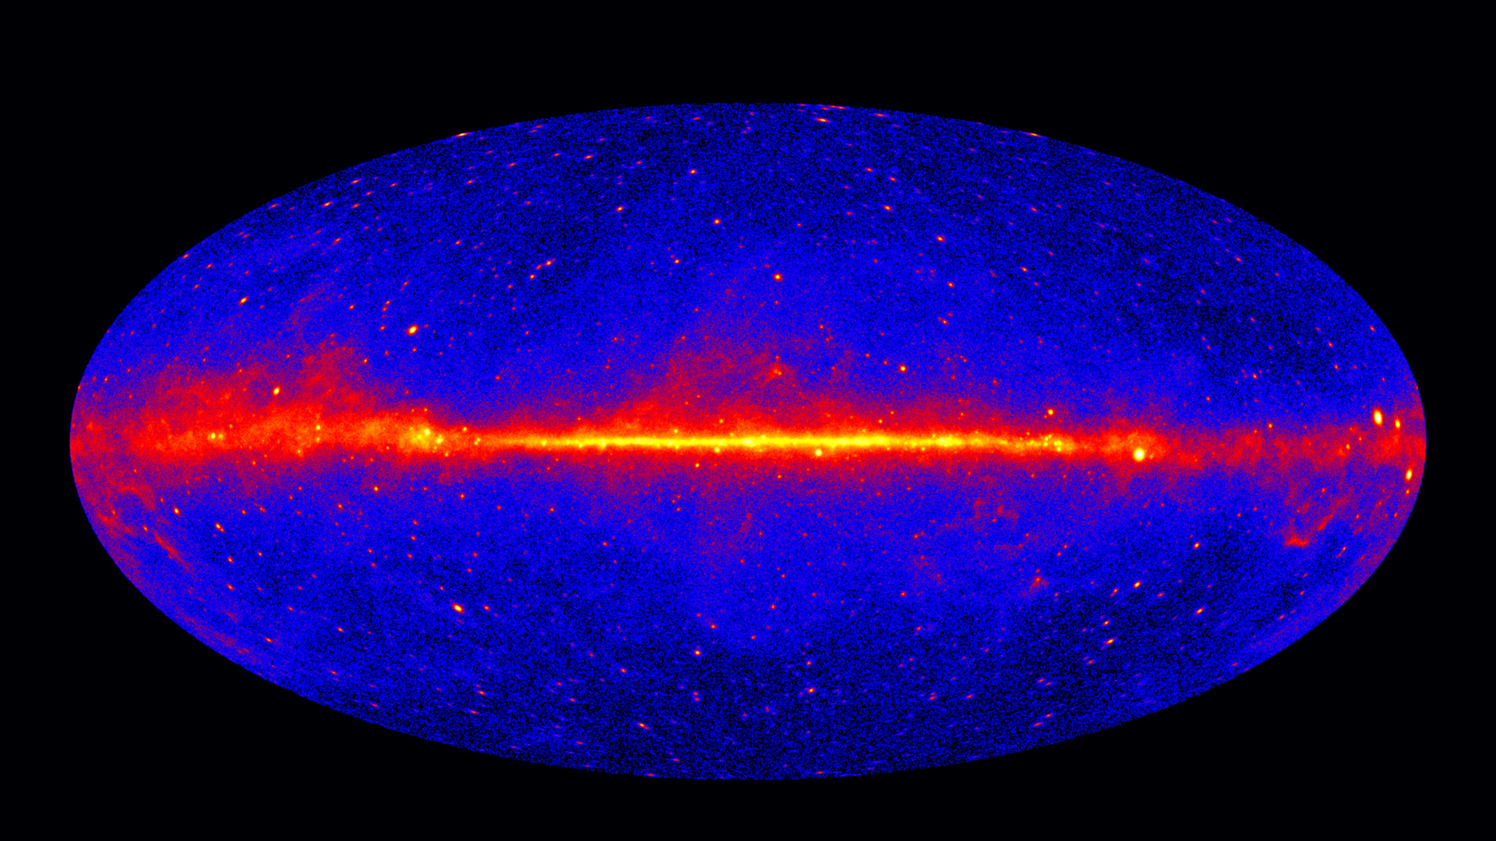
Credit: NASA/DOE/Fermi LAT Collaboration
Gamma-ray sky
energies > 1 GeV
60-month exposition
γ emitted due to different hig-energy interaction processes at the sources
3
Triggering Discoveries in HEP III Patrik Čechvala

Slide 4
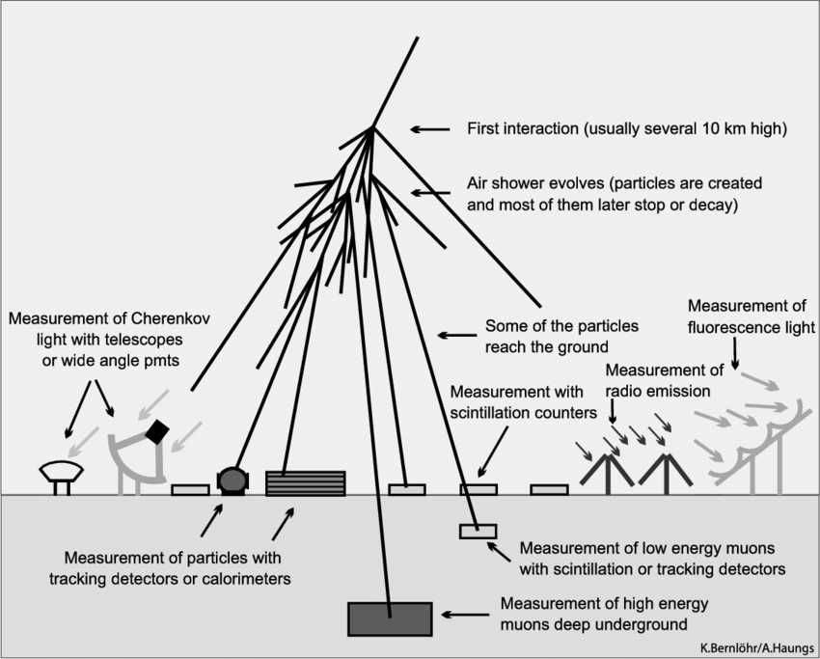
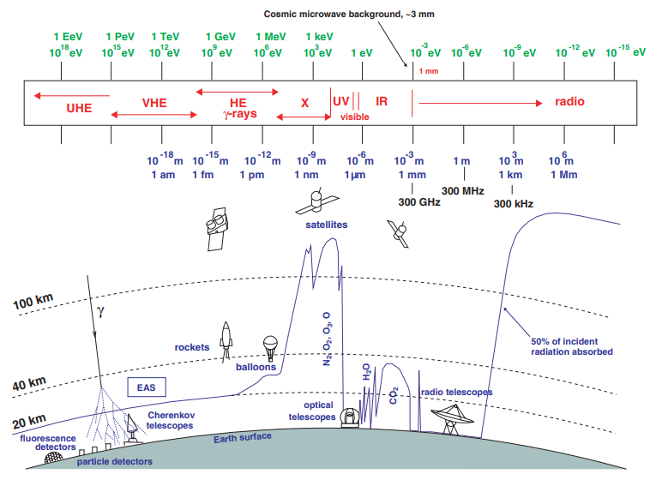
Imaging Atmospheric Cherenkov Telescopes
Longair, 1992
Haungs et al. 2011
Triggering Discoveries in HEP III Patrik Čechvala
4

Slide 5
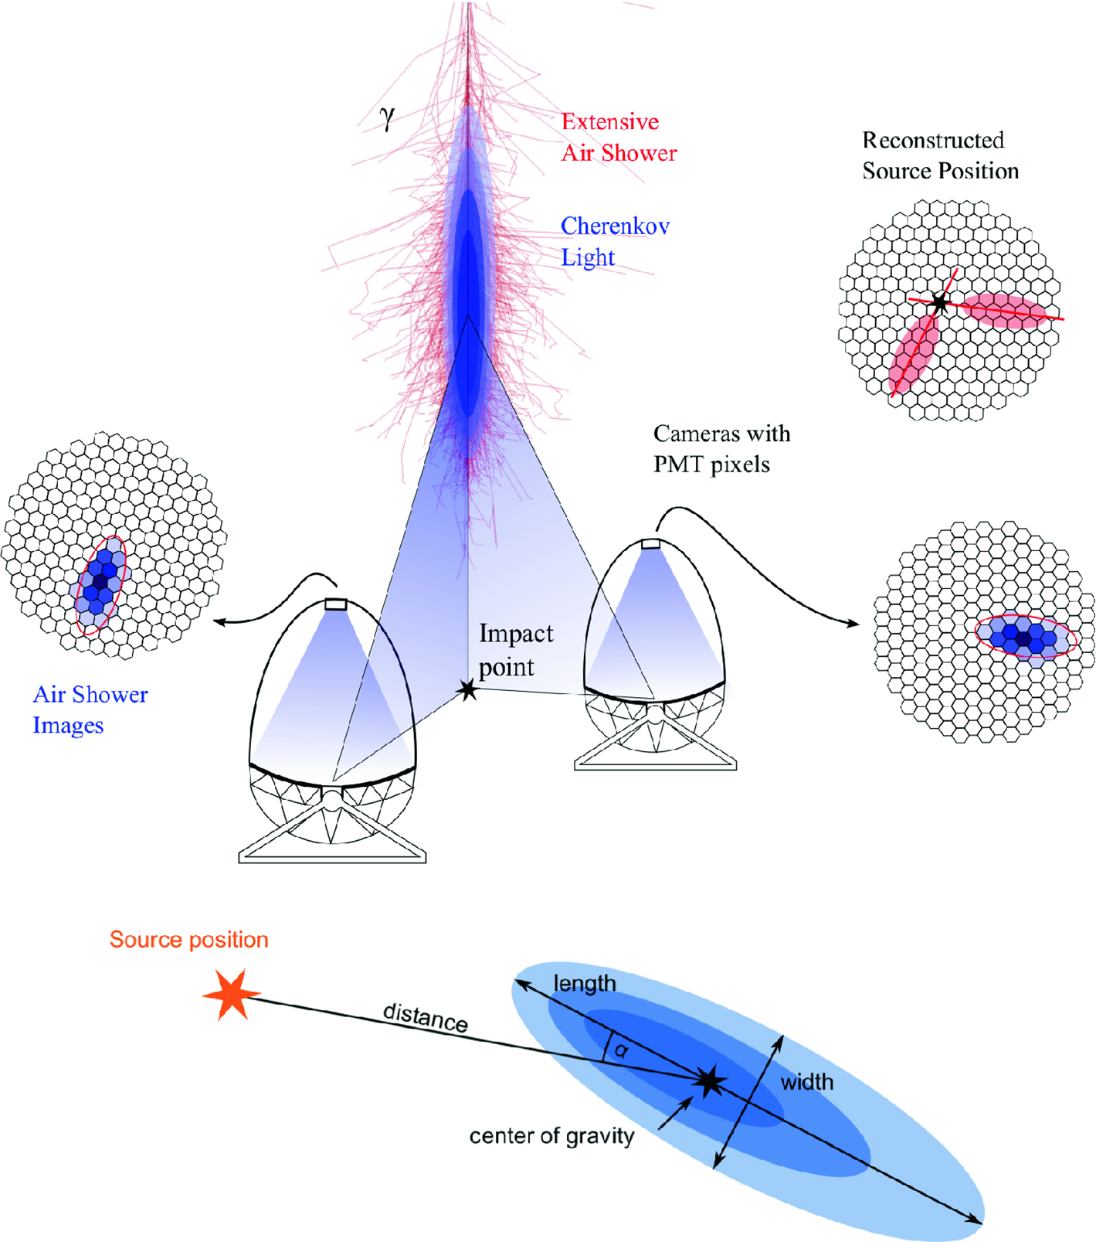
Imaging Atmospheric Cherenkov Telescopes
Credit: MAGIC collaboration
Detection of Cherenkov light emitted by the particles of Extensive Atmospheric Showers
Reflective telescopes on Alt-Az mounts
Sensitive camera photo-detection plane composed of an array of photomultipliers
For multiple telescopes, possibility to operate in stereo regime – improvement of γ/hadron separation and energy regression
5
Triggering Discoveries in HEP III Patrik Čechvala

Slide 6
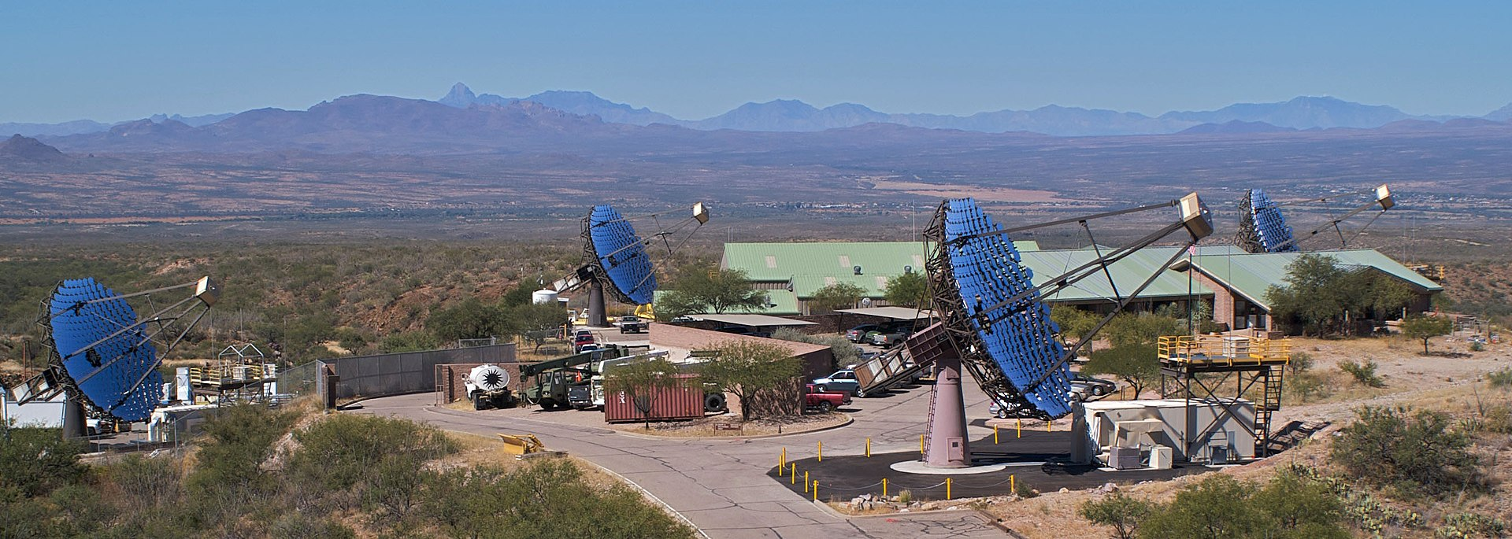

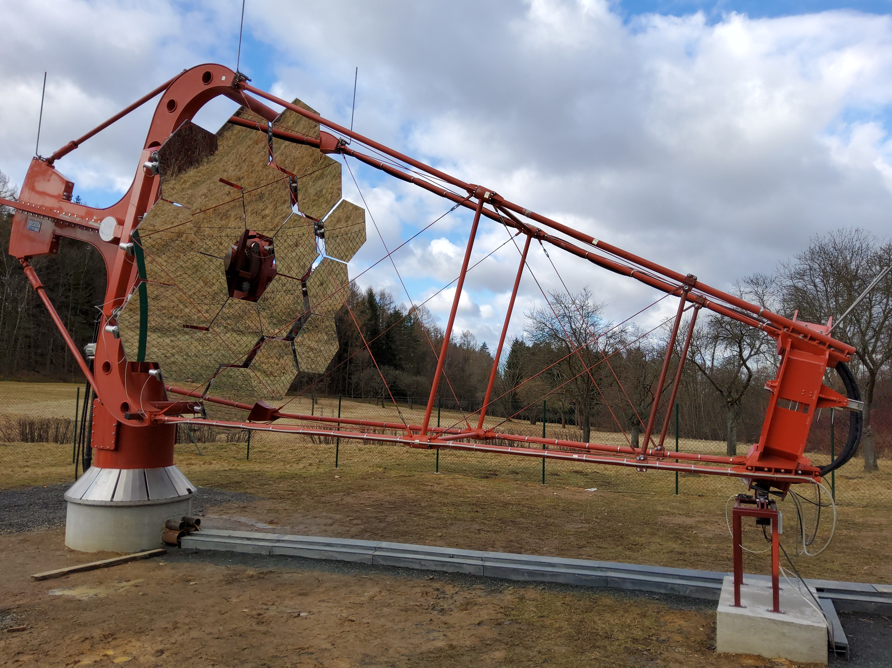
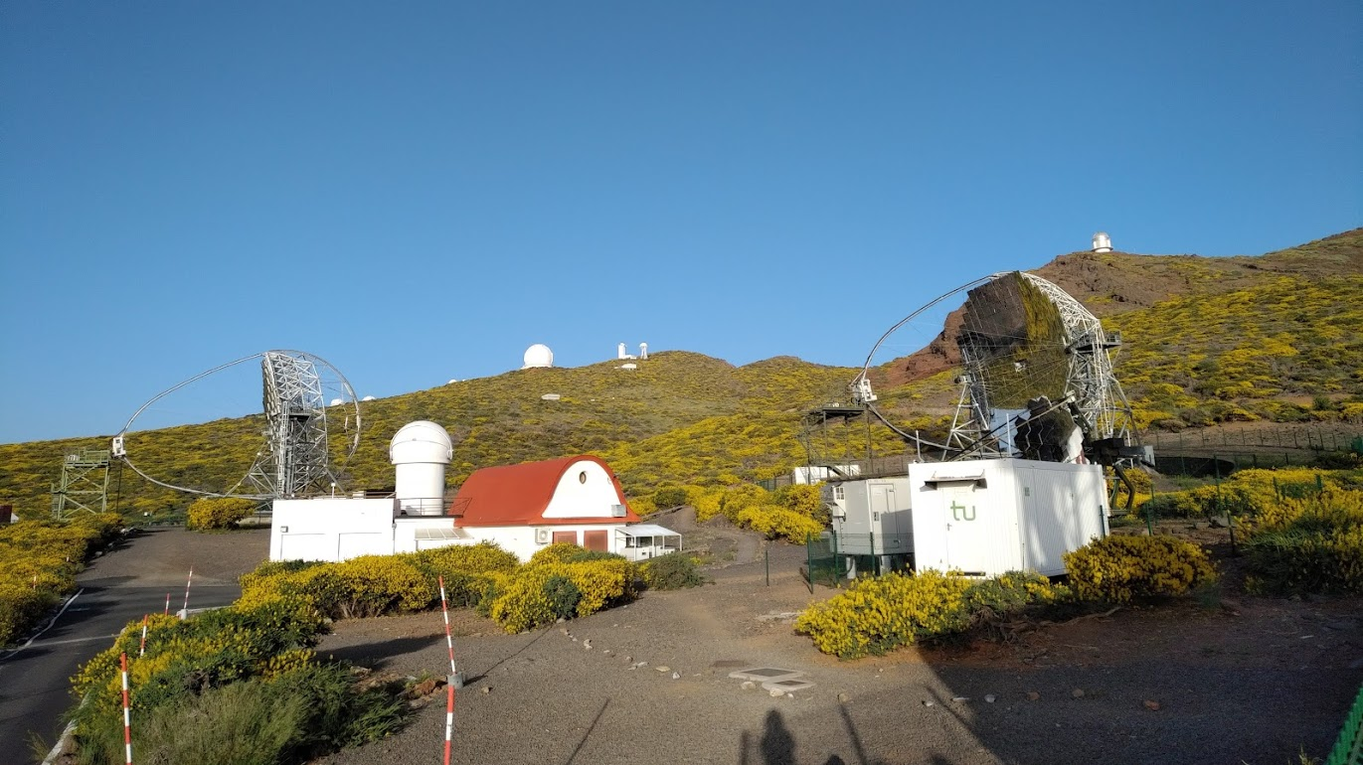
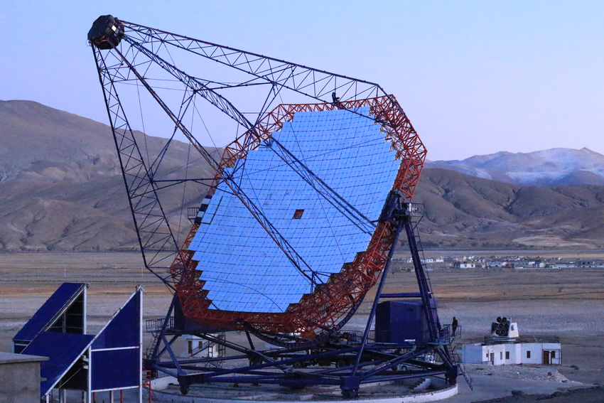
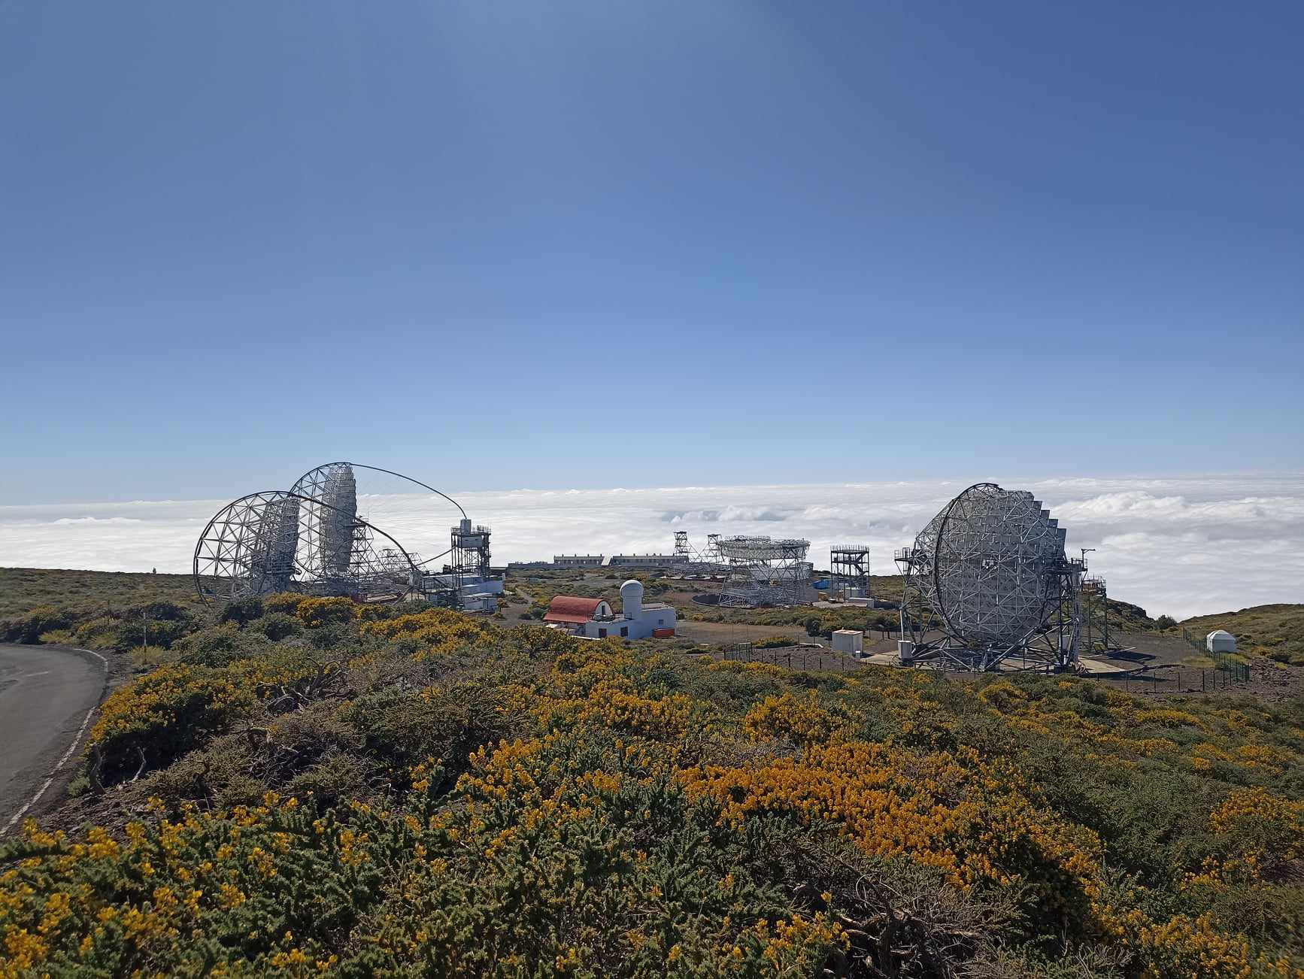
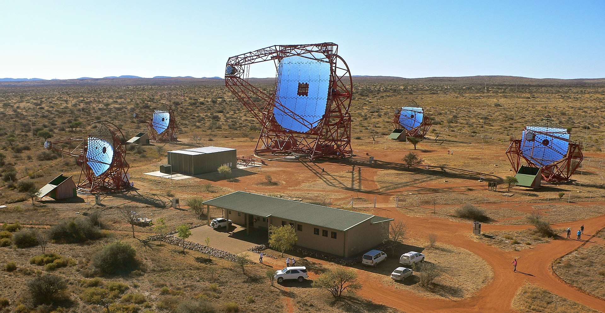
Imaging Atmospheric Cherenkov Telescopes across the world
SST-1M
VERITAS
MAGIC
MACE
LST
H.E.S.S.
Credit: Wikipedia

Slide 7
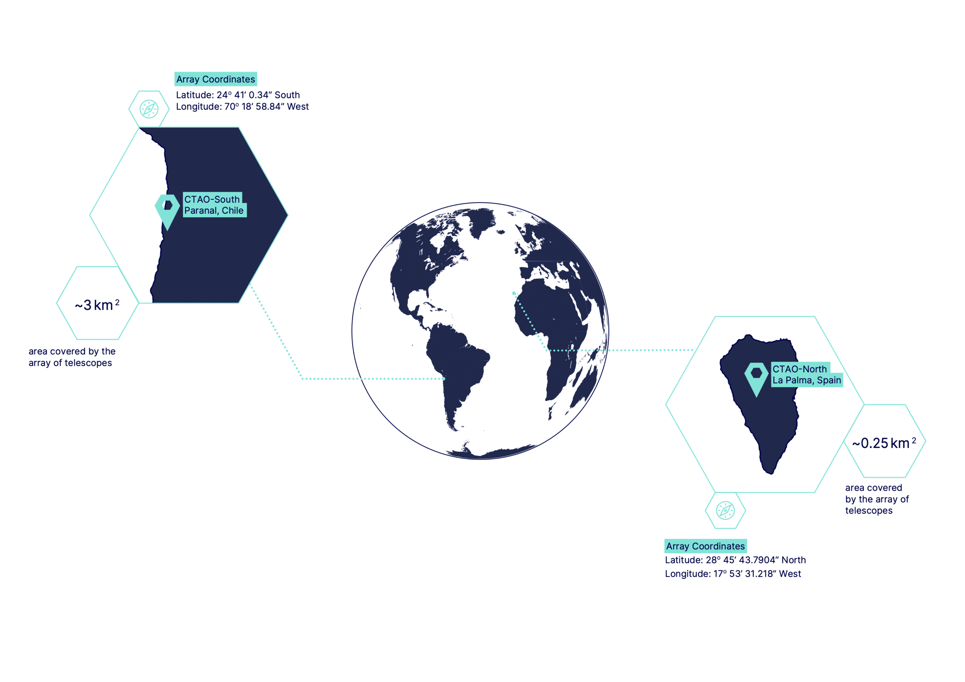
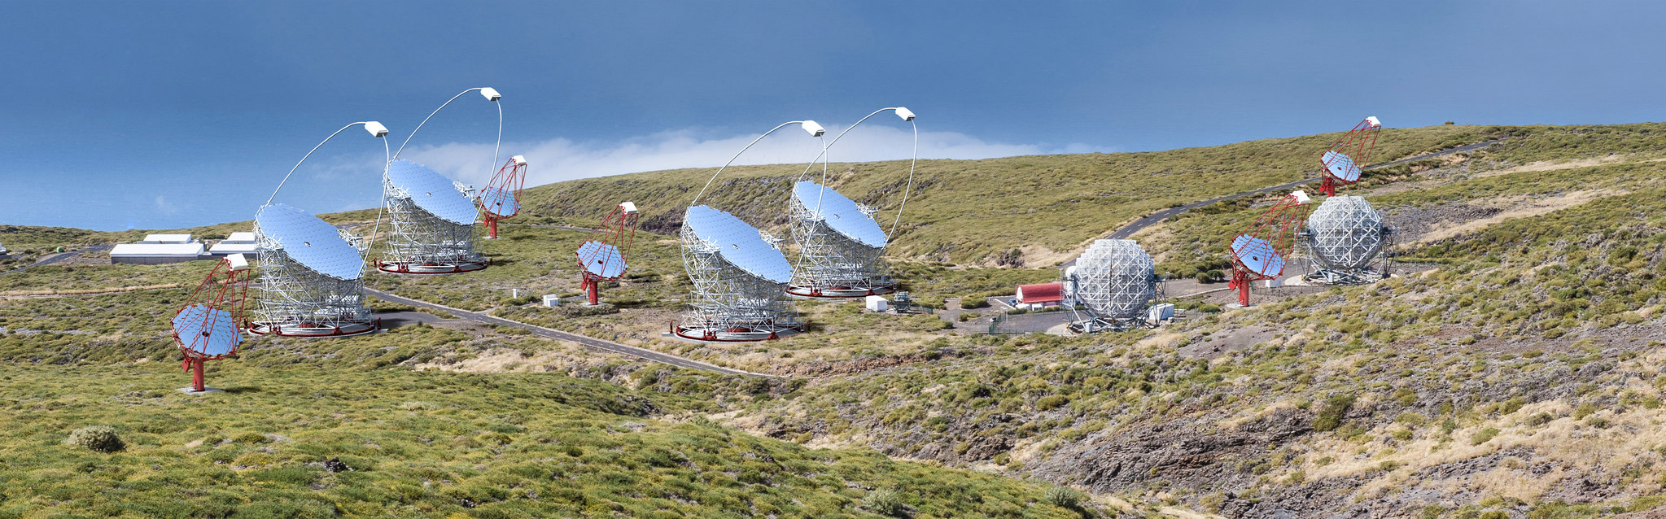
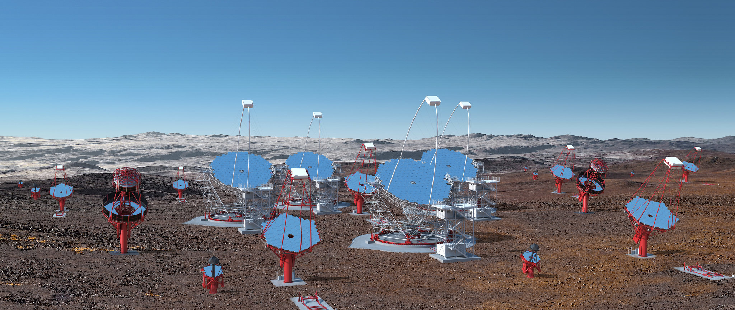
Cherenkov Telescope Array Observatory (CTAO)
Northern Hemisphere Array
Southern Hemisphere Array
Credit: Gabriel Pérez Diaz, IAC/ Marc-André Besel CTAO
7
Triggering Discoveries in HEP III Patrik Čechvala

Slide 8

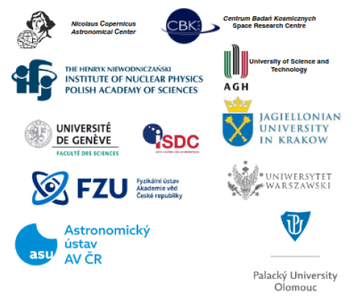
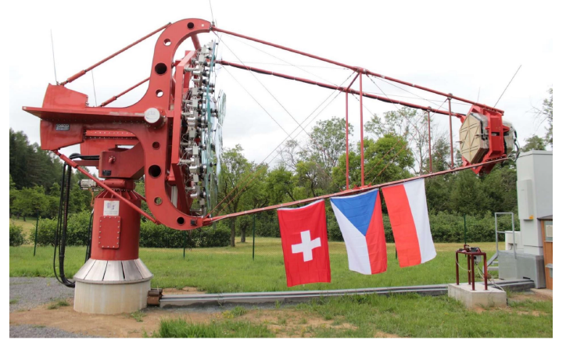
SST-1M project
Collaboration of 17 institutes from 3 countries – Czechia, Poland and Switzerland
Developed as a design of Small Sized Telescopes for CTAO – other design was selected
Constructed 2 SST-1M prototypes – relocated in 2022 from Poland to Ondřejov Observatory of Czech Academy of Sciences near Prague
https://sst-1m.science/
Triggering Discoveries in HEP III Patrik Čechvala
8

Slide 9
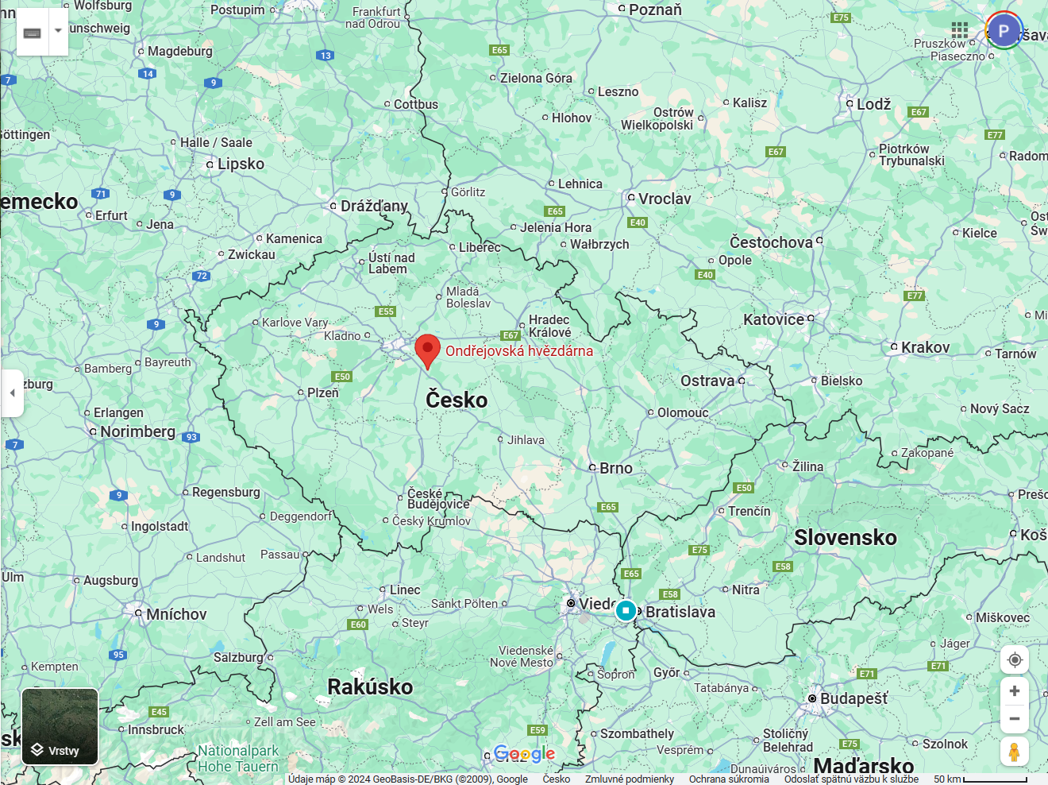
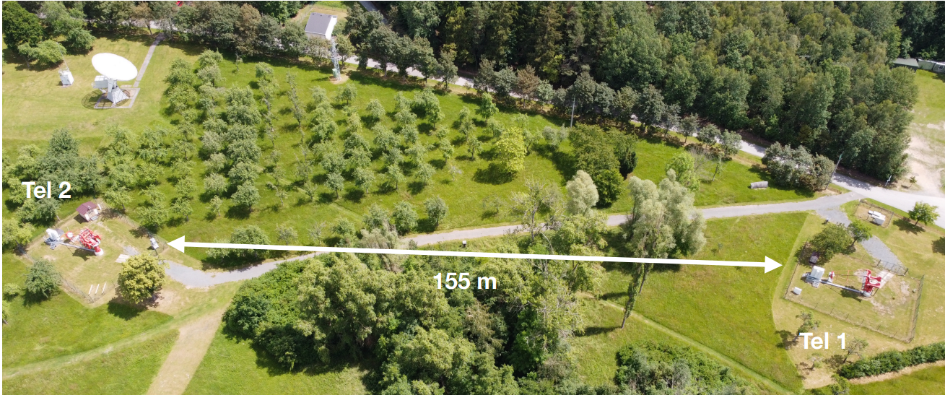
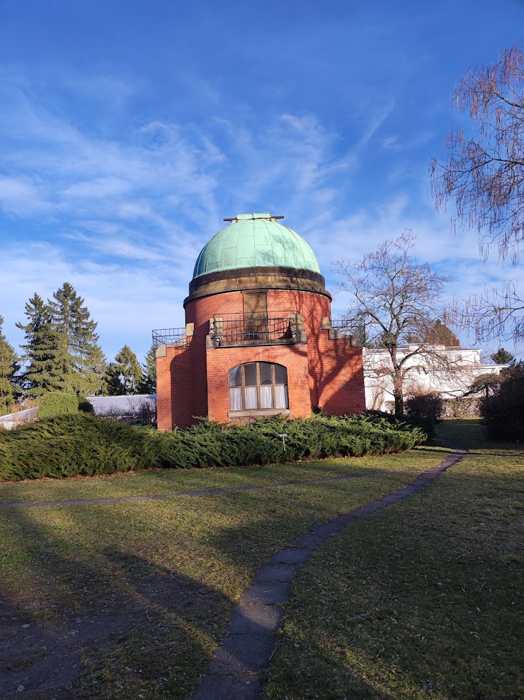
Ondřejov Observatory
(510 m a.s.l.)
https://asu.cas.cz/
Source: Google maps
9

Slide 10
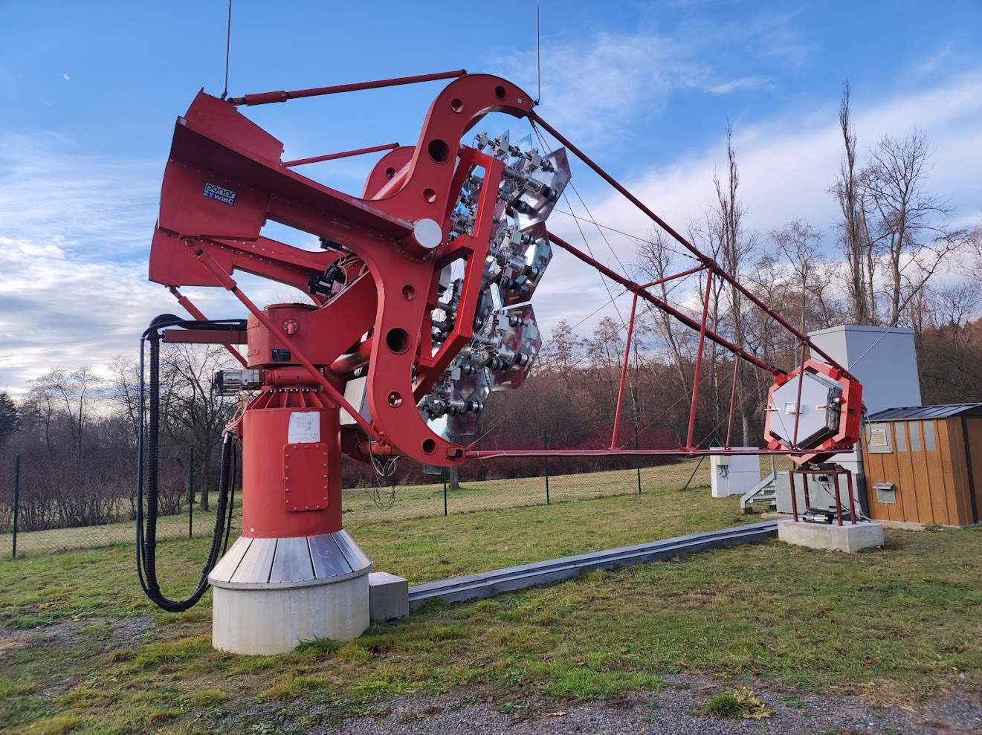
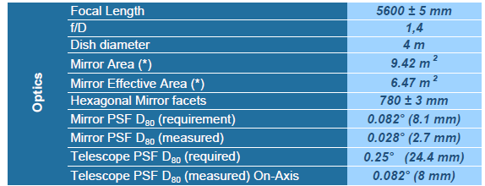
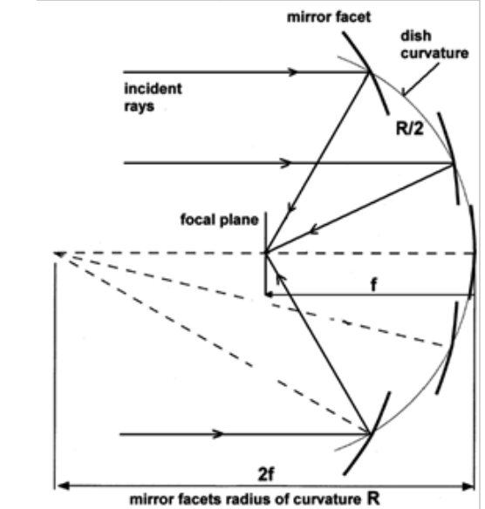
SST-1M telescopes
Telescope 1
Davies-Cotton optics
Segmented mirror – 18 hexagonal mirror facests
Fully remote observations – planned by scheduler
Alispach et al., in press
Telescope 2
Figure adopted from Actis et al., 2011
10
Triggering Discoveries in HEP III Patrik Čechvala

Slide 11
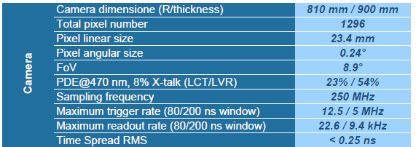
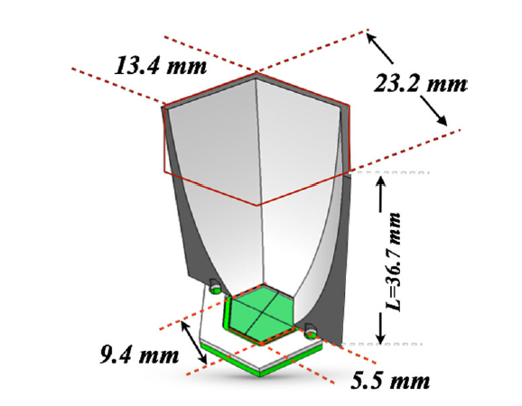
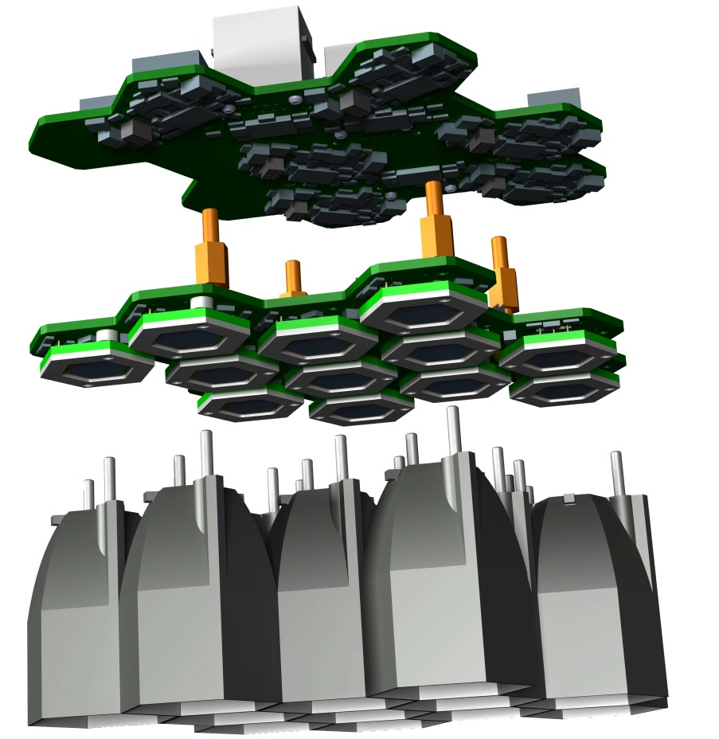
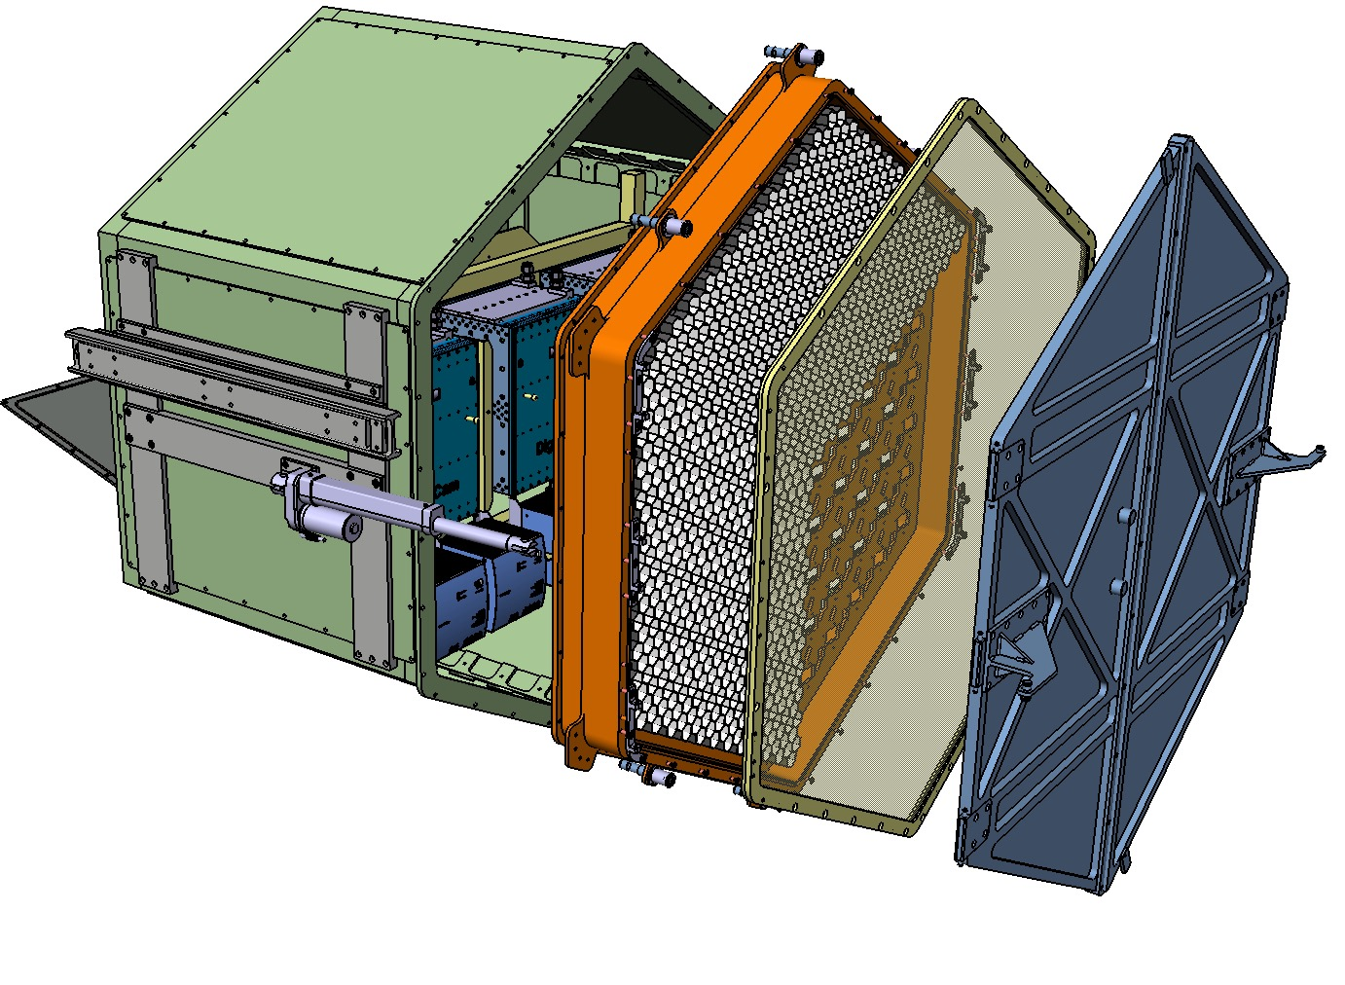
Alispach et al., in press
SST-1M camera
Digital electronics (DigiCam):
12 bits FADC @ 250 MS/s
Fully digital trigger
Power consumption 1200 W
Photo-detection plane:
1296 pixels
Power consumption 500 W
Entrance window:
3.3 mm Borofloat
Cut-off filter at 540 mm for NSB rejection
Hollow light guides:
Cut-off at 24°
2.32 cm linear size
Compression factor of 6
Sensor:
Custom hexagonal Hamamatsu MPPC
4 anodes per pixel with one common cathode
Preamplifier board:
2 operational amplifiers per sensor to reduce pulse length
DC coupling
Slow control board:
Temperature compensation loop (2 Hz)
HV generation, Differential output to DigiCam
Triggering Discoveries in HEP III Patrik Čechvala
11

Slide 12
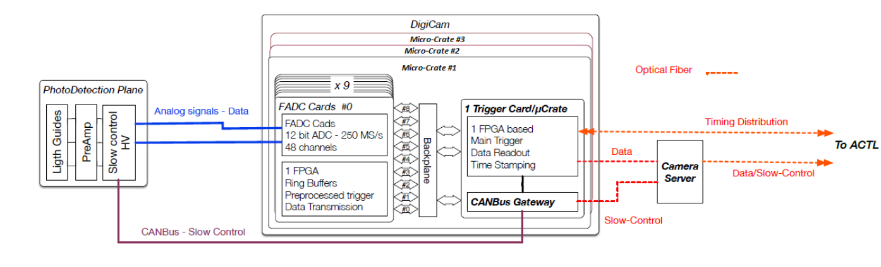
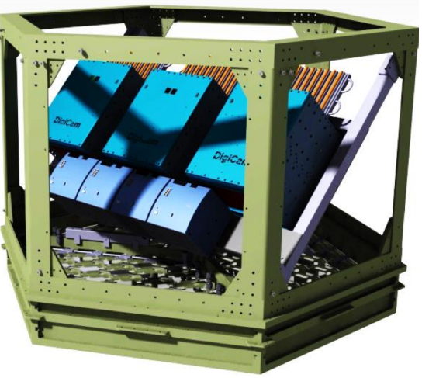
DigiCam, digital electronic readout
Alispach et al., in press
Fully digital trigger – path with reconfigurable algorithms and signal processing
Camera is using 10G Ethernet interface and optimized FPGA
Readout distributed in 3 micro-crates each equipped with 9 FADC boards (27 in total) and 1 trigger board (3 in total, connecting micro-crates)
Digitisation of the signal by FADC and stored in ring buffers
12
Triggering Discoveries in HEP III Patrik Čechvala

Slide 13
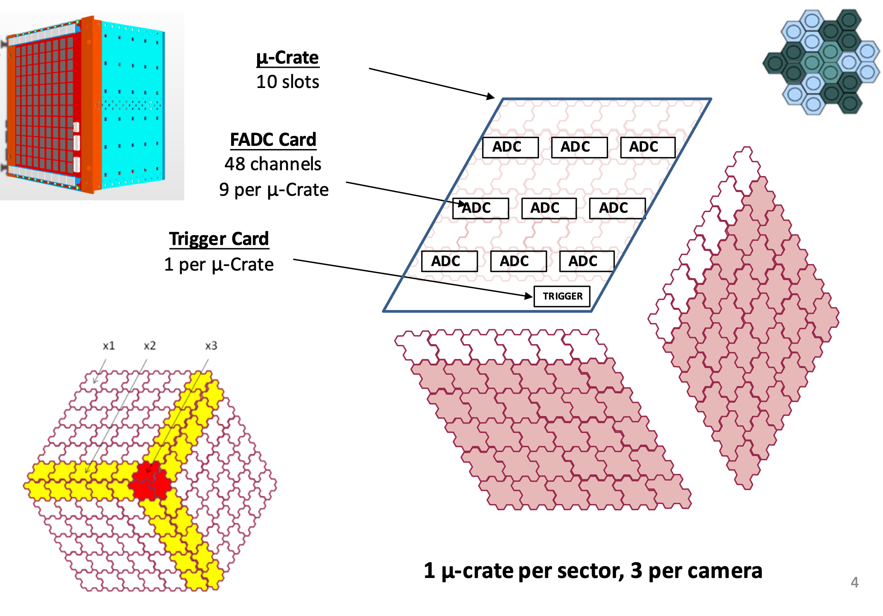
DigiCam, trigger
From readout view – PDP divided into 3 sectors of 432 pixels (36 modules) each connected to one micro-crate
To reduce the size of data processed by trigger board – coupling into triplets and re-binned to 8 bits
Each trigger board processing one sector of PDP (144 triplets) + border (48) triplets
Possibility to modify tresholds per triplet and algorithm
Application of White Rabbit for clock synchronisation and time management
Clocked trigger generator with programmable frequency and pulse length
Triggering Discoveries in HEP III Patrik Čechvala
13

Slide 14
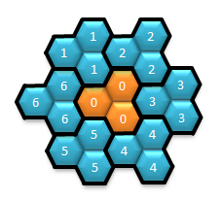
The DigiCam, trigger
Raw data
Baseline subtraction
Pixel clipping
Pixel sum
Patch clipping
Patch sum &
trigger decision
255
0
every sample s of 4 ns of the 12 bits waveforms
baseline subtraction (average of 1024 pre-samples, i.e. ~4 μs)
clipping at pixel level [0, 4096]
sum of the three pixels and possible division
clipping to 8 bits
0 ≤ Σ ≤ 255
1
x 6
0
sum of 7 patches and trigger decision with
threshold [0, 1785]
Triggering Discoveries in HEP III Patrik Čechvala

Slide 15
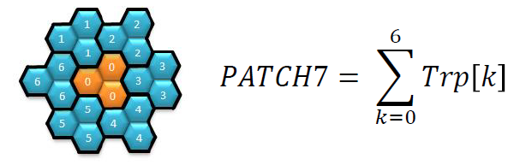
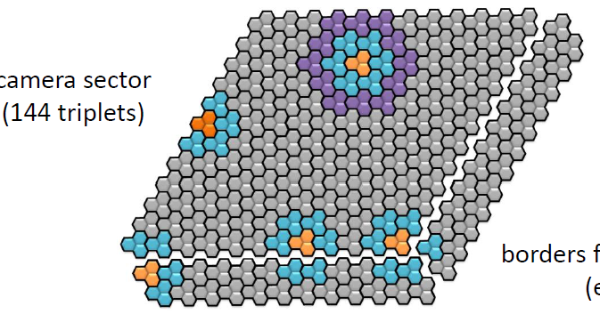
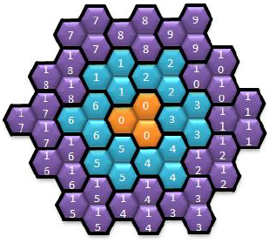
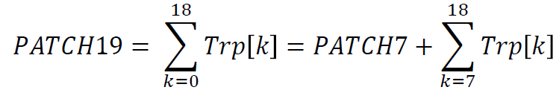
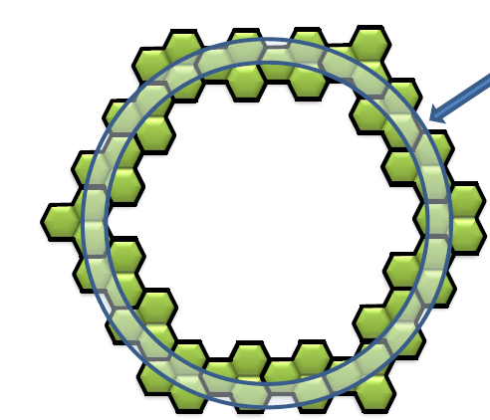
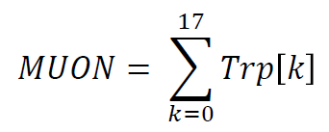
DigiCam, trigger algorithms implemented
several trigger algorithms can run in parallel (different size, shape, ...)
Future prospects
    possibility of the involvement of convolutional neural network for improvement of shower/nigh-sky background discrimination
    real-time analysis pipeline – reaction to alerts and fast-evolving processes
Triggering Discoveries in HEP III Patrik Čechvala
15

Slide 16
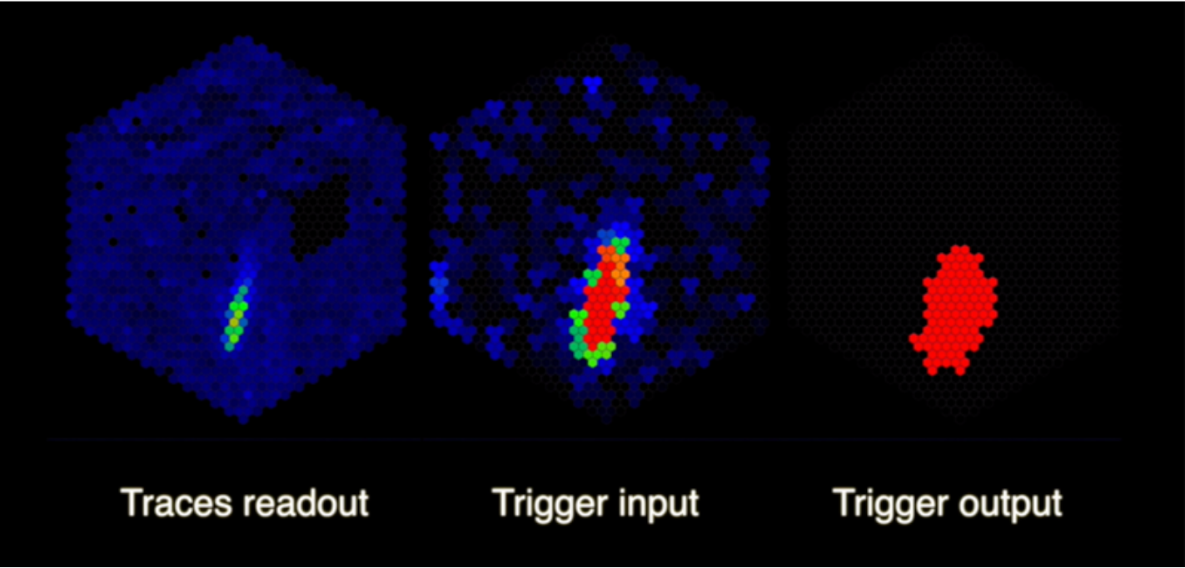
Triggering Discoveries in HEP III Patrik Čechvala
16

Slide 17
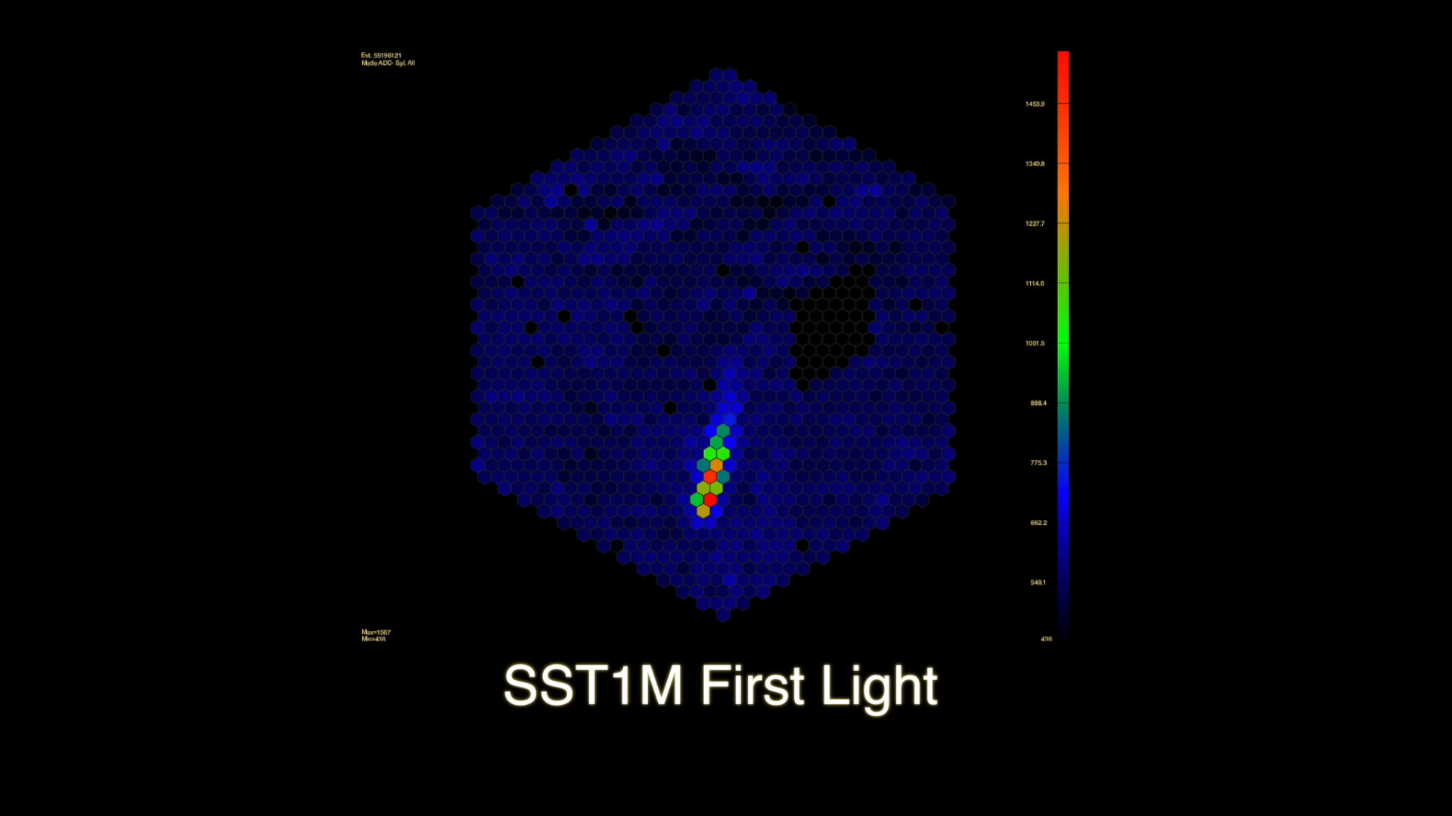
The DigiCam
Trigger
FoV

Slide 18
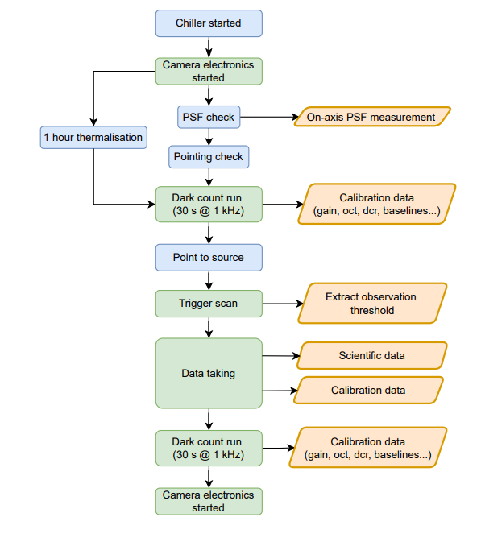
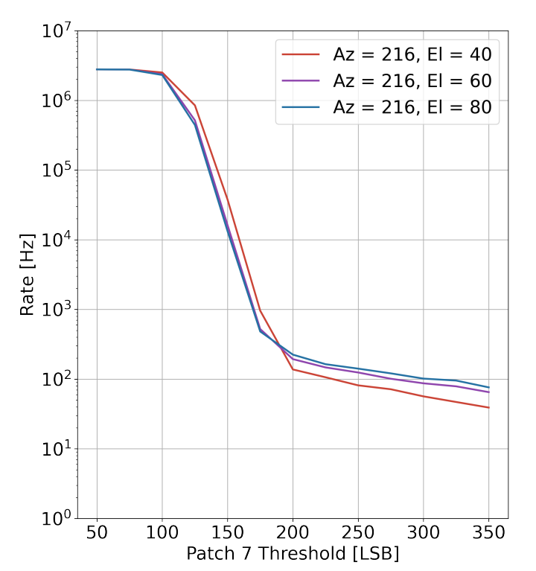
Trigger scan
background
signal
Alispach et al., in press
Performed for the estimation of the treshold for telescope operation
Performed for source position but also for a grid of positions – environmental conditions estimation
Triggering Discoveries in HEP III Patrik Čechvala
18

Slide 19
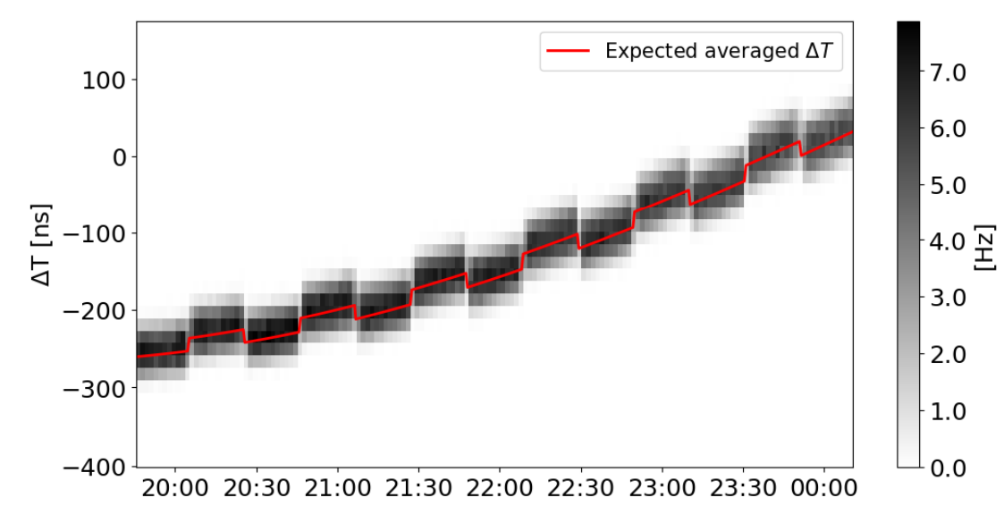
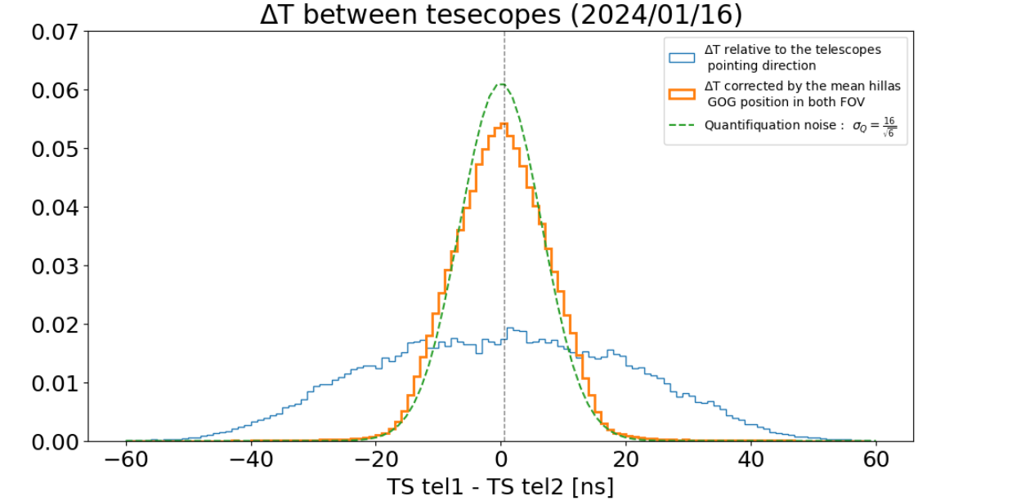
Stereo trigger
Alispach et al., in press
After trigger – data packed into UDP packets and sent to Camera Server software to assemble the whole event
SST1M use software-based stereo trigger
The timestamps are transmitted to the Software Array Trigger (SWAT) – merge the triggers into one stream sorted by time and application of sliding window to search for pairs
Once found ID is attributed
Internal synchronisation of the clocks of the cameras by the White Rabbit
Prospective use of hardware stereo trigger – interconnection of cameras with optical fibers
Triggering Discoveries in HEP III Patrik Čechvala
19

Slide 20
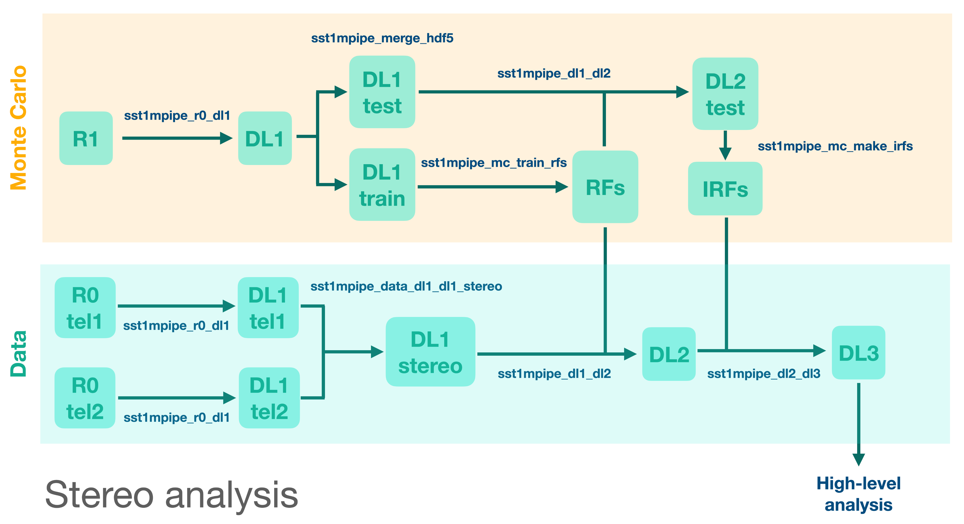

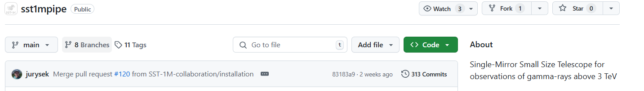
sst1mpipe
Data and Monte Carlo analysis software for low-level analysis – waveform calibration and integration, shower-image parametrisation, stereo reconstruction, random forest training, instrument response function (IRF) calculation
Pipeline is divided into several steps (r0 -> dl1 -> dl2 -> dl3) – based on functions adopted from ctapipe https://github.com/cta-observatory/ctapipe and follows lstchain cta-observatory.github.io/cta-lstchain/
Results are compatible with gamma-astro-data-format (GADF) -> can be forwarded for high-level analysis (dl4/dl5/dl6) performed by gammapy
Juryšek et al., PoS(ICRC2023)592
Juryšek et al., 2024, sst1mpipe v.0.4.1, Zenodo
https://github.com/SST-1M-collaboration/sst1mpipe
Triggering Discoveries in HEP III Patrik Čechvala
20

Slide 21
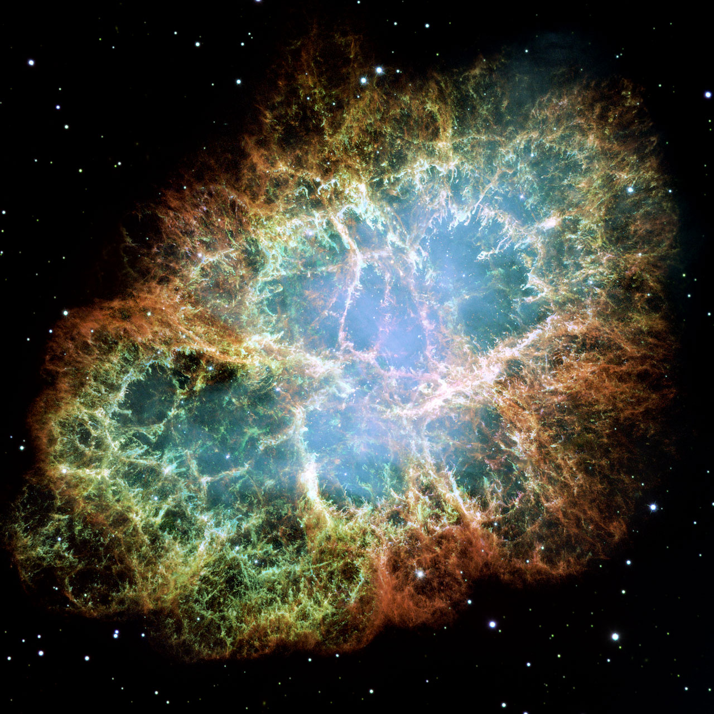
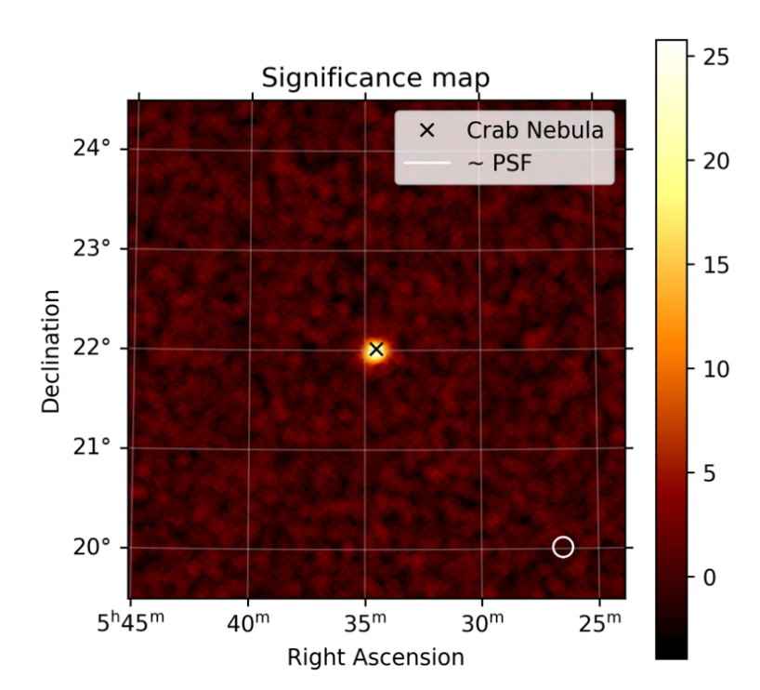
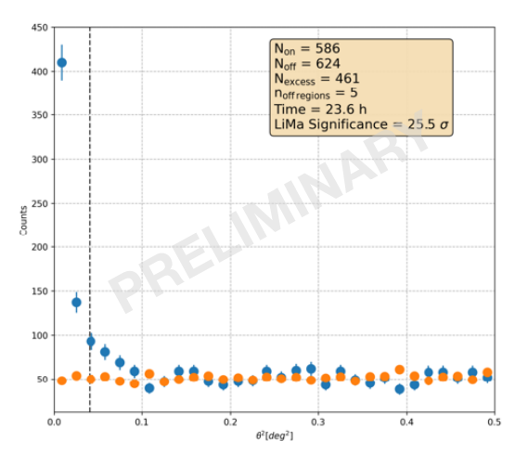
Crab Nebula (M1) observation
Standard candle in gamma-ray astronomy
Obs. campaign 2023/2024 (currently ongoing campaign 2024/2025)
Approx. 23 hours of stereo data after quality cuts
Data zenith angle < 45° and energy treshold 2-3 TeV
5σ detection in less than 2 hours in stereo (in less than 3 hours for mono)
M1 Credit:NASA, ESA and Allison Loll/Jeff Hester (Arizona State University). Acknowledgement: Davide De Martin (ESA/Hubble)
Tavernier et al., PoS(ICRC2023)741
Triggering Discoveries in HEP III Patrik Čechvala
21

Slide 22
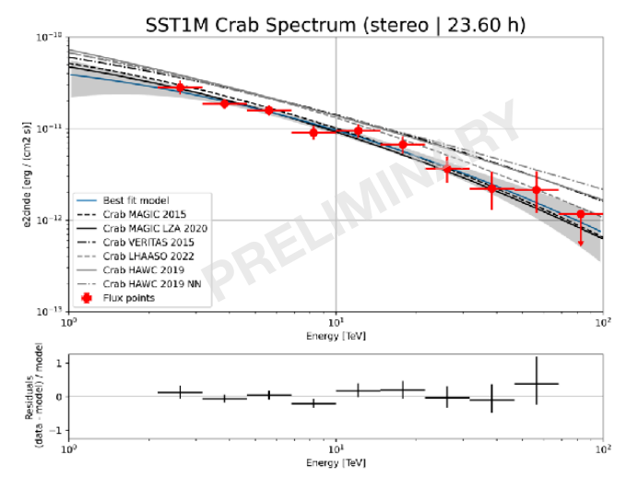
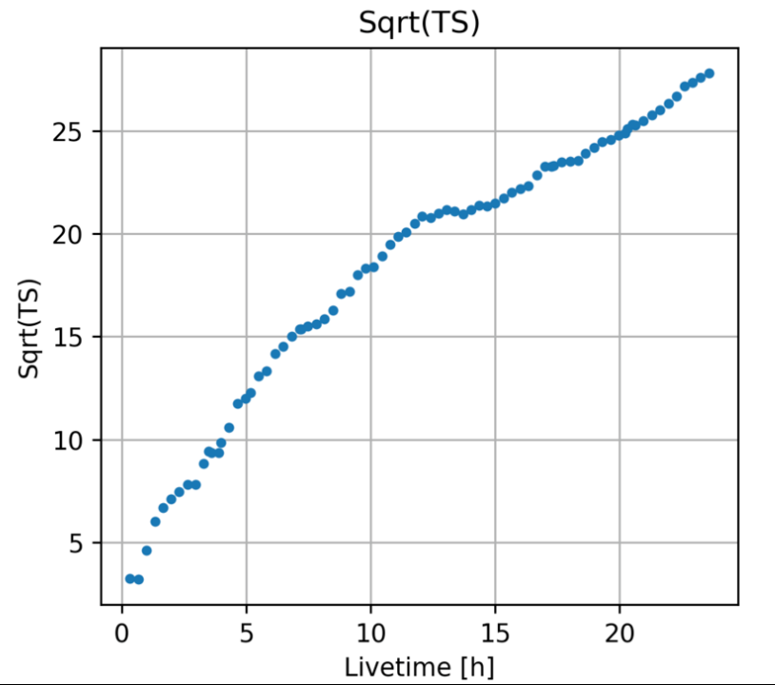
Crab Nebula (M1) observation
Obs. campaign 2023/2024 (currently ongoing campaign 2024/2025)
Approx. 23 hours of stereo data after quality cuts
Data zenith angle < 45° and energy treshold 2-3 TeV
5σ detection in less than 2 hours in stereo (in less than 3 hours for mono)
M1 Credit:NASA, ESA and Allison Loll/Jeff Hester (Arizona State University). Acknowledgement: Davide De Martin (ESA/Hubble)
Triggering Discoveries in HEP III Patrik Čechvala
22

Slide 23
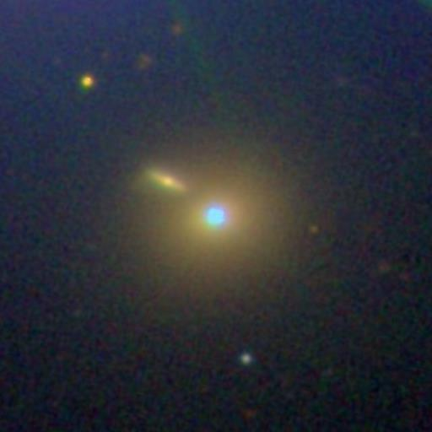



Mrk 421 Credit: Sloan Digital Sky Survey - http://skyserver.sdss.org/
Active Galactic Nuclei (AGN) monitoring
Markarian (Mrk) 421, stereo data
First extragalactic source in true stereo detected by SST-1M
Observation during increased activity on 15.3.2024 – ATel #16533, https://www.astronomerstelegram.org/
Observed spectral index - 2.6 ± 0.3
The result is compatible with result published by HAWC collaboration (Albert et al., 2022) 2.26 ± 0.12
Maximum energies compatible with HAWC (9 TeV)
Triggering Discoveries in HEP III Patrik Čechvala
23

Slide 24


VER 2019+368 (Dragonfly)
Complex region with multiple sources – in radio, in X-rays and in gamma rays
Slightly extended source (approx. 0.5°)
Observational campaign in 2024 – zenith angle ranging 5°-60°
Region discovered by MILAGRO (Abdo et al., 2009)
Resolved into different sources by VERITAS (Abeysekhara et al. 2014, 2018)
Source(s) resolved – VER 2019+368 together with CTB 87
Ongoing analysis
VERITAS
Triggering Discoveries in HEP III Patrik Čechvala
24

Slide 25
Conclusions
Field of gamma-ray astronomy is swiftly developing
2 prototypes of SST-1M successfully built and currently gathering data in stereo regime
Implementation of inovative photo-detection plane – use of SiPMs
Use of fully digital readout (DigiCam)
First detected sources both galactic and extragalactic
Perspective for interesting scientific results in near future (stay tuned!)
Triggering Discoveries in HEP III Patrik Čechvala
25

Slide 26
References
Aquilar et al., DigiCam – fully digital compact camera for SST-1M telescope, 2014, Proc. of SPIE Vol. 9147 91475F-2, DOI: 10.1117/12.2055796
Actis et al. Design concepts for the CherenkovTelescope Array CTA: an advanced facility for ground-based high-energy gamma-ray astronomy. Experimental Astronomy, 32(3):193–316, December 2011, https://doi.org/10.1007/s10686-011-9247-0
Tavernier et al., (2023), PoS(ICRC2023)741, https://doi.org/10.22323/1.444.0741
Alispach et al., The SST-1M imaging atmospheric Cherenkov telescope for gamma-ray astrophysics, in press, https://doi.org/10.48550/arXiv.2409.11310
A. U. Abeysekara et al 2018 ApJ 861 134, 10.3847/1538-4357/aac4a2
Haungs A 2011 Astrophys. Space Sci. Trans. 7 295
Heller, M., Schioppa, E.j., Porcelli, A. et al. An innovative silicon photomultiplier digitizing camera for gamma-ray astronomy. Eur. Phys. J. C 77, 47 (2017). https://doi.org/10.1140/epjc/s10052-017-4609-z
HAWC paper - A. Albert et al 2022 ApJ 929 125, https://doi.org/10.1140/epjc/s10052-017-4609-z
Juryšek et al., (2023), PoS(ICRC2023)592, https://doi.org/10.22323/1.444.0592
Jurysek, J., Tavernier, T., Novotny, V., Hamal, P., Heller, M., Blazek, J., Muraczewki, A., Muthyala, S. R., Alispach, C., Renier, Y., & Coco, V. (2024). sst1mpipe: v0.4.1. 21 March 2024. Zenodo. https://doi.org/10.5281/zenodo.10852981
Longair, S. M.: High Energy Astrophysics. Cambridge University Press, 1992. ISBN 0-521-38374-9.
Rajda et al., 2015, PoS(ICRC2015)931, https://doi.org/10.22323/1.236.0931
SST-1M webpage - https://sst-1m.science/
Institute of Physics CAS - https://www.fzu.cz/pro-zamestnance
Astronomical Institute CAS - https://asu.cas.cz/
H.E.S.S. photo – Klepser, Wikipedia
VERITAS photo - https://www.nsf.gov/news/news_images.jsp?cntn_id=115836&org=NSF
MAGIC photo – Patrik Čechvala
LST photo – Adriana Pisarčíková
MACE photo - Singh, K. K., & Yadav, K. K. (2021). 20 Years of Indian Gamma Ray Astronomy Using Imaging Cherenkov Telescopes and Road Ahead. Universe, 7(4), 96. https://doi.org/10.3390/universe7040096
Triggering Discoveries in HEP III Patrik Čechvala
26

Slide 27
Acknowledgements
The work is supported by the projects funded in Poland by the Minister of Science based on agreements number 2024/WK/03 and DIR/WK/2017/12. The construction, calibration, software control and support for operation of the SST-1M cameras is supported by SNF (grants CRSII2_141877, 20FL21_154221, CRSII2_ 160830, _166913), by the Boninchi Foundation and by the Universite de Geneve, Faculte de Sciences, Department de Physique Nucleaire. The work is supported by the projects of Ministry of Education, Youth and Sports of the Czech Republic: MEYS LM2015046, LM2018105, LM2023047, LTT17006, EU/MEYS CZ.02.1.01/0.0/0.0/ 16_013/0001403, CZ.02.1.01/0.0/0.0/18- _046/0016007 Czech Republic.
The author would like to thank Matthieu Heller (Université de Genève) and Adam Muraczewski (Nicolaus Copernicus Astronomical Center, Polish Academy of Sciences) for valuable discussions. The author would like to acknowledge funding from the European Union’s Horizon Europe Research and Innovation Programme under the Marie Skłodowska-Curie Actions COFUND, Physics for Future, grant agreement No 101081515
Thank you very much for your attention

Slide 28


Backup
Mono and stereo performance comparison
Significant improvement of parameters in stereo mode
Triggering Discoveries in HEP III Patrik Čechvala
28

Slide 29


Backup
Perfomance of SST-1M
Significant improvement of parameters in stereo mode
Results in stereo mode for different zenith angles
Triggering Discoveries in HEP III Patrik Čechvala
29

Slide 30


Perfomance of SST-1M
Significant improvement of parameters in stereo mode
Results in stereo mode
Triggering Discoveries in HEP III Patrik Čechvala
30

Slide 31
Photo-detection plane
Hollow light guides:
Plastic substrate
AlSiO2 coating
Cut-off at 24°
2.32 cm linear size
Compression factor of 6
Sensor:
Custom hexagonal Hamamatsu MPPC
4 anodes per pixel with one common cathode
Embedded NTC temperature sensor
Heller et al., 2017
Preamplifier board:
Discrete components
Trans-impedance topology
2 operational amplifiers per sensor to reduce pulse length
DC coupling
108 modules per 12 pixels – 1296 pixels
Slow control board:
Temperature compensation loop (2 Hz)
HV generation
Differential output to DigiCam
Triggering Discoveries in HEP III Patrik Čechvala
31

