Slide 1
Report from CERN
115th Plenary ECFA Meeting
Joachim Mnich
November 14th, 2023

Slide 2
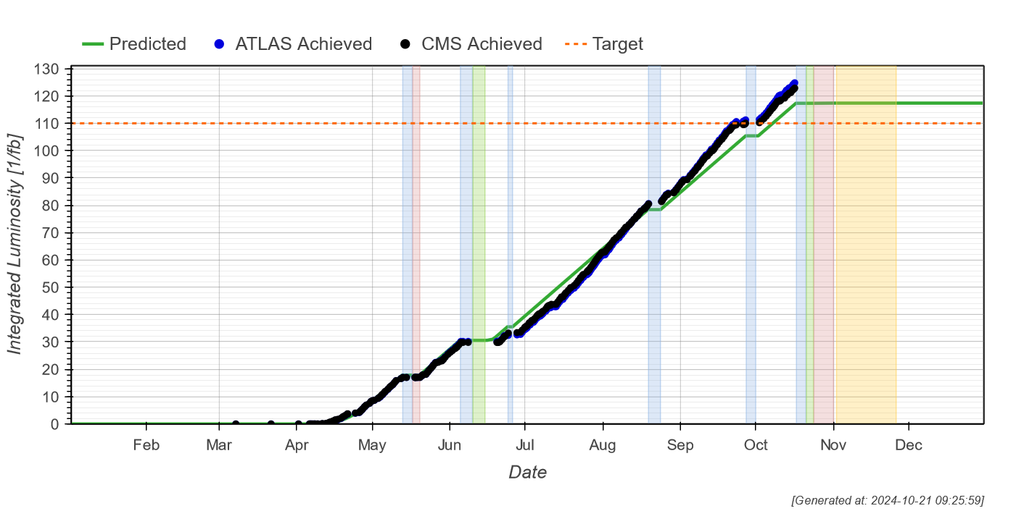
2024 LHC pp Run
Fantastic LHC performance
> 120 fb⁻¹ delivered to ATLAS & CMS

Slide 3
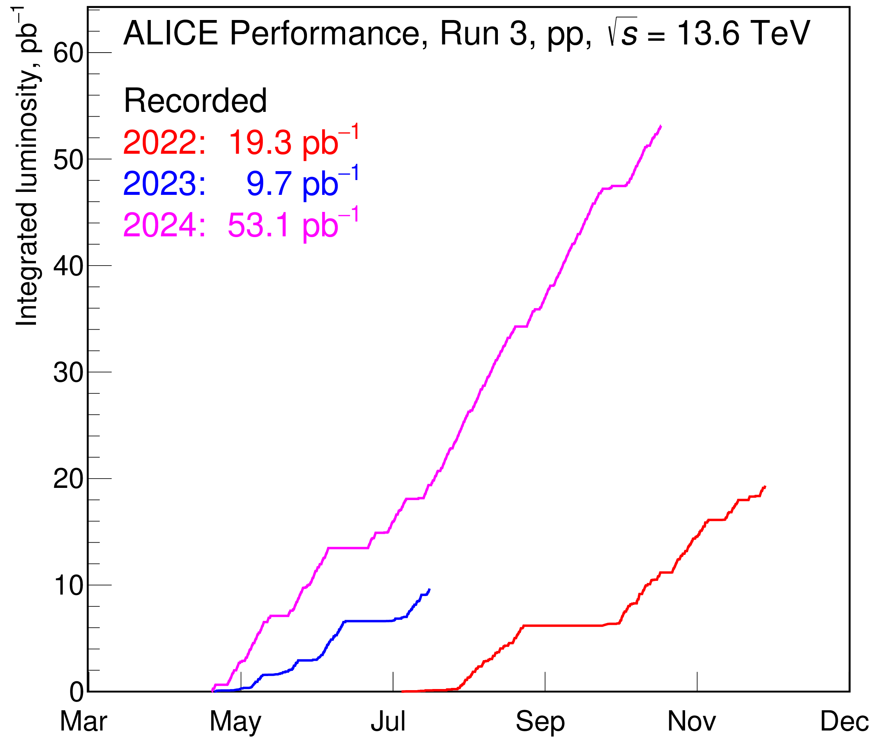
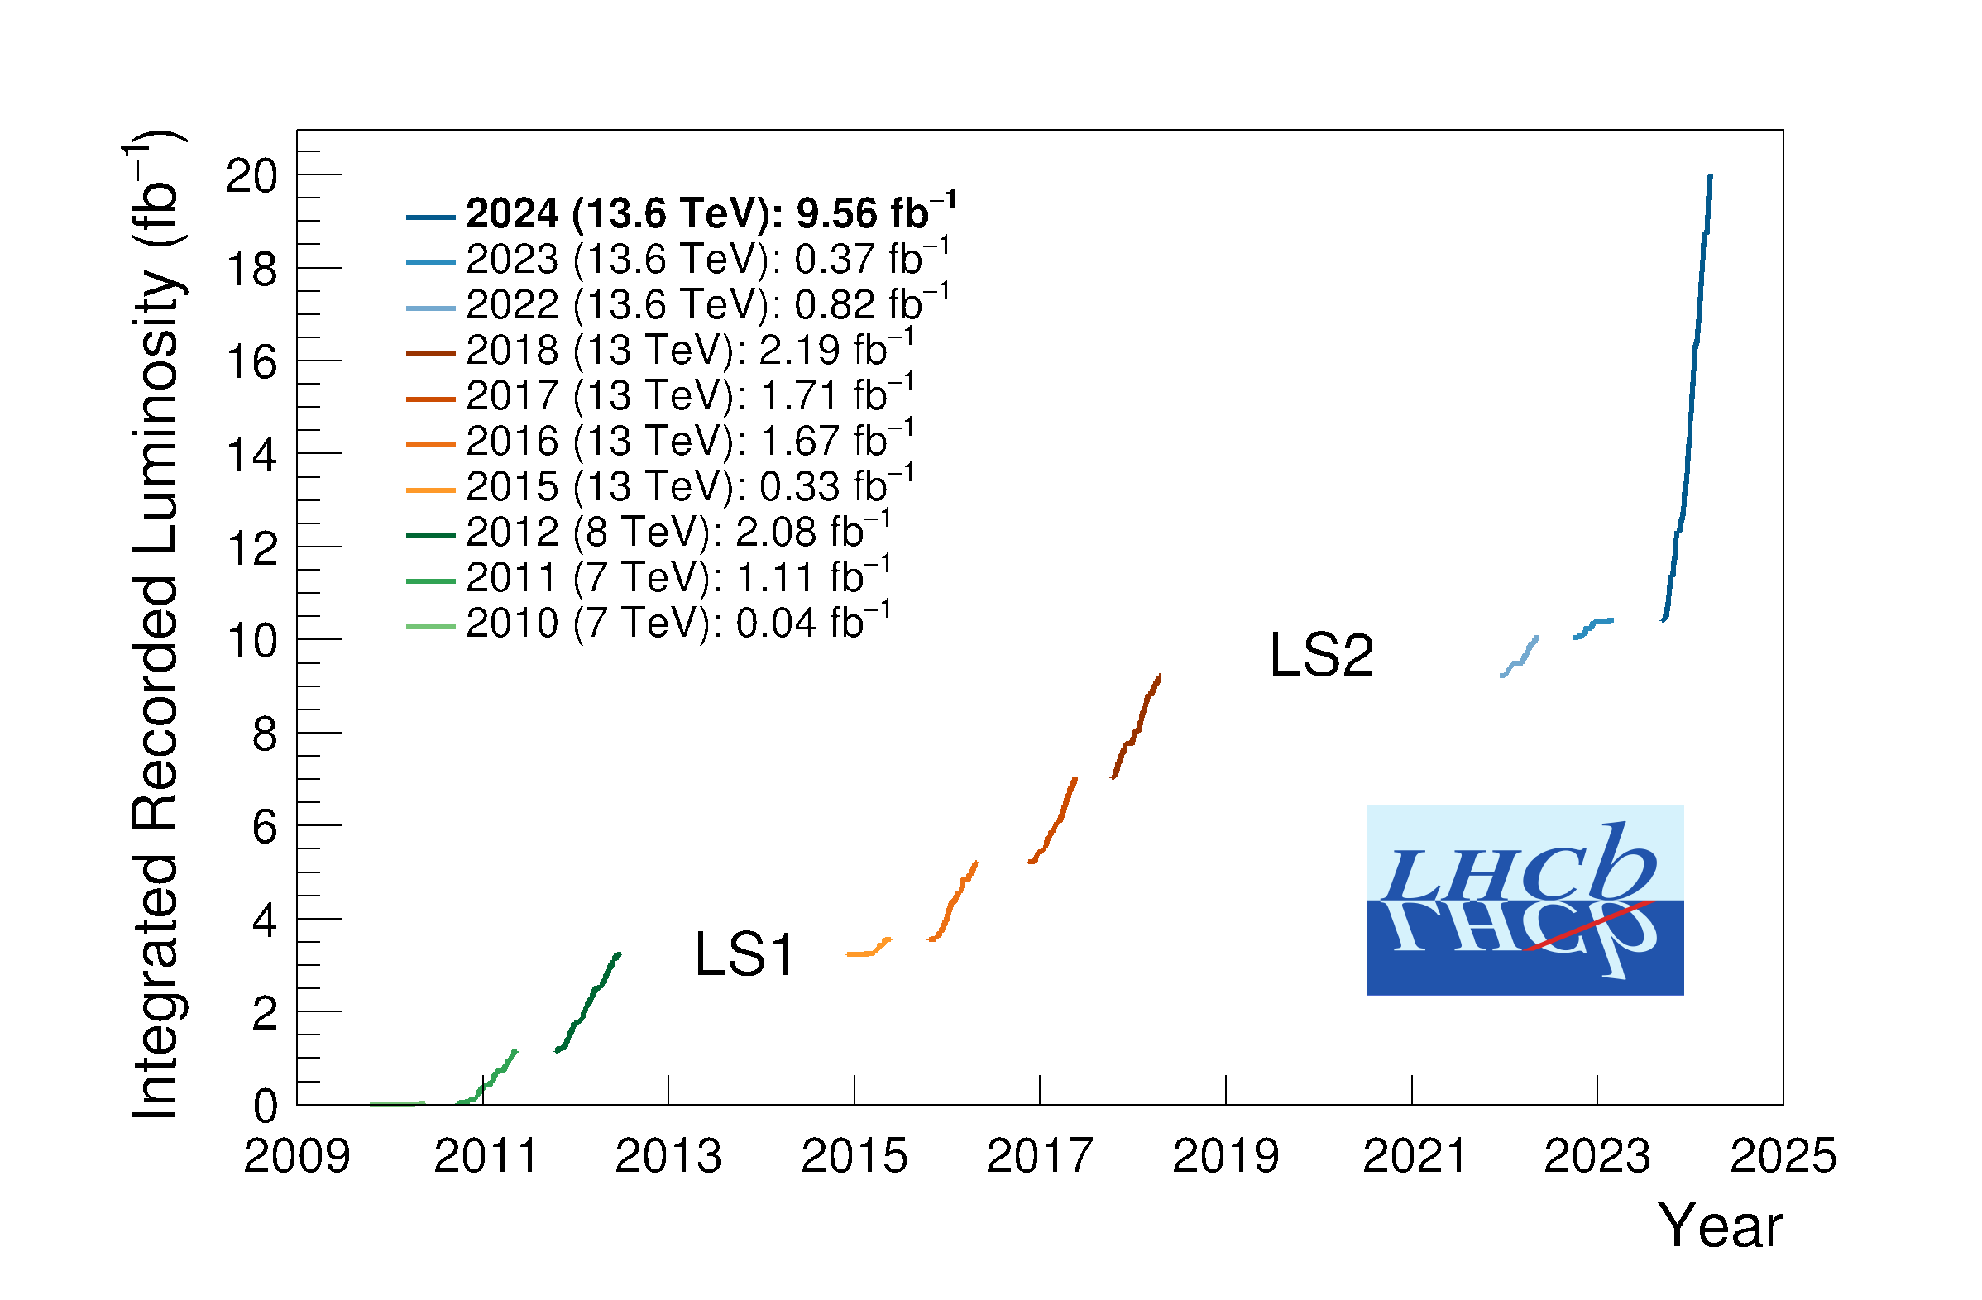
2024 LHC pp Run
LHCb and ALICE doubled their pp luminosity in 2024
With all Phase I upgrades fully commissioned
e.g. ALICE 1000 times more minimum bias events in central barrel because of continuous readout

Slide 4
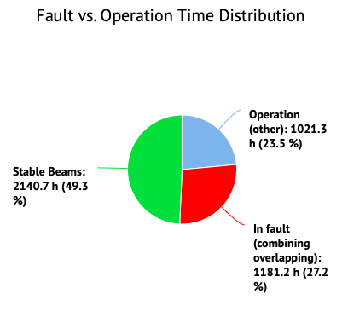
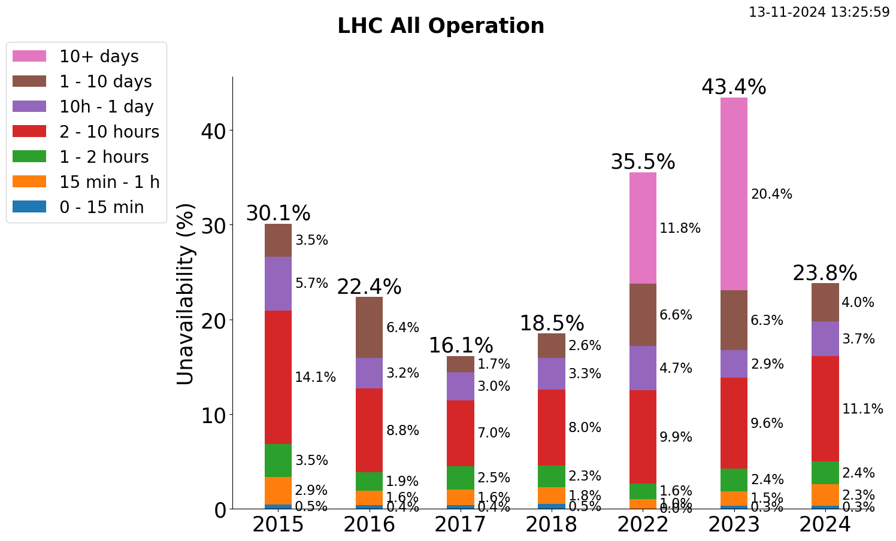
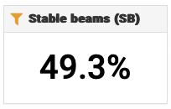
LHC availability 2024

Slide 5
Availability Overview LHC Injector Chain proton period
Facility | Destination | ‘21/’22/’23 Overall [%] | 2023 | Achieved 2024 |  | Period
Facility | Destination |  | Per destination [%] | Overall [%] | Per destination [%] | Period
LINAC4 | PSB | 97.3 / 96.8 / 98 | 98 | 97.1 | 97.1 | 15.02.2024 – 20.09.2024
PSB | PS | 94.5 / 94.8 / 96.1 | 96.4 | 95.7 | 96.1 | 21.02.2024 – 20.09.2024
 | ISOLDE |  | 96.6 |  | 97.2 | 28.03.2024 – 20.09.2024
PS | SPS | 88.1 / 89.6 / 92 | 92.8 | 93.0 | 93.7 | 01.03.2024 – 20.09.2024
 | East Area |  | 93.5 |  | 94.6 | 22.03.2024 – 20.09.2024
 | nTOF |  | 92.8 |  | 94.6 | 25.03.2024 – 20.09.2024
 | AD |  | 92.6* |  | 94.3 | 14.03.2024 – 20.09.2024
SPS | LHC | 73.4 / 74.1 / 86 | 94.3 | 84.1 | 93.9 | 08.04.2024 – 20.09.2024
 | North Area |  | 86.6 |  | 85.3 | 25.03.2024 – 20.09.2024
 | AWAKE |  | 98.4 |  | 96.4 | 15.04.2024 – 20.09.2024
 | HiRadMat |  | 99.1 |  | 98.7 | 29.04.2024 – 20.09.2024

Slide 6
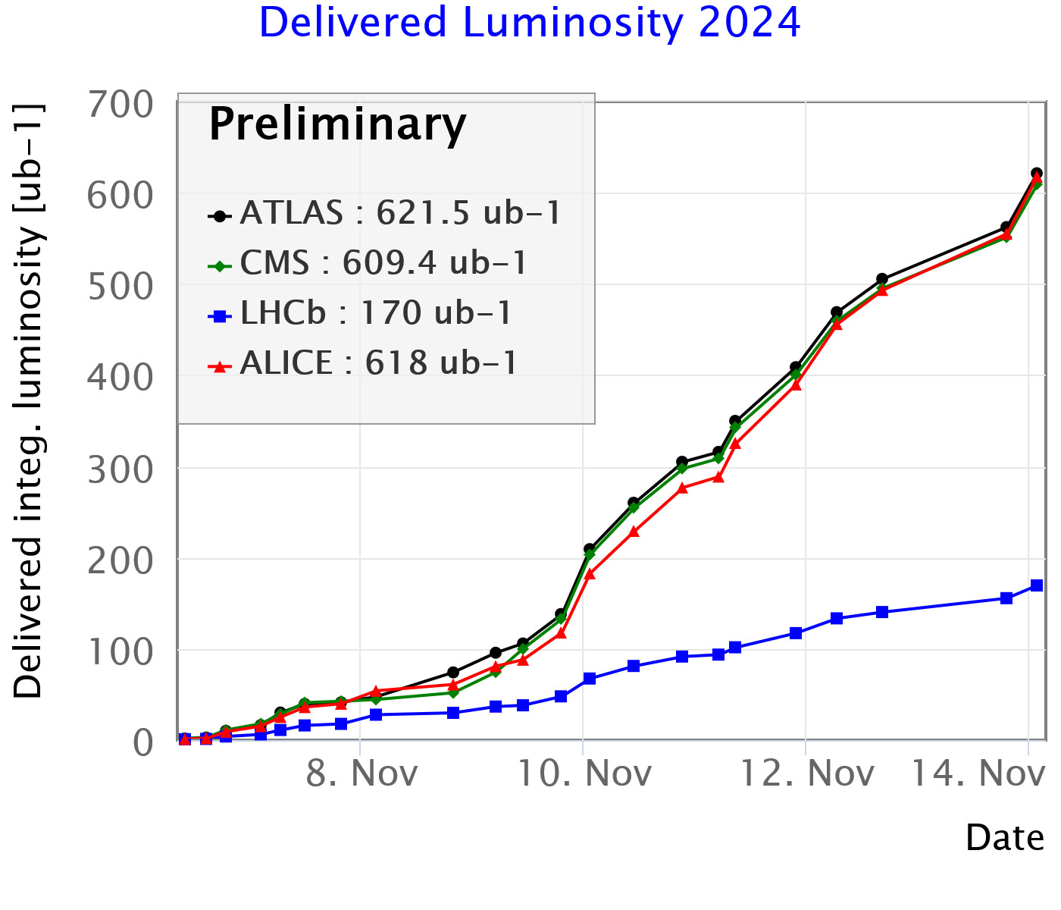
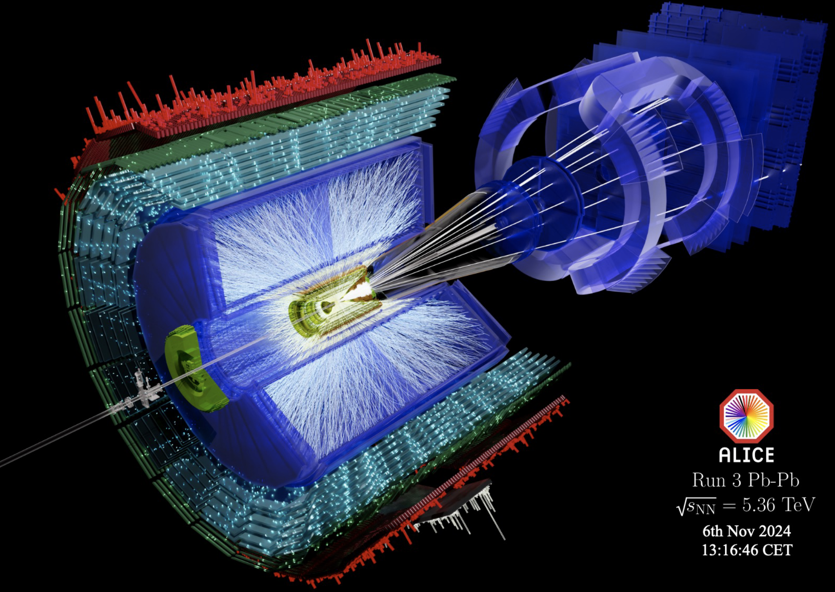
Status 2024 Heavy Ion Run
On track to deliver:
1.9 nb⁻¹ to ATLAS/ALICE/CMS and 0.5 nb⁻¹ to LHCb
End of 2024 run: November 25th

Slide 7

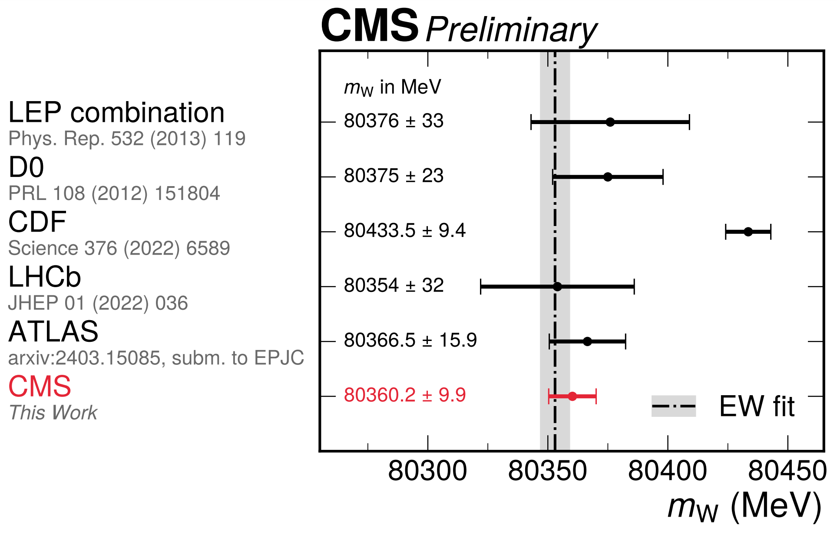
CMS: Measurement of the W Mass
Use well-understood subset of 13 TeV data: 16.8 fb⁻¹ from later part of 2016 run
(~ 30 mean interactions per crossing)
Focus on muon channel
Larger experimental systematics for electrons and hadronic recoil, especially with higher pileup
Result:
m_{W} = 80 360.2 ± 9.9 MeV
This is compatible with the Standard Model expectation and with other measurements
Clear tension with CDF measurement

Slide 8
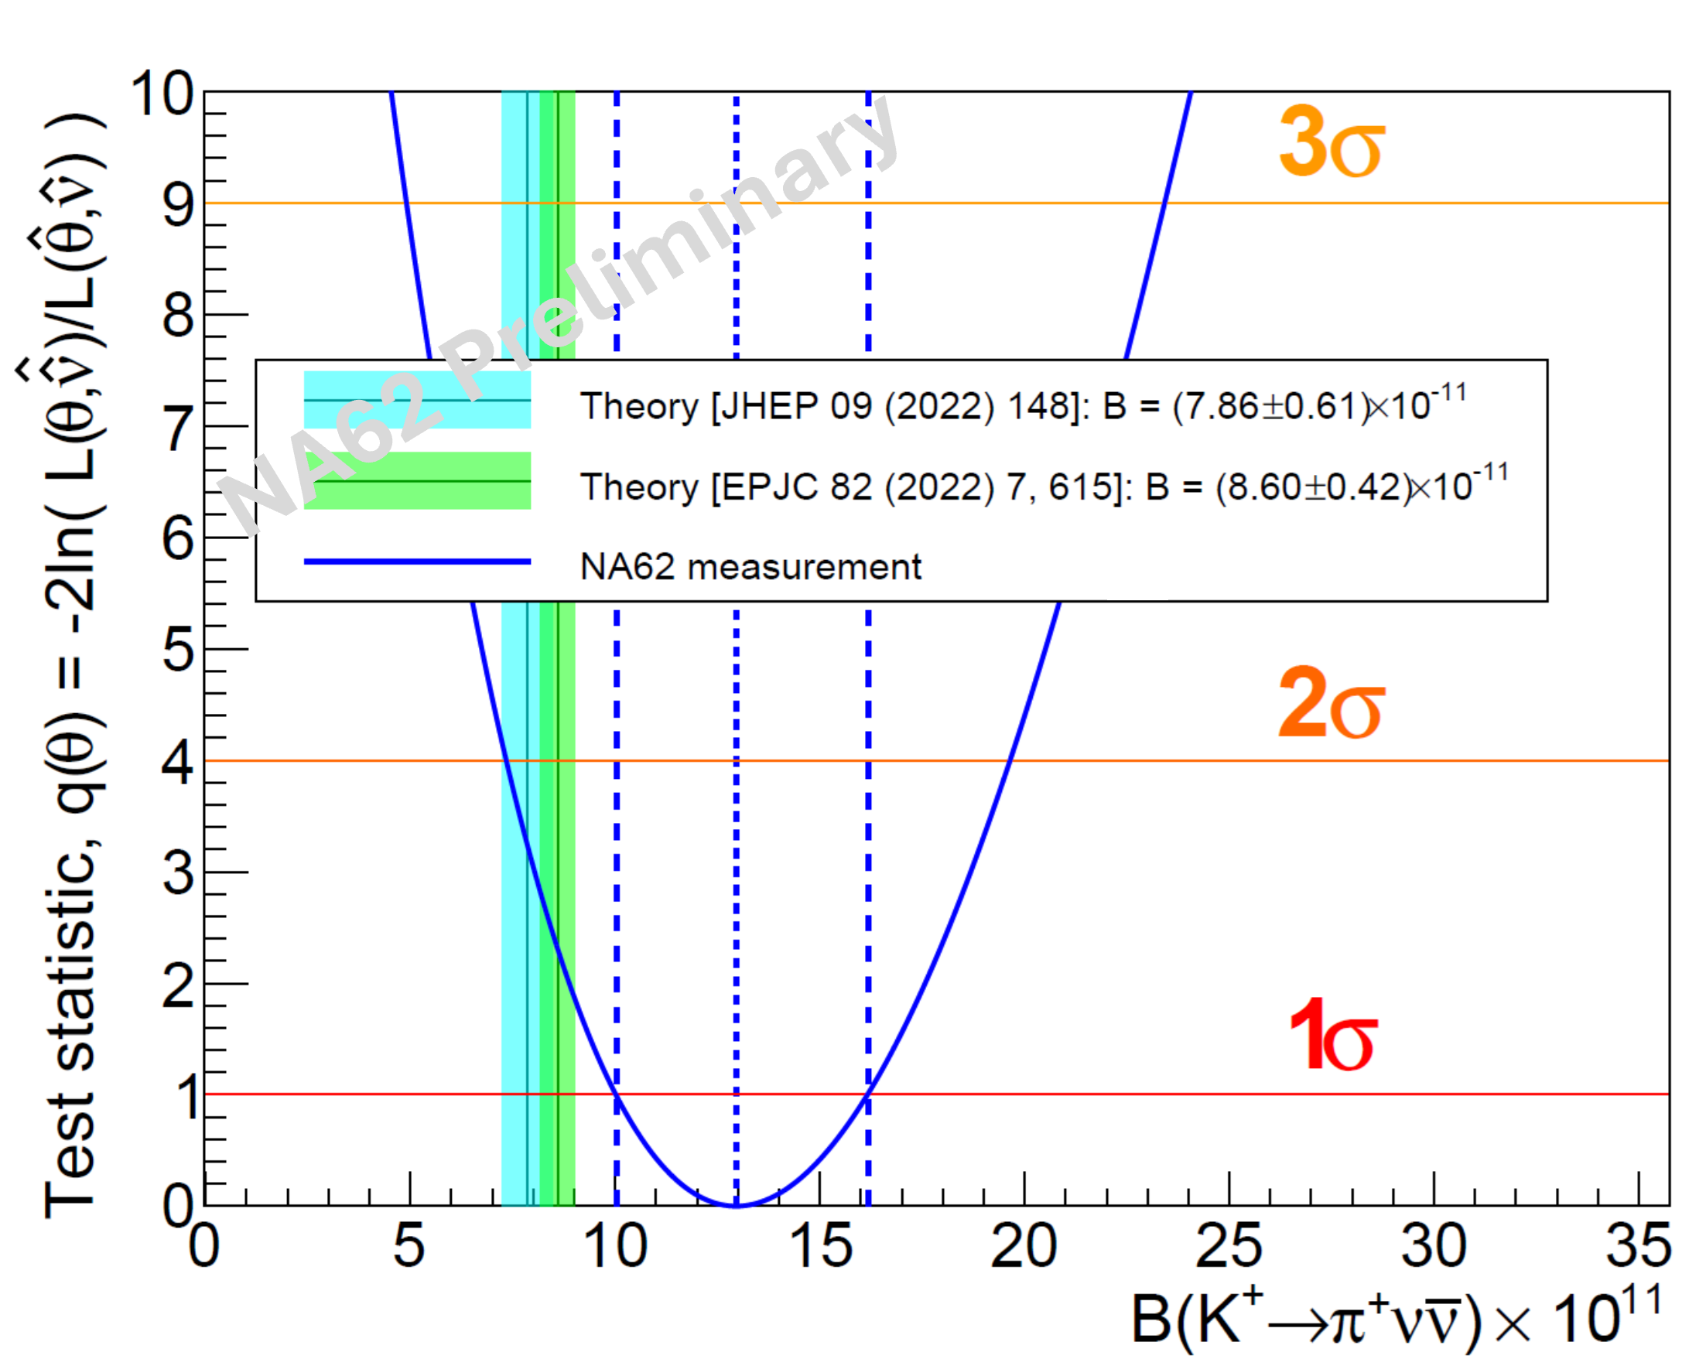
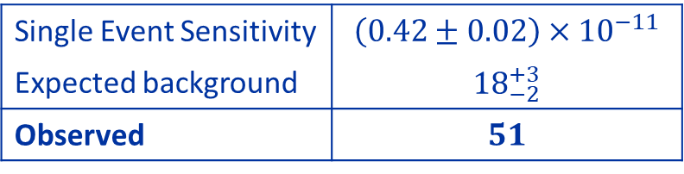


$K^{+}→π^{+}ν\overline{ν}$: NA62 Combined Result 2016-22 Data
Single Event Sensitivity | $\left(0.42±0.02\right)×{10}^{−11}$
Expected background | ${18}_{−2}^{+3}$
Observed | $51$
b-only hyp. rejection significance: $Z=5σ$
$$𝓑_{πνν}=\left[13.0{\left({}_{−2.7}^{+3.0} \right)}_{stat}{\left({}_{−1.2}^{+1.3} \right)}_{syst}\right]×{10}^{−11}$$
$$𝓑_{πνν}=\left({13.0}_{−2.9}^{+3.3}\right)×{10}^{−11}$$
$$𝓑_{πνν}=\left({13.0}_{−2.9}^{+3.3}\right)×{10}^{−11}$$
NA62 Preliminary

Slide 9
Status of HL-LHC and Phase II Projects
A lot of progress in CMS…
See talk
Katja Klein

Slide 10
Status of HL-LHC and Phase II Projects
And a lot of progress in ATLAS…
See talk
Craig Sawyer

Slide 11
Status of HL-LHC and New Schedule
BUT:
Significant delays in the Phase II projects of ATLAS and CMS
in particular ATLAS ITk and CMS HGCAL
no or even negative time contingency left
in addition, significant schedule risks remaining
P2UG/LHCC/SPC conclusion: schedule is not tenable
(conclusion in September 2024)
LS3 Cost and Schedule Review in September 2024
Remaining civil engineering work for HL-LHC requires an extension of LS3 by 4 months
Decision of CERN directorate:
Delay start of HL-LHC by 1 year, composed roughly by 1/2 year extension of Run 3 in 2026 and 1/2 year extension of LS3 as required by the LHC and by CMS
Key dates of new LHC schedule:
Operation in 2026:
short YETS 2025/26
run LHC until end of June with possibly HI run taking place in June
run injectors until end August
Restart in 2030:
start hardware commissioning in January 2030
closure of experimental caverns mid-May
beam in the machine as of June
restart of injectors to be defined
Post-LS3:
LS4 moved by one year: from 2033/34 to 2034/35
LS5 will become an EYETS
Details still to be worked out, optimization to be performed

Slide 12
Schedule Risks
Risks remain also on the new schedule:
Established risk registers with impact and mitigation measures with the experiments
Examples (which were not even thought of before!)
CMS outer shell accident
  incident on the road
  fortunately no major damage
  looks like we were lucky…
lpGBT chip
  by testing large number of components recently a problem with the low power GigaBit Transceiver (lpGBT) chip has been discovered
  in about 1% of the cases the chip does not restart, impact on detectors is being evaluated
  new production will take 6-12 months
To avoid any further, very detrimental delays
Highest priority must be given to the upgrade projects
Increased efforts by all institutes and collaborators will be necessary!

Slide 13
Phase IIb: ALICE and LHC
See talks
Felix Reidt & Vava Gligorov
Scoping documents submitted
For both experiments scenarios of core costs between ≈ 125 MCHF and 180 MCHF are presented
Under scientific and technical review by the LHCC
Results expected by March 2025
In parallel discussions with Funding Agencies to define realistic funding envelopes
Aim to define upgrade scope, based on LHCC and FA input, in spring 2025
Then start to work on TDRs
Detector improvements during LS3:
ALICE: ITS3 and FoCal: TDRs are completed and endorsed by Research Board
LHCb: ECAL, RICH; endorsed by RB; DAQ Enhancement TDR; LHCC recommended for approval

Slide 14
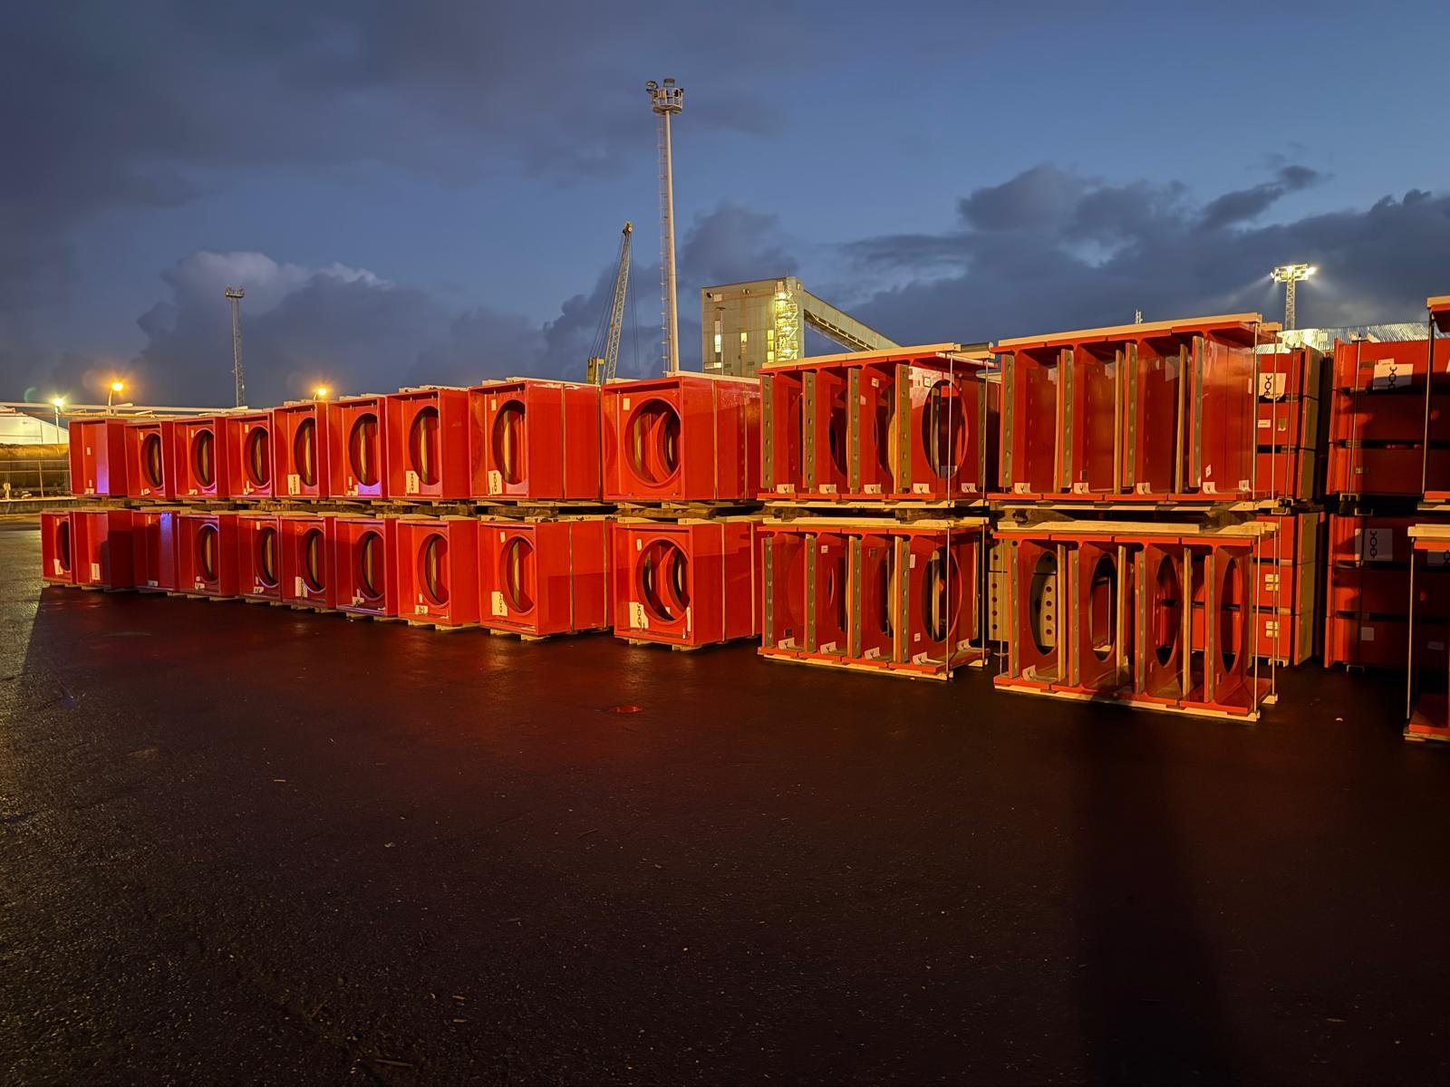
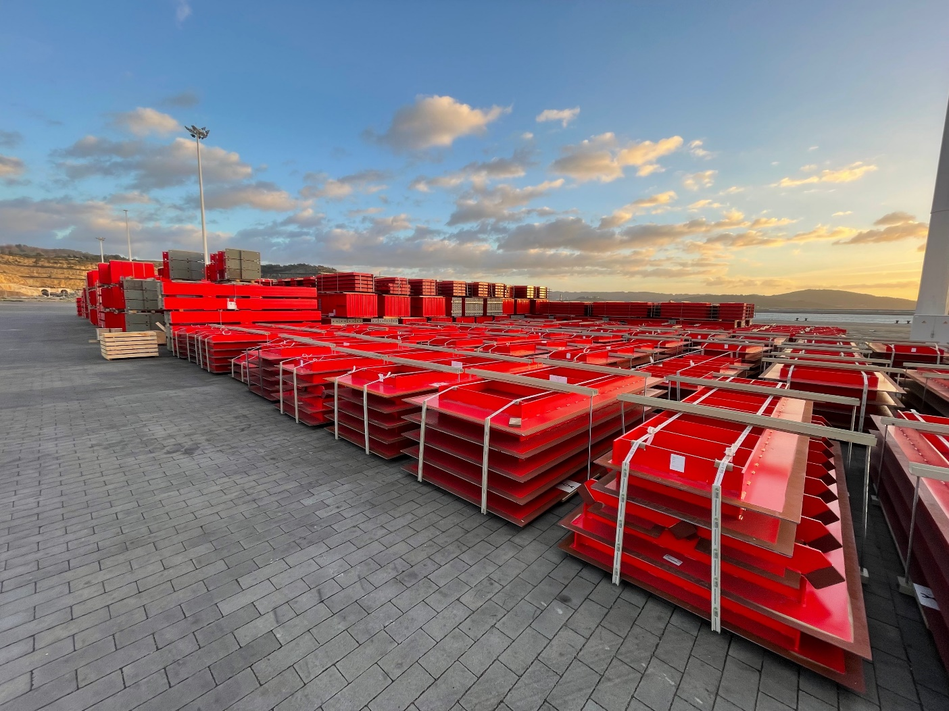
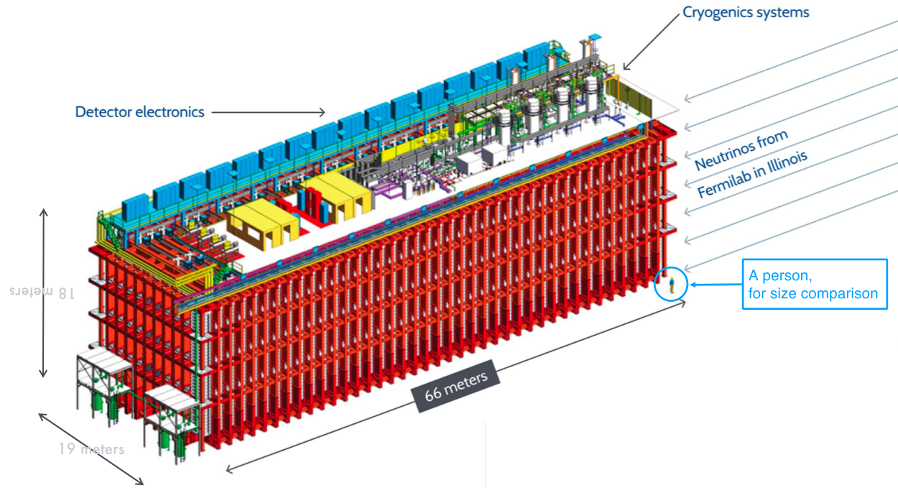
Neutrino Platform and LBNF/DUNE
At CERN two main activities for the LBNF/DUNE project in the US:
Construction of two large cryostats for the DUNE far detectors
Production of warm steel structure completed for both cryostats
Transport of 1st cryostat to the US failed:
Infestation of packaging wood, required re-exporting from US for treatment
Both warm steel structures are now ready for transport to the US
Cryostat #1 in La Coruña harbour after repacking
≈ 66×18×19 m³
Cryostat #2 transported to the harbour

Slide 15

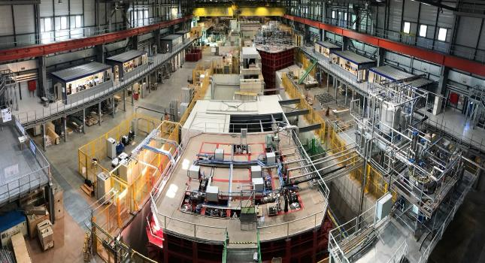
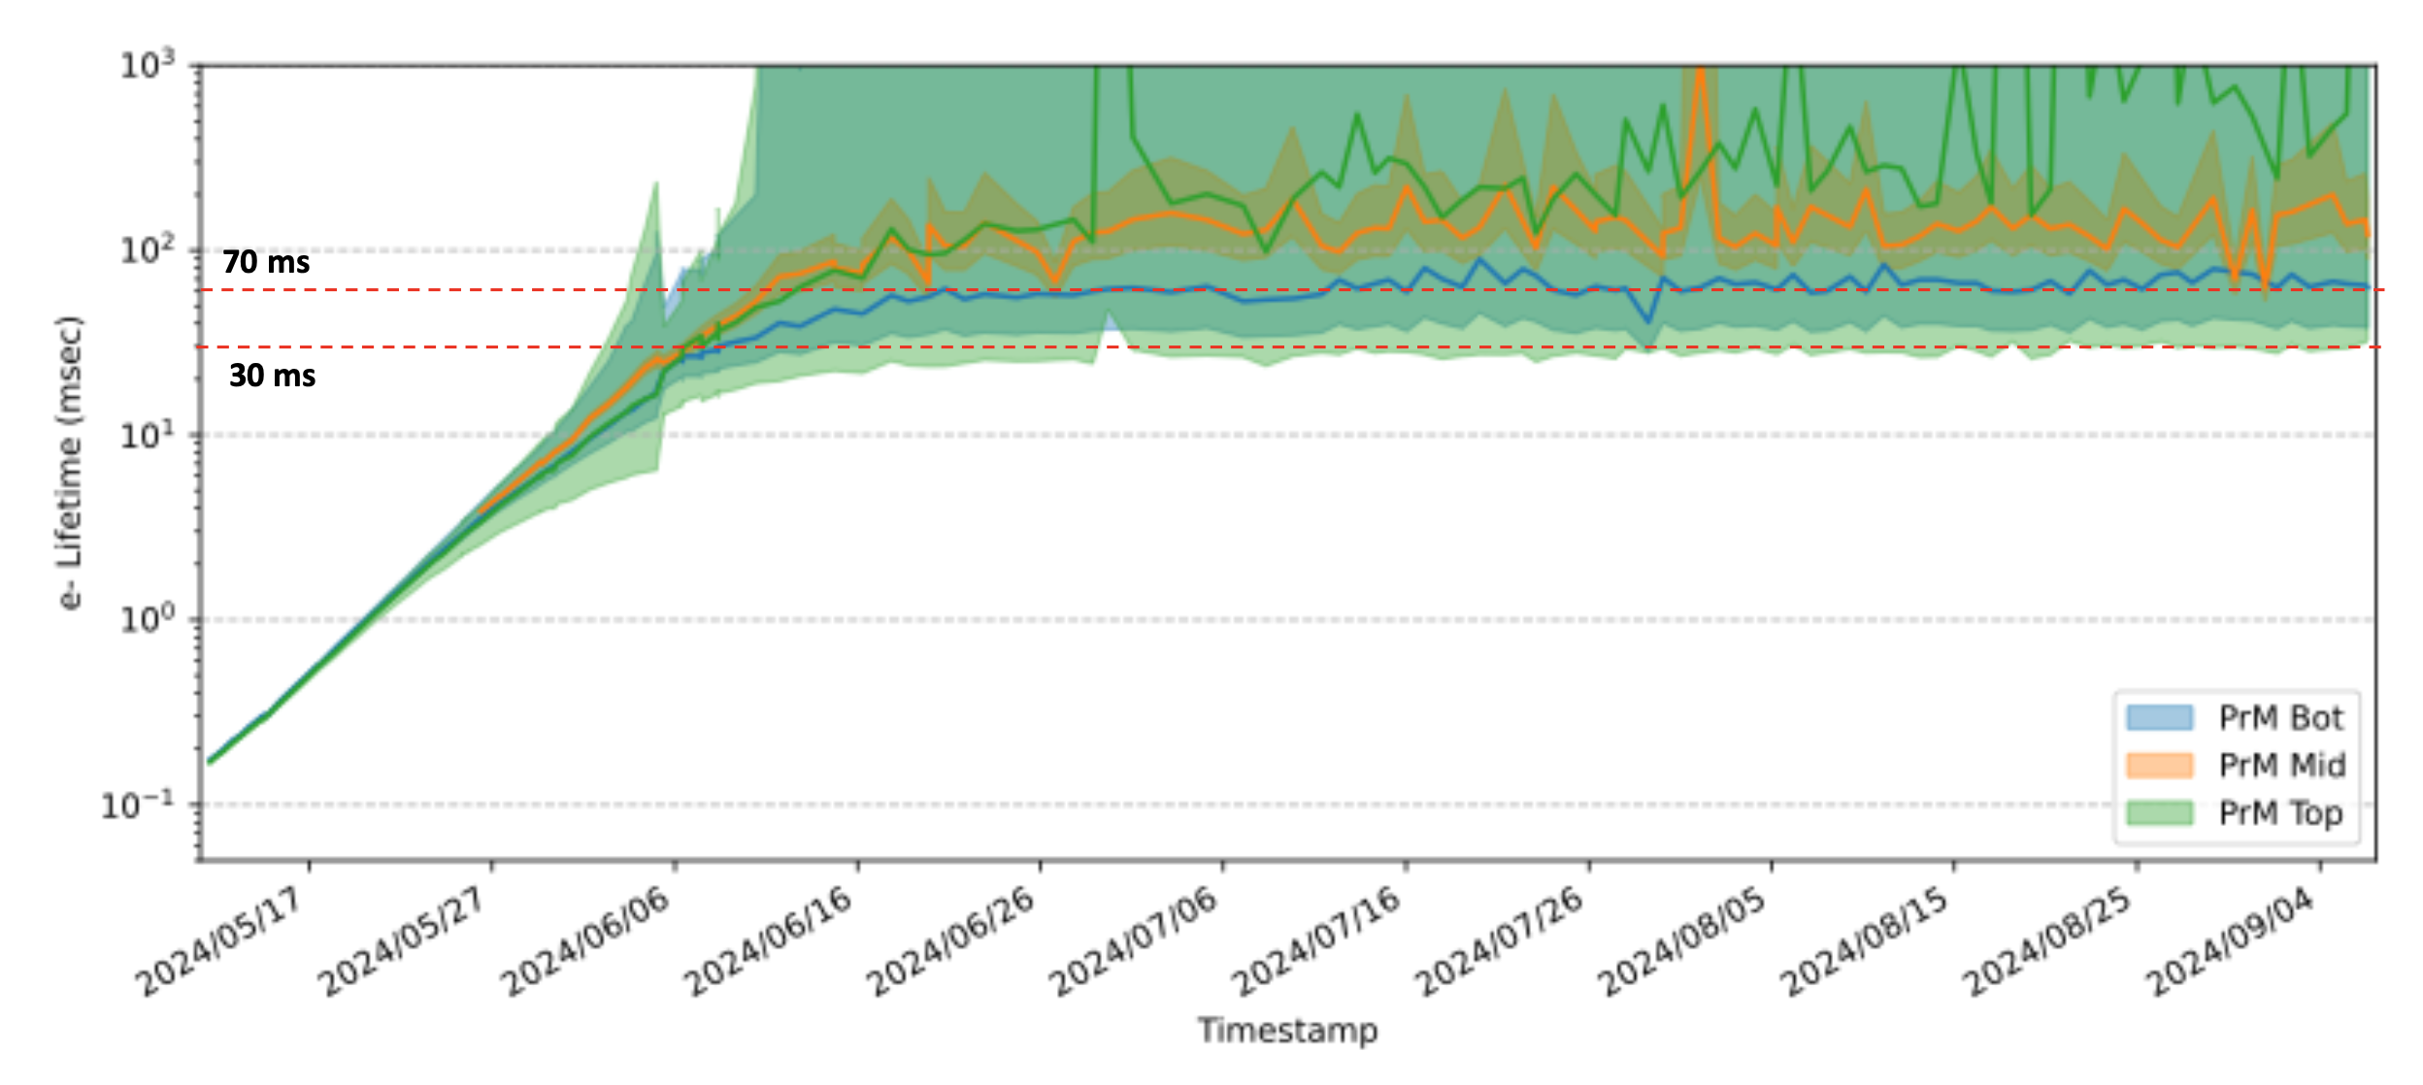
Neutrino Platform Activities
NP02:
Vertical Drift
2) ProtoDUNE: Validation of the final prototypes of the DUNE far detectors (Horizontal and Vertical Drift concepts)
  NP04 in operation since beginning of May
  Extremely pure: drifting electron lifetime exceeding 50 ms
  (Note: requirement is 3 ms)
  Very low electronic noise and only ~1 ‰ channels loss or problematic
  Stable HV >99.9% uptime at nominal field
  DAQ throughput exceeding DUNE requirements
  About 30 million triggers from 10 weeks testbeam campaign:
  Beam scans: 1-7 GeV/c with both polarities
  Most data at 1 GeV/c for pion cross-section measurement
  2 million beam trigger with 5 GeV/c K and p (+/- )
  Unique sample for physics
  4.2 PB of beam data, 0.8 PB of cosmics
NP04:
Horizontal Drift
Purification period after LAr filling

Slide 16
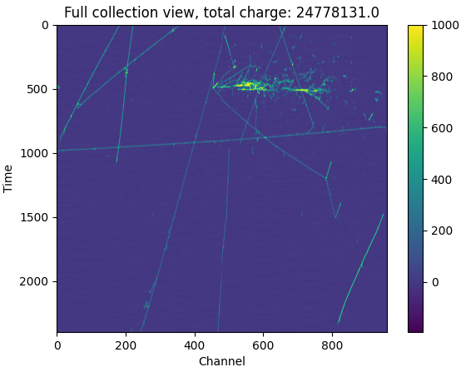
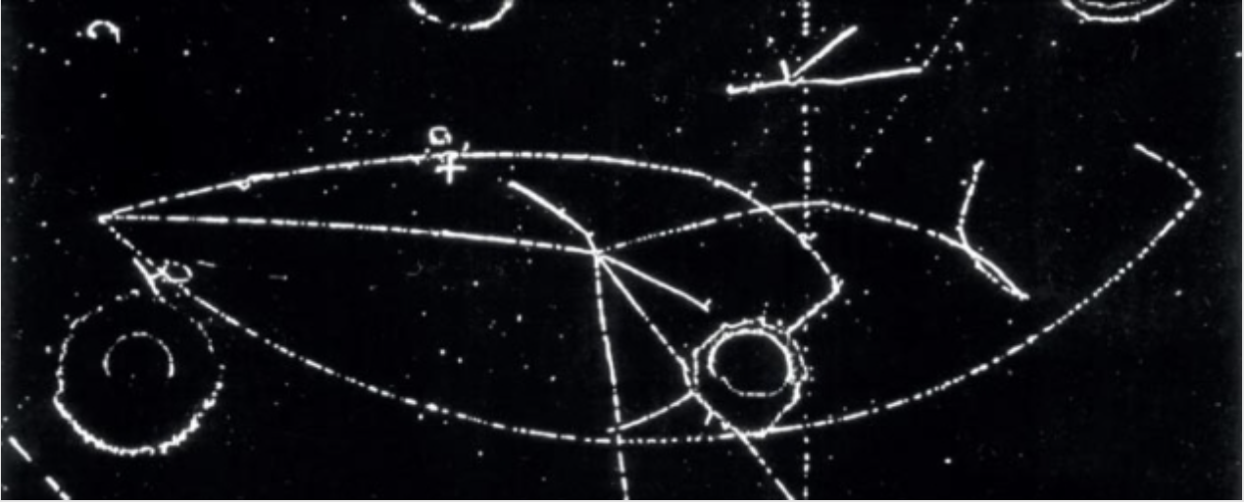
ProtoDUNE: NP04
In a seminar at CERN on 19 July 1973, Paul Musset (Gargamelle) presented the first direct evidence of weak neutral currents
51 yrs after: a NC candidate?

Slide 17
Status DRD Collaborations
DRD1 Gaseous detectors
DRD2 Liquid Detectors
DRD4 Photodetectors & PID
DRD6 Calorimetry
DRD3 Semiconductor Detectors
DRD5 Quantum Sensors
DRD7 Electronics
DRD8 Integration
Fully approved by RB in Dec 2023 on recommendation of the DRDC for 3 years
Fully approved by RB in Mar 2024 on recommendation of the DRDC for 3 years
Full proposal received Oct 2024
MoUs in preparation and being discussed with the DRD collaborations

Slide 18
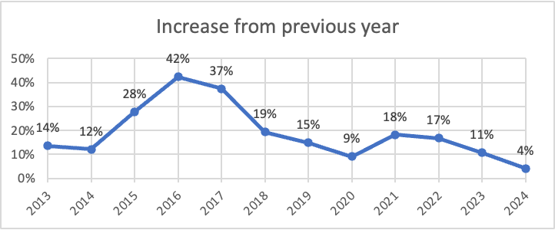
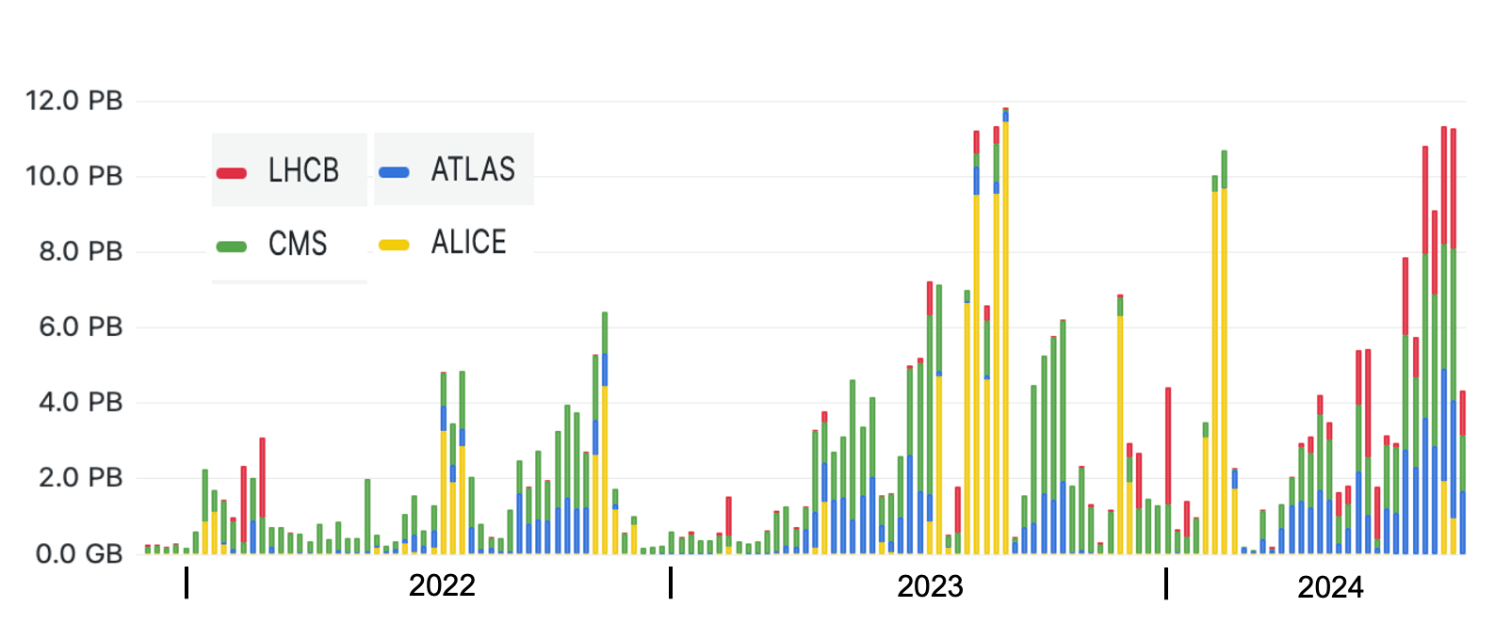
Computing
  CERN Data Centres:
    Prévessin Data Centre (PDC): fully operational.
    Meyrin Data Centre (MDC): record storage rate of 11 PB/week in July 2024, from experiments to MDC
    (guaranteed bandwidth in Run3: 25 PB/week)
  Data promptly archived at CERN and at the Tier-1 centres
  IT infrastructure handles the data flow from the extraordinary performance of the LHC with headroom
  WLCG:
  reached 1.4 million computing cores and over 4 EB of storage, thanks to about 170 sites worldwide
Growing number of compute resources provided to the experiments, but less growth recently
Increases delivered year-by-year
Weekly volume of data archived at the Tier-0 (PB) during Run3

Slide 19

FCC
  Joint statement USA and CERN
  signed in the White House, April 2024
  Ursula von der Leyen
  President of the European Commission
  Recent good news
  FCC week in San Francisco
  Signature of a joint statement between USA and CERN
  Draghi report: includes a chapter
  „The CERN success story“
  Speeches at CERN 70 celebration,
  e.g. President of the European Commission
  Aim to present Feasibility Study to Council in spring 2025, in time for European Strategy Update
  Should the CERN Member States determine the FCC-ee is likely to be CERN’s next world-leading research facility following the high-luminosity LHC, the US intends to collaborate on its construction and physics exploitation, subject to appropriate domestic approvals.
  Speech at CERN70 on October 1st, 2024

Slide 20
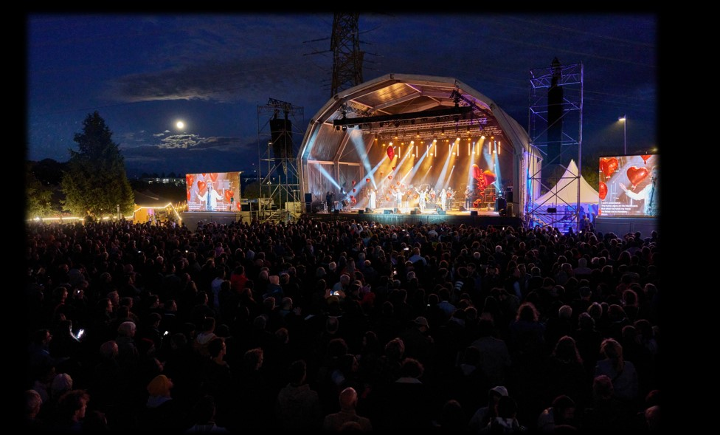
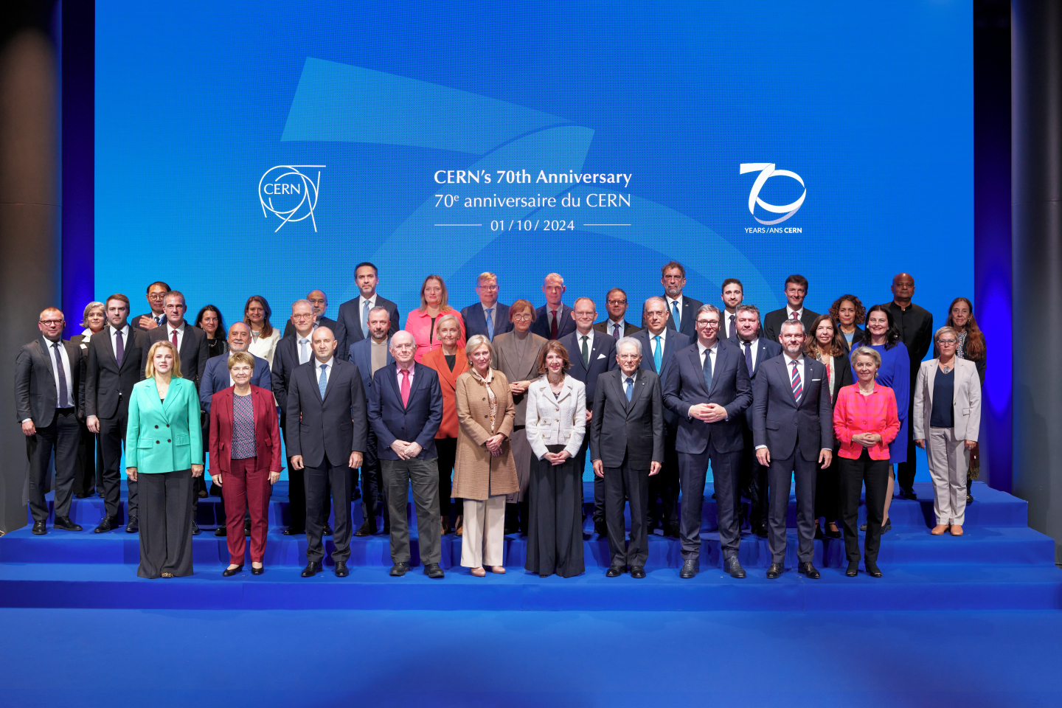
CERN70
Community event on September 17th
Party with 8000 people (CERN access card and their families)
Also > 100 events in Member States and beyond
High level event on October 1st
8 heads of state/government, 13 ministers and other (V)VIPs

Slide 21
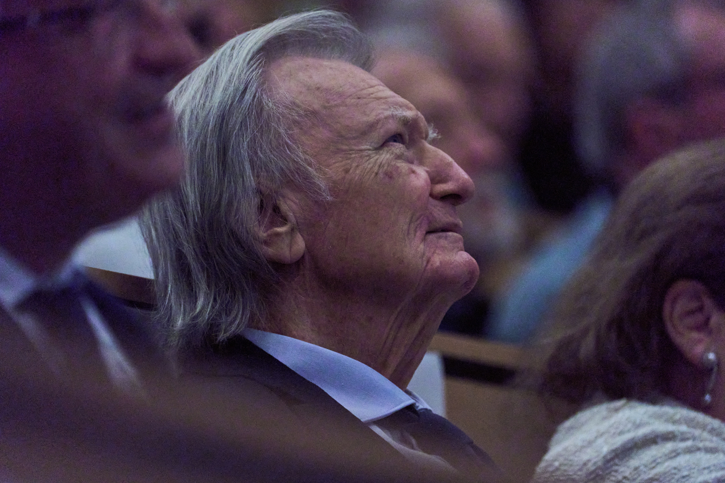
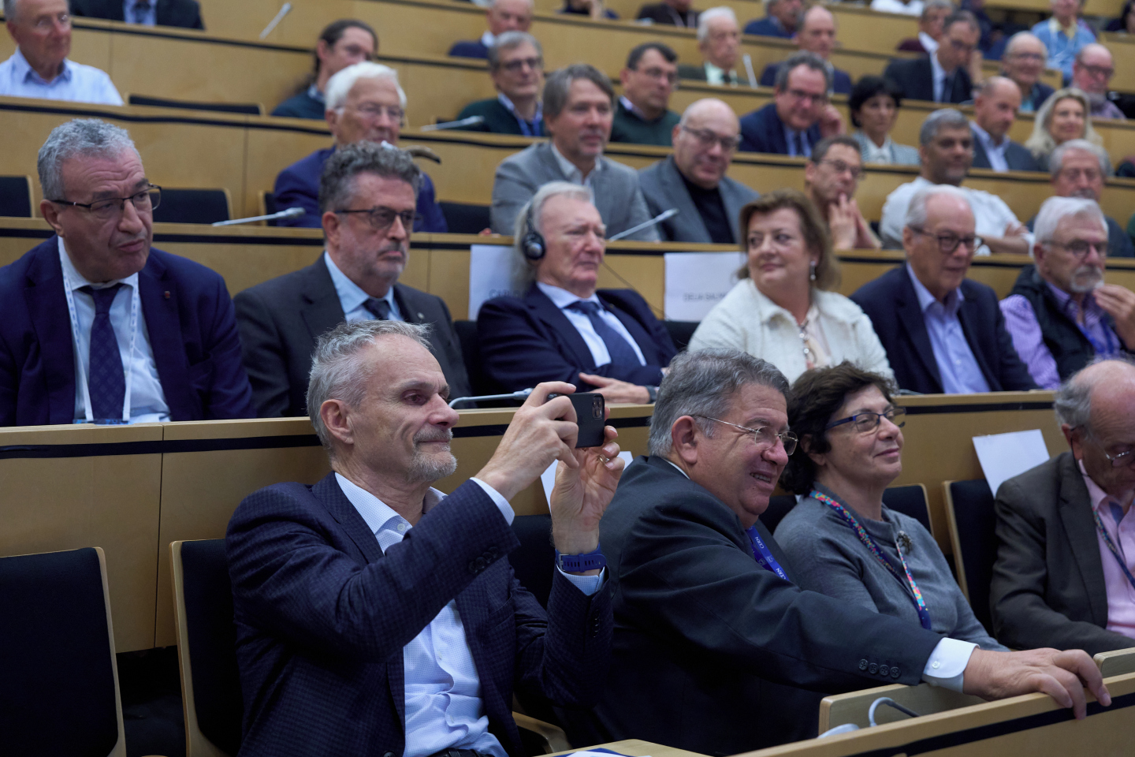
Symposium to honour Carlo Rubbia
Nobel Prize winner
Former CERN DG
Turned 90 years earlier this year
Symposium with excellent speakers describing his truly outstanding achievements in science:
Fabiola Gianotti, Chris Llewellyn Smith,
Gerardus 't Hooft, Sam Ting, Luciano Maiani
and others
See https://indico.cern.ch/event/1450340/
for slides and recordings

Slide 22
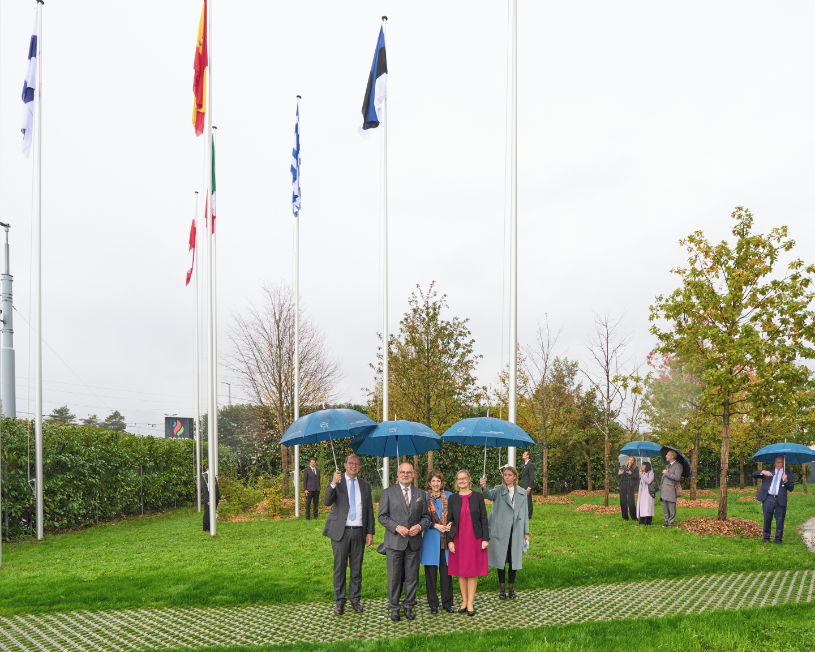
Estonia 24th CERN Member State
As of August 30th, Estonia is 24th CERN Member State
CERN family October 2024:
Flag-raising ceremony Estonia October 17th
24 Member States
Austria – Belgium – Bulgaria – Czech Republic
Denmark – Estonia – Finland – France – Germany
Greece – Hungary – Israel – Italy – Netherlands
Norway – Poland – Portugal – Romania – Serbia
Slovakia – Spain – Sweden – Switzerland – United Kingdom
1 Associate Member State
in the pre-stage to membership
Slovenia
9 Associate Member States
Brazil – Croatia – Cyprus – India – Latvia – Lithuania – Pakistan -Türkiye – Ukraine
6 Observers
Japan – Russia (suspended) – USA
European Union – JINR (suspended) – UNESCO
Chile and Ireland have applied for Associate Membership

Slide 23
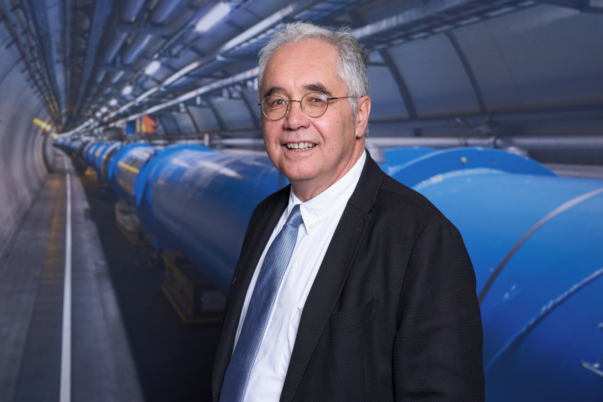
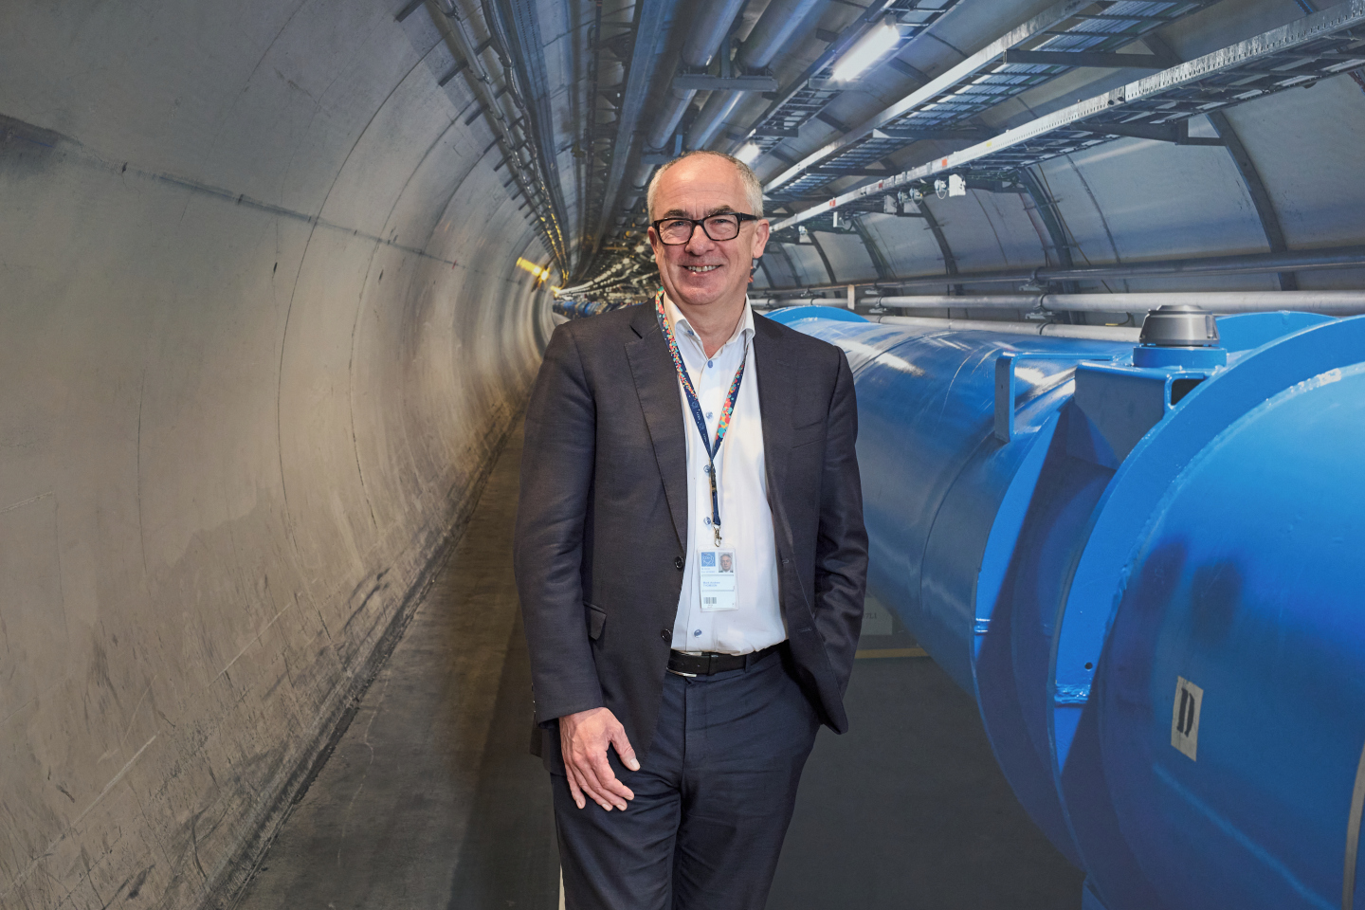
News from CERN Council
Costas Fountas elected as next President of the CERN Council
starting January 1st, 2025
Mark Thomson elected as next Director General of CERN
starting January 1st, 2026

Slide 24
Summary
Very successful proton-proton run in 2024
  More than 120 fb⁻¹ pp luminosity delivered to ATLAS & CMS
  ALICE and LHCb doubled their total pp data sets
  PbPb run is going on
Experiments continue to produce excellent physics results
Despite good progress in Phase II upgrades HL-LHC start had to be delayed by 1 year
  As further significant risks to the schedule remain, additional efforts are required to meet the new schedule
Good progress at Neutrino Platform and for LBNF/DUNE cryostats
WLCG is running smoothly
  Pay attention to development of hardware costs
Successful events at CERN and in Member States celebrating CERN 70th anniversary

Slide 25
Thank you for your attention!

Slide 26
Backup

Slide 27
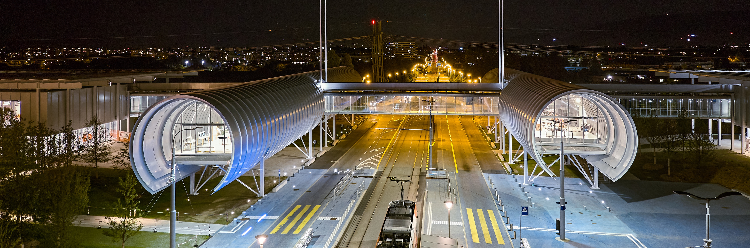
Science Gateway
To date > 400 000 visitors since 8 October 2023 (day of opening to the public) from 159 countries
as compared to ≈ 150 000/year before
≈ 60% individuals and families, ≈ 26% groups
>4800 trainings given to >1400 individual guides
(mostly users and staff)
→ many thanks to all colleagues who volunteered!

Slide 28
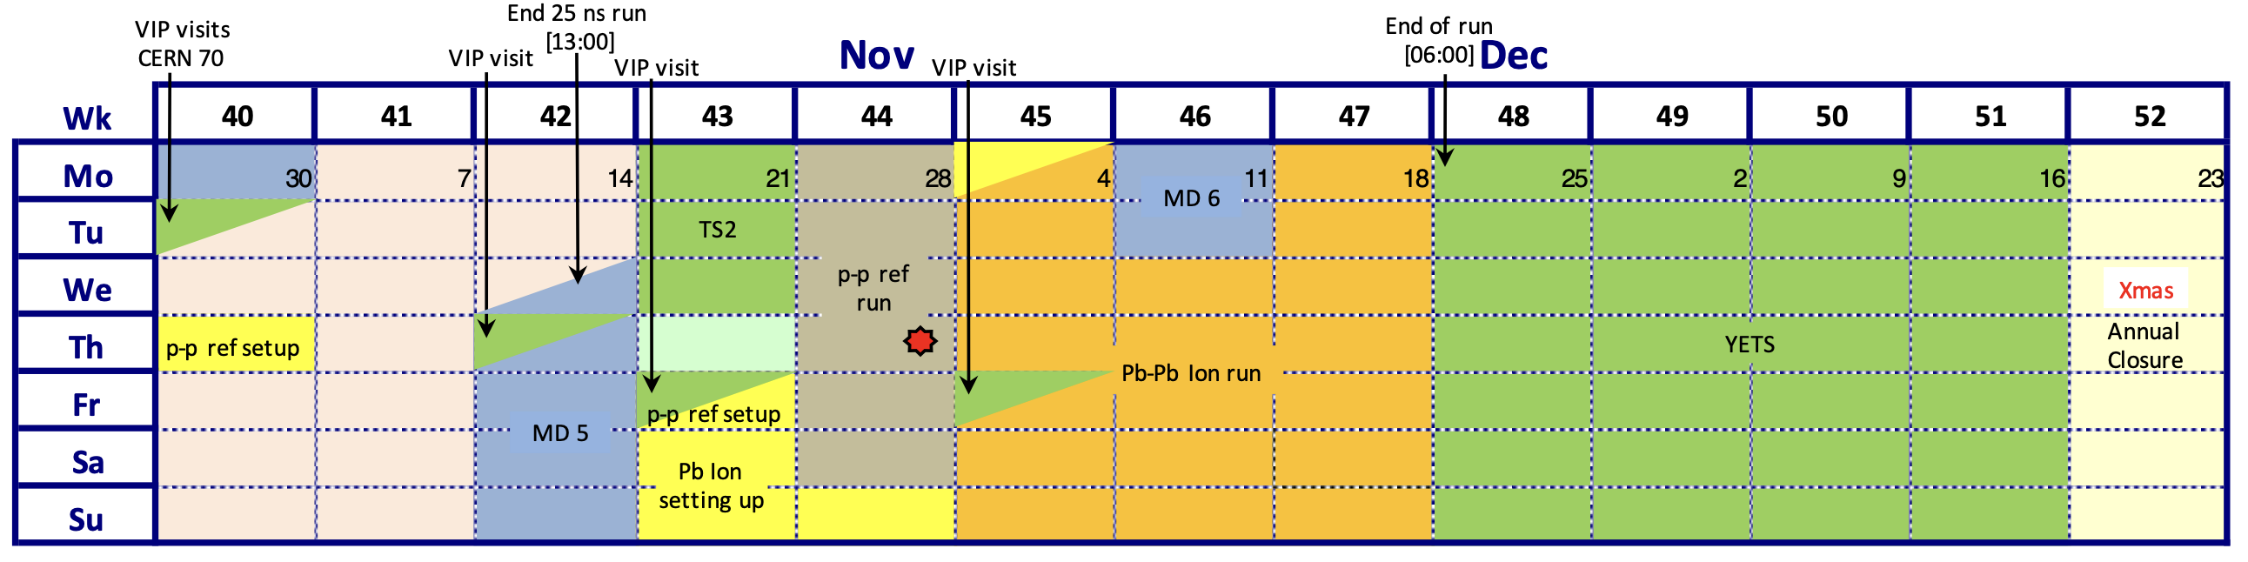
Remaining LHC Schedule for 2024

