Slide 1
Sustainability Assessment of Future Accelerators:
Report from the LDG Working Group
Caterina Bloise (INFN Frascati), Maxim Titov (CEA Saclay)
(on behalf of the LDG Working Group)
115th Plenary ECFA Meeting, CERN, November 14-15, 2024

Slide 2
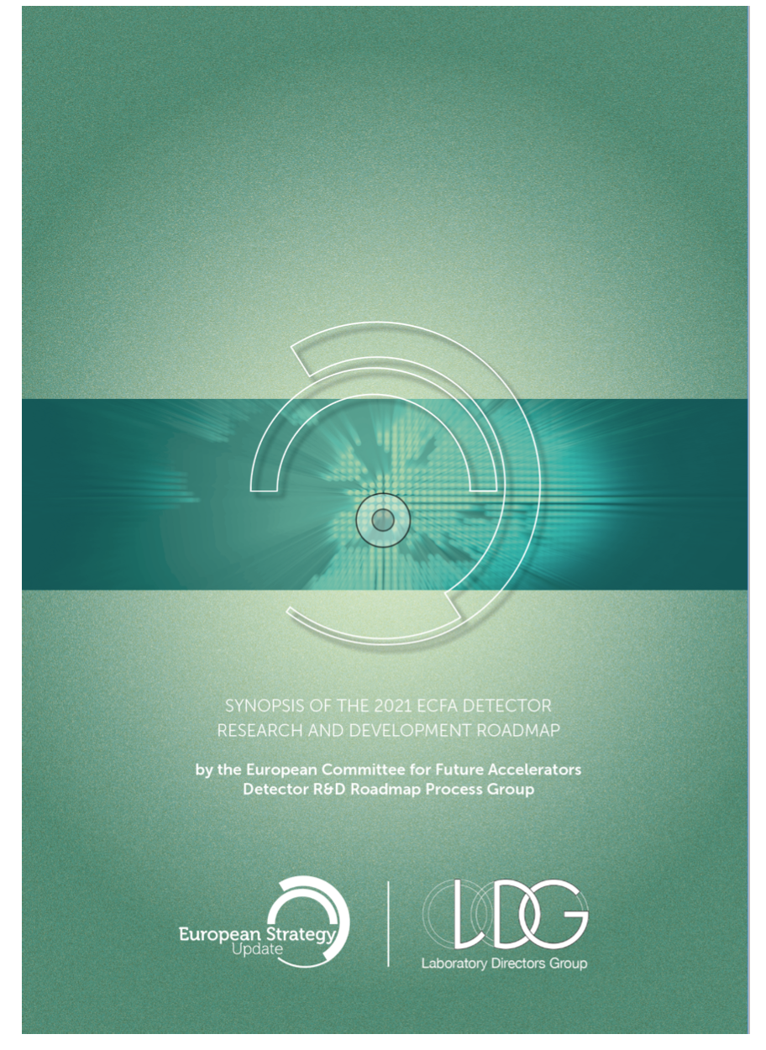
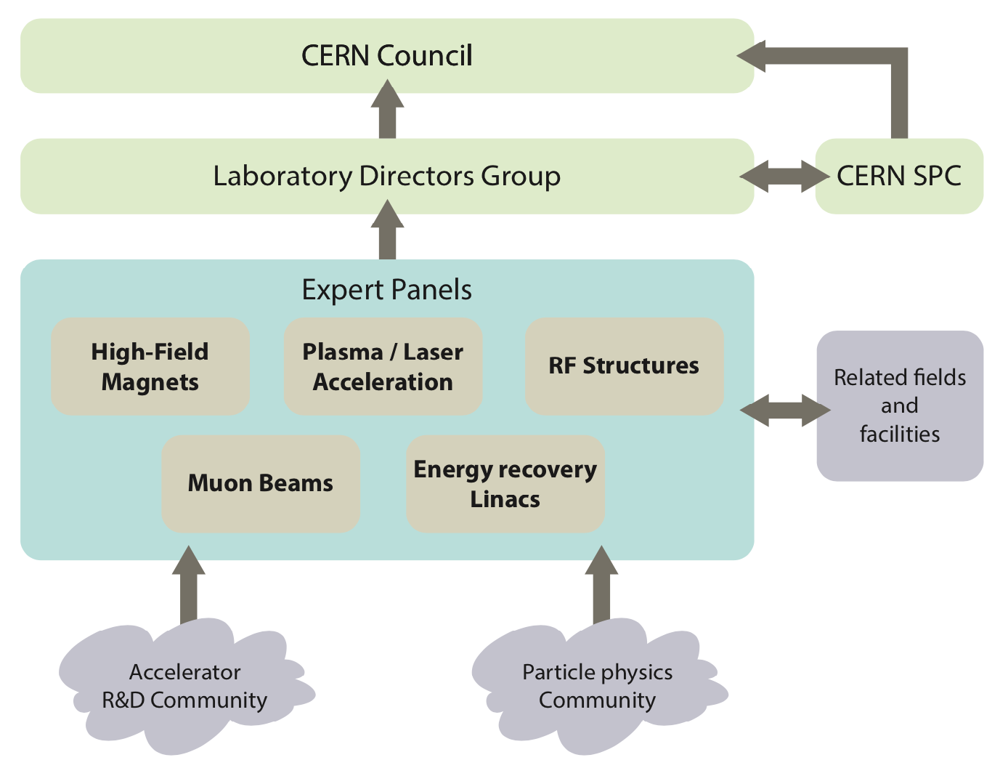
CERN Council has mandated the Laboratory Directors Group (LDG) to define and maintain a prioritized accelerator R&D roadmap towards future large-scale facilities for particle physics.
https://cds.cern.ch/record/2800190/files/146-138-PB.pdf
Sustainability Working Group (added to 5 LDG Expert Panels) since January 2024

Slide 3
LDG Sustainability WG Mandate and Composition
Development of guidelines and a minimum set of key Indicators for the sustainability assessment of future accelerators
Panel consisting of 15 members with technical expertize in evaluation of accelerator sustainability and future collider project representatives
Ensuring broad
community representation:
Sustainability Lab. Panels established at CERN, DESY, ESS, NIKHEF, STFC
ICFA Sustainability Panel
EU- Horizon Programs
Future accelerator projects: FCC, ILC, CePC, CLIC/Muon, LHeC, C3
Invited experts on specific topics
Walib Kaabi - PERLE, EU-iSAS
Mats Lindroos - ESS (deceased May 2, 2024)
Roberto Losito - CERN Sust. Panel
Ben Shepherd - STFC Sust. Task Force
Andrea Klumpp - DESY Sust. Panel, EU-iFAST
Hannah Wakeling - ISIS-II Neutron & Muon Source
Patrick Koppenburg - NIKHEF Sust. Panel
Johannes Gutleber - FCC
Yuhui Li - CePC
Benno List - ILC
Emilio Nanni - ICFA Sust. Panel & C3
Vladimir Shiltsev - LHeC
Steinar Stapnes - CLIC & Muon collider
Caterina Bloise - Co-Chair
Maxim Titov - Co-Chair, EU-EAJADE
in the Editorial Board also
Enrico Cennini (CERN), Luisa Ulric (CERN).
Beatrice Mandelli (CERN), Niko Neufeld (CERN)
Thomas Schoerner (DESY)

Slide 4
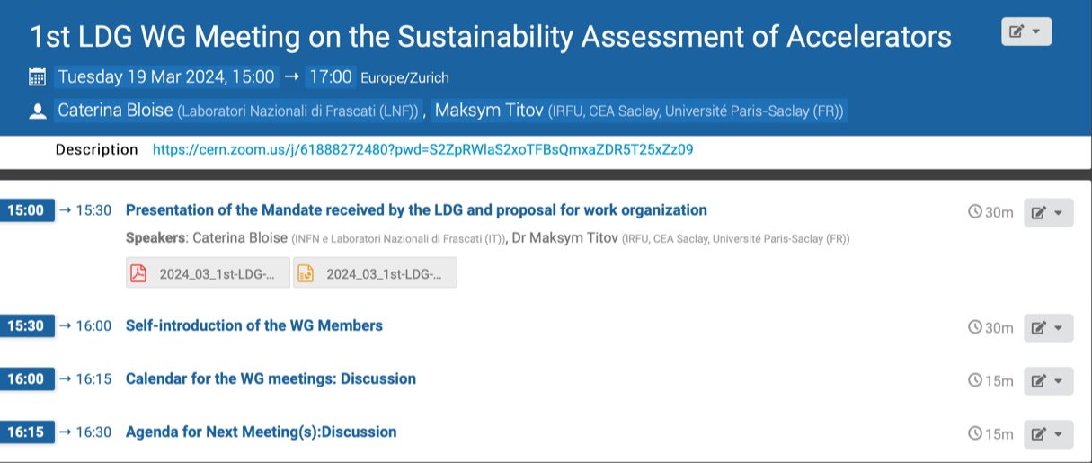
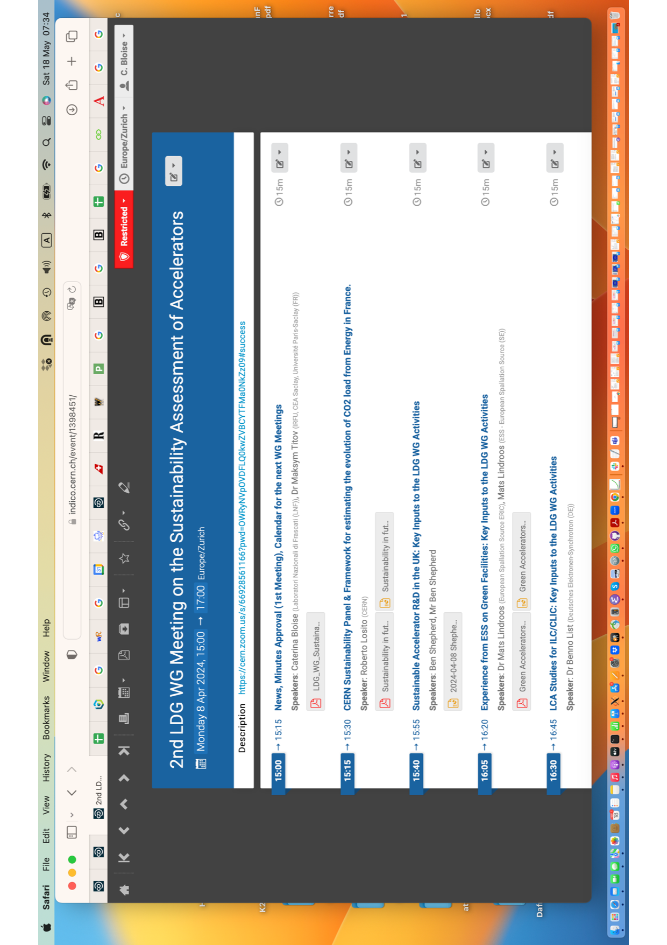
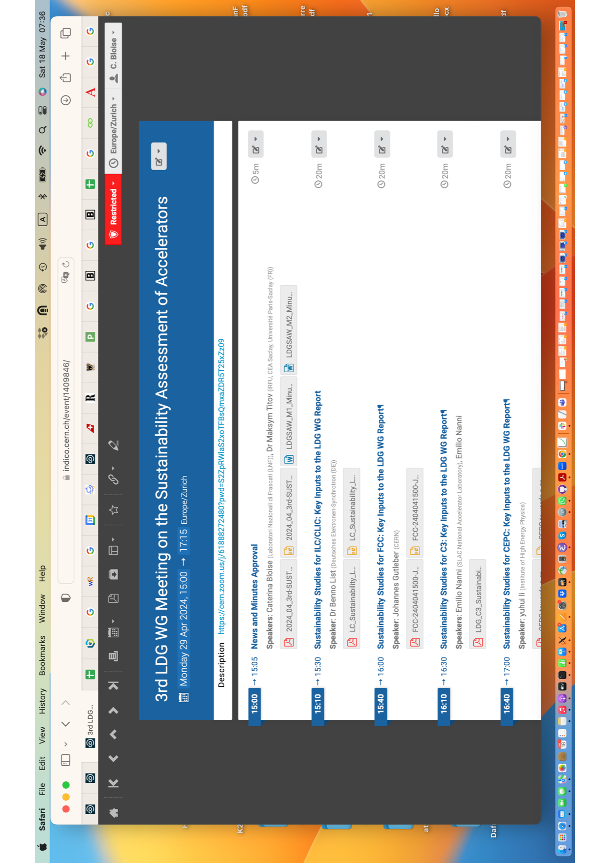
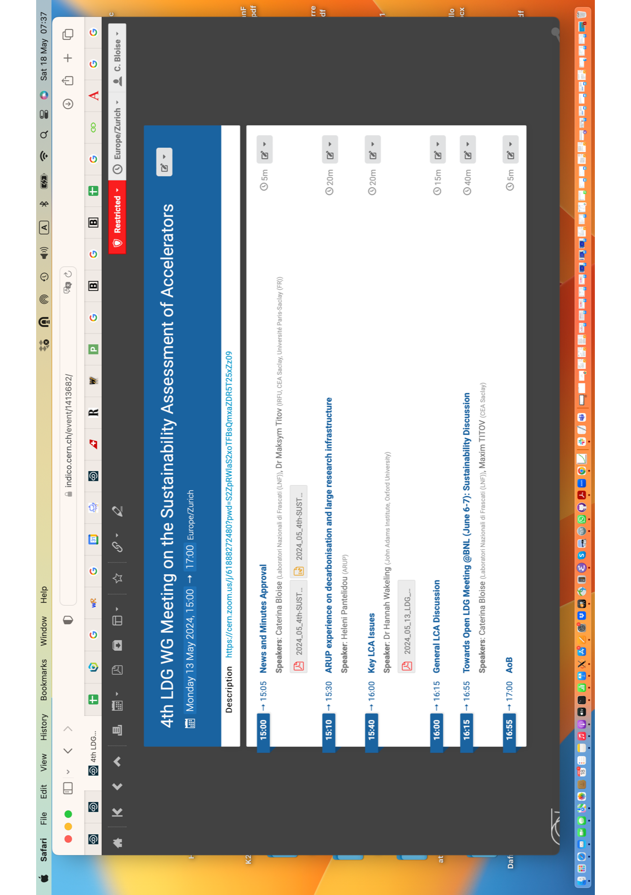
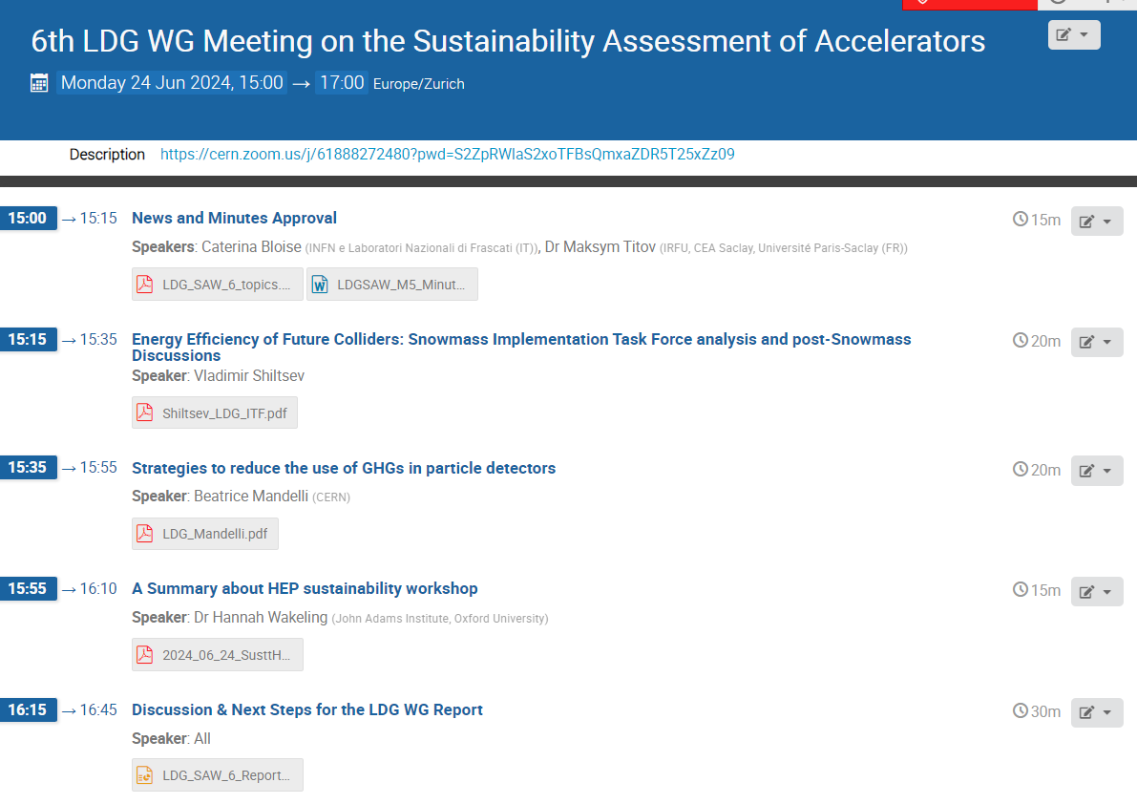
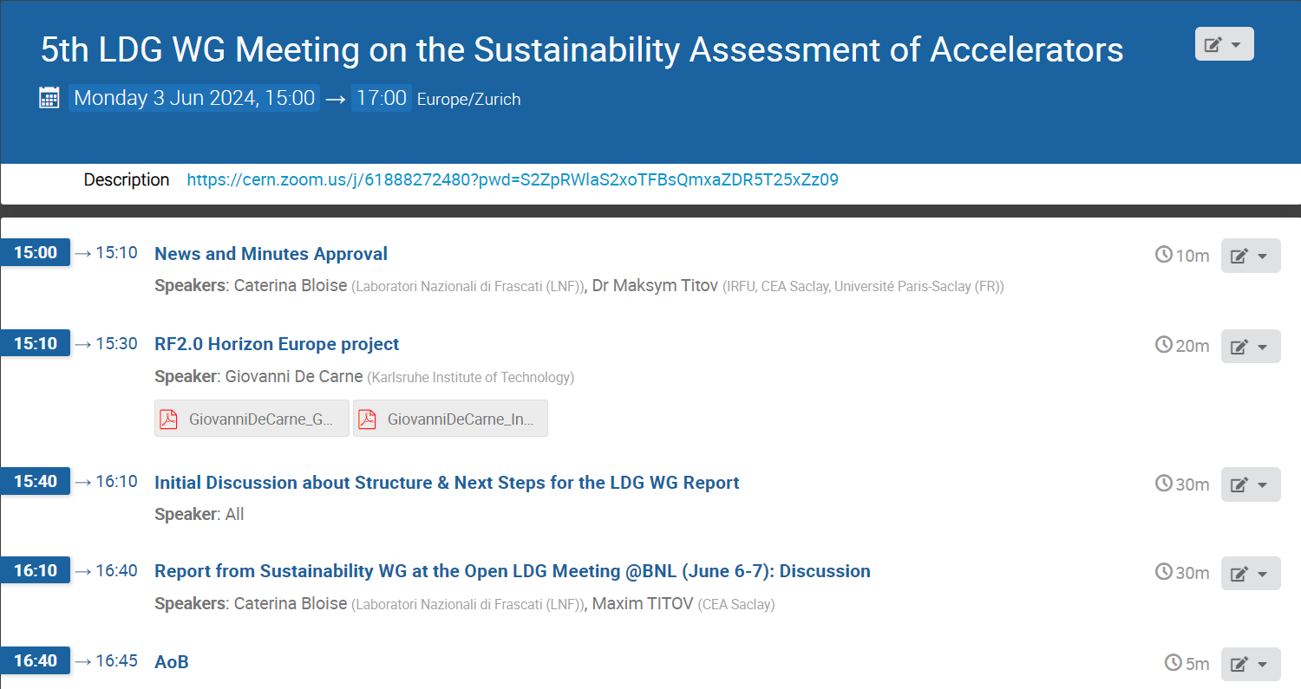
Working Group Activities
Broad range of topics shared:
Reports from the CERN and STFC Sustainability Panels, ESS, Snowmass ITF
Evaluations carried out for Future Higgs
Factories (FCC, ILC, C3, CEPC)
Key LCA issues
Invited expert contributions: Decarbonisation for Large RI (H.Pantelidou, ARUP), LCA of engineering civil works for the FCC (D. Mauree, WSP), EU-Horizon Project RF2.0 (G. DeCarne, KIT), Reduction of GHGs in particle detectors (B. Mandelli, CERN)

Slide 5

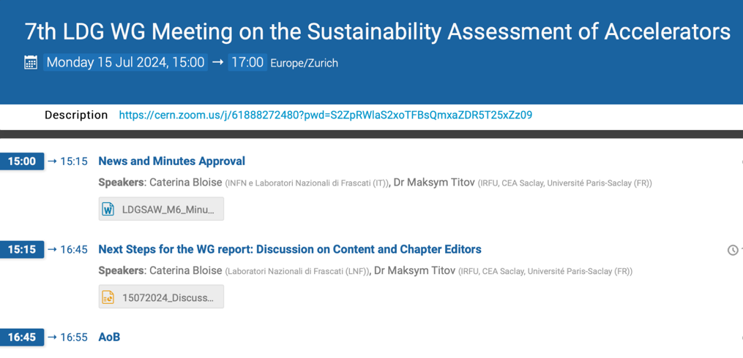
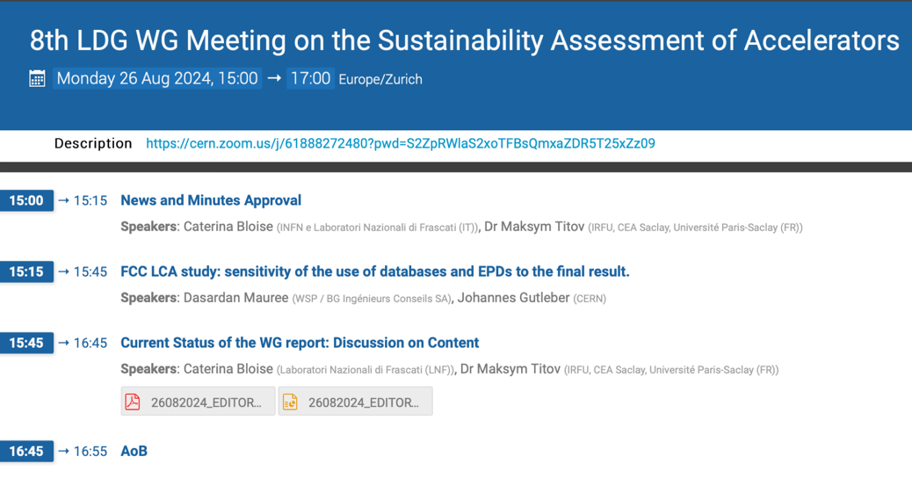
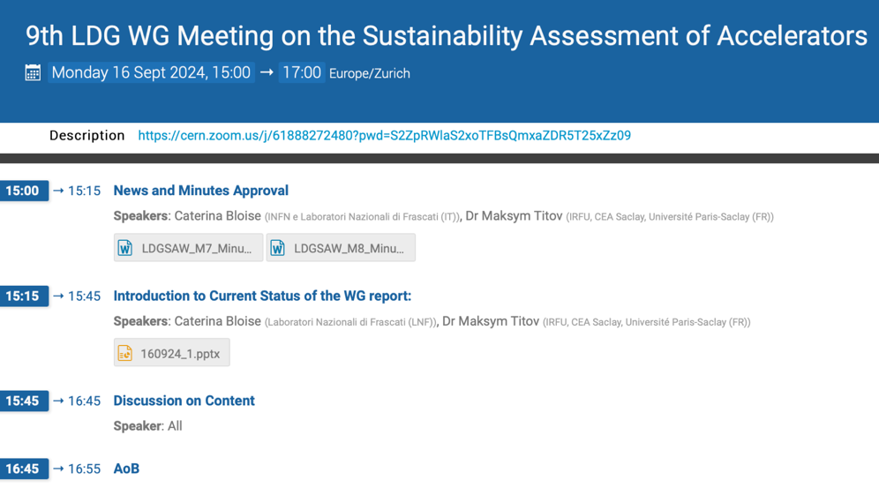
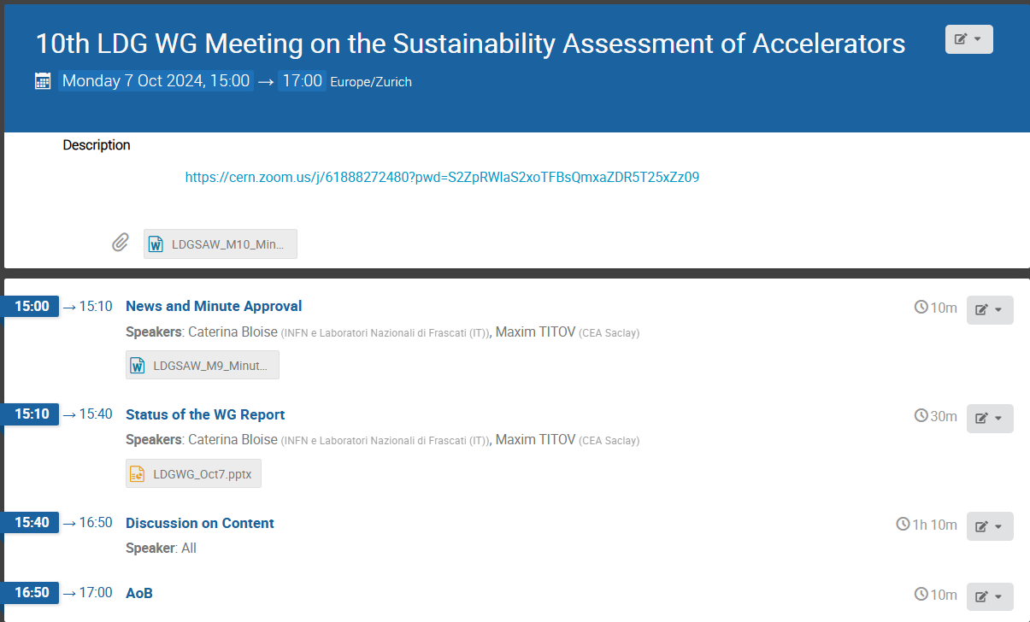
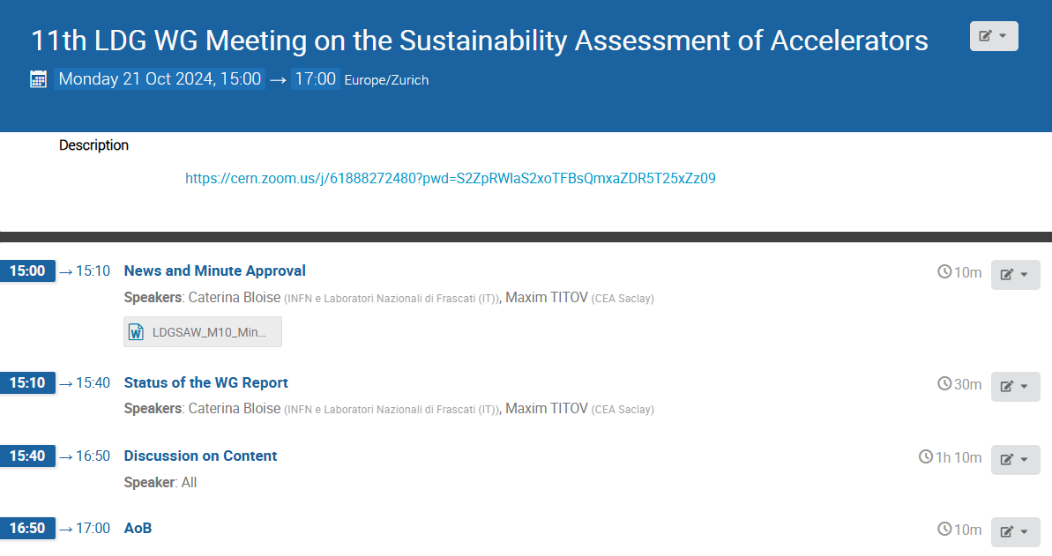
Working Progress Status
- Editorial work assigned
- Report elaboration advanced, many
relevant topics drafted
Focus on Sustainability Assessment for Future Accelerators:
Content:
- Landscape & Highlights
- Recommendations
- Open Questions

Slide 6
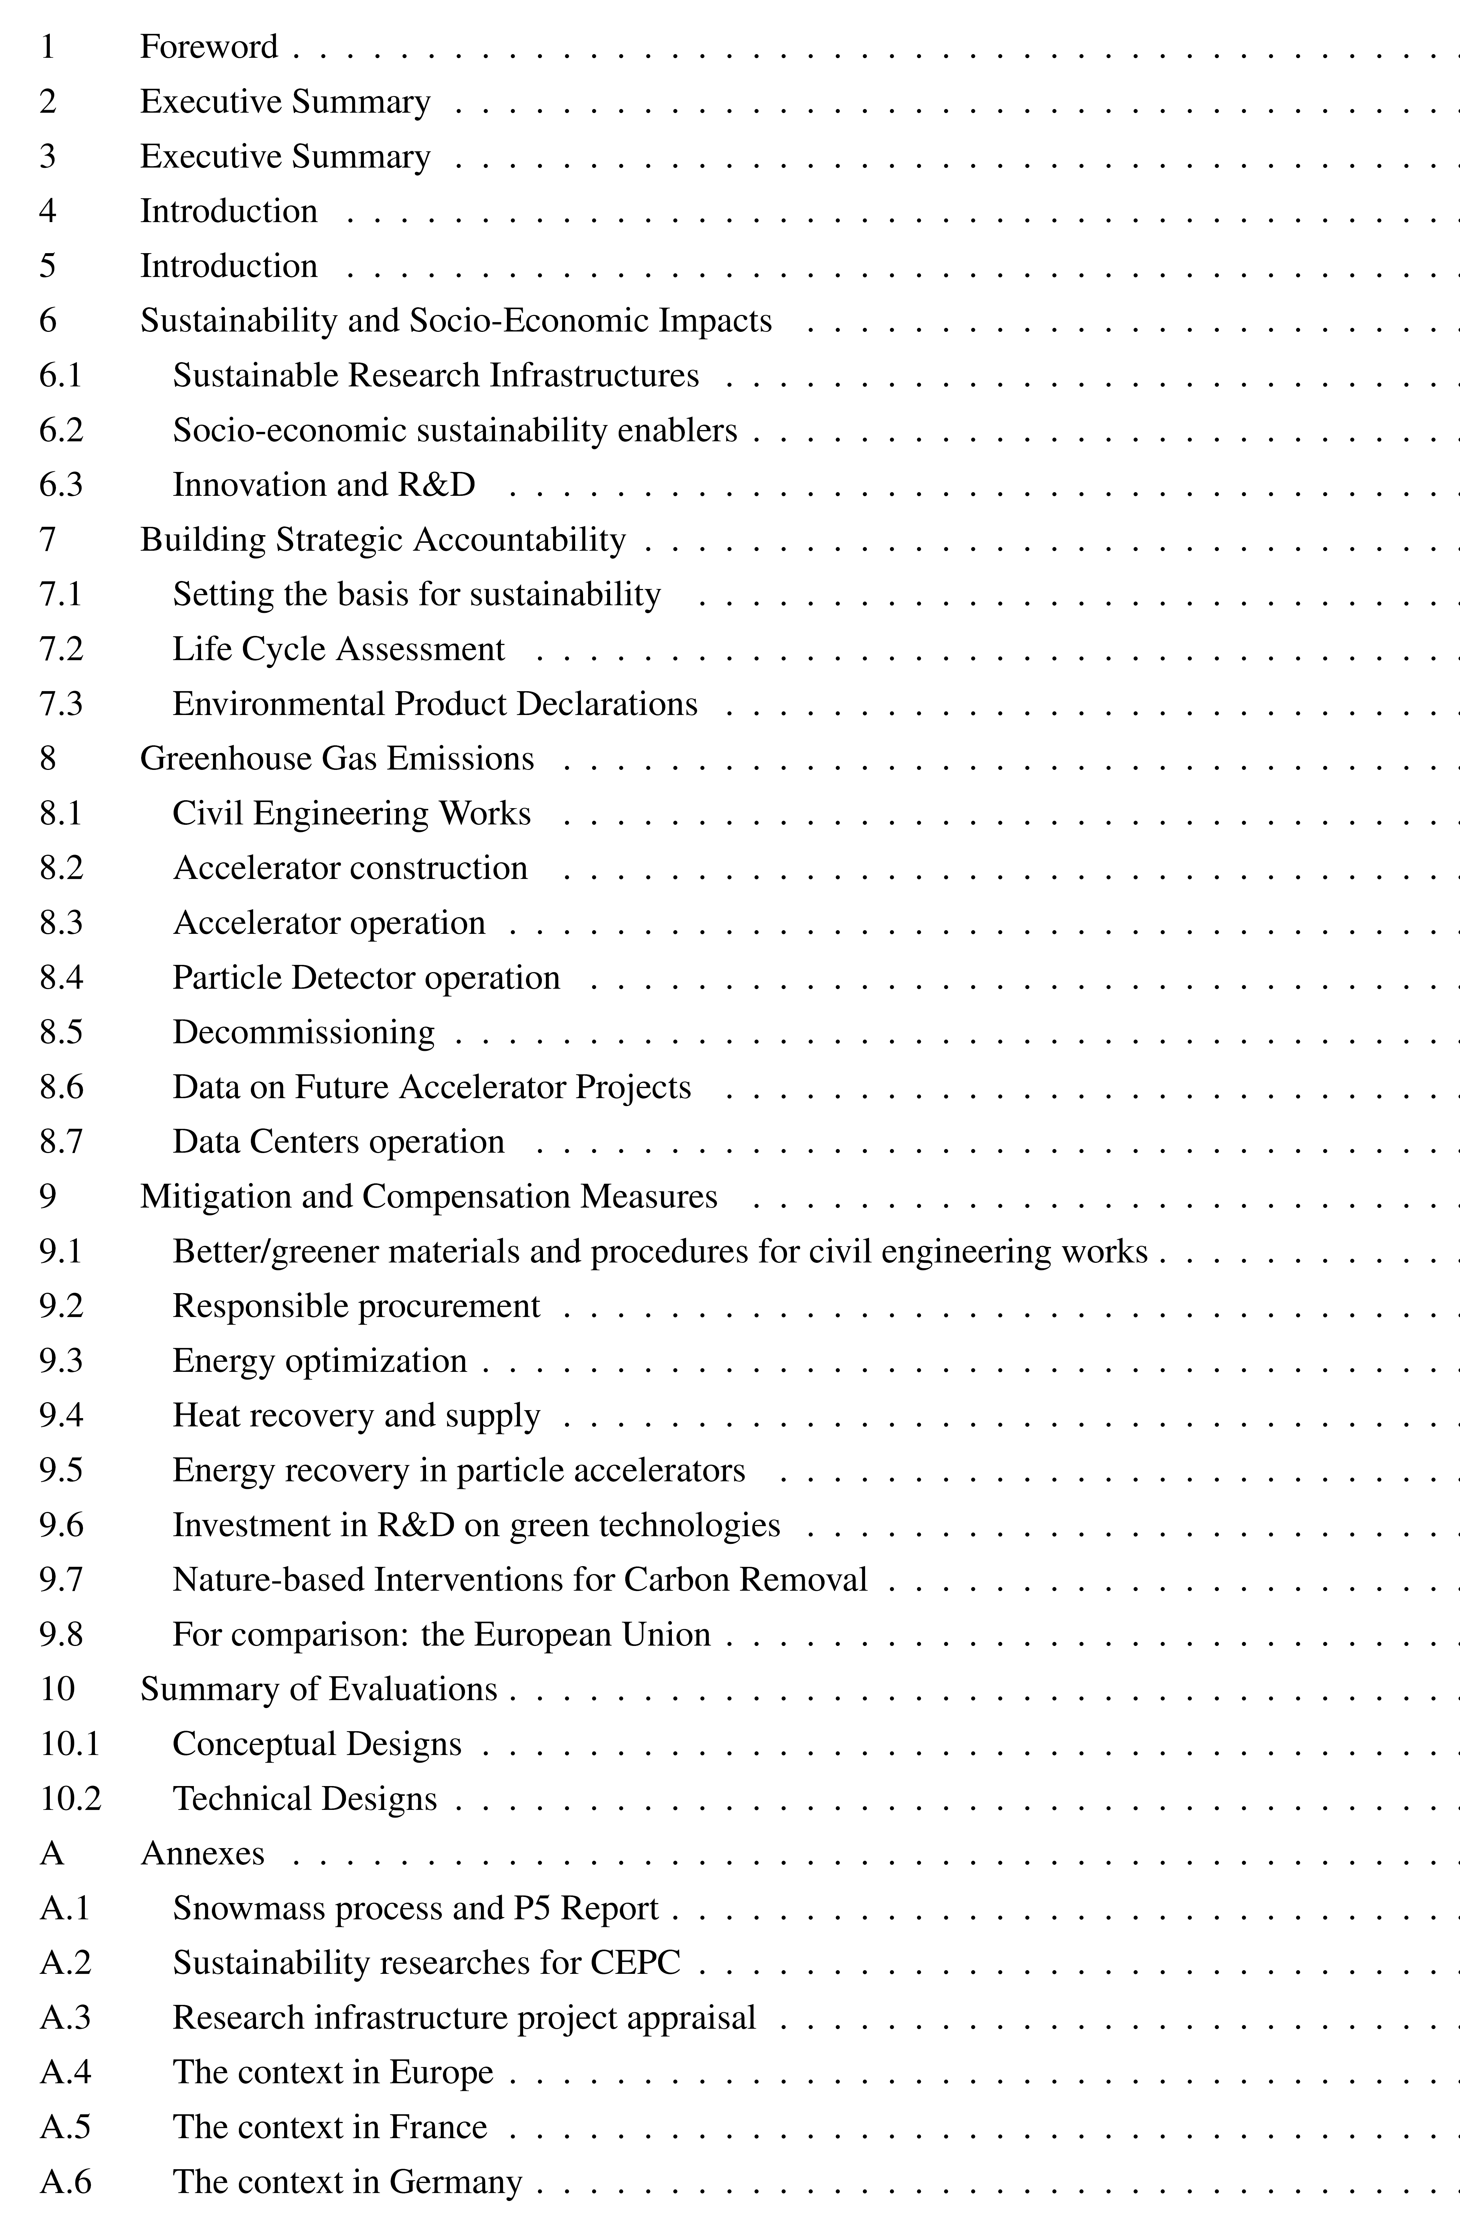
LDG Working
Group REPORT
Structure and basic content suggested by reports to the WG and follow-up discussions
Draft report is expected early 2025
Executive summary as an input to the ESPPU due by March 2025
Caveat:
not all of these topics can be addressed in details in a limited time by end of 2024
A homogeneous evaluations of all issues will probably need more time to develop and deserves a strategy to be pursued

Slide 7
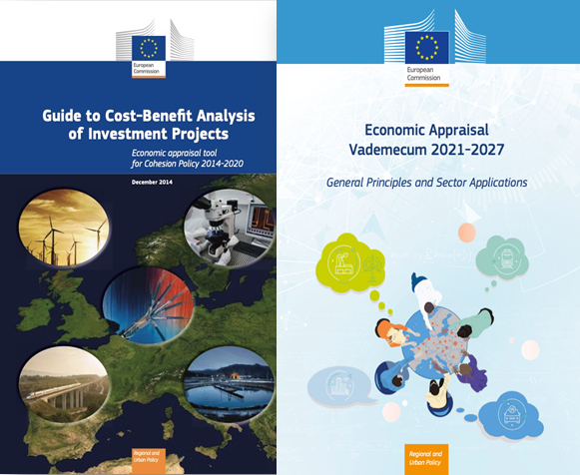
REPORT: Social – Economic Benefit Analysis
Social - Economic Benefits of HEP accelerator-based Research Infrastructures:
in relation to the UN Sustainability Development Goals (environment, economy, society)
  SDG Reference Matrix from UN (2024)
    Fundamental Physics Knoweledge, Accelerator and Detector R&D
    Economic Growth (regional, international, developing countries)
    Education, Innovation, International Cooperation, Cultural Exchange
Comprehensive sustainability assessment based on quantitative Cost-Benefit Analysis: state-of-the-art economics knowledge that integrates total costs, negative environmental externalities, industrial, social and environmental benefits
  EU Policies
    Global Reporting Initiative
    European Sustainability Reporting Standards
    European Union Eco-Management and Audit Scheme (EMAS)
    EC Economic Appraisal Vademecum
    National Guidelines (France, Germany, Switzerland, …)
  Carbon Footprint Accounting and Reporting
    Shadow Carbon Cost
Reference for the integrated model FCC
European Strategy Forum for Research Infrastructures (ESFRI):
socio-economic impact has become one of important considerations in the roadmap process that identifies European investment priorities in Research Infrastructures

Slide 8
REPORT: Life-Cycle Assessment (Methodology & Reporting)
:
  LCA Goal and Scopes Definition
  - project stages: design, construction, operation, decommissioning
  - functional units: accelerator, supporting infrastructures, cryogenic
  systems, detector, computing
  - boundaries: Cradle-to-gate, Cradle-to-grave
  LCA Methodology
    - Impact Categories (Midpoint vs Endpoint)
    - Impact of Emission on Climate Change: GWP100
    - Beyond GWP : ReCiPe2016, ILCD2011, CML-IA2012
  LCA Inventory Analysis
  - infrastructure, materials, energy, production process
    Construction Phase
    Operation Phase
    Decommissioning
  LCA Assessment and
  Interpretation
  - environmental impact,
  - methodology, specific
  software, databases,
  - evaluation of uncertainties
  Environmental Product
  Declaration

Slide 9
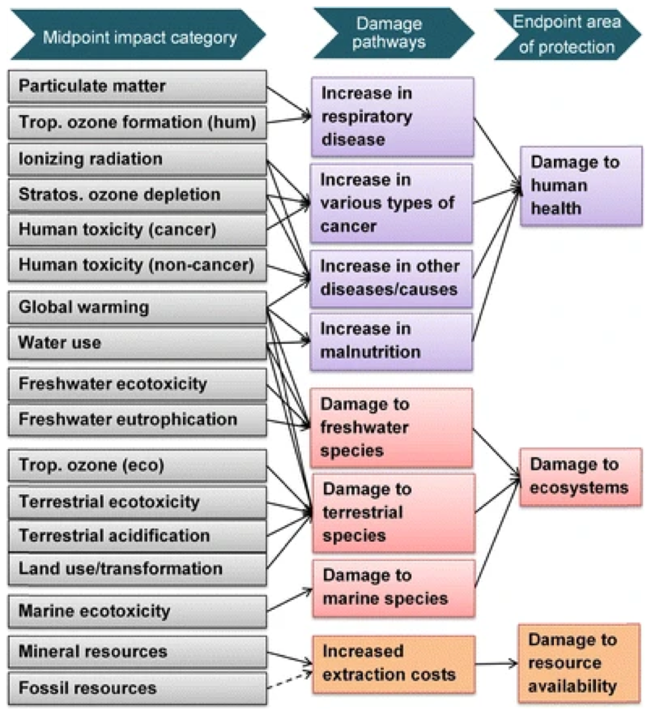
REPORT: Life-Cycle Assessment (Target and Issues)
Goals & Scope also depends on target audience: optimize facility (researchers), recommend improvements (Management), communicate to public (society)
LCA standards for the assessment of future accelerators are not well set:
Common approach how to report and evaluate the data for accelerator RI’s (which impact categories, treatment of CO₂ intensities, attribution of impacts to long term projects);
Common table for sustainability parameters (e.g. parameters for GHG emissions) ;
ISO standards may be too rigid for accelerators to perform full LCA → “simplified LCA”;
Many LCA software available → different packages can give different results (data handling)
LCA database is the most impactful element (global vs. local, age of database);
Collect reference data on materials and specific fabricaition methods for accelerators;
Are there relevant differences in Standards / categories (e.g. Midpoint ReCiPe 2016 vs Endpoint EN 17472 that need to be addressed?
LCA Categories:
Conversion factors used in the evaluation of Midpoint categories are usually considered reliable
Endpoint evaluations are obtained by weighting results obtained on Midpoint ones
A number of categories classes exist
European Production Declarations from the International Reference Life Cycle Data system (ILCD) follow EN 15804
ReCiPe2016

Slide 10
REPORT: Life-Cycle Assessment (Target and Issues)
Goals & Scope also depends on target audience: optimize facility (Researchers), recommend improvements (Management), communicate to public (Society)
LCA standards for the assessment of future accelerators are not well set:
Common approach how to report and evaluate the data for accelerator RI’s (which impact categories, treatment of CO₂ intensities, attribution of impacts to long term projects);
Common table for sustainability parameters (e.g. parameters for GHG emissions) ;
ISO standards may be too rigid for accelerators to perform full LCA → “simplified LCA”;
Many LCA software available → different packages can give different results (data handling)
LCA database is the most impactful element (global vs. local, age of database);
Collect reference data on materials and specific fabricaition methods for accelerators;
Are there relevant differences in Standards / categories (e.g. Midpoint ReCiPe 2016 vs Endpoint EN 17472 that need to be addressed?
LCA Targets for future accelerators infrastructures:
Understand in each area what are the largest sources
What to focus on and not focus on (at each project stage)
Start to look at mitigation strategies
Developing the tools to do this type of analysis for the future
LCA Categories:
Conversion factors used in the evaluation of Midpoint categories are usually considered reliable
Endpoint evaluations are obtained by weighting results obtained on Midpoint ones
A number of categories classes exist
European Production Declarations from the International Reference Life Cycle Data system (ILCD) follow EN 15804
ReCiPe2016

Slide 11
REPORT: Green House Gas Emissions
Green House Gas Emissions (GHG) footprint for future accelerator facilities:
Developing a tool and guidance for quantification could be a good recommendation for the strategy: e.g. evaluate & optimize CO2 impact in a staged approach at concept phase, CDR, TDR levels
- Civil engineering works: LCA for accelerator infrastructure (e.g. tunnels, caverns) & Civil
engineering (LCA A1-A5), Excavated material
- Accelerator construction: accelerator construction: early assessment of areas with the
largest emission, beam line shielding, steel girders and supporting structures, magnets, RF
cavities, power supplies, material manufacturing
- develop reference set of impact values for some commonly used accelerator materials
(high-purity niobium, permanent magnet alloys, etc…)
- Accelerator operation: power for operation (air conditioning and water cooling, cryogenic
plants, RF and klystrons, Magnets)
- Treatment of carbon intensity of electricity related to energy source - depending on future
energy mixes and regions - scenarios, differences e.g. in carbon intensity between
different host countries (regional vs globally averaged impacts), shadow cost scenarios)
- Particle detectors/computing operation : Impact of gases for particle detectors,
Optimisation of power consumption/environmental impact of computing
- Decommissioning: radioactive waste, recycling, site reuse

Slide 12
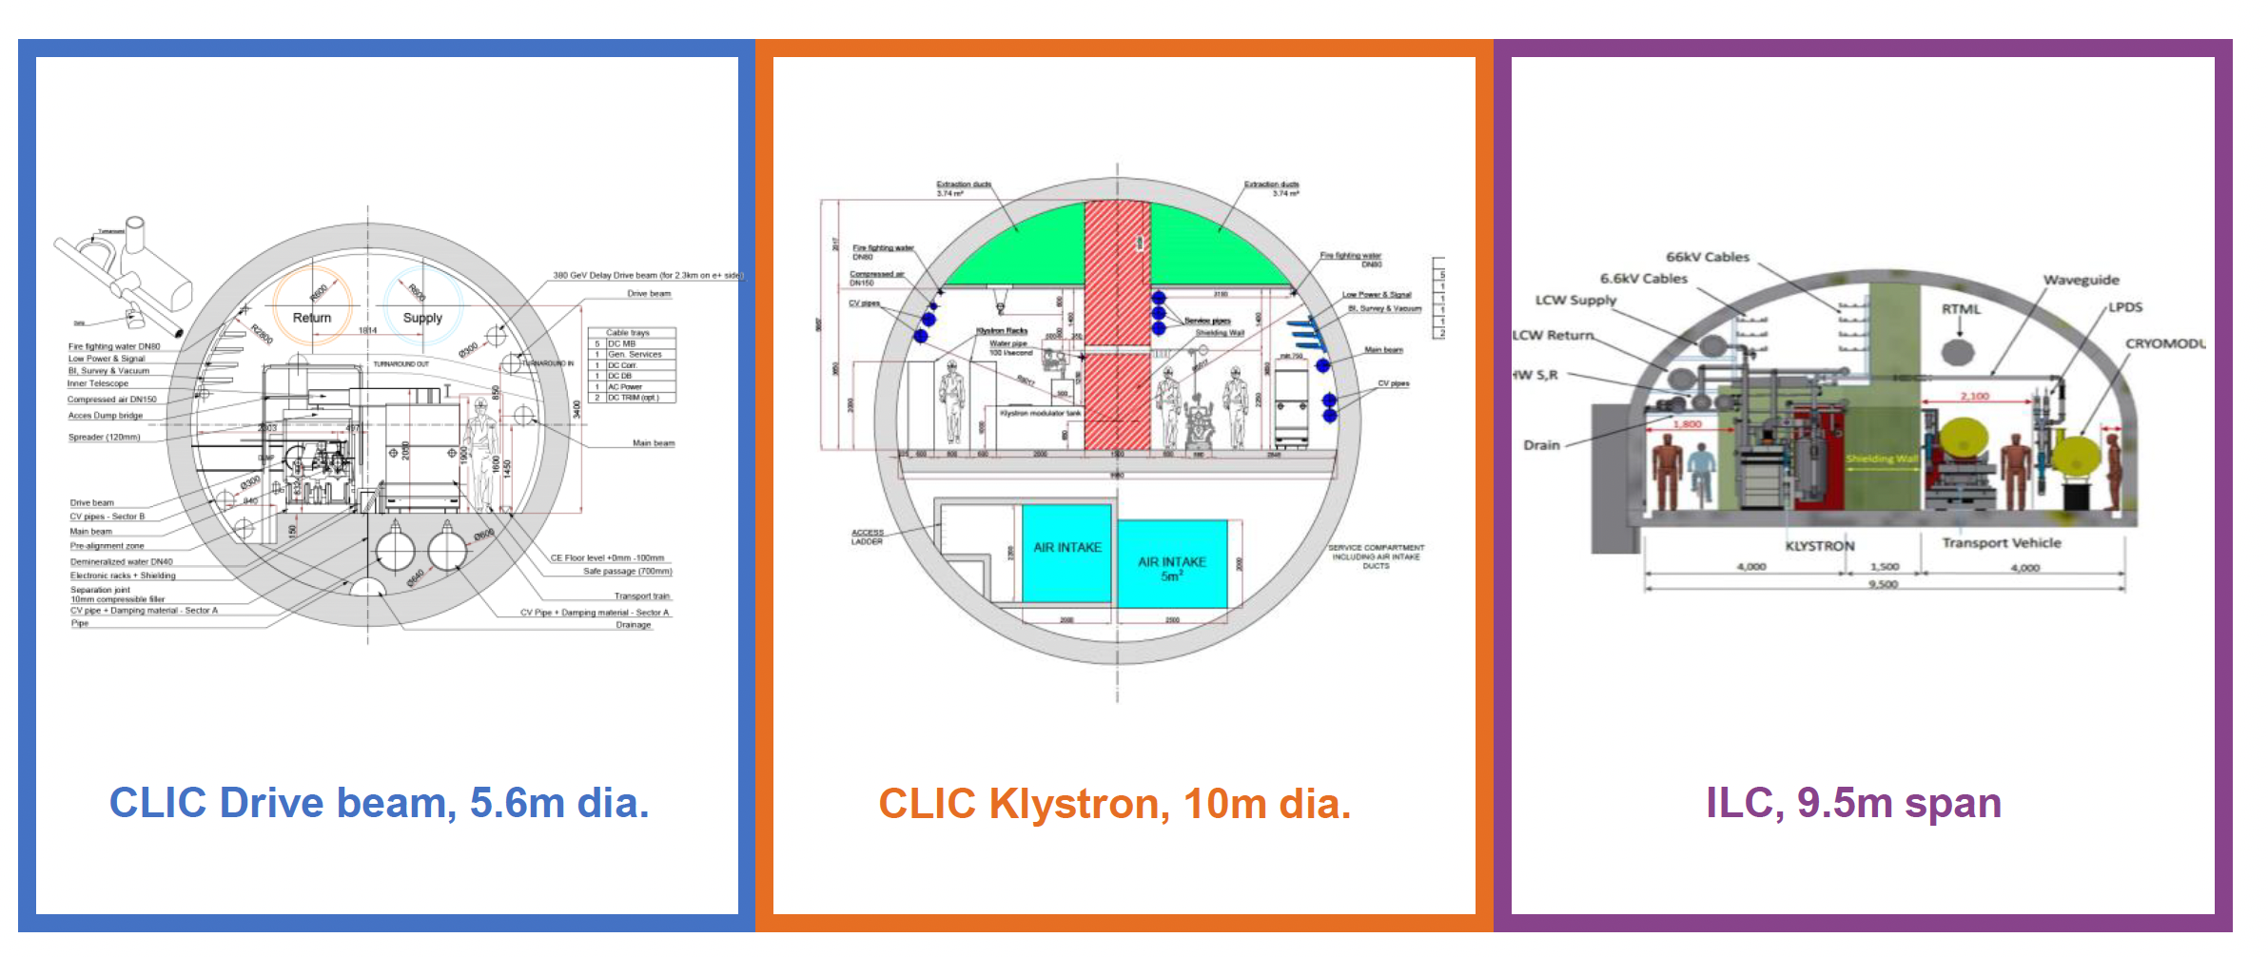
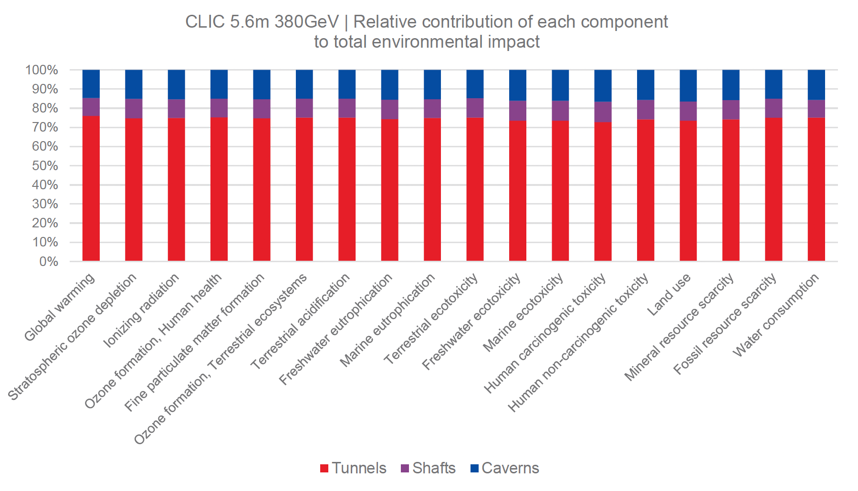
Example: ILC & CLIC LCA Studies
CERN commissioned a study with ARUP to perform a Lifecycle Assessment for the CLIC and ILC civil infrastructure (tunnels, shafts, caverns)
Full ARUP report:
https://edms.cern.ch/document/2917948/1
Study provided results on:
  - Greenhouse gas emissions from construction
  - Full set of ReCiPe 2016 impact categories
  Reduction potential (40%) from optimized design and use of lower carbon material
New LCA study on accelerator construction is being prepared:
- Quantify LCA impact of the full
project (data inventory for ILC
and CLIC accelerator & detector
components)
Reduction potential: 40% reduction through use of low-CO2 materials (steel, concrete) and reduction of tunnel wall thickness)
CO2-eq from underground civil engineering
and electricity for operation

Slide 13
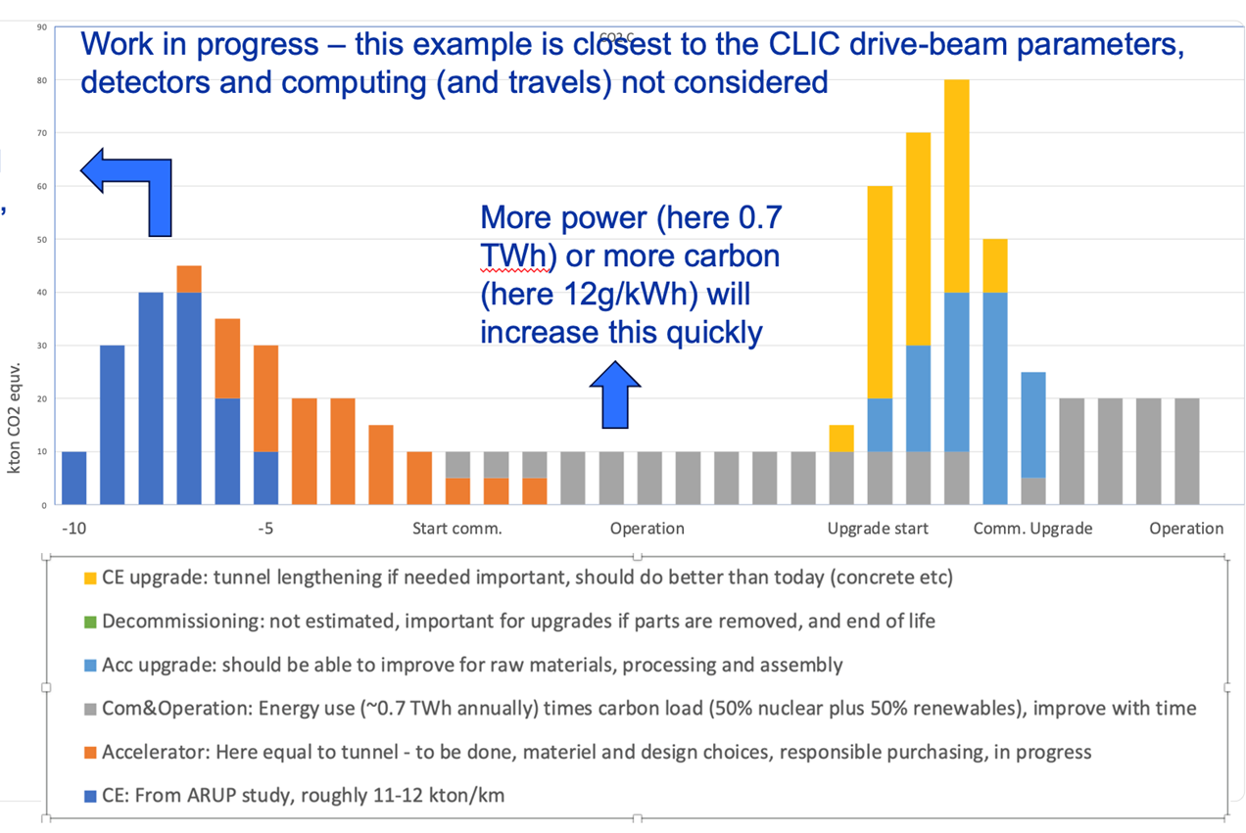
Example: Towards Carbon Accounting with LCA
CLIC, also (being) done for ILC, C3, HALHF
S. Stapnes
This plot (blue part) is for 11 km of tunnel, scales with length, injectors will add
NEXT: working on
machine parts
here, orange graph assumes accelerator hardware &
infrastructure = equal civil
engineering impact
Most likely this is
optimistic, i.e. orange and light blue part will be higher

Slide 14
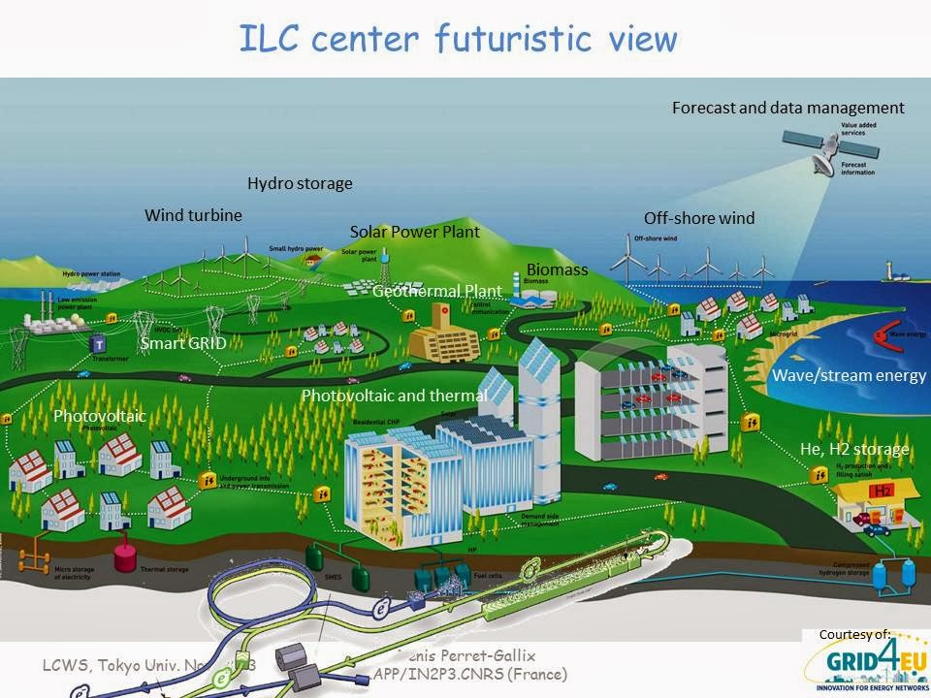
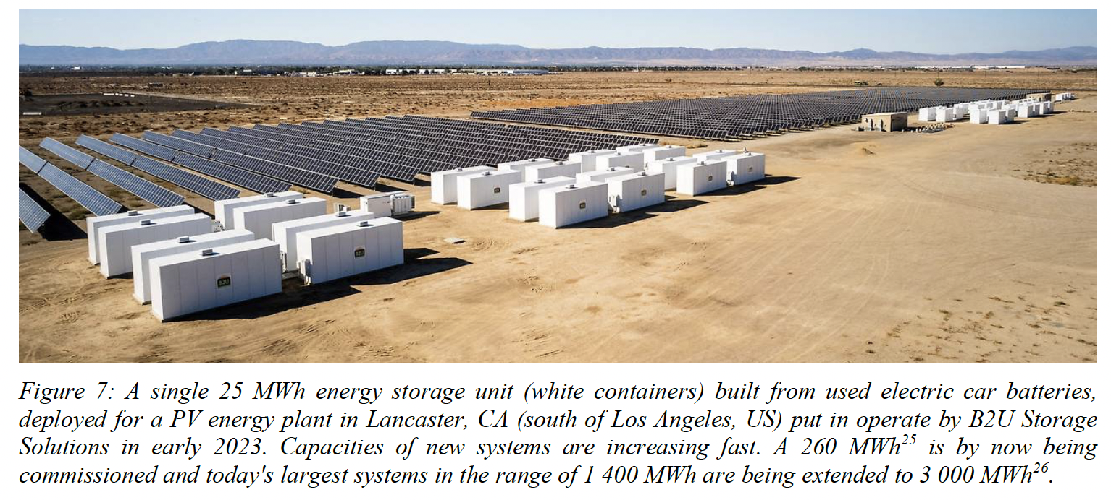
REPORT: Mitigation and Compensation Strategies
Mitigation and Compensation Strategies, Decarbonisation and Impact Reduction
  - Optimization of large civil & accelerator construction footprint & better/greener
  materials (inventory of concrete, steel, Cu, niobium)
  - Responsible procurement
  - Energy/power optimization (improving energy efficiency of key technologies) and
recuperation (heat management, ERL, …)
  - Heat Recovery and supply
  - Investment in R&D on green technologies
  - Sustainable operational concepts (dynamic operation, power purchase agreements)
  - Nature-based interventions for carbon removal (e.g. environmental studies,
  integration in local environment):
Annexes:
  Snowmass process and P5 Report
  Plans to reduce accelerator energy consumption in China
  Research infrastructure project appraisal
  Comprehensive sustainability assessment based on Cost-Benefits Analysis
J. Gutleber, FCC Renewable Energy Supply Feasibility Study,
https://zenodo.org/records/10023947
“Green ILC Concept”
(SOME)
EXAMPLES:

Slide 15
Summary and Outlook
Funding landscape are changing rapidly in Europe and beyond, which will require addressing sustainability and GWP potential for the future large-scale research infrastructures
Sustainability assessment for future large-scale accelerator infrastructures is quite complex:
→ assessment criteria needs to be properly tuned to the maturity of the project (stage)
→ differently developed for Researchers, Management and Society
The LDG Sustainability WG report is advancing, the bulk of issues elaborated pertain to:
- socio-economic benefits of accelerators-based reaserch infrastructures
- basis of sustainability assessment
- methodology and reporting of LCA for future HEP accelerators
- evaluation of Greenhouse gas (GHG) emissions in construction, operation, decommissioning
- mitigation and compensation strategies
The Goal of Sustainability WG is to submit report as an input to the ESPPU in March 2025
→ not all of items can be addressed at this timescale, some might need more time to mature

Slide 16
BACK-UP SLIDES

Slide 17
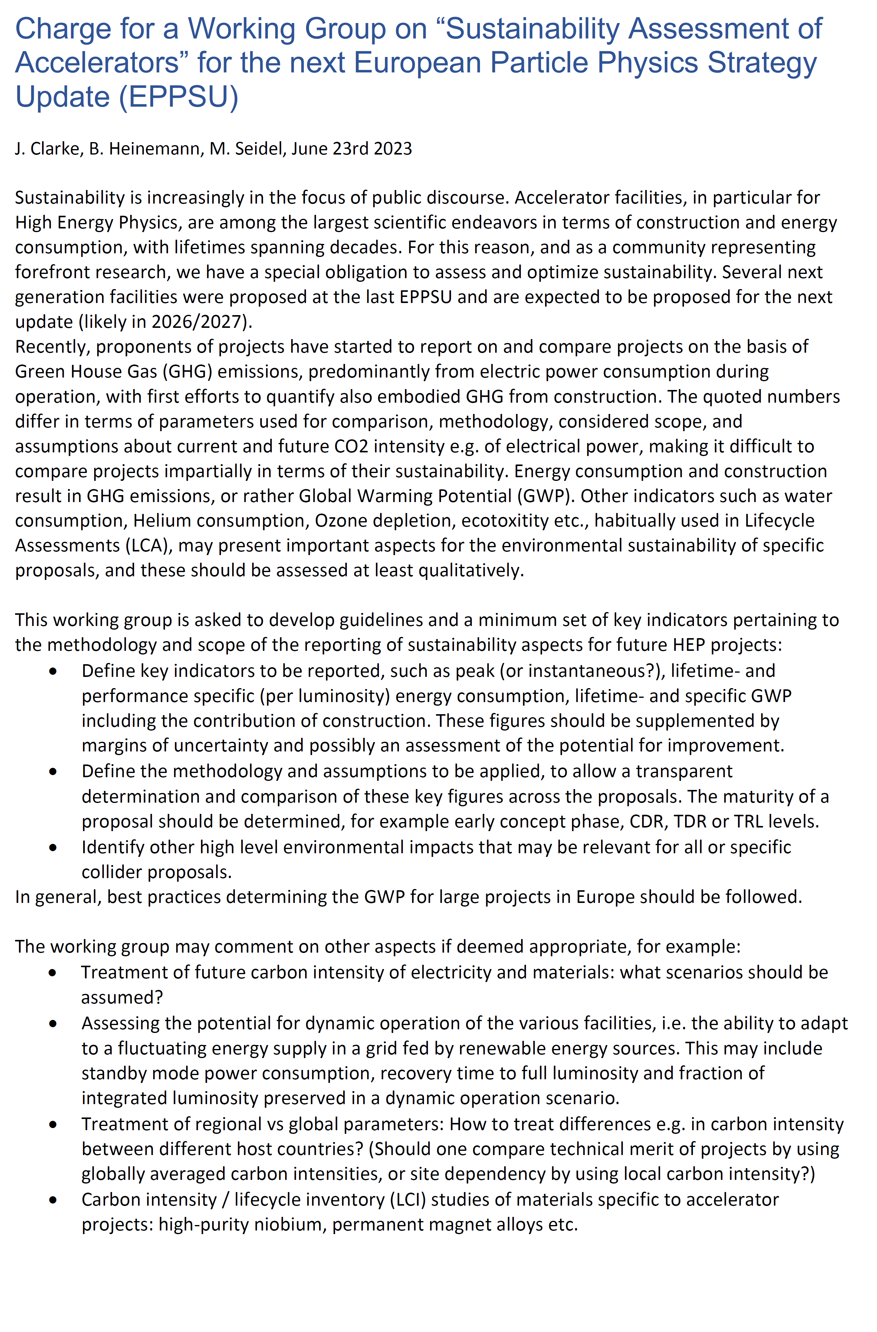
Mandate / Charge of Sustainability LDG Working Group
Definition of key indicators to be reported
Possible examples:
- Peak / instantaneous lifetime- & specific (per
luminosity) energy consumption
- Lifetime and specific Global Warming Potential
(GWP), including construction
- Include margins of uncertainty and possibly an
assessment of the potential for improvement
Definition of methodology & assumptions to be applied for transparent determination of key figures across proposals.
- The maturity of a proposal should be determined, for
example, at early concept phase, CDR, TDR levels
Identification of additional high level environmental impacts that may be relevant for all or specific collider proposals
Also, VERY IMPORTANT - impact on society and public appreciation of the WG report:
HEP benefits and decarbonization path for
the future large – scale accelerator RI’s

Slide 18
Some Other (More Technical) Objectives
LDG WG may comment on other aspects if deemed appropriate, for example:
• Treatment of future carbon intensity of electricity and materials:
- what scenarios should be assumed?
• Assessing the potential for dynamic operation of the various facilities:
- i.e. the ability to adapt to a fluctuating energy supply in a grid fed by renewables. This
may include standby mode power consumption, recovery time to full luminosity and
fraction of integrated luminosity per year preserved in a dynamic operation scenario.
• Treatment of regional vs global parameters:
- how to treat differences e.g. in carbon intensity between different host countries?
• Carbon intensity / lifecycle inventory (LCI) studies of materials specific to the
accelerator projects: high-purity niobium, permanent magnet alloys etc.
• How to interface with open-source LCI databases and LCA tools to potentially
ease/automate the assessment for future research infrastructures
• How the recommendations for colliders can be extended to other scientific /endeavours
related to HEP
• How HEP labs represented in the LDG can share/build up expertise jointly

Slide 19
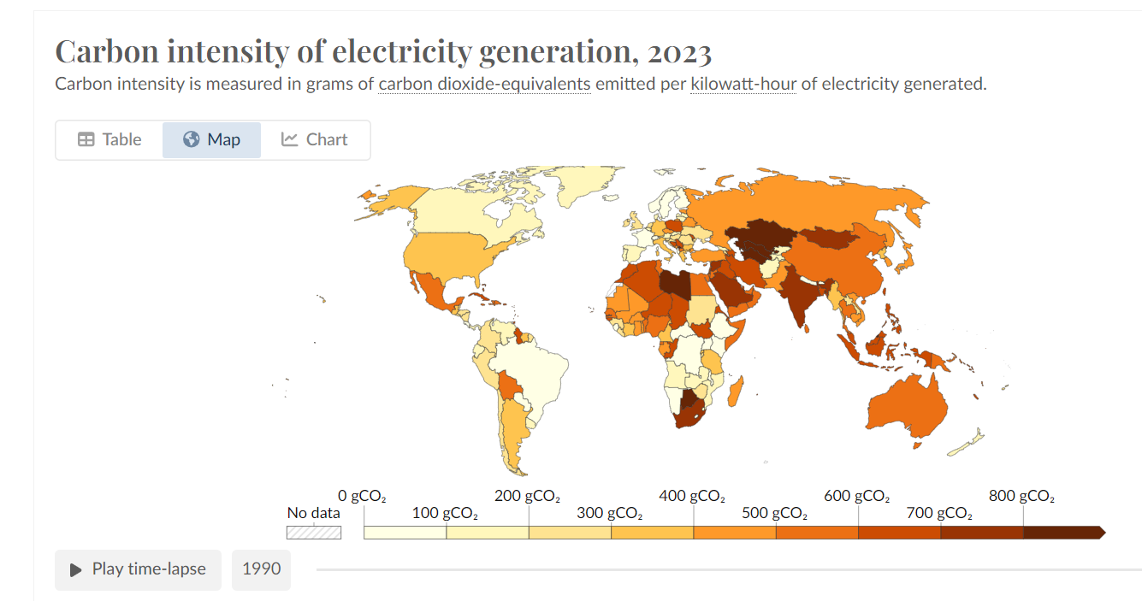
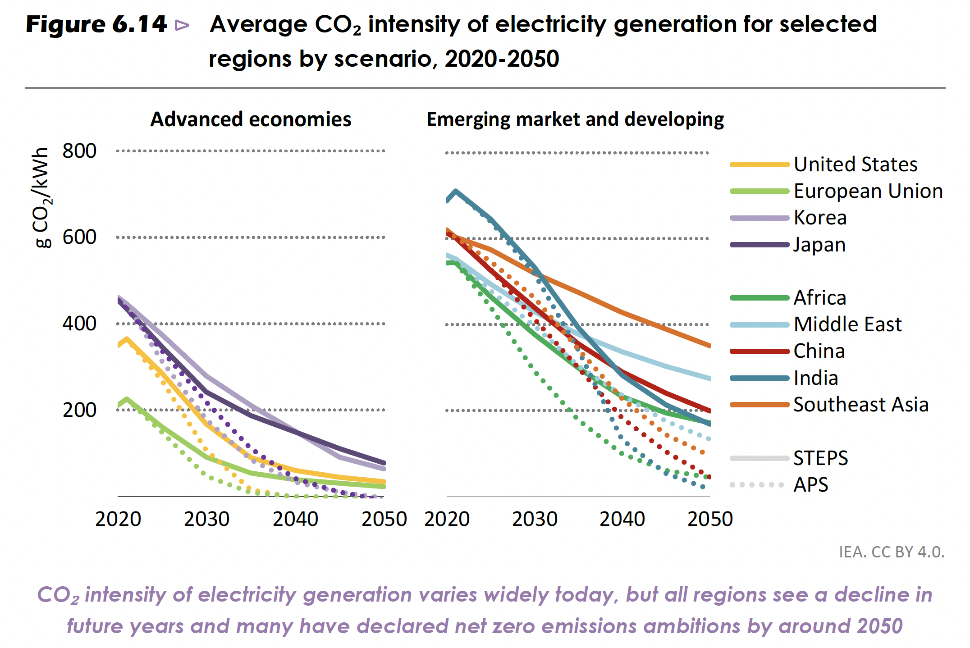
Open Questions: Regional versus Globally Averaged Impacts
Carbon intensity of electricity production varies enormously across regions &countries
→ reference values for assumed CO2
intensity of electricity for relevant regions/labs
Carbon intensity of materials also varies
  Different local standards
  Different geology, primary minerals, concentrations
  Different carbon intensity for local energy, esp. electricity (-> copper, niobium)
Civil construction: steel and cement mostly from local sources, adhere to local codes
Result of LCA depends heavily on
  Source of used materials
  Construction and operation site
  LCA Method: use local values or global averages
Should one evaluate impacts using site-specific or globally averaged impact values?
→ or use general LCA database and move to
more local information as the project matures
(for materials CO2 content) ?
https://ourworldindata.org/grapher/carbon-intensity-electricity
IEA (2022), World Energy Outlook 2022, IEA, Paris https://www.iea.org/reports/world-energy-outlook-2022,
License: CC BY 4.0 (report); CC BY NC SA 4.0 (Annex A)

