Slide 1

Towards an EDP contribution to the ESPP process
Plenary ECFA meeting, LNF Frascati, 4-5 July 2024
P. Allport, D. Contardo, F. Sefkow on behalf of the EDP

Slide 2
Outline
EDP highlights
topics towards an EDP input to the ESPP process
plan to prepare the input

Slide 3
ECFA Detector Panel : web page
more on mandates in presentation of Paris Sphicas at this meeting
represents the community in the CERN DRD collaboration framework
help organise discussion of the common issues* through EDP - DRD Collaborations Managers Forum (mandate)
advise DRDC on priorities wrt the Detector R&D roadmap
helps plan future updates to the Detector R&D roadmap
Co-Chairs: Didier Contardo (IP2I Lyon) and Felix Sefkow (DESY) Scientific Secretary: Jens Dopke (RAL)
Gaseous Detectors: Silvia Dalla Torre (Trieste)
Liquid Detectors: Inés Gil Botella (CIEMAT, Madrid)
Solid State Detectors: Susanne Kuehn (CERN)
PID & Photon Detectors: Roger Forty (CERN)
Quantum and em Tech: Steven Hoekstra (Groningen)
Calorimetry: Laurent Serin (IJCLab)
Electronics: Valerio Re (Bergamo)
Mechanics & integration (DRD8) Jens Dopke (RAL)
Ex Officio:
  Thomas Bergauer (DRDC)
  Paris Sphicas (ECFA Chair)
  Ian Shipsey (ICFA Detector Panel)
Observer:
  Aldo Ianni (APPEC, LNGS),
  Eugenio Nappi (NuPECC, Bari)
New membership approved at this meeting
Felix Sefkow (DESY) replace Phil Allport as EDP co-chair
Jens Dopke (RAL) joining as mechanics & integration expert…
and as EDP secretary
Susanne Kuehn (CERN) replacing Doris Eckstein as SSD expert
also members of DRDC
* ex. cross-DRD areas, interfaces to: other R&D programs; ApPEC and NuPEC ; projects concept groups (of strategic physics programmes identified by ESPP)…

Slide 4
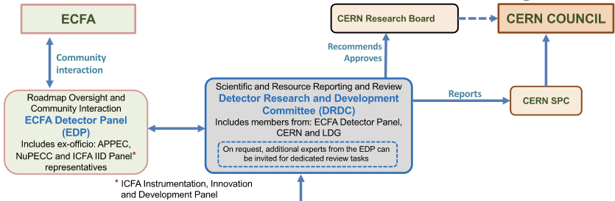
DRD collaborations hosted at CERN (framework)
follows general conditions for execution of experiments at CERN
EDP web page
contact point for the community
EDP/DRD
Managers Forum mandate
common issues
DRD1
Gaseous Detector
M. Titov
E. Oliveri
DRD2
Liquid Detector
R. Guenette
G. Fiorillo
DRD3
Solid State Detector
G. Kramberger
G. Pellegrini
DRD4
Photon det.
and PID
M.Fiorini
G. Wilkinson
DRD5
Quantum,
emerging
techno.
M. Demarteau
M. Doser
DRD6
Calorimetry
R. Poeschl
R. Ferrari
DRD7
Electronics
on-detector
processing
F. Simon
F. Vasey
DRD8
Mechanics and
Integration
B. Schmidt
A. Mussgiller
Approved by CERN RB*,
DRD8 LoI submitted to DRDC, proposal aims end-2024
DRDC wep page, presentations of DRDs at open sessions
presentation of Ines Gil Botella at this meeting
* approvals cover a period of three years – to be renewed

Slide 5
Outline
EDP highlights
topics towards an EDP input to the ESPP process
plan to prepare the input
The planned input to the ESPP aims to provide the EDP perspective on how the goals outlined in the ECFA Detector R&D Roadmap can be achieved by the DRD collaborations
as much as possible generic, although allowing to underline DRD specifics
(it is not an update of the ECFA detector roadmap and neither a review of the DRD proposals and achievements)
note : input to 2020 ESPP process: survey of the community composition and of the R&D aspirations

Slide 6
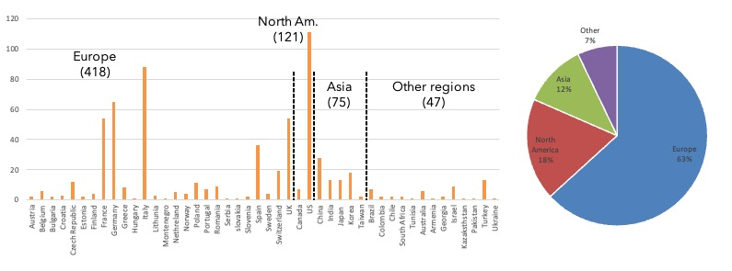
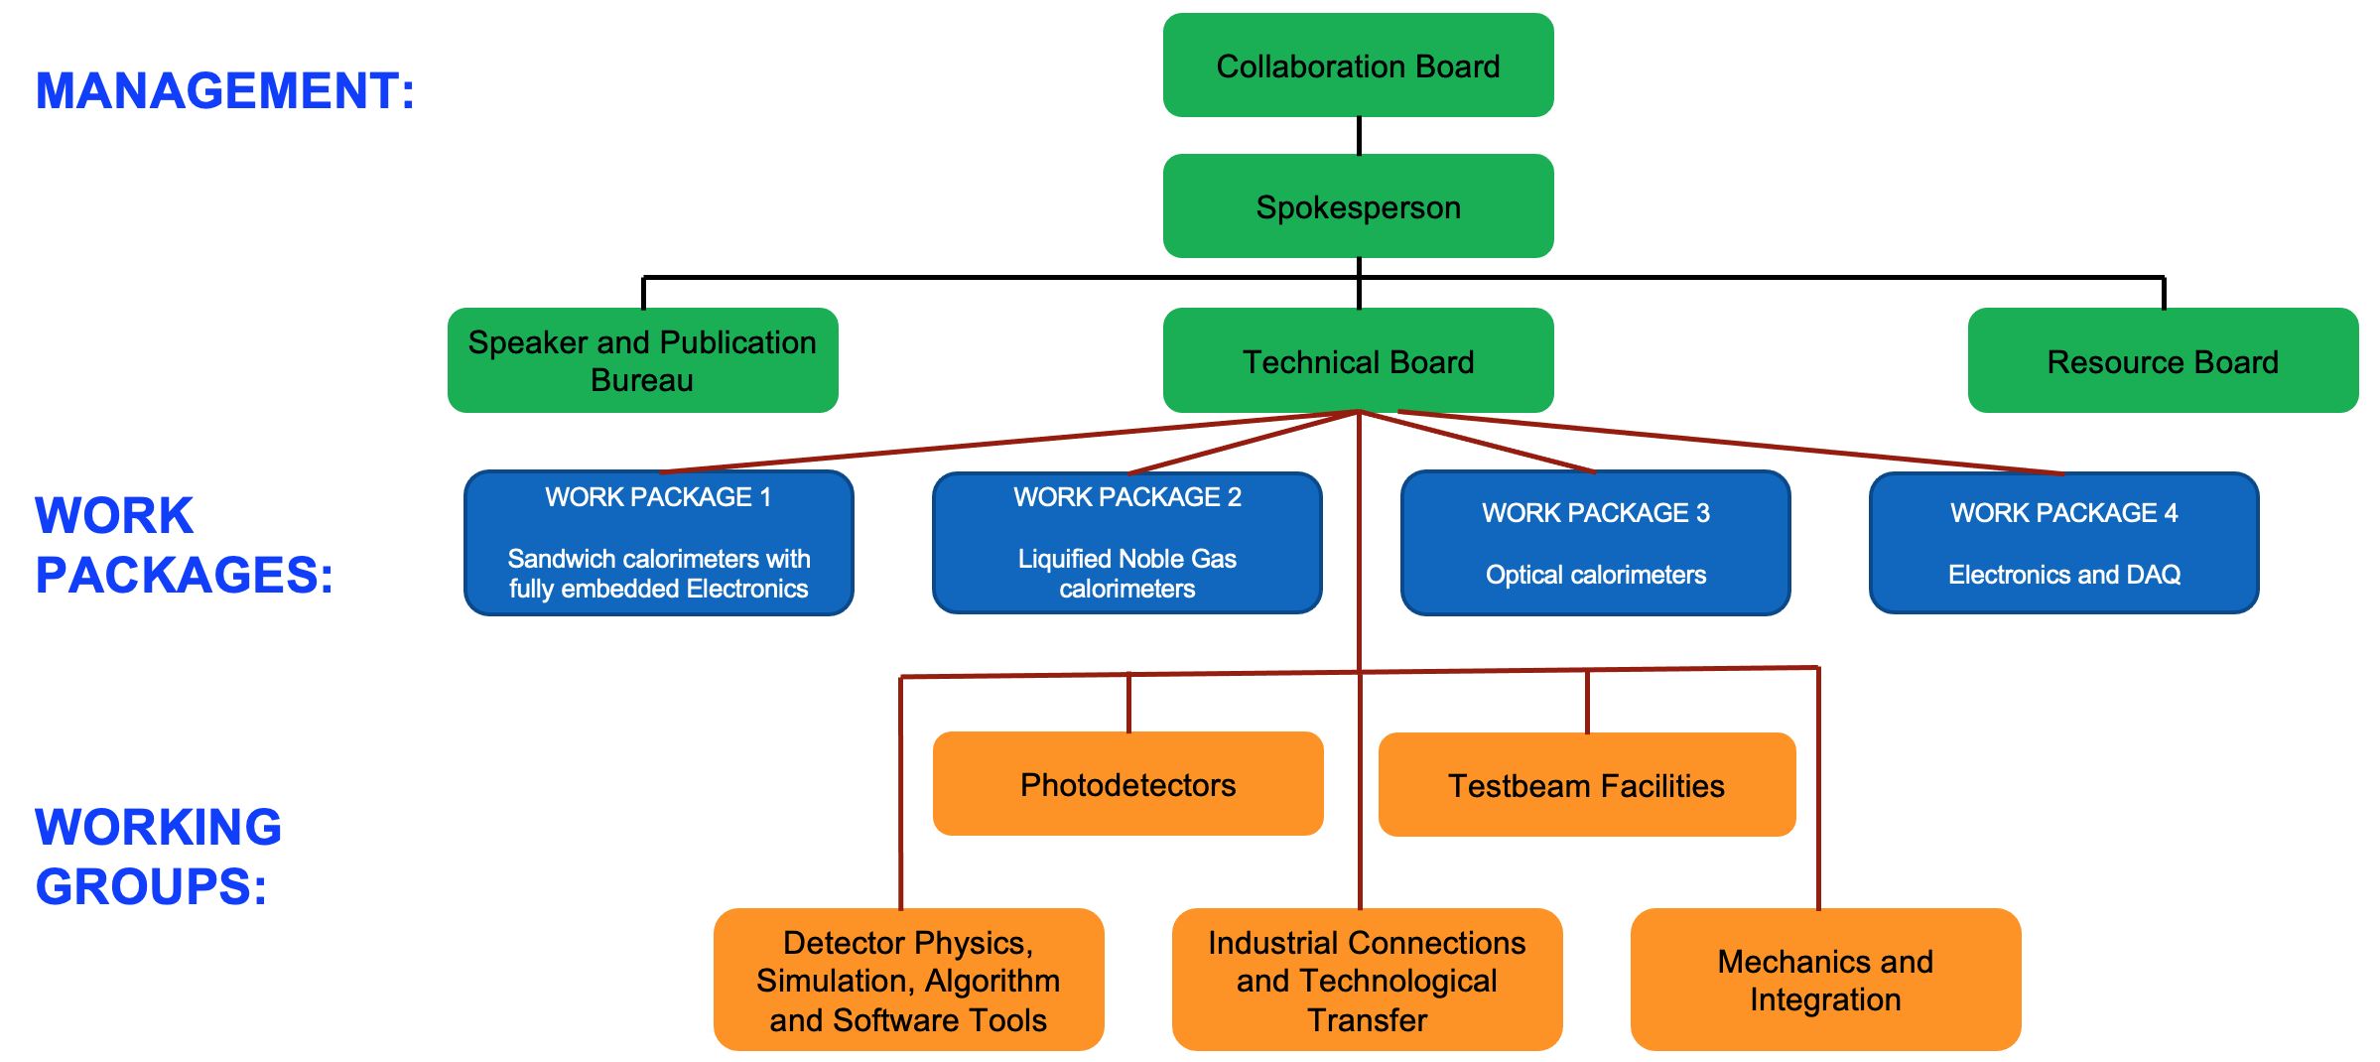
Topics towards the EDP input content : DRD collaboration facts
Preamble referring to the ECFA Detector R&D Roadmap
DRD collaboration implementation
  referring to CERN hosting framework
  work organisation to fulfil the ECFA detector roadmap DRDTs
  community building
    establishing areas of collaborative effort / common projects
  balance achieved in community aspirations and R&D roadmap priorities
  outreach, training and early career efforts
  still an ongoing process,
  also in preparation of MoUs
management bodies
Work Packages – contain “deliverables”
Working Groups - transverse activity forums
661 institute contributions in 46 countries
summed over DRD1, DRD2, DRD3, DRD4, DRD6 and DRD7
typical organisation, ex. DRD6

Slide 7
Topics towards the EDP input content : DRD programme deployment
Scientific outcome expected in the 1st phase of the R&D programs (3-4 years)
  evaluation of technology areas performance potential
  technical solution for medium term strategic projects; consider transitions to specific engineering (TRL ≳ 6)
Preparation of 2nd R&D phase
  ex. longer term collider term FCC-ee project; consider opportunities for new technology (TRL ≲ 3)
Transverse Areas
DRD5, DRD7, (DRD8)
also cover lower TRLs
** ”blue sky” TRL ≲ 3 and speific experiment engineering TRL ≳ 6 at boundaries of DRD coverages

Slide 8
Topics towards the EDP input content : DRD programme deployment
Scientific outcome expected in the 1st phase of the R&D programs (3-4 years)
  evaluation of technology areas performance potential
  technical solution for medium term strategic projects; consider transitions to specific engineering (TRL ≳ 6)
Preparation of 2nd R&D phase
  ex. longer term collider term FCC-ee project, consider opportunities for new technology (TRL ≲ 3)
fixed target, small & non-accelerator progammes
( Dark Matter - neutrino - rare processes - fundamental forces)
have shorter cycles O(5) years in several experiments (many covered in DRD2)
deployment of the work and transitions can have different features
Transverse Areas
DRD5, DRD7, (DRD8)
also cover lower TRLs
** ”blue sky” TRL ≲ 3 and speific experiment engineering TRL ≳ 6 at boundaries of DRD coverages

Slide 9
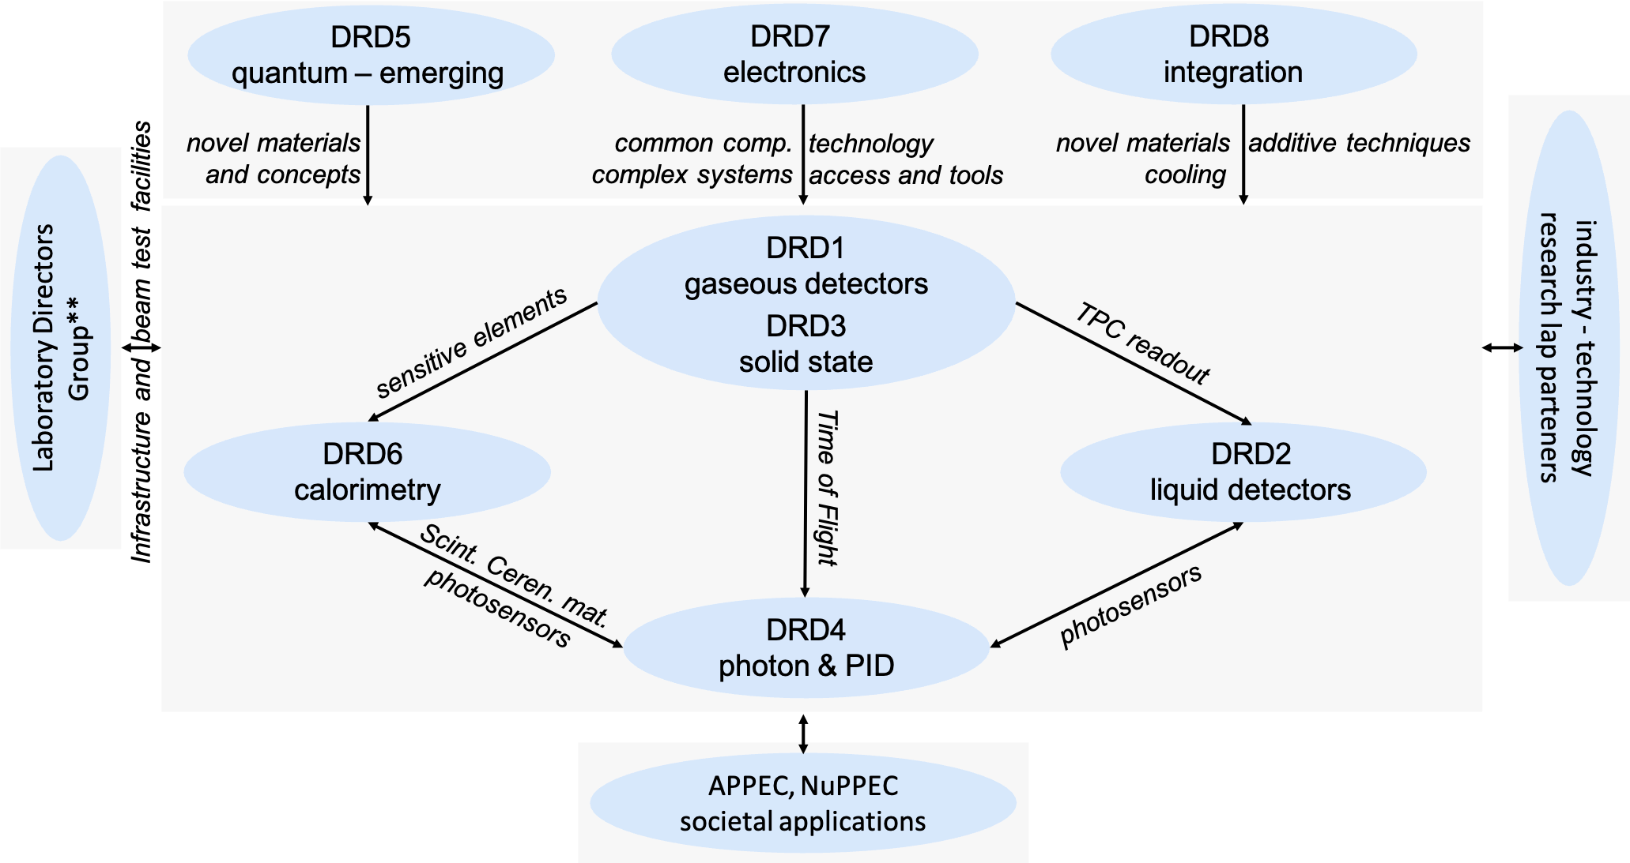
Topics towards the EDP input content : DRD interfacial areas
Cross-DRD aeras (when DRDx can benefit from DRDy progress)
  typical ex. 1 implementing new sensitive components provided by other DRDs in DRD6
  typical ex. 2 implementing new electronics components provided DRD7 in any other DRDs
Interface to other national or international programs (ex. US CPAD, AIDAInnova…)
Relation and collaboration with industrial or academic partners & technology access
Relation and collaboration with other scientific disciplines
Availability of infrastructure for characterisation - in conjunction with LDG*
Mechanisms to ensure coherence and synchronization of the above aspects
* CEA/IRFU-France, CERN-EU, CIEMAT-Spain, DESY-Germany, IJCLab-France, LNF-Italy, LNGS-Italy, Nikhef-Netherlands, PSI-Switzerland, STFC/Daresbury-UK, STFC/RAL-UK

Slide 10
Topics towards the EDP input content : DRD resources
Initial estimates of resources in DRD proposals
  based on a bottom-up approach (not commitments)
  needs and pledges to be consolidated with MoU preparation
    sufficient flexibility to accommodate progress & timeline evolutions & different sources and cycles of resources
Resources appear to be on low side to fulfill entire program ≃ 2/3 & 1/2 for manpower & funding*
  potential ramp-up, ex. expected with completion of on-going projects (HL-LHC upgrades…)
  access to new technologies can be expensive, needing to widely gather contributions
FTE/y available/additional
funding/y available/additional (MCHF)
expected FTE/y & funding/y
≃ average over 3 first years
available ≃ current situation
additional ≃ expected to fulfil progr.
break-down of FTE exists Physicists/PhD/Technical Staff
* R&D programmes are running so far on presently available resources

Slide 11
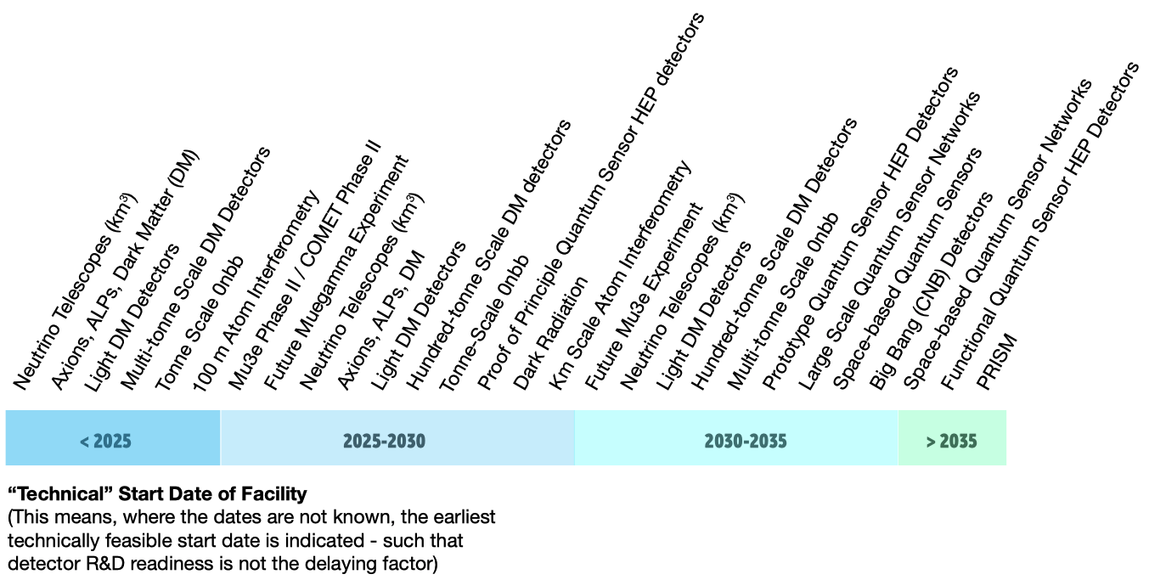
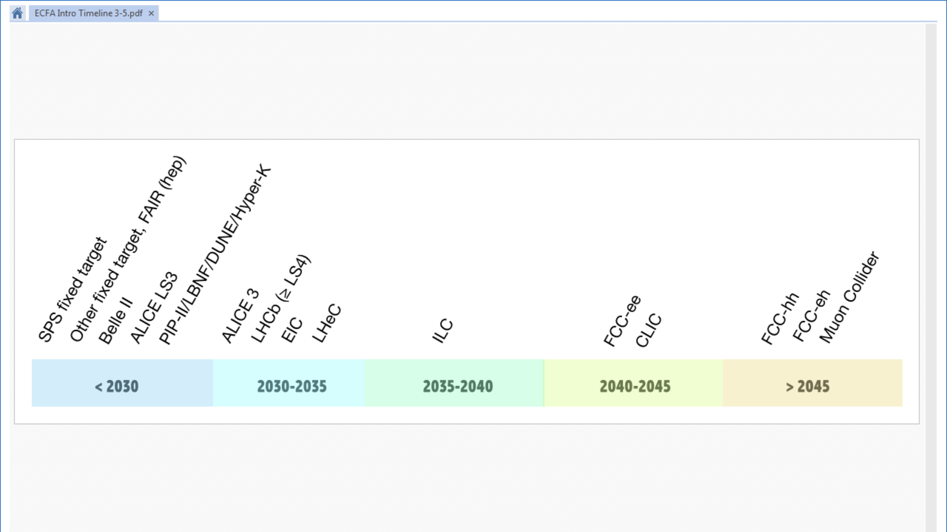
Topics towards the EDP input content : Strategic Projects*
Significant evolution (if any) since ESPP 2020
  requirements and operating conditions, conceptual designs
  timeline and priorities for R&D
Simulation progress
  guiding R&D for specific technology parameters
Involvement in DRD collaborations
upgrades and future large accelerators projects
small accelerators, nuclear reactors, cosmic rays
second and third generation of experiments
* future physics programmes identified in the ESPP and ECFA detector R&D roadmap that are adressed by the DRD collaborations

Slide 12
Outline
EDP highlights
topics towards an EDP input to the ESPP process
plan to prepare the input

Slide 13
Plan to prepare the EDP input and beyond
Further develop the input content and format during summer with EDP
Collect Actors’ views by end-Oct.
  DRD collaborations, EDP - Collaboration Managers Forum
  Strategic Projects concept groups (all strategic areas), ECFA WG3 and ECFA Workshop on e+e- HET Factories 2024 @ Paris (FR), 9-11 Oct, 2024, EDP experts
  ApPEC and NuPEC, EDP ex-officio members
  Institutional ECFA or non-ECFA DRD National Contacts to Funding Agencies
  ECFA ECR panel
Compile material and draft input to ESSP by end-2024
Submit input (after iteration) end-March 2025
Beyond the ESPP conclusion mid-2026
  prepare incremental update of the ECFA Detector R&D Roadmap as needed (requested by the ESPP conclusion)
Your feeback is welcomed

Slide 14
