Slide 1
WP 9.3 progress at INFN-LNL
Nb₃Sn magnetron sputtering
I.FAST 11th WP 9 meeting
UKRI/STFC Daresbury Laboratory – 18.01.2024
Dorothea Fonnesu – INFN Legnaro National Labs

Slide 2
Outline
brief recap (since last meeting on 14.09.2023)
ongoing for Nb3Sn/Cu R&D at LNL and within I.FAST
new characterization results from LOT / Uni Siegen
plan for next characterizations

Slide 3
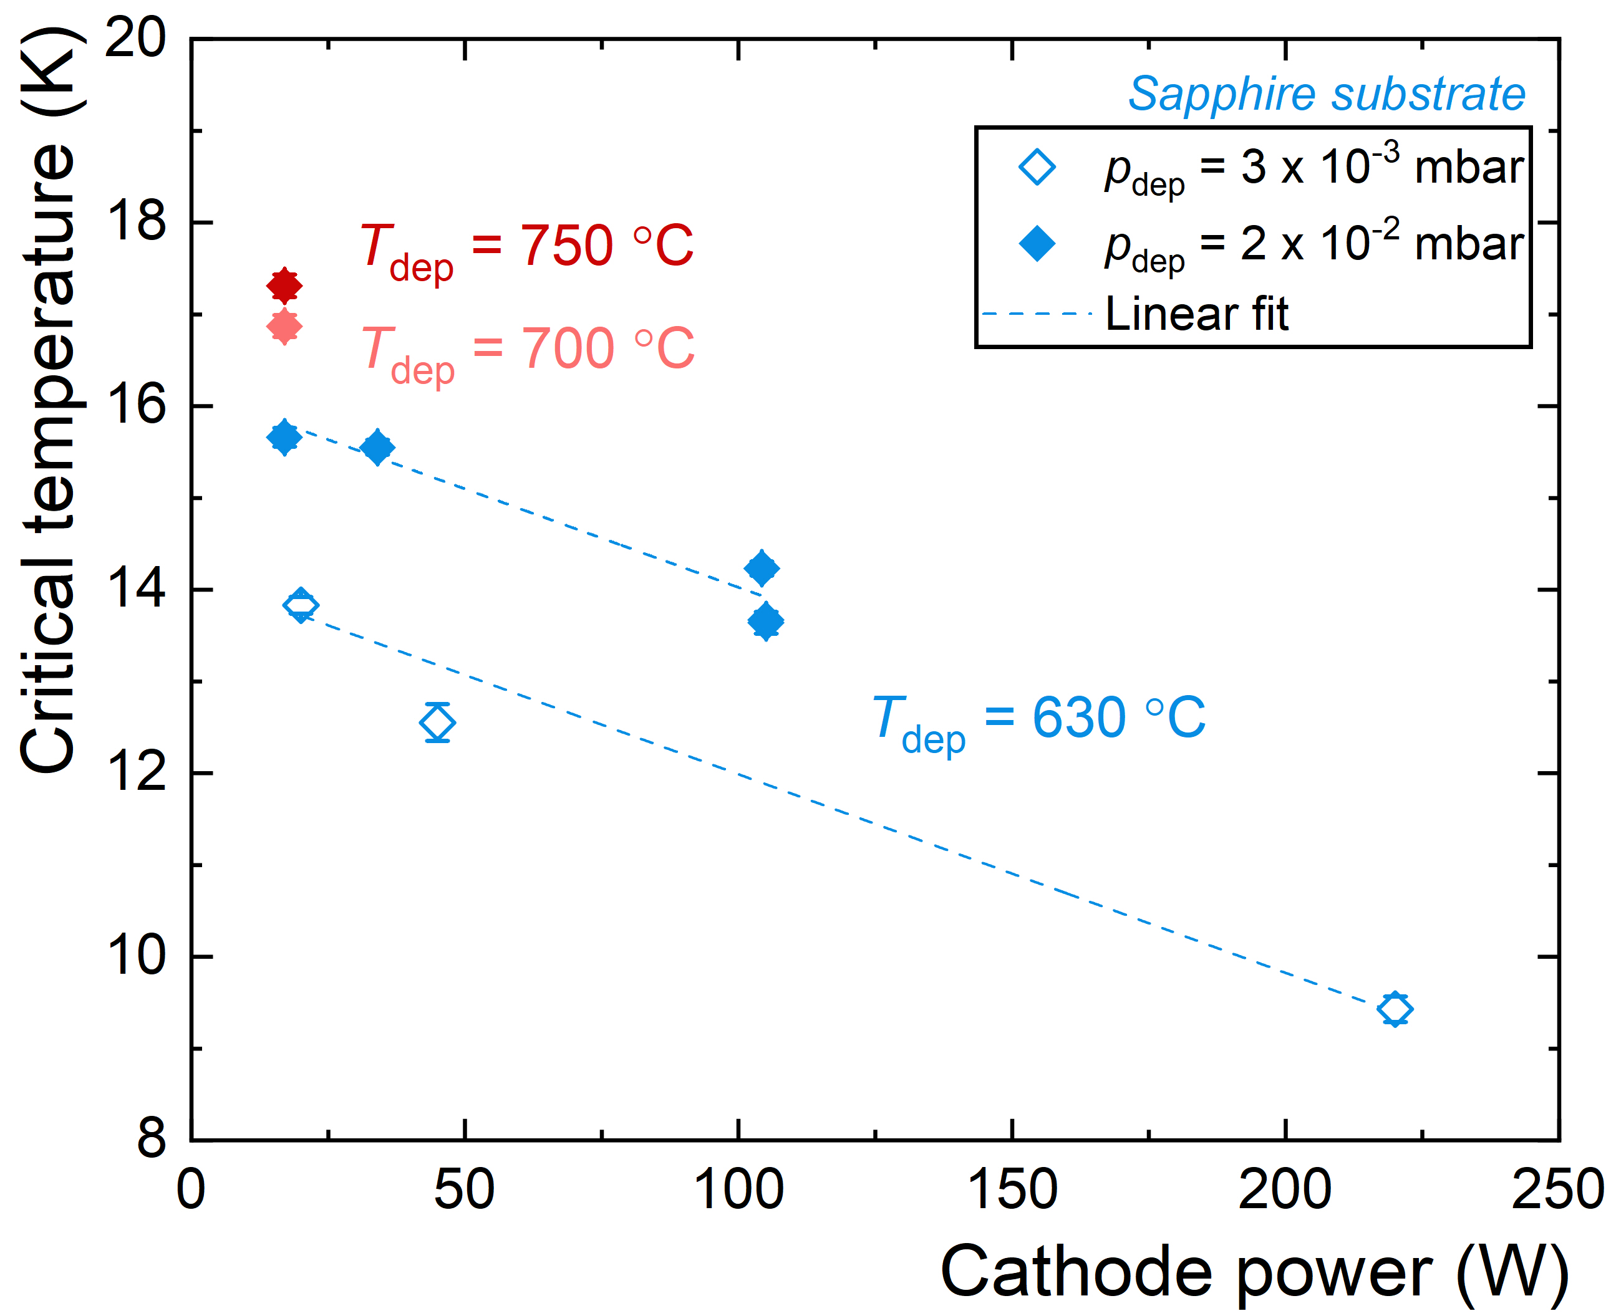
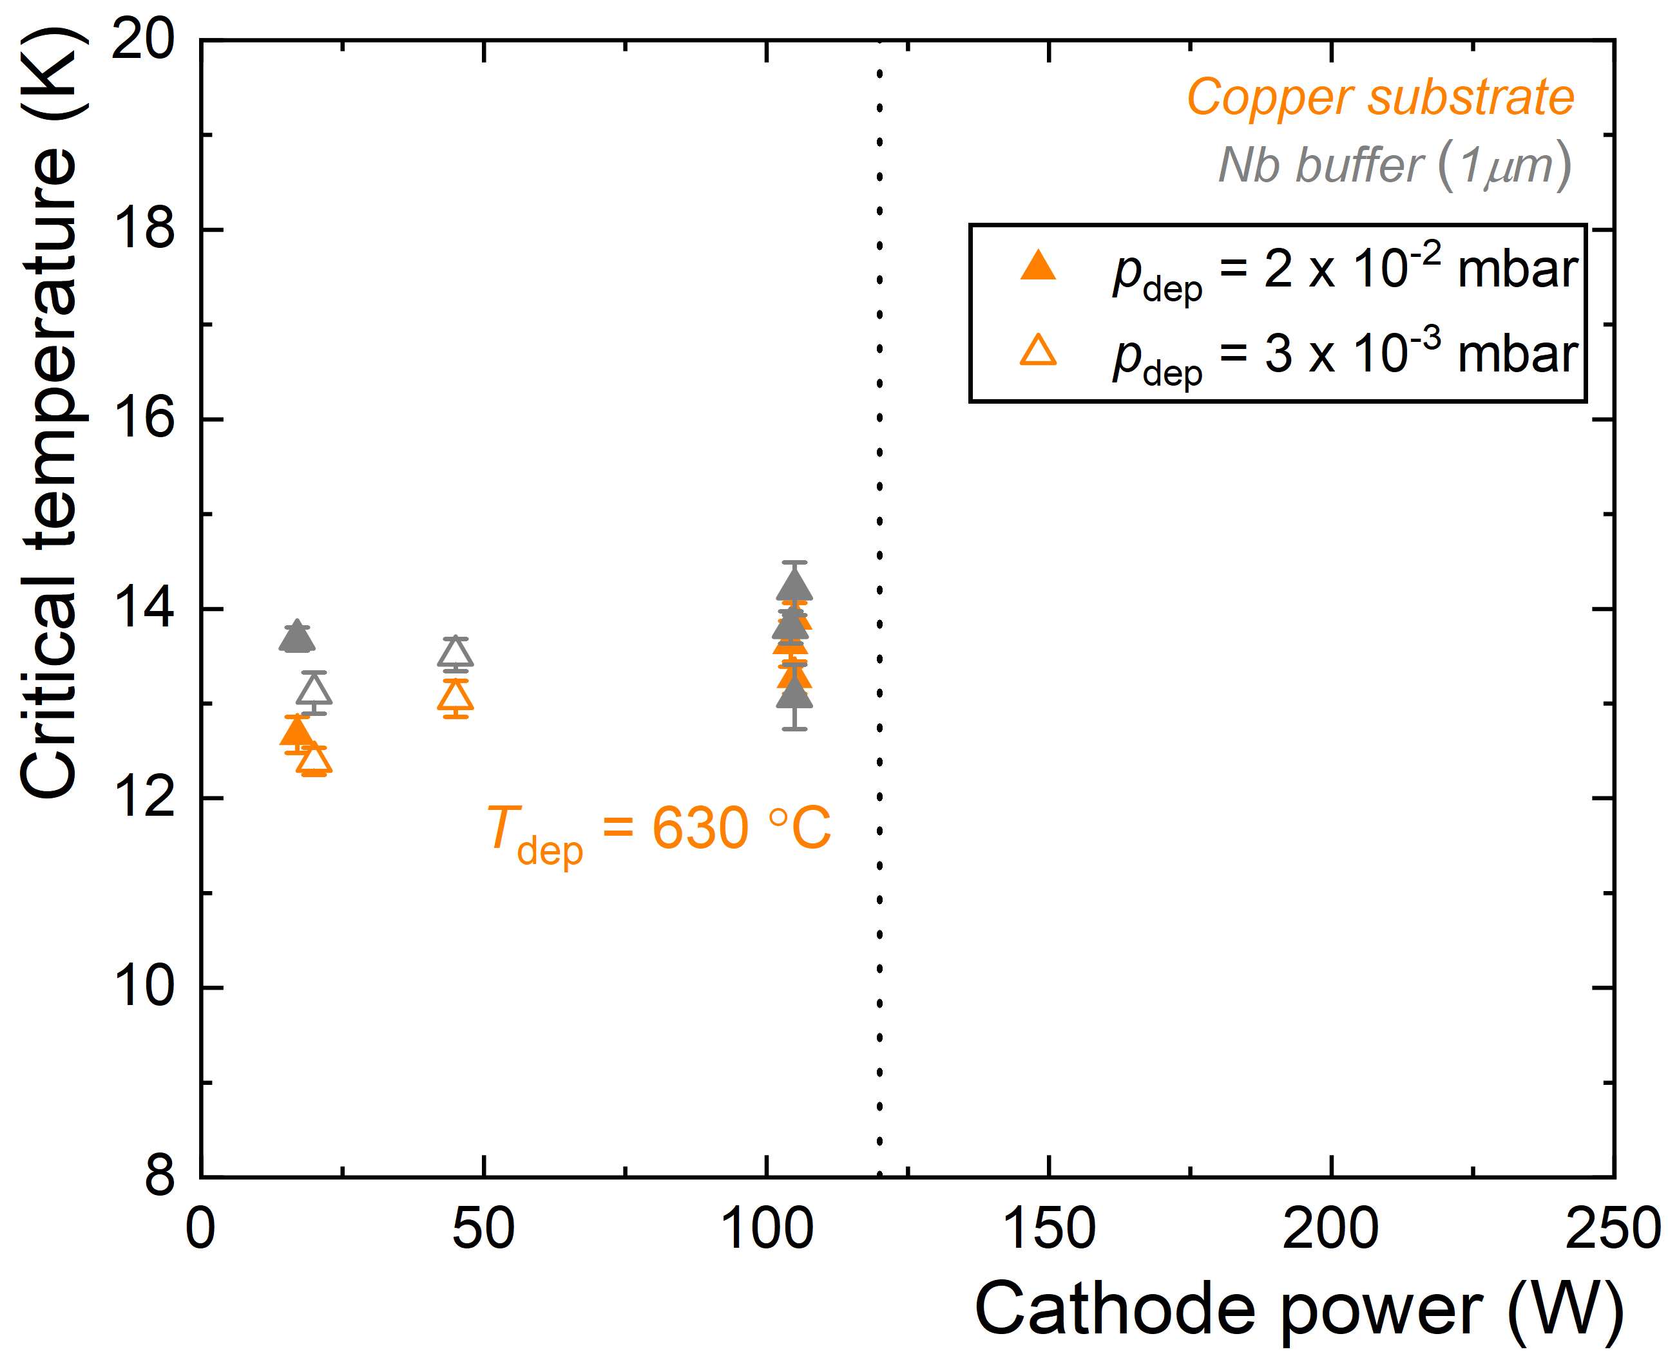
Where we left
↑↓↗↘
Sapphire + 1 μm Nb₃Sn
T_{c} trends on deposition parameters
cathode power ↘ critical temperature ↗
deposition pressure ↗ critical temperature ↗
observed on sapphire, not on Cu or Nb(1um)/Cu substrate
Cu + 1 μm Nb₃Sn
Cu + 1 μm Nb + 1 μm Nb₃Sn

Slide 4
Where we left
T_{c} trends on deposition parameters
cathode power ↘ critical temperature ↗
deposition pressure ↗ critical temperature ↗
observed on sapphire, not on Cu or Nb(1um)/Cu substrate
T_{c} further improves by:
increasing thickness of Nb buffer layer (1um → ... → 50 um)
decreasing annealing time (24h → 5h → 0h)
Cu + 1 μm Nb + 1 μm Nb₃Sn
Cu + 30 μm Nb + 1 μm Nb₃Sn

Slide 5
Where we left
T_{c} trends on deposition parameters
cathode power ↘ critical temperature ↗
deposition pressure ↗ critical temperature ↗
observed on sapphire, not on Cu or Nb(1um)/Cu substrate
T_{c} further improves by:
increasing thickness of Nb buffer layer (1um → ... → 50 um)
decreasing annealing time (24h → 5h → 0h)
Ongoing:
INFN-LNL: Tc, EDS, XRD, data analysis
LOT/Uni Siegen: SEM, EDS of FIB milled cross sections, SIMS (planned)
HZDR: magnetometry, RBS (planned), FLA tests
Uni Bratislava: magnetometry (samples @Uni Siegen)

Slide 6


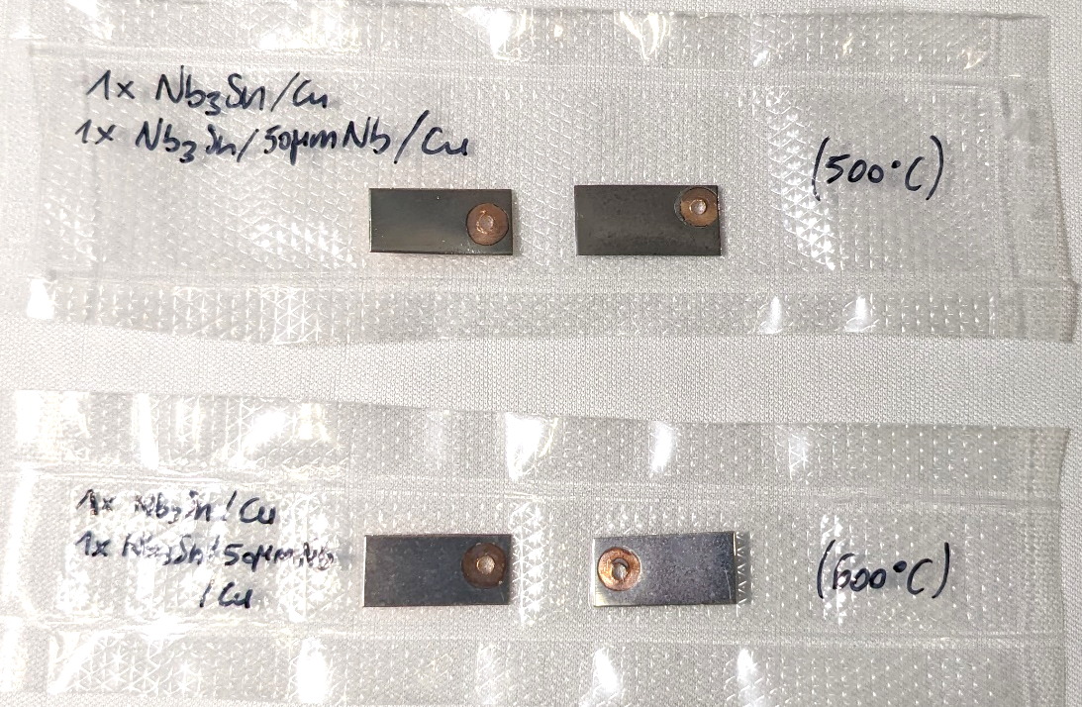
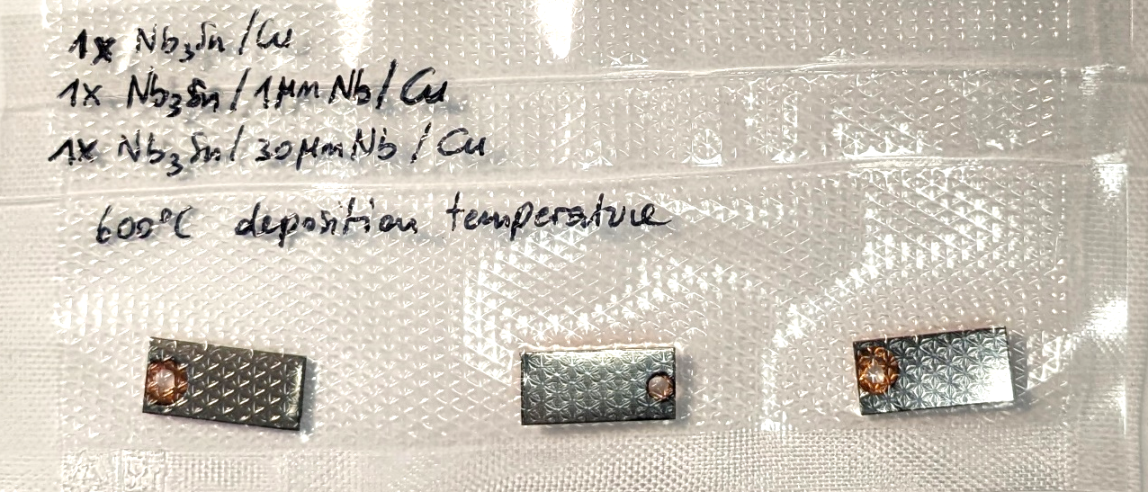
New characterisations
Lehrstuhl für
Oberflächen- und
Werkstofftechnologie
Samples sent to LOT (Uni Siegen)
T_{c}, composition (and more) measured at INFN-LNL
SEM surface images, EDS maps of FIB cross sections measured at LOT, Uni-Siegen by A. Zubtsovskii, T. Staedler
NO ANNEALING
Sample/(buffer layer)/substrate [T_{deposition}] | T_{c} (K) | Sn (At%)
Nb₃Sn / Cu [600°C] | 12.8 ± 0.3 | 21.7
Nb₃Sn / Nb(50µm) / Cu [600°C] | 17.3 ± 0.3 | 23.1
Nb₃Sn / Cu [500°C] | 9.4 ± 0.3 | 24.7
Nb₃Sn / Nb(50µm) / Cu [500°C] | 12.6 ± 0.2 | 26.3
Nb₃Sn / Cu [600°C] annealed | 13.0 ± 0.1 | 20.9
Nb₃Sn / Nb(1µm) / Cu [600°C] annealed | 14.1 ± 0.2 | 25.4
Nb₃Sn / Nb(30µm) / Cu [600°C] annealed | 16.5 ± 0.1 | 23.1
5h ANNEALING
(discussed in backup)

Slide 7
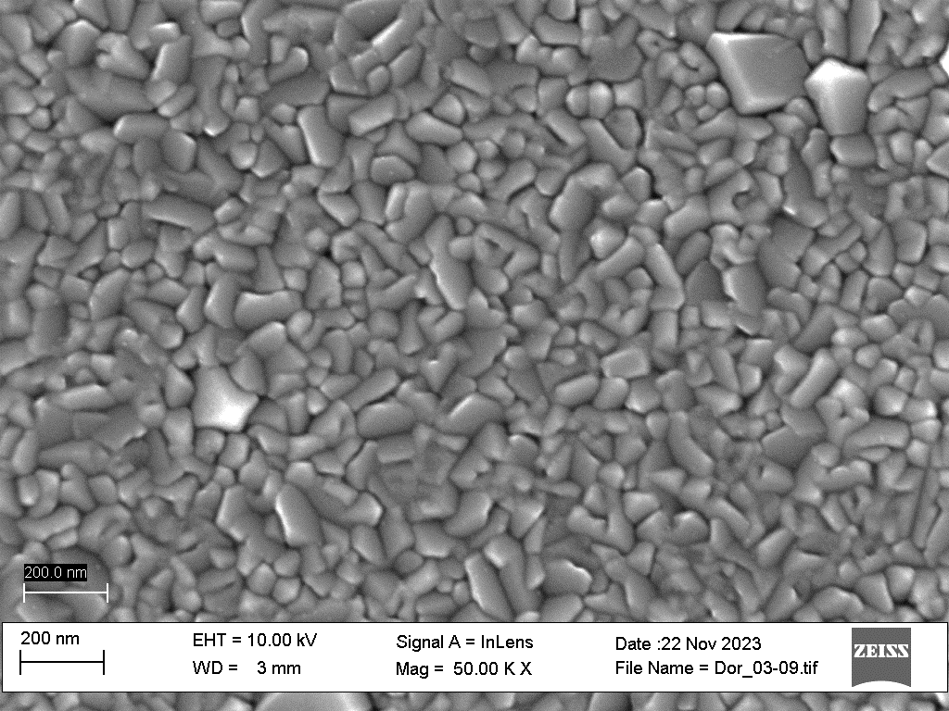
Cu_500
Cu_600
T_{c} = 9.4 K
Sn = 24.7 At%
T_{c} = 12.8 K
Sn = 21.7 At%
Samples without buffer layer
Grain pattern of Cu substrate is visible
Grain size
increases with deposition temperature
Sn content decreases

Slide 8
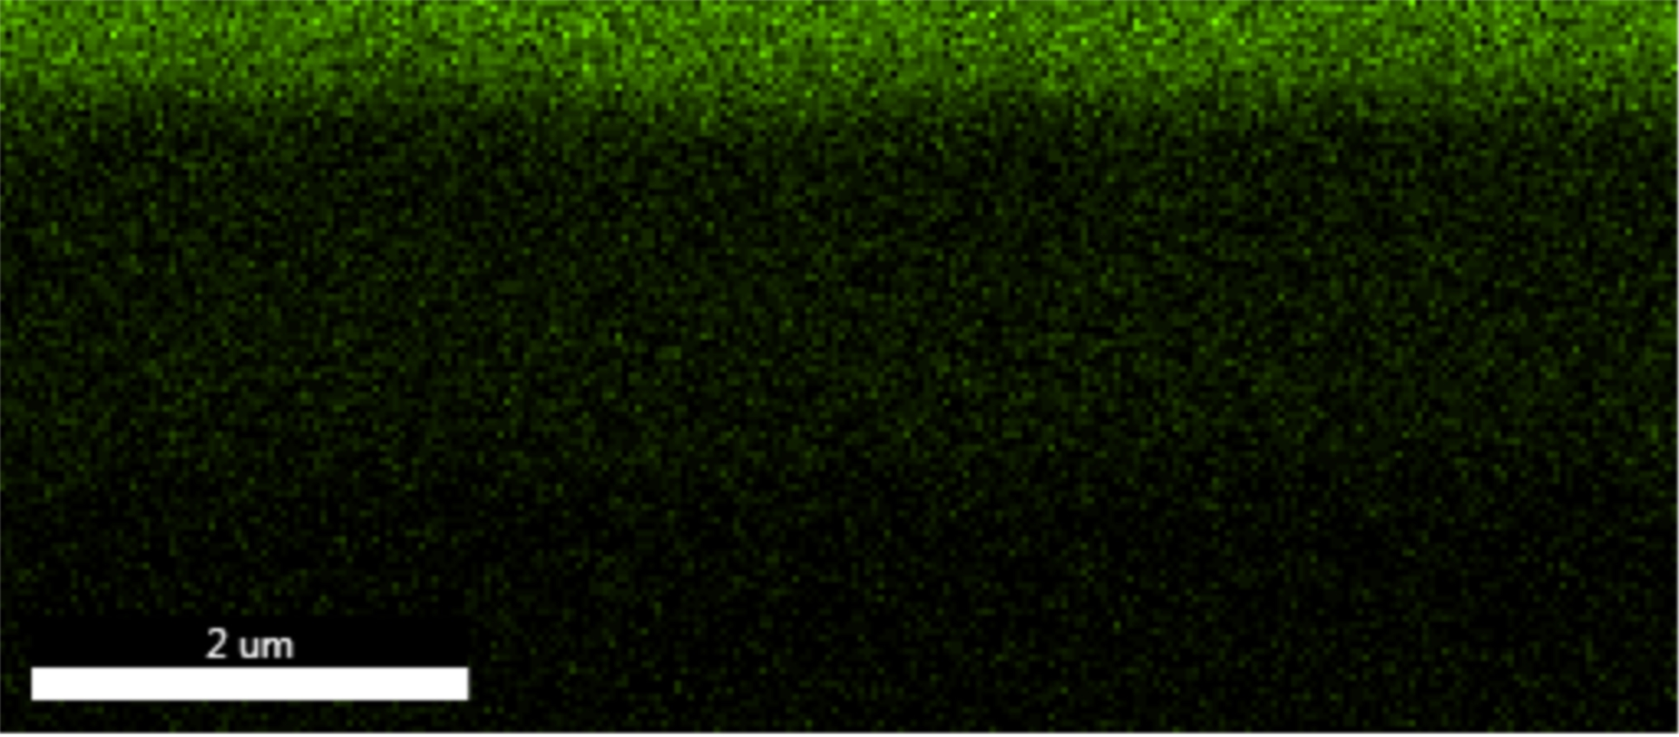
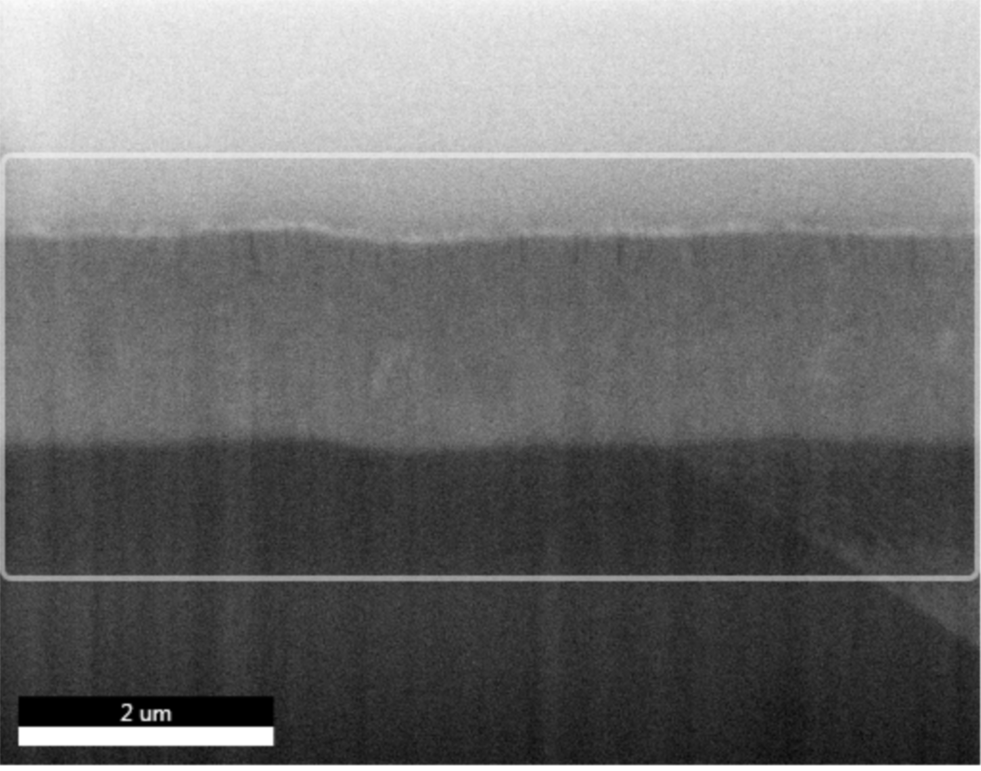
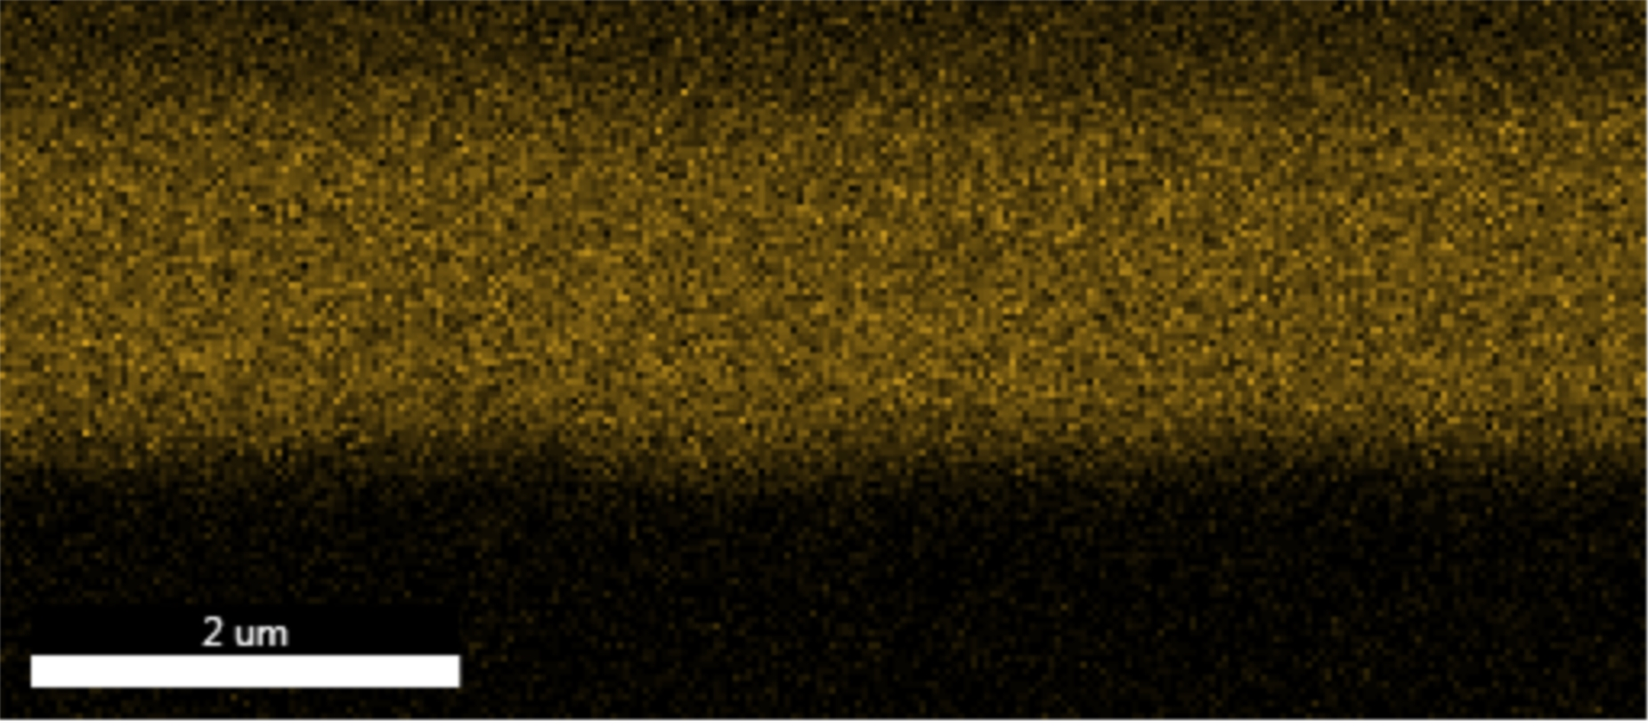
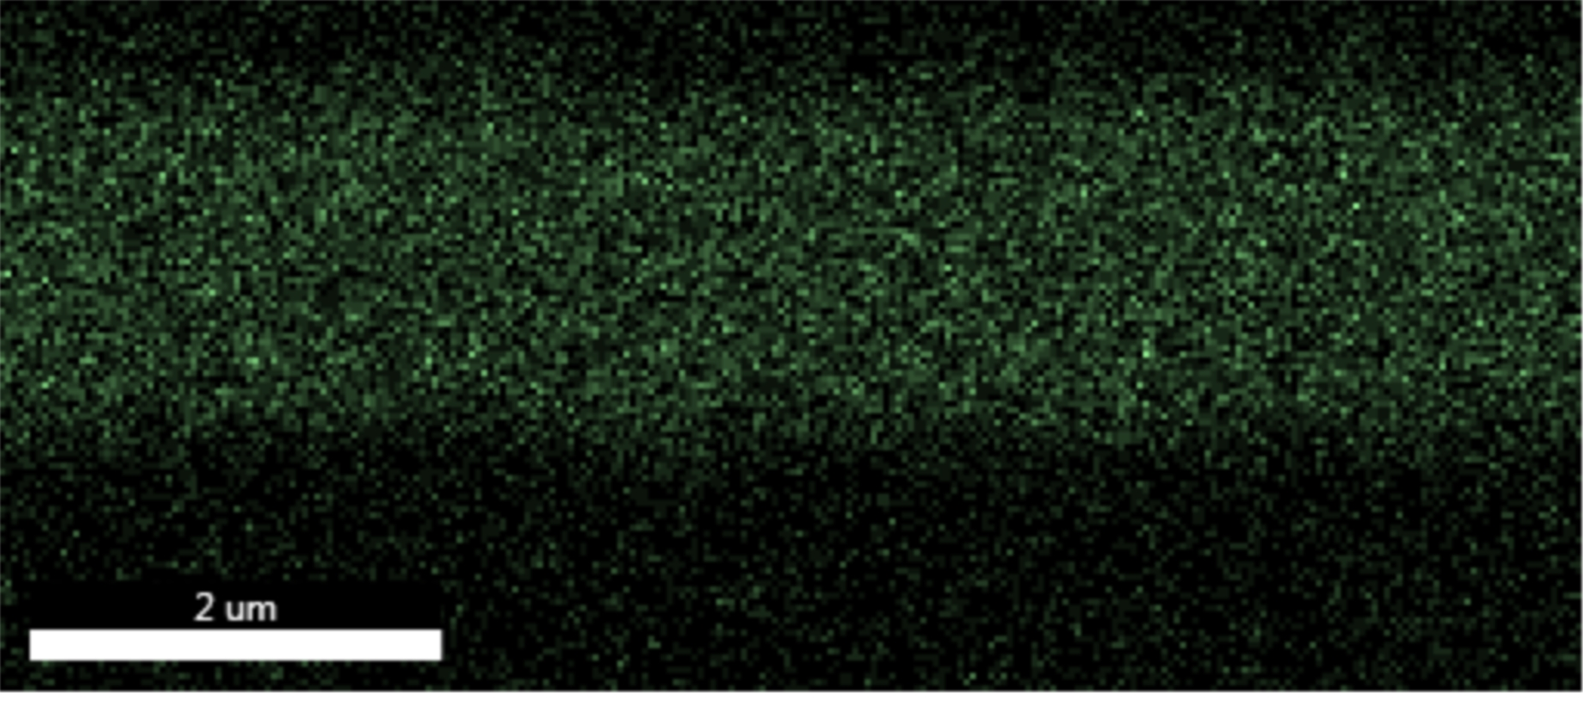
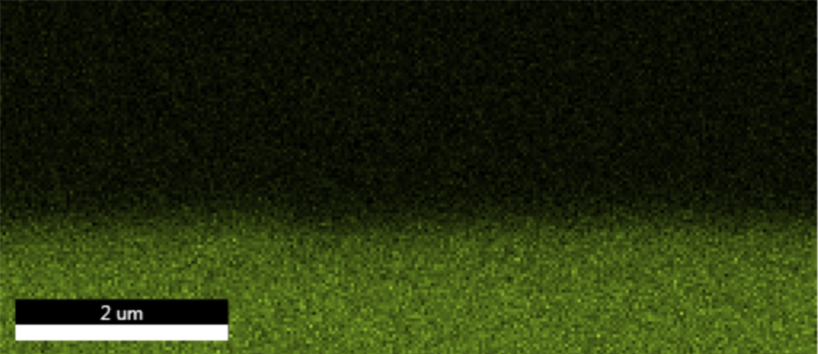
Cu_500
Pt
Nb
T_{c} = 9.4 K
Sn = 24.7 At%
Sn
Film/copper interface appears smeared and Sn-depleted
Rare voids at the top
Not enough to infer about Sn-Cu interdiffusion
Cu

Slide 9
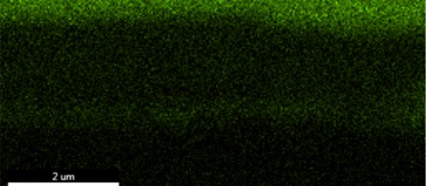
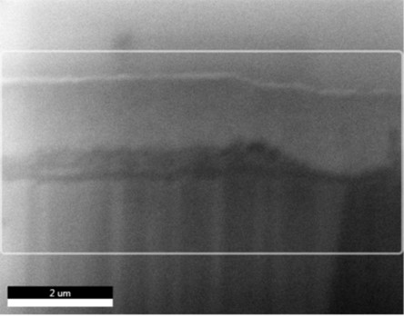
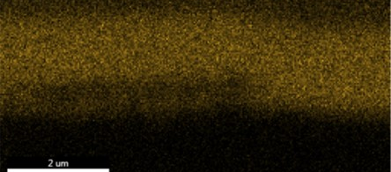
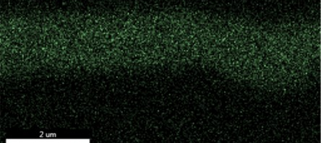
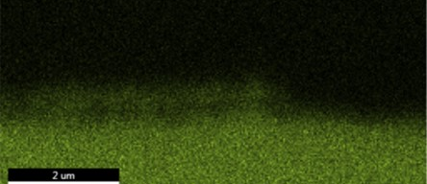
Cu_600
Pt
Nb
T_{c} = 12.8 K
Sn = 21.7 At%
Sn
Film/copper interface appears porous and Sn-depleted
Voids at the film bottom (Pt contamination)
Cu diffusion visible
Cu

Slide 10
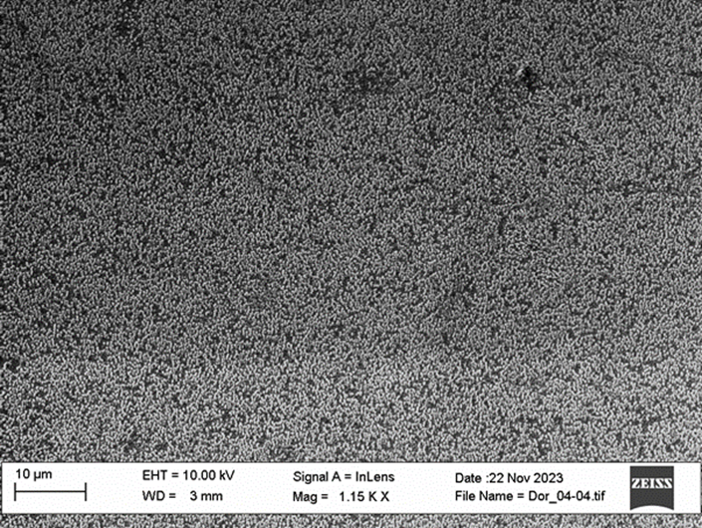
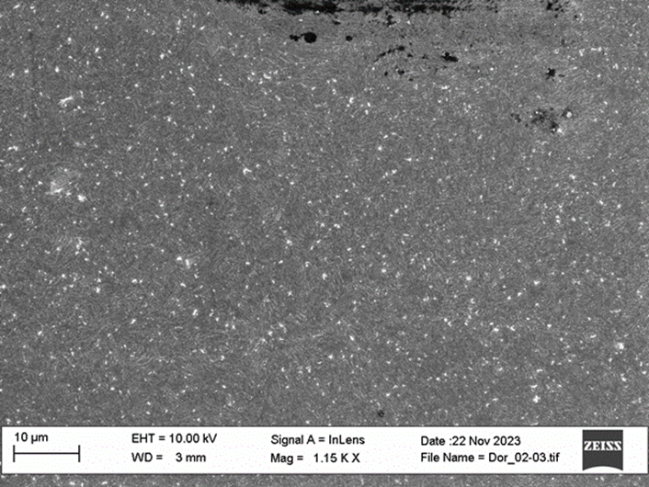
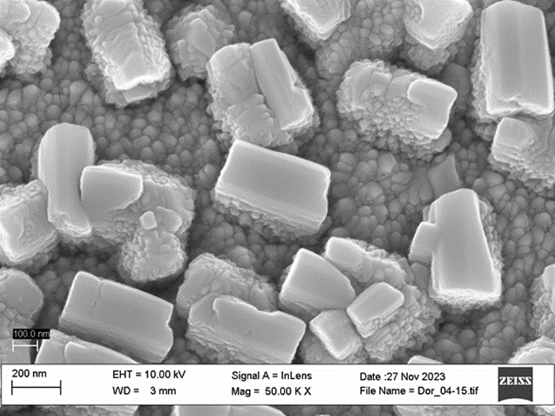
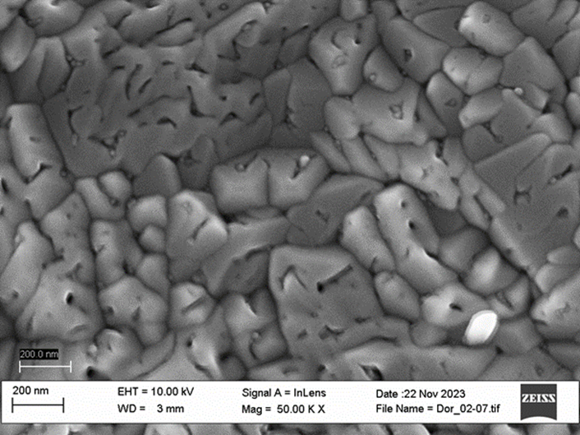
Nb50_Cu_500
Nb50_Cu_600
T_{c} = 12.6 K
Sn = 26.3 At%
T_{c} = 17.3 K
Sn = 23.1 At%
Samples with 50 µm Nb buffer layer
Change in morphology and tin cluster density

Slide 11
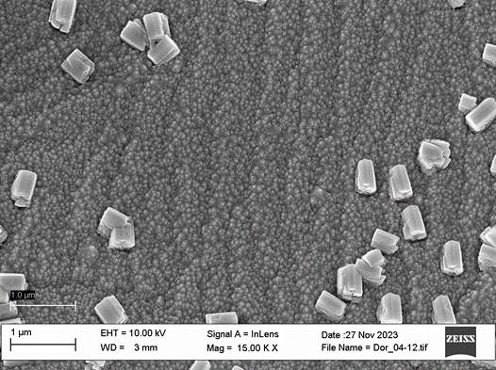
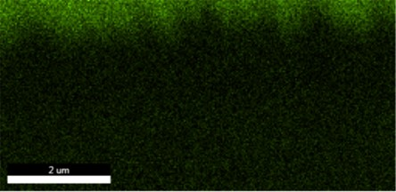
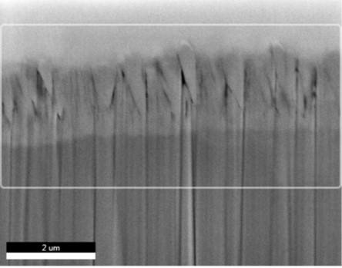

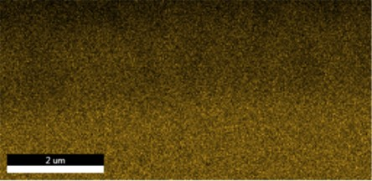
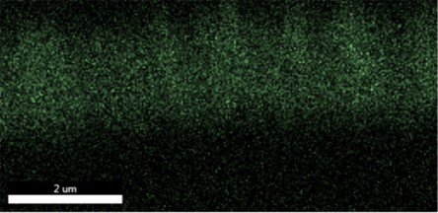
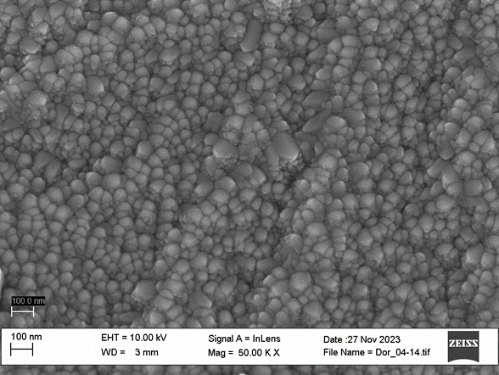
Nb50_Cu_500
Pt
Pt
Nb₃Sn
Nb
Nb
FIB:
20 µm x 3 µm cut
T_{c} = 12.6 K
Sn = 26.3 At%
Sn
Large wedge-like islands on top
Voids between islands

Slide 12
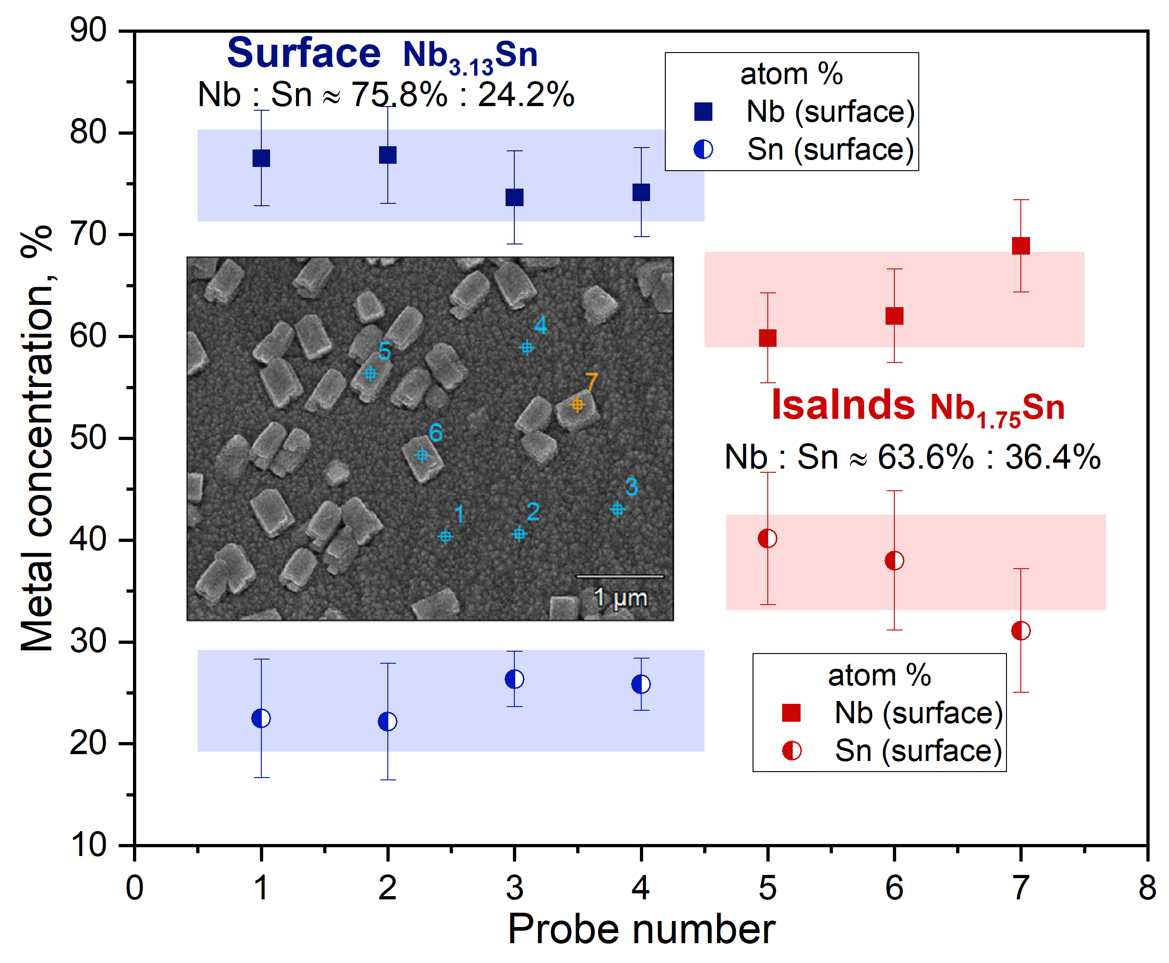
Nb50_Cu_500
T_{c} = 12.6 K
Sn = 26.3 At%

Slide 13
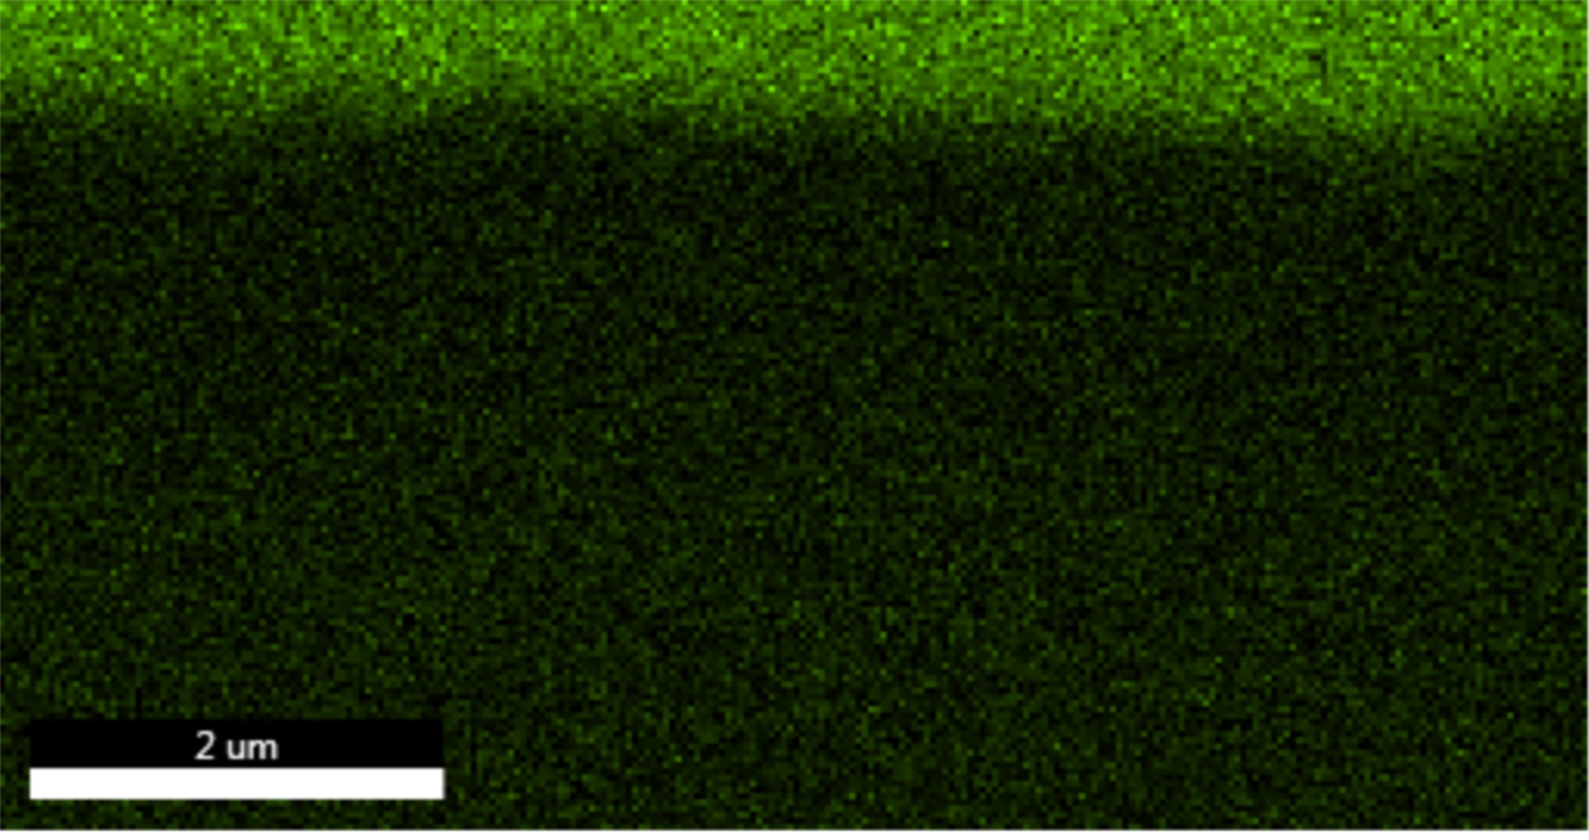
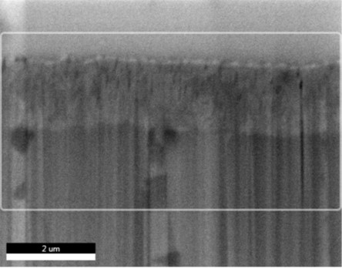
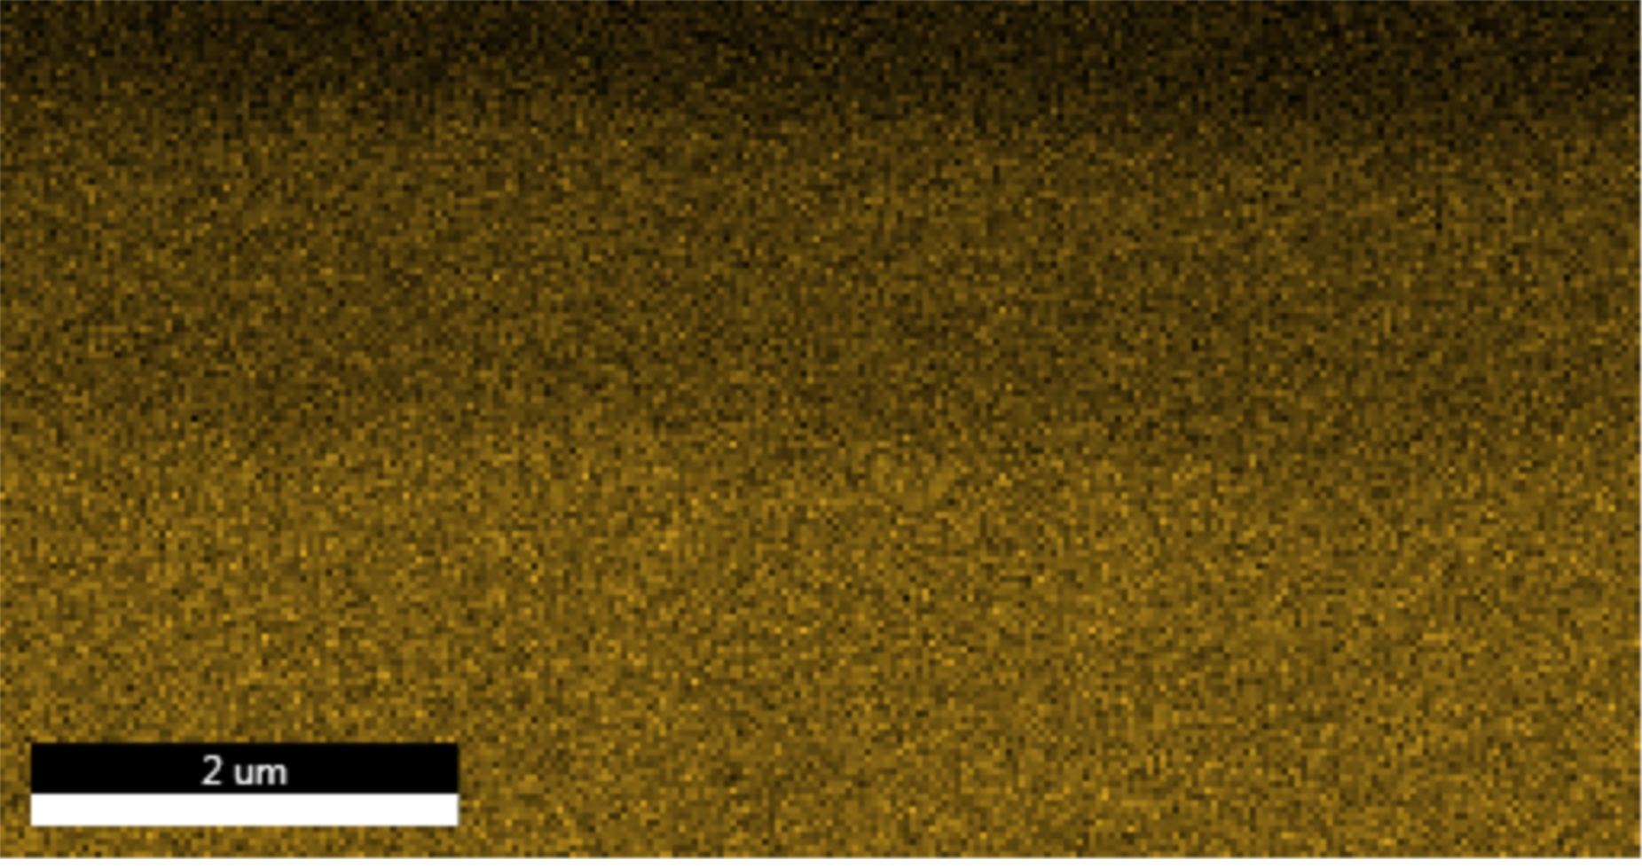
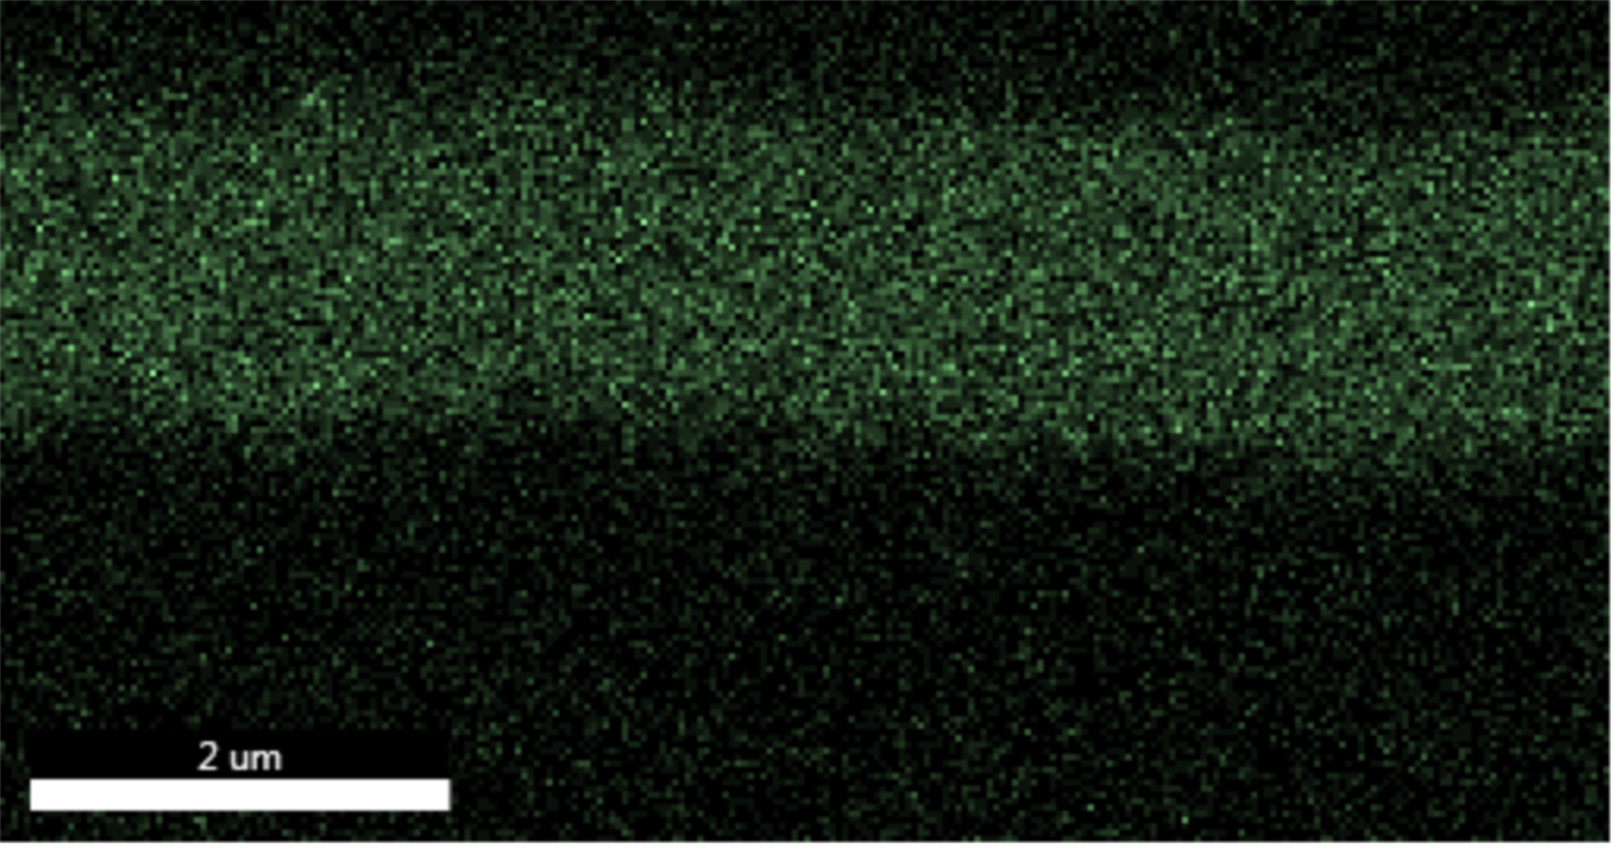
Nb50_Cu_600
Pt
Pt
Nb₃Sn
Nb
Nb
FIB:
20 µm x 3 µm cut
T_{c} = 17.3 K
Sn = 23.1 At%
Sn
Voids in the top part of film
Visible interface between porous and non-porous region

Slide 14
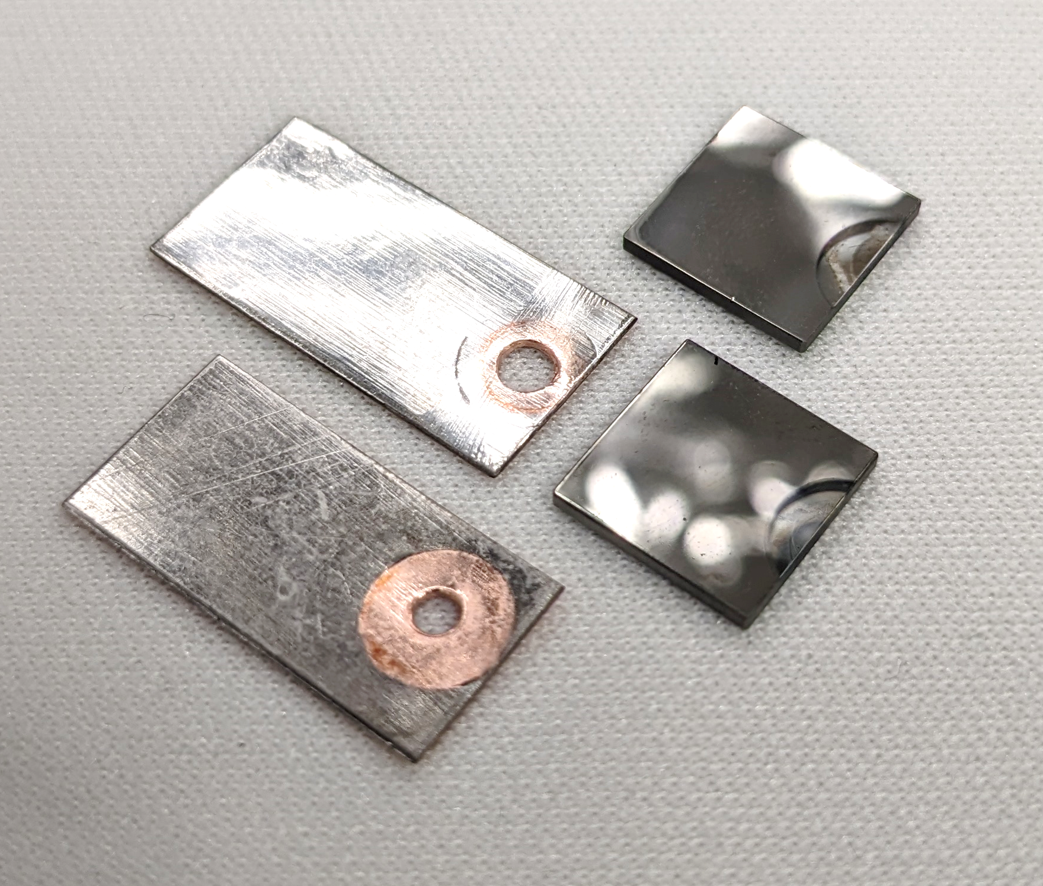
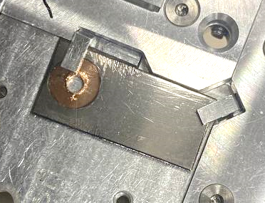
Next characterisations
LOT:
  Nb3Sn/Cu and Nb3Sn/Nb(1um)/Cu at 500 °C and 600 °C for SIMS
  (investigate weight of Nb buffer layer into Sn-Cu interdiffusion, if any)
HZDR:
  is RBS and magnetometry possible on samples sent for FLA tests?
  (Nb3Sn/Cu (2x), Nb3Sn/Nb(1um)/Cu, Nb3Sn/Nb(15um)/Cu, Nb3Sn/Nb(30um)/Cu (2x), deposited at 650 °C, not annealed)
Uni Bratislava:
  Nb3Sn/Nb(50um)/Cu at 500 °C and 600 °C from LOT for magnetometry
  Nb3Sn/Nb(9um)/Cu, Nb3Sn/Nb(40um)/Cu, Nb3Sn/Nb(50um)/Cu at 600 °C (*) with Nb3Sn film 0.6 um thick (standard is 1 um)
  is magnetometry of samples on sapphire substrate possible?
  we could ship those corresponding to the runs analysed by LOT and HZDR
10 mm x 10 mm x 1 mm
sapphire substrate
10 mm x 20 mm x 0.5 mm
copper substrate
FIB milling location

Slide 15
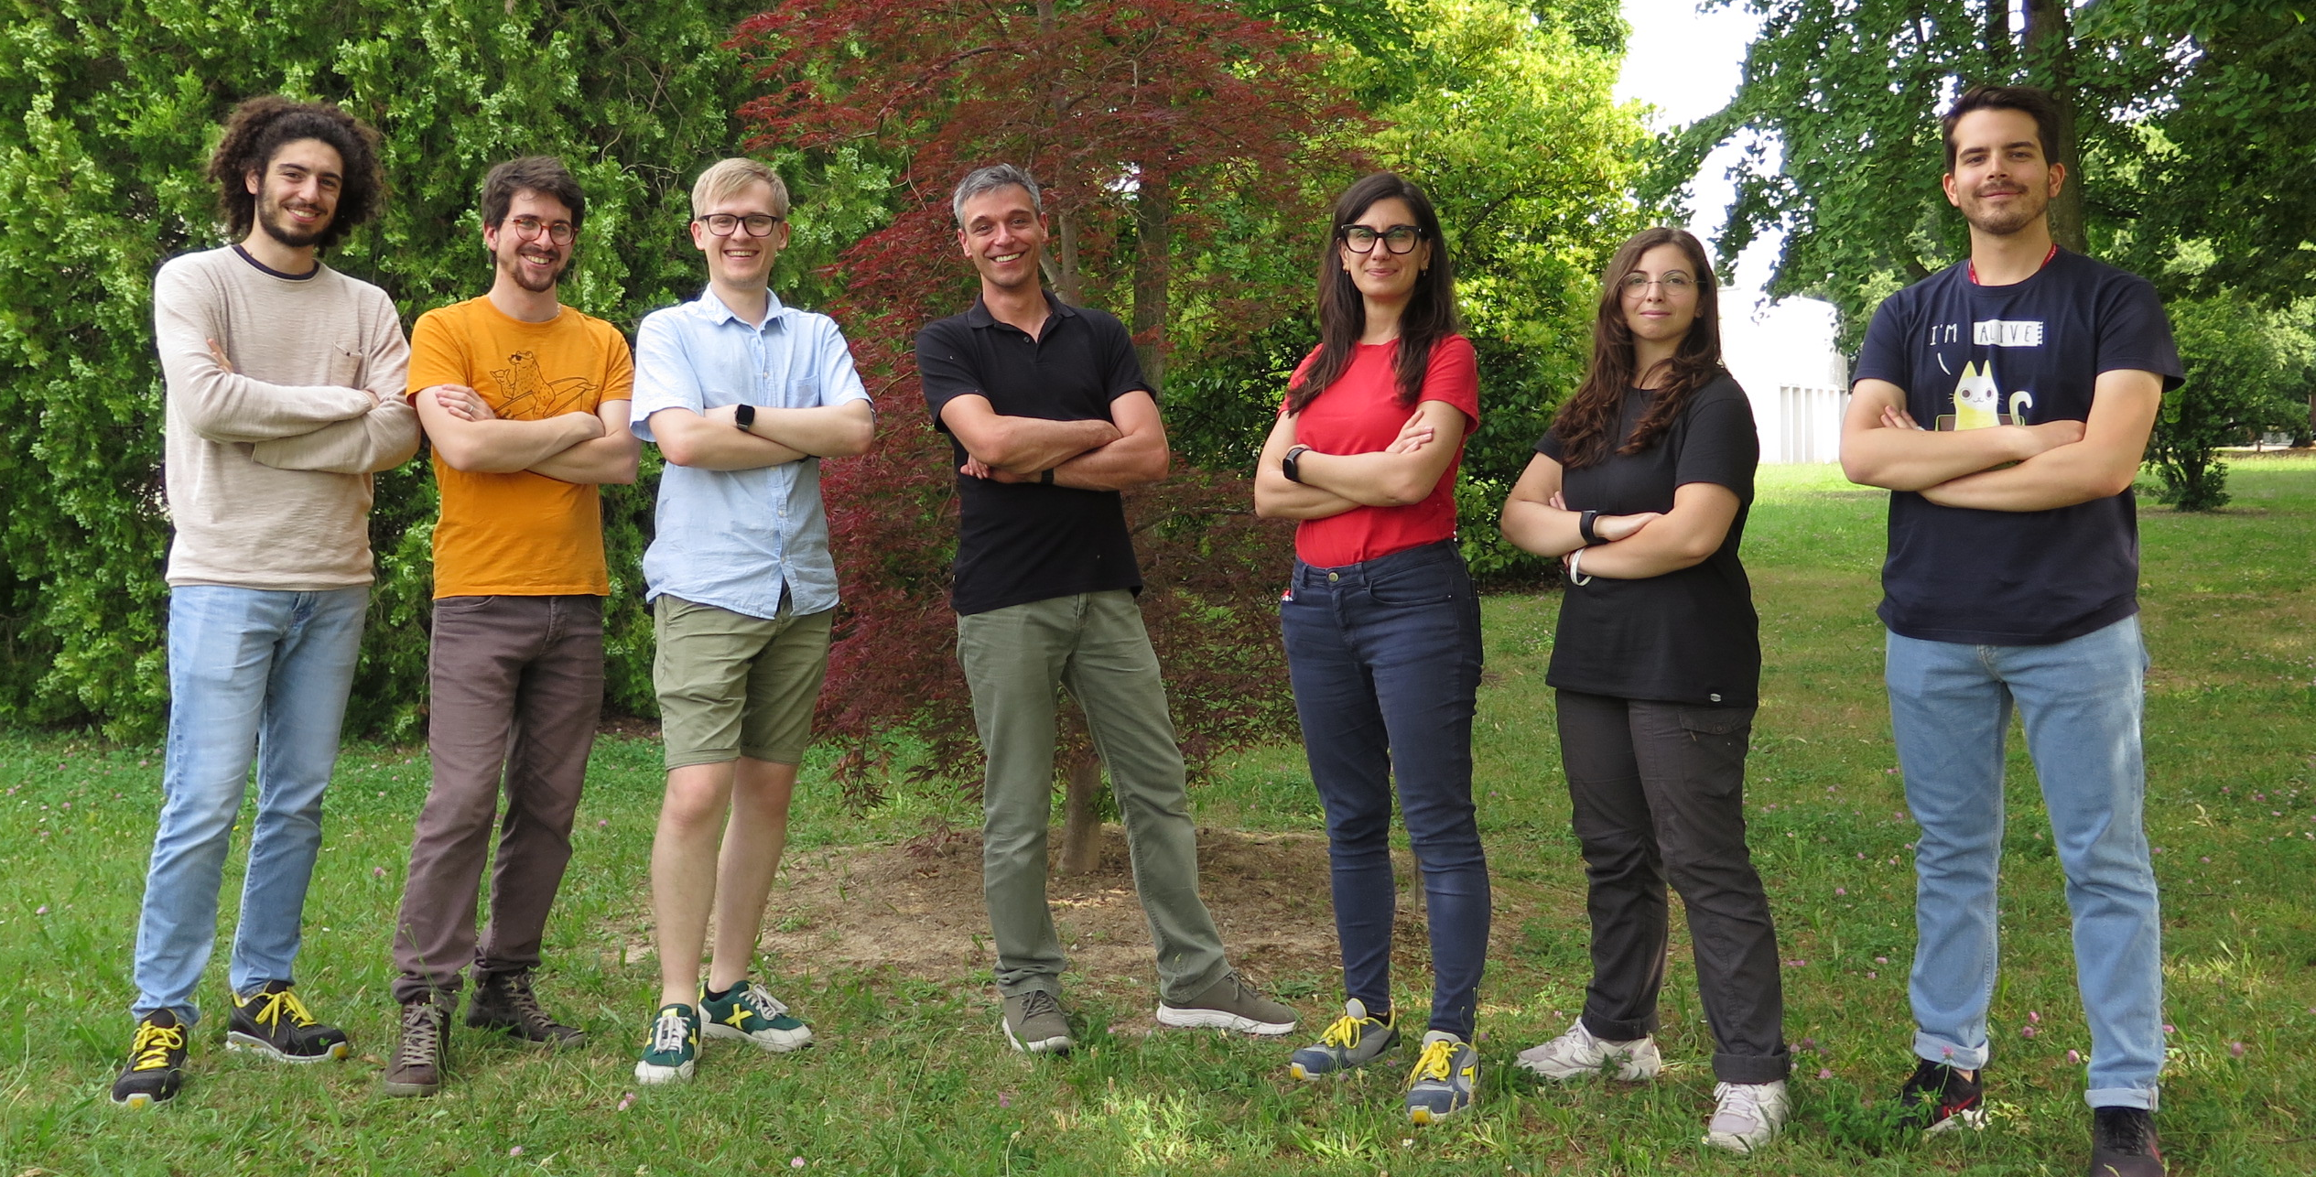

Thank you!
Giovanni
Marconato
Davide Ford
Eduard Chyhyrynets
Cristian Pira
Dorothea Fonnesu
Roberta Caforio
Alessandro Salmaso

Slide 16
Backup

Slide 17
Annealed samples
Sample/(buffer layer)/substrate [T_{deposition}] | T_{c} (K) | Sn (At%)
Nb₃Sn / Cu [600°C] annealed | 12.97 ± 0.13 | 20.9
Nb₃Sn / Nb(1µm) / Cu [600°C] annealed | 14.09 ± 0.16 | 23.1
Nb₃Sn / Nb(30µm) / Cu [600°C] annealed | 16.46 ± 0.14 | 25.4

Slide 18
Cu_600_annealed(5h)
Cu_600
T_{c} = 12.97 K
Sn = 20.9 At%
T_{c} = 12.8 K
Sn = 21.7 At%

Slide 19
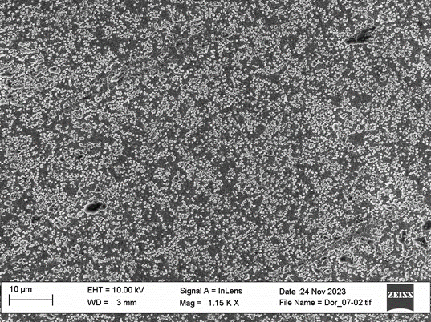

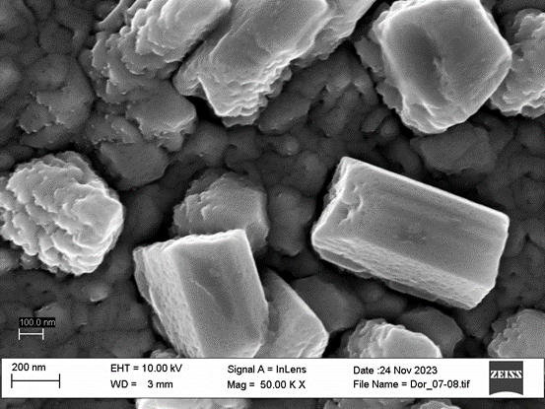

Nb30_Cu_600_annealed(5h)
Nb50_Cu_600
T_{c} = 16.46 K
Sn = 25.4 At%
T_{c} = 17.3 K
Sn = 23.1 At%

Slide 20
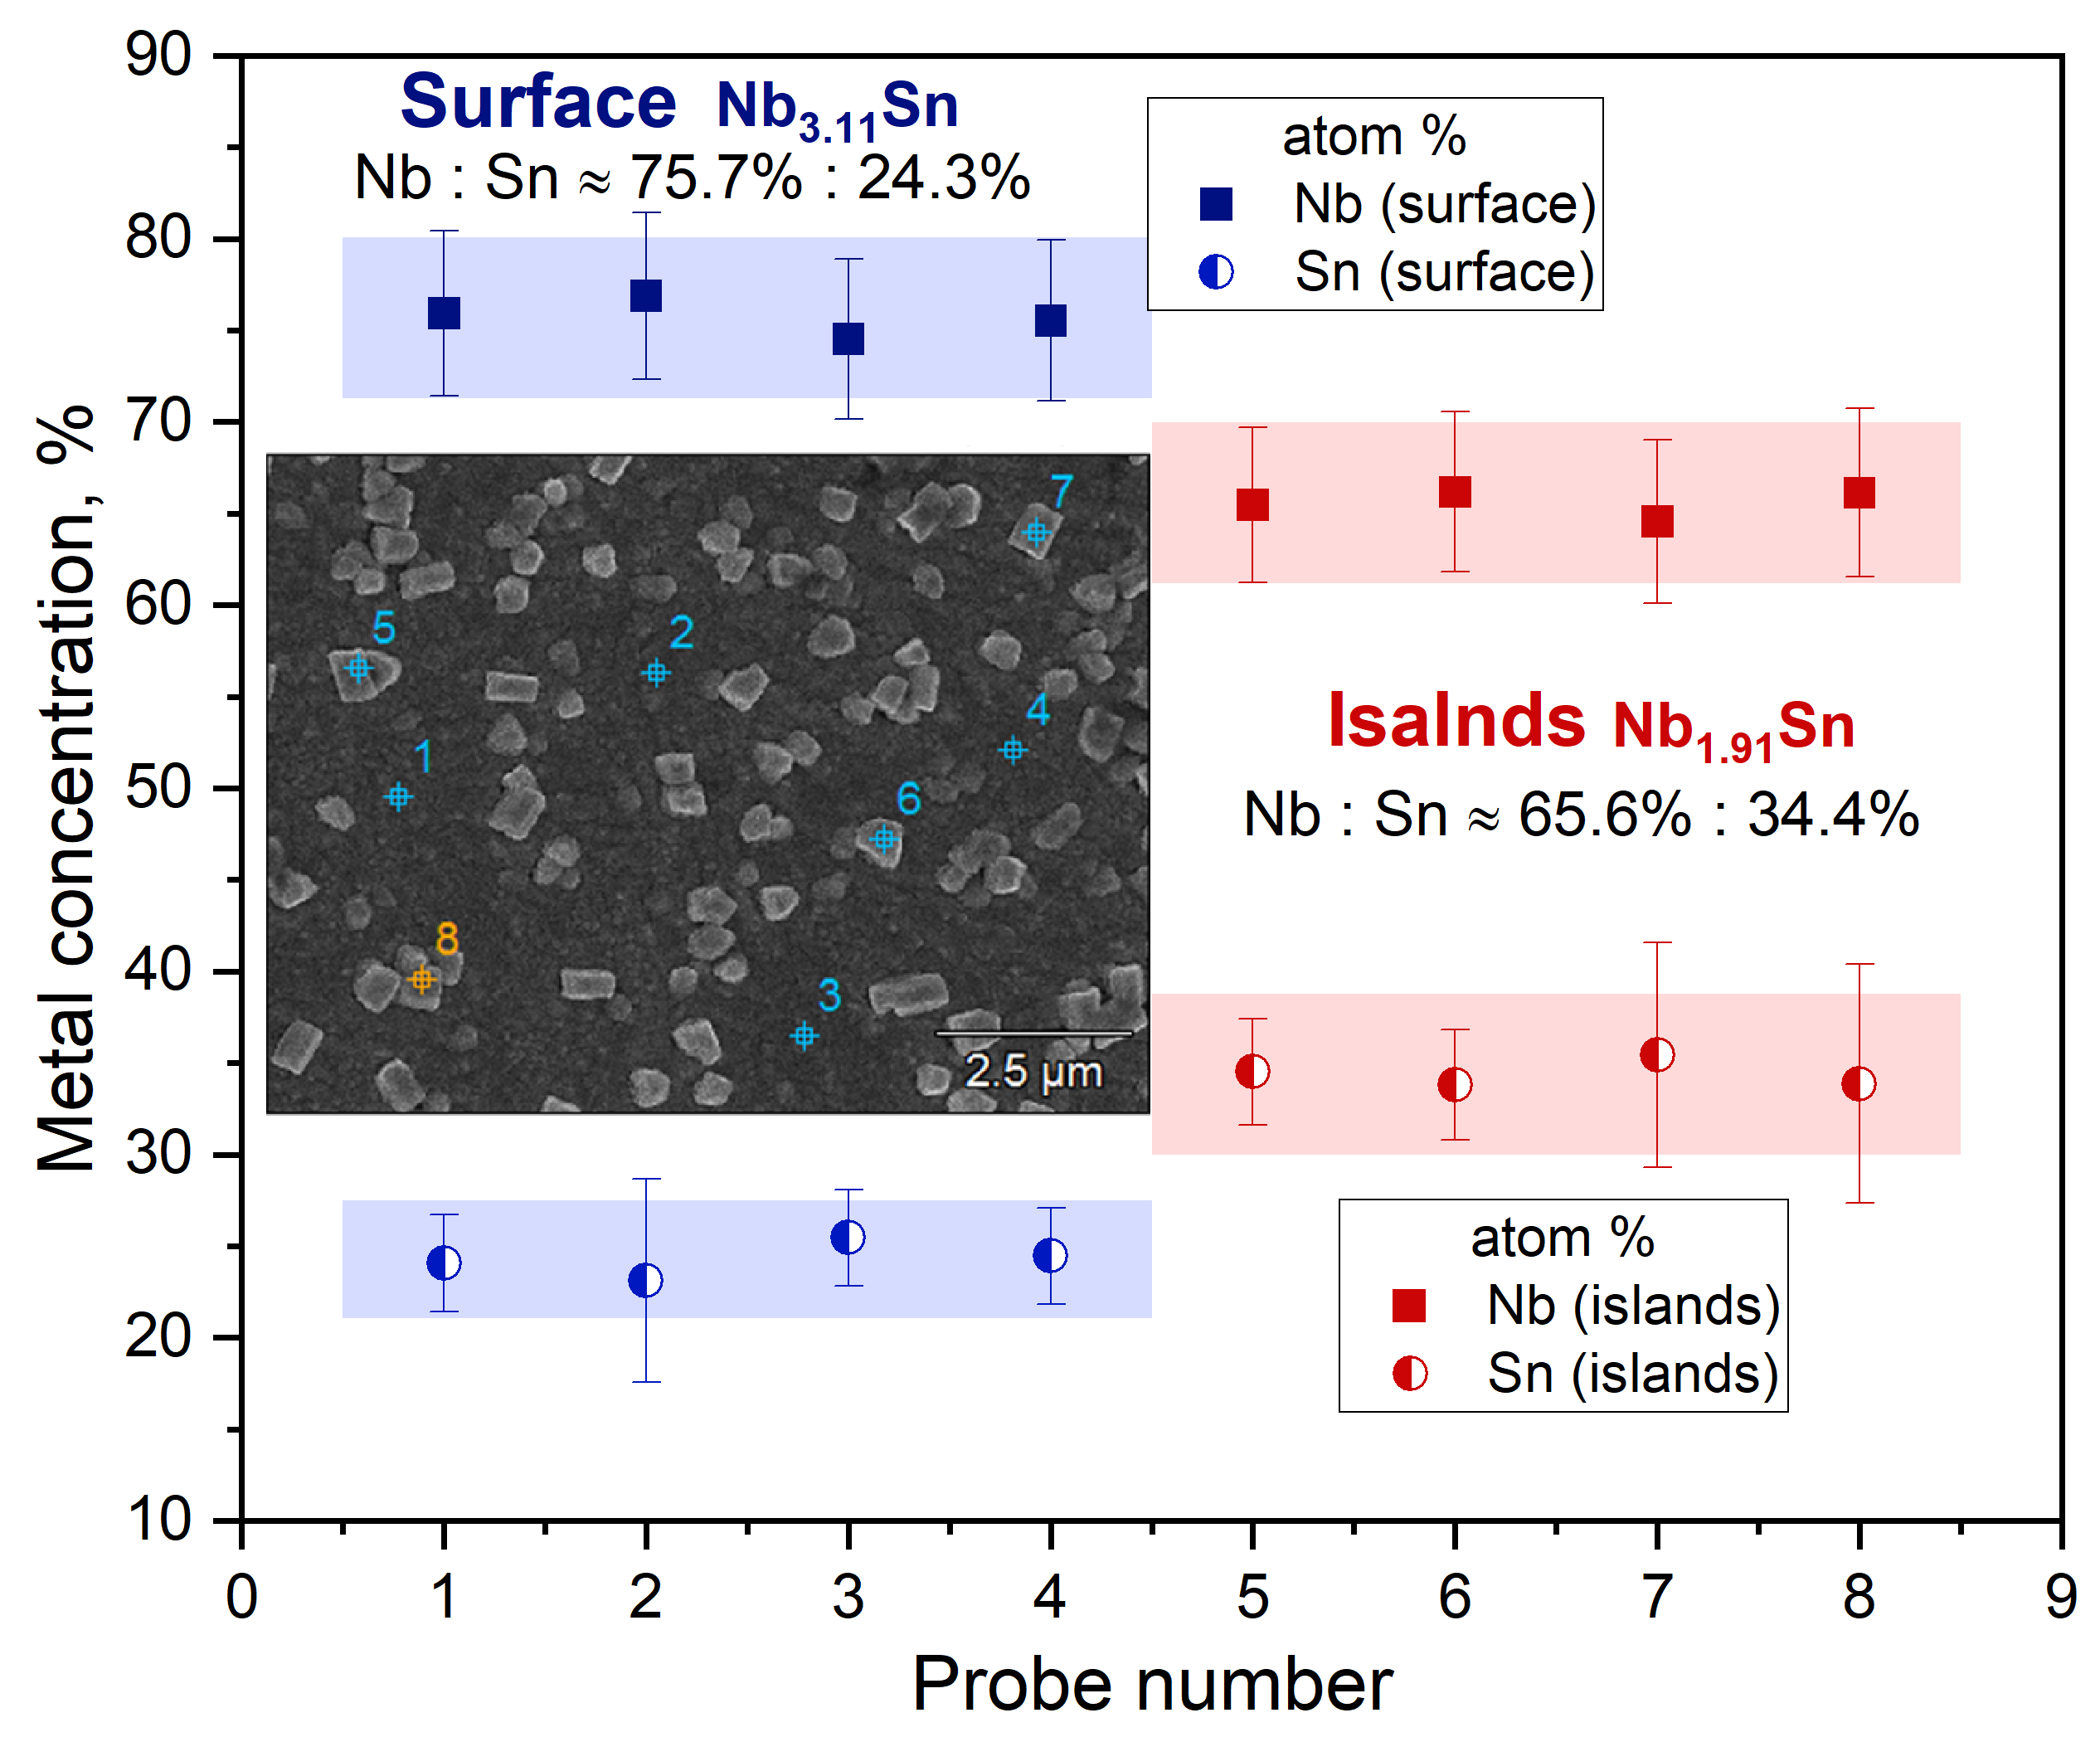
Nb₃Sn/Nb[30µm]/Cu at 600°C
Nb₃Sn/Nb[50µm]/Cu at 500°C

