Slide 1

Task 9.2 progress @
11th IFAST WP9 meeting
18/01/2024
Alessandro Salmaso

Slide 2
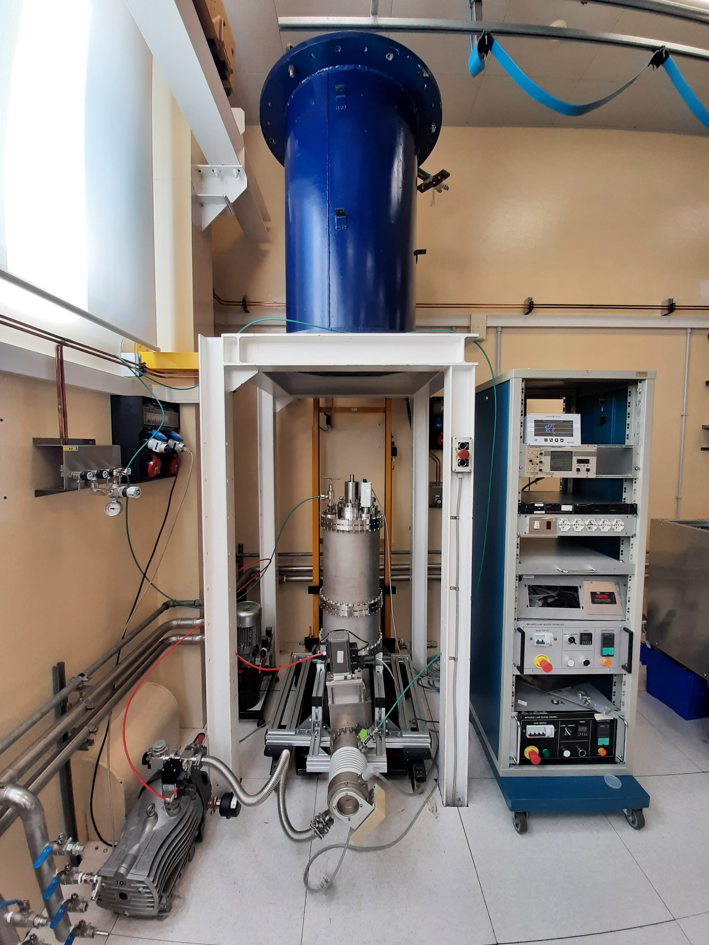
Objective recap
COIL
«Hybrid» coating system for 1.3GHz cavities
  Rectangular magnetron & rotating cavity
  Post magnetron configuration with Nb₃Sn cylindircal target produced via dipping

Slide 3
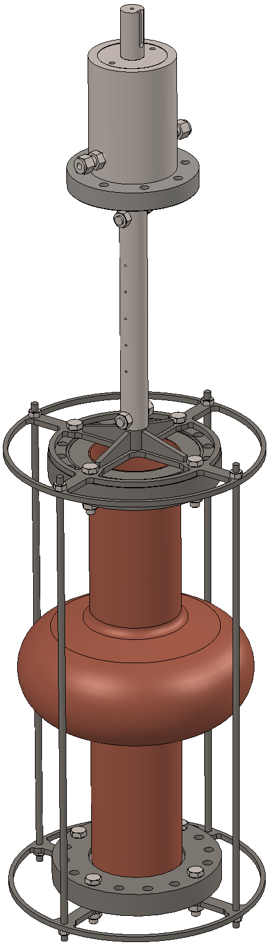
Cavity stand design
Cavity suspended from rotating vacuum feedtrough
Stand designed to center the cavity and minimize deformation due to high temperature deposition

Slide 4
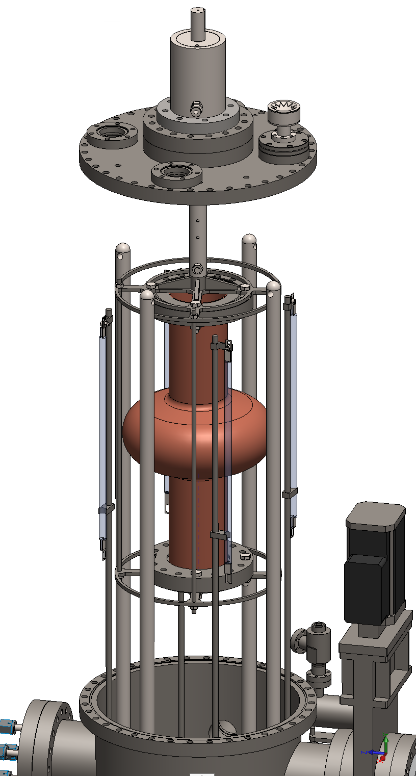
Cavity stand design
Magnetron and cavity will be aligned on the same axis by means of centering system: two disks tangent to four vertical rods with small tolerance

Slide 5
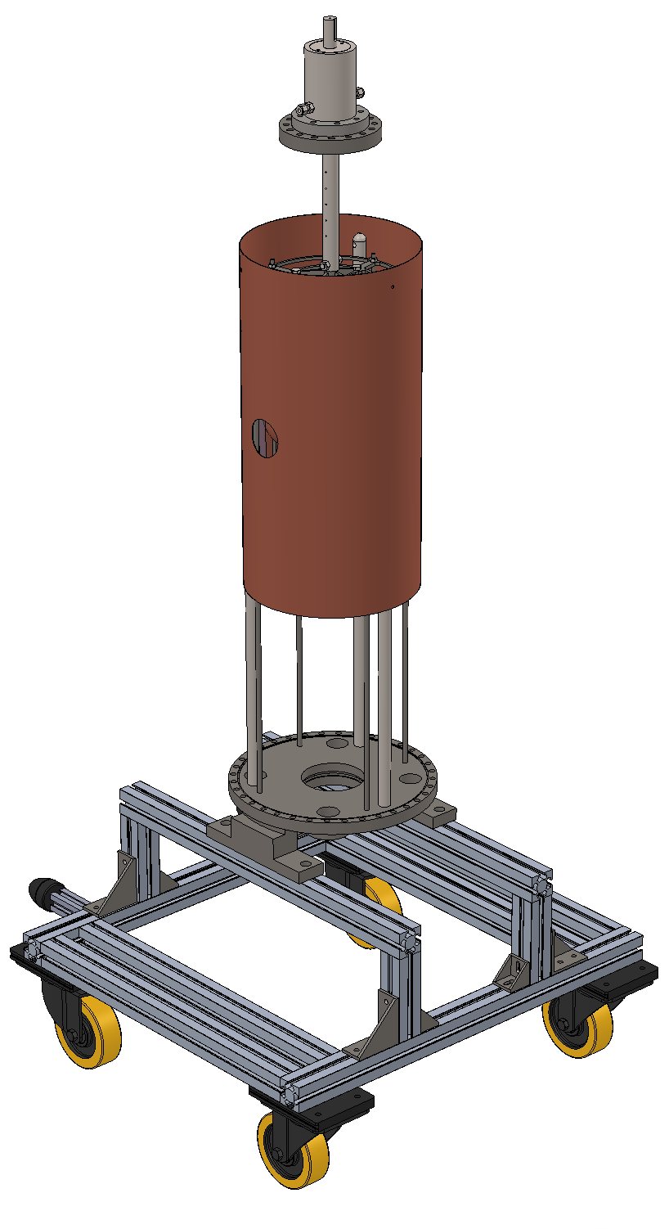
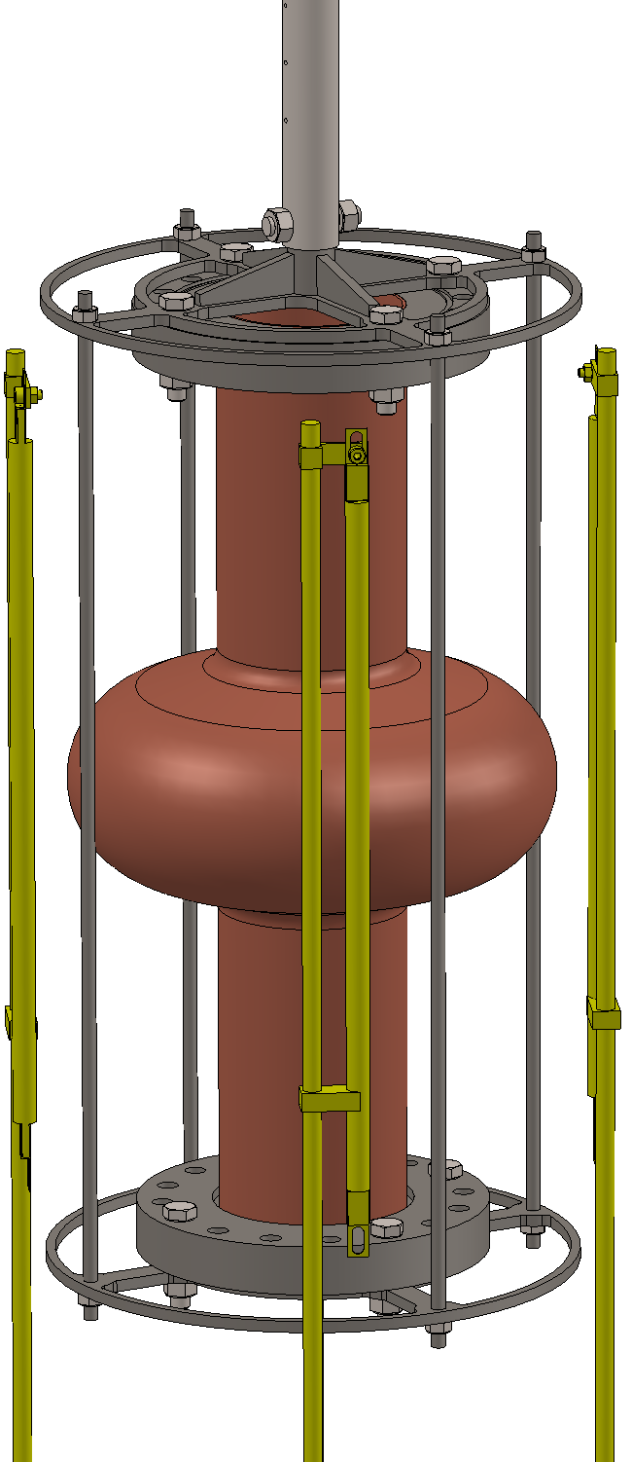

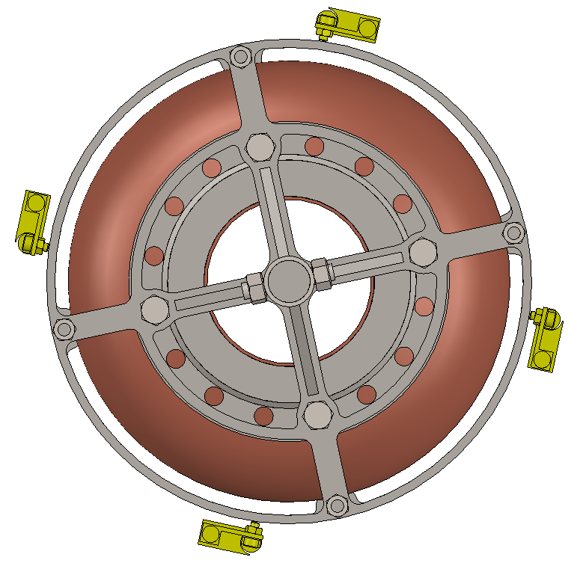
Heating system
4 IR lamps (max)
Copper shield will reduce the heat-up of the chamber

Slide 6
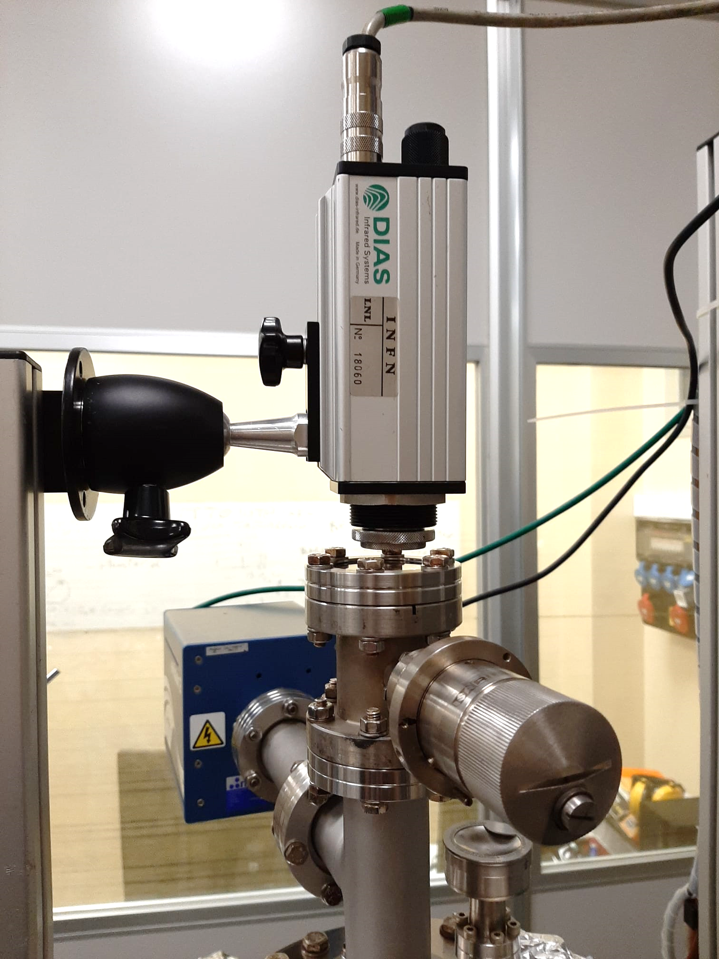
Temperature measurement
Cavity temperature monitored with pyrometer
(range: 250 – 1300°C 1.5 – 1.8 µm)
Directly connected to PID
Needs calibration!

Slide 7
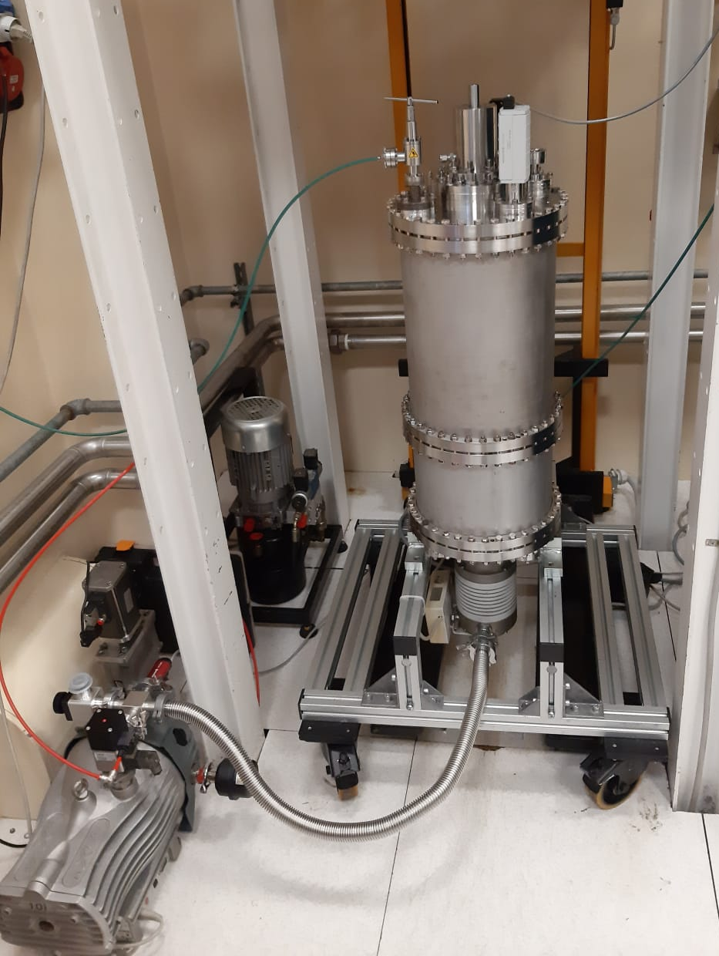
Pumping system
Vacuum pumps tested:
  Turbo ok!
  Scroll failed after a few days
  In maintenance since December
  No leaks on upper and lower flanges

Slide 8
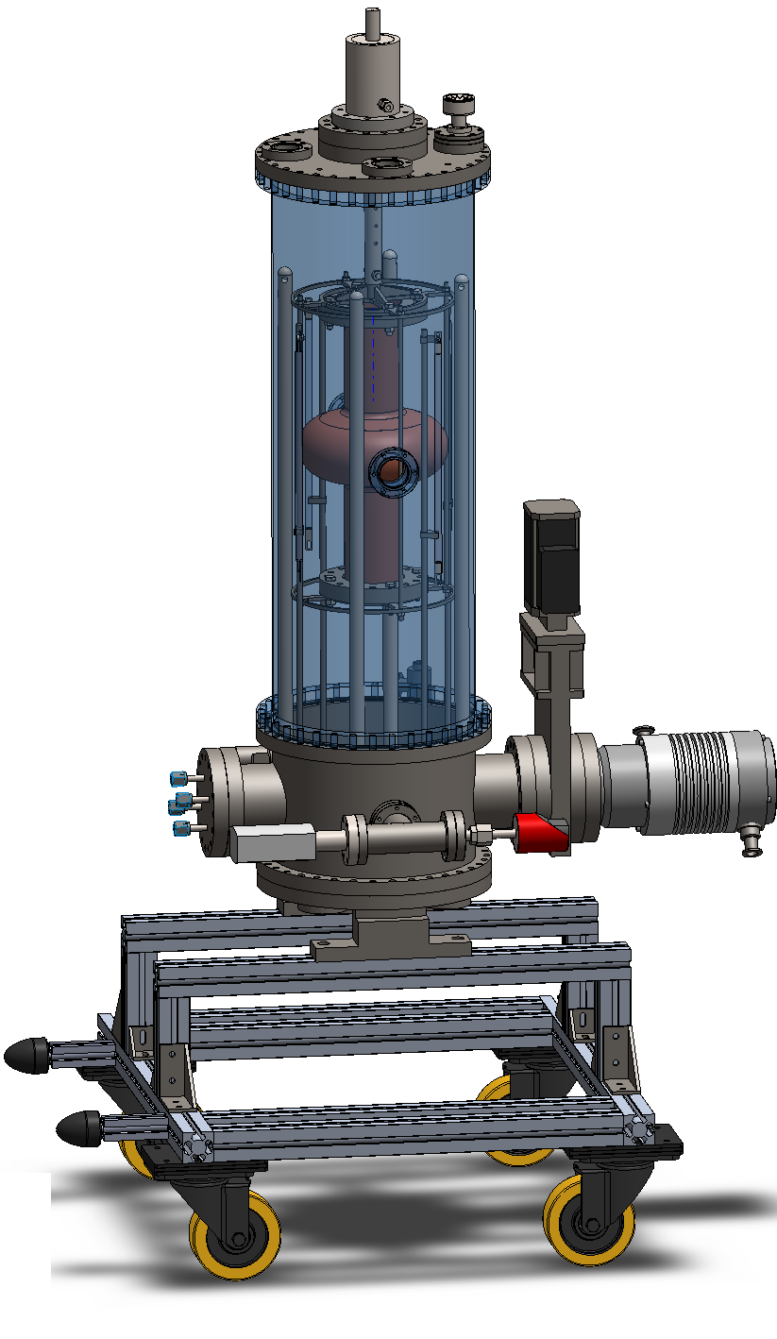
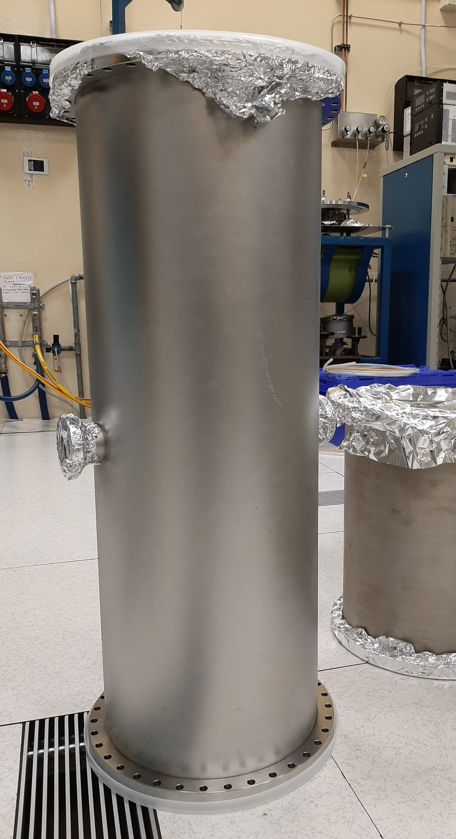
Coating system design
Commisioned a 80cm long chamber to reduce leak risk
Chamber delivered in December
but
the flanges need to be
modified
Components in production

Slide 9
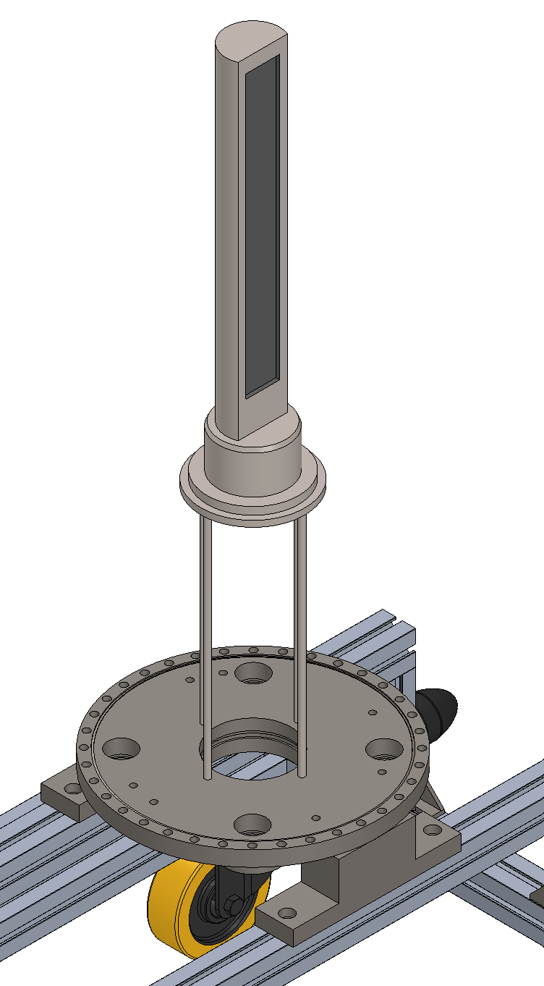
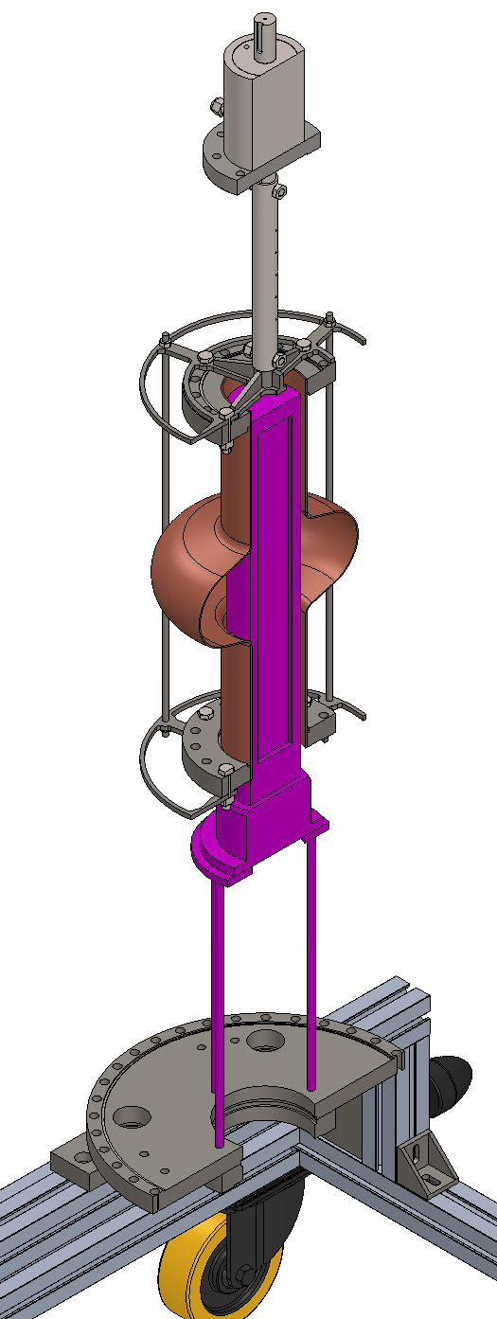
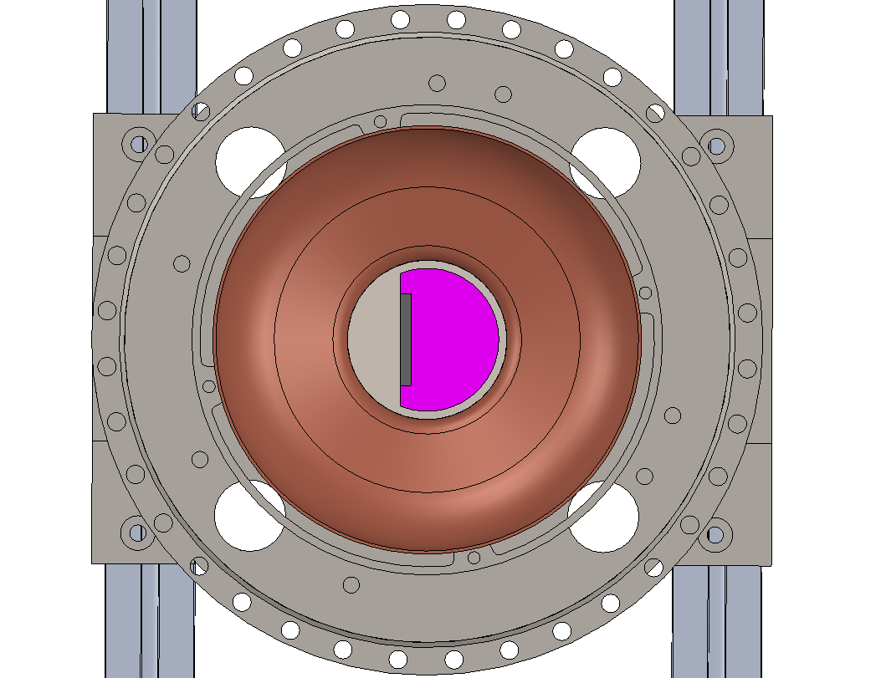
Rectangular magnetron design
Magnetron fixed on the lower flange
Design still ongoing
Target quotation: about 1 k€ + VAT

Slide 10
Future steps
Produce the custom components and assemble the system
Finalize the design of the magnetron source
First tests with Nb on Cu and Nb₃Sn on bulk Nb

Slide 11

alessandro.salmaso@lnl.infn.it
Thanks for your attention

