Slide 1



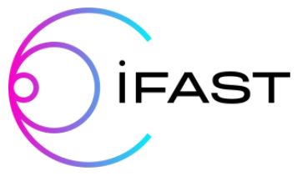


Development of a new low power SRF facility at UKRI/CI
Daniel Seal
daniel.seal@stfc.ac.uk
11th IFAST WP9 Meeting
18th – 19th Jan 2024

Slide 2


Agenda
1. Present capabilities for RF testing
2. 1.3 GHz thin film cavity development.
3. Design of a new low power SRF test facility
4. Next steps
Image © STFC Alan Ford
Notes:
To replace photo with one of your own. 1) Send the geometric shape overlay to the back – Right-Click > Send to Back > Send to Back. 2) Replace image – use the guides provided to correctly position it. 3) Send your image to the back so that the geometric overlay re-appears over the image. Remember to delete the image credit if using your own image.

Slide 3


1. Present capabilities for RF testing
Notes:
The abstract pattern can be removed or repositioned if required. Be careful to ‘Send to Back’ so that it does not obscure any important information.

Slide 4
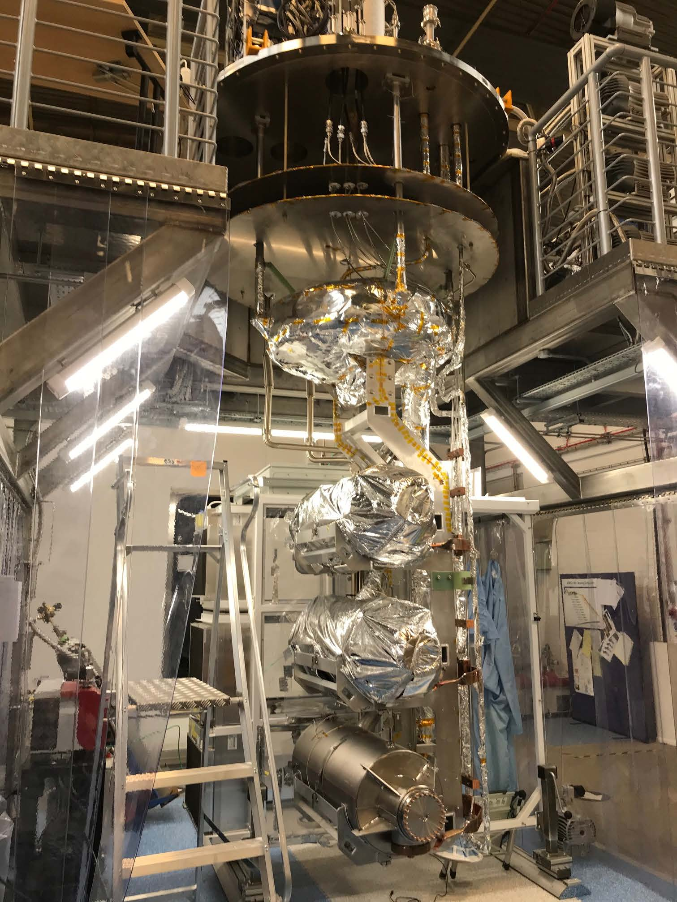
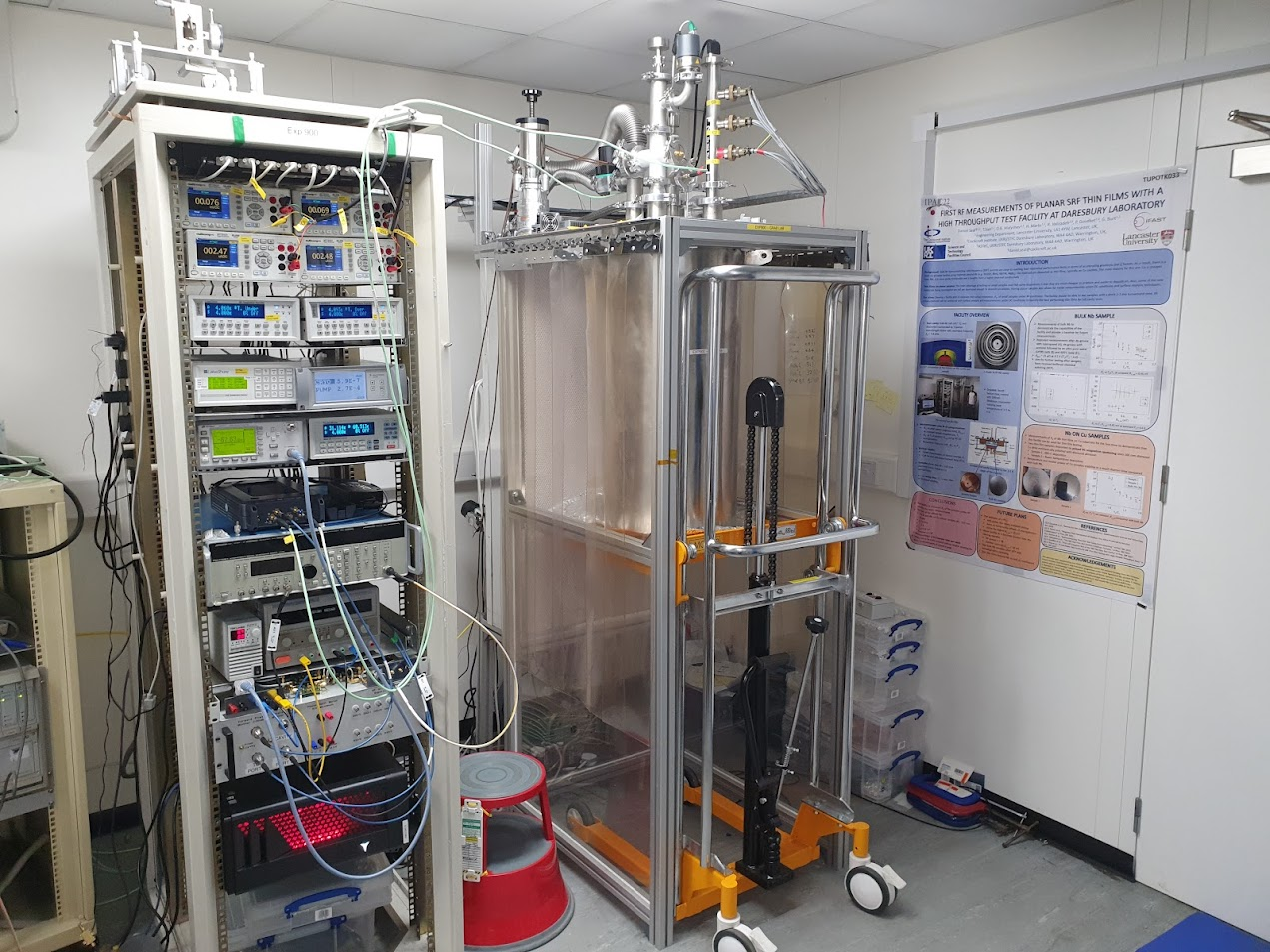
RF facilities
Image © STFC John Dawson
7.8 GHz choke cavity & 6 GHz split cavities
SuRF lab vertical test facility
Notes:
PLEASE DELETE/REPLACE PHOTO CREDIT IF CHANGING THE IMAGE.

Slide 5
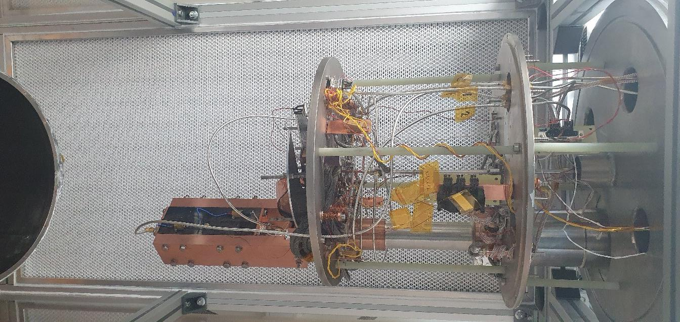
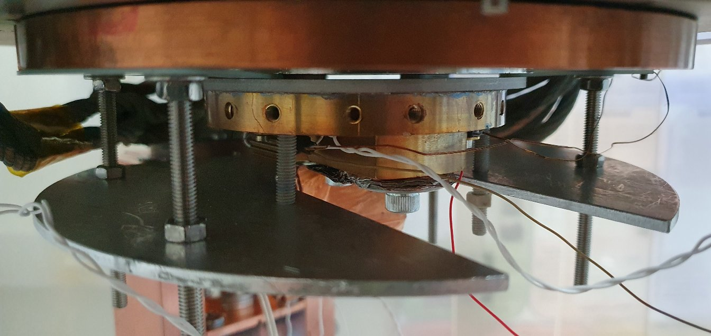
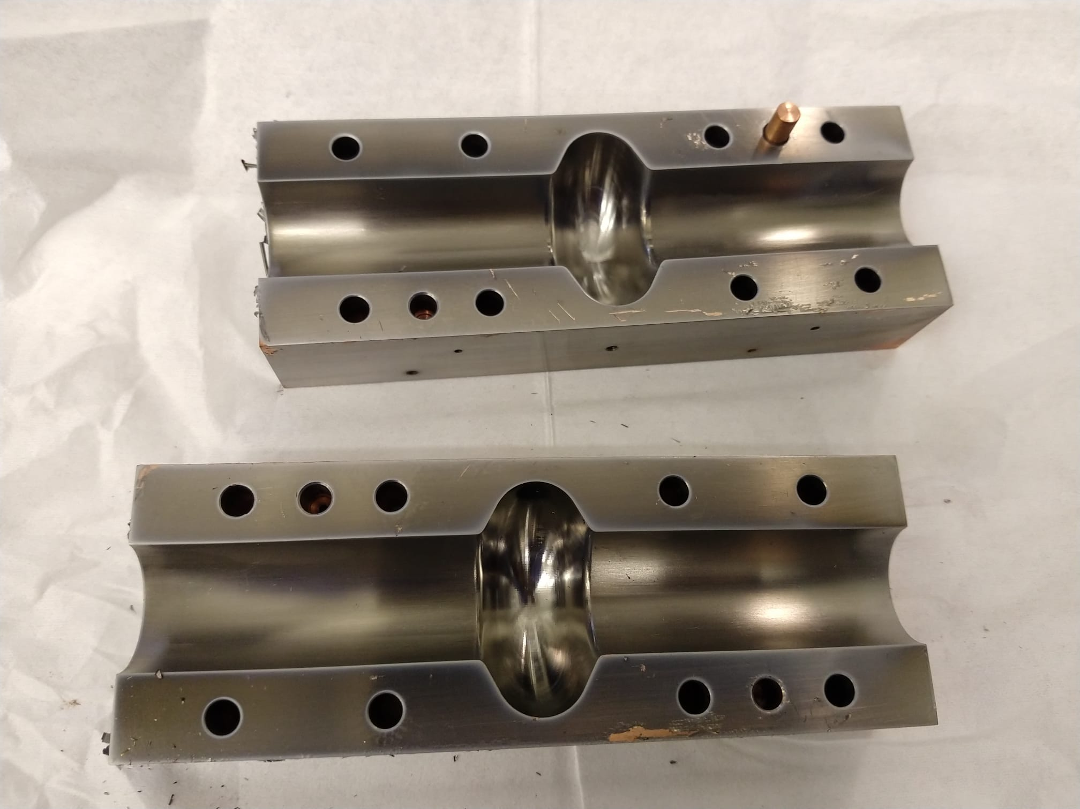
7.8 GHz choke cavity & 6 GHz split cavities
Cryocooler based (LHe free), 1.5 W at 4.2 K
Simple cryostat design
Easy to operate
7.8 GHz thin film sample testing
6 GHz split cavity testing
No space for 1.3 GHz cavities
Image © STFC John Dawson
Notes:
PLEASE DELETE/REPLACE PHOTO CREDIT IF CHANGING THE IMAGE.

Slide 6
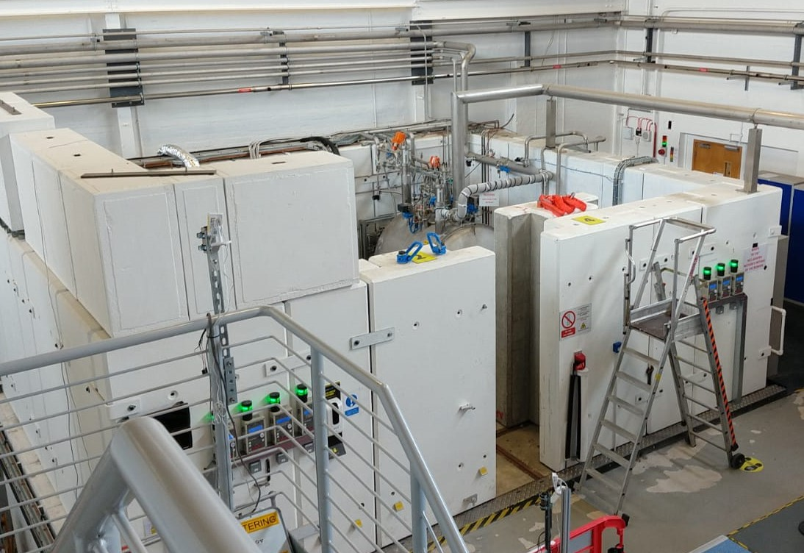
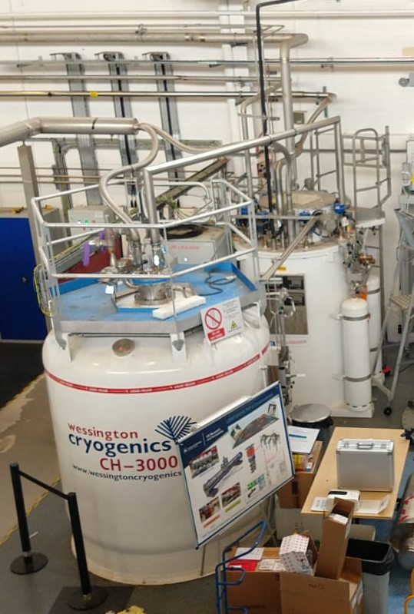
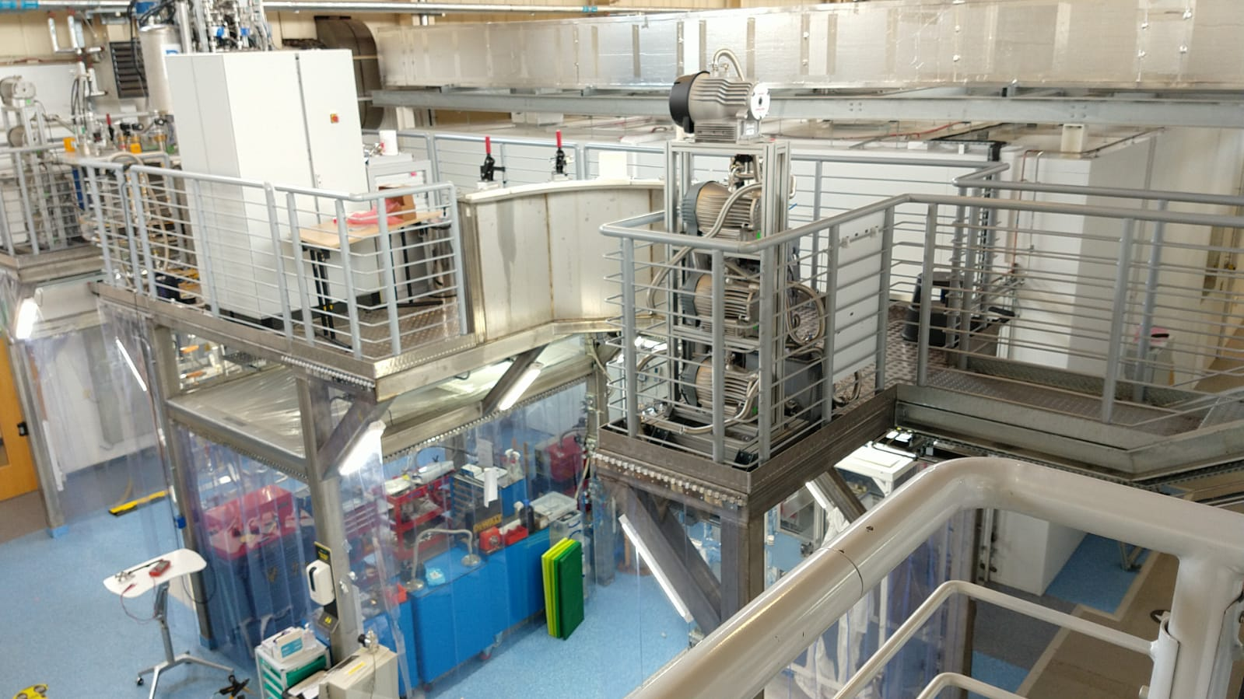
SuRF lab vertical test facility
Full power testing of ESS & PIP-II cavities
Bespoke cleanrooms & HPR facilities
Unique multiple cavity mounting system
LHe cooling < 2 K
Multi-person operation
Some availability for thin film 1.3 GHz cavity tests
Image © STFC John Dawson
Notes:
PLEASE DELETE/REPLACE PHOTO CREDIT IF CHANGING THE IMAGE.

Slide 7
2. 1.3 GHz thin film cavity development
Notes:
The abstract pattern can be removed or repositioned if required. Be careful to ‘Send to Back’ so that it does not obscure any important information.

Slide 8
1.3 GHz cavity development – ideal pathway
Polishing
High power RF testing
Deposition
Limited to a few tests per year in SuRF lab facility!
Notes:
Impossible to use surf facility directly
Solution to use new cryostat insert – see Taaj
Limited to few tests/year
Surf facility mainly for large facility projects – ess, pip 2

Slide 9
Polishing
High power RF testing
Deposition
Low power RF testing
1.3 GHz cavity development – alternative pathway
Good (low field) Q₀ vs E_{acc}!
1 – 2 per week!
A few tests per year!
Film removal
Poor Q₀ vs E_{acc}!
Notes:
Replace this guidance text with your own bullet pointed content.
For further guidance please see https://www.bdadyslexia.org.uk/advice/employers/creating-a-dyslexia-friendly-workplace/dyslexia-friendly-style-guide
Specify new cavity

Slide 10
3. Design of a new low power SRF test facility
Notes:
The abstract pattern can be removed or repositioned if required. Be careful to ‘Send to Back’ so that it does not obscure any important information.

Slide 11
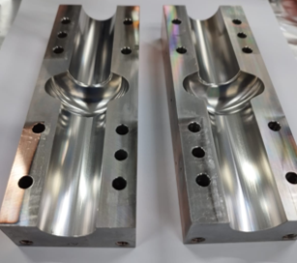
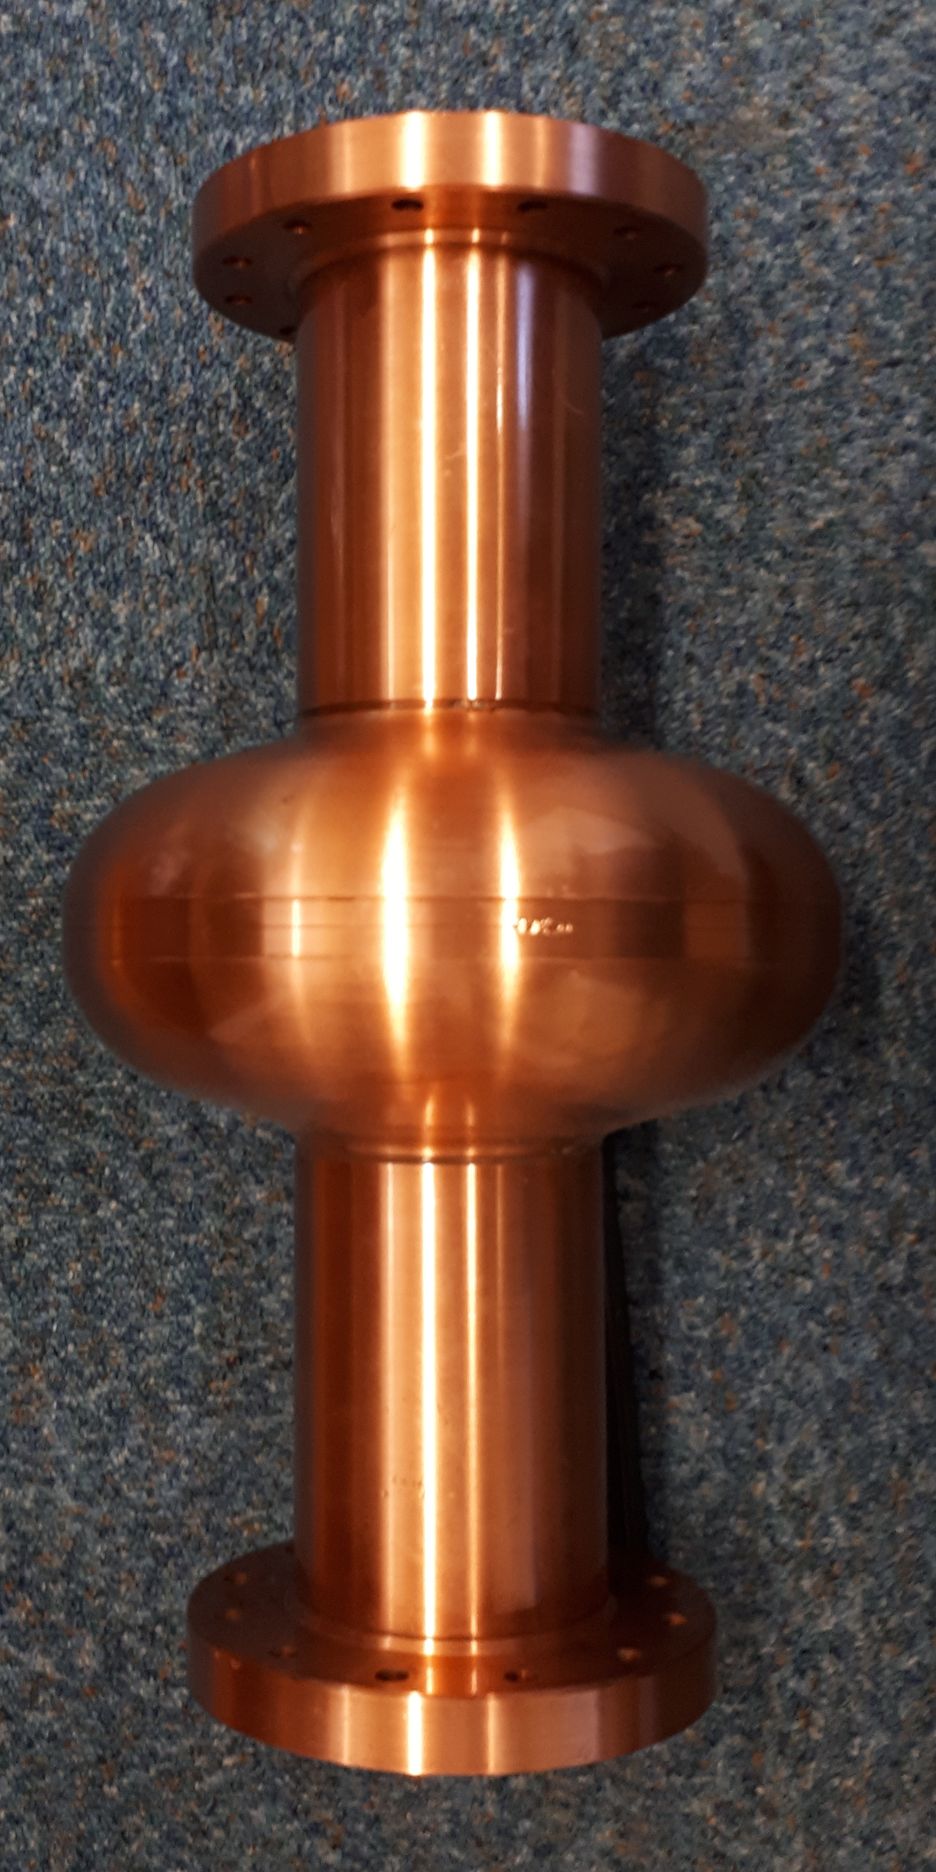
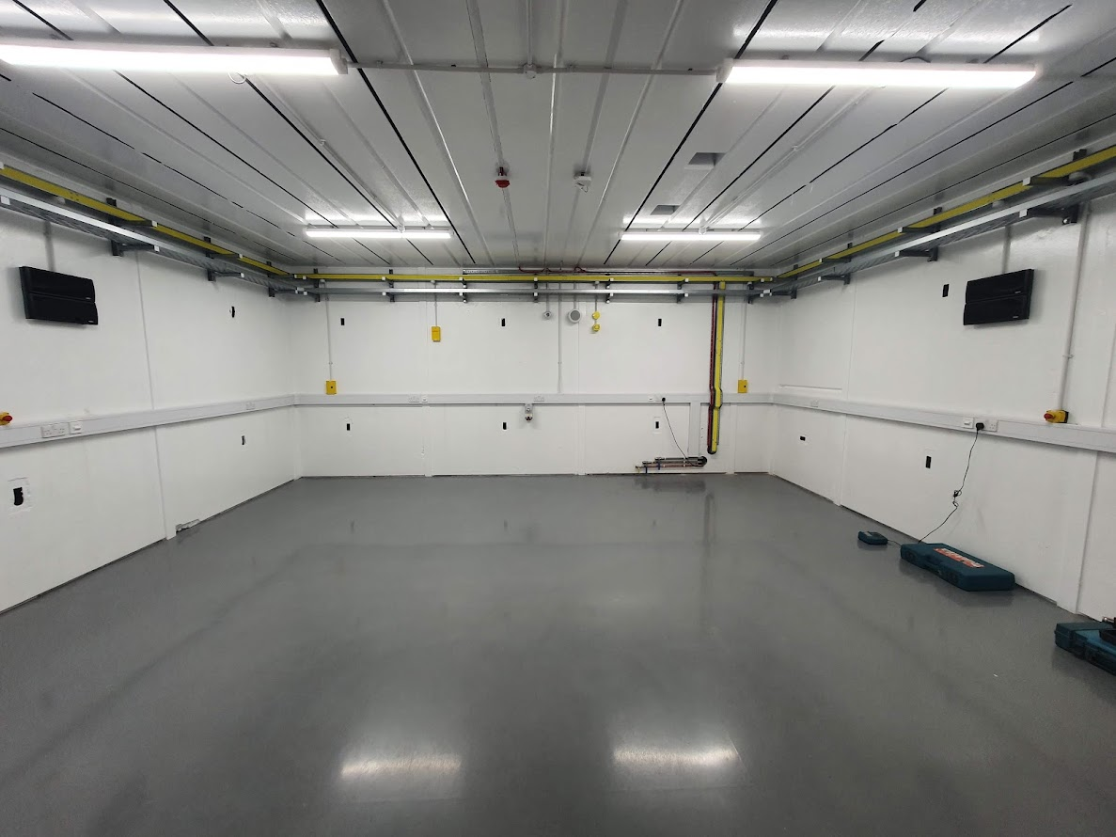
Achieving quick cavity testing
Considerations
Cooling – LHe vs cryocooler?
Operation at 4 K
Vacuum vessel (P ≤ 10⁻⁶ mbar)
Cavity mounting
Suitable to test both 1.3 GHz and 6 GHz cavities
Dedicated test area
RF power levels
Notes:
Replace this guidance text with your own bullet pointed content.
For further guidance please see https://www.bdadyslexia.org.uk/advice/employers/creating-a-dyslexia-friendly-workplace/dyslexia-friendly-style-guide

Slide 12
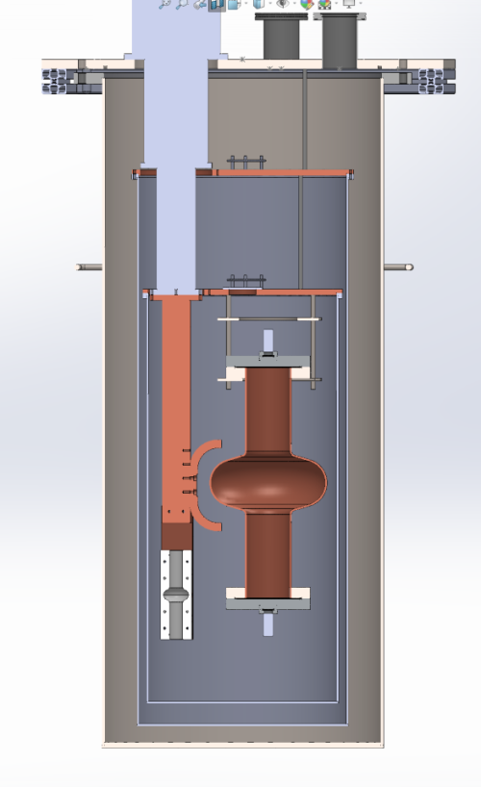
Solution
Design - based on choke cavity facility
Pulse-tube cryocooler – 2.7 W at 4.2 K
Simple cavity mounting procedure
Minimal training required
1.3 GHz cavities mounted to stage 2
6 GHz cavities mounted to cold head
To be housed in new bunker
Ability to test both pulsed RF and CW
Heat links to be designed
External magnetic shield
Courtesy of O. Poynton & J. Rigby
Notes:
Replace this guidance text with your own bullet pointed content.
For further guidance please see https://www.bdadyslexia.org.uk/advice/employers/creating-a-dyslexia-friendly-workplace/dyslexia-friendly-style-guide
Heat links

Slide 13
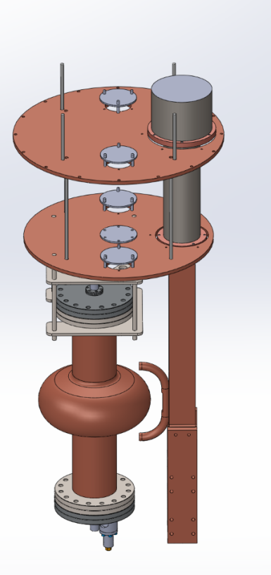
Solution
Cold head
Feedthroughs for RF, wiring etc
1.3 GHz cavity
Heat shields
Adapter for heat links
6 GHz cavity
Courtesy of O. Poynton & J. Rigby
Notes:
Replace this guidance text with your own bullet pointed content.
For further guidance please see https://www.bdadyslexia.org.uk/advice/employers/creating-a-dyslexia-friendly-workplace/dyslexia-friendly-style-guide
Heat links

Slide 14
4. Next steps
Notes:
The abstract pattern can be removed or repositioned if required. Be careful to ‘Send to Back’ so that it does not obscure any important information.

Slide 15
First 1.3 GHz cavity testing in 2024!
December/January – design and procurement completed
February/March – build cryostat support frame
March – delivery of vacuum chamber etc.
March/April – build cryostat & vacuum testing
April/May – electrical & cryogenic testing
June – RF testing
By end 2024 – first consecutive low power & high power tests
Notes:
Replace this guidance text with your own bullet pointed content.
For further guidance please see https://www.bdadyslexia.org.uk/advice/employers/creating-a-dyslexia-friendly-workplace/dyslexia-friendly-style-guide

Slide 16
Acknowledgements
STFC/CI: O. B. Malyshev, J. Rigby, O. Poynton, A. Akintola, T. Sian, R. Valizadeh, L. Smith, J. Conlon, C. Benjamin, S. Pattalwar, G. Miller, A. Blackett-May, A. Vick
Lancaster University/CI: G. Burt, N. Leicester, H. Marks
University of Liverpool/CI: S. Simon, J. Bradley
Notes:
Replace this guidance text with your own bullet pointed content.
For further guidance please see https://www.bdadyslexia.org.uk/advice/employers/creating-a-dyslexia-friendly-workplace/dyslexia-friendly-style-guide

Slide 17



Notes:
The abstract pattern can be removed or repositioned if required. Be careful to ‘Send to Back’ so that it does not obscure any important information.

Slide 18






Science and Technology Facilities Council
@STFC_matters
Science and Technology Facilities Council
Notes:
The abstract pattern can be removed or repositioned if required. Be careful to ‘Send to Back’ so that it does not obscure any important information.

