Slide 1

WP9.2 Progress @
11th IFAST WP9 meeting
Daresbury, 18/01/2024
Cristian Pira

Slide 2
Substrates Production and Polishing
On November sent to STFC:
6 GHz cavity X 1
1.3 GHz cavity X 1
Cu Tubes for WP9.6 X 2

Slide 3


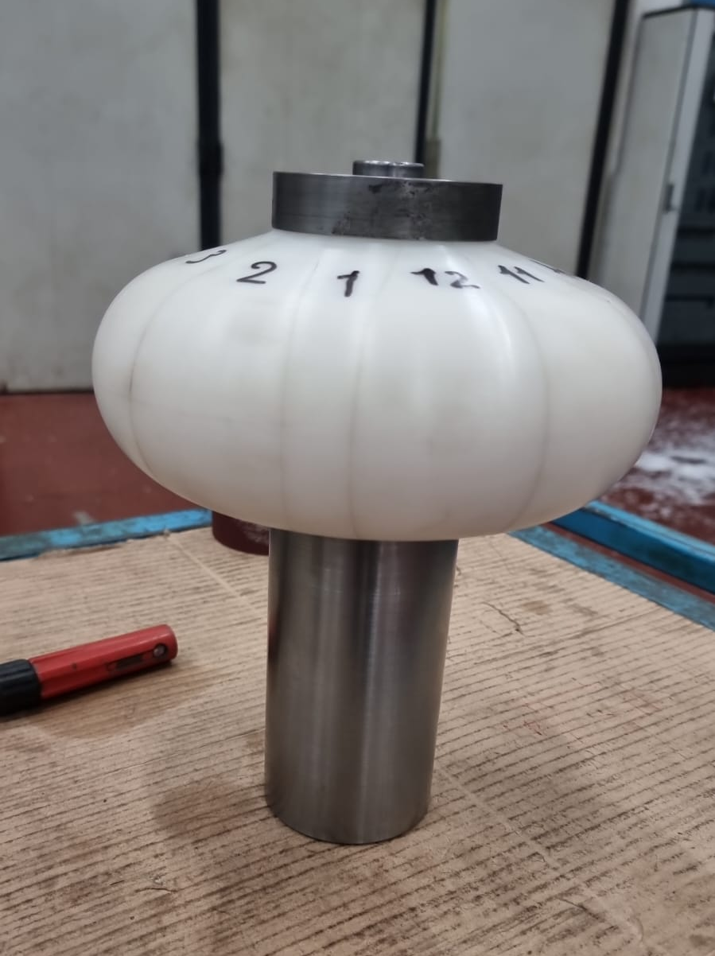
WP 9.2 Cavity Forming
New optimized die produced by Piccoli
Ready for final prototype substrates production
Difficulties in procuring OFE copper sheets to produce substrates for final prototypes
  some OFE-Cu sheets are already in house, but it would be better to have more
  Supplier found (MKE). Oscar Azzolini in charge of procurement
New 1.3 GHz Die for Spinning produced by Piccoli

Slide 4
Ideas to speed up results
Nb bulk substrates instead of Cu ones
(helps to prevent substrate issues in the first results)
  QPR
  6 GHz cavities
  1.3 GHz cavities
1.3 GHz Cu substrates with flat flanges (waiting the welding cavities)
  Is there any RF drawback to take in account?

Slide 5
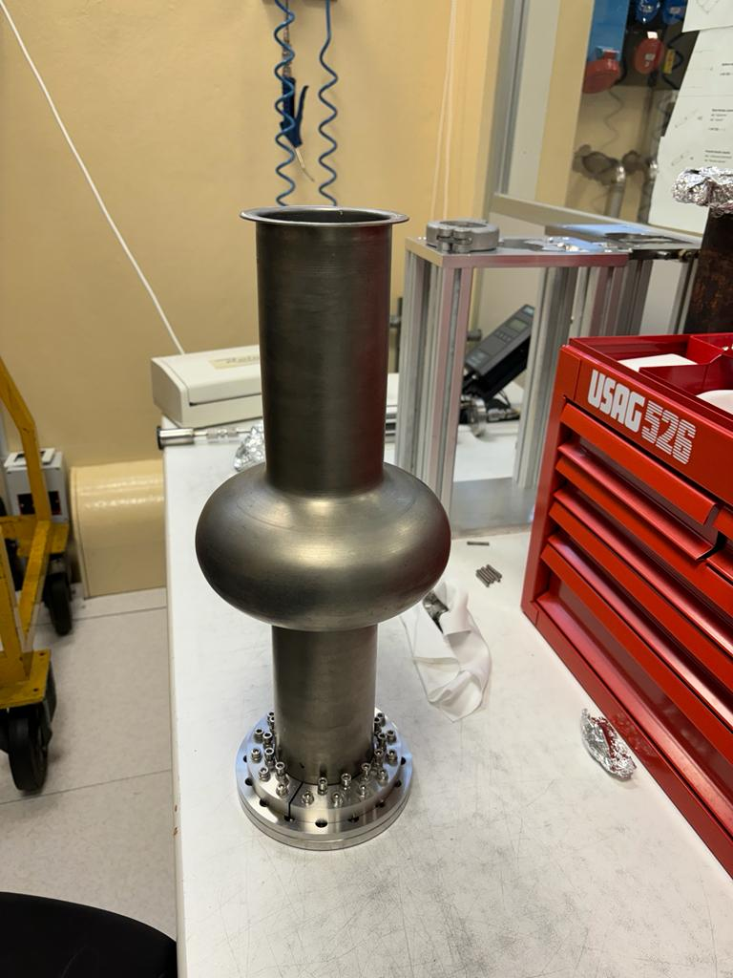
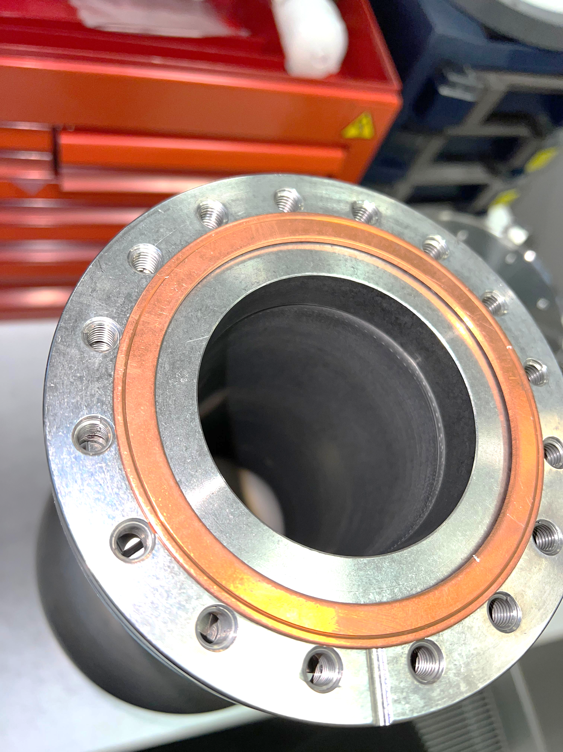

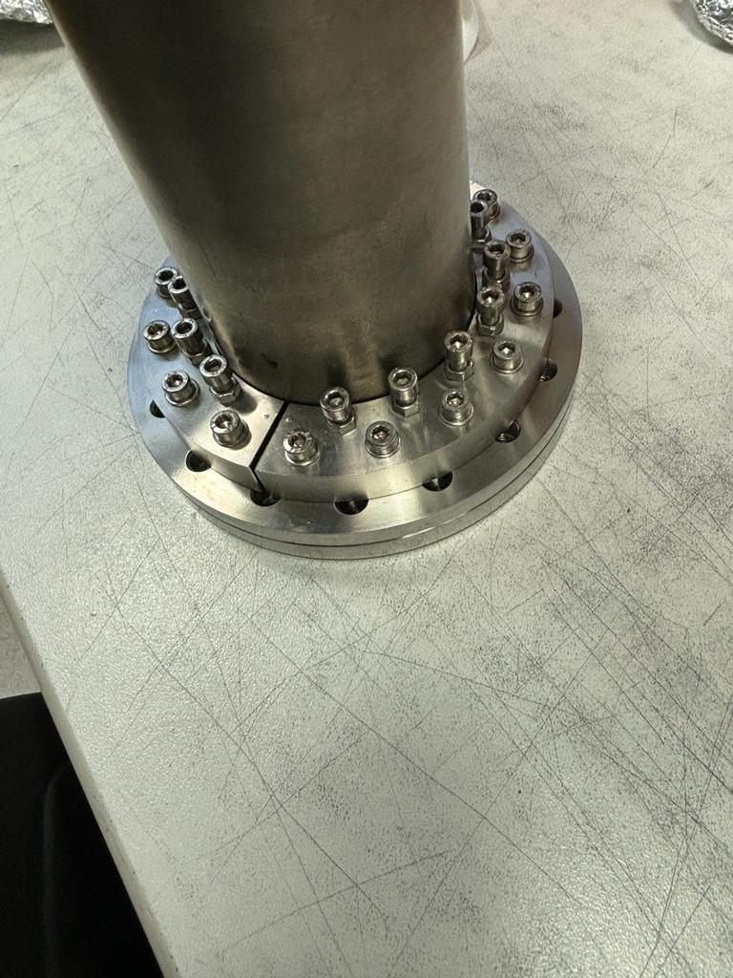
Flat flanges (Indium sealing)

