Slide 1

Twin paradox and chaos
Particles’ trajectories in standing gravitational waves field
Julia Osęka
Astronomical Observatory of Jagiellonian University

Slide 2


Outline
The twin paradox
(Standing) Gravitational waves
Chaos
Chaos vs standing gravitational waves
„Twin paradox” and Chaos
Summary

Slide 3


The twin paradox

Slide 4

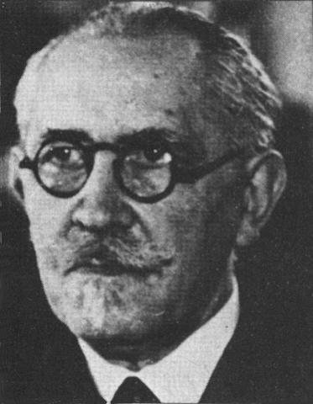



First formulation
1911 r. Paul Langevin
Thought experiment
Flat (no gravity) spacetime
First twin is setting off on a journey, while second is staying on the Earth

Slide 5
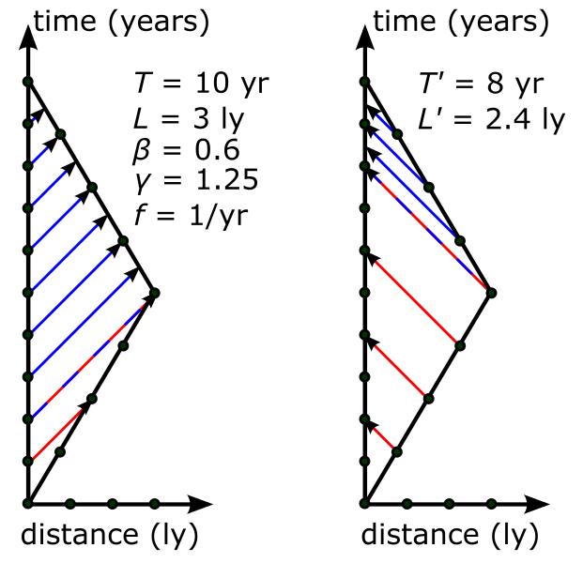
Why the „paradox”?
Misunderstanding of Einstein’s theory of relativity
The twins are not equivalent
There is no paradox here
The „Traveller” is always younger (in flat spacetime)
Credit: Prokaryotic Caspase Homolog

Slide 6
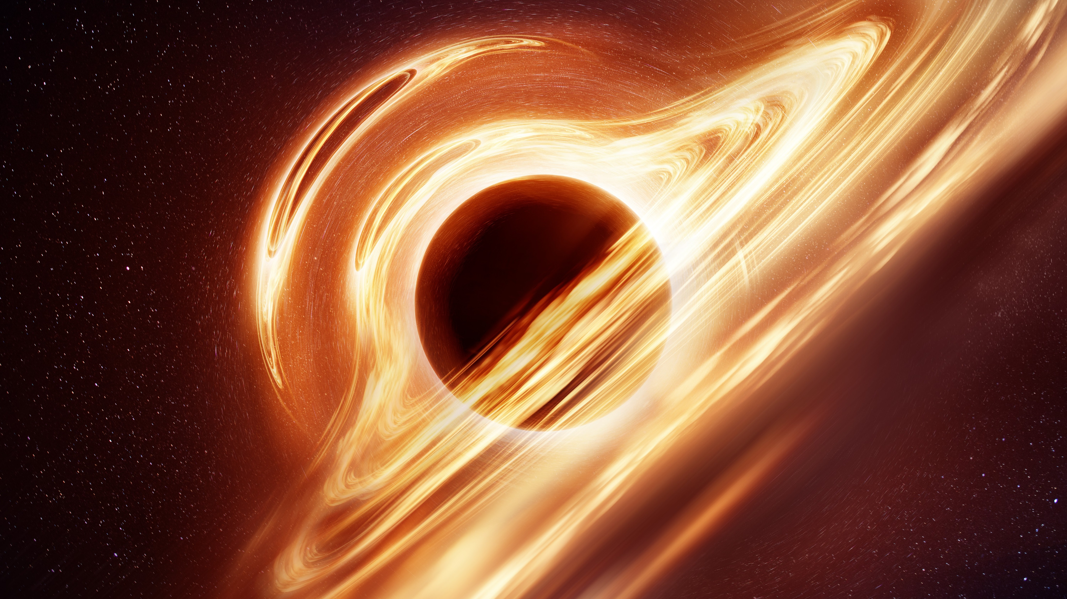
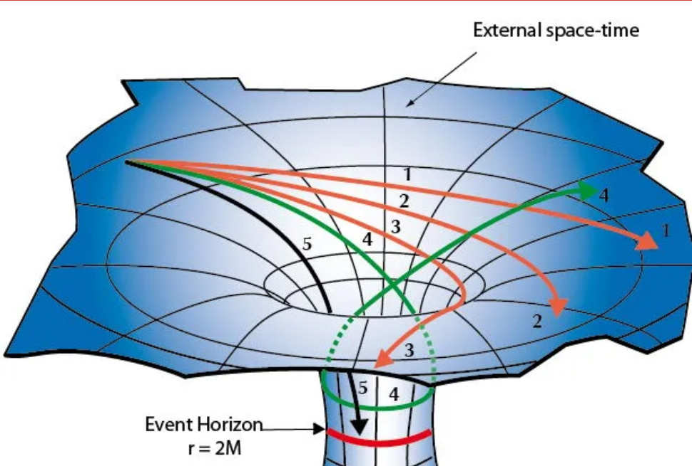

Schwarschild spacetime
More complicated
Sokołowski (2012)
Trajectory matters (neither velocity nor acceleration)
The twin on radial geodesics ($φ=const$) always the oldest
Image credit: solarseven via Getty Images
https://weinsteing.wordpress.com/2017/12/14/the-geodesics-of-the-schwarzschild-metric-3/

Slide 7
Standing gravitational waves

Slide 8


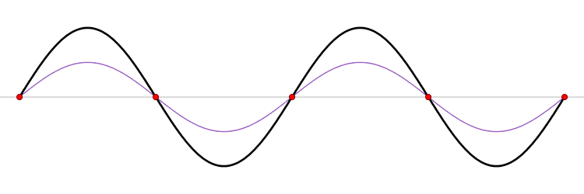
Standing mechanical waves
Not moving in space
Result of interference
Music (string) instruments

Slide 9
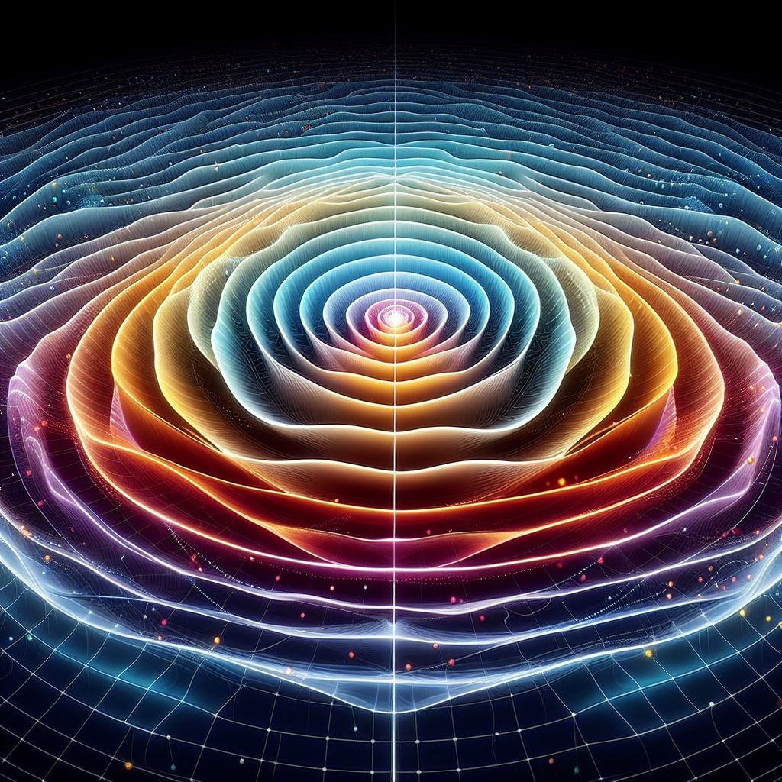
Standing Gravitational Waves (GW)
Similar to mechanical standing waves
Cylindrical symmetry
Vacuum solution of Eintein time-dependent equations

Slide 10
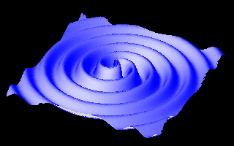
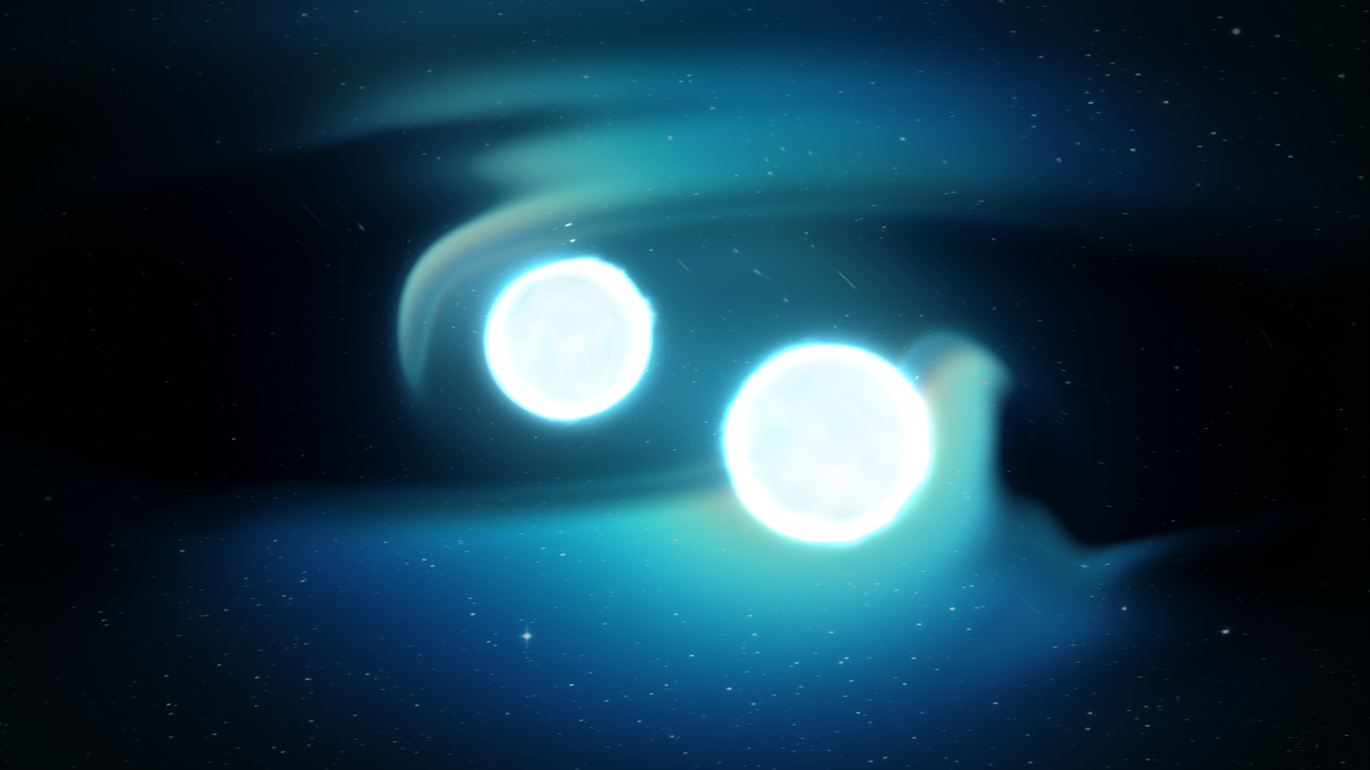
Gravitational wave sources
For example: Close binary systems of compact objects
What about standing gravitational wave sources?

Slide 11
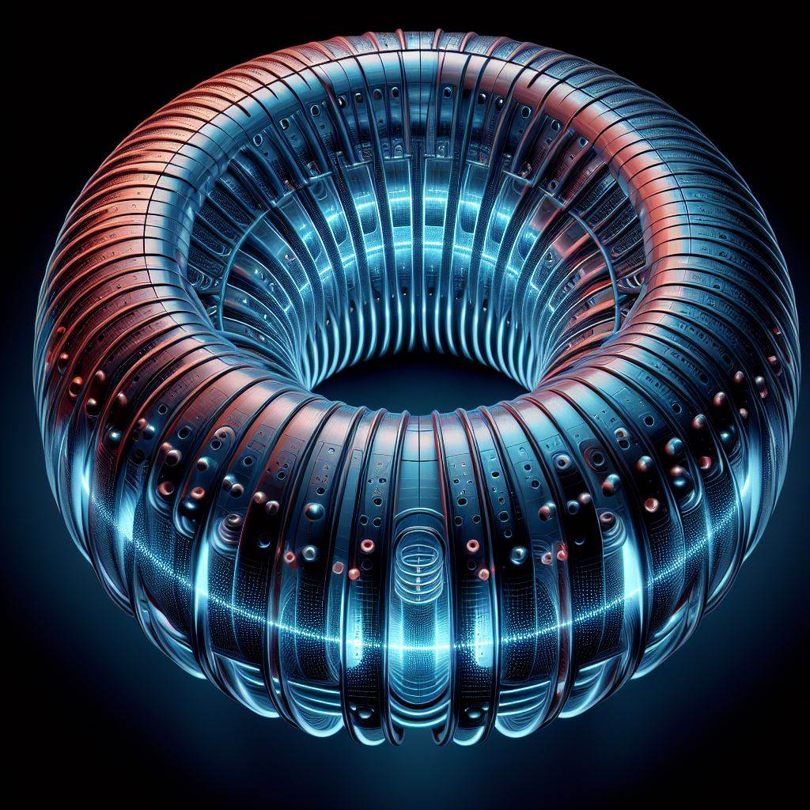

Experiment
Production and detection
A source of GW: A Torus with excited altering EM field
Interference of produced GW $→$ Standing waves
Cylindrical symmetry

Slide 12
Chaos

Slide 13
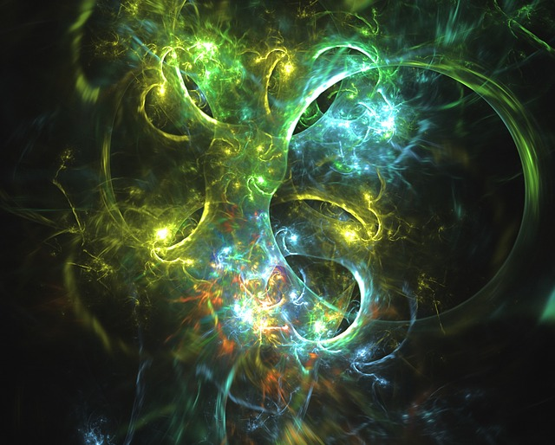
What is chaos?
Sensitivity for initial conditions
Deterministic
Can „imitate” randomness after enough long time

Slide 14
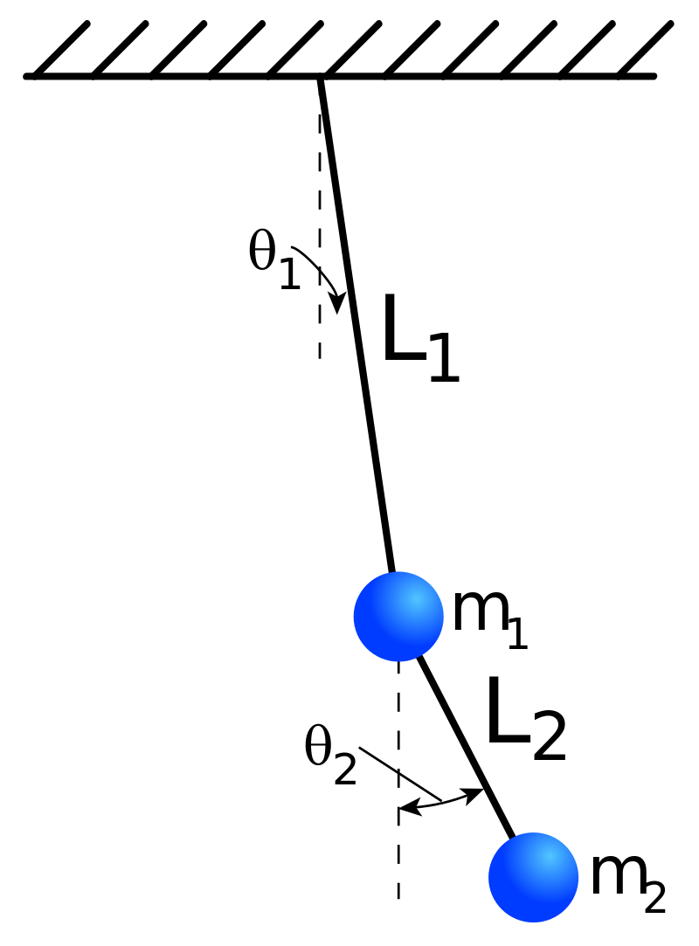
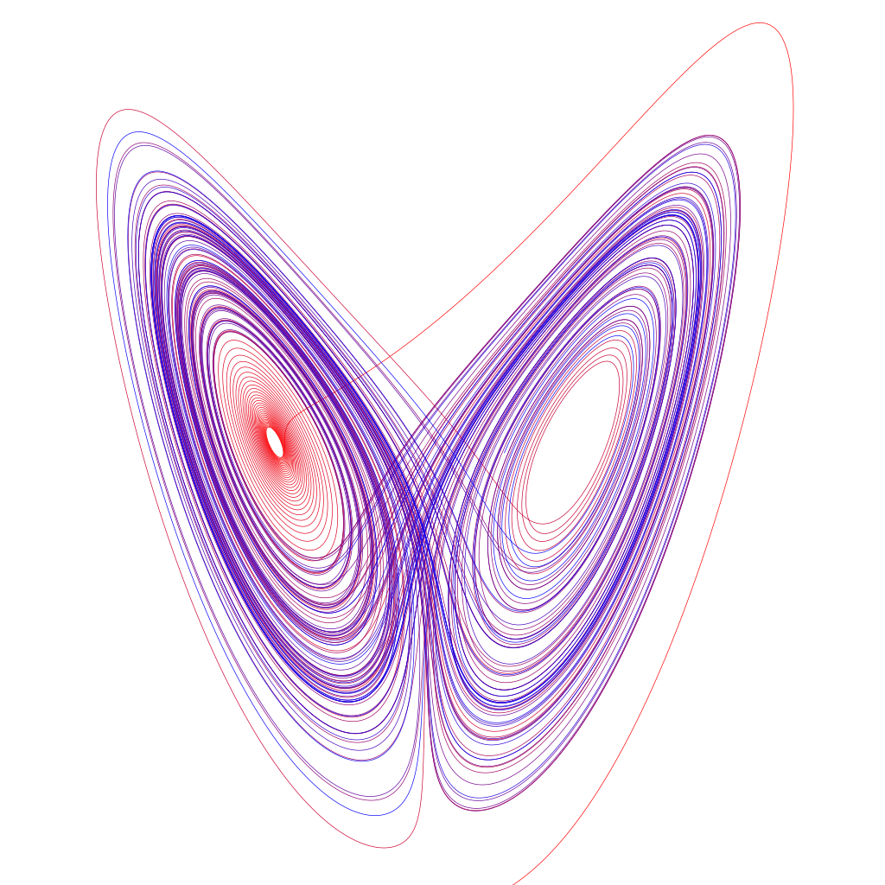


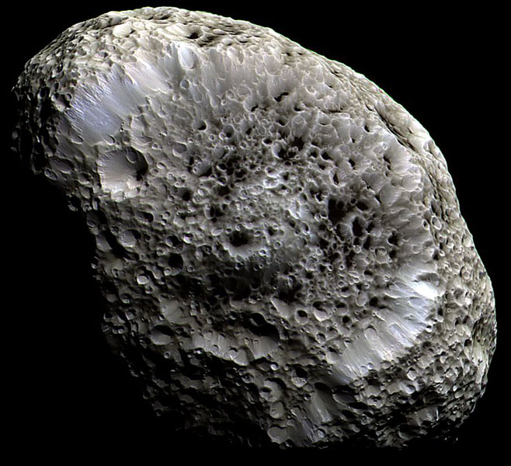
Examples of chaotic systems
„Butterfly effect” and weather forecast
Hyperion (Saturn’s moon) trajectory
Double pendulum
Dschwen
Credit: NASA/JPL/Space Science Institute

Slide 15
Chaos and standing gravitational waves

Slide 16
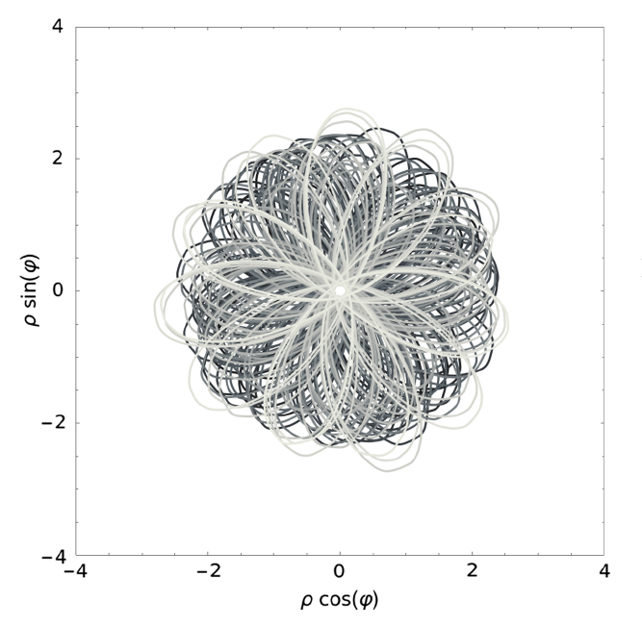
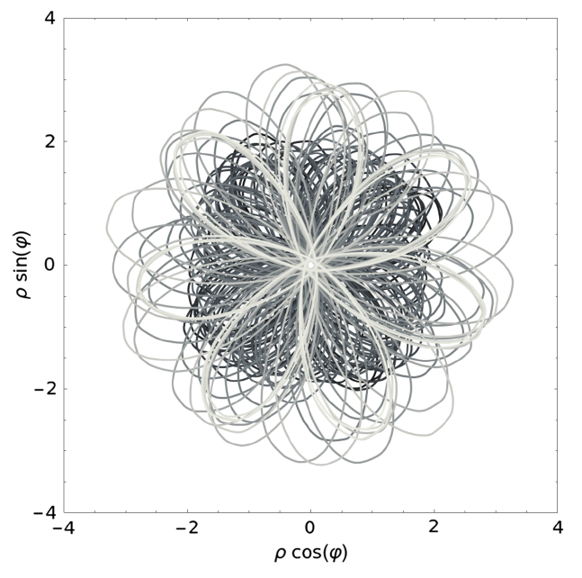


„Chaos and Einstein-Rosen GW”
Szybka, Naqvi, Phys. Rev. D, 108, L081501 (2023)
$z=const$
Trajectories for freely falling particles
Change of $\dot{ρ}$by ${6×10}^{−5}$
Notes:
Cięcie poincare dla trajektorii wzdłuż: t\lambda 2pi k

Slide 17
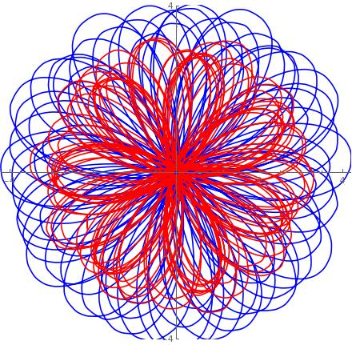

„Twin paradox” and chaos
        Particles start moving from very similar position: $ρ_{A}=3.21, ρ_{B}=3.22$
        Trajectories = geodesics
        Particles need to reunite
        Comparing proper times („age”) of particles: particle B is 17% older
Notes:
Czerwone – A, niebieskie - B

Slide 18
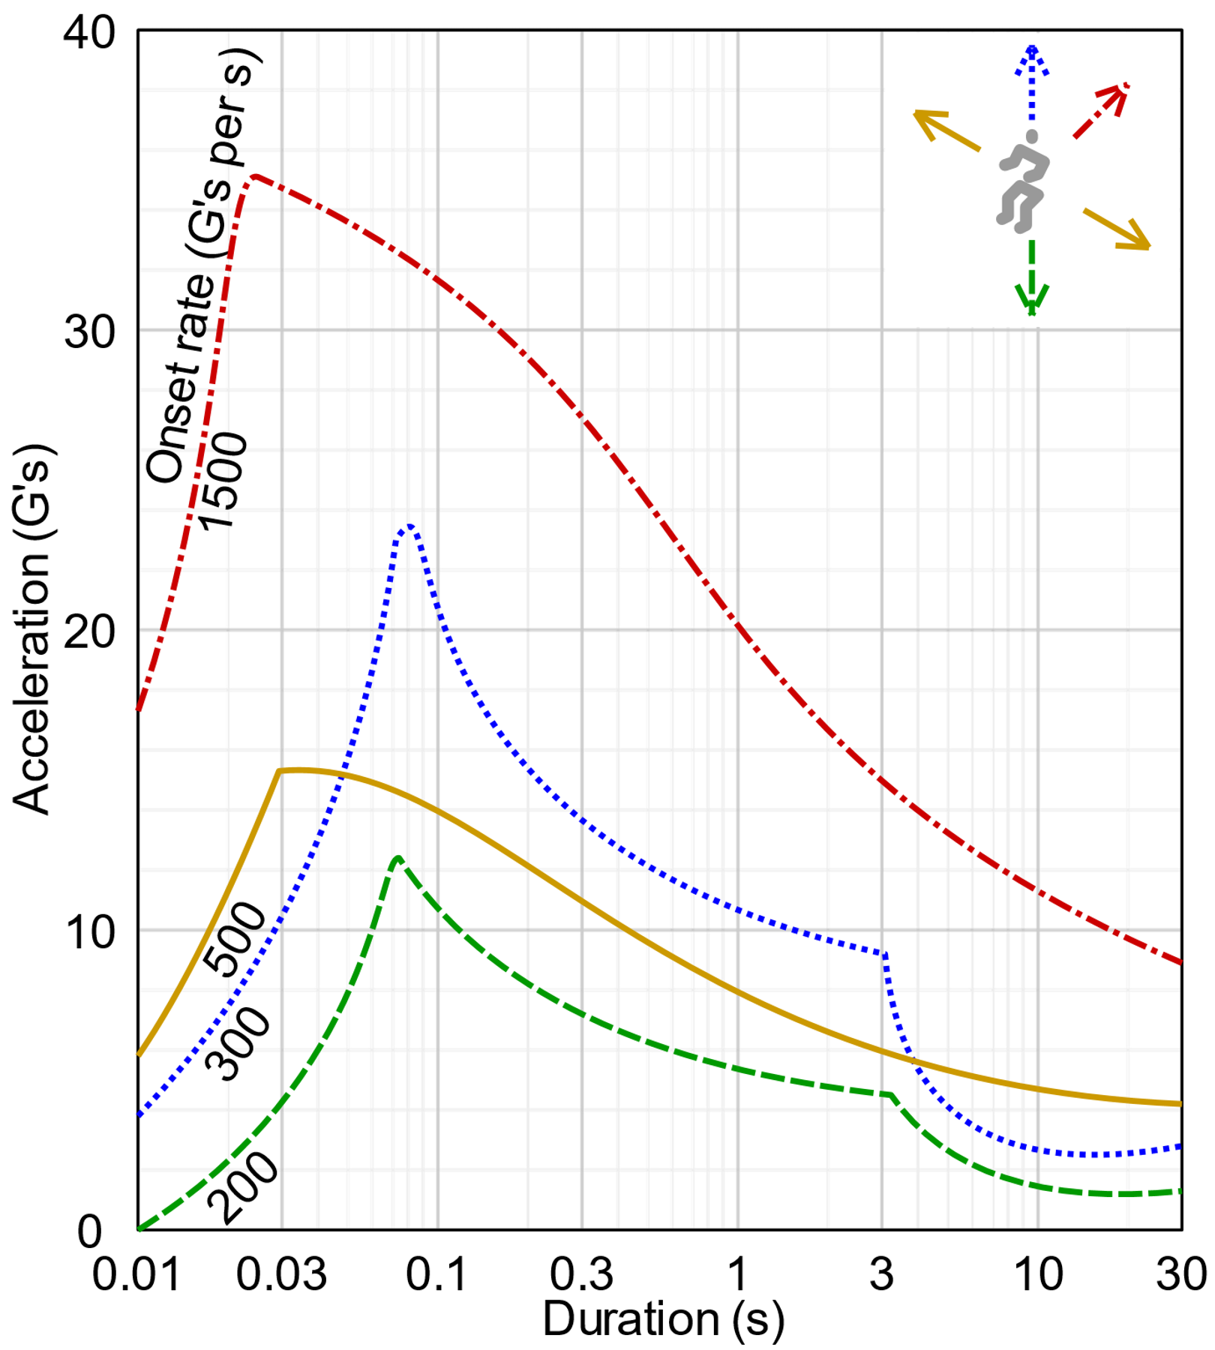

Particles $→$humans
Safe conditions for people
Diagram: Acceleration vs duration
Different colours - different directions

Slide 19
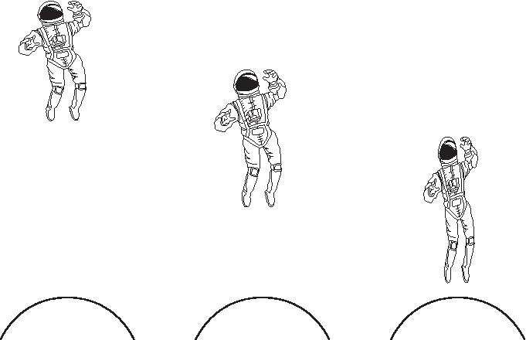

Tidal forces
        No external forces, just effects from standing graviational waves
        Nearby geodesics (trajectories) are becoming closer / more distant
        Tidal forces
Żr.: https://www.rmg.co.uk/stories/topics/what-happens-if-you-fall-black-hole

Slide 20

Summary
        Spacetime with standing gravitational waves
        Chaotic trajectories
        „Twin paradox” – age difference for freely falling particles
        Tidal forces safe (e.g.) for humans $→$ scale of the system

Slide 21

Literature
Sokolowski, Gen. Relativ. Gravit. (2012) 44:1267-1283
Szczególna teoria względności – wykłady prof. Sokołowskiego
„Elementy analizy tensorowej” L. M. Sokołowski
Szybka, Naqvi, Phys. Rev. D, 108, L081501 (2023)
Costa, Natario (2015) „Inertial forces in GR”
Halilsoy, Nuovo Cimento B 102, 563 (1988)
„Chaos w układach dynamicznych” E. Ott
L. P. Grishchuk and M. V. Sazhin, Zh. Eksp. Teor. Fiz. 68, 1569 (1975)

