Slide 1
Site and Civil Engineering Department
Technical Seminar: HEALTHY WORKSPACES
How does architecture impact your work?
Araceli Alvarez Escobar
CERN, 15th January 2024

Slide 2
Agenda
Introduction
Five W of Healthy Workspaces
  What does «healthy workspaces» mean?
  Why «architecture»?
  How have workspaces changed?
  When have regulations been updated?
  Who is CERN?
  Where is CERN in terms of workspace?
New vision
  Interior spaces
  Office space
  Shared spaces
  Exterior spaces
References
  CERN projects
  External projects
  Articles
Summary

Slide 3
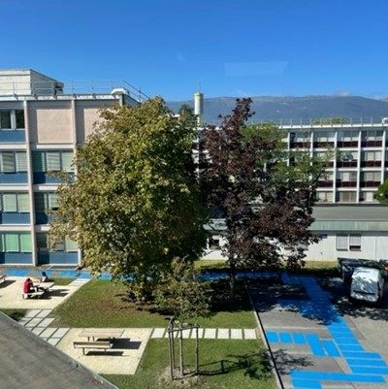
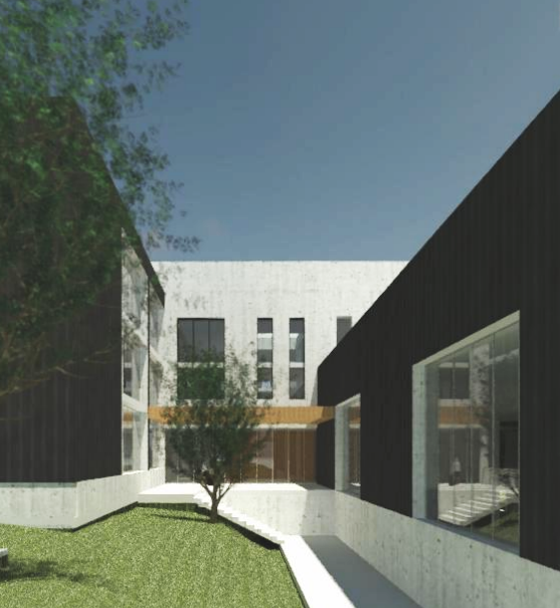
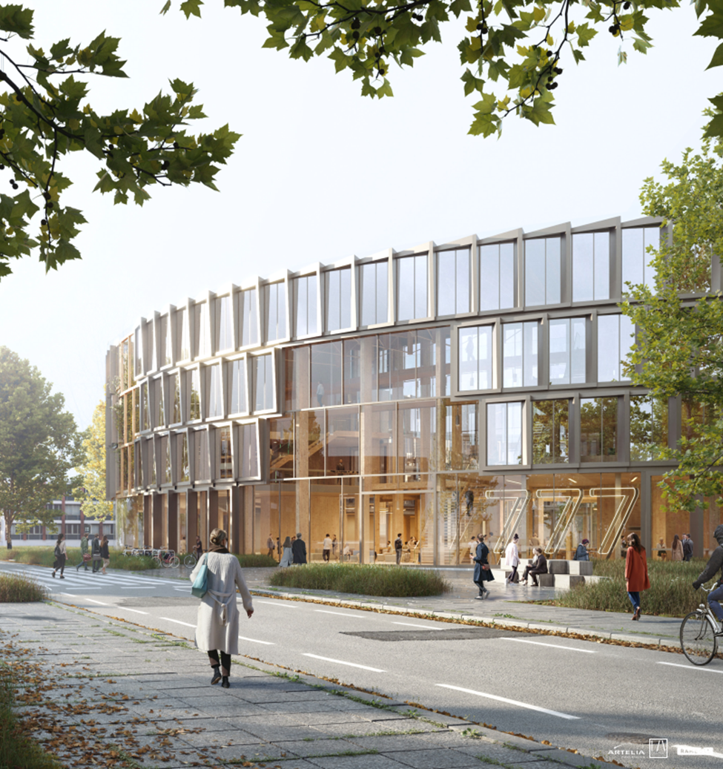
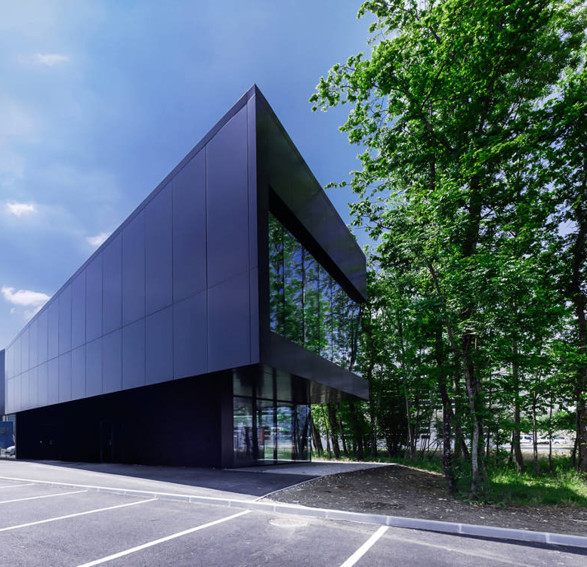
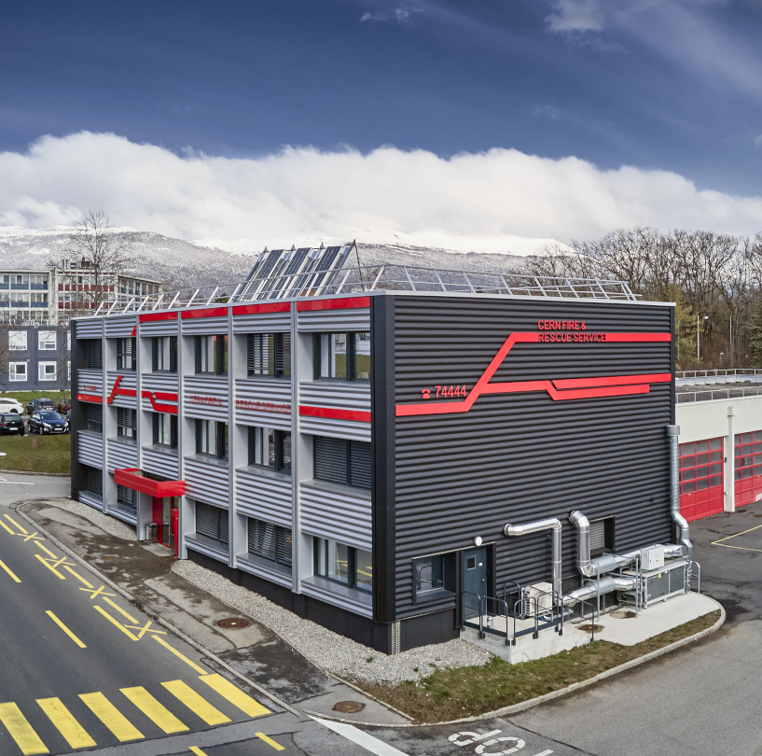
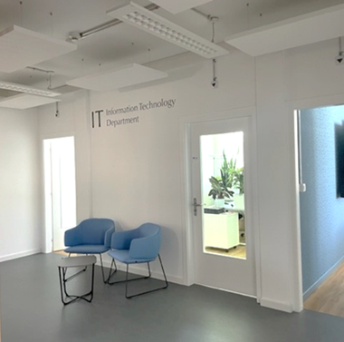
INTRODUCTION
CERN
Escuela Técnica Superior de Arquitectura La Salle, RAMON LLULL UNIVERSITY (Barcelona)
Local Government of Archidona, Málaga “Construction and urbanism department “
Outdoor spot
B34
B140
B777
B774
B4
B65
B156
B31
B52
Internship
Internship
Internship
Technical student
Project Associate (2021)
Fellowship (2024)
Master’s Degree in Architecture (2017)
(*)
PhD proposal : «THE UNKNOWN CITY OF CERN”
Final project «Learning Center»
Degree in Technical Architecture and Construction (2021)

Slide 4






WHAT does «healthy workspaces» mean?
WORKSPACE
- Place in which you work, such as your desk in an office.
- The architectural typology of office buildings encompasses more functions and expands the program’s spectrum; The contemporary configuration integrates numerous “third places”.
- The workspace has different scales, especially at CERN. Our workspace starts already from the moment we cross the CERN gate and ends with the dimension of our table or the transparency of our office’s door.
HEALTHY
- Physiologically healthy (ergonomics, air quality, natural and artificial light….)
- Psychologically healthy (motivation, collaboration, interaction, exchange, integration, equality…)
- Healthy habits and wellness (walking, moving, spending time outside …)
offices, meeting rooms, cafeteria, classrooms, break corners, print corners…
Shared bike/car, shuttle…
clubs, areas, gym, changing rooms…
hotels, restaurant, library…
CERN WORKSPACE OFFER
restaurants, picnic areas, coffee corners…
clubs,changing rooms, gym restaurant, events, conferences, library…
Free time
Offices, meeting rooms, cafeteria, classrooms, break corners, print corners…
restaurant
Shared bike/car, shuttle…
~8h
~4h
~1h

Slide 5
WHY «architecture»?
ARCHITECTURE
“Architecture is the art and science of designing buildings and other physical structures.
A wider definition often includes the design of the total built environment from the macro level of town planning, urban design, and landscape architecture to the micro level of construction details and, sometimes, furniture.
The term “Architecture” is also used for the complex or carefully designed structure of something.”
“What is Architecture?” (Medium)
TECHNICAL INSTALLATIONS
(electricity, HVAC, IT, videoconference systems, safety systems, security systems…)
COMMUNICATION
CONSTRUCTION SOLUTIONS
(partitions, painting, façade, floor finishes, structure…)
SIGNAGE
ARCHITECTURE
SPACE MANAGEMENT
REGULATIONS
(CH, FR, CERN…)
SERVICES
(waste center, mail, catering, security, lockers, storage, furniture, fire compartmentalisation, pollution removal)
Free time
DESIGN
SUSTAINABILITY

Slide 6
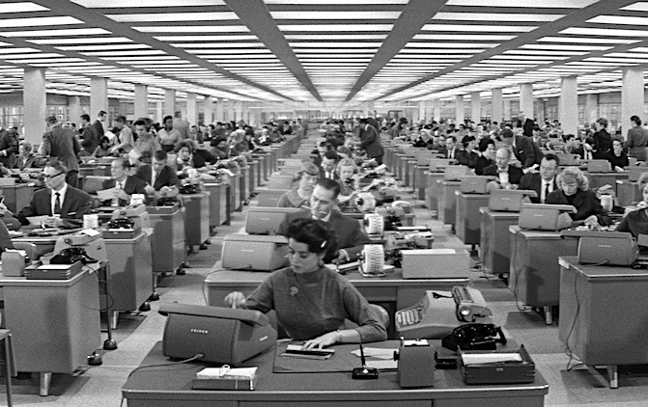
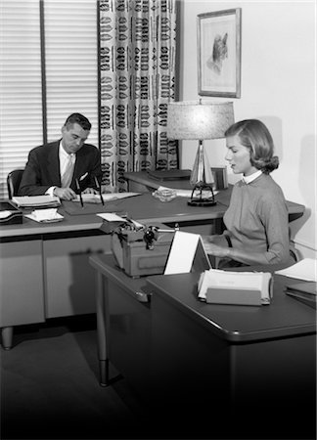
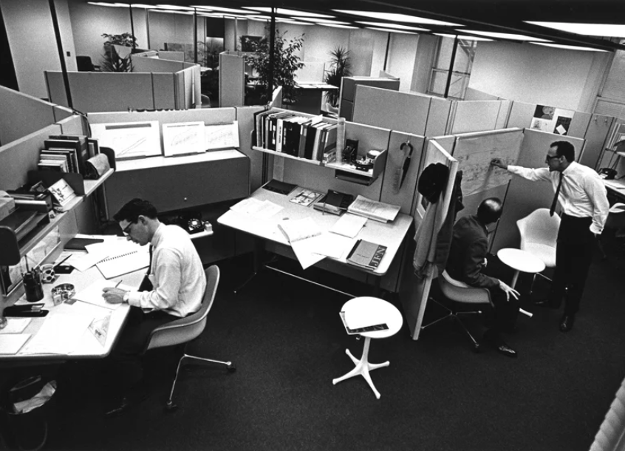
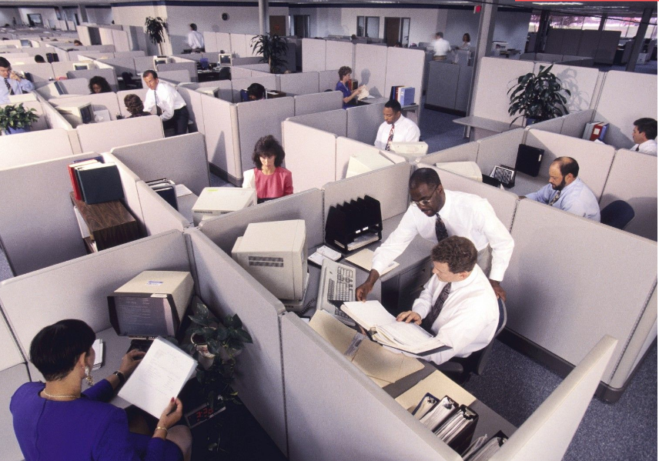
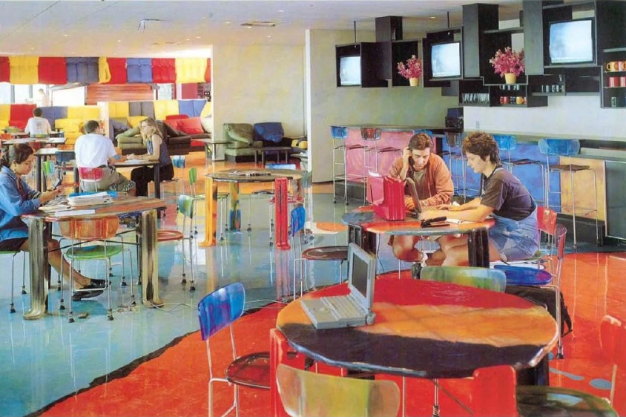
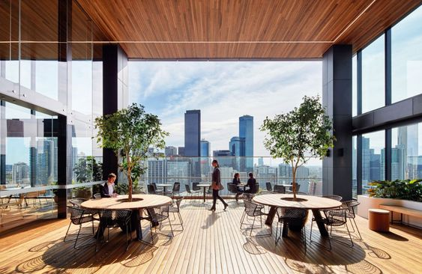
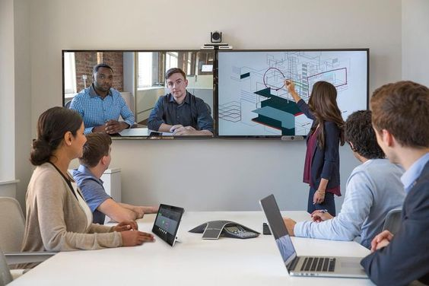
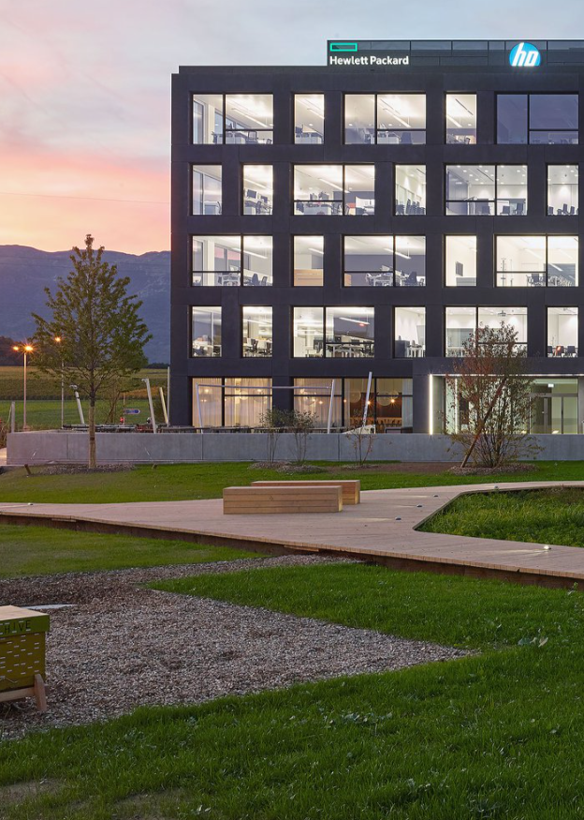
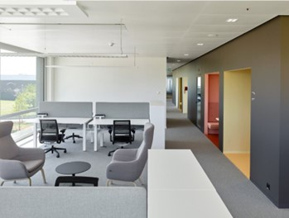
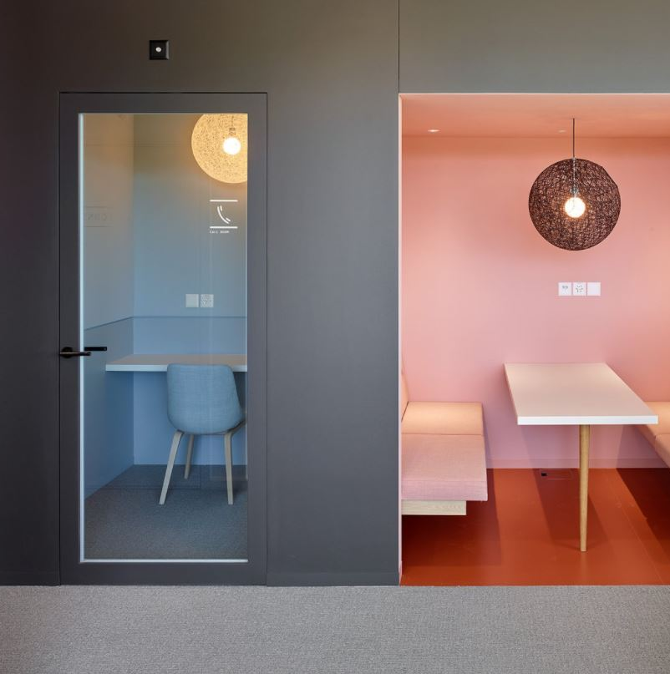
HOW have workspaces changed?
Early 20 century Frederick Taylor (factory layout and
manager’s offices)
1950s - 1960s “Action Plan” offices (three sided movable partitions)
1970s-1980s
Cubicle farm design
1990s-2000s
Hot desking office and digitalisation
21 century The Biophilic approach, flexible offices and collaborative spaces, sustainability
Post – Covid Telework, enterprise social media and new technological innovation
TODAY Multi-space offices
References:
The Hive - Headquarters HP (CCHE) > Space diversity
The Truth About Open Offices (Harvard Business Review) > Flexibility
Architects and their impact on office buildings (Rethinking The future)

Slide 7
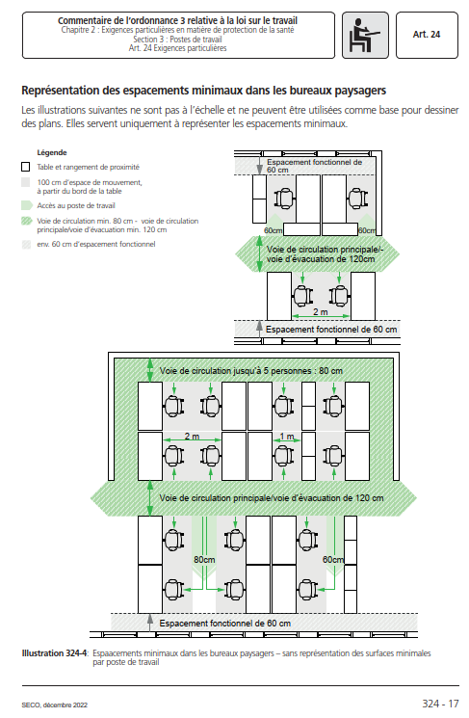
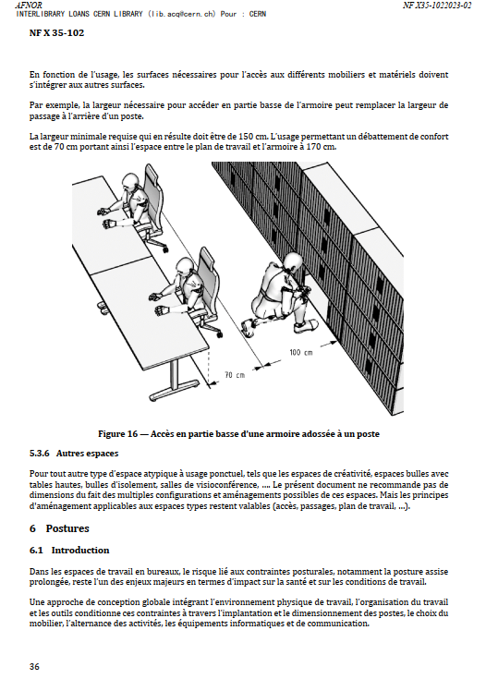
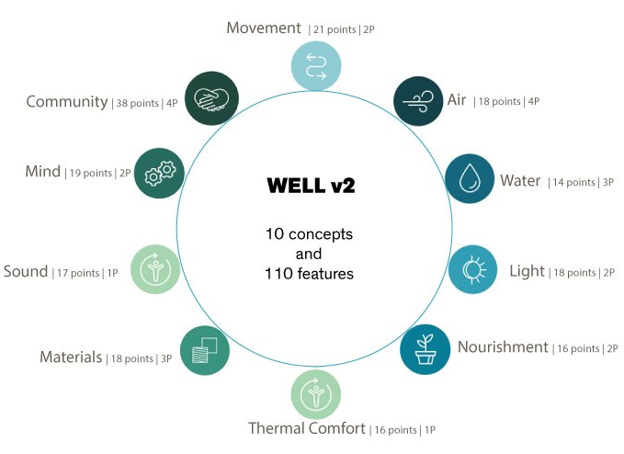
WHEN have regulations been updated?
___________________________________
CERN Space Management Policy
The process to produce a Space Strategy will engage with all Departments and Units at CERN. Profiting of the existing Space Management Forum (SMF), SCE proposed a work plan that:
Defines space regulatory framework for offices and common space management (HSE)
Working group “Official guidelines for offices and common space allocation”
Working group ”Space processes, tools and operational procedures”
Working group ”Space management data and KPIs”
___________________________________
The WELL Building Standard (V2)
Vehicle for buildings and organizations to deliver more thoughtful and intentional spaces that enhance human health and well-being.
Set of strategies that aim to advance human health through design interventions and operational protocols and policies and foster a culture of health and well-being.
Swiss code (since 12/2022): Commentaire de l’ordonnance 3 relative à la loi sur le travail
NF X 35-102 (since 02/2023): Ergonomie — Conception ergonomique des espaces de travail en bureaux
CERN SPACE MANAGEMENT POLICY (on going)
WELL Building Standard (international certificates being used as an inspiration for CERN)

Slide 8
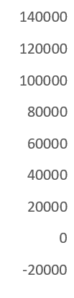



WHO is CERN?
TERTIARY INFRASTRUCTURES AT CERN (m2)
POPULATION
Diversity of contract durations and ages
Potential change in the organization’s structure every 5 years
Diversity of activities, services and professional profiles
International environnement
General interest in innovating, learning and collaborating
Knowledge based organisation
Human beings (perception of colours, proportions, forms…)
ARCHITECTURE
Science-driven architecture (priorities, requirements, budget…)
Diversity of building typologies
High number of existing infrastructures and furniture
Fixed location
Uncertainty on the future spatial needs
Variable density (urban vs countryside)
SITE DENSITY (Km2)
27%
35%
39%
14%
64%
22%
SITE DAILY OCCUPATION (people)
IMPACT ON SURFACE (m2)

Slide 9
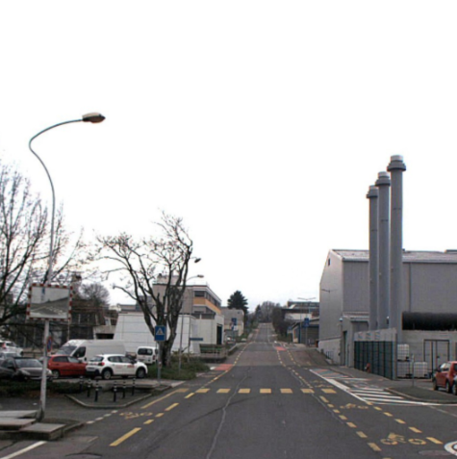
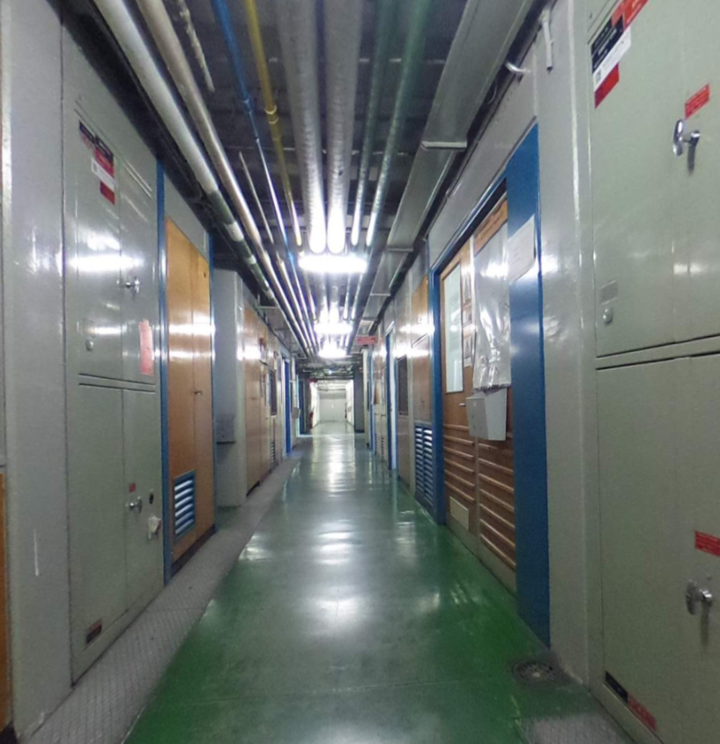
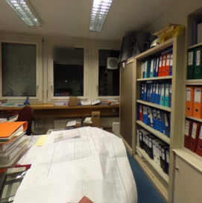
WHERE is CERN in terms of workspace?
Staff and Fellows Survey 2023: Comments about CERN buildings
Real estate conditions
«It’s nice to see that, even I work in a completely outdated infrastructure, I can see other buildings being refurbished and often 3D images of future buildings».
Space management
«A centralized space management policy would allow to improve space utilization, improving monitoring and equity in the space distribution.»
«Things move so slowly at CERN that we miss opportunities. An organization like this should be more advanced regarding space management».
Space offer
«More collaboration spaces (break rooms, outdoor spaces for meetings and lunch…) are needed, as well as improving the current office space quality».
Future vision
«The current work environment impacts on CERN’s image and on the morale of its population. CERN can’t achieve its mission if its built environment keeps being neglected».
«The constructed site needs cleaning and rethinking with a more modern work culture like approach and not only accepting how buildings are currently distributed only because of historic reasons.»
Space quality
«Work conditions are getting worse, making CERN not attractive anymore».
What does the Organization do well?
Development opportunities
Salary & benefits
Work pressure
Collaboration
Other

Slide 10
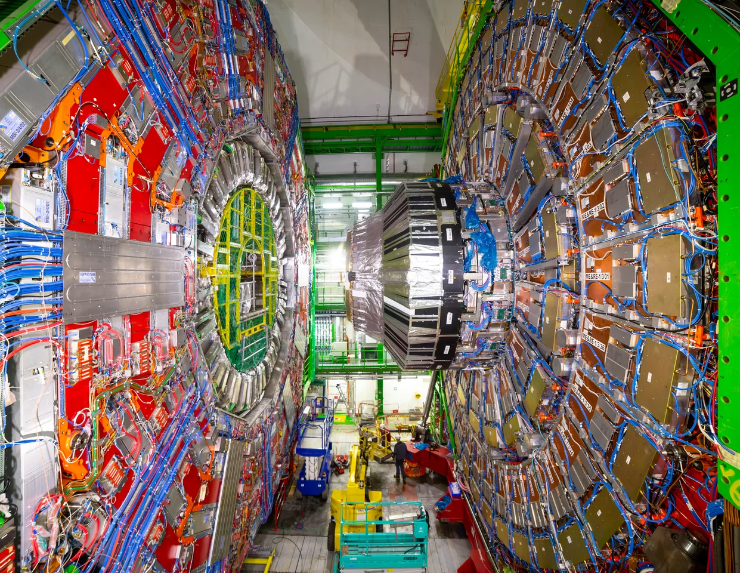
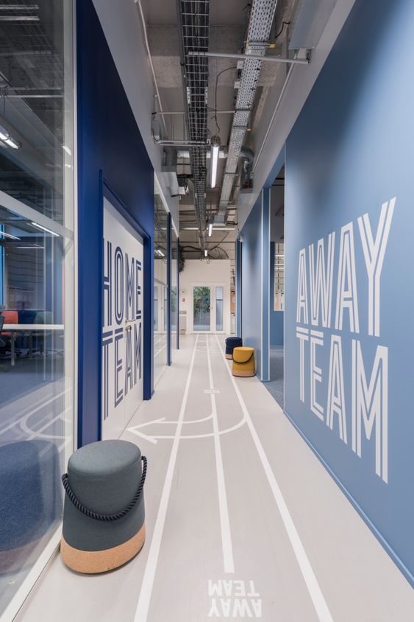
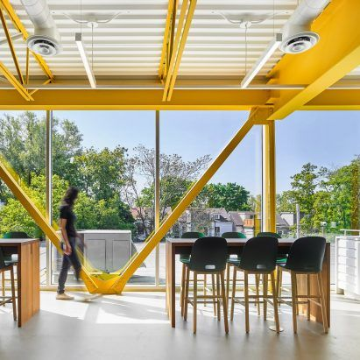
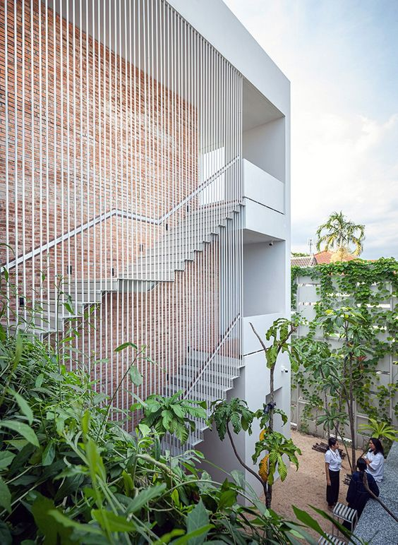
NEW VISION: Interior spaces
Combine different kinds of spaces in a “multi-space office” > answer to different types of activity and professional profiles
Façade, structure and finishings modularity > give flexibility
Increase shared areas > promote exchange and common services
Design efficient distributions > giving various uses to a space
Communicate > direct discussions with future users to guide and publish what is being done to give a sense of evolution
Use reversible construction systems
Use easy maintenance construction systems and materials > Visible installations, openable windows, …
Work with the existing > every existing building has its own schema and particular elements that must be put into value
Use visual effects and signage > colour contrast is an easy low-cost way to make spaces more understandable and user-friendly
Increase energy efficiency > space management, updated technical installations
Increase safety > upgrade in terms of safety regulations
Inspirational images

Slide 11
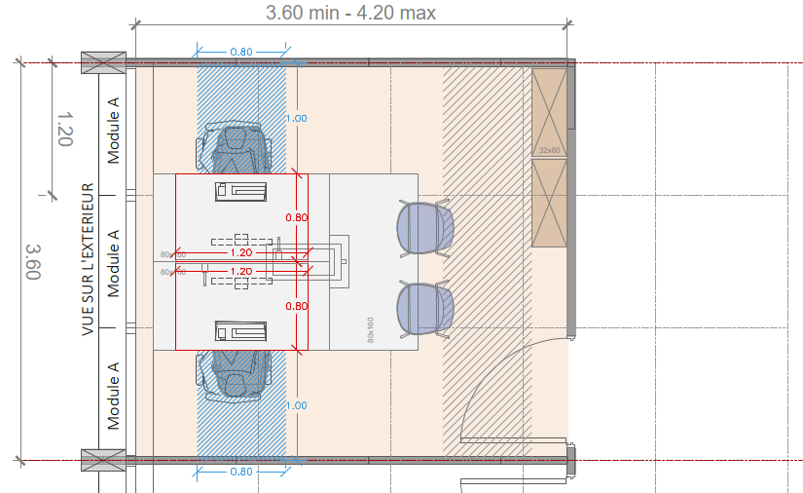
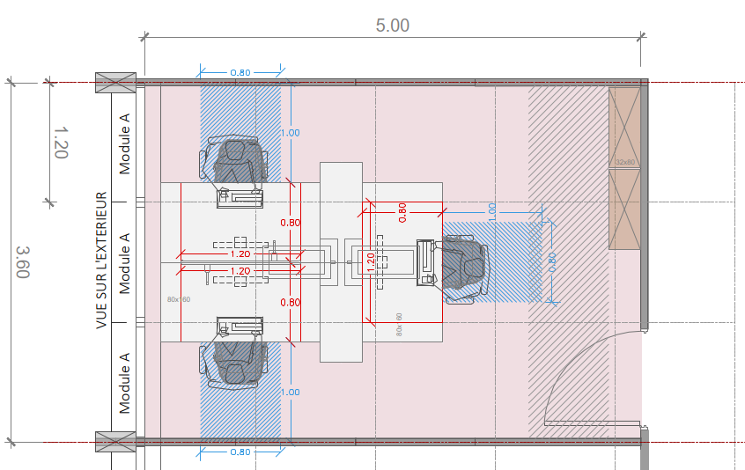
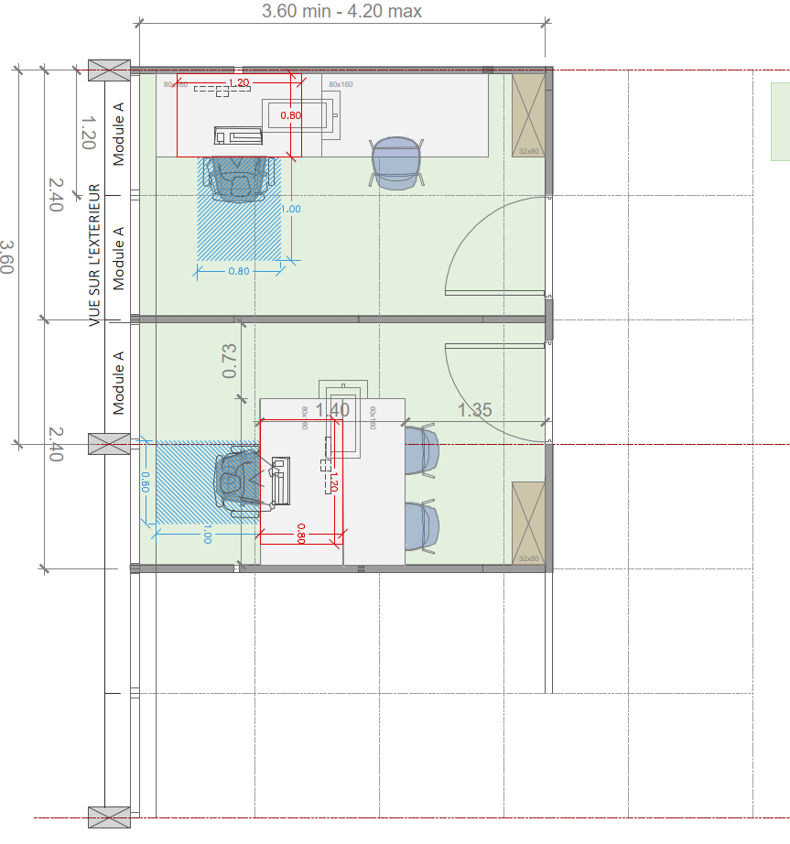
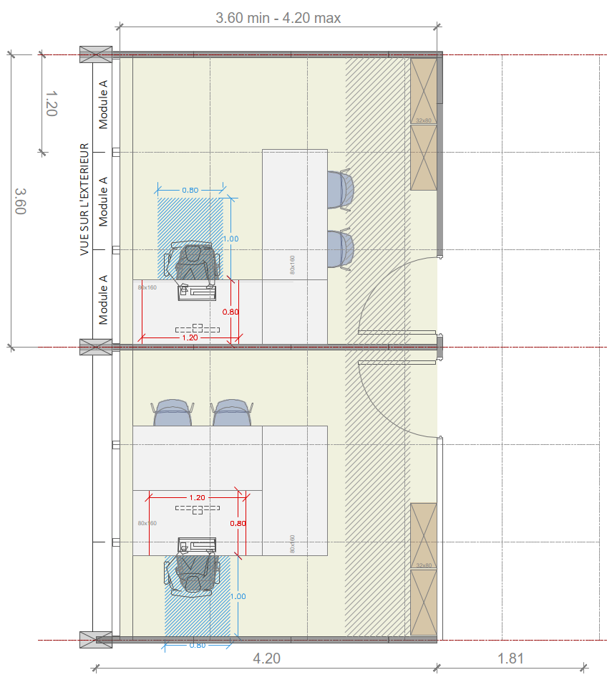
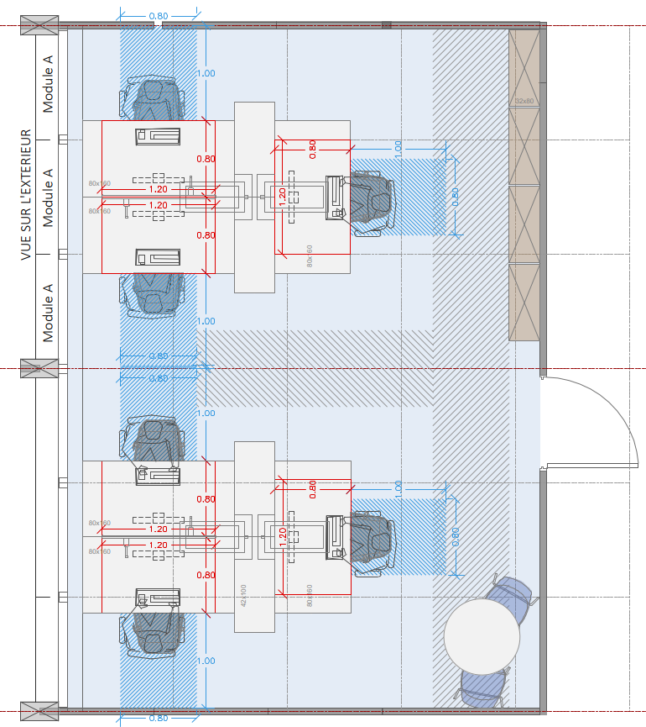
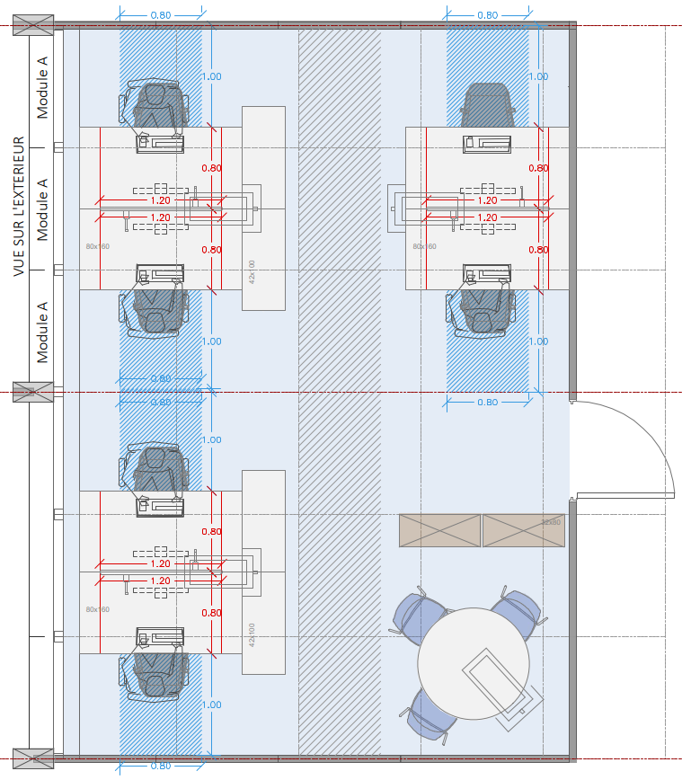
NEW VISION: Office space
Façade module (natural light)
Lighting systems
Installations distribution
Doors and partitions transparency
T2 – 15m2
T3 – 18m2
T1 – 10m2
T0 (Manager Office) – 15m2
T6 – 36m2

Slide 12
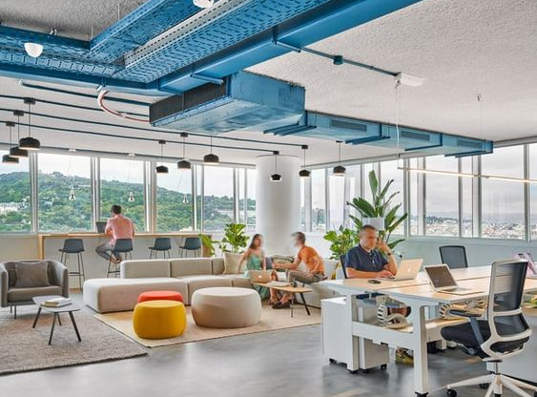
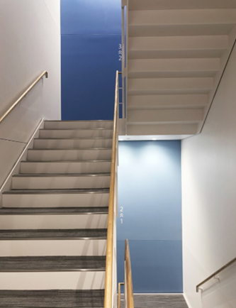
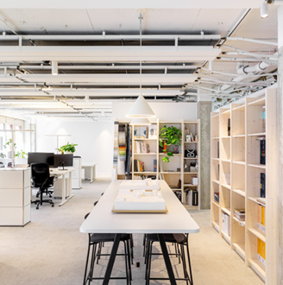
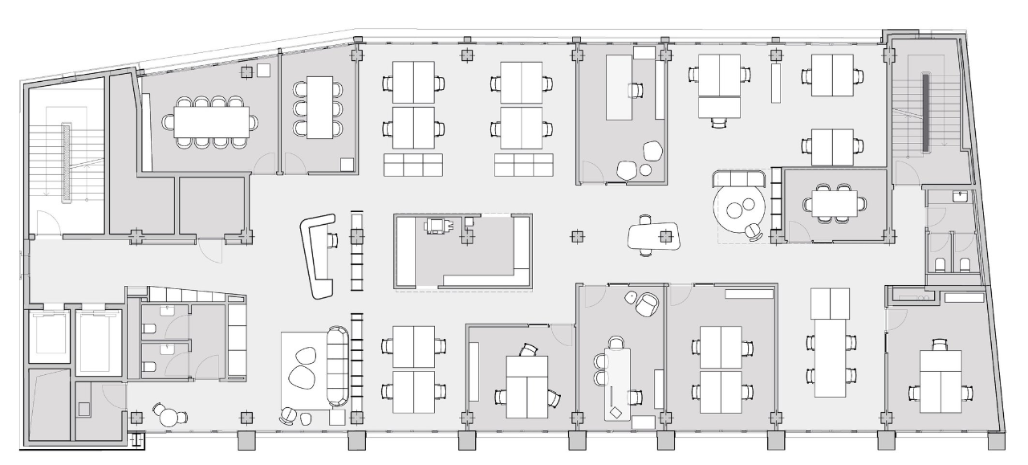
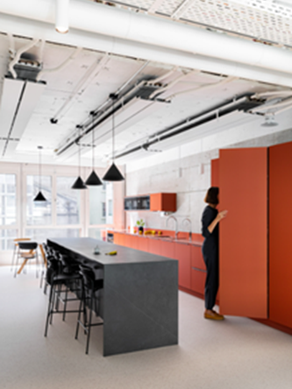
NEW VISION: Shared space
Variable spaces
Print corners with waste center and material storage
Phonebooths and small meeting rooms
Painting and signage
Collaborative areas
Meeting rooms
CCHE Geneva office

Slide 13
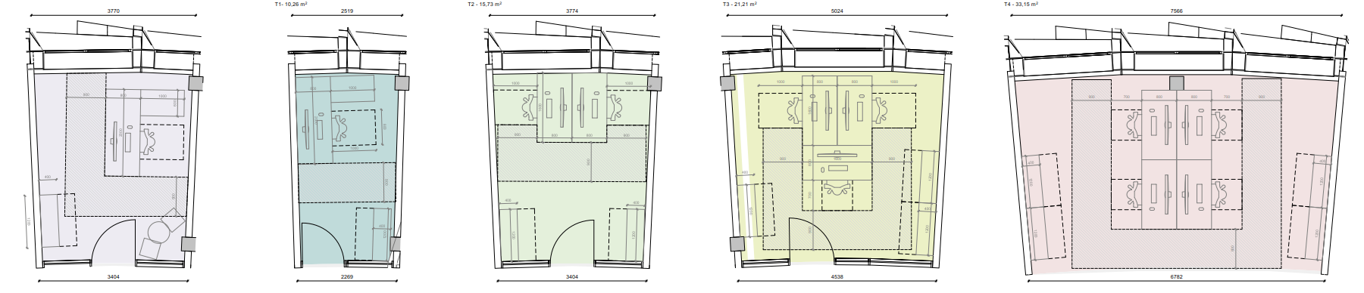
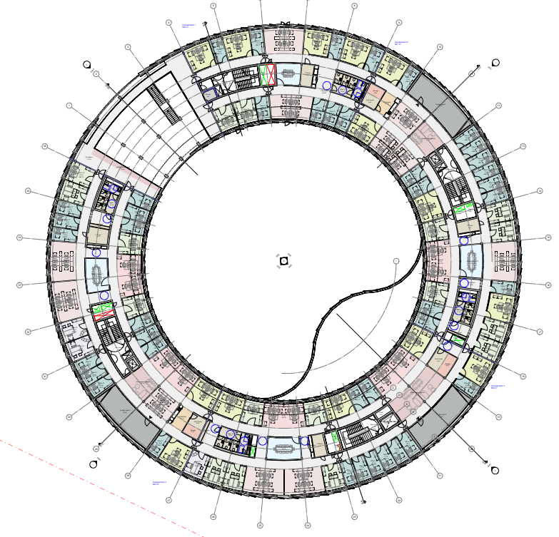

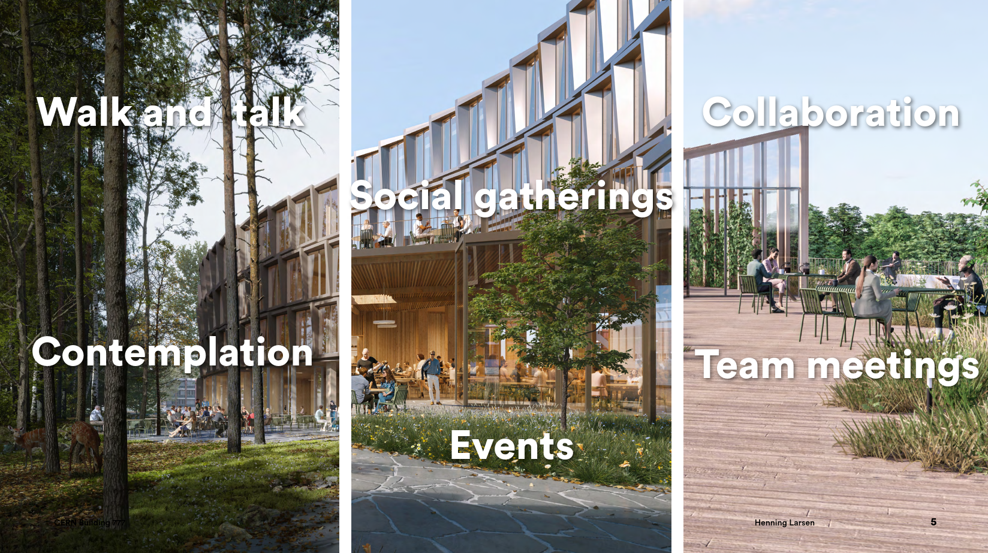
REFERENCES: CERN projects
BUILDING 777 (PREVESSIN SITE)
On going design by the Henning Larsen architecture offices.
Working in direct proximity to:

Slide 14
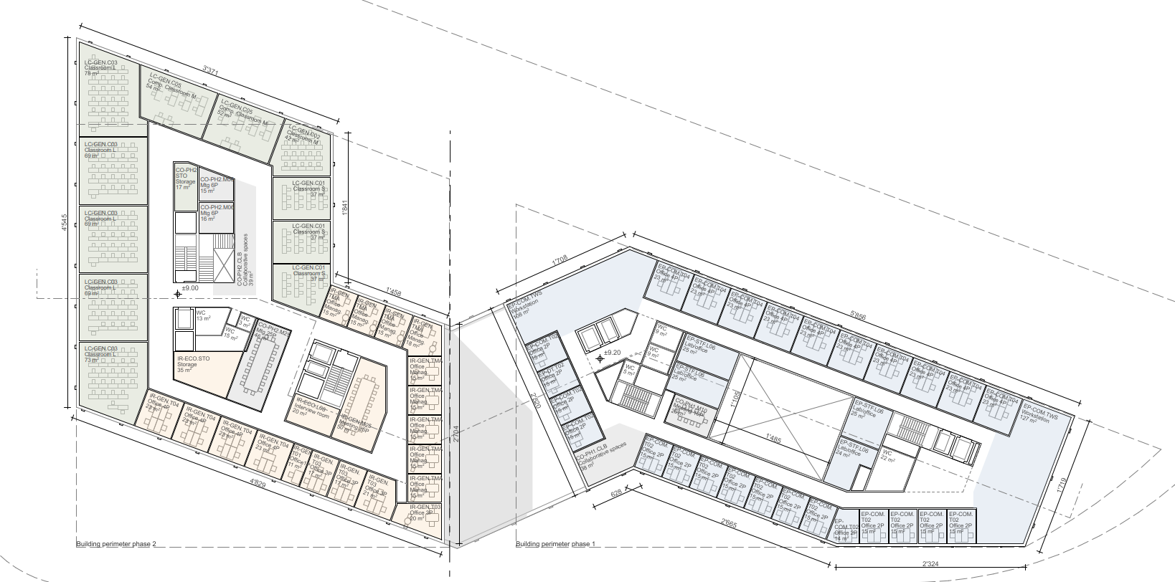
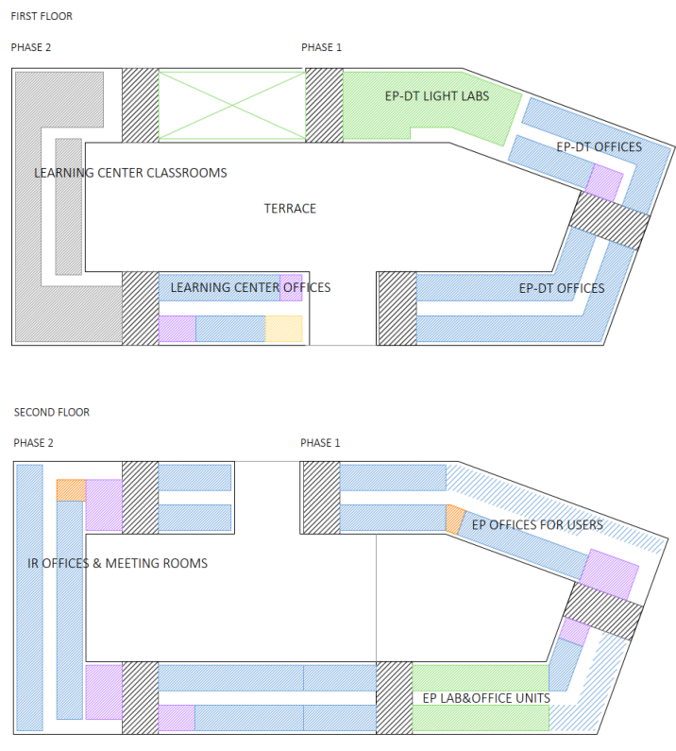
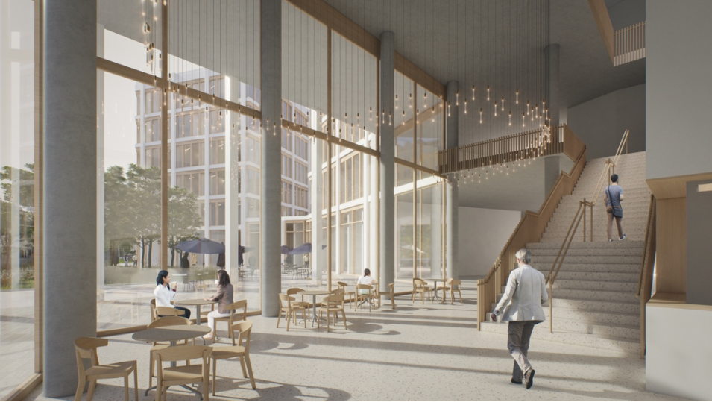
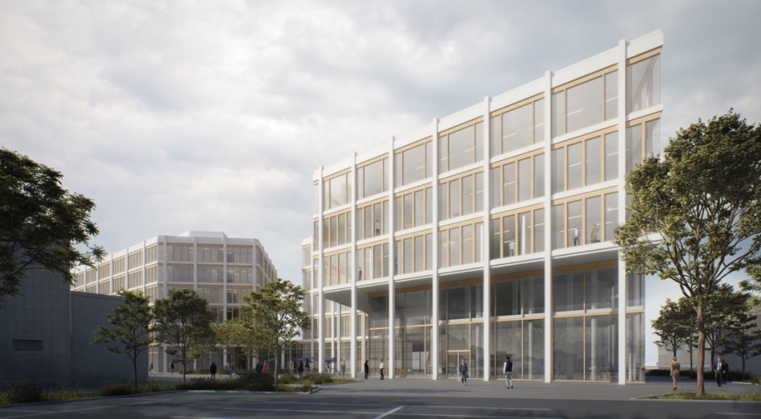

REFERENCES: CERN projects
BUILDING 140 (MEYRIN SITE)
On-going design competition (tender)
Pre-feasibility study (CERN SCE Department
Reference Design (by the CCHE architecture office)

Slide 15
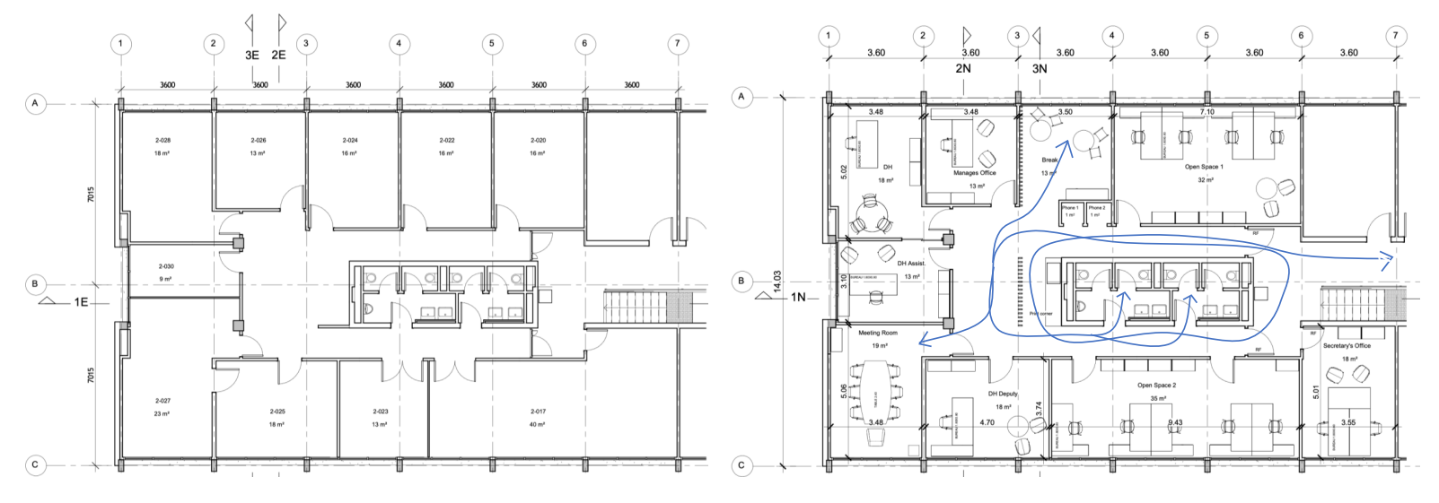
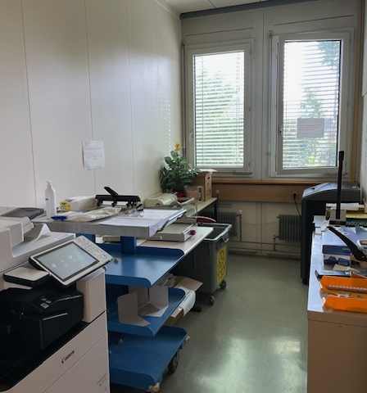
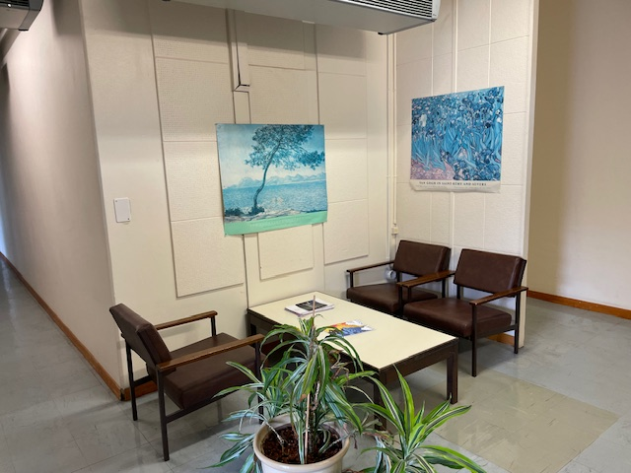
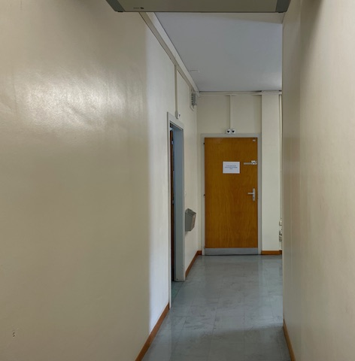
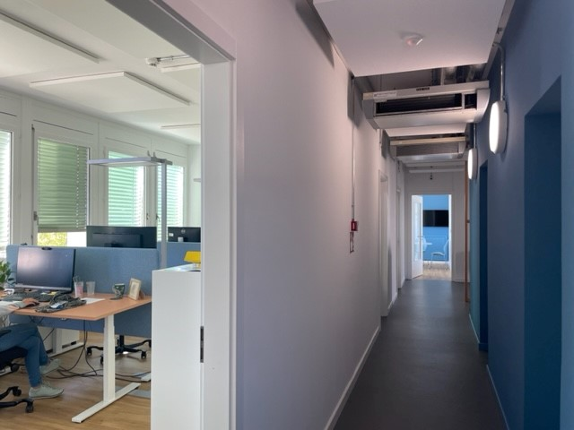


REFERENCES: CERN projects
BUILDING 31 2nd floor (IT Department)
Before
After
Gained 5 new workstations, 1 new meeting room, 1 new collaborative room (with 2 floating workstations) and 2 phone booths

Slide 16




NEW VERSION: Exterior space
Increase shared areas > promote exchange
Combine different kind of spaces > answer to different types of activities
Communicate > direct discussions with users working nearby, totems with information about the project and the location, publications announcing these new areas…
Create a module and a system that can be repeated around the site in different locations
Use easy maintenance elements and materials
Work with the existing
Use visual effects and signage
Increase safety > revision of the walking and cycling circulations and
Foster soft mobility
Inspirational images

Slide 17





REFERENCES: CERN projects
Before
Outdoor Spot 6 (IT area)
After

Slide 18
REFERENCES: Articles
Architects and their impact on office buildings - RTF (re-thinkingthefuture.com)
Workplaces Have Changed – And It’s Time They Change Again (forbes.com)
https://wearetwo.com/office-design-what-it-was-and-what-it-is-now/
https://catalogue.library.cern/literature/mj15x-kbk50
https://medium.com/@AAA_Publication/what-is-architecture-1b52f5339c2a
https://v2.wellcertified.com/en/wellv2/overview
“A single best physical or digital workspace architecture will never be found. That’s because more interaction is not necessarily better, nor is less. The goal should be to get the right people interacting with the right richness at the right times.” The Truth About Open Offices (Harvard Business Review)
The effects of the pandemic on the design of office buildings have taught us to pivot with flexible, resilient, and adaptable design typologies as architects are reinventing office design and reimagining workplaces comprehensively while ensuring the physical as well as mental well-being of the employees“. Architects and their impact on office buildings (Rethinking The future)

Slide 19
SUMMARY
CERN’s workspace starts from the site entrance and not only from our office door;
A single best physical or digital workspace architecture does not exist;
CERN’s population and architecture have specific characteristics that makes it unique;
A diverse offer of kinds of spaces to work at CERN is needed to be at the same level as the organisation;
Large projects and small office renovations are already applying a new way of understanding the workspace;
«Third spaces» for collaboration and exchange are key for a healthy working environment;
The exterior areas are as important as the interior ones for our daily work;
THANK YOU
Teresa Canseco (SCE-TAM-TG)
Mathieu Fontaine (SCE-SAM-CE)
Fabien Vincent (SCE-SAM-IN)
Denis Potard (SCE-SAM-IN)

Slide 20




Slide 21





REFERENCES: External projects
CCHE Geneva office

