Slide 1
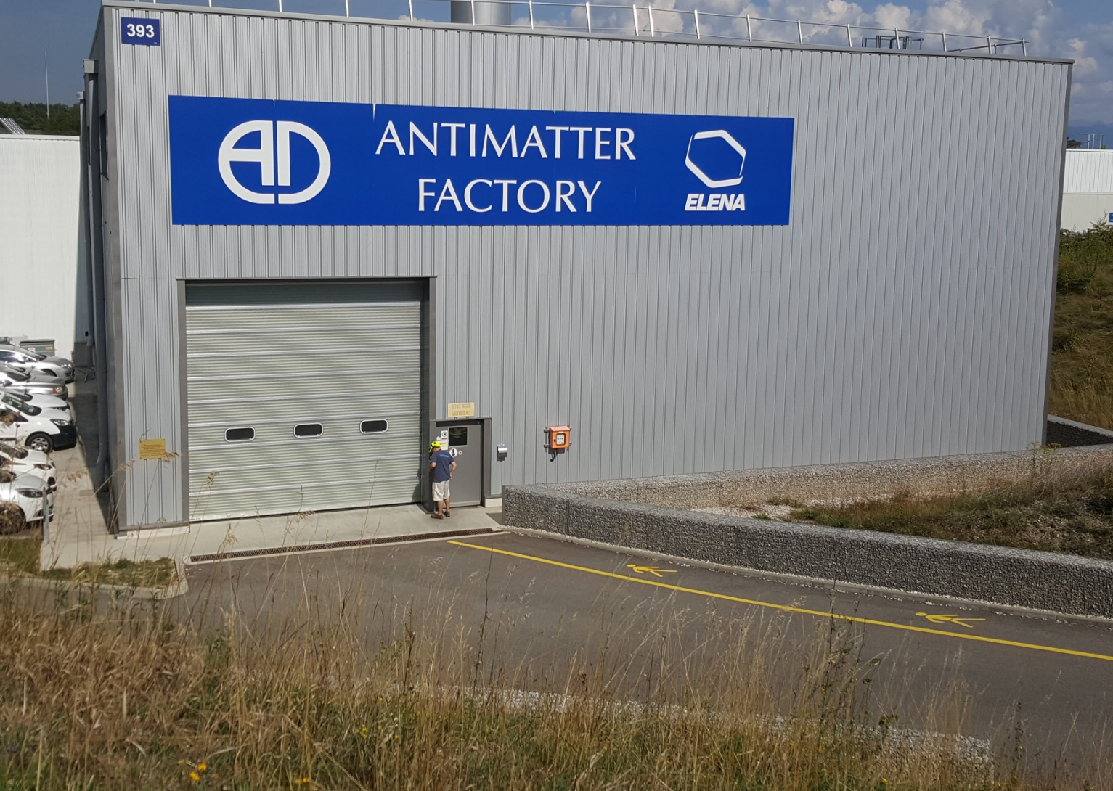
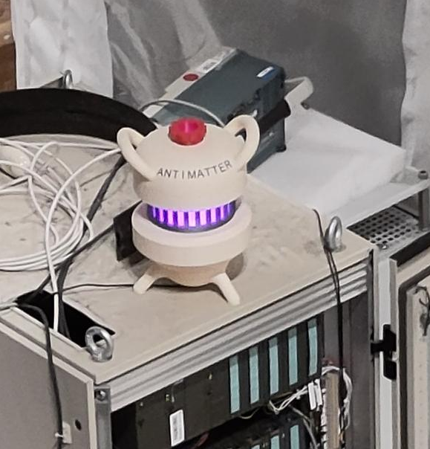
Antihydrogen production at AEgIS
Notes:
Good afternoon
Thanks to Mihail for the introduction and organizing the felleskvolloquia.
Today I will tell you about
- how antimatter was discovered
- why it is questioning our understanding of the world we leave in
- what it can be used for
- and also about my experience as an early career researcher

Slide 2
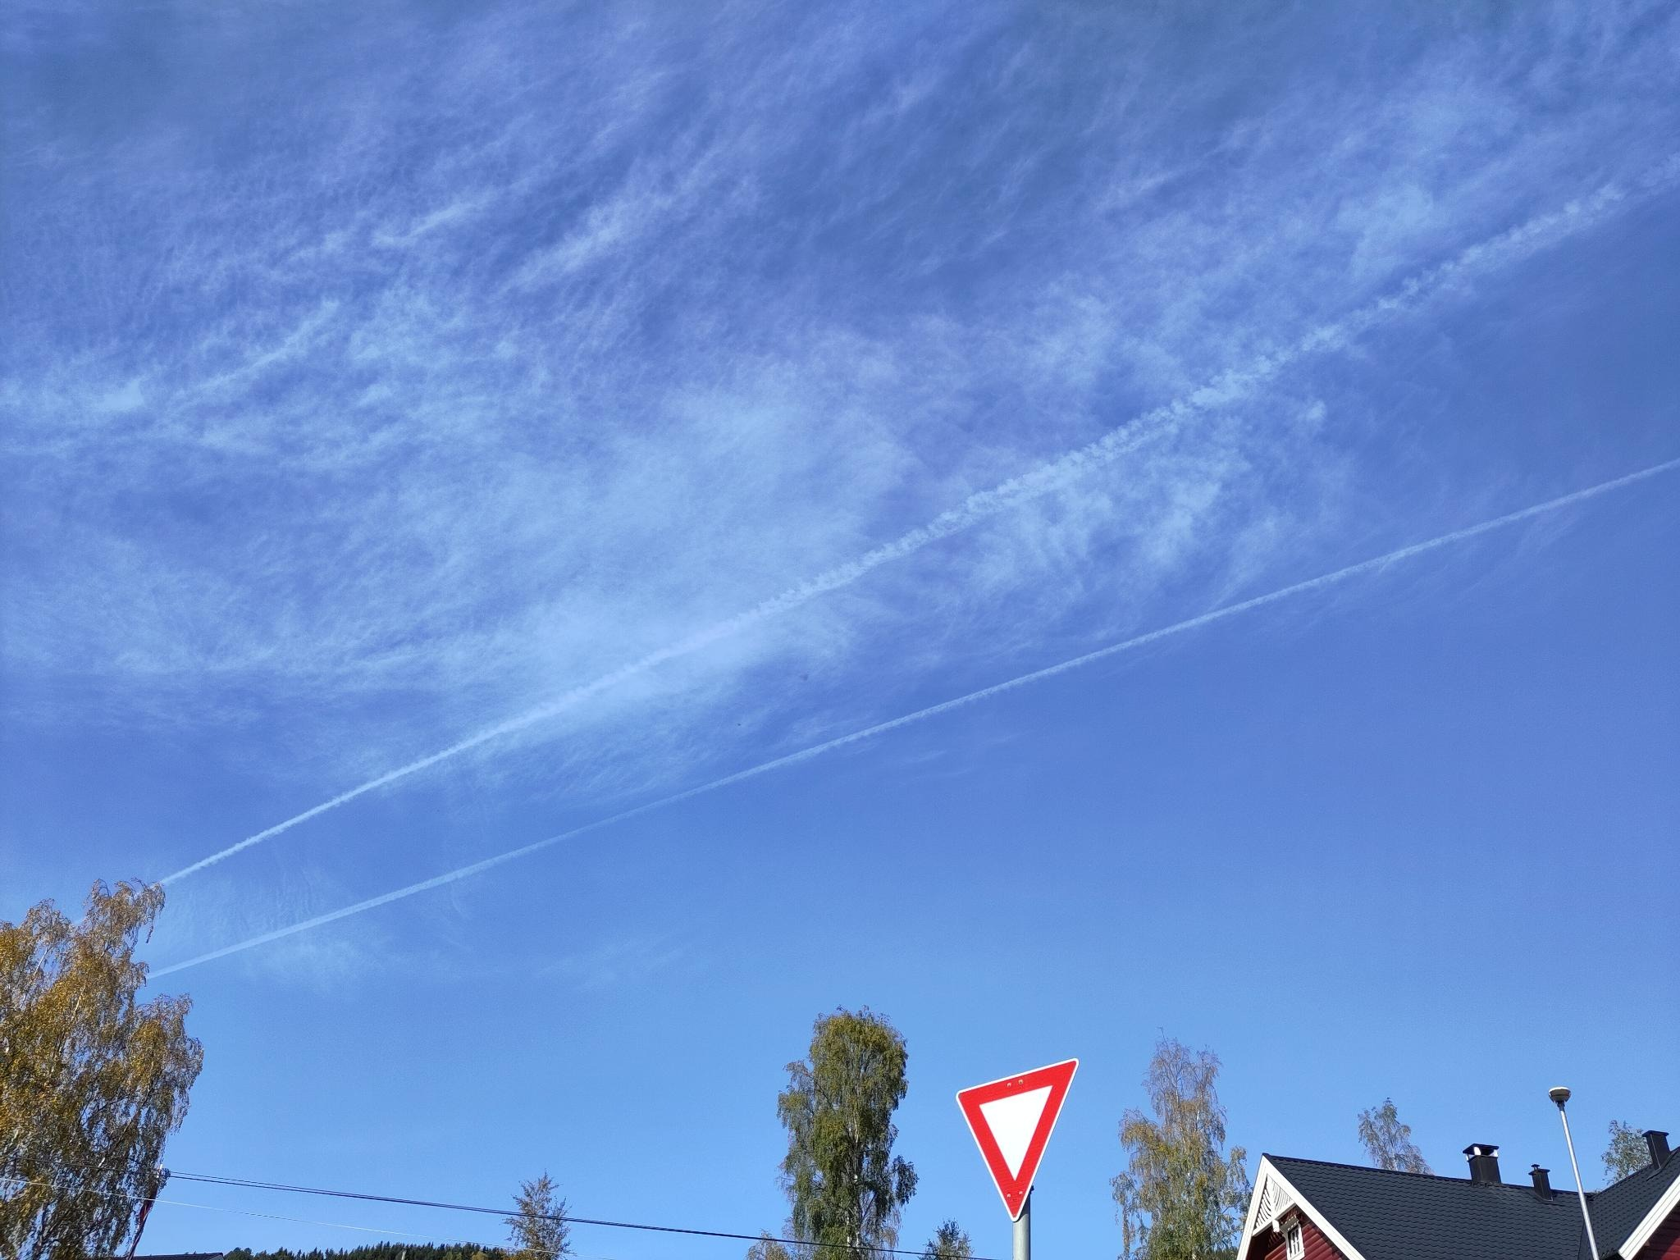
Condensation trails. Fagernes, Norway. 2023/10/01

Slide 3

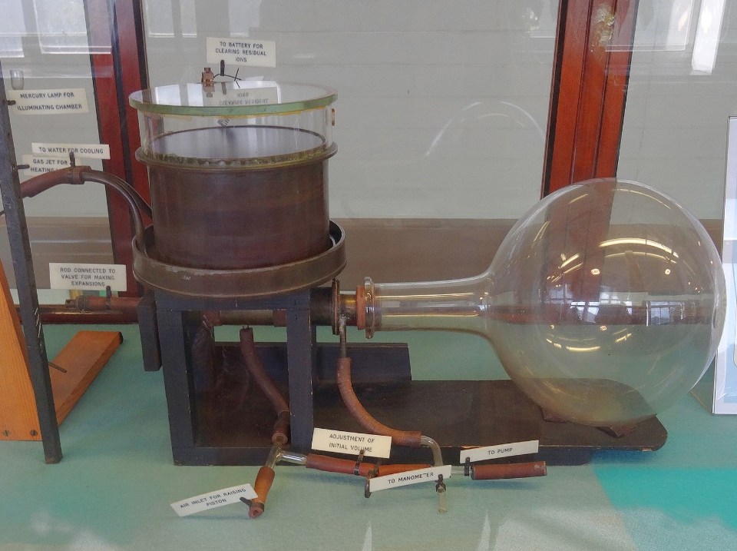
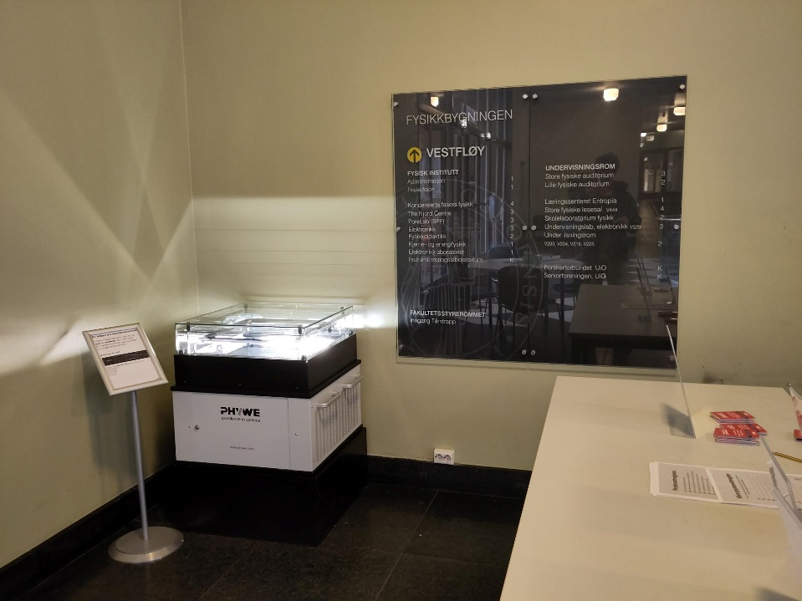
Nacred clouds Oslo. Credits A. Camper. 19.12.2023
The original cloud chamber of C.T.R. Wilson at the Cavendish Lab, Cambridge England. Credits: Rolf Kickuth
Cloud chamber at UiO. Credits A. Camper. 13.10.2023

Slide 4
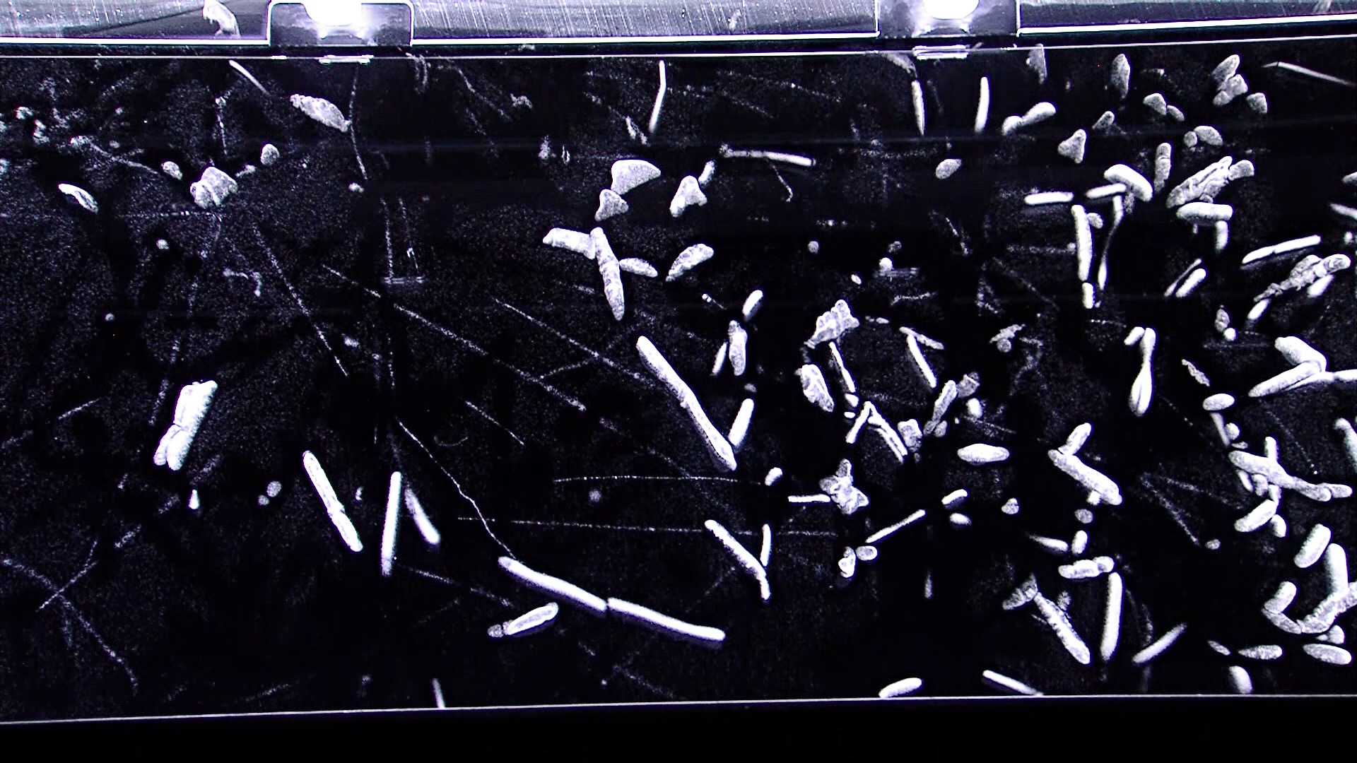
  Cloud chamber with cloud tracks created by particles of ionising radiation (image taken after injection of radon). Credits: Nuledo Cloud Chamber

Slide 5
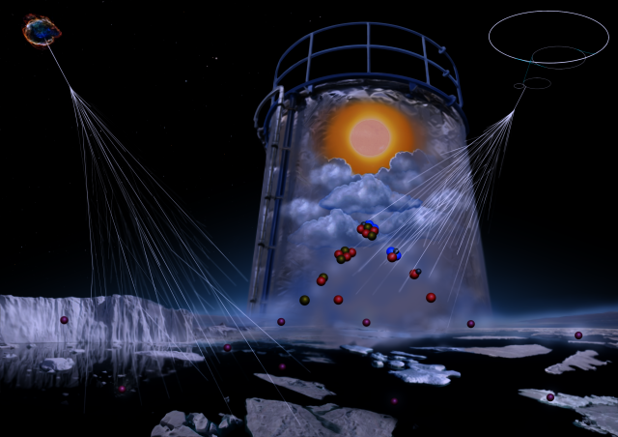
CLOUD (Cosmics Leaving OUtdoor Droplets)
  Simulation of the marine atmosphere in the CLOUD chamber.
  Credits: Helen Cawley
Notes:
Iodine emitted from the sea and ice is converted by ozone and sunlight into iodic acid and other compounds. These form new particles and increase clouds, warming the polar climate. Cosmic rays strongly enhance the particle formation rates.

Slide 6
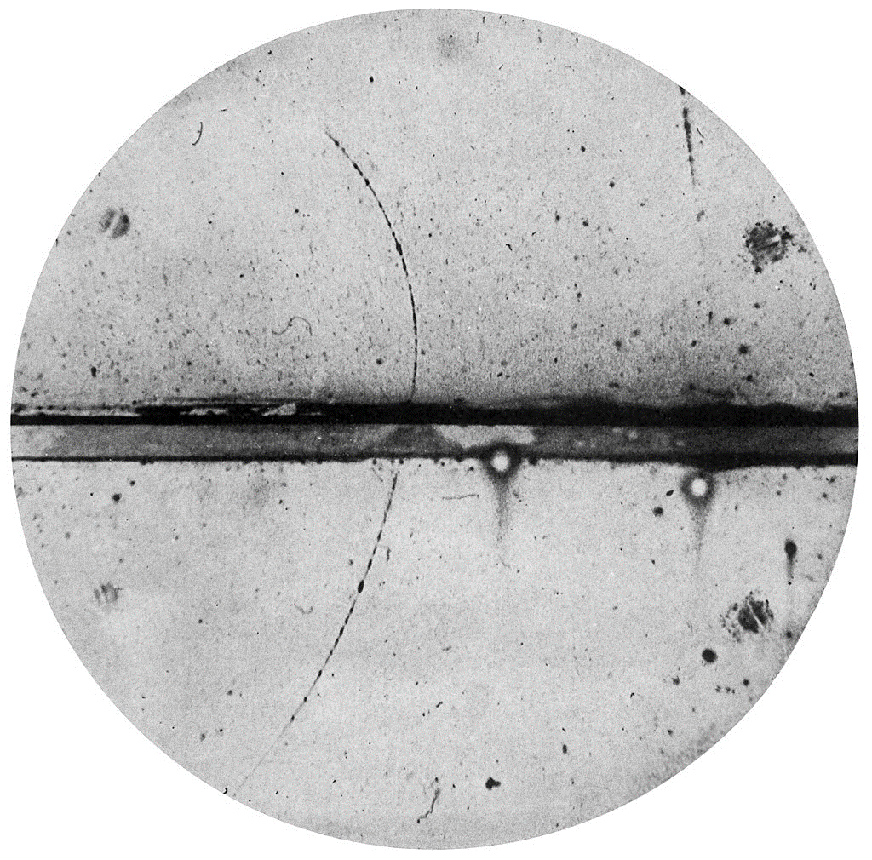
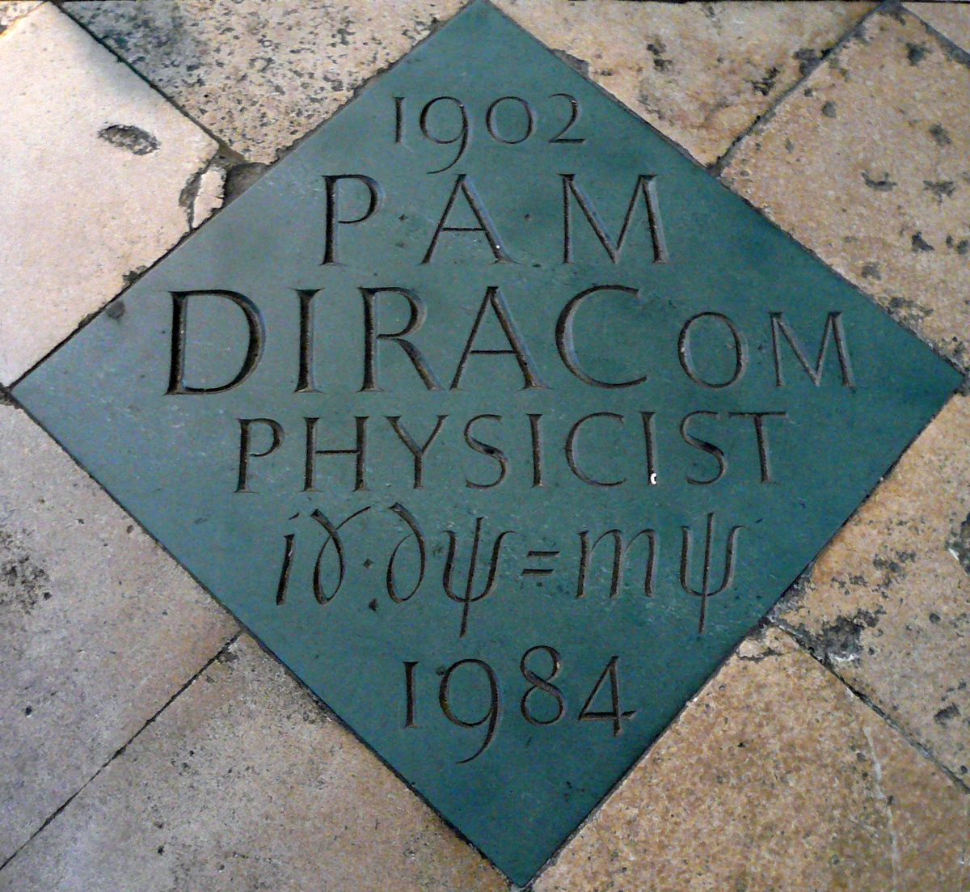
Anderson, Carl D. (1933).
"The Positive Electron". Physical Review 43 (6) 491–494.
Paul Dirac memorial. Westminster Abbey. Credits: Stanislav Kozlovskiy

Slide 7
αντι (anti): opposite
Electron
1932 Caltech
Positron
Proton (uud)
1955 Berkeley
Antiproton (ūūđ)
Hydrogen
1995 CERN
Antihydrogen

Slide 8
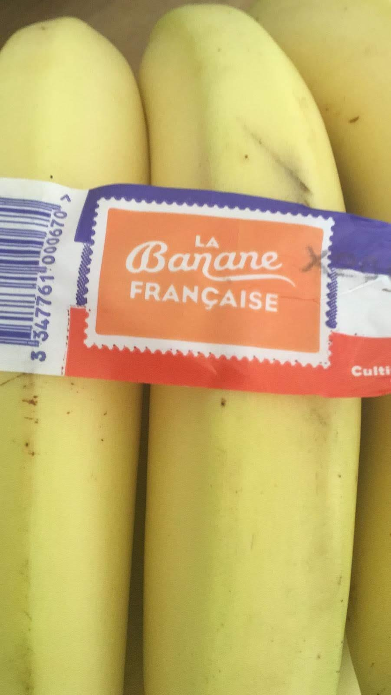

Positron
Proton inside a nucleus
Neutron
Neutrino
β⁺ decay
$$K_{19}^{40}→{Ar}_{18}^{40}+e^{+}+υ_{e}$$
Bananas.
Credits: Antoine Camper

Slide 9
Annihilation
Electron
Positron
E = mc²
γ rays
511keV

Slide 10
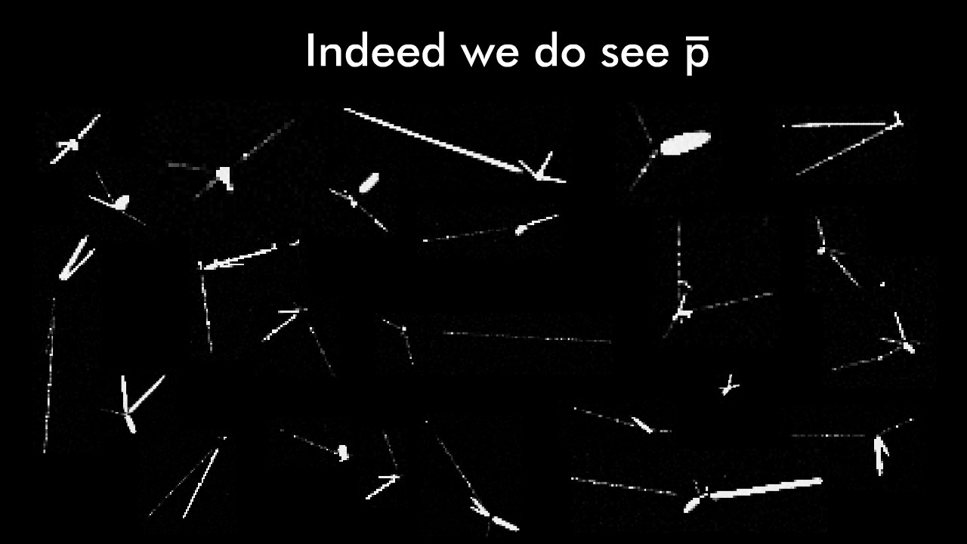
Antiproton decay

Slide 11
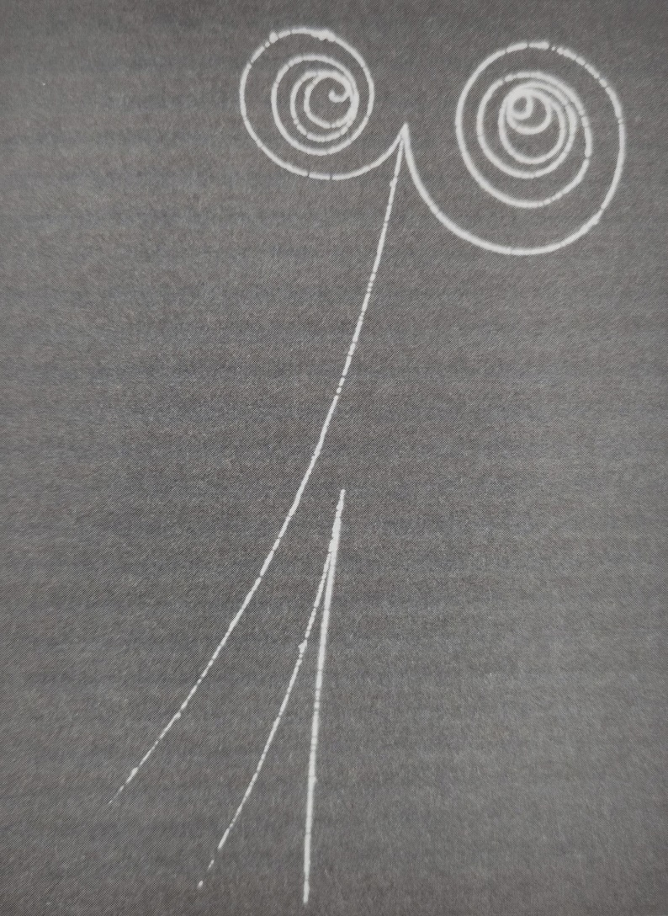
Pair production
Frank Close, Antimatter, p.55
Oxford (2009)

Slide 12
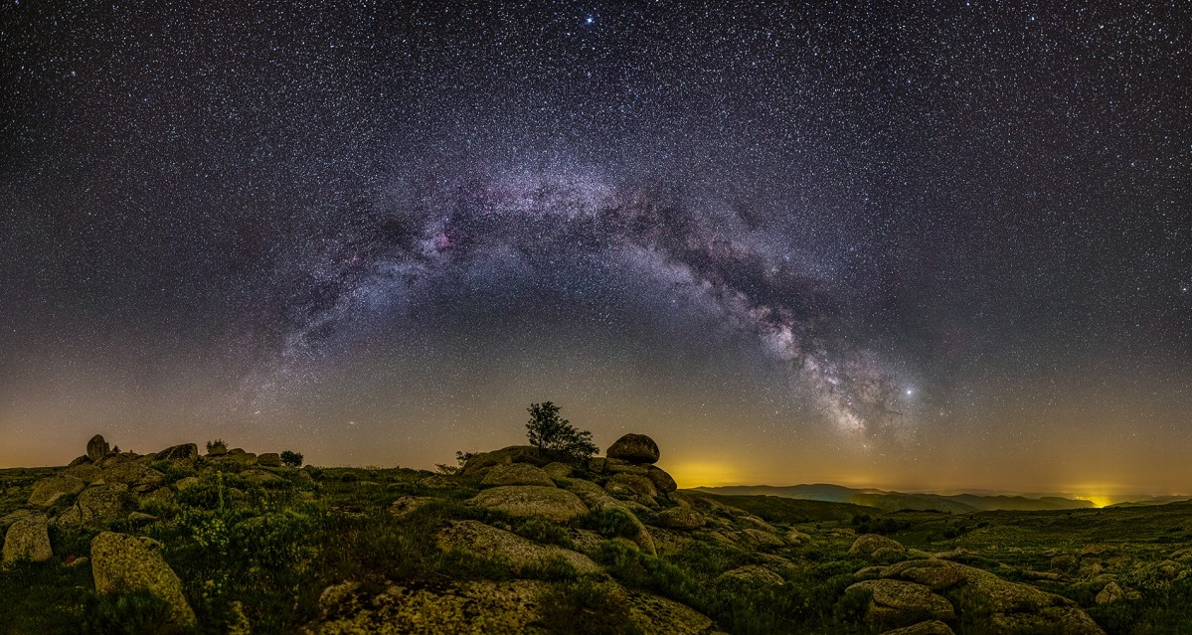
Guillaume Canat, 26.06.2019. Lozère (France)

Slide 13
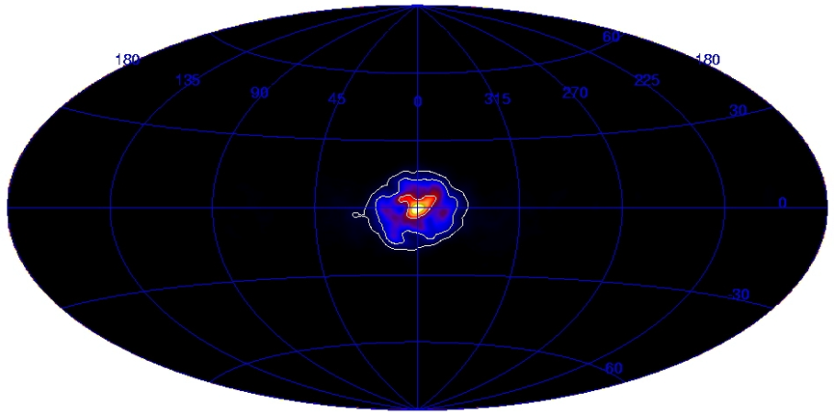
511keV picture of the Milky way.
INTErnational Gamma-Ray Astrophysics Laboratory (INTEGRAL)
European Space Agency
Credits J. Knödlseder - CESR - 2005

Slide 14
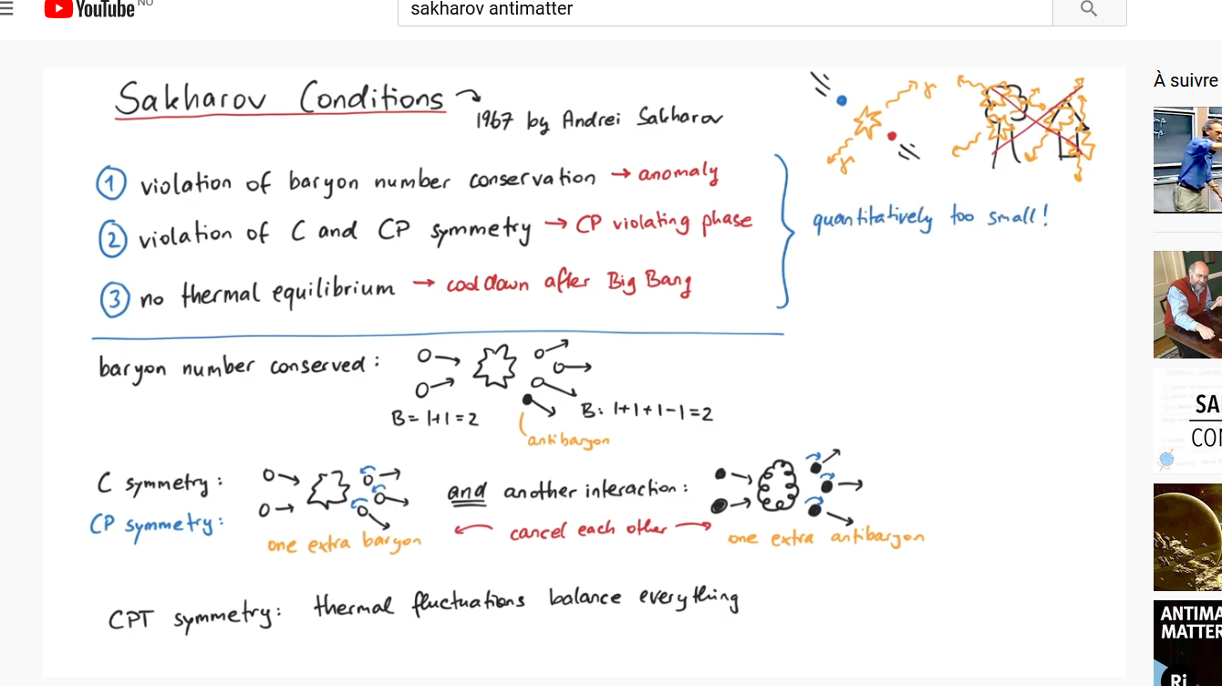
BARYONIC ASSYMETRY
Sakharov conditions (1965):
  Baryon number violation
  CP symmetry violation
  Universe out of thermal equilibrium: thermal fluctuations balance everything
Pretty much physics (youtube)

Slide 15
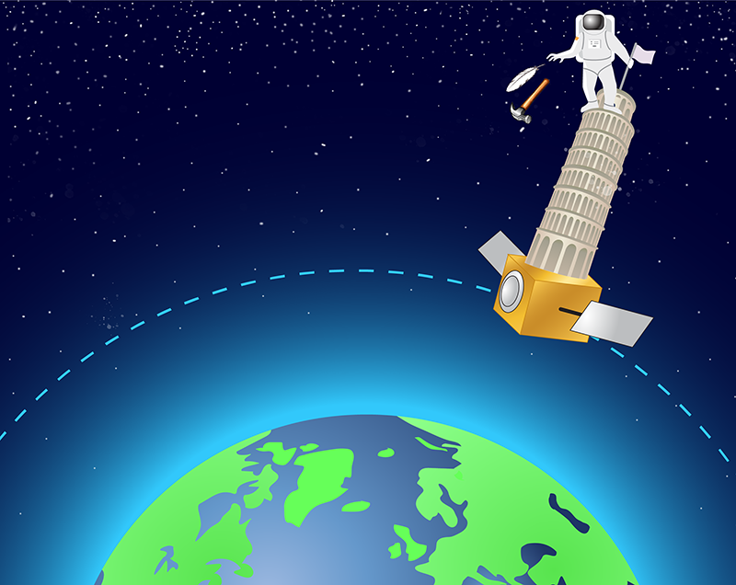
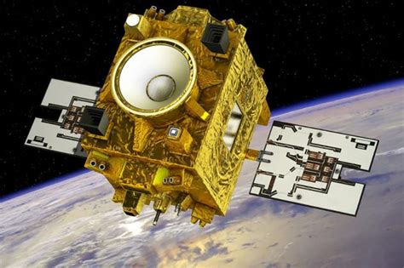
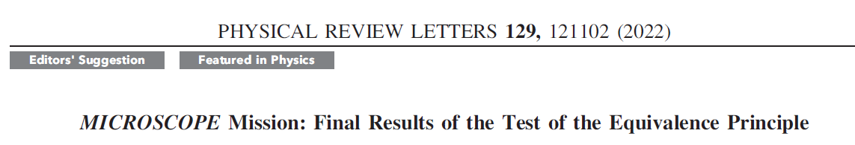
MICROSCOPE mission
Comparative free fall of
Titanium and Platinium cylinders
APS/Carin Cain

Slide 16
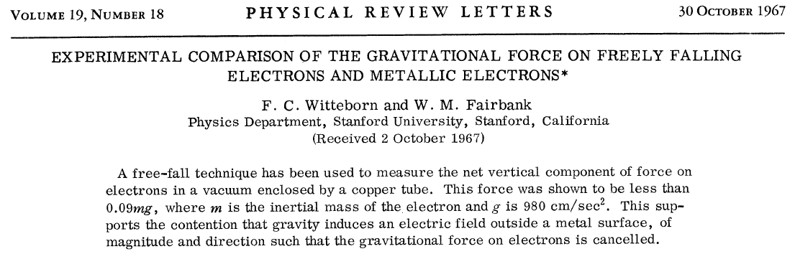
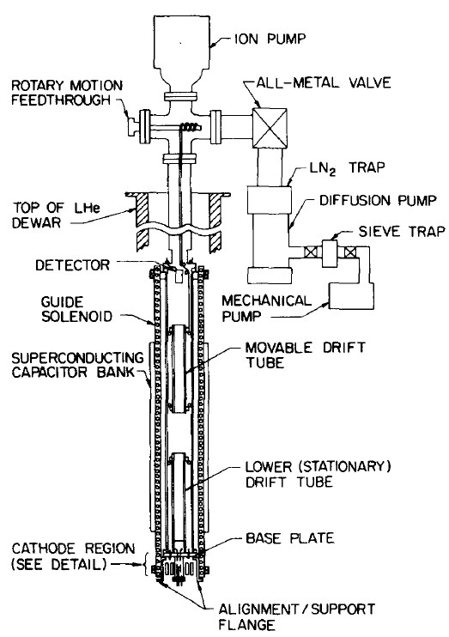
Notes:
Probably this needs another slide or two with more explanation

Slide 17
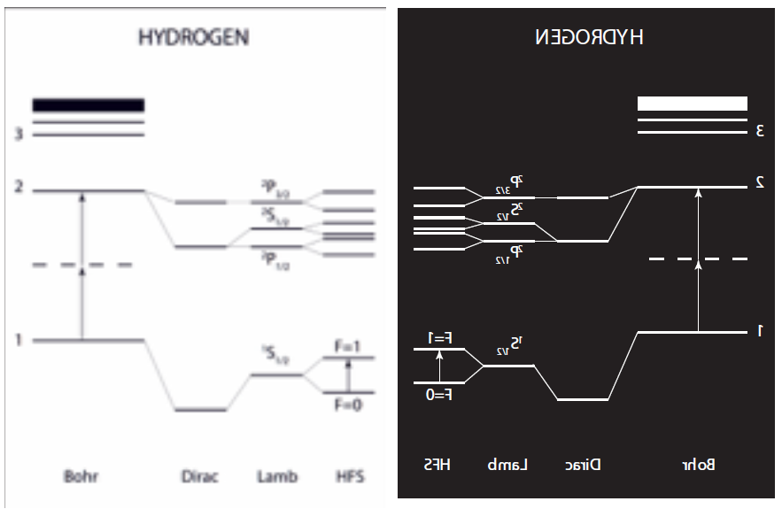


Slide 18
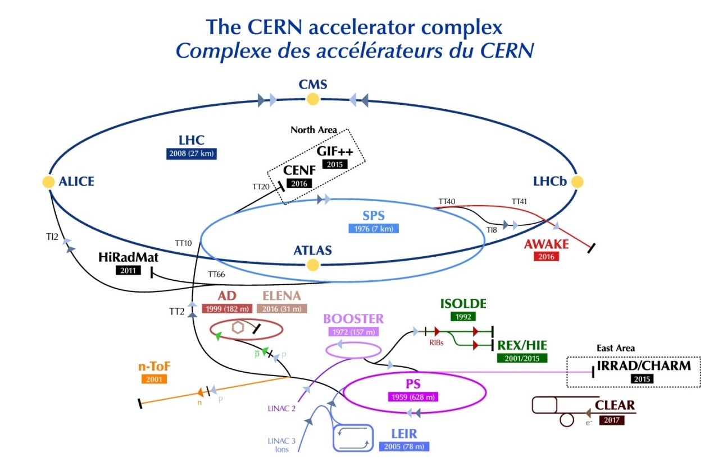

Slide 19
Antiprotons have been used since ~1980, in the beginning mainly for high energy proton-antiproton experiments in the SPS
1980-1986 AA
  3.57 GeV/c Antiproton Accumulator ring
1986-1996 AAC (AA+AC)
  Large acceptance Antiproton Collector ring added to increase capture
  Production rate increased 10-fold to 6*10¹⁰ pbars/h
  10¹² pbars stored (peak). p/pbar collisions in SPS
  + low energy experiments in LEAR
1998 - 2017 AD
  AC converted from fixed energy storage ring to Decelerator. 5*10⁷ pbars slowed down to 100 MeV/c (5.3MeV kinetic). Local experimental area.
2018 - now AD + ELENA (Extra Low ENergy Antiproton ring)
  Addition of a smaller ring for further, controlled deceleration with beam cooling. Much more antiprotons can be captured with cool 100keV pbars.
Courtesy CERN visit centre

Slide 20
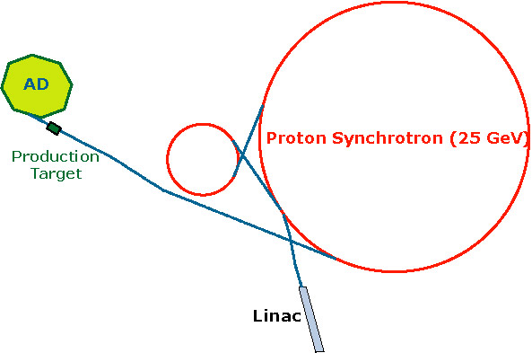
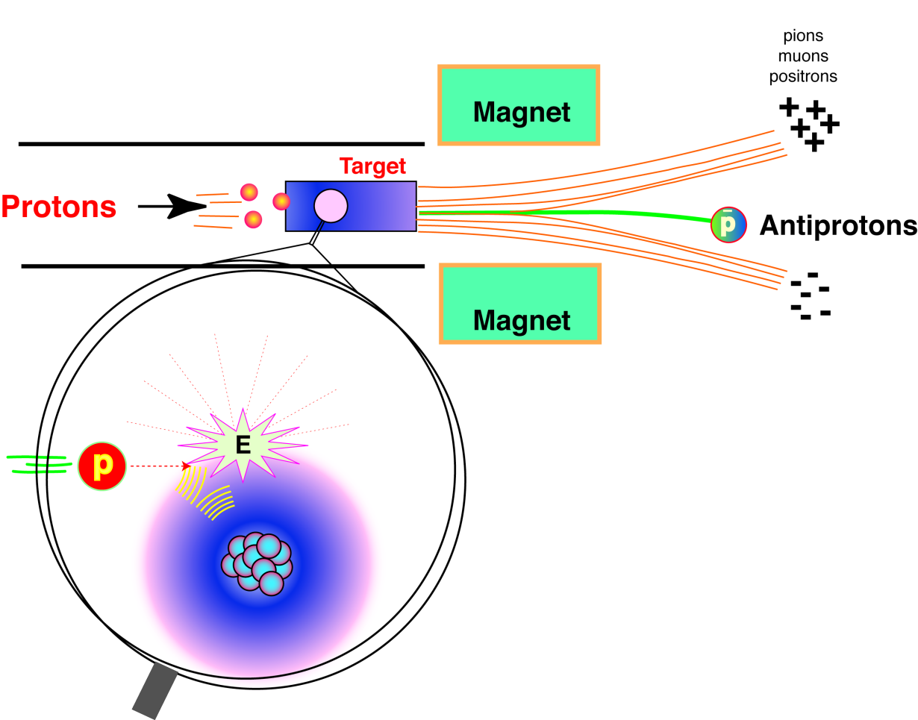
Antiproton Production
Needs (at least) 6.2 GeV of (proton) energy to produce antiprotons
Use the kinetic energy of 25GeV protons readily available at the LHC injector chain
Magnetic fields
used to filter
particles
w. correct
polarity/energy
50,000,000 antiprotons (per 100 s) available at the desired low energy for the present AD experiments
Courtesy CERN visit centre

Slide 21
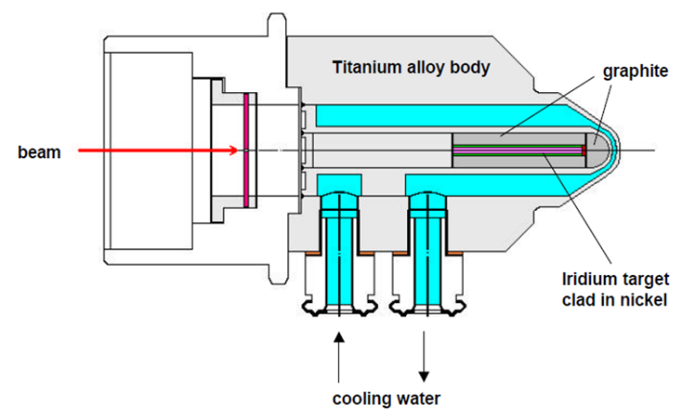
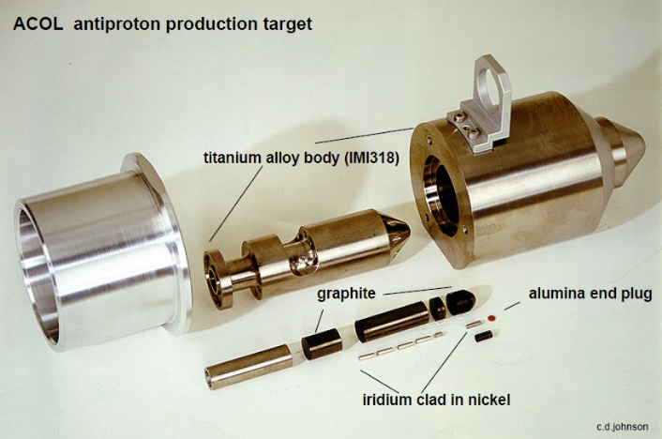
Antiproton production
  Production target:
  Iridium production material
  3*55mm rod
  Graphite cladding
  Water-cooled Ti alloy body
Courtesy CERN visit centre

Slide 22
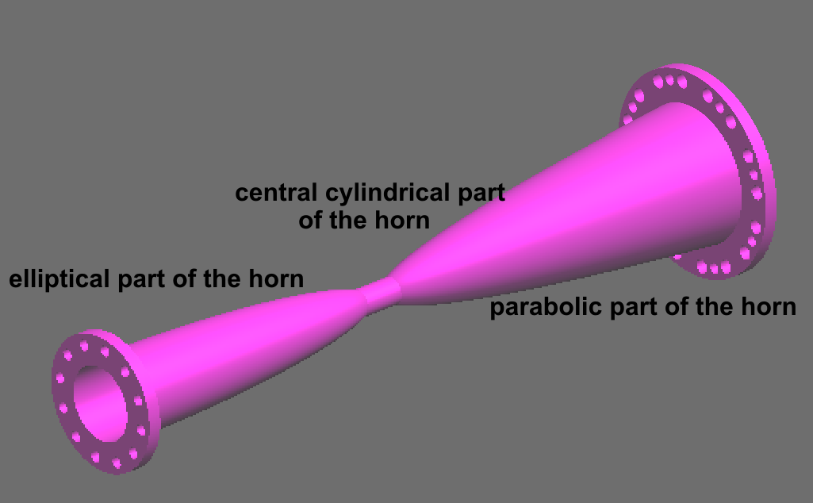
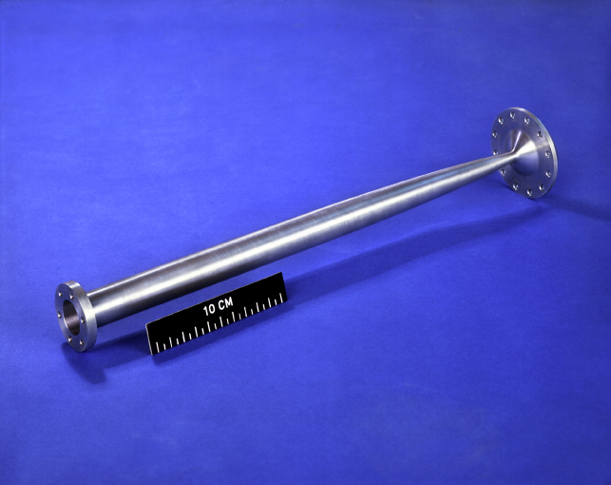
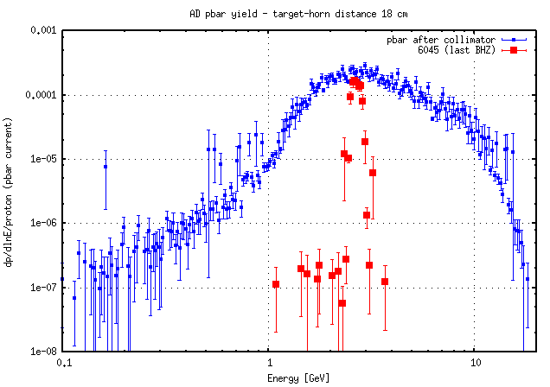
Antiproton focusing – magnetic Horn
With 25 GeV proton beam, antiprotons are collected in the AD ring at 3.6 GeV/c (optimum yield)
But the angular and energy spread is very large…
Magnetic horn acts as an angular focusing lens
400kA, 6kV pulse creates focusing field between outer and inner conductors
Dog-leg shaped injection line filters out energy slice that fits within AD ring acceptance
1.5*10¹³ protons on target yields 5*10⁷ circulating Pbars in AD
Courtesy CERN visit centre
Notes:
-Reliability issues due to mechanical stress
-Highly radioactive area

Slide 23
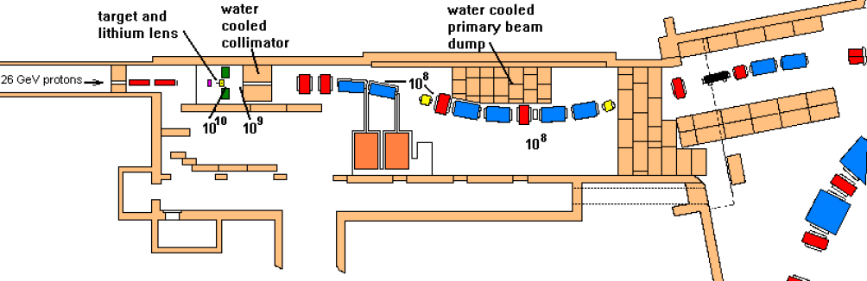
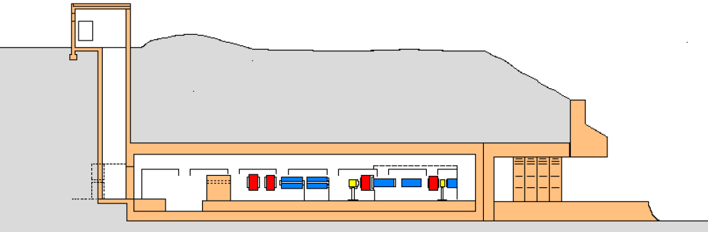
Configuration of the AD-target area
Double spectrometers (reduce the momentum spread of p-bars and associated particles)
Access via lateral tunnel
Courtesy CERN visit centre

Slide 24
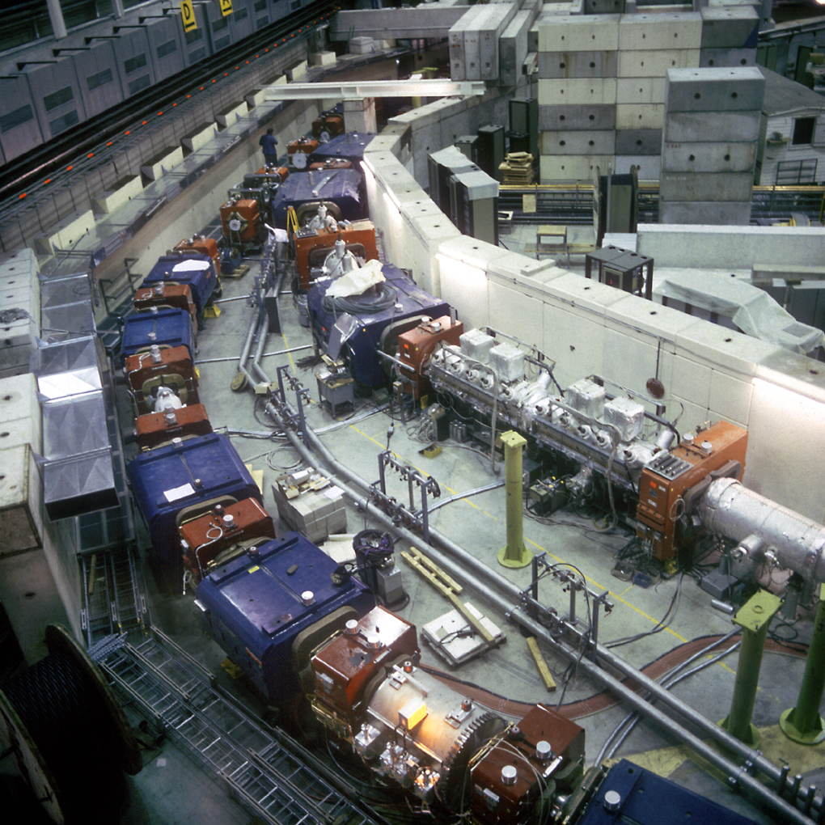
Antiproton Decelerator (AD)
Picture of AAC: Antiproton collector and accumulator rings with shielding roof removed
The outer ring was retained and converted into AD
Courtesy CERN visit centre

Slide 25
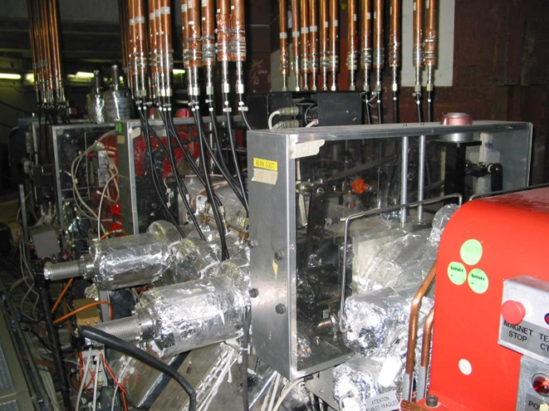
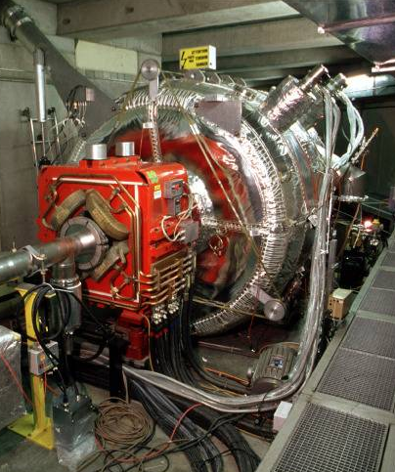
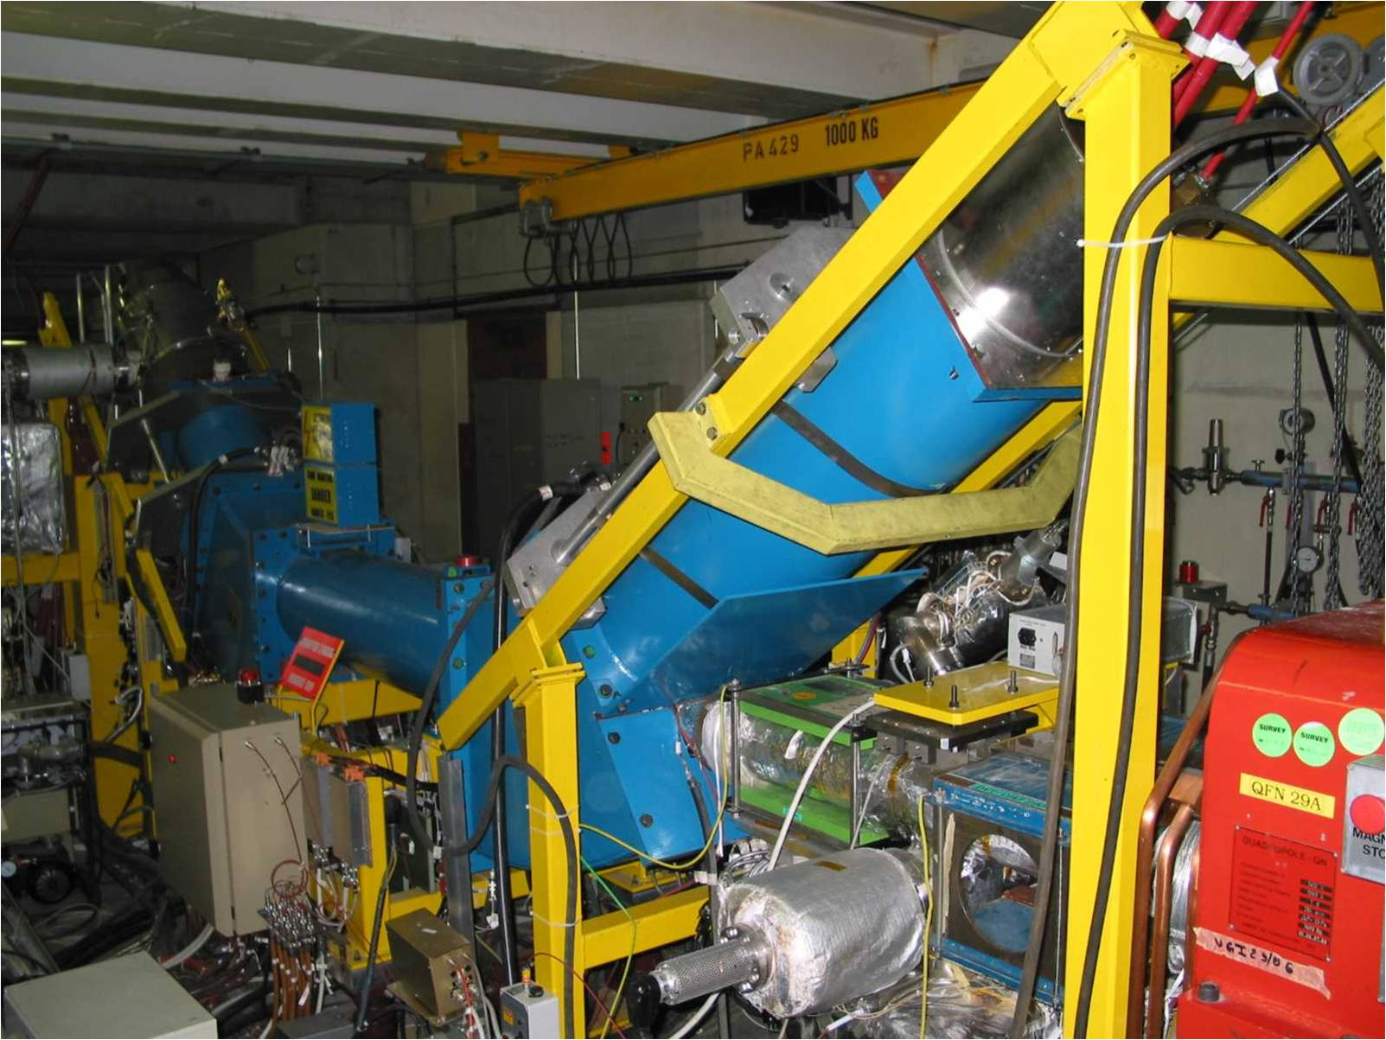
AD machine – inside tunnel
Stochastic cooling pickup tanks:
1 Horizontal & 1 Vertical
inside components Cryo-cooled to 20 K to reduce thermal noise
Moveable inner structures to follow beam size
(picture show kicker tanks with additional transmission lines)
RF cavities for bunch rotation (reduction of energy spread)
10MHz, 600kV each
Electron cooler
30 keV, 2A cathode top right
Collector left
Solenoidal field along blue structure
Pbar orbit correctors on each side
~1m interaction region
Courtesy CERN visit centre

Slide 26
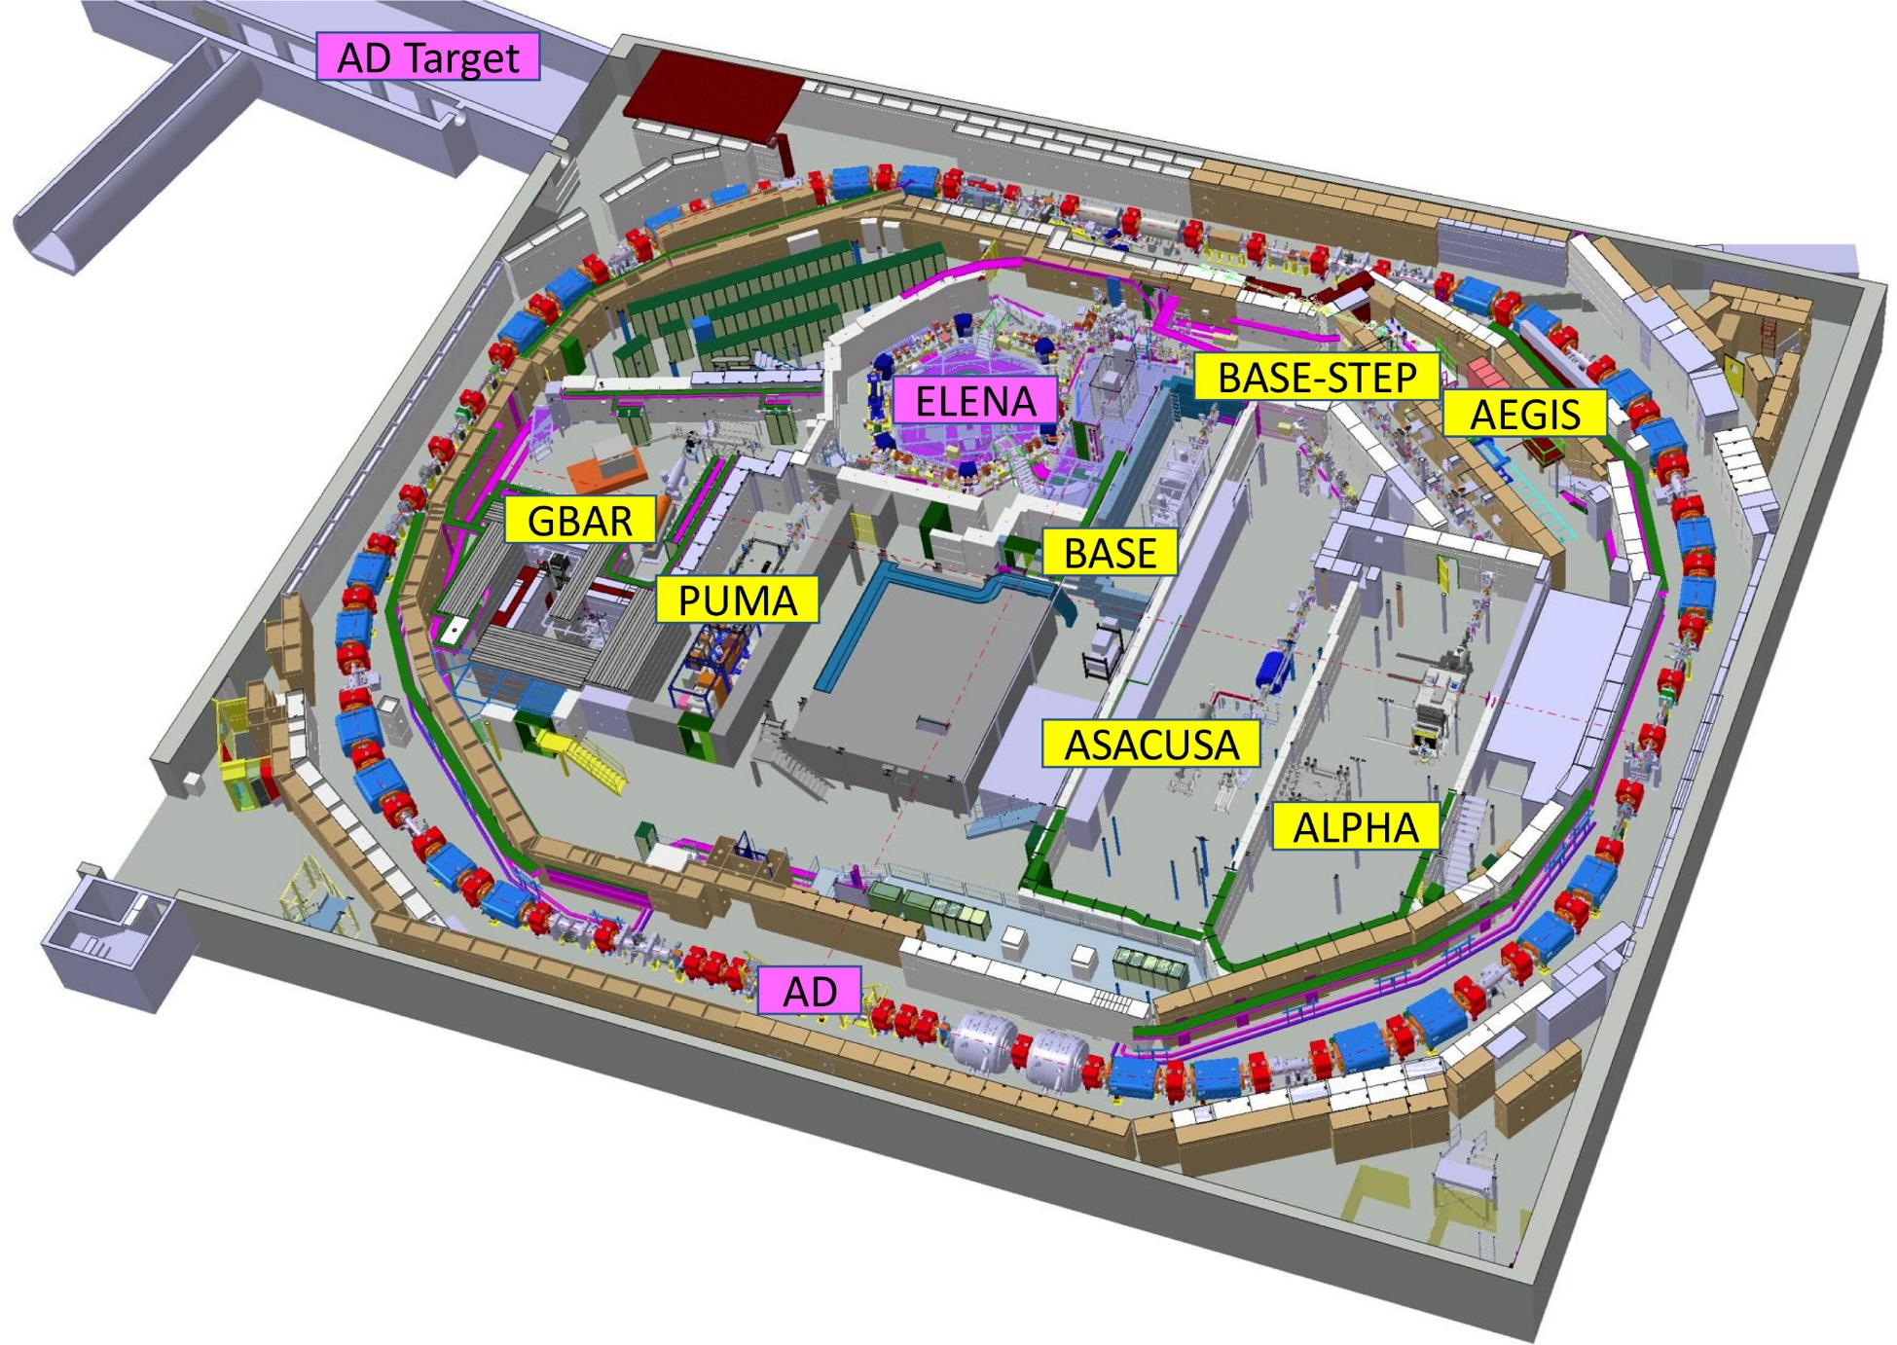
Reproduced from C. Carli et al. Nuclear Physics News 32, 3 (2022)

Slide 27
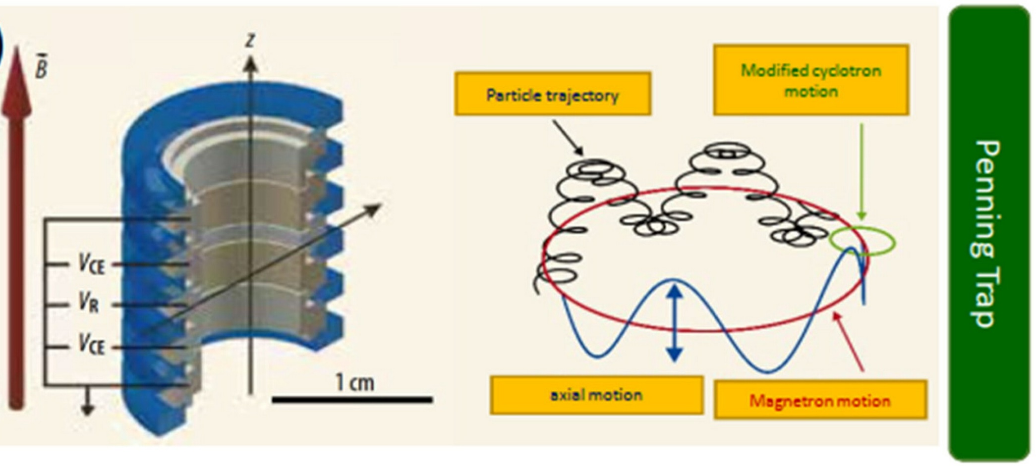
Penning trap
Reproduced from C. Carli et al. Nuclear Physics News 32, 3 (2022)

Slide 28
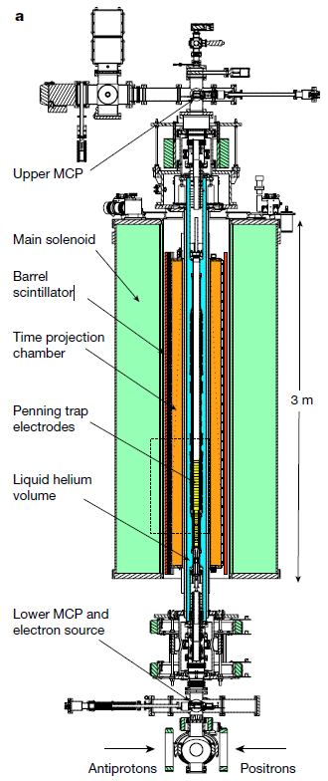
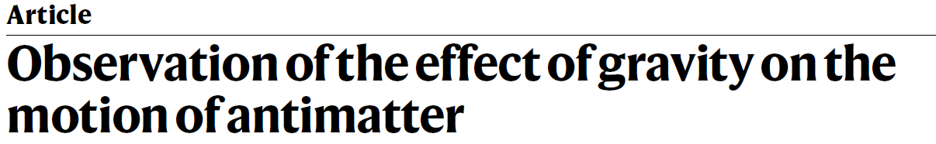
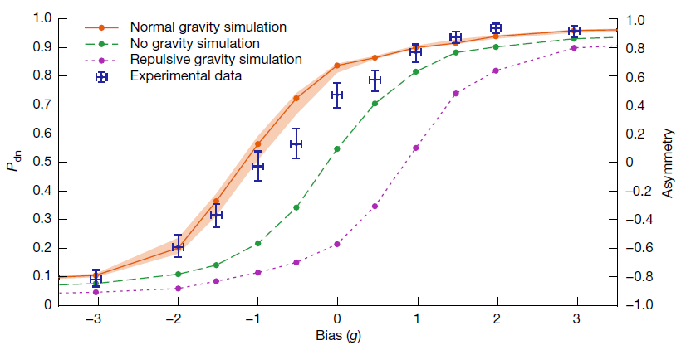






$e$⁺
+
$e$⁺
+
$$\overline{p}$$
$$\overline{p}$$
+
$e$⁺
$e$⁺
Anderson et al. Nature 621, 716-722 (2023)

Slide 29
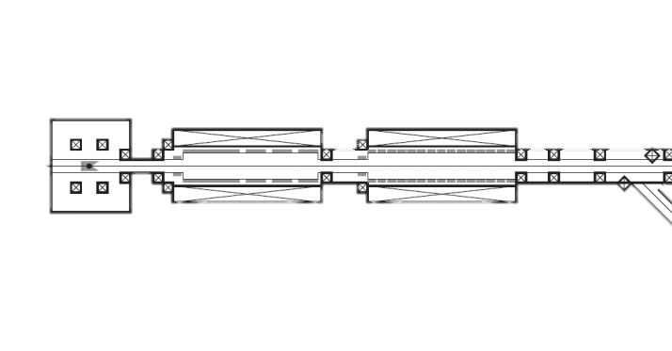
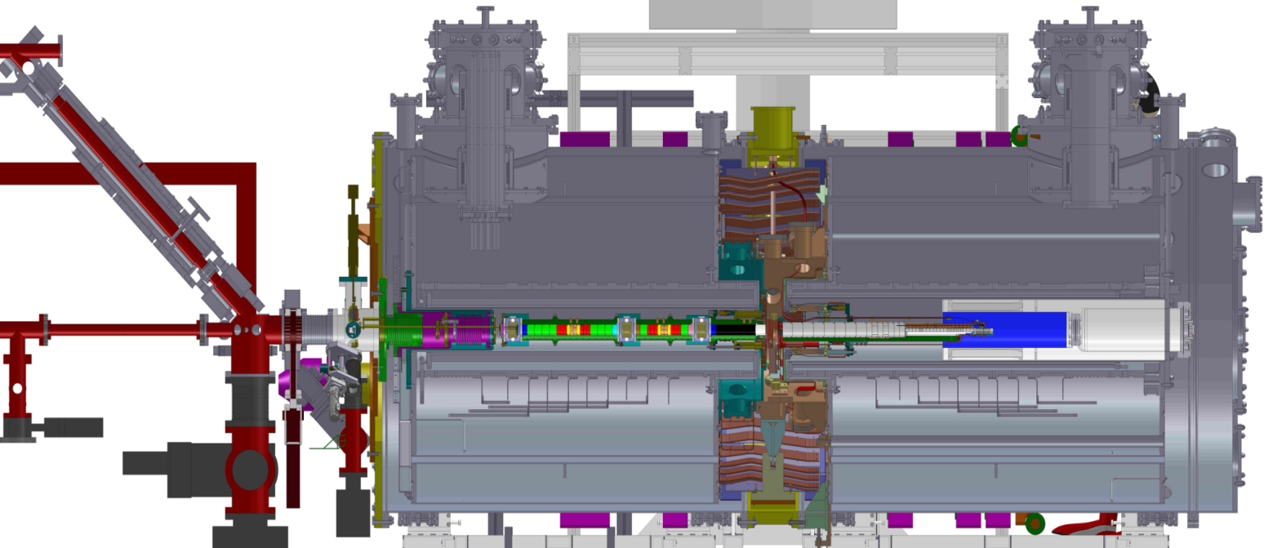
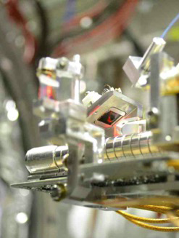
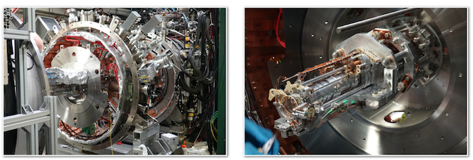
Na²² e⁺ source
4.5 T magnet
1 T magnet
Antiproton beam
Production trap
Catching traps
Notes:
Comments Jan Malamant: Too many complicated words.
My reaction: yes indeed. Make more slides showing 1. only a Penning trap with pbar trapping. 2. only positron source. 3. only Ps formation

Slide 30
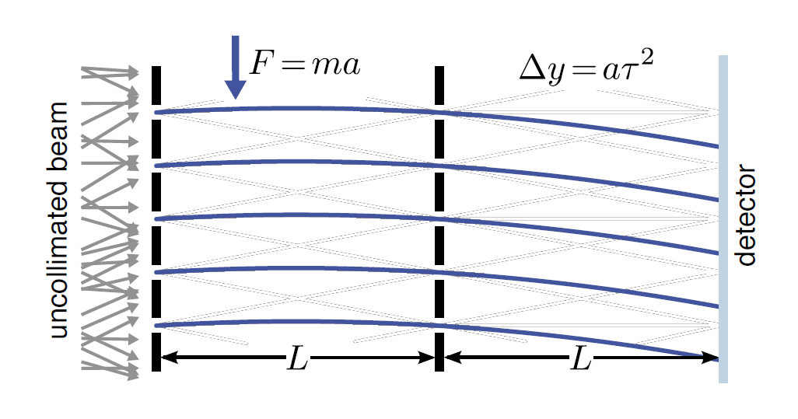
Moiré deflectometer/Talbot-Lau interferometer
g from Δy
requires a pulsed production scheme
1% of g with 1000 antihydrogen at 0.1K
Aghion S. et al (AEgIS collaboration), Nature communications (2013)
Aghion S. et al (AEgIS collaboration), JINST 8 (2013) P08013

Slide 31
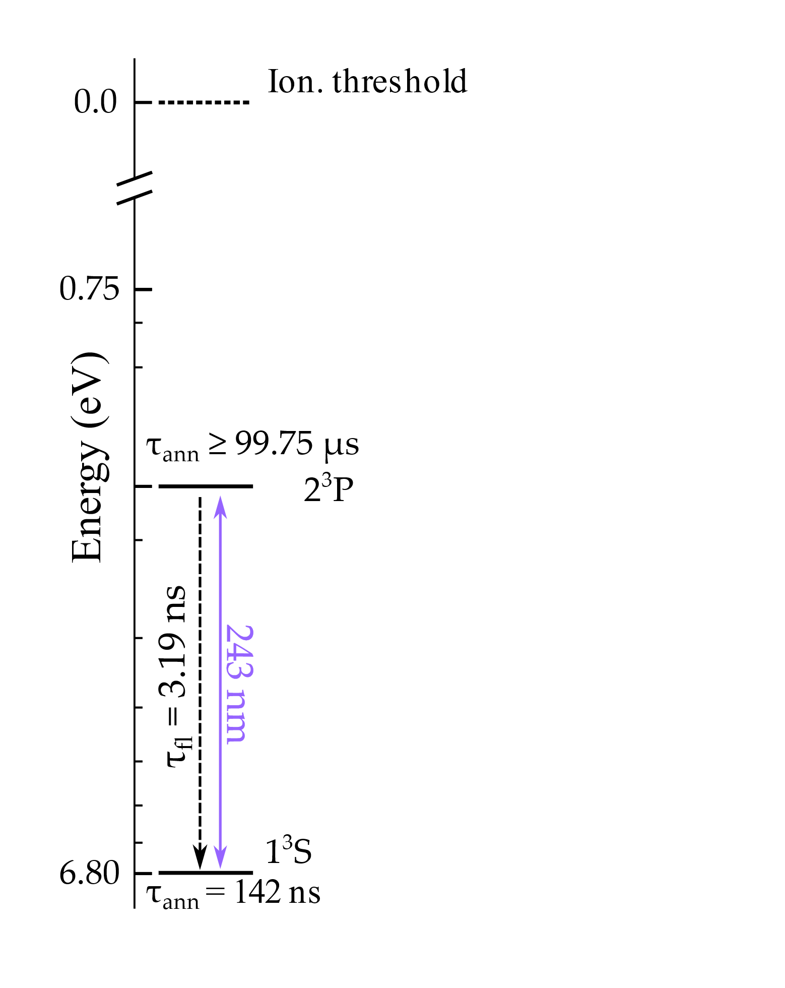
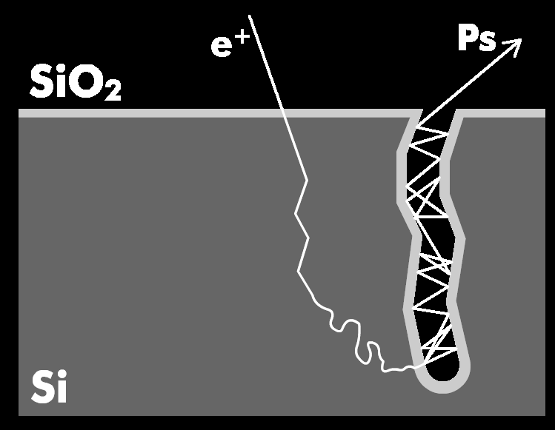


Positron production
Na²² e⁺ source
Positronium (Ps)
$e$⁺
$e$⁻

Slide 32



Positronium (Ps)
Antiproton
Antihydrogen
$e$⁻
+
$$\overline{p}$$
$$\overline{p}$$
$e$⁺
$e$⁺
142 ns lifetime
$e$⁻

Slide 33

Credits Olivia Adams (CERN, 2023)

Slide 34
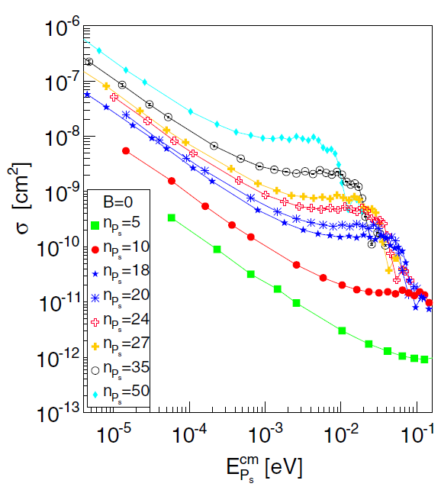
Krasnicky D., Caravita R., Canali C., Testera G., PRA 94 (2016) 022714

Slide 35
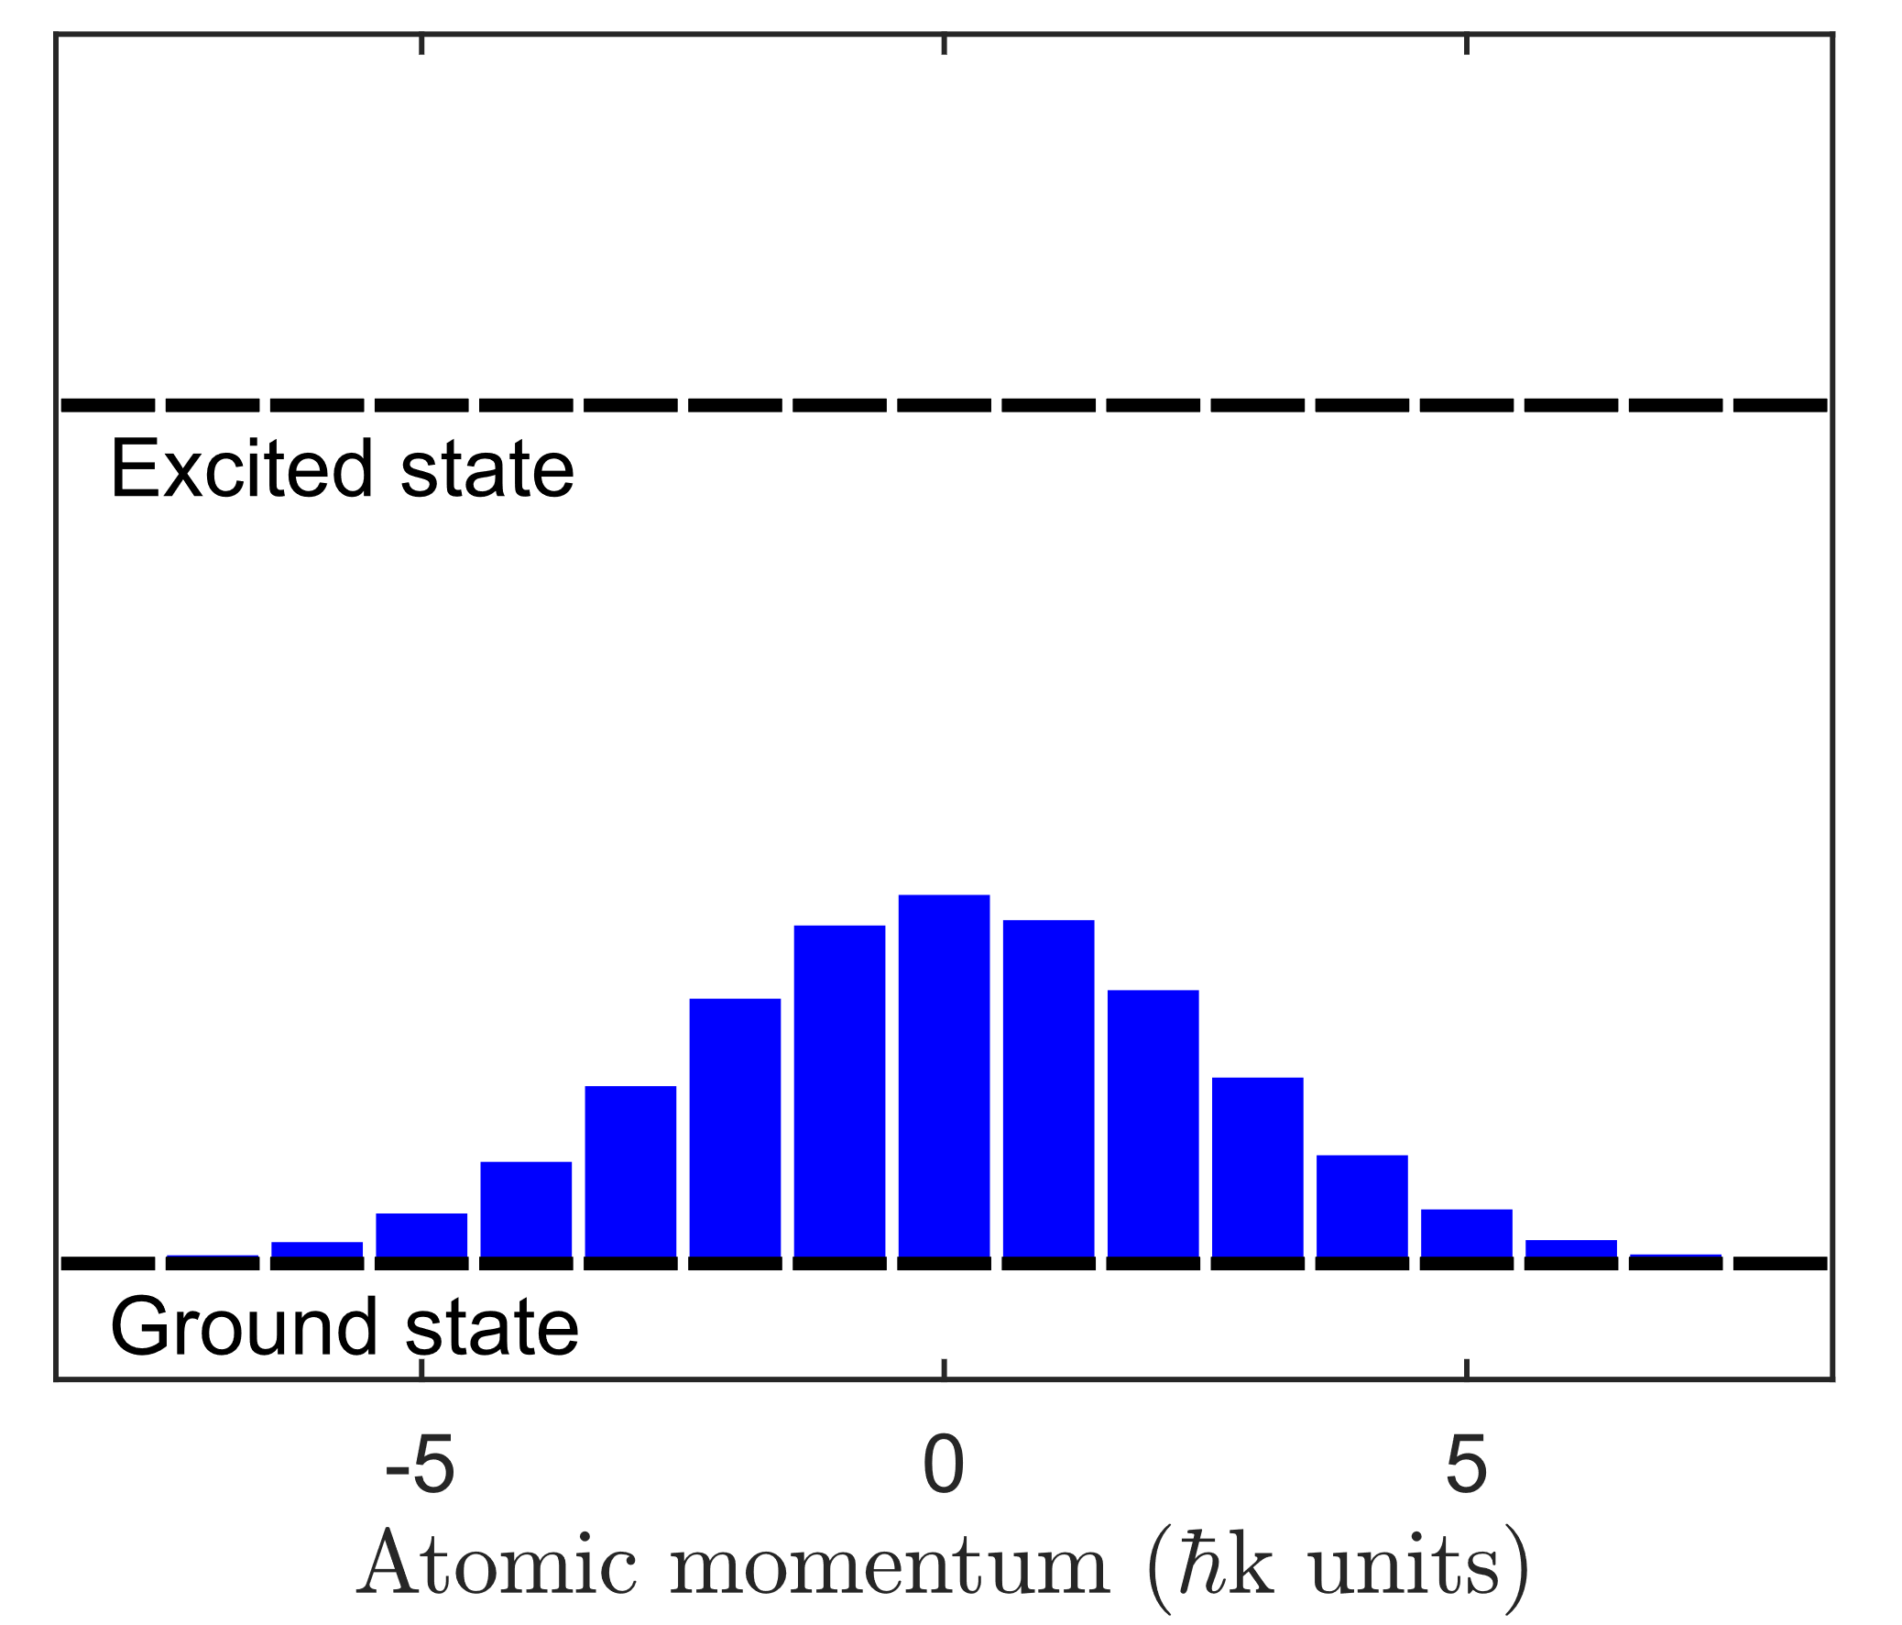
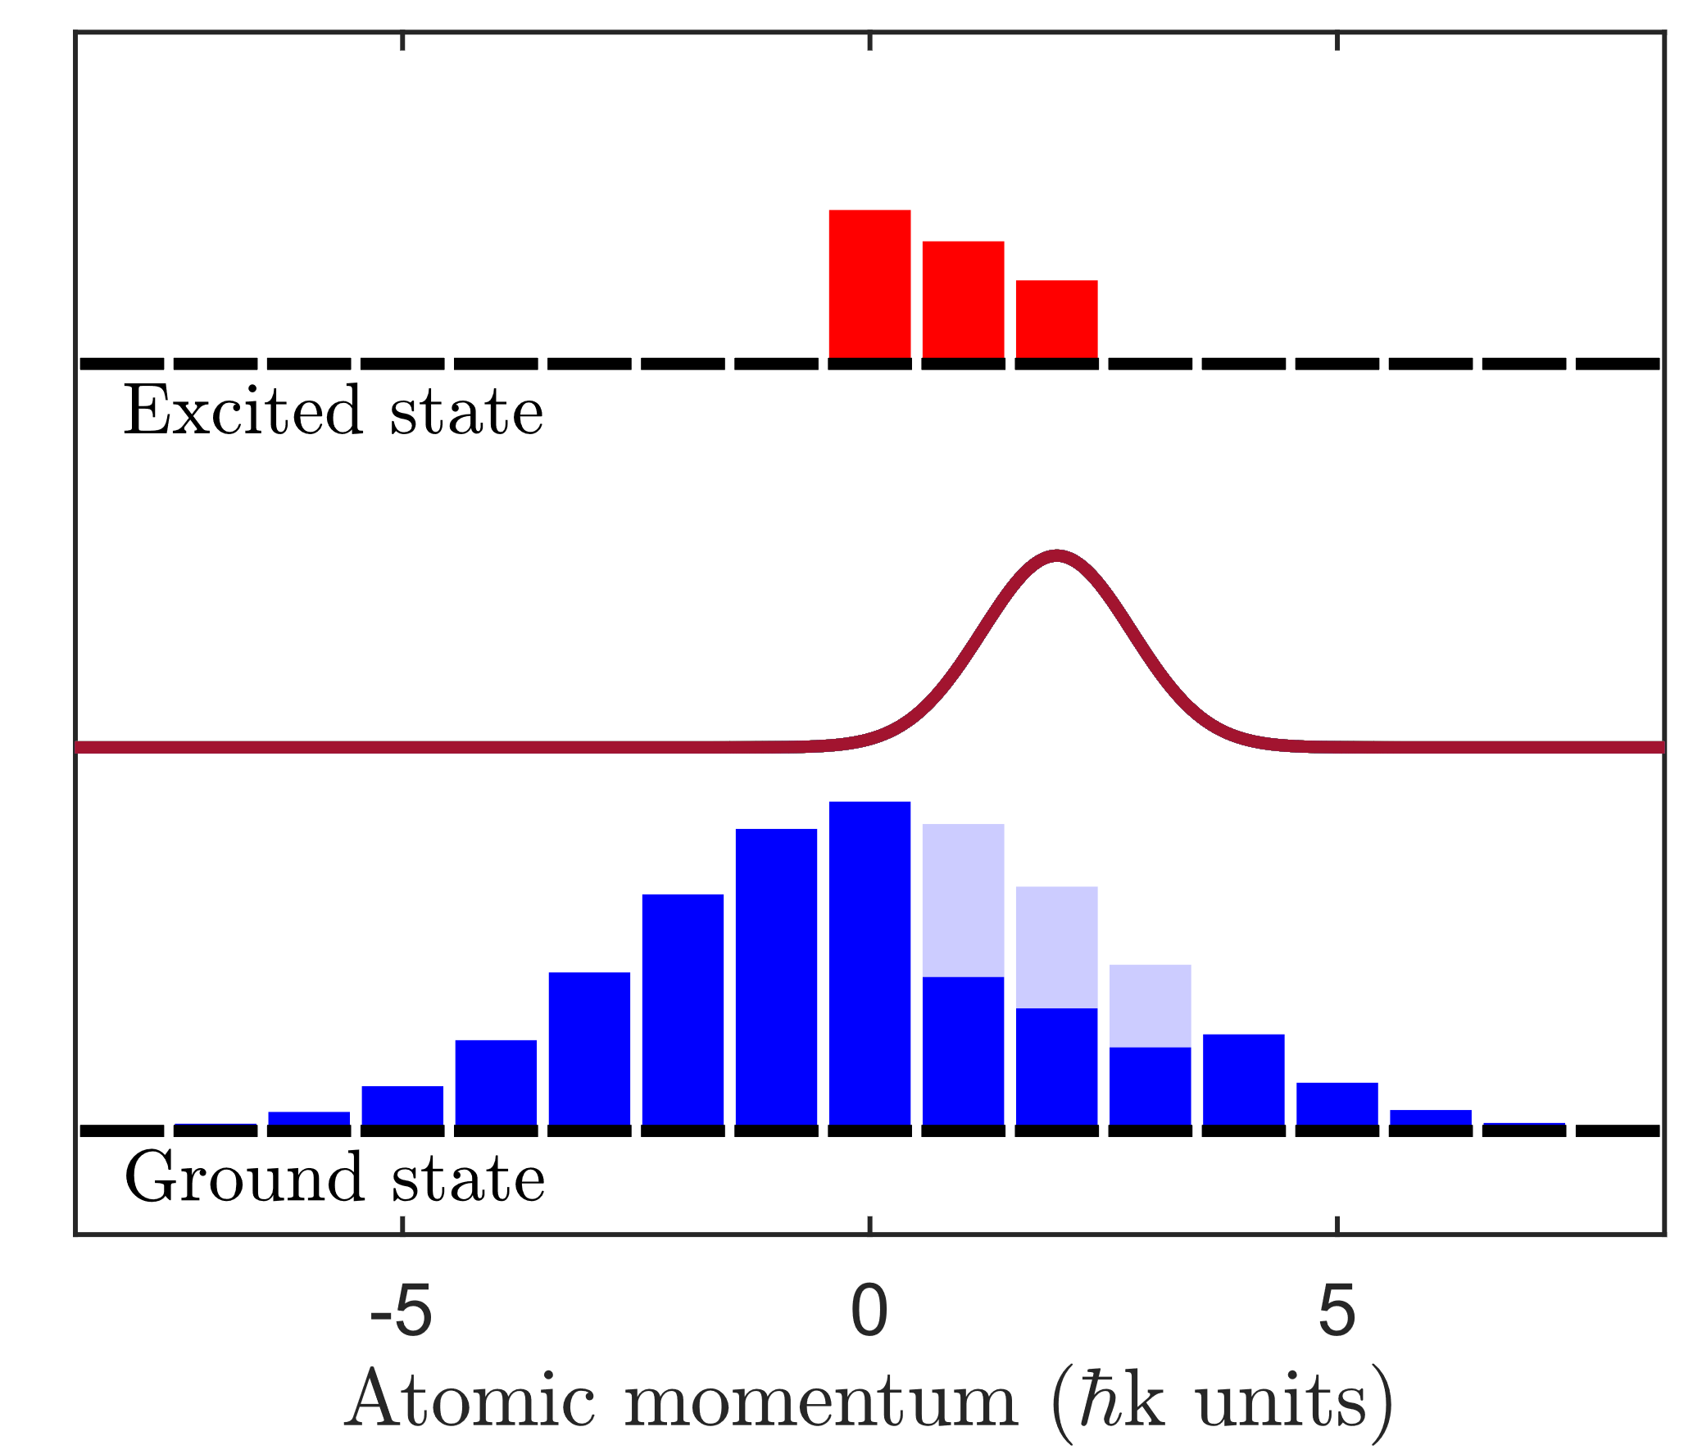

Absorption
Spontaneous emission

Slide 36







Slide 37

Credits: CERN press service

Slide 38




SSPALS Doppler velocimetry
Photo-positron annihilation
$$−S_{205+1064}=\frac{S_{OFF}−S_{205+1064}}{S_{OFF}}$$

Slide 39



Lamb Dip spectroscopy

Slide 40



SSPALS lifetime extension spectroscopy
$$S_{243}=\frac{S_{OFF}−S_{243}}{S_{OFF}}$$

Slide 41




Doppler profile narrowing
$$−S_{cool}=S_{243+205+1064}−S_{243}$$

Slide 42

Thanks for your attention!

Slide 43
Positronium laser cooling
Ps BEC gamma ray laser
Production of positron with lasers – maybe if we find the origin of the baryonic asymmetry we will find a way to make its production more efficient. Or maybe doing so we will develop something different and we haven’t thought of yet
Message to the students: if you want to do physics but think data/AI has a higher job secutiy, don’t worry all physics PhD students in Norway end up doing AI/data analysis

Slide 44
Felleskollokvium
M M Mieto; European Strategy Update
Where is all the antimatter gone? Cosmology, gamma-rays, CP violation, Dirac-Milne Universe
Why gravity on antimatter?
Why antihydrogen? Pauline Comini, Brauning
Production of Hbar in AEgIS and scheme to measure the freefall (SFP 150, principle of the deflectometer, experiment realized with pbars, magnitude of the force measured and comparison with the required sensitivity and experimental dimensioning) ; my grant, Jan’s master thesis, Natali’s PhD on Ps laser cooling.
AEgIS news (record high pbar trapping with ELENA)
What else are pbars good for? Measure vacuum with extremely high precision; produce trappable fully stripped ions; nuclear tweezers/editors; NASA (lift up a rocket with 1g of antihydrogen)
Learn about the baryonic asymmetry to find a way to control the formation of antimatter and optimize its production (cascade?) and open up all opportunities offered by antimatter (rocket launching, cancer treatment, energy storage)
- production of positrons with lasers (more efficient production of antimatter?)
Give a view what your experience as a researcher
A Norwegian PhD in physics often ends up doing AI/data
Antimatter is about nuclear physics, accelerator physics, gravity, atomic physics, astrophysics (spectroscopic difference between H and Hbar, positron binding atoms…) and has applications in medical imaging, energy,

Slide 45
European Strategy Update
Preamble: « many of the mysteries about the universe, such as the nature of dark matter, and the preponderance of matter over antimatter, are still to be explored. »
BARYONIC ASSYMETRY
Sakharov conditions:
  Baryon number violation
  CP symmetry violation
  Universe out of thermal equilibrium: thermal fluctuations balance everything
Pretty much physics (youtube)

Slide 46


«The first priority is the completion of the programme of measurements of the oscillation parameters, most notably the CP-violating phase of the mixing matrix and the neutrino mass ordering. »
Neutral meson oscillations
LHCb (2020):
1st observation of time-dependent CP violation in B_{s}⁰ mesons, in their decays into charged K mesons.
K⁰(d$\overline{s}$): Brookhaven (1964)
B⁰(dƀ): Babar and Belle (2001)
B⁰_{s}(sƀ): LHCb (2013)
D⁰(cū): LHCb (2019)
Going on
ATLAS & CMS
Searching for matter–antimatter asymmetry in the Higgs boson–top quark interaction
DUNE: CP violation in the lepton sector

Slide 47
A tool for dark matter research: axions
ALICE:
New results on the production rates of antideuterons based on data collected at the highest collision energy delivered so far at the Large Hadron Collider. […] the presence of antideuterons in space is a promising indirect signature of dark matter candidates.
BASE:
The BASE collaboration reports the first laboratory search for an interaction between antimatter and a candidate particle for dark matter
₋ d u

Slide 48


AMS-02: Alpha Magnetic Spectrometer
Antimatter in cosmic rays
Aguilar et al., Phys. Rev. Lett. 113, 121102 (2014)

Slide 49
Synergies with neighboring fields
Section 5 of the deliberation document - Synergies with neighbouring fields: «There are also synergies with atomic physics, as exemplified by the antihydrogen experimental programme at CERN’s AD antiproton decelerator and its upgrade, ELENA.»
The quest for new physics with the Physics Beyond Colliders programme, J. Jaeckel et al. Nat. Phys (2020):
«Lower-energy facilities, such as […] the antimatter factory, have been recently upgraded […] and were therefore not considered within the PBC study. »

Slide 50




Nuclear physics with antiprotons
BASE-STEP
d d d
ISOLDE and the PUMA (antiProton Unstable Matter Annihilation)
d d d
d d d
d d d
10⁹
d
d d d
d d d
d d d
d d d
d d d
d d d
d d d
d d d
d d d

Slide 51
Conclusion
Antimatter is part and will be part of:
Search for CP violation beyond the Standard Model
Search for dark matter
Astroparticle physics
Search for CPT violation (atomic physics)
Nuclear physics

Slide 52

“But in any event, it is in the hands of our generation to perform an experiment
to measure the gravitational acceleration of antimatter. Some day it will be done,
whether we do it or not. It will be done. If we do not do it, and the answer eventually
turns out to be what we expect, then future generations will look back upon us a say
it was a shame. But if the answer turns out to be a surprise, then, if we do not do it,
future generations will look back upon us and say we were fools.”

Slide 53



Slide 54

Antimatter moiré deflectometer
Velocity 350 m/s (T = 5K)
Length 0.5m
$τ\sim {10}^{−3}$s
d = 10⁻⁴ m
$φ= \frac{2π}{d}∆y=\frac{2π}{d}a$ $τ^{2}$
Resolution $R_{acc}=\frac{dφ}{da}=2π\frac{τ^{2}}{d}\sim \frac{2π}{100}$
Minimal detectable acceleration
$$a_{min}=\frac{1}{R_{acc}C\sqrt{N}}$$
$a_{min}$ = 1 m/s² for N = 10⁴ and C = 0.16
Aghion S. et al (AEgIS collaboration), Nat Comm 5:4538 (2014)

Slide 55

Positronium production
ion
15
12
10
Positronium (Ps)
<1650nm
8
7
$e$⁺
6
5
4
$e$⁻
3
142 ns lifetime
2
205nm
1
05/07/2023
Antoine Camper
55

Slide 56



Antiproton Decelerator / ELENA
Probing the Weak Equivalence Principle on antimatter:
  gravity on neutral antimatter
Search for CPT violation:
  antihydrogen spectroscopy
  antiproton magnetic moment
  antiprotonic helium (masse of antiprotons)
  antiproton Electric Dipole Moment
«… flavour physics and CP violation, which play a vital role in determining the parameters of the Standard Model, are explored by a wide spectrum of experiments all over the world. These include measurements of electric or magnetic dipole moments of charged and neutral particles, atoms and molecules, …»

