Slide 1


Knowledge Transfer @ CERN
Sandra Muhr
Knowledge Transfer Officer - Medical Applications
Knowledge Transfer Group
CERN

Slide 2
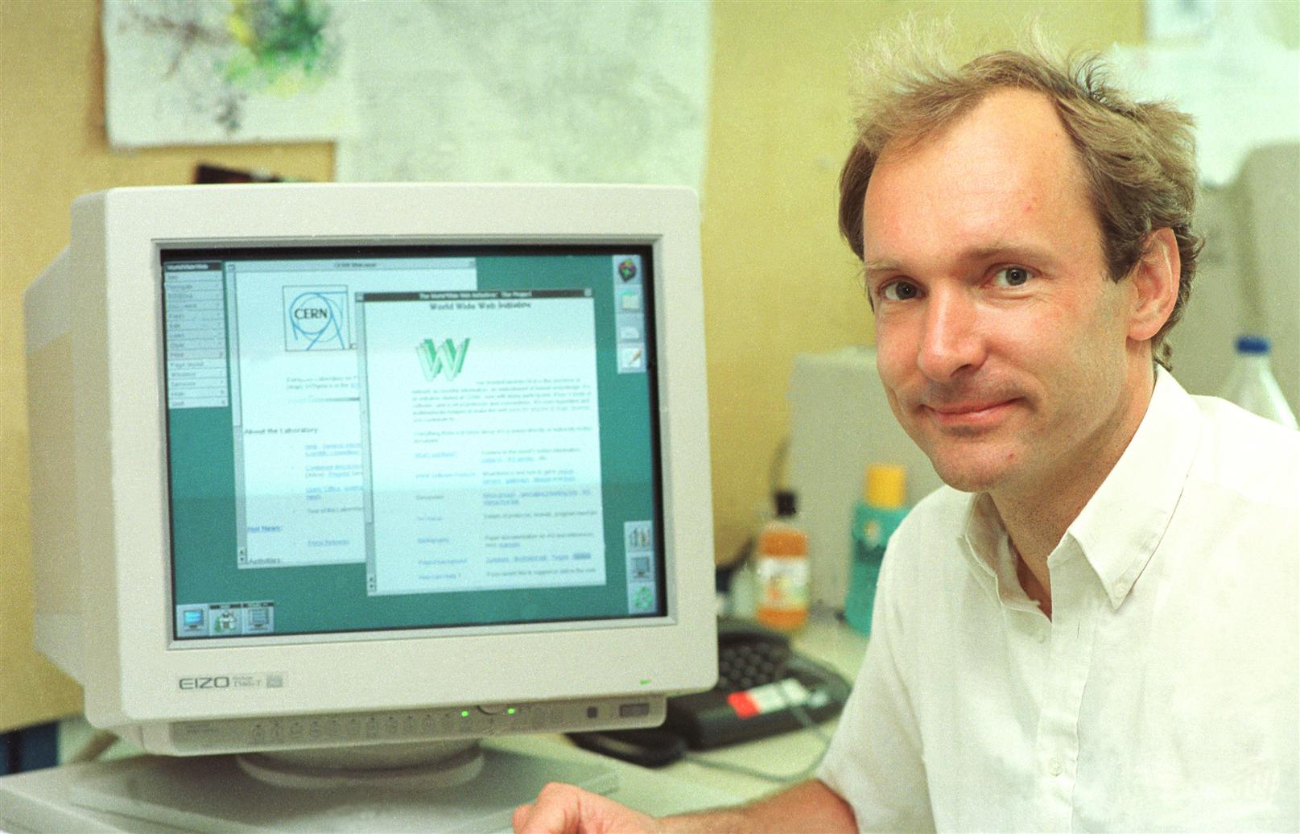
The World Wide Web born at CERN, later used by everyone…

Slide 3
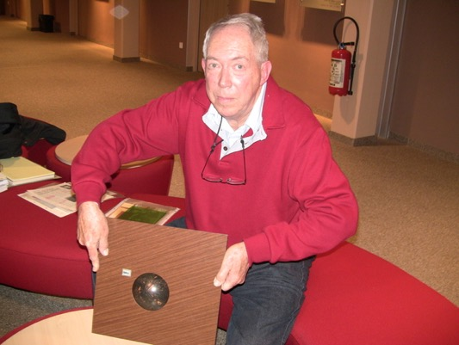
Trackball with optical encoders, used later in the mouse of a PC…

Slide 4
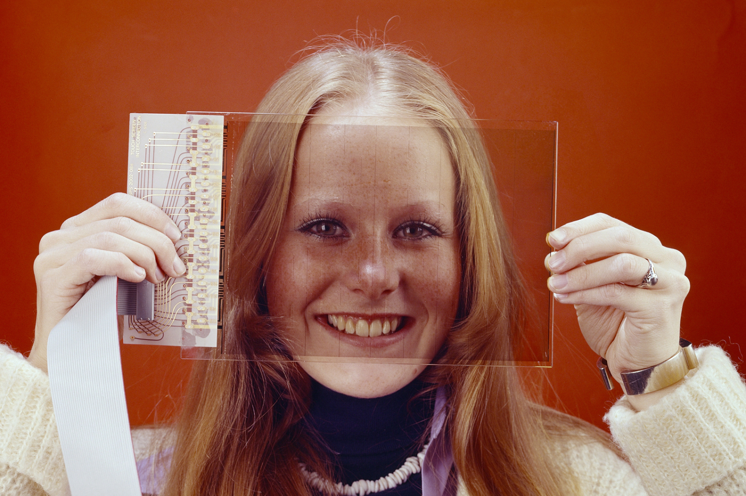
The first touchscreen to exist was at CERN, later used everywhere…

Slide 5
Competences at CERN
Machine Learning and Deep Learning
Industrial Controls and Automation
Metrology
High and Ultra High Vacuum Systems
Data Analytics
Health, Safety and Environment Management
Cryogenics
Optoelectronics and Microelectronics
High Volume Data Management & Storage
Superconducting Magnets
Particle Acceleration and Control
Radiation Protection and Monitoring
Particle Tracking and Calorimetry
Sensors
Material Science
Cooling and Ventilation
Robotics
Collaboration Tools
Radio Frequency Technology
Manufacturing and Mechanical Processes

Slide 6
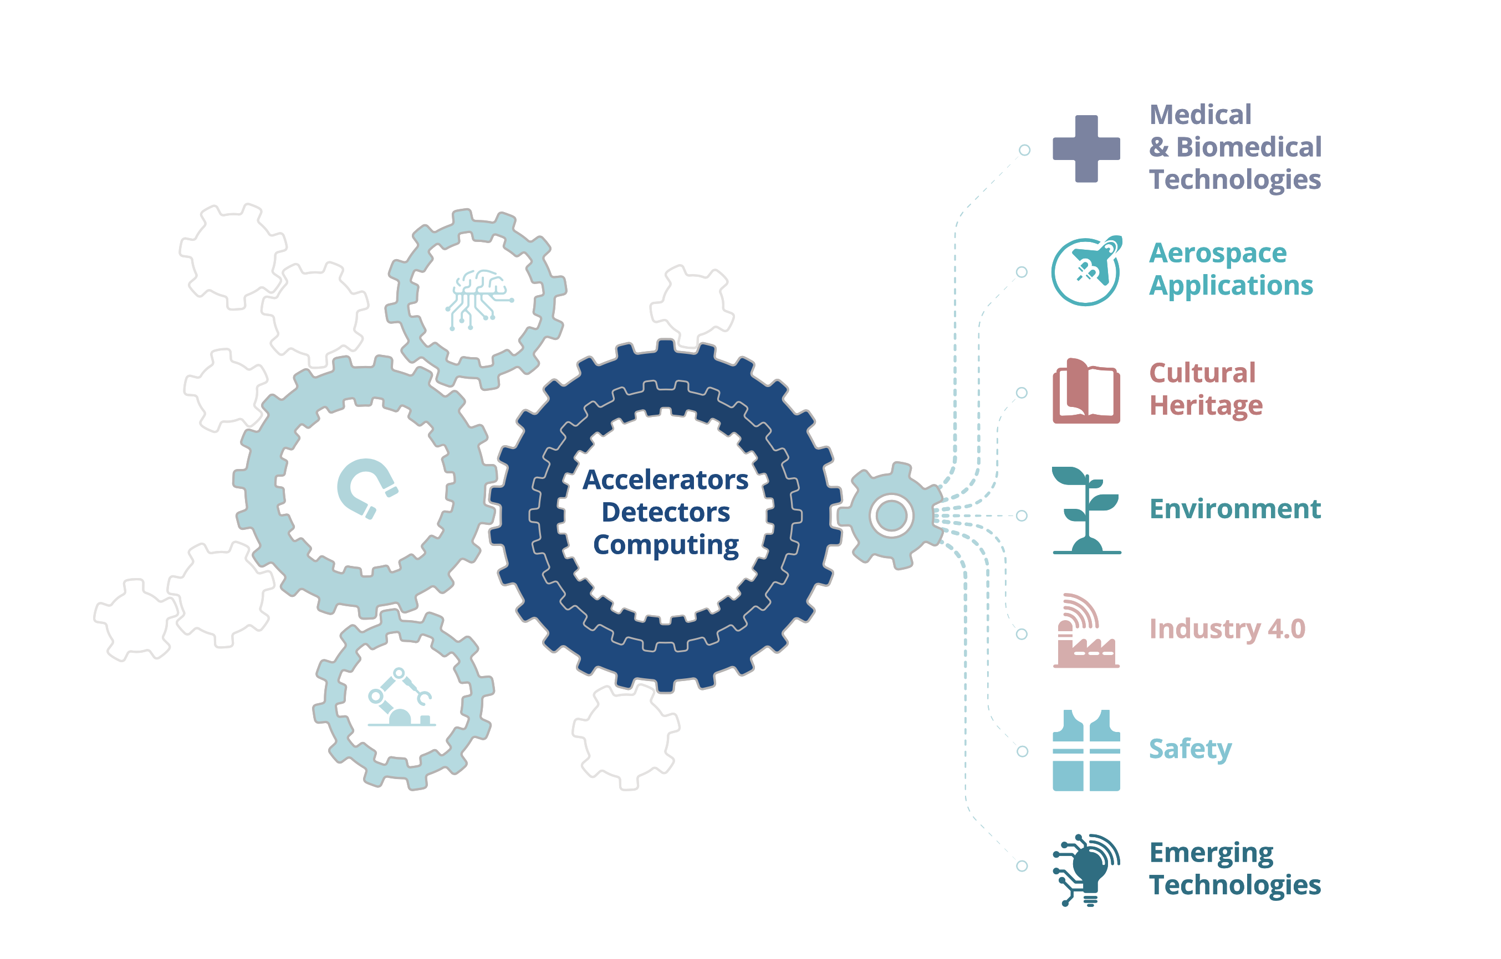
From CERN Technologies...
… to Society

Slide 7
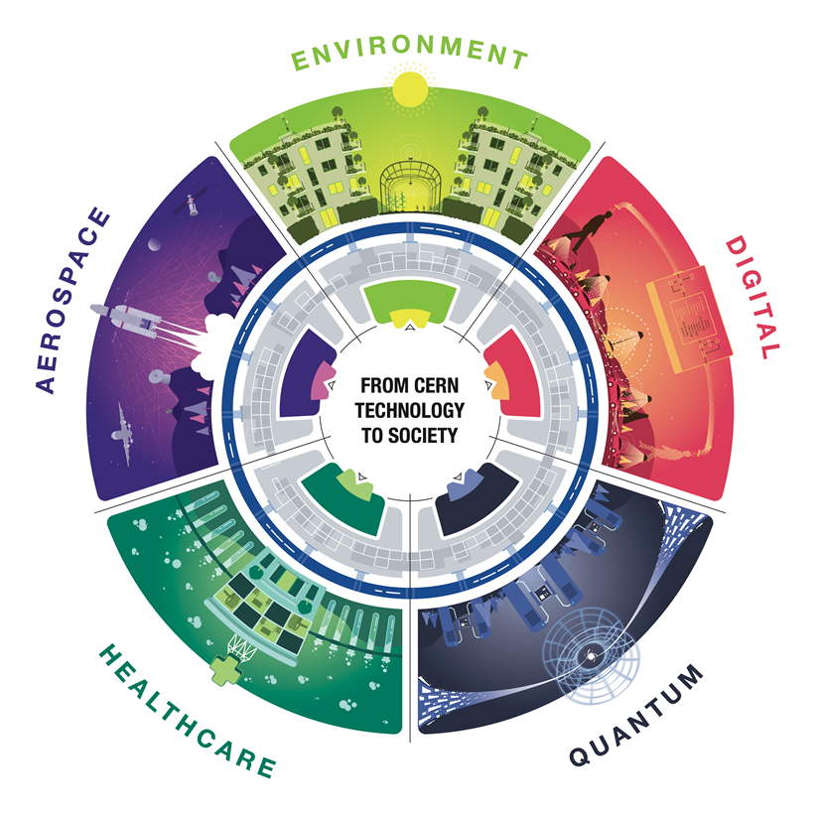
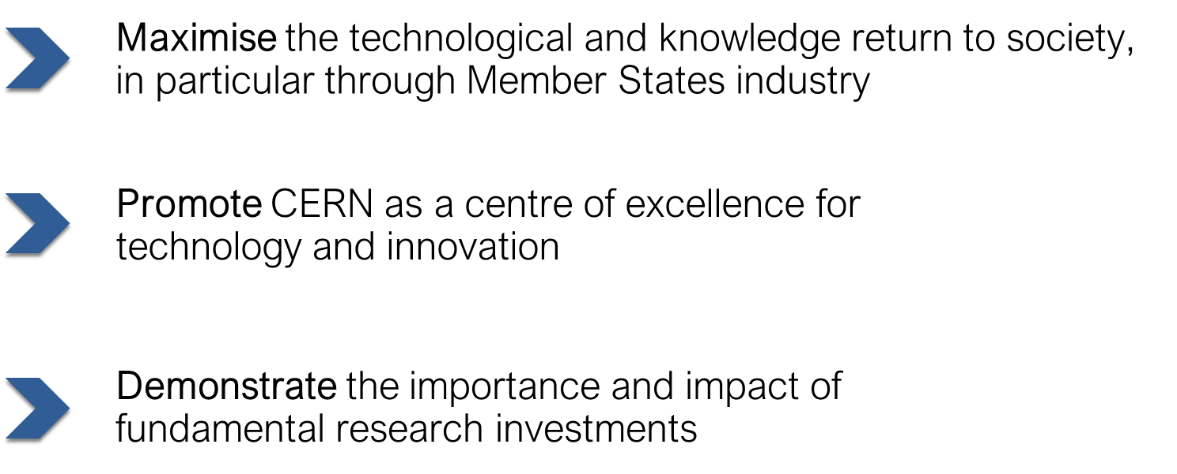
The CERN Knowledge Transfer Group’s Mission
Licence
Access to existing solution
Support to implement
Open source access
Time of experts
Contract research
Specific solution
Outsource its development to CERN
Collaborative R&D
Time of facilities
Specific issue
General issue
Jointly find solution
Jointly develop solution
Open source software
Open source hardware
Consultancy/Service

Slide 8
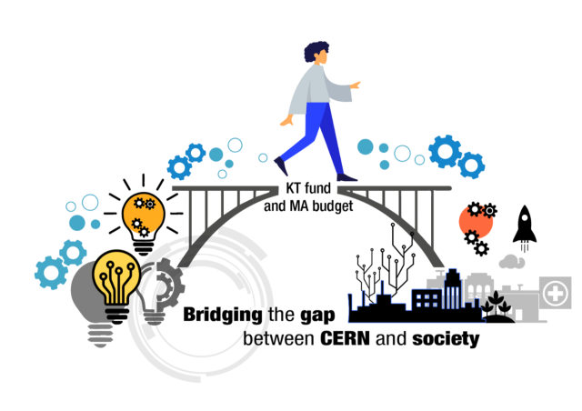
KT fund and MA budget: Bridging the gap between CERN and society
CERN offers two KT funding schemes:
CERN Knowledge Transfer (KT) fund
CERN Medical Applications budget
Since 2011, over 100 projects have been funded, spanning technological fields and applications from healthcare to aerospace, with funding ranging from 15-900 kCHF per project.

Slide 9
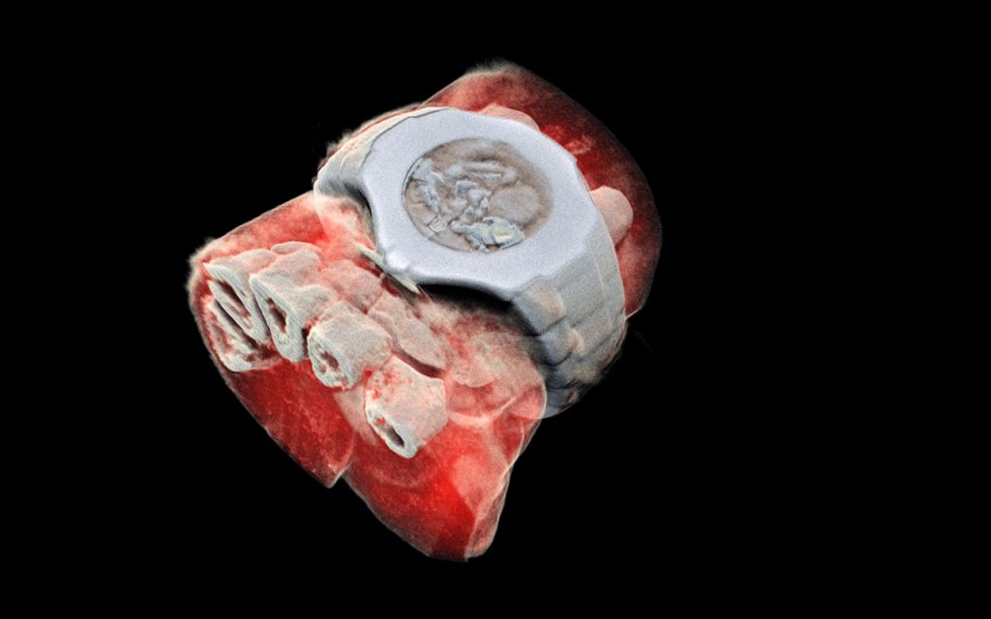
Next generation X ray finally in color (MARS Bio Imaging).
Notes:
The concept of the chip is that it works like a camera, detecting and counting the individual particles hitting the pixels when its electronic shutter is open. This enables high-resolution, high-contrast, very reliable images.

Slide 10
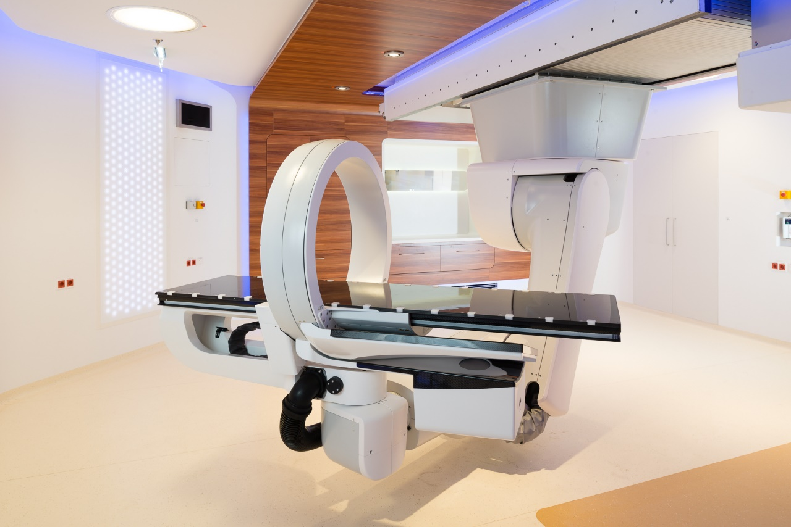
Particle Therapy Centers...

Slide 11
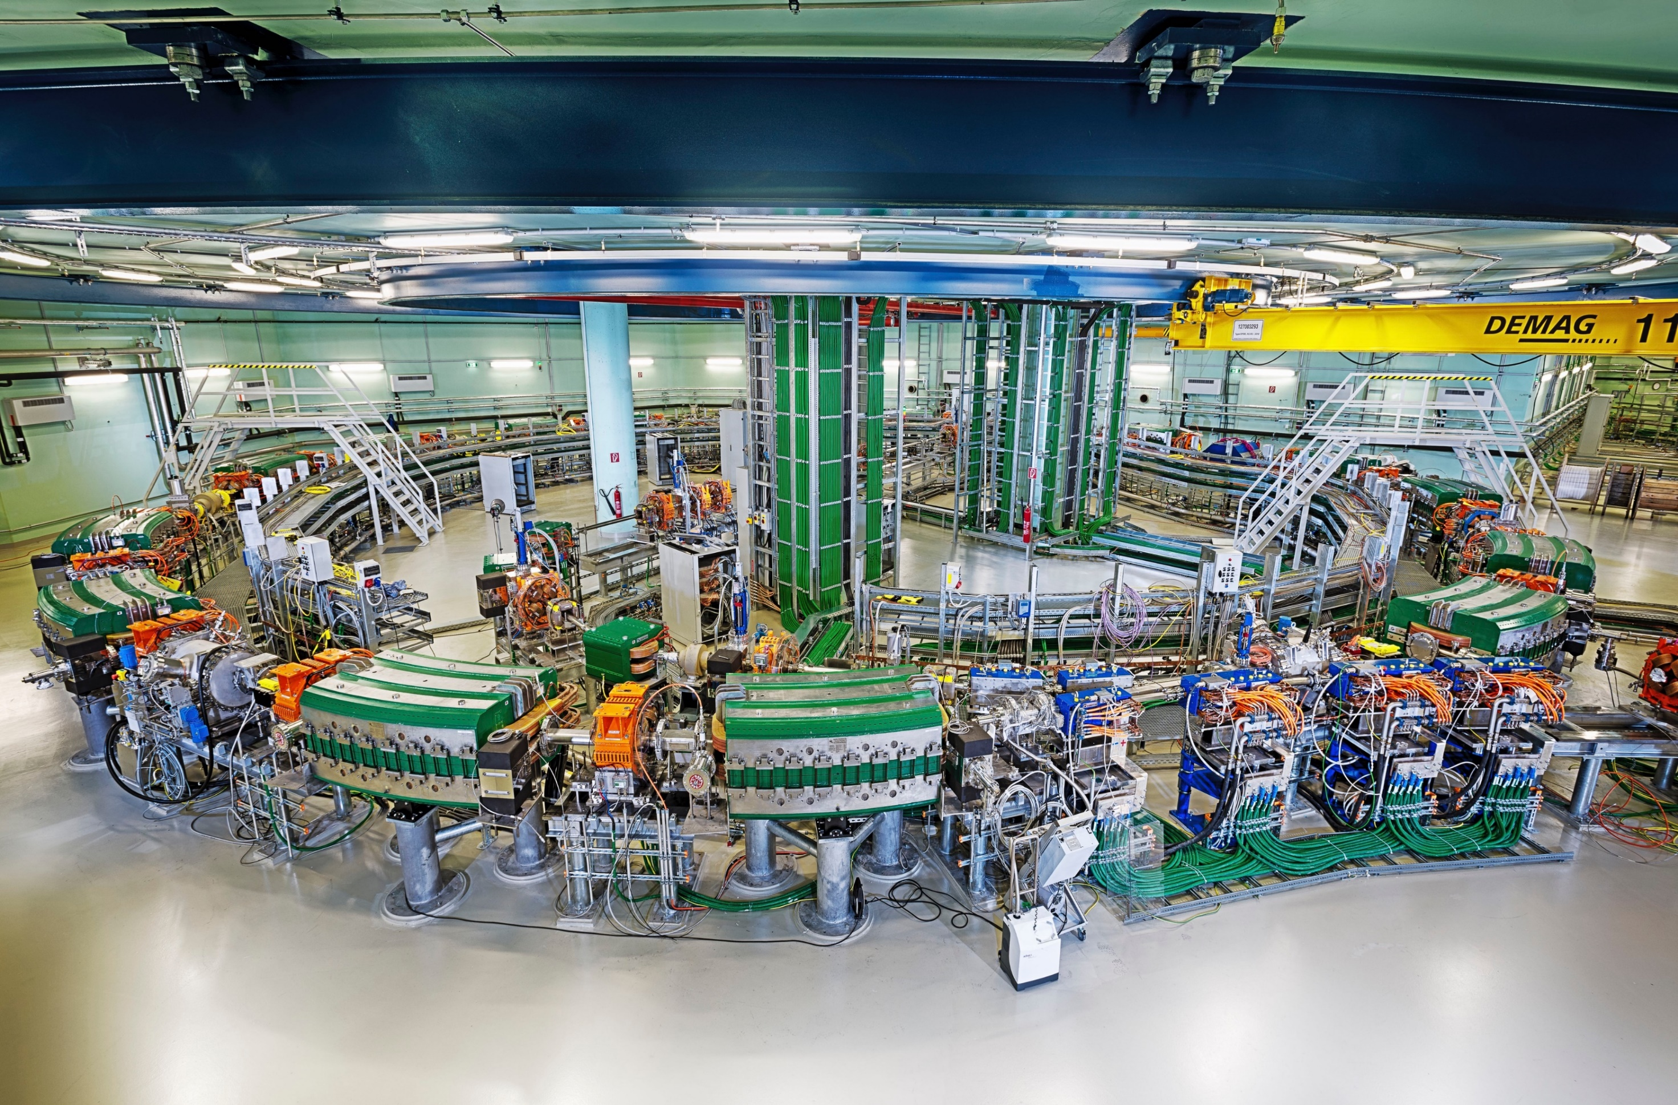
...are using a lot of CERN technology for its proton/ion acceleration

Slide 12
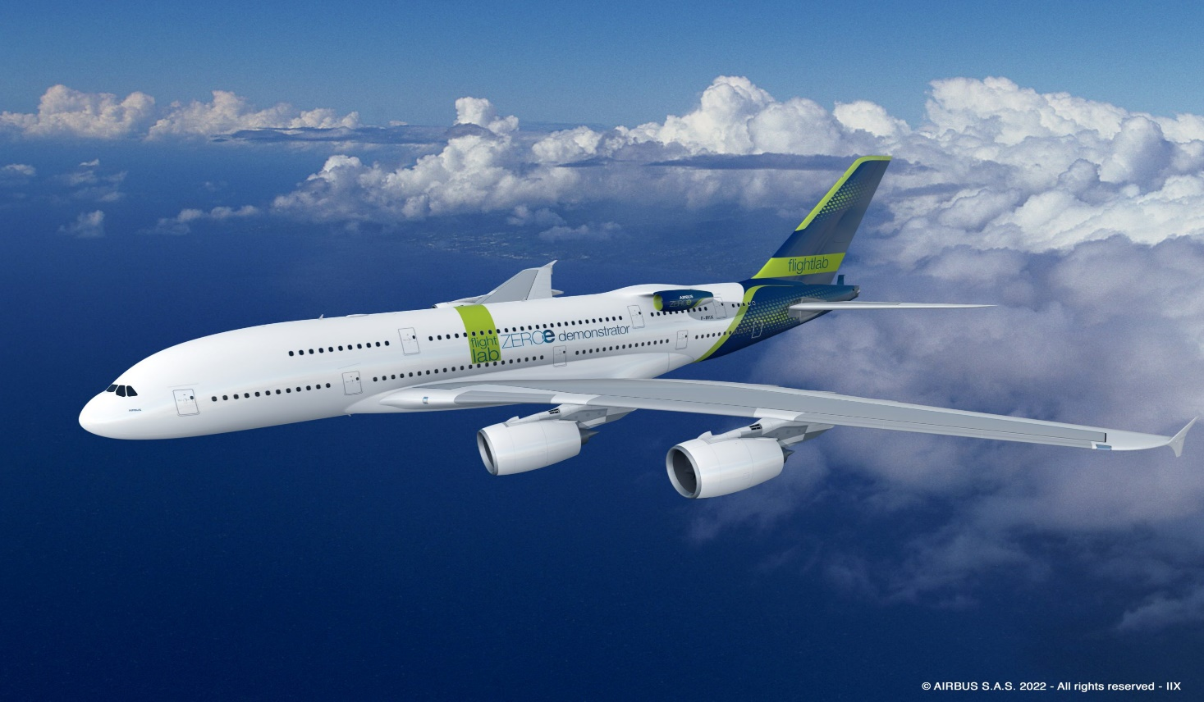
CERN and Airbus partnership: use of superconducting technologies for future low-emission aeroplanes

Slide 13
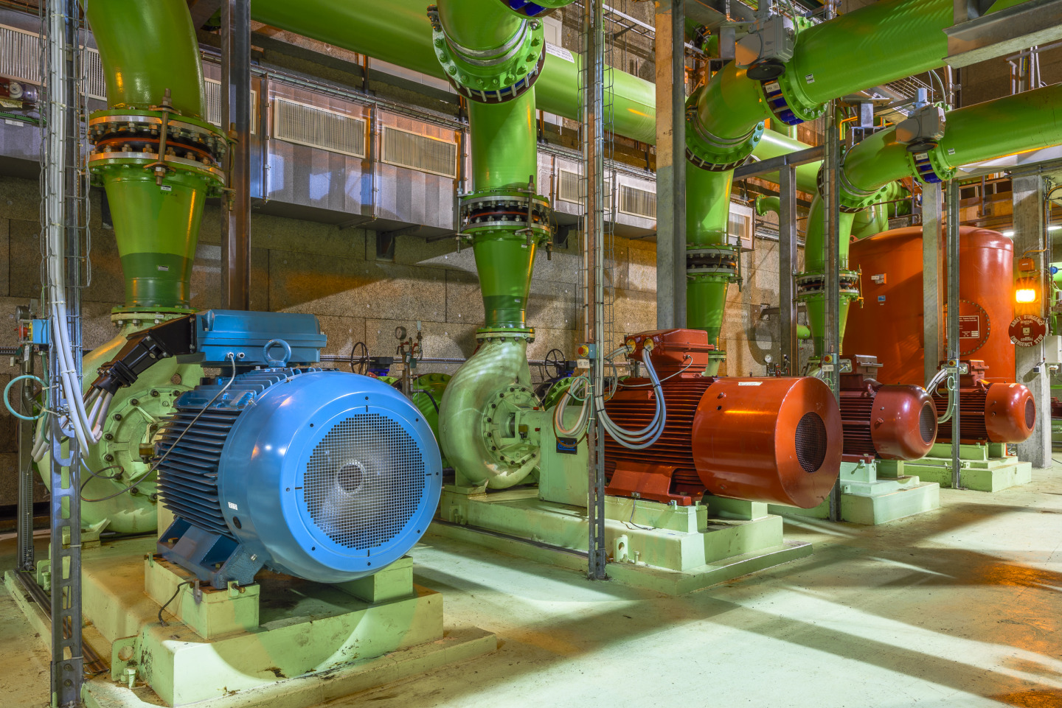
CERN and ABB partnership: reducing environmental impact of large-scale facilities
ABB and CERN concluded MotorSense project, and found potential energy saving of 31 GWh (equivalent to the annual energy consumed by 18.000 EU households) and 4 kt CO2 emissions.

Slide 14
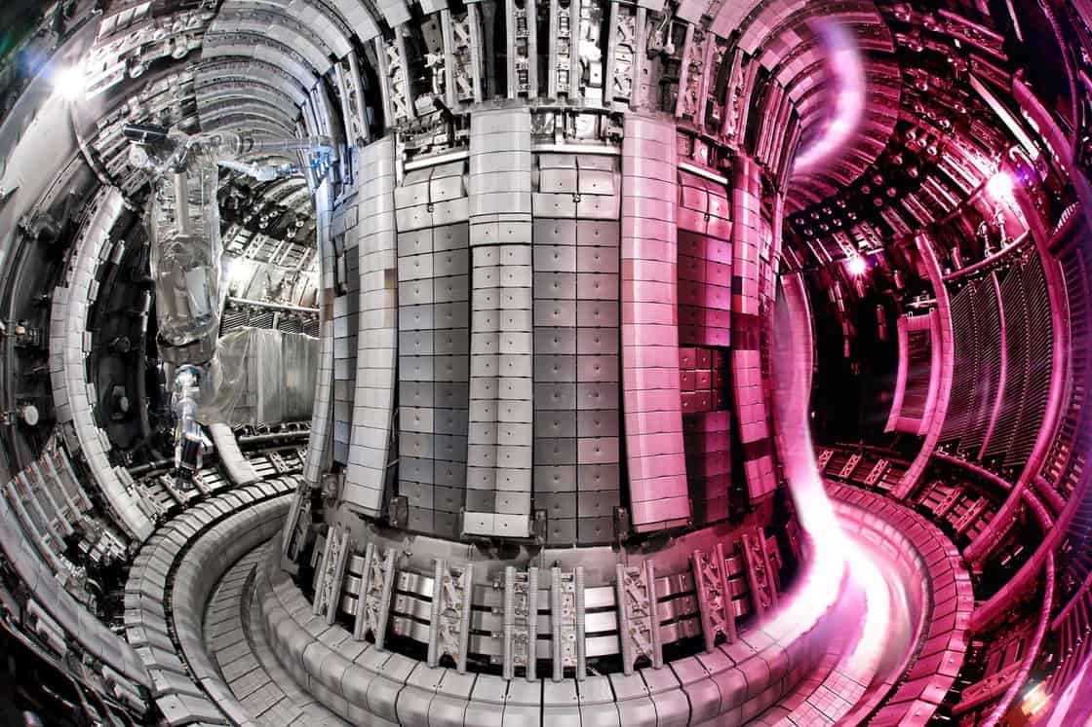
CERN has conducted tests at cryogenic temperatures on steels for fusion tokamaks

Slide 15
Space mission Juice embarks in 2023 with critical components tested at CERN, to replicate Jupiter’s harsh radiative environment

Slide 16

Support deep tech startups in Member States and Associate Member States

Slide 17
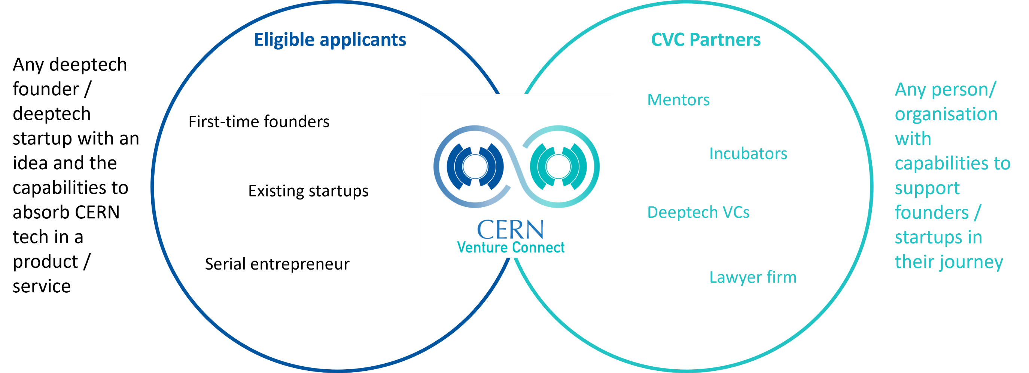
CVC connects deeptech founders to other players in the startup ecosystem

Slide 18
“Vague but exciting…”

Slide 19
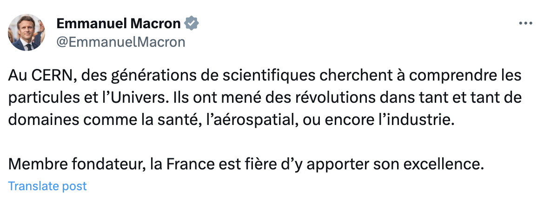
Knowledge Transfer’s Mission

Slide 20
THANK YOU!
Want to know more?
Visit http://kt.cern/
Contact me at sandra.muhr@cern.ch

