Slide 1
Local chromatic correction Final Focus optimization
January 11th , 2023
Pantaleo Raimondi
SLAC National Accelerator Laboratory

Slide 2
Outline
Final Focus DA/MA optimization:
- SR off CS off
- SR on CS off
- SR on CS on
Arc and Final Focus layout
ARC and FF hardware
ARC and FF tolerances

Slide 3
LCCO DA and MA optimization recap
On energy DA very large
Off energy DA reduced due to energy dependent detuning
On energy DA reduced from quads SR
On energy DA reduced from CS

Slide 4
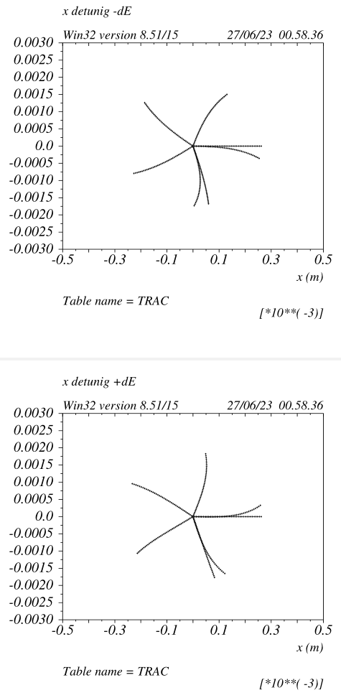
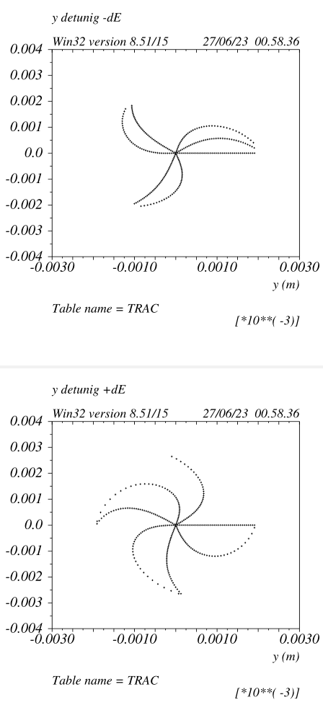
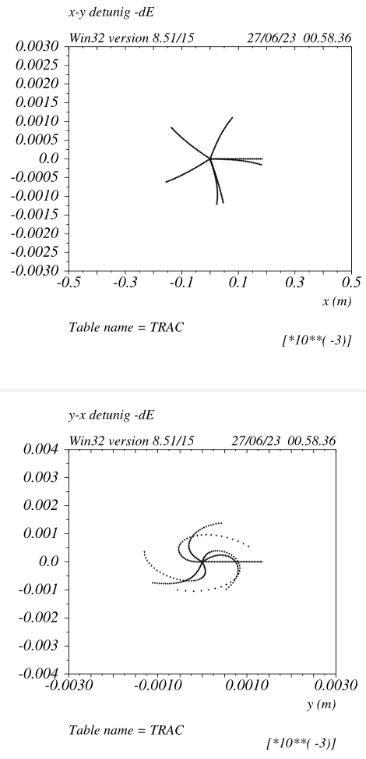
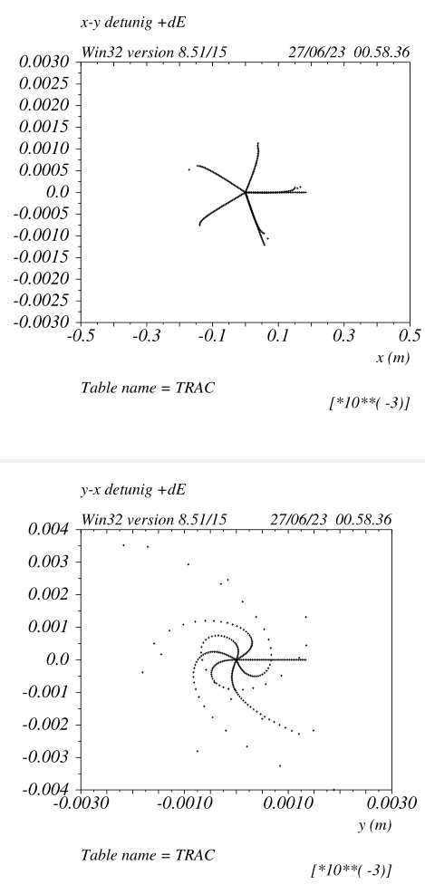
Transverse tracking with dE=+/-0.002 v_65a1
October 19 2023 slide
Detuning on energy is zero on a scale at least 10 times larger
Horizontal DA for small Y offset ~150um

Slide 5
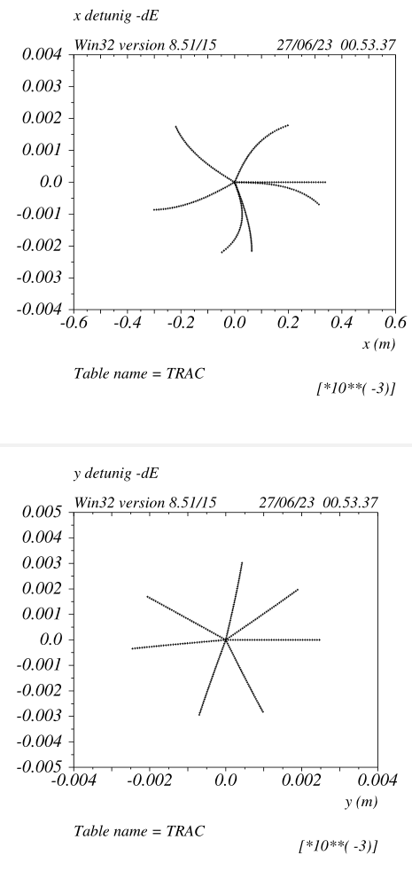
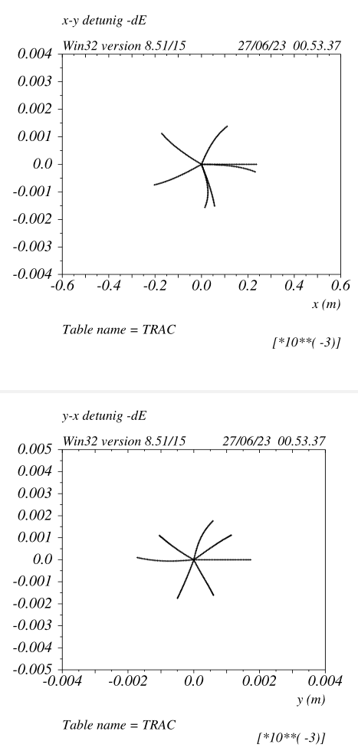
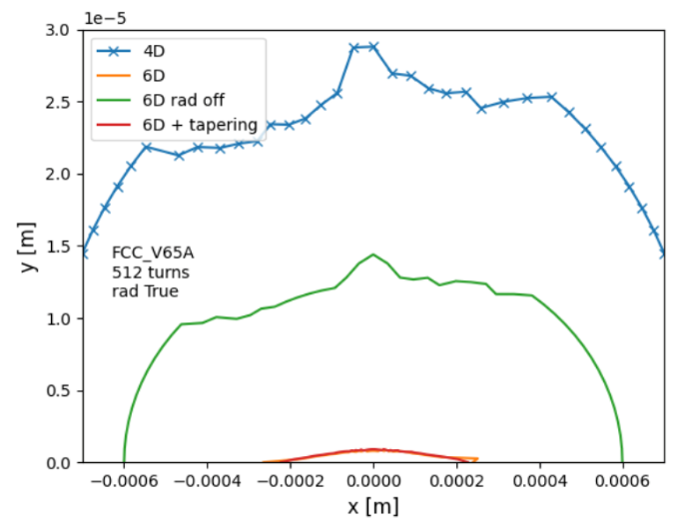
Transverse tracking with dE=+/-0.002
October 19 2023 slide
Tracking with just the 3 quads in the y_CCS
that provide the –I rescaled by 0.2%
The main DA limiting aberrations are
energy dependent y&xy-detuning (octupolar)
due to the breaking of the y_CCS –I condition
off energy. Reducing this aberration can enlarge
the 6D DA in principle up to green
(and possibly the green will approach the blue as well)
Energy dependent X-detuning is small, due to
the lower x-chromaticity and larger dispersion
on the sextupole.

Slide 6
Reduction of the Energy dependent Y & XY detuning
This term is proportional to the K_SD^2, how to cure it?
- Increase dispersion @ SDs. Many solutions have been applied and described in previous presentattions
- Introduce decapoles in the CCSy and CCSx:
Two decapoles at –I (same sextupole locations) will generate an “octupole” for off energy particles.
The –I ensures that the decapole term is canceled.
This is a very effective solution, it cancels the aberration at the source effectively making the –I valid
for all energies.
The strength of the decapoles can be calculated analytically.
In order to make them to work two problems have to be addressed:
- the CCSy –I has to be restored in both planes: x=>de_ydet y:=>de_xydet
- the CCSx –I has to be restored in both planes: x=>de_xdet y:=>de_xydet
and only two pairs of decapole (per FF side) are available
The decapoles are at –I but the DA is (negatively) affected because the cancelation is not perfect,
in particular because the interaction with other non linear elements (the sextupoles).

Slide 7
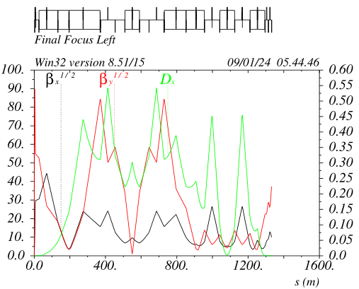
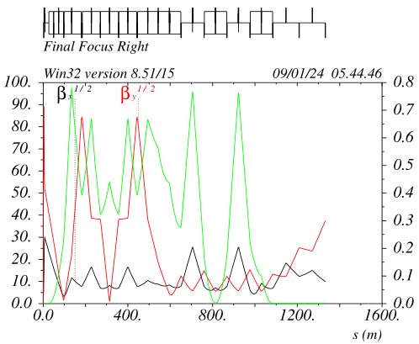
Cancelation of the Energy dependent Y & XY detuning with decapoles
The trick adopted is to use the Left and Right decapoles pairs to cancel “globally” the detuning:
FFL&R instead of FFL and FFR individually.
CCSy_Left decapoles are negative and cancel de_xy_detuning
CCSy_Right decapoles are positive and cancel de_y_detuning
CCSx_L&R decapoles are positive and cancel de_x_detuning
Betax/y@CCSyL/R are set to maximize the decapole effectiveness:
CCSy_L: betay=7100m, betax=250m dx=0.30m K4L_DECDL ~ -2200
CCSy_R: betay=7100m, betax=65m dx=0.40m K4L_DECDR ~ +3000
CCSx_L&R betay~30, betax~650 dx~0.60m K4L_DECFL&R ~ +500
Given the very high order of the aberration the decapoles pairs are very orthogonal
The transverse (mainly vertical) residual nonlinearities of the CCSy decapoles are
canceled altogether because the opposite sign of the Left/Right ones.
The are no side effects on the DA and on on_energy detunings
The third order chromaticity is weakily effected, this result in a small change in the
IP_phase sextupoles settings. Makes the x-IP_phase_sextupoles 10% weaker

Slide 8
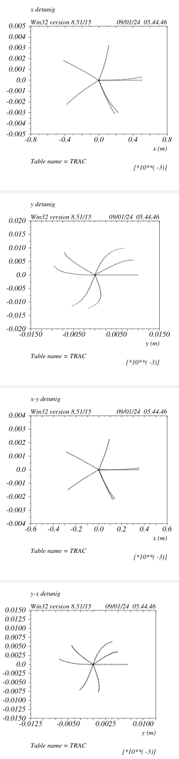
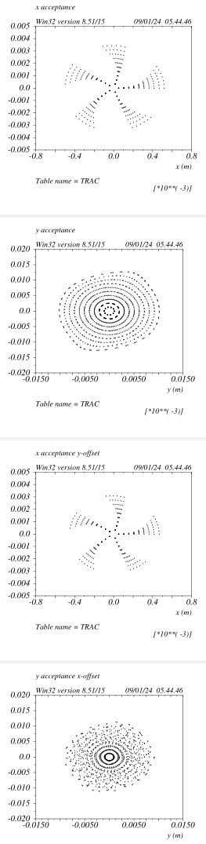
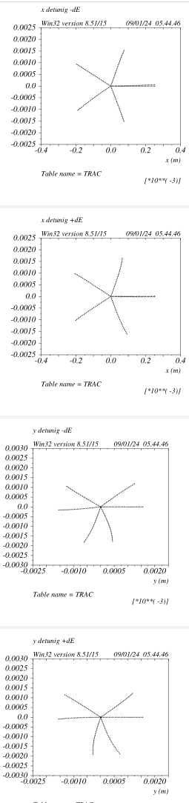
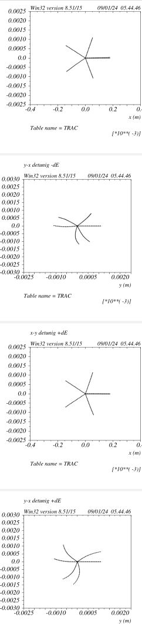
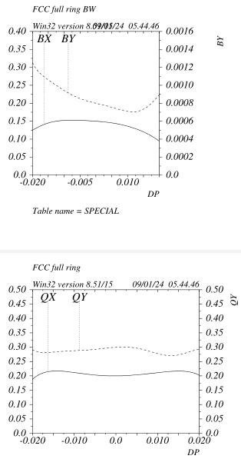
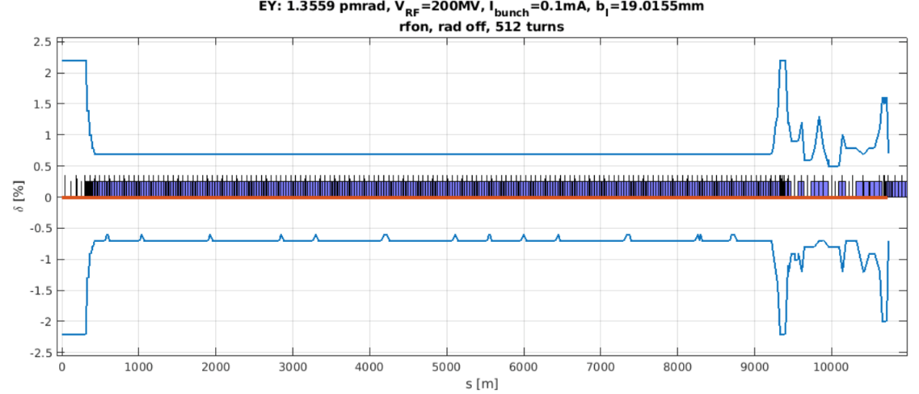
Beam dynamics: v_89
Vertical phase space deformation due
to the decapoles L/R asymmetry
On energy detuning 100 turns tracking
Off energy detuning de=+/-0.2%
Bandwidth around +/-2.2%
Local momentum acceptance

Slide 9
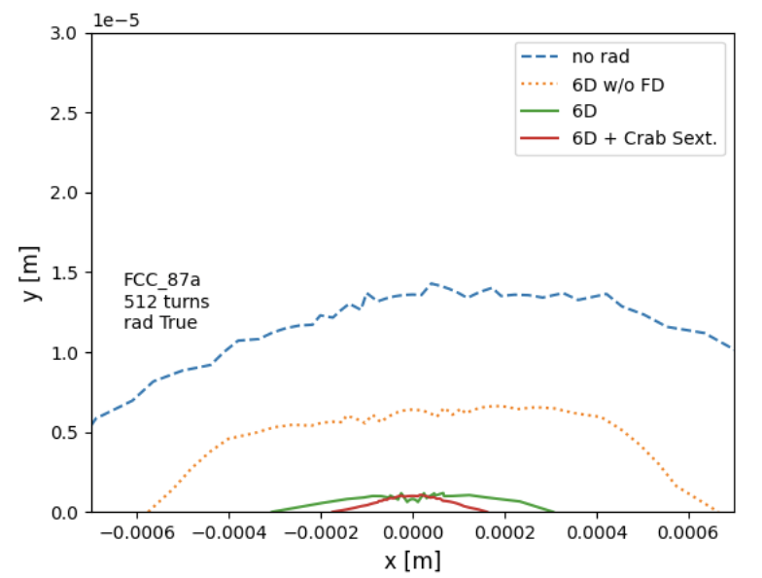
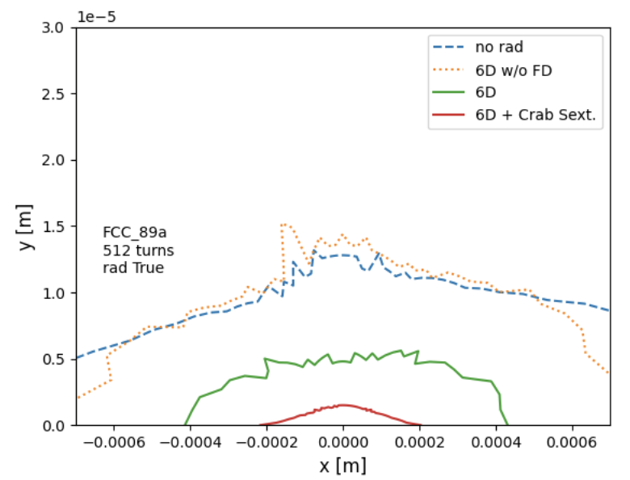
Dynamic aperture without and with SR
v_87 no decapoles
v_89 with decapoles
The effectiveness of the decapoles is evident
This is probably the first time that the degradation due to the quadrupoles-SR and
FD-SR in particular is very effectively addressed
S Liuzzo

Slide 10
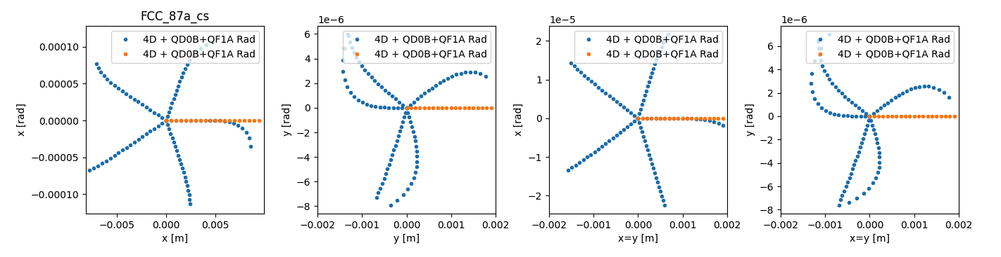
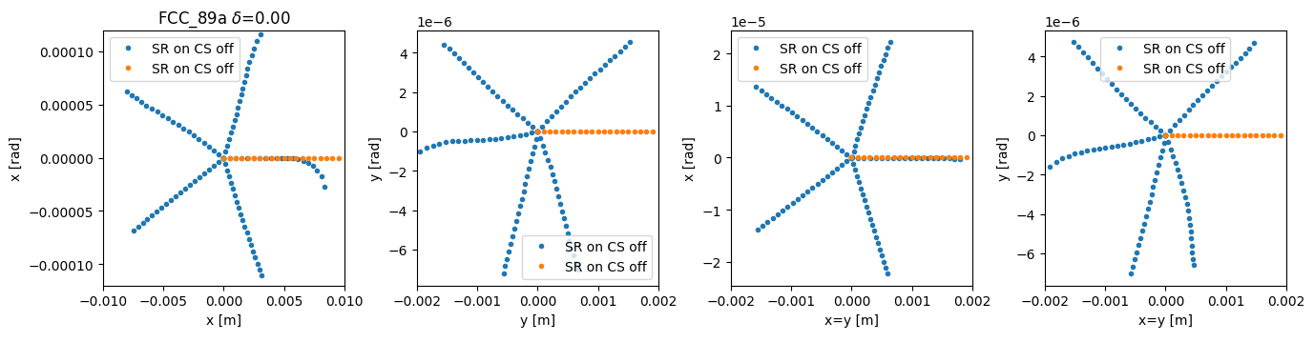
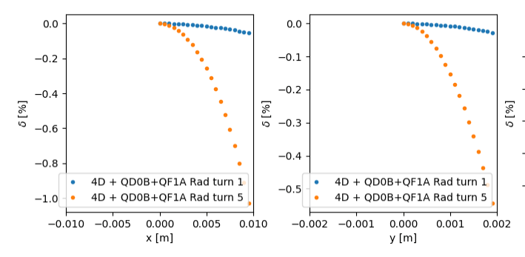
Dynamic aperture without and with SR v_89
no decapoles
with decapoles
The “apparent” 4th power vertical detuning with SR_on is
gone with the decapoles. In fact it was a feed down
due to the de_ydetuning.
The very high order horizontal detuning at the moment is not
understood.
To be noted that the cos2theta_octupolar detuning from the FD_L+R do cancel
each other. This would be nice to prove theoretically as well.
The remaining DA shrinkage que to the FD-SR is simply due to the cumulative energy loss.
After about 20 turns, a particle with an initial offset of 5um loses 2% of its energy and falls
outside the energy acceptance.
S Liuzzo

Slide 11
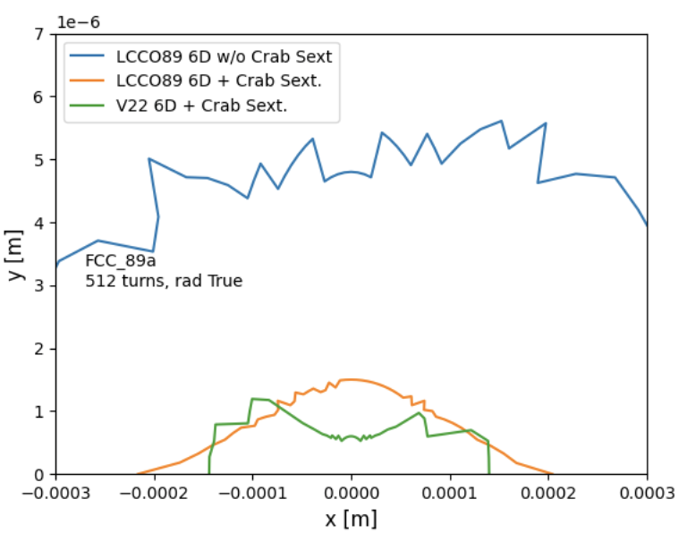
DA optimization with Crab Sextupoles v_89
CS now is the dominant offender for the DA
Nevetherless DA and MA are larger wrt baseline by about a factor 2 both.
The dominant aberration is quadratic wrt to the CS strength. With CS@60% the DA is
about twice larger.
It should be noted that for v_89 the CS pairs can be varied (also individually per IP) with no need of retuning of any other magnet.
What causes the DA shrinkage ?

Slide 12
Optics optimization for CS transparency
Optimized (reduced) all non linearities between the CS
CCSy/x R12s/R34s optimized with CS_on (also good for CS_off)
Reduced the strength of the x IP_phase_sextupoles (they are the main non-linearity offenders):
- by increasing dx on the sextupoles
- by reducing third order x-chromaticity
Optimized betas and alfas (between 0.0 and 0.5) at the x&y IP_phase sextupoles
Flattened x&y betas vs de @ CS
Zeroed dx vs de @ CS

Slide 13
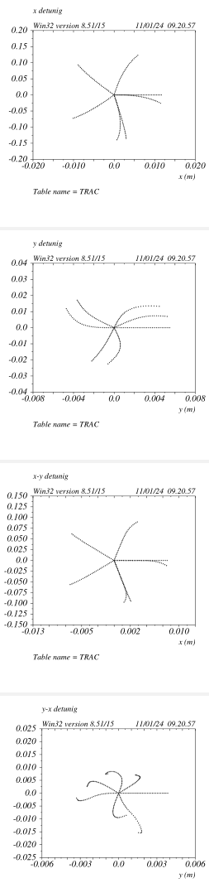
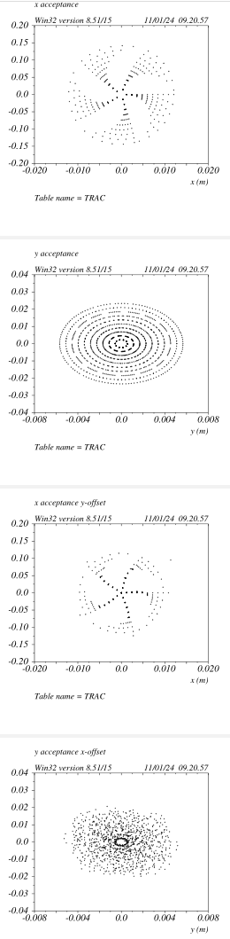
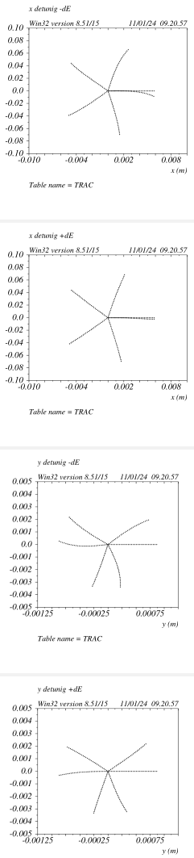
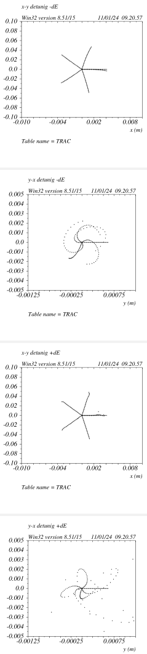
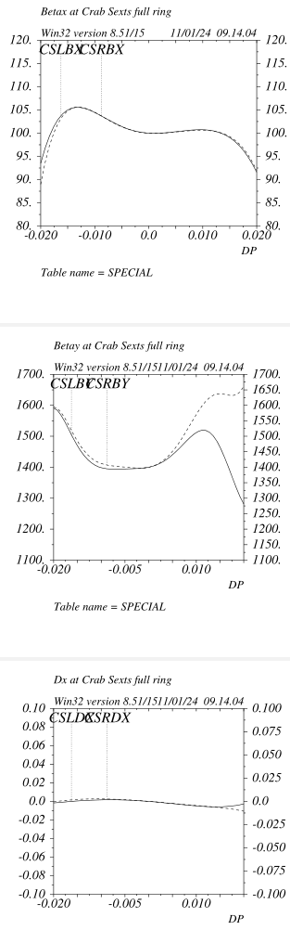
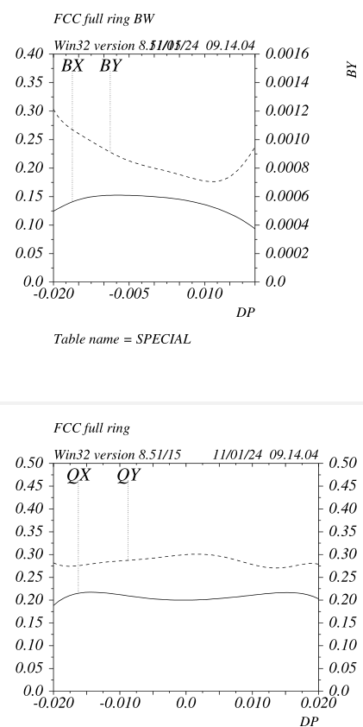
Optics check with CS_on v_89
All ok except one !

Slide 14
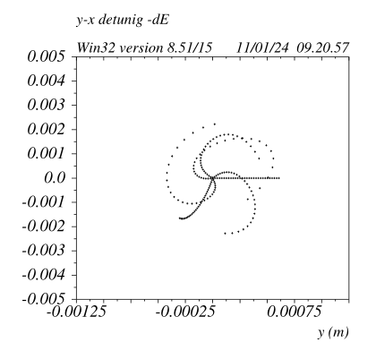
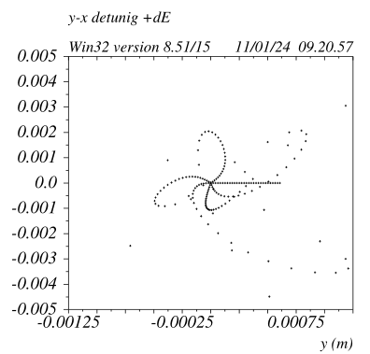
Optics check with CS_on v_89
CS do introduce a very strong de_xy_detuning
It is quadratic wrt to CS strength.
It is much larger (about a factor 2) wrt the one created by the y_CCS (compensated with decapoles)
It seems that it could be removed by correcting the chromaticity
between the CS at the proper phase.
I have seen that it can be reduced with additional sextupoles in the FF however given the strength required they spoil the on energy DA anyway.
Best indication is that a “inner” CCS in the FF with proper betas and phase wrt CS will work. Hard to make but possible.
The other possibility is to correct it outside of the FF, in the ARCs

Slide 15
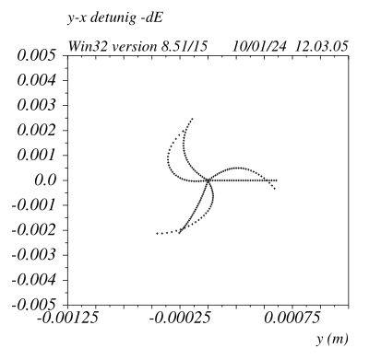

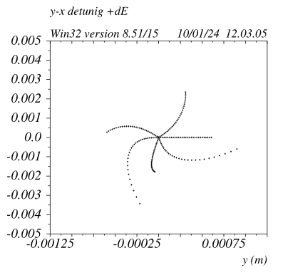
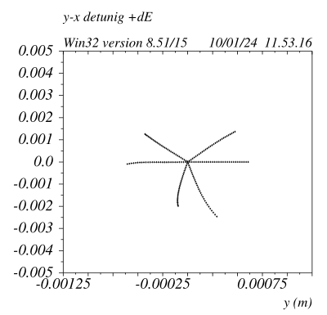
Optics check with CS_on @ 50% v_89
1) It sems that again a decapole pair (per each CS) could do the job
One decapole is on the CS and the twin one in the ARC in a point at
–alpha*I with dx<>0
2) Other possibility is to increase betay@CS, the aberration should decrease inversely. The behaviuor vs betax@CS should be studied as well.
3) Create resonantly this aberration in the ARC should be studied:
with sextupoles modulation
with high order multipoles
4) More ideas are welcome
Added two octupoles @CS
K3L = 9.5
Detunings with de=+/-0.2%
Added two octupoles @CS
K3L = -9.5

Slide 16
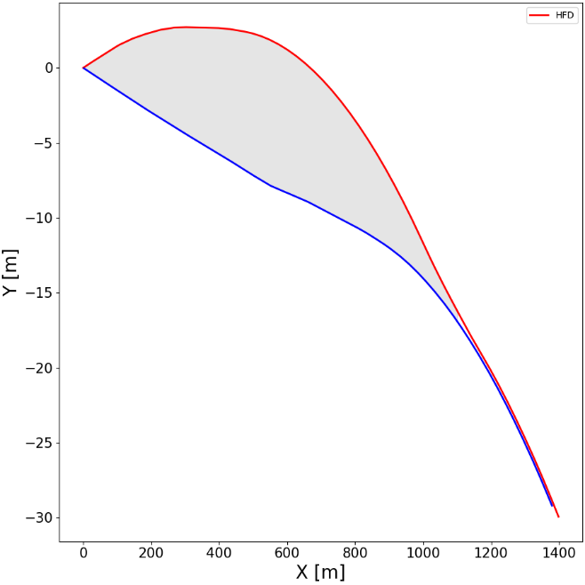
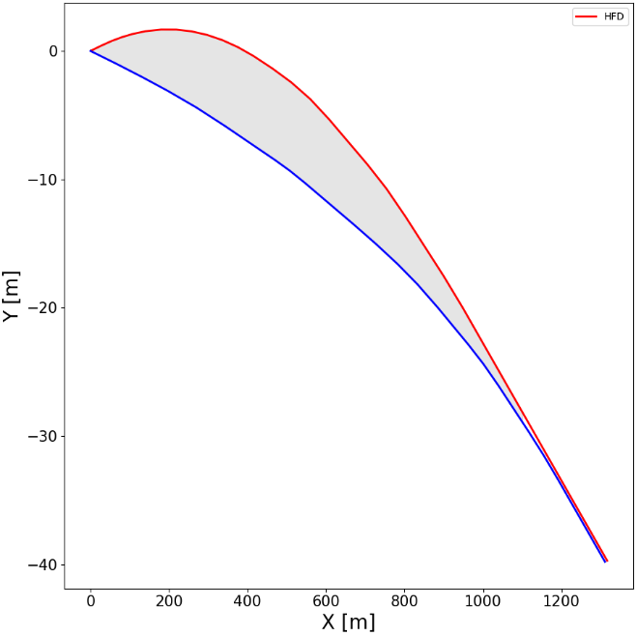
FF layout v_89
V_89 has further reduced IP offset wrt to baseline, to be checked but should be around 7m
There are no reverse bends thus simplifying the SR radiation handling for the distributed absorbers
The stronger dipoles are in the CCSy_R just downstream the IP, they are anyway about 10% weaker wrt the ARCs ones.
The “Soft bend” upstream the IP is about 230m long and has an Ec~130KeV @ttbar
Overall the ratio FF_Eloss/FF_bend_angle is
very similar to the ARC one.
There are no superconducting magnets required except the FD ones (this might change if some zero-leakage quadrupoles are needed). FF sextupoles@ttbar have k_values around 1 (1.5@Z) and are 60cm long.
FF quads are shorter and weaker wrt ARC’s
Baseline: area 6640m2
Max separation 9.6m
LCCO: area 4960m2
Max separation 7m

Slide 17
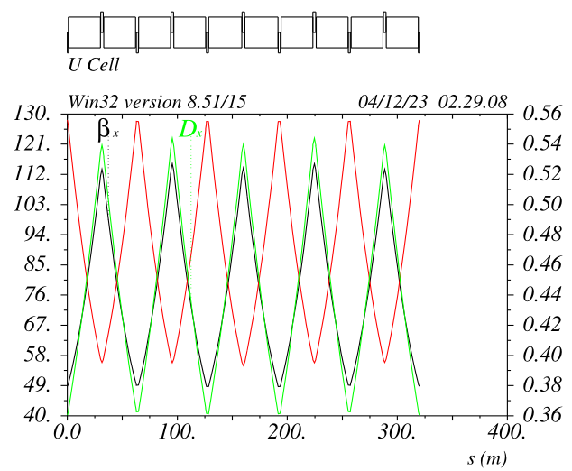
ARC layout Z and ttbar mode
The arc is a standard FODO sequence with two missing sextupole for every 10 quads.
BPMs are placed at each sextupole location (between sext and quad)
The sextupoles are the ones presently designed and the foreseen trimming coils are all what is needed for orbit and optic correction.
Sextupoles are 0.40/0.50m long, power consumption is < 5MW
Quads are 2.4/1.8m long and should consume about 5Kw each, 2240 per ring are needed => 23MW@ttbar
Dipoles are about 29.6m Long
In the case of HTS option the sextupoles are wrapped around the quadrupoles.
In principle by shifting the arc longitudinally by 30m, the QF will overlap with the QD, it then could
be possible to use a 1.8m twin quad + a 0.6m QF on one side only. I think that the cons of this
option greatly exceed the pros, nevetherless it should be mentioned.
Another option is to have an about gradient in the dipole (-0.4T/m 2/3 of the length, 0.4T/m 1/3)
In this case the QDs will be halved in length and the QF reduced by 25% => ~15MW power
Dipoles will be trickier to make and consume more power, a quick check should be done anyway.

Slide 18
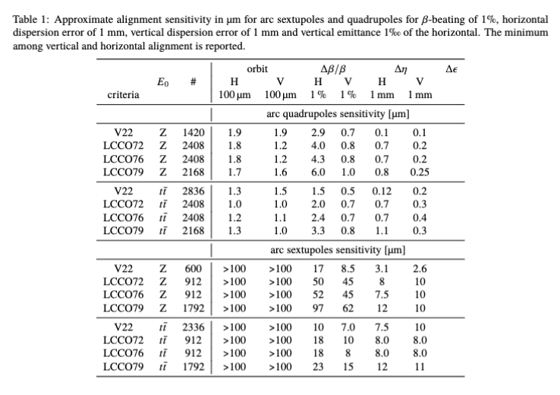
Sextupole ARC sensitivities errors (follow-up to the 4sexts family option)
S Liuzzo
For the 4 sexts family option S Liuzzo has confirmed that the setupoles alignment sensitivities for sextupoles are relaxed by about a factor 1.6 wrt the 2 families case.
The quads sensitivities are also somewhat relaxed by 20-30%

Slide 19
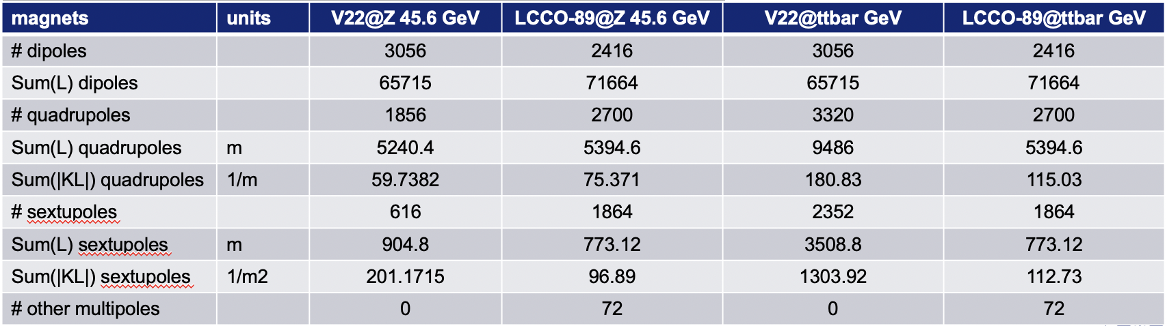
Magnets list
S Liuzzo
As requested by G Roy, S Liuzzo is starting to summarize the overall requirements in terms of
magnets, other quantities will be added (e.g #BPMs, #correctors, RF voltage etc)
The present table is just a skeleton and will be expanded, however already has some useful infos

Slide 20
Summary
The LCCO beam dynamics is extremely well understood and optimized
The understanding of the quads SR on beam dynamics has lead to unprecedented means to mitigate the related DA deterioraton. This will be potentially even more beneficial to the higher energies operation.
DA/MA exceeds the baseline.
There is only one very well identified aberrations that makes the CS detrimental to the DA. The reduction of this effect seems possible.
Hardware requirements for LCCO are much less demanding and are being assessed (as requested by G Roy)

Slide 21
DA optimization with tracking
Ultimately the DA/MA should be optimized with tracking.
It should be stressed this tracking is not finalized to cancel not well identified aberrations and should not be a random process
The tracking will help to best optimized the trade-off between different aberrations. For example:
1) The x-IP-phase sextupoles do cancel the 3rd order x-chromaticity (thus enlarging the MA) but deteriorate the –I between the CS (thus decreasing the DA with CS_on).
2) Last cell sextupoles are also effective to change the BW (betas and tunes vs de)
and the betas vs de at the CS. At the moment they are not used but for sure they are extra degrees of freedom for touch-up and clean-up
3) etc
For EBS we did a lot of iteration between “tracking” and “brain”, tracking provides anyway more infos and hints

Slide 22
Fascinating means to reduce the DA shrinkage for FD SR (1)
When the beam goes through the FD the tails lose energy.
A high order mode cavity (TM0N0, N large), can effectively accelerate the beam with a radial gradient set to compensate such radial energy loss.
Best location for such cavity would be in the yCCS_Left
The cavity can be passive (the beam will excite it)
Interestingly ESRF RF team is designing a TM030 3rd harmonic cavity for bunch lengthening.
The first easy and cheap thing to do is to install in MADx a cavity with a radial gradient specified at will, just to check the soundness of this idea

Slide 23
Fascinating means to reduce the DA shrinkage for FD SR (2)
The electrons at large amplitude in the FD are lost.
There are different ways to cope with this:
They can be scraped before getting at the FD
They can be collimated before getting at the FD
The non-linear collimation can be achieved with octupoles (we developed such scheme for ILC about 25 years ago, but a very specific section was necessary).
The octupoles were arranged in order to produce a “Dynamic beta*”, meaning
that the phase space is locally distorted in a way that large amplitude particles have effectively a larger beta* at the IP wrt to the 0-amplitude particles.
It could be that a set of octupoles placed (symmetrically wrt FF) in the last cell of the ARCs could produce some phase-space deformation

