Slide 1
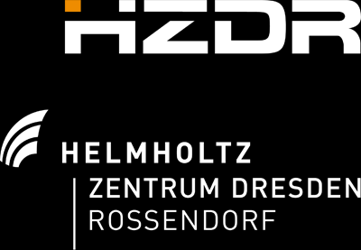







Hybrid LWFA-driven PWFA as a test platform for staged plasma acceleration
Susanne Schöbel^{1,2}, Patrick Ufer^{1,2}, Alastair Nutter³,
Yen-Yu Chang¹, Sébastien Corde⁴, Alexander Debus¹, Andreas Döpp⁵, Moritz Förster⁵,
Thomas Heinemann^{3,6}, Franziska Marie Herrmann^{1,2}, Bernhard Hidding^{3,6}, Stefan Karsch⁵,
Olena Kononenko⁴, Maxwell LaBerge¹, Alberto Martinez de la Ossa⁶, Richard Pausch¹,
Ulrich Schramm^{1,2}, and Arie Irman¹
¹Helmholtz-Zentrum Dresden-Rossendorf, Germany
²TUD Dresden University of Technology, Germany
³University of Strathclyde, Glasgow, UK
⁴LOA, ENSTA ParisTech, CNRS, Ecole Polytechnique, Université Paris-Saclay, France
⁵Ludwig-Maximilians-Universität München, Germany
⁶Heinrich Heine University Düsseldorf, Germany
⁷Deutsches Elektronen-Synchrotron DESY, Hamburg, Germany
Hybrid Collaboration partners:

Slide 2
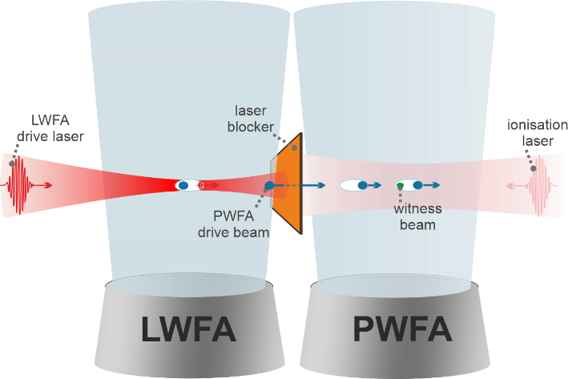
General concept of Hybrid LWFA-PWFA staging
LWFA (e.g. high peak current, compact) and
PWFA (e.g. dephasing free, cold injection schemes)
Combine complementary features of via staging:
by driving PWFA with LWFA beam with the potential to reach:
  Higher brightness
  Enhanced stability
  Higher energy
Theory and Concept:
Hidding, B. et al: PRL 104, 195002 (2010)
Martinez de la Ossa, A. et al. Phil. Trans. R. Soc. A 377: 20180175 (2019)
Hidding, B. et al: Appl. Sci. 2019, 9, 2626 (2019)
Experimental Realizations:
Gilljohann, M. et al. PRX 9, 011046 (2019)
Kurz, T. et al. Nat Commun 12, 2895 (2021)
Couperus Cadabag, J. et al. Physical Review Research 3, L042005 (2021)
Foerster, M. et al. PRX 12, 041016 (2022)
Schöbel, S. et al. New J. Phys. 24 083034 (2022)
2

Slide 3
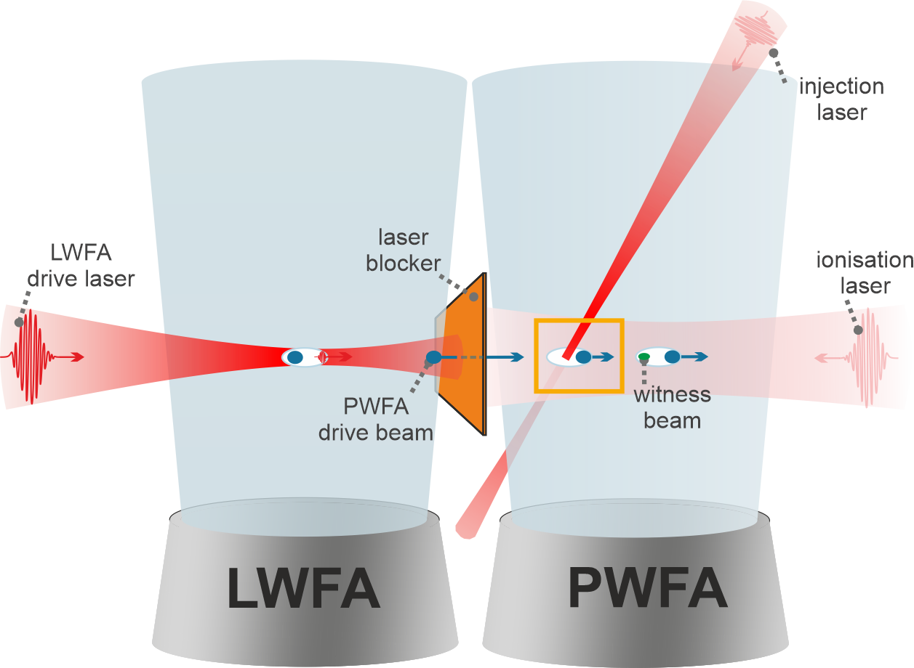

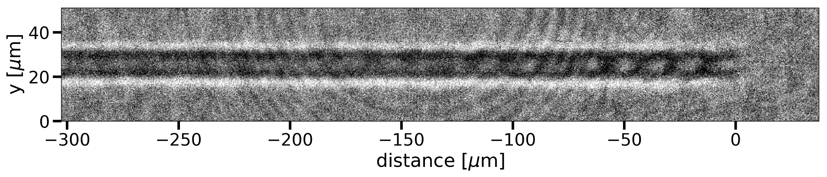
How can Hybrid LWFA-PWFA help address staging questions?
Open geometry: accessible for in situ, non-invasive diagnostics as probing with high spatial and temporal resolution:
precise tracking of laser and electron beams by their filaments
in situ density measurements
Temporal and spatial coupling of different electron and laser beams used for driver generation, witness injection and pre-ionization
Witness beam could potentially have:
higher quality (brightness)
improved stability
3

Slide 4
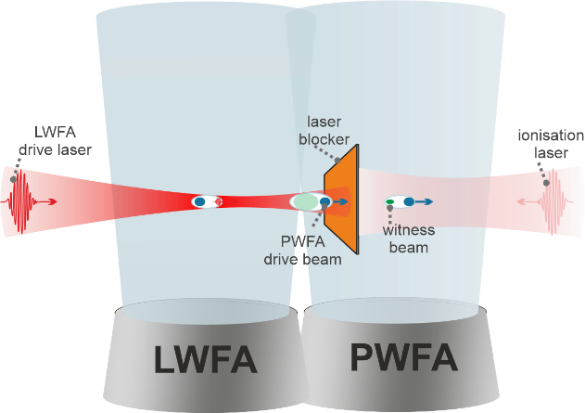
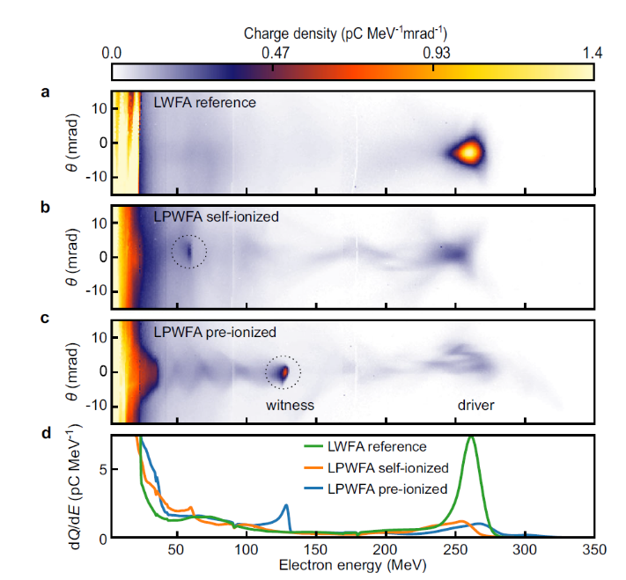
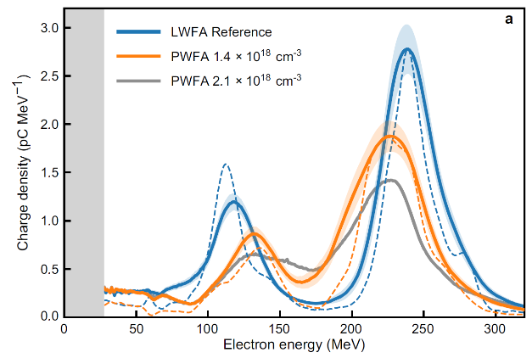
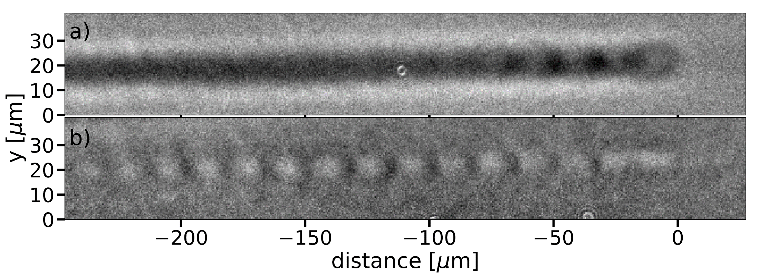
First results of Hybrid LWFA-PWFA staging via external injection
First steps @ HZDR and LMU:
Observation of beam driven plasma waves: LWFA beam is capable to drive a wake in a subsequent stage
Acceleration of witness beams via recapturing downramp (HZDR) or second bucket injection (LMU) from LWFA
Different acceleration gradients in pre- vs. self-ionized regime
3
Kurz, T. et al. Nat Commun 12, 2895 (2021)
Gilljohann, M. et al. PRX 9, 011046 (2019)
Schöbel, S. et al. New J. Phys. 24 083034 (2022)
4

Slide 5
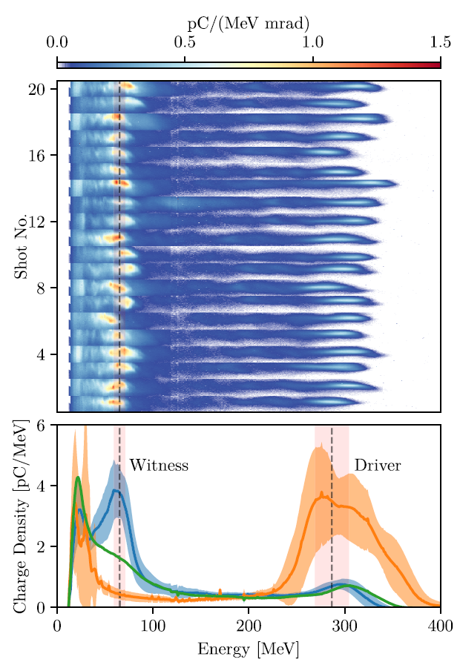
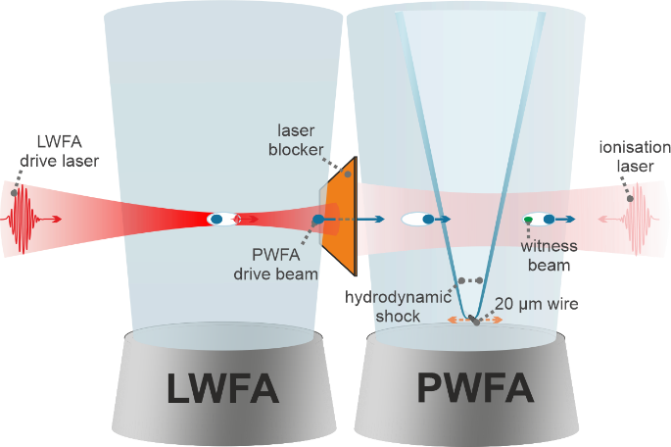
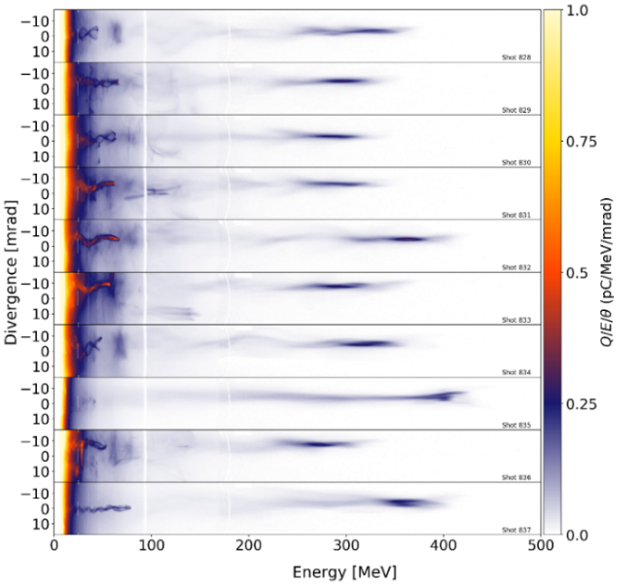
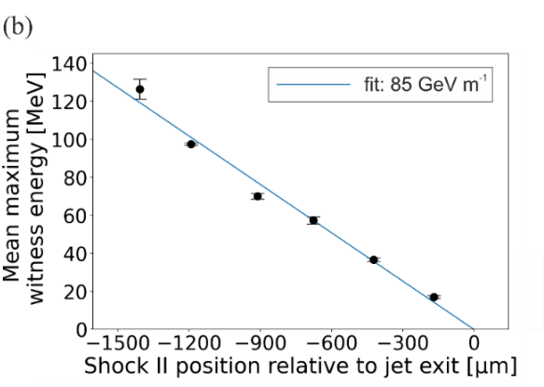
Internal injection via injection at a density downramp
Controllable injection at a density downramp
Optically generated shock:
Foerster, M. et al. PRX 12, 041016 (2022)
reliable injection from hydrodynamic or optically generated shock
witness energy controllable via shock position
no high witness energy
no good witness quality
3
→ Promising concept for high quality witness beams:
Trojan Horse (plasma photocatode) injection
hydrodynamic shock:
Couperus Cabadağ, J. P. et al. Phys. Rev. Research 3 (2021)
5

Slide 6
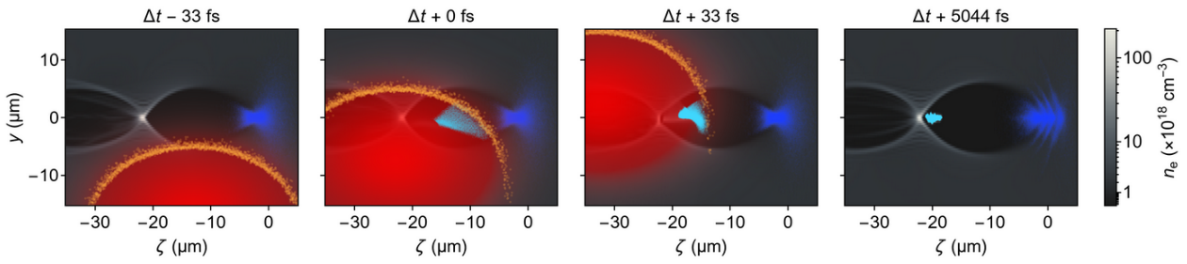
Concept of Trojan Horse injection
Idea:
use ionization (in this case: 2nd level of Helium) to release the witness electrons directly inside the cavity
Ionization done by an additional injector laser
Requires precise spatial temporal overlap of injection laser
(⌀ 16µm) and 1st cavity (here: 25-30µm length)
Monitored using few-cycle probe beam
Need of four laser beams in total:
LWFA driver, Injector laser, source for few-cycle probe beam, pre-ionization laser for PWFA stage
6

Slide 7
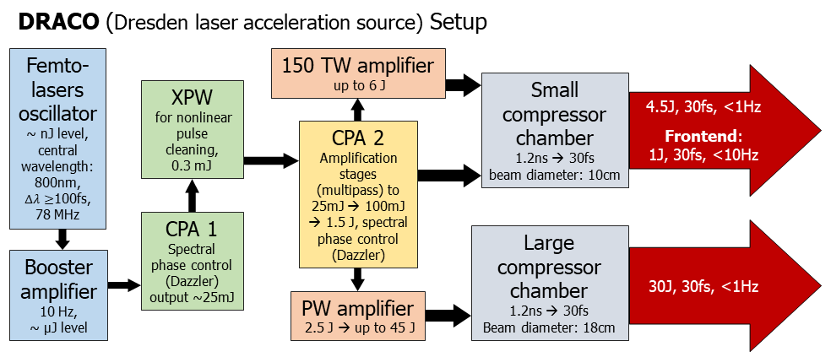
Experimental realization of Trojan Horse injection @DRACO
Need of four laser beams:
LWFA driver, Injector laser, source for few-cycle probe beam, pre-ionization laser for PWFA stage
All beams are extracted from the two arms of the DRACO laser system
(~ 80m from splitting point to target)
150TW arm
LWFA driver beam
few cycle probe
1 PW arm
(not fully amplified, only a part of the beam)
Injection laser
Pre-ionization laser
7

Slide 8
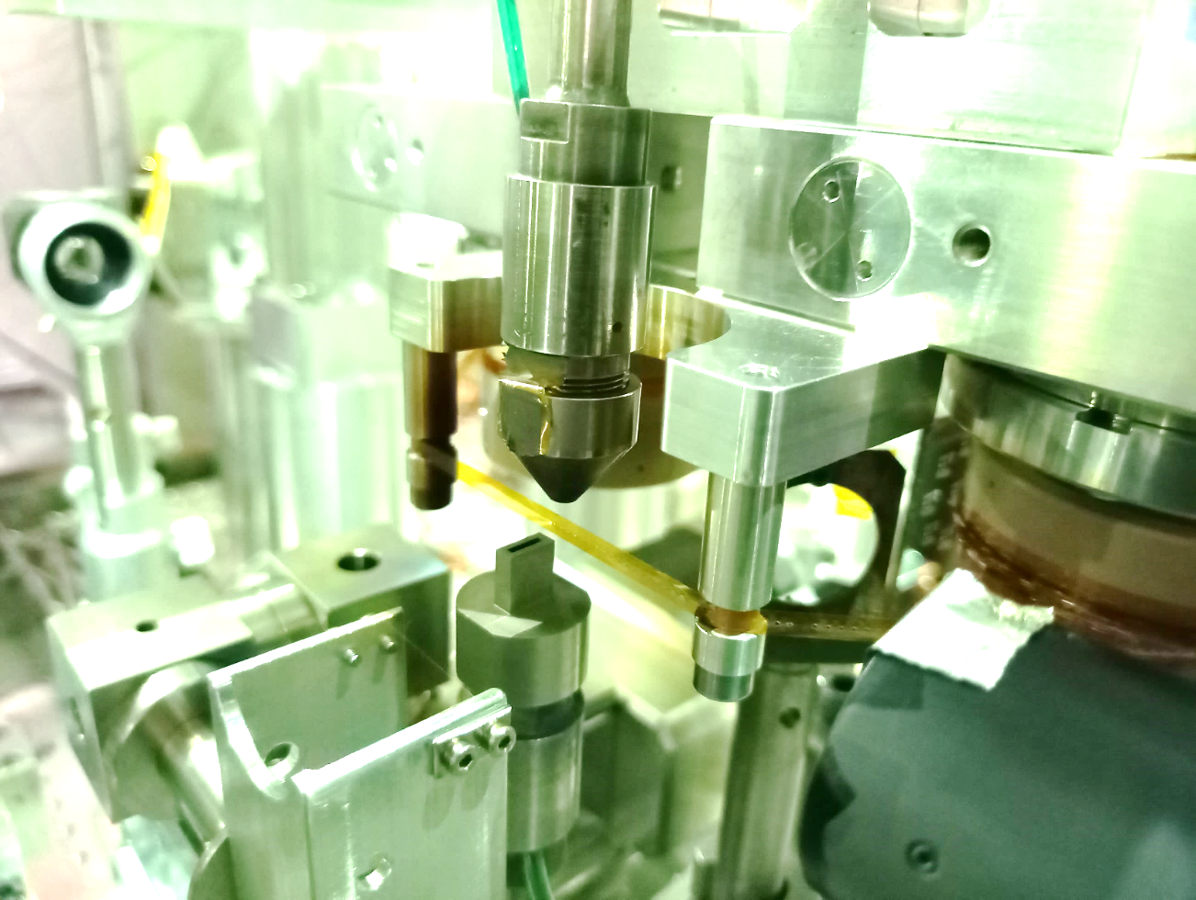
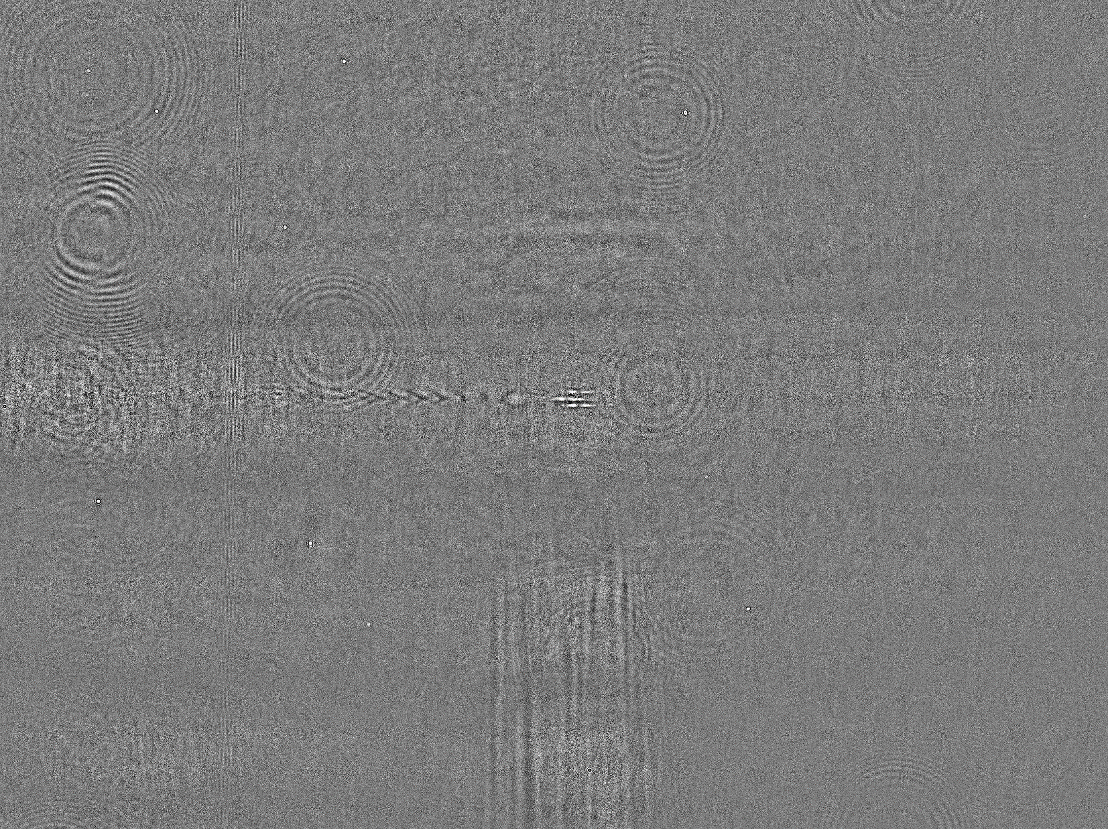
Experimental realization of Trojan Horse injection @DRACO
PWFA injection laser
Traces of all beams in the PWFA stage visible on the shadowgraphy image:
LWFA drive laser
Beam driven, pre-ionized plasma wave
Probe laser
Injection laser filaments
pre-ionizer
filaments
Pre ionizer laser
8

Slide 9
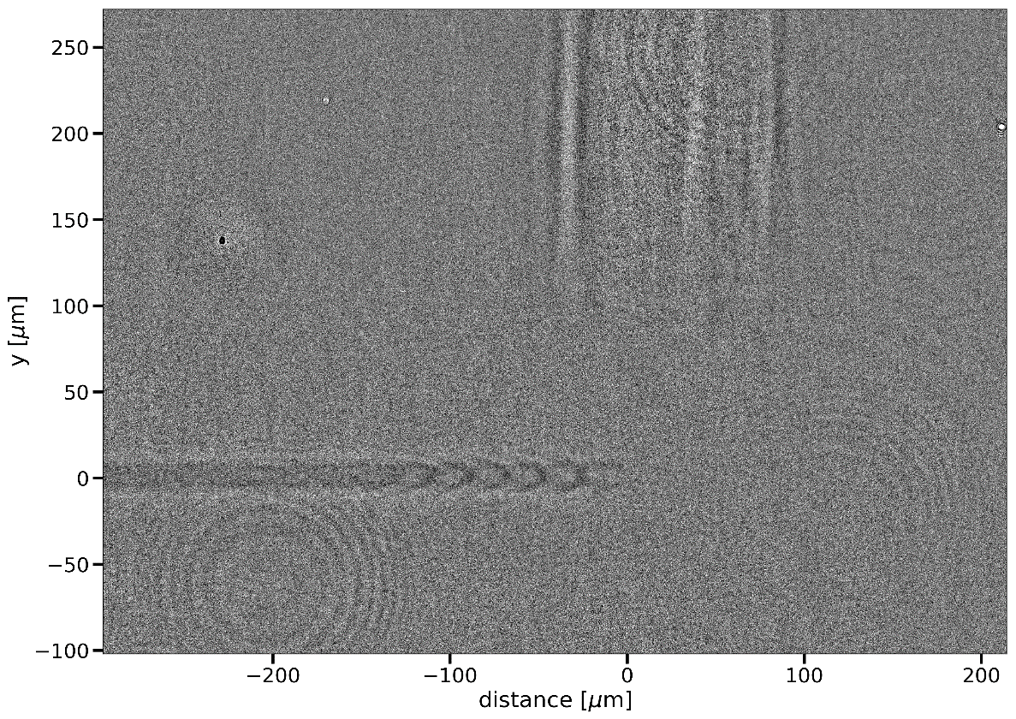
Spatial-temporal overlap using shadowgraphy
Adjustment of:
  Arrival time
  location of the interaction point
in situ monitoring of jitters/drifts
Shadowgraphy is only a projection:
  need of additional cameras to monitor the pointing
  Potential solution: probing from two different angles
Injection laser filaments
Plasma channel ionized
by the driver beam
1st plasma wave cavity
9

Slide 10
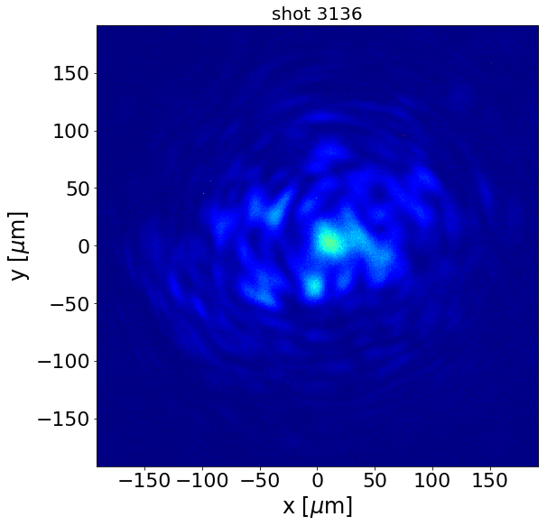
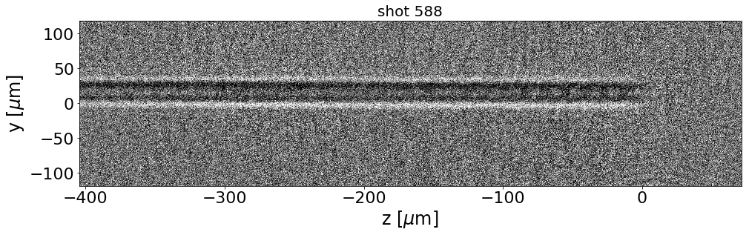
Shot to shot jitters
Shot-to-shot jitter and drift can be monitored using online in situ diagnostics (shadowgraphy, camera monitoring the injector laser after interaction)
For stable witness injection via Trojan Horse injection: small shot-to-shot jitter required to overlap injector laser and first cavity reliably
10

Slide 11
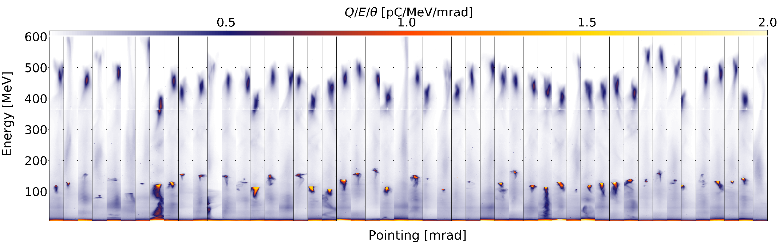
High witness injection probability shows reliable overlap
50 consecutive shots with unchanged nominal parameter (45 successful shots, one with no laser blocker)
→ ~92% injection rate
  sufficient stability of injection laser through plasma
  sufficient stability of the electron driver beam
  Witness beam parameter still jitter due to jitter of overlap and driver beam parameters
11

Slide 12
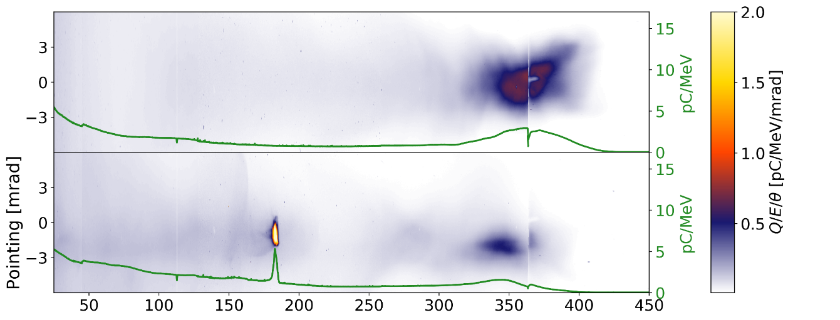

PWFA stage towards quality booster
Witness beam parameters not stable yet, potential sources:
  Alignment of 1st cavity and injection laser jitters
  He+ partially ionized by the driver beam
  → available charge jitters with drive beam parameter
some shots show promising parameters, especially low energy spread
Comparison of peak height in the lineout:
reference shot: 2.96 pC/MeV
average ref. shots: 1.84 pC/MeV
witness beam: 4.16 pC/MeV
→ higher than best reference shot
LWFA only
LPWFA with Trojan Horse injection
Witness beam parameters:
mean energy:
183 MeV
energy spread:
2.7 MeV (1.5%)
charge (FWHM):
8.7 pC
divergence (rms):
0.59 mrad
12

Slide 13
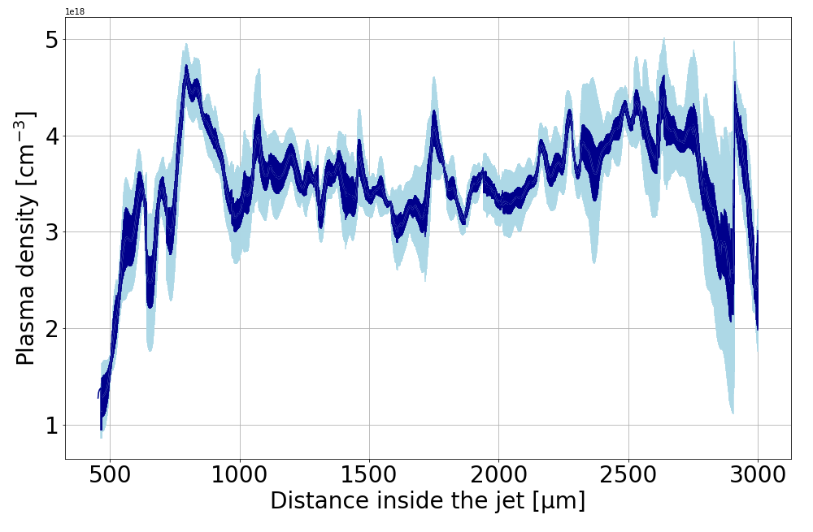
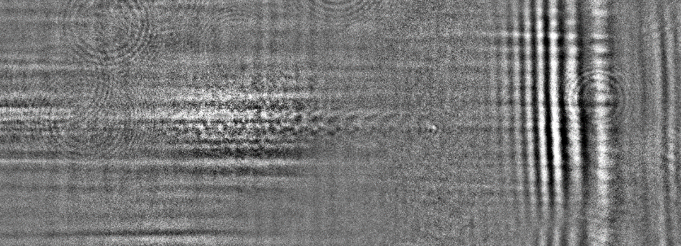




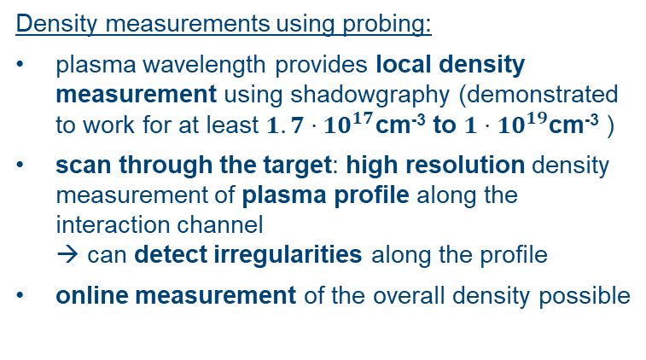
Plasma density measurements using shadowgraphy
Density measurements using probing:
plasma wavelength provides local density measurement using shadowgraphy (demonstrated to work for at least $1.7⋅{10}^{17}$cm⁻³ to $1⋅{10}^{19}$cm⁻³ )
scan through the target: high resolution density measurement of plasma profile along the interaction channel
→ can detect irregularities along the profile
online measurement of the overall density possible
collaboration experiment with groups of Brigitte Cros and Sandrine Dobosz : density measurement using plasma wave probing works in a gas cell (3.6mm thick fused silica walls)
scattering from gas cell wall
plasma wave
TNA Proposal ID: 24579 (2023)
13

Slide 14

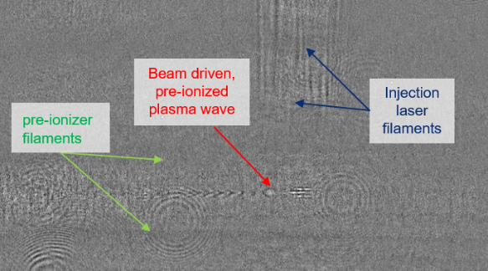
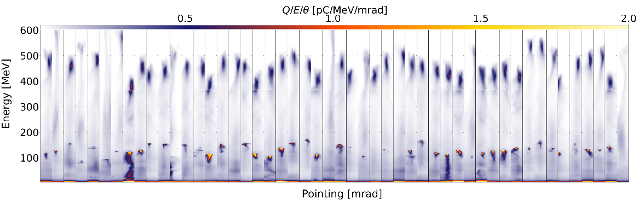
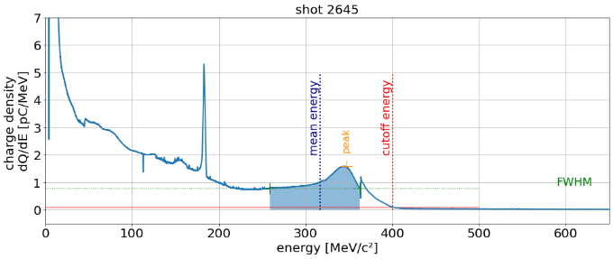
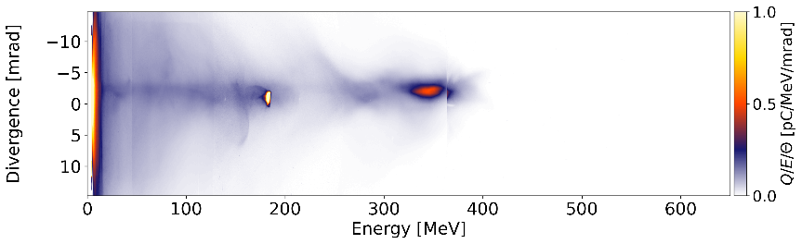
Summary
Probing is the key diagnostic to check alignment and timing as required for staging
  tracking of drifts, estimate shot-to-shot jitter
  local plasma density measurements
  probing also works in gas-cell
  future: tomographic probing?
Trojan horse demonstrated
  Demonstrates ability to get reliable spatio-temporal overlap of injection laser and 1st cavity
  Quality booster
14

Slide 15
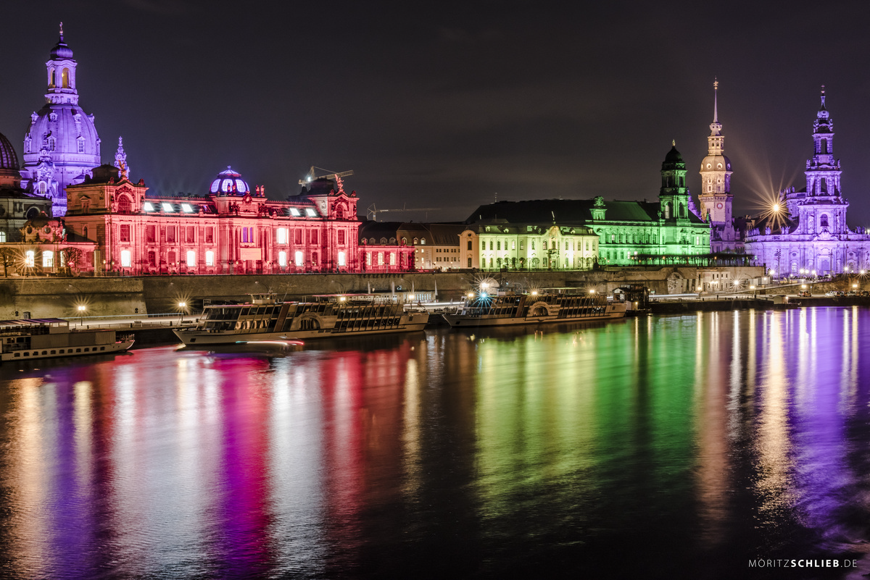
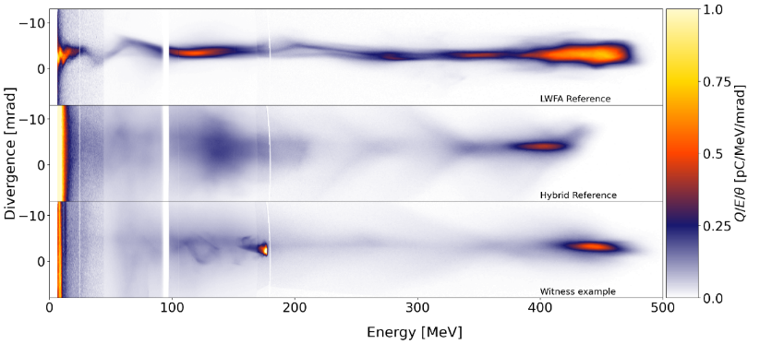
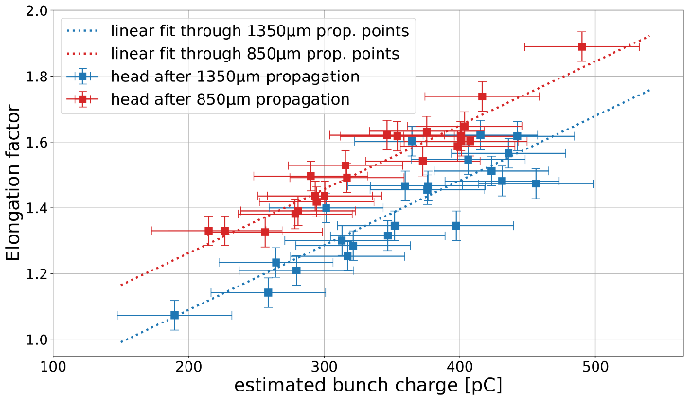



Cavity size vs. driver charge
Thank you for your attention!
And thanks to all the involved people:
LWFA
Reference
PWFA
Reference
Witness
shot
Trojan horse injection
  Better control of pre-ionizer energy ➞ Ionizing ${He}^{+}$
  Smaller Injector spot size for better injection control
Probe depletion study:
  investigating driver depletion and witness influence on the cavity shape
Hybrid Milestone:
  reach higher energy than the drive beam
Hybrid collaboration partners:
Alberto Martinez de la Ossa
Sebastian Corde
Stefan Karsch
Bernard Hidding
Alastair Nutter
Thomas Heinemann
Olena Kononenko
Andreas Döpp
Max Gilljohann
Moritz Förster
HZDR:
Arie Irman
Ulrich Schramm
Vincent Chang
Amin Ghaith
Maxwell LaBerge
Susanne Schöbel
Franziska Herrmann
Patrick Ufer
Richard Pausch
Alexander Debus
Klaus Steiniger
Université Paris Saclay and CEA:
Brigitte Cros
Sandrine Dobosz
Francesco Massimo
Abhishek Panchal
Charles Ballage
Ovidiu Vasilovici
Lodewyk Steyn
Witness beam
Drive beam
Susanne Schöbel s.schoebel@hzdr.de
Alegro Workshop 2024, Lisbon, 19-22 March 2024
13

Slide 16
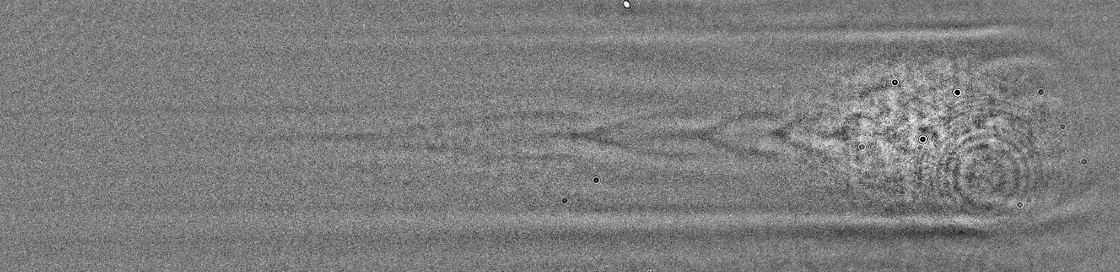
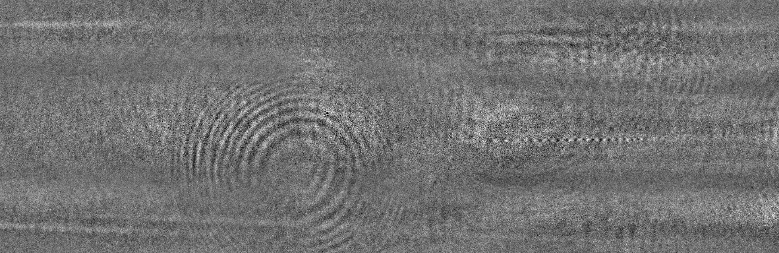
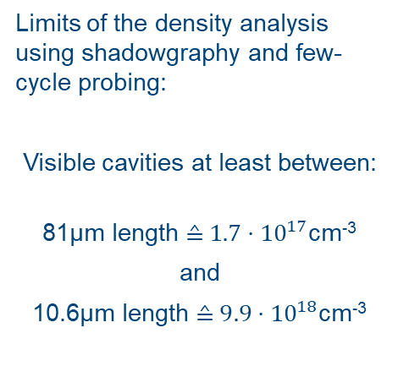


Density limits of the probing:
Limits of the density analysis using shadowgraphy and few-cycle probing:
Visible cavities at least between:
81µm length ≙ $1.7⋅{10}^{17}$cm⁻³
and
10.6µm length ≙ $9.9⋅{10}^{18}$cm⁻³
$λ_{p}≈81μm$
$λ_{p}≈10.6 μm$
16

Slide 17
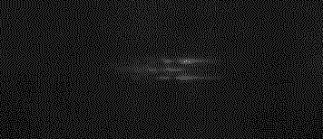
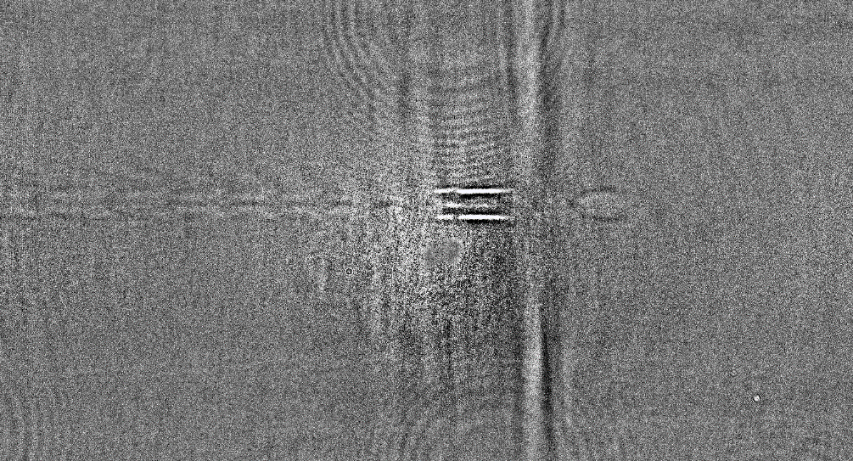
Spatial-temporal overlap using shadowgraphy
Light signal
Emitted light when injector laser hits a plasma sheath
Used for alignment in the axis which is unaccessable for the probe
Appears directly in line with the plasma wave at the interaction point: only there if there is an overlap
17

Slide 18
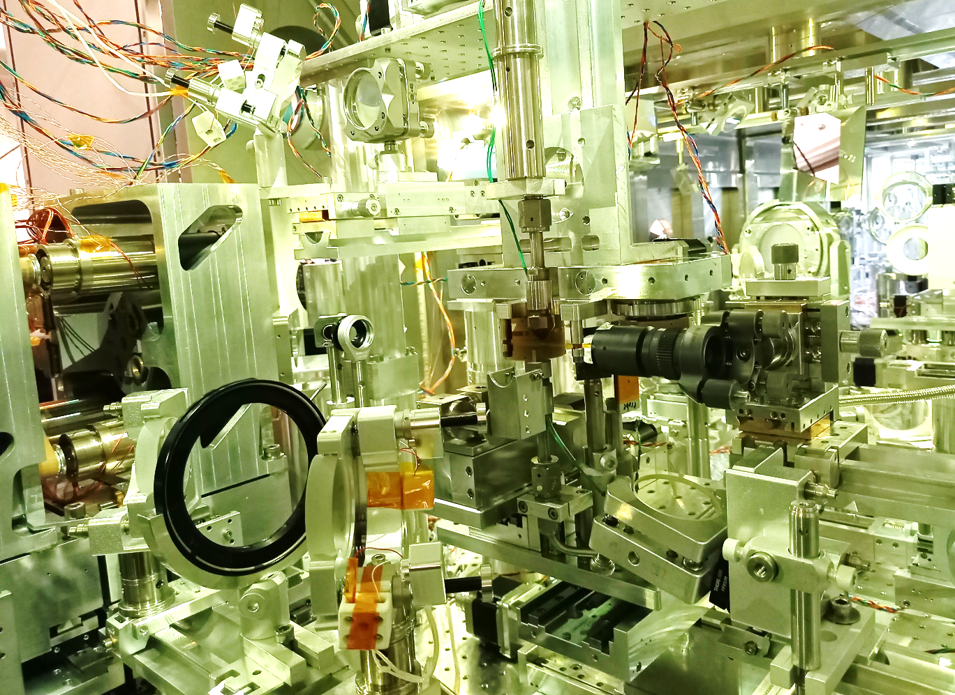
Experimental realization of Trojan Horse injection @DRACO
LWFA drive laser
Probe laser
Pre ionizer laser
PWFA injection laser
18

