Slide 1
Preliminary Investigation of a Higgs Factory based on Proton-Driven Plasma Wakefield Acceleration
ALEGRO
Lissabon, 19-22 March 2024
J. Farmer, A. Caldwell, and A. Pukhov

Slide 2
Introduction
A Higgs factory is a high priority for particle physics.
Plasma wakefield acceleration offers the advantage
of high acceleration gradients
Proton-driven plasma wakefield acceleration would allow
high energy gain in a single stage
potentially higher average gradients
positron acceleration

Slide 3
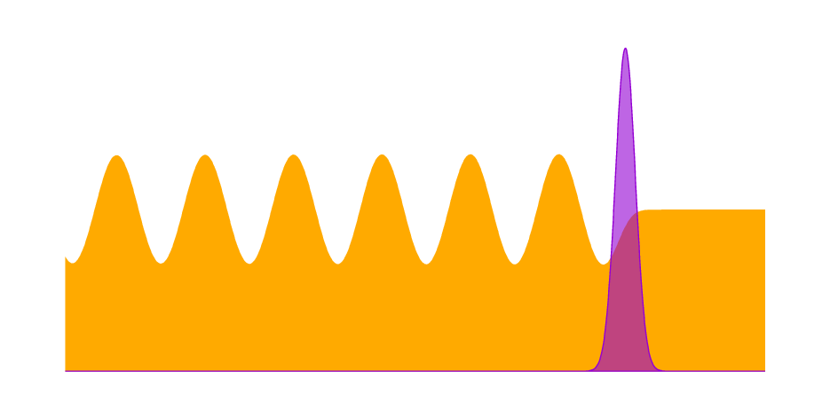

Motivation: plasma wakefields
Damage threshold not a concern for plasma
– already “broken”
– gradients > 1GeV/m
Driver
Plasma
Wakeboarding

Slide 4
Plasma wakefield acceleration
Energy gain limited by choice of driver
laser pulse
electron bunch
proton bunch
Not enough energy in laser/electron driver to reach high witness energy. Solutions include
structured driver (stability)
staging (alignment, average gradient)

Slide 5
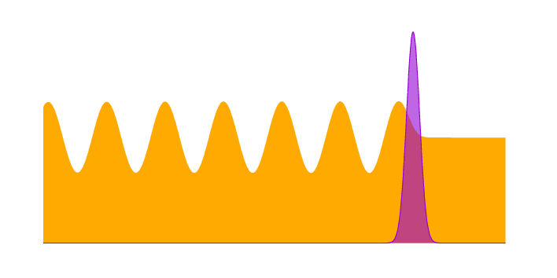
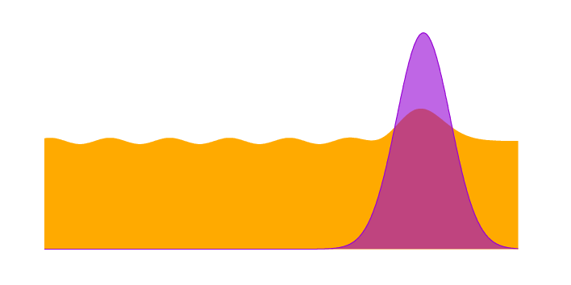
Proton-driven PWFA
Proton beams have plenty of energy
BUT available beams “too long” to efficiently drive a wake
Short driver efficiently excites wakefield
Long driver suppresses its own wake

Slide 6

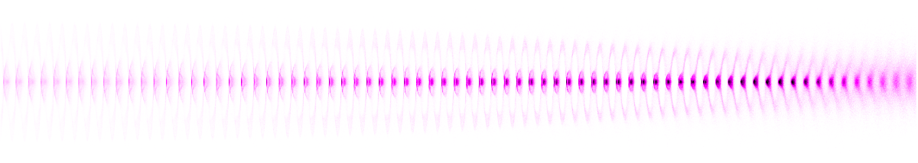
Proton-driven PWFA
Focussing/defocussing fields in plasma
Resulting train of microbunches can drive large wakefields
Long proton beam
Self modulation instability
Train of short microbunches

Slide 7

Proton-driven PWFA
Focussing/defocussing fields in plasma
Resulting train of microbunches can drive large wakefields
Long proton beam
Not this talk!
Self modulation instability
Train of short microbunches

Slide 8
Short proton drivers revisited
It’s worth revisiting short proton drivers.
Pros:
Higher gradients
Higher efficiency
Cons:
Such drivers (L~150 µm)
don’t exist

Slide 9
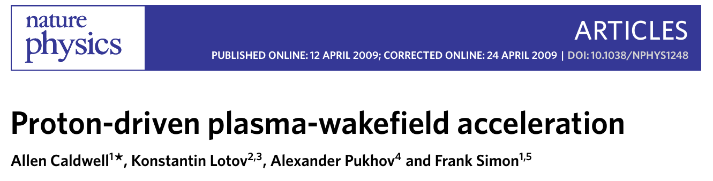
Short proton drivers revisited
Caldwell et al. (2009)
A short proton wakefield driver is not a new idea (2009).
Predates AWAKE! So why now?

Slide 10
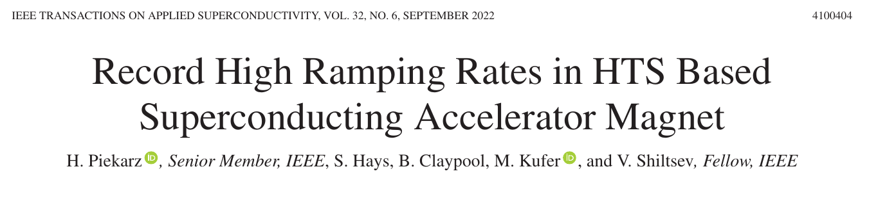
Short proton drivers revisited
Piekarz et al. (2022)
Developments in fast-ramping magnets would allow rapid-cycling (~5 Hz) synchrotrons.
Would allow for competitive luminosities for a proton-driven Higgs factory if bunch length can be achieved.

Slide 11
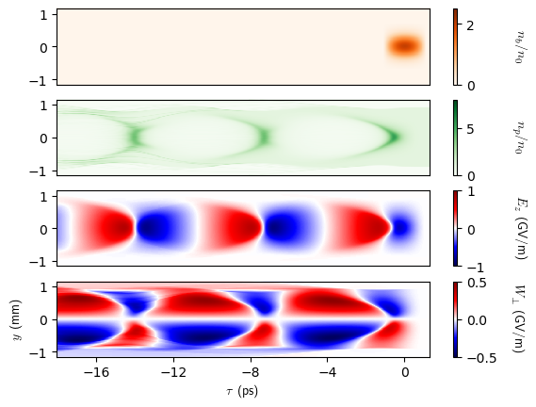
Configuration
Assume a suitably short proton driver can be generated
Moderately nonlinear wakefield allows acceleration of both electrons and positrons

Slide 12
Configuration
Higgs–Z threshold is 216.4 GeV
Add some margin → collision energy of 250 GeV
125 GeV e⁻ colliding with 125 GeV e⁺
HAHLF considers 500 GeV e⁻ colliding with 31.3 GeV e⁺
We need to demonstrate
efficiency
stability

Slide 13
Picking the driver
Assume a suitably short proton driver can be generated
Need to pick driver parameters
High efficiency
Moderately nonlinear wake for positron acceleration

Slide 14
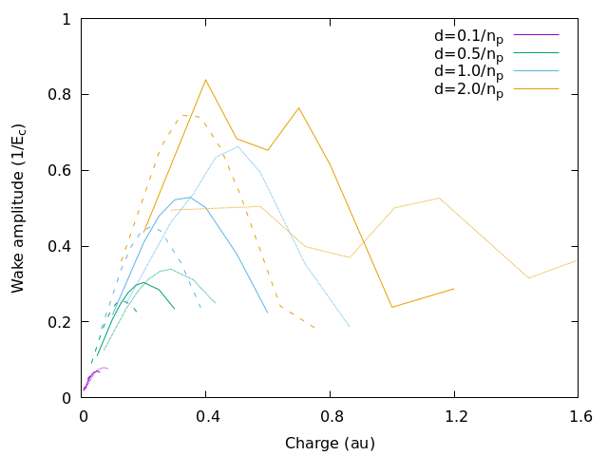
Picking the driver
Picking the driver: efficiency
Scans with different driver
length, density and radius
Optimal driver length
~driver charge density
Too-high current leads to
highly-nonlinear wake
Dashed line: kpr = 0.8
Solid line: kpr = 1.0
Dotted line: kpr = 1.2

Slide 15
Picking the driver
Picking the driver: efficiency
Scans with different driver
length, density and radius
Optimal driver length
~driver charge density
Too-high current leads to
highly-nonlinear wake
Dashed line: kpr = 0.8
Solid line: kpr = 1.0
Dotted line: kpr = 1.2

Slide 16
Picking the driver
Picking the driver: efficiency
Everything scales with
plasma frequency
1x10¹¹ protons gives
plasma density 3x10¹⁴ cm⁻³
driver length 150 µm
Initial wakefields ~ 0.8GV/m
Pick 10% driver energy spread
for “realistic” longitudinal emittance
Dashed line: kpr = 0.8
Solid line: kpr = 1.0
Dotted line: kpr = 1.2

Slide 17
Picking the driver: stability
Initial proton driver chosen to generate suitable wakefields

Slide 18
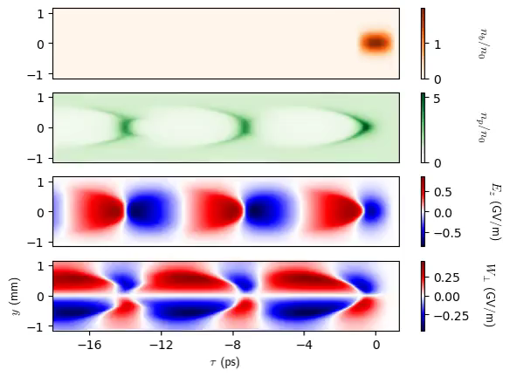
Picking the driver: stability
Initial proton driver chosen to generate suitable wakefields

Slide 19
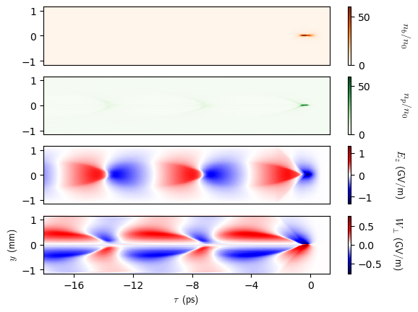
Picking the driver: stability
Initial proton driver chosen to generate suitable wakefields
Driver rapidly pinches
z=30 m

Slide 20
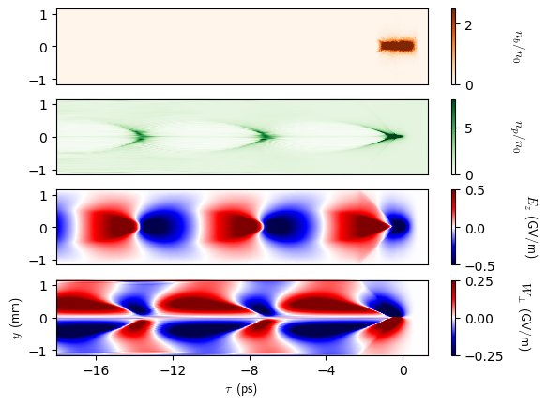
Picking the driver: stability
Initial proton driver chosen to generate suitable wakefields
Driver rapidly pinches
Highly nonlinear wakefield not suitable for positron acceleration
z=30 m

Slide 21
Picking the driver: stability
Good initial wakefields not sufficient:
driver needs to evolve slowly
counteract strong focussing wakefields

Slide 22
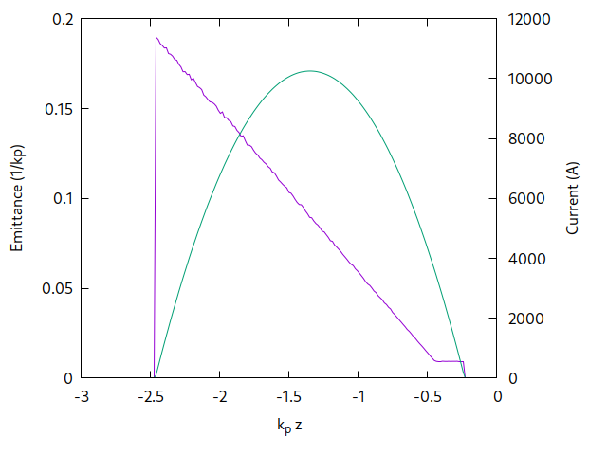
Picking the driver: stability
σz = 150 µm
σr = 240 µm
nb = 1x10¹¹
E = 400 GeV
ϵN = tailored
3 µm at head
initially constant
rises linearly to 75 µm

Slide 23
Picking the driver: stability
How can we generate
a tailored emittance profile?
Most likely:
with difficulty
BUT emittance is initially constant before growing monotonically

Slide 24
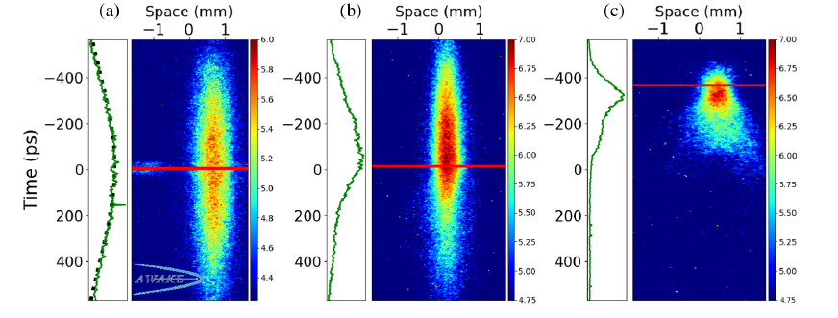
Picking the driver: stability
How can we generate
a tailored emittance profile?
Most likely:
with difficulty
BUT emittance is initially constant before growing monotonically
AWAKE Collaboration, PRL (2019)
Harness plasma instabilities?

Slide 25
Acceleration: dephasing
Initial proton driver chosen to generate suitable wakefields

Slide 26
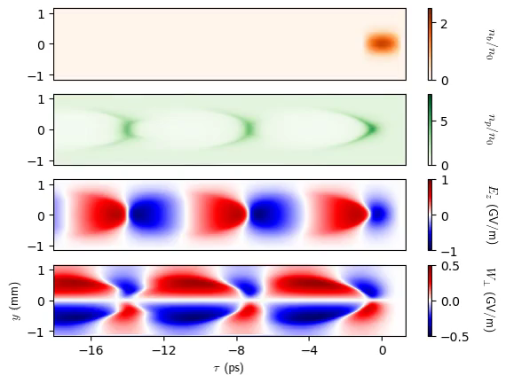
Acceleration: dephasing
Initial proton driver chosen to generate suitable wakefields
Tailored emittance profile stops the bunch from pinching
BUT:
protons “fall back”
in the light frame

Slide 27
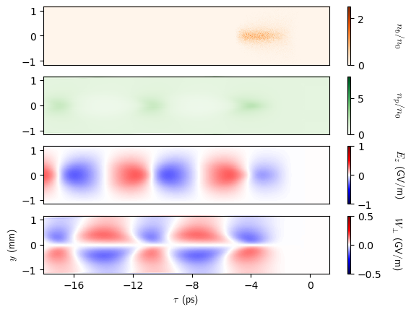
Acceleration: dephasing
Initial proton driver chosen to generate suitable wakefields
Tailored emittance profile stops the bunch from pinching
BUT:
protons “fall back”
in the light frame
z=240 m

Slide 28
Acceleration: dephasing
Initial proton driver chosen to generate suitable wakefields

Slide 29
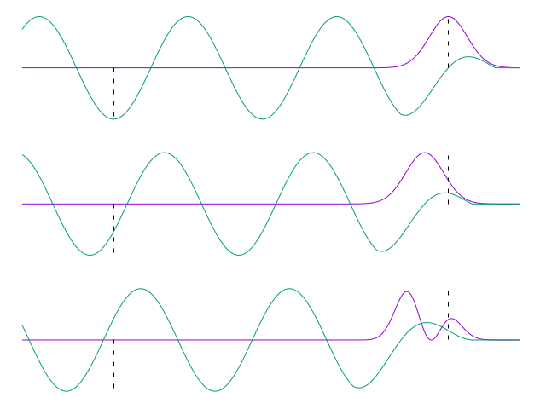
Acceleration: dephasing
Protons are fast,
but not that fast.
Driver evolution
will also modify
wakefield phase.
Witness will “catch up”
with the driver.
Change plasma density to keep phase constant

Slide 30
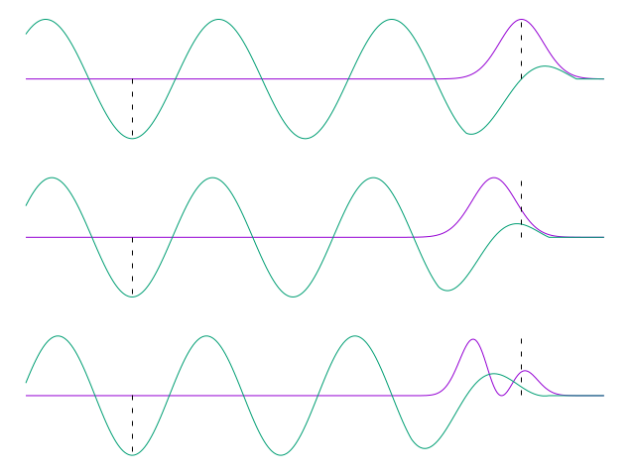
Acceleration: dephasing
Protons are fast,
but not that fast.
Driver evolution
will also modify
wakefield phase.
Witness will “catch up”
with the driver.
Change plasma density to keep phase constant

Slide 31
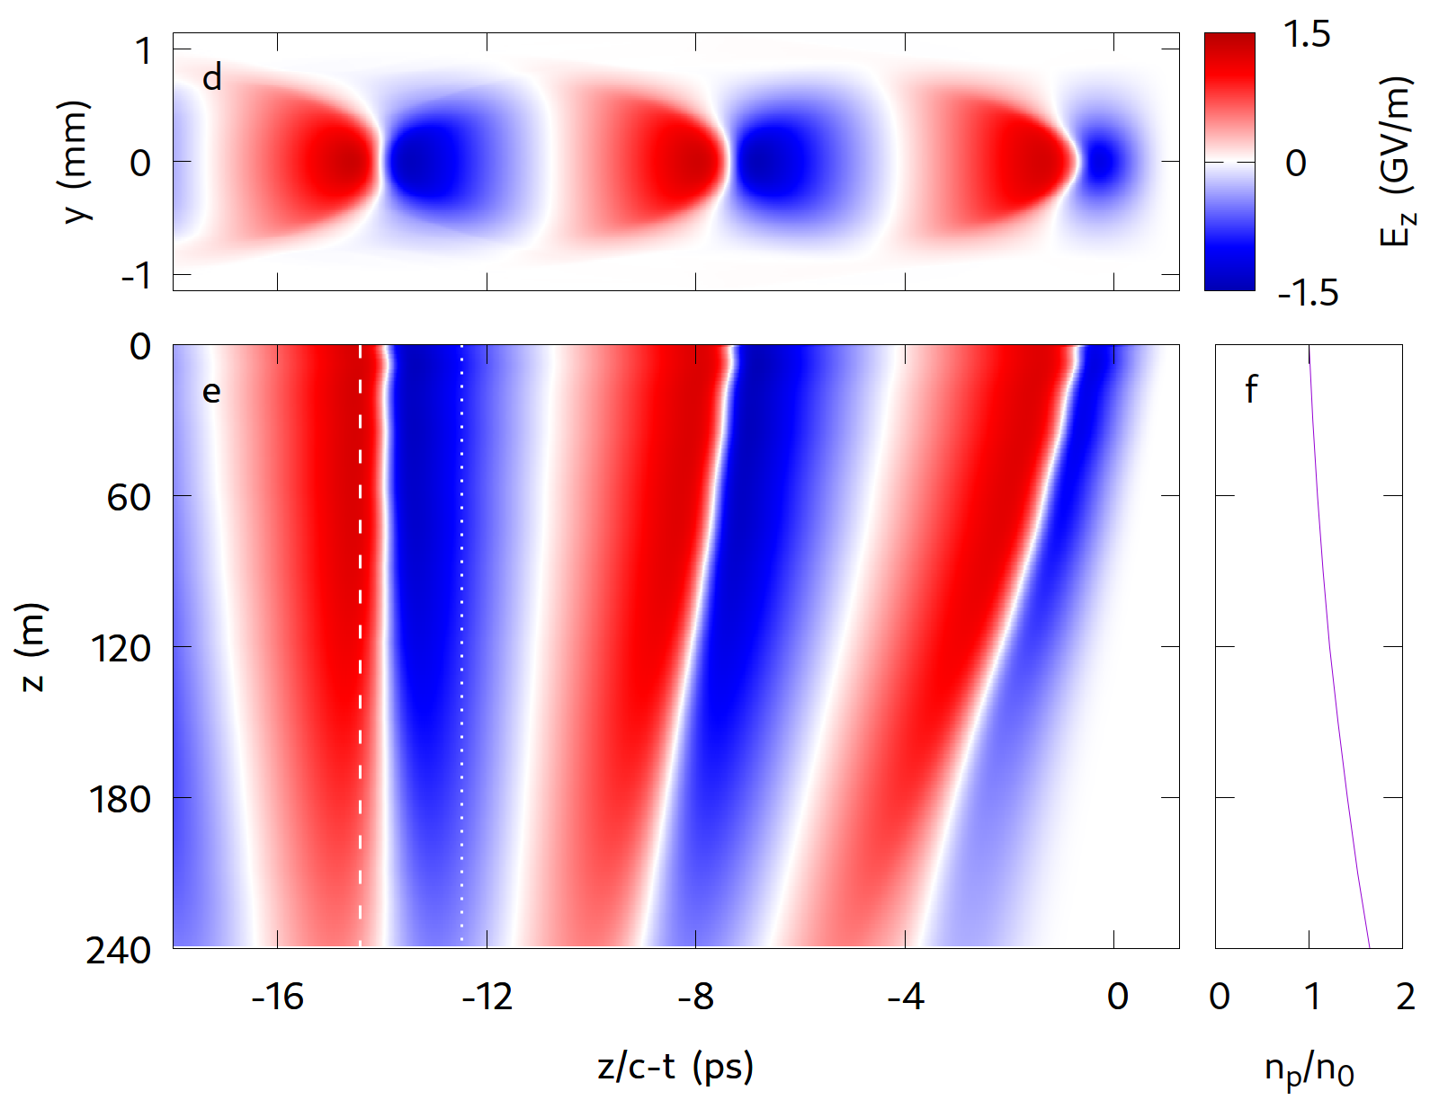
Acceleration: dephasing
Change plasma density
to keep phase constant

Slide 32
Acceleration
We now have all the building blocks for Higgs factory
Large accelerating wakefields
Regions suitable for electron and positron acceleration
Stable accelerating phase
Just (!) need to simulate acceleration

Slide 33
Acceleration
Large focussing fields mean extremely tiny witness radius
at high energy
~1 µm for electrons
~100 nm for positrons
Simulations don’t resolve this
Nonphysical emittance growth
Nonphysical energy spread growth
However, simulations do provide proof-of-concept for energy gain

Slide 34
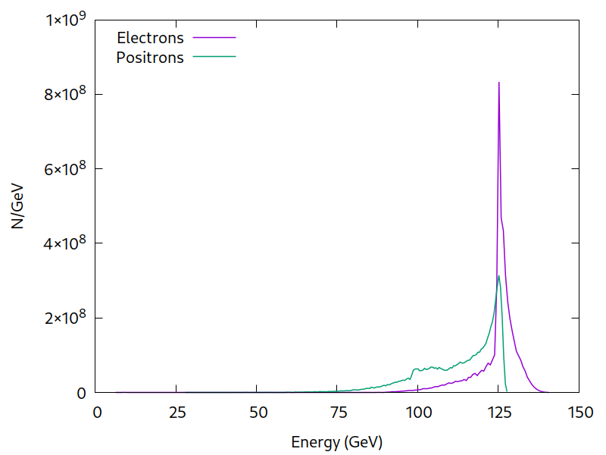
Acceleration
Driver:
10¹¹ protons at 400 GeV
Witness:
10¹⁰ electrons/positrons
injected at 1 GeV
Energy spread is
nonphysical!

Slide 35
Acceleration
Simulations show proof-of-concept for acceleration
10% of driver charge accelerated to 125 GeV in ~180 m
With tailored witness current profile, 20% should be possible
S. van der Meer, CLIC Note (1985)
Requires long plasma stage:
CERN is already investing in this technology
N. E. Torrado et al (2023)
B Buttenschön, N Fahrenkamp and O Grulke (2019)

Slide 36
Luminosity
Simulations don’t resolve emittance or energy spread,
so we assume that these can be controlled.
For electrons: AWAKE Run 2c
Olsen et al. (2019), Farmer et al (arXiv)
For positrons: simulation study by Hue et al.
C. S. Hue et al. (2021)

Slide 37
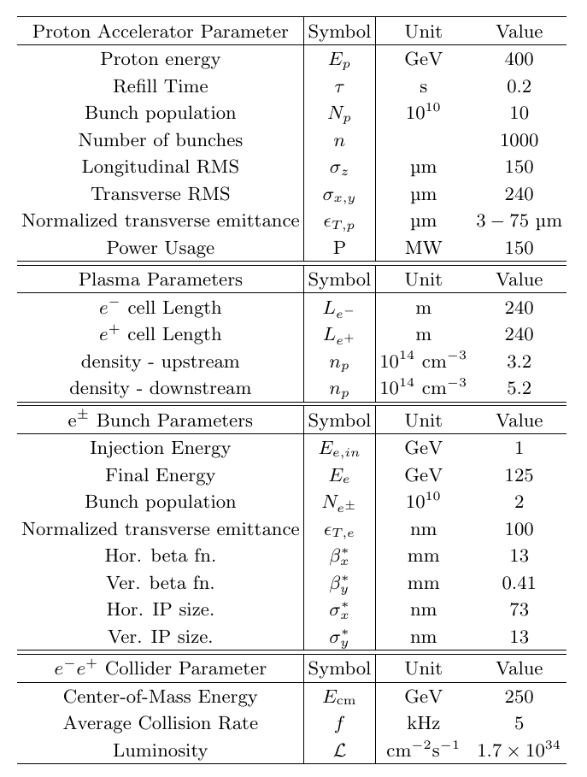
Luminosity
Combine everything:
Assume proton beams at 5 Hz,
with 1000 bunches per beam
Assume witness beams with
20% driver charge,
100 nm emittance*, ILC optics,
and negligible energy spread
*Flat beams should be investigated
and this scheme is competitive:
1.7x10³⁴ cm⁻²s⁻¹

Slide 38
Luminosity
Preliminary Investigation of a Higgs Factory
based on Proton-Driven Plasma Wakefield Acceleration
J. Farmer, A. Caldwell, and A. Pukhov
Now on arXiv
Combine everything:
Assume proton beams at 5 Hz,
with 1000 bunches per beam
Assume witness beams with
20% driver charge,
100 nm emittance*, ILC optics,
and negligible energy spread
*Flat beams should be investigated
and this scheme is competitive:
1.7x10³⁴ cm⁻²s⁻¹

Slide 39
Outlook
Key challenges:
rapid-cycling proton synchrotron with short bunches
demonstration of drive bunches with tailored emittance
experimental demonstration of emittance control for PWFA acceleration of positron bunches
acceleration of flat witness bunches
long plasma stages at high rep rate

Slide 40
~ Fin ~

Slide 41
~ Backups ~

Slide 42
Footprint
Fits on the Fermilab site
(P5 review)

Slide 43
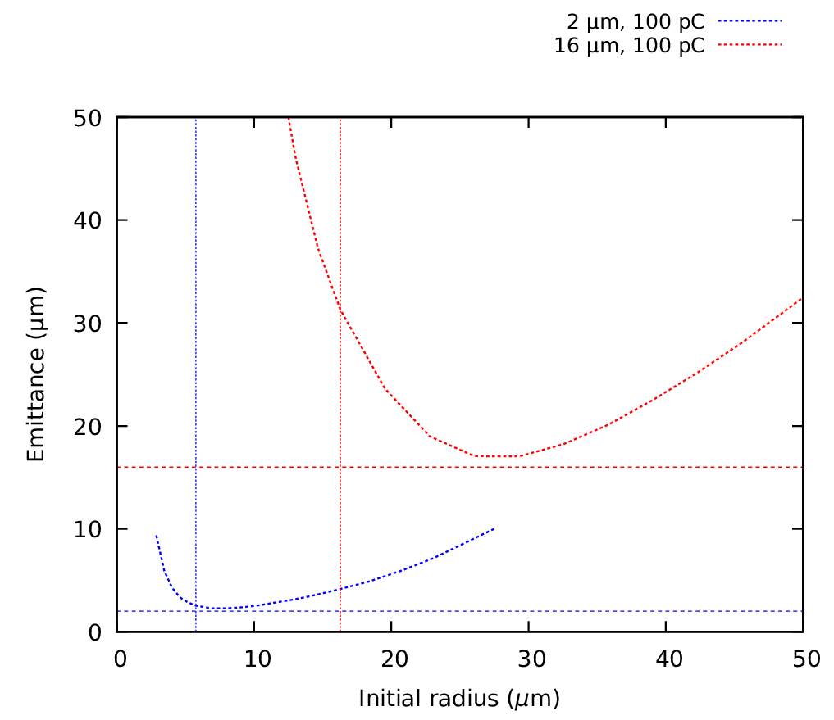
Emittance
Simulations for AWAKE Run 2c how that a blowout is not required to have emittance control.
Obviously a big gap between this and positron beams with sub-µm emittance!
16 µm initial
emittance
2 µm initial
emittance
Adapted from Farmer et al (arXiv)

Slide 44
Extension to HALHF
Acceleration limited by dispersion, not energy depletion:
scales as 1/ɣ².
Use a 800 GeV driver, accelerate to ~500 GeV in ~1 km.

Slide 45
Cooling
Witness with 10% driver charge
absorbs ~20% of wakefield energy
Witness with 20% driver charge
absorbs ~40% of wakefield energy
Assume acceleration over 240m,
gives required cooling as 12.5 kW/m

Slide 46
Cooling
Moderately nonlinear wakefields retain their structure after loading.
Could use a second witness bunch to “mop up” excess wakefield

Slide 47
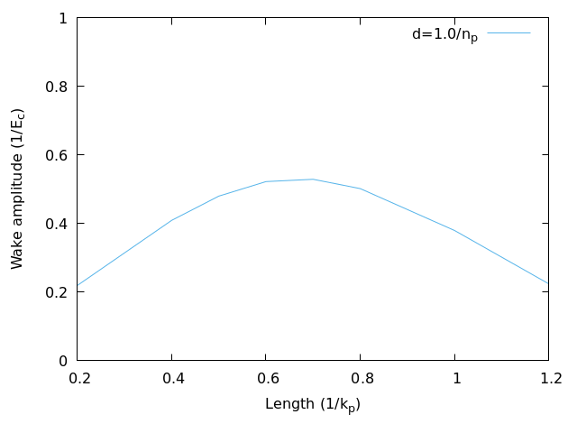
Picking the driver: efficiency
Solid line: kpr = 1.0
Scan driver length.

Slide 48
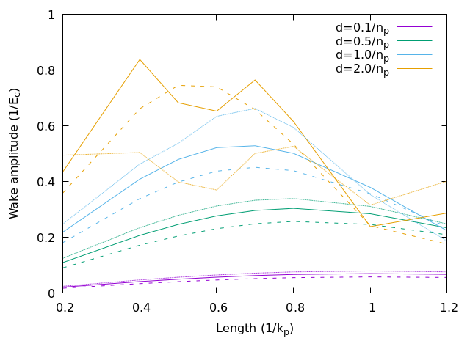
Picking the driver
Picking the driver: efficiency
Scan driver length.
Optimal length depends
on beam charge density.
High current leads to
nonlinear plasma response.
Dashed line: kpr = 0.8
Solid line: kpr = 1.0
Dotted line: kpr = 1.2

Slide 49
Picking the driver
Picking the driver: efficiency
Replot wakefield as a
function of beam charge.
Dashed line: kpr = 0.8
Solid line: kpr = 1.0
Dotted line: kpr = 1.2

Slide 50
Picking the driver
Picking the driver: efficiency
Replot wakefield as a
function of beam charge.
Optimal is best gradient
per unit charge.
Dashed line: kpr = 0.8
Solid line: kpr = 1.0
Dotted line: kpr = 1.2

